Slide 1
Laser Based H⁻ Beam Diagnostics
Yun Liu
for Beam Instrumentation Team
Research Accelerator Division
Spallation Neutron Source
Notes:
1

Slide 2
Outline
Overview of laser based H⁻ beam diagnostics
SCL laser wire profile monitor
HEBT laser emittance scanner
MEBT laser bunch shape monitor
Commissioning experience
Conclusion
Notes:
2

Slide 3
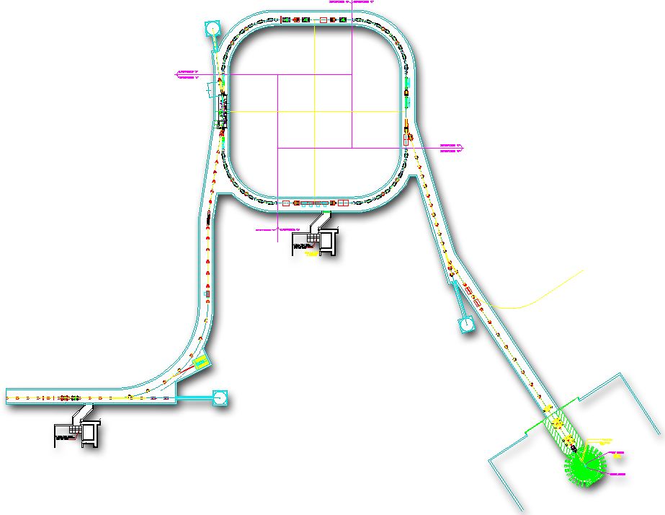
Laser Based Beam Instrumentation at the SNS Accelerator Complex
1
MEBT Laser Bunch Shape Monitor
Injection
2
SCL Laser Wire Profile Monitor
4
Ring
Extraction
3
HEBT Laser Emittance Scanner
4
Laser Assisted H- Stripping
Macro-pulse Laser
Ion Source
2.5 MeV
87 MeV
186 MeV
387 MeV
1 GeV
RTBT
HEBT
DTL
Liquid Hg Target
MEBT
CCL
SRF, β=0.61
SRF, β=0.81
1
3
2
Mode-lock Laser
Q-Switch Laser
Notes:
3

Slide 4
Photo-ionization – Physics behind Laser Based Ion Beam Diagnostics
Photo-ionization
S
H⁻
hν
H⁰
H⁰
e
Electron Collector
N
Notes:
4
4

Slide 5
Laser Wire Profile Monitor
Laser
X-scan
H⁰
Deflector
Y-scan
H⁻
electron
y
z
Faraday Cup
H⁻ beam
x
Notes:
5

Slide 6
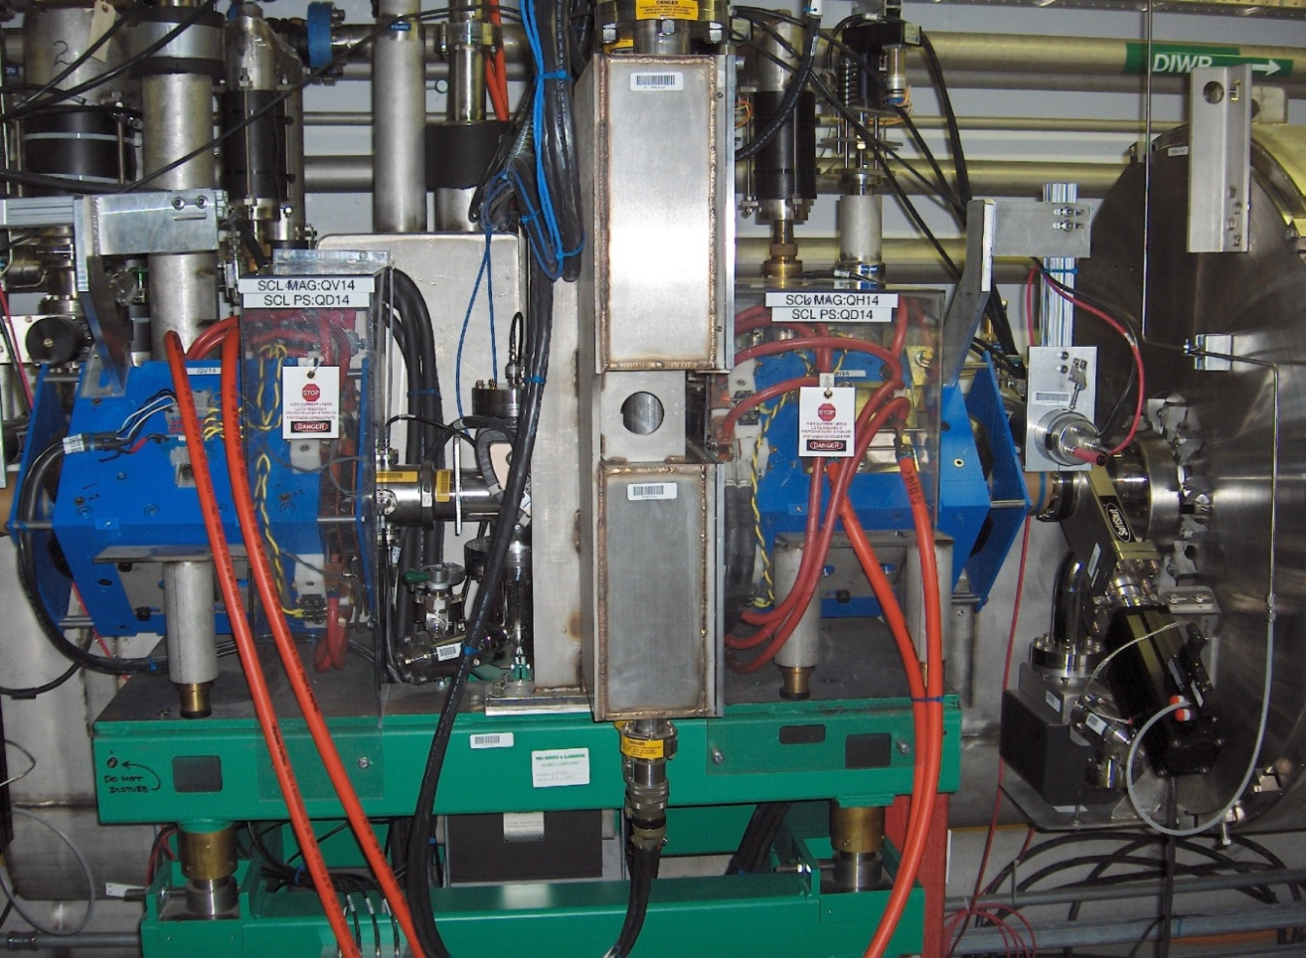
SCL Laser Wire Profile Measurement System
250 m
160 m
25 m
1
2
3
4
5
12
13
14
15
17
27
32
Camera
Laser light
Pick-up BS
H-scan
M
FM
M
Telescope
Laser
V-scan
PZT Mirror
Ion Beam
Laser Room
BD
VW
Liu et al, NIMA 612 (2010) 241–253;
Appl. Opt. 49 (2011) 6816-6823.
Notes:
6
6

Slide 7
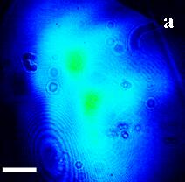
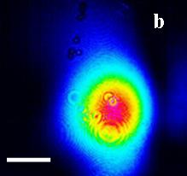
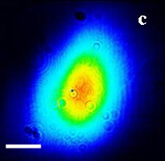
Laser Transport Line
250 m
160 m
25 m
1
2
3
4
5
12
13
14
15
17
27
32
c
b
a
Laser Beam
Pick-up Mirror # | Individual Mirror Reflectivity (%) | Receiving Power Ratio (calculated) | Receiving Power Ratio (measured)
CM01 | 100 | 11.7 | 8.9
CM02 | 50 | 11.7 | 11.4
CM03 | 33 | 11.7 | 9.3
CM04 | 25 | 11.7 | 11.6
CM12 | 20 | 11.7 | 12.7
CM13 | 20 | 14.6 | 13.8
CM14 | 10 | 8.1 | 10.2
CM15 | 10 | 9.0 | 8.7
CM32 | 10 | 10.0 | 8.2
a
b
c
1cm
Notes:
7
7

Slide 8
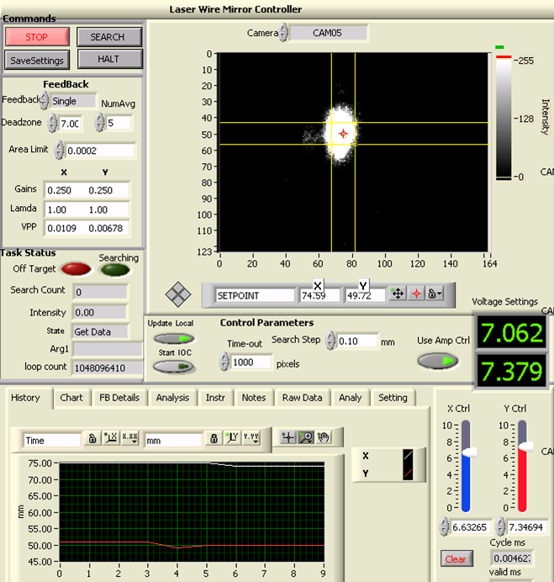
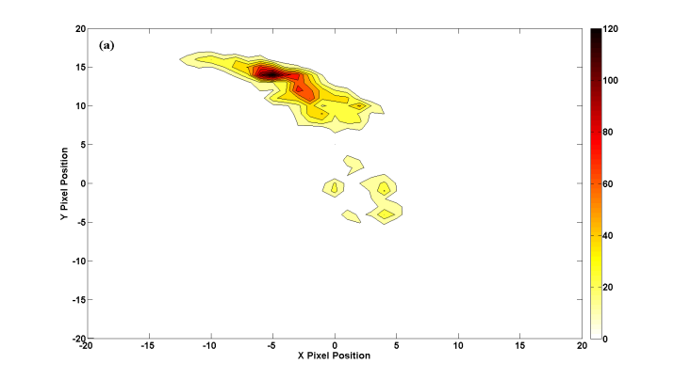
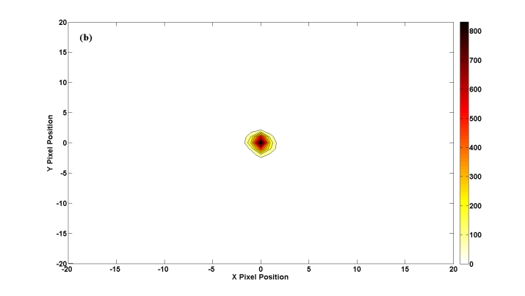
Laser Beam Pointing Stabilization
Feedback off
piezo-driven mirror
Position (220 m from laser)
beam sampler
L
laser
image sensor
Feedback on
driver
set point
Transported laser power
controller
error signal generation
±1.25 mm @ 250 m
Hardin et al, Opt. Express 19 (2011) 2874-2885.
Notes:
8
8

Slide 9
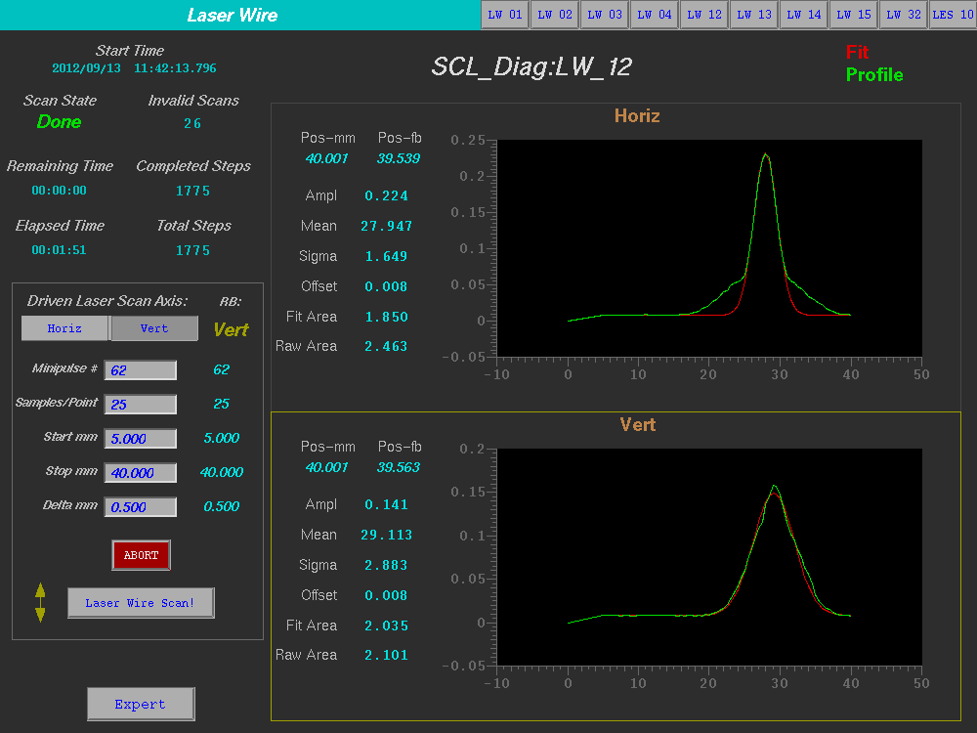
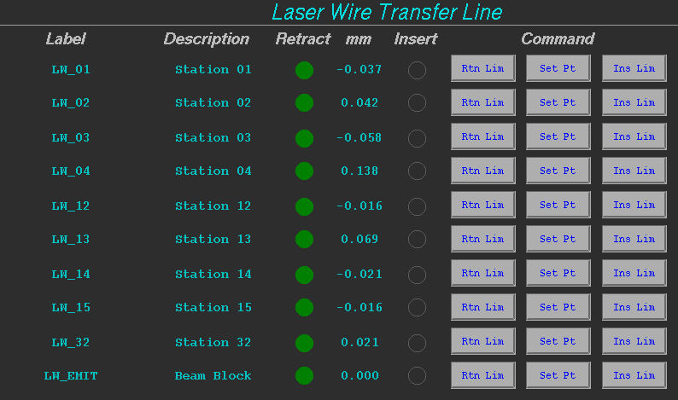
EDM Screens for Laser Wire System
From EPICS, user can select one, multiple, or all scanners
From EPICS, user can select scan range, step size, average number. Fitting is automatically conducted.

Slide 10
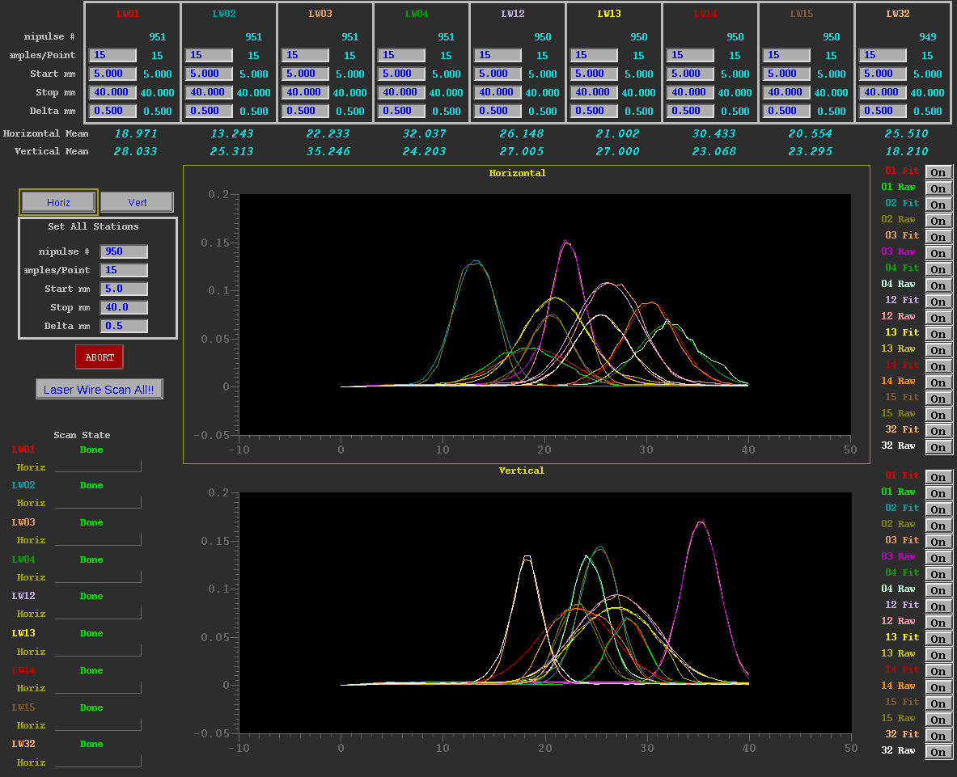
Simultaneous Profile Scan

Slide 11
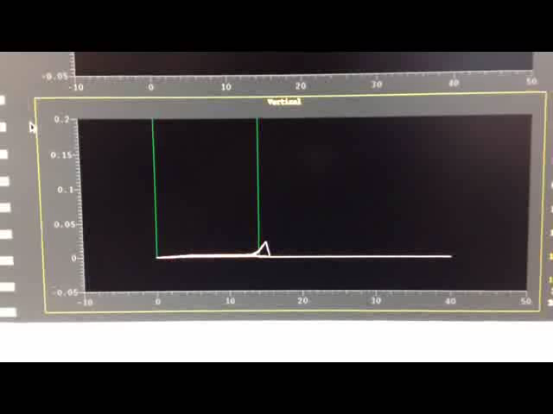
Simultaneous Profile Scan

Slide 12
SCL H- Profiles (1150 KW, Sept. 20, 2013)
 | 1 | 2 | 3 | 4 | 12 | 13 | 14 | 15 | 32
σx (mm) | 3.62 | 2.19 | 1.68 | 4.18 | 3.22 | 3.13 | 2.63 | 2.08 | 2.61
σy (mm) | 1.86 | 1.92 | 1.88 | 1.75 | 3.99 | 4.04 | 3.75 | 2.02 | 1.45
32
15
14
13
12
4
3
2
1
Y
Z
5 mm
X

Slide 13
SCL H- Profiles (850 KW, April 15, 2013)
 | 1 | 2 | 3 | 4 | 12 | 13 | 14 | 15 | 32
σx (mm) | 2.32 | 2.45 | 3.79 | 2.3 | 2.23 | 2.58 | 2.47 | 2.73 | 2.8
σy (mm) | 1.97 | 1.72 | 1.99 | 1.85 | 2.42 | 2.44 | 2.32 | 2.27 | 1.8
32
15
14
13
12
4
3
2
1
Y
Z
X
5 mm

Slide 14
SCL H- Profiles (950 KW, Sept. 13, 2012)
 | 1 | 2 | 3 | 4 | 12 | 13 | 14 | 15 | 32
σx (mm) | 3.02 | 1.65 | 3.34 | 4.39 | 1.70 | 2.75 | 3.12 | 3.10 | 3.89
σy (mm) | 2.05 | 2.48 | 2.40 | 1.78 | 2.79 | 3.40 | 3.56 | 2.78 | 3.32
32
15
14
13
12
4
3
2
1
Y
Z
X
5 mm
Liu et al, PRST-AB 16 (2013) 012801

Slide 15
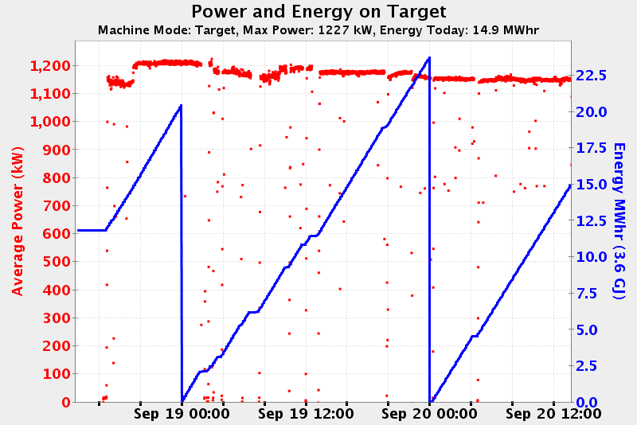
Beam Status during LW Measurement
Measurement time window

Slide 16
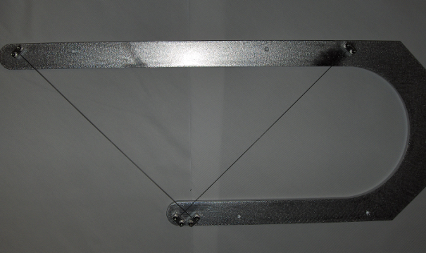
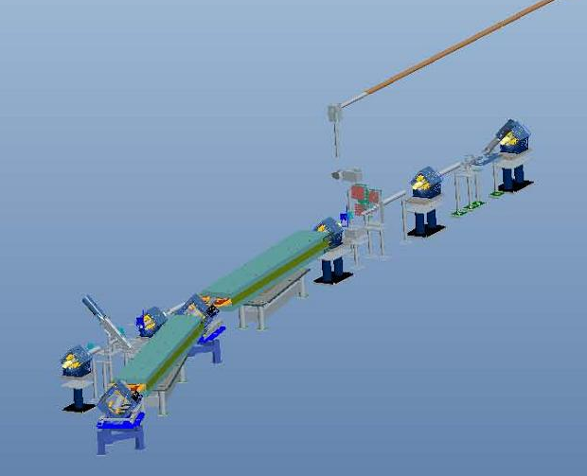
HEBT Laser Emittance Scanner
Laser Transport Line
from SCL
Laser Slit
H⁻
~11.6 m
Wire Scanner
Dipole
Telescope
Laser Slit
Wire Scanner
H-scan
H⁰
V-scan
to Linac dump
Ion Beam
to Ring
HEBT
H⁻
Laser wire scanner converts a narrow channel of H⁻ beam into H⁰ beam
Titanium wire scanner measures divergence of the H⁰ beam released from laser slit
Measurement is nonintrusive.
Notes:
16
16

Slide 17
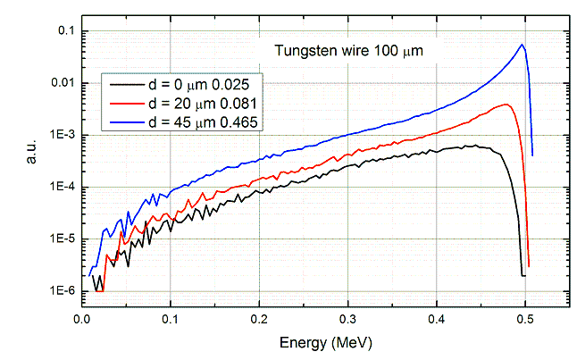
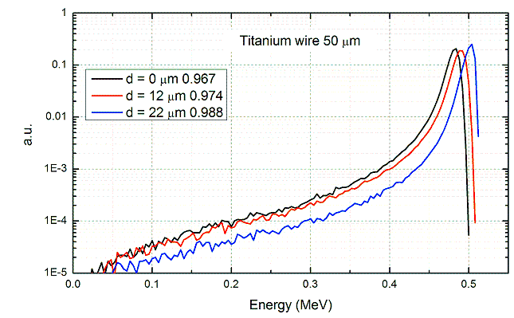
Performance Evaluation of Wires
Fraction of electrons passing through the wire
100-um Tungsten Wire
50-um Titanium Wire

Slide 18
Multi-wire Ti Scanner
Wire thickness: 50 μm
Wire spacing: 25 μm
10
2
1
Ti Wire Bundle
Notes:
18
18

Slide 19
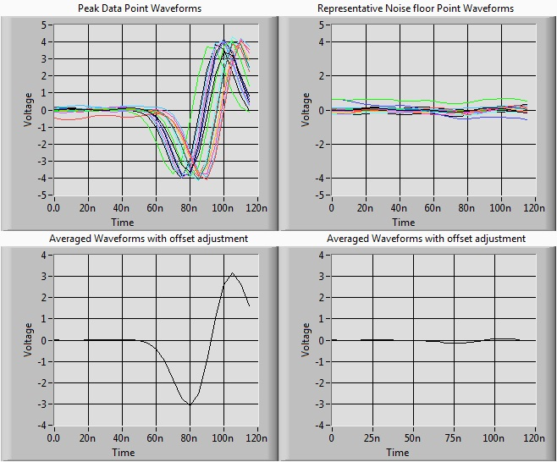
Raw Signal from Improved System

Slide 20
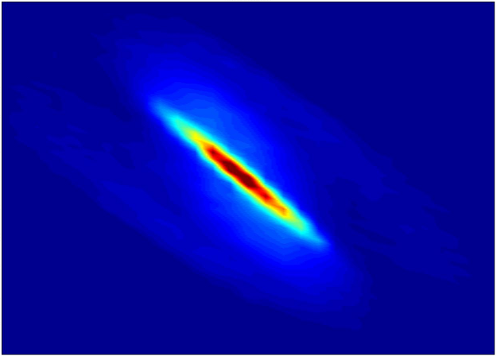
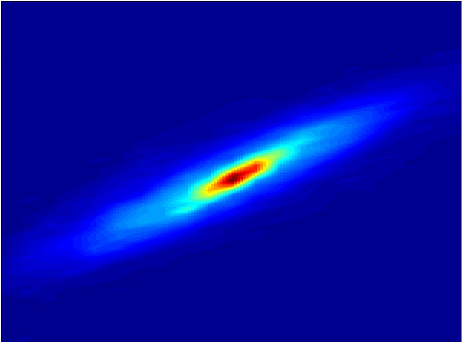
Emittance Measurement with Improved System
Horizontal
Vertical
2
1
3
1
0.5
0.5
2
y′ (mrad)
x′ (mrad)
0
1
0
-0.5
1
-0.5
-1
-1
-4
-2
0
2
4
0
-4
-2
0
2
4
0
x (mm)
y (mm)
ε ~ 0.45 mm⋅ mrad
Liu et al, NIMA 675 (2012) 97–102
Notes:
20

Slide 21
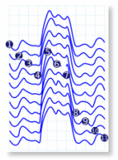
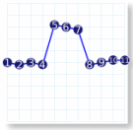
Laser Based Longitudinal Profile Measurement
Laser
Pico-second laser pulses
Mirror
H⁰
1
Frequency shift
Magnet
2
H⁻
3
80.5 MHz
÷
H⁻ beam
11
Output
402.5 MHz
∼
MCP
SR570
H⁻ bunches
Beam dump
Measurement
Laser source: Ti:Sapphire mode-locked laser
Externally locked to accelerator clock
Pulse width: 2.5 ps
Repetition rate: 80.5 MHz (5th subharmonic of RF frequency)
~100 ps
Notes:
21

Slide 22
R&D: Fiber Transmission of ps Laser Pulses
Isolator
HWP
Pol
L
A
Ti:Sapphire Laser
LMA Fiber
B
BS
Pol
L
Pulse width measurement
PD
BS
Prism
Power Meter
BS
HWP
Camera
M
M
L1
Prism
PBS
L
θ_{in}
BBO
θ₀
Filter
Fiber
PD
A
B

Slide 23
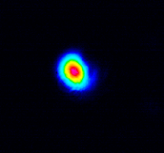
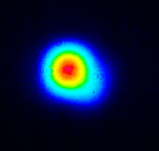
Transmission of ps Laser Pulses through LMA Fiber
Pulse width broadening
Over 85% of overall transmission efficiency through a 30 m fiber
Nearly diffraction-limited output beam
A beam diameter of less than 400 µm at a working distance of 600 mm
At 3 KW transmitted (peak) power, pulse width broadens to 11.6 ps
Beam profiles after fiber transmission
Near-field

Slide 24
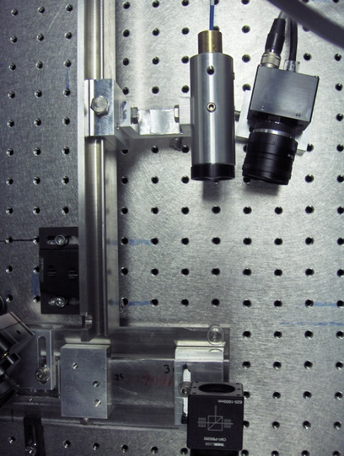
Setup Installed at SNS MEBT
A
Optical Fiber
Fiber probe
Camera
Picomotor Actuator
PBS
Power meter
USB Juno
H⁻ beam
PC
Vacuum Chamber

Slide 25
Measurement Results – Frequency Offset Mode
Instantaneous measurement
H- beam RF frequency: 402.5 MHz
Laser repetition rate: 80.501 MHz
Measured waveform is a magnified (in time domain) picture of the H- beam microbunch. The magnification factor is f₀/Df ~ 80,500.
~125 ps
2.5 ns
Huang et al., Appl. Opt. 52 (2013) 4462-4467

Slide 26
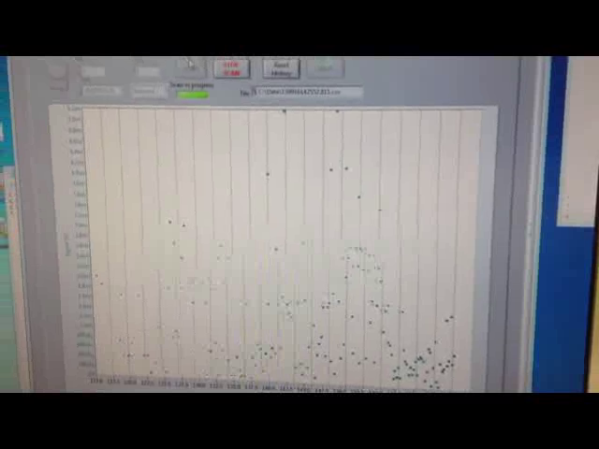
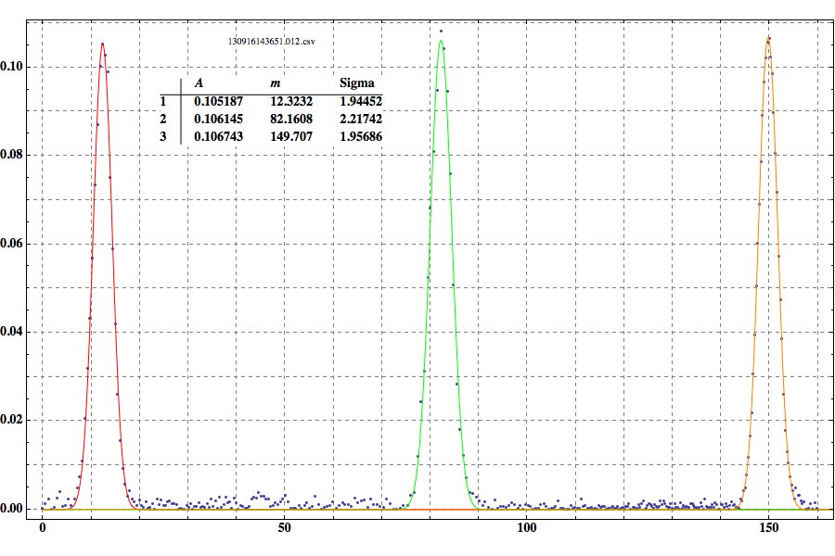
Measurement Results – Phase Scan Mode
Measurement time depends on H- beam frequency: 20 seconds for 60 Hz beam and 5 minutes for 1 Hz beam.

Slide 27
Commissioning Experience
Item | Findings | Solution
Laser Transport Line | Drift and vibration | Beam stabilization using active feedback Optical fiber based transport line (for low power)
Laser fluence | Over focusing of laser beam caused vacuum window breakdown | Avoid beam collimation optics close to measurement station. Ensure laser fluence below 1 J/cm².
Influence on beam | Electron collection magnets can cause tiny beam deflection | Correction magnet installed Orbit correction
Radiation hardness of laser | Laser driver (> 6 m from beam line) damaged in 1-2 days Unclear about laser head | Laser should be located outside the beamline for hadron machine
Image sensors | Gigabit Ethernet cameras (> 1.5 m from beamline) | Have to replace every 1-2 years
Motion control | Stepper motor (~ 30 cm from beam line); Picomotor actuators (1.5 m from beamline) | Stepper motors are very robust Open-loop picomotors have to be used

Slide 28
SUMMARY
World-first demonstration of simultaneous H- beam profile scan using a single laser source. The system has been brought to operation level – a single push-button initiates profile scan at 9 locations of SCL (corresponding to energy levels of 200 MeV -1 GeV).
Laser emittance scanner has been commissioned at SNS HEBT.
Longitudinal profile measurement system has been developed using optical fiber transmission of picosecond laser pulses.
Laser based beam diagnostics at accelerator facilities is reliable and realistic and provides a useful tool for beam tuning and physics study.
Notes:
28

