Slide 1
Emittance Measurement via H- Laser Stripping at LINAC4
Project Status
T. Hofmann, F. Roncarolo, CERN
S. Gibson, G. Boorman, A. Bosco, Royal Holloway University of London
C. Gabor, Rutherford Appleton Laboratory
September 2013
Thomas Hofmann
CERN – Beam Instrumentation (BE/BI/PM)
thomas.hofmann@cern.ch

Slide 2
Contents
Project Overview
Simulations
Components (Laser & Detector)
3 MeV Test Setup
Summary - Outlook

Slide 3
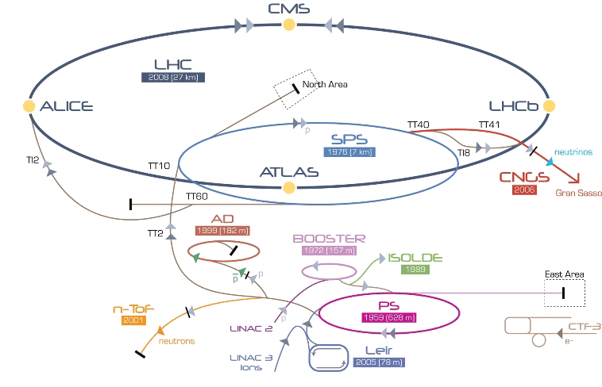
CERN Accelerator overview
LINAC 4
LHC luminosity upgrade!

Slide 4
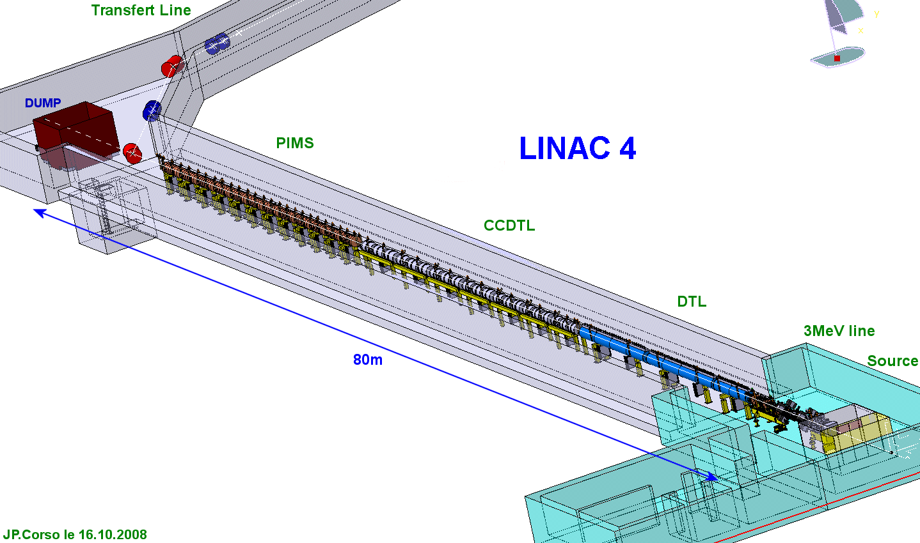
LINAC 4 overview
Particle Type | H⁻ ions
Top Energy | 160 MeV
Current | 40 mA
Pulse freq. | 1 Hz
Pulse length | 400 µs
Vacuum pressure | 10⁻⁷ mbar
Estimated Completion Date | End 2015
Transfer line to PSB
160 MeV
100 MeV
50 MeV
Laser Emittance Meter
3 MeV Testbench

Slide 5
Concept of Laser Emittance Meter for 160 MeV
Detector
H⁰
Laser
H⁻
x-scan
Bending Magnet
y-scan
H⁻ beam
Principle:
H⁻ beam
H⁰ beamlet
beamlet
after drift
Notes:
ICT: new LHC transformer to replace the FBCT in order to solve the beam position dependency issue

Slide 6
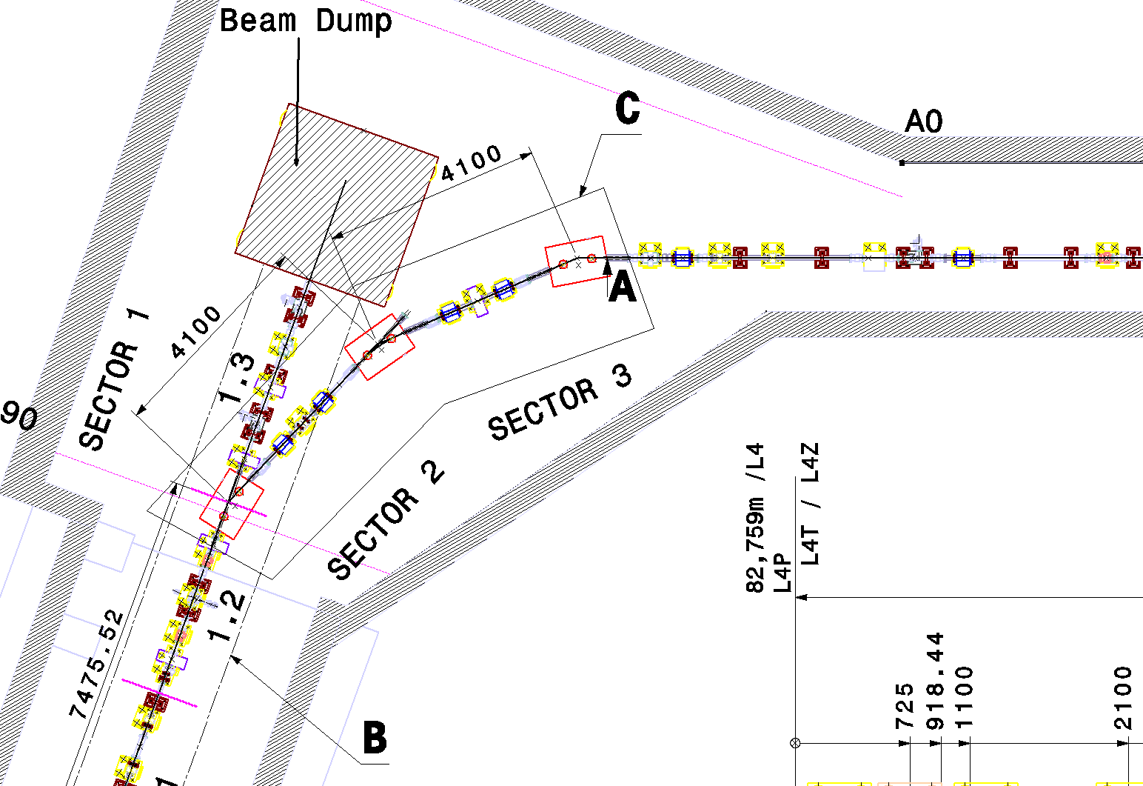
Current Situation at end of LINAC4
PS-Booster
Detector
Laser
LINAC4 PIMS

Slide 7
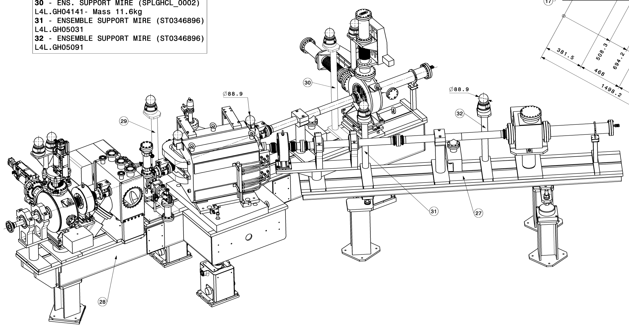
Setup at 3 MeV Diagnostics Testbench
SEM grid
Dipole
Slit

Slide 8
LINAC4 pulse structure
1 s
400 µs - Macropulse
After Chopper:
622 ns
372 ns
Micropulse
RF-system:
352 MHz
2.84 ns
full- & empty
buckets

Slide 9
Contents
Project Overview
Simulations
Components (Laser & Detector)
3 MeV Test Setup
Summary - Outlook

Slide 10
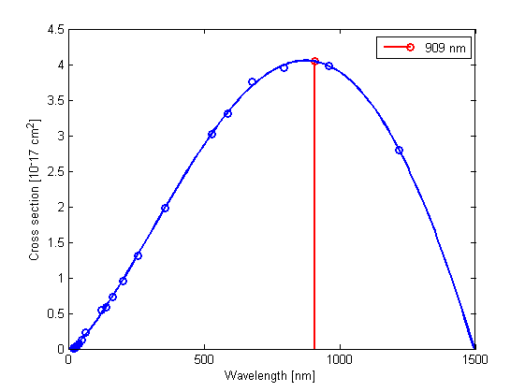
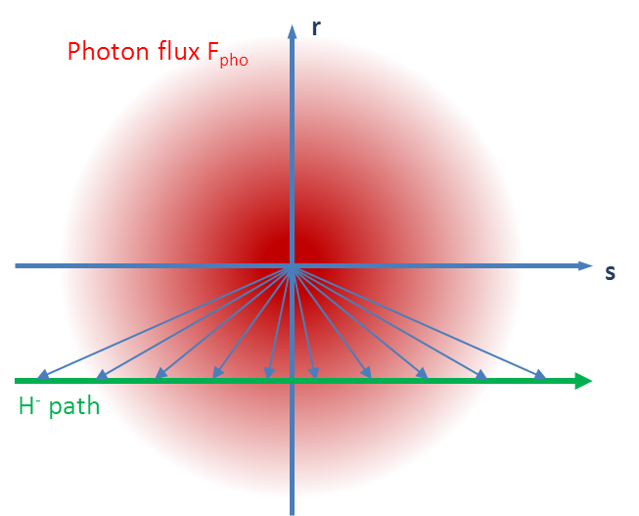
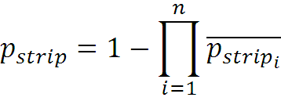
Laser-Particle Interaction
Gaussian Laser Beam with M²(Beam quality)
Lorentz-Shift of Photon Energy
At 160 MeV: 1064 nm -> 909 nm
Photon flux varies along particle path
Calculation of p_{strip} at n positions
Ref: J.T. Broad and W.P. Reinhardt, Phys. Rev. A14 (6) (1976) 2159
Laser requirements:
Laser wavelength: 1064 nm
M² < 3 for diameter < 200 µm
P_{Peak} > 10 kW

Slide 11
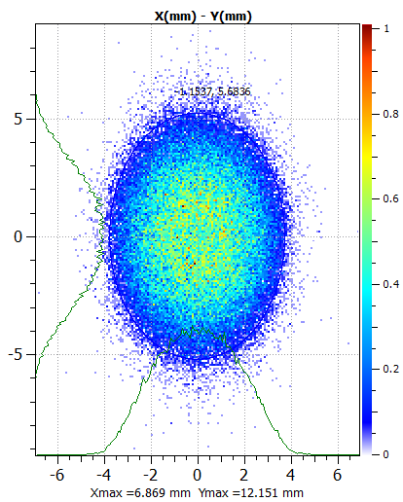
Particle Distribution @ 160 MeV
Size (1 sigma): x = 1.7 mm; y = 2.3 mm
Divergence (1 sigma): x‘ = 0.6 mrad; y’ = 0.7 mrad
Laser
200 µm
~ 4 m
Detector
Drift
Laser

Slide 12
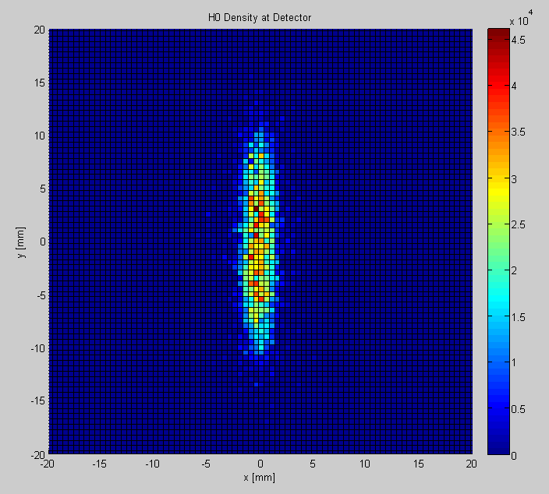
H⁰ distribution at detector plane
Detector requirements:
~ 10⁵ H⁺ / mm² -> Radiation Hardness
Size: ~ 30 x 30 mm
Resolution: 200 µm -> ~5 strips/sigma
Resolution: 500 µm

Slide 13
Contents
Project Overview
Simulations - Background
Components (Laser & Detector)
3 MeV Test Setup
Summary - Outlook

Slide 14
Sources for Background - Overview
Black-body Stripping
Magnetic field Stripping
Both negligible
Ref: Development of beam transverse profile and emittance monitors for the CERN LINAC4, B. Cheymol
Residual Gas Stripping
Simulations done
Intrabeam Stripping
Simulations to be done
Ref: Intrabeam Stripping in H⁻ LINACS, V. Lebedev
Dipole
H⁰
H⁻
e⁻
H⁰
H⁻
H₂
e⁻
H⁻
H⁰
e⁻
H⁻
H⁻

Slide 15
Model for residual gas stripping at 160 MeV
Residual gas consits mainly of H₂
RMS values:
x’ = 0.8 mrad
y’ = 1 mrad
Diameter = 10 mm
Detector requirement:
Fast! (τ_{Detector} < t_{LaserPulse})
40 m
 | LEBT | RFQ | Chopper | DTL | CCDTL | PIMS
Vacuum Pressure [mbar] | 10⁻⁵ | 10⁻⁷ | 10⁻⁷ | 10⁻⁷ | 10⁻⁷ | 10⁻⁷
P_{Stripping} | 2.6E-02 | 2.3E-04 | 1.4E-05 | 8.6E-06 | 4.3E-06 | 2.4E-06
H⁻ arriving [1/ns] | 6.5E+01 | 1.3E+01 | 6.1E-01 | 4.6E+00 | 4.8E+01 | 6.1E+02
Accumulated background level at detector = 7.4E+02 [1/ns]

Slide 16
Measurement Setup at 3 MeV Teststand
SEM grid
H⁰ background
200 µm slit
H⁻ beam

Slide 17
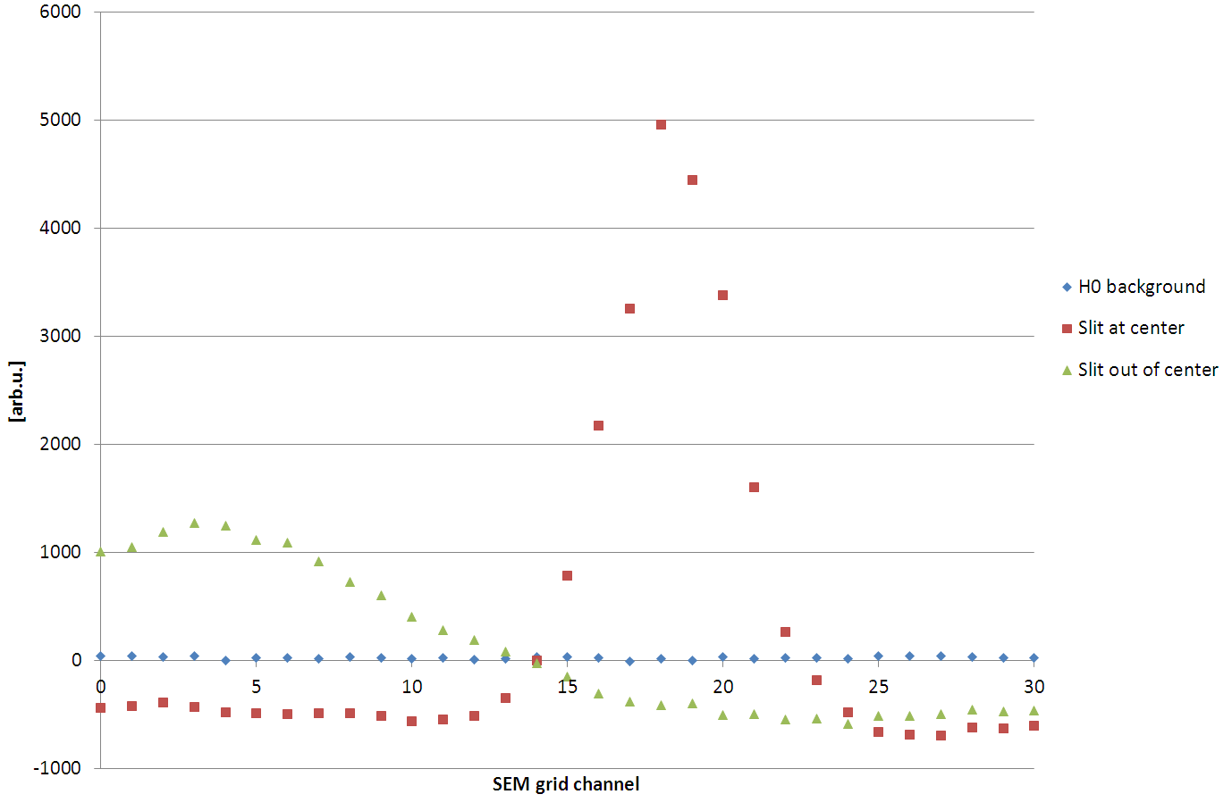
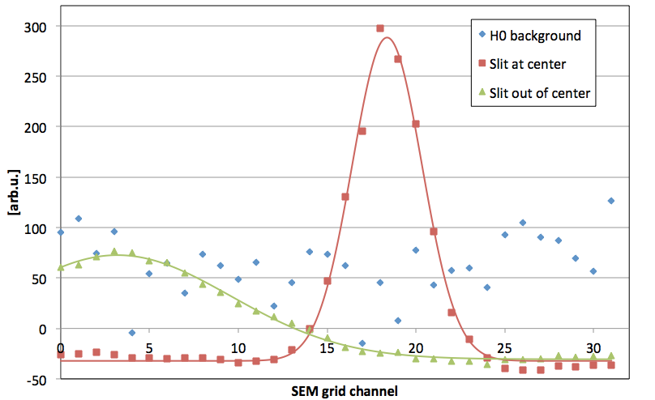
Measurement Results from 3 MeV Teststand
Slit-and-grid (slitsize 200µm)
Scaling of background
6% laser efficiency
H⁰ instead of H⁻
Overall Scaling factor: 39
Time behaviour not measured yet!

Slide 18
Contents
Project Overview
Simulations
Components (Laser & Detector)
3 MeV Test Setup
Summary - Outlook

Slide 19
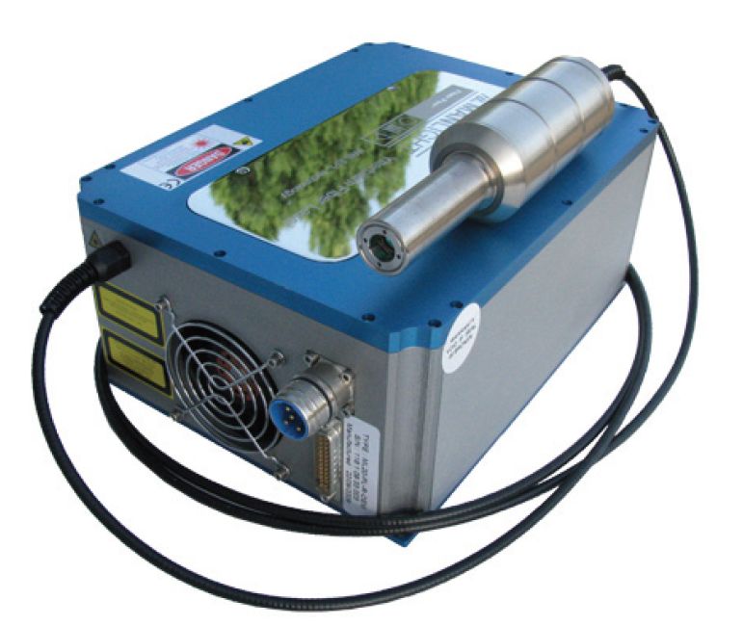
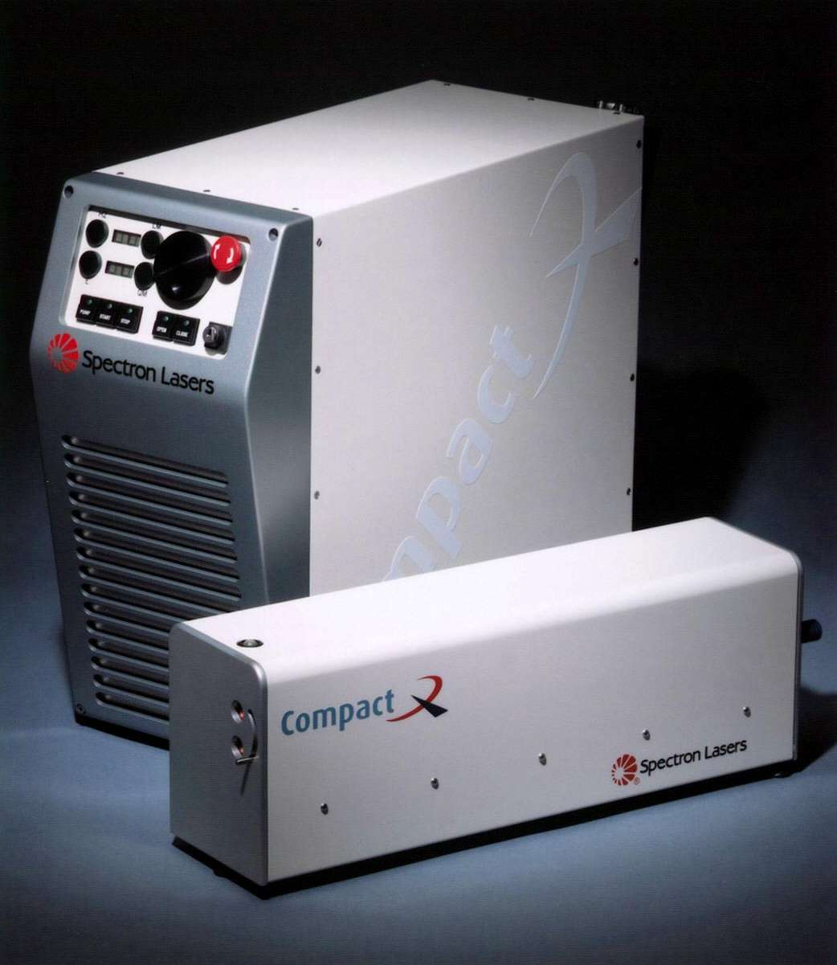
Lasers
Laser | Fiber-laser Yb-doped | Solid-State Nd-YAG
Model | Manlight ML-30-PL-R-TKS | Spectron Mini-Q SLMQ1S
Wavelength | 1080 nm | 1064 nm
Energy | 0.9 mJ | 50 mJ
t_{pulse} | 110 ns | 9 ns
Beam quality – M² | 1.7 | 1.3
Repetition rate | 30kHz | 20 Hz
Beam transport | Fiber | Free Space
P_{strip} @ 3 MeV | 6 % | 100 %
P_{strip} @ 160 MeV | 1 % | 100 %
Ref: Description of laser transport and delivery system for the FETS laserwire emittance scanner, A. Bosco, IBIC13

Slide 20
Laser impact on system performance
 | Laser Parameters | Fiber-laser | Nd-YAG
Spatial resolution | M² | + | ++
Laser pulses / LINAC4 pulse | f_{Rep} | 12 | 1
Detector requirements (Bandwidth, Rad hardness) | t_{pulse}; E_{Pulse} | ++ | -
Handling; Maintenance | Laser transport | +++ | --
Signal - Noise Ratio:
SNR / laserpulse | Fiber-laser | Nd-YAG | Background
3 MeV Particles/bunch | 1.4e6 | 4.3e7 | 7.8e3
SNR | 154 | 5513
160 MeV Particles/bunch | 2.7e5 | 4.3e7 | 2.1E+03
SNR | 129 | 20476
Detector:
Size: 30x30 mm
Time resolution in ns-range
Laser in center of beam
Detector 3 m behind the slit
SNR averaged over detector size
Beam shapes as simulated
Notes:
Spatial resolution (w0 –reighleigh)
Nd-YAG:
Breiter weil 100% stripping
Slit-breite einstellbar durch focussierung -> Besseres SNR leicht möglich!!!!
Detector requirements
Fiberlaser:
Pulse length higher -> Bandwidth detector can be lower
Pulse energy lower -> Rad – hardness!
Repetition rate
Better SNR through avg possible

Slide 21
Detector alternatives: Overview
Type | SEM grid | Scintillator | Semiconductor e.g. Silicon | Poly crystal Diamond | Gaseous Detector (GEM)
Size | +++ | ++ | ++ | ++ | +++
Resolution | - | +++ | ++ | ++ | ++
Sensitivity | --- | + | +++ | +++ | +++
Bandwidth* | +++ | --- | ++ | ++ | +
Homogeneity** | +++ | ++ | +++ | - | ++
Rad. Hardness | ++ | --- | -- | - | ++
* Just charge creation. System depends of course on readout electronics!
**without irradiation.

Slide 22
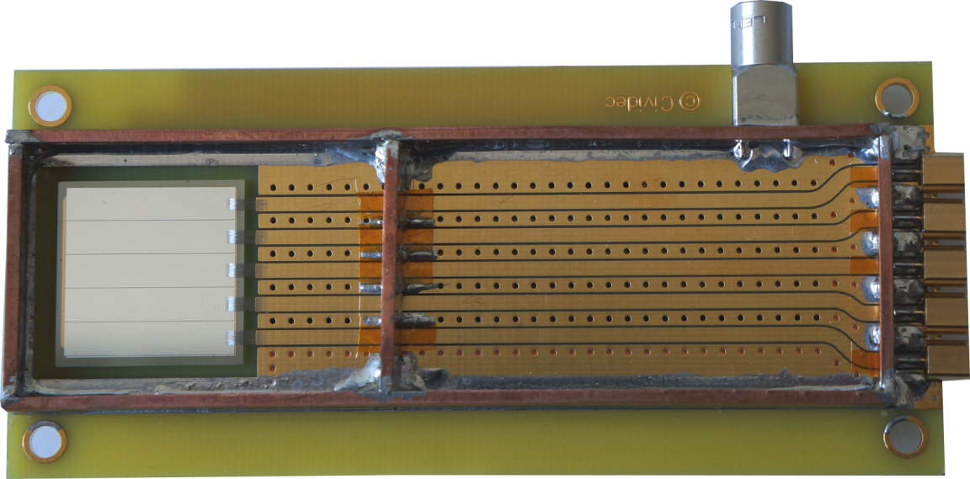
Detector for 3 MeV Tests
 | Detector CIVIDEC
Type | Polycrystalline
Size | 19 x 19 mm
Resolution | 5 channels
Thickness | 500 µm

Slide 23
Contents
Project Overview
Simulations
Components (Laser & Detector)
3 MeV Test Setup
Summary - Outlook

Slide 24
3 MeV Testbench
Transfer line to PSB
160 MeV
100 MeV
50 MeV
Testbench

Slide 25
Setup at 3 MeV Diagnostics Testbench
Diamond Detector
Laser
viewport

Slide 26
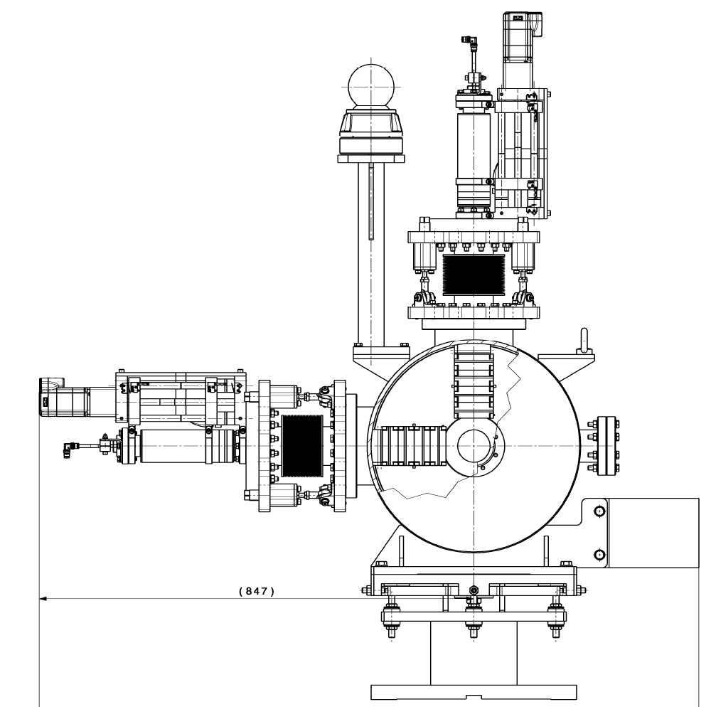
Integration Laser Setup
Diagnostics rack
Linear stage with 500 mm lens
tube
PXI-System
Class 4
fiber laser
Coupling
Ref: Fiber Laser Transport for the Photodetachment Emittance Measurements at FETS, Alessio Bosco

Slide 27
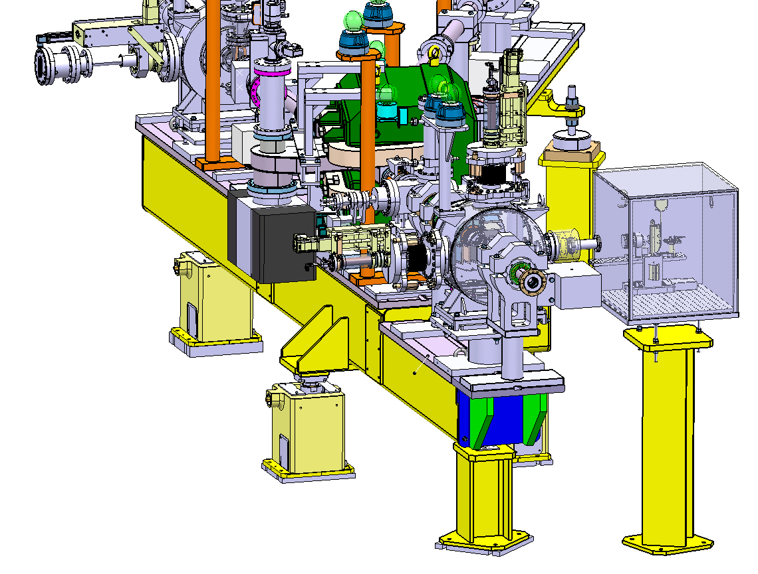
Integration Laser Setup

Slide 28
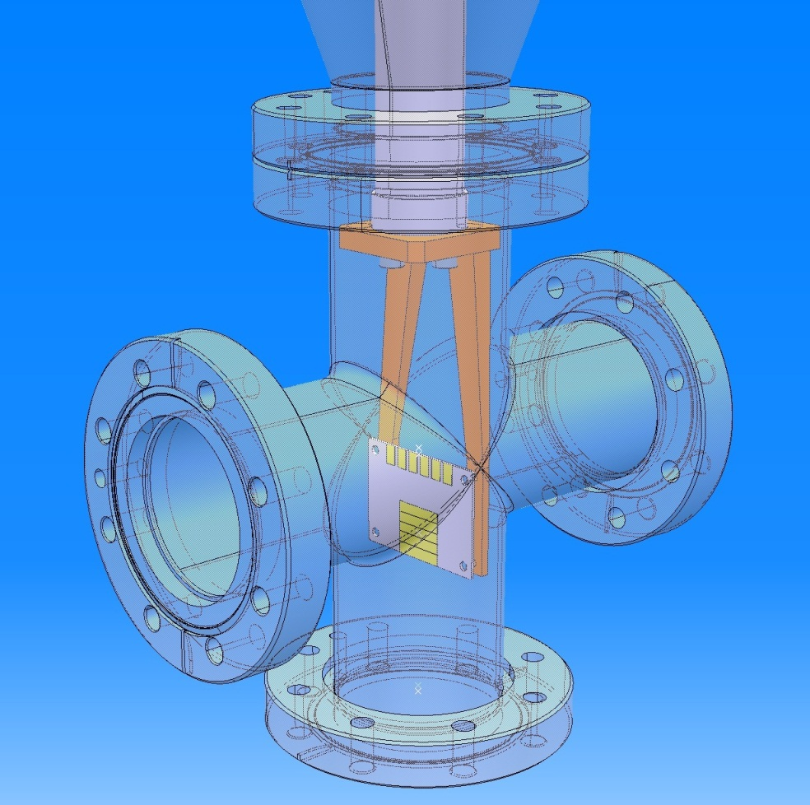
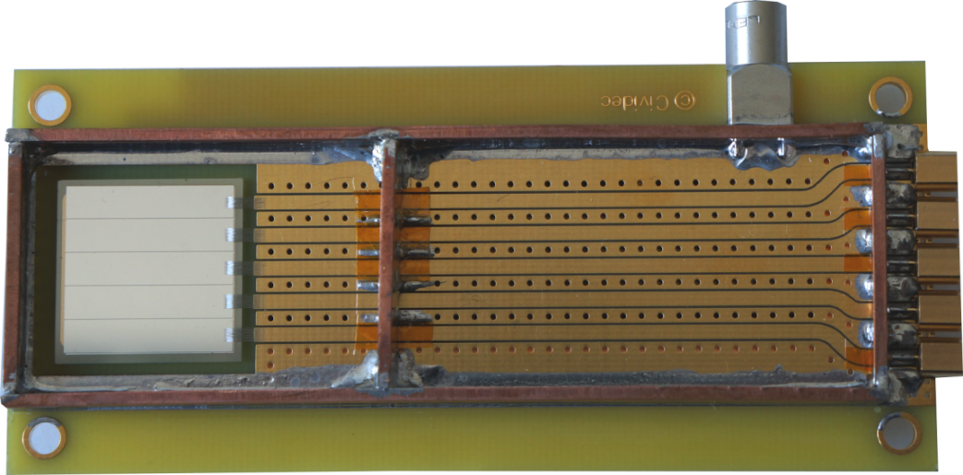
Integration diamond detector
Installation of detector 3.3m downstream the laser
Vertical movement driven by stepping motor
Interlocked to protect detector in case of magnet failure
Readout: 1 GHz Scope

Slide 29
DAQ and Control Concept
LASER
SCR
From ion
source
1GHz Scope
Digitizer
Time/Cnt
ethernet
PXI
Triggers
External PCs
Camera
Serial
Firewire/USB
Filter
Wheel
Beam
Expander
Movers

Slide 30
Contents
Project Overview
Simulations
Components (Laser & Detector)
3 MeV Test Setup
Summary - Outlook

Slide 31
Summary
Simulations done regarding the following:
Laser – Particle interaction
Background level
Review and comparison of suitable components
Preparations towards tests at 3 MeV done (together with RHUL)
Development of fiber-laser setup and fiber-based transport to beampipe
Implementation of diamond-detector in testbench
Design of system for DAQ and controls

Slide 32
Outlook
Tests at 3 MeV teststand (Okt 2013 – March 2014)
Background characterization
Test of diamond detector
Test of laser stripping with low power fiber-laser
Developments for 160 MeV prototype
Detector
Simulations: Gaseous detectors
Readout concept for high number of channels (~128)
Laser
Decision for lasertype (Nd-YAG / fiber-laser)
Development of optical transport line for 160 MeV setup
Test of system at 160 MeV (Hopefully Mid 2015)

Slide 33
That’s it.
Thanks for your attention!

Slide 34
SPARE

Slide 35
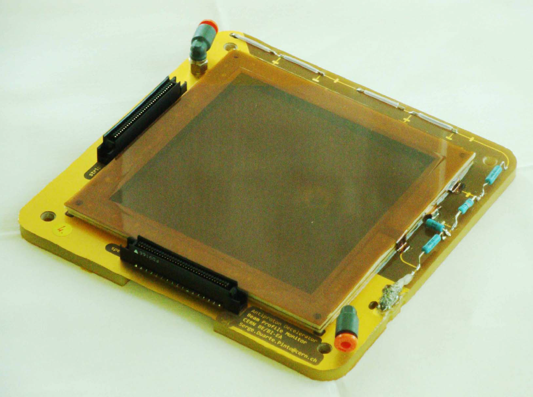
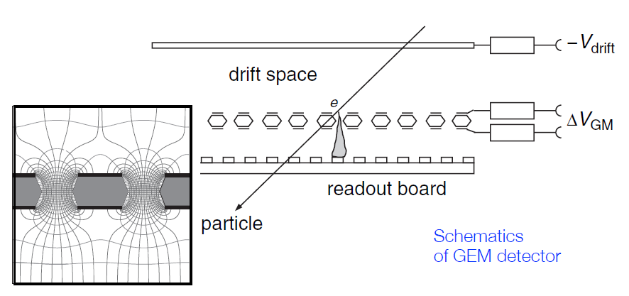
Alternative for 160 MeV Setup: Gaseous detector
High sensitivity (> 100 e-/H⁰)
Sufficient spacial resolution (100 µm)
Big sizes possible (> 10 x 10 cm)
High bandwidth (ns)
No radiation damage reported!
Similar application already realized
Ref: GEM-based beam profile monitors for the antiproton decelerator
But: Futher simulations needed

Slide 36
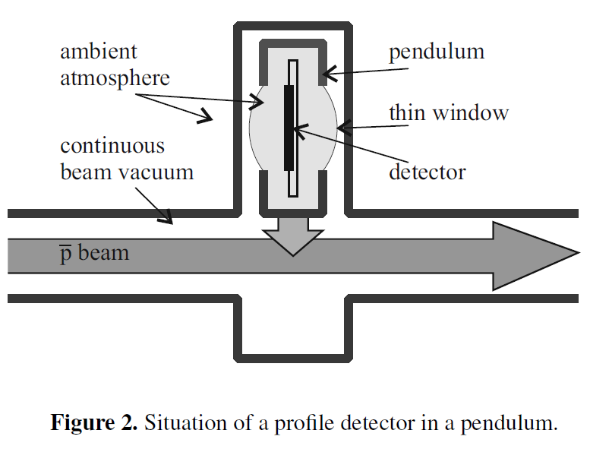
Comparison with AD setup (Duarte Pinto, Spanggaard)
 | Antiproton Deccelerator | LINAC4
Particle | Antiproton | H⁺
Beam Energy | 5.3 ... 126 MeV | 160 MeV
Spill length | 150 ... 300 ns | 10 ... 150 ns
Rate | 7*10¹² Particles/s*mm² | 10¹² ... 10¹⁴ H⁺/s*mm²
Size | 100 x 100 mm | ~ 20 x 20 mm
Resolution | 1.6 mm (x & y) | ~ 100 µm
Time resolution | 20 ms | ~ 5 ... 20 ns
Radiation hardness | ? | ~ 10¹⁵...10¹⁶ H⁺/cm⁻²
Homogeinity | ? | ~ +/- 1 % over lifetime

Slide 37
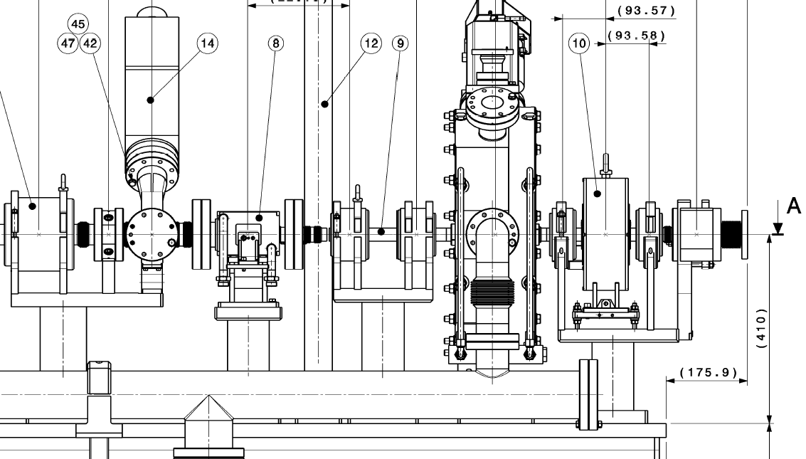
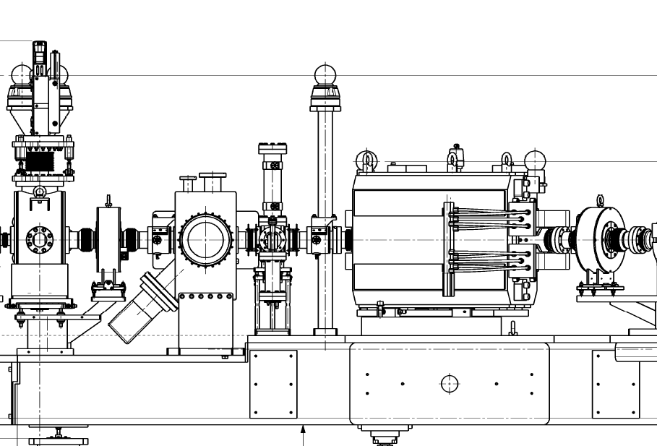
Chopper Quad settings
Aim: Maximal amount of particles stripped
Optimisation of Quadrupol gradients to focus beam
Q1: 8.15 T/m
Q2: -7.15 T/m
Q3: 11.9 T/m
Q4: -11.5 T/m
Laser Viewport
Quads
Quads

Slide 38
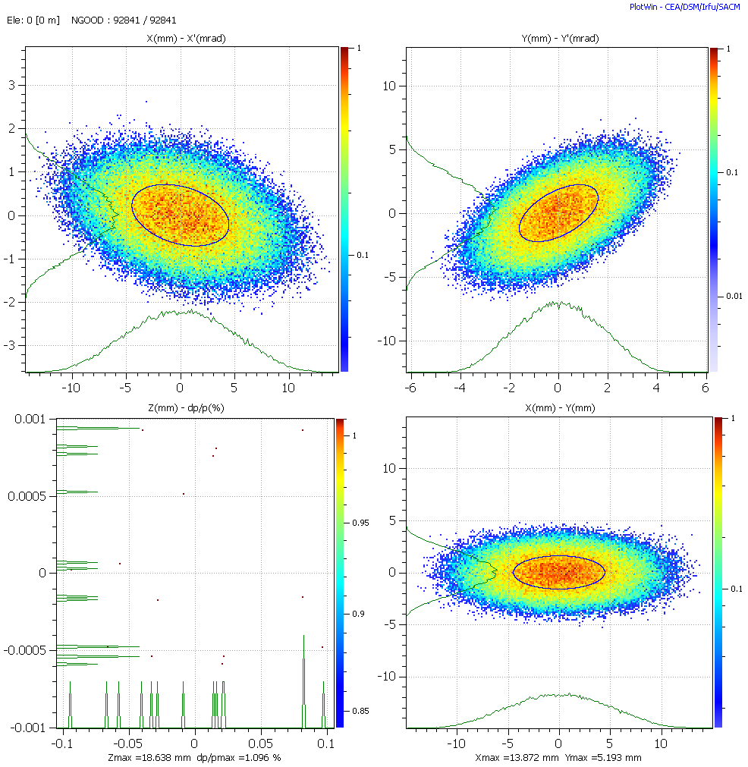
Beam shape @ 3 MeV at laser

Slide 39
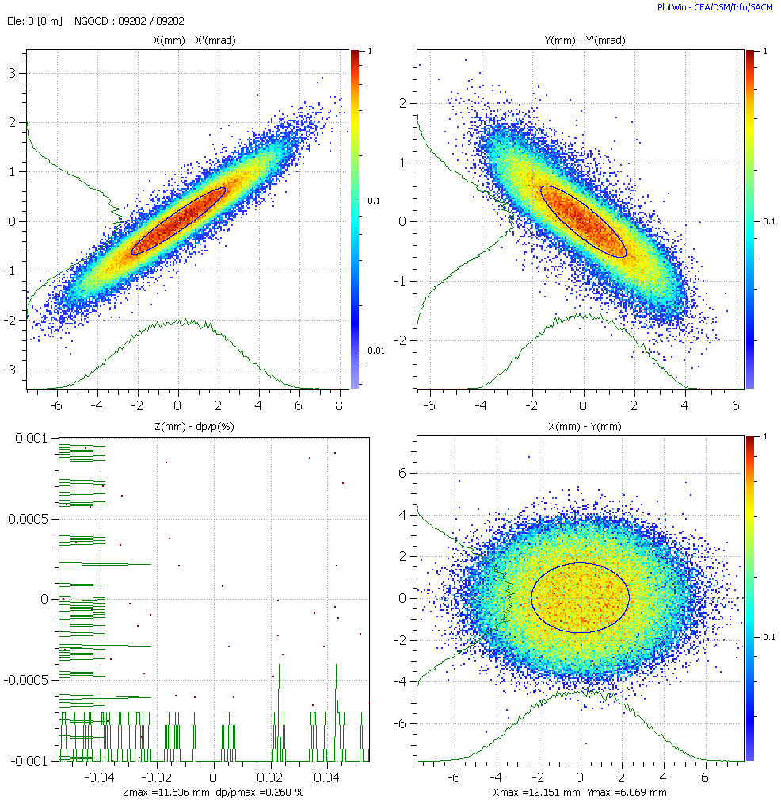
Beam after PIMS

Slide 40
Result: Beam dynamics @ 3 MeV
Size (1 sigma): x = 4.5 mm; y = 1.6 mm
Divergence (1 sigma): x‘ = 0.7 mrad; y’ = 2.2 mrad
Q1
Q2
~ 3 m
Laser
Drift
Laser

Slide 41
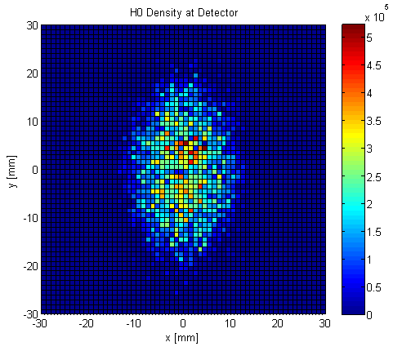
Stripping & propagation to detector
Divergence (1 sigma): x‘ = 0.7 mrad (conv)
y’ = 2.2 mrad (div)
3.0 m
Drift
Laser
Profile measurement not possible
BUT: No Signal / Background ratio is good

Slide 42
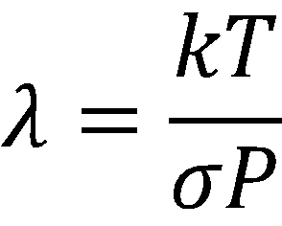
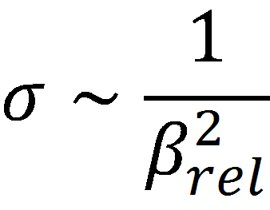
Residual Gas Stripping
Beam pipe
H⁰
l = length
H⁻
H₂
Stripping probability rises with gas pressure
Stripping probability decreases with particle energy
e⁻
;

Slide 43
Residual gas composition
Residual gas consits mainly of H₂
For background simulations just H₂ is taken
Ref: Chiara Pasquino

Slide 44
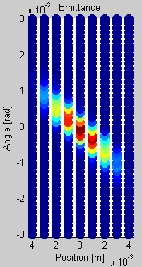
160 MeV Emittance Simulation

Slide 45
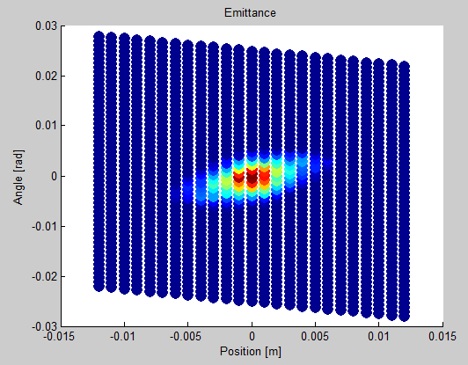
3 MeV Emittance

Slide 46
Radiation hardness
Model: NIEL (Non ionizing energy loss)
Displacement damage
Damage equivalent to
1 MeV neutron
Effects (for Si)
Leakage current
Doping change
-> Change of sensitivity
Issues
Sensitivity inhomogeneities
Transverse drift of e⁻ and
-> Inhomogenous detector behavior
3 MeV
160 MeV

Slide 47
Fluence Scenario @ 3 MeV
Scenario for 40 mA beam current
Can be scaled with beam current
Fluence scenario for LINAC4 at | 3 MeV
Position | after RFQ
Fluence in central mm^2 of detector per pulse
Fiber laser created H0 per laserpulse | 2.50E+05
Hardness parameter (NIEL) | 10
Background per 400us pulse | 1.40E+07
Hardness parameter (NIEL) Background | 10
Equivalent fluence in center per laser position [1/cm^2] | 1.43E+10

Slide 48
To be done: Detector – Particle interaction
Detector thickness: 500 µm
Range of 3 MeV Proton in Diamond: 48 µm
Gain (e⁻/H⁰) ?
H⁰
e⁻
p
48 µm
500 µm

