Slide 1
Overview of Present and Future Laser Diagnostics for Fermilab H- Accelerators
Vic Scarpine, Fermilab
Presenting for the H- laser diagnostics team

Slide 2
Booster/Linac Laser Profile Monitor

Slide 3
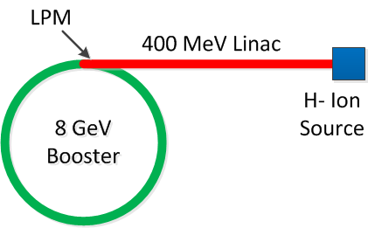
Booster Laser Profile Monitor (LPM)*
* Courtesy of Dave Johnson et al.
I_{B} ~ 35 mA
Pulse rate up to 15 Hz
200 MHz bunching
~ 1e9 H- per bunch
Utilize photons from Nd:YAG laser ( λ = 1064 nm) to photodetatch the outer electron from the H- ions creating neutral H0 atoms and free electrons.
For a 50 mJ 10 ns laser pulse with an average laser size of 200 um, we neutralize about 92 % of the H- passing through the laser.
The liberated electrons are swept into electron detector by weak magnetic field.
With a laser beam diameter << H- beam, we can scan the laser across the H- beam and collect the electrons at each position of the scan thus giving us a density profile of the H- beam.
For typical source currents of ~ 35mA -> 200 MHz bunch intensities of ~1E9 with a bunch separation of ~5 ns. For a laser pulse duration of ~10 ns we impact only a single bunch each linac cycle.

Slide 4
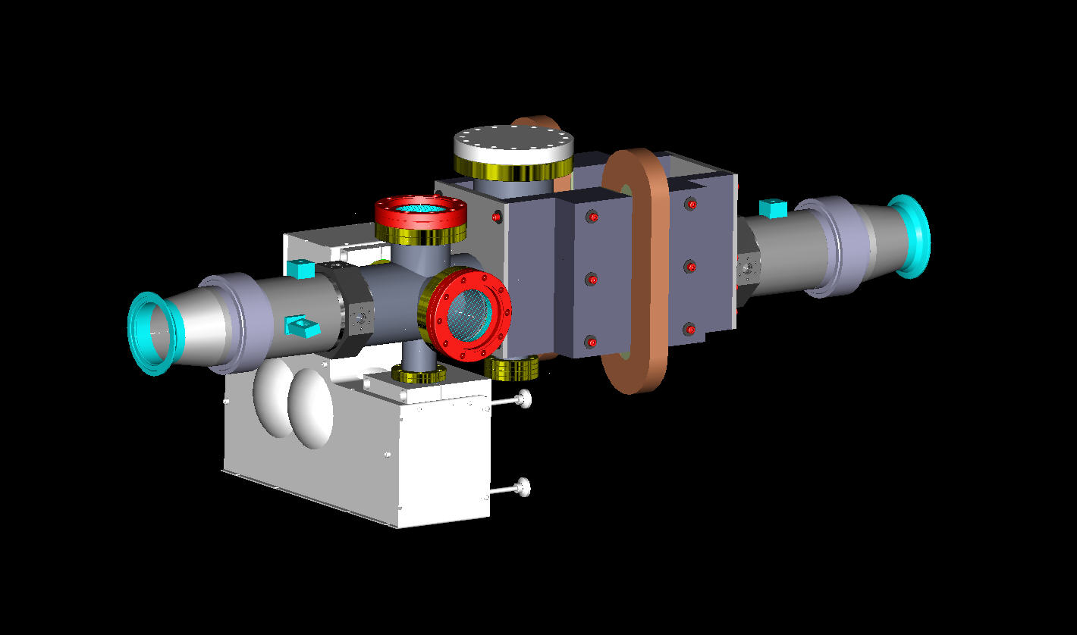
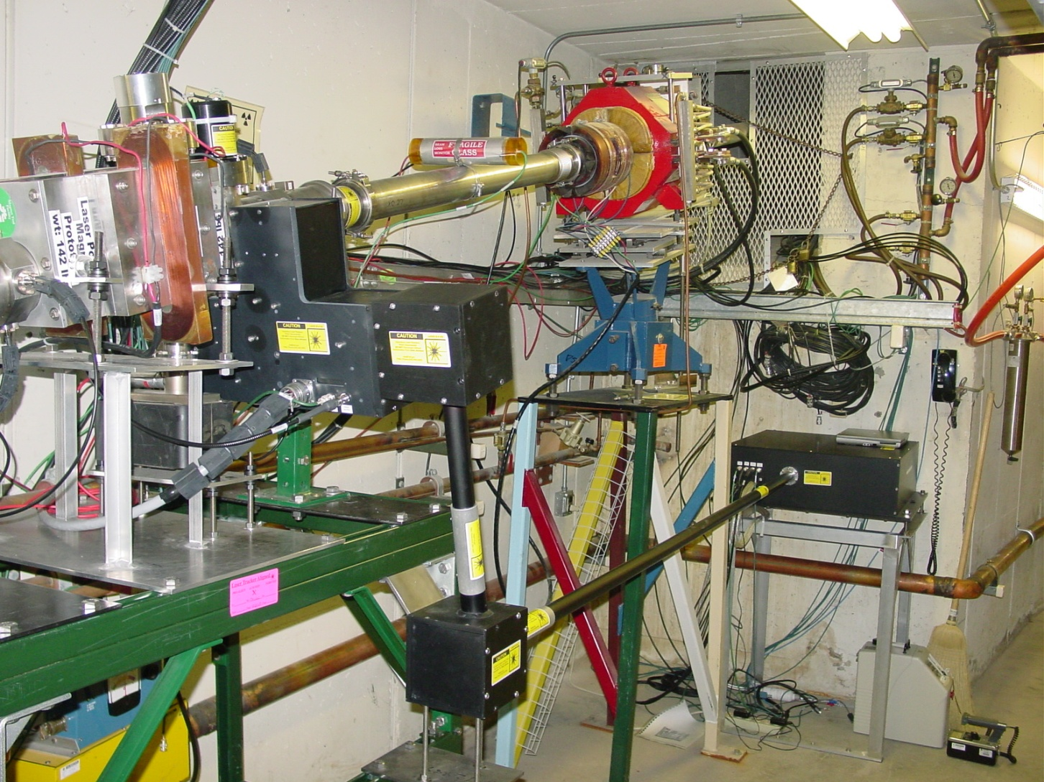
Fermilab LPM
viewports (laser beam dump not shown)
electron detector port
button BPM
Installation in Booster
Nd-YAG Laser far from LPM
Reduce Booster radiation effect
Long transport – difficult alignment
H- beam
electron magnet
optics box
H-
Q-switch laser
Laser energy: ~ 50 mJ/pulse
Wavelength: 1064 nm
Pulse length: 9 nsec
Pulse rate: 20 Hz
Fast rotating mirrors (±4⁰ / 100 µsec)
e⁻ detector

Slide 5
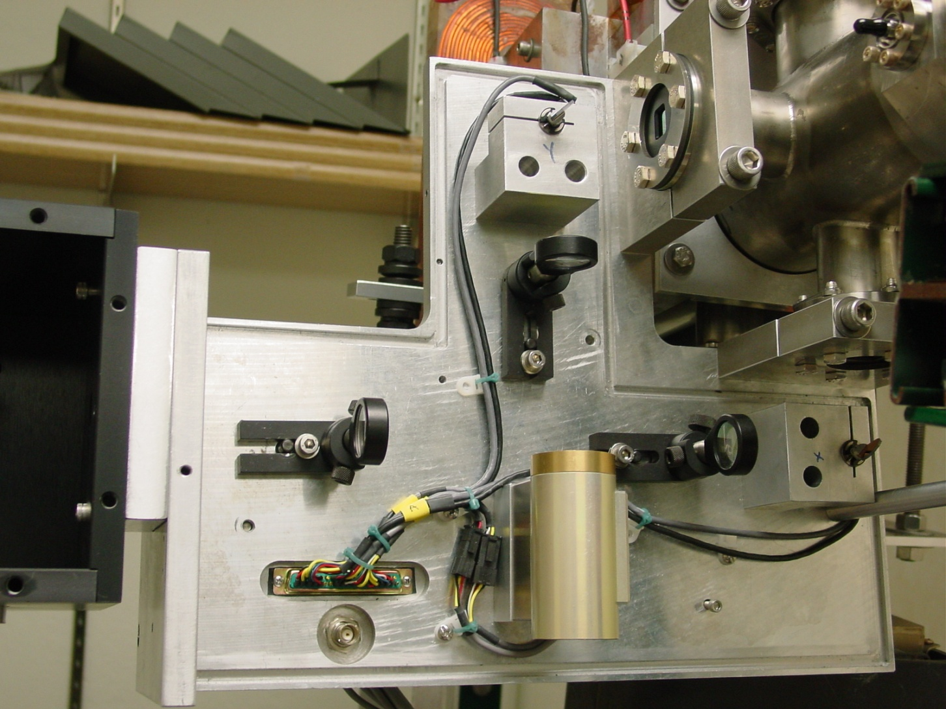
LPM Laser Paths
Optics Box
LPM Cross Section

Slide 6
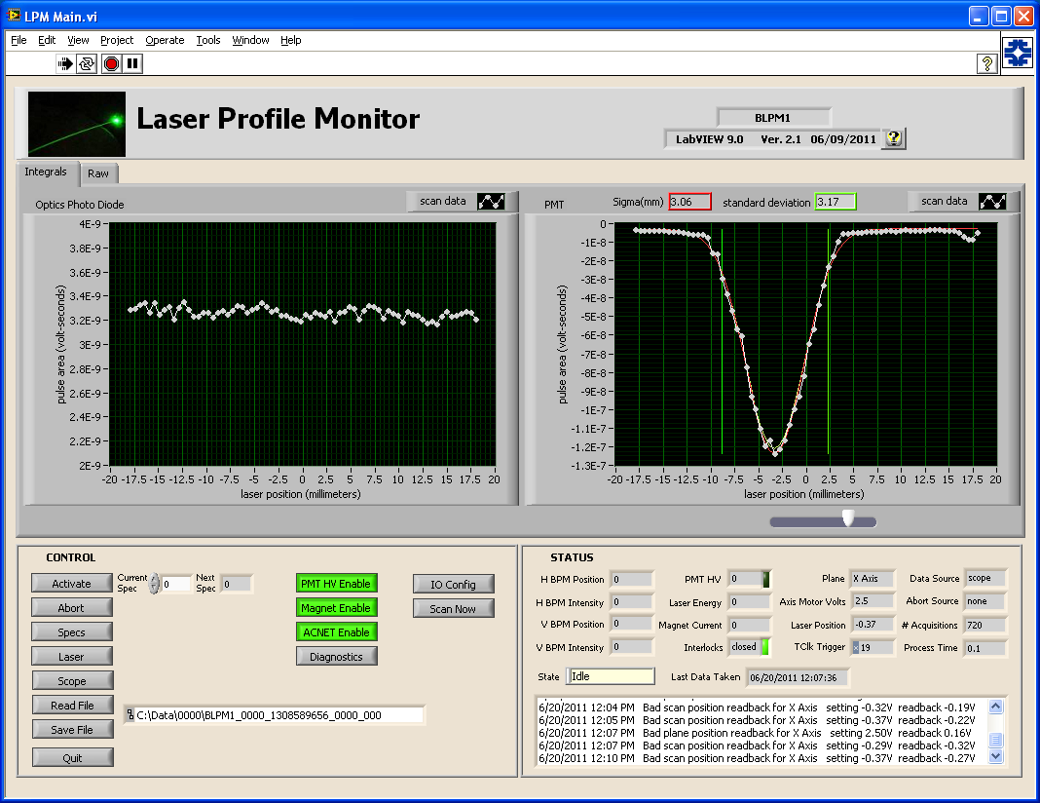
LPM Profile example
Bunch intensity ~1E9
Scan range -18 to 18 mm
PMT HV 700 V
LED Signal
PMT Signal
72 data points across scan
10 beam samples/data point
Is this real beam or reflection?
Laser Intensity
Beam
Profile
Small peak area ~ 2.3% of Main bunch

Slide 7
LPM Issues and Status
Hardware Issues
Laser power supply damaged by radiation
Moved power supply up stairs
Scanning galvanometers issues
Optical position feedback loop maxed out voltage
Suspect darkened led – working with vendor
Status
Coming out of 1+ year shutdown – beam is back
Data analysis resuming
Need to further optimize the laser energy/timing, PMT high voltage, and better understand the PMT signal and ADC optimization

Slide 8
Laser Diagnostics for Fermilabs Future Accelerators

Slide 9
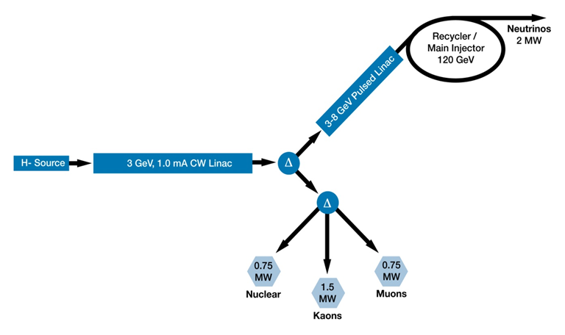
Project X Goals
The goal is to construct and operate the foremost Intensity Frontier facility in the world.
A neutrino beam for long baseline neutrino oscillation experiments
MW-class low-energy proton beams for kaon, muon, neutrino, and nuclei/
nucleon based precision experiments
A path toward a muon source for possible future Neutrino Factory and/or a Muon Collider

Slide 10
Project X Beam Measurement Goals
Beam current
DCCTs, Toroids, High-Bandwidth Resistive Wall Current Monitors (RWCM)
Beam position and phase
Warm and cold BPMs
Beam energy and energy spread
Time-of-flight from BPM phase, spectrometer magnet
Beam transverse profiles
Wire scanners, multi-wires, laser wires
Beam transverse emittance
Allison scanner, slit-wire scanners, laser emittance monitor
Beam longitudinal profiles
Wire-based bunch shape monitor, picosecond laser wires
Beam halo
Vibrating wire, high-gain wires, laser wires, apertures, diamond detectors
Beam loss monitoring
Ion chambers, neutron detectors
Chopped beam extinction efficiency
High-Bandwidth RWCM, single (few) particle detection
List of ~ 15 unique instruments needed for Project X

Slide 11
Project X Injector Experiment (PXIE)
Build an integrated systems test of the first ~ 30 MeV of Project X
Validate front-end concept to minimize technical risk elements
Demonstrate wideband chopper
Low-β superconducting acceleration
Integrated systems test goals:
1 mA average current with 80% chopping of beam in MEBT
Efficient acceleration with minimal emittance dilution
The scope of beam diagnostics are to identify and provide the instrumentation systems necessary to successful commission, characterize and operate PXIE and to validate the system test goals.
Development and testing of H- laser diagnostics

Slide 12
PXIE Beamline
H-
LEBT
HWR-CM
SSR1-CM
HEBT/
Dump
RFQ
MEBT
5 mA
30 keV
5 mA
~ 2.1 MeV
1 mA
~ 2.1 MeV
1 mA
~ 25 MeV
~ 40 m long
CW H- source delivering 5 mA at 30 keV
LEBT with beam pre-chopping
CW RFQ operating at 162.5 MHz and delivering 5 mA at 2.1 MeV
MEBT with integrated wide-band chopper and beam absorbers capable of generating arbitrary bunch patterns at 162.5 MHz, and disposing of 4 mA average beam current
Low beta superconducting cryomodules: 1 mA to ~25 MeV
Beam dump capable of accommodating 2 mA at 25 MeV (50 kW) for extended periods.
Associated beam diagnostics, utilities and shielding

Slide 13
MEBT Instrumentation
RF
Kick1
RF
Kick2
Dump
RF
MEBT Operational Beam Measurements: (red = CW)
Transverse position - BPMs
Bunch Phase – BPMs → time-of-flight → beam energy
Beam Current – DCCT, Toroids, RWCM (resistive wall current monitor)
Extinction – RWCM with fast scope
Transverse shape – wire scanners, laser wires
Transverse emittance – slit/multiwire (low-res), double slit/Faraday cup (hi-res), Quad scans
Longitudinal shape – laser wires, chopper, wire bunch shape monitor
Absorber Profiler – OTR Imager or IR imager

Slide 14
Current HEBT concept
Laser Transverse Emittance Monitor
Dump dipole
Thin foil
Absorber
R
W
C
M
Extinction Monitor
Laser wire
/Wire
Scanner
combo
H⁰
H⁺
H0 Profile Monitor*
Multi-port
Diagnostics Box
H⁻
BPM (4 button warm)
Laser wire
/Wire
Scanner
combo
*H0 profile monitor:
neutralization monitor
emittance measurement
R
W
C
M
Quad doublet
With X&Y corr.
MEBT design
Sweeping dipole
Multi-port diagnostics Box: (similar to SNS MEBT 6-pack)
Extinction monitor - tbd
Transverse emittance - slit/detector
wire scanner and/or laser wire
halo monitor – tbd
Longitudinal bunch shape monitor
Laser wire
future “unknown” diagnostics
High-Power
Dump
Transverse Beam Position and Longitudinal Phase - Warm BPMs
Same as MEBT BPM design and functionality
Beam Current Monitor
Two RWCM – like MEBT
Profiles in dump line to measure energy spread
Up to 30 kW of CW H- beam power

Slide 15
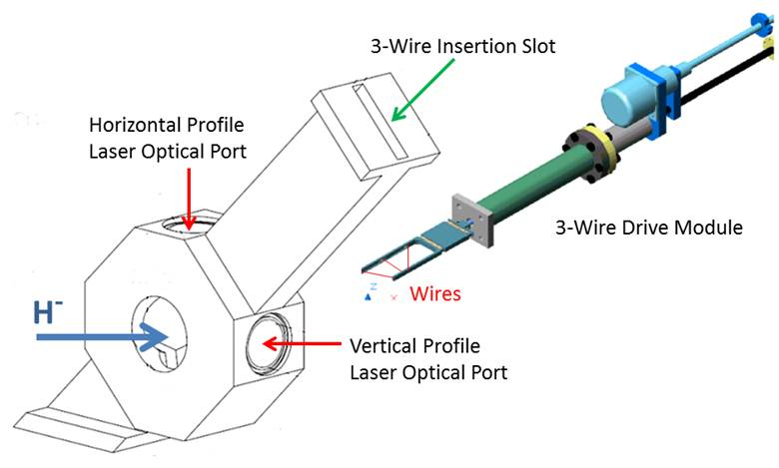
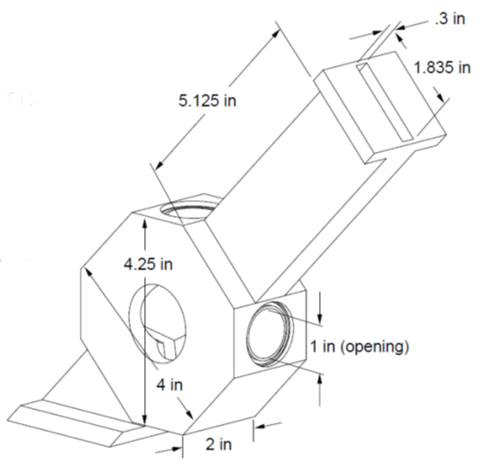
Combined Wire Scanner - Laser Wire Unit
Transverse 3-wire wire scanner plus laser wire module
Hybrid wire scanner with laser ports
Modified version of SNS design
Wire scanner in pulsed beam operation only
Laser wire in either pulsed or CW beam operation
Laser wire intended to measure transverse and longitudinal profiles
Will different lasers be required for transverse versus longitudinal measurements?
Can wires or lasers measure profile tails/halo?
Transverse halo measurements with wire suffer from cross-talk
Halo measurement with laser suffer from scattered light effects
Locations: MEBT, between SC cryomodules, HEBT

Slide 16
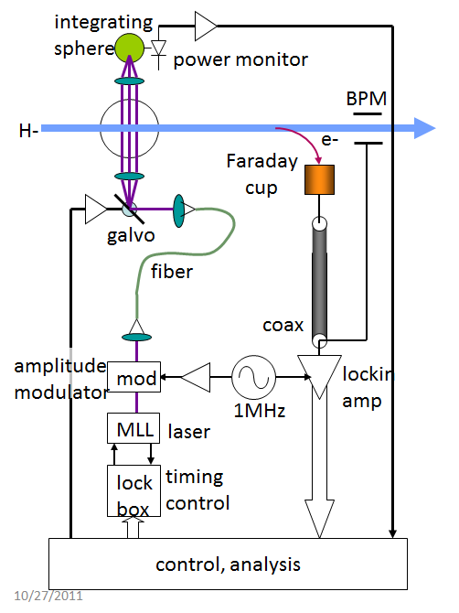
Low-Power Transverse and Longitudinal Laser Wire
Mode-locked psec laser used to measure both transverse and longitudinal profiles
Laser rep-rate is locked to accelerator RF
Distribute modulated laser pulses via fibers
Narrow-band lock-in amp detects modulated signal
Measure profiles by either:
Collection of electrons
Use BPM as notched-beam pickup would allow laser monitor to fit between cryomodules
Questions:
What is the photodissociation efficiency?
What are the noise issues?
What are the nonlinear limits to power in the fiber?
What signal-to-noise ratios and averaging times are practical?
R. Wilcox, LBNL

Slide 17
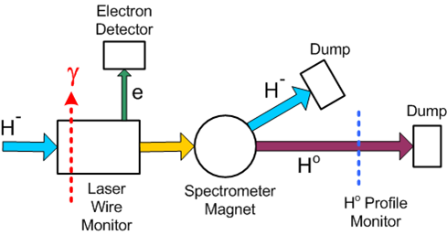
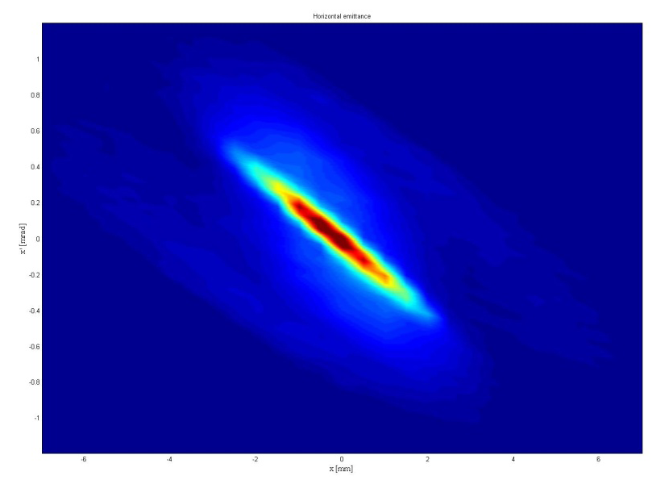
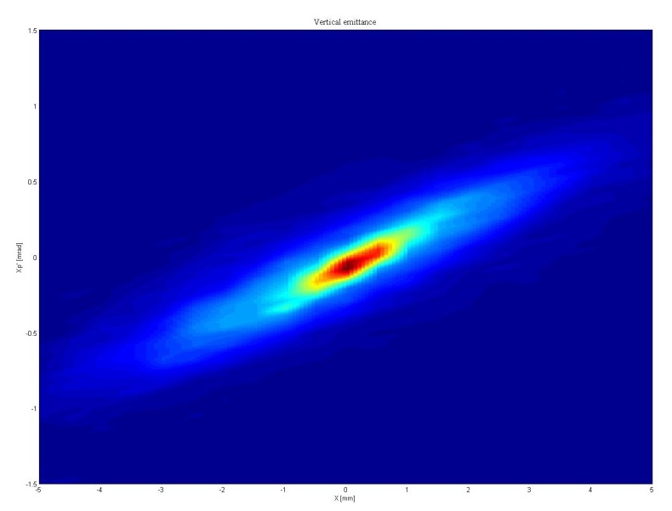
Laser Wire Emittance Monitor
Preliminary SNS Measurements (Y. Liu)
Horizontal
Laser Wire Emittance Monitor
Laser acts like slit → x
Generates H0
H0 profiler measure H0 divergence → x’
Background from beam neutralization
Demonstrated at SNS
Operate at the end HEBT
Vertical

Slide 18
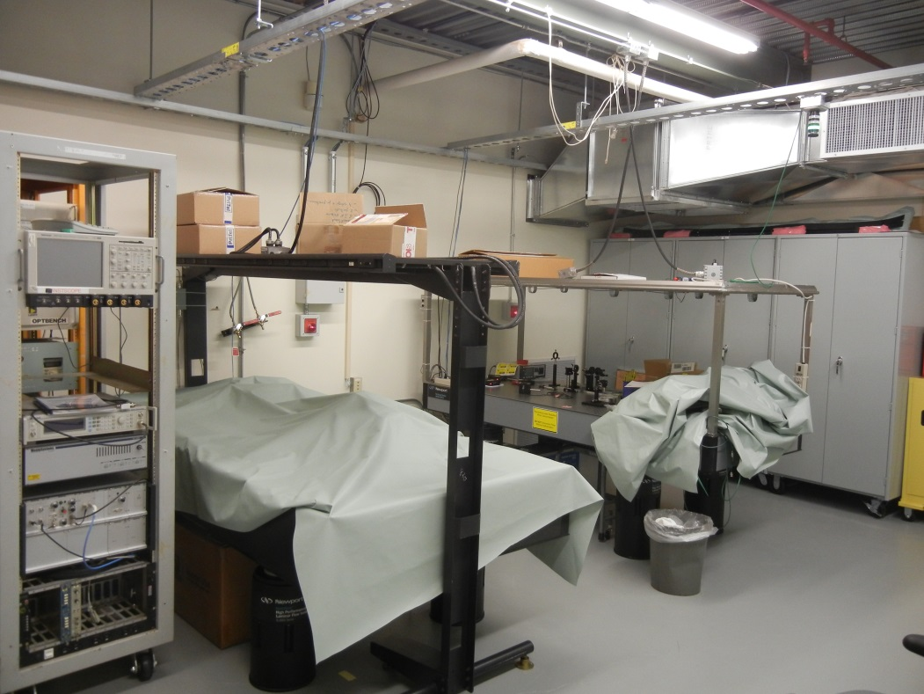
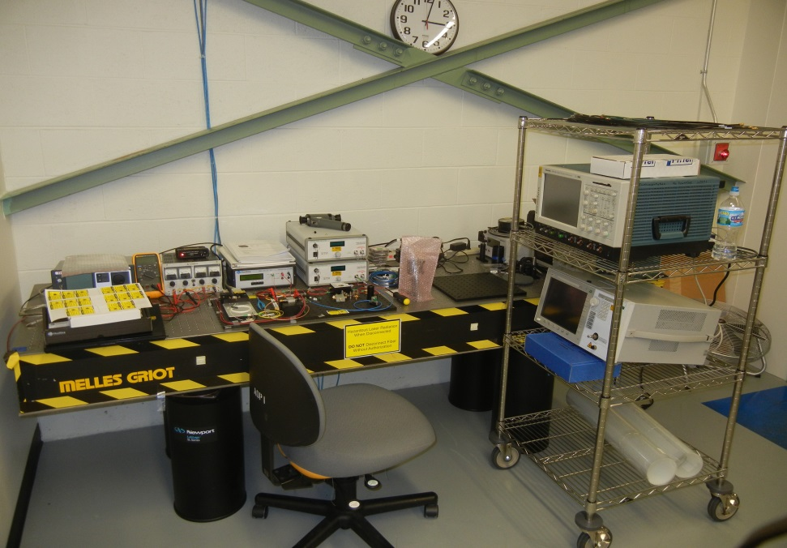
R&D Laser Lab
Development of a laser lab for R&D laser work
Interlocked room
Temperature controlled
Class IV laser operation
Three optical tables

Slide 19
Conclusion
Fermilab has installed and operated an initial laser profile monitor
Future high-intensity H- accelerators will require both transverse and longitudinal laser diagnostics
PXIE to provide a testbed for the development and testing various laser profile diagnostics

