Slide 1
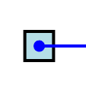
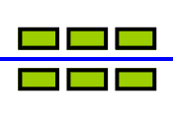
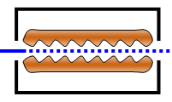
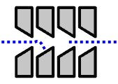







Laser diagnostics for the Front End Test Stand at RAL
Christoph Gabor (ASTeC)
Rutherford Appleton Laboratory, UK
christoph.gabor@stfc.ac.uk
In the Photo—Detachment Emittance Instrument (PD—EMI ) are involved
A.Letchford, J.Pozimski, D.Faircloth, P.Savage, S.Gibson,
A.Bosco, G.Boorman
and special thanks to V.Scarpine and the former HINS team for beam time
The Front End Test Stand FETS collaboration

Slide 2
Outline of my talk.
This can only be an overview and not more than a summary of the different aspects of PD—EMI.
However, the focus is on the idea and the principle. The aim is to explain why a spatial detector for the H^{O}(PD) is advantageous. .
Introduction: How do we (FETS) want to measure emittance in a non-destructive way?
Measurements and simulations about this emittance
method.
Summary of the hardware:
  (laser) → refer to Alessio Bosco’s (RHUL)
  dipole magnet and vacuum vessel
  scintillator
  integration into the beamline

Slide 3
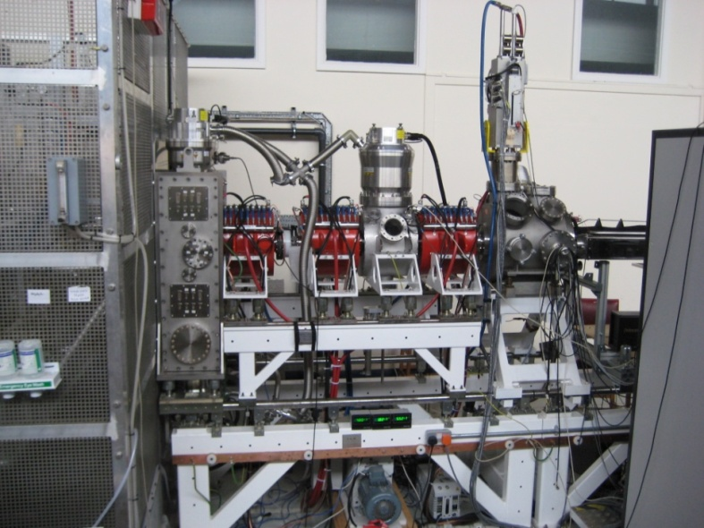
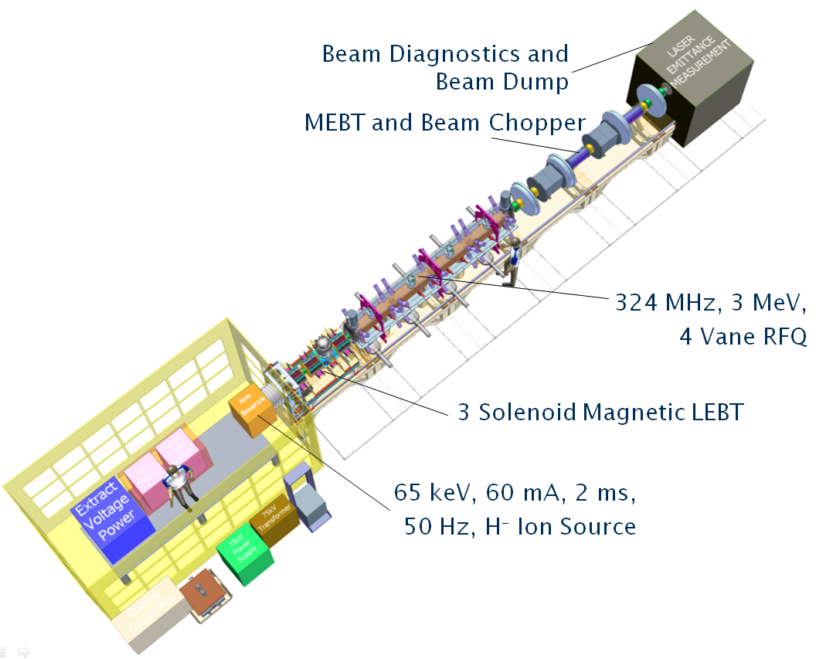
The FETS project — A brief overview of the components.
So far, only the
LEBT is operational. The RFQ is due to
delivery and assembly.
A concrete
shielding in mandatory.

Slide 4
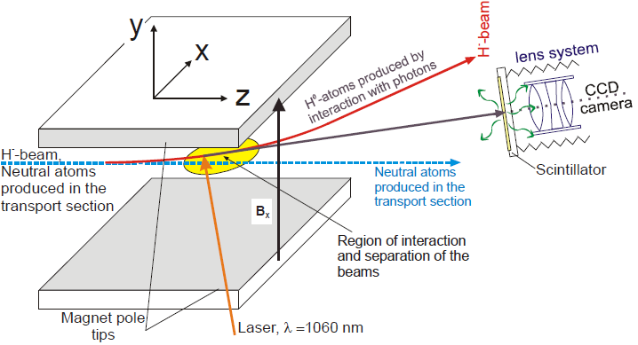
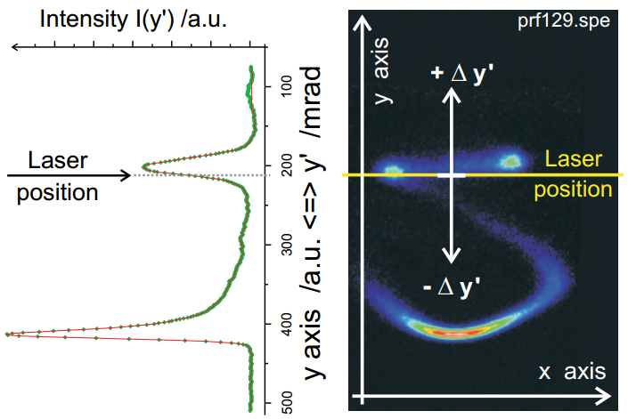
The basic idea of the PD—EMI.
The magnet splits the beam at Interaction Point into 3 different beamlets.
For each position of the laser, one integration is necessary for I(y’).
Alternatively, one can add up all distributions and ends with a full 2D (real space) picture of the beam.

Slide 5


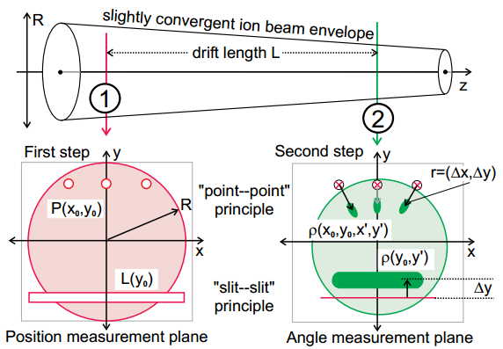
Differences between the various principles of measuring the emittance.
Shown are the two extreme point—point and slit—slit method.
Envelope of the ion beam.
Cross section of the ion beam.

Slide 6
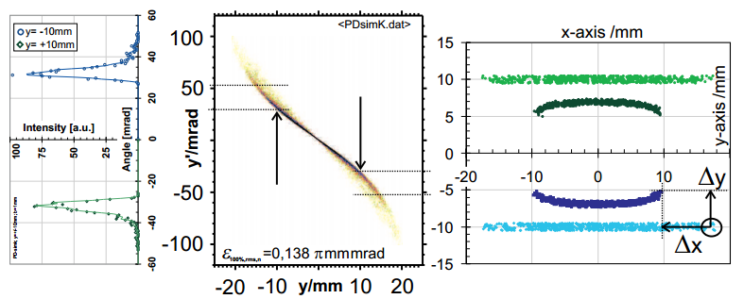
Simulations to understand the transfer function of a “2.5D emittance measurement.
Drift length between the 2 planes is 100mm.
Collimation is not shown and takes place in (xy)-plane.
Particles are collimated like a ribbon, no further structure is assumed
In the right graph, both distributions are shown at their position when “neutralized” and after the drift.

Slide 7
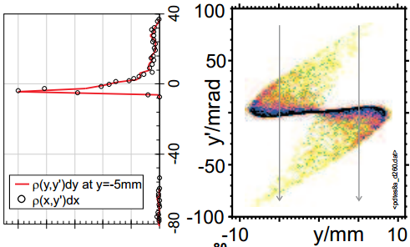
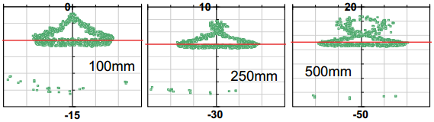
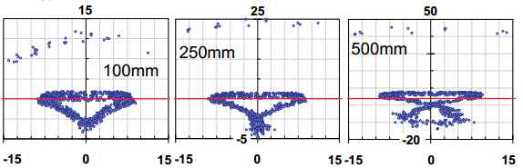
Simulations in more complex situations (I.).
drift length
aberrations
laser position
→ all this influences shape and size of the signal.

Slide 8
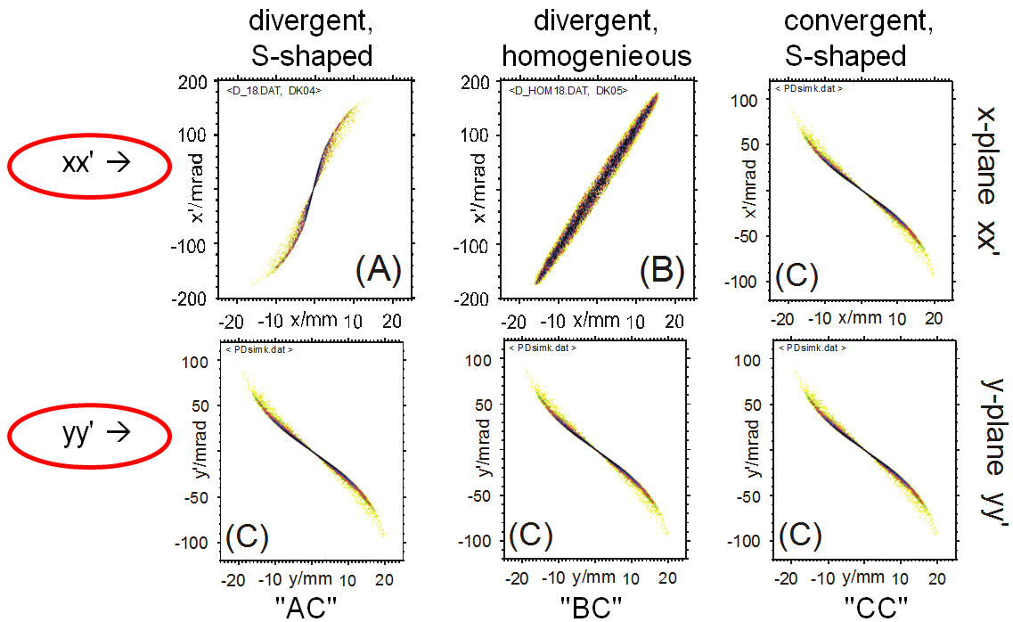
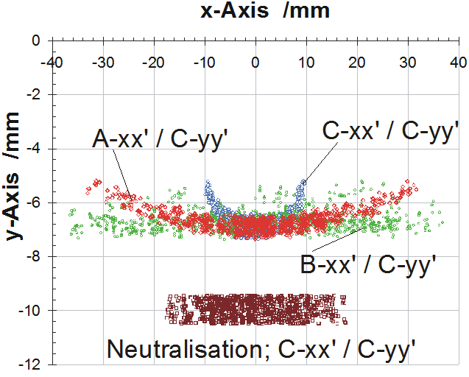
Simulation with different emittance in x- and y-plane.

Slide 9
Measurements as ‘proof-of-principle’ and to verify simulations.
Measurements are taken on a 10keV, 0.5mA beam with a 20W laser
No absolute scaling
Images are shown in pseudo-colours
Each measurement has its own noise floor
The line marks the (vertical) position of the laser

Slide 10
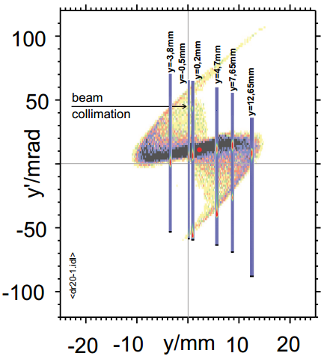
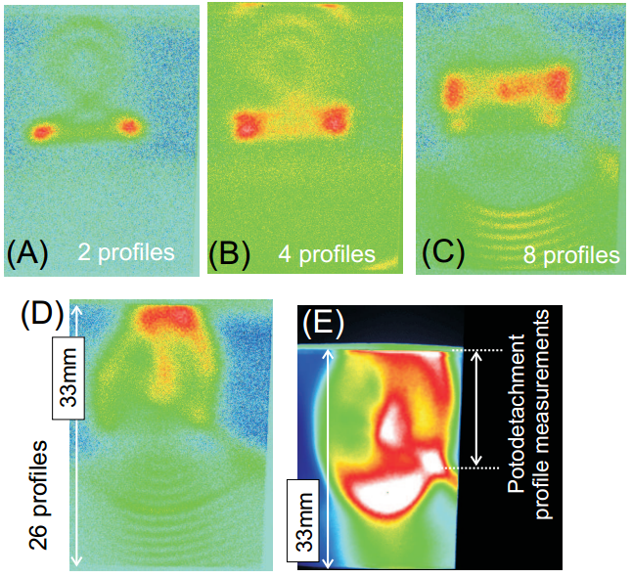
Comparison with slit—slit emittance and 2D distribution.
measured emittance at the IP
intensity density is shown in pseudo-colours
profiles scaled to y’/ mrad
Summing up several ‘profiles’ (in (xy) distribution and comparing with full 2D profile.
This is the basis for image reconstruction to calculate emittance in others than yy’ plane.

Slide 11
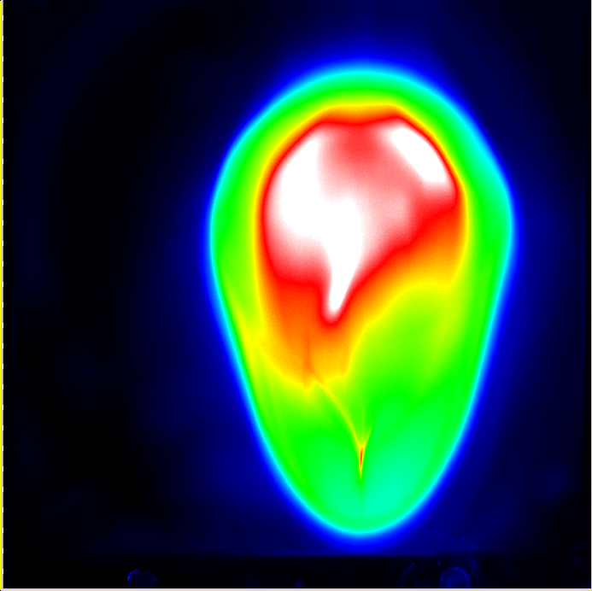
Example of an anti—S shaped aberration (ISIS Penning IS).
This result has been measured with a slit and a scintillator. Note, that the transfer function is independent of the actual instrumentation method applied.
It shows a unique pattern of aberration which is caused by the dipole. This helped to improve the beam dynamics in the magnet.

Slide 12
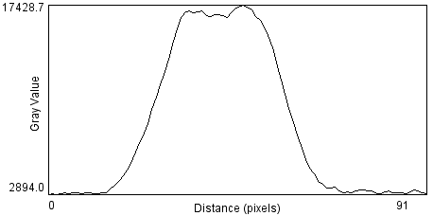
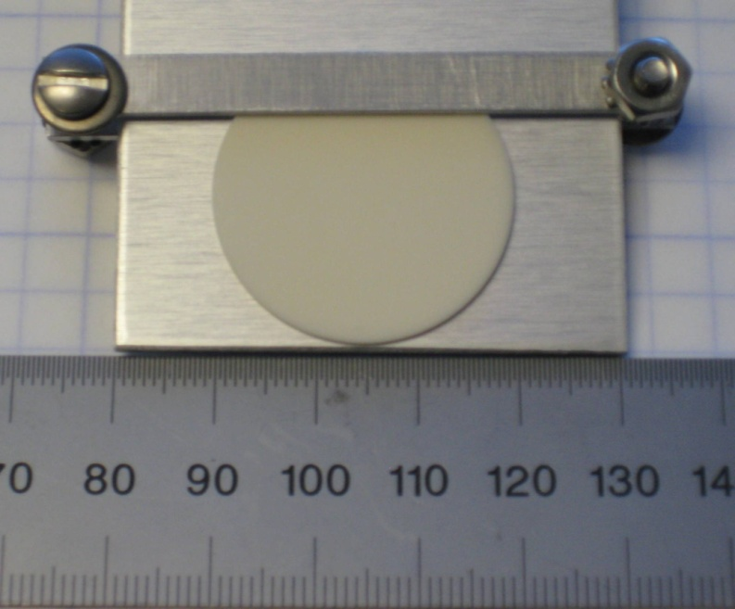
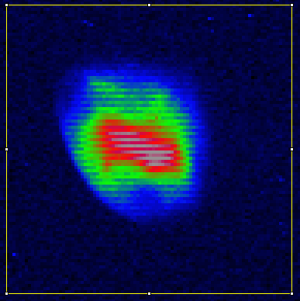
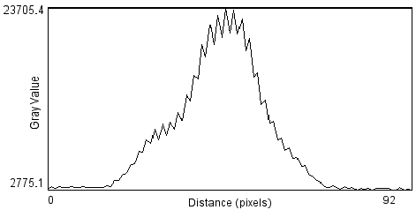
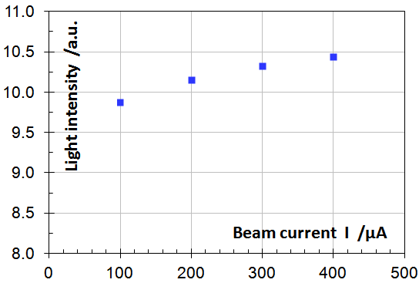
A scintillator provides as a particle detector provides the light for an image intensified camera (test-exp. @ FNAL).
Both measurements and simulations have shown the advantages of a particle detector with spatial resolution for H^{O}(PD).
measured with ND2
300uA_ND2_F4_01-14-162907
protons, 2.5MeV, uA-current, low resolution, only 8bit,
(exp.) time limited

Slide 13
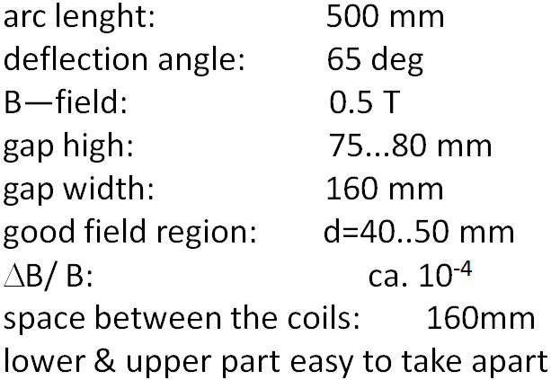
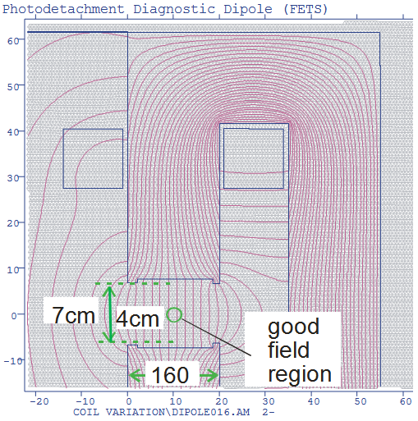
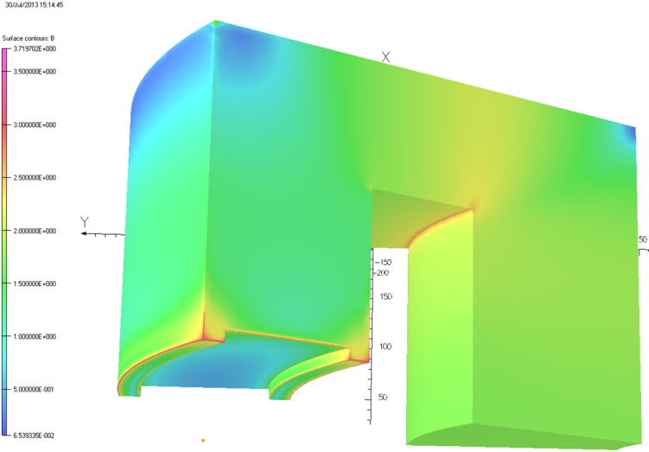
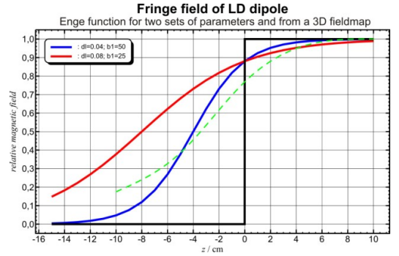
The PD—diagnostics (dipole) magnet.
The coils must provide enough space for ports and laser windows.
3D model of the magnet

Slide 14
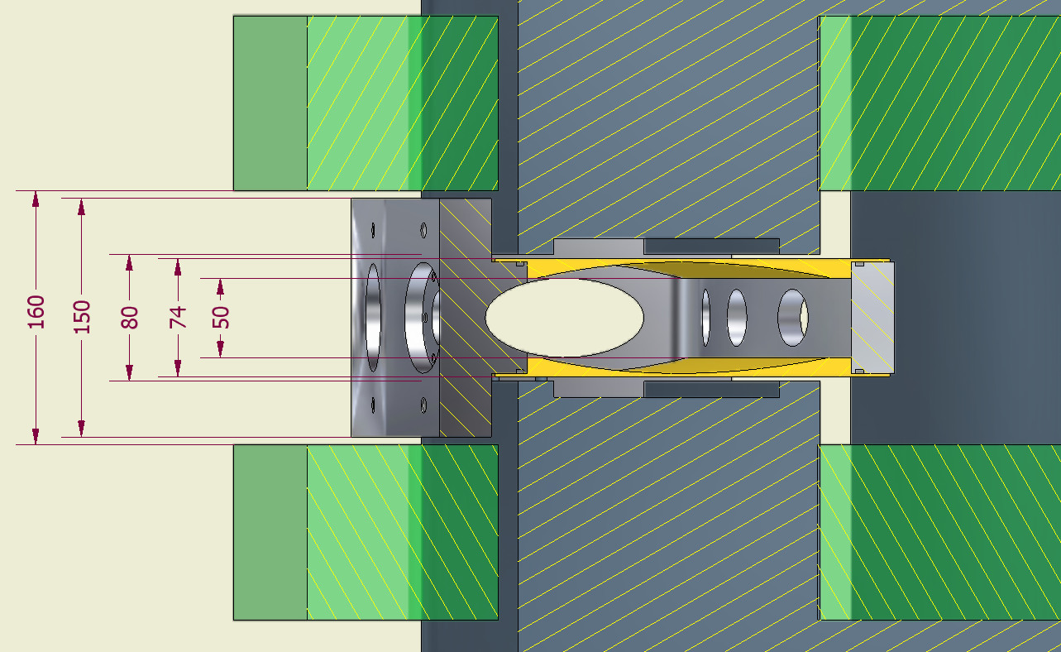
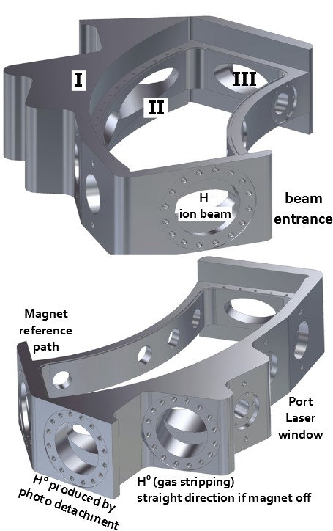
Magnet vessel to house the different beamlets.
Magnet with vessel shown.
Coils provide the space for the ports of the vessel.
Top and bottom are tapered to provide maximum clearance and withstand the vacuum pressure.

Slide 15
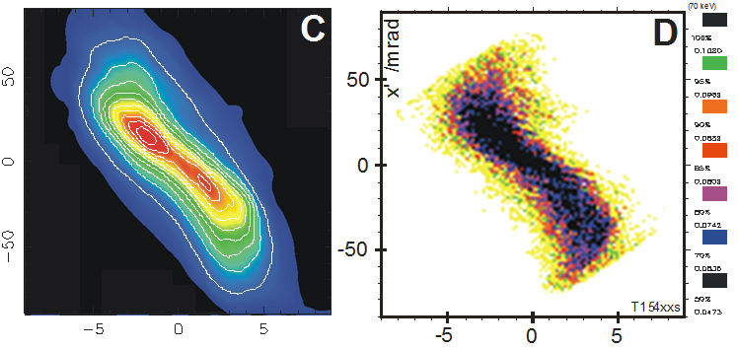
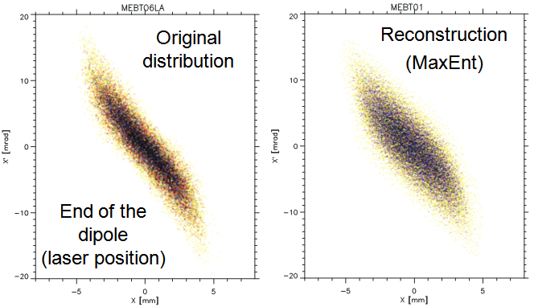
Image reconstruction to determine ε_{xx’ e.g.} in other than yy’
courtesy to D. Sivia who helped with the programming applying MaxEnt and provided MemSys.
Transferring this principle to the FETS MEBT (TraceWin).

Slide 16
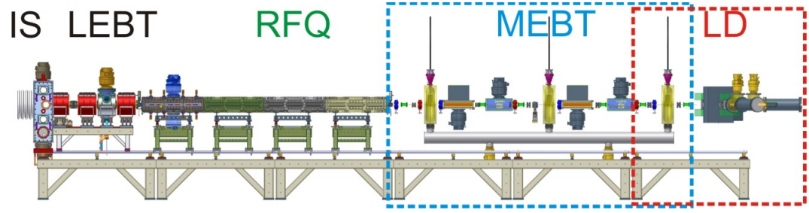
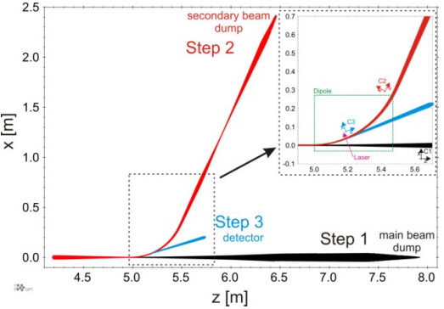
Further particle simulations and possible effects on the measurements and beam transportation.
The focus is on tracking through dipole, to the beam dump and less about the emittance transfer function.
Simulations for particle tracking through the structure.
Last MEBT doublet should matches beam into the magnet AND must not exceed the power density of the beam dump. MEBT not yet finalized ☹
The different beam lets need to define and have their own coordinate system.
Reference (dipole) beam path is RED

Slide 17
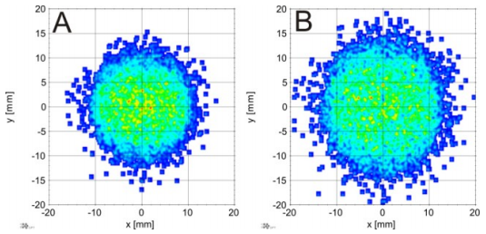
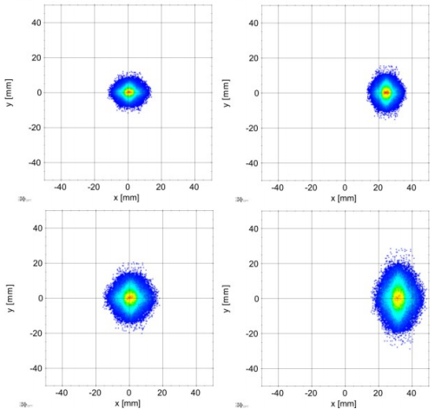
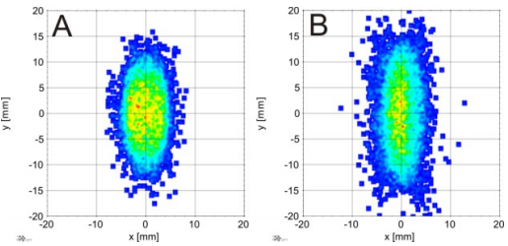
Particle simulations (II).....some results.
Simulations have been carried out with a multi-purpose code called GPT.
xy—distribution at the exit of the dipole
(CS for H^{O}(PD) after 20° deflection
Hard edge model
Fringe field (OPERA 3D)
z= Laser IP
Top. Dipole is off
Bottom. Dipole effect due to weak focusing.
(A) Exit of the dipole
(B) 50cm downstream towards the beam dump (reference path)
z=60cm downstream

Slide 18
What I haven’t said so far or felt short.
Focused on the motivation of the idea of the measurement principle and advantages.
Scintillator tests, dipole, vessel, beam particle simulations
Longitudinal emittance measurements, 1D profile scanner.
The idea of image reconstruction can be pursued differently:
  beam envelope should have a focus ‘downstream’ the scint.
  move scintillator
  vary the focal length (Quad-settings)
Alternatively, change the laser envelope, use instead of a parallel beam a sharp focus.
Constraints given by the time frame of the project (e.g. commissioning within FETS and plans beyond).

Slide 19
Summary of my talk.
The use of a scintillator as a particle detector is more than
reasonable (and looks promising after tests at HINS).
Measurements and simulations about this emittance
method.
Parts for the FETS experiment are well under way.
Simulations to implement the instrument to rest of
the beam line.
Outlook:
  further development of the components
  more particle simulations to investigate the influence
  of the magnet
  commissioning during the FETS phase and experiments beyond
  more work on a beam profile scanner suitable at 3MeV

Slide 20
Commissioning of PD-EMI to ‘proof-principle’.
Mount bottom half of dipole on adjustable support stand
Place vacuum vessel without top lid onto dipole base.
Secure vessel to dipole base.
Adjust support stand to bring the vessel on axis.
Setup mirrors and moveable stage.
Set laser alignment.
Place lid on vessel.
Lower in place top half of dipole.
Check vessel alignment has not moved.
Done.

Slide 21
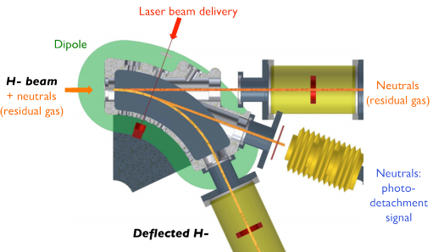
Overview of the magnet and laser set-up near the interaction point.
Diagnostics vessel and magnet are the key parts to link all the different aspects and beam lets together.

Slide 22
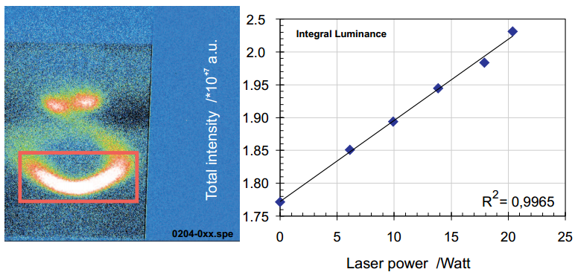
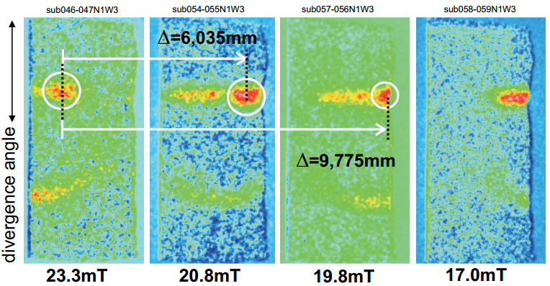
Demonstration that the signal is really neutralized by the laser (careful noise control, i.e. gas stripping background).

