Slide 1
BNL Laser
Profile, Energy and Space Charge Potential
Monitor
Deepak Raparia
September 26, 2013

Slide 2
Acknowledgements
B. Briscoe, R. Connolly, , V. Lodestro, W. Shaffer, C. Degen, L. DeSanto, W. Meng, S. Bellavia, N. Tsoupas

Slide 3
OUTLINE
Introduction
LPM build at BNL
2000: 0.750 and 200 MeV (collaboration with SNS)
2007: 0.750 MeV @ MEBT (collaboration with FNAL)
2010: 66-200 MeV @ HEBT (energy and profile)
2015: 66-200 MeV @ BLIP
Conclusion

Slide 4
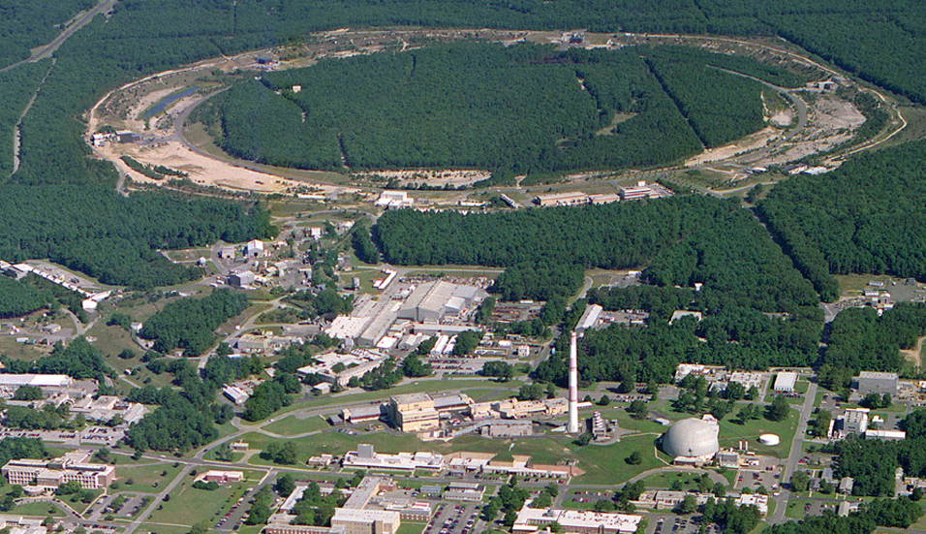
AGS/RHIC Accelerator Complex
Jet Target & RHIC Polarimeters
12:00 o’clock
Electron Lens
10:00 o’clock
Coherent electron Cooling
2:00 o’clock
RHIC
PHENIX
8:00 o’clock
RF
4:00 o’clock
STAR
6:00 o’clock
LINAC
NSRL
EBIS
Booster
AGS
BLIP
Launched ‘72 upgraded 2x
Tandems

Slide 5
LINAC Beam Parameters
Frequency 201.25 MHz
Injection Energy 0.750 MeV
Final Energy* 10-200 MeV
Peak Current 48 mA/ ~ .5 mA P^
Pulse Length 450 μs
Repetition Rate 6.67 Hz
Number of Tank 9
Length 144.8 m
Total Peak RF Power 22 MW
*Energy can be changed energy pulse to pulse

Slide 6
Linac Beam Parameters
BLIP
Energy 66/116/139/181/200 MeV
RR 6.67 Hz, Pulse width ~ 450 µs,
Peak Beam current ~ 48 mA
Max integrated current 135 μA
Beam time 92.5% /super Cycle
RHIC/Booster
To booster one pulse every super cycle (Pulse width 226 µs)
To HEBT one pulse every super cycle (Pulse width 302 µs)
Energy 200 MeV
Super Cycle ~ 4 sec , Peak current ~ 500 µA
Beam time 7.5%/super Cycle
NSRL
Energy 200/116 /38 MeV
Beam time 7.5%/super Cycle, Pulse width 302 µs

Slide 7
Laser profile and energy measurement devices build by BNL
Profile monitors at 0.75 and 200 MeV (Collaboration with SNS)
2000 MEBT and HEBT, Laser: Nd:YAG; Detector: CT, & BPM
Energy, profile and SCP at 750 keV (Collaboration with FNAL)
2007 MEBT, Laser: Nd: YAG, detector: Faraday cup
Energy and profile monitor at 200 MeV
2009 HEBT, Laser: Nd:YAG, YLIAM20EG ; detector: FC, screen
Profile monitor at 200 MeV (2015 BLIP)
2015, BLIP, laser: YLIAM30EG ;Detector: faraday cup

Slide 8
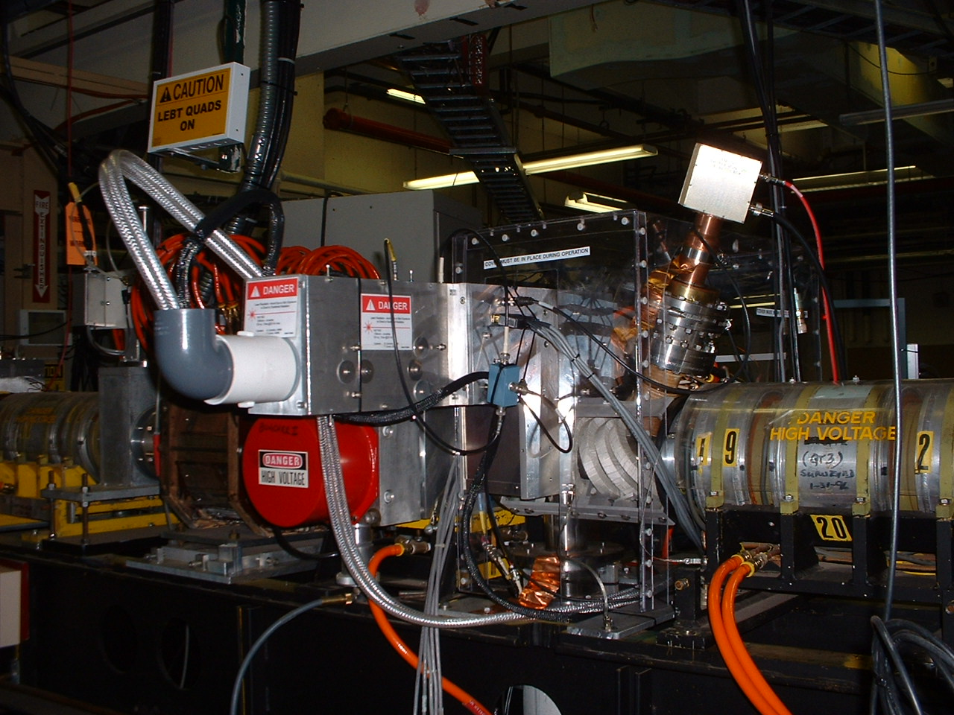
MEBT

Slide 9
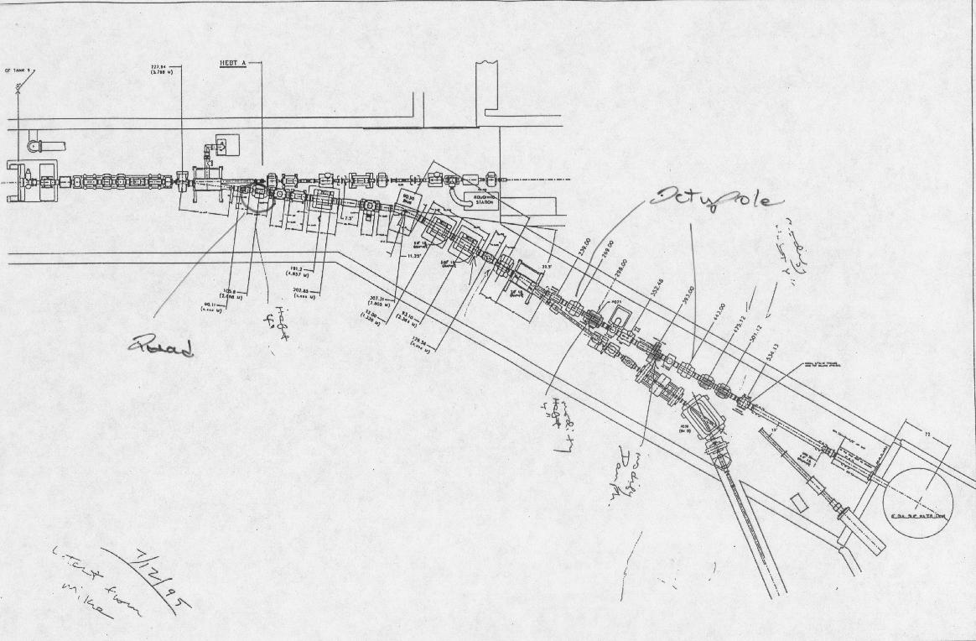
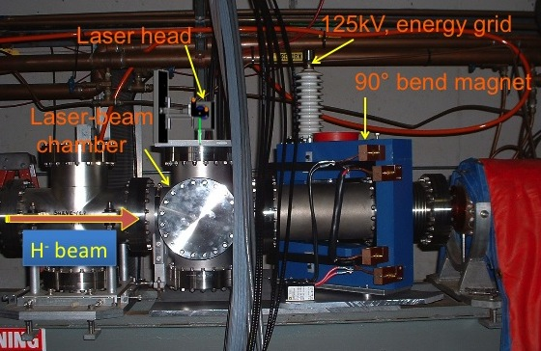
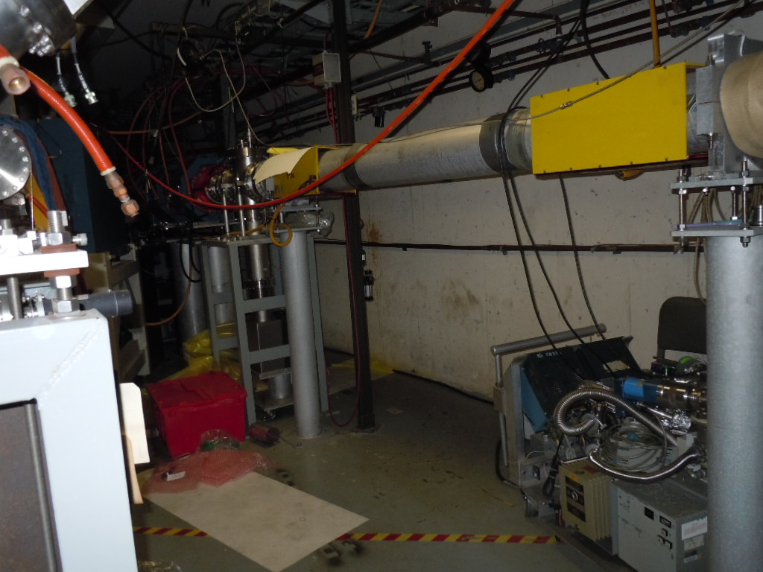
Layout of Existing BLIP Beam Line
2000
Tank-9
To Booster & Polarimeter
2010
2015

Slide 10
2000,colloboration with SNS
R. Connolly
At 750 keV, signal was 10-ns notch in the beam created by removing electrons from the beam with a Q-switch Nd:YAG, 200mJ/pulse
Detector : current transformer
Scope trace of CT showing notch
Created by laser pulse
Measured profile (H) with Gaussian fit
10 Gm dipole to remove electron
Second one to straight the h- beam

Slide 11
200 MeV: collaboration with SNS
R. Connolly
At 200 MeV, CFT 200laser , Three 45 deg mirrors and strip line BPM before and after to measure notch created by laser
Detector: stripline BPM
Setup at HEBT
Logic used to detect current notch
200 MeV, BNL HEBT
Profile with laser (Blue) and carbon wire (red)

Slide 12
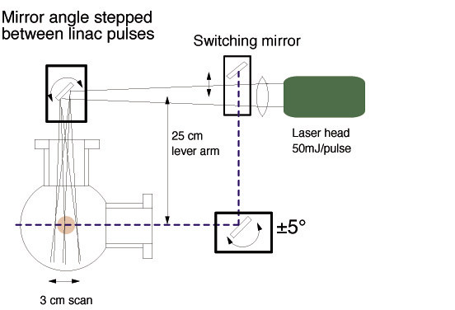
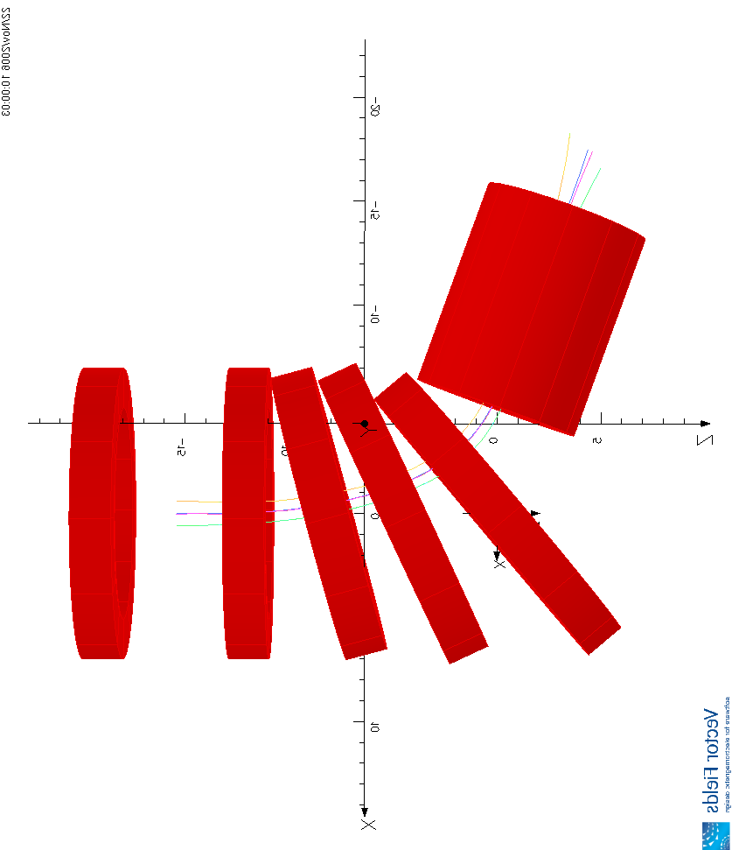
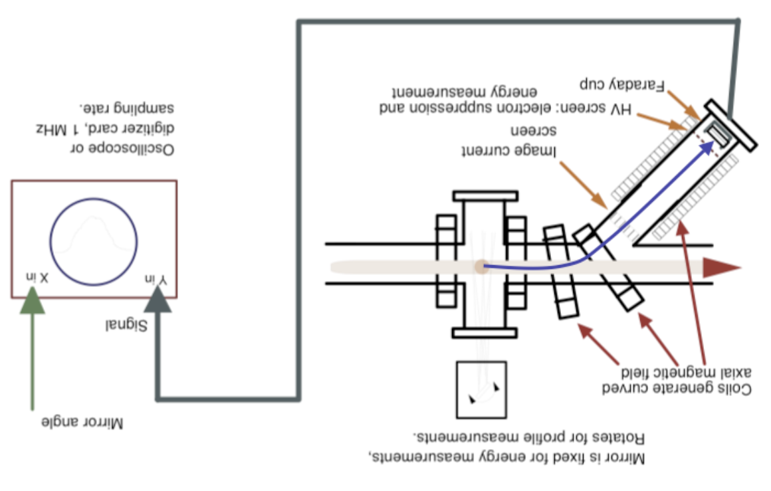
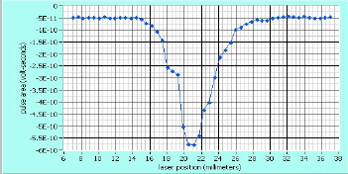
2007: collaboration with FNAL
Laser: Nd:YAG
Detector : faraday cup
Nd:YAG (λ=1064nm)
Transverse Optical System
Labview
H- Beam profile
e from H- are guided by magnetic field
Solenoid Magnetic Field

Slide 13
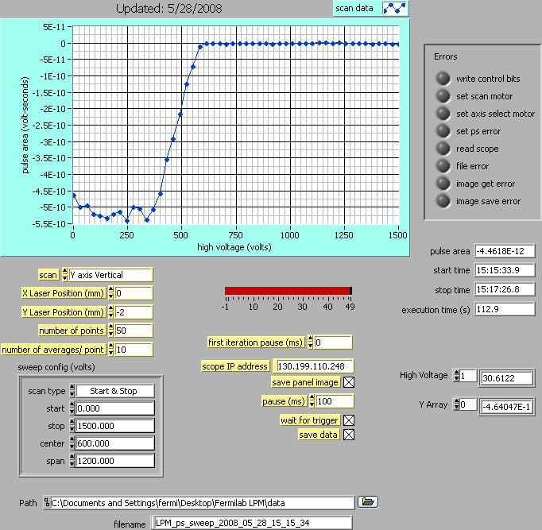
De attached electron Energy measurement
Energy of H-
Energy spread of H-
Space charge potential of H- beam
Beam size of H- in three dimension
Distribution (current density) of H-

Slide 14
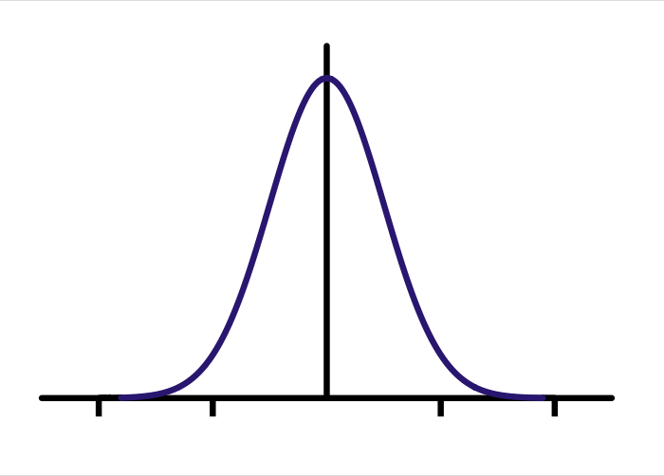
Space Charge Potential DC Beam
T_{e} =T_{e0}+ ϕ
a_{x}=13.5, a_{y}=7.0 mm,
b_{x}=b_{y}= 38 mm
R=(x+y)/2=10.25 mm
V₀(70mA) ~ 200 V
T_{e}=408+200 =~600 V
ϕ
r
E_{e0}=7.5.10⁵/1838
=408 V

Slide 15
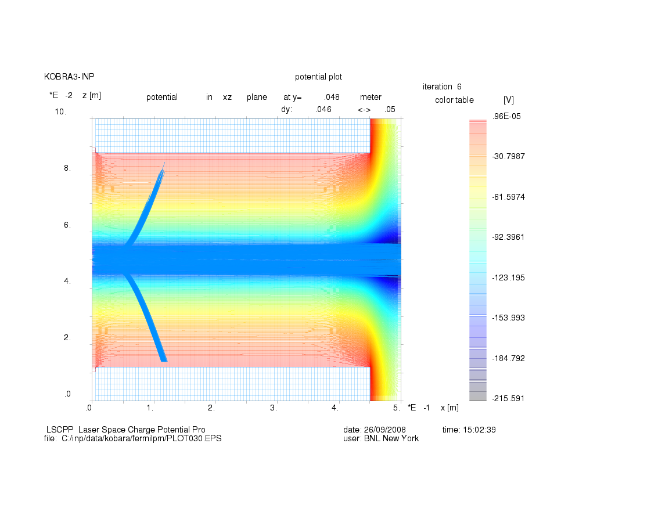
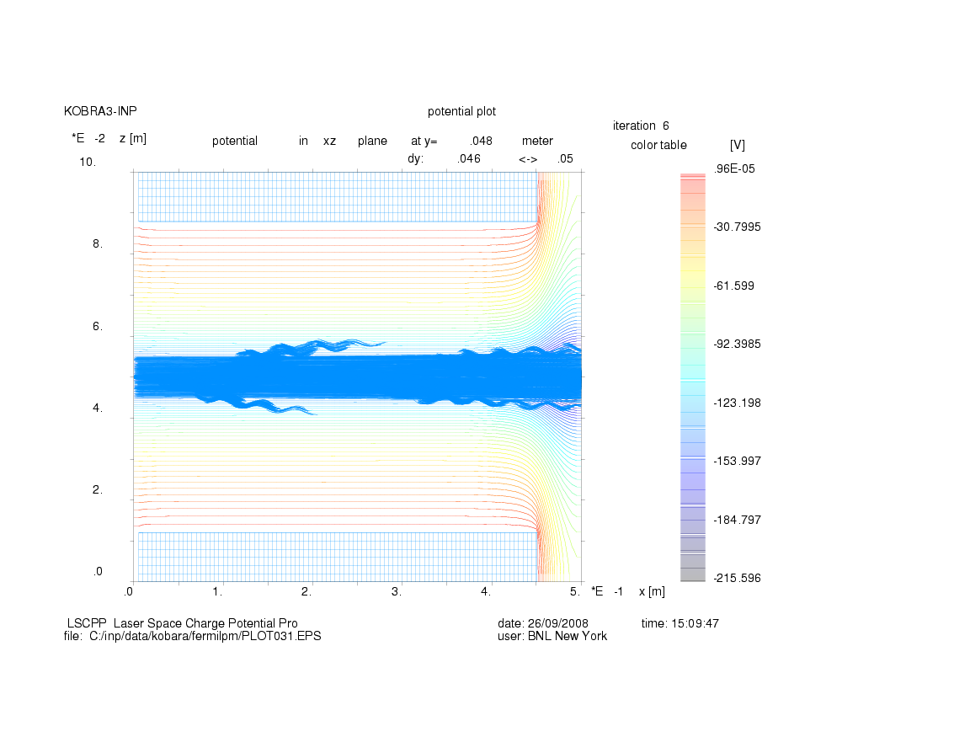
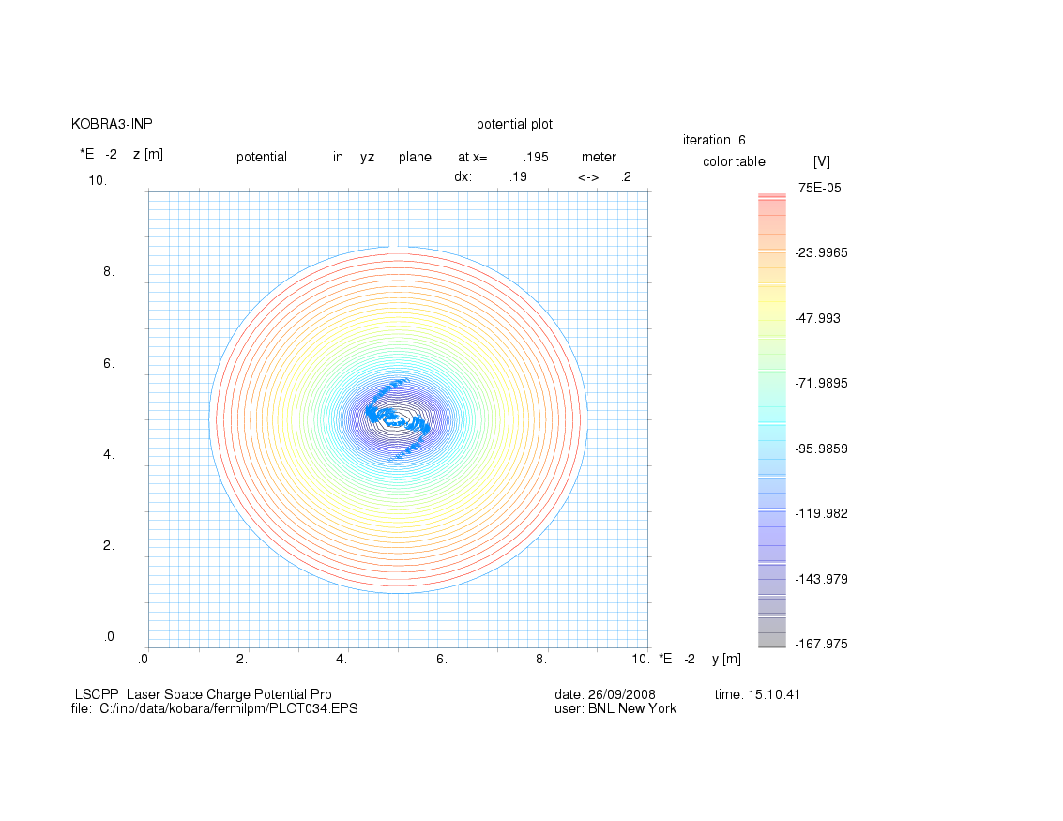
KOBRA Simulations
X-Z Plane
Axial Mag. Field =0
X-Z Plane
Axial Mag. Field =100G
X-Y Plane; Axial Mag. Field =100G

Slide 16
SCP Bunched Beam
Electric Field due to uniform ellipsoid
X-Z Plane
E_{H-} = 750,000 eV
ΔE_{H-}=±20,000 eV
E_{e} = 408 eV
ΔE_{e} =±10.9 eV
SCP Potential in X-Z Plane
LASER

Slide 17
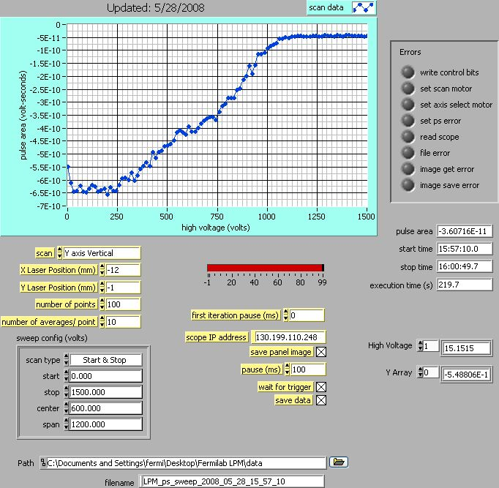
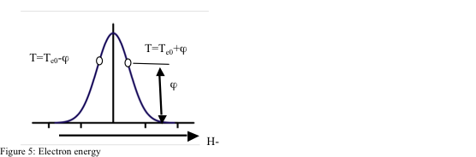
Buncher ON, Full Current

Slide 18
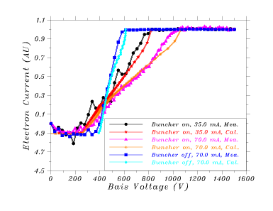

Slide 19
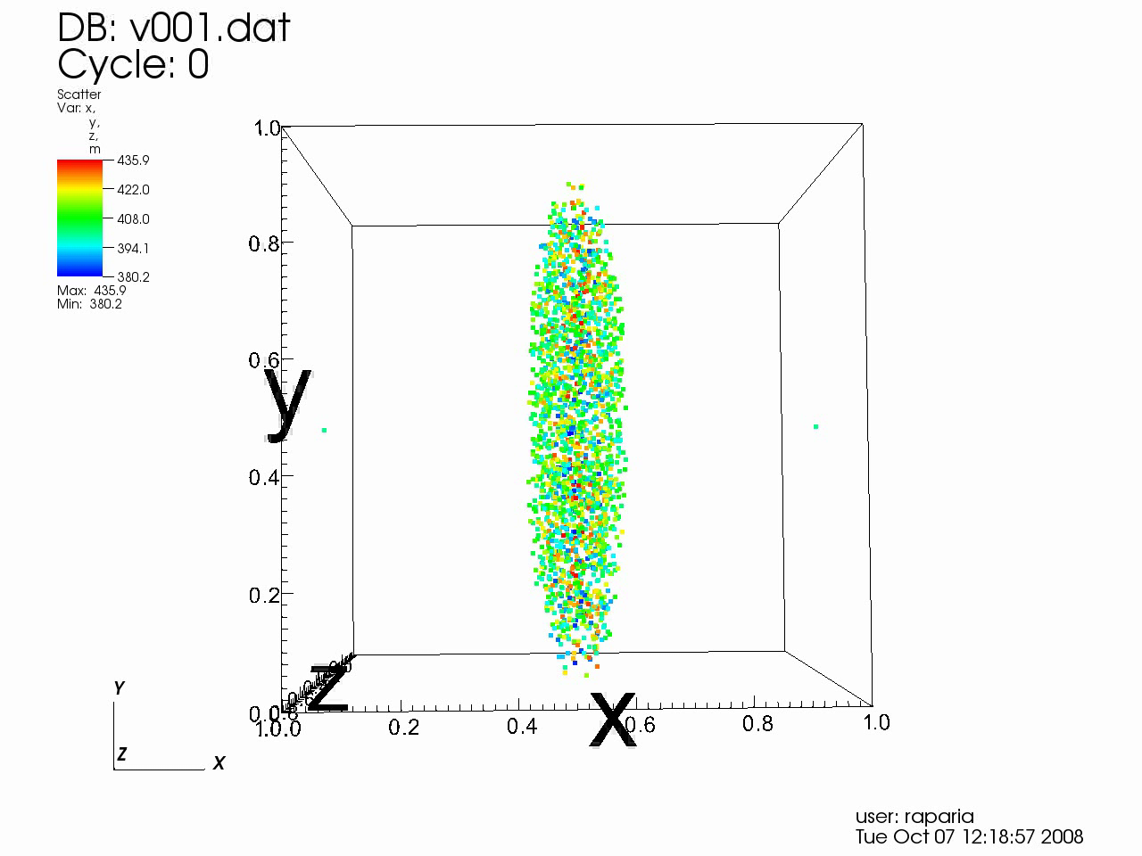
Electron Energy at Detector

Slide 20
Beam Parameters Used in Calculations
Current (mA) | Buncher On/Off | DC Component (%) | Bunch Length (deg)
70 | Off | 100 | 360
70 | On | 50 | 90
35 | On | 30 | 70
17.5 | On | 5 | 60

Slide 21
Energy Measurement
At low energies (ΔE(m_{e}/m_{p}) << SCP)
- Space Charge Potential (SCP)
- Bunch Length and Bunching Factor
At high (Δ E(m_{e}/m_{p}) >> SCP)
- Energy Spread (ΔE)

Slide 22
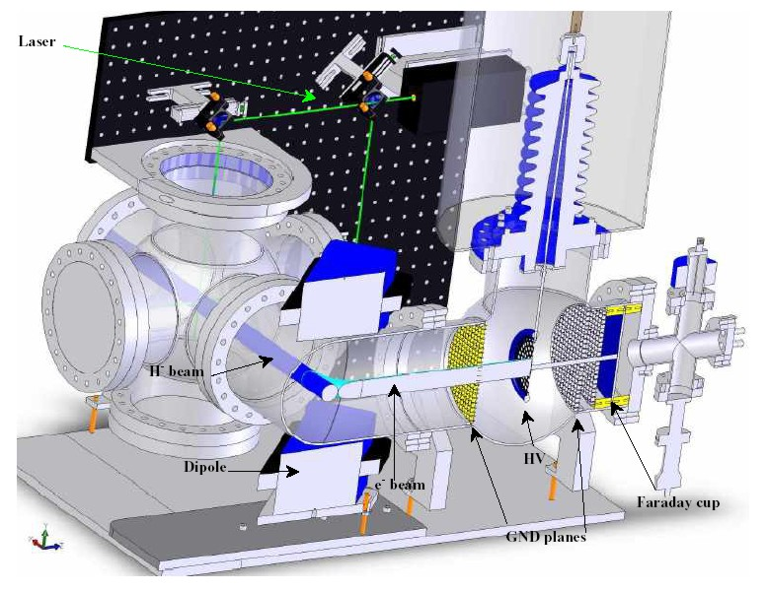
HEBT LPM
This is the detector installed in the HEBT after DTL,9.
Laser head was on optics plate.
Energy analysis of the signal electrons.

Slide 23
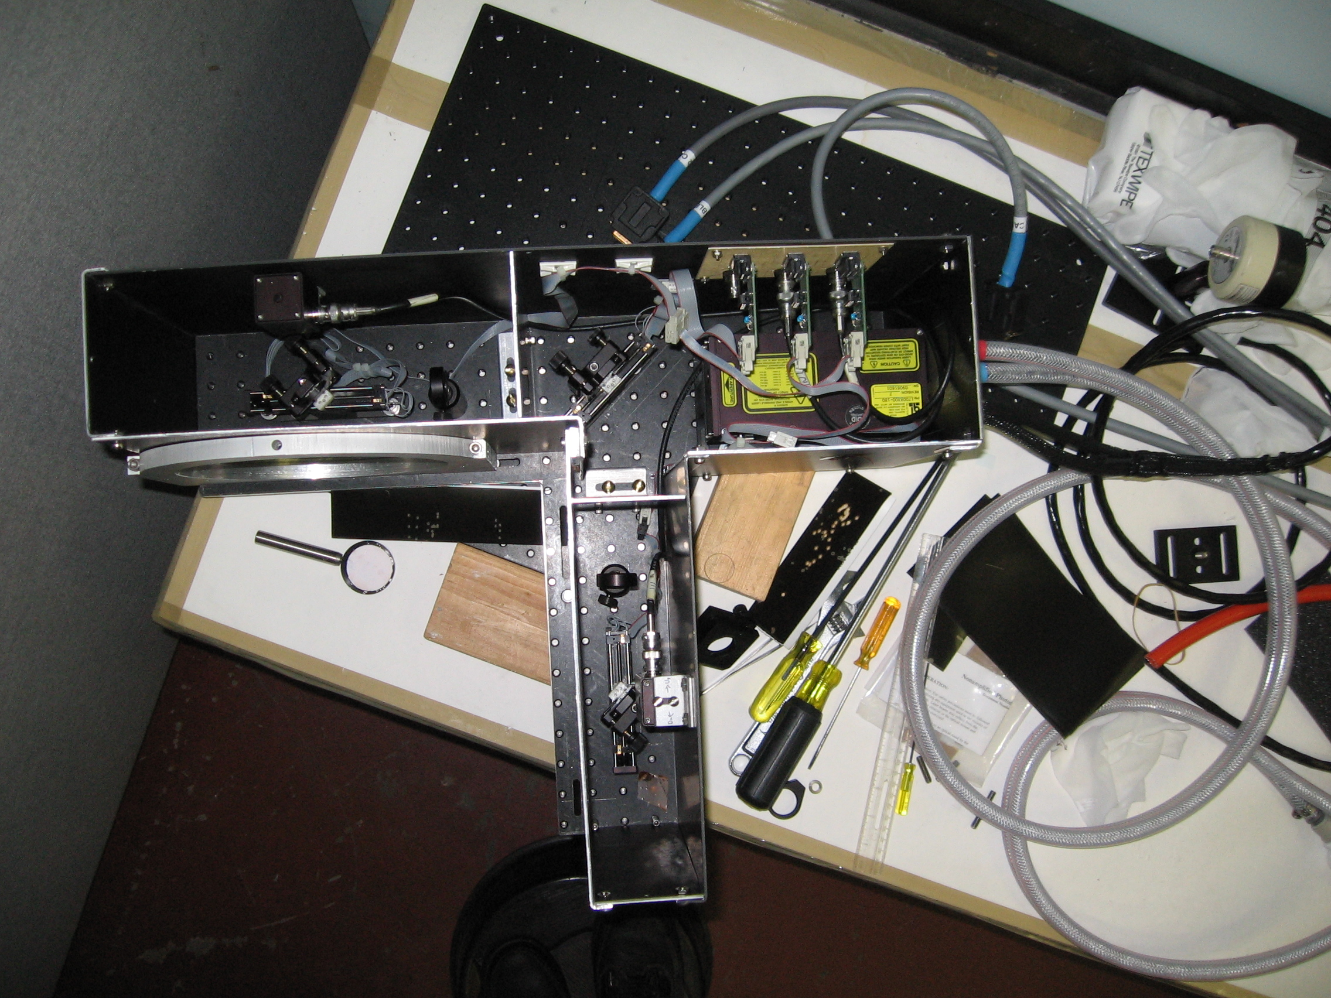
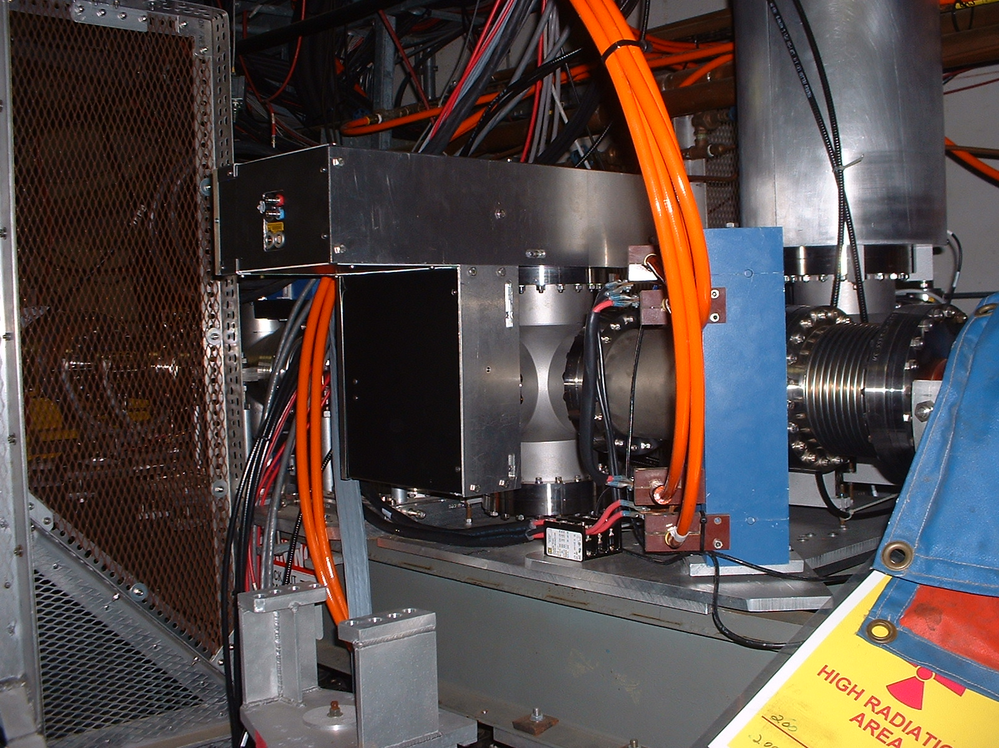
2009: HEBT LPM
Tunnel installation without optics plate
Optics plate
Q-switched Nd:YAG , 100 mJ/pulse, 10 ns pulse, 20 Hz
Lasted only few weeks
Scan of signal vs. deflecting magnet current.

Slide 24
2009: Gas Stripped Electron Energy Measurement
BLIP main interest to know the energy of H-
We used gas stripped electrons for this measurement

Slide 25
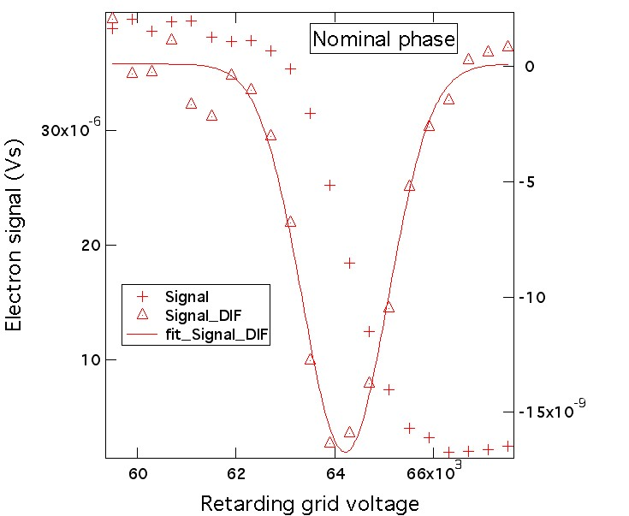
Data from Energy Scan Connolly
A Gaussian is fitted to the derivative of the signal vs. grid voltage data. The center (64.2kV) is the average electron energy from the beam motion and the width (σ=0.87kV) is from beam-energy spread and from the space-charge potential spread. The proton energy is m_{p}/m_{e}=1836 times the measured electron energy:
E_{p} = 118 MeV
σ_{p} = 1.6 MeV
Measured electron energy verse time in the pulse
0.6% drop in the energy during 0.5 ms beam pulse

Slide 26
2010: Profile measurement By LPM at HEBT
Vertical
Horizontal

Slide 27
2013 New Fiber laser for HEBT LPM
New YLIA M20EG is being install now for 2014 run
Laser head will be outside tunnel
We transport light into tunnel on 1 mm optical fiber in the tunnel

Slide 28
NEW LPM will be install in the BLIP line
R. Connolly

Slide 29
Operation for BLIP LPM
R. Connolly
The fiber laser produces 100ns light pulses 10-50μs apart. During one 400μs linac cycle we will digitize 8-40 electron signal pulses.
To construct the average beam profile we will sum all of these pulses for each laser position.
Beam raster at 5kHz executes two revolutions during single measurement. To confirm rastering we will look for modulation of the electron signal during a single linac cycle.
Average profile is built up from 50-100 linac pulses.
One plane is measured at a time. Raster modulation appears in both vertical and horizontal measurements.

Slide 30
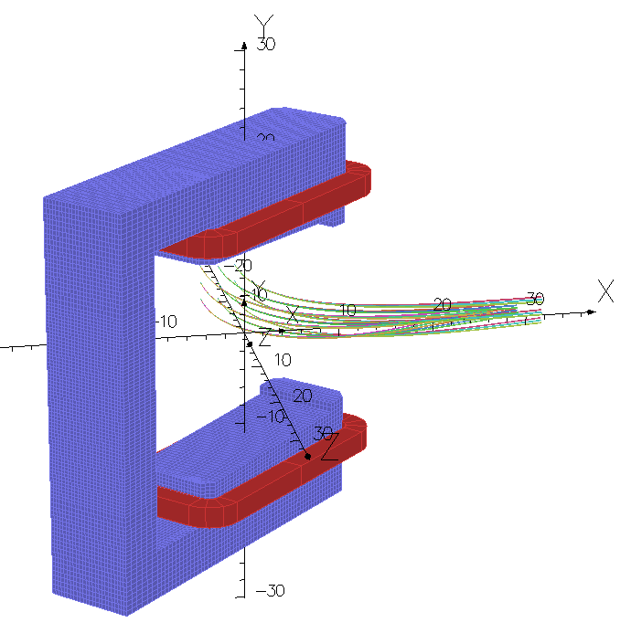
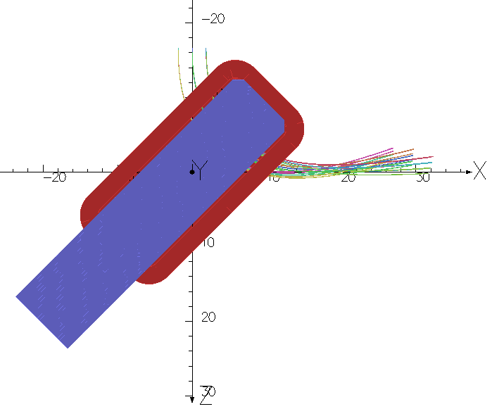
Electron tracks from BLIP-beam
W. Meng
Perspective View
Top View

Slide 31
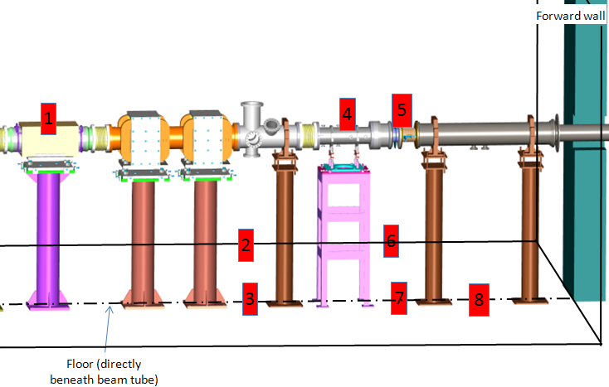
TLD Readings in the BLIP Spur During Operations
C. Cullen
1 2 3 4 5 6 7 8
One minute duration
1 2 3 4 5 6 7 8
Ten minute duration
1
4
5
Be window
BLIP TARGET
LPM
2
6
3
7
8

Slide 32
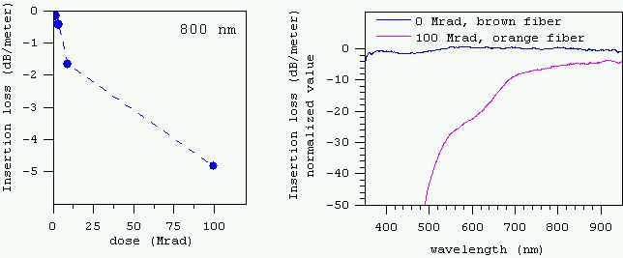
Life time of fiber
R. Connolly
Darkening of fiber:
  This effect is much smaller at 1060nm wavelength than in visible
From the dosimetry data on the last slide we estimate the radiation dose rate at the LPM to be 2550 rad/hour. 100Mrad will be achieved after 1633days or 4.5 years of continuous running.
The glass fiber will be replaced as required.
Co-60 source on Corning Infinicar fibers (non-rad-hard fiber).
Radiation damage to linear actuators used to translate laser optics. The NAI actuators currently used show no damage after one year in the HEBT however there are circuit boards in the tunnel for terminating the long drive lines. During the 2015 beam run we can test several translation stages in the BLIP tunnel.

Slide 33
Conclusions
Measurement of profile H⁻ beams by laser neutralization is a proven technique used at BNL, Fermilab and SNS.
Measurement of H- energy by measuring electrons energy is very convenient and reliable
For low space charge beams, it is possible to measure energy spread
For space charge dominated beam, it space charge potential can be measured.
It may be possible for measure current densities for BLIP beams

