Slide 1
Cryogenic Lasers for High-Power, Short-Pulse Sources*
T. Y. Fan
3rd Mini-Workshop on H⁻ Laser Stripping and Accelerator Applications
Sept. 26-27, 2013
*This work was sponsored by DARPA under Air Force contract FA8721-05-C-0002. Opinions, interpretations, conclusions, and recommendations are those of the authors, and are not necessarily endorsed by the United States Government.
Notes:
Title page.

Slide 2
H⁻ Stripping Laser Performance Requirements and Challenges
Performance requirements
Diffraction limited BQ
Transform-limited pulses
Temporal waveform (10’s ps pulses in macropulse, high peak power)
Large energy per macropulse
Linearly polarized
High average power
Laser technology attributes
Excellent thermo-optic performance
High efficiency
Low nonlinearity
Long upper-state lifetime and high energy storage
Challenges
Managing thermo-optics
Managing nonlinearities
Cost/Complexity
Cryogenic Yb laser technology has attractive laser technology attributes needed to meet H- stripping requirements
Notes:
The unique performance requirements of H- stripping lead to three main challenges for laser systems. To meet these challenges, it is necessary that a candidate laser technology approach has the attributes of shown in the right-hand column.

Slide 3
Motivation
Goal: Many laser applications require
  High average and peak power
  Near-diffraction-limited beam quality
  Manageable size
  High efficiency
Challenges
  Average power and beam quality of solid-state lasers are generally limited by thermo-optic effects
  Size and cost of solid-state laser systems generally driven by low efficiency
    Lower efficiency systems require more pump lasers, larger power supplies, and larger cooling systems
High average power
High peak power
Cryogenically cooled Yb lasers offer the most promise
in addressing these challenges.
Notes:
Many laser applications require both high peak and high average power. For a given pulse energy, a shorter pulse duration gives you a higher peak power, whereas a higher pulse frequency results in higher average power. And often, it’s required that that power be delivered with near diffraction limited beam quality. But from a practical consideration, we may also need these lasers to be both manageable in size and highly efficient. In fact, the weight and fieldability of a tactical laser is often limited by the system efficiency.
We face two principle challenges in obtaining high average power and good beam quality from in a compact light-weight package. First, power and beam quality of solid-state lasers are generally limited by thermo-optic effects. Second, cost, size, and weight of packaged systems are generally limited by low efficiency. Both of these challenges are addressed with cryogenic cooling.

Slide 4
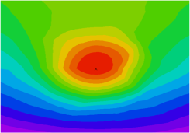
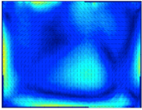
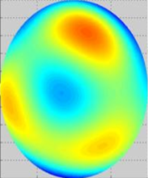
Thermo-optic Properties at
Cryogenic Temperature
Thermal effects limit average power and beam quality
κ
dn/dT
CTE
temperature
non-uniformity
beam distortion
stress induced
birefringence
Properties of Undoped YAG
Poor thermal conductivity κ can inhibit heat removal, resulting in large temperature non-uniformity.
This changes the index, through dn/dT, and results in beam distortion.
Thermal expansion (CTE) creates stress which can cause depolarization and damage.
Favorable
Thermal Conductivity (W/m K)
CTE (ppm/K), dn/dT (ppm/K)
Favorable
Cryogenic cooling significantly improves thermo-optic properties in crystals
Temperature (K)
Notes:
The thermo-optic properties of many Yb host systems improve as they are cooled to cryogenic temperatures. This graph shows the thermal conductivity, coefficient of thermal expansion, and temperature dependence of the refractive index for undoped YAG. All properties scale favorably as the temperature is decreased. These trends are true in crystalline dielectrics in general.

Slide 5
Properties of Yb³⁺
Broad absorption enables diode-laser pumping.
  High E-O efficiency, scalability, convenience.
Low quantum defect minimizes heat load and results in high intrinsic efficiency
Transition from quasi-three level to four level at low temperature.
Energy Levels in Yb:YAG
Laser:
1030 nm
Pump:
940 nm
Energy
Material | Yb:YAG | Yb:YLF | Nd:YAG | Ti:Sapph
χ_{QL} | 9.6 % | 3.6 % | 31 % | 50 %
3k_{B}T @ 300K,
9k_{B}T @ 100K
Cryogenic Yb³⁺ lasers are very efficient and can dissipate little heat
Notes:
The broad absorption features of Yb enable diode pumping, which has high electrical-to-optical efficiency, is scalable, and available from commercial vendors in convenient modules. The very low quantum defect minimizes the heat load on the system.
Because of favorable spectroscopic properties at cryogenic temperatures, cooled Yb:YAG lasers are expected to be more efficient than their room temperature counterparts. A schematic of the energy levels in Yb:YAG is shown on the right. The final state of the lasing transition and the ground state are separated by 612 cm⁻¹, which is only 3kT at room temperature. With this small of an energy difference, there is a significant thermal population in the final lasing state, leading to 3-level laser operation. At 100 K, however, these two states are separated by 9kT, leading to more efficient 4-level laser operation.

Slide 6
Thermal Dissipation for Yb Lasers
Cooled Gain Element
Unabsorbed
Pump
Quantum Defect
Pump
Photons
Laser
Output
Absorbed
Pump
Untrapped
Fluorescence
Trapped
Typical cryogenic heat load in Yb:YAG is 0.3 W dissipated per W output
  9% of absorbed pump power dissipated in Yb:YAG by quantum defect
  Additional contribution to cold-tip thermal load from trapped fluorescence
  At 0.3 W dissipated per W of output, 10-kW laser (3 kW of heat) will consume ~1 LPM of L N₂
Recent demonstration of cryogenic dissipation of 0.11 W per W output in Yb:YLF
Notes:
It is useful to understand how much heat is dissipated by these lasers in order to estimate the amount of L N₂ that is consumed during operation. In typical Yb:YAG lasers developed at Lincoln Lab approximately 0.3 W of heat is generated for every W of output power. This corresponds to a 10-kW laser consuming 1 LPM of L N₂. This heat load primarily originates from quantum defect heating (small in Yb systems relative to other lasers) and trapped fluorescence. More recently, we have been putting effort into Yb:YLF because of the potential for low thermal load and demonstrated around 0.11 W of heat per W of laser output power.

Slide 7
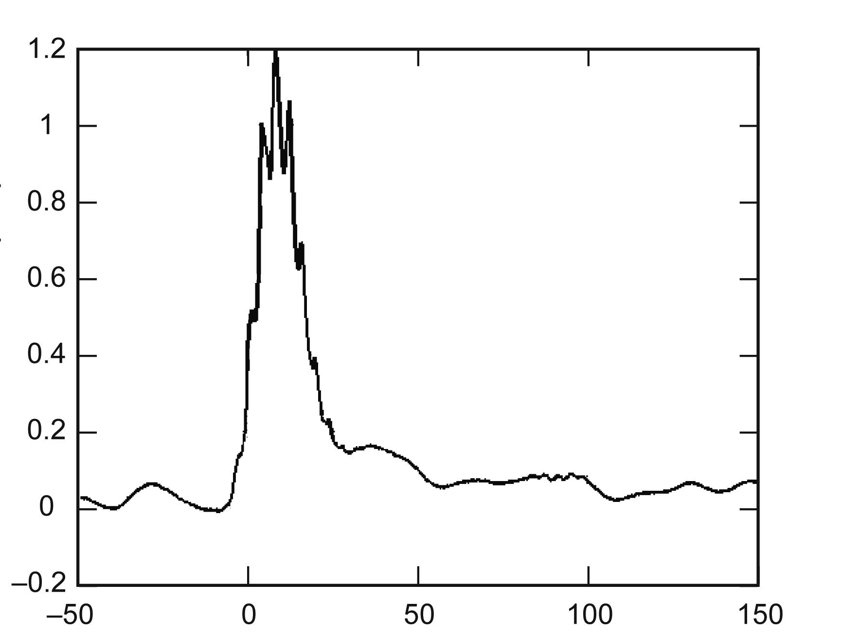
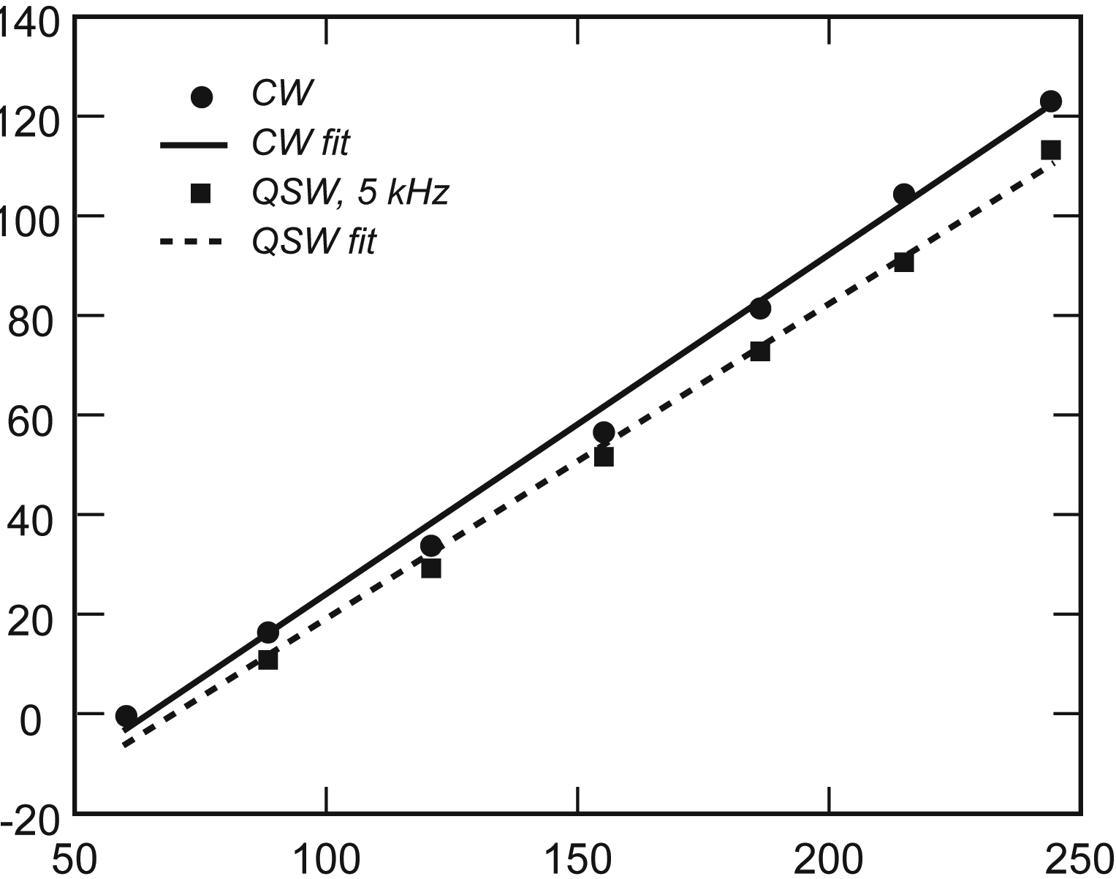
100-W Yb:YAG Q-switched Oscillator
Fiber-Coupled Pump Laser
Pulse Profile
At 114 W
LN₂ Dewar
Yb:YAG Crystal
Polarizers
Dichroic Mirror
Rel. Inten. (a.u.)
λ/4
Laser Output
Output
Coupler
BBO Pockels Cell
Time (ns)
114-W average power
55% optical-optical efficiency
M² < 1.06, linearly polarized
OC reflectivity = 10%, L = 0.5 m, Near-flat-flat resonator
16-ns pulses at 5-kHz repetition rate
Hybl et al., IEEE JQE (2010)
Notes:
Cryogenic Yb:YAG lasers have been operated in a Q-switched mode. In a very simple resonator, we obtained >100-W average power with excellent beam quality and short pulses. This work was published in IEEE JQE in 2010.

Slide 8

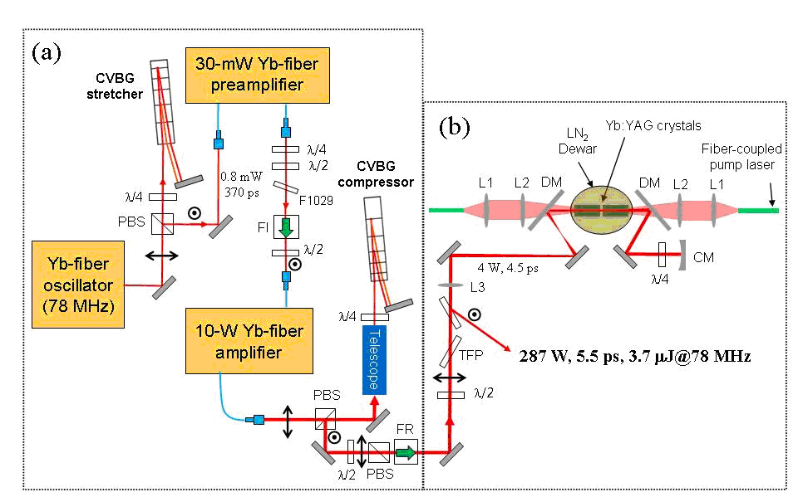
High-Power Yb:YAG ps-pulse Laser System
Yb:YAG Power Amplifier
287-W, 5.5-ps,
3.7 μJ @ 78 MHz
output
Hong et al., Opt. Lett. (2008)
Output
Simple, nearly ideal, drop-in power amplifier
Notes:
This chart describes how a cryogenically cooled Yb:YAG amplifier can be used to generate high-average-power ps-class laser output. This work was performed in collaboration with the group of Franz Kaertner on campus at MIT. On campus, a Watt-class ps laser system was generated using a fiber laser, fiber-based preamplifier, and a fiber-based amplifier. This beam was then amplified with two passes through a cryogenically cooled Yb:YAG amplifier. The output was 287 W of ~ 5 ps pulses.

Slide 9
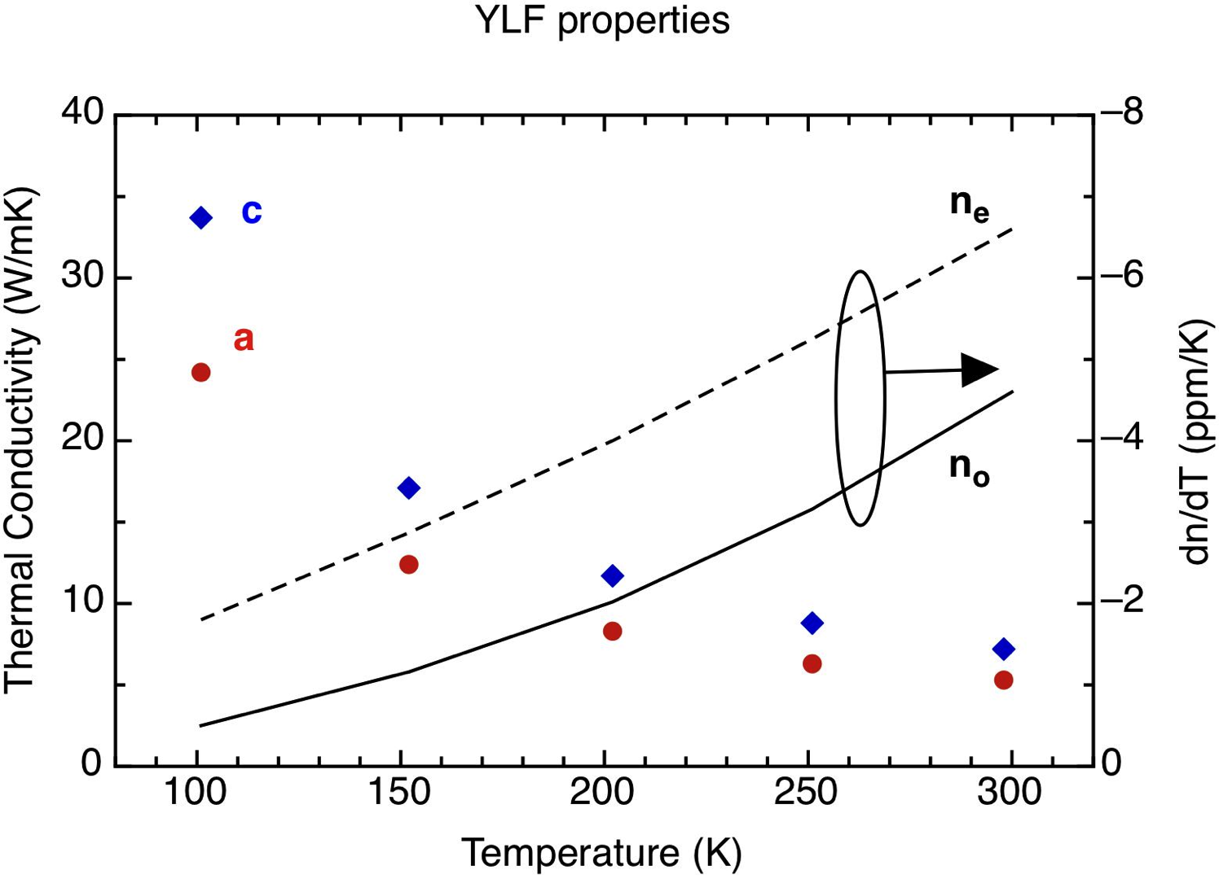
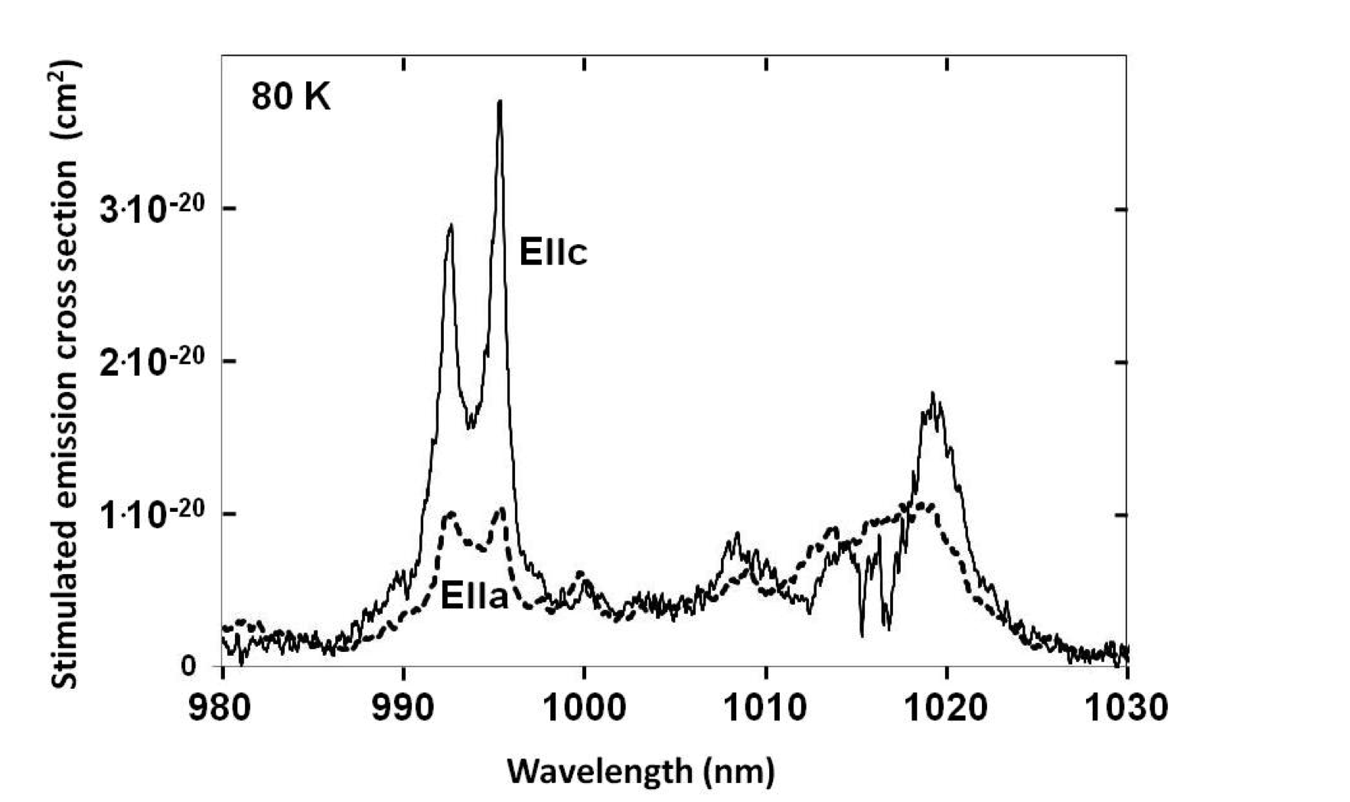
Cryogenic Yb:YLF Provides Path to High-Power Short-Pulse Lasers
Low thermo-optic effects for good beam quality
Small quantum defect for high efficiency
  Pump at 960 nm
Longer upper state lifetime than Yb:YAG (0.95 ms vs 2.0 ms) and ~5x reduced nonlinear refractive index for small nonlinear effects
YLF Properties
Yb:YLF Gain Spectrum
Relative Thermo-Optic FOMs
 | Yb:YAG (100 K) | Yb:YLF (100 K) | Nd:YAG (300 K)
Optical Distortion | ~90 λ_{p} = 0.94 µm | ~90 λ_{p} = 0.96 µm λ_{l} = 0.995 µm | 1
Birefringence | ~35 | ∞ | 1
~17 nm FWHM
Notes:
One interesting direction is development of high-average-power femtosecond sources. Yb:YLF is a promising material for building such a system. It has good thermo-optic properties (published in 2005) and reasonable gain bandwidth at cryogenic temperature, measured by both us and others. The figures thermo-optic figures of merit, as defined in the earlier part of this talk, are excellent.

Slide 10
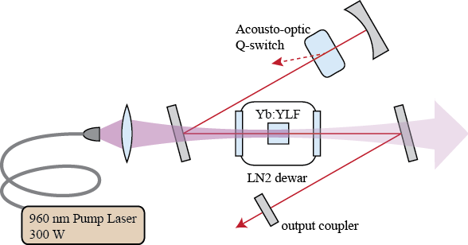
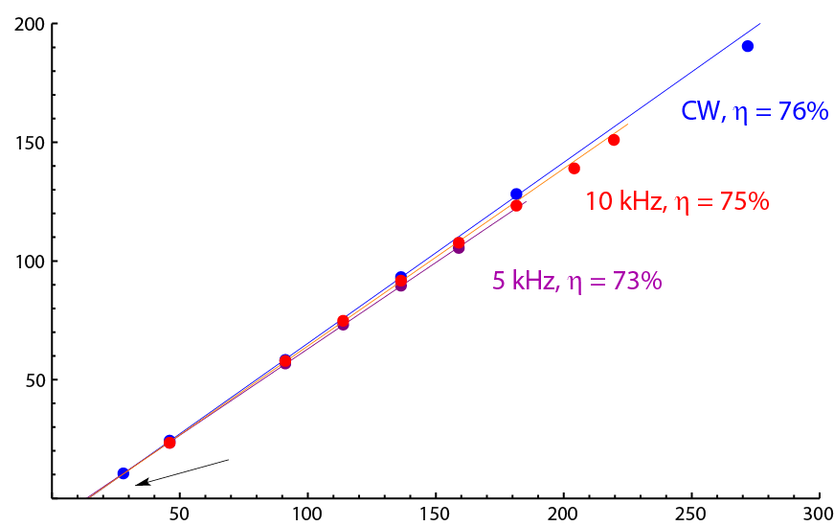
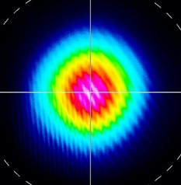
100-W-class Q-switched Yb:YLF (995 nm)
Proof-of-principle pulsed cryogenic Yb:YLF laser to demonstrate:
Power scaling to >100-W level
Diffraction limited beam quality
ns-class pulses with short coherence length
Efficient operation
Performance Data
149 W output at 10 kHz Q-switched PRF
M² beam quality of 1.04 (at 143 W)
64 ns pulse duration at 100 W, 10 kHz
  0.11 W heat deposited per 1 W output CW
Minimal thermo-optic effects
Output Power (W)
Excellent performance and low thermal load sets stage for significant power scaling
13 W Pump Threshold
Absorbed Pump Power (W)
Miller et al., in press
Notes:
We have built a proof-of-principle Yb:YLF laser operating in the 100-W class at 995 nm with ns-class pulsed waveform. This laser performed with near diffraction limited beam quality. Operation was very efficient (75% slope efficiency) requiring very modest amounts of liquid nitrogen for cooling.

Slide 11
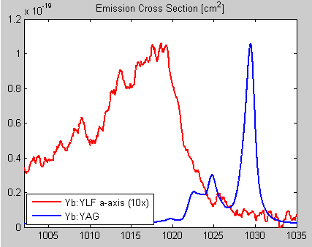
Cryogenic Yb:YLF at 1020 nm
Cryogenic Yb:YLF Provides Path to kW-Class Femtosecond Lasers
Large gain bandwidth for short pulses.
Similar to YAG in efficiency and superlative thermo-optics.
100-W class chirped pulse amplification system for sub-picosecond pulses
Ti:Sapph
1-nJ Seed
Stretch to 400 ps
Pulse Pick from 85 MHz to 10 KHz
Regenerative Amplifier to 1 mJ, 10 W
Power Amplifier to 10 mJ, 100 W
Compress to 865 fs
D. Miller et al., Optics Lett. 37, 2700 (2012)
Notes:
Cryogenically cooled Yb:YLF, however, provides a path to killowatt-class femtosecond pulse operation. It has a gain bandwidth which is significantly broader than Yb:YAG. It has excellent thermo-optic properties, allows for direct diode pumping, and high efficiency.
The amplifier system is composed of the following elements:
A titanium:sapphire master oscillator which produces the seed pulses.
A grating based pulse stretcher which increases the pulse duration to 400 ps.
An RTP pulse picker which reduces the pulse repetition frequency.
A regenerative pre amplifier which amplifier to 10 W.
A power amplifier which amplifies to 100 W.
A grating pulse compressor which compressed the pulses to sub-picosecond duration.

Slide 12
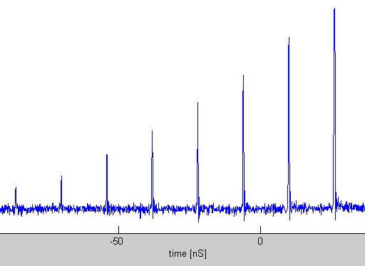
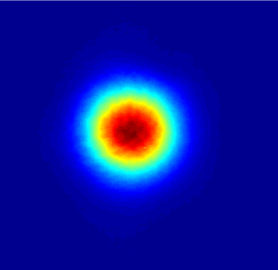
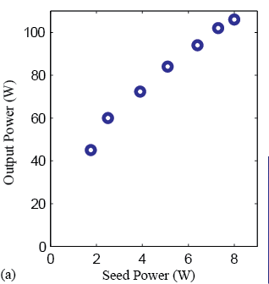
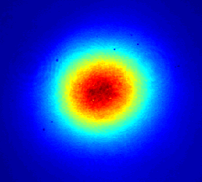
Yb:YLF Amplification Results
1 nJ
1 mJ
10 mJ
Regen
Power Amp
Regenerative Amplifier
10 W (1 mJ) output at 46 W of pump power.
Nearly diffraction limited beam quality.
Power Amplifier
106 W (10.6 mJ) output at 280 W pump.
M² = 1.3 beam quality
28 passes
Notes:
The amplified power out of the regenerative amplifier is 10 W at 46 W of absorbed pump power. The amplified pulse energy is 1 mJ at 10 kHz PRF. We use a beam profiler to measure the beam diameter at several locations after the output. From the beam divergence we find that the beam quality is diffraction limited to within the accuracy of our measurement.
The power amplifier is operated at a constant pump power while the input power is controlled by a half-wave plate that redirects some fraction of RA output off a polarizer. This maintains a consistent level of thermal focusing so the compensating optics do not need to be readjusted. The gain elements absorb 280 W of the incident 350 W pump light. The output power as a function of input from the RA is shown in the figure. At full power the output reaches 106 W, corresponding to 10.6 mJ pulse energy. The beam has an M² of 1.3, as inferred from the beam divergence.

Slide 13
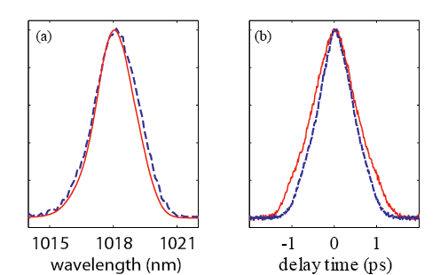
Yb:YLF Pulse Compression
Pulse Energy | Δλ | Δτ | × trans. limit
1 mJ | 2.4 nm | 696 fs | 1.1
6 mJ | 2.2 nm | 758 fs | 1.15
10 mJ | 2.2 nm | 865 fs | 1.26
(a) optical spectra and (b) autocorrelation traces of amplified pulses at 1 mJ (blue dashed) and 10 mJ (red solid) pulse energy.
865 fs = shortest cryo-Yb pulses reported at high power.
Spectral narrowing is modest.
  Ideal system would use room temp pre-amp for broader bandwidth.
Pulse compression limited by nonlinear phase (B-integral).
Cryo Yb:YLF power amplifier may scale to kW-class for >200 fs pulses
Notes:
This shows the output spectrum and pulse width of this femtosecond laser system as the energy per pulse increases. There is beginning to be a bit of pulse broadening caused by nonlinear phase.

Slide 14
Ultrashort Pulse Lasers for H⁻ Stripping
(50 ps pulses)
Laser Technology Attributes | Cryo Yb:YLF (995 nm) | Cryo Yb:YAG | Nd Lasers (300 K) | Yb Fibers
Thermo-optics
Efficiency
Nonlinearity
Energy storage
Comments | Low thermal load, low nonlinear refractive index and long upper state lifetime make this attractive candidate | Higher thermal load, larger nonlinear refractive index, and shorter upper state lifetime than cryo Yb:YLF | Neither particularly poor nor attractive in any attribute compared with other approaches | Long length and small mode size drive nonlinearity and limit ability to store energy
Better
Worse
Notes:
A stop-light table is presented in this chart to compare cryo-Yb materials to other materials commonly used to generate short pulses. For H⁻ stripping, we assume that there is no need for pulses shorter than about 50 ps. In terms of the laser technology attributes needed for H- stripping, the cryo-Yb materials offer significant advantages in all of the relevant categories.

Slide 15
Summary
Cryo-cooled Yb lasers are well suited for high average power while maintaining pristine beam quality
Nanosecond pulse waveforms can be obtained from extremely simple lasers with small footprints and high efficiency
Cryo-cooled Yb lasers enable the scaling of ultrashort pulse (ps and fs) laser systems to average and peak powers otherwise unobtainable
Cryogenic Yb:YLF at 995 nm appears particularly attractive for H⁻ stripping application
Notes:
Summary.

Slide 16
Backups

Slide 17
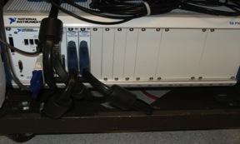

8-Fiber Coherent Combining Schematic
We have coherently combined eight 0.5-kW IPG PM fiber amplifiers
  Beam combining uses tiled configuration via 1x8 fiber/μlens array
  Phase control achieved via single detector and phase control algorithm
Fiber
Amps
Master
Oscillator
Phase
Modulators
Delay
Lines
1x8
Splitter
Δf = 10 GHz
Fiber/μlens
array
Far-field
on-axis
intensity
Slit
Detector
COTS EO Phase Modulators
+/-30 V, 0.2 mA, 20-MHz BW
FPGA-based
Phase Controller
All eight 0.5-kW IPG PM fiber amplifiers are coherently combined to achieve 4-kW with 70% fill-factor μlens
Notes:
We have built a phase control system based on multi-dither technique. The MO is split into eight legs and each leg has its own phase modulator and is amplified to 0.5 kW. The amplifier outputs are spliced to a fiber array and collimated with a microlens array. Part of the output is tapped as the feedback sensor, and fed into the controller. The controller is FPGA-based and capable of 400-kHz dither rate. The controller drives the phase modulators directly since these modulators requires < 1 mA drive current.

Slide 18
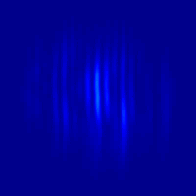
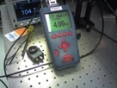
8-Fiber Coherent Combining Results
We measured far-field profile at full power to characterize combining performance
Far-field Cross-section
8 amps combined
Intensity, a. u.
50x
1 amp only
Farfield Angle (a.u.)
Tophat
a
b
Ideal 70%-fill Array
c
Measured Array
Fraction encircled energy
PITB BQ=√(a/c)=1.25
Bucket Radius (λ/D)
Highest power fiber-beam-combined system with good beam quality
Achieved highest combined power with good BQ from fibers
Yu et al. (2011)
Notes:
We measured far-field profile to characterize our combined outputs. The on-axis intensity is 50x that of a single 0.5-kW fiber amp. The ideal for 8 amps is 64x. Fifty-seven percent of the total energy is in the central lobe; our fill-factor is 70%. The beam quality is 1.25.

