Slide 1
Diode-Pumped Solid-State Amplifiers
3rd mini-Workshop on H- Laser Stripping and Accelerator Applications
September 27th, 2013
Jay Doster, Ryan Feeler, Faming Xu

Slide 2
Overview
NGCEO Company Overview
DPSS vs. Flashlamp Lasers
DPSS Amplifier Architecture
Pulse trains w/DPSS Amplifiers
Example Lasers

Slide 3
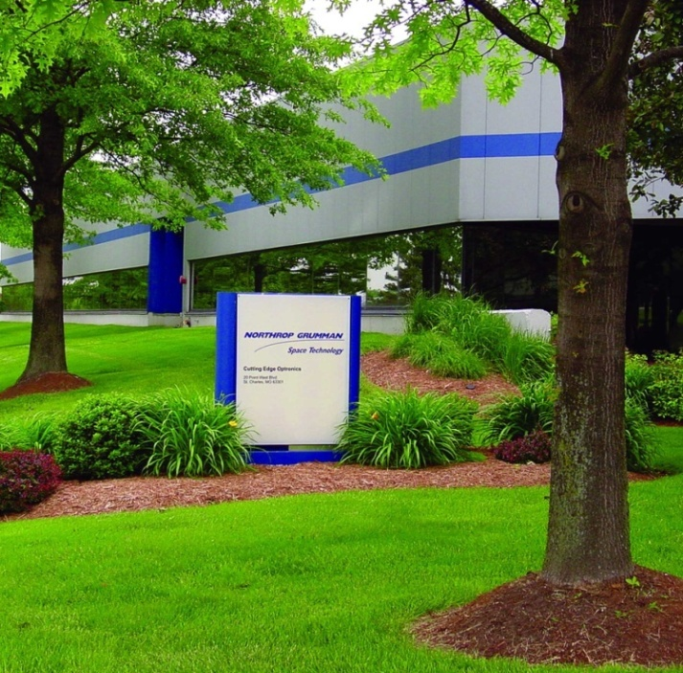
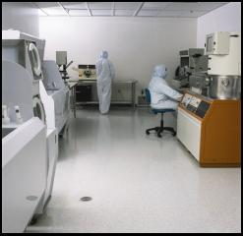
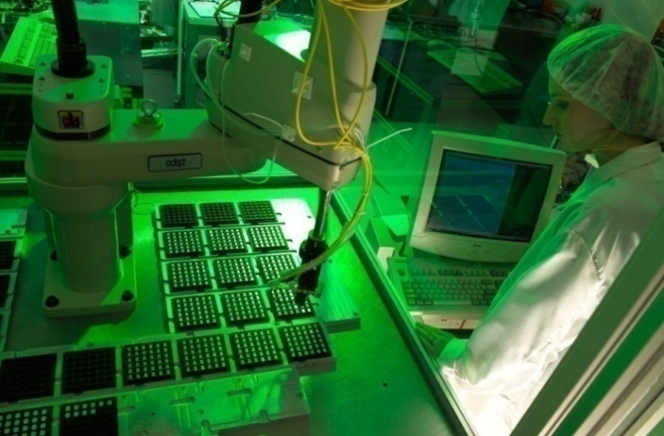
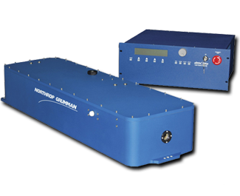
NGCEO Overview
Cutting Edge Optronics is a wholly-owned subsidiary of Northrop Grumman
Located outside of St. Louis, MO
In business since 1992
36,000 ft² facility – 85-90 people
All manufacturing and R&D done at this facility

Slide 4
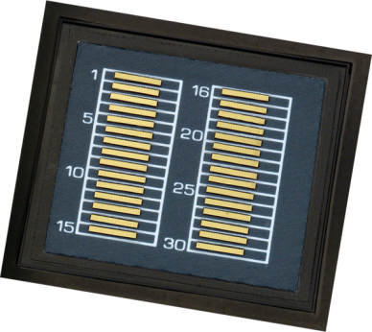

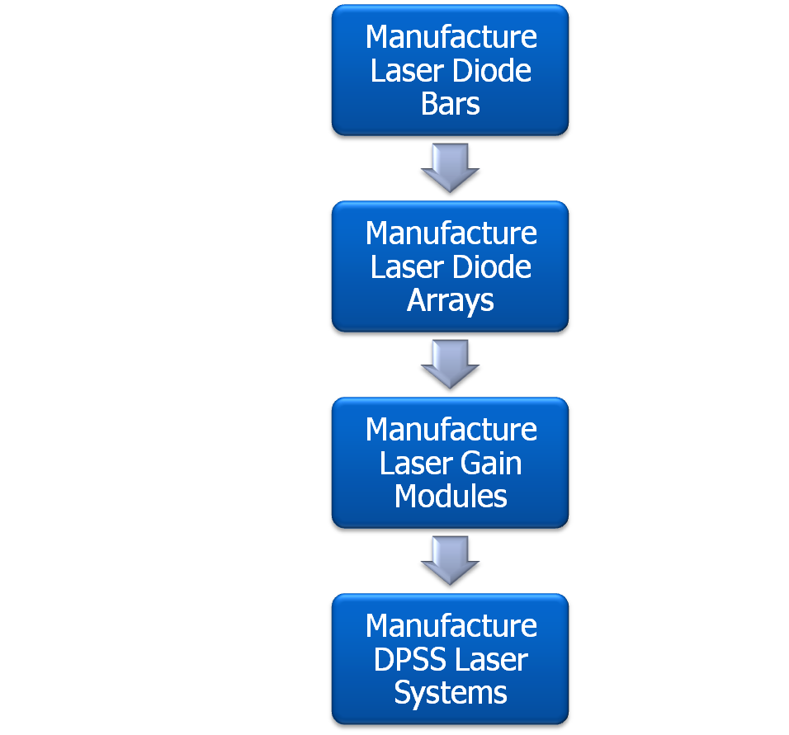


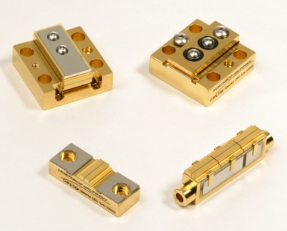

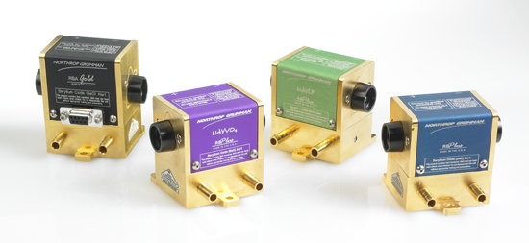

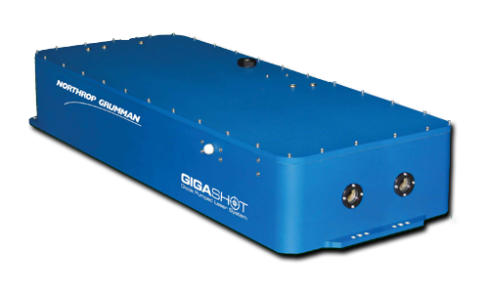

NGCEO Product Overview / Business Model
Outsourced EPI Growth
Ext. Sales
Internal or External Diode Bars
Ext. Sales
NGCEO designs & manufactures OEM laser components
for commercial, scientific, and military applications
Ext. Sales
Manufacture Laser Control Electronics
Ext. Sales

Slide 5
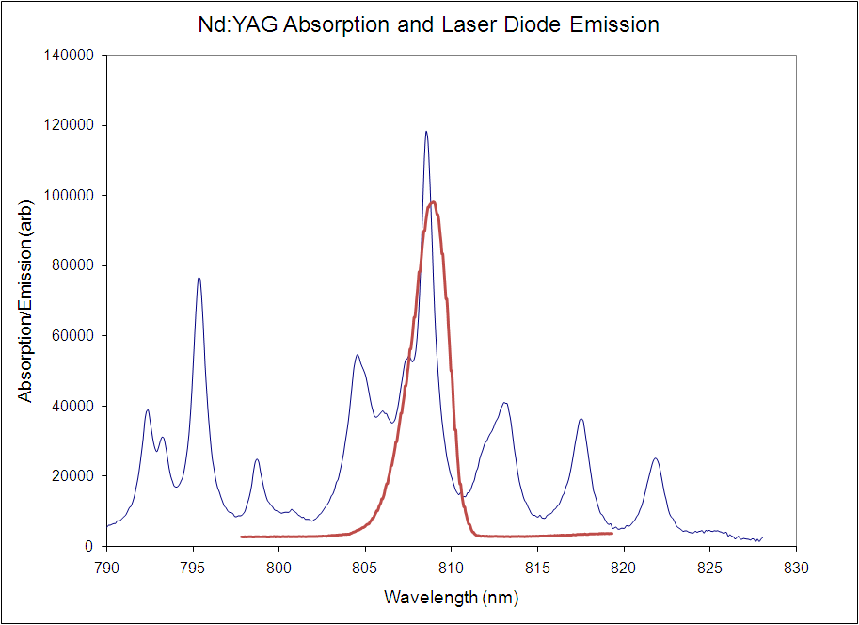
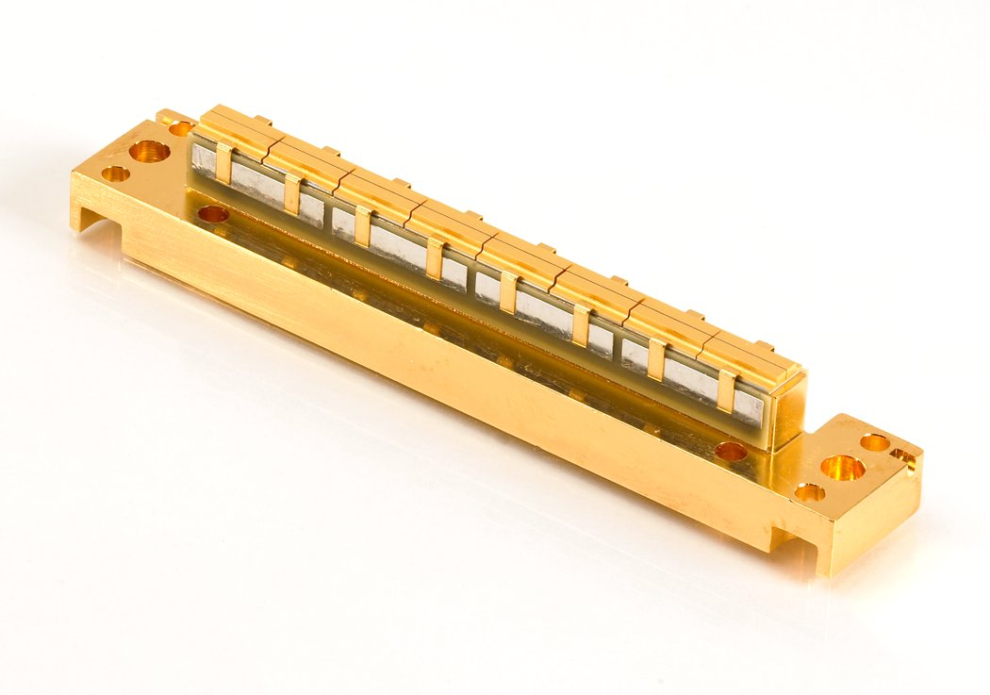
Motivation – Why choose DPSS?
Diodes are spectrally matched to the absorption line of laser crystal.
  Increased system efficiency.
  Reduced heat loads on rod.
This allows higher pump powers or higher repetition rates than lamp pumped counterparts.
  Direct replacement of lamp pumped units.
  Increased performance of existing architectures.
Diodes are highly efficient (typically 55-60% at operating point)

Slide 6
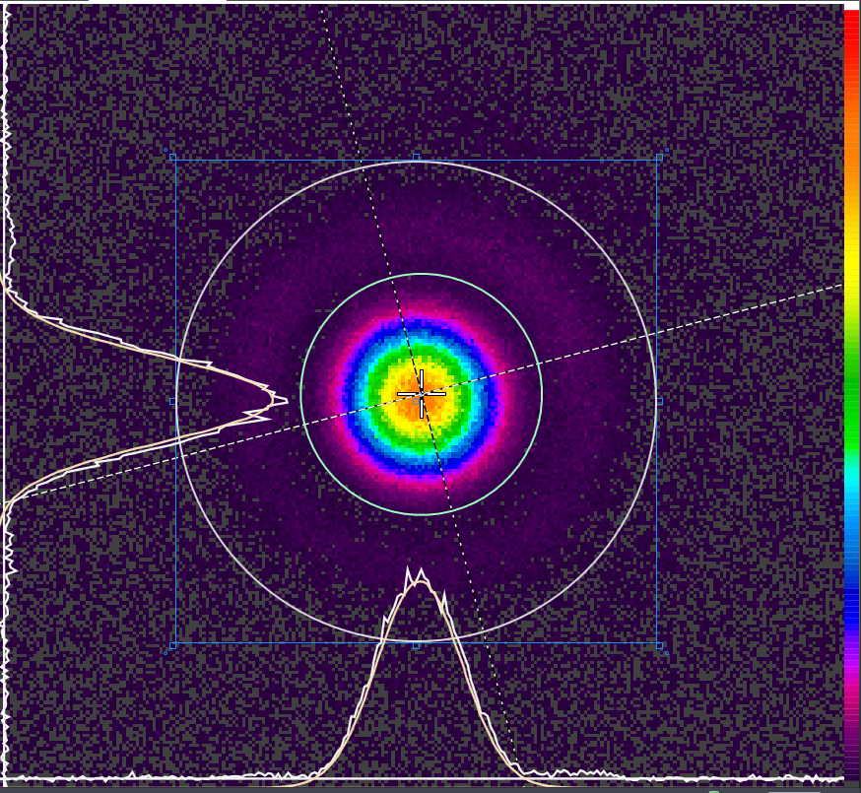
Motivation – What are the Advantages of Diode Pumping?
Efficient pump source and efficient coupling lead to the following:
  Higher repetition rate capability (> 10X)
  Lower thermal lensing
  Less beam distortion
  Extremely long lifetimes (> 10 Billion shots for typical DPSS systems, with additional derating possible for multi-year lifetimes)
  Greater/easier control
    Compared to most SSL time scales, the response time of a diode is infinitely fast
    Straight-forward to control and pulse shape with electronics
    Much lower voltages (arcing issues diminished)
  Higher wall plug efficiencies
  Improved pulse-to-pulse stability
Gigashot beam profile
- 350mJ, 1064nm, 110Hz

Slide 7
Quasi-CW Laser Gain Modules

Slide 8
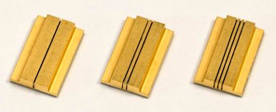
Quasi-CW Gain Modules
Data shown is for Nd:YAG
  Others available (Nd:YLF, Yb:YAG, Nd:Glass, etc.)
Incorporate long life diode packages.
Modules are available with rod sizes from 2mm to 25mm in diameter, 3cm to 170cm long, bar counts from 9 to 360, and pump energies up to 40 Joules.
Modules use common parts to reduce costs and manufacturing times.

Slide 9
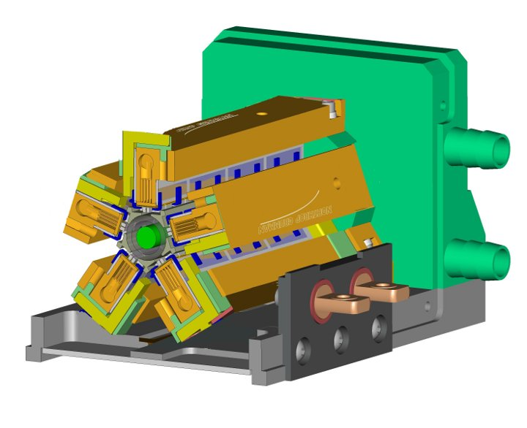
Gain Module Architecture
The laser crystal is cooled by passing water over the rod at high Reynolds number.
Five around array design gives more uniform pump light distribution.
Pump chamber includes a high reflector to increase the optical to optical coupling and increases the uniformity of the pump distribution.
Design allows easily changing pump lengths and rod sizes.
Coolant interface to module is easily modified to accommodate plumbing configuration of choice.
Design for 4-12mm rod diameters

Slide 10
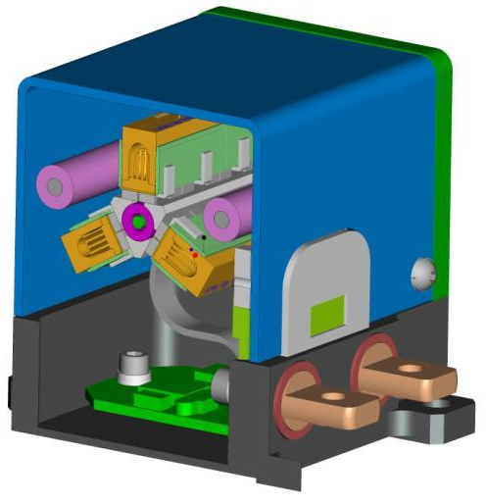
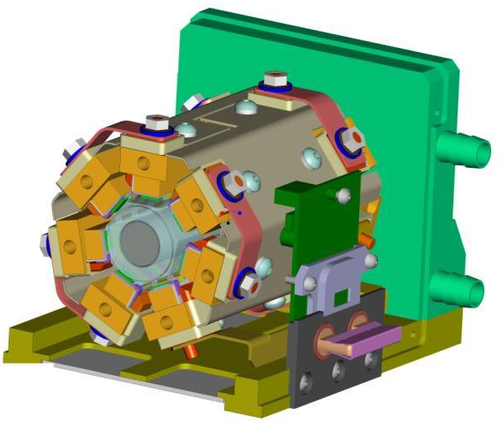
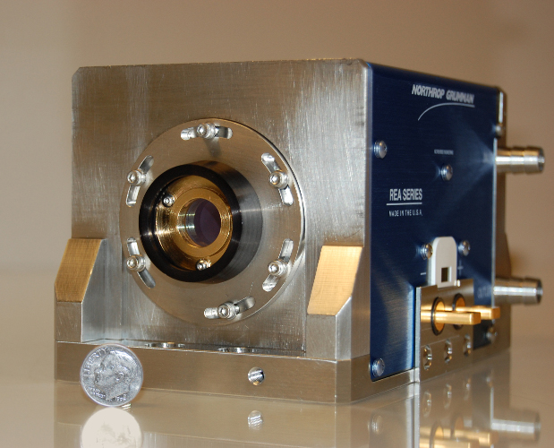
Gain Module Architecture (2)
Transition to 7-around pumping for rod diameters > 12mm
3-around pumping for smaller rod diameters (2-3mm)
  Often used as pre-amplifiers for multi-stage systems

Slide 11
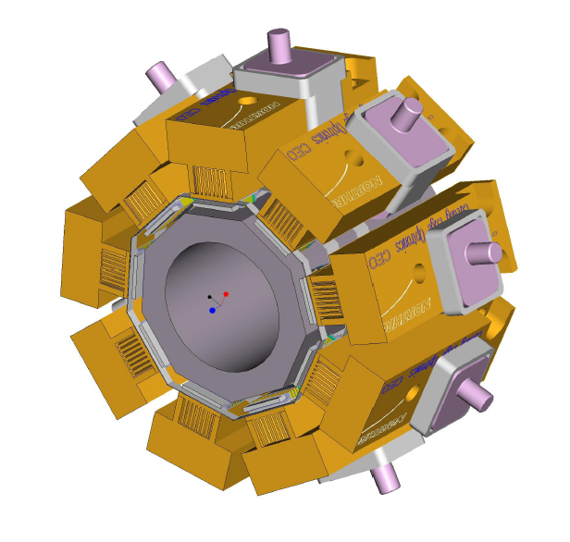
Gain Module Architecture (3)
18-25mm amplifiers utilize 9-fold pumping design
Same arrays as previous slides, just more of them
# of arrays is based on optimal filling of laser rod – leads to superior uniformity

Slide 12
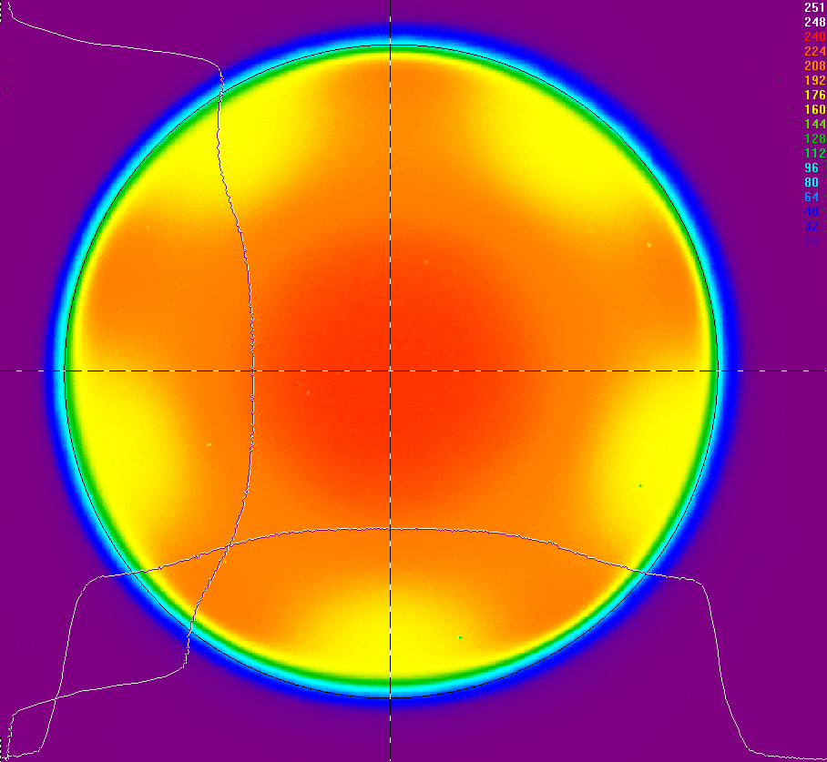
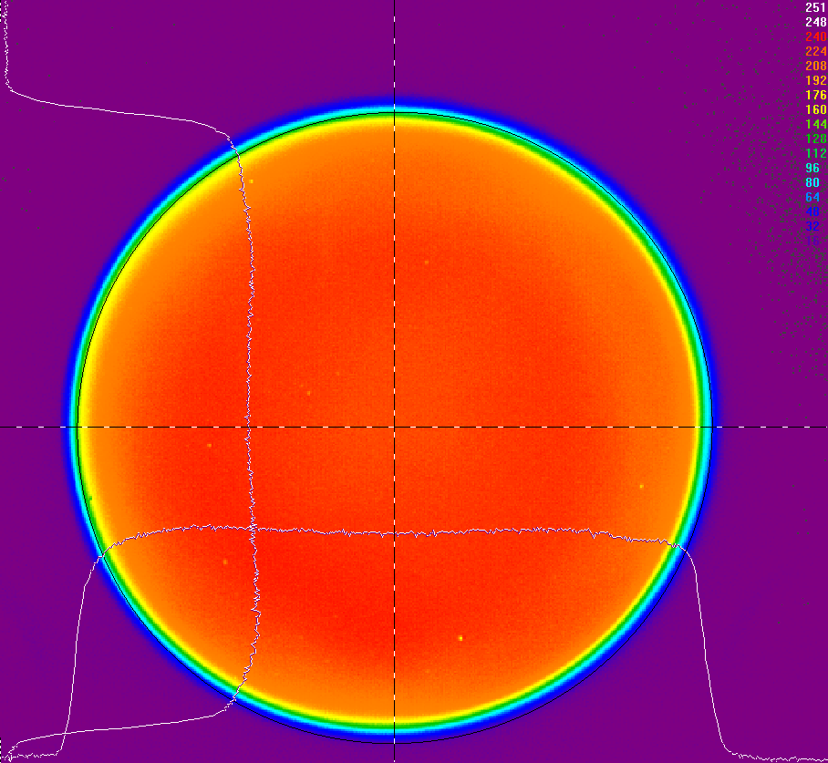
Uniformity
The gain uniformity of the larger REA series modules has been greatly improved.
Results in less beam distortion, more usable aperture area, and higher system efficiency.

Slide 13
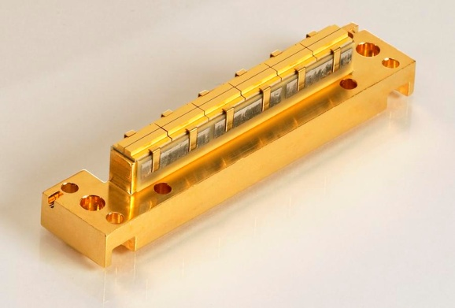
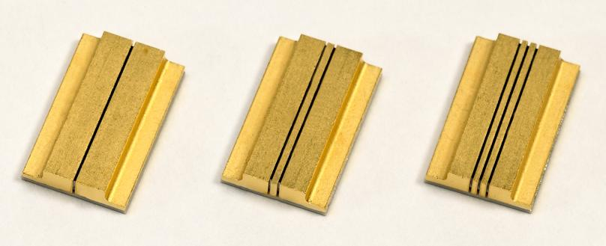
Laser Diode Arrays
NGCEO diode array fabrication is very modular
  Varied # bars per subassembly
  Varied # of subassemblies per array
➔ Pump power can be easily tailored for any application with COTS arrays and COTS pricing
Subassemblies/Array = 1, 2, 3 … 17
Bars/Subassembly = 1, 2, 3, … ~ 8

Slide 14
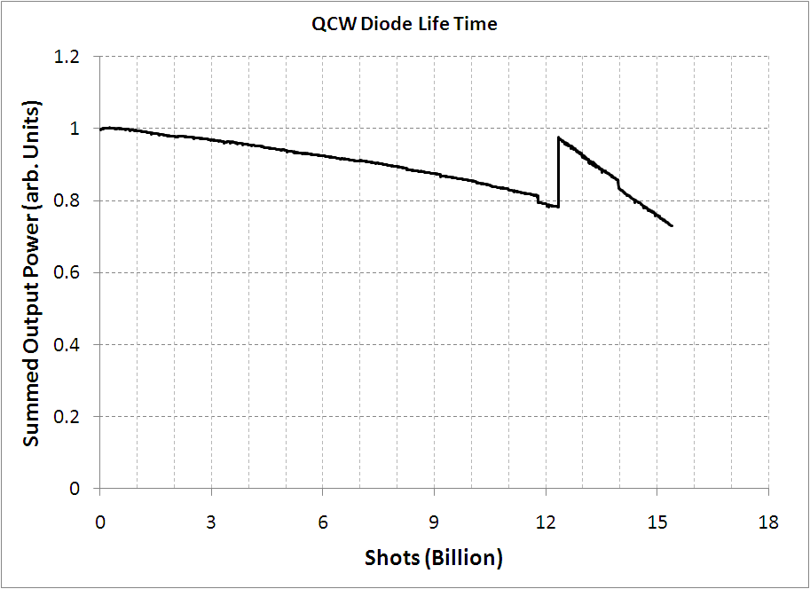
Diode Pump Life Time
Diode are life tested under full operating conditions.
12+ billion shot life times (corresponds to ‘macro’ pulses)
  10,000 operating hours at ~370 Hz.
Quality has improved significantly since this data was taken – new life test underway
SPIE 758304
Summed output of 60 bars
Packaged in an REA-like configuration
See also SPIE 791808
Notes:
Single-Bar Golden BulletsTM
Four-Bar Golden BulletsTM
Sample Size (packages)
24
15
Sample Size (bars)
24
60
Wafers used
3
3
Drive Current (A)
110
110
Peak Power / bar (W)
~ 120
~ 120
Peak Power / array (W)
~ 120
~ 480
Repetition Rate (Hz)
750
750
Pulse Width (µs)
200
200
Duty Factor
15%
15%

Slide 15
Infinitely-Customizable Laser Solutions
A wide variety of COTS parts allows the customer to select from a nearly infinite array of potential amplifiers
All at standard COTS pricing
Parameter | Min | Max | Comment
Rod Diameter | 2mm | 25mm
Pump Length | 1cm | 17cm
Duty Cycle | 0% | CW | Must account for thermal lensing and distortion
Peak Pump Power per cm | N/A | > 6kW | Impacts duty cycle

Slide 16
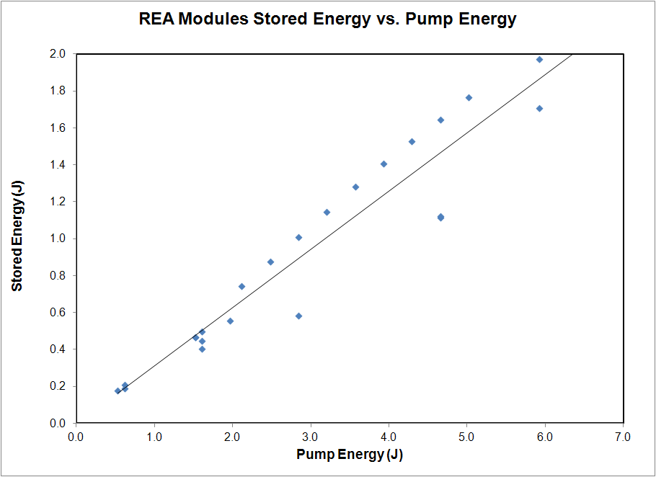
Gain Module Amplifier Performance

Slide 17
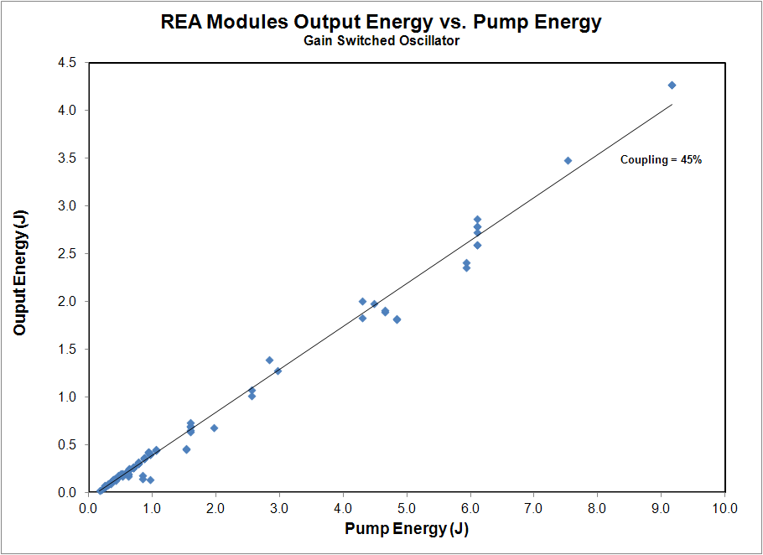
REA Modules Output Energy
Notes:
Slope efficiency 47% Good coupling
4.2J output
Linear

Slide 18
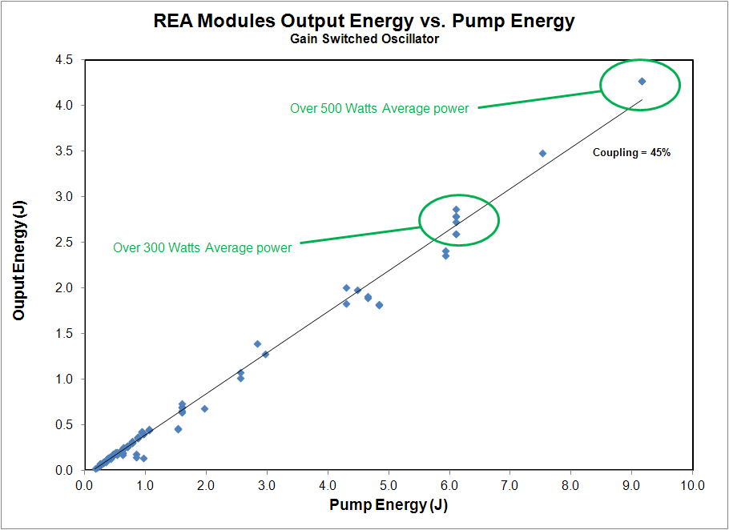
REA Modules Output Energy
Notes:
Slope efficiency 47% Good coupling
4.2J output
Linear

Slide 19
Pulse Trains
What are pulse trains?
  A series a short pulse width, closely spaced pulses, occurring in a series of bursts.
  Pulse width 100ns or shorter.
  Repetition rates of 5kHz or more.
  Bursts of 100Hz or less.
  The burst of pulses is called a ‘macro-pulse’.
These are not hard limits, but guidelines.
  Engineering trades to accommodate ‘unusual’ situations.
2ms long ‘macro-pulse’
10 Hz
‘macro-pulse’ repetition rate
10s of kHz – Combustion Diagnostics
MHz – Particle Physics
40ns pulses, at ‘high’ repetition rate

Slide 20
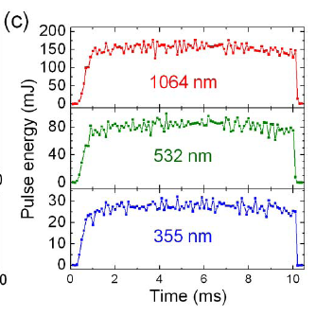
Example – Combustion Diagnostics
Combustion diagnostics utilizes longer macro pulses (5-100ms) and lower micro-pulse repetition rates (~ 10kHz)
Mikhail Slipchenko, et. al.
  www.spectralenergies.net
Optics Letters
  Volume 37, No. 8, April 15th, 2012
Demonstrates energy stability to 10ms
Subsequent work done to stretch the stable region to 40-100ms

Slide 21
Example – Laser Stripping
Input pulse train is 10ps, 400MHz, 0.5mJ per pulse. The macro-pulse width is about 1.2ms.
Amplifier architecture is a RBA double passed followed by an REA single passed.
Output is 200mJ per pulse. This equates to an overall amplification of 400.
RBA20-1P1
Amplifier Module
Source Laser
REA4006-1P1
Amplifier Module
Russel Wilcox, LBNL, “An H- stripping laser using commercial, diode-pumped Nd:YAG amplifiers”, presented at Laser Stripping Workshop, April 11, 2011.

Slide 22
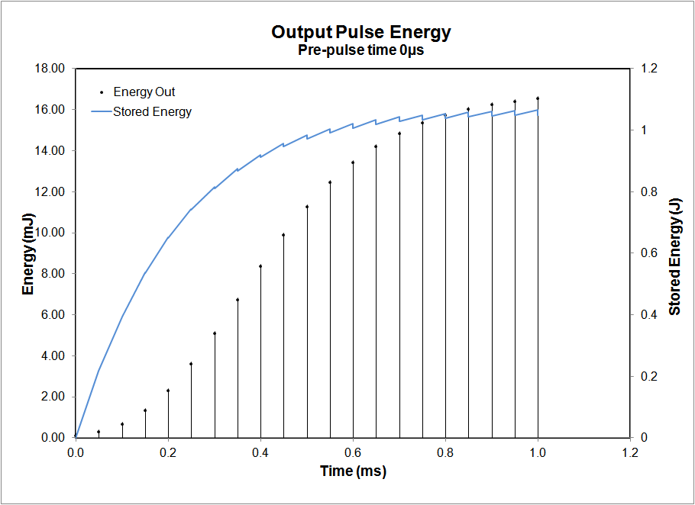
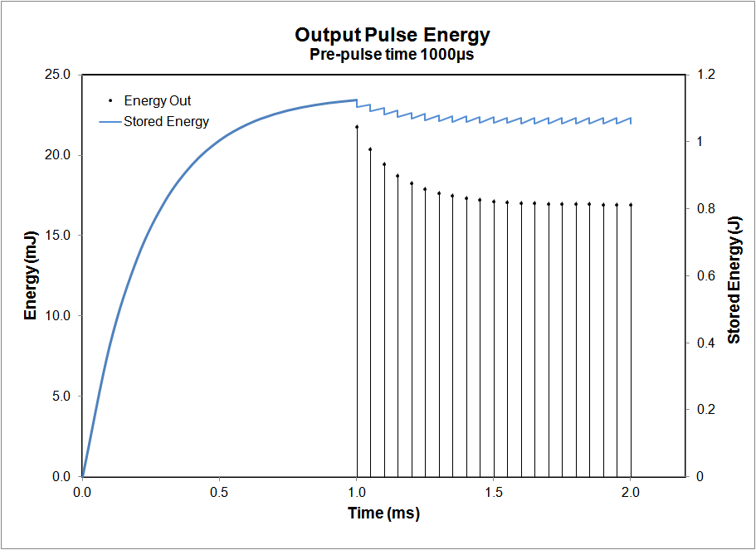
Examples of Modeling Output
The biggest challenge is generating pulse trains with equal output energies
  Becomes more difficult with more ‘layers’
Modeled Example:
  Input laser pulse train is characterized by 12ns pulses, 100µJ, 10kHz repetition rate.
  The macro-pulse is 1ms long and repeats at 2Hz.
  The amplifier is a REA6308-2P200.
  How long before optical pulses arrive should the current pulse begin?

Slide 23
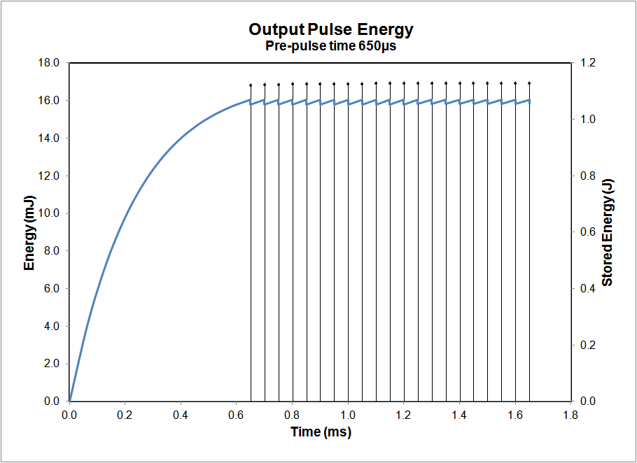
Just Right….

Slide 24
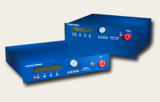
Another way to smooth output
NGCEO is currently developing the software necessary to shape the current pulses in our drivers
Pulse shape supplied to driver via RS-232
~ 350 current values per pulse

Slide 25
Example Lasers

Slide 26
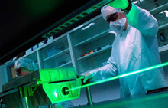
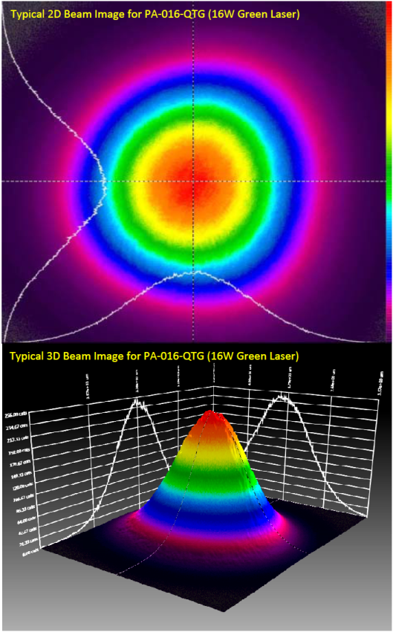
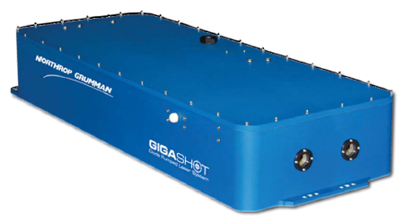
Example Lasers
Mine Detection Laser
- Helicopter platform (Navy)
DPSS EO Q-switched laser
~ 8ns pulse width
~ 350mJ IR
~ 110Hz
DPSS AO Q-switched laser
~ 100ns pulse width
20-400W @ 10kHz
External Sales

Slide 27
AO Q-Switched IR Lasers
Model | Repetition Rate Range (kHz) | Average Power (W) | Pulse Width (ns) | M²
PA-20-QTI | 5-30 | 20 | < 100 | < 1.3
PA-35-QMI | 5-50 | 35 | < 200 | < 6
PA-50-QMI | 5-50 | 50 | < 200 | < 6
PA-100-QMI | 5-50 | 100 | < 200 | < 15
PA-150-QMI | 5-50 | 150 | < 200 | < 20
PA-200-QMI | 5-50 | 200 | < 200 | < 20
PA-400-QMI | ~ 10 | 400 | < 220 | < 37
CW pumped, AO Q-switched
Low gain, high average power
Green versions of all lasers available
  Diamond cutting
  Ti:Sapphire pumping

Slide 28
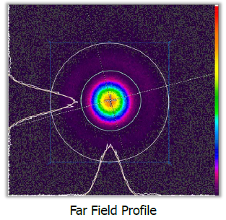
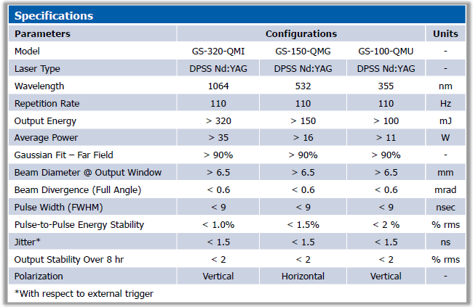
EO Q-Switched Lasers
QCW pumped, EO Q-switched
High gain, low average power
Additional pulse energies and repetition rates available.

Slide 29
Conclusion
DPSS Amplifiers/Systems offer numerous advantages over flashlamps
  Higher efficiency
  Higher repetition rates
  Less thermal distortion & thermal lensing effects
Wide applicability to pulse trains

Slide 30
For More Information
ryan.feeler@ngc.com
www.ceolaser.com
  Application note #18 – pulse train amplification
320mJ, 110Hz, 1064nm, M² < 2, <9 ns
150mJ, 110Hz, 532nm, M² < 2, <9 ns
200W Average Power @ 532nm

Slide 32

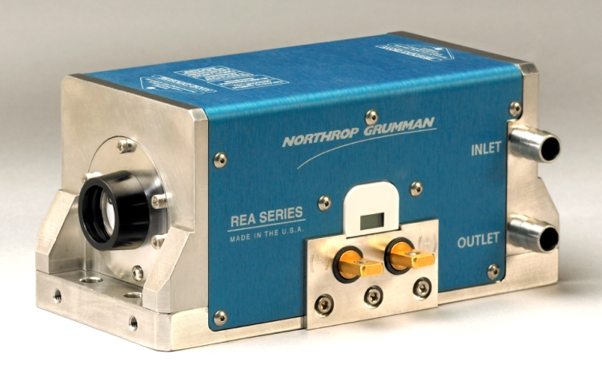
Different Gain Materials: Nd:YLF
Quasi-CW pump YLF gain modules are also available.
Rod sizes up to 25mm.
  Uses same technology and parts as a standard Nd:YAG module
Long pulse energies over 1 Joule at 5Hz have been demonstrated.
  6.35 mm rod, 60 mm pumped length, 30 bars, 3 Joules pump energy.

Slide 33
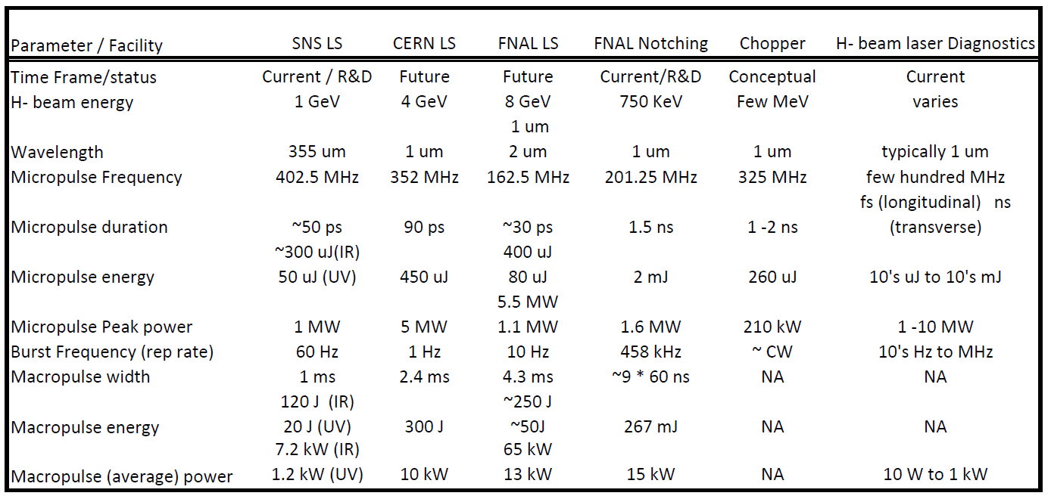
Pulse Train Applications

Slide 34
Example Data
Data on following slides shows the interactions between a few key input variables and output parameters:
  Rod size
  Pump power
  Small-signal gain
  Stored energy
Model has been pegged to experimental data (dozens of different configurations)
All applications are handled (and modeled) on a case-by case basis in order to compensate for:
  Input beam characteristics (flat-top vs. Gaussian, pulse width considerations, etc.)
  ASE
  Potential for gain clamping
  Etc.

Slide 35
Example #1 – SSG vs. Rod Diameter
(Fixed Stored Energy)
SSG plotted as a function of rod diameter
Fixed stored energy – 1J
6cm pump length
60 pump bars
  12kW pump power
  250 µs pump pulse
  ➔ 3J pump energy
5-around symmetry

Slide 36
Example #2 – Performance vs. Pump Length
SSG can be increased by increasing the pump length
Assume pump power per cm is fixed
At SSG ~ 280, the gain is clamped
  Adding pump length is to no advantage
  Power/bar can be decreased and still maintain the same SSG
6.35mm diameter rod
2kW/cm pump power in unclamped region
Gain is clamped at ~ 280

Slide 37
Example #3 – Performance vs. Pump Power
(Fixed Physical Dimensions)
SSG can be increased by increasing the pump power per cm
Assume the physical configuration is fixed
  Fixed rod diameter
  Fixed pump length
6.35mm diameter rod
6 cm pump length
Gain is clamped at ~ 280

Slide 38
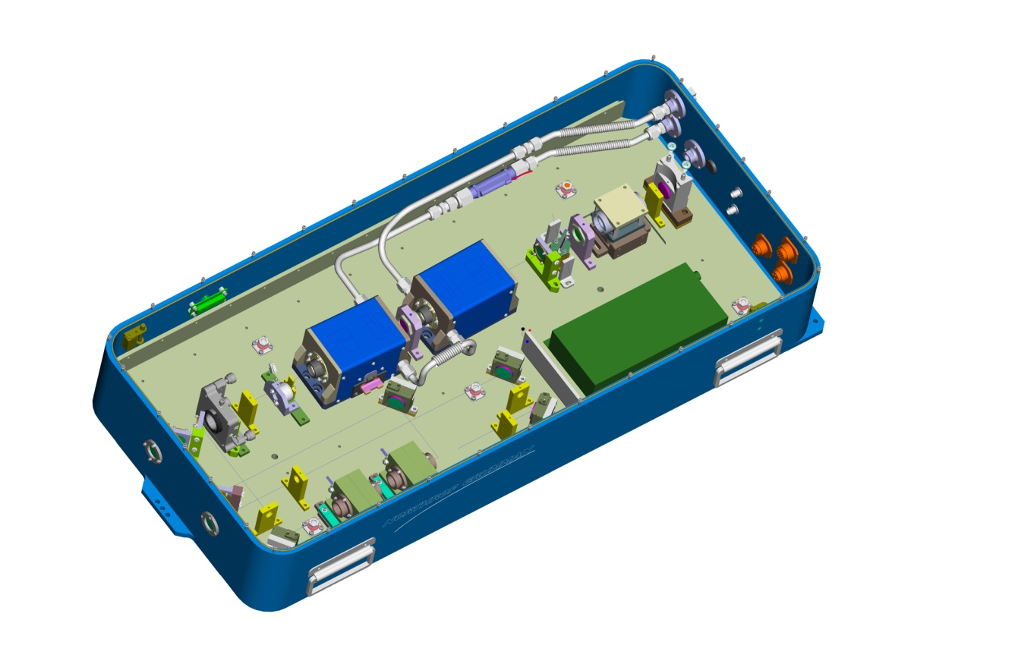
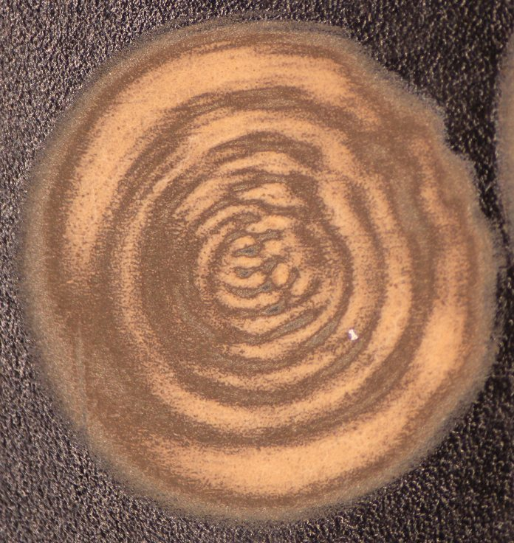
Example Laser - Gigashot
Wavelength: 1064 nm
Repetition Rate: 110 Hz
Pulse Energy: 350 mJ
Pulse Width: 6-8 ns
Beam Quality: M² <2
Beam Diameter: ~5.6 mm
Full Divergence Angle: ~0.6 mrad
110 Hz Burn Mark

Slide 39
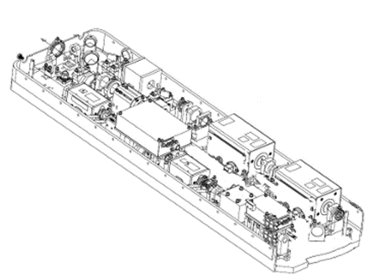
Example Laser
High average power, high energy laser system.
100mJ, 1064nm, 1000Hz, 10ns, M²<3
Oscillator is based on a RBA with an output of 20mJ q-switched at 1000Hz, M² = 1.2
Followed by one RBA class and two REA class amplifiers leading to 100mJ, M²=3 output.

