Slide 1




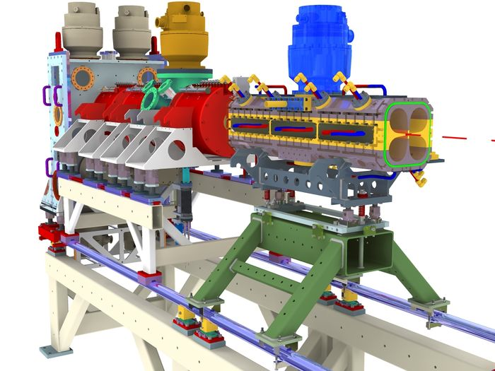
Fiber laser transport for the photo-detachment emittance measurements at FETS
Alessio Bosco JAI @ Royal Holloway University of London
Main Contributors:
G. Boorman, S. Emery, S. Gibson – RHUL
C. Gabor, A. Letchford - STFC RAL
J. Pozimski, P Savage – Imperial College
T. Hofmann - CERN
3rd mini-Workshop on H- Laser Stripping and Accelerator Applications
Fermi National Accelerator Laboratory – Batavia, IL, USA – 26-27 September 2013
1

Slide 2
Outline
Introduction
Fiber laser
Fiber transport
Final focus assembly
Laser measurements before and after transport
Tests at Linac4
Summary and outlook
Fiber laser transport for the photo-detachment emittance measurements at FETS
3rd mini-Workshop on H- Laser Stripping and Accelerator Applications
2

Slide 3
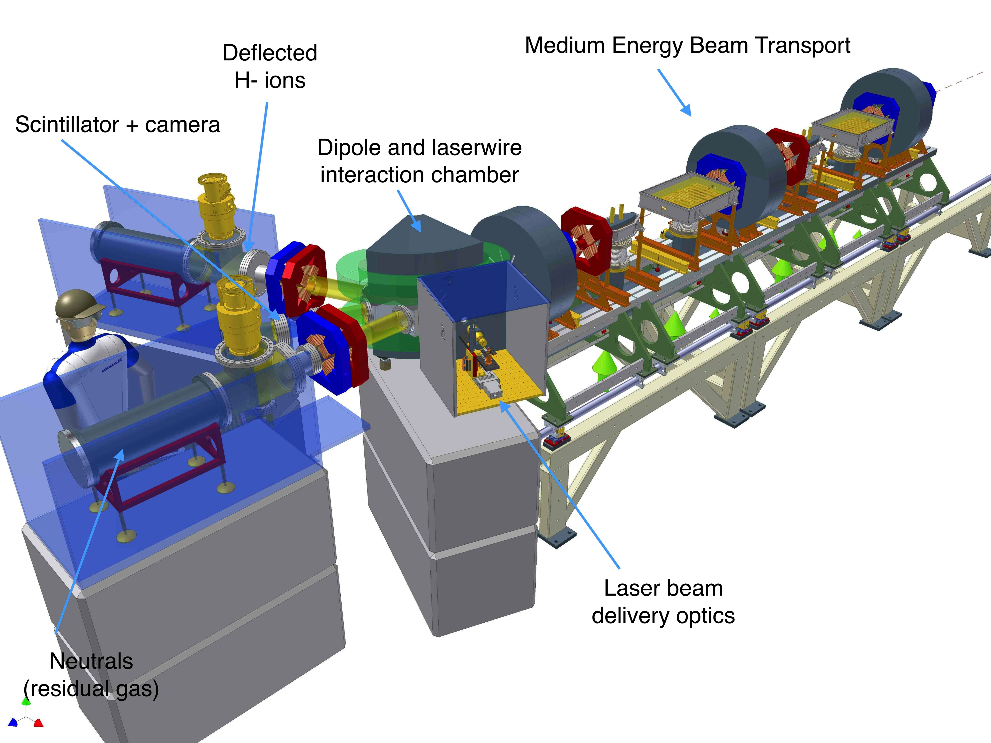
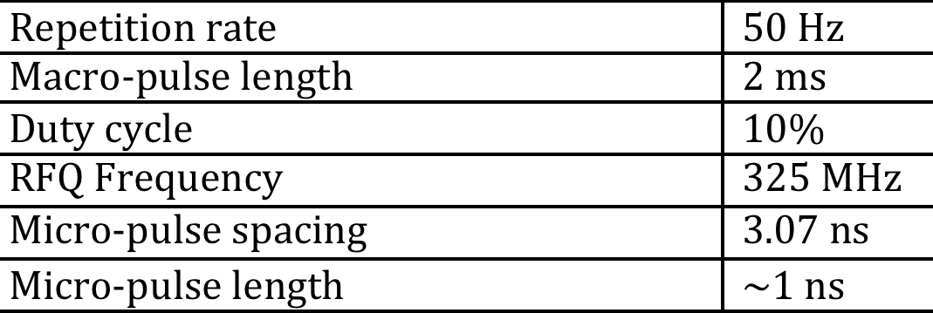
Introduction
Laser based diagnostic at the Front End Test Stand (FETS) at Rutherford Labs
Photo-neutralization of H- ions for size and emittance measurements @ 3MeV
Summary of Accelerator Parameters
Please refer to Christoph Gabor’s talk for details on the Photo-detachment Experiment
Fiber laser transport for the photo-detachment emittance measurements at FETS
3rd mini-Workshop on H- Laser Stripping and Accelerator Applications
3

Slide 4
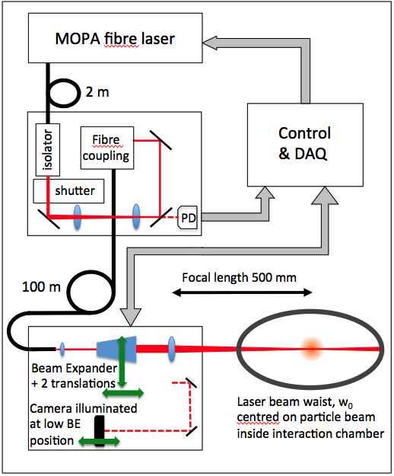
Introduction
Experimental setup layout:
Laser System
Fiber Transport (10 – 100 m)
Laser delivery to interaction area
Control and DAQ (Labview based)
Particle detection (not discussed here)
Fiber laser transport for the photo-detachment emittance measurements at FETS
3rd mini-Workshop on H- Laser Stripping and Accelerator Applications
4

Slide 5
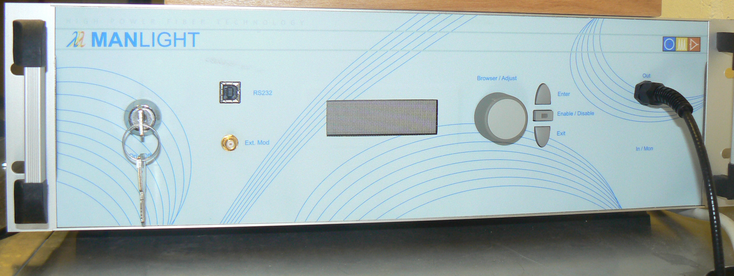
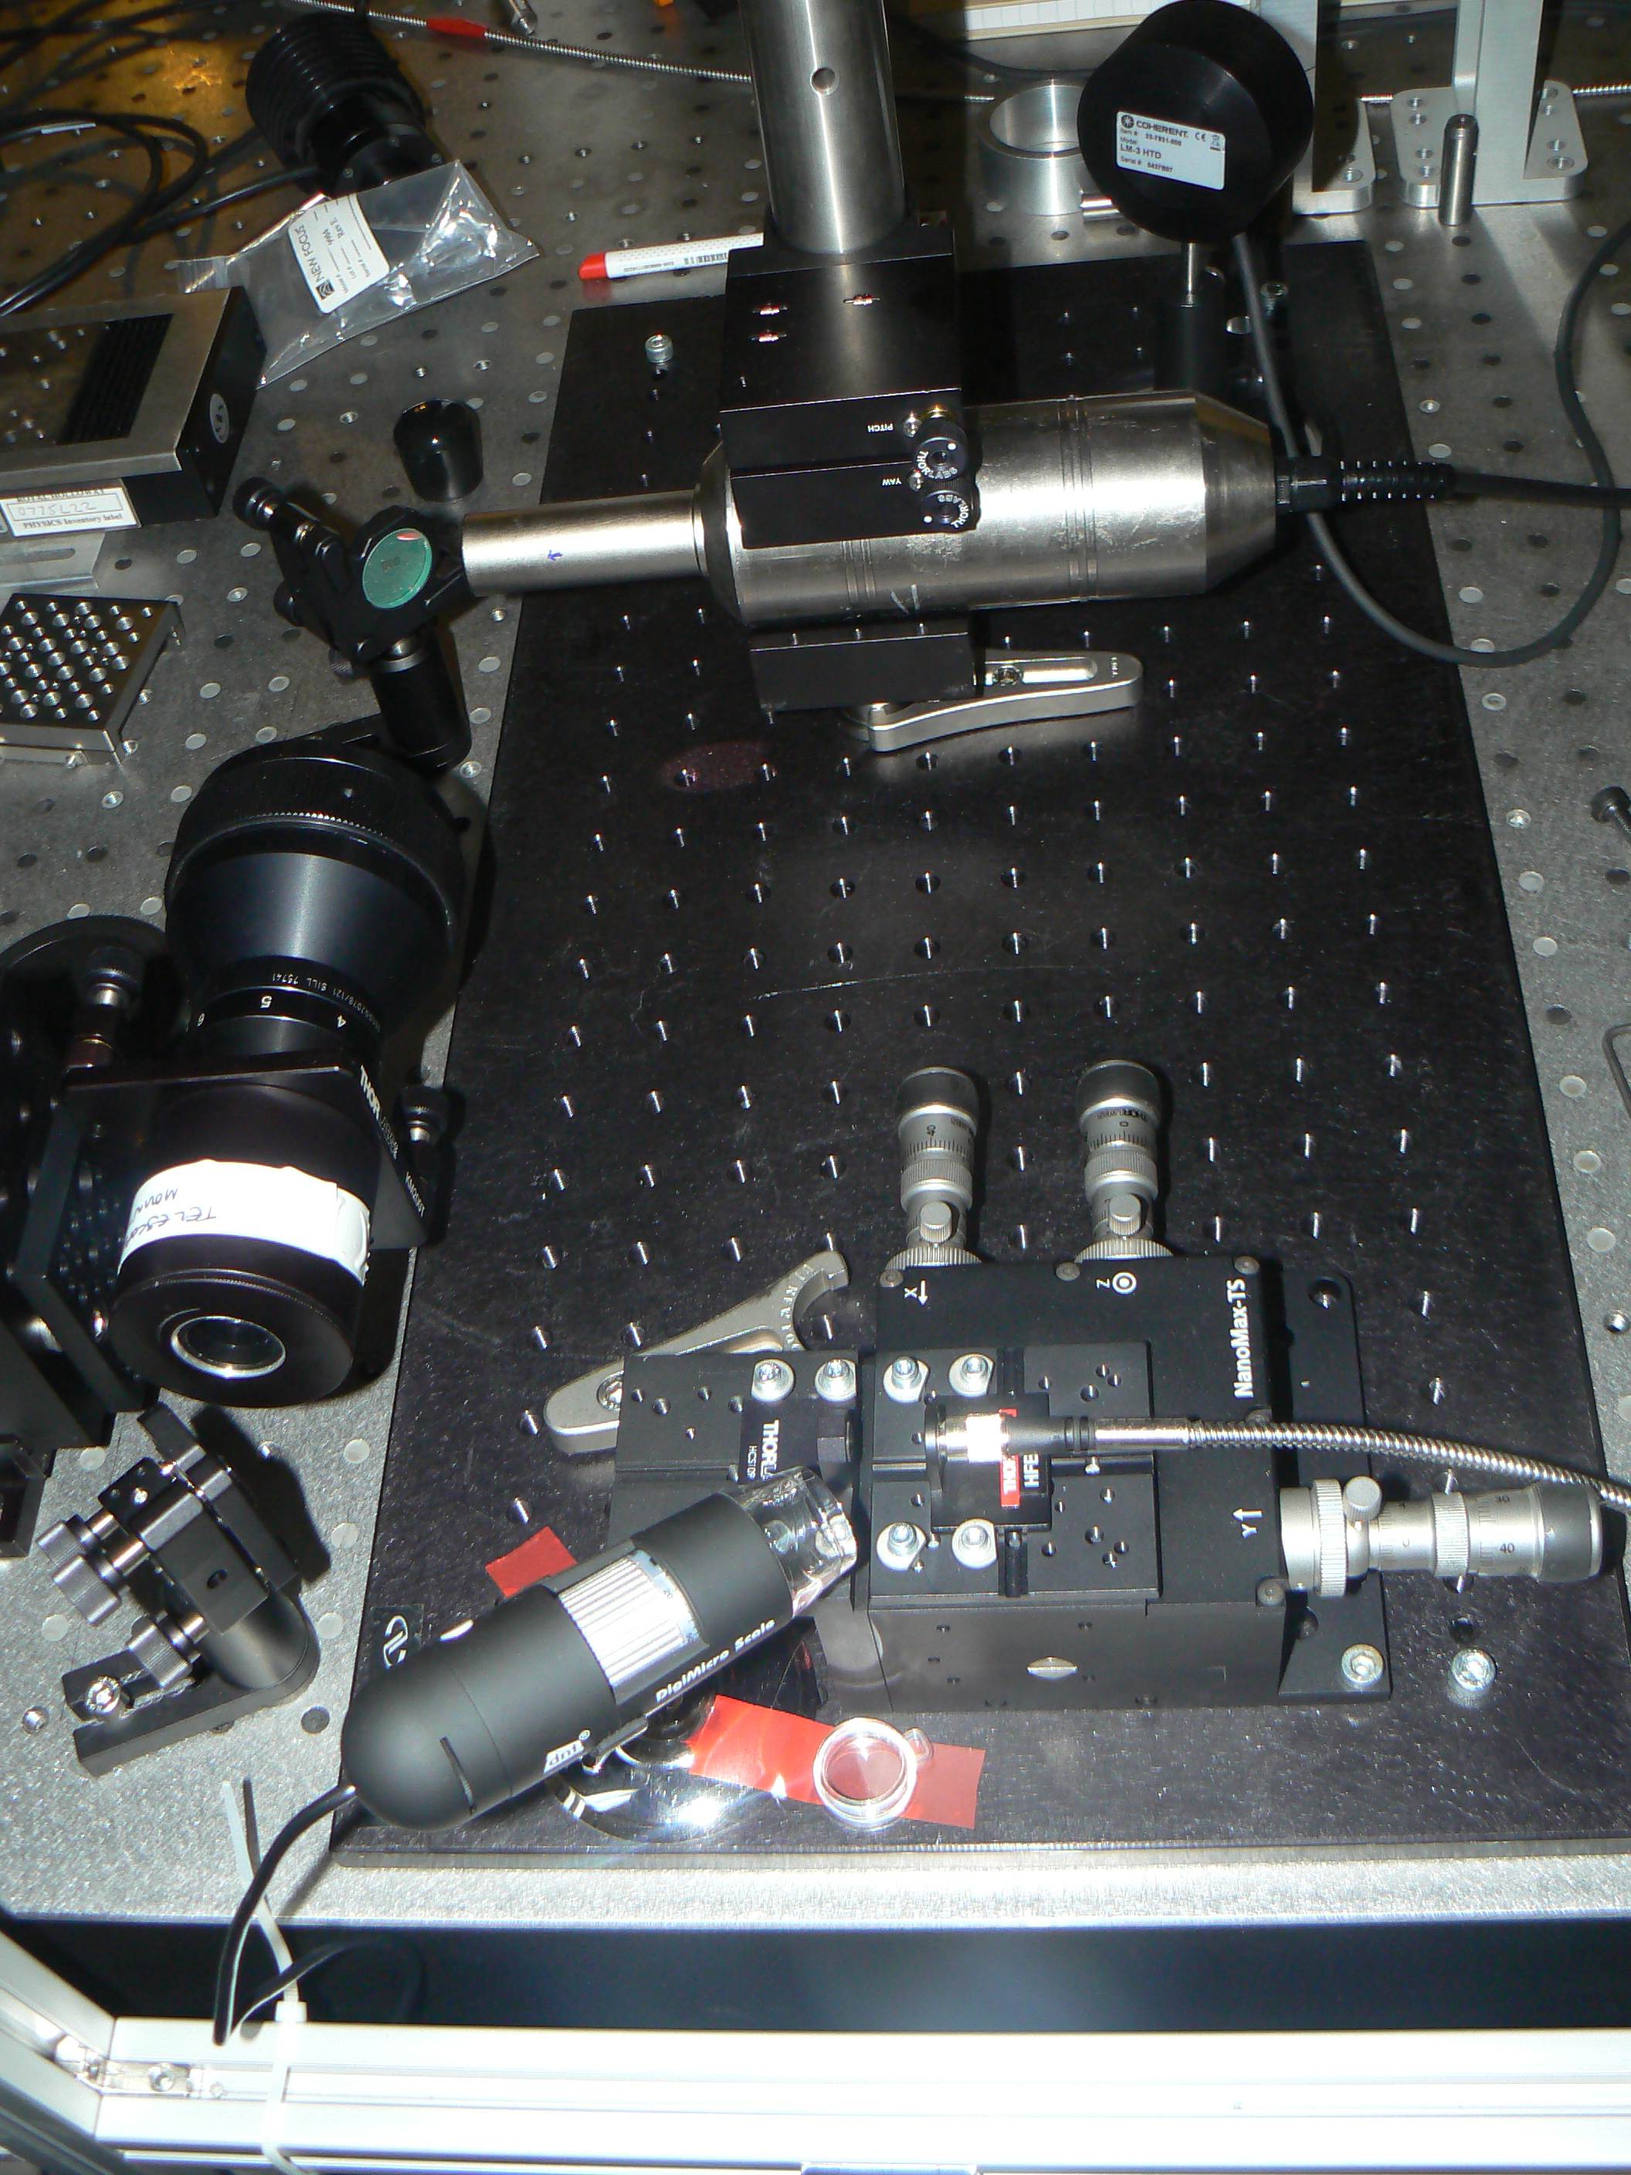
Fiber Laser Description
All Fiber (Yb:doped) MOPA
2m Fiber Pigtail
TTL driven Pump
λ = 1080 nm
Pulse Duration 90 – 110 ns
Max Peak Power = 8 kW
Rep rate = 30 – 100 kHz
Max Av. Power (CW Pump) = 30 W
Fiber laser transport for the photo-detachment emittance measurements at FETS
3rd mini-Workshop on H- Laser Stripping and Accelerator Applications
5

Slide 6
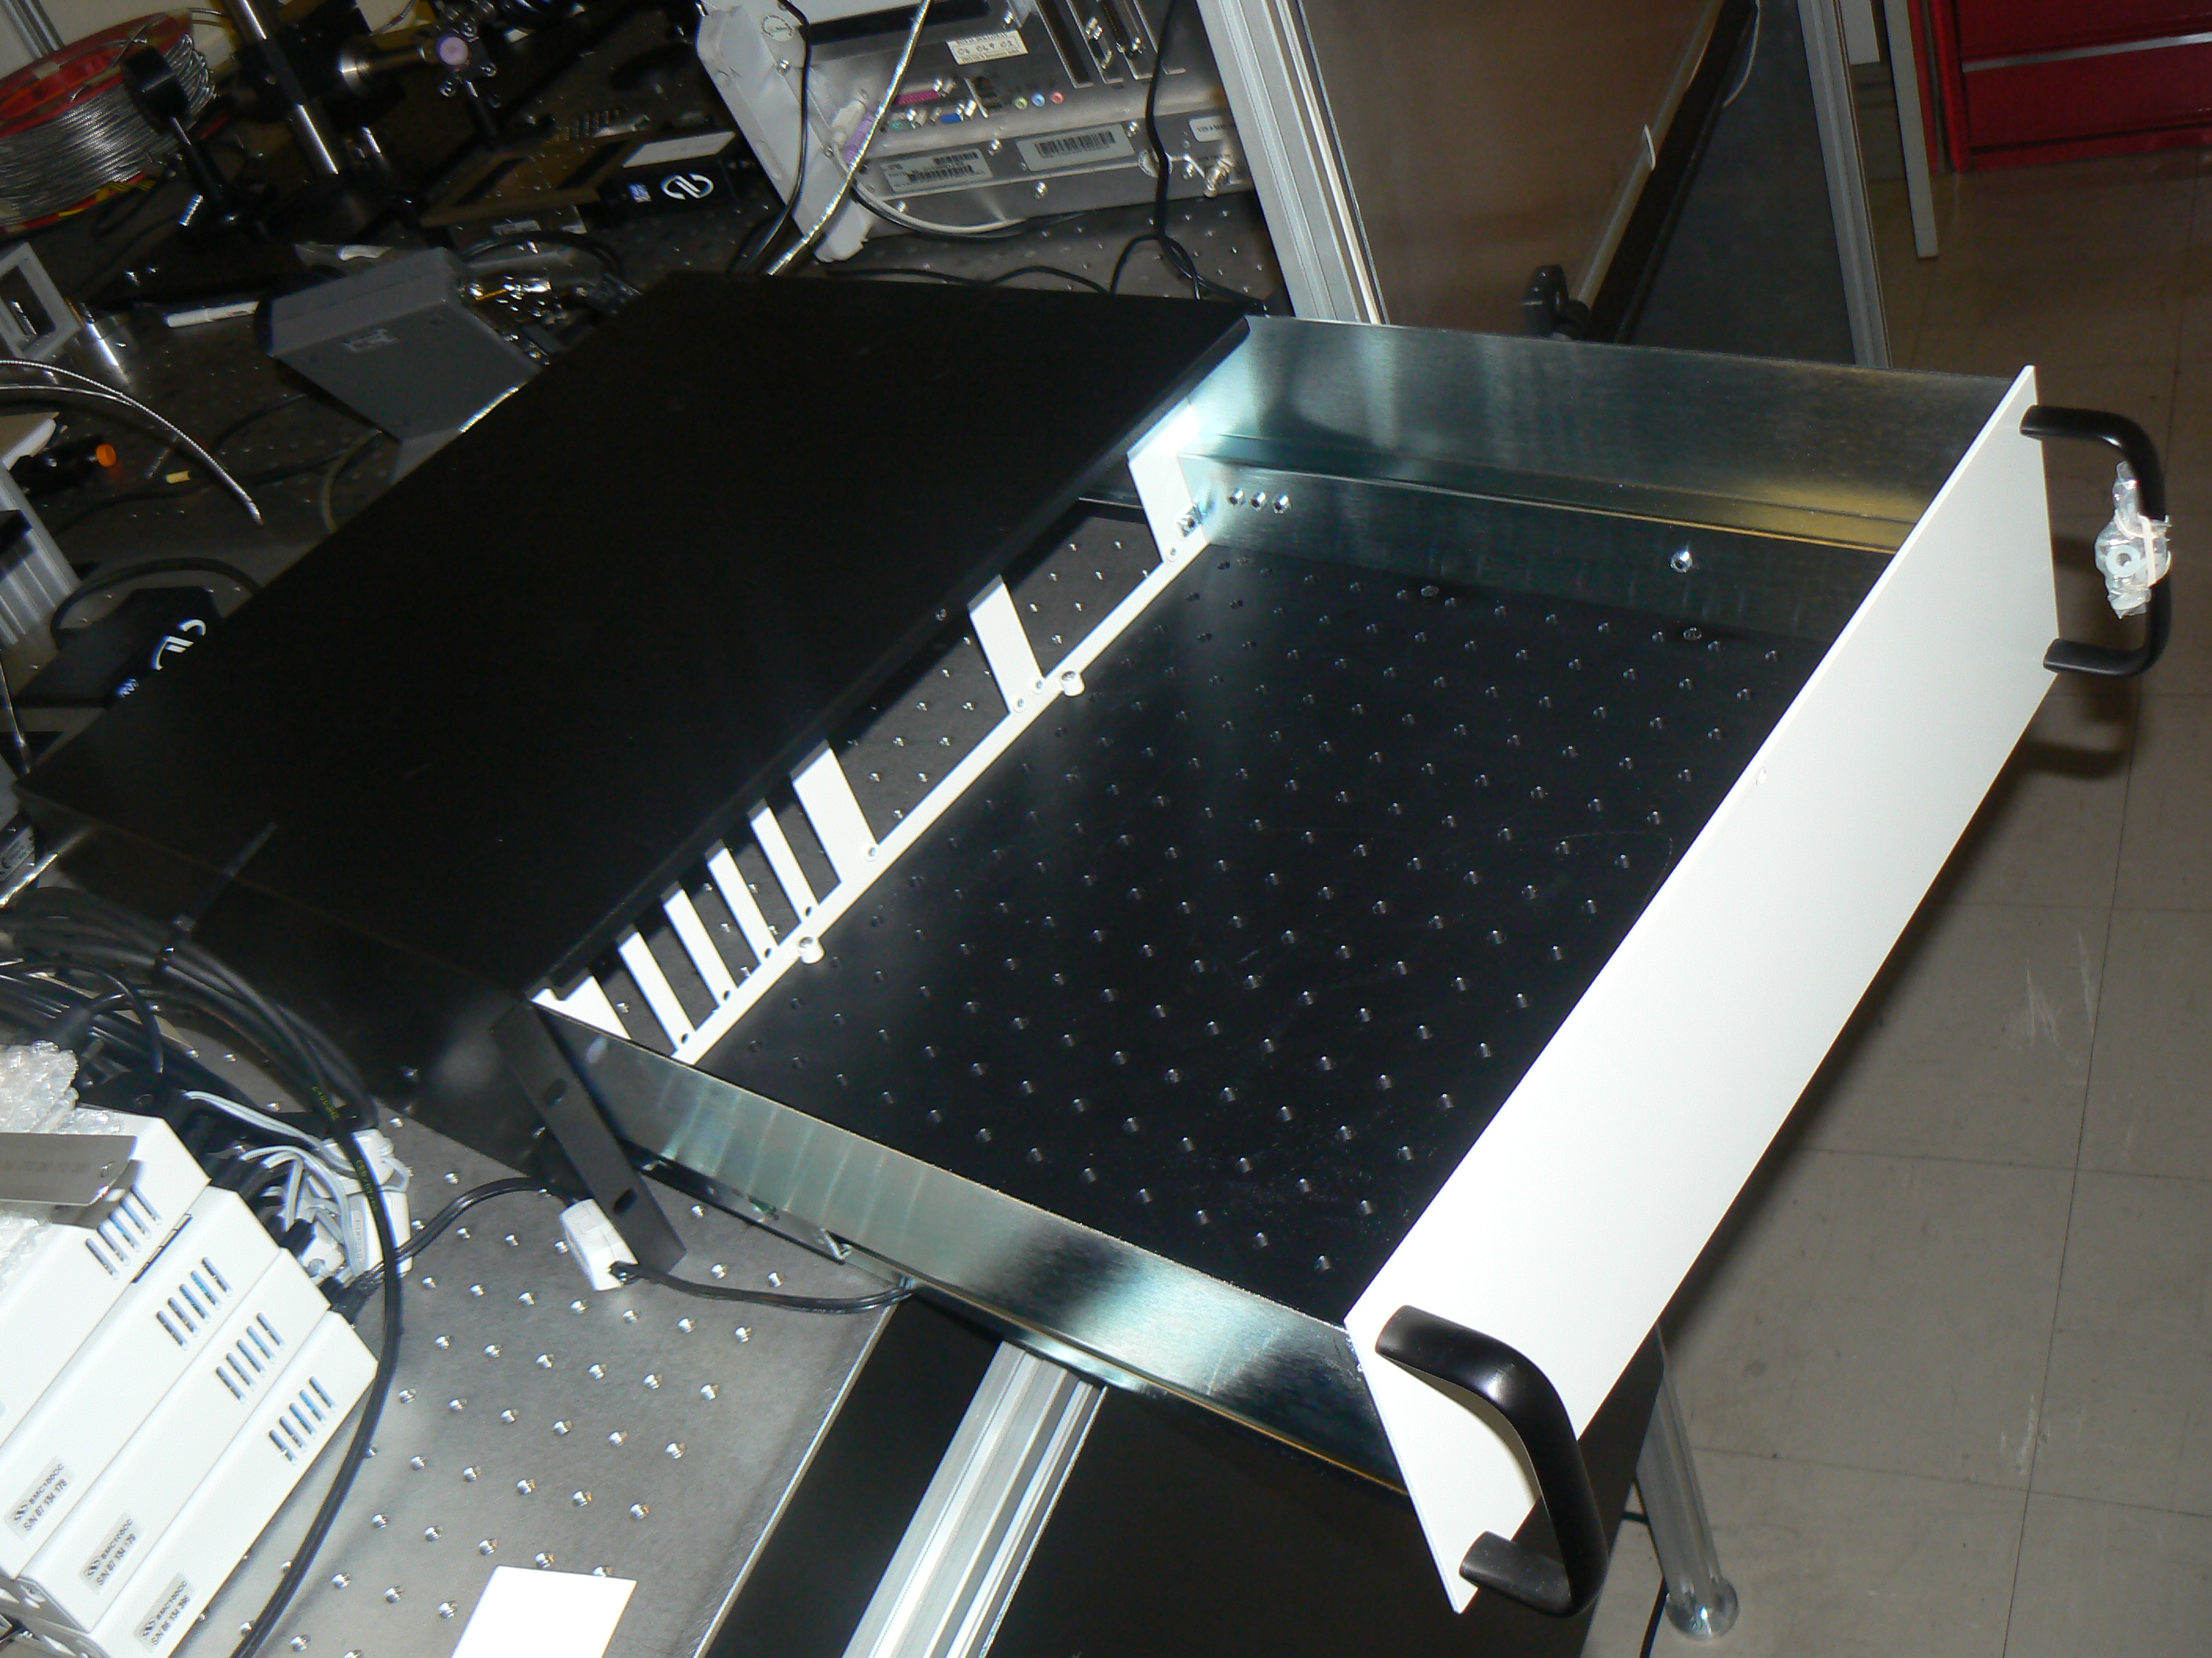


Fiber Transport Description
Fiber coupling:
3 axes stage with 100 nm resolution
Optics will be aligned in a 19” rack box
Fiber Model LMA-GDF-20/130-M Length of fiber = 100 m (under test)
Coupling Efficiency in fiber = 70%
Numerical Aperture = 0.08
Core Diameter = 20 μm
Equivalent M² = 2.35
Fiber laser transport for the photo-detachment emittance measurements at FETS
3rd mini-Workshop on H- Laser Stripping and Accelerator Applications
6

Slide 7
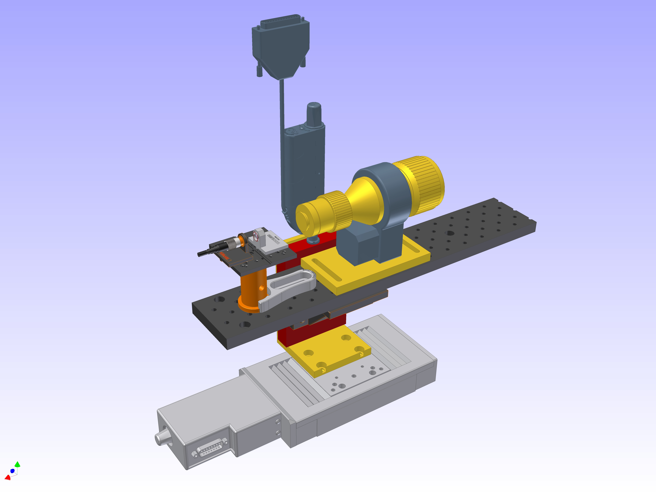
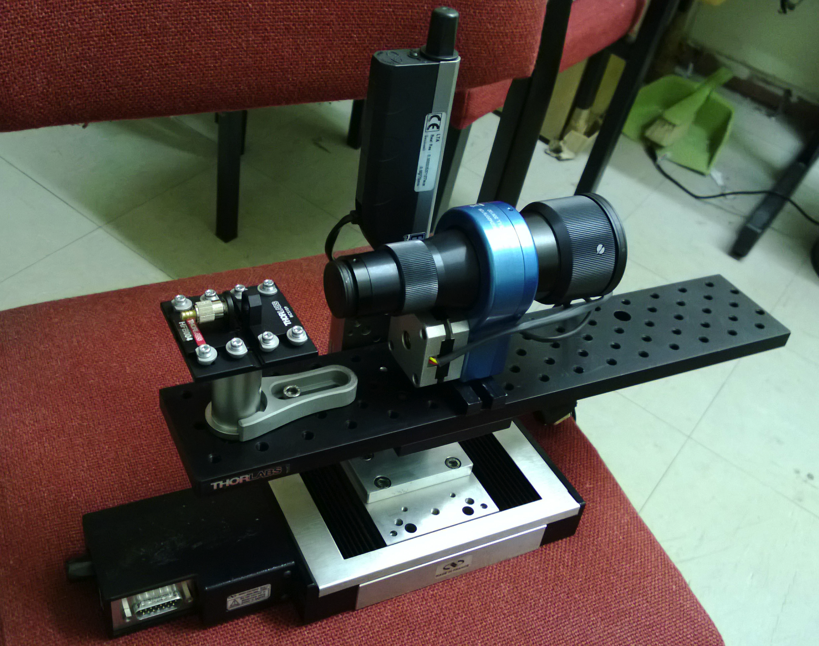
Laser Delivery
Longitudinal and transversal motorized translation stages (1 μm resolution)
Fixed plate contains all the optical element for virtually alignment-free operation
Motorized zoom beam expander 1 – 8 times magnification factor (collimated beam)
Possibility to add a lens after the BE for spot sizes variable from 1/8 – 1 times (focused beam)
Fiber laser transport for the photo-detachment emittance measurements at FETS
3rd mini-Workshop on H- Laser Stripping and Accelerator Applications
7

Slide 8
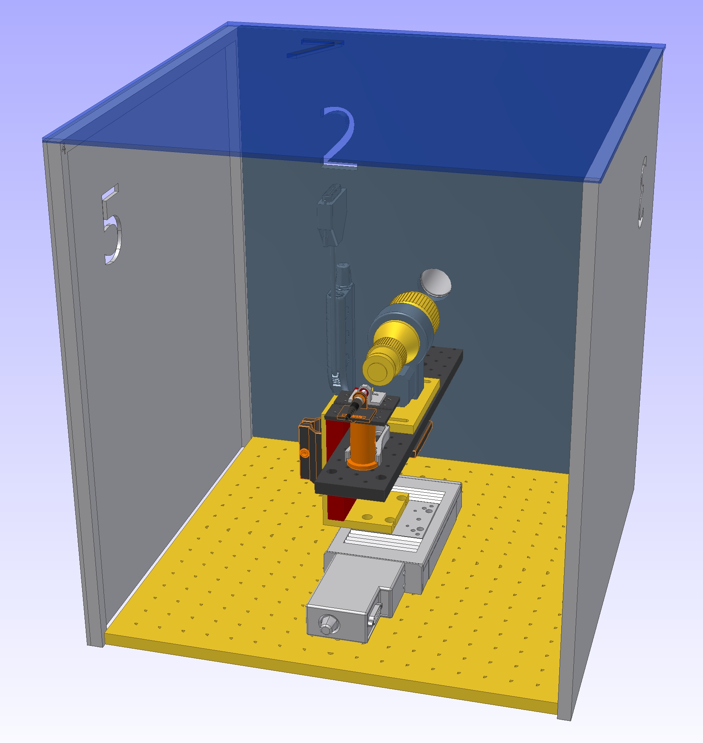
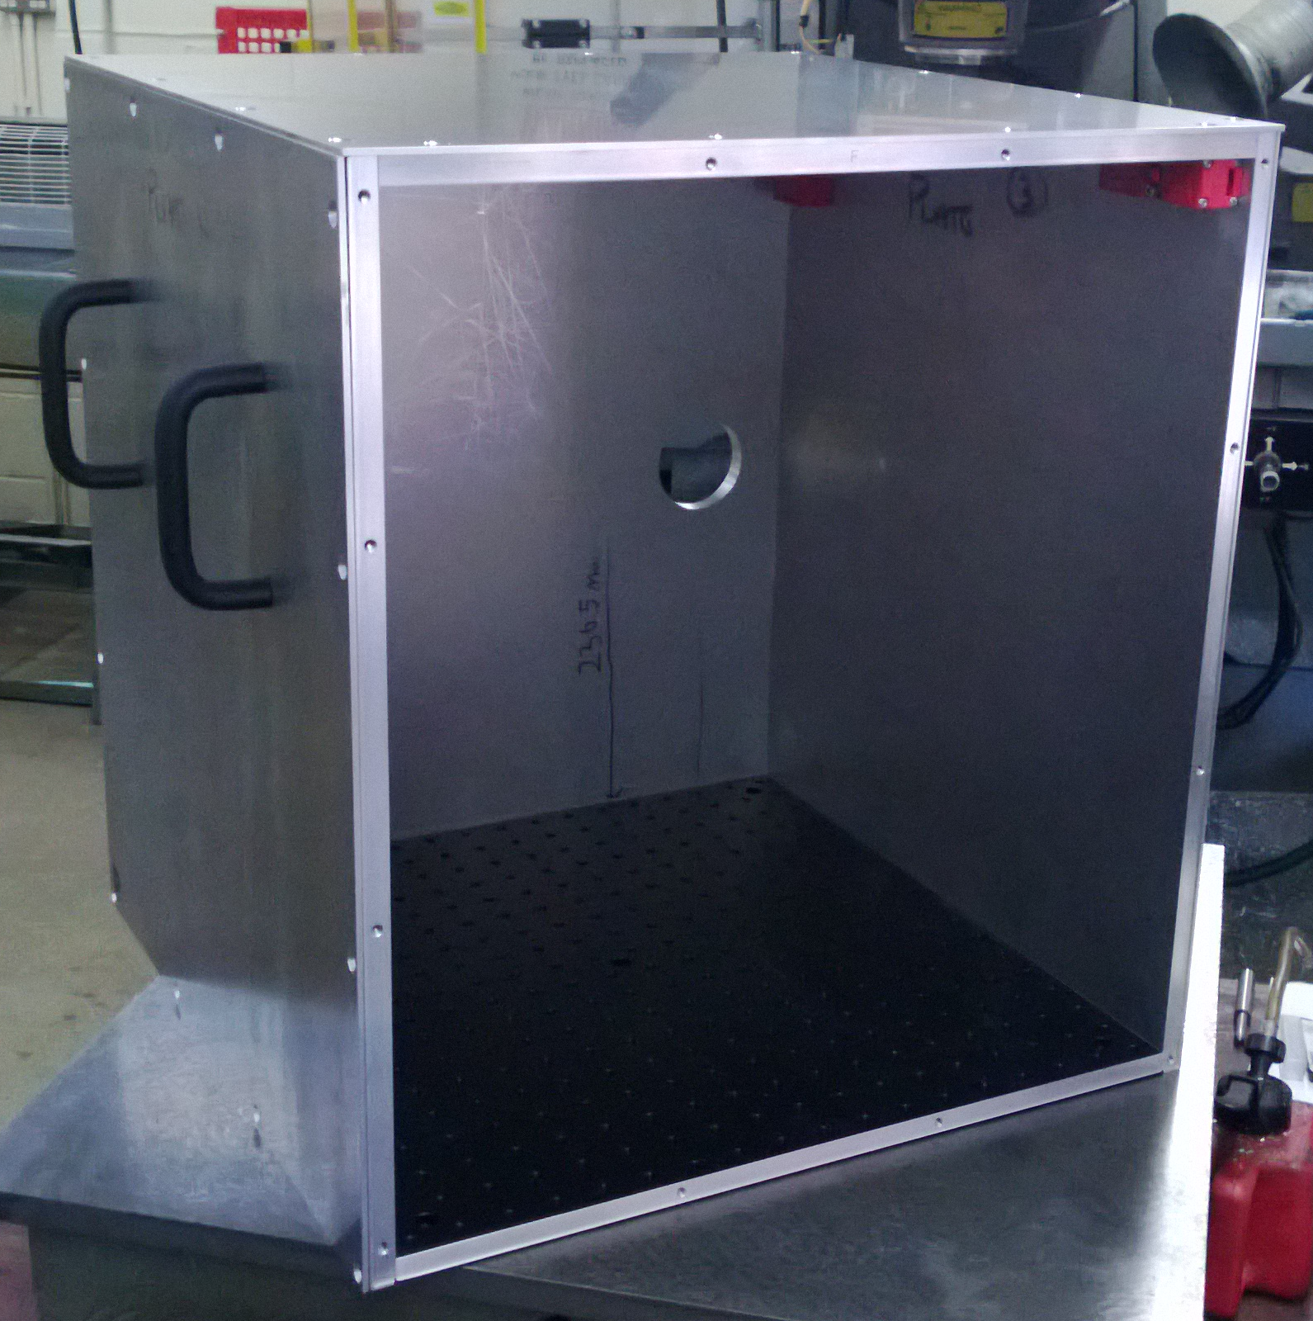
Laser Delivery
Beam delivery system enclosed in aluminum box, on 450x450mm breadboard.
The top and two side panels are removable for access.
Opening the box breaks the interlock and dumps the laser beam.
Key to override interlock for exceptional access / alignment.
Fiber laser transport for the photo-detachment emittance measurements at FETS
3rd mini-Workshop on H- Laser Stripping and Accelerator Applications
8

Slide 9
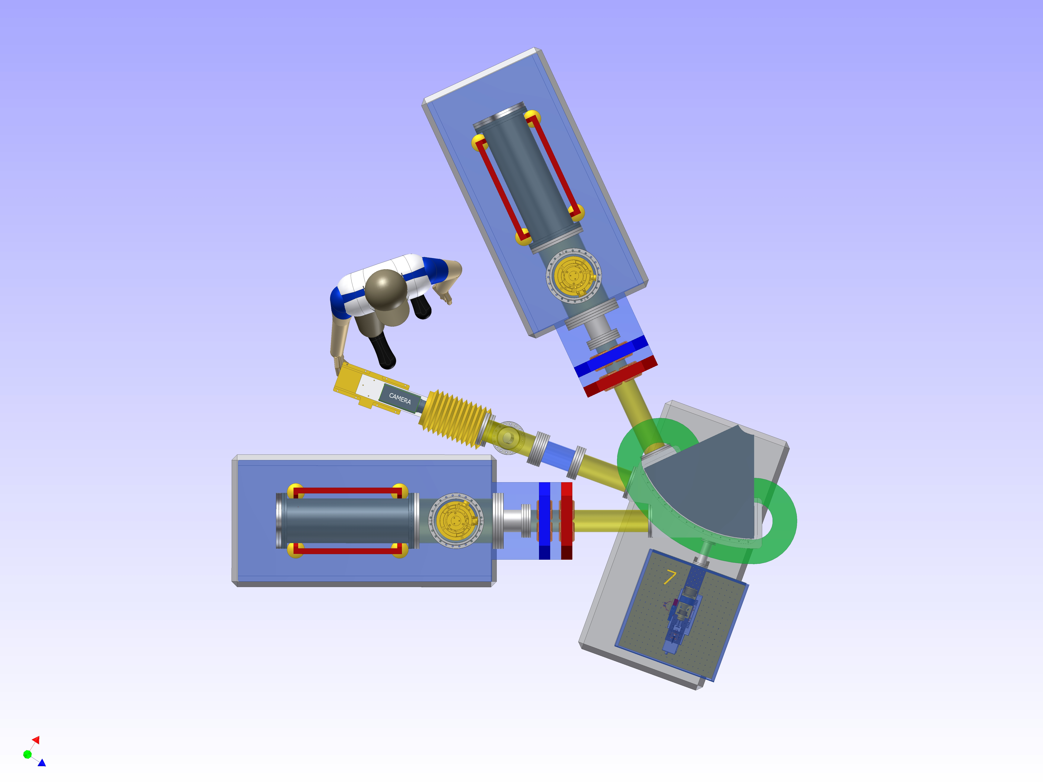
Laser Delivery
CAD model of the FETS diagnostic chamber.
Fiber laser transport for the photo-detachment emittance measurements at FETS
3rd mini-Workshop on H- Laser Stripping and Accelerator Applications
9

Slide 10
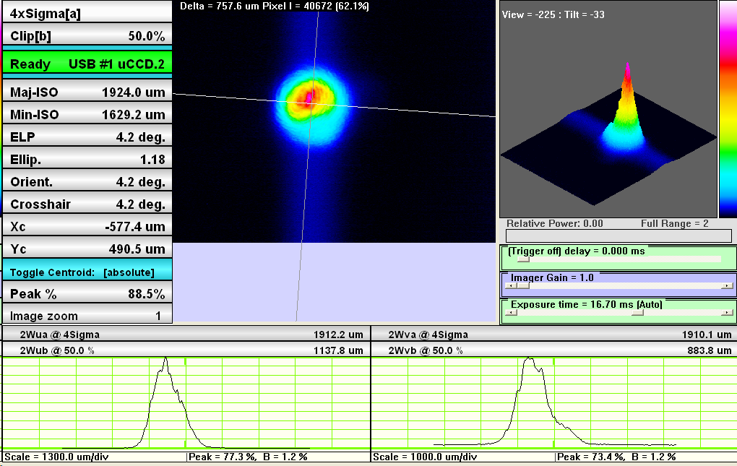
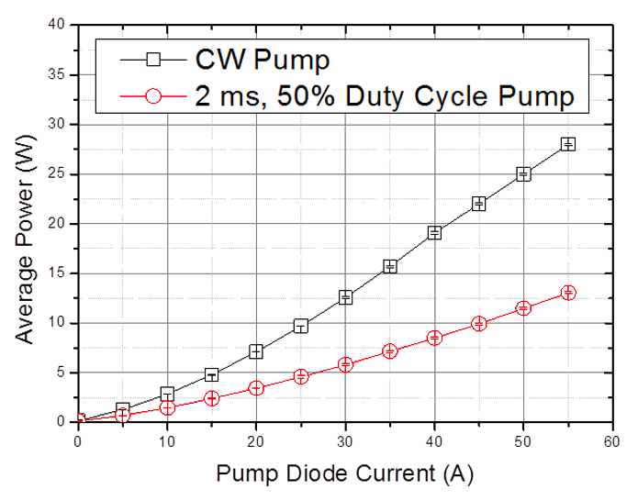
Pre-Transport Laser Measurements
Transverse Mode
M²_{x} = 1.81
M²_{y} = 1.61
Shows some astigmatism
Power Vs Current
Fiber laser transport for the photo-detachment emittance measurements at FETS
3rd mini-Workshop on H- Laser Stripping and Accelerator Applications
10

Slide 11
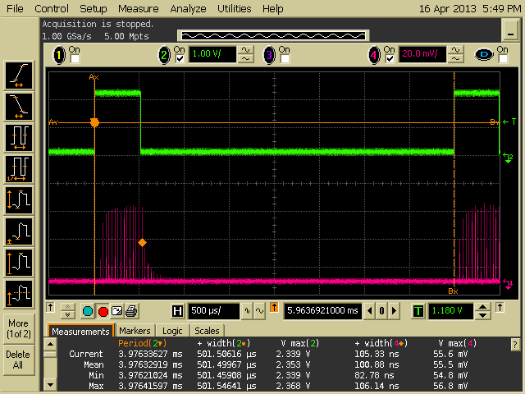
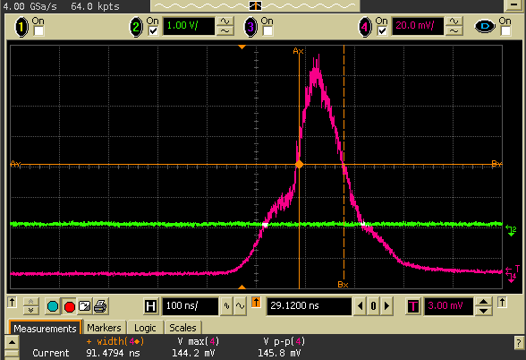
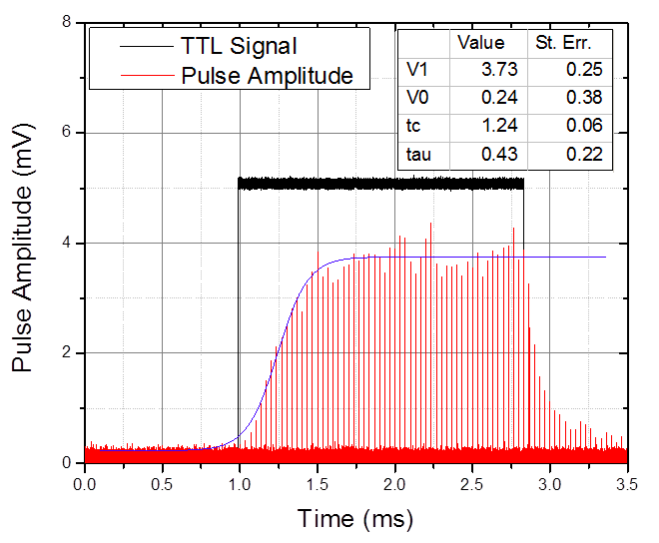
Pre-Transport Laser Measurements
2.5 ms Pulses @ 50 Hz Rep. Rate (12.5% duty cycle)
28 W within the macropulse, 3.5 W average power
Amplification Rise Time = 430 μs
Pulse Duration ~ 92 ns
Fiber laser transport for the photo-detachment emittance measurements at FETS
3rd mini-Workshop on H- Laser Stripping and Accelerator Applications
11

Slide 12


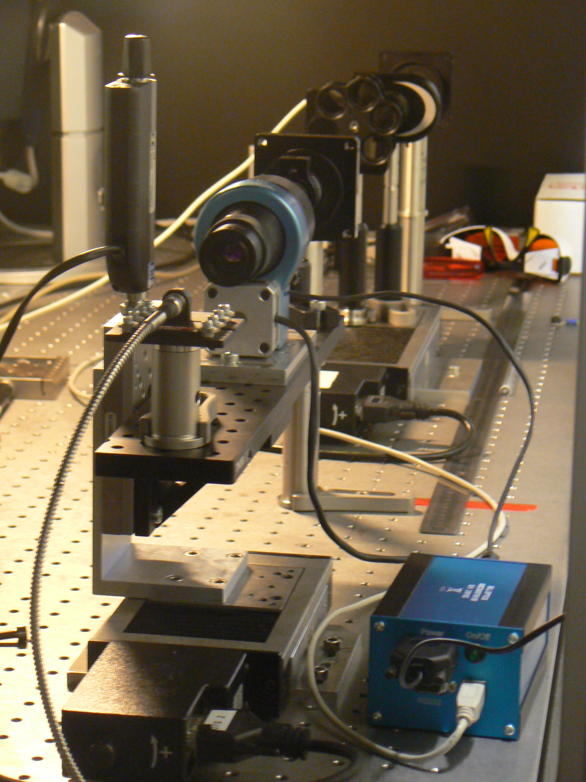
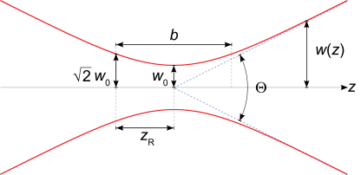
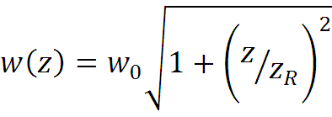

M² measurement Setup
Post Transport Measurements
Camera scanned through +/- 75 mm
to measure beam variation around focus.
Beam waist
Rayleigh range
Beam transverse size (@ 1/e²)
Fiber laser transport for the photo-detachment emittance measurements at FETS
3rd mini-Workshop on H- Laser Stripping and Accelerator Applications
12

Slide 13
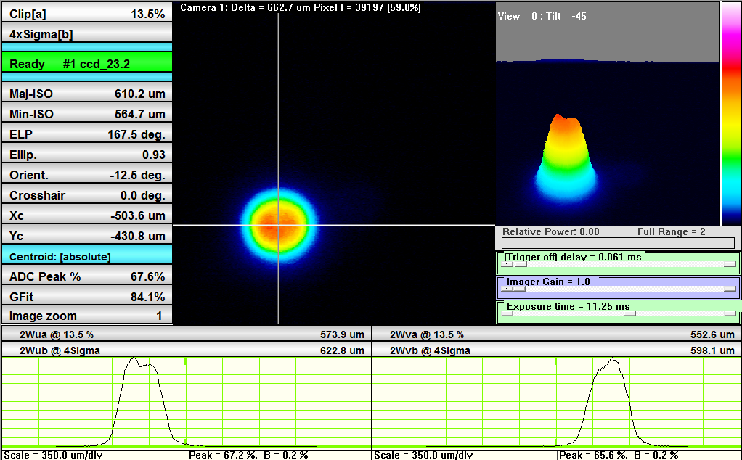
M² measurement: Z = -75mm
Post Transport Measurements
Fiber laser transport for the photo-detachment emittance measurements at FETS
3rd mini-Workshop on H- Laser Stripping and Accelerator Applications
13

Slide 14
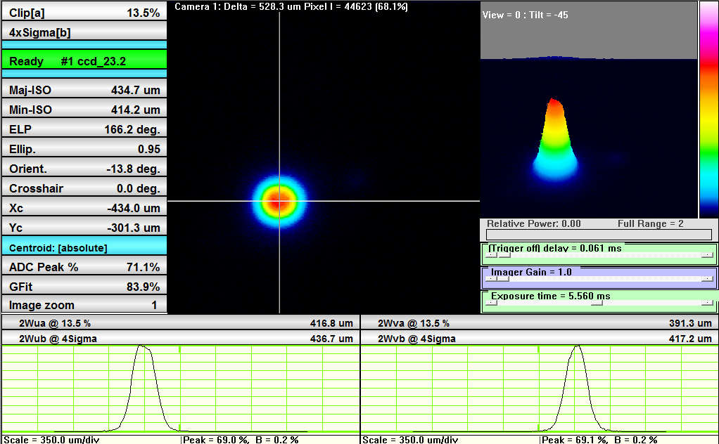
M² measurement: Z = -45mm
Post Transport Measurements
Fiber laser transport for the photo-detachment emittance measurements at FETS
3rd mini-Workshop on H- Laser Stripping and Accelerator Applications
14

Slide 15
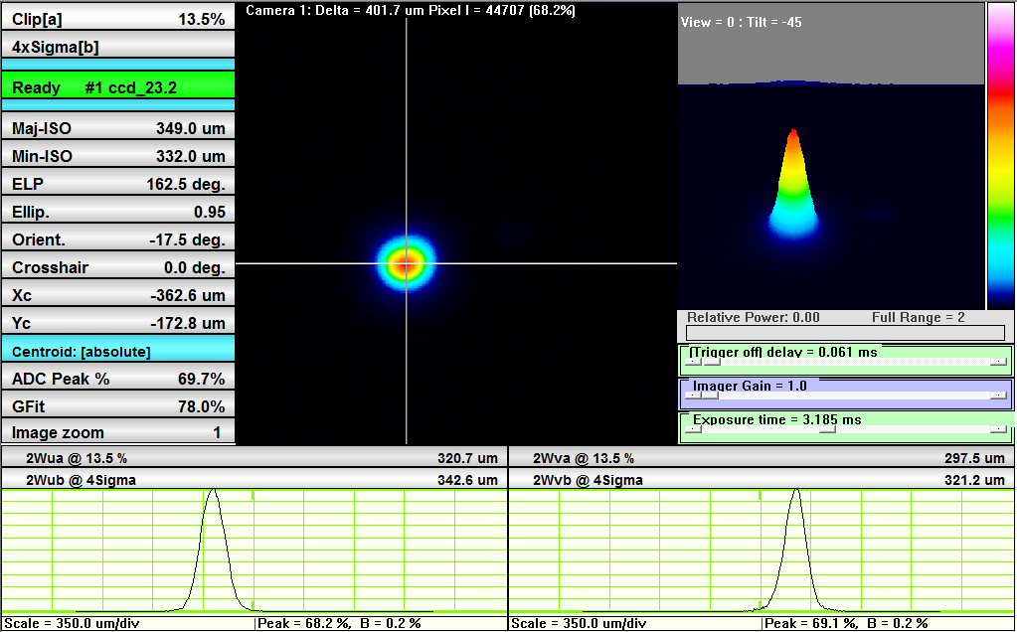
M² measurement: Z = -15mm
Post Transport Measurements
Fiber laser transport for the photo-detachment emittance measurements at FETS
3rd mini-Workshop on H- Laser Stripping and Accelerator Applications
15

Slide 16
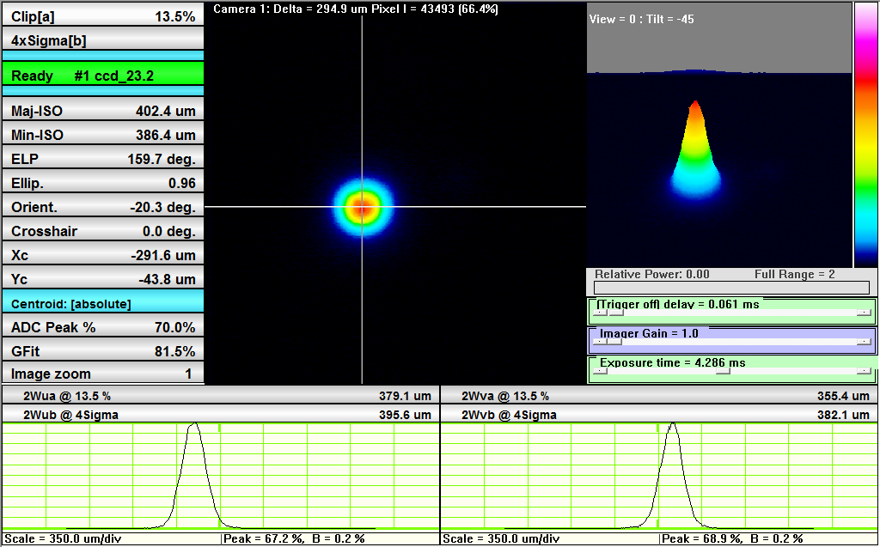
M² measurement: Z = +15mm
Post Transport Measurements
Fiber laser transport for the photo-detachment emittance measurements at FETS
3rd mini-Workshop on H- Laser Stripping and Accelerator Applications
16

Slide 17
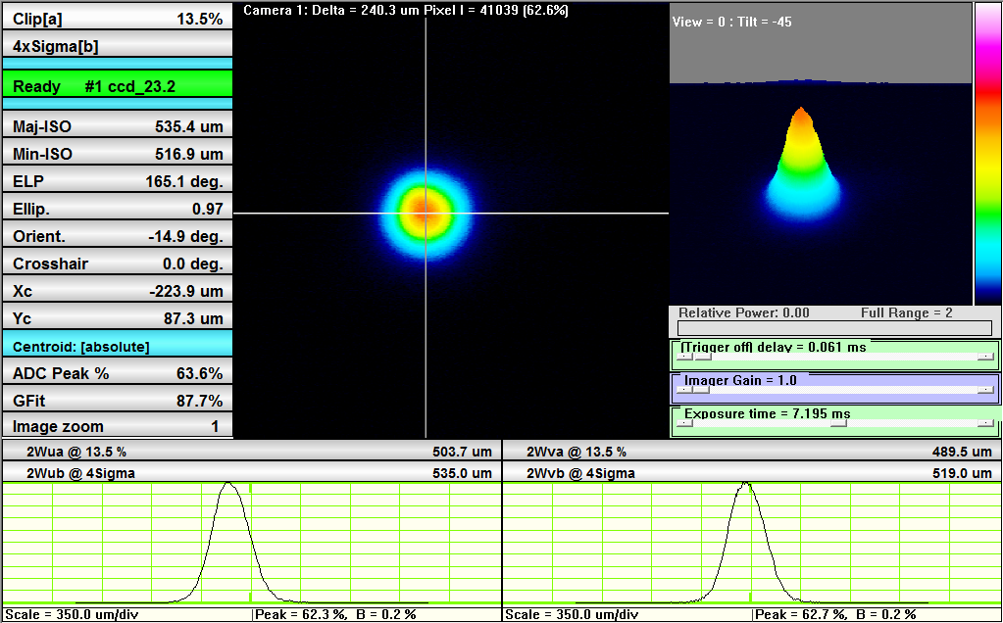
M² measurement: Z = +45mm
Post Transport Measurements
Fiber laser transport for the photo-detachment emittance measurements at FETS
3rd mini-Workshop on H- Laser Stripping and Accelerator Applications
17

Slide 18
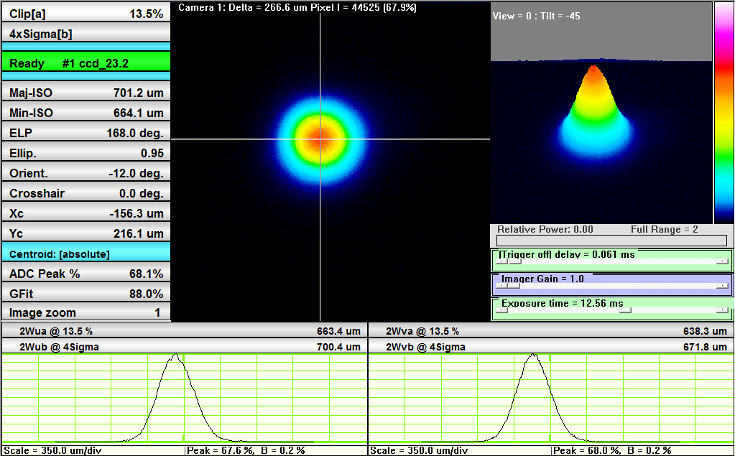
M² measurement: Z = +75mm
Post Transport Measurements
Fiber laser transport for the photo-detachment emittance measurements at FETS
3rd mini-Workshop on H- Laser Stripping and Accelerator Applications
18

Slide 19
Post Transport Measurements
M²_{x} = 1.756 +/- 0.012
w_{0x} (2σ) = 176 +/- 1.4 μm
M²_{y} = 1.756 +/- 0.018
w_{0y} (2σ) = 174 +/- 1.7 μm
  Transverse mode very near Gaussian at focus.
  M² better than expected from fiber specs.
  Fiber transport corrects the laser astigmatism and improves laser mode.
Fiber laser transport for the photo-detachment emittance measurements at FETS
3rd mini-Workshop on H- Laser Stripping and Accelerator Applications
19

Slide 20
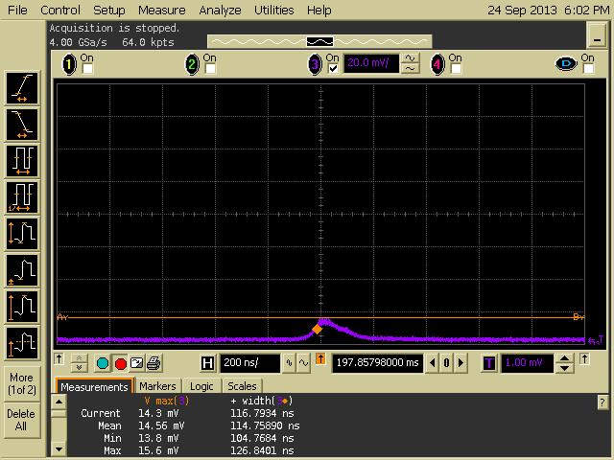
Longitudinal Pulse Profile
Post Transport Measurements
Measured with a 10 W laser (Max Peak Power = 2.5 kW) that we borrowed
from the laser company whilst our 30W system was under maintenance.
Peak Power = 0.62 kW
Fiber laser transport for the photo-detachment emittance measurements at FETS
3rd mini-Workshop on H- Laser Stripping and Accelerator Applications
20

Slide 21
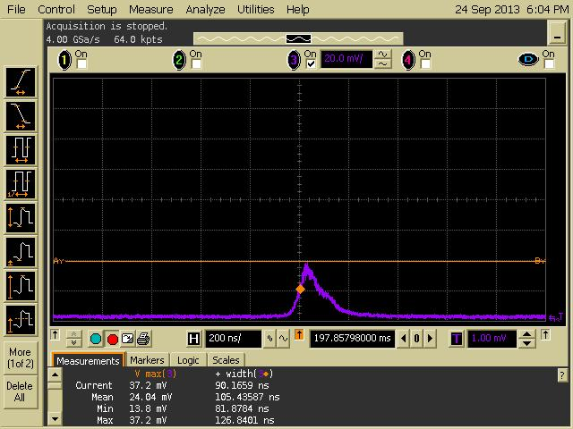
Longitudinal Pulse Profile
Post Transport Measurements
Measured with a 10 W laser (Max Peak Power = 2.5 kW) that we borrowed
from the laser company whilst our 30W system was under maintenance.
Peak Power = 1.25 kW
Fiber laser transport for the photo-detachment emittance measurements at FETS
3rd mini-Workshop on H- Laser Stripping and Accelerator Applications
21

Slide 22
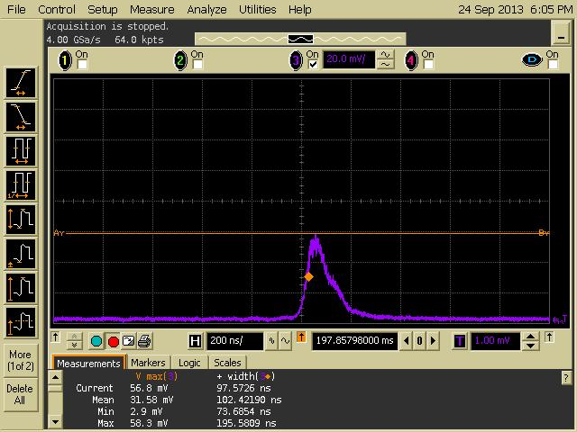
Longitudinal Pulse Profile
Post Transport Measurements
Measured with a 10 W laser (Max Peak Power = 2.5 kW) that we borrowed
from the laser company whilst our 30W system was under maintenance.
Peak Power = 1.87 kW
Fiber laser transport for the photo-detachment emittance measurements at FETS
3rd mini-Workshop on H- Laser Stripping and Accelerator Applications
22

Slide 23
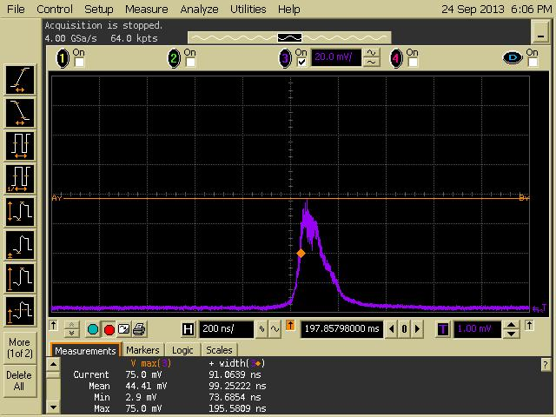
Longitudinal Pulse Profile
Post Transport Measurements
Measured with a 10 W laser (Max Peak Power = 2.5 kW) that we borrowed
from the laser company whilst our 30W system was under maintenance.
Peak Power = 2.50 kW
Fiber laser transport for the photo-detachment emittance measurements at FETS
3rd mini-Workshop on H- Laser Stripping and Accelerator Applications
23

Slide 24
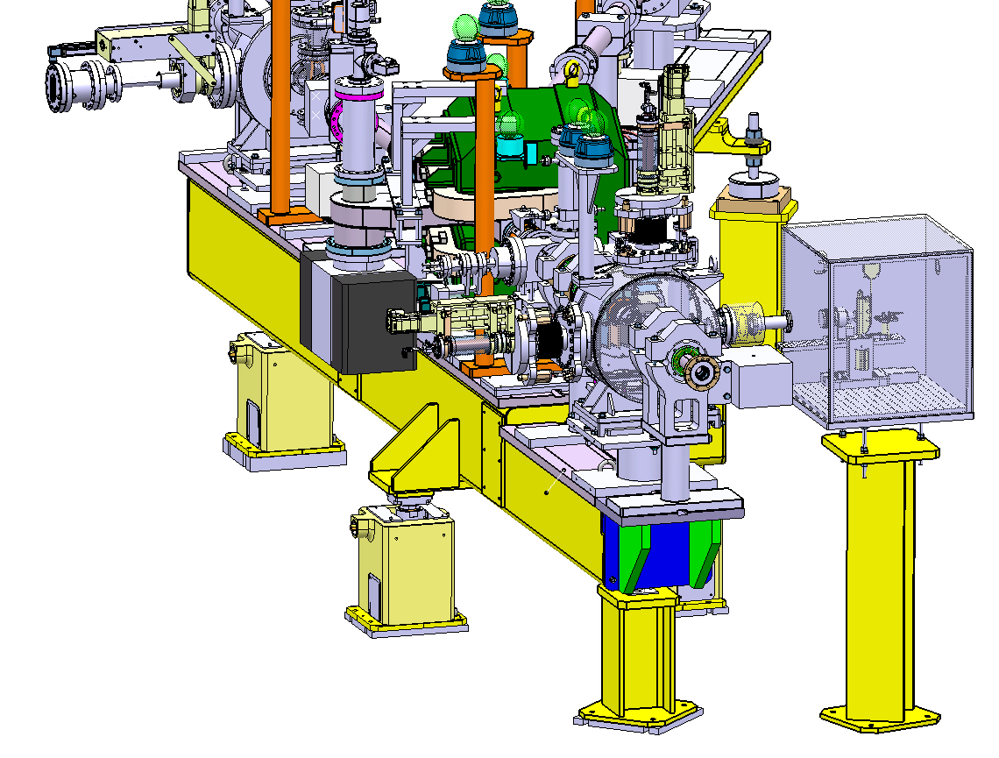
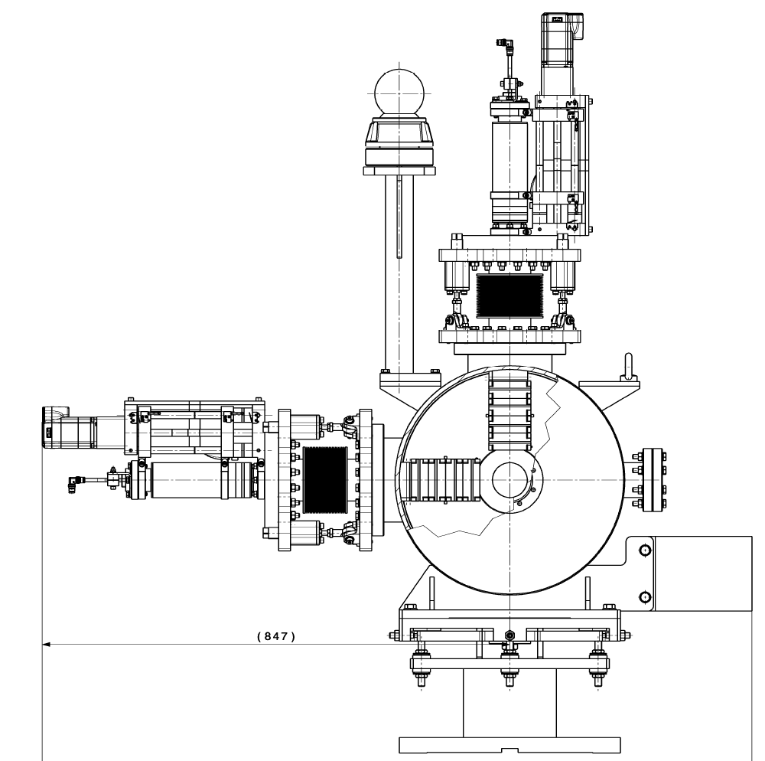
Tests At Linac4
Laser and fiber installation expected for the first half of November 2013
Diagnostics rack
PXI-System
Class 4 fiber laser
Coupling
Linear stage with 500 mm lens
tube
Please refer to Thomas Hofmann’s talk for details on the detection and simulations
Fiber laser transport for the photo-detachment emittance measurements at FETS
3rd mini-Workshop on H- Laser Stripping and Accelerator Applications
24

Slide 25
Summary and Outlook
ADVANTAGES of FIBER TRANSPORT
Extremely stable and virtually alignment-free
Excellent transverse mode quality
Close to zero position jitter
LIMITS of FIBER TRANSPORT
Peak power handling capabilities (limit on transport length?)
Coupling efficiency (70 – 80%)
Fiber laser transport for the photo-detachment emittance measurements at FETS
3rd mini-Workshop on H- Laser Stripping and Accelerator Applications
25

