Slide 1
Computational Needs for the Growing Field of Neural Engineering
Bryan Howell
PhD Candidate in Biomedical Engineering
CIEMAS 1133
August 27th, 2013

Slide 2
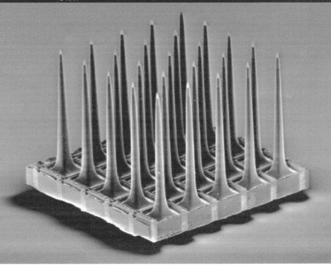
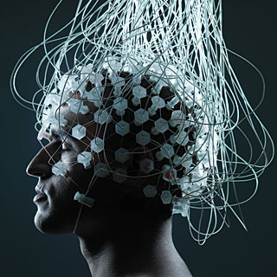
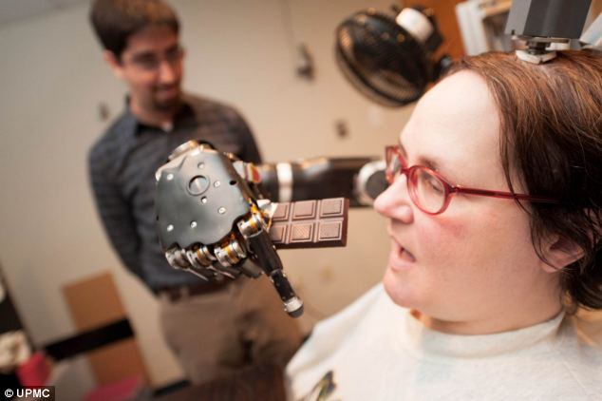
Central Nervous System (CNS) Electrical Recording Therapies
Recording electrodes extract information from the nervous system by measuring the electrical activity of neural elements (e.g. axons and neurons) residing in the tissue
Brain Computer Interface (BCI)
(electroencephalogram (EEG))
Brain Machine Interface (BMI)
(single unit recordings)
Utah Array
Branner and Normann, 1999
http://futurepredictions.com
http://emergingtruth.wordpress.com
Notes:
Neural engineers work with technology that interfaces between the organic and inorganic

Slide 3
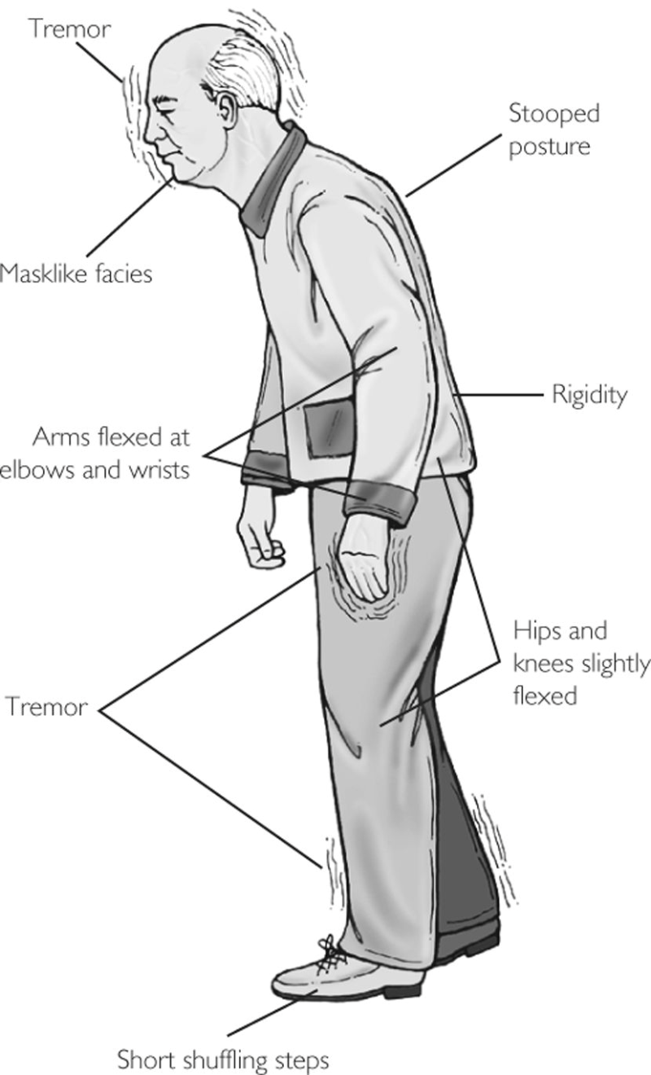
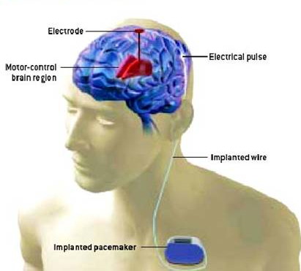

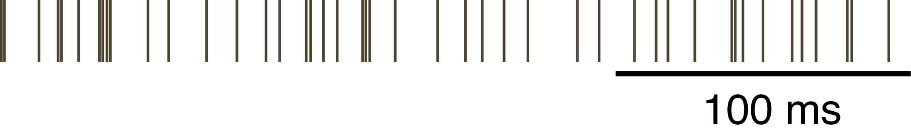
Deep Brain Stimulation is an Effective Therapy for Parkinson’s Disease
Symptoms
Tremor
Rigidity
Akinesia
Postural Instability
http://www.biotele.com/DBS.htm
Regular
Deep Brain Stimulation Patterns
Non-regular
http://medical-dictionary.thefreedictionary.com/_/viewer.aspx?path=mosbyCAM&name=500070-fx19.jpg
Notes:
Typically, DBS uses high frequency, “regular” patterns of stimulation. We think that the pattern of stimulation could be exploited to increase the efficacy or efficiency of stimulation.
What can we do for the people (a) for which drugs do not help anymore or (b) for which aren’t responsive to the drugs (e.g., Depression, etc…).

Slide 4
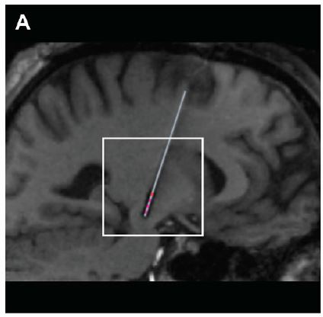
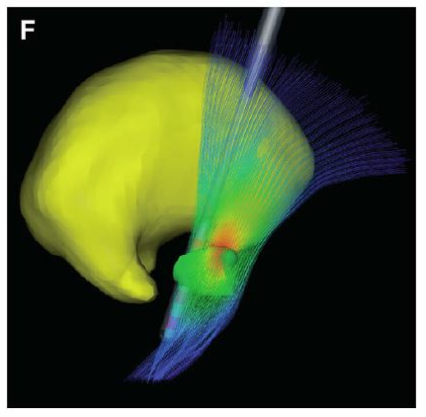
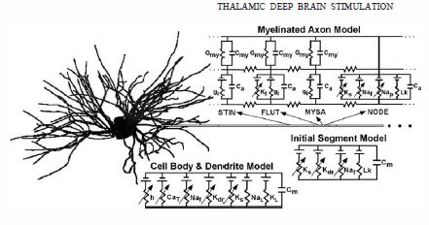
What is needed to model DBS?
Volume conductor model, model of stimulating electrode in brain tissue
  Finite Element Method (FEM)
Cable models of neural elements (e.g., neurons and axons)
  Finite Difference Method (FDM)
A LOT OF TIME!
Chaturvedi et al., 2010
McIntyre et al., 2004

Slide 5
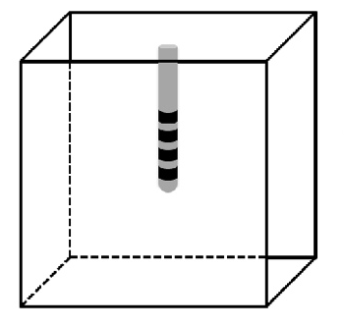

Closed-Loop Optimization Using a Numerical Algorithm
Solve Volume Conductor Model
Solve Time
5 s - 1 hr
2. Stimulate Neural Population
4. Update Geometry (Repeat)
Numerical
Algorithm
Solve Time
10 min – 1.5 hr (100 elements)
3. Evaluate Cost Function
Power Efficiency
Selectivity

Slide 6
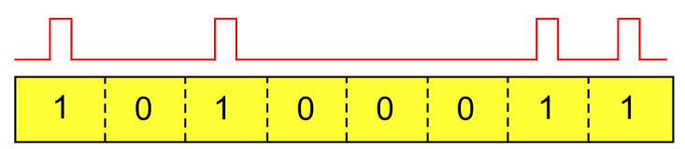
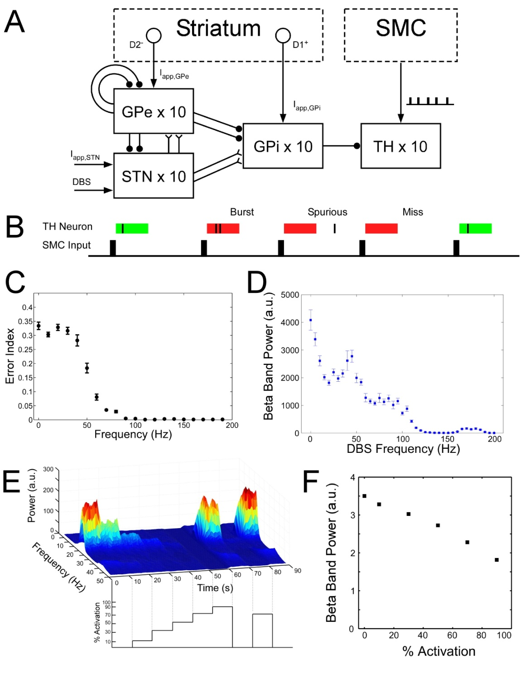
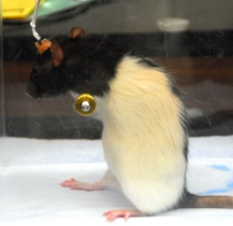
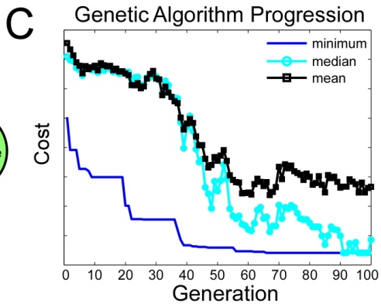
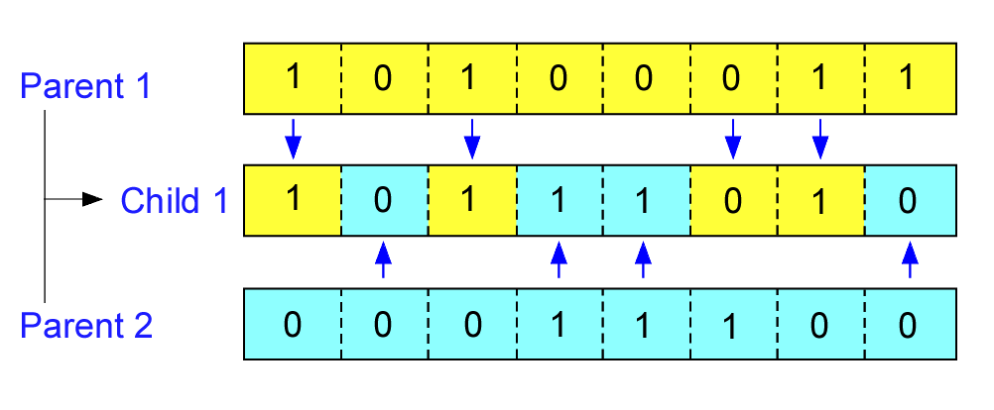
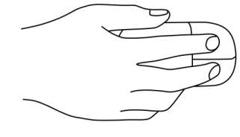
Genetic Algorithm Design Steps
1) Initialize
2) Evaluate
DBS Current
Binary Sequence
1 ms
Outcome Measure
3) Reproduce
4) Best Solution
Uniform Crossover

Slide 7
The Usefulness of (DSCR) Cluster
Efficiency analyses
  Brute force: 600 FEM simulations + 600 (FDM) NEURON simulations
Selectivity analyses
  Genetic algorithm (GA): 10 GA, 20 solutions/ generation, 150 generations
Notes:
DSCR = Duke Shared Cluster Resource

Slide 8
Impact of Cluster
Typical GA Simulation
  100 Generations
  200 Patterns Evaluated in Each Generation
  Approximately 10-30 min/job
    Depends on model complexity (relatively simple)
~140 days
~2 days

Slide 9
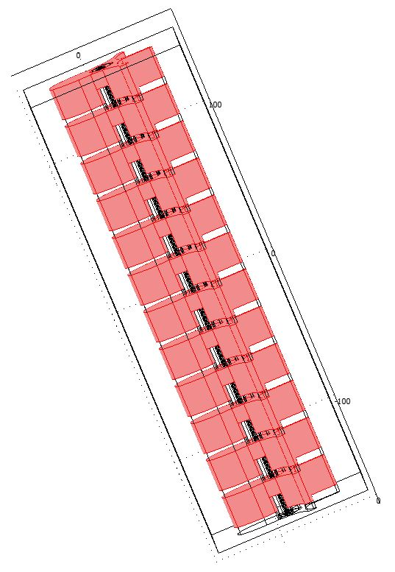
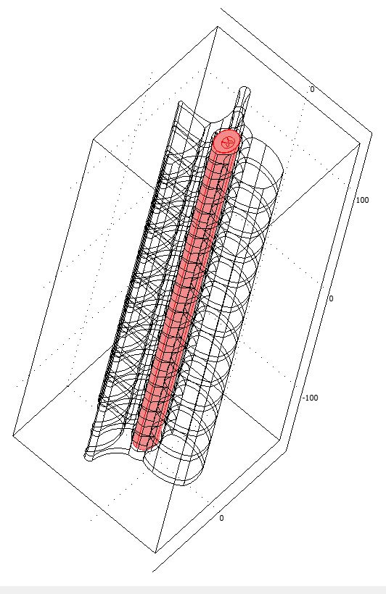
The Growing Need for Cluster Computing
The models our lab uses are relatively simplistic
More complex models require more computational resources
  Patient-specific models of brain, spine, and nerves
  Network models that include the phenomenon of adaption and plasticity
FEM Spine Model
~ 30 minutes
NEURON Simulations
~ 60 minutes
10 GA
20 solutions / generation
150 generations
Selectivity Analysis
~ 5 years

Slide 10

How to make computational neural engineering more…enjoyable
More available nodes (more jobs / unit time)
Better interface between cluster and local machine
  File transfer can be a rate limiting step!
FEM Spine Model
~ 30 minutes
NEURON Simulations
~ 60 minutes
Bug, oversight, error, network down, etc…
10 GA
20 solutions / generation
150 generations
Selectivity Analysis
~ 5 years
http://ilifejourney.wordpress.com

Slide 11
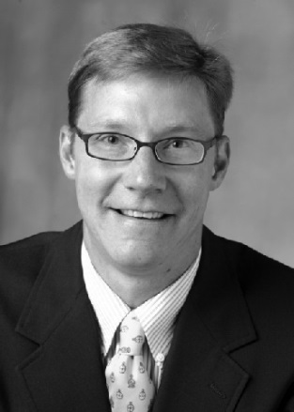
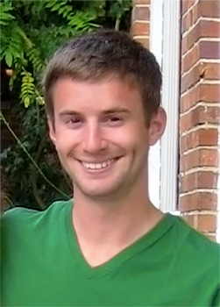
Aknowledgements
Dr. Warren M. Grill
  Advisor
David Brocker
  GA to optimize
  temporal patterns for DBS
NIH Grant R01-NS040894 and NIH F31-NS079105

Slide 12
Questions?
Bryan Howell
PhD Candidate in Biomedical Engineering
CIEMAS 1133
August 27th, 2013

Slide 13
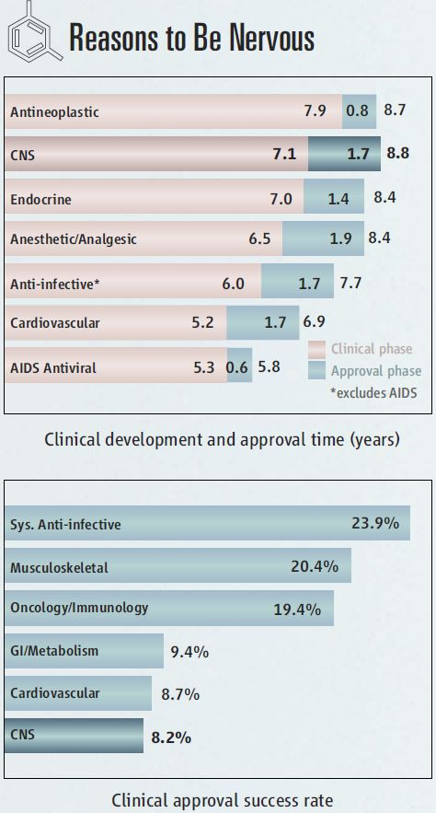
Why do we need neural engineering?
Future developments in pharmacological therapies for central nervous system (CNS) disorders doesn’t look promising
Regardless, pharmacological therapies do not work for everyone

Slide 14
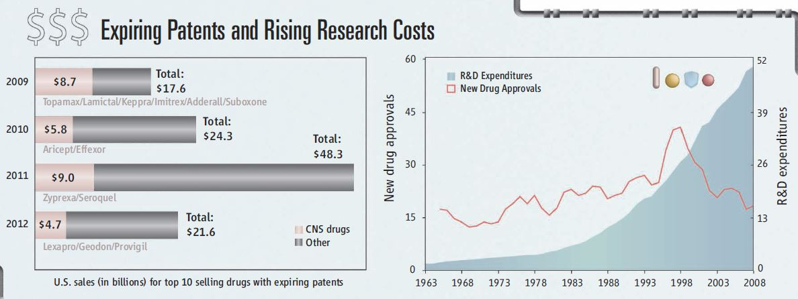
Why do we need neural engineering?
Future developments in pharmacological therapies for central nervous system (CNS) disorders doesn’t look promising
Regardless, pharmacological therapies do not work for everyone

Slide 15
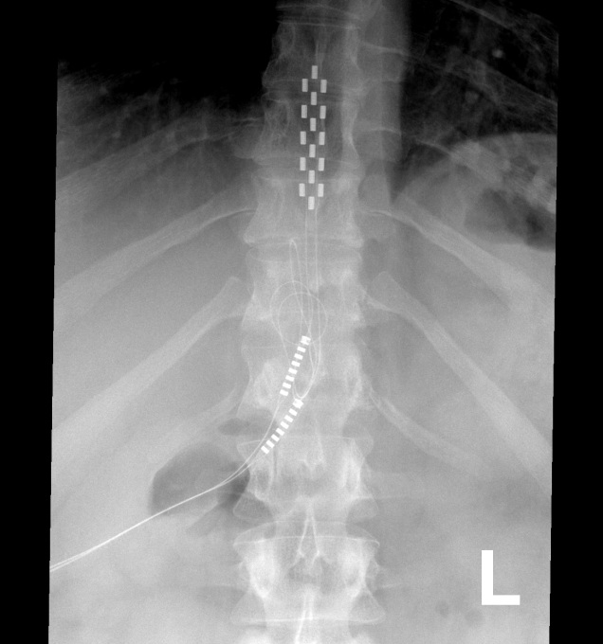
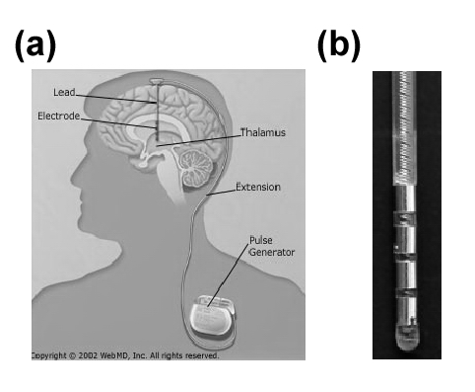
CNS Electrical Stimulation Therapies
Implanted electrodes deliver electrical pulses within specific regions of the CNS to modulate neural activity
Spinal Cord Stimulation (SCS)
Deep Brain Stimulation (DBS)
CNS Electrode
1.5 mm
www.soniclab.umn.edu
http://www..wikipedia.com
www.medicine.net.com

Slide 16
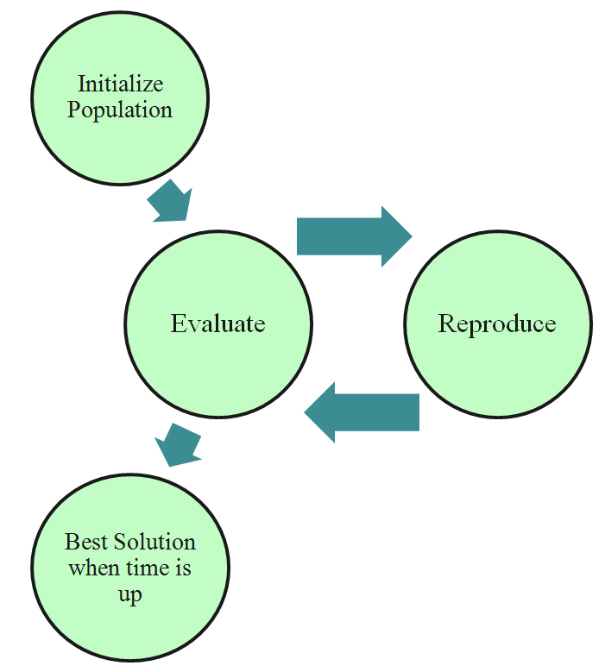
Design Methodology for Non-Regular Temporal Patterns of Stimulation
Couple
Complex Biophysical Model
of Relevant Brain Structures
Genetic Algorithm

