Slide 1
Intro to Storage Ring EDMs and proton EDM experiment
Yannis Semertzidis, BNL
Snowmass on the Mississippi
Minneapolis, July 31, 2013
Goal: 10⁻²⁹ecm and with an upgrade (stochastic cooling,…) can reach 10⁻³⁰ecm
R&D: 1) SQUID-based BPMs, 2) Polarimeter, 3) Precision tracking/SCT, 4) E-field tests
Staging: <10⁻²⁷ecm; <10⁻²⁹ecm; <10⁻³⁰ecm

Slide 2
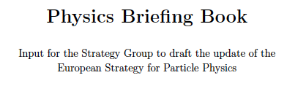

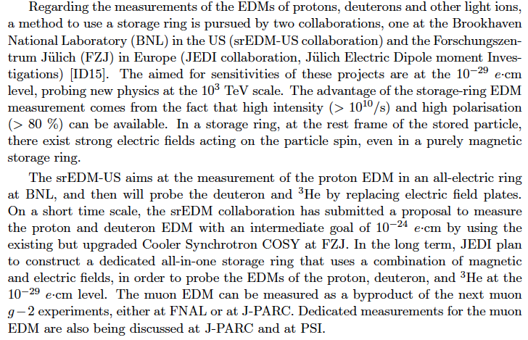

Slide 3
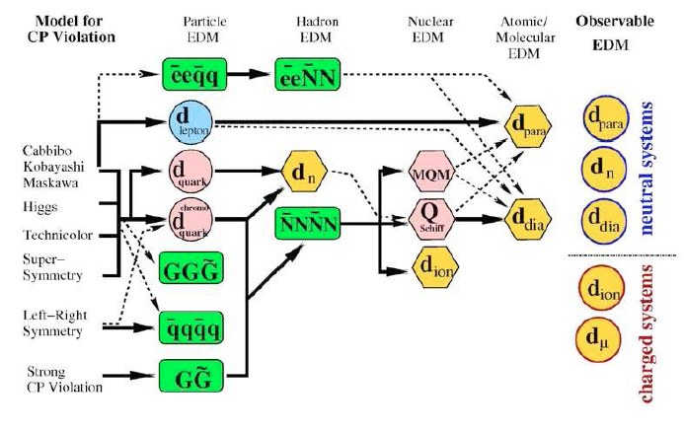

Slide 4
Colloquium questions related to EDM
IF19. If the LHC does not discover new physics, what can be learned from more precise measurements in the quark flavor sector? What level of precision is desirable for neutron/proton, electron and atomic EDM experiments in this scenario?
What if LHC does find New Physics?

Slide 5
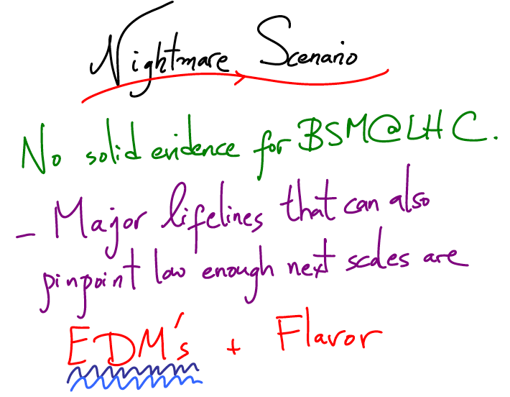
Physics of EDM of fundamental particles.
Proton EDM: >10³ TeV for SUSY-like New Physics
Nima Arkani-Hamed, Intensity
Frontier, Rockville, 2011

Slide 6
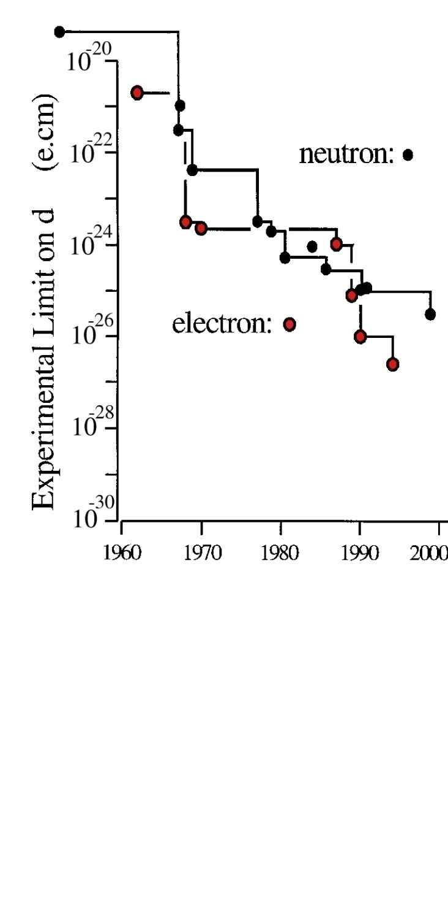
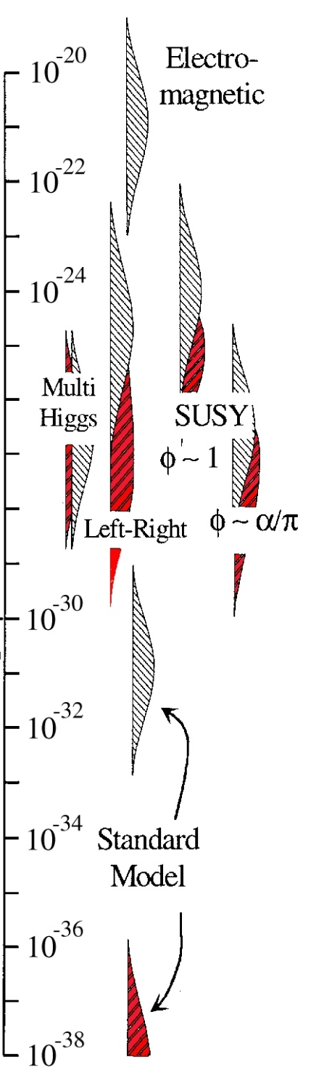
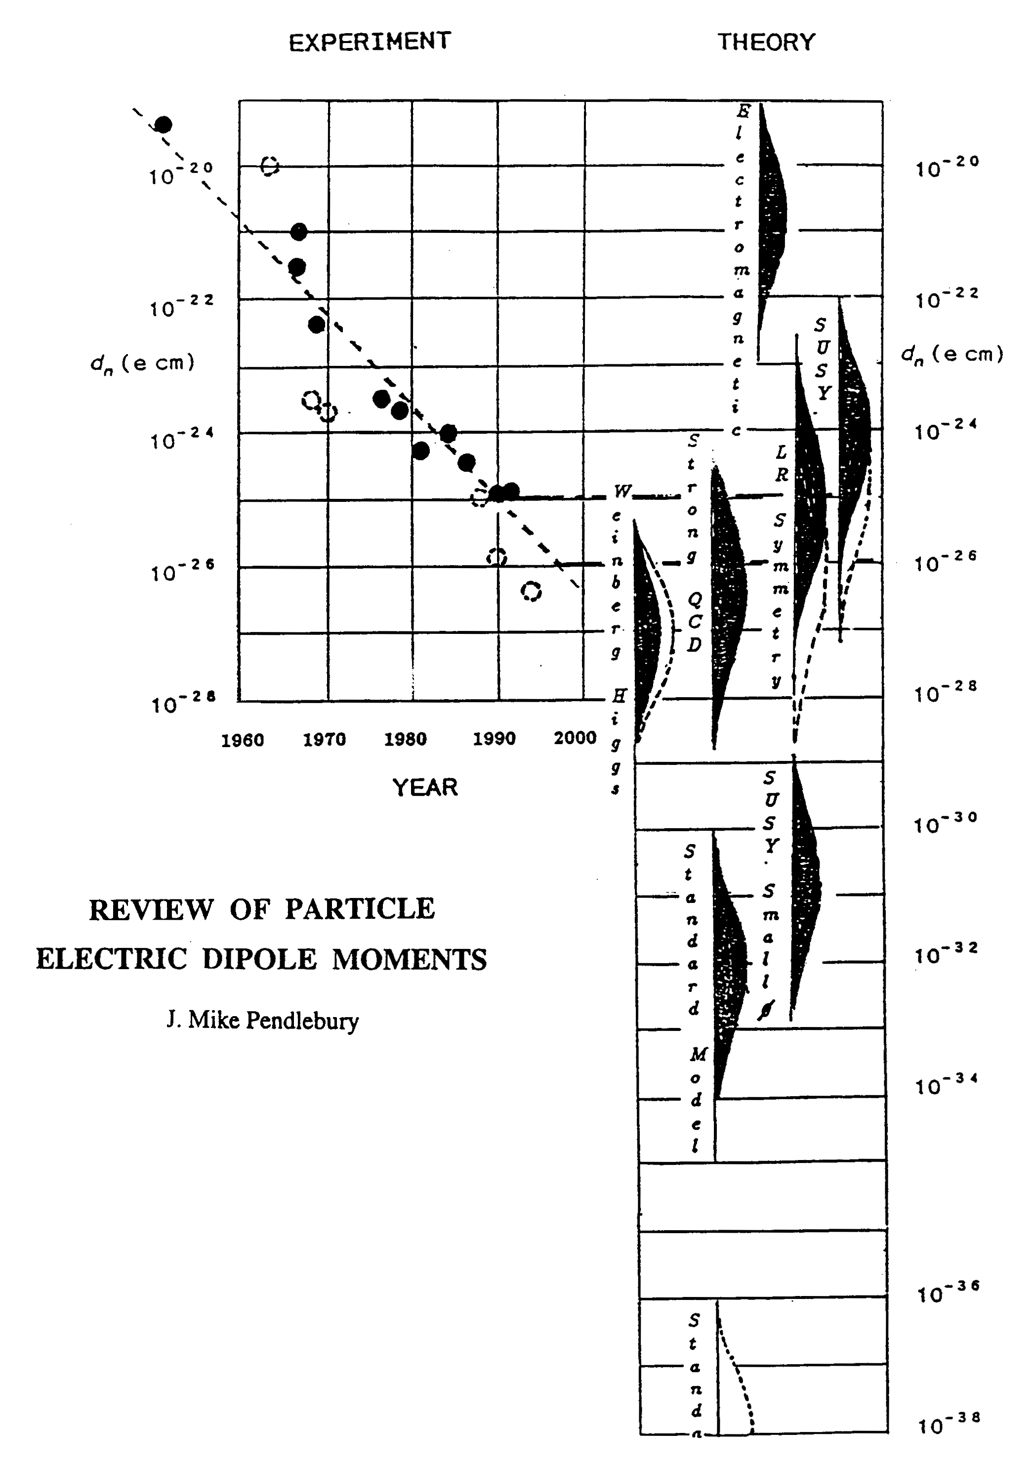
Sensitivity to Rule on Several New Models
Gray: Neutron
Red: Electron
If found it could explain
Baryogenesis
n current
e current
GUT SUSY
Electroweak
Baryogenises
n target
p, d target
e target
Upgrade?
Statistics limited
pEDM experiment
complementary to LHC
e-cm
J.M.Pendlebury and E.A. Hinds, NIMA 440 (2000) 471

Slide 7



EDMs of different systems
Theta_QCD:
Super-Symmetry (SUSY) model predictions:
Measure all three: proton, deuteron and neutron EDMs to determine CPV source

Slide 8
Physics reach of magic pEDM (Marciano)
Sensitivity to new contact interaction: 3000 TeV
Sensitivity to SUSY-type new Physics:
The proton EDM at 10⁻²⁹e∙cm has a reach of >300TeV or, if new physics exists at the LHC scale, δ<10⁻⁷-10⁻⁶ rad CP-violating phase; an unprecedented sensitivity level.
The deuteron EDM sensitivity is similar.
Notes:
8

Slide 9
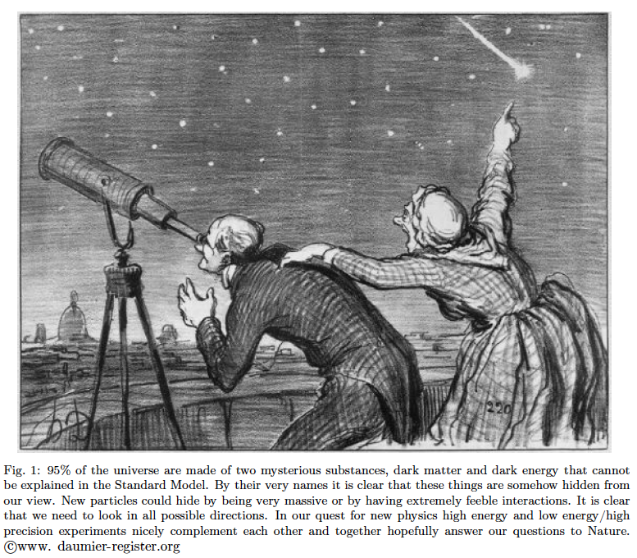
A balanced approach is best…!

Slide 10
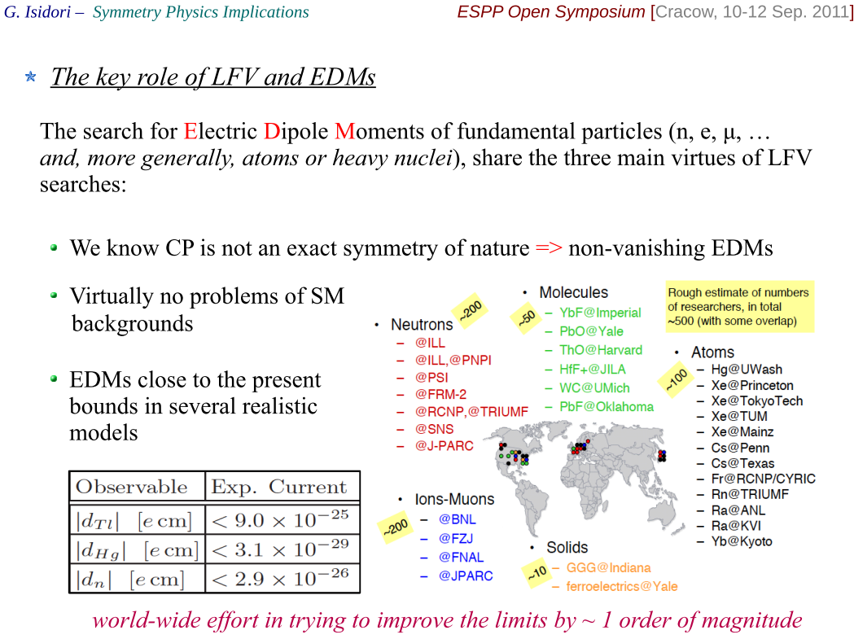
Physics: Potential of EDMs
G. Isidori at ESPP Open Symposium, Cracow (Sept. 2012)

Slide 11
For particles with intrinsic angular momentum (spin S):
In a magnetic field (B), there is a torque:

Slide 12
For particles with an EDM along the spin:
In an Electric field (E), there is a torque:

Slide 13
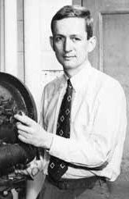
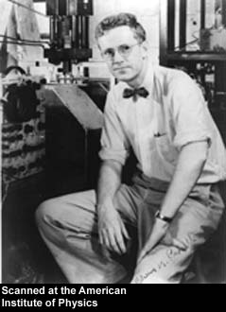
Purcell and Ramsey:
“The question of the possible existence of an electric dipole moment of a nucleus or of an elementary particle…becomes a purely experimental matter”
Phys. Rev. 78 (1950)

Slide 14
A charged particle between Electric Field plates would be lost right away…
+
So work on the EDM
starts with the neutron
and neutral atoms (e⁻)
-
+
Notes:
Yannis Semertzidis, BNL. ICHEP02, 31 July 2002
14

Slide 15
Measuring an EDM of Neutral Particles
H = -(d E + μ B) ● I/I
B
E
B
E
m_{I} = 1/2
µ
µ
ω₁
ω₂
d
d
m_{I} = -1/2
d = 10⁻²⁸ e cm
E = 200 kV/cm
⇒
δω = 10⁻⁷ rad/s →
~1 turn/year

Slide 16
EDM Experimental Issues
Statistics (~1-10 n/cm³)
Magnetic fields can mimic EDM signal (need to measure B-fields acting on the particles)
Geometrical phase: spin rotations in three dimensions don’t commute.

Slide 17
Charged particles in a Storage Ring!
Position is determined by the fields
Notes:
17

Slide 18
Clock-wise (CW) & Counter-Clock-wise Storage
Electric storage ring
Any radial magnetic field sensed by the
stored particles will also cause their
vertical splitting.
Notes:
18

Slide 19
Comparing Methods
Neutrons in a box have an advantage: no electric force, small volumes
Protons in a storage ring:
Primary source, revolution in statistics
Position displacement sensitive to background magnetic fields
Geometrical phase: EDM-like signal depends on azimuthal location; position displacement

Slide 20
Short History of EDM
1950’s neutron EDM experiment started to search for parity violation (Ramsey and Purcell).
After P-violation → EDMs require both P,T-Violation
1960’s EDM searches in atomic systems
1970’s Indirect Storage Ring EDM method from the CERN muon g-2 exp.
1980’s Theory studies on systems (molecules) w/ large enhancement factors
1990’s First exp. attempts w/ molecules. Dedicated Storage Ring EDM method developed for muons.
2000’s Proposal for sensitive dEDM exp. developed.
2010’s Proposal for sensitive pEDM exp. developed.

Slide 21
We have developed the Storage Ring EDM Method:
(http://www.bnl.gov/edm)
Muon EDM sensitivity 10⁻²⁴ecm
Proton EDM sensitivity 10⁻²⁹ecm→10⁻³⁰ecm
Deuteron EDM sensitivity 10⁻²⁹ecm
Under develop.: eEDM pre-cursor exp.: 10⁻²⁷ ?
³He (~neutron equivalent), …p, d, n EDMs are needed to decipher the CP-violation source…

Slide 22
Physics strength comparison (Marciano)
System | Current limit [e⋅cm] | Future goal | Neutron equivalent
Neutron | <1.6×10⁻²⁶ | ~10⁻²⁸ | 10⁻²⁸
¹⁹⁹Hg atom | <3×10⁻²⁹ |  | 10⁻²⁵-10⁻²⁶
¹²⁹Xe atom | <6×10⁻²⁷ | ~10⁻³⁰-10⁻³³ | 10⁻²⁶-10⁻²⁹
Deuteron nucleus |  | ~10⁻²⁹ | 3×10⁻²⁹- 5×10⁻³¹
Proton nucleus | <7×10⁻²⁵ | ~10⁻²⁹-10⁻³⁰ | 10⁻²⁹-10⁻³⁰
Notes:
22

Slide 23
Storage Ring Proton EDM Method
Precision physics in storage rings

Slide 24
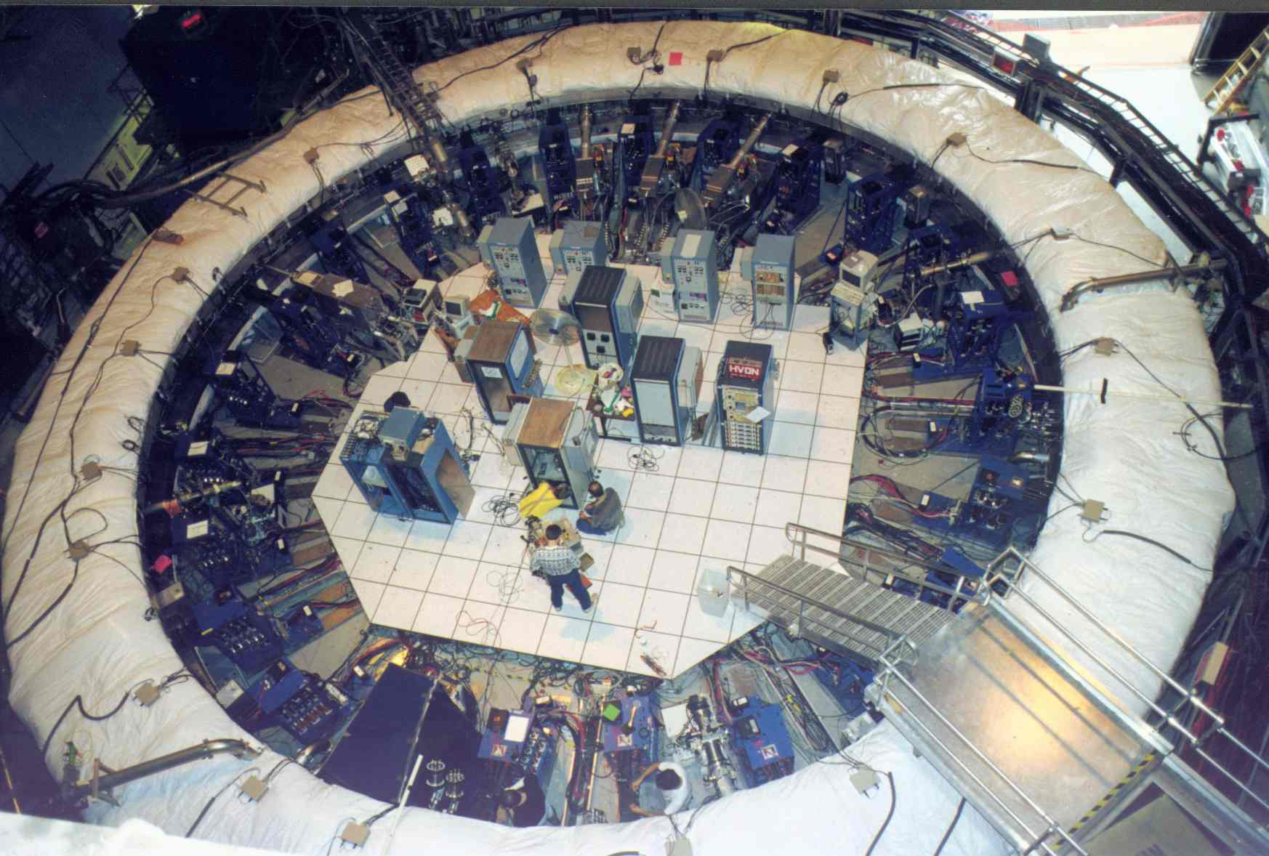
Muon g-2: Precision physics in a Storage Ring
Statistics limited… to improve sensitivity by a factor of 4 at Fermilab

Slide 25
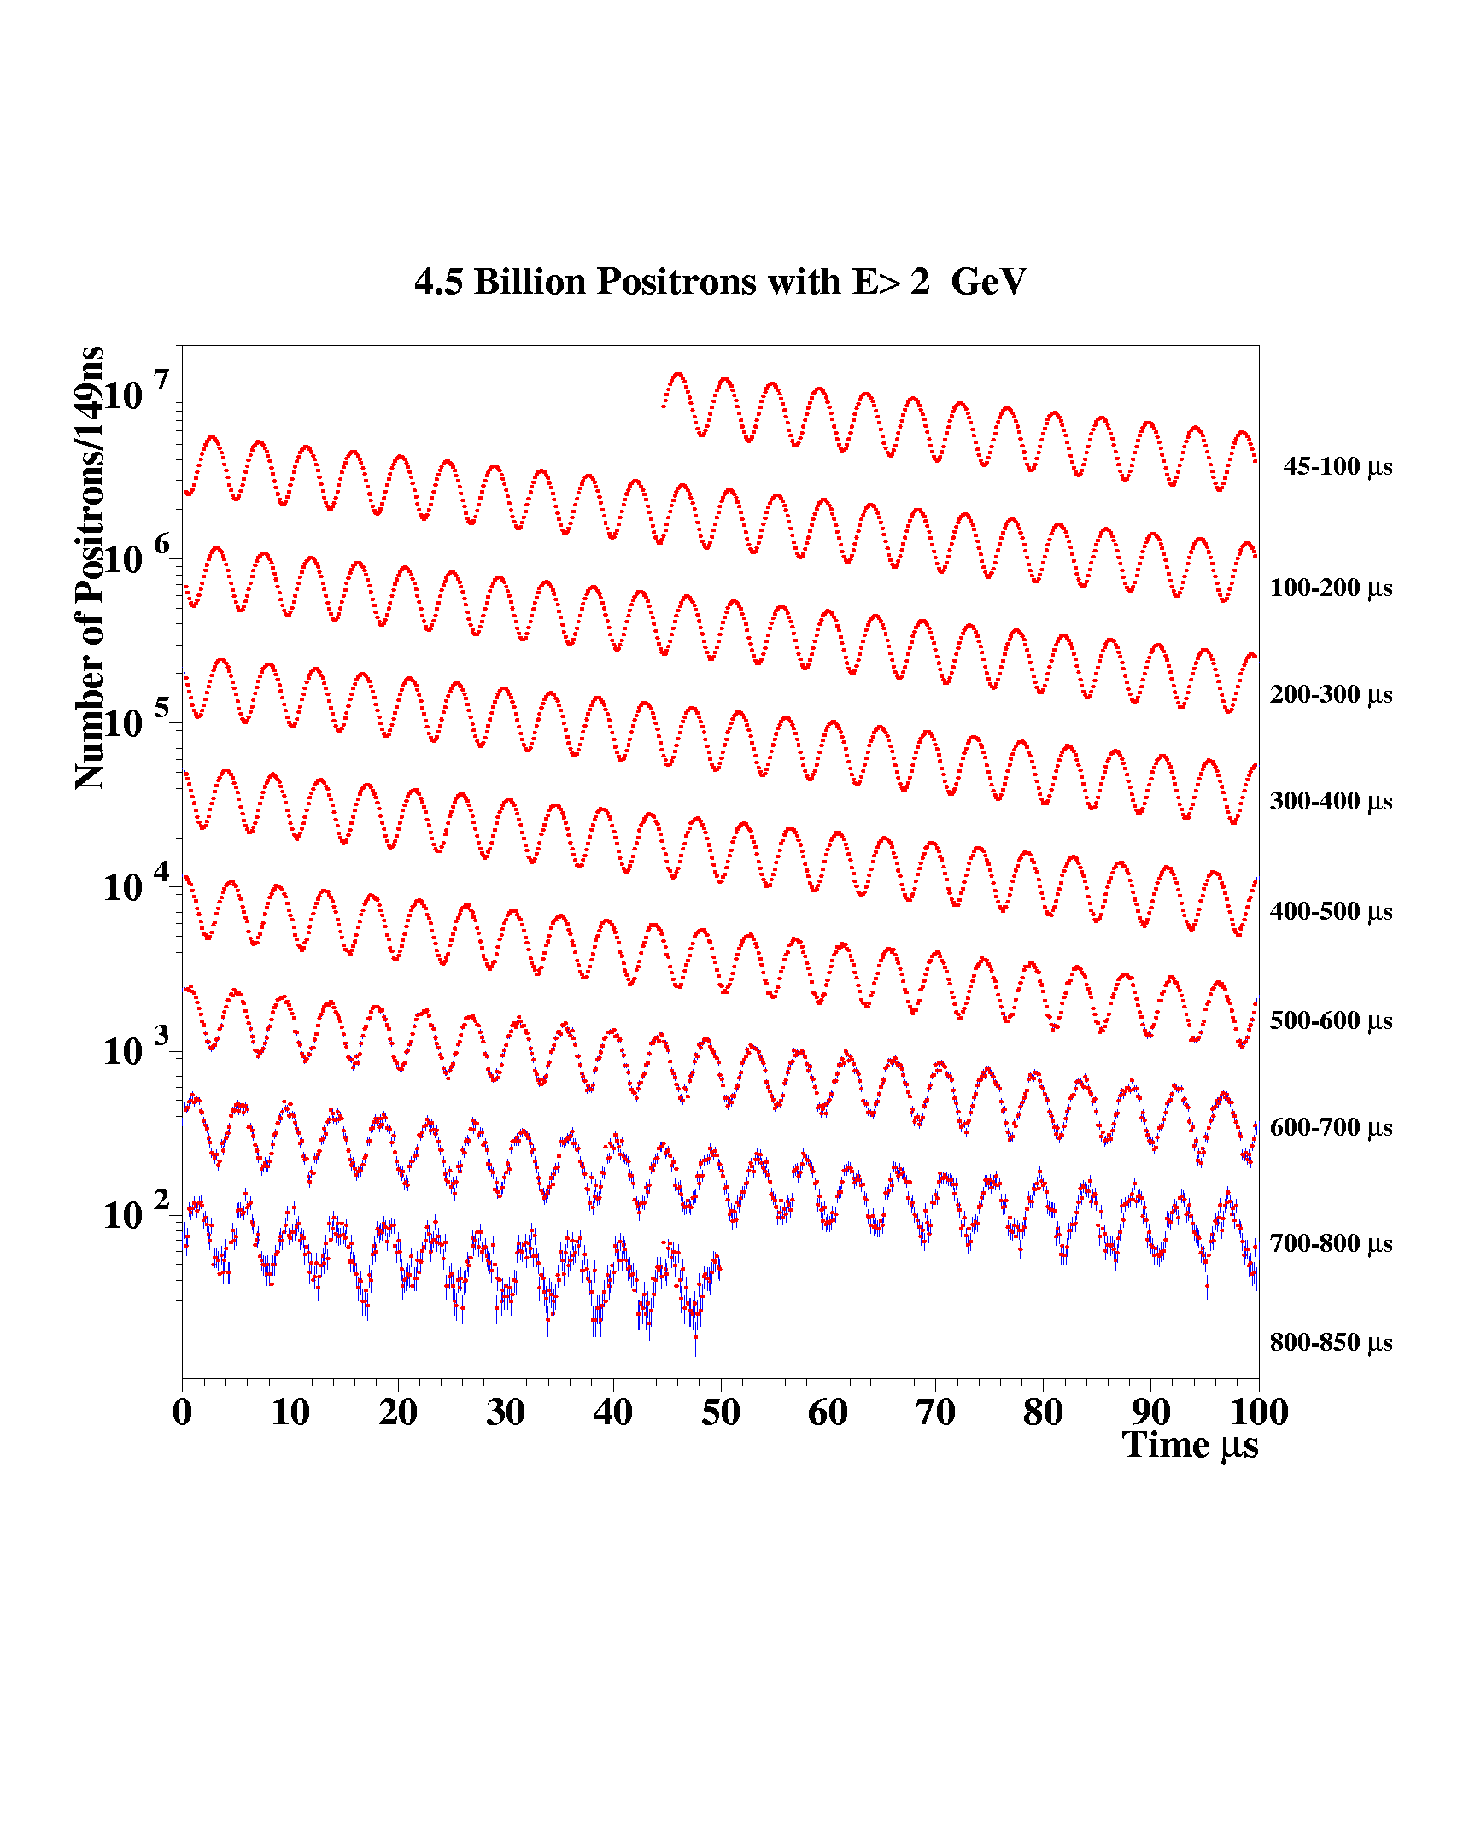
Muon g-2: 4 Billion e⁺ with E>2GeV
Sub-ppm accuracy,
statistics limited

Slide 26
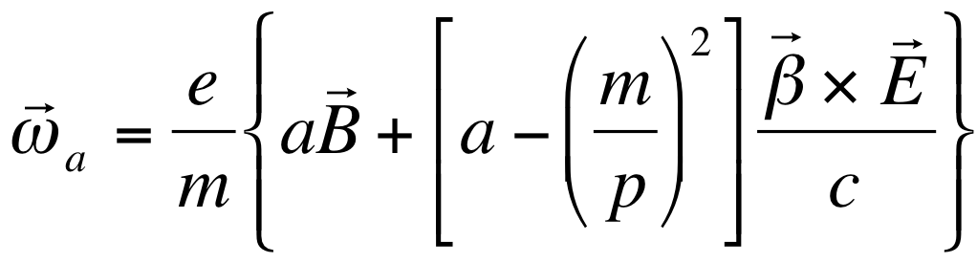
Breakthrough concept: Freezing the horizontal spin precession due to E-field
Muon g-2 focusing is electric: The spin precession due to E-field is zero at “magic” momentum (3.1GeV/c for muons, 0.7 GeV/c for protons,…)
The “magic” momentum concept was used in the muon g-2 experiments at CERN, BNL, and …now at FNAL.

Slide 27
Indirect Muon EDM limit from the g-2 Experiment
z
B
y
s
β
x
Ron McNabb’s Thesis 2003:

Slide 28
The proton EDM uses an ALL-ELECTRIC ring: spin is aligned with the momentum vector
At the magic momentum
Momentum
vector
E
Spin vector
the spin and momentum
vectors precess at same
rate in an E-field. Similar
to muon g-2 method.
E
E
E
Yannis Semertzidis, BNL
Notes:
Yannis Semertzidis, BNL
28

Slide 29
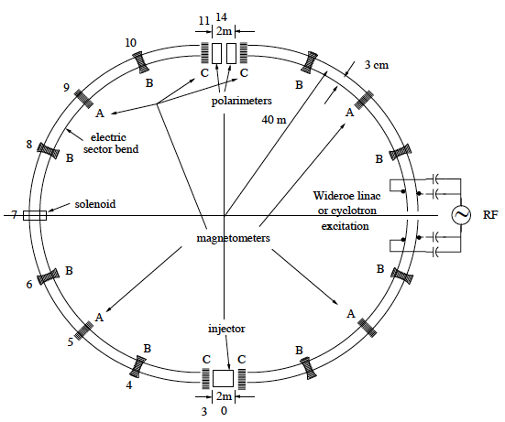
proton EDM proposal to DOE NP: November 2011
Lattice: R. Talman
Weak vertical focusing to optimize
SCT and BPM operation
B: quadrupoles

Slide 30
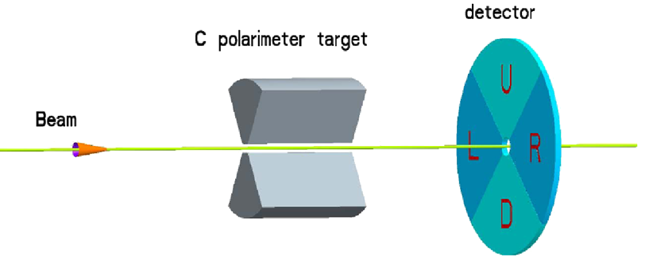
pEDM polarimeter principle (placed in a straight section of the ring): probing the proton spin components as a function of storage time
“defining aperture”
polarimeter target
Micro-Megas TPC detector
and/or MRPC
Extraction: lowering the vertical focusing strength
carries EDM signal
increases slowly with time
carries in-plane (g-2) precession signal

Slide 31
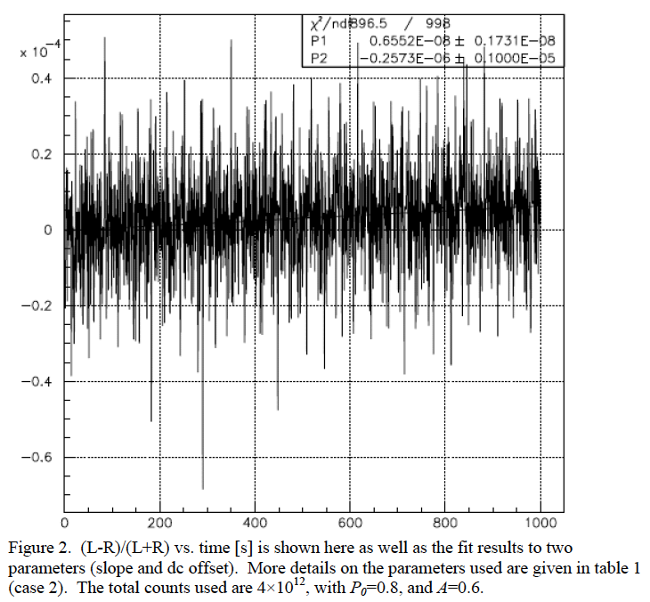


The EDM signal: early to late change
Comparing the (left-right)/(left+right) counts vs. time we monitor the vertical component of spin
M.C. data
Signal is max
when ω_{a}~0
(L-R)/(L+R) vs. Time [s]

Slide 32
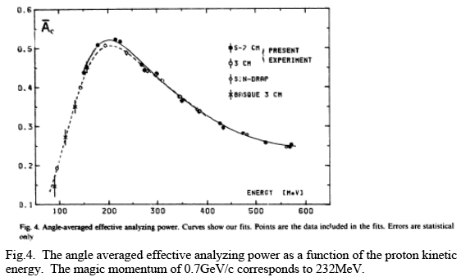
The polarimeter analyzing power at P_{magic} is very large
Analyzing power can be further optimized

Slide 33
Proton beam parameters
Counter-Rot. P-beams | 0.7 GeV/c, 233 MeV | ≥80% polariz.; | ~4×10¹⁰ protons/store
<200ns base length | Repetition period: 20 minutes | Beam energy: ~1J | Average beam power: ~1mW
Beam emittance: 95%, norm. | Horizontal: 2 mm-mrad | Vertical: 6 mm-mrad | (dp/p)_{rms}~ 2×10⁻⁴
CW & CCW injections. One RF-cavity.
Beam parameters can be presently available at BNL;
need to duplicate at FNAL (pol. protons, etc.)
Notes:
33

Slide 34
The current status
Have developed R&D plans for
1) BPM magnetometers (need to test in rings)
2) SCT tests at COSY (benchmark estimations)
3) E-field development (first phase R&D done)
4) Polarimeter prototype (first phase R&D done)
5) Simulation/tracking (great progress)
We had two successful technical reviews: Dec 2009, and March 2011.
Proposal to DOE NP for proton EDM at BNL: November 2011; LOI to FNAL: October 2012

Slide 35
International srEDM Network
Common R&D
srEDM Coll. pEDM
Proposal to DOE NP
EOI to FNAL
SQUID-based BPMs tests at RHIC
Precision simulation
Systematic error studies
E-field tests
…
JEDI (COSY/Jülich)
Ring design
EDM at COSY
Polarimeter tests
Spin Coherence Time tests
Precision simulation
Cooling
E-field tests
…

Slide 36
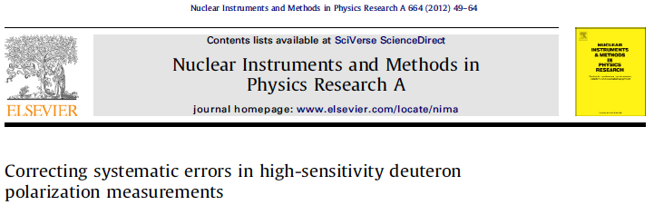
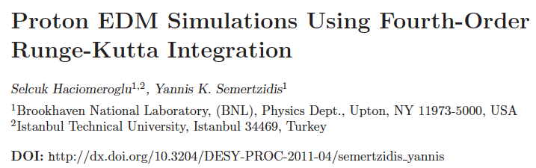
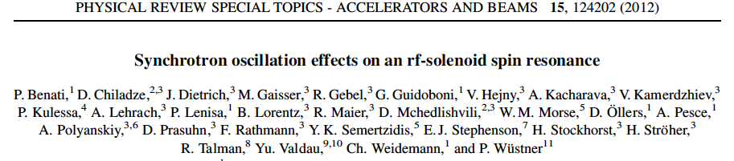
R&D progress

Slide 37
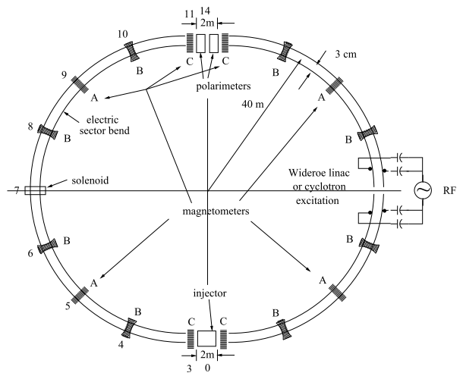
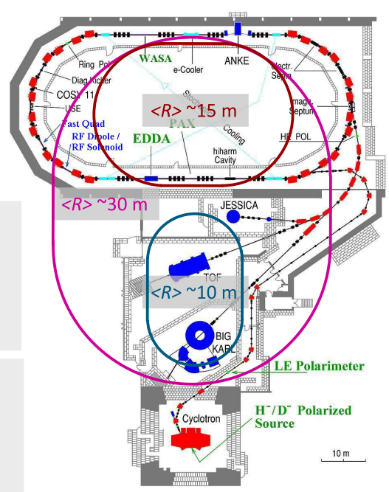
Two storage ring projects being pursued
USA: protons
all-electric machine
Jülich, focus on deuterons,
or a combined machine
CW and CCW stored beams
(from R. Talman)
(from A. Lehrach)

Slide 38
Experiment Parameters (proposal)
Proton magic momentum: 0.7 GeV/c (233 MeV kinetic)
E = 10.5 MV/m for 3 cm plate separation
R = 40 m; plus straight sections
Weak vertical focusing: vertical tune 0.2→ 0.1
Stored particles: ~10¹⁰ per 10³s, 10⁴ injections

Slide 39
What makes the pEDM experiment
Magic momentum (MM): high intensity charged beam in an all-electric storage ring
High analyzing power: A>50% at the MM
Weak vertical focusing in an all-electric ring: SCT allows for 10³s beneficial storage; prospects for much longer SCT with mixing (cooling and heating, smaller dp/p)
The beam vertical position tells the average radial B-field; the main systematic error source
Geometrical-phase specs: 0.1mm

Slide 40
1. SQUID-Based BPM
The beam separation depends on the strength of the vertical tune: plan for 0.1
Modulate vertical tune by ~10% at 10³-10⁴ Hz
This creates a radial B-field at 10³-10⁴ Hz to be picked up by a SQUID

Slide 41
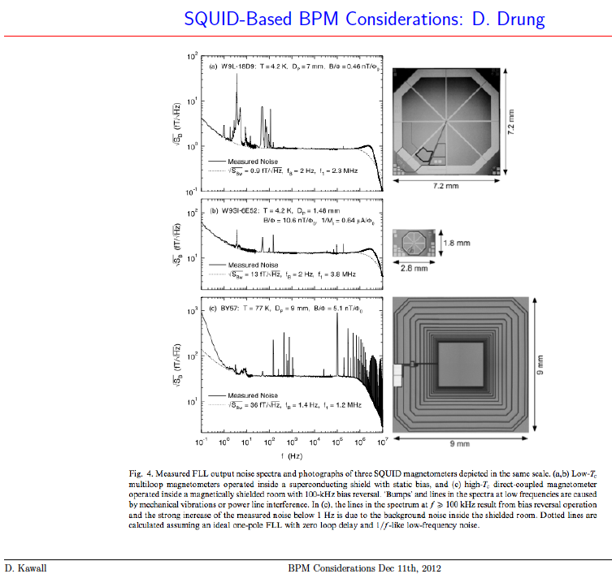
D. Kawall
Modulation
frequency range

Slide 42
2. Polarimeter Development
Polarimeter tests with runs at COSY (Jülich/Germany) demonstrated < 1ppm level systematic errors: N. Brantjes et al., NIM A 664, 49, (2012)
Technologies under investigation:
Micro-Megas/Greece: high rate, pointing capabilities, part of R&D for ATLAS upgrade
MRPC/Italy: high energy resolution, high rate capability, part of ALICE development

Slide 43
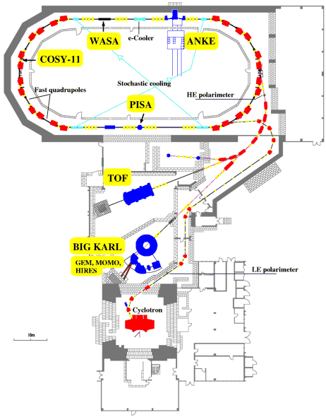
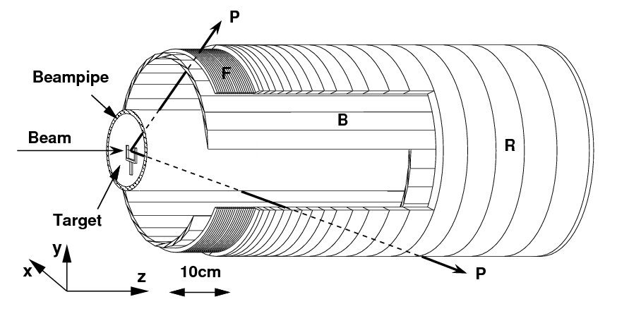
Storage Ring EDM
Technical Review – 12/7/2009
Polarimeter Development
COSY in Jülich/Germany tests
COSY ring:
EDDA detector:
Rings and bars to determine angles.
Use EDDA
detector
UP
LEFT
DOWN
RIGHT
Azimuthal angles yield two asymmetries:
E. Stephenson, Indiana University
4

Slide 44
3. Spin Coherence Time: need >10² s
Not all particles have same deviation from magic momentum, or same horizontal and vertical divergence (all second order effects)
They cause a spread in the g-2 frequencies:
Present design parameters allow for 10³ s store Cooling/mixing during storage could prolong SCT (upgrade option).

Slide 45
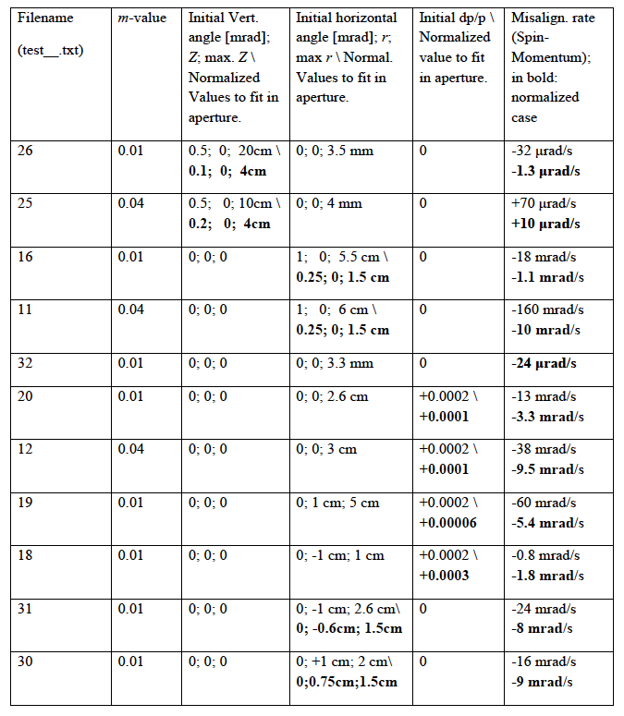
Vert. tune = .1
Vertical
oscillations
Horizontal
oscillations
Horizontal
Oscill. dp/p
With RF-cavity ON

Slide 46
4. Large Scale Electrodes, New: pEDM electrodes with HPWR
Parameter | Tevatron pbar-p Separators | BNL K-pi Separators | pEDM
Length | 2.6m | 4.5m | 3m
Gap | 5cm | 10cm | 3cm
Height | 0.2m | 0.4m | 0.2m
Number | 24 | 2 | 10²
Max. HV | ±180KV | ±200KV | ±150KV

Slide 47
E-field plate module: Similar to the (26) FNAL Tevatron ES-separators
Beam position
0.4 m
3 m

Slide 48
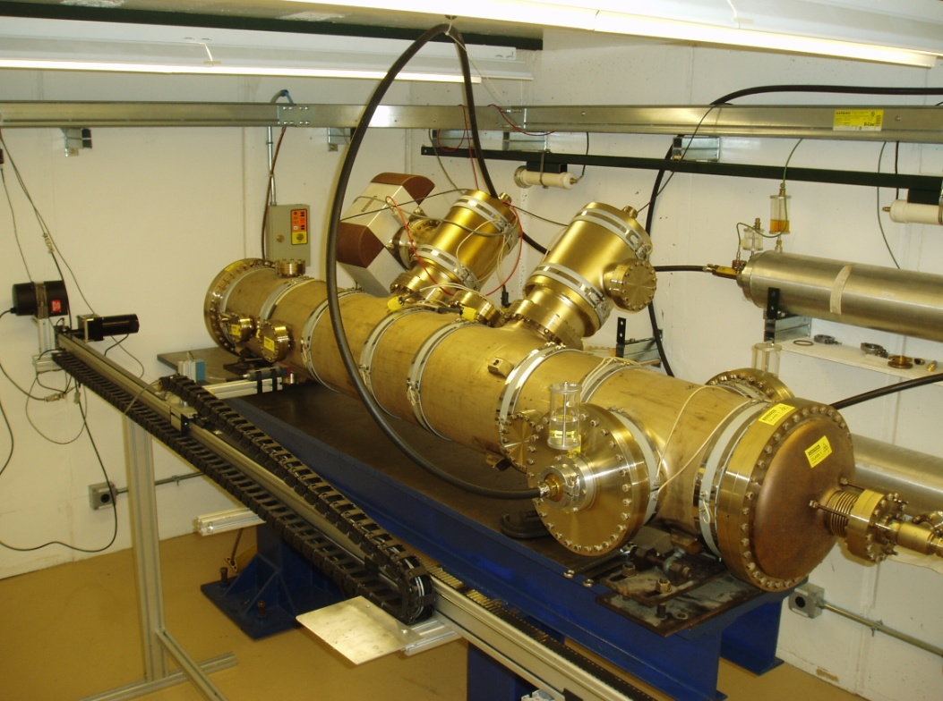
E-field plate module: Similar to the (26) FNAL Tevatron ES-separators
Beam position
0.4 m
3 m

Slide 49
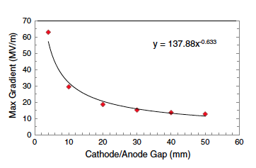
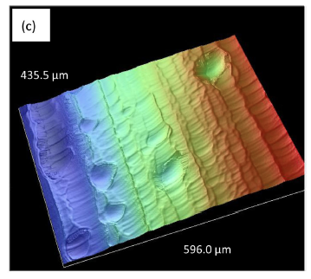
E-field strength vs. plate gap
R&D work at JLAB
Large grain Nb plates
PRSTAB 15,083502, 2012

Slide 50
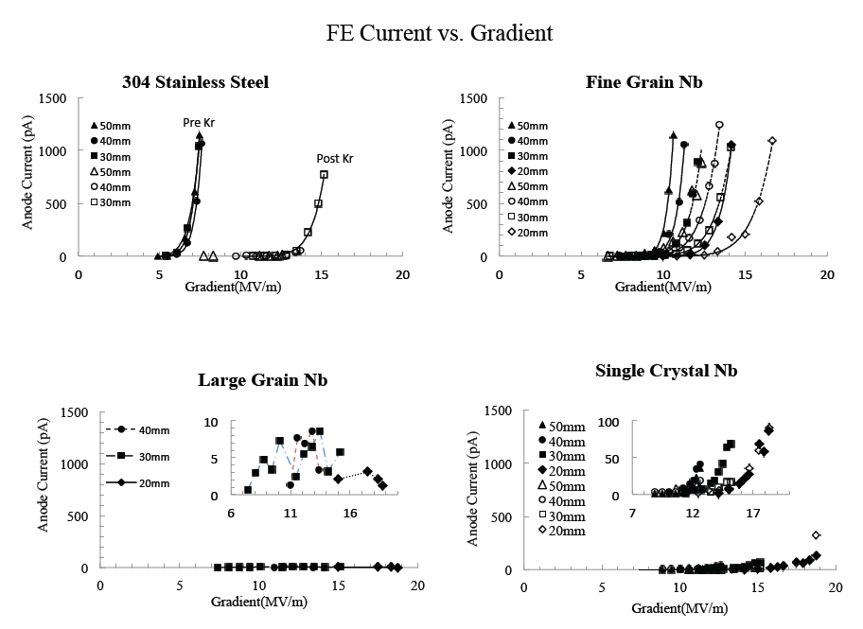
Recent E-field results at JLab

Slide 51
Technically driven pEDM timeline
12
13
14
15
16
17
18
19
20
21
Two years R&D (E-field, BPM, Polarimeter, SCT)
One year final ring design
Two years ring/beam-line construction
Two years installation
One year “string test”

Slide 52
Staging the experiment
Proton Intensity 10⁸⁻⁹ / storage; sensitivity: <10⁻²⁷e•cm. Beam intensity and specs relaxed
Proton Intensity 4x10¹⁰ / storage; sensitivity: 10⁻²⁹e•cm
Stochastic cooling (mixing → large SCT); 4x10¹⁰ / storage; sensitivity: 10⁻³⁰e•cm.

Slide 53
Why does the world need a Storage Ring EDM experiment at the 10⁻²⁹ e-cm level ?
The proton, deuteron and neutron combined can pin-down the CP-violating source should a non-zero EDM value is discovered. Critical: they can differentiate between a theta-QCD source and beyond the SM.
The proton and deuteron provide a path to the next order(s) of sensitivity.
Yannis Semertzidis, BNL

Slide 54
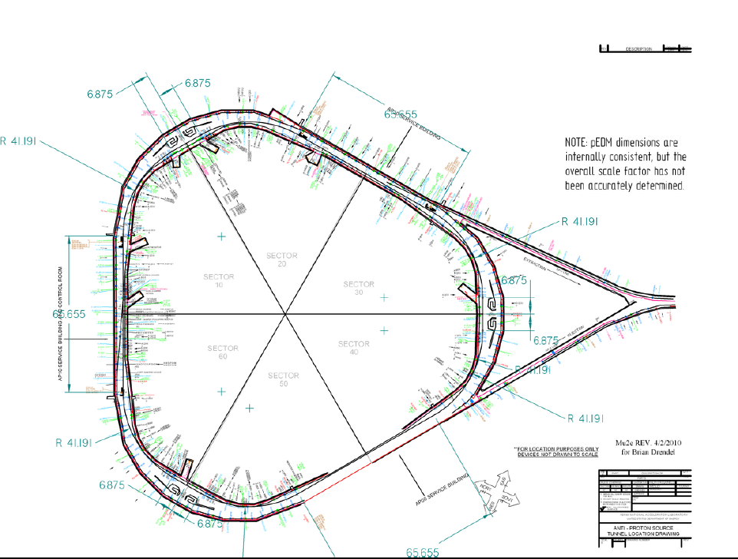
What now?
BNL proposal to NP DOE November 2011
FNAL: Expression of Interest presentation at PAC in October 15. DOE, HEP effort. Submit a proposal to FNAL in FY2014.

Slide 55

Storage Ring EDM Collaboration
Aristotle University of Thessaloniki, Thessaloniki/Greece
Research Inst. for Nuclear Problems, Belarusian State University, Minsk/Belarus
Brookhaven National Laboratory, Upton, NY/USA
Budker Institute for Nuclear Physics, Novosibirsk/Russia
Royal Holloway, University of London, Egham, Surrey, UK
Cornell University, Ithaca, NY/USA
Institut für Kernphysik and Jülich Centre for Hadron Physics Forschungszentrum Jülich, Jülich/Germany
Institute of Nuclear Physics Demokritos, Athens/Greece
University and INFN Ferrara, Ferrara/Italy
Laboratori Nazionali di Frascati dell'INFN, Frascati/Italy
Joint Institute for Nuclear Research, Dubna/Russia
Indiana University, Indiana/USA
Istanbul Technical University, Istanbul/Turkey
University of Massachusetts, Amherst, Massachusetts/USA
Michigan State University, East Lansing, Minnesota/USA
Dipartimento do Fisica, Universita’ “Tor Vergata” and Sezione INFN, Rome/Italy
University of Patras, Patras/Greece
CEA, Saclay, Paris/France
KEK, High Energy Accel. Res. Organization, Tsukuba, Ibaraki 305-0801, Japan
University of Virginia, Virginia/USA
>20 Institutions
>80 Collaborators
http://www.bnl.gov/edm

Slide 56
Issues are/to be working on
Effect of fringe field to beam/spin dynamics. (BNL, Eric Metodiev/Harvard Univ. et al., …)
SQUID-based BPM detector development based on present technology. (FNAL/BNL)
Reproduce J-LAB E-field tests for our geometry; test a 1m long prototype.
SCT benchmarking at COSY. Ed Stephenson/Indiana, COSY, et al.,

Slide 57
Summary
Proton EDM: A revolution in EDM sensitivity
When done it can shed light on the EW-Baryogenesis models
E-field measurements for our E-field plate geometry will define ring radius
A flagship-experiment at a prestigious lab

Slide 58
Extra slides

Slide 59
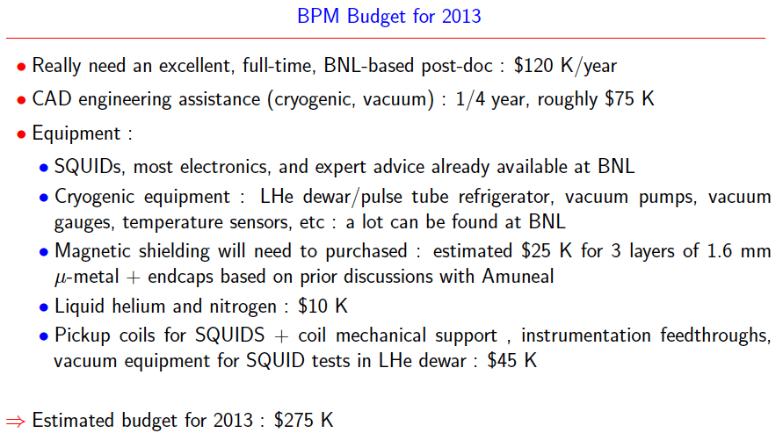
Budget for testing at RHIC by D. Kawall

Slide 60
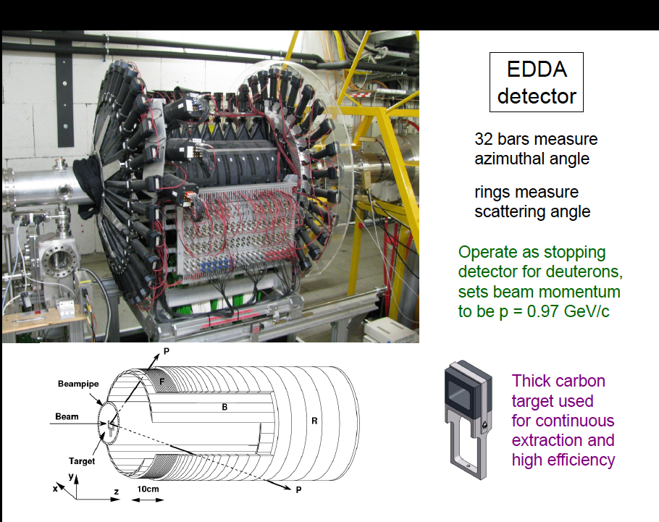

Slide 61
E-field strength
The field emission without and with high pressure water rinsing (HPR)
for 0.5cm plate separation.
Recent developments in achieving high E-field strengths with HPR treatment (from Cornell ILC R&D)
Notes:
61

Slide 62
B-field from (same sign) CR beams
Azimuthal B-field cancels
Vertical splitting creates a
radial B-field oscill. 10³-10⁴Hz
Low Tc SQUID sensitivity is adequate
Need to demonstrate in an accelerator environment (RHIC IP)
Two years R&D, $0.6M; first support: US-Japan

Slide 63
Maximum E-field vs. Plate gap
No dark current detected for large grain Nb!
PRSTAB 15,083502, 2012
16 MV/m at 30 mm
30 MV/m at 10 mm

Slide 64
Smaller-Ring Parameters
Ring circumference: 150 m
Bending radius: ~20 m
Plate distance: 2 cm
Radial E-field: ~210 kV/cm
High Voltage: ±210 kV

Slide 65
Total cost: exp + ring + beamline for two different ring locations @ BNL
System | Experiment w/ indirects | Conventional plus beamline w/ indirects | Total
pEDM at ATR | $25.6M | $20M | $45.6M
pEDM at SEB | $25.6M | $14M | $39.6M
System | Experiment w/ 55% contingency | Conv. & Beamline w/ contingency | Total
pEDM at ATR | $39.5M | $29.2M | $68.7M
pEDM at SEB | $39.5M | $22.6M | $62.1M
EDM ring+tunnel
and beam line
EDM ring

Slide 66
We have developed the Storage Ring EDM Method (g-2 technique with Electric fields)
(http://www.bnl.gov/edm)
Muon EDM sensitivity 10⁻²⁴ecm
Proton EDM sensitivity 10⁻²⁹ecm→10⁻³⁰ecm
Deuteron EDM sensitivity 10⁻²⁹ecm
³He (~neutron equivalent), …p, d, n EDMs are needed to decipher the CP-violation source…

Slide 67
Gas cluster ion beam surface treatment: getting rid of ~μm level asperities

Slide 68
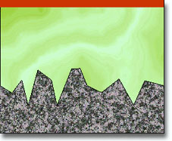
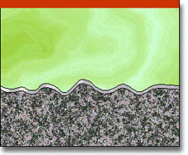
Electropolishing Process Verses Mechanical Polishing
Mechanical polish
Electropolish
Roughness: 4 - 40 microinches
(depends from abrasive grit number)
Roughness: 2 - 5 microinches
Mechanical polishing is an operation
designed to prepare a metal surface for
electropolishing or to satisfy non-critical
surface roughness requirements. Mechanical polishing reduces all surface ridges, microprotrusions, pits and discrepancies to provide a homogeneous appearance and roughness.
Electropolishing (used since early 1950’s) is the electrochemical removal of microscopic irregularities or diminution scratches, burns and unwanted harp edges from metal surfaces. Typical material removal is .0001”- .0004”
per surface.
Smoothness of the metal surface is one of the primary and
most advantageous effects of electropolishing.
Electropolishing should improve separator performance.

Slide 69
High Voltage Electrical Breakdown in Vacuum
It is generally agreed that a vacuum breakdown is a vapor arc, taking place in material evaporated from the electrodes. Evidence is the observation of localized light during breakdown and electrode material transferred across the gap.
Electron field emission mechanism for initiating the breakdown
According with this model, electrons are assumed to be field emitted from the tip of microprotrusion at an isolated site on the surface of broad-area cathode.
Question: where is the metal vapor produced at the anode or cathode?
Is it enough power to vaporize anode material by field emitted electrons bombarded anode or positive ions produced at the anode lead to rupture of the cathode or that resistive heating on the cathode causes them to melt and ultimately to vaporize. This mechanism dominates at gaps less than 2 mm.
Microparticle or “clump” model
Clump of loosely adhesive material is drawn across the gap by the electric field so as to strike the opposite electrode with enough energy to produce high local temperature in the electrode or clump material with melting and vaporizing.
Pre-operational electrode surface will be characterized by having a finite number of microscopic particles. These will originate from various stages of mechanical polishing, and may be in the form of either impurity particle of polishing material or dust particles. Another source of microparticles are those originated from thermal instabilities at either the cathode or anode “hot” spot. For uniform gaps the breakdown voltage should vary as the square root of the gap spacing. The model is dominating at large gaps.
Ion exchange mechanism
This mechanism is assumed to be initiated by say random positive ion created in the gap that is then accelerated by the field to generate further negative ions on impact with cathode, which subsequently generate more positive ions on impact with the anode etc. Thus, if the ion multiplication factor > 1, the process will develop in the breakdown mode. It is very sensitive to chemicals contaminations.
Anode
e
Cathode
Secondary
Primary
e
The breakdown consists of many complicated and complex phenomena with no single process involved.

Slide 70
Experiment Parameters (proposal)
Proton magic momentum: 0.7 GeV/c (233 MeV kinetic)
E = 10.5 MV/m for 3 cm plate separation
R = 40 m; plus straight sections
Weak vertical focusing: vertical tune 0.2→ 0.1
Stored particles: ~10¹⁰ per 10³s, 10⁴ injections

Slide 71
Recent development: Data!
Maximum E-field vs. Plate gap
No dark current detected for large grain Nb!
PRSTAB 15,083502, 2012
16 MV/m @ 30 mm
20 MV/m @ 20 mm
30 MV/m @ 10 mm
R=40 m

Slide 72
Smaller-Ring Parameters
Ring circumference: 150 m; 100 m
Bending radius: ~20 m; 13 m
Plate distance: ~2 cm; 1 cm
Radial E-field: ~21 MV/m; ~30 MV/m
EDM limit: 10⁻²⁸ecm; 10⁻²⁷ecm

Slide 73
Staging the experiment
Proton Intensity >10⁸ / storage; sensitivity: <10⁻²⁷e•cm; cost < $50M (fully loaded)
Proton Intensity 4x10¹⁰ / storage; sensitivity: 10⁻²⁹e•cm
Stochastic cooling: 4x10¹⁰ / storage; sensitivity: 10⁻³⁰e•cm

Slide 74
Summary
Proton EDM: A revolution in EDM sensitivity 10⁻²⁹ecm→10⁻³⁰ecm, different systematics from nEDM
Two major technical reviews at BNL: Dec 2009, March 2011
Mini, conceptual review, at FNAL by the local accelerator group: March 2012 (“we love it”; “it is time to develop the proposal for FNAL”)

Slide 75
Total cost: exp + ring + beamline for two different ring locations @ BNL
System | Experiment w/ indirects | Conventional plus beamline w/ indirects | Total
pEDM at ATR | $25.6M | $20M | $45.6M
pEDM at SEB | $25.6M | $14M | $39.6M
System | Experiment w/ 55% contingency | Conv. & Beamline w/ contingency | Total
pEDM at ATR | $39.5M | $29.2M | $68.7M
pEDM at SEB | $39.5M | $22.6M | $62.1M
EDM ring+tunnel
and beam line
EDM ring

Slide 76
D. Kawall
Modulation
frequency range

Slide 77
2. Polarimeter Development
Polarimeter tests with runs at COSY (Jülich/Germany) demonstrated < 1ppm level systematic errors: N. Brantjes et al., NIM A 664, 49, (2012)
Technologies under investigation:
Micro-Megas/Greece: high rate, pointing capabilities, part of R&D for ATLAS upgrade
MRPC/Italy: high energy resolution, high rate capability, part of ALICE development

Slide 78
3. Spin Coherence Time: need >10² s
Not all particles have same deviation from magic momentum, or same horizontal and vertical divergence (all second order effects)
They cause a spread in the g-2 frequencies:
Present design parameters allow for 10³ s store Cooling/mixing during storage could prolong SCT (upgrade option?).

Slide 79
Spin is the only vector defining a direction of a “fundamental” particle with spin
-
+

Slide 80
Electric Dipole Moment: two possibilities
-
+
+
-

Slide 81
If we discover that the proton
Has a non-zero EDM value, i.e. prefers only one of the two possible states:
+
-
-
+
Then P and T symmetries are violated and through CPT, CP-symmetry is also violated.

Slide 82
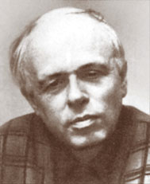
CPT
T-Violation CP-Violation
Andrei Sakharov 1967:
CP-Violation is one of three conditions to enable a universe containing initially equal amounts of matter and antimatter to evolve into a matter-dominated universe, which we see today….
Notes:
Yannis Semertzidis, BNL. ICHEP02, 31 July 2002
82

