Slide 1


DOE Program Managers’
Meeting with
Principal Investigators
CSS2013 • Snowmass on the Mississippi
Minneapolis, Minnesota
July 29 – August 6, 2013
Abid Patwa
Program Manager
Office of High Energy Physics
Office of Science, U.S. Department of Energy

Slide 2

Outline
Energy Frontier Program & Issues
Budget and Issues
FY 2014 HEP Comparative Review Process
FY 2013 HEP Comparative Review Statistics
Early Career Research Program
Questions & Answers
2

Slide 3
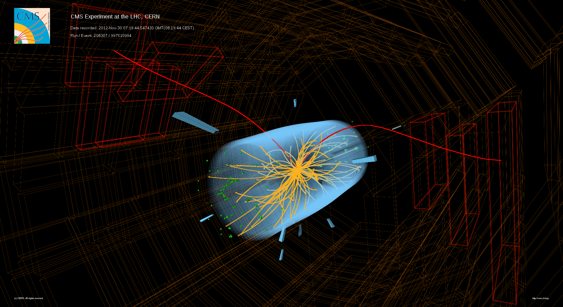

Energy Frontier
Program
B_{s} Candidate Event from CMS
(Recorded 2012; pp collisions at 8 TeV)
B_{s} → μμ Decay Channel

Slide 4
HEP Energy Frontier Experiments
Experiment | Location | CM Energy; Status | Description | # Institutions; # Countries | #US Institutions | #US Coll.
DZero | Fermilab Tevatron Collider [Batavia, Illinois, USA] | 1.96 TeV; Operations ended: Sept. 30, 2011 | Higgs, Top, Electroweak, SUSY, New Physics, QCD, B-physics | 74 Institutions; 18 Countries | 33 Univ., 1 National Lab | 192
CDF (Collider Detector at Fermilab) | Fermilab Tevatron Collider [Batavia, Illinois, USA] | 1.96 TeV; Operations ended: Sept. 30, 2011 | Higgs, Top, Electroweak, SUSY, New Physics, QCD, B-physics | 55 Institutions; 14 Countries | 26 Univ., 1 National Lab | 224
ATLAS (A Toroidal LHC ApparatuS) | CERN, Large Hadron Collider [Geneva, Switzerland / Meyrin, Switzerland] | 7-8 TeV; 13-14 TeV Run 1 ended: Dec. 2012 Run 2 start: 2015 | Higgs, Top, Electroweak, SUSY, New Physics, QCD, B-physics, and Heavy-Ion | 174 Institutions; 38 Countries | 40 Univ., 4 National Labs | 556
CMS (Compact Muon Solenoid) | CERN, Large Hadron Collider [Geneva, Switzerland / Cessy, France] | 7-8 TeV; 13-14 TeV Run 1 ended: Dec. 2012 Run 2 start: 2015 | Higgs, Top, Electroweak, SUSY, New Physics, QCD, B-physics, and Heavy-Ion | 179 Institutions; 41 Countries | 46 Univ., 1 National Lab | 676
Collaboration data as of May 2013.
US-ATLAS comprises ~21% of the international ATLAS Collaboration
US-CMS comprises ~33% of the international CMS Collaboration
4

Slide 5
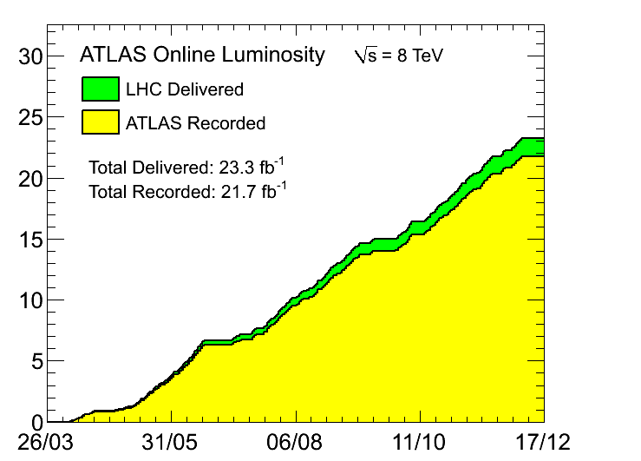
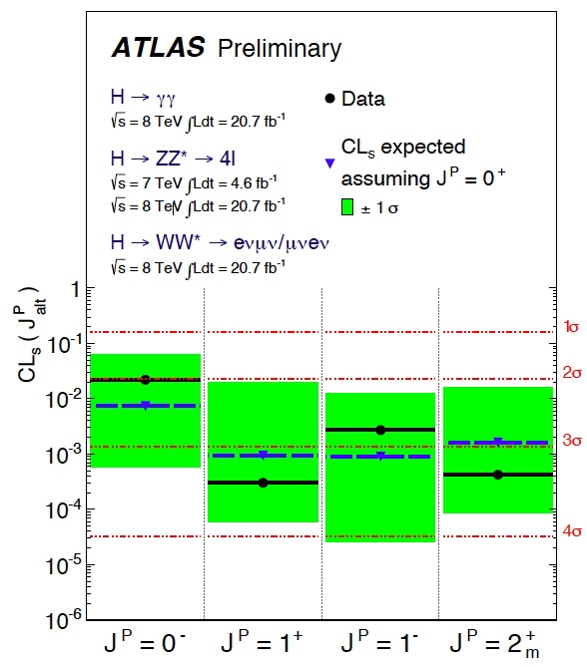
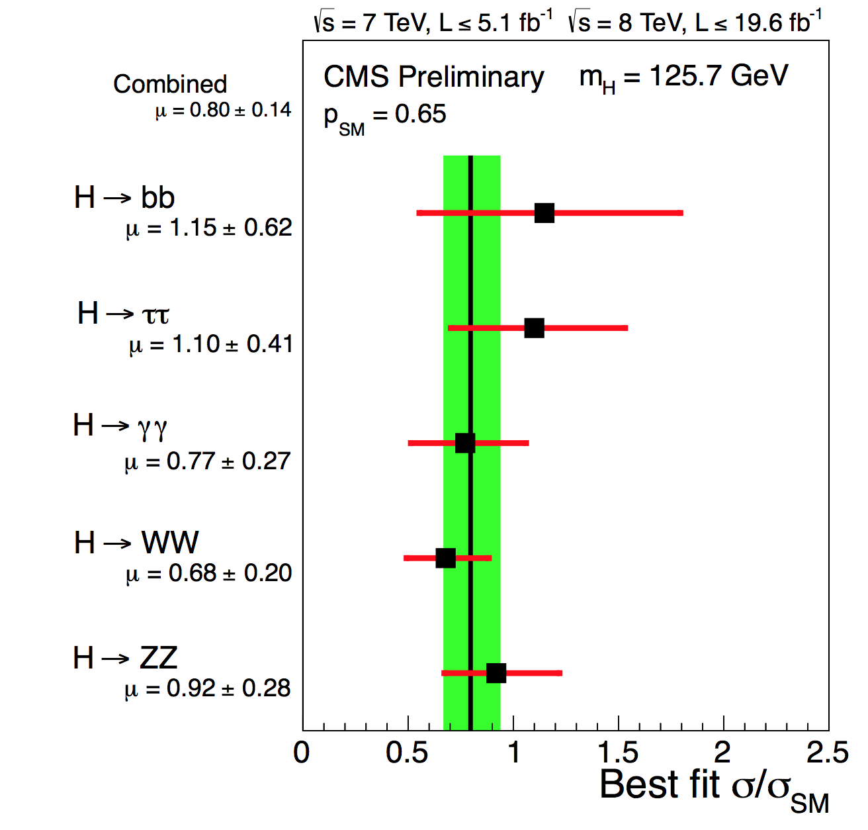
Energy Frontier Status
Fermilab Tevatron (DØ and CDF)
Working with DØ and CDF collaborations on orderly completion of legacy analyses as part of its ramp-down program.
Large Hadron Collider (LHC) at CERN
Run 1 (proton) completed in Dec. 2012
Working with experiments to develop plan for contributions to “Phase-1” upgrades
  CD-0 approval last September 2012 ($22-34M each experiment: ATLAS and CMS).
  CD-1 reviews scheduled in
  August 2013.
Current program
Analyze and publish results from LHC Run 1
2013-2014 shutdown: repair splices in
LHC magnets; detector maintenance and consolidation, upgrades and repairs
In 2015: resume running at 13~14 TeV
Still no smoking guns for BSM physics
  What will 13~14 TeV running tell us?
  Focus on new physics
Completion of Run I; CMS & ATLAS recorded: ~22 fb⁻¹
Total Integrated Luminosity [fb⁻¹]
Day in 2012
Combined
μ = 0.80 ± 0.14
1σ
2σ
3σ
4σ
(Ref: SM Higgs boson: J^{P} = 0⁺)
J^{P} = 0– J^{P} = 1⁺ J^{P} = 1– J^{P} = 2⁺
m
ATLAS Spin-Parity
[Lepton-Photon 2013]
CMS Signal Strength
[Lepton-Photon 2013]
5

Slide 6
Planning
HEP is putting in place a comprehensive program across the frontiers
  In five years,
    The CMS and ATLAS upgrades will be installed at CERN
    NOνA, Belle-II, Muon g-2 will be running on the Intensity Frontier
    Mu2e will be in commissioning, preparing for first data
    DES will have completed its science program and new mid-scale dark energy spectroscopic instrument and DM-G2 should begin operation
    The two big initiatives, LSST and LBNE, will be well underway
Need to start planning now for what comes next
  Engaging with DPF community planning process – [Snowmass] that will conclude this summer
  Now setting up a prioritization process – [á la P5] using that as input
Research funding will decrease for the next several years
  Programmatic priorities and comparative reviews will be used to optimize the resources
  See also ‘Budget’ slides, this talk…
Both the universities and the laboratories will be affected
  University Comparative Reviews (held annually each ~Fall)
  Lab Comparative Reviews in: Detector R&D (July 2012); Energy Frontier (July 2012);
  Accelerator Science (March 2013); Intensity Frontier (May 2013); Cosmic Frontier (this Sept.)
6

Slide 7
Energy Frontier Issues
Discussions with CERN about follow-on to LHC Agreement proceeding
  Necessary precursor to planning for “Phase-II” upgrades; US scope for “Phase-II” TBD.
Energy Frontier science plan will require high-energy, high-luminosity LHC running
  What is the real physics of the TeV scale?
    this will likely take a few years to sort itself out
  US “Snowmass/P5” process is an important element, along with European and
  Japanese HEP strategies
Significant collaborations with other regions on future colliders will require a
high-level approach between governments
  Modest ground-level R&D efforts can continue as funding allows
  We support an international process to discuss future HEP facilities that respects the interests of major national and regional partners as well as realistic schedule
  and fiscal constraints
  Once Snowmass/P5 studies and the community input are complete, we will be in a better position to evaluate future US priorities for the HEP program in detail
  We encourage active engagement by all interested parties
7

Slide 8
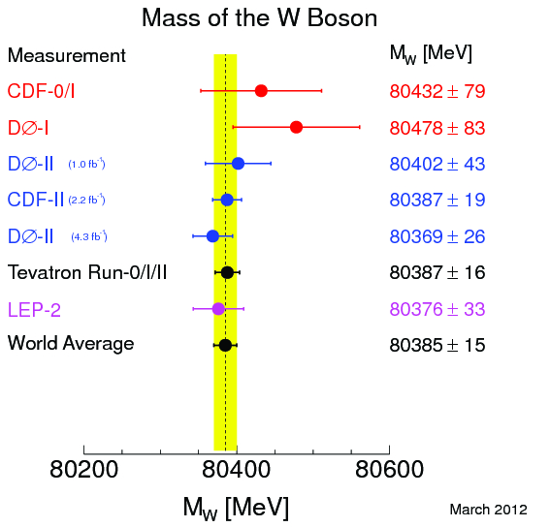
Energy Frontier Research:
Next Steps and General Observations (I)
Tevatron
  Complete ramp-down of Tevatron research program
  during next ~ year with final physics results
    Final statement on Higgs with full dataset &
    analysis improvements (this year)
    Legacy measurements
      W mass (δM_{W} → 10 MeV) with ~10 fb⁻¹
      Top quark: precision mass,
      forward-backward asymmetry
      QCD, heavy-flavor physics
General observations of Tevatron program
  During peer-conducted reviews, questions panelists frequently must answer
    are results from the analysis superseded by the LHC experiments (CMS, ATLAS, or LHCb)?
    is the analysis “publishable” within reasonable timescales?
As budgets continue to be under pressure, guidance provided to complete
Tevatron analyses efforts as soon as possible
Tevatron
8

Slide 9
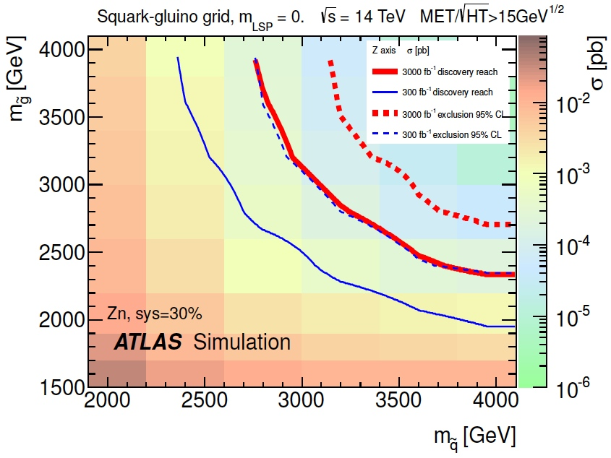
Energy Frontier Research:
Next Steps and General Observations (II)
LHC
  Discovery of Higgs-like boson by CMS and ATLAS
  ⇒ measure properties: couplings, spin/parity
    is it consistent with one predicted in SM?
  Publish physics results with √s = 8 TeV data [Run I]
      Higgs, top, and electroweak measurements
      Search for new physics BSM: exotic particles, SUSY, …
      QCD, heavy-flavor physics
… and steps in next ~5 years
  LHC will increase energy (√s = 13~14 TeV) and luminosity (L > 10³⁴ cm⁻²s⁻¹) for
  2015-2017 Run 2 (~100 fb⁻¹); and post-Phase-1: 2019-2021 Run 3 (~300 fb⁻¹)
    expand sensitivity reach for new physics
  Phase-1 upgrade activities will mix with physics research-related efforts
    proposals are encouraged to address a balanced effort in both
Other general observations
  Encourage community to exploit and interact with LHC Physics Center (LPC, CMS) or Analysis Support Center (ASC, ATLAS)
Solid – 5σ discovery
Dashed – 95% exclusion
9

Slide 10
HEP Budgets

Slide 11
DOE OHEP Organization
11

Slide 12
HEP Budget Overview
FY2014 budget philosophy was to enable new world-leading HEP capabilities in the U.S. through investments on all three frontiers
  Accomplished through ramp-down Research and operations of existing Projects
  When we were not able to fully implement this approach (i.e., start new projects), converted planned project funds to R&D: Research → Projects → Research
    Therefore, the FY14 Request shows increases for Research that are due to this
    added R&D “bump”, while Construction/project funding is only slightly increased
    In the interim (since submission of FY14 Request), actual FY13 Research funding
    also increased because of inability to get projects started
    Initial FY14 plan for Research will be down more than the originally advertised 2-3% relative to FY13
  Details in following slides…
Impact of these actions:
  Several new efforts are delayed:
    LHC detector upgrades, LBNE, 2nd Generation Dark Matter detectors, MS-DESI
  US leadership/partnership capabilities will be challenged by others
  Workforce reductions at universities and labs
Key areas in FY2014 Request
  Maintaining forward progress on new projects via Construction and Research
  (incl. R&D for projects) funding lines
12

Slide 13
Recent Funding Trends
Ramp up ILC and SRF R&D programs
Trading Projects for more Research
In the late 90’s the fraction of the budget devoted to projects was about 20%.
  Progress in many fields require new investments to produce new capabilities.
The projects started in 2006 are coming to completion.
New investments are needed to continue US leadership in well defined research areas.
Possibilities for future funding growth are weak. Must make do with what we have.
13

Slide 14
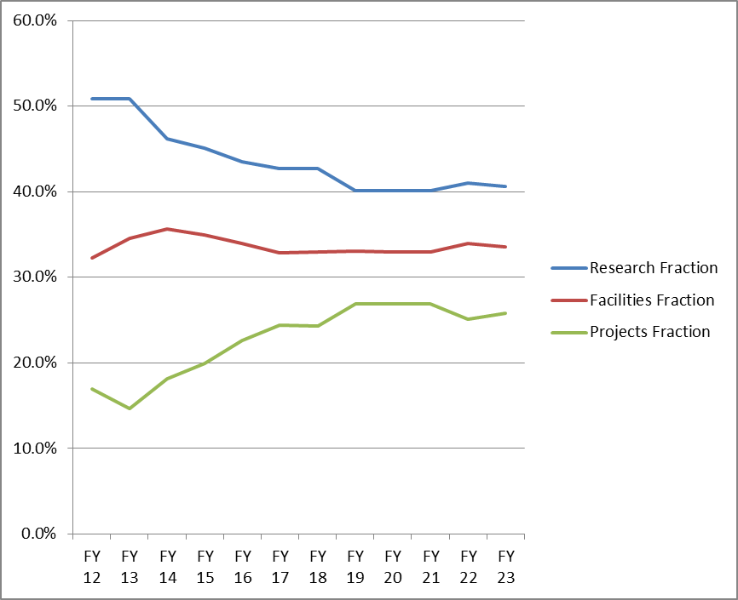
One Possible Future Scenario
Trading Research for more Projects
About 20% (relative) reduction in Research fraction over ~5 years
  In order to address priorities, this will not be applied equally across Frontiers
This necessarily implies reductions in scientific staffing
  Some can migrate to Projects but other transitions are more difficult
We have requested Labs to help manage this transition as gracefully as possible
14

Slide 15
FY 2014 High Energy Physics Budget
(Data in new structure, dollars in thousands)
Description | FY 2012 Actual | FY 2013 July Plan | FY 2014 Request | Explanation of Change [FY14 Request vs. FY12 Actual]
Energy Frontier Exp. Physics | 159,997 | 148,164 | 154,687 | Ramp-down of Tevatron Research
Intensity Frontier Exp. Physics | 283,675 | 287,220 | 271,043 | Completion of NOνA (MIE), partially offset by Fermi Ops
Cosmic Frontier Exp. Physics | 71,940 | 78,943 | 99,080 | Ramp-up of LSST-Camera
Theoretical and Computational Physics | 66,965 | 66,398 | 62,870 | Continuing reductions in Research
Advanced Technology R&D | 157,106 | 131,885 | 122,453 | Completion of ILC R&D
Accelerator Stewardship | 2,850 | 3,132 | 9,931 | FY14 includes Stewardship-related Research
SBIR/STTR | 0 | 0 | 21,457
Construction (Line Item) | 28,000 | 11,781 | 35,000 | Mostly Mu2e; no LBNE ramp-up
Total, High Energy Physics: | 770,533 ^{(a)} | 727,523 ^{(b,c)} | 776,521 | wrt FY13: Up +3.6% after SBIR correction wrt FY12: Down -2% after SBIR correction
Ref: Office of Science (SC): | 4,873,634 | 4,621,075 ^{(c)} | 5,152,752
SBIR = Small Business Innovation Research
STTR = Small Business Technology Transfer
^{(a)} The FY 2012 Actual is reduced by $20,327,000 for SBIR/STTR.
^{(b)} The FY 2013 [July Plan] is reduced by $20,791,000 for SBIR/STTR. ^{(c)} Reflects sequestration.
15

Slide 16
HEP Energy Frontier
Funding (in $K) | FY 2012 Actual | FY 2013 July Plan | FY 2014 Request | Comment
Research | 91,757 | 86,172 | 96,129 ^{(a)} | Tevatron ramp-down offset by R&D for LHC detector upgrades
Facilities | 68,240 | 61,992 | 58,558
LHC Detector Ops | 64,846 ^{(b)} | 56,912 | 56,774 | LHC down for maintenance
LHC Upgrade Project | 0 | 3,000 | 0 | LHC detector upgrades (OPC)
Other | 3,394 | 2,080 | 1,784 | IPAs, Detailees, Reviews
TOTAL, Energy Frontier: | 159,997 | 148,164 | 154,687
OPC = Other Project Costs
^{(a)} Includes $12M (= $6M CMS + $6M ATLAS) Phase-1 detector upgrades [R&D];
Therefore, Energy Frontier Core Research FY14 Request = 84,129k
^{(b)} Per interagency MOU, HEP provided LHC Detector Ops funding during FY12 CR
to offset NSF contributions to Homestake de-watering activities.
16

Slide 17
Energy Frontier Research Budget
($M)
Fiscal Year
FY13 core research budget saw reduction of ~6% relative to FY12
  driven by completion of Tevatron run [September 2011] and subsequent
  end-game of Tevatron physics program
17

Slide 18
Energy Frontier Research Budget
($M)
Supports:
1) Funding [low-level,
e.g., FY13 total = $68k]
of EF-related
conferences or
workshops at
universities or
laboratories
Fiscal Year
FY13 core research budget saw reduction of ~6% relative to FY12
  driven by completion of Tevatron run [September 2011] and subsequent
  end-game of Tevatron physics program
17

Slide 19
Energy Frontier Research Budget
($M)
Mainly Supports:
1) Bridge Funding
2) Grant continuations
3) Comparative
Review proposals
4) Supplements
5) University Service
Accounts (at labs)
Fiscal Year
FY13 core research budget saw reduction of ~6% relative to FY12
  driven by completion of Tevatron run [September 2011] and subsequent
  end-game of Tevatron physics program
17

Slide 20
Energy Frontier Research Budget
($M)
Mainly Supports:
ANL
BNL
Fermilab
LBNL
SLAC
Fellows prgm.
to universities
(US-ATLAS,
US-CMS LPC)
Fiscal Year
FY13 core research budget saw reduction of ~6% relative to FY12
  driven by completion of Tevatron run [September 2011] and subsequent
  end-game of Tevatron physics program
17

Slide 21
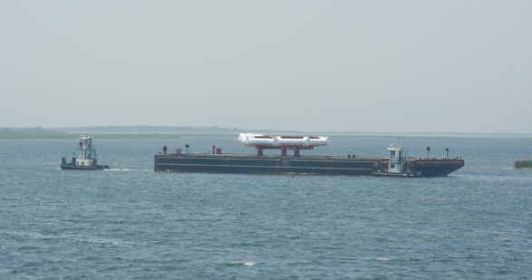
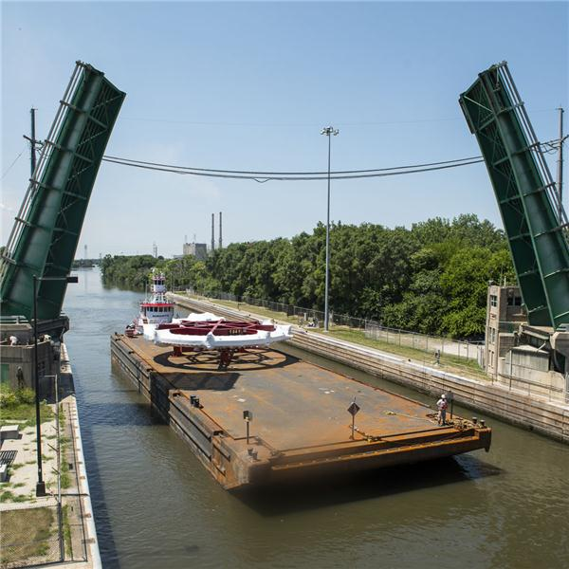
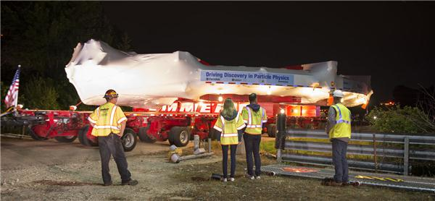
Major Item of Equipment (MIE) Issues
We were not able to implement [most] new MIE-fabrication starts in the FY14 request
  Muon g-2 experiment is the only new start in HEP that was not requested in FY13
  LSST-Camera and Belle-II, which didn’t receive approval in FY13, are requested again in FY14
Brookhaven National Laboratory
Muon g-2 Ring: On Barge, Departing Southern Long Island
June 25, 2013
On Barge, Through Joliet Locks; July 20, 2013
Entering Fermilab-site, Eola Rd. Gate; July 26, 2013
This upsets at least 2 major features of our budget strategy:
  Strategic plan: “Trading Research for Projects”
  Implementation of facilities balanced across Frontiers
18

Slide 22
HEP Physics MIE Funding
Funding (in $K) | FY 2012 Actual | FY 2013 July Plan | FY 2014 Request | Description
MIE’s | 55,770 | 45,687 | 39,000
Intensity Frontier | 41,240 | 19,480 | 0 | NOνA ramp-down
Intensity Frontier | 6,000 | 5,857 | 0 | MicroBooNE
Intensity Frontier | 500 | 0 | 0 | Reactor Neutrino Detector at Daya Bay
Intensity Frontier | 1,030 | 5,000 | 8,000 | Belle-II
Intensity Frontier | 0 | 5,850 | 9,000 | Muon g-2 Experiment
Cosmic Frontier | 1,500 | 1,500 | 0 | HAWC
Cosmic Frontier | 5,500 | 8,000 | 22,000 | Large Synoptic Survey Telescope (LSST) Camera
TOTAL MIE’s | 55,770 | 45,687 | 39,000
19

Slide 23
HEP Physics Construction Funding
Funding (in $K) | FY 2012 Actual | FY 2013 July Plan | FY 2014 Request
Construction - TPC | 53,000 | 28,388 | 45,000
Long Baseline Neutrino Experiment | 21,000 | 17,888 | 10,000
TEC | 4,000 | 3,781 | 0
OPC | 17,000 | 14,107 | 10,000
TPC | 21,000 | 17,888 | 10,000
Muon to Electron Conversion Experiment | 32,000 | 10,500 | 35,000
TEC | 24,000 | 8,000 | 35,000
OPC | 8,000 | 2,500 | 0
TPC | 32,000 | 10,500 | 35,000
TEC = Total Estimated Cost (refers to Capital Equipment expenses)
OPC = Other Project Costs
TPC = Total Project Cost
20

Slide 24
FY 2014 HEP Comparative Review Process

Slide 25
Purpose
In FY2012, DOE/HEP started a process of comparative grant reviews for research grants which were scheduled for renewal (+ any new proposals as desired)
  Existing grants which did not renew in FY2012 (“continuations”) were not affected by this change in the 1st round
Previously all HEP proposals responding to the general Office of Science (SC) call were individually peer-reviewed by independent experts.
This change in process has been recommended by several DOE advisory committees, most recently the 2010 HEP Committee of Visitors (COV):
  “In several of the cases that the panel read, proposal reviewers expressed negative views of the grant, but only outside of their formal responses. Coupled with the trend in the data towards very little changes in the funding levels over time, this suggests that grants are being evaluated based on the historical strength of the group rather than the current strength or productivity of the group. This is of particular concern when considering whether new investigators, new science, or high-risk projects can be competitive. Comparative reviews can be a powerful tool for addressing these issues and keeping the program in peak form.”
  Recommendation: Use comparative review panels on a regular basis.
Currently with the FY14 FOA, we are in 3rd round of annual comparative review process
The goal of this effort is to improve the overall quality and efficacy of the HEP research program by identifying the best proposals with highest scientific impact and potential
22

Slide 26
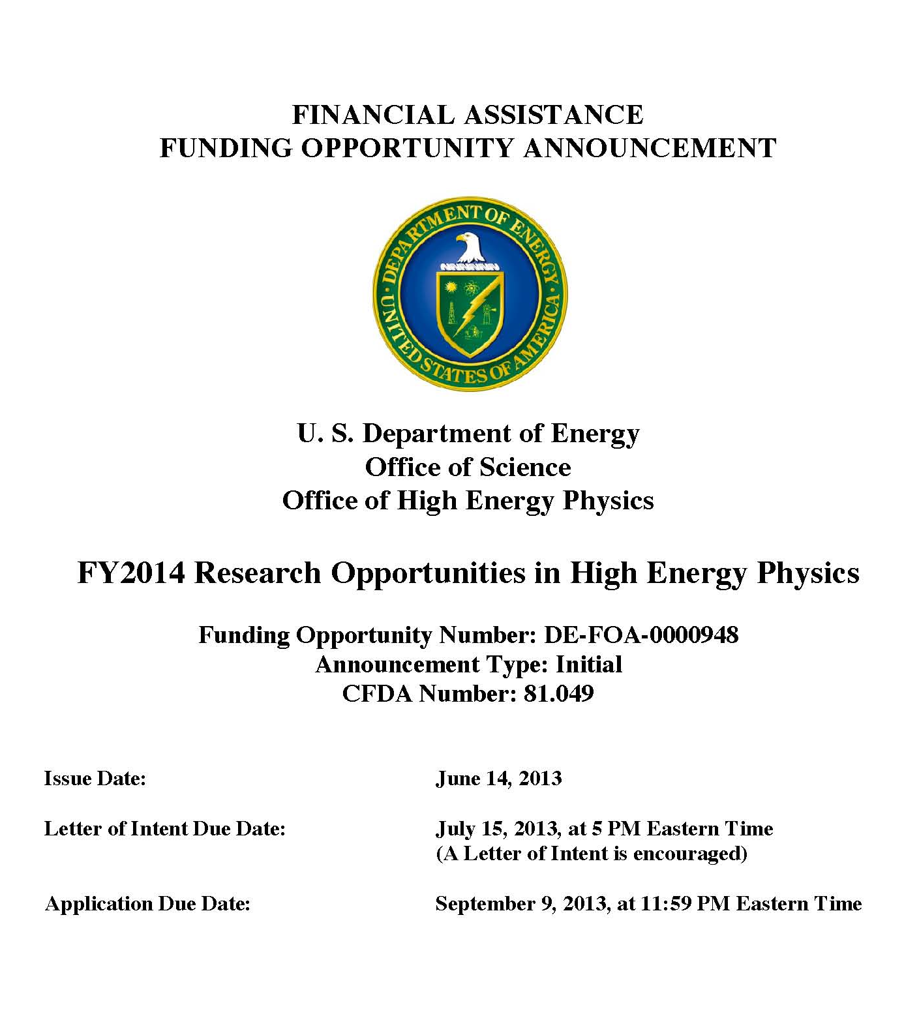
FY14 HEP Comparative Review FOA
DE-FOA-0000948
  Issued June 14, 2013
Six HEP research subprograms
  Energy, Intensity, and
  Cosmic Frontiers
  HEP Theory
  Accelerator Science and Technology R&D
  Particle Detector R&D
Letter of Intent due July 15, 2013 by 5 PM Eastern Time
  Strongly encouraged
23

Slide 27
FY14 HEP Comparative Review FOA
DE-FOA-0000948
  Issued June 14, 2013
Six HEP research subprograms
  Energy, Intensity, and
  Cosmic Frontiers
  HEP Theory
  Accelerator Science and Technology R&D
  Particle Detector R&D
Letter of Intent due July 15, 2013 by 5 PM Eastern Time
  Strongly encouraged
  as of today, deadline has past
23

Slide 28
FY14 HEP Comparative Review FOA
DE-FOA-0000948
  Issued June 14, 2013
Six HEP research
subprograms
  Energy, Intensity, and
  Cosmic Frontiers
  HEP Theory
  Accelerator Science and Technology R&D
  Particle Detector R&D
Letter of Intent due July 15, 2013 by 5 PM Eastern Time
  Strongly encouraged
Final Proposal (i.e., Application) deadline Sept. 9, 2013 by
11:59 PM Eastern Time
23

Slide 29
Frequently Asked Questions (FAQs)
FAQ for FY14 HEP Comparative Review
  available at: http://science.energy.gov/~/media/hep/pdf/files/pdfs/Funding%20Opportunities/FY14_Comp_Review_FAQUPDATED_JULY11_2013.pdf
  updated: July 11, 2013
In addition to information provided in FOA, FAQ addresses topics on:
  Eligibility requirements
  Proposal types and scope of proposals being considered
  Guidance for new faculty members and those without current HEP grants
  Guidance for PIs with existing HEP grants
  Letter of Intent
  Proposal and Application requirements
  Budgets information, including guidance on scope of request(s)
  Information on overall scientific merit review process
24

Slide 30
HEP Data Management
Effective with all solicitations and invitations for research funding issued on or after October 1, 2013.
The DOE Office of Science Statement on Digital Data Management will require a Data Management Plan with all proposals submitted for Office of Science research funding.
See March 12, 2013 HEPAP presentation by Laura Biven:
http://science.energy.gov/~/media/hep/hepap/pdf/march-2013/2013_Spring_HEPAPBriefing_v3_NoBackup_LBiven.pdf
More information will also be available in the FOAs, via the DOE Office of Science website, and on the High Energy Physics webpage.
Note: Proposals submitted to the FY14 HEP Comparative Review FOA [DE-FOA-0000948] or to the FY14 Early Career Research Program FOA [DE-FOA-0000958] that have already been posted will not require Data Management Plans.
25

Slide 31
Logistics (FY14 Comparative Review)
Post-FOA deadline
  All applications are pre-screened for compliance to FOA, includes:
    verification of senior investigator status
    compliance with proposal requirements: e.g., page limits, appendix material,
    use of correct DOE budget and budget justification forms, …
    responsive to subprogram descriptions
  Prior to submission, all PIs should carefully follow guidelines in FOA (and read FAQ)
For review process, experts of panelists selected
  Each panelist assigned to review 3-5 proposals
    minimum 3 reviews per proposal, additional reviewers added depending on the size of a research group and scope of research activities
    Panel convenes (in ~November 2013) to discuss each proposal and each senior
    investigator, provide additional reviews for proposal(s), and for comparative
    evaluation of proposals and senior investigators
      size of each subprogram’s panel and length of a panel meeting depends on
      number of applications to review
Post-Review process
  Assess reviews at DOE OHEP on each proposal and each senior investigator in order
  to develop guidance and funding levels
    in addition to reviews, solicit input from other DOE Program Managers & Grant Monitors
  PIs given [prioritized] guidance and funding levels (~mid-January 2014) and
  request Revised Budgets and Justifications ⇒ route through SC and Chicago Office
Funded grants to begin 1st year: on or about May 1, 2014
26

Slide 32
HEP Research Activities Supported
What DOE supports
  Research efforts (mainly scientists) on R&D, experiment design, fabrication,
  data-taking, analysis-related activities
  Theory, simulations, phenomenology, computational studies
  Some engineering support may be provided in Particle Detector R&D subprogram
    support depends on merit review process and programmatic factors
  Consider funding efforts that are in direct support of our programs
Faculty support
  Typically, 2-months summer support assumes DOE “buys” 100% research time throughout the academic year
  Summer support should be adjusted according to % time they are on research effort
    associated funding (post-docs, travel) is also adjusted accordingly
Research Scientists
  Support may be provided, but due to long-term expectations, need to consider
  case-by-case on merits: whether the roles and responsibilities are well-matched with individual capabilities and cannot be fulfilled by a term position
  Efforts are related towards research; not long-term operations and/or project activities
What’s not supported by research grants
  Any significant operations and/or project-related activities:
    Engineering, major items of equipment, consumables for prototyping or production
  Non-HEP related efforts
    Gravity waves (LIGO), Heavy Ion (RHIC), AMO Science, etc.
27

Slide 33
Subprogram Review Panels
The Comparative Review process is very competitive and hard choices have to be made based on the reviews, as well as to fit into our limited funding availability
  The process by definition implies that certain proposals and investigators will be ranked at the top, middle, and bottom.
It is understood that the vast majority of people applying are working hard and their efforts are in support of the HEP program. Due to the rankings & comments by the reviewers and our constrained budgets, some people whose research activities and level of effort who are ranked lower in terms of priority and impact relative to others in the field will not be funded on the grant
  This does not necessarily mean the person cannot continue working on the experiments; they are not being funded by the grant to do it. It could be that the person has a critical role in the program but this did not come out in the proposal or review process. That is why it is imperative to respond to the FOA solicitation and detail each person’s efforts.
The subprogram review panel sees all of the proposals and will make recommendations and rankings relative to each other. When the panel is faced with comparing efforts, impacts and a limited budget, rather than rank the whole proposal low, they may provide guidance regarding details of the proposals
  e.g., person X should not be funded; do not add additional postdoc on this effort
28

Slide 34
Programmatic Considerations
Generally very useful to have head-to-head reviews of PIs working in similar areas, particularly for large grants
Lots of discussion of relative strengths and weaknesses of individual
proposals and PIs
Many factors weigh into final funding decisions
  Compelling research proposal for next ~3 years
    Interesting? Novel? Significant? Plausibly achievable?
    Incremental? Implausibly ambitious? Poorly presented?
  Significant recent contributions in last 3-4 years
    Synergy and collaboration within group (as appropriate)
    Contributions to the research infrastructure of experiments
  Alignment with programmatic priorities
Supportive of excellent people, including excellent new people, even when times are tough!
29

Slide 35
Comparative Review Criteria
(In descending order of importance)
1. Scientific and/or Technical Merit of the Project
For e.g., what is the likelihood of achieving valuable results? How might the results of the proposed research impact the direction, progress, and thinking in relevant scientific fields of research? How does the proposed research compare with other research in its field, both in terms of scientific and/or technical merit and originality? Please comment individually on each senior investigator.
2. Appropriateness of the Proposed Method or Approach
For e.g., how logical and feasible is the research approach of each senior investigator? Does the proposed research employ innovative concepts or methods? Are the conceptual framework, methods, and analyses well justified, adequately developed, and likely to lead to scientifically valid conclusions? Does the applicant recognize significant potential problems and consider alternative strategies?
3. Competency of Research Team and Adequacy of Available Resources
For e.g., what are the past performance and potential of each senior investigator? How well qualified is the research team to carry out the proposed research? Are the research environment and facilities adequate for performing the research? Does the proposed work take advantage of unique facilities and capabilities?
4. Reasonableness and Appropriateness of the Proposed Budget
Are the proposed resources and staffing levels adequate to carry out the proposed research? Is the budget reasonable and appropriate for the scope?
5. Relevance to the mission of the Office of High Energy Physics (HEP) program
How does the proposed research of each senior investigator contribute to the mission, science goals and programmatic priorities of the subprogram in which the application is being evaluated? I s it consistent with HEP’s overall mission and priorities? How likely is it to impact the mission or direction of the HEP program?
6. General Comments and Overall Impression
Include any comments you may wish to make on the overall strengths and weaknesses of the proposal, especially as compared to other research efforts in this area. If there are significant or unique elements of the overall proposal, including institutional setting and resources, synergies with other relevant subprograms, or other broader considerations not noted above please include them here.
30

Slide 36
Scoring by Panelists
Table A: Scoring system definition.
Qualifier | Poor | Fair | Good | Very Good | Excellent | Outstanding
Score | 1 | 2 | 3 | 4 | 5 | 6
Using the grading system in Table A above, please provide scores for the overall proposal in the respective Energy Frontier subprogram area.
  Please provide scores from 1 [Poor] to 6 [Outstanding] for each of the five criteria in Sections 1-5 in Table B below. Your scores should be supported by your answers to questions 1-5.
Table B: Overall Score in the Energy Frontier.
Criterion | Overall Score [1 to 6]
1) Scientific Merit
2) Appropriateness
3) Competency
4) Budget
5) Mission Relevance
31

Slide 37
Rating by Panelists
Table C: In comparison with similar Energy Frontier research efforts, please indicate whether you judge this program to lie in the bottom, 2nd, 3rd, 4th, or top quintile. Enter an “X” in the appropriate box.
Next, for each senior investigator listed in Table D, provide scores for the following [two] criteria:
  (1) the merit and potential impact of the proposed work
  (2a) the competency of the investigator and the likelihood of success. Use grading system defined in Table A.
  (2b) compared to other senior investigators working in the same area at this and other institutions, how would you rank this investigator overall in terms of quintiles?
    Please put an “X” in the appropriate box in Table D. Your ratings below should be supported by your answers to questions 1 to 5 and the scores in Table D itself.
Bottom 1-20% | Bottom 21%-40% | Mid 41%-60% | Top 61%-80% | Top 81%-100%
Table D: Individual Energy Frontier senior investigator scores.
Senior Investigator | Scientific merit and potential impact of proposed work [enter 1 to 6] | Competency of senior investigator’s team and likelihood of success [enter 1 to 6] | Compared to other senior investigators working in the same area, how would you rank this senior investigator overall? Please enter one “X” per senior investigator in one of the columns below.
 |  |  | Bottom 1%-20% | Bottom 21%-40% | Mid 41%-60% | Top 61%-80% | Top 81%-100%
Senior Investigator #1
Senior Investigator #2
Senior Investigator #3

Slide 38
Comparative Evaluation
DOE Program Managers will need to determine:
  The threshold for funding each proposal
  The level of support for each funded proposal
A “comparative” evaluation:
  Reviewer scores / rankings of the proposals and senior investigators provide essential (additional) input to DOE’s process of optimizing resource allocations for the University research program
  Not everyone can be “Above Average”
33

Slide 39
FY 2013 HEP Comparative review statistics

Slide 40
FY13 Submitted Proposals
FY 2013 cycle:
  185 proposals requesting support totaling $335.782M in one or more of the six sub-programs received by the September 10, 2012 deadline in response to “FY 2013 Research Opportunities in High Energy Physics” [DE-FOA-0000733]
After pre-screening all incoming proposals for responsiveness to the subprogram descriptions and for compliance with the proposal requirements: 12 were declined before the competition
  There were hard page limits and other requirements. Proposals not respecting the page limits or other requirements were NOT reviewed
    5 proposals declined without review for this reason
    1 proposal was missing a research narrative
    4 were outside the scope of HEP
    2 proposals were non-responsive
  PIs with proposals that were rejected for “technical” reasons could re-submit to
  general DOE/SC solicitation
11 proposals were withdrawn by the respective sponsoring institutions
  4 were duplicate submissions
  6 were supplemental requests submitted to the incorrect FOA
  1 proposal was submitted from a federal agency which was ineligible
35

Slide 41
FY13 Reviewers & Panels
For the FY13 HEP Comparative Review process, 162 submitted proposals reviewed, evaluated and discussed by several panels of experts who met in the 6 HEP subprograms:
30 of the proposals requested research support from 2 or more of the 6 subprograms, e.g., “umbrella” proposals
  In such cases, the proposal was sent in its entirety to all relevant panels
  However, the panels were asked to explicitly compare and rank only the section(s) of the proposal relevant to the sub-program they were reviewing
Each proposal that satisfied the requirements of the solicitation was sent out for
review by at least 3 experts and then subsequent comparative evaluation by the panel
  130 reviewers participated in the review process
    for proposals on similar topics, reviewers were sent multiple proposals
  834 reviews were completed with an average 5.2 reviews per proposal
Subprogram | Panel Deliberations | # of Total Proposals [includes proposals containing multiple subprograms]
Intensity Frontier | November 5-6, 2012 | 31
Theory | November 6-8, 2012 | 53
Particle Detector R&D | November 8-9, 2012 | 22
Energy Frontier | November 13-15, 2012 | 45
Accelerator Science and Technology R&D | November 13-14, 2012 | 40
Cosmic Frontier | November 14-16, 2012 | 28
36

Slide 42
FY13 Review Data by Proposal
 | Energy | Intensity | Cosmic | Theory | Acc. R&D | Det. R&D | HEP Total
Received | 46 | 33 | 33 | 56 | 44 | 30 | 185
Declined/Withdrawn Without Review | 1 | 2 | 5 | 3 | 4 | 8 | 23
Reviewed | 45 (1) | 31 (5) | 28 (14) | 53 (11) | 40 (21) | 22 (14) | 162 (58)
Funded | 40^{(a)} (0) | 24 (3) | 18 (4) | 35 (4) | 17^{(b)} (3) | 12 (6) | 101 (20)
Declined | 5 (1) | 7 (2) | 10 (10) | 18 (7) | 23 (17) | 10 (8) | 61 (38)
“Success Rate” (%) (Previous/New) | 89 | 77 | 64 | 66 | 43 | 55 | 62 (78/34)
NOTES:
Single proposals with multiple research subprograms are counted multiple times (1 /subprogram)
( ) indicates number of proposals from research groups that did not receive DOE HEP funding in FY12.
“Success Rate” is = # Funded/ # Reviewed.
Most proposals are not fully funded at requested level.
About 68% of the proposals reviewed were from research groups that received DOE HEP funding in FY12.
Overall success rate of reviewed proposals for previously (newly) funded groups was 78% (34%).
^{(a)} 3 of 40 Energy funded proposals were provided term support (<1 year) for graduate students and post-docs.
^{(b)} 5 of 17 Accelerator R&D funded proposals were provided term support (<1 year).
37

Slide 43
FY13 Review Data by Senior Investigator
 | Energy | Intensity | Cosmic | Theory | Acc. R&D | Det. R&D | HEP Total
Received | 127 | 56 | 61 | 155 | 57 | 47 | 504
Declined/Withdrawn Without Review | 1 | 2 | 8 | 9 | 4 | 18 | 42
Reviewed | 126 (7) | 54 (8) | 54 (30) | 146 (24) | 53 (25) | 29 (19) | 462 (113)
Funded | 112 (3) | 43 (6) | 27 (7) | 115 (11) | 24 (4) | 19 (9) | 338 (40)
Declined | 14 (4) | 11 (2) | 26 (23) | 31 (13) | 29 (21) | 13 (10) | 124 (73)
“Success Rate” (%) (Previous/New) | 89 | 80 | 51 | 79 | 45 | 53 | 73 (85/35)
NOTES:
( ) indicates number of senior investigators that did not receive DOE HEP funding in FY12.
“Success Rate” is = # Funded/ # Reviewed.
Overall success rate for previously (newly) funded DOE HEP PIs was 85% (35%).
Most (but not all) PIs who are funded, are funded at requested effort level.
38

Slide 44
FY13 Review Data
Jr. Faculty and Research Scientists
 | Total # Jr. Faculty Reviewed (New) | # Jr. Faculty Funded (New) | Total # Res. Scientists Reviewed (New) | # Res. Scientists Funded (New)
Accelerator R&D | 7 (7) | 1 (1) | 34 (11) | 20 (0)
Cosmic Frontier | 10 (8) | 3 (3) | 2 (2) | 0 (0)
Detector R&D | 3 (2) | 1 (1) | 10 (5) | 6 (2)
Energy Frontier | 16 (3) | 15 (2) | 28 (2) | 18 (1) *
Intensity Frontier | 9 (5) | 7 (5) | 5 (0) | 4 (0)
Theory | 15 (7) | 13 (6) | 3 (0) | 0 (0)
HEP Total | 60 (32) | 40 (18) | 81 (20) | 47 (3)
* DOE worked with US-CMS and US-ATLAS management to find support for fraction of needed
Research Scientists through the LHC Ops program.
39

Slide 45
More on Research Scientists (RS)
Efforts of all RS that have support requested in a proposal are evaluated by the panel
See also Q&A-40 of FAQ…
  Requests to support RS dedicated full-time (and long-term) to operational and/or project activities for an experiment will not be supported by respective frontier research areas
  If RS conducting physics research-related activities, requests [scaled to % of time on
  such efforts] can be included
    any final support will be based on the merit review process
Common reviewer comments that result in unfavorable merit reviews:
  ‘RS conducting scope of work typically commensurate at the postdoctoral-level…’
  ‘RS involved in long-term operation/project activities with minimum physics research efforts…’
    such efforts may review well in a DOE review of the operation/project program
    but not as well in a review of the experimental research program
What is physics research-related activities?
  Object reconstruction/algorithm development, performance studies, data taking and analysis, and mentorship of students & postdocs in these areas
  Scientific activities in support of detector/hardware design and development
From the research program, cases become an issue when operations/projects
become the dominant activity long-term
  A well-balanced portfolio that includes physics research-related activities is encouraged
40

Slide 46
FY13 Proposals vs. FY12 Status
 | New | Up | Flat | Down | No-Fund | Decline | Total
Accelerator R&D | 3 | 2 | 4 | 8 | 6 | 17 | 40
Cosmic Frontier | 4 | 7 | 1 | 6 | 0 | 10 | 28
Detector R&D | 6 | 2 | 2 | 2 | 2 | 8 | 22
Energy Frontier | 0 | 10 | 2 | 28^{(a)} | 1 | 4 | 45
Intensity Frontier | 3 | 8 | 6 | 7 | 5 | 2 | 31
Theory | 4 | 2 | 7 | 22 | 11 | 7 | 53
HEP Total | 20 | 20 | 14 | 48 | 22 | 38 | 162
Single proposals with multiple research subprograms are counted multiple times (1 /subprogram)
New = HEP research effort was not funded at this institution in FY12.
Up = FY13 funding level +2% or more compared to FY12.
Flat = FY13 funding level within ±2% of FY12.
Down = FY13 funding -2% or more compared to FY12.
No-Fund = No funding is provided in FY13. This effort was funded in FY12.
Decline = This effort was not funded in FY12.
Energy Frontier: 45 proposals reviewed in FY13 – request: $31.3M (12-month); funded: $18M (11-month)
^{(a)} 11 of 28 proposals had Tevatron (CDF or D0) research activities associated with them in addition to CMS/ATLAS research activities. In general, the Tevatron efforts saw a downward reduction with respect to FY12.
41

Slide 47
Early career research program (ECRP)

Slide 48
Early Career (EC): Next Round in FY14
FY14 FOA [DE-FOA-0000958] posted on July 23, 2013 at the Early Career website:
  http://science.energy.gov/early-career/
Read the FY14 FAQ, also on above web site
  addresses most of the common Q&A collected over the last 4 years
Features of FY14
  Entering 5th year
    some population of candidates will no longer be eligible due to the “3-strikes rule”
  Mandatory Pre-application requirement. Two pages.
    Deadline: September 5, 2013, 5 PM Eastern
    all interested PIs encouraged to register as soon as possible in DOE/SC Portfolio Analysis and Management System (PAMS) for submission [link provided in EC website]
  Full proposals due: November 19, 2013, 5 PM Eastern
    candidates will have more than 3 months to develop a plan, write a narrative,
    and submit an application
Presidential Early Career Awards for Scientists and Engineers (PECASE)
  PECASE-eligible candidates are selected from the pool of Early Career awardees
    http://science.energy.gov/about/honors-and-awards/pecase/
43

Slide 49
HEP Early Career General Observations
Reviewers often look for innovative proposals
  Usually something a bit off the beaten track that the PI can claim as their own
    during preparation, PIs should address “why is it critical that I carry-out this research?”
  Somewhat speculative but not too risky
  Provide unique capabilities. What does not get done?
In experimental HEP proposals that are submitted to ECRP FOA
  Looking for a balanced program
    strong physics effort and hardware project attached to an experiment
    (e.g., Phase-1 upgrades for LHC)
Many lab and some university proposals suffered from “isn’t the lab/project going to do that anyway?”
  Some proposals were clear efforts to start funding some project or R&D that
  HEP has not yet approved – “the camel’s nose under the tent”
  The theory lab proposals were questioned on cost-effectiveness
Prior to submission, applicants may want to seek guidance from senior faculty and/or staff while preparing proposals (including budget material)
Because different reviewers weigh the criteria differently (or have their own physics biases) there is a larger spread in panel rankings
44

Slide 50
HEP Early Career FY10-13 Demographics
L = National Laboratory Proposal
U = University Proposal
Subprogram Awards | FY10 (L/U) | FY11 (L/U) | FY12 (L/U) | FY13 (L/U) | Total (L/U)
Energy | 3 (1/2) | 3 (1/2) | 1 (0/1) | 2 (0/2) | 9 (2/7)
Intensity | 2 (1/1) | 1 (0/1) | 3 (2/1) | 1* (0/1) | 7 (3/4)
Cosmic | 2 (0/2) | 3 (2/1) | 3 (1/2) | 2 (1/1) | 10 (4/6)
HEP Theory | 6 (1/5) | 4 (0/4) | 3 (0/3) | 3 (1/2) | 16 (2/14)
Accelerator | 1 (1/0) | 2 (2/0) | 2 (1/1) | 1 (0/1) | 6 (4/2)
HEP Awards | 14 (4/10) | 13 (5/8) | 12 (4/8) | 9 (2/7) | 48 (15/33)
Proposals | 154 (46/108) | 128 (43/85) | 89 (34/55) | 78 (29/49) | 449 (152/297)
* Funded by DOE Office of Basic Energy Sciences (BES) as an EPSCoR [Experimental Program to Stimulate Competitive
Research] award with grant monitored by DOE Office of High Energy Physics (HEP).
Early Career Research Program is very competitive (~10% success rate)
45

Slide 51


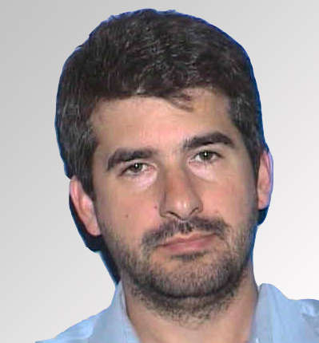

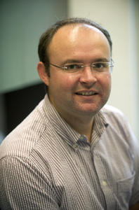

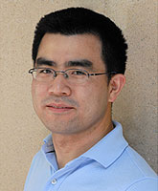
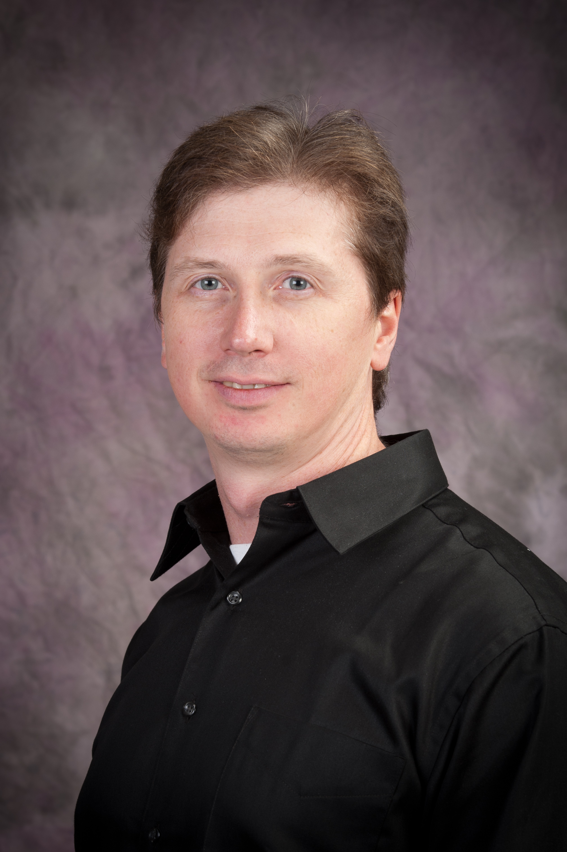

EC Recipients: Energy Frontier
“Model‐Independent Dark‐Matter Searches at the ATLAS Experiment and Applications of Many‐core Computing to
High Energy Physics”
  ― Dr. Amir Farbin (ATLAS Experiment)
  University of Texas, Arlington
“Diamond Pixel Luminosity Telescopes”
  ― Dr. Valerie Halyo (CMS Experiment)
  Princeton University
FY10
“Enhancing the LHC Discovery Potential with Jets, Missing E_{T}, and bit ‐tagging Physics Signature Reconstruction
in ATLAS”
  ― Dr. Ariel Schwartzman (ATLAS Experiment)
  SLAC National Accelerator Laboratory
“Taus and the Trigger for Discovery at ATLAS”
― Dr. Sarah Demers (ATLAS Experiment)
  Yale University
“Precision Physics and Searches with Top and Bottom Quarks”
― Dr. Aran Garcia-Bellido (CMS Experiment)
  University of Rochester
FY11
“Enhancement of the Trigger Capability for New Physics at the Large Hadron Collider”
― Dr. Jinlong Zhang (ATLAS Experiment)
  Argonne National Laboratory
“Search for New Physics and Upgrade of the Muon Spectrometer at ATLAS”
― Dr. Junjie Zhu (ATLAS Experiment)
  University of Michigan, Ann Arbor
FY12
“Quest for a Top Quark Partner and Upgrade of the Pixel Detector Readout Chain at the CMS”
― Dr. Andrew Ivanov (CMS Experiment)
  Kansas State University
FY13
“Search for the Higgs and Physics Beyond the Standard Model with the CMS Electromagnetic Calorimeter”
― Dr. Toyoko J. Orimoto (CMS Experiment)
  Northeastern University

Slide 52
EC Recipients: Energy Frontier
“Model‐Independent Dark‐Matter Searches at the ATLAS Experiment and Applications of Many‐core Computing to
High Energy Physics”
  ― Dr. Amir Farbin (ATLAS Experiment)
  University of Texas, Arlington
“Diamond Pixel Luminosity Telescopes”
  ― Dr. Valerie Halyo (CMS Experiment)
  Princeton University
FY10
Congratulations
to recipients in the
Energy Frontier research program,
and
Congratulations to all
Early Career Research Award recipients!
“Enhancing the LHC Discovery Potential with Jets, Missing E_{T}, and bit ‐tagging Physics Signature Reconstruction
in ATLAS”
  ― Dr. Ariel Schwartzman (ATLAS Experiment)
  SLAC National Accelerator Laboratory
“Taus and the Trigger for Discovery at ATLAS”
― Dr. Sarah Demers (ATLAS Experiment)
  Yale University
“Precision Physics and Searches with Top and Bottom Quarks”
― Dr. Aran Garcia-Bellido (CMS Experiment)
  University of Rochester
FY11
“Enhancement of the Trigger Capability for New Physics at the Large Hadron Collider”
― Dr. Jinlong Zhang (ATLAS Experiment)
  Argonne National Laboratory
“Search for New Physics and Upgrade of the Muon Spectrometer at ATLAS”
― Dr. Junjie Zhu (ATLAS Experiment)
  University of Michigan, Ann Arbor
FY12
“Quest for a Top Quark Partner and Upgrade of the Pixel Detector Readout Chain at the CMS”
― Dr. Andrew Ivanov (CMS Experiment)
  Kansas State University
FY13
“Search for the Higgs and Physics Beyond the Standard Model with the CMS Electromagnetic Calorimeter”
― Dr. Toyoko J. Orimoto (CMS Experiment)
  Northeastern University

Slide 53
REFERENCE
SLIDES

Slide 54

Office of
High Energy Physics
Fundamental
to the
Frontiers of
Discovery
HEP’s Mission:
To explore the most fundamental questions about the nature of the universe at the Cosmic, Intensity, and Energy Frontiers of scientific discovery, and to develop the tools and instrumentation that expand that research.
HEP seeks answers to Big Questions:
How does mass originate?
Why is the world matter and not anti-matter?
What is dark energy? Dark matter?
Do all the forces become one and on what scale?
What are the origins of the Universe?
HEP offers high-impact research opportunities from small-scale to large international collaborations at each of the three HEP Frontiers.
More than 20 physicists supported by the Office of High Energy Physics
have received the Nobel Prize.

Slide 55
HEP Physics and Technology
Experimental
Theory
Simulation
The Energy Frontier
Origins of Mass
Matter/Anti-matter
Asymmetry
Dark matter
Neutrino Physics
Proton Decay
The Intensity
Frontier
Dark energy
Cosmic Particles
The Cosmic
Frontier
Origin of Universe
Unification of Forces
New Physics
Beyond the Standard Model
Along Three Paths
Accelerators
Detectors
Computing
  Enabled by
  Advanced Technologies
Physics Frontiers

Slide 56
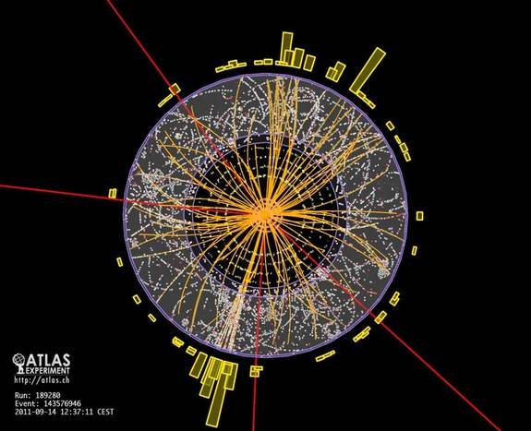
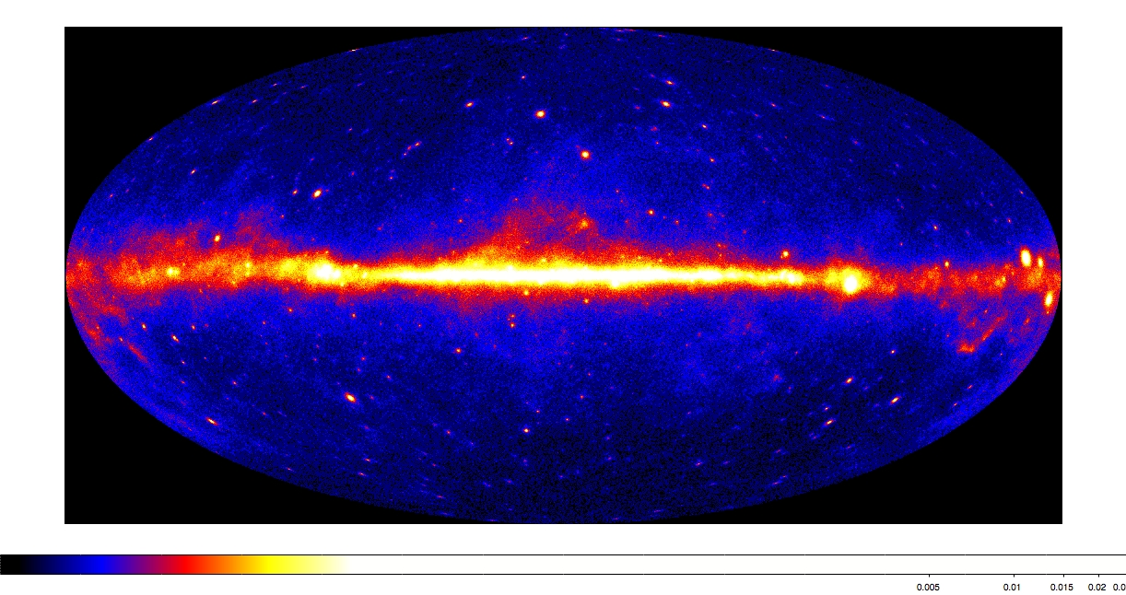
From Deep Underground to the Tops of Mountains,
HEP pushes the Frontiers of Research
Research at the Energy Frontier — HEP supports research where powerful accelerators such as the LHC are used to create new particles, reveal their interactions, and investigate fundamental forces, and where experiments such as ATLAS and CMS explore these phenomena.
Research at the Intensity Frontier — Reactor and beam-based neutrino physics experiments such as Daya Bay and LBNE may ultimately answer some of the fundamental questions of our time: why does the Universe seem to be composed of matter and not anti-matter?
Research at the Cosmic Frontier — Through ground-based telescopes, space missions, and deep underground detectors, research at the cosmic frontier aims to explore dark energy and dark matter, which together comprise approximately 95% of the universe.
Theory and Computation — Essential to the lifeblood of High Energy Physics, the interplay between theory, computation, and experiment drive the science forward. Computational sciences and resources enhance both data analysis and model building.
Accelerator Science — Supports R&D at national labs and universities in beam physics, novel acceleration concepts, beam instrumentation and control, high gradient research, particle and RF sources, superconducting magnets and materials, and superconducting RF technology.

Slide 57

The LHC Forecast
~3000 fb⁻¹
LS1 LS2 LS3
√s = 7 – 8 TeV
13 ~ 14 TeV
14 TeV
14 TeV
L = 10²⁷→ 7x10³³
1 x10³⁴
2 x10³⁴
5 x10³⁴
Phase – 0 [Shutdown]
<μ> = 20
<μ> = 27
<μ> = 55
Phase – 1 Upgrade
Phase – 2 Upgrade
Integrated Luminosity (fb⁻¹)
<μ> = 140
~300 fb⁻¹
~100 fb⁻¹
25 fb⁻¹
2010
2012
2014
2016
2018
2020
2022
2024
…...
2030
Calendar Year

Slide 58

Future Lepton Colliders and LHC Phase-II
Guidance for proposals on e.g., future lepton colliders (LC) and/or LHC Phase-II detector upgrades
  General approach to such R&D proposals, where LC and Phase-II are common examples
  Proposals in such research areas may be submitted in addition to a group’s research activities on
  one of the LHC experiments (CMS or ATLAS)
  If so, proposals encouraged to address project narrative separately – one for each research area
  as part of an “umbrella” proposal on multiple research tasks
    for e.g., Task A devoted to ATLAS research efforts, Task B on LC, etc…
    as specified in Section IV of FOA, list all PIs and budget info for each area in the ‘Cover Page Supplement for Proposals with Multiple Research Areas or Thrusts’ material of the proposal
    proposal must comply with all FOA requirements, including page limits
  Detector R&D may support some level of engineering/M&S whereas Energy Frontier typically does not
  Depending on scope of work described in these tasks, DOE Program Managers will assess which Panel (i.e., Energy Frontier or Particle Detector R&D) to solicit reviews
Task C: Phase-II inspired R&D with technology also applied to Dark Matter experiments at the Cosmic Frontier
Task C: Detector-
specific Phase-II
research
Energy Frontier
Applications addressing
physics studies and
pre-conceptual R&D directed towards specific future Energy Frontier experiments
Particle Detector R&D
Supports “generic” R&D activities on physics of particle detection that has potential
for wide applicability
and/or high impact
Task B: LC-inspired
research with
applications of R&D
towards future detectors
for Intensity Frontier
experiments
Task B: LC-
specific research
Final decisions on support will depend on the scientific merit review process, and other programmatic and budgetary factors

Slide 59
HEP Intensity Frontier Experiments
Experiment | Location | Status | Description | #US Inst. | #US Coll.
Belle II | KEK, Tsukuba, Japan | Physics run 2016 | Heavy flavor physics, CP asymmetries, new matter states | 10 Univ., 1 Lab | 55
CAPTAIN | Los Alamos, NM, USA | R&D; Neutron run 2015 | Cryogenic apparatus for precision tests of argon interactions with neutrinos | 5 Univ., 1 Lab | 20
Daya Bay | Dapeng Penisula, China | Running | Precise determination of θ₁₃ | 13 Univ., 2 Lab | 76
Heavy Photon Search | Jefferson Lab, Newport News, VA, USA | Physics run 2015 | Search for massive vector gauge bosons which may be evidence of dark matter or explain g-2 anomaly | 8 Univ., 2 Lab | 47
K0TO | J-PARC, Tokai , Japan | Running | Discover and measure K_{L}→π⁰νν to search for CP violation | 3 Univ. | 12
LArIAT | Fermilab, Batavia, IL | R&D; Phase I 2013 | LArTPC in a testbeam; develop particle ID & reconstruction | 11 Univ., 3 Lab | 38
LBNE | Fermilab, Batavia, IL & Homestake Mine, SD, USA | CD1 Dec 2012; First data 2023 | Discover and characterize CP violation in the neutrino sector; comprehensive program to measure neutrino oscillations | 48 Univ., 6 Lab | 336
MicroBooNE | Fermilab, Batavia, IL, USA | Physics run 2014 | Address MiniBooNE low energy excess; measure neutrino cross sections in LArTPC | 15 Univ., 2 Lab | 101
MINERνA | Fermilab, Batavia, IL, USA | Med. Energy Run 2013 | Precise measurements of neutrino-nuclear effects and cross sections at 2-20 GeV | 13 Univ., 1 Lab | 48
MINOS+ | Fermilab, Batavia, IL & Soudan Mine, MN, USA | NuMI start-up 2013 | Search for sterile neutrinos, non-standard interactions and exotic phenomena | 15 Univ., 3 Lab | 53
Mu2e | Fermilab, Batavia, IL, USA | First data 2019 | Charged lepton flavor violation search for 𝜇N→eN | 15 Univ., 4 Lab | 106
Muon g-2 | Fermilab, Batavia, IL, USA | First data 2016 | Definitively measure muon anomalous magnetic moment | 13 Univ., 3 Lab, 1 SBIR | 75
NOνA | Fermilab, Batavia, IL & Ash River, MN, USA | Physics run 2014 | Measure ν_{μ}-ν_{e} and ν_{μ}-ν_{μ} oscillations; resolve the neutrino mass hierarchy; first information about value of δ_{cp} (with T2K) | 18 Univ., 2 Lab | 114
ORKA | Fermilab, Batavia, IL, USA | R&D; CD0 2017+ | Precision measurement of K⁺→π⁺νν to search for new physics | 6 Univ., 2 Lab | 26
Super-K | Mozumi Mine, Gifu, Japan | Running | Long-baseline neutrino oscillation with T2K, nucleon decay, supernova neutrinos, atmospheric neutrinos | 7 Univ. | 29
T2K | J-PARC, Tokai & Mozumi Mine, Gifu, Japan | Running; Linac upgrade 2014 | Measure ν_{μ}-ν_{e} and ν_{μ}-ν_{μ} oscillations; resolve the neutrino mass hierarchy; first information about value of δ_{cp} (with NOνA) | 10 Univ. | 70
US-NA61 | CERN, Geneva, Switzerland | Target runs 2014-15 | Measure hadron production cross sections crucial for neutrino beam flux estimations needed for NOνA, LBNE | 4 Univ., 1 Lab | 15
US Short-Baseline Reactor | Site(s) TBD | R&D; First data 2016 | Short-baseline sterile neutrino oscillation search | 6 Univ., 5 Lab | 28

Slide 60
Broader
Impacts of HEP

Slide 61
The Accelerator R&D Stewardship Program
The mission of the HEP long-term accelerator R&D stewardship program is to support fundamental accelerator science and technology development of relevance to many fields and to disseminate accelerator knowledge and training to the broad community of accelerator users and providers.
Strategies:
  Improve access to national laboratory accelerator facilities and resources for industrial and for other U.S. government agency users and developers of accelerators and related technology;
  Work with accelerator user communities and industrial accelerator providers to develop innovative solutions to critical problems, to the mutual benefit of our customers and the DOE discovery science community;
  Serve as a catalyst to broaden and strengthen the community of accelerator users and providers
Strategic plan sent to Congress in October 2012
Incorporated into FY2014 Budget Request as new subprogram in HEP

Slide 62
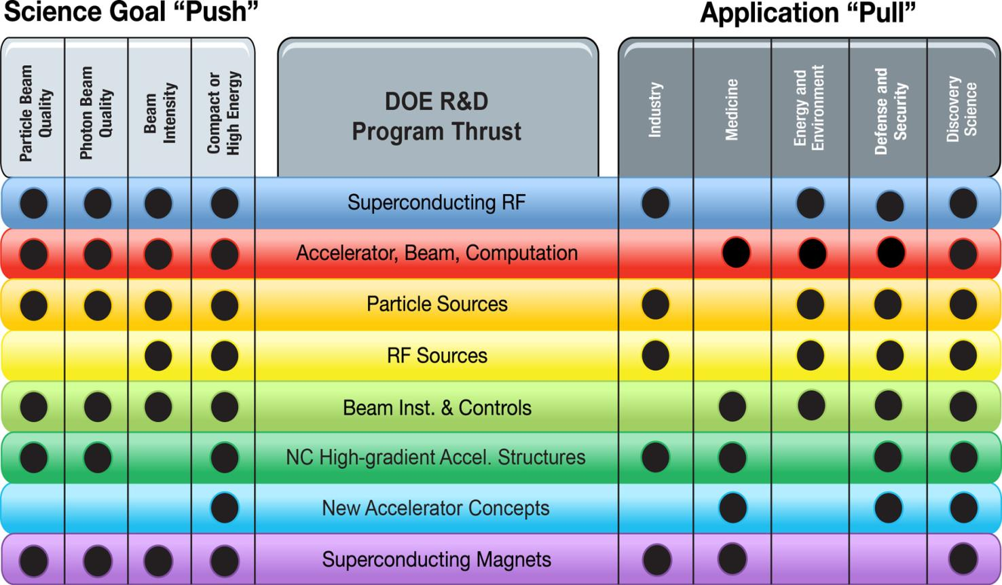
Connecting Accelerator R&D to Science and to End-User Needs

Slide 63
Budget
REFERENCE SLIDES

Slide 64
FY 2014 Request Crosscuts

Slide 65
Note on HEP Research Funding
The FY 2014 Request for HEP Research was $384M, about a 6% increase compared to
FY 2013, but $26 million of this is planned to go to R&D for Dark Matter G2,
DESI, and LHC upgrades.
Our current FY 2014 planning is based on the House markup of the Energy and Water Appropriation which is overall slightly below the Request
  The House mark directed HEP to move $8 million to LBNE PED, $2 million to SURF, and lower the overall HEP budget by $4 million. The choice was made to take all of these reductions from Research due to our priority to increase Project spending.
These two effects reduce Research to $343M, about a 5% reduction w.r.t. FY 2013
At the beginning of the year it is necessary to hold back funds for decisions to be made later in the year, such as the Early Career Research Program and other needs.
  This results in an approximately 6% reduction relative to FY 2013 for the initial distribution of funds. This is the average effect on initial HEP research funding.
There is some small variation in the impact to individual HEP subprograms, and program managers have the authority to provide more or less than the average reduction based on program priorities and the results of merit review.
The House mark is a budget indicator but not the final word on FY 2014. When Congress passes a budget, there could be either an increase or a decrease in HEP research funding.

Slide 66
HEP Physics Funding by Activity
Funding (in $K) | FY 2012 Actual | FY 2013 July Plan | FY 2014 Request | Explanation of Change wrt FY12
Research | 391,329 | 362,284 | 383,609 | Reduction mostly ILC R&D
Facility Operations and Exp’t Support | 249,241 | 265,305 | 271,561^{(a)} | NOνA ops start-up and Infrastructure improvements
Projects | 129,963 | 99,934 | 99,894
Energy Frontier | 0 | 3,000 | 0 | Phase-1 LHC detector upgrades
Intensity Frontier | 86,570 | 62,794 | 37,000 | NOνA ramp-down, start Muon g-2
Cosmic Frontier | 12,893 | 19,159 | 24,694 | LSST
Other | 2,500 | 3,200 | 3,200 | LQCD hardware
Construction (Line Item) | 28,000 | 11,781 | 35,000 | Mostly Mu2e; no LBNE ramp-up
SBIR/STTR | 0 | 0 | 21,457
TOTAL, HEP | 770,533 | 727,523^{(b)} | 776,521
^{(a)} Includes $1,563K GPE.
^{(b)} Reflects sequestration.

Slide 67
HEP Intensity Frontier
Funding (in $K) | FY 2012 Actual | FY 2013 July Plan | FY 2014 Request | Comment
Research | 53,261 | 52,108 | 53,562 | Ramp-down of B-factory research offset by increased support for new initiatives
Facilities | 143,844 | 172,318 | 180,481
Expt Ops | 6,615 | 7,354 | 7,245 | Offshore and Offsite Ops
Fermi Ops | 119,544 | 143,128 | 156,438 | Accelerator and Infrastructure improvements
B-factory Ops | 10,031 | 5,654 | 4,600 | Completion of BaBar D&D
Homestake* | 5,478 | 14,000 | 10,000
Other | 2,176 | 2,182 | 2,198 | GPE and Waste Mgmt
Projects | 86,750 | 62,794 | 37,000
Current | 73,770 | 52,794 | 27,000 | NOνA + MicroBooNE ramp-down
Future R&D | 12,880 | 10,000 | 10,000
TOTAL, Intensity Frontier | 283,675 | 287,220 | 271,043
*Per interagency MOU, HEP provided LHC Detector Ops funding during FY12 CR to offset NSF contributions to Homestake
dewatering activities.

Slide 68
HEP Cosmic Frontier
Funding (in $K) | FY 2012 Actual | FY 2013 July Plan | FY 2014 Request | Comment
Research | 47,840 | 48,836 | 62,364 | R&D for G2 Dark Matter
Facilities | 11,207 | 10,948 | 12,022 | Offshore and offsite Ops
Projects | 12,893 | 19,159 | 24,694
Current | 9,153 | 9,500 | 23,200 | LSSTcam fabrication begins
Future R&D | 3,380 | 9,659 | 1,484 | Dark energy and dark matter projects move to conceptual design
TOTAL, Cosmic Frontier | 71,940 | 78,943 | 99,080

Slide 69
HEP Theory and Computation
Funding (in $K) | FY 2012 Actual | FY 2013 July Plan | FY 2014 Request | Comment
Research | 64,465 | 63,198 | 59,670
HEP Theory | 55,929 | 54,621 | 51,196 | Follows programmatic reductions in Research
Computational HEP | 8,536 | 8,577 | 8,474
Projects | 2,500 | 3,200 | 3,200 | Lattice QCD hardware
TOTAL, Theory and Comp. | 66,965 | 66,398 | 62,870

Slide 70
HEP Advanced Technology R&D
Funding (in $K) | FY 2012 Actual | FY 2013 July Plan | FY 2014 Request | Comment
Research | 134,006 | 111,888 | 105,303
General Accel. R&D | 59,280 | 61,791 | 57,856 | Selected long-term R&D moves to Accelerator Stewardship
Directed Accel. R&D | 46,587 | 22,692 | 23,500 | Completion of ILC R&D
Detector R&D | 28,139 | 27,405 | 23,947 | Funding for liquid argon R&D is reduced
Facility Operations | 23,100 | 19,997 | 17,150 | Completing SRF infrastructure at Fermilab
TOTAL, Advanced Technology R&D | 157,106 | 131,885 | 122,453

Slide 71
Accelerator Stewardship
Funding (in $K) | FY 2012 Actual | FY 2013 July Plan | FY 2014 Request | Comment
Research | 0 | 82 | 6,581 | Recast of Accelerator R&D activities relevant to broader impacts
Facility Operations | 2,850 | 3,050 | 3,350 | Incremental FACET ops for stewardship research
TOTAL, Accel. Stewardship | 2,850 | 3,132 | 9,931

Slide 72
HEP Project Status
Subprogram | TPC ($M) | CD Status | CD Date
INTENSITY FRONTIER
Long Baseline Neutrino Experiment (LBNE) | TBD | CD-1 | December 10, 2012
Muon g-2 | 40 | CD-0 | September 18, 2012
Mu2e | 249 | CD-1 | July 11, 2012
Next Generation B-Factory Detector Systems (BELLE-II) | 16 | CD-3a | November 8, 2012
NuMI Off-Axis Electron Neutrino Appearance Exp’t (NOνA) | 278 | CD-3b | October 29, 2009
Micro Booster Neutrino Experiment (MicroBooNE) | 19.9 | CD-3b | March 29, 2012
Main INjector ExpeRiment for ν-A (MINERνA) | 16.8 | CD-4 | June 28, 2010 [Finished]
Daya Bay Reactor Neutrino Experiment | 35.5 | CD-4b | August 20, 2012 [Finished]
ENERGY FRONTIER
LHC ATLAS Detector (Phase-1) Upgrade | TBD | CD-0 | September 18, 2012
LHC CMS Detector (Phase-1) Upgrade | TBD | CD-0 | September 18, 2012
COSMIC FRONTIER
Dark Matter (DM-G2) | TBD | CD-0 | September 18, 2012
Mid-Scale Dark Energy Spectroscopic Instrument (MS-DESI) | TBD | CD-0 | September 18, 2012
Large Synoptic Survey Telescope (LSST) | 173 | CD-1 | April 12, 2012
Dark Energy Survey (DES) | 35.1 | CD-4 | June 4, 2012 [Finished]
ADVANCED TECHNOLOGY R&D
Accelerator Project for the Upgrade of the LHC (APUL) | 11.5 | CD-2/3 | July 29, 2011
Berkeley Lab Laser Accelerator (BELLA) | 27.2 | CD-4 | January 17, 2013 [Finished]
Facility for Advanced Accelerator Experimental Tests (FACET) | 14.5 | CD-4 | January 31, 2012 [Finished]

Slide 73
Current LBNE Strategy
We are trying to follow the reconfiguration [phased] plan for LBNE, though it has hit some snags
  Out-year budgets are challenging
  Some members of the community objected that the phased LBNE was not what the previous P5 [or they] had in mind
The plan, as it currently stands:
  Use time before baselining to recruit partners (international and domestic) that expand scope and science reach
We also take note of the House language on LBNE:
  “The Committee recognizes the importance of this project to maintaining American leadership in the intensity frontier and to basic science discovery of neutrino and standard model physics. However, the Committee also recognizes that LBNE construction must be affordable under a flat budget scenario. As such, the Committee supports the Office of Science’s challenge to the High Energy Physics community to identify an LBNE construction approach that avoids large out-year funding spikes or to identify viable alternatives with similar scientific benefits at significantly lower cost.”

Slide 74
FY13 Comparative review stats

Slide 75
FY13 Declined Proposals
Based on: reviewers’ assessments, comparison and ranking of the proposals by the panel(s) within the subprogram(s), evaluations of the needs of the HEP research program by the respective Program Managers, potential impact of the proposed work, proposals’ responsiveness to the FY13 HEP Comparative Review FOA, budgetary constraints
  61 proposals were recommended for declination
    12 proposals seeking new scope of research support (currently funded by OHEP)
    12 proposals requested support to extend currently funded research (“renewal”)
    37 proposals from senior investigators not supported by a DOE HEP
    grant in FY12
      including 7 proposals from Small Business applicants
      15 proposals came from senior investigators who were not
      successful in the FY12 Comparative Review

