Slide 1
Cosmic Frontier Colloquium CF-5: DE and CMB

Slide 2
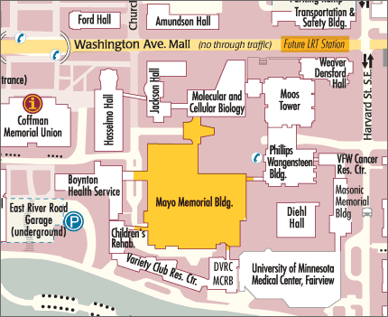
Today at 1:45pm Mayo Memorial Auditorium Cosmic Surveys Colloquium Beyond Einstein: The Physics Driving Cosmic Acceleration Beyond Planck: Neutrino and GUT-Scale Physics from the Cosmos Beyond: Extending the Reach Tough Questions for Cosmology
East Side, just over the bridge
Don’t we already know w=-1, so why do you need more data?
Precision Cosmology - Do cosmologists understand what systematic errors?
From mm to um: what do we learn as a function of the observed wavelength?
Is there a smoking gun for cosmic inflation, and how do we know if we find it?
How can we weigh neutrinos in the cosmic web? Can we also count them?
Are we done after the Stage IV Dark Energy experiments?

Slide 3
Agenda
Introduction K. Honscheid
CF-5 Reports (20 min each)
Distances E. Linder
Growth D. Huterer
Cross Correlations J. Rhodes
10:30 – 11:00 Coffee Break
Novel Probes B. Jain
Neutrinos in the Cosmos K. Abazajian
Inflation A. Lee

Slide 4
CF-5 Deliverables http://www.snowmass2013.org/tiki-index.php?page=Dark+Energy+and+CMB

Slide 5
CF-5 Deliverables http://www.snowmass2013.org/tiki-index.php?page=Dark+Energy+and+CMB
A. Kim, N. Padmanabhan
D. Huterer, D. Kirkby
J. Rhodes, D. Weinberg
B. Jain
J. Carlstrom, A. Lee
K. Abazajian

Slide 6
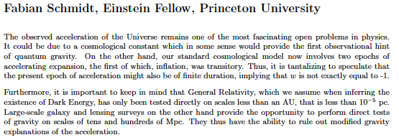
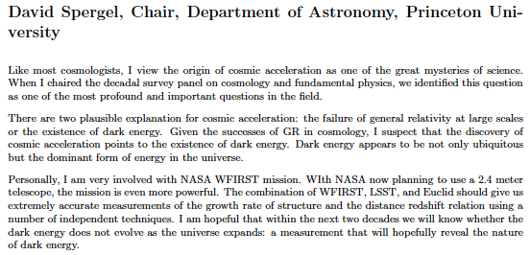
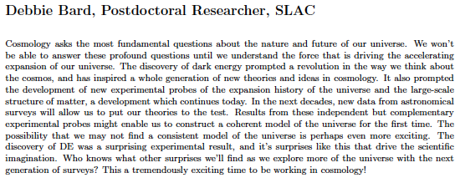
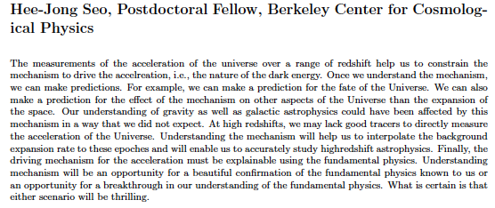
Why Study Dark Energy

Slide 7
CF-5 Program@Snowmass
5 Parallel Sessions
DE Program, Systematics, Neutrinos, Facilities, Inflation
Duncan Hanson, CMB Lensing

Slide 8
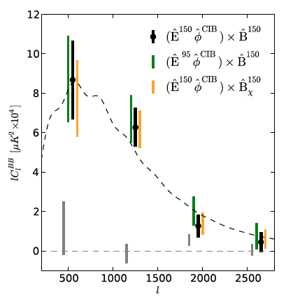
CF-5 Program@Snowmass
5 Parallel Sessions
DE Program, Systematics, Neutrinos, Facilities, Inflation
Duncan Hanson, CMB Lensing
7.7 σ

Slide 9
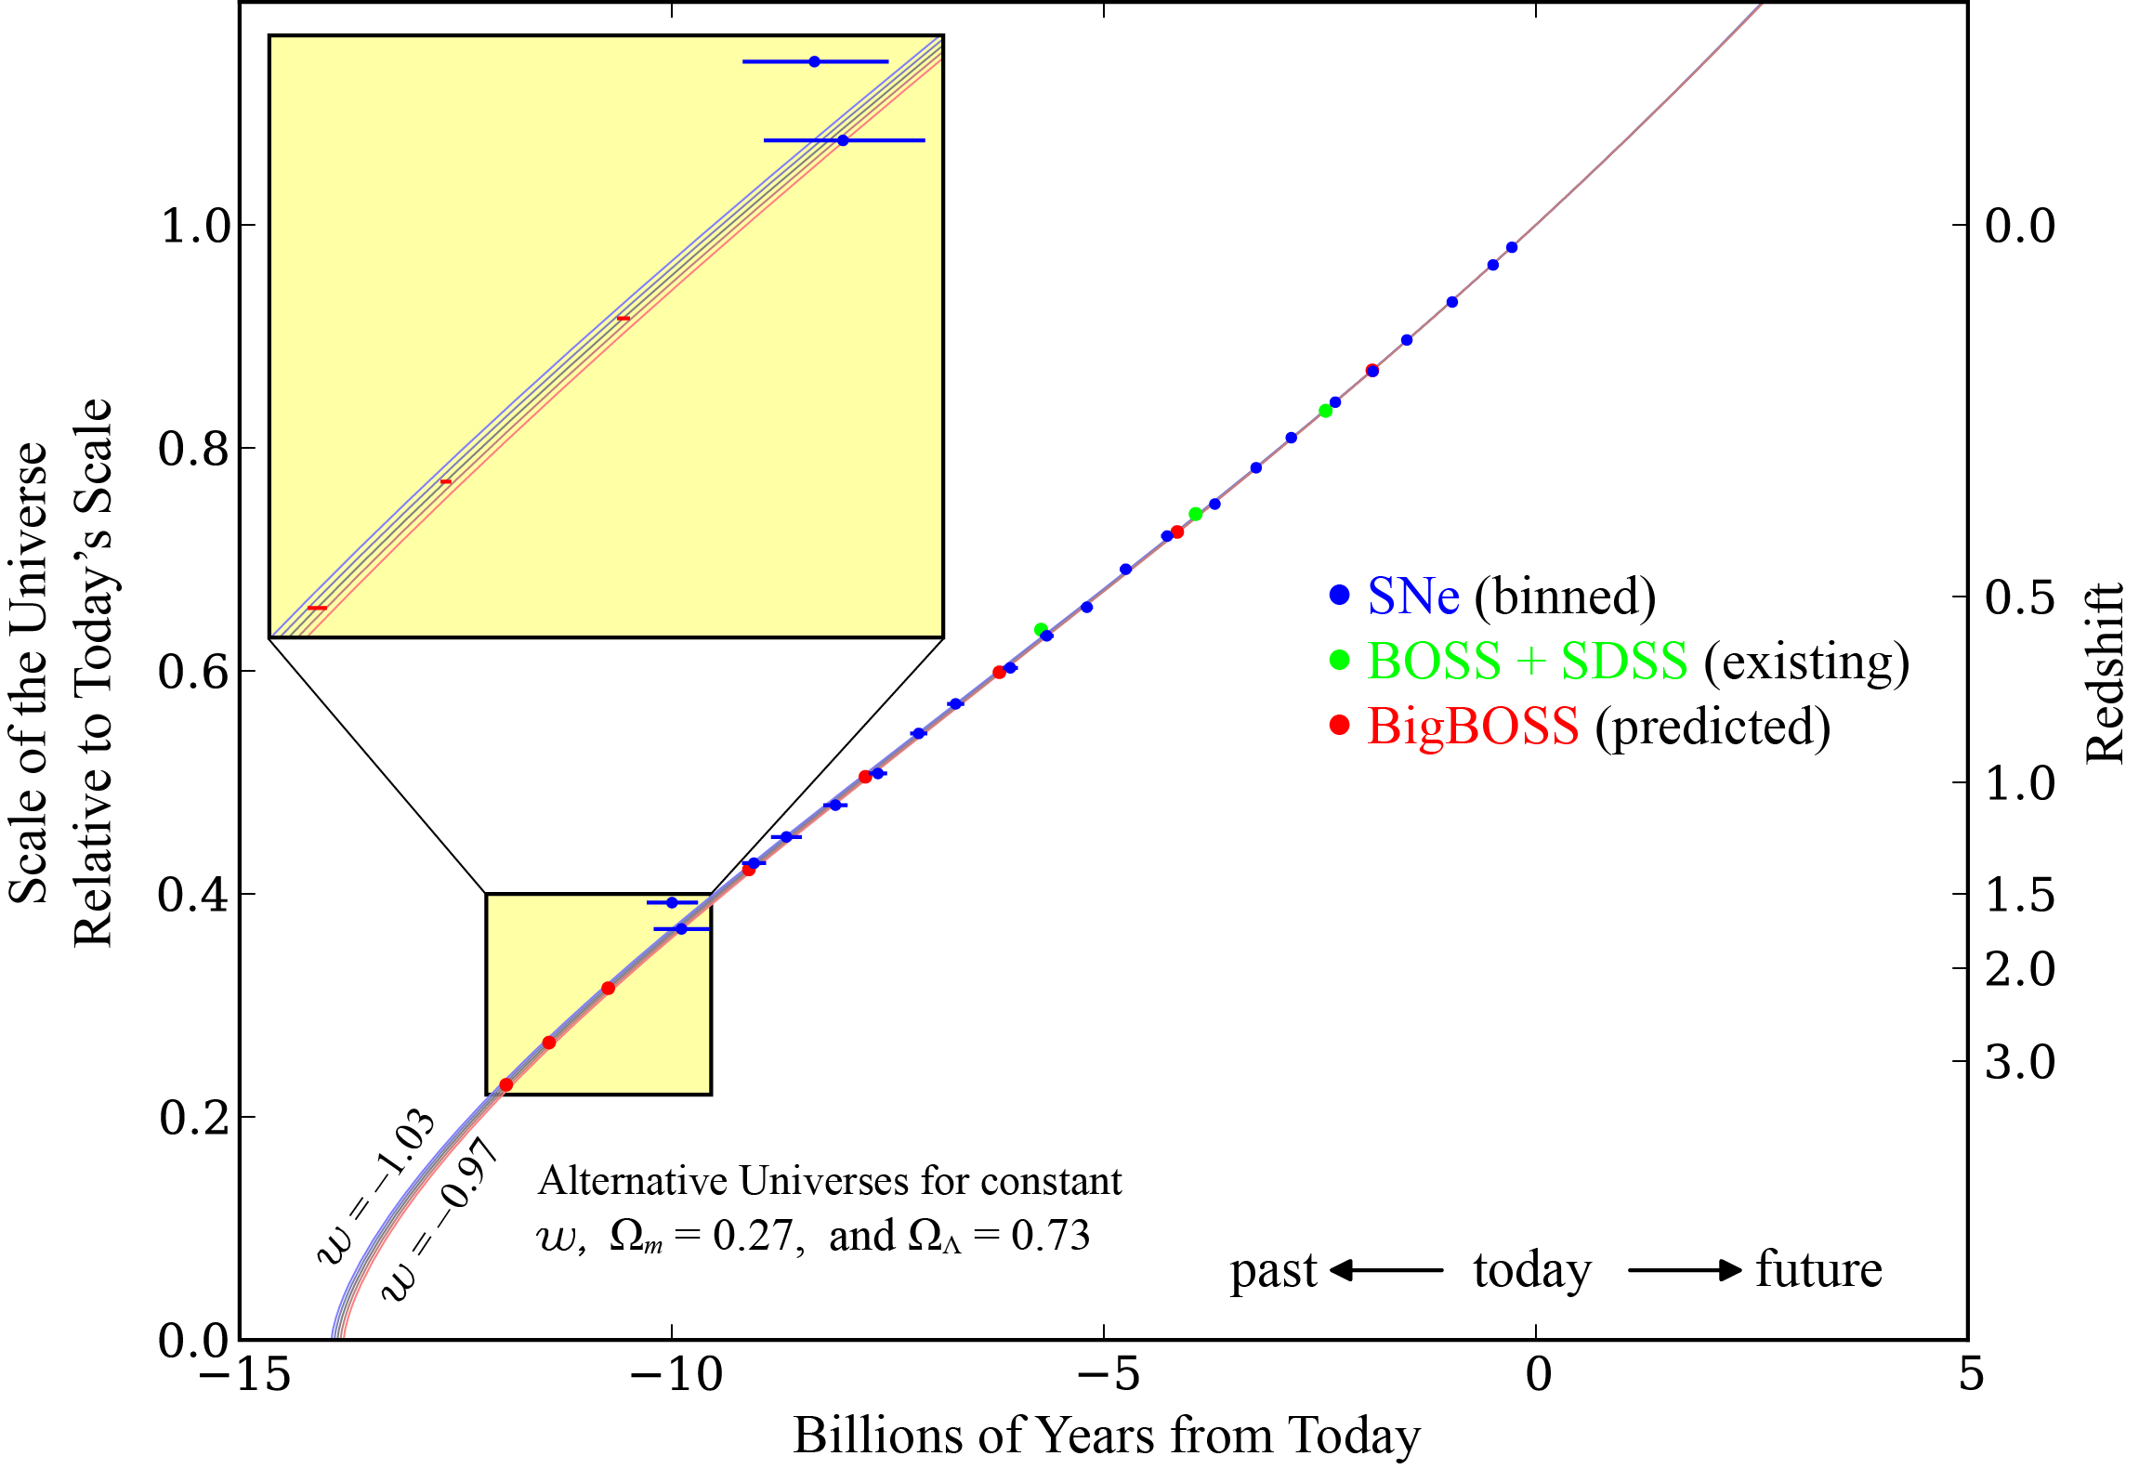
Precision Cosmology
Michael Levi
Saul Perlmutter
DESI

Slide 10
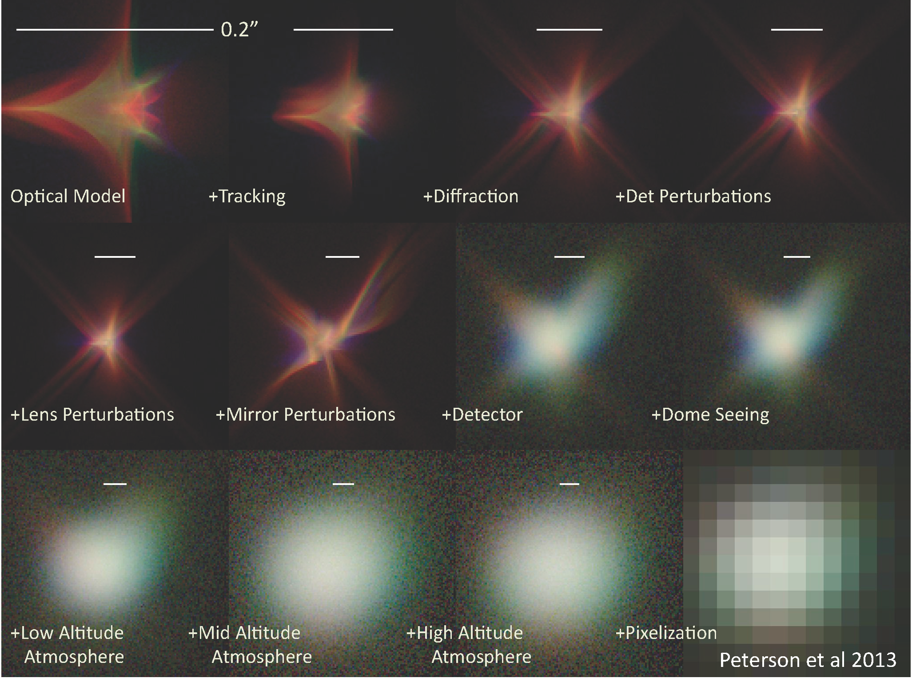
Controlling Systematic Uncertainties
LSST Photon Simulator

Slide 11
DE Program
J. Newman
Cosmic Variance

Slide 12
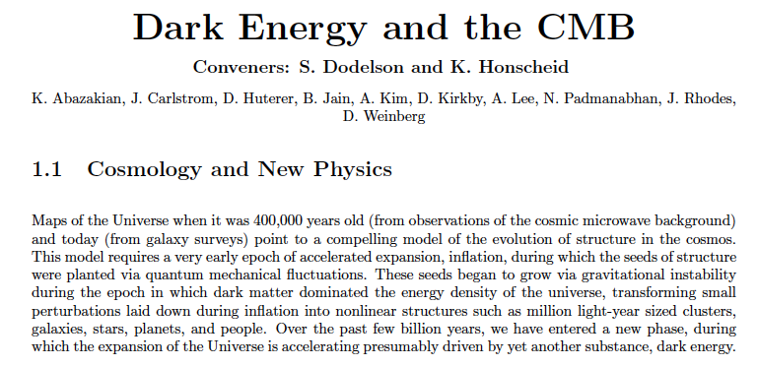
CF-5 Report

Slide 13
CF-5 Findings
Cosmic Surveys are sensitive to fundamental physics
discovery of the accelerating universe
strong evidence for an epoch of early expansion near GUT scale
indirect detection of cosmic neutrino background
compelling evidence for non-baryonic dark matter
To date only a tiny fraction of the available information has been explored
Strategic, valuable information, accessible to experiments, remains unmined
Great potential to discover something fundamentally new

Slide 14
CF-5 Recommendations
Remain a Leader in Dark Energy
US played leading role in discovering the acceleration of the Universe
A combination of imaging and spectroscopic surveys is needed to pinpoint the new physics driving the accelerations
Current suite of surveys, Stage III, will be the first to implement the vision of multiple probes and small systematics.
The next stage is needed to complete this program and to achieve percent level uncertainties
The community strongly support the program of Stage III and Stage IV dark energy experiments

Slide 15
CF-5 Recommendations
Build a Stage IV CMB Polarization Experiment
The current generation of small scale experiments will complete data taking near the end of the decade
The community understands that next generation experiment will require a nation-wide coherent effort
Moving to hundreds of thousands of detector elements will require the involvement of the National Labs working with the university community

Slide 16
CF-5 Recommendations
Extend the Reach With small investments the dark energy program can be augmented in three important ways
A targeted spectroscopic campaign, in particular to calibrate photometric redshifts
Continued investment for instrumentation R&D
Support for theoretical work and small enhancements to the survey program to develop a suite of novel probes of gravity and dark energy

