Slide 1
Neutrinos in the Cosmos
R.Svoboda, Snowmass on the Big Muddy, July 31 2013

Slide 2
solar
atmospheric
solar
atmospheric
See www.nu-fit.org, arXiv:1209.3023

Slide 3
Atmospheric Neutrinos and Neutrino Mass Hierarchy
Example:LBNE
A.Blake and H.Gallagher, ISOUP, May 24-27 Asilomar

Slide 4
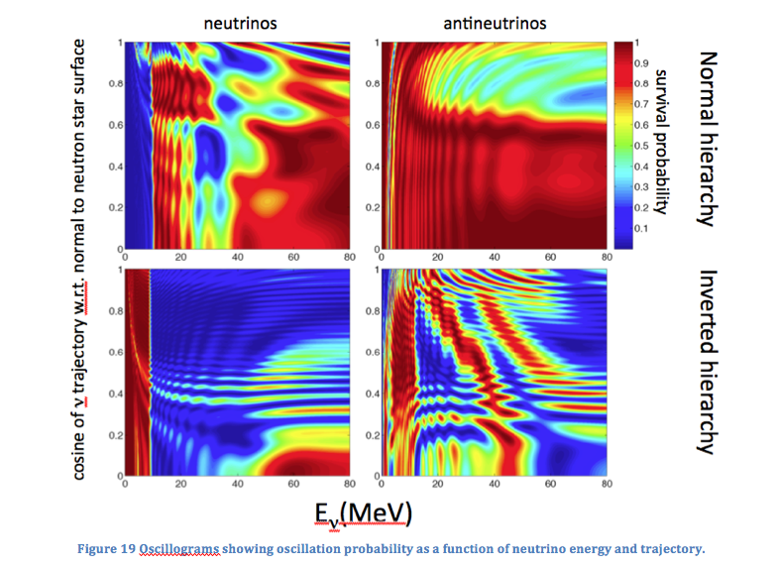
Supernova Neutrinos
G.Fuller, ISOUP, 24-27 May, Asilomar

Slide 5
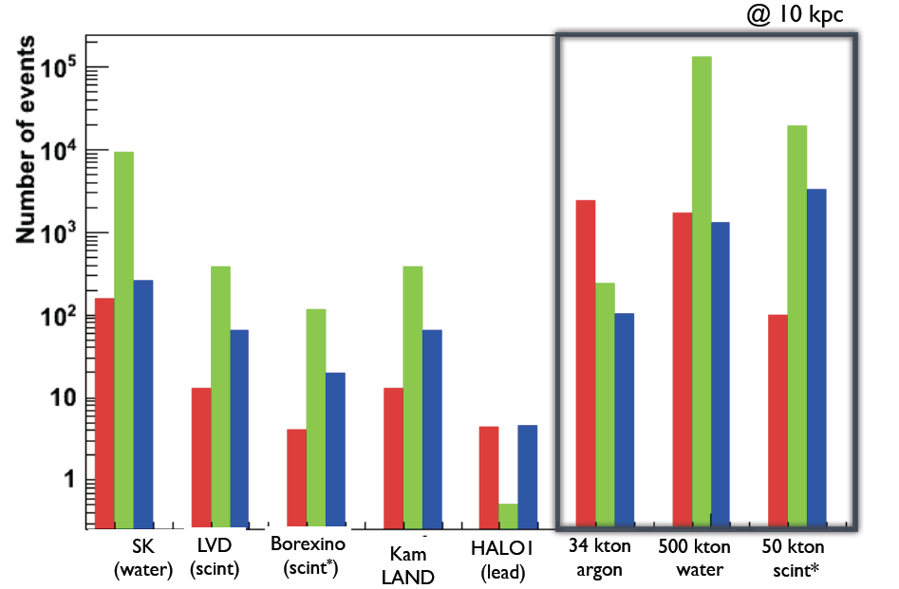
F.Cavanna, ISOUP, 24-27 May, Asilomar

Slide 6
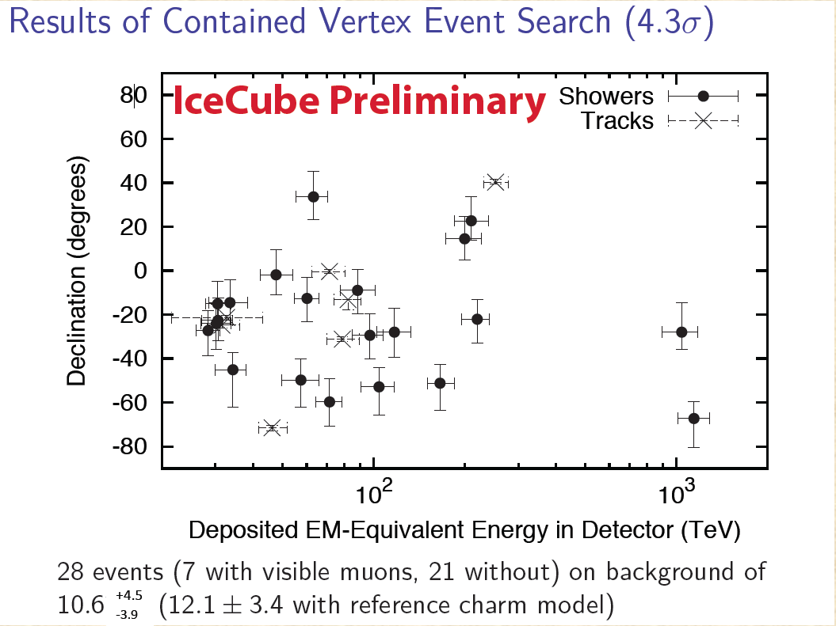
UHE Neutrinos
G.Sullivan, ISOUP, May 24-27, Asilomar

Slide 7
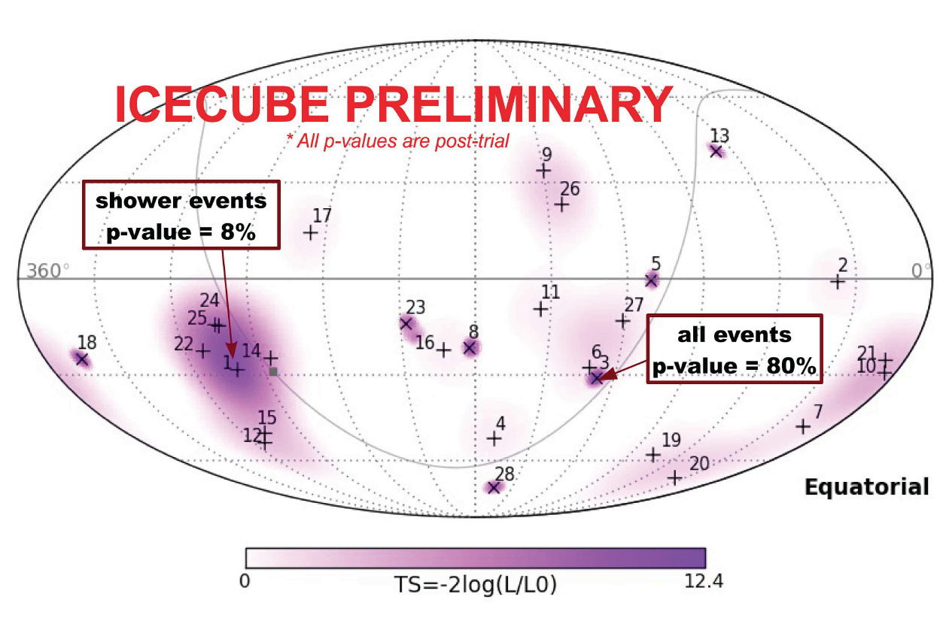
G.Sullivan, ISOUP, 24-27 May, Asilomar

Slide 8
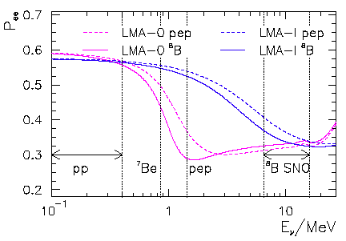
Solar Neutrinos and NSI
What we might see
What we expect
BOREXINO and SNO+
A. Friedland, C. Lunardini and C. Peña-Garay, Phys. Lett. B 594, 347 (2004).

Slide 9
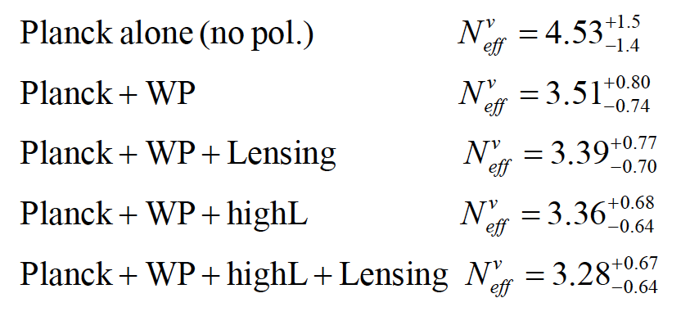
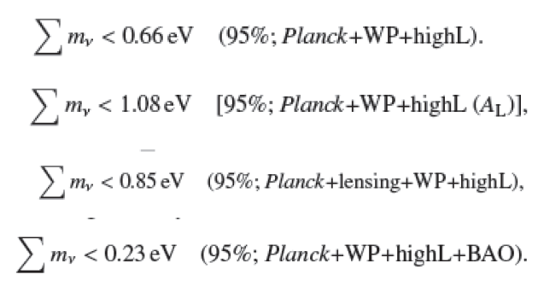
Neutrino Mass/Neff and CMB
Caution: must include
Mixing effects…
Melchiorri et al. (Planck)

Slide 10
Sterile Neutrinos
Bounds on heavy sterile neutrinos (candidate for Warm Dark Matter)
Tremaine-Gunn, Lyman-α, Dwarf Spherical Galaxy density all limit sterile neutrino mass and mixing.

Slide 11
Neutrinos and the Cosmos
Potential for surprises!
wide scope of applications, experimental reach
some measurements are unique
necessity for underground detectors is critical!
See talks at Asilomar pre-meeting:
http://neutrino.physics.ucdavis.edu/indico/conferenceDisplay.py?confId=0

