Slide 1
Beyond Einstein : The Physics Driving Cosmic Acceleration
Nikhil Padmanabhan
Yale

Slide 2
Dark Energy : The Big Questions
Is cosmic expansion accelerating because of a breakdown of GR on cosmological scales or because of a new energy component that exerts repulsive gravity within GR?
If the latter, is it consistent with a cosmological constant or does it evolve in time?
Any answers to this will point to new physics!

Slide 3
Dark Energy : Observables
Measure the expansion rate of the Universe
  The distance-redshift relations
  Directly measure H(z)
Measure the rate at which structures grow in the Universe
  Growth function D(z), and its derivatives

Slide 4
Dark Energy or Modified Gravity?
Two paradigms
  Dark energy
    What is its equation of state? How does it evolve with redshift?
    Is it consistent with a cosmological constant?
  Modified gravity
    How do structures form in the Universe?
    Are matter and light affected the same way?
  This is a rich set of questions, and requires multiple probes.

Slide 5
Dark Energy vs Modified Gravity
Expansion and growth probe different aspects

Slide 6
Where we are today
Deceleration
Expansion Rate
Acceleration
TIme

Slide 7
Probes of Dark Energy
 | Expansion | +Growth
Imaging | Supernovae | Lensing / Clusters
Spectro | BAO | Redshift Distortions
These are somewhat artificial distinctions
Information/Robustness from combining different probes
Notes:
Drop the alphabet soup.

Slide 8
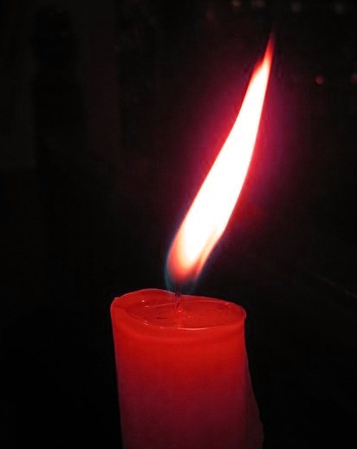
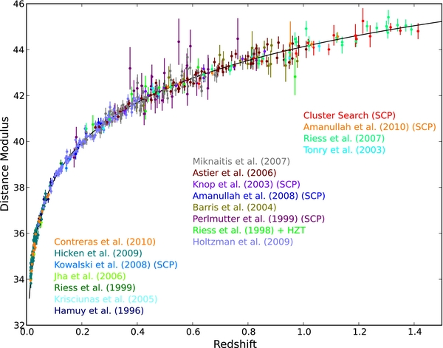
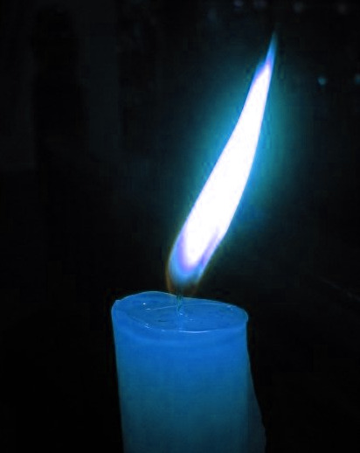

Supernovae
Log(distance)
Redshift

Slide 9
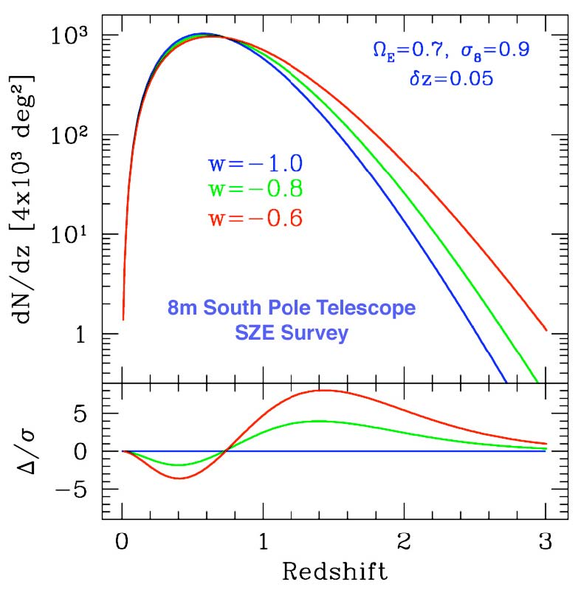
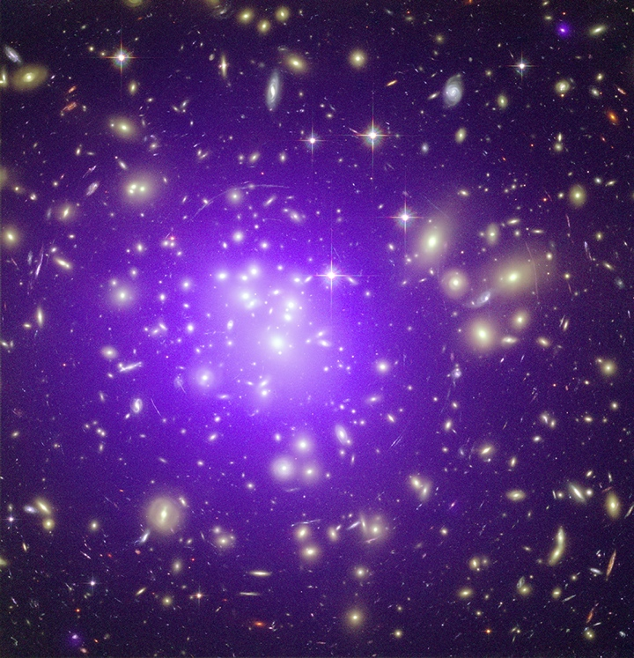
Clusters
Volume
Effect
Growth of Structure Effect
Dark energy affects the abundance of clusters (dN/dz) through the matter power spectrum and the growth rate of structure

Slide 10
Mapping the Universe
Two observable fields
  Matter Density
    Growth of structure
  Velocities
    Response to the matter density
Imaging and Spectroscopic surveys give different, complementary views
  Imaging surveys : Lensing
  Spectroscopic surveys : BAO/Redshift Distortions

Slide 11
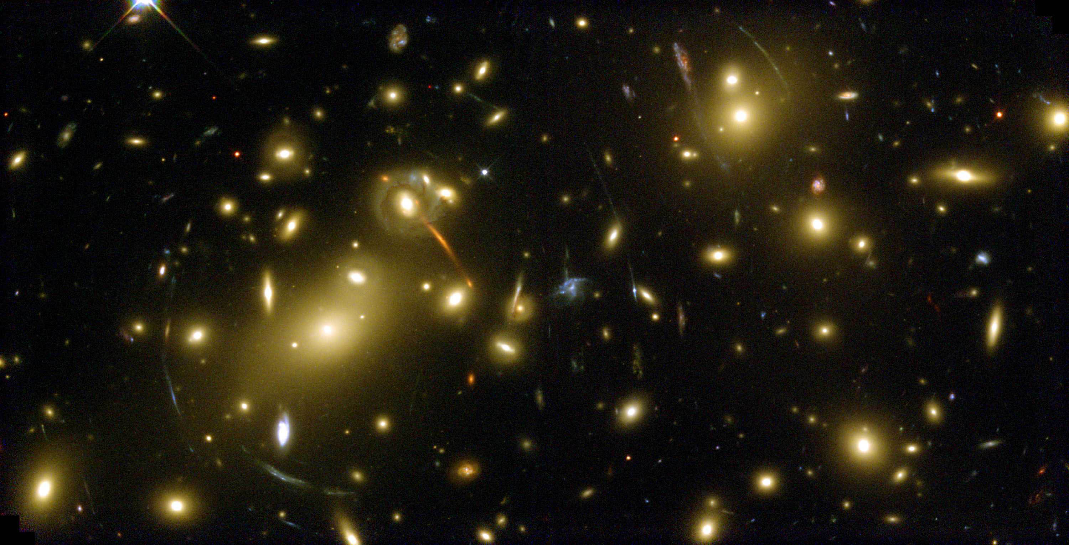

Slide 12
Lensing

Slide 13
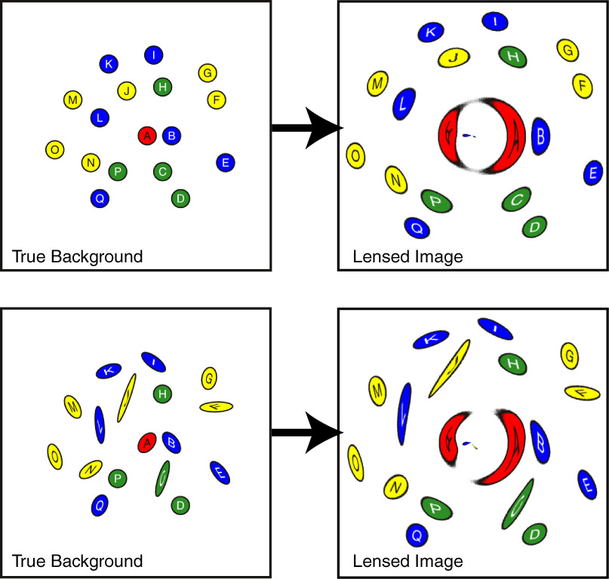
Lensing
Directly measures the matter
Measures an integrated matter density
Probes expansion and growth
2D measurement (somewhat mitigated by multiple source planes)

Slide 14
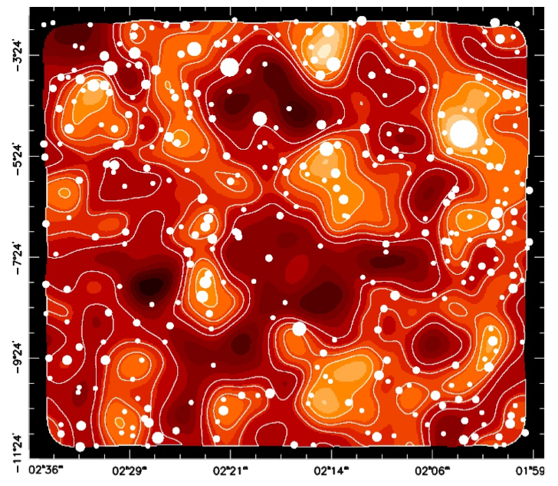

Slide 15
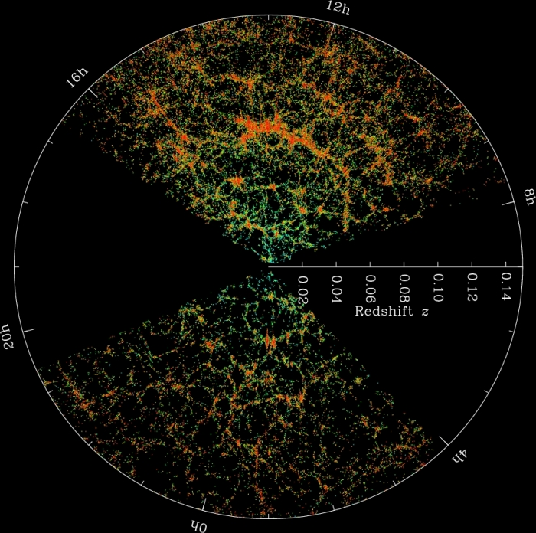

Slide 16
Spectroscopic surveys
Use the 3D distribution of galaxies
Angular positions from imaging surveys
Radial positions from redshifts
  Hubble expansion
  “Peculiar” velocities : redshift space distortions (sensitive to velocity field)
Two probes
  BAO : A standard ruler to measure the expansion
  Redshift Distortions : Growth through peculiar velocities

Slide 17
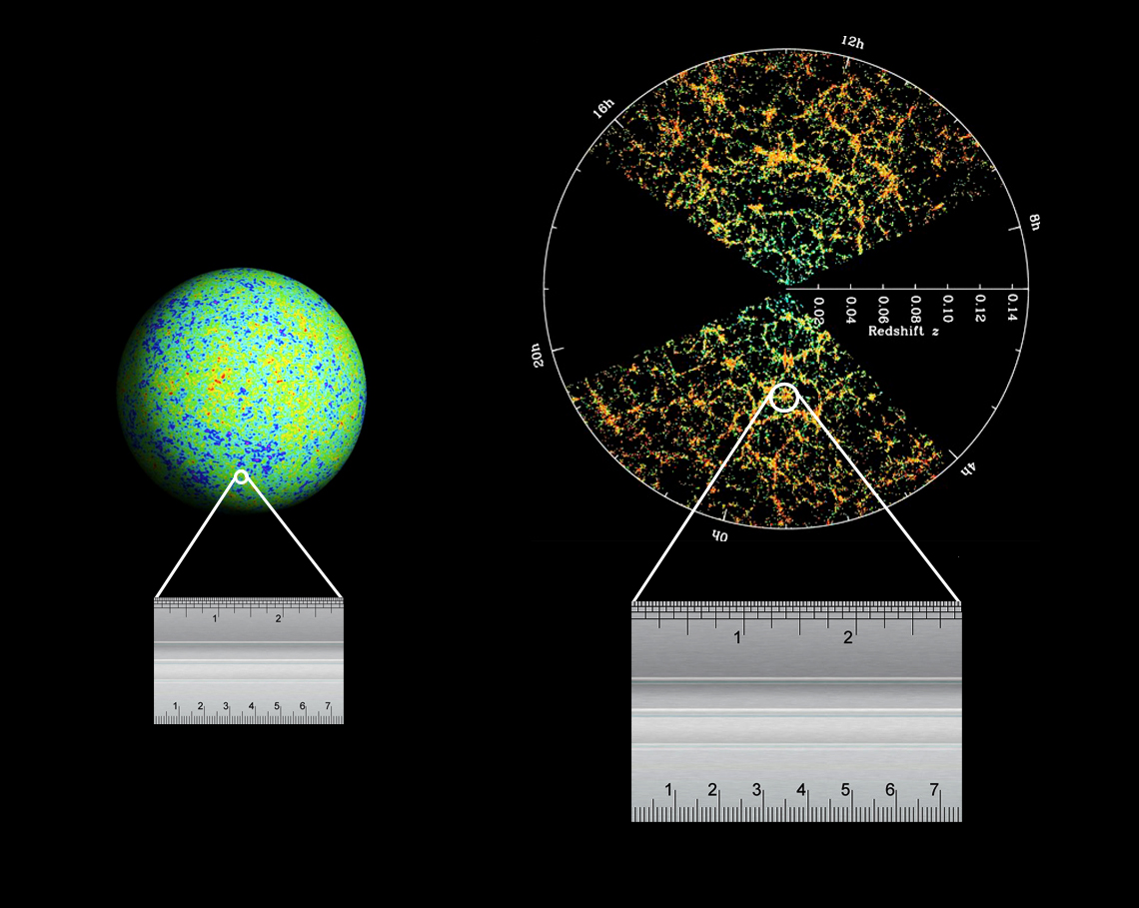
Baryon Acoustic Oscillations
Sound waves in the early Universe imprint a characteristic scale in the CMB and the galaxy densities

Slide 18
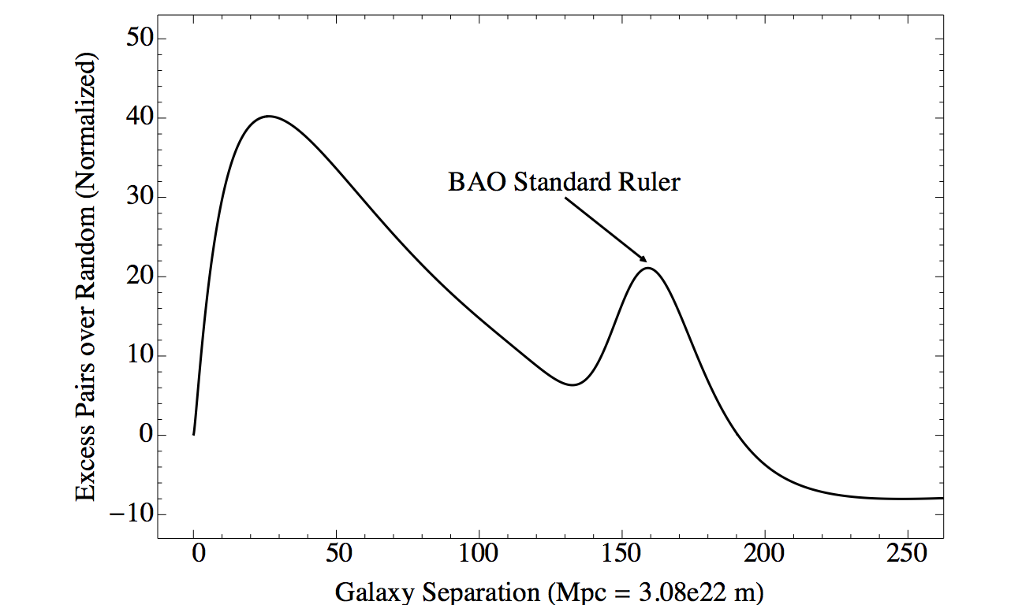
Baryon Acoustic Oscillations
Sound waves in the early Universe imprint correlations in the distribution of galaxies
Imprint of sound waves frozen
In the early Universe
Absolute scale measured by the CMB to 0.4%
Standard ruler analogous to standard candles

Slide 19
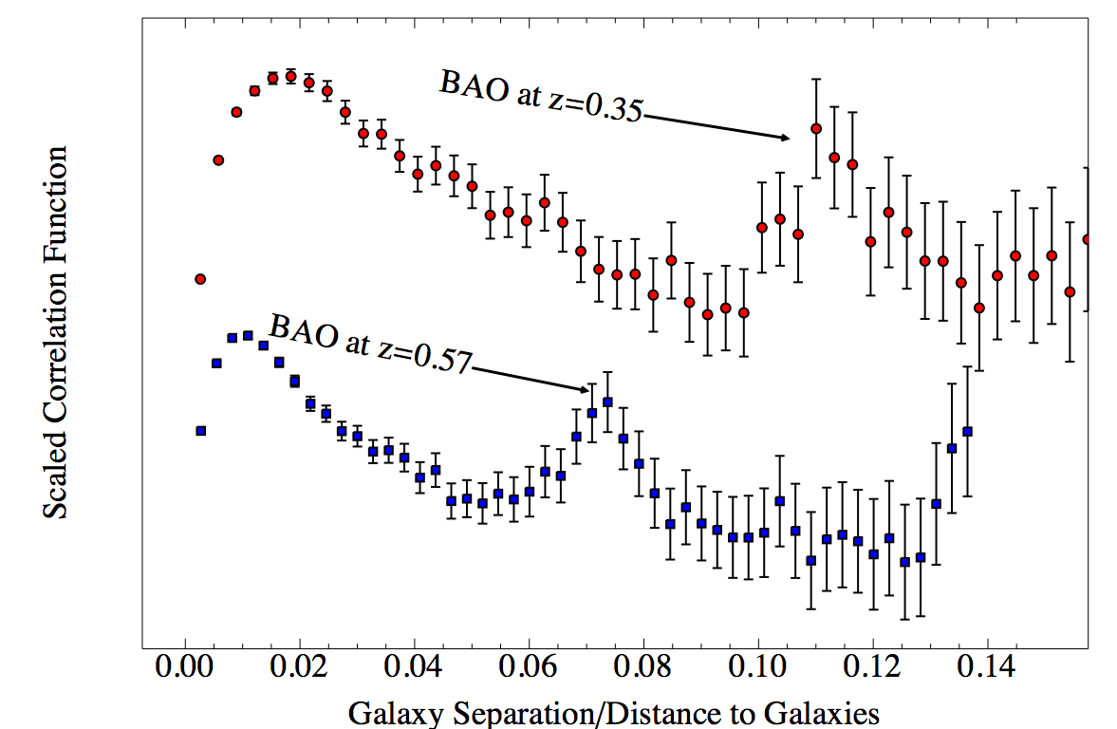
BOSS measures the BAO standard ruler
6.7 sigma
1.7% distance

Slide 20
The Future
Extract ~all the cosmological information readily accessible to us
  There is a finite amount of cosmological information; the cosmic variance limit
  Extend out in redshift
Get measurements of comparable accuracy between different probes

Slide 21
Dark Energy Experiments: 2013 - 2031
2013
2015
2017
2019
2021
2023
2025
2027
2029
BOSS
2031
Dark Energy Survey (DES)
BOSS
HETDEX
HSC imaging
PFS spectroscopy
Extended BOSS (eBOSS)
Dark Energy Spec. Instrument (DESI)
Euclid
Large Synoptic Survey Telescope (LSST)
Blue = imaging
Red = spectroscopy
WFIRST-AFTA
See CF5 Facilities white paper for details

Slide 22
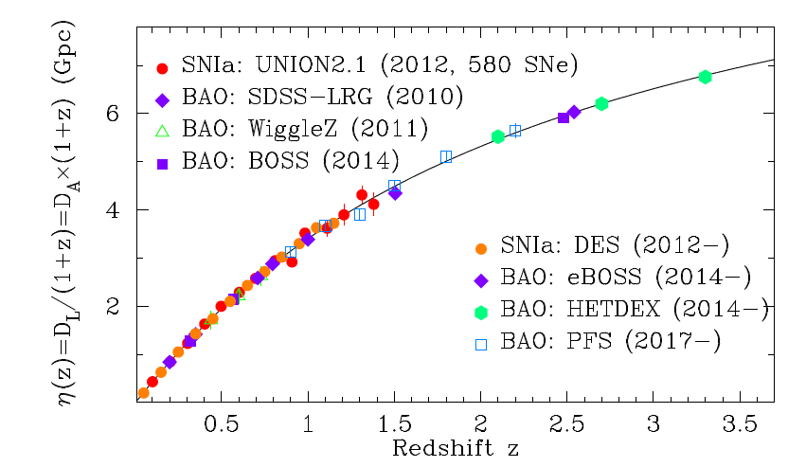
Measuring Distances

Slide 23
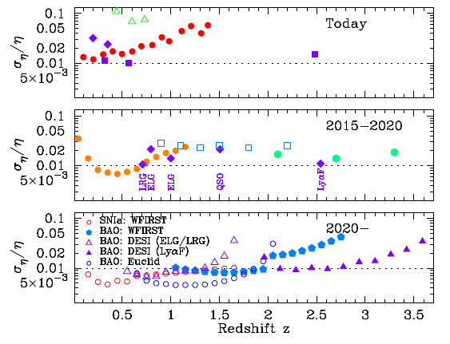
Measuring Distances

Slide 24
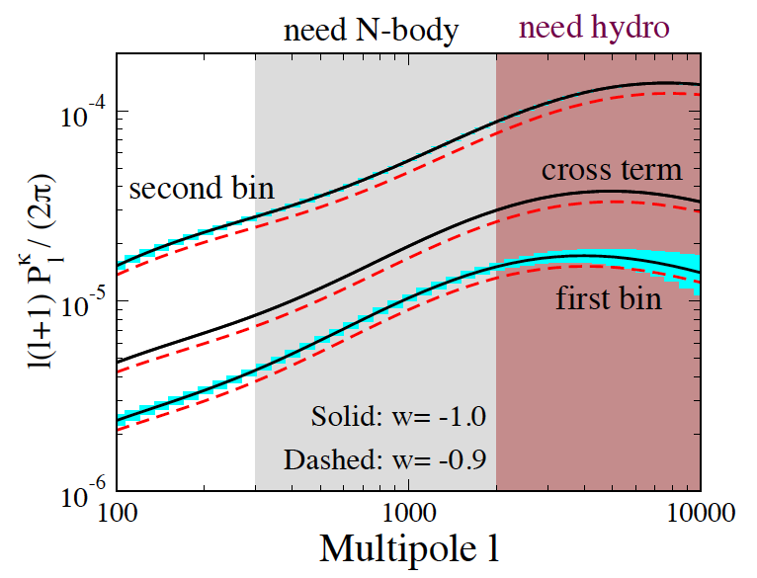
Measuring growth
Lensing surveys
Spectroscopic surveys

Slide 25
Dark Energy Experiments: 2013 - 2031
2013
2015
2017
2019
2021
2023
2025
2027
2029
BOSS
2031
Dark Energy Survey (DES)
BOSS
HETDEX
HSC imaging
PFS spectroscopy
Extended BOSS (eBOSS)
Dark Energy Spec. Instrument (DESI)
Euclid
Large Synoptic Survey Telescope (LSST)
Blue = imaging
Red = spectroscopy
WFIRST-AFTA
See CF5 Facilities white paper for details

Slide 26
Summary
We have a rich experimental program to probe the phenomenology of dark energy.
What will we learn?
  Cosmological constant
  Evolving dark energy
  Deviations from GR
  Something else…
This will be exciting!

