Slide 1
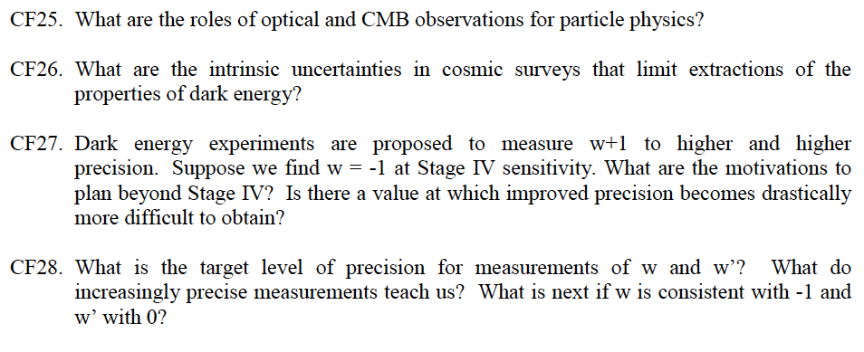
Tough Questions

Slide 2
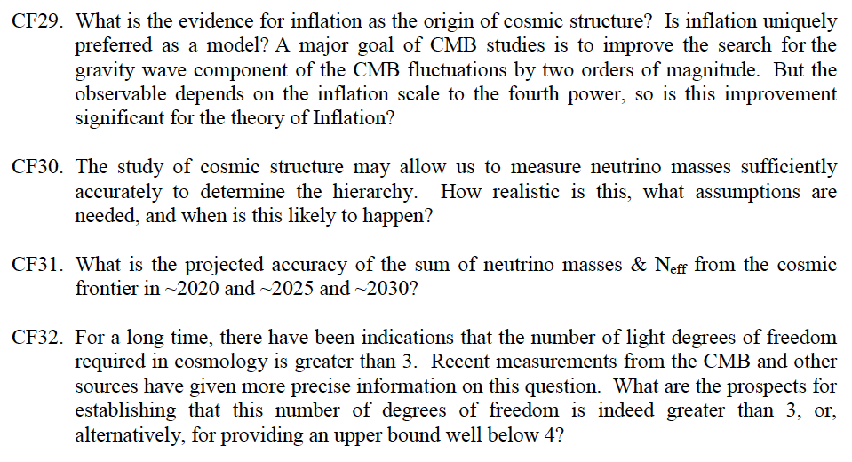

Slide 3
Proposed Tough Questions for Colloquium
We know w=-1, so why do you need more data?
Will astrophysical systematics derail our ambitious goals?
Are there more Nobel Prizes left in the CMB?
What expertise do HEP experimentalists bring to the Cosmic Frontier?
Is the search for inflation-produced gravitational waves a fishing expedition?
Can we learn anything about UV completion from these searches?
What can the cosmos tell us about neutrinos? What assumptions need to be made?
Are we done after the Stage IV Dark Energy experiments?

