Slide 1
(How) Does NP Community Make Its Case in D.C.?
Steve Vigdor, Snowmass on the Mississippi, Aug. 1, 2013
DOE Nuclear Physics Funding 1987-2013
Includes the Isotope Program starting in 2009; does not include ARRA funding
Bottom line: ~constant effort budget for field over past 25 years, with occasional bumps that raise the community’s hopes, but no real sign of budget doubling!

Slide 2
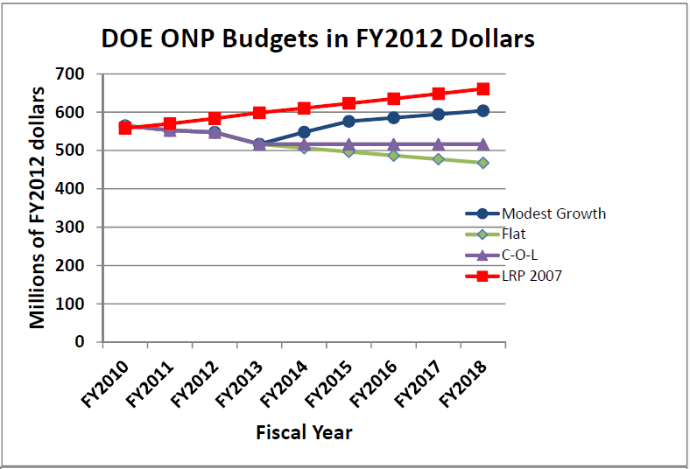
Ongoing NP “Crisis” Stems from “Budget Doubling” Assumption in 2007 Long Range Plan
From the January 2013 NSAC Subpanel (Tribble-II) Report: Implementing the 2007 Long Range Plan
Budgets through FY13 are as delivered; for FY14 and beyond and for the LRP 2007 line, budgets are projected according to various models

Slide 3
Some Things NP Community Does Well in Making Case
Long Range Plans with broad community involvement and buy-in, but also clear prioritization of projects across entire field
Stable, coherent message about field’s priorities
Tribble Panel exercises to make painful priority choices when budgets fall far short of LRP assumptions
Credibility in responding to budget reality, but also…
Opportunity to enunciate very clearly what will be lost
ONP stewardship of radioisotope production viewed as relevant
Workshops with strong end user involvement ⇒ address real short- and long-term needs of industry & medicine
Effective ONP-sponsored glossy brochure (Accelerating Innovation) on ongoing relevance to national needs
Shows “How nuclear physics benefits us all”
Nuclear Physics Day (May 6, 2013) “fly-in” to D.C.
~90 users of major national facilities interacting with local Rep. and Senate offices to deliver coherent message re importance of research, applications, training
Avoid projects that cost more than $1B
Stage as necessary to get Office of Science support
Apply breakthrough technology to reduce costs

Slide 4
“Speaking With One Voice”
Community buy-in to planning relies on:
Perceived success of the LRP approach
Perception that alternative involves less input from community at large
Perception that with sufficient patience, each subfield will “get its turn”:
1979 LRP priority → 1994 CEBAF construction completion
1983 LRP priority → 1999 RHIC construction completion
2002 LRP priority → 2019(?) FRIB construction completion
NRC Decadal Surveys (1984-6, 1997-9, 2010-12) complement the LRP’s:
They reinforce, and do not alter, the community’s priorities as set forth in most recent LRP
They provide a more expansive and compelling summary of the scientific goals and accomplishments, at a level suitable for Congressional staffers (as if they had the time…)

Slide 5
A Few Other General Comments
Deliver scientific messages to Congressfolk and staffers passionately and compellingly, but above all succinctly.
Be prepared to answer their obvious questions: why should man on the street care? Why should answering these questions have higher priority than job creation/ border security/ national defense increases/ social safety net/ …?
Emphasize training of technically skilled and creative workforce, danger of losing U.S. leadership – but have answers (statistics help!) for why HEP has greater role than other scientific fields in such training
Couple long-term scientific goals to real attention to short- and medium-term technological impacts – understand what end users of technology need, not just what HEP want them to need! Advertise SBIR, etc. successes, ongoing efforts
Spell out natural connections of your field to national priorities, but don’t stretch too far to adjust funding to political priorities “of the moment”

