Slide 1
Response to questions, regarding the proton EDM experiment Yannis Semertzidis, BNL
Snowmass on the Mississippi
Minneapolis, August 2, 2013
What is the analyzing power vs. lab scattering angle? By Brendan Casey
Is the small angle beam-beam scattering with transverse polarization buildup a systematic error? By Steve Vigdor
More on tracking results and E-fringe-field progress.

Slide 2
2. Polarimeter Development
Polarimeter tests with runs at COSY (Jülich/Germany) demonstrated < 1ppm level systematic errors: N. Brantjes et al., NIM A 664, 49, (2012)
Technologies under investigation:
Micro-Megas/Greece: high rate, pointing capabilities, part of R&D for ATLAS upgrade
MRPC/Italy: high energy resolution, high rate capability, part of ALICE development

Slide 3
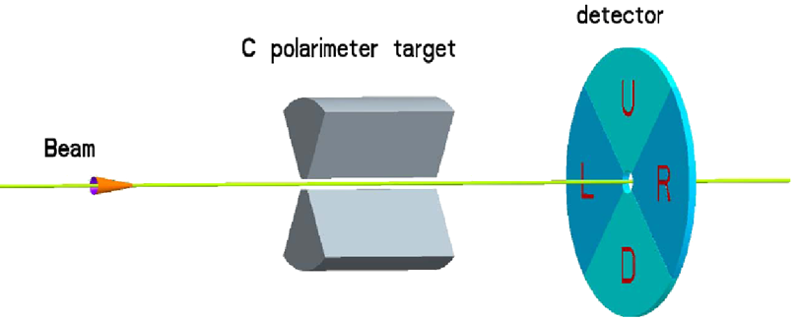
pEDM polarimeter principle (placed in a straight section of the ring): probing the proton spin components as a function of storage time
“defining aperture”
polarimeter target
Micro-Megas TPC detector
and/or MRPC
Extraction: lowering the vertical focusing strength
carries EDM signal
increases slowly with time
carries in-plane (g-2) precession signal

Slide 4
Polarimeter rates:
Beam intensity with 2×10¹⁰ pol. protons/ ~10³s and a detection efficiency of 1% → 200KHz for ~3000cm² area, or ~100Hz/cm² on average but much higher at small radius. Design: ~1KHz/pad.
70 cm

Slide 5
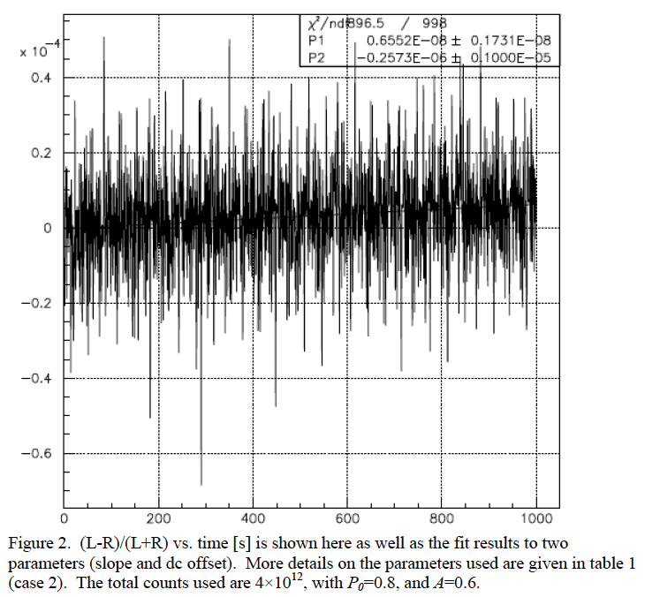
The EDM signal: early to late change
Comparing the (left-right)/(left+right) counts vs. time we monitor the vertical component of spin
M.C. data
Signal is max
when ω_{a}~0
(L-R)/(L+R) vs. Time [s]

Slide 6
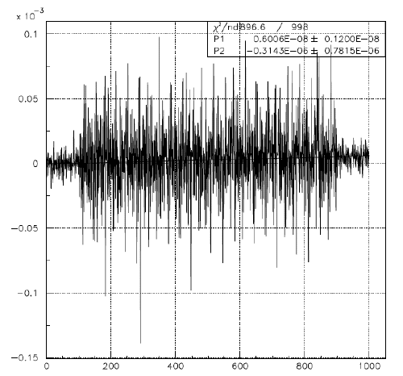
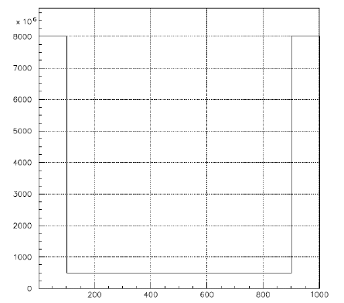
Optimizing the counting rate
We can take most counts at the beginning and the end of the storage time and some in between for spin direction monitoring.
Maximum rate: 4 × the
average rate.
Variable counting rate
as a function of time [s]
(L-R)/(L+R) vs. Time [s]

Slide 7
Proton Statistical Error (230MeV):
τ_{p} : 10³s Polarization Lifetime (Spin Coherence Time)
A : 0.6 Left/right asymmetry observed by the polarimeter
P : 0.8 Beam polarization
N_{c} : 4×10¹⁰p/cycle Total number of stored particles per cycle
T_{Tot}: 10⁷s Total running time per year
f : 0.5% Useful event rate fraction (efficiency for EDM)
E_{R} : 10.5 MV/m Radial electric field strength (95% azim. cov.)
Notes:
Yannis Semertzidis, BNL
7

Slide 10
Polarimeter R&D plan (E.S.)
Construct a prototype polarimeter, based on Micro-Megas and/or MRCP
Test at COSY
“Good” Polarimeter:
1) High rate capability, ~1-10kHz/cm²-statistics, 2) Pointing back capability <10mrad/event-Syst.
DAQ system (timing ~1ns, amplitude ~20%)
Construct a working polarimeter
1 post doc, materials
Total: $1M

Slide 11
Is the small angle beam-beam scattering with transverse polarization buildup a systematic error? By Steve Vigdor
The two counter-rotating beams are kept aligned to a high degree (better than 1nm per root(Hz)). The small angle scattering is highly uniform around the azimuth of the beam profile. It is therefore not a systematic error.
Beams rotating in the same direction with bunches of opposite helicity, which would cancel the effect (opposite to EDM signal).
However, if it’s significant to de-polarize the beams it may affect the statistical accuracy, so we will address it quantitatively.

Slide 12
“Geometrical phase” effect
Spins in three dimensions do not commute, meaning spin precessions could arise even if the line field integral is zero but locally they produce large deviations from “magic” behavior.
A combination of horizontal and vertical E-field misalignment, the most dangerous: N=1 horizontal and N=1 vertical phase shifted by 90°.

Slide 13
Multiplanar Plate Misalignments
Radial plate misalignments introduce longitudinal electric fields which accelerate the particle away from the magic momentum

Slide 14
Geometric Phases: Order Matters
1
2
"Correct" Order
3
"Wrong" Order

Slide 15
A(δ1) x B(δ2) x A(-δ1) x B(-δ2) = C(δ1δ2)

Slide 16
Study Model (by Ab Patil, HS summer student 2012)
E (V/m)
The longitudinal and vertical electric fields are assumed to have the same functional form around the ring

Slide 17
Data Analysis: Segmentation
The geometric phase is a function of azimuthal position around the ring

Slide 18
Vertical Spin Precession vs. Time for sections 1 and 5 of the ring
The average around the ring is zero, but unlike a genuine EDM signal it varies around the ring

Slide 19
Solutions
Inserting more polarimeters- at least two, if not four
The radial and vertical beam positions as a function of azimuthal position can help illuminate the problem

Slide 20
Vertical Beam Position (as a function of azimuthal location) [m]
Radial Beam Position (as a function of azimuthal location) [m]
ρ = R-R₀
Z
ρ
BPMs located around the ring with absolute position resolution in horizontal and vertical direction of 0.1mm can solve the problem.

Slide 21
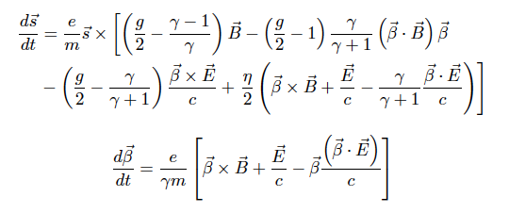
Tracking for Electric Ring, by Selcuk Haciomeroglu, BNL and ITU, PhD work
T-BMT equations in the presence of E and B-fields:
In our case we set B=0 everywhere.

Slide 22
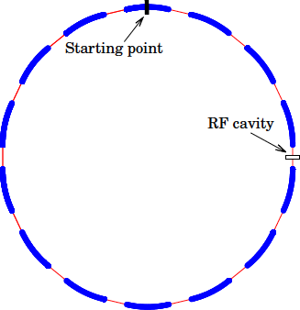
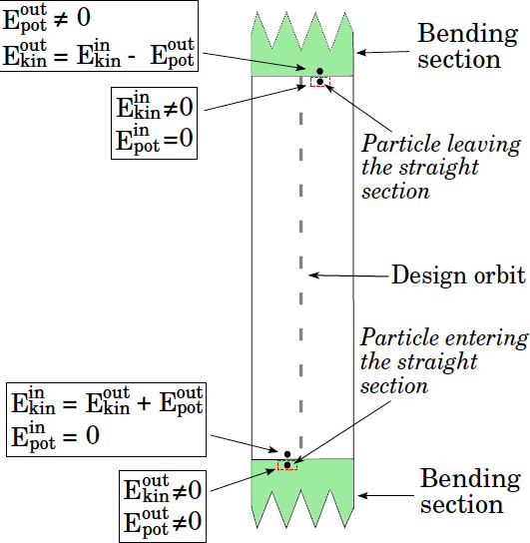
Electric Ring model
Bending/straight section: hard-edge approximation
R₀=40 m

Slide 23
Electric Ring model
E-field value as a function of position
Vertical focusing by modifying the E-field plates
n=1+m, m field focusing index=0.2→0.1
Best SCT with low m
Horizontal tune Q_{x}=sqrt(1-m+1/γ²), vertical tune Q_{y}=sqrt(m)

Slide 24
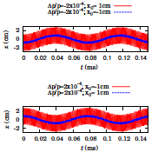
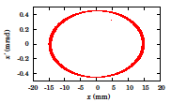
Results
Excellent beam stability

Slide 25
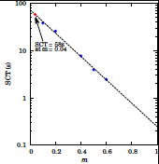
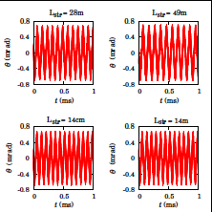
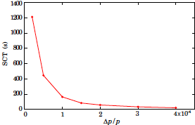
Results
Excellent SCT

Slide 26
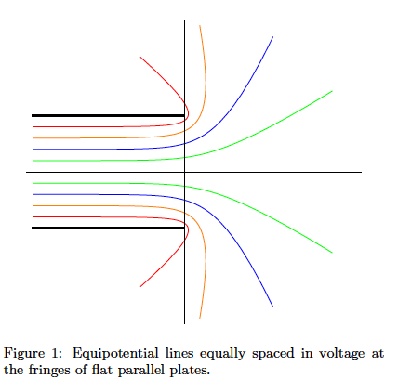
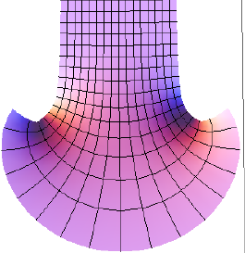
Next with realistic fringe fields
Eric Metodiev, Harvard Univ., Kevin Huang HS summer student. Analytic estimation of E-fields and precision tracking…

Slide 27
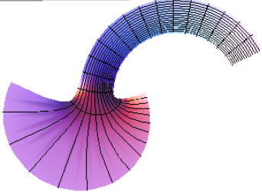
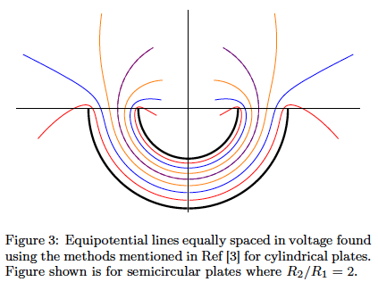
Fringe fields in cylindrical case

Slide 28
Issues are/to be working on
Effect of fringe field to beam/spin dynamics. (BNL, Eric Metodiev/Harvard Univ. et al., …)
SQUID-based BPM detector development based on present technology. (FNAL/BNL)
Reproduce J-LAB E-field tests for our geometry; test a 1m long prototype.
SCT benchmarking at COSY. Ed Stephenson/Indiana, COSY, et al.,

Slide 29
Summary
Lots of exciting/challenging issues to work on
Issues with fringe-fields need careful consideration
Having lots of fun developing the proton EDM proposal for FNAL. Expect to submit it in FY2014

Slide 30
Extra slides

Slide 31
3. Spin Coherence Time: need >10² s
Not all particles have same deviation from magic momentum, or same horizontal and vertical divergence (all second order effects)
They cause a spread in the g-2 frequencies:
Present design parameters allow for 10³ s store Cooling/mixing during storage could prolong SCT (upgrade option?).

Slide 32
Staging the experiment
Proton Intensity >10⁸ / storage; sensitivity: <10⁻²⁷e•cm; cost < $50M (fully loaded)
Proton Intensity 4x10¹⁰ / storage; sensitivity: 10⁻²⁹e•cm
Stochastic cooling: 4x10¹⁰ / storage; sensitivity: 10⁻³⁰e•cm

Slide 33
1. SQUID-Based BPM
The beam separation depends on the strength of the vertical tune: plan for 0.1
Modulate vertical tune by ~10% at 10³-10⁴ Hz
This creates a radial B-field at 10³-10⁴ Hz to be picked up by a SQUID

Slide 34
B-field from (same sign) CR beams
Azimuthal B-field cancels
Vertical splitting creates a
radial B-field oscill. 10³-10⁴Hz
Low Tc SQUID sensitivity is adequate
Need to demonstrate in an accelerator environment (RHIC IP)
Two years R&D, $0.6M; first support: US-Japan

Slide 35
D. Kawall
Modulation
frequency range

Slide 36
Budget for testing at RHIC by D. Kawall

Slide 38
E-field strength
The field emission without and with high pressure water rinsing (HPR)
for 0.5cm plate separation.
Recent developments in achieving high E-field strengths with HPR treatment (from Cornell ILC R&D)
Notes:
38

Slide 39
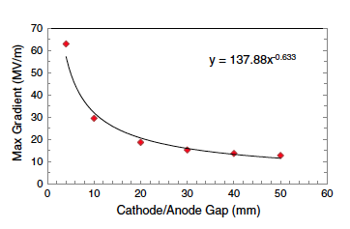
Smaller-Ring Parameters
Ring circumference: 150 m
Bending radius: ~20 m
Plate distance: 2 cm
Radial E-field: ~210 kV/cm
High Voltage: ±210 kV

Slide 40
Total cost: exp + ring + beamline for two different ring locations @ BNL
System | Experiment w/ indirects | Conventional plus beamline w/ indirects | Total
pEDM at ATR | $25.6M | $20M | $45.6M
pEDM at SEB | $25.6M | $14M | $39.6M
System | Experiment w/ 55% contingency | Conv. & Beamline w/ contingency | Total
pEDM at ATR | $39.5M | $29.2M | $68.7M
pEDM at SEB | $39.5M | $22.6M | $62.1M
EDM ring+tunnel
and beam line
EDM ring

Slide 41
Recent development: Data! Maximum E-field vs. Plate gap
No dark current detected for large grain Nb!
PRSTAB 15,083502, 2012
16 MV/m @ 30 mm
20 MV/m @ 20 mm
30 MV/m @ 10 mm
R=40 m

Slide 42
Smaller-Ring Parameters
Ring circumference: 150 m; 100 m
Bending radius: ~20 m; 13 m
Plate distance: ~2 cm; 1 cm
Radial E-field: ~21 MV/m; ~30 MV/m
EDM limit: 10⁻²⁸ecm; 10⁻²⁷ecm

