Slide 1

Lepton & Gamma Colliders for the Energy Frontier
Mark Palmer
Frontier Capabilities:
Energy Frontier Lepton & Gamma Colliders Sub-Group
July 29, 2013
CSS2013, June 28-August 6: “Snowmass on the Mississippi”

Slide 2
Outline
Introduction
Circular e⁺e⁻
ILC
Other LC Concepts
γ−γ Colliders
μ Collider
Closing Comments

Slide 3
Introduction
The Working Group and Inputs
The Working Group Assessments
Comments on Making Comparisons

Slide 4
Frontier Capabilities: Lepton Colliders
Accelerator Capabilities Convener: Bill Barletta (MIT)
Lepton Colliders Working Group:
    Sub-conveners: Marco Battaglia (UCSC), Markus Klute (MIT), Kaoru Yokoya (KEK), & myself
    EF Liaison: Tor Raubenheimer (SLAC)
    Sub-Group Meeting at MIT:
    https://indico.cern.ch/conferenceDisplay.py?ovw=True&confId=233944
Submissions covered a broad range of capabilities and possibilities a many contributors to what follows

Slide 5
Working Group Assessment
The goal of the working group has been to:
  Summarize the capabilities that can support the physics needs of Energy Frontier
  Evaluate the major technical challenges and cost drivers
  Identify the R&D path required to develop the necessary capabilities
It should be noted that:
  All of the options have some technical challenges
  None of the options under consideration is cheap
  But, we do have real options with contrasting strengths and weaknesses (as well as varying states of readiness)
  a which makes the process of charting an optimal route forward challenging when we are discussing timescales of decades

Slide 6
Comment on Concept Maturity
It should also be noted that the concepts described here span a broad range of maturity
  R&D concepts requiring significant validation
  Full technical designs where performance has been explicitly sacrificed in order to achieve something that can be built
    And to fit within a specific budget profile
  Design extrapolations
    Based on well-understood individual technologies in many cases
    However, not yet validated in full detail
Thus capabilities comparisons are non-trivial at this level
  Attention should be paid to “strategic” (ie, physics) benefits
  Audience should ask pointed questions about how realistic any individual plan is

Slide 7
Lepton & Photon Colliders
  e⁺e⁻ Circular Colliders:
  >100 GeV Scale
  Linear Colliders:
    e⁺e⁻ Colliders with
    E < 1 TeV & E1> 1 TeV
    γ-γ Colliders
  μ⁺μ⁻ Colliders: Up to 10 TeV

Slide 8
e⁺e⁻ Circular Colliders
Comments
LEP2 nearly reached the Higgs
Technical Issues
Synchrotron Radiation:
Trends in the Discussion
Re-use of the LEP tunnel (conflict w/LHC) as well as various site-filler options initially discussed
Recent focus: 80-100km ring leading to a
100 TeV scale hadron collider (VHE-LHC/VLHC)
Rings are robust and well-understood technology
RF Efficiency
Energy Bandwidth
Takes a longer term view
Limits SR issues
Collective Effects
Beam Lifetime (~10³ sec) and Top-Up Injection

Slide 9
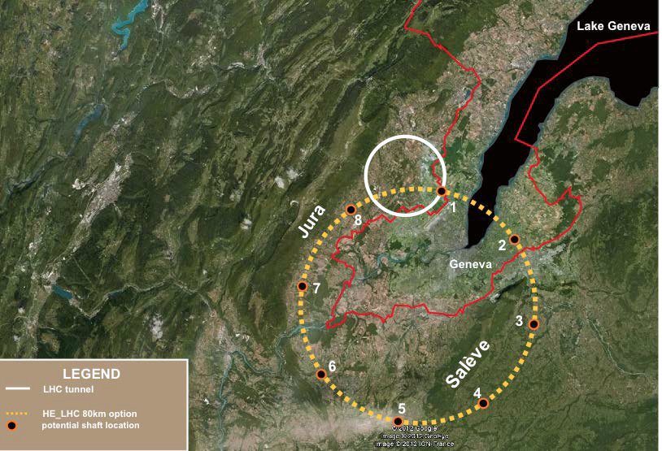
The TLEP Concept
350 GeV C.M. e⁺e⁻
a 100 TeV pp
J. Osborne, C. Waaijer

Slide 10
Electron-Positron Storage Rings:
Parameters for Selected Options
 | LEP2 | TLEP* – HZ | TLEP* - t | FNAL** - HZ
Beam Energy [GeV] | 104.5 | 120 | 175 | 120
Circumference [km] | 26.7 | 80 | 80 | 100
Beam current [mA] | 4 | 24.3 | 5.4 | 12.9
Number of bunches | 4 | 80 | 12 | 34
Bunch population [10¹²] | 0.575 | 40.8 | 9.0 | 0.79
Horizontal emittance [nm] | 48 | 9.4 | 10 | 16
Vertical emittance [nm] | 0.25 | 0.02 | 0.01 | 0.08
β_{x}* [mm] | 1500 | 500 | 1000 | 200
β_{y}* [mm] | 50 | 1 | 1 | 2
Hourglass factor | 0.98 | 0.75 | 0.65 | 0.81
SR power/beam [MW] | 11 | 50 | 50 | 20
Bunch length [mm] | 16 | 1.7 | 2.5 | 3.2
Momentum acceptance [%] | 1.25 | 2.5 | 2.5 | 3.0
Beam-beam parameter / IP | 0.07 | 0.1 | 0.1 | 0.1
Luminosity / IP [10³⁴ cm⁻²s⁻¹] | 0.0125 | 4.8 | 1.3 | 1.8
* Assumes 4 IPs ** Assumes 1 or 2 IPs

Slide 11
e⁺e⁻ Circular Colliders
Status
TLEP Design Study has been launched
Not aware of any other significant effort underway
R&D
Focus on detailed technical assessments
Challenges, but no obvious showstoppers
Time
TLEP: Conceptual Design Report by 2015
TLEP: Technical Design Report by 2018
TLEP: Aiming for construction readiness in 2020’s
Technical Statement

Slide 12
Linear Colliders
Luminosity
The strong fields at the interaction point result in
  A luminosity enhancement characterized by the disruption parameter
  Beamstrahlung emission gives rise to energy spread and backgrounds at the interaction point

Slide 13
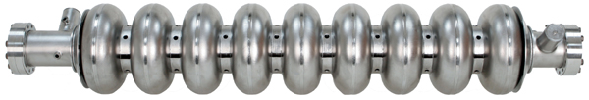
Linear Collider Options
A range of options have been explored
  ILC: Based on SRF technology
  Most mature concept for E_{CM}<1 TeV
  CLIC: Based on drive-beam and NCRF technology
  RF Gradients: 100 MV/m
  Could be applied for E_{CM}<1 TeV, but designs up to 3 TeV are documented
Yield ’10 ~ ’12:
> 90% @ 25 MV/m
~ 80% @ 28 MV/m
~ 70% @ 35 MV/m

Slide 14
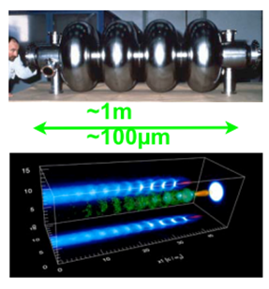
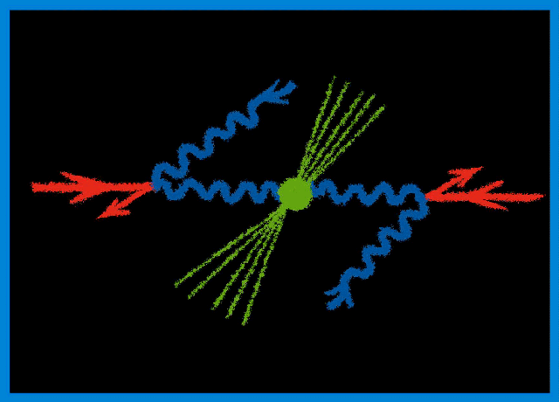
Linear Collider Options
Options (cont’d)
  Wakefield Accelerators:
  Potential for very high energies
  Possibly could be used for LC
  afterburner
  Significant R&D remains
  γ−γ: High power laser beams
  Compton backscattered from
  e⁻ or e⁺ beams
    γγaH cross section ~200fb
    Concept could be applied at an
    ILC or CLIC

Slide 15
M. Ross

Slide 16
A factor of
2.5 in L/P_{wall}
M. Ross

Slide 17
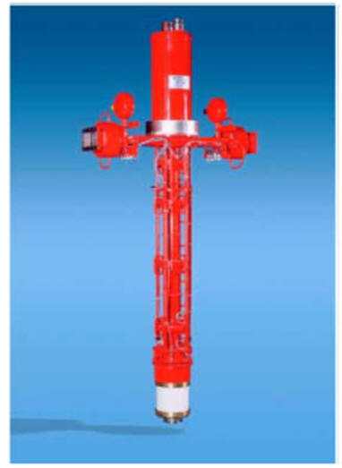
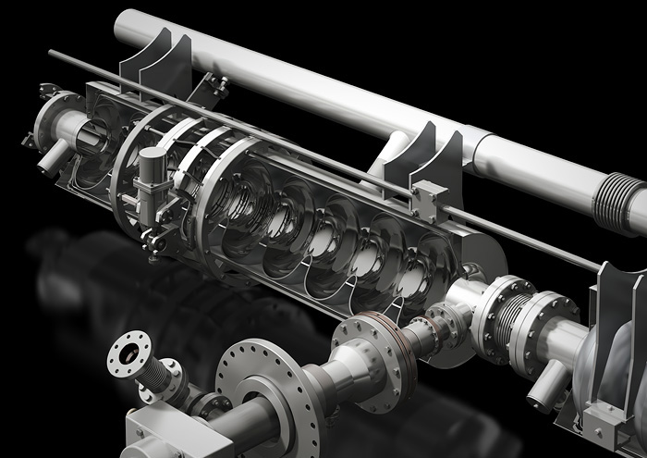
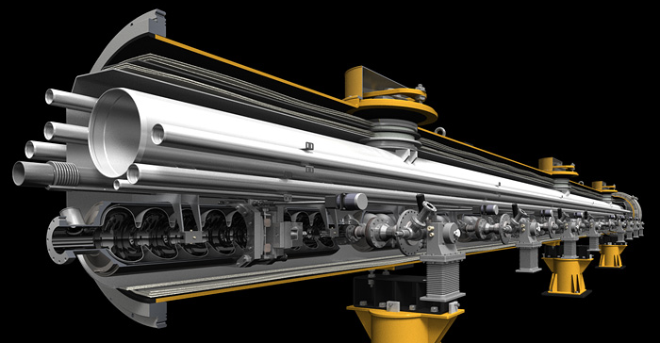
ILC SCRF Technology
M. Ross
10 MW MB Klystron
Graphics by Rey. Hori

Slide 18
M. Ross

Slide 19
Japanese Siting
M. Ross

Slide 20
ILC Parameters
Centre-of-mass energy | E_{cm} | GeV | 250 | 350 | 500 |  | 1000
Beam energy | E_{beam} | GeV | 125 | 175 | 250 |  | 500
Estimated AC power | P_{AC} | MW | 128 | 142 | 162 |  | 300
Collision rate | f_{rep} | Hz | 5 | 5 | 5 |  | 4
Electron linac rate | f_{linac} | Hz | 10 | 5 | 5 |  | 4
Number of bunches | n_{b} |  | 1312 | 1312 | 1312 |  | 2450
Bunch separation | Dt_{b} | ns | 554 | 554 | 554 |  | 366
Pulse current | I_{beam} | mA | 5.8 | 5.8 | 5.79 |  | 7.6
RMS bunch length | σ_{z} | mm | 0.3 | 0.3 | 0.3 |  | 0.250
Electron polarisation | P₋ | % | 80 | 80 | 80 |  | 80
Positron polarisation | P₊ | % | 30 | 30 | 30 |  | 20
Luminosity (inc. waist shift) | L | ×10³⁴ cm⁻²s⁻¹ | 0.75 | 1.0 | 1.8 |  | 3.6
Fraction of luminosity in top 1% | L_{0.01}/L |  | 87.1% | 77.4% | 58.3% |  | 59.2%

Slide 21
The ILC
Status
Technical Design Report now complete
Decision point on moving forward has been reached
R&D
Most significant R&D issues addressed during ILC Technical Design Phase [SRF cavity R&D, including industrialization; FLASH beam tests; damping ring studies, CESRTA; damping ring and beam delivery system studies at KEK-ATF]
Time
Some technical challenges remain (eg, complete ATF2 program), but no obvious showstoppers
Timescale contingent on decision process and international support
Team ready to move forward with detailed engineering and site-specific design

Slide 22
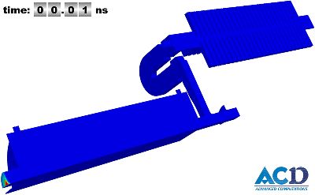
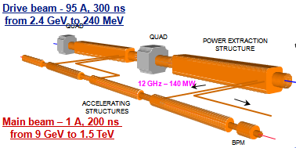
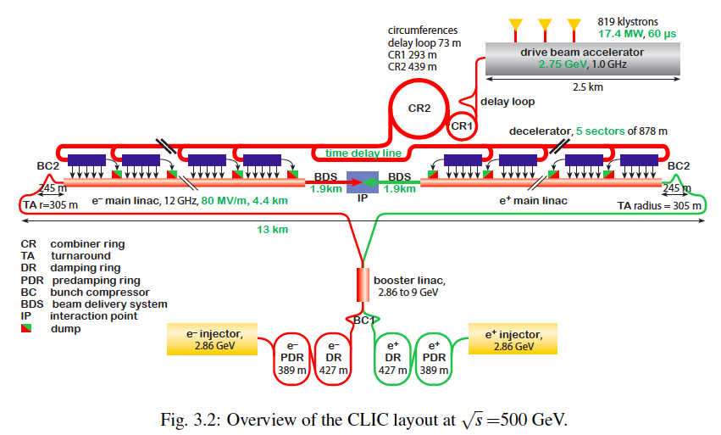
CLIC layout at 500 GeV

Slide 23
Potential Staged CLIC Parameters

Slide 24
Linear Colliders with E > 1 TeV
ILC is ~ 50 km at 1 TeV
    Possible to consider higher gradient SCRF materials or PWFA boost
CLIC design is aimed at upgradable design → 0.5-3 TeV
    Geographic gradient of 4x higher than ILC
Advanced acceleration options (plasma, dielectric)
    Plasma acceleration has made great progress however still huge challenges in beam quality and stability
    Extremely low charge dielectric-laser accelerators may provide only reasonable parameters in multi-TeV regime
    None of AARD options are close to being ready
Some plasma and dielectric options act as transformers taking high power beams → high energy beams
    Possible to develop upgrade options for ILC-like technology?

Slide 25
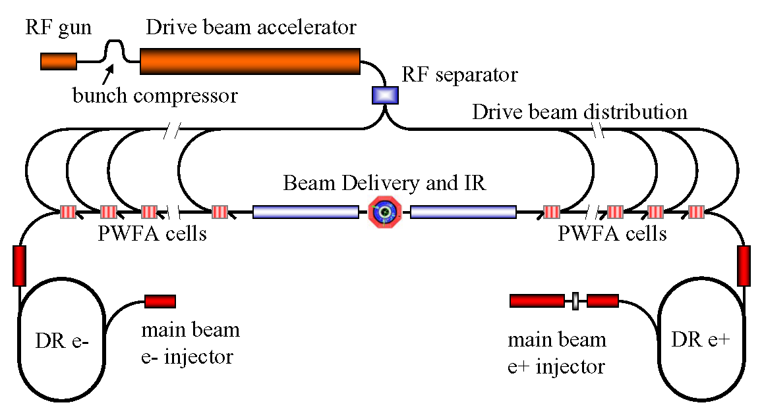
Concept of Beam-Driven Plasma Linac
Concept for a 1 TeV plasma wakefield-based linear collider
  Use conventional Linear Collider concepts for main beam and drive beam generation and focusing and PWFA for acceleration
    Makes good use of PWFA R&D and 30 years of conventional rf R&D
  Concept illustrates
  focus of PWFA
  R&D program
    High efficiency
    Emittance preservation
    Positrons
  Allows study
  of cost-scales
  for further
  optimization of R&D

Slide 26
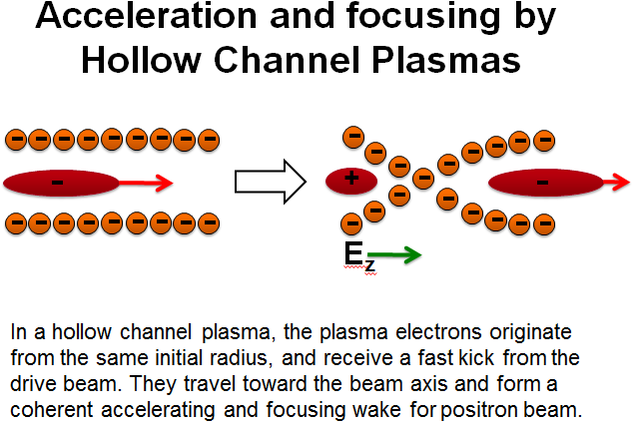
Challenges for Positron
Plasma Wakefield Acceleration
M. Hogan
Positron Witness Bunch
Electron Drive Bunch
+
+
+
+
+
+
Positive Ion Background
-
-
-
-
-
-
-
+
+
+
+
+
+
-
-
-
-
-
-
-
+
+
+
+
+
+
+
+
+
+
+
+
+
+
Accelerating and Defocusing
Field for Positrons
Decelerating and Focusing
Field for Electrons

Slide 27
Possible Linear Collider Parameters
ILC and CLIC parameters from design reports; 10 TeV DBA scaled from Wei Gai
communication; 10 TeV DLA and Plasma Accelerator from 2010 ICUIL/ICFA Workshop

Slide 28
CLIC and Wakefield LCs
Status
CLIC Conceptual Design Report complete
Wakefield Accelerator Concepts – Feasibility being assessed
R&D
CLIC: Focus on technology and advanced systems R&D
Time
Wakefield Accelerators:
CLIC: Timescale dependent on finalized technical design and physics needs
Ability to accelerate positrons
Demonstration of multi-stage acceleration
Understanding the extrapolation of all parameters to the regimes required for HEP accelerator use (emittance preservation, achievable energy spread, beam loading, repetition rate)
Wakefield LCs:
Expect non-HEP applications on the ~decade timescale
Collider R&D phase to fully assess feasibility is likely decades scale
First application might be an ILC “afterburner”

Slide 29
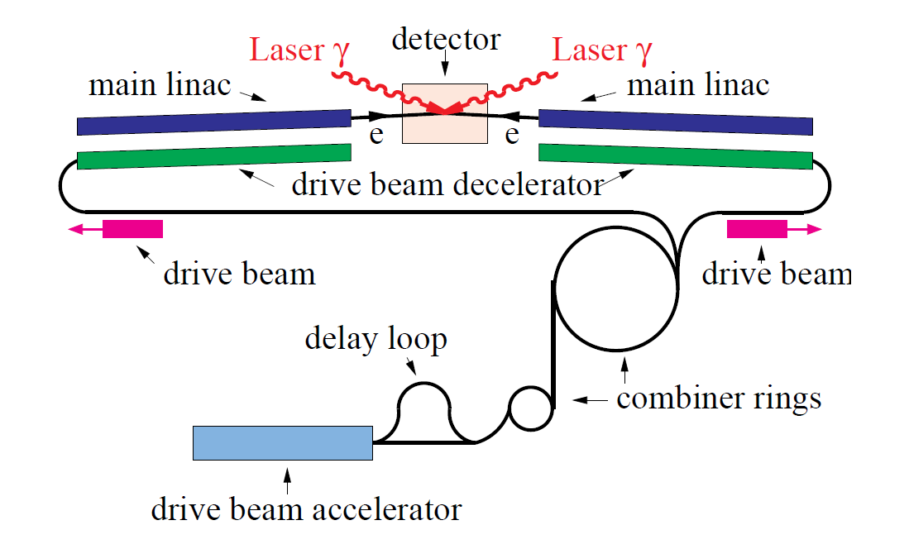
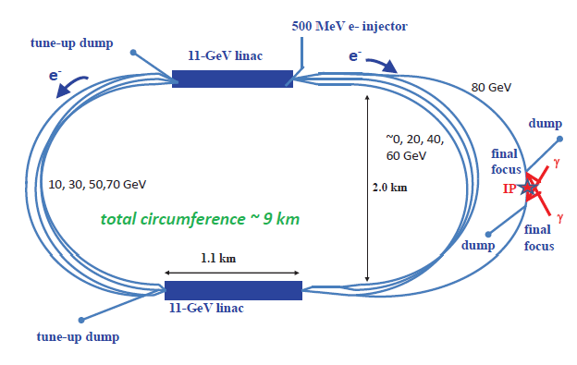
γ−γ Collider Concepts
γ−γ Higgs Factory (E_{CM}~160 GeV, photons carry ~80% of CM E) might represent a `low cost’ option to demonstrate the technology
Relative to LC: No positrons, damping rings, bunch compressors,…
Laser parameters are challenging; requires optical cavity schemes
CLICHÉ: CLIC Higgs Experiment
 | SAPPHiRE
Beam Energy | 80 GeV
Power Consumption | 100 MW
Polarization | 80%
Ave Beam Current | 0.32 mA
E-e- geometric luminosity | 2.2x10^34
Laser wavelength | 351 nm
Repetition rate | 200 kHz
Laser pulse energy | ~5 J

Slide 30
γ−γ Colliders
Status
Principal technical challenge is laser system
R&D
Would need to establish a full Technical Design
Time
In principle, a decision point could be reached in a few years
Validate feasibility of required laser – significant recent progress
Question: Would the community be interested in a standalone facility versus eventual companion capability with an e⁺e⁻ LC? Can this provide the required physics?

Slide 31
Muon Accelerator Concepts
Major Challenges

Slide 32
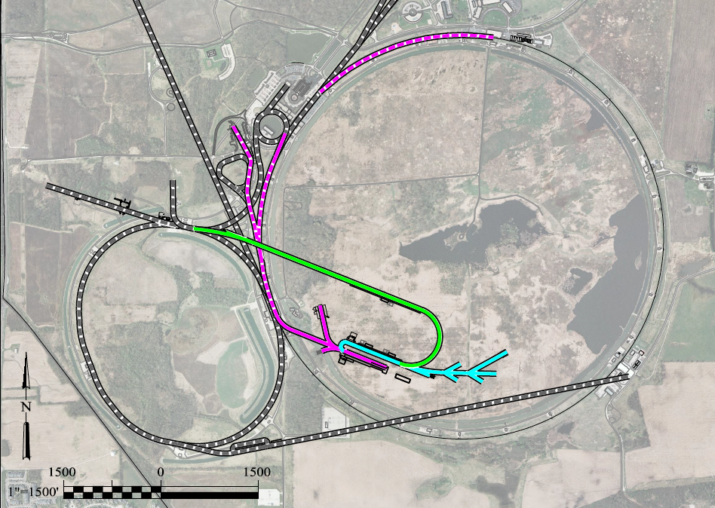
A Muon Accelerator Facility for Cutting Edge Physics on the Intensity and Energy Frontiers
Based on Project X Stage II
To SURF
LBNE
Buncher/
Accumulator
Rings
RLA to 63 GeV +
300m Higgs Factory
NF Decay Ring:
νs to SURF
Front End+4D+6D
Project X
Stage III
Linac + RLA to ~5 GeV
Project X
Stage II
Project X
Stage I
A 1.5 TeV collider
would fit within the
Tevatron ring
ft
νSTORM + Muon Beam
R&D Facility
ft

Slide 33
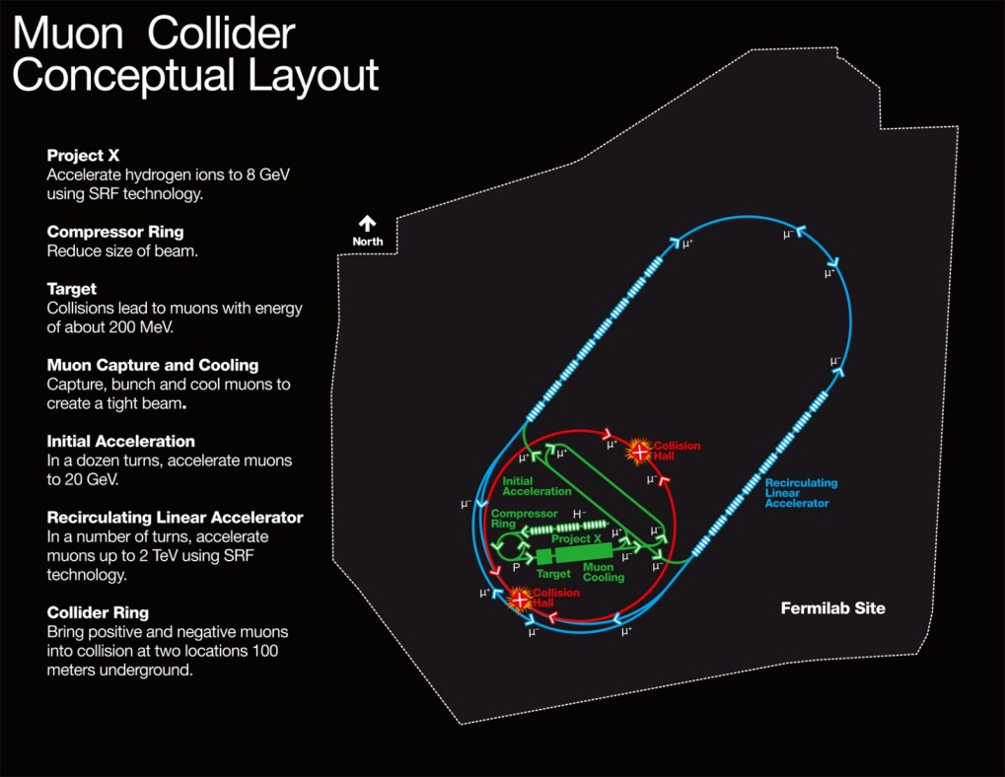
MAP Designs for a Muon-Based Higgs Factory and Energy Frontier Colliders
Range of Top Params:
δE/E ~ 0.01 - 0.1%
L_{avg} ~ 0.7 - 6 × 10³³
Exquisite Energy
Resolution
Allows Direct
Measurement
of Higgs Width
Site Radiation mitigation with depth and lattice design: ≤ 10 TeV
Success of advanced cooling
concepts a several × 10³²

Slide 34
Muon Colliders
Status
MAP Feasibility Assessment underway
R&D
Establishing Initial Baseline Design
Muon Ionization Cooling Experiment
Time
Feasibility Assessment by end of decade
Staging Study: Physics + R&D + Demos required for next stage
Technology R&D: Cooling channel hardware, RF in B-fields, high field magnets (synergistic with HE-LHC needs)
Completion of MICE by end of decade
NuMAX (initial long baseline NF): Informed Decision by ~2020
Collider Program: Informed Decision by mid-2020s

Slide 35
CLOSING Remarks
Long-Term Perspective
Conclusions

Slide 36
Some Connections…
A theme that has arisen in the capabilities discussions has been that of upgrade paths
  Note that a number of “constrained” options didn’t even get mention in this presentation
There are many special synergies that also come into play:
  TLEP and a ~100 TeV hadron collider
  Muon Collider and the Neutrino Program
  Technology linkages (eg, MAP and HE LHC magnet development)
  γ−γ as a companion capability to an LC
  A wakefield accelerator upgrade to a conventional LC
  And this is not an exhaustive list…

Slide 37
Establishing
A Long-Term
Perspective
US-HEP
Energy Frontier
Research Program
Support Strong
Global Connections
Develop the Next Generation(s) of Accelerator Specialists
Nurture a Vibrant and Cutting Edge
Accelerator R&D Program
Maintain Investment in World Class Domestic
HEP Accelerator Capabilities and Infrastructure

Slide 38
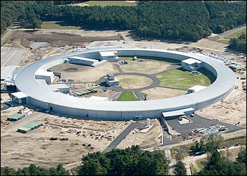
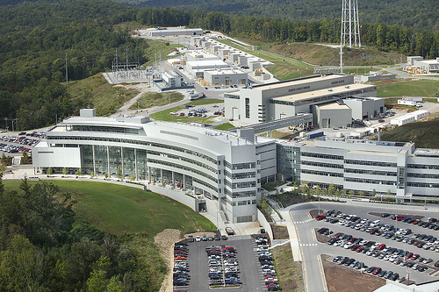
What do you get for a Billion Dollars?
NSLS-II: $0.9B, 0.8 km storage ring
SNS: $1.4B, 1 GeV Linac, Ring, high-power target, 1km
S. Henderson
HF2012

Slide 39
Jim Siegrist’s “Boundary Conditions”
Jim Siegrist, CPM2012
https://indico.fnal.gov/getFile.py/access?contribId=4&sessionId=2&resId=3&materialId=slides&confId=5841
It’s imperative to make the case for the physics we need,
But we must also develop a coherent plan that is realistic if we want to preserve the health and vitality of the U.S. HEP program
The challenges for all of the options presented here go beyond the technical

Slide 40
Conclusions I
The LHC program for the next 20 years is well-defined
  Questions arise as to what comes next
    For example: Is an investment in a facility such as TLEP desirable on the 10 year timescale because it can lead to a VHE-LHC/VLHC capability in ~30 years?
There is little question that the ILC design is, at present, the most complete and well-studied design for a machine targeted at the Higgs
  But, what will we do if the next round of LHC data finally shows something at > 1 TeV?
  On the relevant timescale (assuming advances in the R&D program), we may want to consider comparisons such as the plot on the next page…

Slide 41
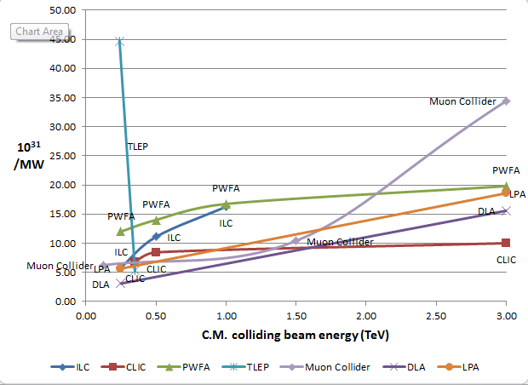
J-P. Delahaye
Luminosity
Metric:
N_{det} × L_{avg} / P_{tot}
What is the comparison between
TLEP with 2 IPs and ILC 250 at
full power?

Slide 42
Conclusions II
The necessity of US engagement in the ongoing LHC program is clear
As is maintaining global connections if the next collider facility is off-shore
At the same time we cannot ignore other elements of the US HEP program
  Investing in our domestic facilities which support non-collider portions of HEP
  Maintaining a robust R&D program which benefits both our global connections and can open the door to additional world class capabilities in the US
  And continue to train the experts to support the next generation of facilities

