Slide 1
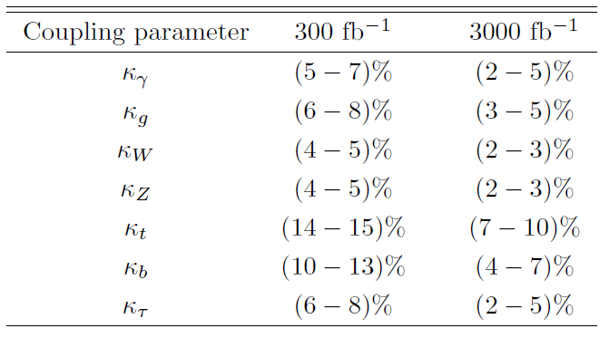

Slide 2
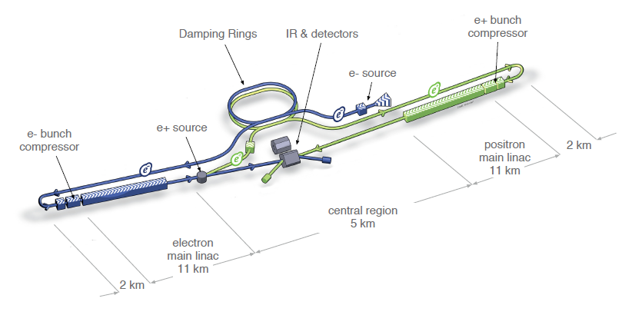
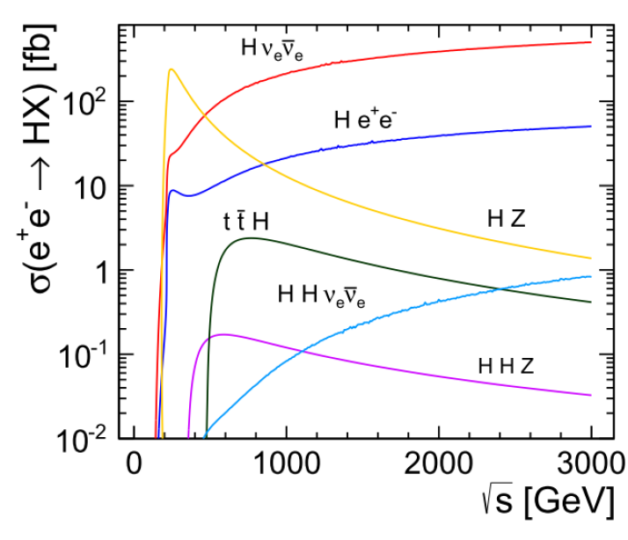

Slide 3
Energy/Lumi Scenarios
Each scenario corresponds to accumulated luminosity at a certain point in time.
Assumption: run for 3X10⁷ s at baseline lumi at each of Ecm=250,500,1000 GeV, in that order. Then go back and run for 3X10⁷ s at upgrade lumi at each of Ecm=250,500,1000 GeV.

Slide 4
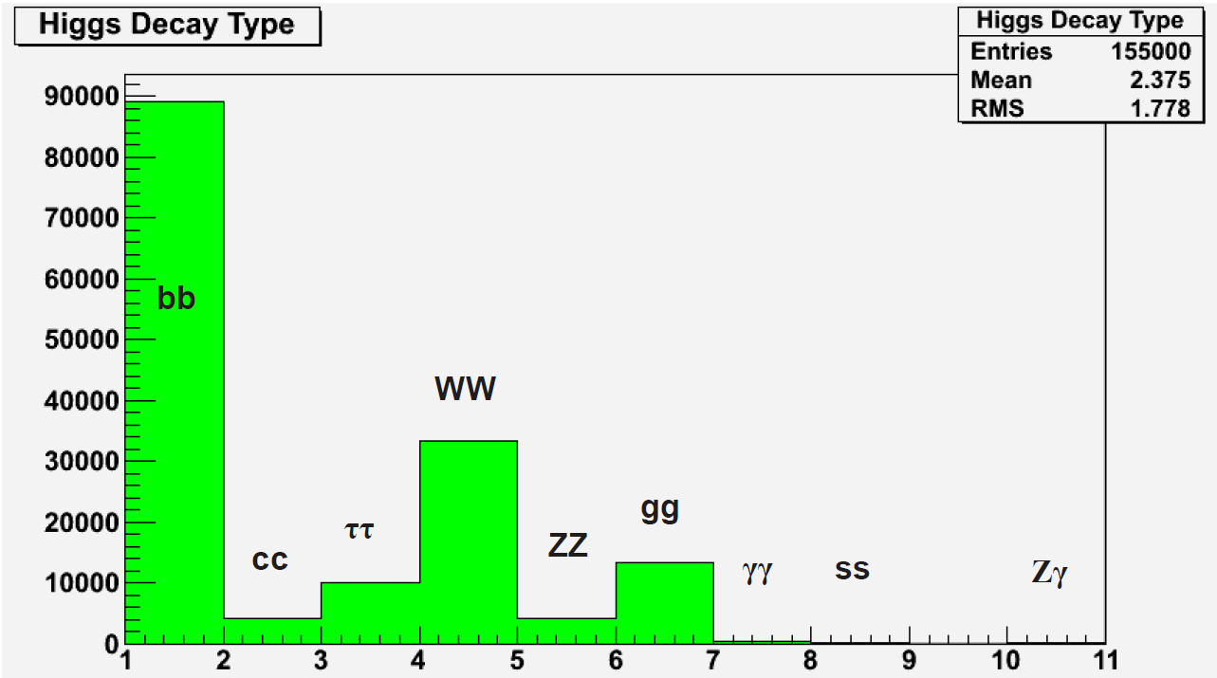
μμ

Slide 5
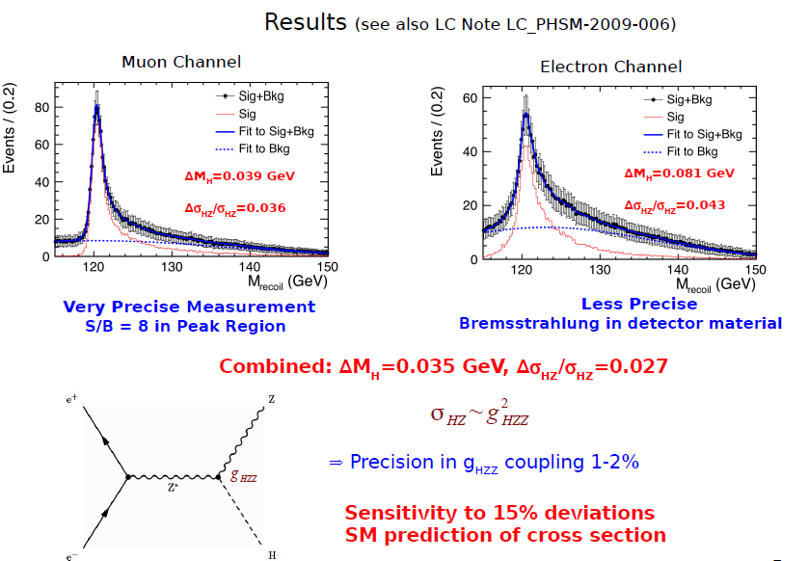

Slide 6
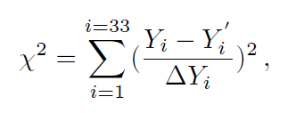

Slide 9
Backup Slides

Slide 10
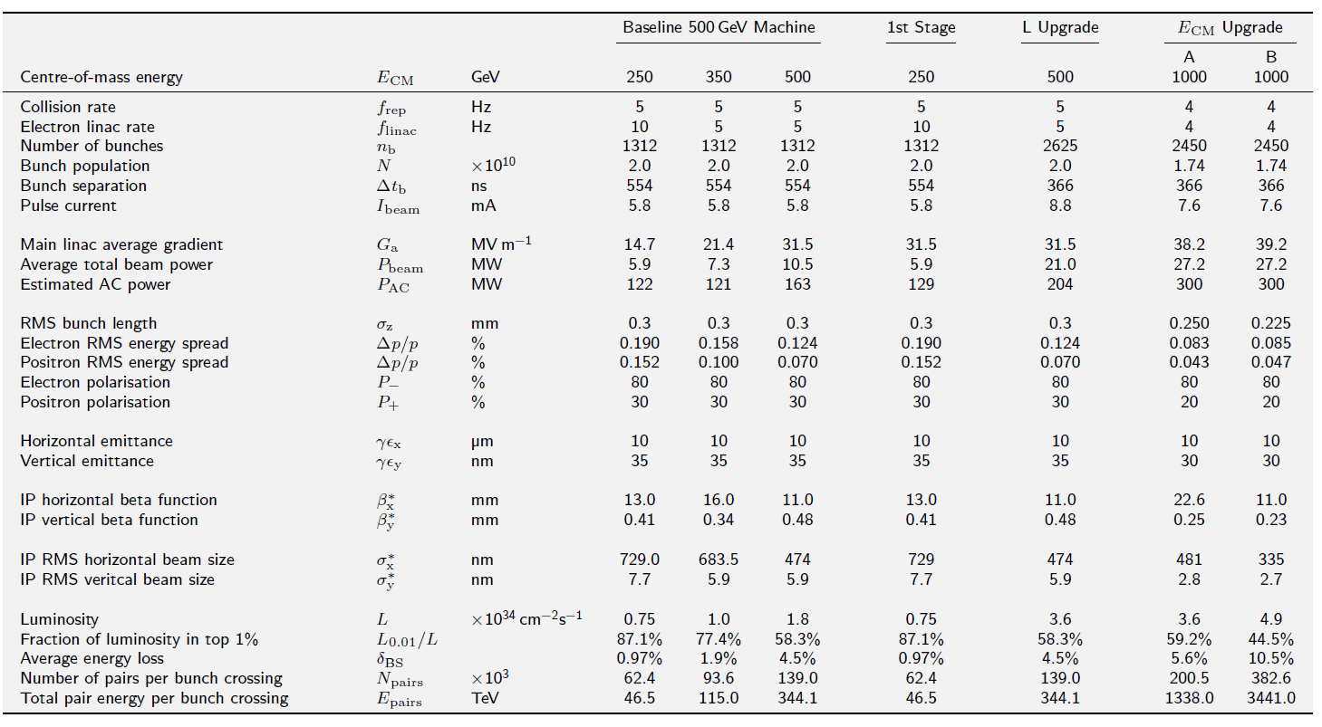
ILC Accelerator Parameters from TDR

Slide 11
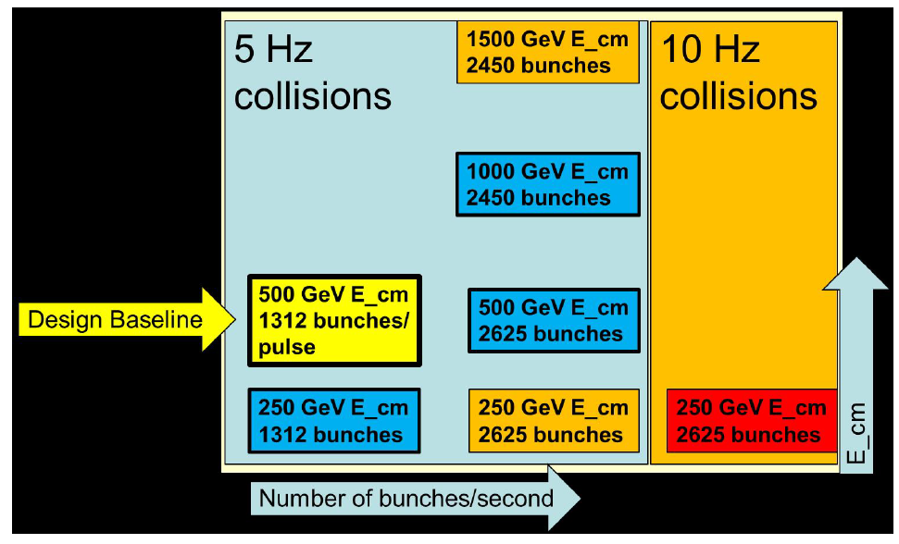
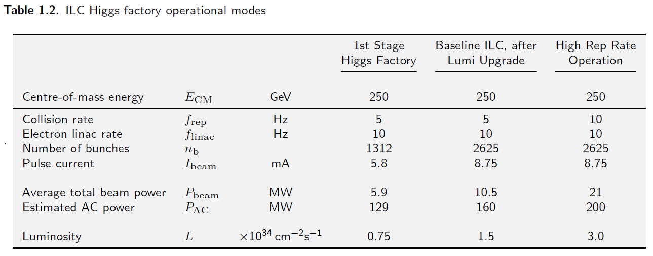
Lumi Upgrade at Ecm=250 GeV* * not in TDR – private communication from Marc Ross and Nick Walker

Slide 12
