Slide 1
ANSE: Advanced Network Services for the HEP Community
Networking for
the LHC Program
Harvey B Newman
California Institute of Technology
Snowmass on the Mississippi
Minneapolis, July 31, 2013

Slide 2

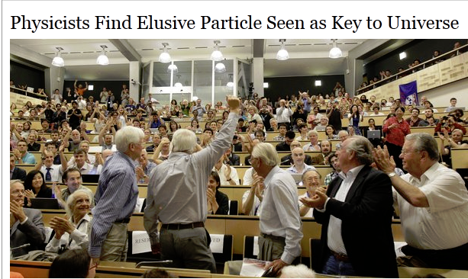


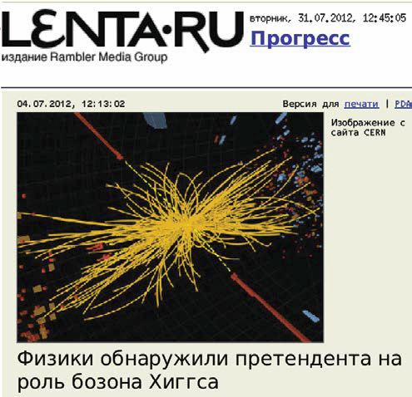
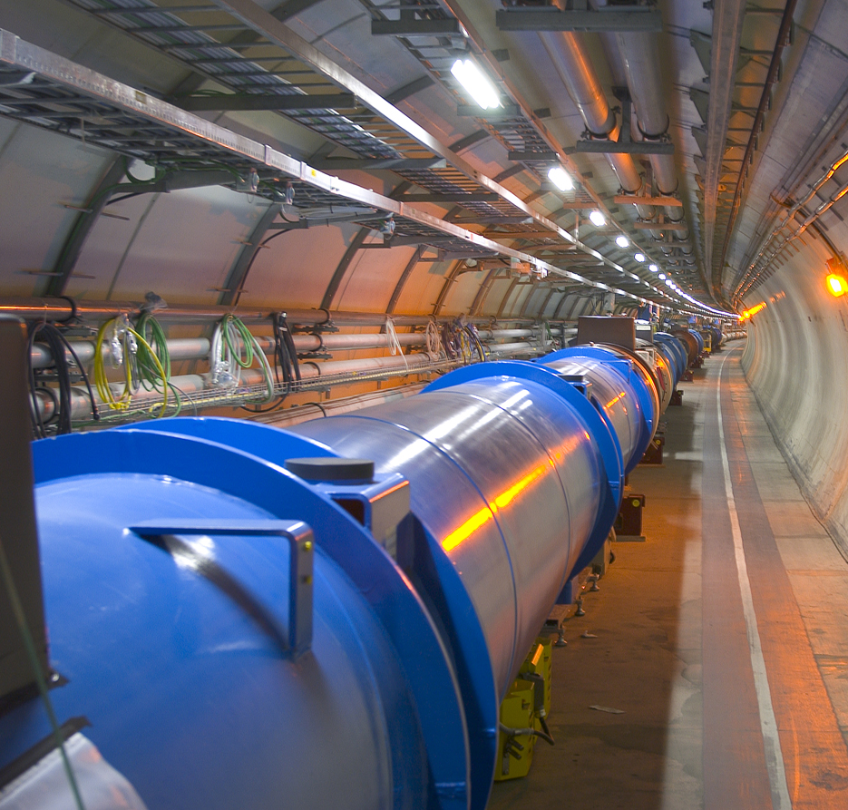
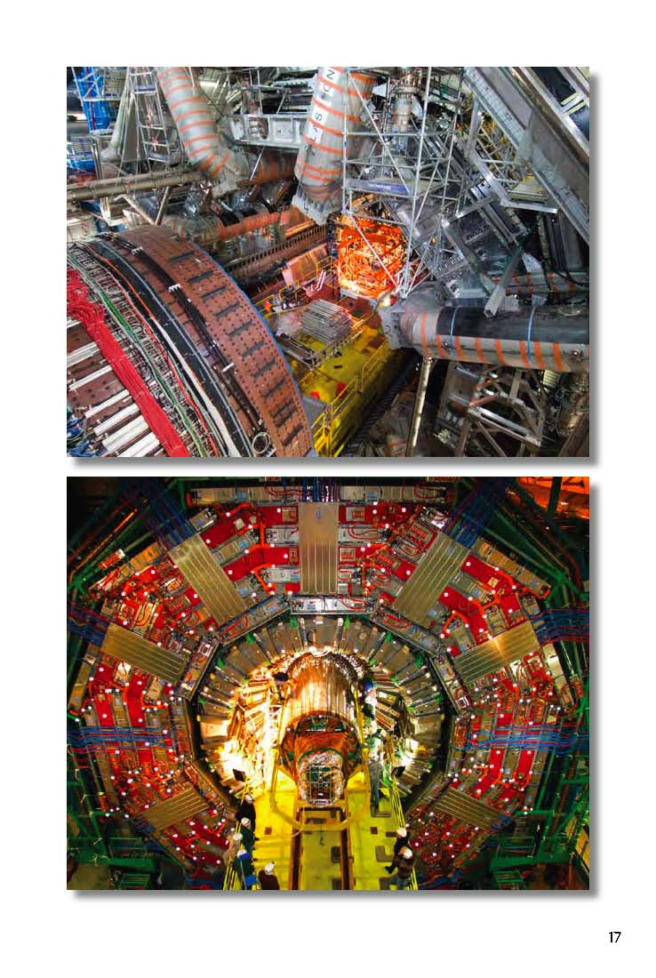

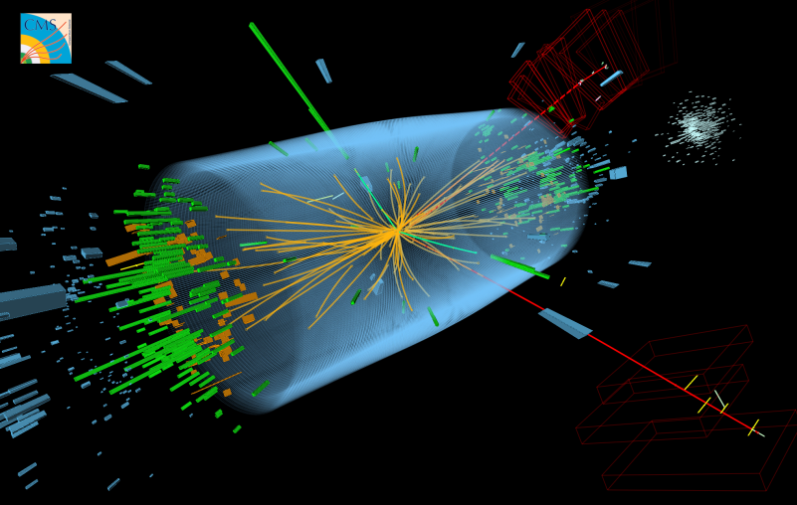
Discovery of a Higgs Boson
July 4, 2012
Theory : 1964
LHC + Experiments Concept: 1984
Construction: 2001
Operation: 2009
Highly Reliable High Capacity
Networks
Had an Essential Role in the Discovery

Slide 3
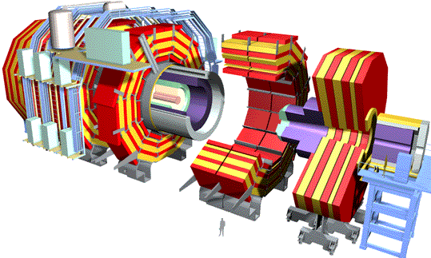

LHC Data Grid Hierarchy: A Worldwide System Invented and Developed at Caltech (1999)
11 Tier1 and
160 Tier2 + 300 Tier3 Centers
~PByte/sec
Online System
~300-1500 MBytes/sec
Experiment
CERN Center
PBs of Disk;
Tape Robot
Tier 0 +1
Tier 1
10 – 40 to 100 Gbps
London
Paris
Taipei
Chicago
Tier 2
CACR
Tier2 Center
Tier2 Center
Tier2 Center
Tier2 Center
Tier 3
10 to N X 10 Gbps
100s of Petabytes by 2012
100 Gbps+ Data Networks
Institute
Institute
Institute
Institute
Physics data cache
1 to 10 Gbps
Synergy with US LHCNet:
State of the Art Data Networks
Tier 4
Workstations
A Global Dynamic System
A New Generation of Networks: LHCONE, ANSE

Slide 4
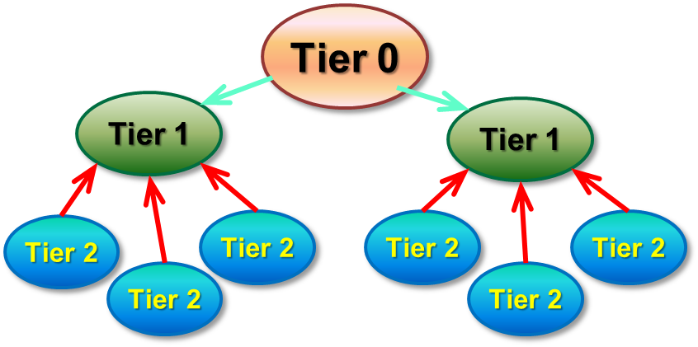
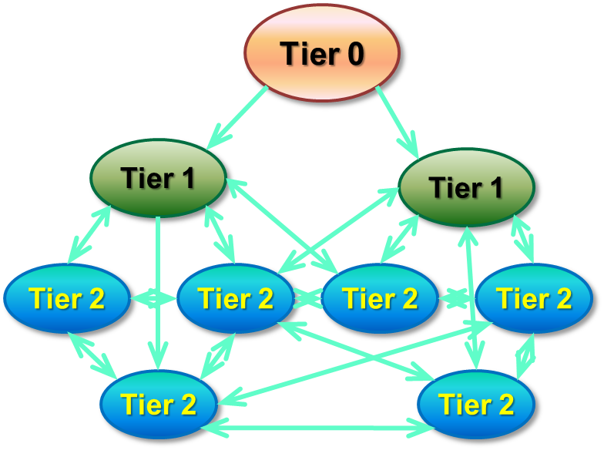
Some Background:
LHC Computing Model Evolution
The original MONARC model was strictly hierarchical
Changes introduced gradually since 2010
Main evolutions:
  Meshed data flows: Any site
  can use any other site as source of data
  Dynamic data caching: Analysis sites
  will pull datasets from other sites
  “on demand”, including from Tier2s in other regions
    In combination with strategic pre-placement of data sets
  Remote data access: jobs executing locally,
  using data cached at a remote site in
  quasi-real time
    Possibly in combination with
    local caching
Variations by experiment
Increased reliance on network performance !

Slide 5
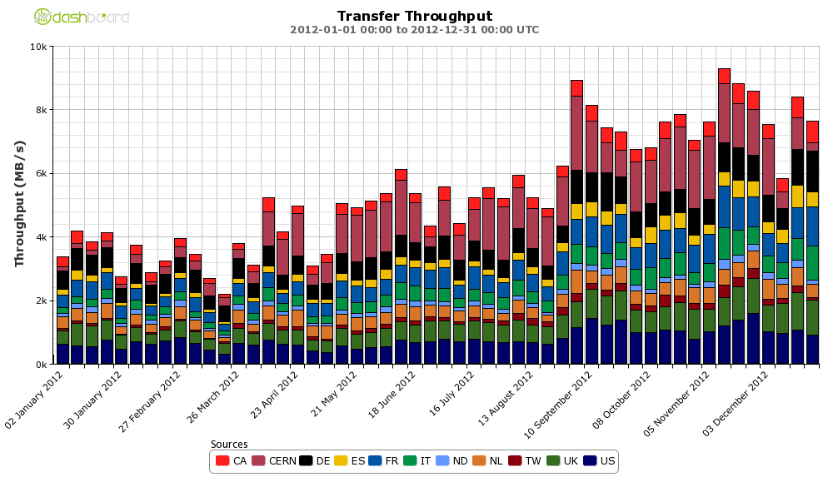
ATLAS Data Flow by Region: 2009- April 2013
2012-13: >50 Gbps Average, 112 Gbps Peak
171 Petabytes Transferred During 2012
2012
Versus
2011:
+70%
Avg;
+180% Peak
After Optimizations
designed to reduce network traffic in
2010-2012

Slide 6
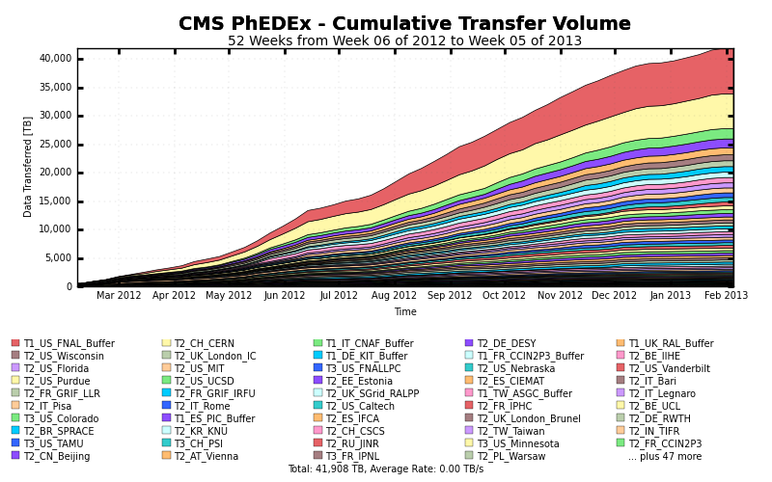
CMS Data Transfer Volume (Feb. 2012– Jan. 2013)
42 PetaBytes Transferred Over 12 Months
= 10.6 Gbps Avg. (>20 Gbps Peak)
2012
Versus
2011:
+45%
Higher Trigger Rates and Larger Events in 2015

Slide 7
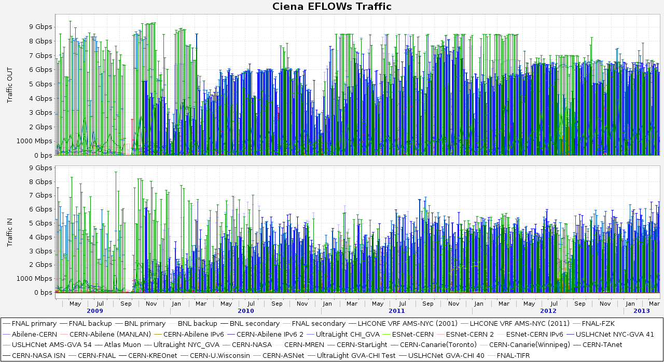
US LHCNet Peak Utilization: Many Peaks of 5 to 9+ Gbps (for hours) on each link

Slide 8

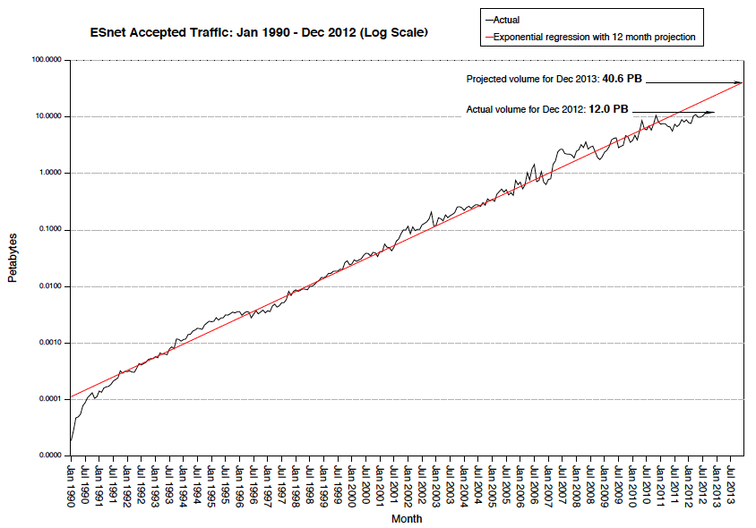
Remarkable Historical ESnet Traffic Trend
ESnet Traffic Increases
10X Each 4.25 Yrs, for 20+ Yrs
15.5 PBytes/mo. in April 2013
The Trend Continues
Actual Dec 2012
12 PBy/mo
100,000
Apr 2007
1 PBy/mo.
10,000
1000
Nov 2001
100 TBy/mo.
Jul 1998
10 TBy/mo.
Avg. Annual Growth: 72%
100
Oct 1993
1 TBy/mo.
53 months
Projection
to 2016:
100 PBy/mo
10
Terabytes / month
40 months
1
57 months
Actual
Exponential fit + 12 month projection
0.1
38 months
W. Johnston, G. Bell
Log Plot of ESnet Monthly Accepted Traffic, January 1990 – December 2012

Slide 9
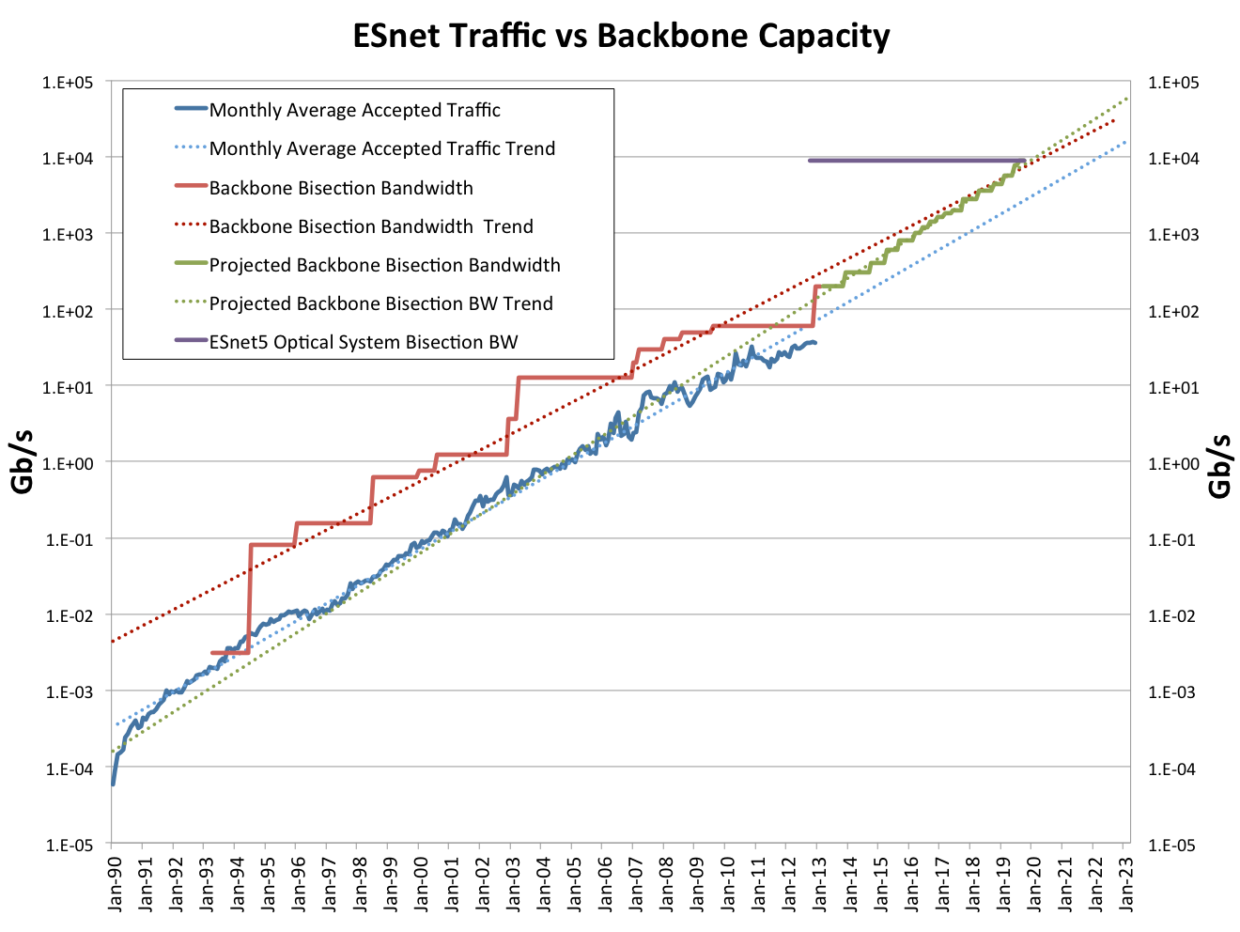
Internet2 contract expires
Add routers, optical chassis incrementally starting 2015
Optical system full in 2020
88 x 100G
Routed net exceeds ESnet4 complexity
Greg Bell, ESnet
10x100G on all routes by 2017; start deploying ESnet6
New waves starting Early 2014

Slide 10
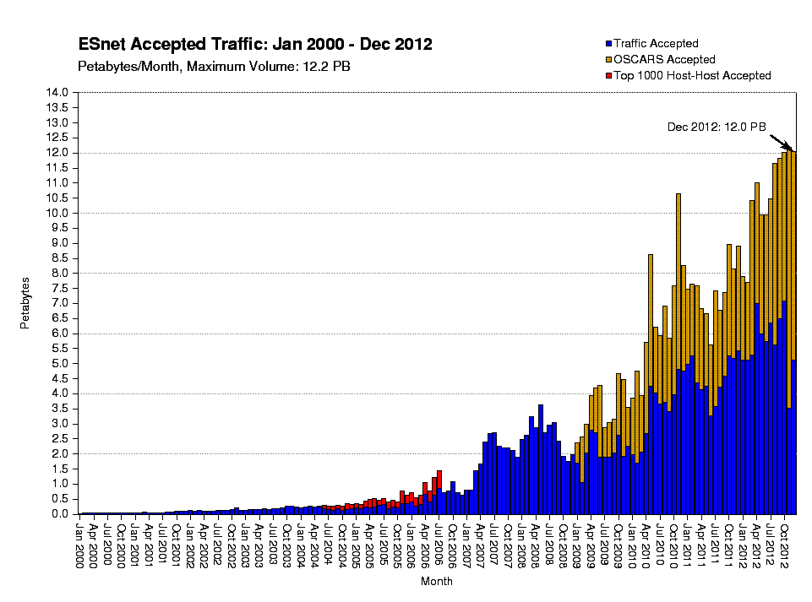
Hybrid Networks: Dynamic Circuits
with Bandwidth Guarantees
(PBytes/
Month)
ESnet Accepted Traffic
2000-2012
Half of the 100 Petabytes Accepted by Esnet in 2012
was Handled by Virtual Circuits with Guaranteed Bandwidth
12
Traffic on Circuits
10
8
Using “OSCARs” Software
by ESnet and collaborators
6
4
2
0
Large Scale Flows are Handled by (Dynamic) Circuits:
Traffic separation, performance, fair-sharing, management

Slide 11
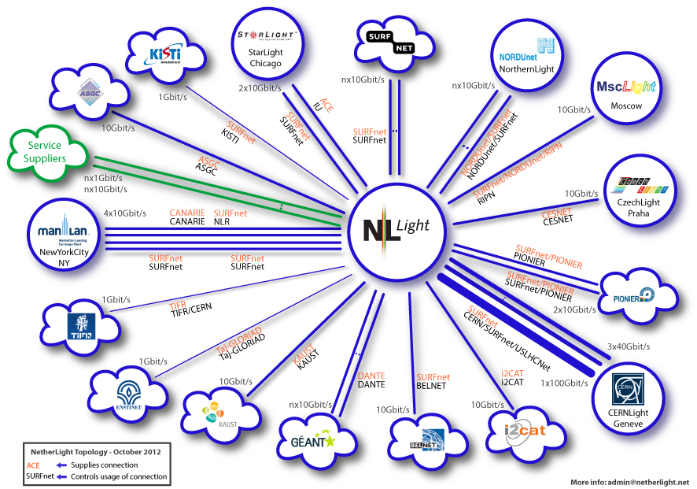
Open Exchange Points: NetherLight Example
1-2 X 100G, 3 x 40G, 30+ 10G Lambdas, Use of Dark Fiber
www.glif.is
Inspired Other Open Lightpath
Exchanges
Daejon (Kr)
Hong Kong
Tokyo
Praha (Cz)
Seattle
Chicago
Miami
New York
3 x 40G
1-2 x 100G
2013-14: Dynamic Lightpaths +
IP Services
Above 10G
Convergence of Many Partners on Common Lightpath Concepts
Internet2, ESnet, GEANT, USLHCNet; nl, cz, ru, be, pl, es, tw, kr, hk, in, nordic

Slide 12
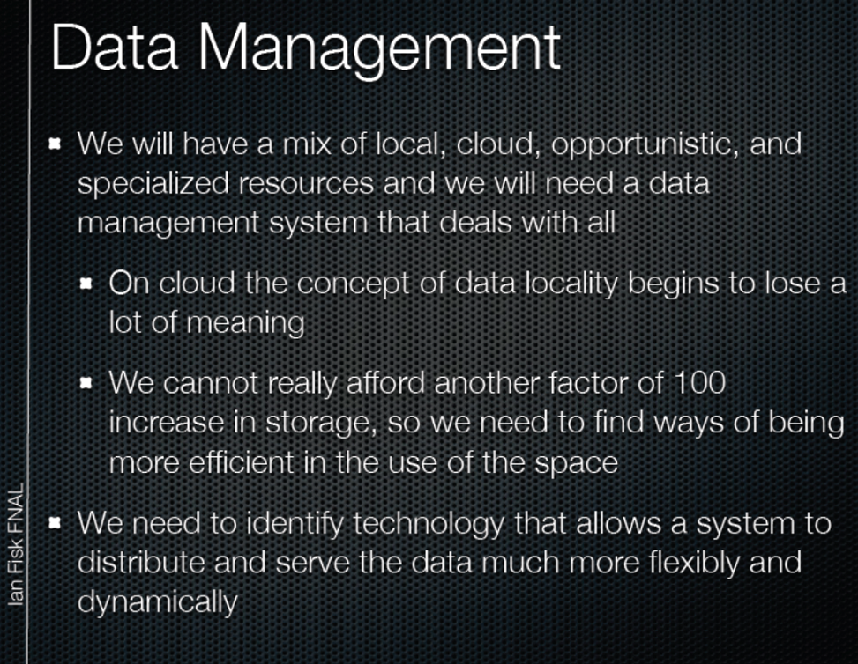
A View of Future LHC Computing and Network Systems
Ian Fisk and Jim Shank at the July 30 Computing Frontier Session,
for the Energy Frontier
Prerequisites: Global Scale realtime monitoring + topology

Slide 13
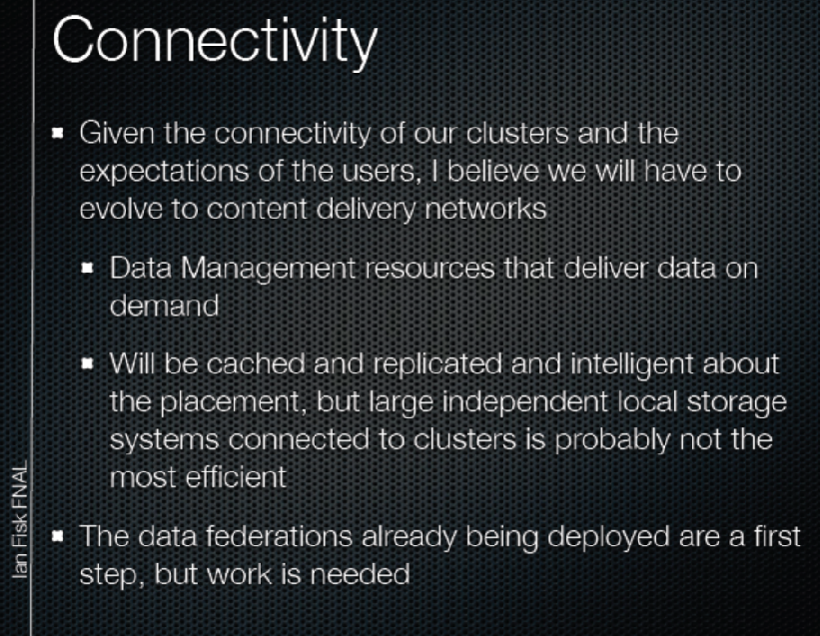
A View of Future LHC Computing and Network Systems
Ian Fisk and Jim Shank at the July 30 Computing Frontier Session,
for the Energy Frontier
Agile, larger scale, intelligent network-based systems will have a key role

Slide 14
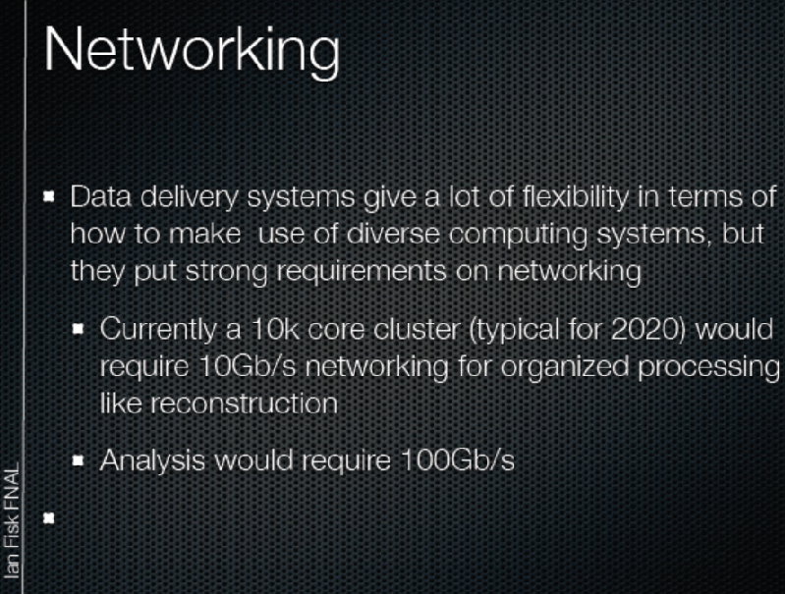
A View of Future LHC Computing and Network Systems
Ian Fisk and Jim Shank at the July 30 Computing Frontier Session,
for the Energy Frontier
Many 100G-enabled end clients: A challenge to next generation networks

Slide 15
ANSE: Advanced Network Services for Experiments
ANSE is a project funded by NSF’s CC-NIE program
  Two years funding, started in January 2013, ~3 FTEs
Collaboration of 4 institutes:
  Caltech (CMS)
  University of Michigan (ATLAS)
  Vanderbilt University (CMS)
  University of Texas at Arlington (ATLAS)
Goal: Enable strategic workflow planning including network capacity as well as CPU and storage as a co-scheduled resource
Path Forward: Integrate advanced network-aware tools with the mainstream production workflows of ATLAS and CMS
  In-depth monitoring and Network provisioning
  Complex workflows: a natural match and a challenge for SDN
Exploit state of the art progress in high throughput long distance data transport, network monitoring and control

Slide 16
ANSE - Methodology
Use agile, managed bandwidth for tasks with levels of priority
along with CPU and disk storage allocation.
  Allows one to define goals for time-to-completion,
  with reasonable chance of success
  Allows one to define metrics of success, such as the rate of work completion, with reasonable resource usage efficiency
  Allows one to define and achieve “consistent” workflow
Dynamic circuits a natural match
  As in DYNES which targets Tier2s and Tier3s
Process-Oriented Approach
  Measure resource usage and job/task progress in real-time
  If resource use or rate of progress is not as requested/planned,
  diagnose, analyze and decide if and when task replanning is needed
Classes of work: defined by resources required, estimated
time to complete, priority, etc.

Slide 17
ANSE Objectives and Approach
Deterministic, optimized workflows
  Use network resource allocation along with storage and CPU resource allocation in planning data and job placement
  Use accurate (as much as possible) information about the network to optimize workflows
  Improve overall throughput and task times to completion
Integrate advanced network-aware tools in the mainstream production workflows of ATLAS and CMS
  Use tools and deployed installations where they exist
  Extend functionality of the tools to match experiments’ needs
  Identify and develop tools and interfaces where they are missing
Build on several years of invested manpower, tools and ideas
(some since the MONARC era, circa 2000-2006)

Slide 18
Tool Categories
Monitoring (Alone):
  Allows Reactive Use: React to “events” (State Changes)
  or Situations in the network
    Throughput Measurements  Possible Actions:
      (1) Raise Alarm and continue (2) Abort/restart transfers
      (3) Choose different source
    Topology (+ Site & Path performance) Monitoring  possible actions:
      (1) Influence source selection
      (2) Raise alarm (e.g. extreme cases such as site isolation)
Network Control: Allows Pro-active Use
    Reserve Bandwidth Dynamically: prioritize transfers, remote
    access flows, etc.
    Co-scheduling of CPU, Storage and Network resources
    Create Custom Topologies  optimize infrastructure to
    match operational conditions: deadlines, workprofiles
          e.g. during LHC running periods vs reconstruction/re-distribution

Slide 19
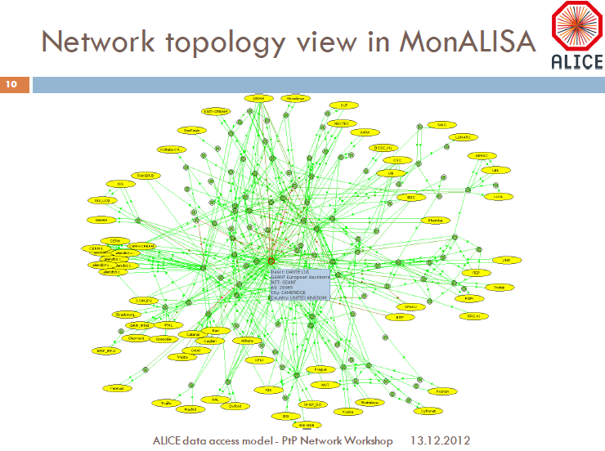
Components for a working system: In-Depth Monitoring
Monitoring: PerfSONAR and MonALISA
All LHCOPN and many LHCONE sites have PerfSONAR deployed
  Goal is to have all LHCONE instrumented for PerfSONAR measurement
Regularly scheduled tests between configured pairs of end-points:
  Latency (one way)
  Bandwidth
Currently used to construct a dashboard
Could provide input to algorithms
developed in ANSE for PhEDEx and
PanDA
ALICE and CMS experiments are using
the MonALISA monitoring framework
  Real time
  Accurate bandwidth availability
  Complete topology view
  Higher level services

Slide 20
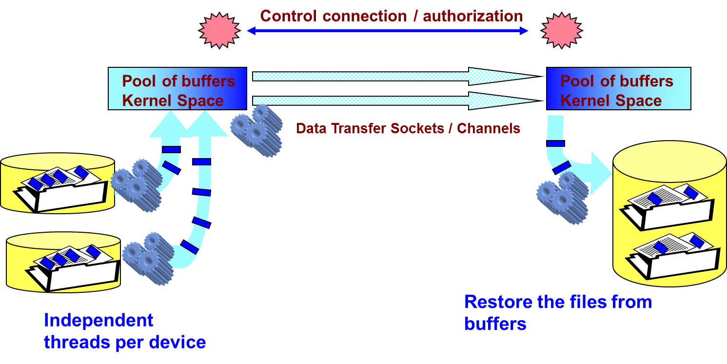
Fast Data Transfer (FDT) http://monalisa.caltech.edu/FDT
DYNES instrument includes a storage element, FDT as transfer application
FDT is an open source Java application for efficient data transfers
Easy to use: similar syntax with SCP, iperf/netperf
Based on an asynchronous, multithreaded system
Uses the New I/O (NIO) interface and is able to:
  Decompose/Stream/Restore any list of files
  Use independent threads
  to read and write on each
  physical device
  Transfer data in parallel on
  multiple TCP streams,
  when necessary
  Use appropriate size of
  buffers for disk IO and
  networking
  Resume a file transfer
  session
FDT uses IDC API to request dynamic circuit connections
Open source TCP-based Java application; the state of the art since 2006

Slide 21
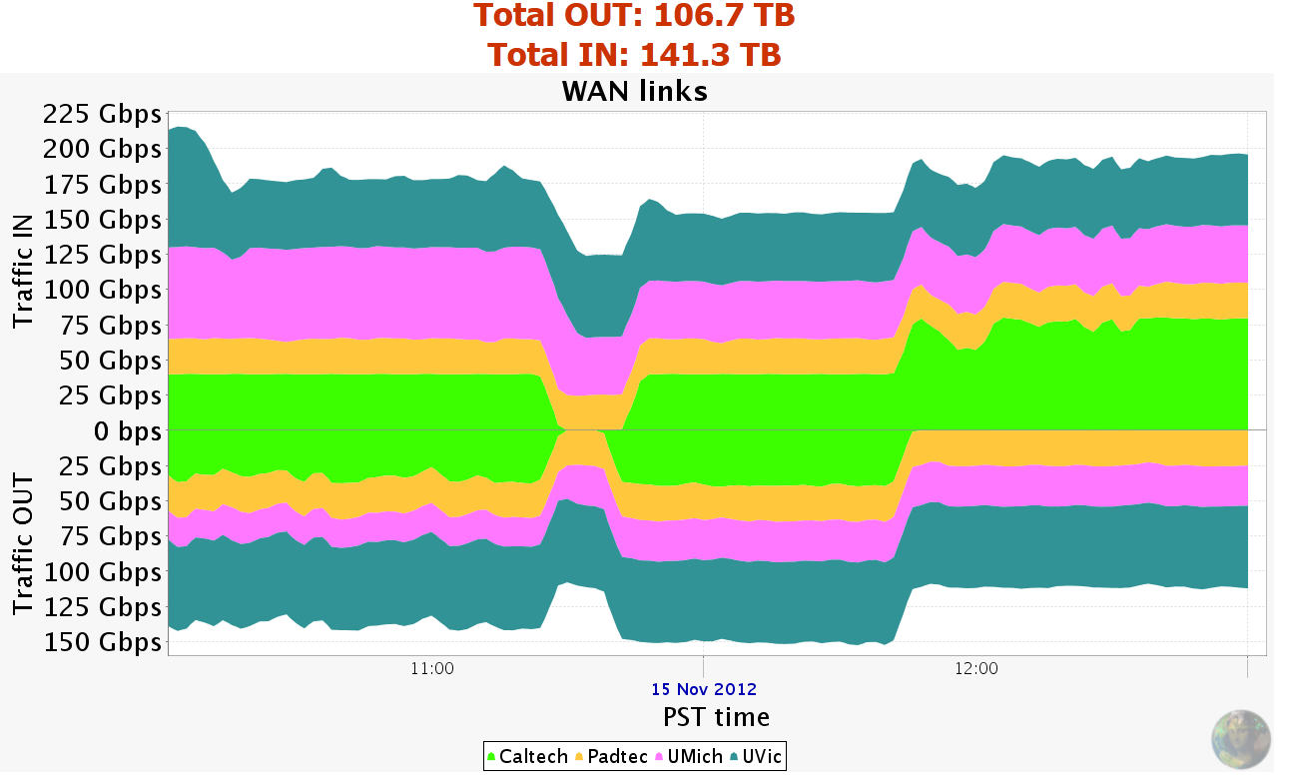
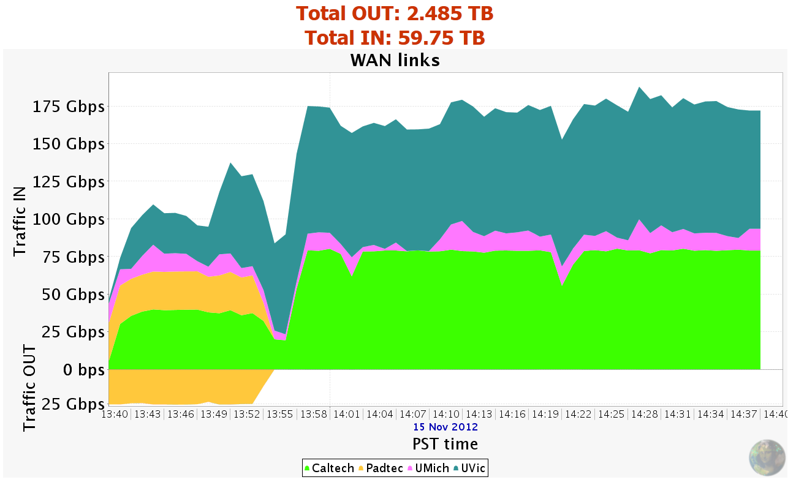
SC12 November 14-15 2012
Caltech-Victoria-Michigan-Vanderbilt; BNL
FDT Memory
to Memory
300+ Gbps In+Out Sustained
from Caltech,
Victoria, UMich
To 3 Pbytes
Per Day
FDT Storage
to Storage
http://monalisa.caltech.edu/FDT/
175 Gbps
(186 Gbps Peak)
Extensive use of FDT, Servers with 40G Interfaces.
+ RDMA/Ethernet
HEP Team and Partners
Have defined the state of the art
in high throughput long range transfers since 2002
1 Server Pair:
to 80 Gbps (2 X 40GE)
21

Slide 22
ATLAS Computing: PanDA
Kaushik De, Univ. Texas at Arlington
PanDA Workflow Management System (ATLAS):
A Unified System for organized production and user analysis jobs
  Highly automated; flexible; adaptive
  Uses asynchronous Distributed Data Management system
  Eminently scalable: to > 1M jobs/day (on many days)
Other Components (DQ2, Rucio): Register & catalog data; Transfer data to/from sites, delete when done; ensure data consistency; enforce ATLAS computing model
PanDA basic unit of work: A Job
  Physics tasks split into jobs by ProdSys layer above PanDA
Automated brokerage based on CPU and Storage resources
  Tasks brokered among ATLAS “clouds”
  Jobs brokered among sites
  Here’s where Network information will be most useful!

Slide 23
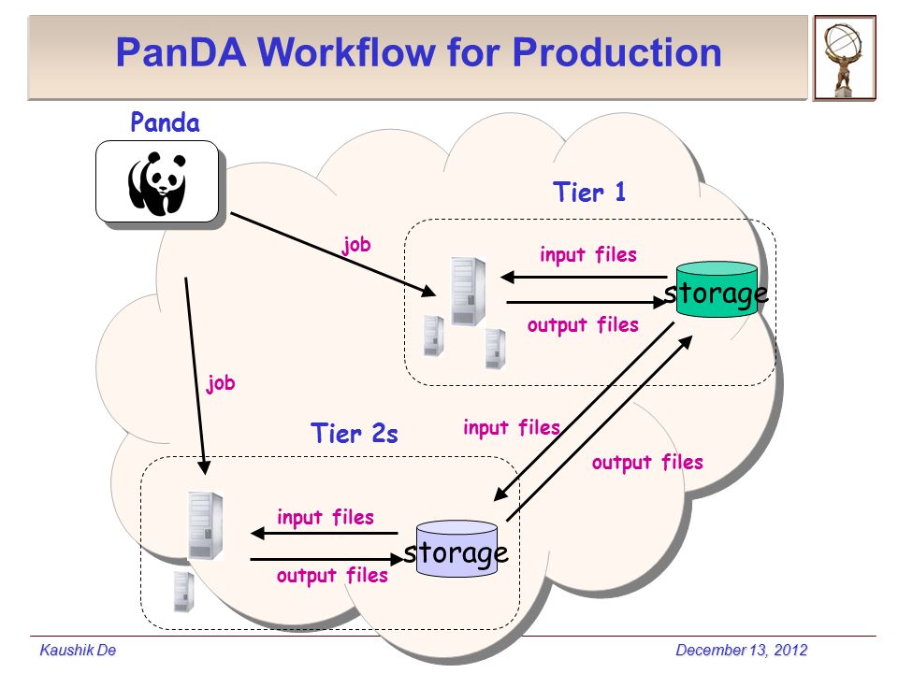
ATLAS Production Workflow
Kaushik De, Univ. Texas at Arlington
PANDA: A central element overseeing ATLAS workflow.
The locus for decisions based
on network information

Slide 24
CMS Computing: PhEDEx
PhEDEx is the CMS data-placement management tool
  a reliable and scalable dataset (fileblock-level) replication system
  With a focus on robustness
Responsible for scheduling the transfer of CMS data across the grid
  using FTS, SRM, FTM, or any other transport package: FDT
PhEDEx typically queues data in blocks for a given src-dst pair
  From tens of TB up to several PB
Success metric so far is the volume of work performed;
No explicit tracking of time to completion for specific workflows
  Incorporation of the time domain, network awareness , and reactive actions, could increase efficiency for physicists
Natural candidate for using dynamic circuits
  could be extended to make use of a dynamic circuit API like NSI

Slide 25
CMS: Possible Approaches within PhEDEx
From T. Wildish,
PhEDEx team lead
There are essentially four possible approaches within
PhEDEx for booking dynamic circuits:
  Do nothing, and let the “fabric” take care of it
    Similar to LambdaStation (by Fermilab + Caltech)
    Trivial, but lacks prioritization scheme
    Not clear the result will be optimal
  Book a circuit for each transfer-job i.e. per FDT or gridftp call
    Effectively executed below the PhEDEx level
    Management and performance optimization not obvious
  Book a circuit at each download agent, use it for multiple
  transfer jobs
    Maintain stable circuit for all the transfers on a given src-dst pair
    Only local optimization, no global view
  Book circuits at the Dataset Level
    Maintain a global view, global optimization is possible
    Advance reservation

Slide 26
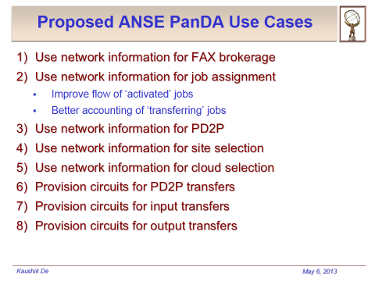
PanDA and ANSE
Kaushik De (UTA) at Caltech Workshop

Slide 27
FAX Integration with PanDA
ATLAS has developed detailed plans for integrating FAX with PanDA over the past year
  Networking plays an important role in Federated storage
  This time we are paying attention to networking up front
  The most interesting use case – network information used for brokering of distributed analysis jobs to FAX enabled sites
  This is first real use case for using external network information in PanDA
Kaushik De (UTA)

Slide 28
PD2P – How LHC Model Changed
PD2P = PanDA Dynamic Data Placement
PD2P is used to distribute data for user analysis
  For production PanDA schedules all data flows
  Initial ATLAS computing model assumed pre-placed data distribution
  for user analysis – PanDA sent jobs to data
  Soon after LHC data started, we implemented PD2P
Asynchronous usage based data placement
  Repeated use of data → make additional copies
  Backlog in processing → make additional copies
  Rebrokerage of queued jobs → use new data location
  Deletion service removes less used data
  Basically, T1/T2 storage used as cache for user analysis
This is perfect for network integration
  Use network status information for site selection
  Provisioning - usually large datasets are transferred, known volume

Slide 29
ANSE - Relation to DYNES
In brief, DYNES is an NSF funded project (2011-13) to deploy a cyberinstrument linking up to 50 US campuses through Internet2 dynamic circuit backbone and regional networks
  based on Internet2 ION service, using OSCARS technology
  Led to new development of circuit software: OSCARS; PSS, OESS
DYNES instrument can be viewed as a production-grade ‘starter-kit’
  comes with a disk server, inter-domain controller (server)
  and FDT installation
  FDT code includes OSCARS IDC API  reserves bandwidth,
  and moves data through the created circuit
The DYNES system is “naturally capable” of advance reservation
We will need to work on mechanisms for protected traffic to most campuses, and evolve the concept of the Science DMZ
Need the right agent code inside CMS/ATLAS to call the API whenever transfers involve two DYNES sites
[Already exists with Phedex/FDT]

Slide 30
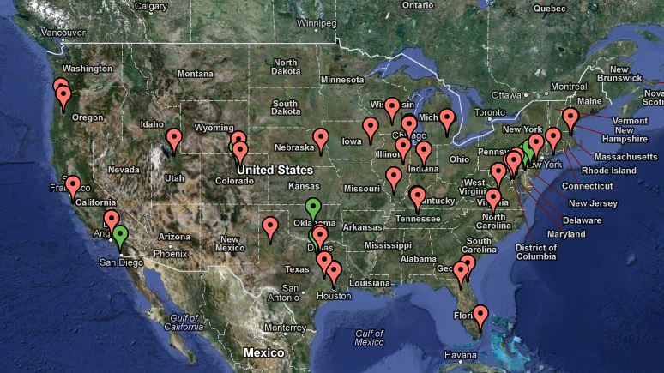
DYNES Sites
DYNES is extending circuit capabilities to ~40-50 US campuses
DYNES is ramping up to full scale, and will transition to routine Operations in 2013
Will be an integral part of the point-to-point service in LHCONE
Extending the OSCARS scope; Transition: DRAGON to PSS, OESS

Slide 31
ANSE Current Activities
Initial sites: UMich, UTA, Caltech, Vanderbilt, UVIC, CERN,
and the US LHCNet and Caltech network points of presence
Monitoring information for workflow and transfer management
  Define path characteristics to be provided to FAX and PhEDEx
  On a NxN mesh of source/destination pairs
  use information gathered in perfSONAR
  Use LISA agents to gather end-system information
Dynamic Circuit Systems
  Working with DYNES at the outset
    monitoring dashboard, full-mesh connection setup and BW test
  Deploy a prototype PhEDEx instance for development and evaluation
    integration with network services
  Potentially use LISA agents for pro-active end-system configuration

Slide 32
ATLAS Next Steps
UTA and Michigan are focusing on getting estimated bandwidth along specific paths available for PanDA (and PhEDEx) use.
  Site A to SiteB; NxN mesh
Michigan (Shawn McKee, Jorge Batista) is working with the perfSONAR-PS metrics which are gathered at OSG and WLCG sites.
  Batista is working on creating an estimated bandwidth matrix for WLCG sites querying the data in the new dashboard datastore.
  The “new” modular dashboard project (https://github.com/PerfModDash) has a collector, a datastore and a GUI.
  The perfSONAR-PS toolkit instances provide a web services interface open for anyone to query, but would rather use the centrally collected data that OSG and WLCG will be gathering.
  Also extending the datastore to gather/filter
  traceroutes from perfSONAR
Shawn McKee
Michigan

Slide 33
ATLAS Next Steps: University of Texas at Arlington (UTA)
UTA is working on PanDA network integration
Artem Petrosyan, with experience in the PanDA team is preparing a web page with the best sites in each cloud for PanDA: well-advanced
  Collecting data from existing ATLAS SONAR (data transfer) tests and load them into the AGIS (ATLAS information) system.
  Implementing the schema for storing the data appropriately
  Creating metadata for statistical analysis & prediction
  With a web UI to present the best destinations
  for job and data sources.
In parallel with AGIS and web UI work, Artem is working with PanDA to determine the best locations to access and use the information he gets from SONAR as well as the information Jorge gets from perfSONAR-PS.
Also coordinated with the BigPanDA (OASCR) project at BNL (Yu)

Slide 34

CMS PhEDEx Next Steps
Testbed Setup: Well advanced
Prototype installation of PhEDEx for ANSE/LHCONE
  Using Testbed Oracle instance at CERN
  Install website
  Install site agents at participating sites
    One box per site, (preferably) at the site
    Possible to run site-agents remotely, but need remote access to SE to check if file transfers succeeded/delete old files
  Install management agents
    Done at CERN
  For a few sites, could all be run by 1 person
  Will provide a fully-featured system for R&D
    Can add nodes as/when other sites
    want to participate
Tony Wildish Princeton

Slide 35
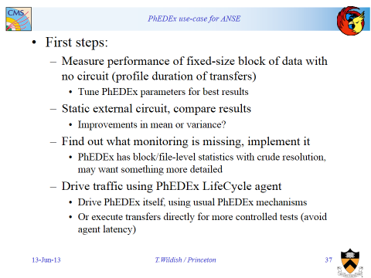
PhEDEx & ANSE, Next Steps
Caltech Workshop May 6, 2013

Slide 36
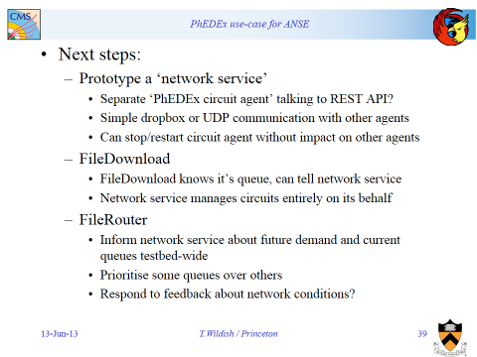
PhEDEx & ANSE, next steps
Caltech Workshop May 6, 2013

Slide 37
ANSE: Summary and Conclusions
The ANSE project will integrate advanced network services
with the LHC Experiments’ mainstream production SW stacks
Through interfaces to
  Monitoring services (PerfSONAR-based, MonALISA)
  Bandwidth reservation systems (NSI, IDCP, DRAC, etc.)
By implementing network-based task and job workflow decisions (cloud and site selection; job & data placement) in
  PanDA system in ATLAS
  PhEDEx in CMS
The goal is to make deterministic workflows possible
  Increasing the working efficiency of the LHC program
  Profound implications for future networks and other fields
A challenge and an opportunity for Software Defined Networks
ANSE is an essential first step to achieve the future vision + archhitecturesof LHC Computing: e.g. as a data intensive CDN

Slide 38
Thank you !
Questions ?
newman@hep.caltech.edu

Slide 39
BACKUp SLIDES FOLLOW
newman@hep.caltech.edu

Slide 40
Components for a Working System: Dynamic Circuit Infrastructure
To be useful for the LHC and other communities,
it is essential to build on current & emerging standards, deployed
on a global scale
Jerry Sobieski, NORDUnet

Slide 41
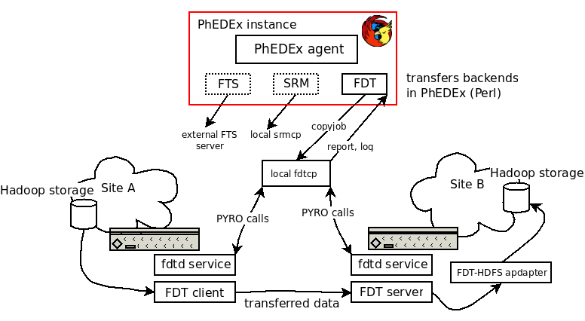
DYNES/FDT/PhEDEx
FDT integrates OSCARS IDC API to reserve network capacity for
data transfers
FDT has been integrated with PhEDEx at the level of download agent
Basic functionality OK
  more work needed to understand performance issues with HDFS
Interested sites are welcome to test
With FDT deployed as part of DYNES, this makes one possible entry point for ANSE

Slide 42
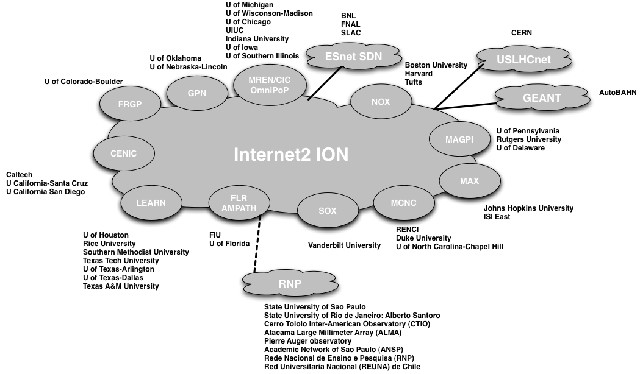
DYNES High-level topology
The DYNES Instrument

Slide 43
What Drives ESnet’s
Network Architecture, Services, Bandwidth, and Reliability?
      For details, see endnote 3
And US LHCNet’s
W. Johnston, ESnet

Slide 44
The ESnet [and US LHCNet] Planning Process
1) Observing current and historical network traffic patterns
  What do the trends in network patterns predict for future network needs?
2) Exploring the plans and processes of the major stakeholders (the Office of Science programs, scientists, collaborators, and facilities):
  2a) Data characteristics of scientific instruments and facilities
    What data will be generated by instruments and supercomputers coming on-line over the next 5-10 years?
  2b) Examining the future process of science
    How and where will the new data be analyzed and used – that is, how will the process of doing science change over 5-10 years?
  Note that we do not ask users what network services they need,
  we ask them what they are trying to accomplish and how (and where all of the pieces are) then the network engineers derive network requirements
  Users do not know how to use high-speed networks so ESnet assists with knowledge base (fasterdata.es.net) and direct assistance for big users
Notes:
44

Slide 45
Usage Characteristics of Instruments and Facilities
Fairly consistent requirements are found across the large-scale sciences
Large-scale science uses distributed applications systems in order to:
  Couple existing pockets of code, data, and expertise into “systems of systems”
  Break up the task of massive data analysis into elements that are physically located where the data, compute, and storage resources are located
Identified types of use include
  Bulk data transfer with deadlines
    This is the most common request: large data files must be moved in an length of time that is consistent with the process of science
  Inter process communication in distributed workflow systems
    This is a common requirement in large-scale data analysis such as the LHC Grid-based analysis systems
  Remote instrument control, coupled instrument and simulation, remote visualization, real-time video
    Hard, real-time bandwidth guarantees are required for periods of time (e.g. 8 hours/day, 5 days/week for two months)
    Required bandwidths are moderate in the identified apps – a few hundred Mb/s
  Remote file system access
    A commonly expressed requirement, but very little experience yet
W. Johnston, ESnet
Notes:
45

Slide 46

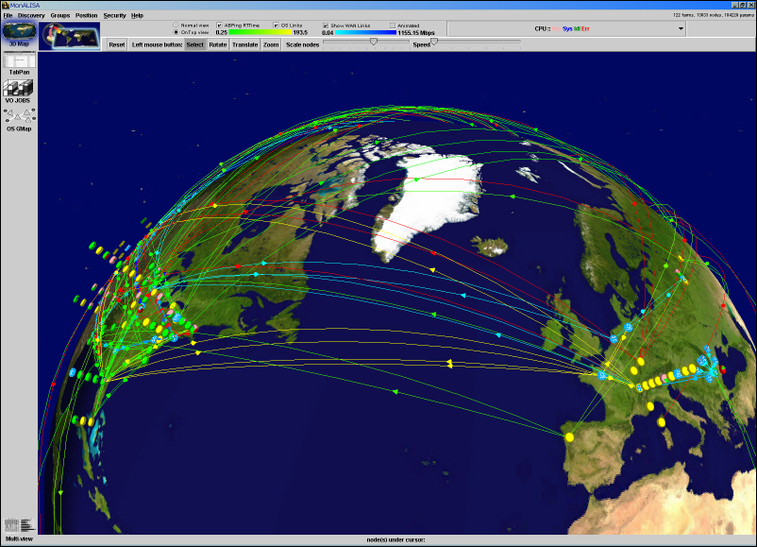
Monitoring the Worldwide LHC Grid
State of the Art Technologies Developed at Caltech
MonALISA Today
Running 24 X 7
at 370 Sites
Monitoring
  40,000 computers
  > 100 Links On
  Major Research and Education Networks
Using Intelligent Agents
Tens of Thousands
of Grid jobs running
concurrently
Collecting > 1,500,000 parameters in real-time
MonALISA: Monitoring Agents in a
Large Integrated Services Architecture
A Global Autonomous Realtime System
Also World leading expertise in high speed data throughput over long range networks (to 187 Gbps disk to disk in 2013)

Slide 47
ATLAS Data Flow by Region: Jan. – Dec. 2012
~50 Gbps Average, 102 Gbps Peak
171 Petabytes Transferred During 2012
2012
Versus
2011:
+70%
Avg;
+180% Peak
After Optimizations
designed to reduce network traffic in
2010-2012

Slide 48
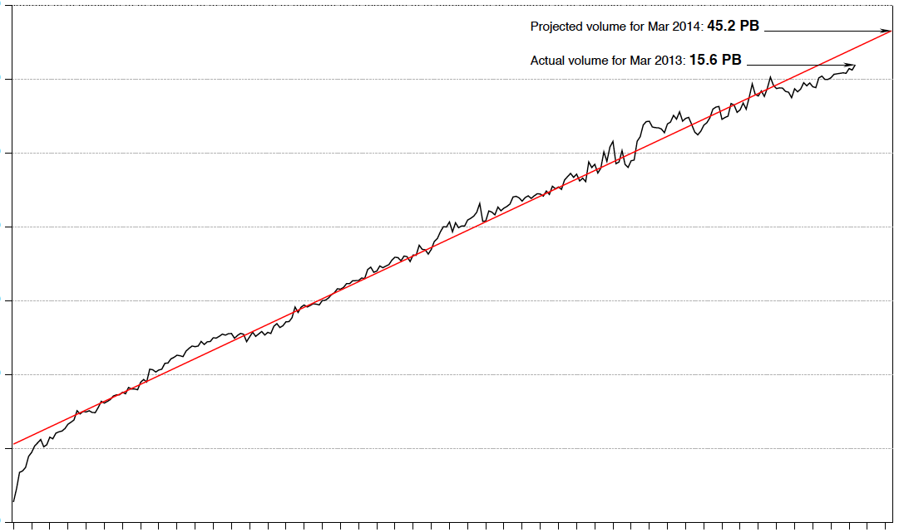
The Trend Continues …
Log Plot of ESnet Monthly Accepted Traffic, January 1990 – March 2013
100 PB
10 PB
1 PB
100 TB
10 TB
1 TB
100 GB
ESnet Traffic Increases
10X Each 4.25 Yrs, for 20+ Years
Bytes/month transferred by ESnet
Exponential Fit
’90 ’91 ’92 ‘93 ’94 ’95 ’96 ’97 ’98 ’99 ’00 ’01 ’02 ’03 ’04 ’05 ’06 ’07 ’08 ’09 ’10 ’11 ’12 ’13
Year

