Slide 1


DOE Office of High Energy Physics (HEP)
Snowmass Program Managers’ Meeting
Cosmic Frontier
CSS2013 • Snowmass on the Mississippi
Minneapolis, Minnesota
July 29 – August 6, 2013
Kathy Turner
Program Manager – Cosmic Frontier
Office of High Energy Physics
Office of Science, U.S. Department of Energy

Slide 2

Outline
PART 1
HEP Program - Intro
HEP Program - Budget & Issues
Cosmic Frontier – Program Status & Plans
PART 2
Cosmic Frontier – Research Program
FY 2014 HEP Comparative Review Process
FY 2013 HEP Comparative Review Statistics
Early Career Research Program
2

Slide 3
PART 1

Slide 4
HEP Program - Intro
Notes:
4

Slide 5
HEP Physics and Technology
Experimental
Theory
Simulation
The Energy Frontier
Origins of Mass
Matter/Anti-matter
Asymmetry
Dark matter
Neutrino Physics
Proton Decay
The Intensity
Frontier
Dark energy
Cosmic Particles
The Cosmic
Frontier
Origin of Universe
Unification of Forces
New Physics
Beyond the Standard Model
Along Three Paths
Accelerators
Detectors
Computing
  Enabled by
  Advanced Technologies
Physics Frontiers

Slide 6
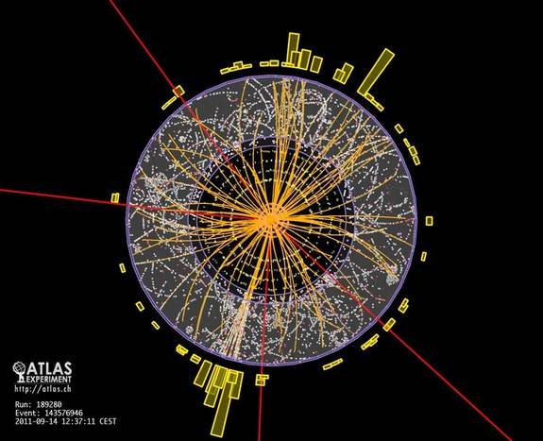
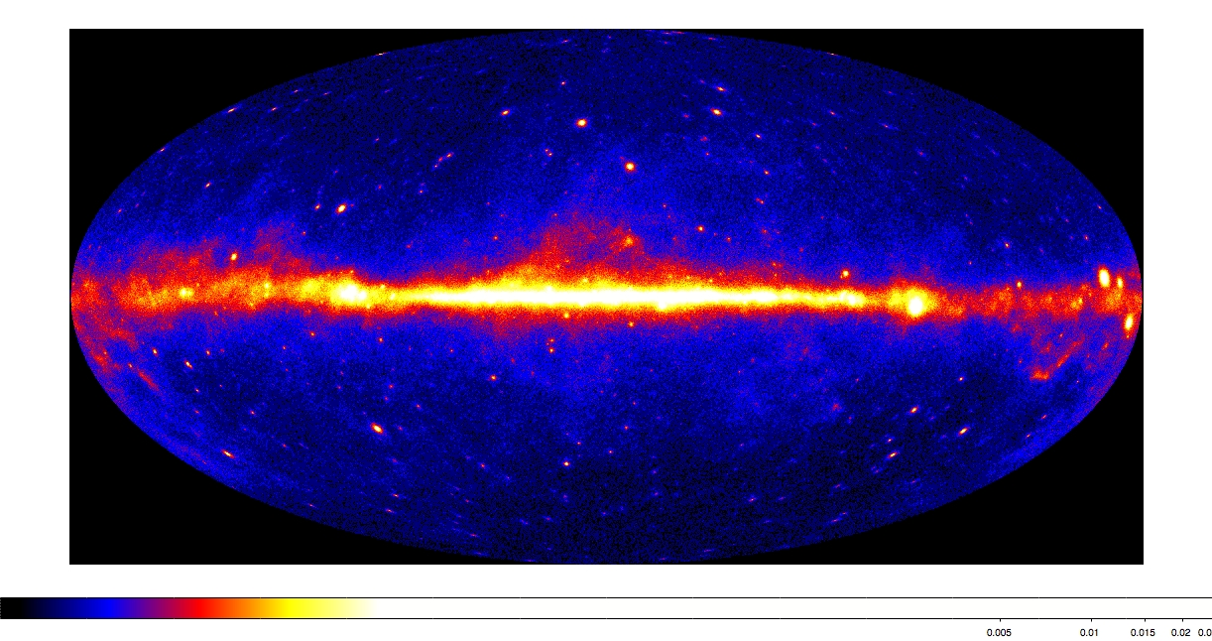
From Deep Underground to the Tops of Mountains,
HEP pushes the Frontiers of Research
Research at the Energy Frontier — HEP supports research where powerful accelerators such as the LHC are used to create new particles, reveal their interactions, and investigate fundamental forces, and where experiments such as ATLAS and CMS explore these phenomena.
Research at the Intensity Frontier — Reactor and beam-based neutrino physics experiments such as Daya Bay and LBNE may ultimately answer some of the fundamental questions of our time: why does the Universe seem to be composed of matter and not anti-matter?
Research at the Cosmic Frontier — Through ground-based telescopes, space missions, and deep underground detectors, research at the cosmic frontier aims to explore dark energy and dark matter, which together comprise approximately 95% of the universe.
Theory and Computation — Essential to the lifeblood of High Energy Physics, the interplay between theory, computation, and experiment drive the science forward. Computational sciences and resources enhance both data analysis and model building.
Accelerator Science — Supports R&D at national labs and universities in beam physics, novel acceleration concepts, beam instrumentation and control, high gradient research, particle and RF sources, superconducting magnets and materials, and superconducting RF technology.

Slide 7
DOE HEP Organization

Slide 8
HEP Program Model & Guidance
Program Model
Science Mission-driven – We develop and support a specific portfolio of projects
the emphasis is on doing experiments and getting results
make significant, coherent contributions to facilities/experiments selected for the program
support a science collaboration in all stages, leading to the best possible science results
form partnerships or use other agency’s facilities when needed (e.g. we don’t build telescopes)
  Program Guidance
  FACA panels – official advice to the government:
  High Energy Physics Advisory Panel (HEPAP)
    – provides the primary advice on the High Energy and Particle Physics programs to DOE and NSF
    - Subpanels for detailed studies (e.g. P5)
  Astronomy and Astrophysics Advisory Committee (AAAC)
    – reports to NASA, NSF and DOE on areas of overlap
  Other Input:
  APS Division of Particles and Fields (DPF) – Snowmass
  National Academies of Science - Astronomy & Astrophysics Decadal survey (New Worlds New Horizons 2010 – NWNH2010)
  Specific studies, e.g. Dark Energy science group in summer 2012→ Science case for a HEP dark energy program developed by a task force at HEP request (Rocky Kolb, chair). This was seen as a good model for the different science areas

Slide 9
HEP Program Execution - Reviews
    HEP Comparative Research Grants Program
    -- Panel reviews of all proposals to 6 different subprograms (Cosmic, Energy, Intensity, Theory, Accel. R&D, Detector R&D)
    -- The 6 panel reviews are held ~ November each year & successful grants start ~ May
    Office of Science (SC) Early Career program
    -- This is an SC-wide program but each office holds separate panel reviews
    -- Both universities and laboratories can submit proposals.
    -- HEP’s are held ~ January each year; funding starts in the summer
    HEP Comparative Review of Laboratory Research programs
    -- Panel review for each subprogram held every 3 years to comparatively review lab research programs
    -- Each subprogram is reviewed every 3 years
      FY13 Intensity Frontier review (May 2013)
      FY13 Cosmic Frontier review (September 2013)
    HEP reviews of Lab programs
    -- individual program and operations reviews
    Project reviews – as needed
    -- Depending on size of project, will have Lehman or HEP-run reviews
    Cosmic Frontier specific: Experiment Operations
    -- Panel review of operating, or about-to-start operating experiments; will do this ~ biannually (Sept 2012)
Reviewed each experiment individually (i.e. didn’t rank/prioritize against each other)
For experiments that don’t already have an agreed-upon operations phase, we will use this as an opportunity to set the operations budget & schedule (note: we have ramp down experiments in order to start new ones)

Slide 10
HEP Budget & Issues

Slide 11
HEP budget - Recent Funding Trends
Ramp up ILC and SRF R&D programs
Trading Projects for more Research
In the late 90’s the fraction of the budget devoted to projects was about 20%.
  Progress in many fields require new investments to produce new capabilities.
The projects started in 2006 are coming to completion.
New investments are needed to continue US leadership in well defined research areas.
Possibilities for future funding growth are weak. Must make do with what we have.

Slide 12
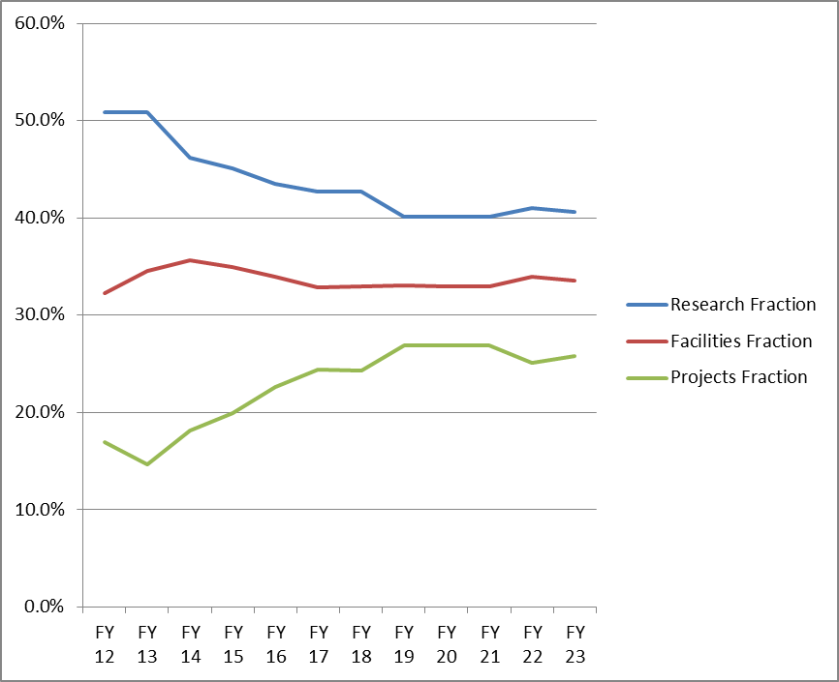
One Possible Future Scenario
Trading Research for more Projects
About 20% (relative) reduction in Research fraction over ~5 years
  In order to address priorities, this will not be applied equally across Frontiers
This necessarily implies reductions in scientific staffing
  Some can migrate to Projects but other transitions are more difficult
We have requested Labs to help manage this transition as gracefully as possible

Slide 13
HEP Budget – FY14
The President’s Request (PR) budget usually comes out ~ February each year
    HEP FY14 PR budget submitted ~ November 2012; released ~ April 2013
  The ACTUAL budget that we get for the FY is usually different – following the House, Senate process & budget approval.
  Our budget that we plan to at the beginning of each FY is usually lower than the PR; if we get increased funds after the budget is approved, we can make changes to the program.
In developing the FY2014 PR budget, HEP philosophy was to enable new world-leading HEP capabilities in the U.S. through investments on all three frontiers
  Accomplished through ramp-down Research and operations of existing Projects
  When we were not able to fully implement this approach (i.e., start fabrication of new projects), converted some planned Project funds to R&D, which was put into the Research budget :
  Research → Projects → Research (including Project R&D)
      Therefore, the FY14 Request shows somewhat artificial increases for Research due to including R&D “bump”, while Construction/Project funding is only slightly increased
      In the interim (since submission of FY14 Request), actual FY13 Research funding also increased because of inability to get Projects started
      Initial FY14 plan for Research will be down more than the originally advertised 2-3% relative to FY13
  More details in following slides…

Slide 14
HEP Budget – FY14
Impact of these actions:
  Several new efforts are delayed:
      LHC detector upgrades, LBNE, Dark Matter Generation 2 (DM-G2), Dark Energy Spectroscopic Instrument (DESI)
  US leadership/partnership capabilities will be challenged by others
  Workforce reductions at universities and labs
Key areas in FY2014 Request
  Maintaining forward progress on new projects via Construction and Research
  (incl. R&D for projects) funding lines

Slide 15
FY 2014 High Energy Physics Budget
(Data in new structure, dollars in thousands)
Description | FY 2012 Actual | FY 2013 July Plan | FY 2014 Request | Explanation of Change [FY14 Request vs. FY12 Actual]
Energy Frontier Exp. Physics | 159,997 | 148,164 | 154,687 | Ramp-down of Tevatron Research
Intensity Frontier Exp. Physics | 283,675 | 287,220 | 271,043 | Completion of NOνA (MIE), partially offset by Fermi Ops
Cosmic Frontier Exp. Physics | 71,940 | 78,943 | 99,080 | Ramp-up of LSST-Camera
Theoretical and Computational Physics | 66,965 | 66,398 | 62,870 | Continuing reductions in Research
Advanced Technology R&D | 157,106 | 131,885 | 122,453 | Completion of ILC R&D
Accelerator Stewardship | 2,850 | 3,132 | 9,931 | FY14 includes Stewardship-related Research
SBIR/STTR | 0 | 0 | 21,457
Construction (Line Item) | 28,000 | 11,781 | 35,000 | Mostly Mu2e; no LBNE ramp-up
Total, High Energy Physics: | 770,533 ^{(a)} | 727,523 ^{(b,c)} | 776,521 | wrt FY13: Up +3.6% after SBIR correction wrt FY12: Down -2% after SBIR correction
Ref: Office of Science (SC): | 4,873,634 | 4,621,075 ^{(c)} | 5,152,752
SBIR = Small Business Innovation Research
STTR = Small Business Technology Transfer
^{(a)} The FY 2012 Actual is reduced by $20,327,000 for SBIR/STTR.
^{(b)} The FY 2013 [July Plan] is reduced by $20,791,000 for SBIR/STTR. ^{(c)} Reflects sequestration.
15

Slide 16
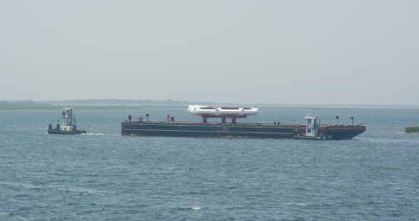
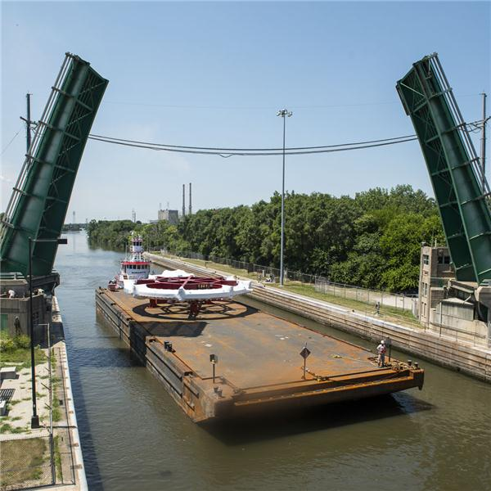
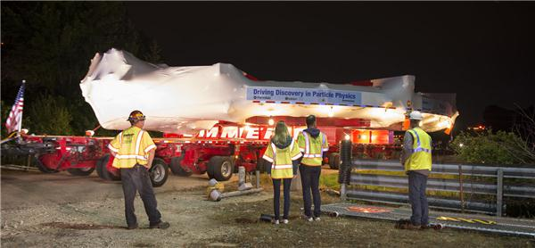
Major Item of Equipment (MIE) Issues
We were not able to implement [most] new planned MIE-fabrication starts in the FY14 request
  Muon g-2 experiment is the only new start in HEP that was not requested in FY13
  LSST-Camera and Belle-II, which had fabrication starts in the FY13 PR but didn’t receive approval, are requested again in FY14
  DM-G2 and DESI fabrication starts are not in FY14 PR budget.
Brookhaven National Laboratory
Muon g-2 Ring: On Barge, Departing Southern Long Island
June 25, 2013
On Barge, Through Joliet Locks; July 20, 2013
Entering Fermilab-site, Eola Rd. Gate; July 26, 2013
This upsets at least 2 major features of our budget strategy:
  Strategic plan: “Trading Research for Projects”
  Implementation of facilities balanced across Frontiers

Slide 17

Cosmic Frontier
PROGRAM Status & Plans
Notes:
17

Slide 18
Cosmic Frontier Program
Science Mission-driven – We develop and support a specific portfolio of projects
the emphasis is on doing experiments and getting results
Make significant, coherent contributions to facilities/experiments selected for the program
Form partnerships or use other agency’s facilities when needed (e.g. we don’t build telescopes)
Once we decide to do a project, we support a science collaboration in all stages, leading to the best possible science results
Cosmic Frontier Program “thrusts”
  Discover (or rule out) the particle(s) that make up Dark Matter
  Advance understanding of the physics of Dark Energy
  Understanding the high energy universe: Cosmic-rays, Gamma-rays
  Other efforts, including small CMB contributions & efforts

Slide 19
HEP Cosmic Frontier
Funding (in $K) | FY 2012 Actual | FY 2013 July Plan | FY 2014 Request | Comment – FY14
Research (lab + univ) | 47,840 | 48,836 | 62,364 | Includes R&D for DM-G2, DESI
Facilities | 11,207 | 10,948 | 12,022 | Experimental Operations
Projects | 12,893 | 19,159 | 24,694
Current (small) | 2,613 |  | 1,200
Current (MIE) | 7,000 | 9,500 | 22,000 | FY13 HAWC ends, FY14 LSSTcam fab. starts
R&D for Future | 3,280 | 9,659 | 1,494
TOTAL, Cosmic Frontier | 71,940 | 78,943 | 99,080
Budgets:
Research – scientists and their expenses
Project (R&D, Fabrication) & Operations (Facilities) – covers technical, engineering, computer professional, management, other personnel & expenses, M&S, computers, utilities, common funds, etc.
MIE = Major Item of Equipment
Project funding lines above cover DM-G1, DM-G2, HAWC, LSST-camera, DESI, SPTpol

Slide 20

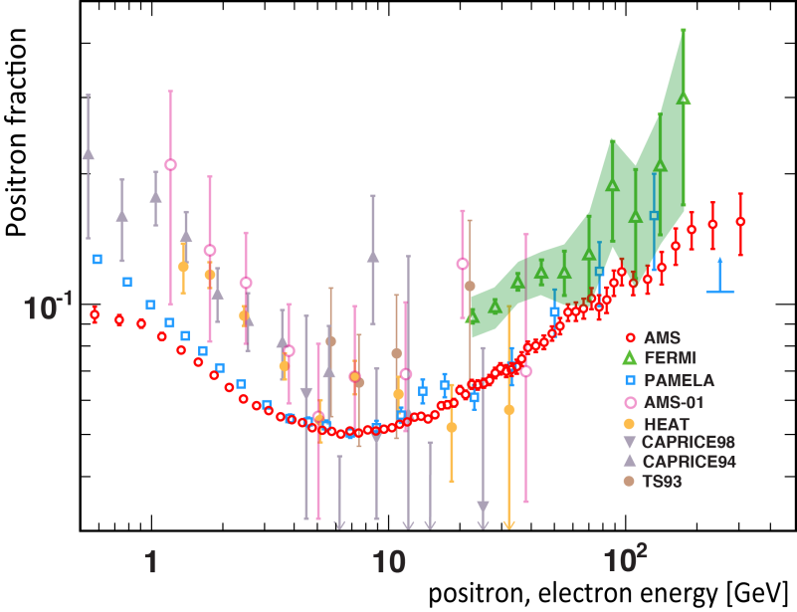
Cosmic Frontier Program Status
DES First Light
Current program
  Several operating experiments studying high-energy cosmic and gamma rays:
  Fermi/GLAST, VERITAS, Auger, AMS
  Several 1st generation (G1) dark matter direct detection experiments operating:
  ADMX, LUX, CDMS-Soudan, DarkSide, Xenon
  Several dark energy experiments are operating: BOSS, Supernova surveys; Dark Energy Survey (DES) is starting 5-year survey in Sept. 2013
  Other areas: SPTpol (CMB), Holometer
AMS First Results

Slide 21
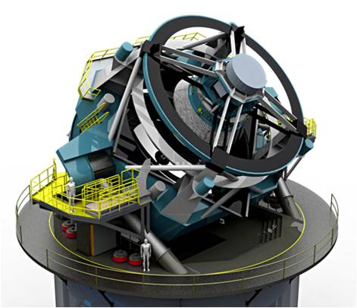
Cosmic Frontier Program Status
Planning for the Future
  2nd-Generation Dark Matter (DM-G2) experiments to probe most of preferred phase space
  Large Synoptic Survey Telescope to make definitive ground-based Stage IV Dark Energy measurements using weak lensing
  Dark Energy Spectroscopic Instrument (DESI) to complement DES/LSST with Stage IV measurements using baryon acoustic oscillations
  High Altitude Water Cherenkov (HAWC) starts full operations ~ August 2014
  Other projects to be considered by HEPAP/P5 following the DPF/Snowmass process
In addition to Project activities, we support scientists doing:
Simulations/planning as well as R&D, Fabrication efforts on these planned experiments
A small # of people doing science studies on WFIRST, Euclid; data analysis on Planck
Science studies on other potential projects in the program

Slide 22
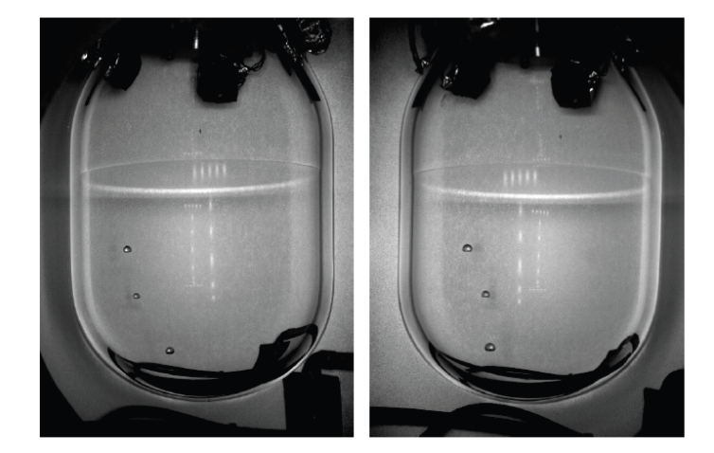
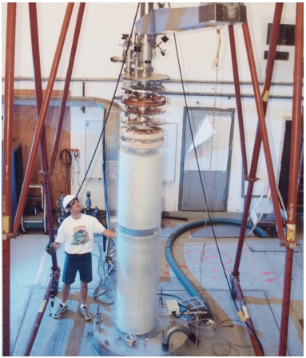
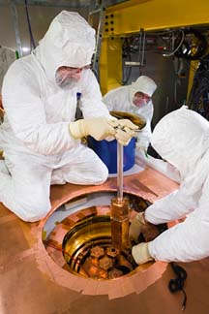
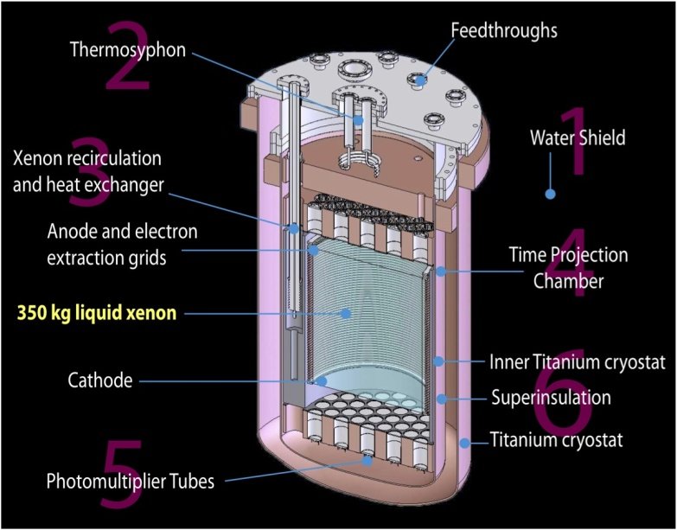
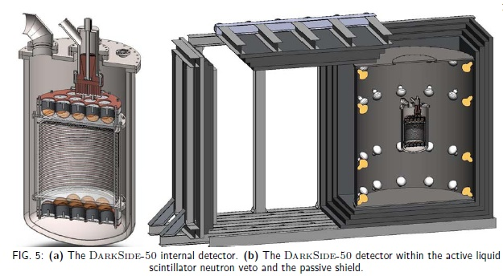
Direct-Detection Dark Matter – Current “Generation 1” (DM-G1)
Cryogenic Dark Matter Search (CDMS) at Soudan mine - germanium detectors
- operating
COUPP Bubble Chamber – Fermilab, SNOLab
- commissioning
Axion Dark Matter eXperiment (ADMX) Phase-2a at U.Washington
commissioning; start science run in summer
Large Underground Xenon (LUX) detector – Sanford Lab, Homestake mine – now underground & in commissioning
DarkSide-50 – Dual-Phase liquid argon TPC at LNGS Gran Sasso; commissioning

Slide 23
Dark Matter – future
  → Need balanced, staged program of experiments w/multiple technologies in the near term.
  - Have a path forward for next phase of direct detection dark matter experiments
Future: Dark Matter 2nd-Generation (DM-G2) experiments
Need balanced program that probe most of preferred phase space
Program in coordination with NSF
      CD-0 approved in September 2012
      FY13 R&D awards announced at March HEPAP meeting:
        ADMX-Gen2, LZ, SuperCDMS-SNOLab, DarkSide-G2, COUPP-500
      Down-selection for experiments to move to fabrication phase planned for late 2013.
      FY14 President’s Request: R&D continues

Slide 24
Dark Energy – status & future
  ➔ We have a balanced, staged program of experiments w/ all methods: supernovae, BAO, galaxy clustering, weak lensing, etc.
  Typically using facilities that belong to other agencies which provides data for a wide community for a variety of astronomical measurements.
  DOE’s interest is the nature of Dark Energy, causing the expansion of the universe to accelerate.
  → we provide instrumentation and science collaboration for dark energy studies
  Current:
  Supernova surveys, BOSS, DES starting in September
  Future
  Projects, experiments being planned: DESI, LSST
  Science efforts on WFIRST, Euclid
  Other possibilities: extend BOSS operations?
  Questions:
    How far do we need to go in each method after the planned program?
    R&D studies needed?

Slide 25
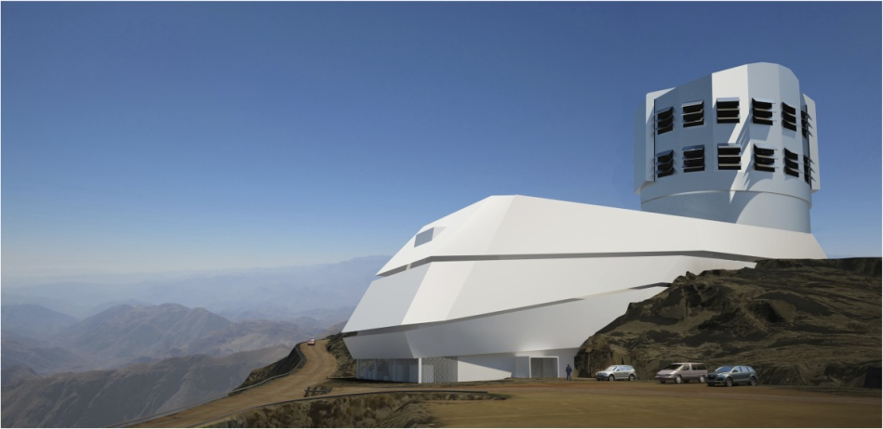
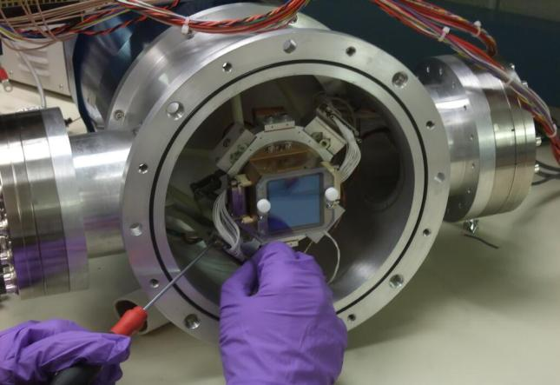
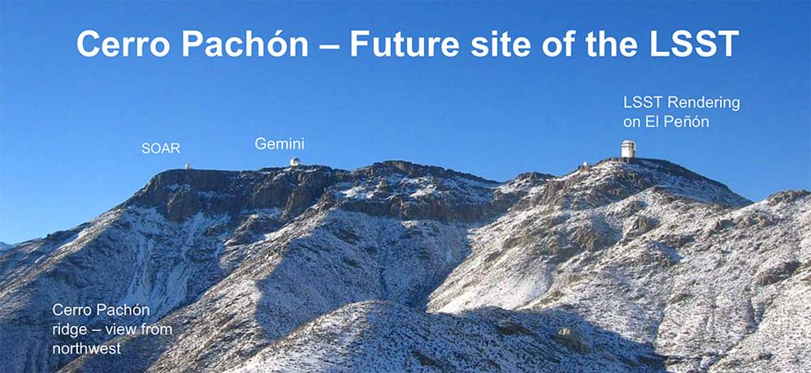
Large Synoptic Survey Telescope (LSST)
Science:
Dark Energy Science Collaboration (LSST-DESC) formed to start preparations for precision analyses.
Project:
8.4 m telescope facility and associated instrumentation on Cerro Pachon (8,800 ft) in Chile.
Partnership between DOE and NSF, with contributions from private and foreign institutions
NSF is the lead-agency, responsible for telescope & data management; DOE is responsible for the 3-billion pixel imaging camera, LSST-camera (managed by SLAC)
Status:
Critical Decision 1 (CD-1) approved for LSST-camera in Feb. 2012
FY 2014 President’s Request budget for DOE includes fabrication start for LSST-camera
FY 2014 President’s Request budget for NSF includes MREFC funds for LSST construction
DOE “Lehman” status review of LSST-camera in June
NSF Final Design Review in October
Camera: fully functional prototype sensors

Slide 26
Dark Energy Spectroscopic Instrument (DESI)
August 2012: HEP community dark energy science plan identified a wide-field spectroscopic survey to carry out a Stage IV dark energy program using the Baryon Acoustic Oscillations and Redshift Space Distortions methods as a high priority medium-scale project to maintain US leadership in this area.
9/18/12 -- Critical Decision 0 (CD-0) for DESI experiment approved
The CD-0 statement calls for the development of new instrumentation to be operated in the time gap between other dark energy experiments (i.e. DES & LSST).
December 2012: assigned Project Office to LBNL
January 2013: HEP and NSF-AST signed a statement of agency principles
HEP goal is to do the survey in 3-5 years with 70-100% of the dark time and is willing to pay operating costs; HEP would like to make the site selection asap to meet the envisioned schedule.
NSF is interested in identifying a suitable telescope to support MS-DESI; Mayall telescope at Kitt Peak is likely to be available for usage and a decision could be made ~ April 2013; Blanco not known yet to be available and decision is not likely possible in the April 2013 time frame.
May 2013:
DESI project office at LBNL sent HEP a science alternatives analysis report in response to request for studies to support HEP’s decision-making process in selecting a preferred telescope facility.
DOE sent a letter to NSF indicating that the Mayall telescope is our preferred site for hosting DESI.
Current:
DOE & NSF having regular talks about possible opportunities, constraints and models for the experiment and use of a telescope facility.
R&D continuing in FY14
Planning Lehman review in January 2014

Slide 27
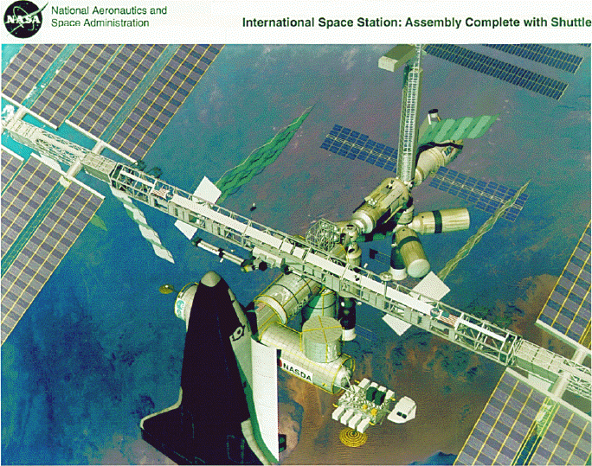
High Energy Cosmic-ray, Gamma-ray experiments
  ➔Experiments measuring properties of high energy cosmic-rays & gamma rays; can also explore acceleration mechanisms and do indirect searches for dark matter candidates.
Current:
AMS – on International Space Station
Pierre Auger - cosmic ray observatory
VERITAS – gamma-ray array
Fermi Gamma-ray Space Telescope
HAWC – gamma ray array; data taking starts in 2014.
Future planning:
Cherenkov Telescope Array (CTA):
NWNH-2010 recommended US contribution to CTA in higher budget scenarios (4th on list of ground-based experiments) and that funding be split approximately 2/3 NSF and 1/3 DOE.
-- DOE/HEP gave guidance to the US collaboration:
  Following the Astro2010, we consider NSF to be in the lead for considering the project.
  We have no funding identified for a contribution to CTA in the foreseeable future and therefore aren’t funding R&D for it
Auger Collaboration planning to propose an upgrade.
At this time, we are funding science studies for the future only
Alpha Magnetic Spectrometer (AMS) on the International Space Station – launched May 2011
Any future project directions will depend on Snowmass, P5 results and funding.
27

Slide 28
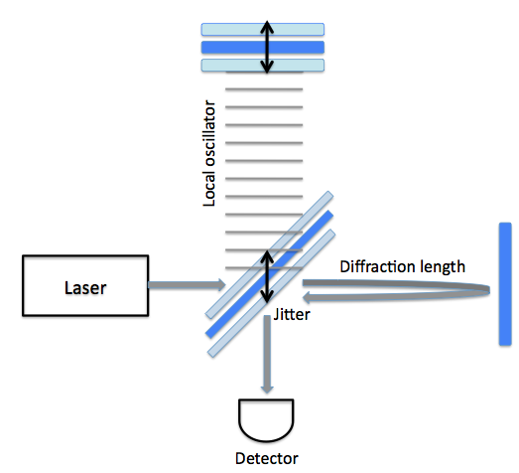
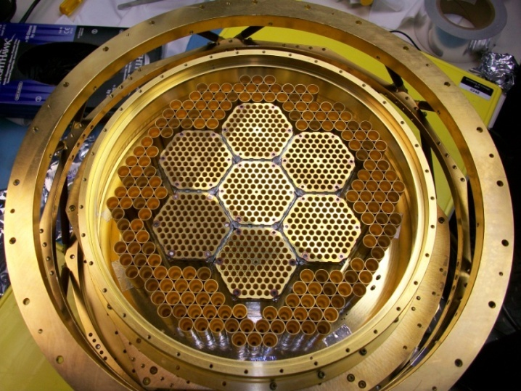
Cosmic Frontier – CMB & Other experiments
South Pole Telescope polarization (SPTpol)
- CMB polarization experiment
HEP provided support for outer-ring detector fabrication and is supporting operations for ANL activities.
Collaboration proposing SPTpol-3G as next step
Planck Space Mission
– HEP participating in data processing & analysis.
Correlated position noise in interferometers
Holometer status:
Full vacuum system in place & finishing mechanical installation
Will go into full commissioning in the next few months
Future:
Science studies now; any future projects will depends on Snowmass, P5 results and funding.

Slide 29
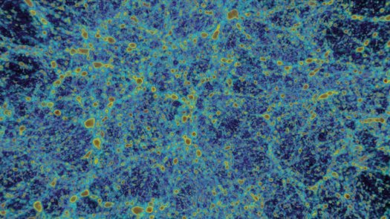
Cosmic Frontier – Related efforts
Computational Cosmology
SciDAC-3 (Scientific Discovery through Advanced Computing) DOE award to Cosmic
Frontier Computational Collaboration at DOE Labs (2012 for 3 Years): Computation-
Driven Discovery for the Dark Universe PI: S. Habib
ESA/NASA Planck mission: First comprehensive simulations run at DOE NERSC
Computing Facility generating 35TB of data – used to validate ongoing analysis of the real
Planck data in preparation for their release in January 2013. POC: J. Borrill, LBNL
Allocations at NERSC: Both DES and LSST planning on using NERSC for simulations
and analysis
HEP Theory Program
funds Cosmic Frontier related theory efforts; typically not directly in support of experiments in the program
Detector R&D
- Funds generic detector R&D; some efforts related to Cosmic Frontier needs
29

Slide 30
Cosmic Frontier – Program Guidance & Planning
  In planning the program, we are following guidance from the Particle Astrophysics Science Advisory Group (PASAG) HEPAP Subpanel (Oct. 2009) ➔
  Recommended an optimized program over the next 10 years in 4 funding scenarios
  Dark matter & dark energy remain the highest priorities; but don’t zero out everything else
  Prioritization Criteria - Make contributions to select, high impact experiments:
    That directly address HEP science goals
    That will make a visible or leadership contribution
    For which the HEP community makes contributions – instrumentation, collaborations, analysis techniques etc.
At the Cosmic Frontier, the emphasis is on doing experiments
Design and build instrumentation and bring other resources (e.g. computing)
Use other agency’s facilities where needed (i.e. we don’t build telescope facilities)
Fund collaborations with expertise needed for all phases of an experiment - design, fabrication, operations, and data analysis to produce robust measurements
30

Slide 31
Cosmic Frontier – Program balance, issues, considerations
➔Important to pro-actively develop an independent, balanced, robust program
Program Balance:
Staged implementation & results
Include near term and low cost options, using multiple methods and technologies as required; as well as larger projects
Balance between Cosmic thrusts
Experiments directly-aligned with goals or provide input/contributions to goals
Experiments in which only part of the data is of interest to the HEP program
Balance of speculative efforts with ones that guarantee results
Domestic and off-shore
In determining which experiments to do, we consider →
Science goals and how it will address DOE-HEP goals
What does our community bring to the experiment? Visible, leadership contributions?
Contributions in line with % of the project relevant to our science goals.
Roles and responsibilities be in line with our contributions.
Partnerships - plusses and minuses
Don’t “mayonnaise” funds all over many small efforts.
Current Budget/Program issues
Will need to ramp down some experiments in the next few years to make room for new projects.
31

Slide 32
PART 2

Slide 33
COSMIC FRONTIER
RESEARCH Program

Slide 34
Cosmic Frontier – Research Model
PASAG Criteria can also be applied to research efforts on projects in the program:
will the effort will significantly advance HEP science goals?
will the researcher(s) make significant/visible/leadership impact & contributions
In practice, we typically support teams/collaborations of scientists with the necessary expertise and responsibilities to take experiments through all phases, from R&D, Fabrication, Operations, and Data Analysis
-- Science planning is expected throughout all phases to end up with coordinated data analysis by a collaboration (1 precision result rather than 100 independent results)
-- Understand that people have different strengths & are involved in different aspects.
-- Support theory/simulations/phenomenology/computational efforts in direct support of our experiments (otherwise should be proposed to the Theory program).
Priority is to support efforts in our program, where we have responsibility for experiment.
- Need to make sure that our experiments are adequately supported before supporting or adding to research efforts for other programs.
34

Slide 35
Cosmic Frontier – Considerations
Peer reviews and program planning reflect these traditions.
Consider:
Is the activity in direct support of our science/experiment and priorities?
For experiments with broad science program, what efforts are needed to support our science interests?
What are the priority efforts needed now for a particular experiment?
What is the experience, responsibilities and commitment (% time) of the researcher? Will they have time to make significant contribution?
Funding isn’t optimized by funding small fractions of lots of different people that aren’t making large or continuous contributions to the experiment, in addition to their own data analysis.
For experiments with a broad science program, need to ensure that we are concentrating on the most important efforts for HEP program (e.g. dark energy on multi-use facility.
35

Slide 36
Cosmic Frontier: Research Funding
Cosmic Frontier experimental research budget covers:
Scientist support for our program - Faculty, research scientist, postdoc, graduate student, & their expenses
Small technical, engineering, equipment, etc for their efforts in their lab
-- but anything major should be proposed for R&D/Fab/Ops budgets
Effort in our program:
We typically assume that if we provide 2 months summer support for a faculty member and his/her group, that we are buying 100% of their research time throughout the entire year on this effort. Otherwise, we pro-rate if they have other activities/grants.
Typical HEP researcher:
Involved in “service” work for the experiment as well as science research
Has program of experiments and plan from 1 experiment to the next
Not funded for 1 particular study or effort here and there
Makes long term commitments to our experiment/science – he/she has specific commitments & responsibilities for our projects/experiments that may include analyzing data with one experiment while planning the next one.
36

Slide 37
Cosmic Frontier – model & review
Model for working in the field:
Get involved in experiment/science and take on responsibilities for the collaboration and then submit proposal. We don’t usually fund people on speculation.
Have involvement in the community so that you are part of the HEP community! (e.g. DPF Snowmass planning).
Lot of science topics may be in dark energy plan or related to dark energy but need to think of what is the priority & main efforts needed
Need to explain long term program not just your studies for next 3 years.
Good to have program working on (e.g.) DES and LSST – not just all LSST simulations. Not all has to be funded by HEP, but should explain how your program progresses
Show track record and have responsibilities before funding starts.
Have responsibilities for the experiment – not just science simulations & analysis.
Transitioning to a new project/field requires a lot of work to get up to speed.
- best for faculty member to take the time to really learn the field and take on responsibility first
Review Comments:
Yes, everything helps dark energy, but with limited funds we have to prioritize
Most proposers are excellent scientists but is it clear that what they’re doing is a priority at this time & how integrated they are in experiments?
Just because you had major contributions in the past, doesn’t mean that you will be funded if you don’t have responsibilities, commitments now.
Yes, adding 5 grad students and 5 postdocs to your group would let you get more done, but we are working on optimizing resources and need to spread out responsibilities and support across the collaboration.
37

Slide 38
Cosmic Frontier – Size of the Research Program
Increasing size of projects in the budget – will need researchers to support these.
The labs have led the entry to dark energy → need to increase the # of university PI’s.
- Need to ensure healthy balance for other areas too.
There is a lot of pressure on the program in terms of requests for funding.
-- In the FY13 comparative grant review process, there were 28 proposals with 55 PI’s/Co-PI’s; ~ $7.9M requested; ~ $3.4M in funding available
38

Slide 39
FY 2014 HEP Comparative Review Process

Slide 40
Purpose
In FY2012, DOE/HEP started a process of comparative grant reviews for research grants which were scheduled for renewal (+ any new proposals as desired)
  Existing grants which did not renew in FY2012 (“continuations”) were not affected by this change in the 1st round
Previously all HEP proposals responding to the general Office of Science (SC) call were individually peer-reviewed by independent experts.
This change in process has been recommended by several DOE advisory committees, most recently the 2010 HEP Committee of Visitors (COV):
  “In several of the cases that the panel read, proposal reviewers expressed negative views of the grant, but only outside of their formal responses. Coupled with the trend in the data towards very little changes in the funding levels over time, this suggests that grants are being evaluated based on the historical strength of the group rather than the current strength or productivity of the group. This is of particular concern when considering whether new investigators, new science, or high-risk projects can be competitive. Comparative reviews can be a powerful tool for addressing these issues and keeping the program in peak form.”
  Recommendation: Use comparative review panels on a regular basis.
Currently with the FY14 FOA, we are in 3rd round of annual comparative review process
The goal of this effort is to improve the overall quality and efficacy of the HEP research program by identifying the best proposals with highest scientific impact and potential

Slide 41
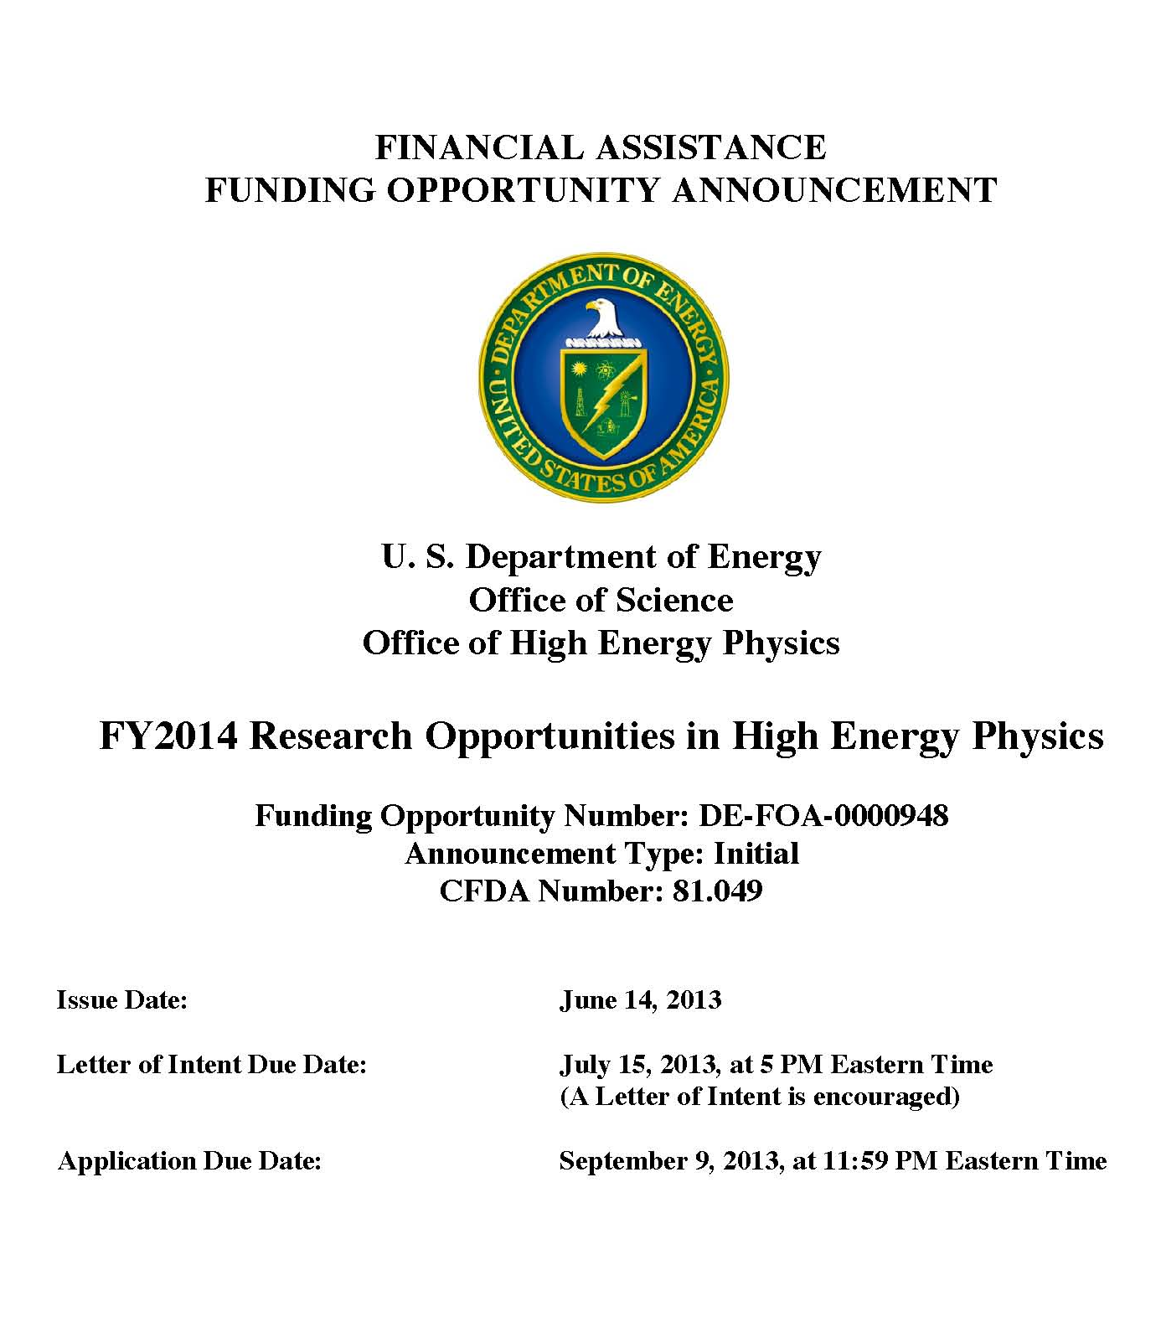
FY14 HEP Comparative Review FOA
DE-FOA-0000948
  Issued June 14, 2013
Six HEP research subprograms
  Energy, Intensity, and
  Cosmic Frontiers
  HEP Theory
  Accelerator Science and Technology R&D
  Particle Detector R&D
Letter of Intent due July 15, 2013 by 5 PM Eastern Time
  Strongly encouraged

Slide 42
FY14 HEP Comparative Review FOA
DE-FOA-0000948
  Issued June 14, 2013
Six HEP research subprograms
  Energy, Intensity, and
  Cosmic Frontiers
  HEP Theory
  Accelerator Science and Technology R&D
  Particle Detector R&D
Letter of Intent due July 15, 2013 by 5 PM Eastern Time
  Strongly encouraged
  as of today, deadline has past

Slide 43
FY14 HEP Comparative Review FOA
DE-FOA-0000948
  Issued June 14, 2013
Six HEP research
subprograms
  Energy, Intensity, and
  Cosmic Frontiers
  HEP Theory
  Accelerator Science and Technology R&D
  Particle Detector R&D
Letter of Intent due July 15, 2013 by 5 PM Eastern Time
  Strongly encouraged
Final Proposal (i.e., Application) deadline Sept. 9, 2013 by
11:59 PM Eastern Time

Slide 44
Frequently Asked Questions (FAQs)
FAQ for FY14 HEP Comparative Review
  available at: http://science.energy.gov/~/media/hep/pdf/files/pdfs/Funding%20Opportunities/FY14_Comp_Review_FAQUPDATED_JULY11_2013.pdf
  updated: July 11, 2013
In addition to information provided in FOA, FAQ addresses topics on:
  Eligibility requirements
  Proposal types and scope of proposals being considered
  Guidance for new faculty members and those without current HEP grants
  Guidance for PIs with existing HEP grants
  Letter of Intent
  Proposal and Application requirements
  Budgets information, including guidance on scope of request(s)
  Information on overall scientific merit review process

Slide 45
HEP Data Management
Effective with all solicitations and invitations for research funding issued on or after October 1, 2013.
The DOE Office of Science Statement on Digital Data Management will require a Data Management Plan with all proposals submitted for Office of Science research funding.
See March 12, 2013 HEPAP presentation by Laura Biven:
http://science.energy.gov/~/media/hep/hepap/pdf/march-2013/2013_Spring_HEPAPBriefing_v3_NoBackup_LBiven.pdf
More information will also be available in the FOAs, via the DOE Office of Science website, and on the High Energy Physics webpage.
Note: Proposals submitted to the FY14 HEP Comparative Review FOA [DE-FOA-0000948] or to the FY14 Early Career Research Program FOA [DE-FOA-0000958] that have already been posted will not require Data Management Plans.

Slide 46
Logistics (FY14 Comparative Review)
Post-FOA deadline
  All applications are pre-screened for compliance to FOA, includes:
    verification of senior investigator status
    compliance with proposal requirements: e.g., page limits, appendix material,
    use of correct DOE budget and budget justification forms, …
    responsive to subprogram descriptions
  Prior to submission, all PIs should carefully follow guidelines in FOA (and read FAQ)
For review process, experts of panelists selected
  Each panelist assigned to review 3-5 proposals
    minimum 3 reviews per proposal, additional reviewers added depending on the size of a research group and scope of research activities
    Panel convenes (in ~November 2013) to discuss each proposal and each senior
    investigator, provide additional reviews for proposal(s), and for comparative
    evaluation of proposals and senior investigators
      size of each subprogram’s panel and length of a panel meeting depends on
      number of applications to review
Post-Review process
  Assess reviews at DOE OHEP on each proposal and each senior investigator in order
  to develop guidance and funding levels
    in addition to reviews, solicit input from other DOE Program Managers & Grant Monitors
  PIs given [prioritized] guidance and funding levels (~mid-January 2014) and
  request Revised Budgets and Justifications ⇒ route through SC and Chicago Office
Funded grants to begin 1st year: on or about May 1, 2014

Slide 47
HEP Research Activities Supported
What DOE supports
  Research efforts (mainly scientists) on R&D, experiment design, fabrication,
  data-taking, analysis-related activities
  Theory, simulations, phenomenology, computational studies
  Some engineering support may be provided in Particle Detector R&D subprogram
    support depends on merit review process and programmatic factors
  Consider funding efforts that are in direct support of our programs
Faculty support
  Typically, 2-months summer support assumes DOE “buys” 100% research time throughout the academic year
  Summer support should be adjusted according to % time they are on research effort
    associated funding (post-docs, travel) is also adjusted accordingly
Research Scientists
  Support may be provided, but due to long-term expectations, need to consider
  case-by-case on merits: whether the roles and responsibilities are well-matched with individual capabilities and cannot be fulfilled by a term position
  Efforts are related towards research; not long-term operations and/or project activities
What’s not supported by research grants
  Any significant operations and/or project-related activities:
    Engineering, major items of equipment, consumables for prototyping or production
  Non-HEP related efforts
    Gravity waves (LIGO), Heavy Ion (RHIC), AMO Science, etc.

Slide 48
Subprogram Review Panels
The Comparative Review process is very competitive and hard choices have to be made based on the reviews, as well as to fit into our limited funding availability
  The process by definition implies that certain proposals and investigators will be ranked at the top, middle, and bottom.
It is understood that the vast majority of people applying are working hard and their efforts are in support of the HEP program. Due to the rankings & comments by the reviewers and our constrained budgets, some people whose research activities and level of effort who are ranked lower in terms of priority and impact relative to others in the field will not be funded on the grant
  This does not necessarily mean the person cannot continue working on the experiments; they are not being funded by the grant to do it. It could be that the person has a critical role in the program but this did not come out in the proposal or review process. That is why it is imperative to respond to the FOA solicitation and detail each person’s efforts.
The subprogram review panel sees all of the proposals and will make recommendations and rankings relative to each other. When the panel is faced with comparing efforts, impacts and a limited budget, rather than rank the whole proposal low, they may provide guidance regarding details of the proposals
  e.g., person X should not be funded; do not add additional postdoc on this effort

Slide 49
Programmatic Considerations
Generally very useful to have head-to-head reviews of PIs working in similar areas, particularly for large grants
Lots of discussion of relative strengths and weaknesses of individual
proposals and PIs
Many factors weigh into final funding decisions
  Compelling research proposal for next ~3 years
    Interesting? Novel? Significant? Plausibly achievable?
    Incremental? Implausibly ambitious? Poorly presented?
  Significant recent contributions in last 3-4 years
    Synergy and collaboration within group (as appropriate)
    Contributions to the research infrastructure of experiments
  Alignment with programmatic priorities
Supportive of excellent people, including excellent new people, even when times are tough!

Slide 50
Comparative Review Criteria
(In descending order of importance)
1. Scientific and/or Technical Merit of the Project
For e.g., what is the likelihood of achieving valuable results? How might the results of the proposed research impact the direction, progress, and thinking in relevant scientific fields of research? How does the proposed research compare with other research in its field, both in terms of scientific and/or technical merit and originality? Please comment individually on each senior investigator.
2. Appropriateness of the Proposed Method or Approach
For e.g., how logical and feasible is the research approach of each senior investigator? Does the proposed research employ innovative concepts or methods? Are the conceptual framework, methods, and analyses well justified, adequately developed, and likely to lead to scientifically valid conclusions? Does the applicant recognize significant potential problems and consider alternative strategies?
3. Competency of Research Team and Adequacy of Available Resources
For e.g., what are the past performance and potential of each senior investigator? How well qualified is the research team to carry out the proposed research? Are the research environment and facilities adequate for performing the research? Does the proposed work take advantage of unique facilities and capabilities?
4. Reasonableness and Appropriateness of the Proposed Budget
Are the proposed resources and staffing levels adequate to carry out the proposed research? Is the budget reasonable and appropriate for the scope?
5. Relevance to the mission of the Office of High Energy Physics (HEP) program
How does the proposed research of each senior investigator contribute to the mission, science goals and programmatic priorities of the subprogram in which the application is being evaluated? I s it consistent with HEP’s overall mission and priorities? How likely is it to impact the mission or direction of the HEP program?
6. General Comments and Overall Impression
Include any comments you may wish to make on the overall strengths and weaknesses of the proposal, especially as compared to other research efforts in this area. If there are significant or unique elements of the overall proposal, including institutional setting and resources, synergies with other relevant subprograms, or other broader considerations not noted above please include them here.

Slide 51
Scoring by Panelists
Table A: Scoring system definition.
Qualifier | Poor | Fair | Good | Very Good | Excellent | Outstanding
Score | 1 | 2 | 3 | 4 | 5 | 6
Using the grading system in Table A above, please provide scores for the overall proposal in the respective HEP subprogram area.
  Please provide scores from 1 [Poor] to 6 [Outstanding] for each of the five criteria in Sections 1-5 in Table B below. Your scores should be supported by your answers to questions 1-5.
Table B: Overall Score in the Subprogram.
Criterion | Overall Score [1 to 6]
1) Scientific Merit
2) Appropriateness
3) Competency
4) Budget
5) Mission Relevance

Slide 52
Rating by Panelists
Table C: In comparison with similar Subprogram research efforts, please indicate whether you judge this program to lie in the bottom, 2nd, 3rd, 4th, or top quintile. Enter an “X” in the appropriate box.
Next, for each senior investigator listed in Table D, provide scores for the following [two] criteria:
  (1) the merit and potential impact of the proposed work
  (2a) the competency of the investigator and the likelihood of success. Use grading system defined in Table A.
  (2b) compared to other senior investigators working in the same area at this and other institutions, how would you rank this investigator overall in terms of quintiles?
    Please put an “X” in the appropriate box in Table D. Your ratings below should be supported by your answers to questions 1 to 5 and the scores in Table D itself.
Bottom 1-20% | Bottom 21%-40% | Mid 41%-60% | Top 61%-80% | Top 81%-100%
Table D: Individual Subprogram senior investigator scores.
Senior Investigator | Scientific merit and potential impact of proposed work [enter 1 to 6] | Competency of senior investigator’s team and likelihood of success [enter 1 to 6] | Compared to other senior investigators working in the same area, how would you rank this senior investigator overall? Please enter one “X” per senior investigator in one of the columns below.
 |  |  | Bottom 1%-20% | Bottom 21%-40% | Mid 41%-60% | Top 61%-80% | Top 81%-100%
Senior Investigator #1
Senior Investigator #2
Senior Investigator #3

Slide 53
Comparative Evaluation
DOE Program Managers will need to determine:
  The threshold for funding each proposal
  The level of support for each funded proposal
A “comparative” evaluation:
  Reviewer scores / rankings of the proposals and senior investigators provide essential (additional) input to DOE’s process of optimizing resource allocations for the University research program
  Not everyone can be “Above Average”

Slide 54
FY 2013 HEP Comparative review statistics

Slide 55
FY13 Submitted Proposals
FY 2013 cycle:
  185 proposals requesting support totaling $335.782M in one or more of the six sub-programs
  received by the September 10, 2012 deadline in response to “FY 2013 Research Opportunities in High Energy Physics” [DE-FOA-0000733]
After pre-screening all incoming proposals for responsiveness to the subprogram descriptions and for compliance with the proposal requirements: 12 were declined before the competition
  There were hard page limits and other requirements. Proposals not respecting the page limits or other requirements were NOT reviewed
    5 proposals declined without review for this reason
    1 proposal was missing a research narrative
    4 were outside the scope of HEP
    2 proposals were non-responsive
  PIs with proposals that were rejected for “technical” reasons could re-submit to general DOE/SC solicitation
11 proposals were withdrawn by the respective sponsoring institutions
  4 were duplicate submissions
  6 were supplemental requests submitted to the incorrect FOA
  1 proposal was submitted from a federal agency which was ineligible

Slide 56
FY13 Reviewers & Panels
For the FY13 HEP Comparative Review process, 162 submitted proposals reviewed, evaluated and discussed by several panels of experts who met in the 6 HEP subprograms:
30 of the proposals requested research support from 2 or more of the 6 subprograms, e.g., “umbrella” proposals
  In such cases, the proposal was sent in its entirety to all relevant panels
  However, the panels were asked to explicitly compare and rank only the section(s) of the proposal relevant to the sub-program they were reviewing
Each proposal that satisfied the requirements of the solicitation was sent out for
review by at least 3 experts and then subsequent comparative evaluation by the panel
  130 reviewers participated in the review process
    for proposals on similar topics, reviewers were sent multiple proposals
  834 reviews were completed with an average 5.2 reviews per proposal
Subprogram | Panel Deliberations | # of Total Proposals [includes proposals containing multiple subprograms]
Intensity Frontier | November 5-6, 2012 | 31
Theory | November 6-8, 2012 | 53
Particle Detector R&D | November 8-9, 2012 | 22
Energy Frontier | November 13-15, 2012 | 45
Accelerator Science and Technology R&D | November 13-14, 2012 | 40
Cosmic Frontier | November 14-16, 2012 | 28

Slide 57
FY13 Review Data by Proposal
 | Energy | Intensity | Cosmic | Theory | Acc. R&D | Det. R&D | HEP Total
Received | 46 | 33 | 33 | 56 | 44 | 30 | 185
Declined/Withdrawn Without Review | 1 | 2 | 5 | 3 | 4 | 8 | 23
Reviewed | 45 (1) | 31 (5) | 28 (14) | 53 (11) | 40 (21) | 22 (14) | 162 (58)
Funded | 40^{(a)} (0) | 24 (3) | 18 (4) | 35 (4) | 17^{(b)} (3) | 12 (6) | 101 (20)
Declined | 5 (1) | 7 (2) | 10 (10) | 18 (7) | 23 (17) | 10 (8) | 61 (38)
“Success Rate” (%) (Previous/New) | 89 | 77 | 64 | 66 | 43 | 55 | 62 (78/34)
NOTES:
Single proposals with multiple research subprograms are counted multiple times (1 /subprogram)
( ) indicates number of proposals from research groups that did not receive DOE HEP funding in FY12.
“Success Rate” is = # Funded/ # Reviewed.
Most proposals are not fully funded at requested level.
About 68% of the proposals reviewed were from research groups that received DOE HEP funding in FY12.
Overall success rate of reviewed proposals for previously (newly) funded groups was 78% (34%).
^{(a)} 3 of 40 Energy funded proposals were provided term support (<1 year) for graduate students and post-docs.
^{(b)} 5 of 17 Accelerator R&D funded proposals were provided term support (<1 year).

Slide 58
FY13 Review Data by Senior Investigator
 | Energy | Intensity | Cosmic | Theory | Acc. R&D | Det. R&D | HEP Total
Received | 127 | 56 | 61 | 155 | 57 | 47 | 504
Declined/Withdrawn Without Review | 1 | 2 | 8 | 9 | 4 | 18 | 42
Reviewed | 126 (7) | 54 (8) | 54 (30) | 146 (24) | 53 (25) | 29 (19) | 462 (113)
Funded | 112 (3) | 43 (6) | 27 (7) | 115 (11) | 24 (4) | 19 (9) | 338 (40)
Declined | 14 (4) | 11 (2) | 26 (23) | 31 (13) | 29 (21) | 13 (10) | 124 (73)
“Success Rate” (%) (Previous/New) | 89 | 80 | 51 | 79 | 45 | 53 | 73 (85/35)
NOTES:
( ) indicates number of senior investigators that did not receive DOE HEP funding in FY12.
“Success Rate” is = # Funded/ # Reviewed.
Overall success rate for previously (newly) funded DOE HEP PIs was 85% (35%).
Most (but not all) PIs who are funded, are funded at requested effort level.

Slide 59
FY13 Review Data
Jr. Faculty and Research Scientists
 | Total # Jr. Faculty Reviewed (New) | # Jr. Faculty Funded (New) | Total # Res. Scientists Reviewed (New) | # Res. Scientists Funded (New)
Accelerator R&D | 7 (7) | 1 (1) | 34 (11) | 20 (0)
Cosmic Frontier | 10 (8) | 3 (3) | 2 (2) | 0 (0)
Detector R&D | 3 (2) | 1 (1) | 10 (5) | 6 (2)
Energy Frontier | 16 (3) | 15 (2) | 28 (2) | 18 (1) *
Intensity Frontier | 9 (5) | 7 (5) | 5 (0) | 4 (0)
Theory | 15 (7) | 13 (6) | 3 (0) | 0 (0)
HEP Total | 60 (32) | 40 (18) | 81 (20) | 47 (3)
* DOE worked with US-CMS and US-ATLAS management to find support for fraction of needed
Research Scientists through the LHC Ops program.

Slide 60
More on Research Scientists (RS)
Efforts of all RS that have support requested in a proposal are evaluated by the panel
See also Q&A-40 of FAQ…
  Requests to support RS dedicated full-time (and long-term) to operational and/or project activities for an experiment will not be supported by respective frontier research areas
  If RS conducting physics research-related activities, requests [scaled to % of time on
  such efforts] can be included
    any final support will be based on the merit review process
Common reviewer comments that result in unfavorable merit reviews:
  ‘RS conducting scope of work typically commensurate at the postdoctoral-level…’
  ‘RS involved in long-term operation/project activities with minimum physics research efforts…’
    such efforts may review well in a DOE review of the operation/project program
    but not as well in a review of the experimental research program
What is physics research-related activities?
  Object reconstruction/algorithm development, performance studies, data taking and analysis, and mentorship of students & postdocs in these areas
  Scientific activities in support of detector/hardware design and development
From the research program, cases become an issue when operations/projects
become the dominant activity long-term
  A well-balanced portfolio that includes physics research-related activities is encouraged

Slide 61
FY13 Proposals vs. FY12 Status
 | New | Up | Flat | Down | No-Fund | Decline | Total
Accelerator R&D | 3 | 2 | 4 | 8 | 6 | 17 | 40
Cosmic Frontier | 4 | 7 | 1 | 6 | 0 | 10 | 28
Detector R&D | 6 | 2 | 2 | 2 | 2 | 8 | 22
Energy Frontier | 0 | 10 | 2 | 28^{(a)} | 1 | 4 | 45
Intensity Frontier | 3 | 8 | 6 | 7 | 5 | 2 | 31
Theory | 4 | 2 | 7 | 22 | 11 | 7 | 53
HEP Total | 20 | 20 | 14 | 48 | 22 | 38 | 162
Single proposals with multiple research subprograms are counted multiple times (1 /subprogram)
New = HEP research effort was not funded at this institution in FY12.
Up = FY13 funding level +2% or more compared to FY12.
Flat = FY13 funding level within ±2% of FY12.
Down = FY13 funding -2% or more compared to FY12.
No-Fund = No funding is provided in FY13. This effort was funded in FY12.
Decline = This effort was not funded in FY12.
^{(a)} 11 of 28 proposals had Tevatron (CDF or D0) research activities associated with them in addition to CMS/ATLAS research activities. In general, the Tevatron efforts saw a downward reduction with respect to FY12.

Slide 62
Early career research program (ECRP)

Slide 63
Early Career (EC): Next Round in FY14
FY14 FOA [DE-FOA-0000958] posted on July 23, 2013 at the Early Career website:
  http://science.energy.gov/early-career/
Read the FY14 FAQ, also on above web site
  addresses most of the common Q&A collected over the last 4 years
Features of FY14
  Entering 5th year
    some population of candidates will no longer be eligible due to the “3-strikes rule”
  Mandatory Pre-application requirement. Two pages.
    Deadline: September 5, 2013, 5 PM Eastern
    all interested PIs encouraged to register as soon as possible in DOE/SC Portfolio Analysis and Management System (PAMS) for submission [link provided in EC website]
  Full proposals due: November 19, 2013, 5 PM Eastern
    candidates will have more than 3 months to develop a plan, write a narrative,
    and submit an application
Presidential Early Career Awards for Scientists and Engineers (PECASE)
  PECASE-eligible candidates are selected from the pool of Early Career awardees
    http://science.energy.gov/about/honors-and-awards/pecase/

Slide 64
HEP Early Career General Observations
Reviewers often look for innovative proposals
  Usually something a bit off the beaten track that the PI can claim as their own
    during preparation, PIs should address “why is it critical that I carry-out this research?”
  Somewhat speculative but not too risky
  Provide unique capabilities. What does not get done?
In experimental HEP proposals that are submitted to ECRP FOA
  Looking for a balanced program
    strong physics effort and hardware project attached to an experiment
    (e.g., Phase-1 upgrades for LHC)
Many lab and some university proposals suffered from “isn’t the lab/project going to do that anyway?”
  Some proposals were clear efforts to start funding some project or R&D that
  HEP has not yet approved – “the camel’s nose under the tent”
  The theory lab proposals were questioned on cost-effectiveness
Prior to submission, applicants may want to seek guidance from senior faculty and/or staff while preparing proposals (including budget material)
Because different reviewers weigh the criteria differently (or have their own physics biases) there is a larger spread in panel rankings

Slide 65
HEP Early Career FY10-13 Demographics
L = National Laboratory Proposal
U = University Proposal
Subprogram Awards | FY10 (L/U) | FY11 (L/U) | FY12 (L/U) | FY13 (L/U) | Total (L/U)
Energy | 3 (1/2) | 3 (1/2) | 1 (0/1) | 2 (0/2) | 9 (2/7)
Intensity | 2 (1/1) | 1 (0/1) | 3 (2/1) | 1* (0/1) | 7 (3/4)
Cosmic | 2 (0/2) | 3 (2/1) | 3 (1/2) | 2 (1/1) | 10 (4/6)
HEP Theory | 6 (1/5) | 4 (0/4) | 3 (0/3) | 3 (1/2) | 16 (2/14)
Accelerator | 1 (1/0) | 2 (2/0) | 2 (1/1) | 1 (0/1) | 6 (4/2)
HEP Awards | 14 (4/10) | 13 (5/8) | 12 (4/8) | 9 (2/7) | 48 (15/33)
Proposals | 154 (46/108) | 128 (43/85) | 89 (34/55) | 78 (29/49) | 449 (152/297)
* Funded by DOE Office of Basic Energy Sciences (BES) as an EPSCoR [Experimental Program to Stimulate Competitive
Research] award with grant monitored by DOE Office of High Energy Physics (HEP).
Early Career Research Program is very competitive (~10% success rate)

Slide 66
REFERENCE
SLIDES

Slide 67

Office of
High Energy Physics
Fundamental
to the
Frontiers of
Discovery
HEP’s Mission:
To explore the most fundamental questions about the nature of the universe at the Cosmic, Intensity, and Energy Frontiers of scientific discovery, and to develop the tools and instrumentation that expand that research.
HEP seeks answers to Big Questions:
How does mass originate?
Why is the world matter and not anti-matter?
What is dark energy? Dark matter?
Do all the forces become one and on what scale?
What are the origins of the Universe?
HEP offers high-impact research opportunities from small-scale to large international collaborations at each of the three HEP Frontiers.
More than 20 physicists supported by the Office of High Energy Physics
have received the Nobel Prize.

Slide 68
HEP Program Model
DOE Office of Science: We are a science mission agency
Provide science leadership and support to enable significant advances in specific science areas
Lab environment with a variety of resources & infrastructure needed to design, build, operate facilities/projects selected for the Program; computing facilities for data modelling and analysis
Encourage scientific teams/collaborations with expertise in required areas to participate in all phases, leading to the science results.
Partnerships as needed to leverage additional science and expertise
Include speculative science (e.g. led to dark energy discovery)
Energy & Intensity Frontier: Design, build, operate facilities to do experiments
Cosmic Frontier: We do experiments! Design and build instrumentation & bring other resources (e.g. computing), operations, research activities; use other agency’s facilities (e.g. telescopes) when needed.
Model has been very successful:
See http://science.energy.gov/about/honors-and-awards/doe-nobel-laureates/
68

Slide 69
Comparative Review process
REFERENCE SLIDES

Slide 70
FY13 Declined Proposals
Based on: reviewers’ assessments, comparison and ranking of the proposals by the panel(s) within the subprogram(s), evaluations of the needs of the HEP research program by the respective Program Managers, potential impact of the proposed work, proposals’ responsiveness to the FY13 HEP Comparative Review FOA, budgetary constraints
  61 proposals were recommended for declination
    12 proposals seeking new scope of research support (currently funded by OHEP)
    12 proposals requested support to extend currently funded research (“renewal”)
    37 proposals from senior investigators not supported by a DOE HEP
    grant in FY12
      including 7 proposals from Small Business applicants
      15 proposals came from senior investigators who were not
      successful in the FY12 Comparative Review
Notes:
70

Slide 71
Broader Impacts of HEP refernce slides

Slide 72
The Accelerator R&D Stewardship Program
The mission of the HEP long-term accelerator R&D stewardship program is to support fundamental accelerator science and technology development of relevance to many fields and to disseminate accelerator knowledge and training to the broad community of accelerator users and providers.
Strategies:
  Improve access to national laboratory accelerator facilities and resources for industrial and for other U.S. government agency users and developers of accelerators and related technology;
  Work with accelerator user communities and industrial accelerator providers to develop innovative solutions to critical problems, to the mutual benefit of our customers and the DOE discovery science community;
  Serve as a catalyst to broaden and strengthen the community of accelerator users and providers
Strategic plan sent to Congress in October 2012
Incorporated into FY2014 Budget Request as new subprogram in HEP

Slide 73
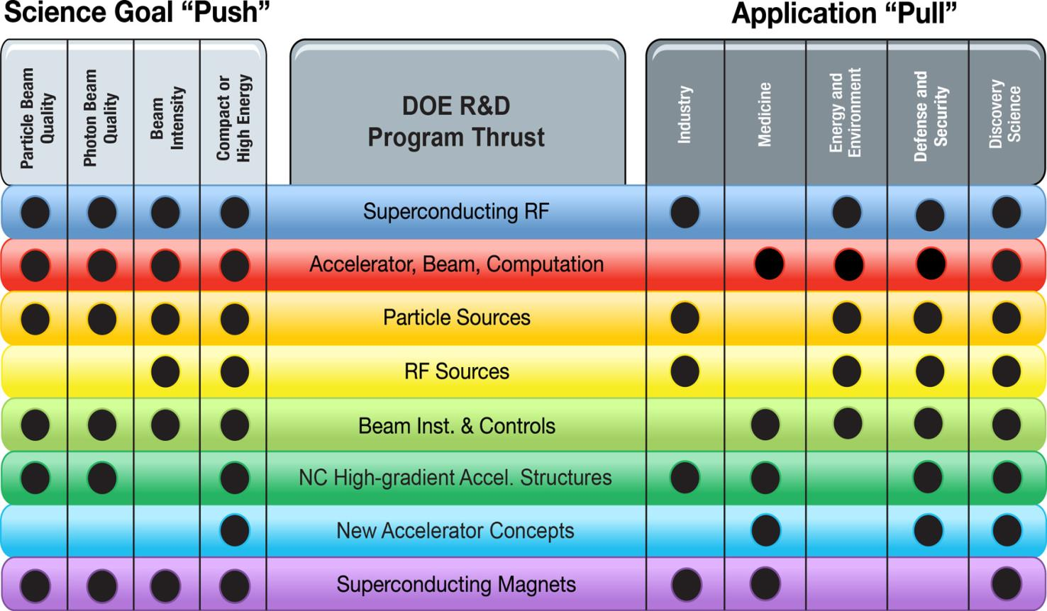
Connecting Accelerator R&D to Science and to End-User Needs

Slide 74
Budget
REFERENCE SLIDES

Slide 75
FY 2014 Request Crosscuts

Slide 76
HEP Physics Funding by Activity
Funding (in $K) | FY 2012 Actual | FY 2013 July Plan | FY 2014 Request | Explanation of Change wrt FY12
Research | 391,329 | 362,284 | 383,609 | Reduction mostly ILC R&D
Facility Operations and Exp’t Support | 249,241 | 265,305 | 271,561^{(a)} | NOνA ops start-up and Infrastructure improvements
Projects | 129,963 | 99,934 | 99,894
Energy Frontier | 0 | 3,000 | 0 | Phase-1 LHC detector upgrades
Intensity Frontier | 86,570 | 62,794 | 37,000 | NOνA ramp-down, start Muon g-2
Cosmic Frontier | 12,893 | 19,159 | 24,694 | LSST
Other | 2,500 | 3,200 | 3,200 | LQCD hardware
Construction (Line Item) | 28,000 | 11,781 | 35,000 | Mostly Mu2e; no LBNE ramp-up
SBIR/STTR | 0 | 0 | 21,457
TOTAL, HEP | 770,533 | 727,523^{(b)} | 776,521
^{(a)} Includes $1,563K GPE.
^{(b)} Reflects sequestration.

Slide 77
HEP Physics MIE Funding
Funding (in $K) | FY 2012 Actual | FY 2013 July Plan | FY 2014 Request | Description
MIE’s | 55,770 | 45,687 | 39,000
Intensity Frontier | 41,240 | 19,480 | 0 | NOνA ramp-down
Intensity Frontier | 6,000 | 5,857 | 0 | MicroBooNE
Intensity Frontier | 500 | 0 | 0 | Reactor Neutrino Detector at Daya Bay
Intensity Frontier | 1,030 | 5,000 | 8,000 | Belle-II
Intensity Frontier | 0 | 5,850 | 9,000 | Muon g-2 Experiment
Cosmic Frontier | 1,500 | 1,500 | 0 | HAWC
Cosmic Frontier | 5,500 | 8,000 | 22,000 | Large Synoptic Survey Telescope (LSST) Camera
TOTAL MIE’s | 55,770 | 45,687 | 39,000

Slide 78
HEP Physics Construction Funding
Funding (in $K) | FY 2012 Actual | FY 2013 July Plan | FY 2014 Request
Construction - TPC | 53,000 | 28,388 | 45,000
Long Baseline Neutrino Experiment | 21,000 | 17,888 | 10,000
TEC | 4,000 | 3,781 | 0
OPC | 17,000 | 14,107 | 10,000
TPC | 21,000 | 17,888 | 10,000
Muon to Electron Conversion Experiment | 32,000 | 10,500 | 35,000
TEC | 24,000 | 8,000 | 35,000
OPC | 8,000 | 2,500 | 0
TPC | 32,000 | 10,500 | 35,000
TEC = Total Estimated Cost (refers to Capital Equipment expenses)
OPC = Other Project Costs
TPC = Total Project Cost

Slide 79
HEP Energy Frontier
Funding (in $K) | FY 2012 Actual | FY 2013 July Plan | FY 2014 Request | Comment
Research | 91,757 | 86,172 | 96,129 ^{(a)} | Tevatron ramp-down offset by R&D for LHC detector upgrades
Facilities | 68,240 | 61,992 | 58,558
LHC Detector Ops | 64,846 ^{(b)} | 56,912 | 56,774 | LHC down for maintenance
LHC Upgrade Project | 0 | 3,000 | 0 | LHC detector upgrades (OPC)
Other | 3,394 | 2,080 | 1,784 | IPAs, Detailees, Reviews
TOTAL, Energy Frontier: | 159,997 | 148,164 | 154,687
OPC = Other Project Costs
^{(a)} Includes $12M (= $6M CMS + $6M ATLAS) Phase-1 detector upgrades [R&D];
Therefore, Energy Frontier Core Research FY14 Request = 84,129k
^{(b)} Per interagency MOU, HEP provided LHC Detector Ops funding during FY12 CR
to offset NSF contributions to Homestake de-watering activities.

Slide 80
HEP Intensity Frontier
Funding (in $K) | FY 2012 Actual | FY 2013 July Plan | FY 2014 Request | Comment
Research | 53,261 | 52,108 | 53,562 | Ramp-down of B-factory research offset by increased support for new initiatives
Facilities | 143,844 | 172,318 | 180,481
Expt Ops | 6,615 | 7,354 | 7,245 | Offshore and Offsite Ops
Fermi Ops | 119,544 | 143,128 | 156,438 | Accelerator and Infrastructure improvements
B-factory Ops | 10,031 | 5,654 | 4,600 | Completion of BaBar D&D
Homestake* | 5,478 | 14,000 | 10,000
Other | 2,176 | 2,182 | 2,198 | GPE and Waste Mgmt
Projects | 86,750 | 62,794 | 37,000
Current | 73,770 | 52,794 | 27,000 | NOνA + MicroBooNE ramp-down
Future R&D | 12,880 | 10,000 | 10,000
TOTAL, Intensity Frontier | 283,675 | 287,220 | 271,043
*Per interagency MOU, HEP provided LHC Detector Ops funding during FY12 CR to offset NSF contributions to Homestake
dewatering activities.

Slide 81
HEP Theory and Computation
Funding (in $K) | FY 2012 Actual | FY 2013 July Plan | FY 2014 Request | Comment
Research | 64,465 | 63,198 | 59,670
HEP Theory | 55,929 | 54,621 | 51,196 | Follows programmatic reductions in Research
Computational HEP | 8,536 | 8,577 | 8,474
Projects | 2,500 | 3,200 | 3,200 | Lattice QCD hardware
TOTAL, Theory and Comp. | 66,965 | 66,398 | 62,870

Slide 82
HEP Advanced Technology R&D
Funding (in $K) | FY 2012 Actual | FY 2013 July Plan | FY 2014 Request | Comment
Research | 134,006 | 111,888 | 105,303
General Accel. R&D | 59,280 | 61,791 | 57,856 | Selected long-term R&D moves to Accelerator Stewardship
Directed Accel. R&D | 46,587 | 22,692 | 23,500 | Completion of ILC R&D
Detector R&D | 28,139 | 27,405 | 23,947 | Funding for liquid argon R&D is reduced
Facility Operations | 23,100 | 19,997 | 17,150 | Completing SRF infrastructure at Fermilab
TOTAL, Advanced Technology R&D | 157,106 | 131,885 | 122,453

Slide 83
Accelerator Stewardship
Funding (in $K) | FY 2012 Actual | FY 2013 July Plan | FY 2014 Request | Comment
Research | 0 | 82 | 6,581 | Recast of Accelerator R&D activities relevant to broader impacts
Facility Operations | 2,850 | 3,050 | 3,350 | Incremental FACET ops for stewardship research
TOTAL, Accel. Stewardship | 2,850 | 3,132 | 9,931

Slide 84
Note on HEP Research Funding
The FY 2014 Request for HEP Research was $384M, about a 6% increase compared to
FY 2013, but $26 million of this is planned to go to R&D for Dark Matter G2,
DESI, and LHC upgrades.
Our current FY 2014 planning is based on the House markup of the Energy and Water Appropriation which is overall slightly below the Request
  The House mark directed HEP to move $8 million to LBNE PED, $2 million to SURF, and lower the overall HEP budget by $4 million. The choice was made to take all of these reductions from Research due to our priority to increase Project spending.
These two effects reduce Research to $343M, about a 5% reduction w.r.t. FY 2013
At the beginning of the year it is necessary to hold back funds for decisions to be made later in the year, such as the Early Career Research Program and other needs.
  This results in an approximately 6% reduction relative to FY 2013 for the initial distribution of funds. This is the average effect on initial HEP research funding.
There is some small variation in the impact to individual HEP subprograms, and program managers have the authority to provide more or less than the average reduction based on program priorities and the results of merit review.
The House mark is a budget indicator but not the final word on FY 2014. When Congress passes a budget, there could be either an increase or a decrease in HEP research funding.

Slide 85
HEP Projects
REFERENCE SLIDES

Slide 86

The LHC Forecast
~3000 fb⁻¹
LS1 LS2 LS3
√s = 7 – 8 TeV
13 ~ 14 TeV
14 TeV
14 TeV
L = 10²⁷→ 7x10³³
1 x10³⁴
2 x10³⁴
5 x10³⁴
Phase – 0 [Shutdown]
<μ> = 20
<μ> = 27
<μ> = 55
Phase – 1 Upgrade
Phase – 2 Upgrade
Integrated Luminosity (fb⁻¹)
<μ> = 140
~300 fb⁻¹
~100 fb⁻¹
25 fb⁻¹
2010
2012
2014
2016
2018
2020
2022
2024
…...
2030
Calendar Year

Slide 87

Future Lepton Colliders and LHC Phase-II
Guidance for proposals on e.g., future lepton colliders (LC) and/or LHC Phase-II detector upgrades
  General approach to such R&D proposals, where LC and Phase-II are common examples
  Proposals in such research areas may be submitted in addition to a group’s research activities on
  one of the LHC experiments (CMS or ATLAS)
  If so, proposals encouraged to address project narrative separately – one for each research area
  as part of an “umbrella” proposal on multiple research tasks
    for e.g., Task A devoted to ATLAS research efforts, Task B on LC, etc…
    as specified in Section IV of FOA, list all PIs and budget info for each area in the ‘Cover Page Supplement for Proposals with Multiple Research Areas or Thrusts’ material of the proposal
    proposal must comply with all FOA requirements, including page limits
  Detector R&D may support some level of engineering/M&S whereas Energy Frontier typically does not
  Depending on scope of work described in these tasks, DOE Program Managers will assess which Panel (i.e., Energy Frontier or Particle Detector R&D) to solicit reviews
Task C: Phase-II inspired R&D with technology also applied to Dark Matter experiments at the Cosmic Frontier
Task C: Detector-
specific Phase-II
research
Energy Frontier
Applications addressing
physics studies and
pre-conceptual R&D directed towards specific future Energy Frontier experiments
Particle Detector R&D
Supports “generic” R&D activities on physics of particle detection that has potential
for wide applicability
and/or high impact
Task B: LC-inspired
research with
applications of R&D
towards future detectors
for Intensity Frontier
experiments
Task B: LC-
specific research
Final decisions on support will depend on the scientific merit review process, and other programmatic and budgetary factors

Slide 88
HEP Intensity Frontier Experiments
Experiment | Location | Status | Description | #US Inst. | #US Coll.
Belle II | KEK, Tsukuba, Japan | Physics run 2016 | Heavy flavor physics, CP asymmetries, new matter states | 10 Univ., 1 Lab | 55
CAPTAIN | Los Alamos, NM, USA | R&D; Neutron run 2015 | Cryogenic apparatus for precision tests of argon interactions with neutrinos | 5 Univ., 1 Lab | 20
Daya Bay | Dapeng Penisula, China | Running | Precise determination of θ₁₃ | 13 Univ., 2 Lab | 76
Heavy Photon Search | Jefferson Lab, Newport News, VA, USA | Physics run 2015 | Search for massive vector gauge bosons which may be evidence of dark matter or explain g-2 anomaly | 8 Univ., 2 Lab | 47
K0TO | J-PARC, Tokai , Japan | Running | Discover and measure K_{L}→π⁰νν to search for CP violation | 3 Univ. | 12
LArIAT | Fermilab, Batavia, IL | R&D; Phase I 2013 | LArTPC in a testbeam; develop particle ID & reconstruction | 11 Univ., 3 Lab | 38
LBNE | Fermilab, Batavia, IL & Homestake Mine, SD, USA | CD1 Dec 2012; First data 2023 | Discover and characterize CP violation in the neutrino sector; comprehensive program to measure neutrino oscillations | 48 Univ., 6 Lab | 336
MicroBooNE | Fermilab, Batavia, IL, USA | Physics run 2014 | Address MiniBooNE low energy excess; measure neutrino cross sections in LArTPC | 15 Univ., 2 Lab | 101
MINERνA | Fermilab, Batavia, IL, USA | Med. Energy Run 2013 | Precise measurements of neutrino-nuclear effects and cross sections at 2-20 GeV | 13 Univ., 1 Lab | 48
MINOS+ | Fermilab, Batavia, IL & Soudan Mine, MN, USA | NuMI start-up 2013 | Search for sterile neutrinos, non-standard interactions and exotic phenomena | 15 Univ., 3 Lab | 53
Mu2e | Fermilab, Batavia, IL, USA | First data 2019 | Charged lepton flavor violation search for 𝜇N→eN | 15 Univ., 4 Lab | 106
Muon g-2 | Fermilab, Batavia, IL, USA | First data 2016 | Definitively measure muon anomalous magnetic moment | 13 Univ., 3 Lab, 1 SBIR | 75
NOνA | Fermilab, Batavia, IL & Ash River, MN, USA | Physics run 2014 | Measure ν_{μ}-ν_{e} and ν_{μ}-ν_{μ} oscillations; resolve the neutrino mass hierarchy; first information about value of δ_{cp} (with T2K) | 18 Univ., 2 Lab | 114
ORKA | Fermilab, Batavia, IL, USA | R&D; CD0 2017+ | Precision measurement of K⁺→π⁺νν to search for new physics | 6 Univ., 2 Lab | 26
Super-K | Mozumi Mine, Gifu, Japan | Running | Long-baseline neutrino oscillation with T2K, nucleon decay, supernova neutrinos, atmospheric neutrinos | 7 Univ. | 29
T2K | J-PARC, Tokai & Mozumi Mine, Gifu, Japan | Running; Linac upgrade 2014 | Measure ν_{μ}-ν_{e} and ν_{μ}-ν_{μ} oscillations; resolve the neutrino mass hierarchy; first information about value of δ_{cp} (with NOνA) | 10 Univ. | 70
US-NA61 | CERN, Geneva, Switzerland | Target runs 2014-15 | Measure hadron production cross sections crucial for neutrino beam flux estimations needed for NOνA, LBNE | 4 Univ., 1 Lab | 15
US Short-Baseline Reactor | Site(s) TBD | R&D; First data 2016 | Short-baseline sterile neutrino oscillation search | 6 Univ., 5 Lab | 28

Slide 89
HEP Project Status
Subprogram | TPC ($M) | CD Status | CD Date
INTENSITY FRONTIER
Long Baseline Neutrino Experiment (LBNE) | TBD | CD-1 | December 10, 2012
Muon g-2 | 40 | CD-0 | September 18, 2012
Mu2e | 249 | CD-1 | July 11, 2012
Next Generation B-Factory Detector Systems (BELLE-II) | 16 | CD-3a | November 8, 2012
NuMI Off-Axis Electron Neutrino Appearance Exp’t (NOνA) | 278 | CD-3b | October 29, 2009
Micro Booster Neutrino Experiment (MicroBooNE) | 19.9 | CD-3b | March 29, 2012
Main INjector ExpeRiment for ν-A (MINERνA) | 16.8 | CD-4 | June 28, 2010 [Finished]
Daya Bay Reactor Neutrino Experiment | 35.5 | CD-4b | August 20, 2012 [Finished]
ENERGY FRONTIER
LHC ATLAS Detector (Phase-1) Upgrade | TBD | CD-0 | September 18, 2012
LHC CMS Detector (Phase-1) Upgrade | TBD | CD-0 | September 18, 2012
COSMIC FRONTIER
Dark Matter (DM-G2) | TBD | CD-0 | September 18, 2012
Mid-Scale Dark Energy Spectroscopic Instrument (MS-DESI) | TBD | CD-0 | September 18, 2012
Large Synoptic Survey Telescope (LSST) | 173 | CD-1 | April 12, 2012
Dark Energy Survey (DES) | 35.1 | CD-4 | June 4, 2012 [Finished]
ADVANCED TECHNOLOGY R&D
Accelerator Project for the Upgrade of the LHC (APUL) | 11.5 | CD-2/3 | July 29, 2011
Berkeley Lab Laser Accelerator (BELLA) | 27.2 | CD-4 | January 17, 2013 [Finished]
Facility for Advanced Accelerator Experimental Tests (FACET) | 14.5 | CD-4 | January 31, 2012 [Finished]

Slide 90
Current LBNE Strategy
We are trying to follow the reconfiguration [phased] plan for LBNE, though it has hit some snags
  Out-year budgets are challenging
  Some members of the community objected that the phased LBNE was not what the previous P5 [or they] had in mind
The plan, as it currently stands:
  Use time before baselining to recruit partners (international and domestic) that expand scope and science reach
We also take note of the House language on LBNE:
  “The Committee recognizes the importance of this project to maintaining American leadership in the intensity frontier and to basic science discovery of neutrino and standard model physics. However, the Committee also recognizes that LBNE construction must be affordable under a flat budget scenario. As such, the Committee supports the Office of Science’s challenge to the High Energy Physics community to identify an LBNE construction approach that avoids large out-year funding spikes or to identify viable alternatives with similar scientific benefits at significantly lower cost.”

Slide 91
Cosmic Frontier program
REFERENCE SLIDES

Slide 92
Cosmic Frontier (Experimental) Program - Funding
 | FY12 actual | FY13 current | FY14 President's Request
Research (labs & univ) | 47843 | 48681 | 62364
Experimental Operations | 8505 | 10111 | 12022
R&D | 3278 | 9659 | 1494
Fabrication (small projects) | 2613 |  | 1200
Fabrication (MIE projects) | 7000 | 9500 | 22000
TOTAL | 69239 | 77951 | 99080
Budgets:
Research – scientists and their expenses
R&D, Fabrication, Operations – covers technical, engineering, computer professional, management, other personnel & expenses, M&S, computers, utilities, common funds, etc.
MIE = Major Item of Equipment
92

Slide 93
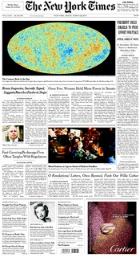
Status - April 2013
DOE effort on Planck
ESA’s Planck satellite mission was launched in 2009 to make the most precise measurement yet of the temperature and polarization of the cosmic microwave background (CMB) - the remnant radiation from the big bang.
3/21/13: ESA and NASA, a major partner in Planck, released preliminary cosmology results based on Planck's first 15 months of temperature data. It made the front page of the NY Times on 3/22/13 (above the fold!)
Strength in data analysis is a major U.S. contribution and was made possible in part because of the DOE and NASA interagency cooperation for supercomputing resources.
A DOE and NASA MOU in 2007 provided Planck with a multi-year allocation of NERSC resources which has so far amounted to tens of millions of hours of massively parallel processing, plus the necessary data-storage and data-transfer resources.
With the guaranteed allocation, the U.S. Planck Team was also able to base its dedicated computational resources at NERSC and take advantage of NERSC's global file-system capability and systems administration expertise.
The JPL-based US team includes scientists in LBNL’s Computational Cosmology Center (C³) who are responsible for using NERSC supercomputers to generate the thousands of mission simulations needed to analyze the flood of data from Planck.
Comprising 250,000 maps, this is the largest simulation set ever fielded in support of a CMB mission, but still only 10% of the set needed for the full Planck analysis.
NY Times – 3/22/13

Slide 94
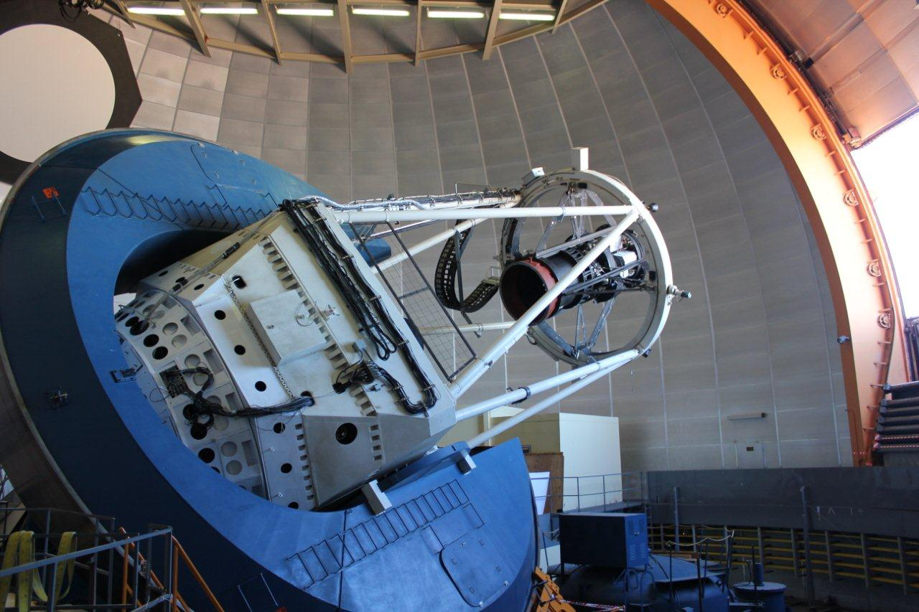

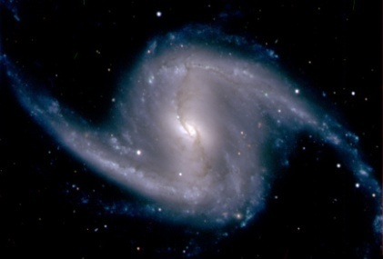
Dark Energy Survey (DES)
  Fornax cluster with close-up of the galaxy NGC 1365
DES – first light on 9/2/12
  DOE/NSF partnership with private and foreign contributions
  DOE/NSF Joint Oversight Group (JOG) meets monthly
  HEP supported fabrication of the Dark Energy camera (DECam), managed by Fermilab, which was installed on Blanco telescope in Chile
  NSF supporting telescope and camera operations and the data management system
  Status: commissioning & science verification completed; camera working well, telescope performance improved; will start the 5 year science survey in Sept. 2013
  April 2013: Panel review of DES pre-operations status and planning

Slide 95

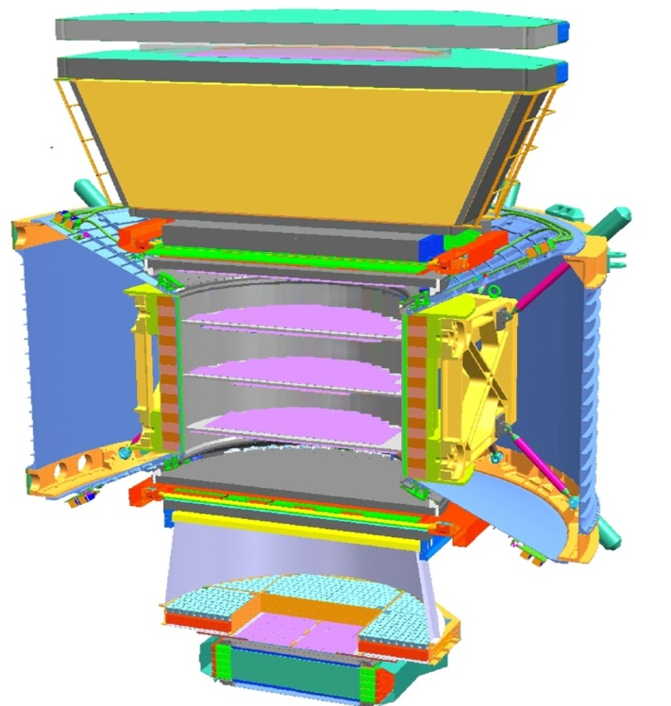


Status – May 2013
Alpha Magnetic Spectrometer (AMS)
1
Launched on May 16, 2011, (Endeavor, STS-134); installed on ISS
- Has collected over 25 billion events in first 18 months of operations, including 6.8 million electrons or positrons.
AMS is a U.S.-DOE-led international collaboration of 16 Countries, 60 Institutes and 600 Physicists.
95% of the ~$2B construction costs came from Europe and Asia .
NASA provided a dedicated Space Shuttle flight, the use of the ISS resources (power, data, …) and mission management.
CERN hosts the AMS Payload Operations Control Center (POCC).
A major challenge of operating on the ISS is the extreme thermal environment – has to be continually monitored and adjusted.
TRD
TOF
2
3-4
Tracker
5-6
7-8
TOF
RICH
9
ECAL
April 3, 2013: First Results announced! The data show that the positron fraction is steadily increasing from 10 to ~ 250 GeV, but from 20 to 250 GeV the slope decreases by an order of magnitude.

Slide 96
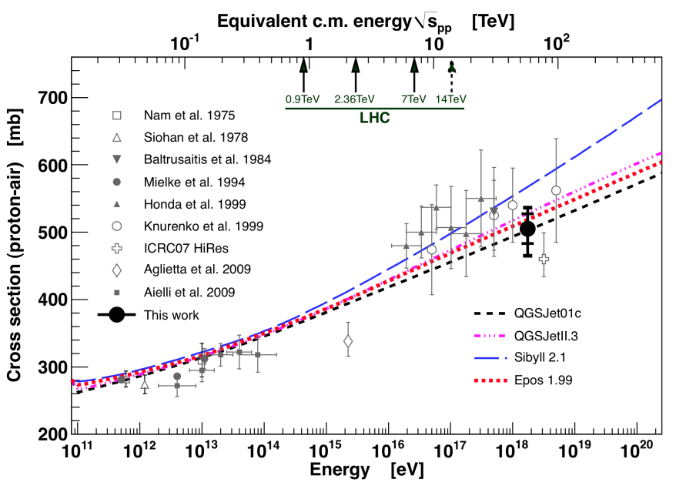
Pierre Auger Observatory
  Science: observe, understand and characterize the Ultra High Energy (UHE) cosmic rays and probe
  particle interactions at UHE.
  Observatory: installed over a 3000 km² site in Argentina with 24 fluorescence telescopes & 1600
  surface Cherenkov detectors
  Enhancements: 3 high elevation fluorescence telescopes, 60 infill detectors, muon counter array, + more
  Collaboration & Partnership: Large international collaboration of 18 countries, 463 collaborators
  -- Fermilab hosts the Project Office – Project Office will transition to Argentina ~ 2014. After that, DOE’s commitment will still be to provide common funds based on # of participants.
  → International Finance Board meets annually
  Publications: As of end 2012: 36 full-authored papers,
  Operations Status: Data taking started in 2004. Full array completed in 2008; Collaboration plans to run through to at least 2015.
  Future: Collaboration is doing R&D for enhancements and future detection techniques which may extend the lifetime of the Observatory → proposal is being prepared to submit later in 2013.
Proton-air cross section measured at center-of-mass 57 TeV (2012).
96

Slide 97
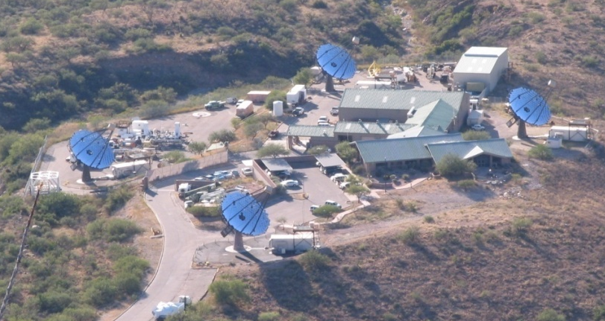
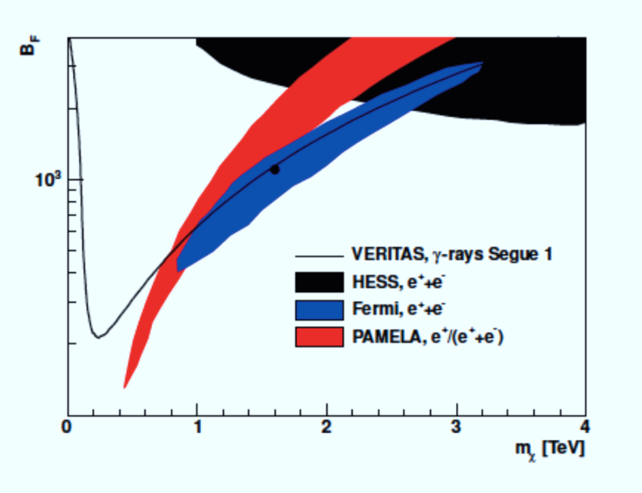
VERITAS
(Very Energetic Radiation Imaging Telescope Array System)
Four 12-meter Cherenkov telescope high energy (100 GeV
to 30 TeV) gamma-ray array at Whipple observatory in Arizona
Collaboration/Partnership: ~100 scientists from US
(DOE,NSF,SAO), Canada, Ireland, UK.
→DOE, NSF, SAO Joint Oversight Group meets quarterly
Current Status of experiment:
Operating since Fall 2007
Recently started 6th season of operations & 1st with upgrade, which was completed summer 2013
Collaboration requesting to continue operations through FY17
November 2012: DOE told VERITAS that we expect to fund DOE part of their operations for 3 more years and consider this to complete the experiment; this plan depends on getting the funding shares from other agencies
Recent Highlights:
Discovery of new, unexpected VHE emission from the Crab Pulsar
VERITAS DM limits from dwarf galaxy Segue 1
Limits on boost factor in leptophillic
DM models (region above line excluded);
arVix:1202.2144, accepted in PRD.
97

Slide 98
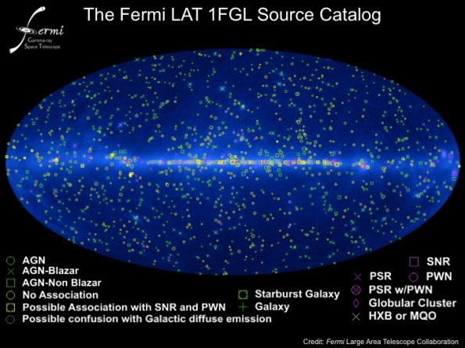
Fermi Gamma-ray Space Telescope (FGST)
DOE, NASA and 4 international partners on Large Area Telescope; NASA leads the mission
HEP plans continued support for the Instrument Science Operations Center (ISOC) at SLAC
through at least FY 2014 – will revisit extending to FY2016
International Finance Board meets twice a year
Recent highlights include:
Collaboration update at Fermi Symposium (October 2012) on the ~135 GeV bump in the spectrum from the Galactic Center region and elsewhere:
-- systematics under careful investigation; more statistics will answer the question
-- upgrade of event reconstruction and analysis (“Pass 8”) in 2013 will further improve instrument performance
first blind search detection of a millisecond pulsar
  - Science Express 1229054 online 25 October 2012
measurement of cosmic extragalactic background light
  - Science 30 November 2012: 1190-1192
search for dark matter in gamma-ray lines
  - Phys Rev D 86, id. 022002, July 2012
98

Slide 99
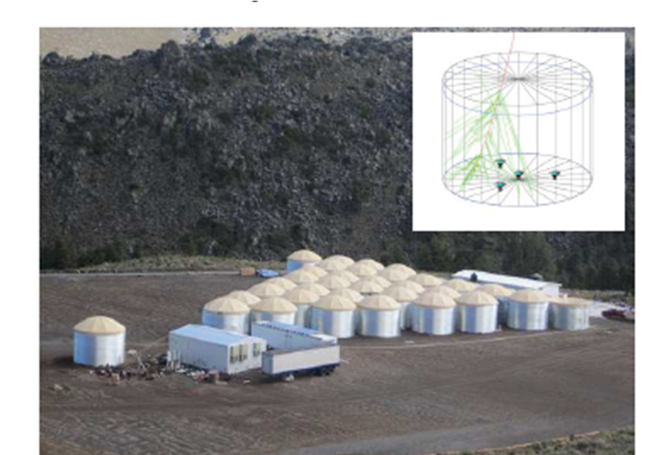
High Altitude Water Cherenkov (HAWC)
Gamma Ray Observatory
Extensive Air Shower Detector with 250-300 Water
Cherenkov Detector tanks located at 13500’ in Mexico
Collaboration: 150 scientists from US and Mexico
Partnership: US (DOE, NSF) and Mexico (CONACyT)
→DOE, NSF, Mexico Joint Oversight Group meets quarterly
Status:
Project fabrication 2011-2014
Sept 2012: 30 tank array completed
May 2013: 100 tank array will be completed and start operations in August 2013
June 2013: panel review of their operations plan
August 2014: operations with full array starts
Cosmic-ray skymap from one day of HAWC 30 data demonstrating the HAWC reconstruction and analysis

Slide 100
Cosmic Frontier – Program Model
  Portfolio planning & guidance -- use HEPAP’s Particle Astrophysics Science Assessment Group (PASAG) 2009 report:
  Recommended an optimized program over the next 10 years in 4 funding scenarios
  Dark matter & dark energy remain highest priorities; don’t zero out everything else
  Prioritization Criteria - Make contributions to select, high impact experiments:
      That directly address HEP science goals
      That will make a visible or leadership contribution
      With HEP community contributions: instrumentation, collaborations, analysis techniques etc.
Facilities: Many Cosmic Frontier experiments use facilities which have a much broader science program than the interests of HEP program → we make project contributions at an appropriate level & support research efforts for our science interests.
Interagency projects: can provide necessary, additional resources → to opportunities for increased science.
While all government agencies follow the same rules, there are differences in the details which need to be taken into account to ensure data and science analysis return
Processes for planning/deciding on projects, managing/funding projects, funding research, etc
HEP emphasis on collaboration for coordinated science planning & analysis.
100

