Slide 1
Cosmic Particles and Fundamental Physics
Tough Questions
G. Sinnis
J. Beatty, A. Olinto, A Nelson

Slide 2
The Questions
What are the roles of cosmic-ray, gamma-ray, and neutrino experiments for particle physics (Gus Sinnis)
  What future experiments are needed in these areas and why?
  Are there areas in which these can have a unique impact?
What are the leading prospects for detecting GZK neutrinos? (Jim Beatty)
  What experimental program is required to do this in the next 5 years, 10 years, 20 years, and how important is this?
What will it take to identify the mechanism for baryogenesis or leptogenesis? (Ann Nelson)
  Are there scenarios that could conceivably be considered to be established by experimental data in the next 20 years?
  What experiments are required to achieve this?

Slide 3
Scientific Motivation for CGN relevant for HEP
Indirect WIMP Dark matter (see CF-2 for discussion). Indirect detection has unique capabilities
  Sensitivity to high mass wimps
  Understanding cosmological evolution of dark matter
Non-WIMP Dark Matter
  Axions (unique region of parameter space)
  Q-Balls (unique direct detection techniques using CGN experiments)
  Primordial black holes (unique sensitivity to final phase of evaporation)
Fundamental Symmetries
  Lorentz Invariance (window into physics at the Planck scale)
Cross Sections and new physics
  JEM-EUSO 300 TeV C-M energy of collisions (already hints of non-standard interactions at Auger)
  High-Energy neutrino cross sections sensitive to extra dimensions
Neutrino mass hierarchy
  Supernova neutrinos
  Atmospheric neutrinos

Slide 4
Physics | Technique | Background | Solution
Axions | AGN spectra | Intrinsic spectra, EBL level, UHECR production of secondary gammas | Many AGN, large redshift range, precision spectra from 100 MeV to TeV, particle acceleration Variability of distant AGN (all-sky monitor)
LIV | AGN/GRB timing | Acceleration mechanism | Many detections, large redshift range, particle acceleration
Primordial Black Holes | Short burst search | Gamma-Ray Bursts | Precision spectra and time evolution
Q-Balls | Direct Detection | N/A | N/A

Slide 5
Gamma Rays
To extract fundamental physics (dark matter, primordial black holes, axion-like particles, Lorentz invariance tests, etc.) We need:
  Large database of objects with various astrophysical characteristics (distance, energy, local environments)
  Precision measurements of energy and time evolution across large energy span (multi-wavelength/messenger observations)
  Combination of all-sky finders and precision TeV instruments
Instrument needs
  CTA (VERITAS), HAWC (or nextGen all-sky instrument), Fermi

Slide 6
CTA + US
CTA-baseline

Slide 7
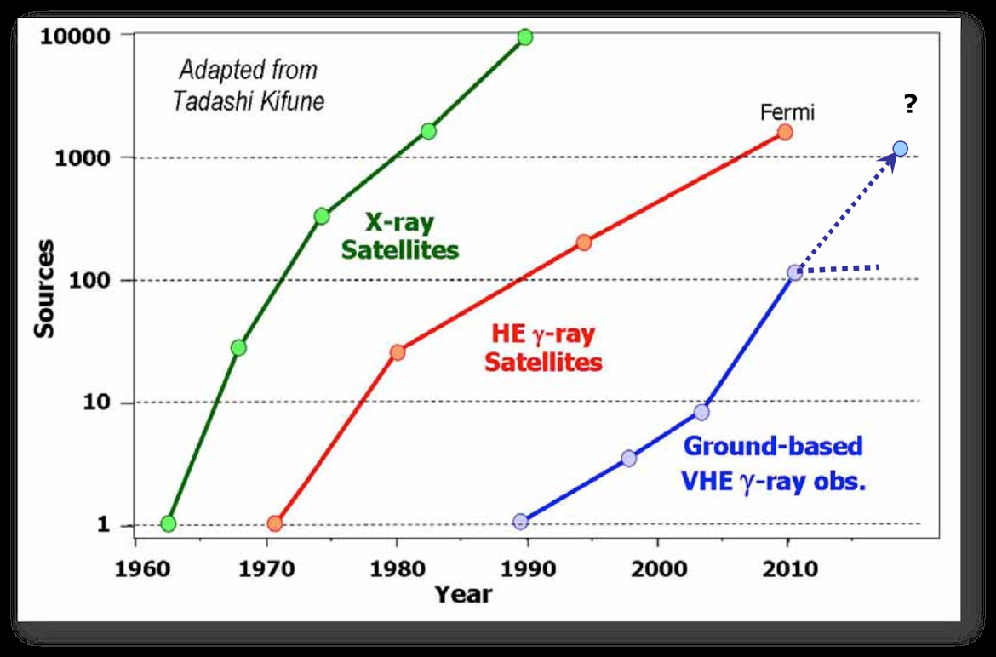
Progress in Gamma Rays
CTA
From R. Ong

Slide 8
Summary
We are entering an era of precision VHE gamma-ray astrophysics
  Unprecedented angular and energy resolution
  Unprecedented sensitivity
  Huge energy range (100 MeV – 100 TeV)
  Will enable understanding of astrophysical processes
Extraction of fundamental physics possible with future instruments (operated simultaneously)
  Fermi, HAWC, VERITAS ➔ CTA

Slide 9
CF-34
What are the roles of cosmic-ray, gamma-ray, and neutrino experiments for particle physics?
There is a broad range of fundamental physics that can be gleaned from astrophysical sources (dark matter, axions, primordial black holes, Q-balls, Lorentz invariance violation, etc.) that can not be reached through other methods. To extract the particle physics we must understand the astrophysics. This will require that we detect a large number of sources with a precision (energy and angular resolution, temporal evolution) and energy span that is beyond our current capabilities. CTA will usher in the era of precision VHE astrophysics and in conjunction with current instruments (Fermi and HAWC) will provide a view of the high-energy universe that that will lead to an understanding of the astrophysical processes at work in these extreme objects and enable us to probe the laws of physics at energies, couplings, and mass scales that are unique.

