Slide 1
Columnar Recombination: a tool for nuclear recoil directional sensitivity in dense xenon gas
David Nygren
Lawrence Berkeley National Laboratory

Slide 2
Summary
NEXT- 100 experiment for 0-ν ββ search at Canfranc based on HP Xe concept
Seen as spring-board for ton-scale system
Novel approach for directional sensitivity in WIMP nuclear recoils exploits columnar recombination
If successful, active mass → ton-scale is possible

Slide 3
Simultaneous searches?
DOE OHEP unable to consider dual-purpose system due to OMB decree 0-ν ββ → ONP
Next generation projects will be expensive!
A dual-purpose detector should be considered…
Gas phase offers attractive possibilities:
Remarkably good energy resolution (0ν-ββ)
NEXT Collaboration uses HPXe
Small S2/S1 fluctuations
Event topology (0ν-ββ & WIMPs)
Nuclear recoil direction in dense gas – maybe

Slide 4
“Discovery” ?
What criteria should be established for a claim of “discovery” of WIMP dark matter?
Perhaps – observation of a net flow in WIMP flux – aka “directionality” is an essential part.

Slide 5
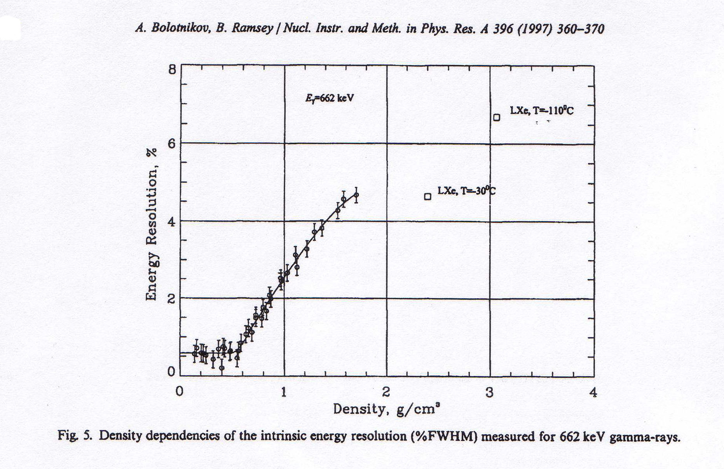
Why Xenon Gas? Energy resolution in Xenon depends very strongly on density
Here, the fluctuations are normal
Fano factor
F = 0.15
Unfolded resolution:
δE/E ~0.6% FWHM
Very large fluctuations between light/charge!
F ~ 20 !!
Ionization signal only!
For ρ <0.55 g/cm³, energy resolution from ionization is “intrinsic”

Slide 6
Why Xenon Gas? Energy resolution in Xenon depends very strongly on density
Here, the fluctuations are normal
Fano factor
F = 0.15
Unfolded resolution:
δE/E ~0.6% FWHM
Very large fluctuations between light/charge!
F ~ 20 !!
WIMPs:
Large S2/S1 fluctuations
Ionization signal only!
For ρ <0.55 g/cm³, energy resolution from ionization is “intrinsic”

Slide 7
World record: Energy resolution δE/E = 1% FWHM for ¹³⁷Cs 662 keV γ-rays in xenon!
Data from LBNL-TAMU HPXe TPC
This result is important for both 0-νββ & WIMP searches
Ionization signal only
This result shows that fluctuations are “normal” in HPXe

Slide 8
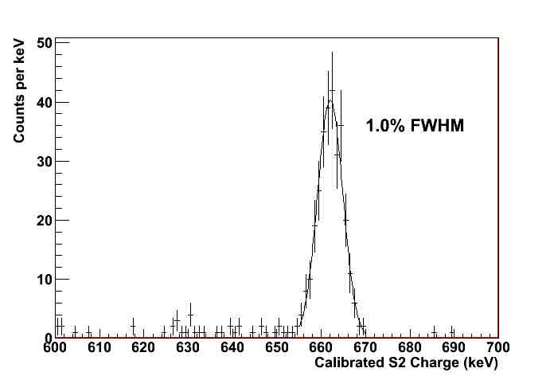
The peak is Gaussian.
A world record for xenon-based detectors
¹³⁷Cs γ-ray: 662 keV

Slide 9
Asymmetric TPC with “Separated functions”
Virtual Fiducial surface
Transparent -HV cathode
Electroluminescent plane
Energy plane
Energy & primary scintillation signals recorded here, with PMTs
electrons
EL signal created here
Tracking
performed
here, with
“SiPMT” array
ions
Operating pressure:
10 -15 bars
Field cage: teflon
Notes:
Electroluminescence is noiseless

Slide 10
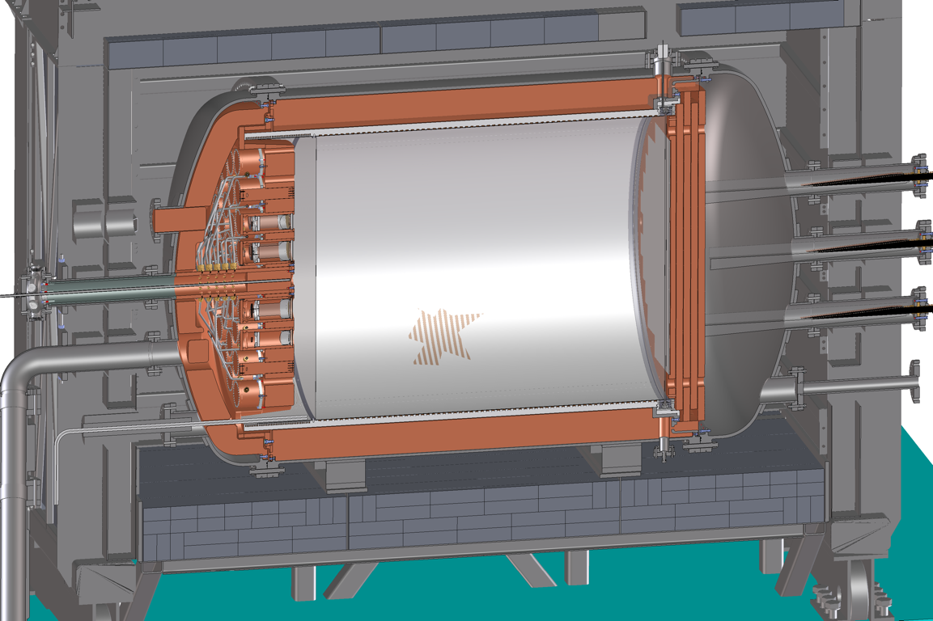
THE NEXT-100 DETECTOR
NEXT Collaboration, NEXT-100 Technical Design Report, arXiv:1202.0721

Slide 11
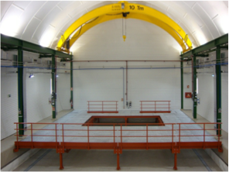
NEXT at Laboratorio Subteranneo de Canfranc (LSC), Spain
The experiment will be located at Hall A at the LSC. Working platform and basic gas system already in place.

Slide 12
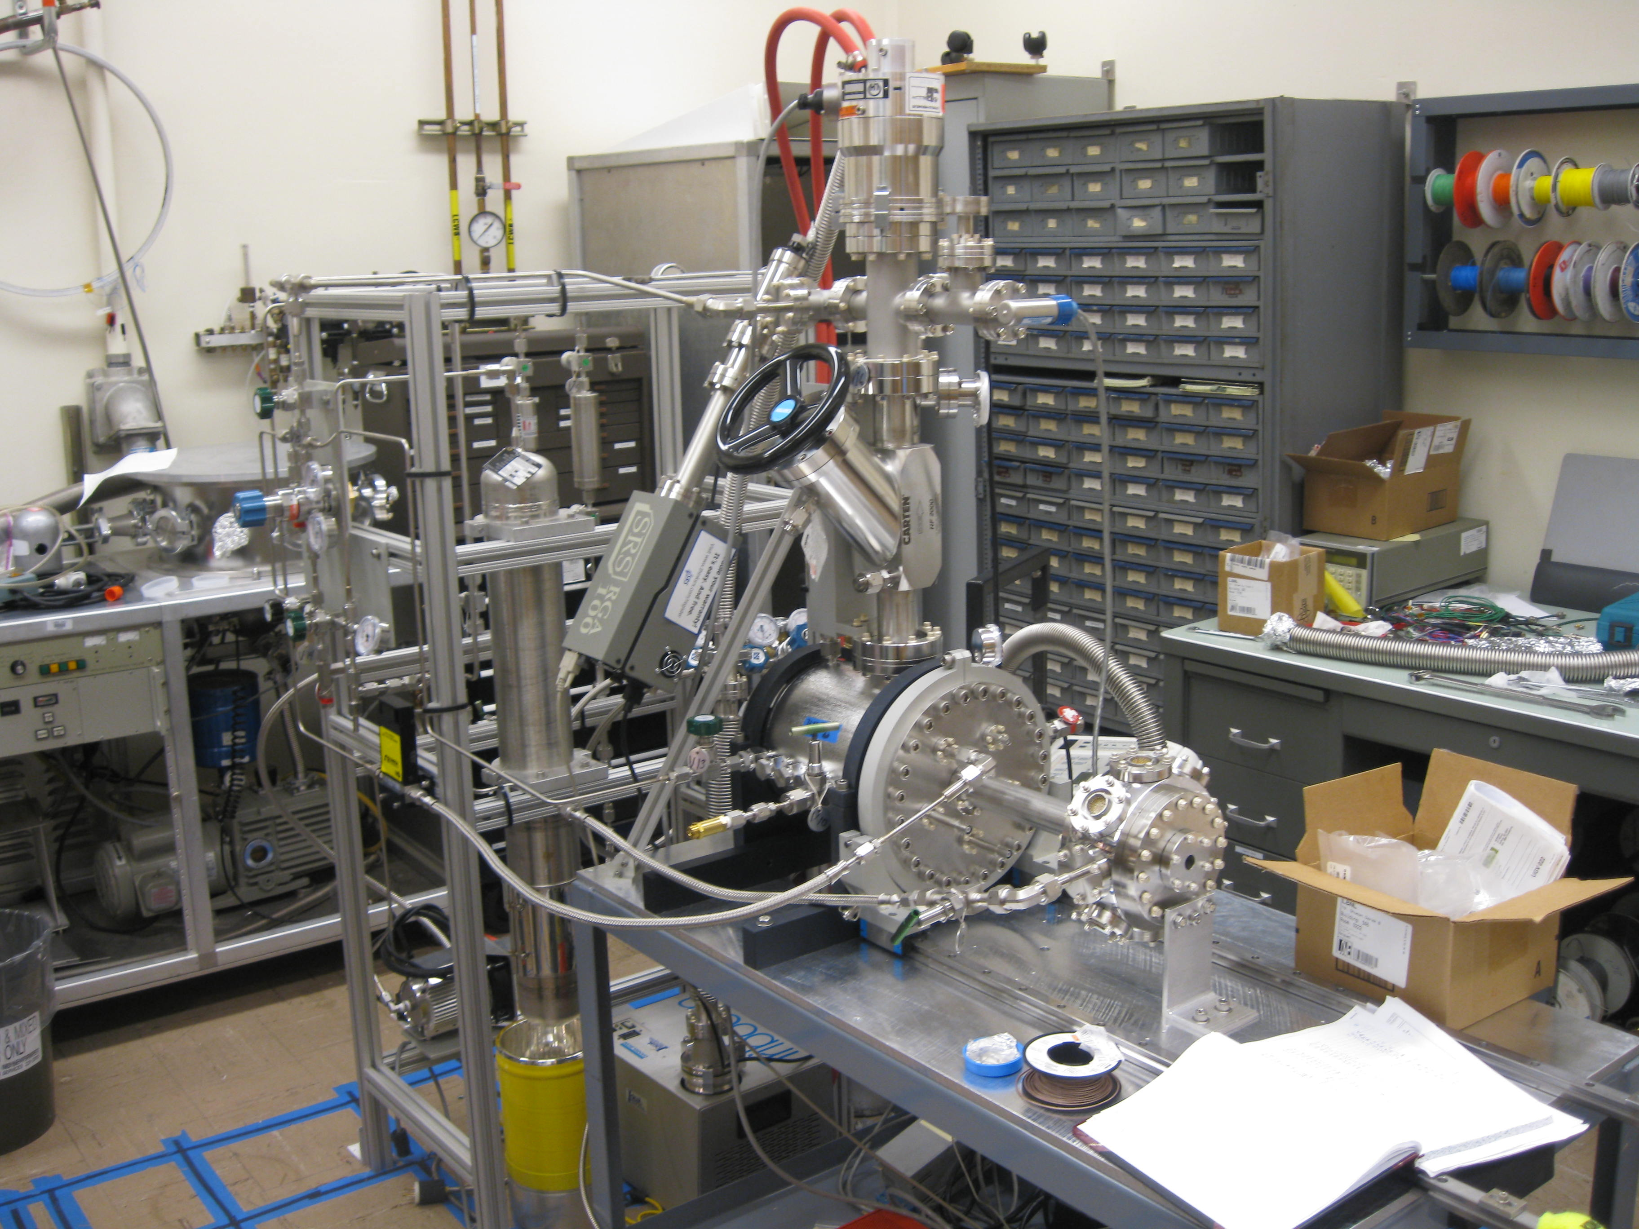
LBNL-TAMU TPC
TIPP 2011
12

Slide 13
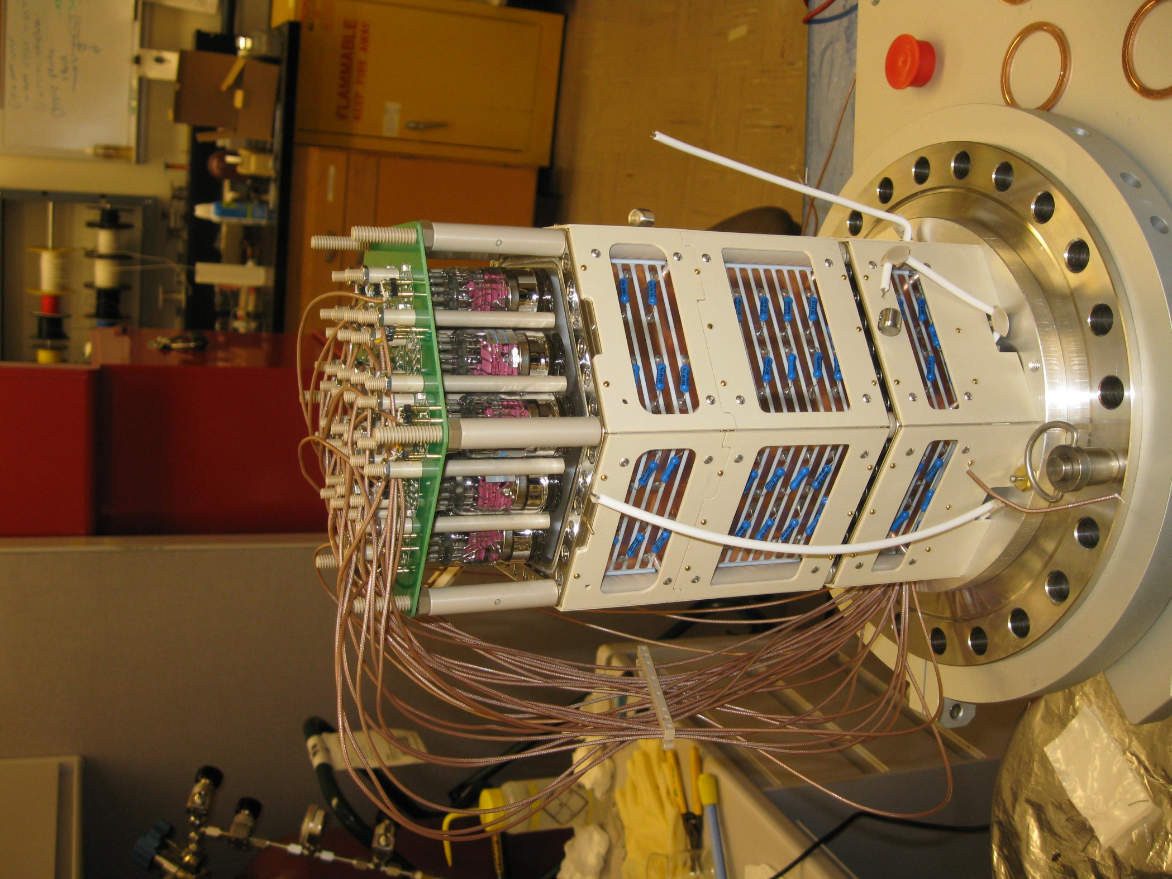
Field cages/Light cage PTFE with copper stripes
19 PMTs and PMT bases
Electroluminescence region 10 kV across a 4 mm gap
13

Slide 14
Tracking: PMTs → SiPMs
NEXT-DEMO (IFIC, Valencia)

Slide 15
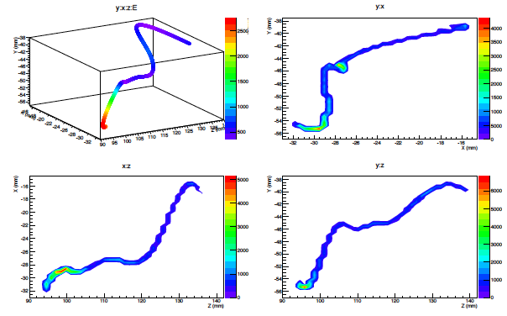
Real track from ¹³⁷Cs γ-ray – reconstructed with SiPMs
NEXT-DEMO IFIC, Valencia

Slide 16
Pure xenon gas: 0ν- ββ :
1% FWHM energy resolution verified by LBNL/NEXT at 662 keV → 0.5% FWHM @ Q-value
Event reconstruction with SiPMs verified; confirms x 30 – 50 background rejection
Nature of neutrino: Majorana – Dirac?
NEXT – schedule limited by funding issues
Notes:
0.01 to 0.05 ckky expected backgrounds in simulation

Slide 17
Dark Matter Search with HPXe
The superb energy resolution available, in principle, also helps the WIMP search
Intrinsic S2/S1 fluctuations are much smaller
Gas phase permits molecular additives that offer remarkable performance opportunities
Beneficial for 0ν-ββ, too, but no time to discuss

Slide 18
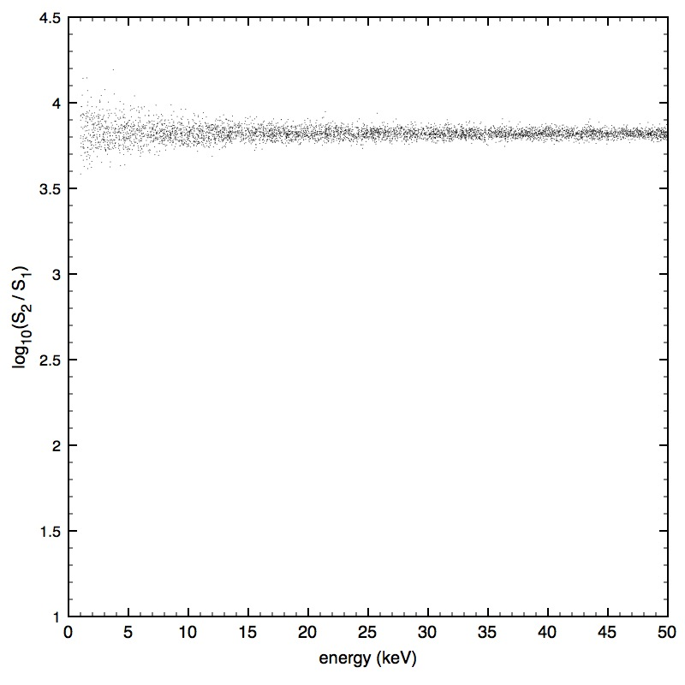
Simulation: electron recoils in pure HPXe, F = 0.15, !0% optical efficiency
Plot: Justo Martin-Albo,
IFIC, Valencia
Simulation!
S2 = ionization signal = Q
S1 = scintillation signal = L

Slide 19
Simulation: electron recoils in pure HPXe, F = 0.15, !0% optical efficiency
Simulation!
Nuclear recoils here?
S2 = ionization signal = Q
S1 = scintillation signal = L

Slide 20
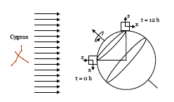
Directional sensing for nuclear recoils?
A sidereal variation of “WIMP wind from Cygnus”
WIMP <V> comparable to earth’s velocity: ~230 km/s
A substantial anisotropy in nuclear recoils should be observable
Notes:
Anisotropy of recoils is substantial
Sidereal day 1/366 different from solar diurnal day

Slide 21
Today’s techniques
All current approaches attempt to visualize the nuclear recoil track:
Nuclear Emulsions (expanded optical readout !! )
Low-pressure TPCs (~50 g/detector)
D³ (GEM + pixel ASIC)
DMTPC (CF₄ optical CCD)
DRIFT (CS₂⁻, CF₄, MWPC )
MIMAC (CF₄ + μMegas )
NEWAGE ( Gem, μ-dots )

Slide 22
Columnar Recombination: a nuisance? - or a new way to “see” directionality?
Columnar Recombination (CR) occurs when:
A drift electric field E exists;
Tracks are highly ionizing;
Tracks display an approximately linear character;
The angle between E and track is small:
track
E
E
track
CR small: less light, more charge
Substantial CR: more light, less charge
Notes:
Electrons have to drift past the ion column, which is waiting to grab them.

Slide 23
Credit: Vic Gehman
α = 10°

Slide 24
Credit: Vic Gehman
α = 80°

Slide 25
Columnar recombination and Directionality sensing in nuclear recoils
Columnar recombination (CR) can be quite sensitive to the angle between a highly ionizing track and an electric field E;
For a given event energy, more recombination would yield more scintillation, less ionization
Therefore, a comparison – event by event – of scintillation/ionization is a measure of CR
Notes:
Recombination signal in xenon: 173 nm VUV !

Slide 26
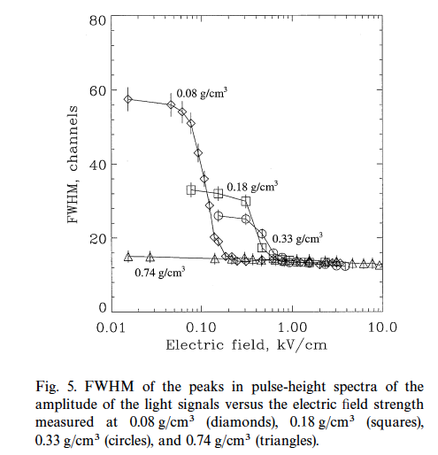
CR Exists!
Evidence for columnar recombination in
α-particle tracks in dense xenon gas.
FWHM depends on
E-field and density!
Bolotnikov & Ramsey
NIM A 428 (1999)
pp 391-402

Slide 27
What is the optimum Xe density?
Define (electrostatic) Columnarity: C
C = R/r₀
R = the nuclear recoil track range
r₀ = Onsager radius r₀ = e²/ε E, where E is electron energy (usually taken as kT)
in xenon gas for ρ ≈ 0.05 g/ cm³:
R₀ ~ 70 nm
R ~ 2100 nm for 30 keV nuclear recoil
C ≈ 30 in this example
Hopeless for liquid density: C < 1

Slide 28
Columnarity is key
We want C to be fairly large, i.e. C > 10
This condition is probably met for KE ≥ 20 keV in xenon gas for ρ ≈ 0.05 g/ cm³, or less
Figure of Merit M = V_{det}/V_{track} = 10¹⁷ per m³
CR M is better than low-density TPC by x10⁹

Slide 29
Molecular gymnastics can help
Primary excitations ~ ionization
Excitations carry no directional information!
Convert excitations to ionization by Penning effect
Use appropriate molecular additive – which one?
Trimethylamine (TMA) displays a strong Penning effect in Xe
Molecular additive:
will cool electrons – facilitates CR
Neutralizes xenon ions by charge exchange
Track “image” transformed to molecular ion image
Molecular ions recombine with electrons → “light”

Slide 30
How to maximize a CR signal…
Large size of gas-phase TPC requires optical detection by wavelength-shifting plastic (WLS)
WLS: maximum efficiency at 300 nm
WLS: negligible efficiency at 173 nm VUV of xenon
Miracle needed: Penning molecule must display efficient UV fluorescence at ~300 nm
Providence: trimethylamine is known to fluoresce very efficiently at ~300 nm !!!

Slide 31
Scenario
“S1” signal may display strong columnar recombination
A substantial effect for nuclear recoils (~100x minimum ionizing)
A negligible effect for electron recoils
This may provide a way to “see” WIMP directionality without direct imaging of nuclear recoil tracks
Density restriction on gas is moved to ~10 bars
X100 increase relative to low density TPC concept
Drift length restriction due to diffusion is removed
Simpler spatial detection requirements at anode plane
Larger monolithic detector possible, x10 – 100 volume
Several hundred kg active mass possible, if true!

Slide 32
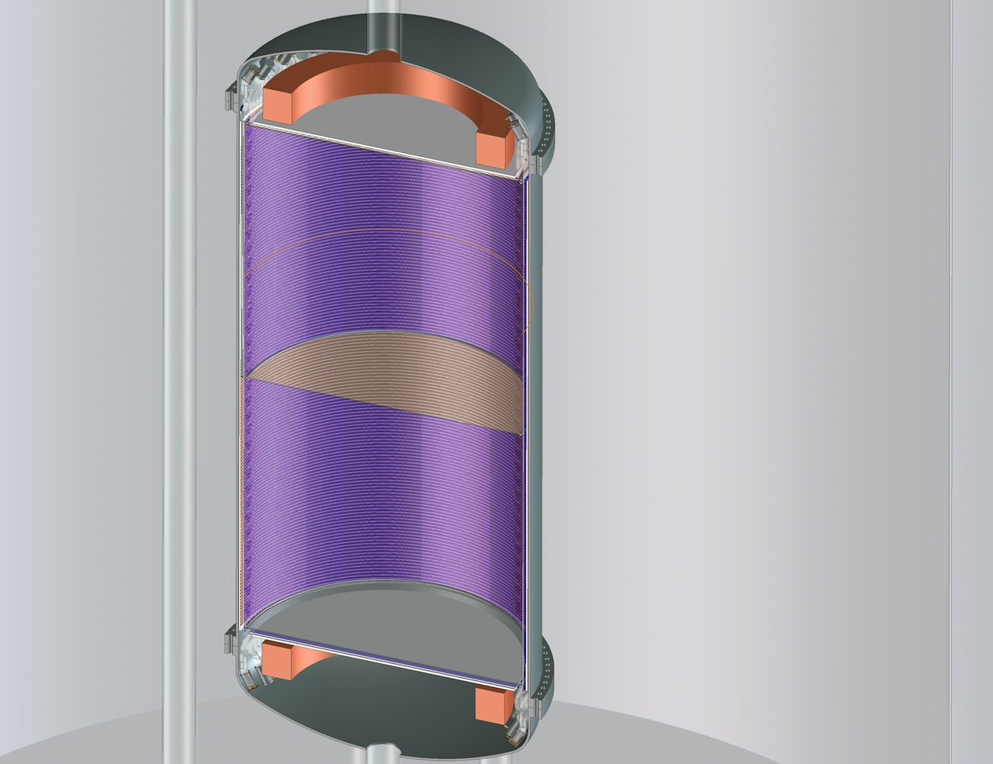
Size: 2.3 meter diameter
2 x 3 meter drift length
With WLS, only a few dozen PMTs are needed
With E-field in opposing directions, a “head-tail” effect might show up
Notes:
Head-tail effect?

Slide 33
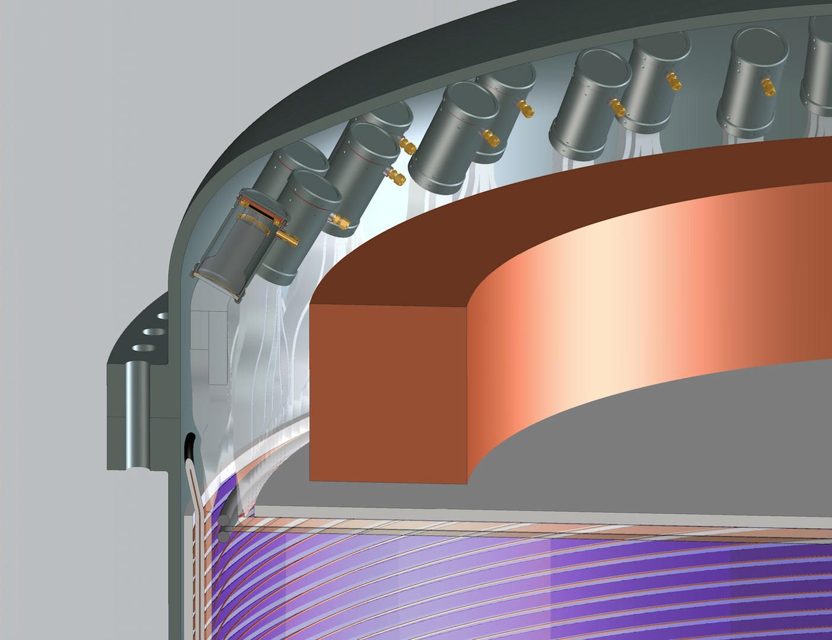

Slide 34
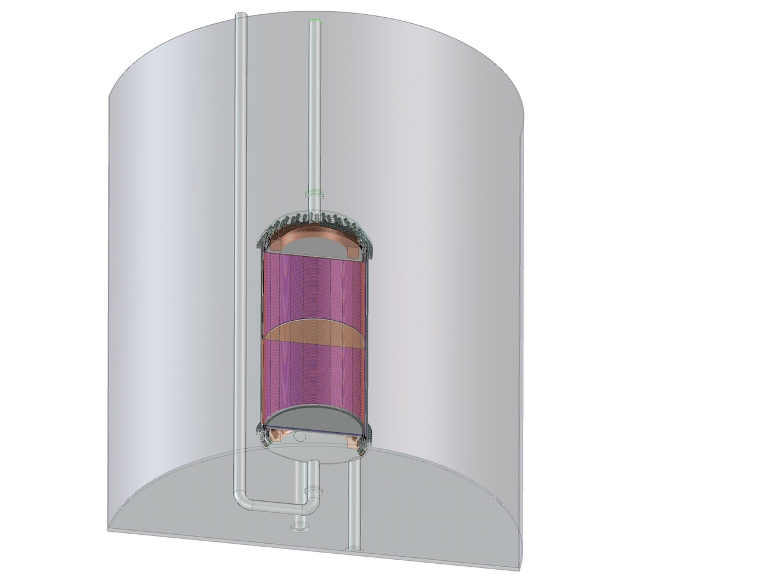
Large, but maybe not too large…

Slide 35
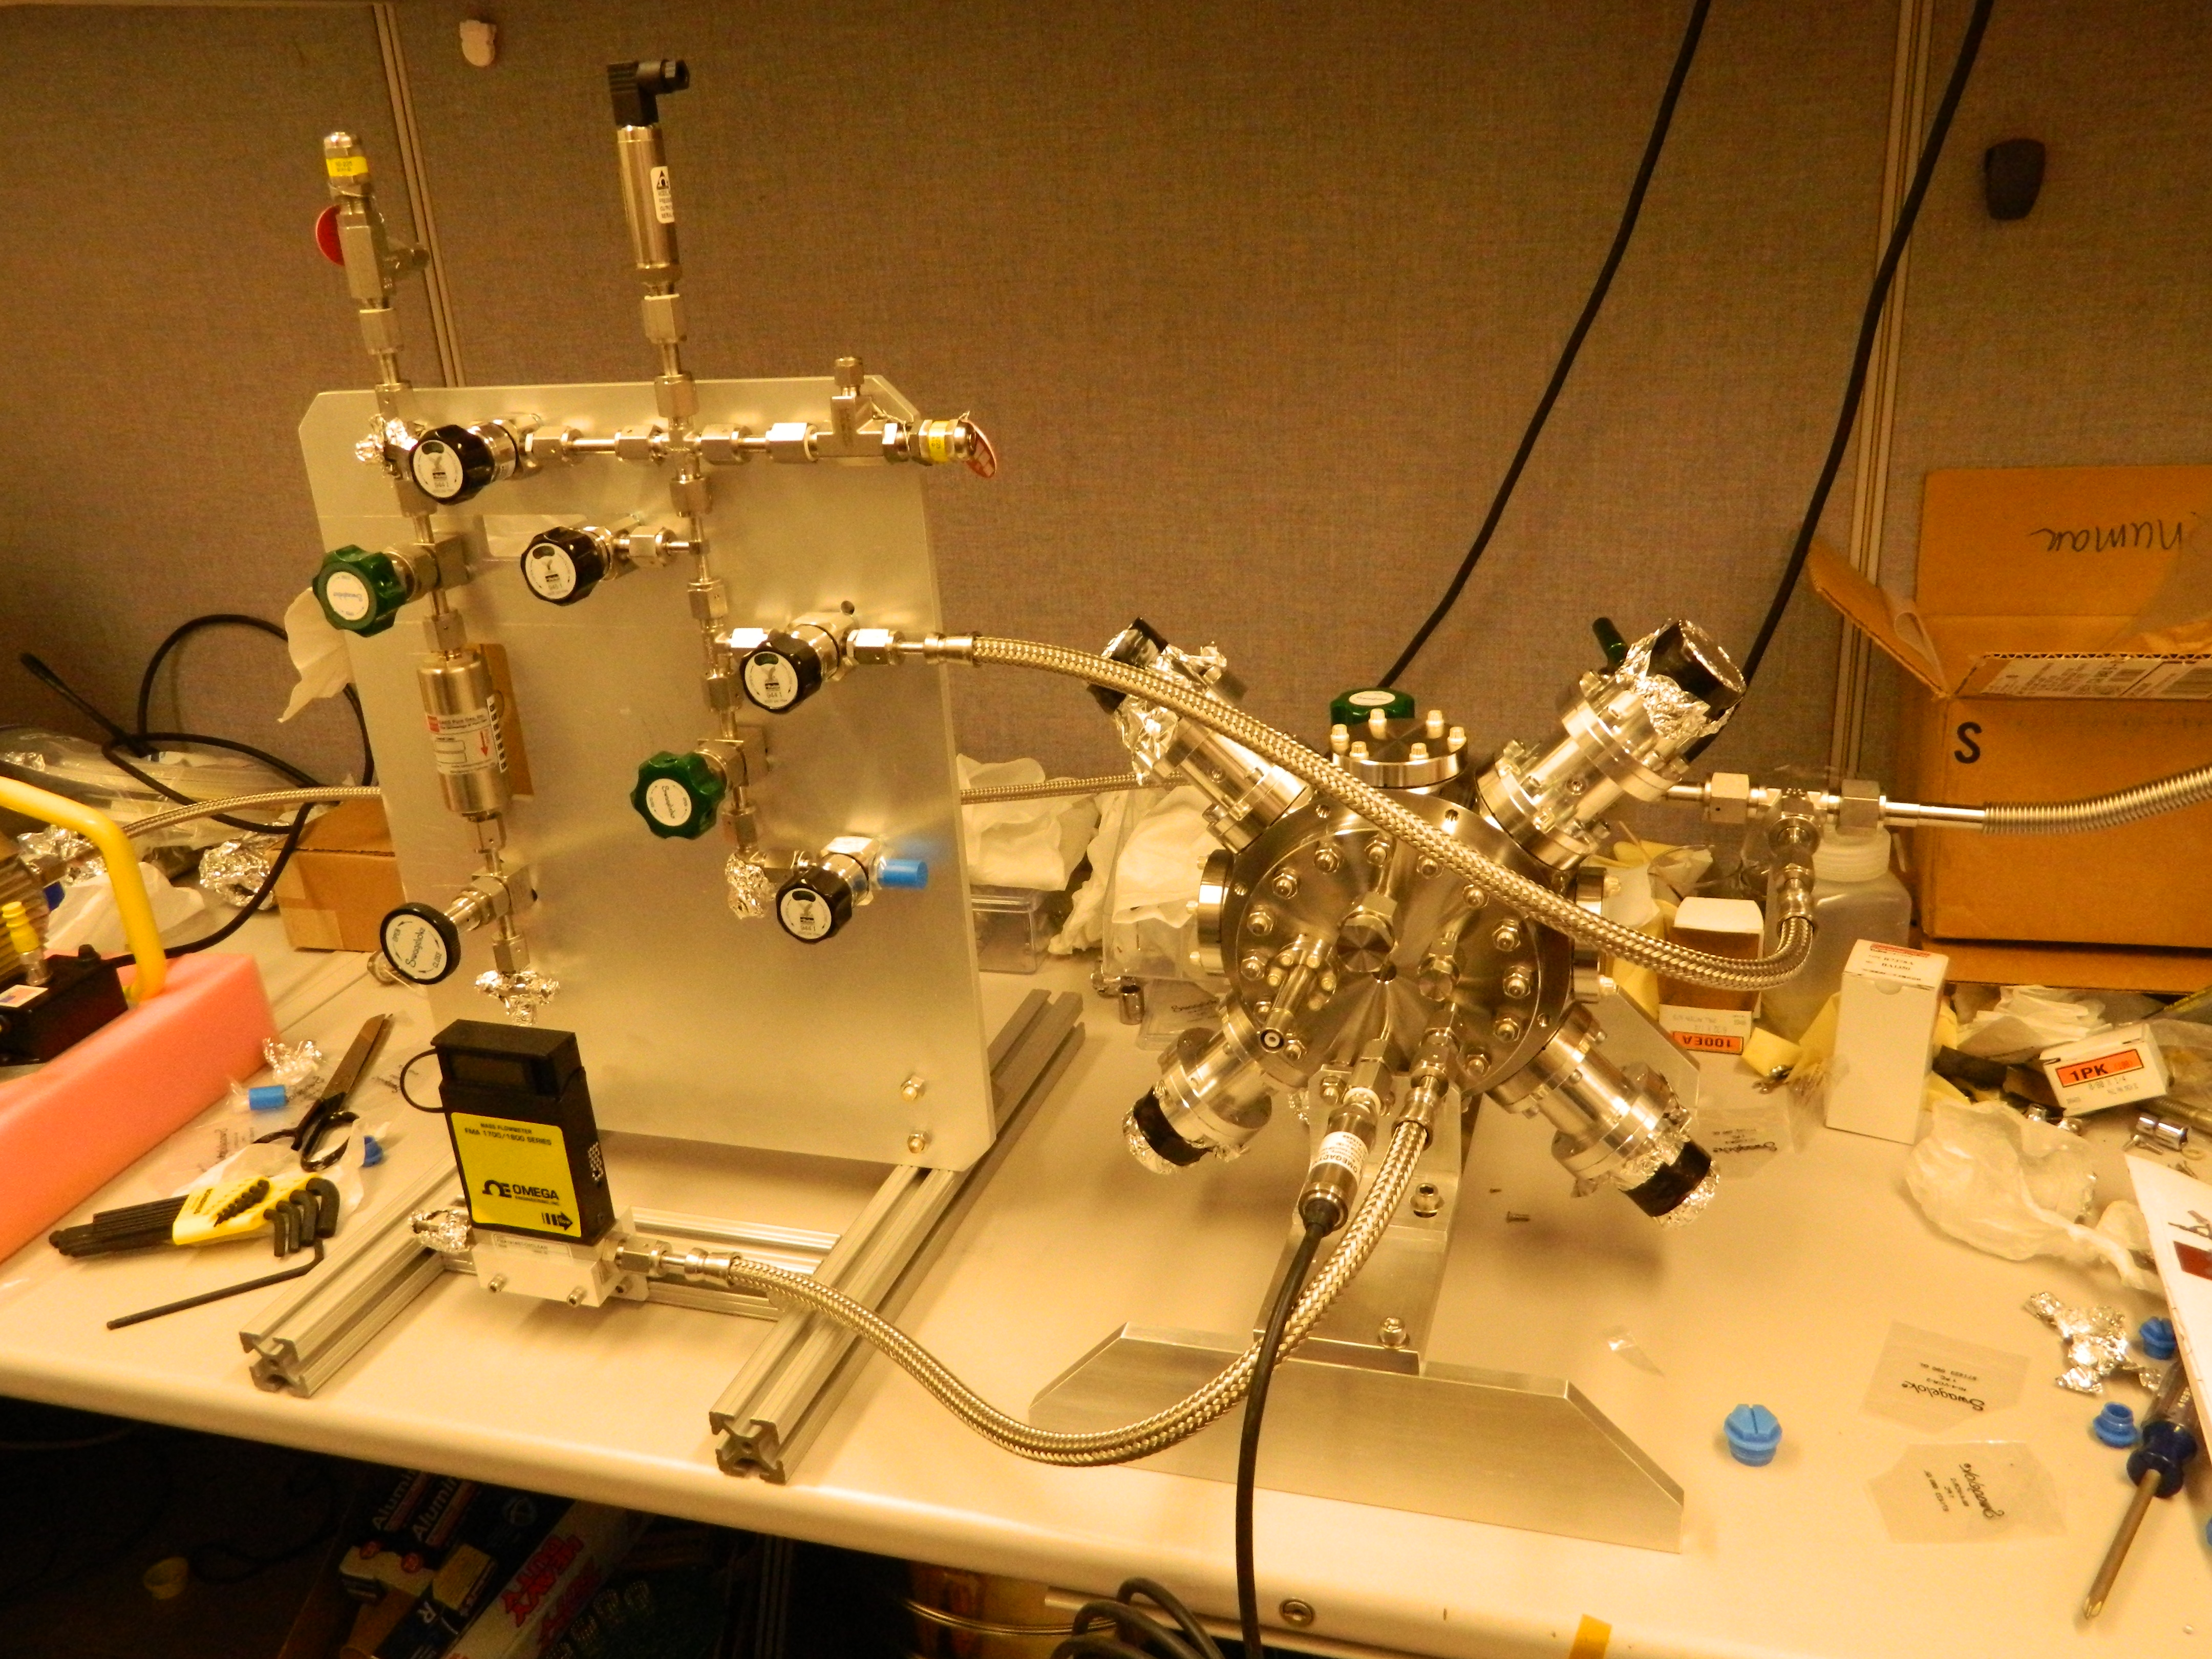
The “TEA-Pot”

Slide 36
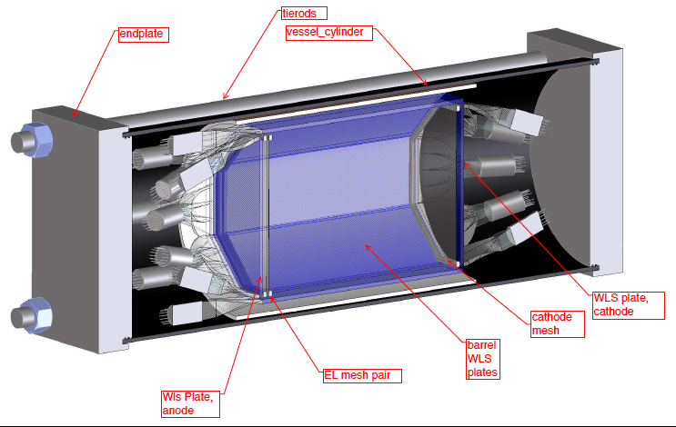
OSPREY: “Opportunities for Superior Performance in Rare Event Yields”
S2/S1 responses
“WIMP directionality”

Slide 37
Perspective
Is this a true story, or a fairy tale?
At least, serves as imagination stretcher…
Plausible at each step, but unknowns exist:
Has Nature chosen WIMP mass: 50 – 350 Gev?
Penning efficiency of TMA?
Fluorescence efficiency of TMA in recombination?
Rate of ionic charge exchange?
Cooling rate of electrons after ionization?
Head-Tail sensitivity?
Simulation and experimental effort starting…

Slide 38
Perspective
Gas phase offers superb energy resolution, event visualization, and flexibility in operation
EL gain stage is a key element for near-intrinsic energy resolution for 0ν-ββ search and low energy signals
Small energy partition fluctuations imply superb S2/S1 discrimination between electron and nuclear recoils
Directionality signal for WIMP search at 100’s of kg in monolithic TPC would exceed current reach by >1000

Slide 39
Thank you

Slide 40
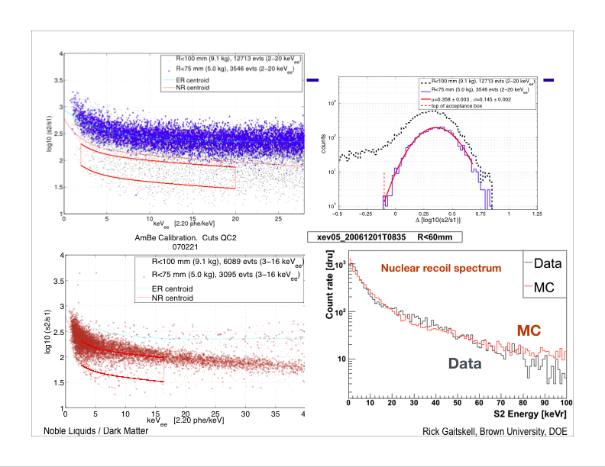
S2 = Primary ionization signal
S1 = Primary scintillation signal
Xenon10 – LXe data
Gamma events (e - R)
Log₁₀ S2/S1
γ events show large S₂/S₁ fluctuations at all energies, not improving with energy
Neutron events (N - R)

Slide 41
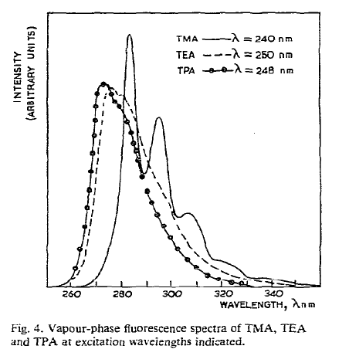

Slide 42
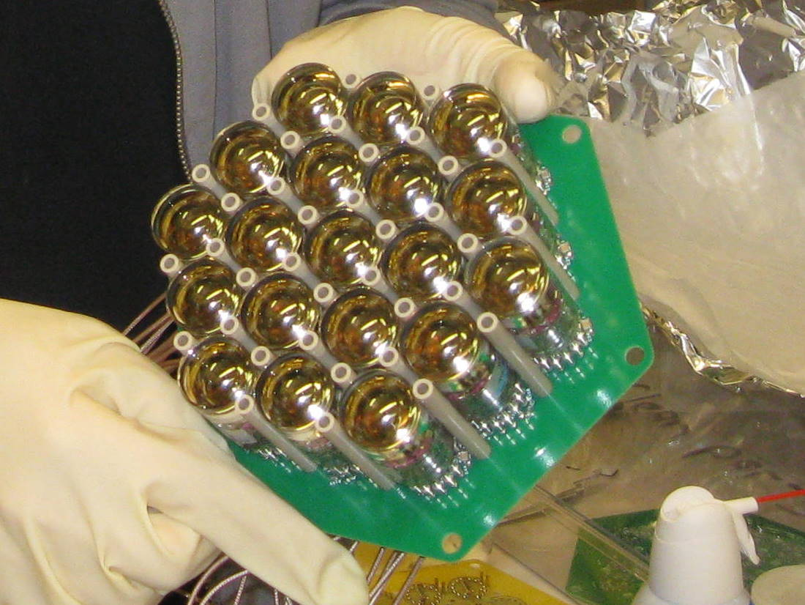
PMT Array: inside the pressure vessel Quartz window 2.54 cm diameter PMTs
TIPP 2011
42

Slide 43
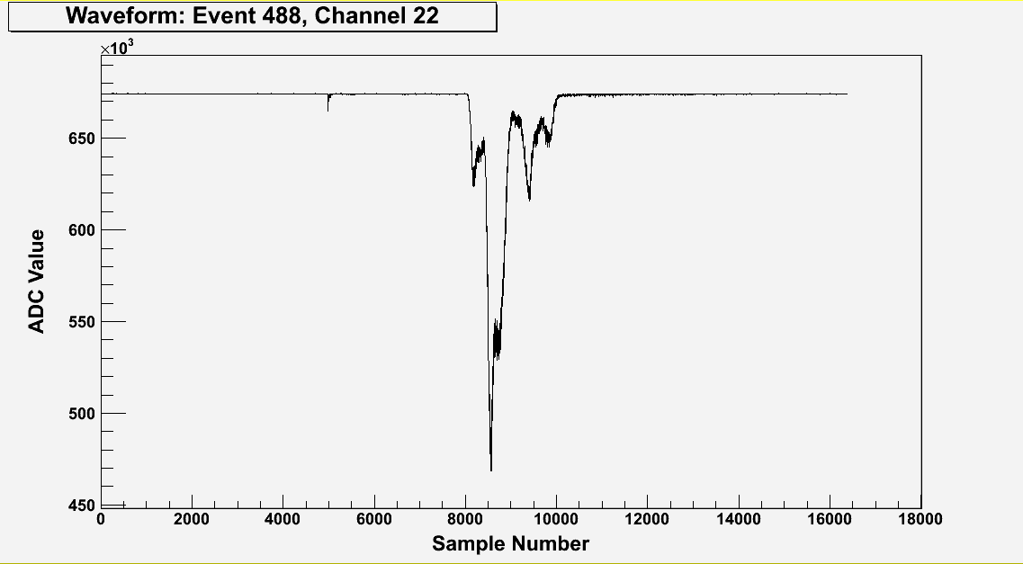
A typical ¹³⁷Cs γ waveform (sum of 19 PMTs) ~300,000 detected photoelectrons
Primary Scintillation (S1)
T0 of event
Electroluminescence (S2)
structure reflects topology
Drift Time:z-position (~0.01mm/sample)
Drift velocity ~1 mm/ms
TIPP 2011
43
10ns/sample

Slide 45
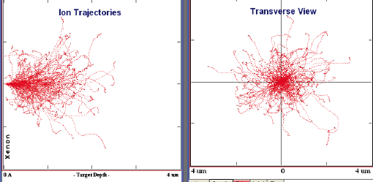
Do nuclear recoils retain directionality?
SRIM: 200 Xenon 30 keV nuclear recoil events in HPXe Xenon – unweighted by energy loss

Slide 46
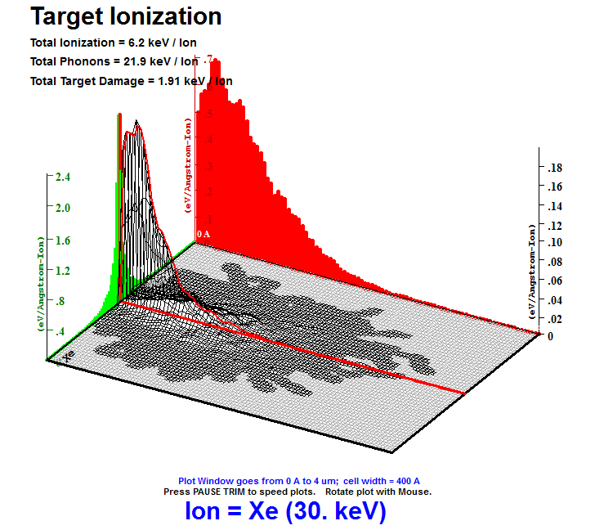
30 keV Xe ions in 10 bars xenon gas
SRIM simulations:
Verified for solids, not guaranteed for simulations in gas
Nuclear recoils are messier than α-particles

Slide 47
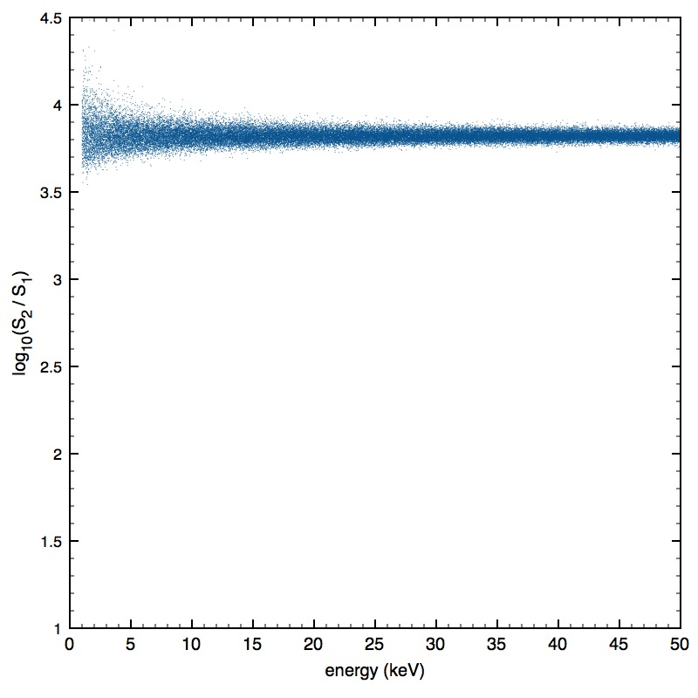
Gaussian behavior persists at x10 number of events
➔ Superb electron-nuclear recoil discrimination!
➔ Efficient use of active mass – no brutal cuts

Slide 48
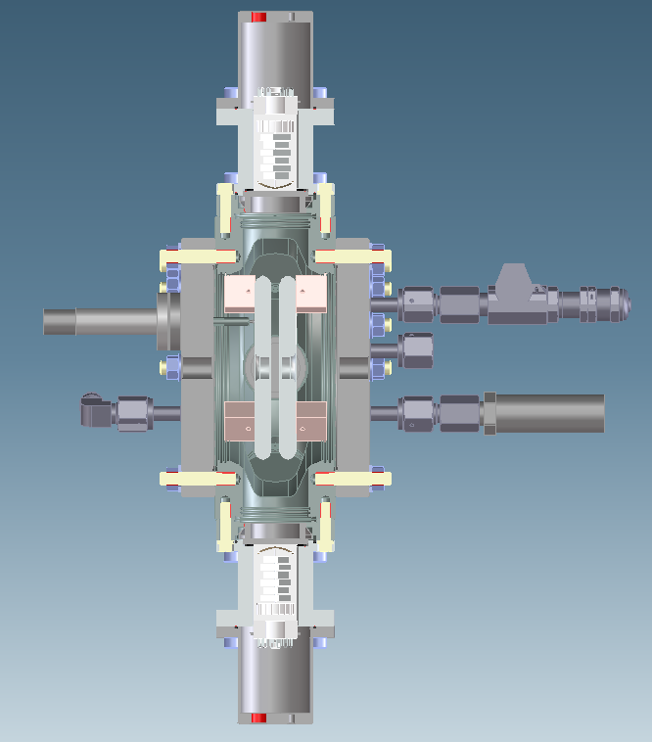
the “TEA-pot”
Basic responses measurements:
A parallel-plate ionization chamber with optical sensing, using 4 PMTs that look at the gap from the sides
We will measure both light and charge as functions of density, electric field, and fraction of TMA/TEA,

Slide 49
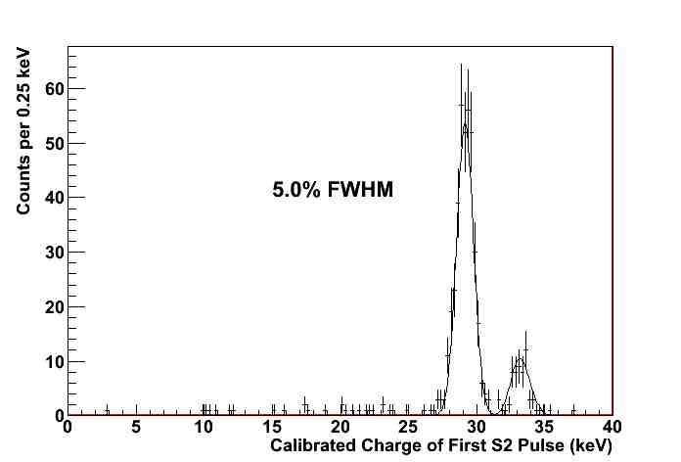
The x-ray peaks around ~30 keV

Slide 50
Energy resolution at Q_{ββ} = 2457 keV
δE/E = 2.35 ⋅ (F⋅W/Q)^{1/2}
F ≡ Fano factor (HPXe) : F = 0.15
w ≡ Average energy per ion pair: w ~ 25 eV
Q ≡ Energy deposited from ¹³⁶Xe --> ¹³⁶Ba:
N = Q/w ~100,000 primary electrons
σ_{N} = (F⋅N)^{1/2} ~124 electrons rms!
δE/E = 0.28% FWHM intrinsic HPXe
Scaling our result: δE/E ≈ 0.5% FWHM @ Q_{ββ}
Notes:
Only about x3 worse than Ge diodes!

Slide 51
 ISU  UNM
Spain provides:
Most of the collaborators
Most secured funding
Host Laboratory - LSC
Key contributions from international groups
Engineering and integration
TPC expertise
high-pressure gas detectors
Xenon supply & enrichment

