Slide 1
Long-term physics prospects

Slide 2
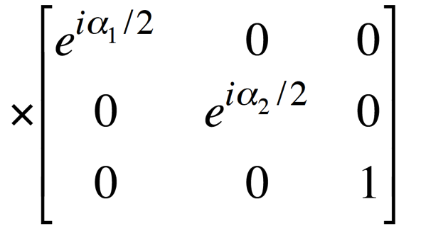
Standard Neutrino Model:
Three mass states
linked to three
flavour states via
unitary mixing
matrix;
Additional, sterile, states conceivable:
  Would imply:
    3-neutrino mixing matrix not unitary
Notes:
The Double Chooz collaboration, by measuring the "disappearance" of electron antineutrinos, presents hints for oscillation also involving the third angle with the following value: sin^2(2theta_13) = 0.085 +/- 0.051. The probability given by preliminary results that there is no oscillation is only 7.9%.

Slide 3
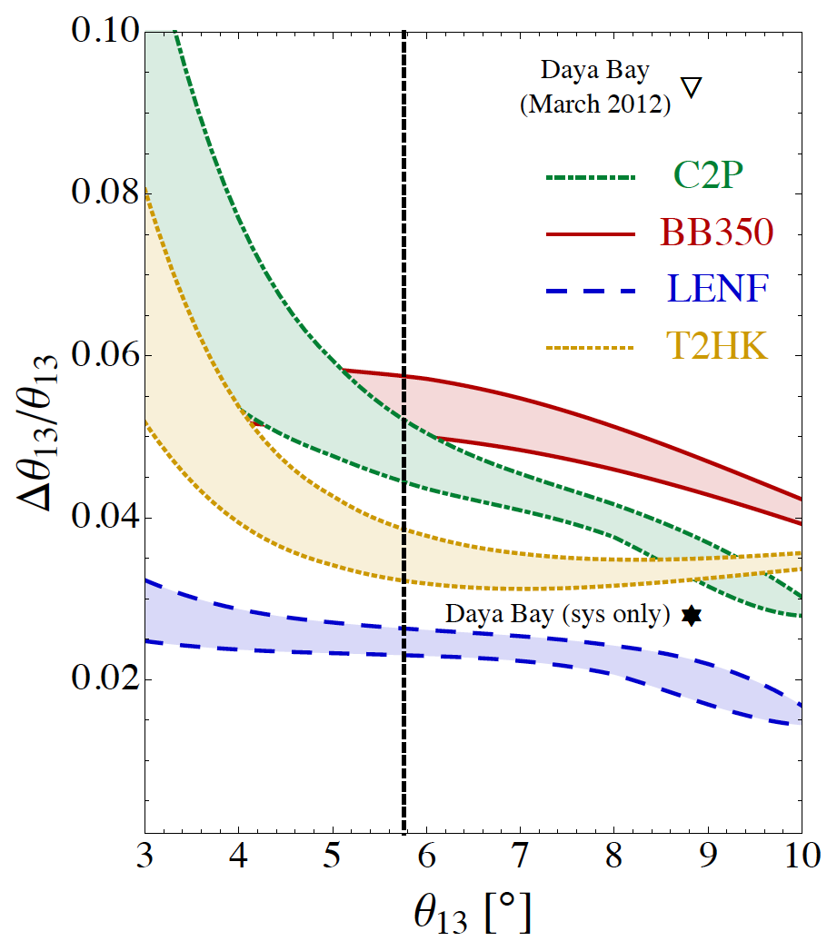
The SνM measurement programme:
Looking beyond MINOS, T2K,
NOνA, DChooz, Daya Bay, Reno, …
  θ₁₃ will be very well known
Therefore future programme
must:
  Complete the “Standard
  Neutrino Model” (SνM):
    Determine the mass hierarchy
    Search for (and discover?) leptonic
    CP-invariance violation
  Establish the SνM as the correct
  description of nature:
    Determine precisely the degree to which θ₂₃ differs from π/4
    Determine θ₁₃ precisely
    Determine θ₁₂ precisely
  Search for deviations from the SνM:
    Test the unitarity of the neutrino mixing matrix
    Search for sterile neutrinos, non-standard interactions, …
arXiv:1203.5651
Notes:
Peroration:
Goals of the presentation:
Show sensitivity and precision of the beta beam and neutrino factoru
Show maturity of R&D
Demonstrate that there are short-term contributions, especially nuSTORM

Slide 4
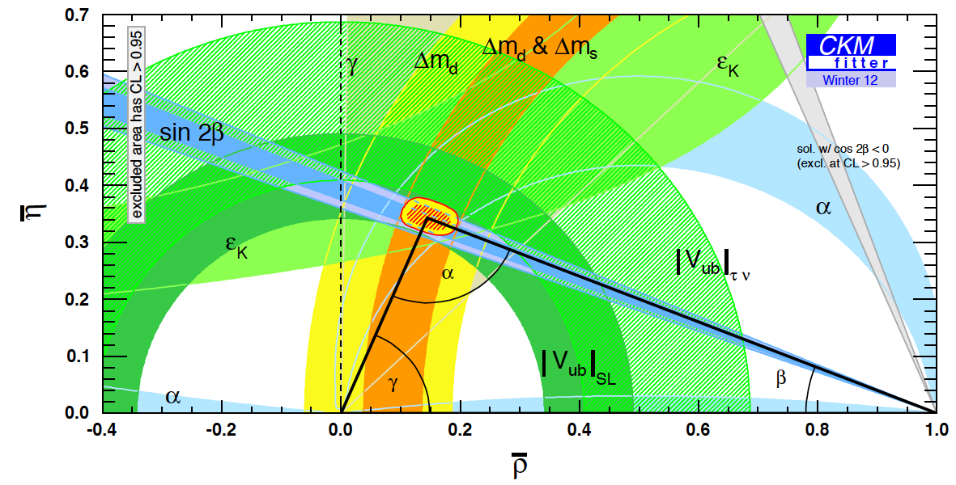
The case for precision:
What determines the goal for sensitivity and precision?
  Sensitivity:
    Definitive discovery!
      Must have sensitivity of “~5σ”
      To resolve the LSND/miniBooNE “suite of anomalies” may set the bar higher!
  Precision:
    Field presently led by experiment;
      Too many, or too few, theories;
    Goal to determine parameters with a precision comparable to that with which the quark-mixing parameters are known
PDG
Notes:
Peroration:
Goals of the presentation:
Show sensitivity and precision of the beta beam and neutrino factory
Show maturity of R&D
Demonstrate that there are short-term contributions, especially nSTORM

Slide 5
Option thumbnails:
Conventional super-beams:
  Wide-band, long baseline: e.g. LBNE, LBNO
    <E_{μ}> ~ 2—3 GeV; matched to LAr or Fe calorimeter;
    Long-baseline allows observation of first and second maximum
    Near detector exploited to reduce systematic errors
  Narrow-band, short baseline: e.g. T2HK, SPL
    <E_{μ}> ~ 0.5 GeV; matched to H₂0 Cherenkov;
    Short-baseline allows observation of first maximum
    Near detector exploited to reduce systematic errors
Beta-beam, short baseline: e.g. CERN γ=100;
  <E_{μ}> ~ 0.5 GeV; matched to H₂0 Cherenkov;
  Short-baseline allows observation of first maximum
  Requires short-baseline super-beam to deliver competitive performance
Neutrino Factory: e.g. IDS-NF E_{μ}=10 GeV, NuMax(+) E_{μ}=5 GeV;
  Uniquely well known flux (flavour content and energy spectrum);
  Baseline 1300—2500 km
  Requires a magnetised detector
  Identified by EUROnu as the facility for the high-precision programme

Slide 6
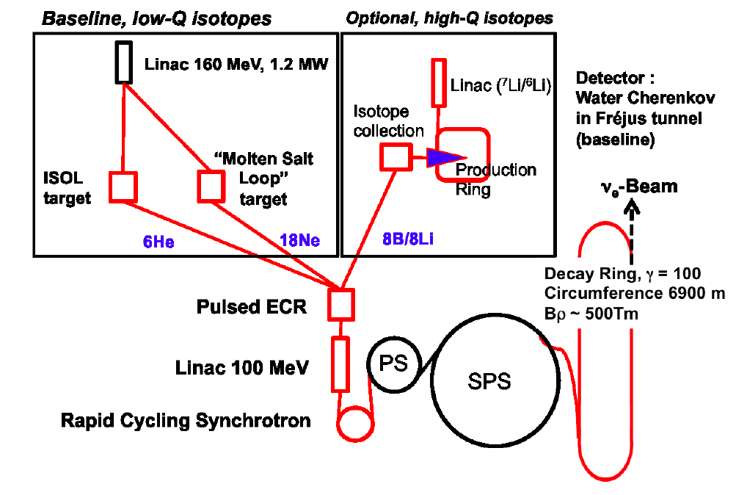
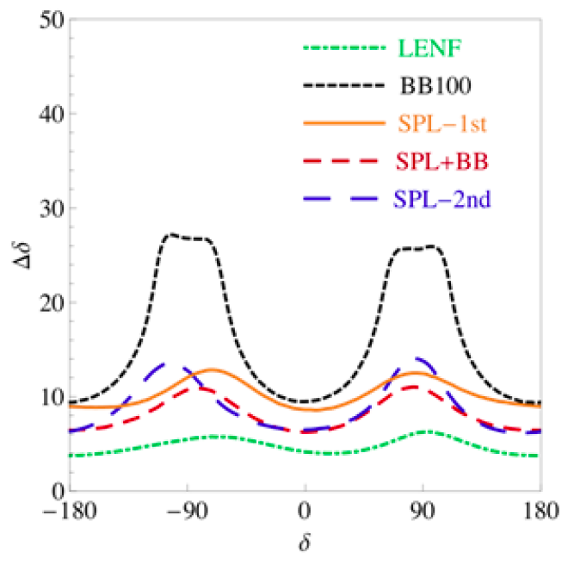
Beta-beam:
10.1103/PhysRevSTAB.16.021002
Advantage:
  Pure ν_{e} beam
Disadvantages:
  Ion beams have high rigidity:
    Practically limited to low neutrino energy
  To obtain competitive sensitivity require high-power super-beam
EUROnu conclusions:
  Given the superior performance of the Neutrino Factory and the cost of a combined beta-beam and super-beam complex and (if implemened at CERN) the disruption to the LHC programme;
    Staged implementation of the Neutrino Factory identified as the preferred option

Slide 7
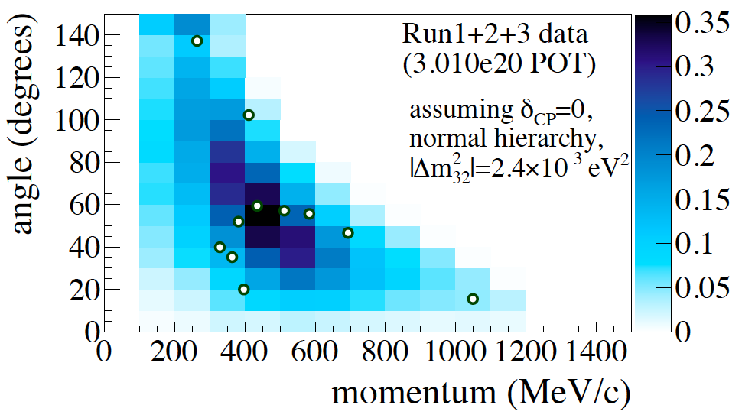
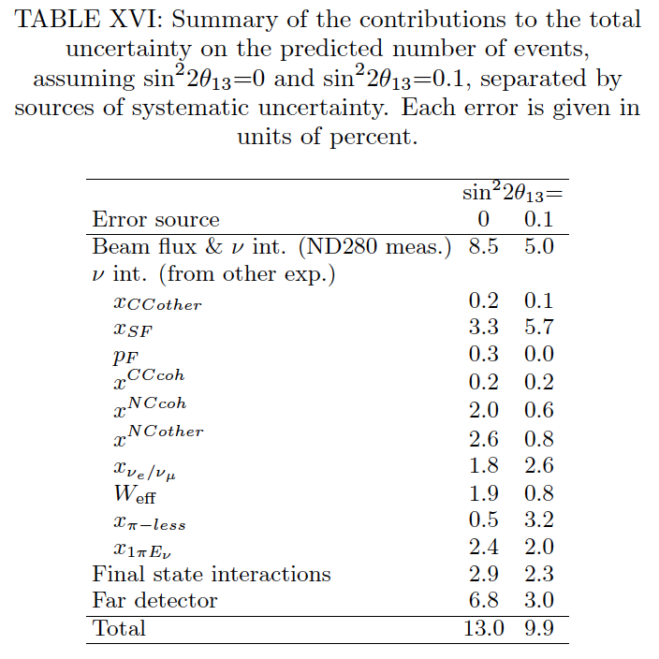
T2K: evidence for ν_{μ}➔ν_{e}; the state of the art:
arXiv:1304.0841
7.4%
Statistics:
  Sample: 11 events
Systematics:
  Flux/cross section: 5% [using CCQE and 1pi from ND280]
  Neutrino-nucleus scattering: 7.4%
  Final state interactions: 2.3%

Slide 8
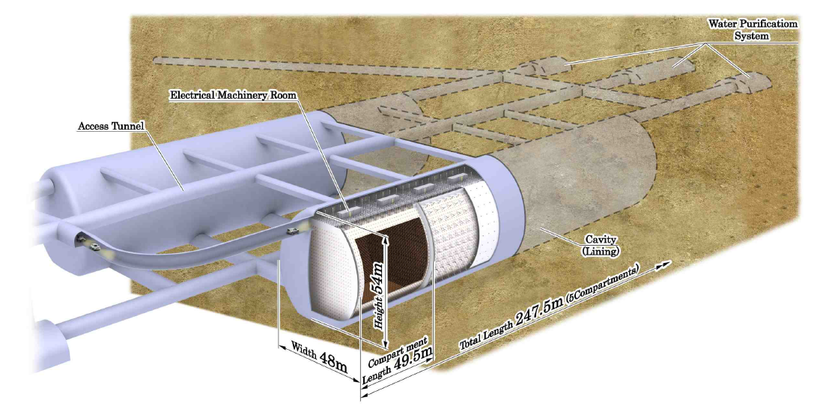
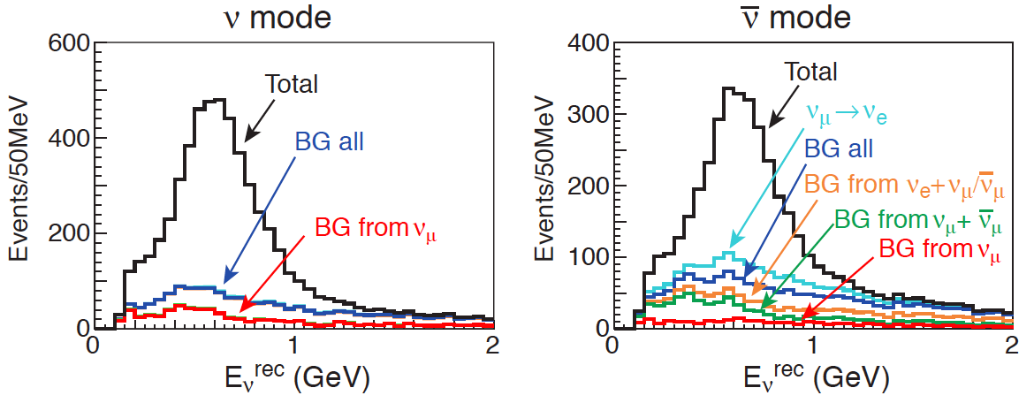
T2 Hyper-Kamiokande:
arXiv:1109.3262
Source:
  JPARC neutrino beam served: 1.66 MW
Detector: water Cherenkov
  Fiducial mass: 560 kTonne
  Site:
    2.5° off axis;
    Baseline ~290 km

Slide 9
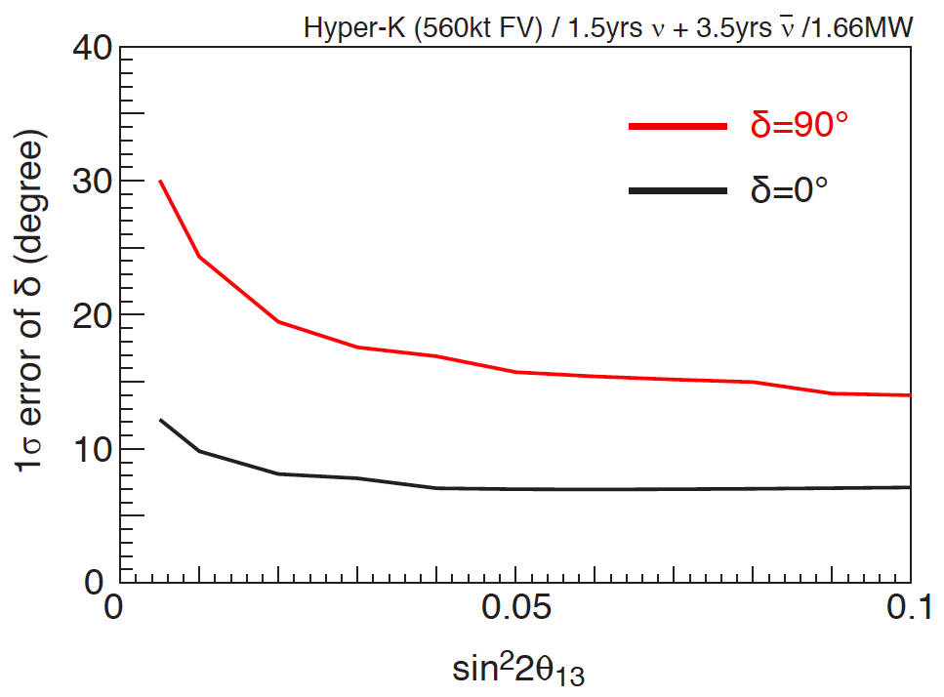
T2 Hyper-Kamiokande:
arXiv:1109.3262
Systematic uncertainties:
  Signal: 5%
  νμ induced background: 5%
  νe induced background: 5%
  Relative neutrino/anti-neutrino normalisation: 5%

Slide 10
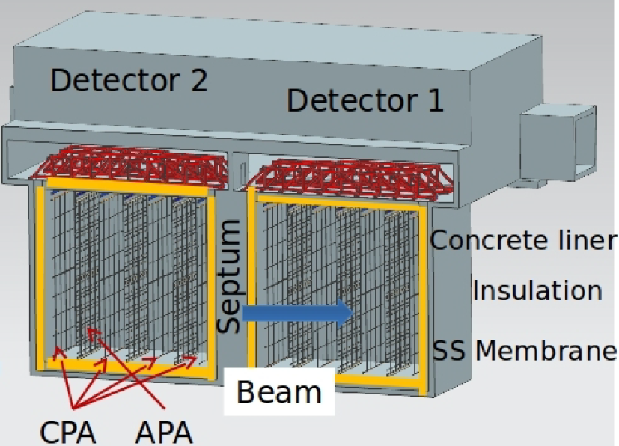
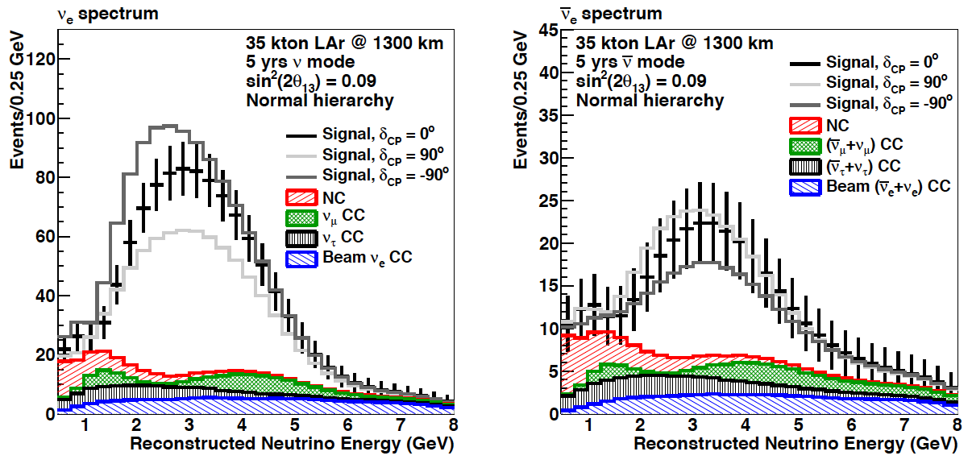
Long-Baseline Neutrino Experiment:
Source:
  FNAL MI: 700 kW
  Project X: 2.3 MW [upgrade]
Detector: LAr TPC
  Fiducial mass: 10 kTonne
    Upgrade to 34 kTonne
  Site: SURF
    On axis;
    Baseline 1300 km
arXiv:1307.7335

Slide 11
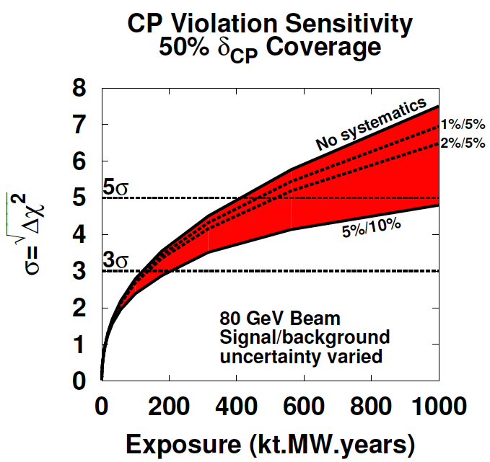
Long-Baseline Neutrino Experiment:
Systematic uncertainties:
  Signal: 1%
  Background: 5%
arXiv:1307.7335

Slide 12
Neutrino Factory:
Optimise discovery potential for CP and MH:
  Requirements:
    Large ν_{e} (ν_{e}) flux
      Detailed study of
      sub-leading effects
Unique:
    (Large) high-energy
    ν_{e} (ν_{e}) flux
      Optimise event rate at
      fixed L/E
      Optimise MH sensitivity
      Optimise CP sensitivity

Slide 13
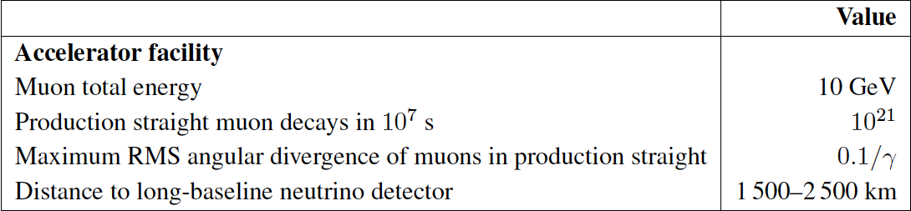
Neutrino Factory:
Two approaches:
  Optimise L and E to match detector threshold
    IDS-NF approach:
      1.4% signal
      20% background

Slide 14
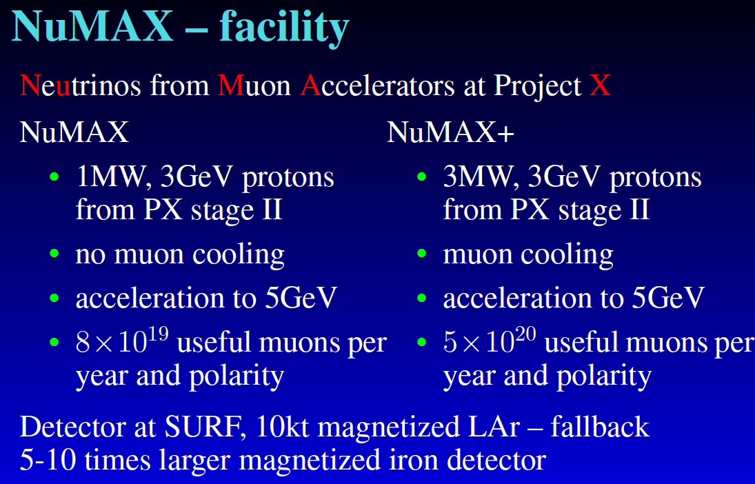
Neutrino Factory:
Two approaches:
  Optimise L and E to match detector threshold
    IDS-NF approach:
  Exploit LAr detector sited 1300 km from FNAL
    MAP/MASS approach:

Slide 15
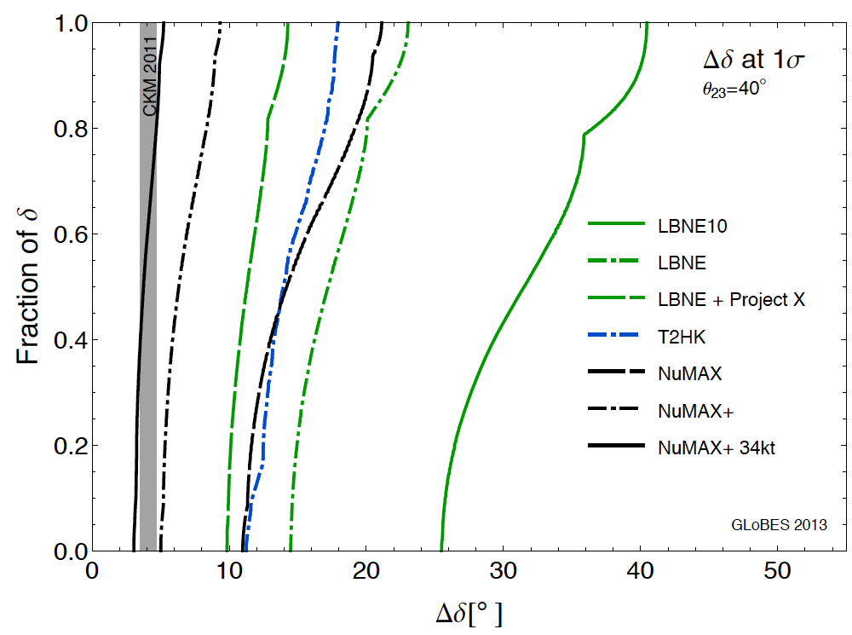
Neutrino Factory:
arXiv:1301.7727

Slide 16
Conclusions:
The combination of NB and WB super-beams have the potential to:
  Determine the mass hierarchy; and
  Make a first sweep of the CP parameter space
Substantial contribution to first scientific imperative:
  To complete the Standard Neutrino Model (SνM)
To establish the SνM as the correct description of nature requires:
  Development of a capability to produce large, high-energy data sets; and
  To control systematic uncertainties
    This requires a dedicated programme
An incremental programme can (has) been articulated:
  Scientific imperative: develop three-pronged programme:
    Deliver critical oscillation measurements through super-beam (LBNE/T2HK) programme;
    Establish systematic-uncertainty control programme
      Including measurement of νeN cross sections at nuSTORM
    Develop capability required to implement the Neutrino Factory
  To realise this fantastic programme seems likely to require international coordination

