Slide 1
Belle II Organization and Physics
T. Browder (University of Hawaii)
Organization
Belle II Physics
(Will skip introductory material that has already been covered by Yamauchi-san, Jim Fast-san will cover the detector and Asner-san will cover computing issues)

Slide 2
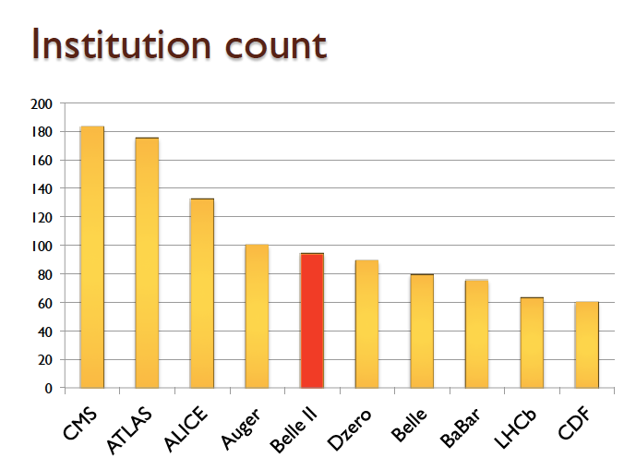
As of July 2013, Belle II has 560 members, 94 institutes and 23 countries.
(13 US Institutes, 63 members)

Slide 3
“Free ride is over in Japan”
In contrast to Belle, 50% of Belle II detector is provided by foreign countries. M+O contributions from each participating country.
Critical and essential role of foreign institutes in management of the experiment. KEK and Japanese universities are now adapting to a modern international style experiment.
T2K was a good example that has been a success

Slide 4
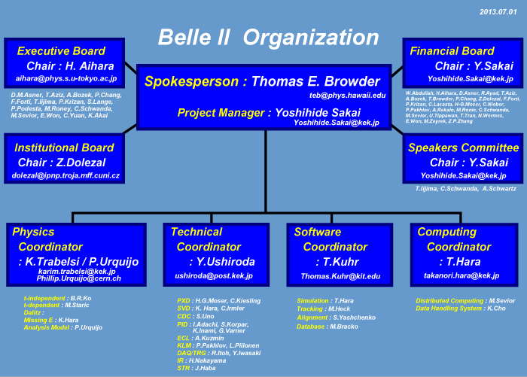

Slide 5

2008:
Critical Role of the B factories in the verification of the KM hypothesis was recognized and cited by the Nobel Foundation
A single irreducible phase in the weak interaction matrix accounts for most of the CPV observed in kaons and B’s.
CP violating effects in the B sector are O(1) rather than O(10⁻³) as in the kaon system.

Slide 6

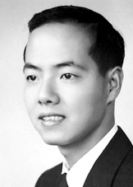
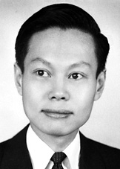
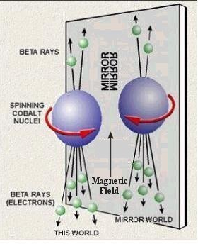
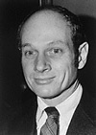
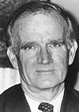
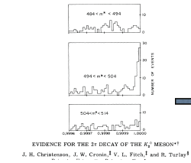
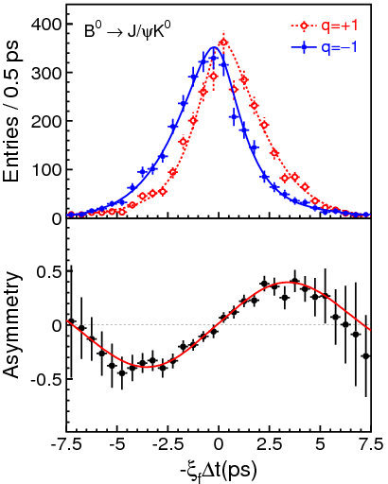
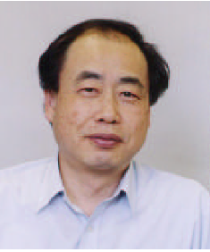
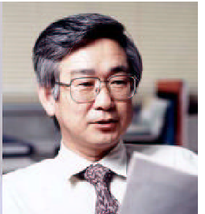
Nobel Prizes from Surprising Discoveries about Weak Interactions of Quarks
Maximal P violation
1957
T.D. Lee
C.N. Yang
Small CP violation
1980
J. Cronin
V. Fitch
O(1) CP violation and 3 generations
M. Kobayashi
T. Maskawa
2008

Slide 7

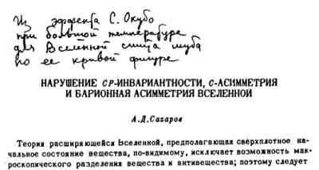

Are we done ? (Didn’t the B factories accomplish their mission, recognized by the 2008 Nobel Prize in Physics ?)
BAU: KM (Kobayashi-Maskawa) mechanism still short by 10 orders of magnitude !!!

Slide 8
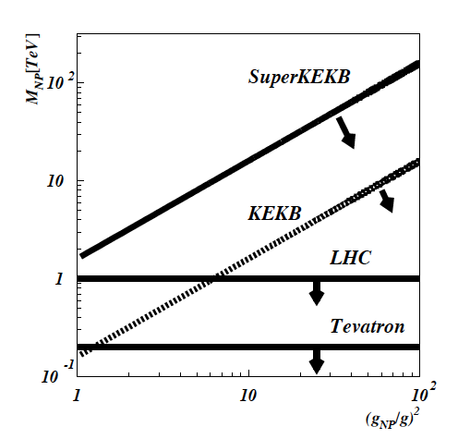
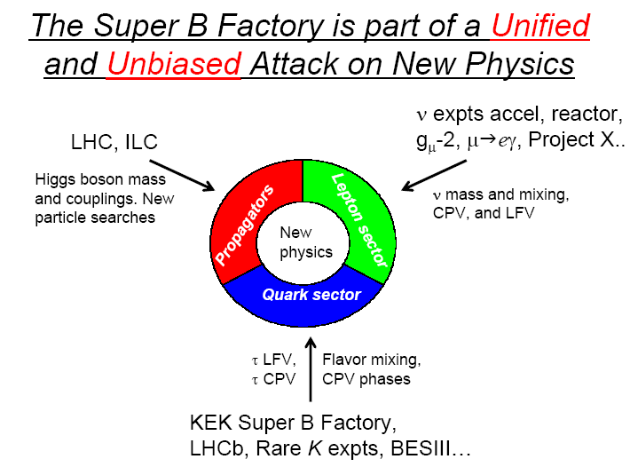
Why the SFF is so important.
A Super Flavor Factory (SFF) studies processes that are 1-loop in the SM but may be O(1) in NP : FCNC, mixing, CPV.
Current experimental bound is
O(10-100) TeV depending on NP coupling.
Thus if the LHC finds NP at O(1 TeV) it
must have a non-trivial flavor structure.
Coupling
Minimal Flavor Violating (MFV)
Enhanced Flavor coupling
Even if no new particles are found at the LHC, current SM couplings provide sensitivity to new particles at a SFF.
There must be new sources of CPV to explain the BAU (Baryon Asymmetry of the Universe)

Slide 9
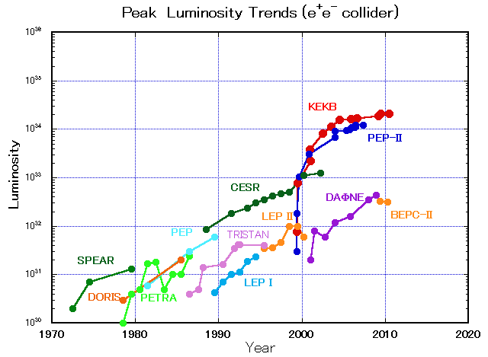
SuperKEKB is the e⁺e⁻ intensity frontier
10³⁶
40 times higher luminosity
KEKB
PEP-II

Slide 10
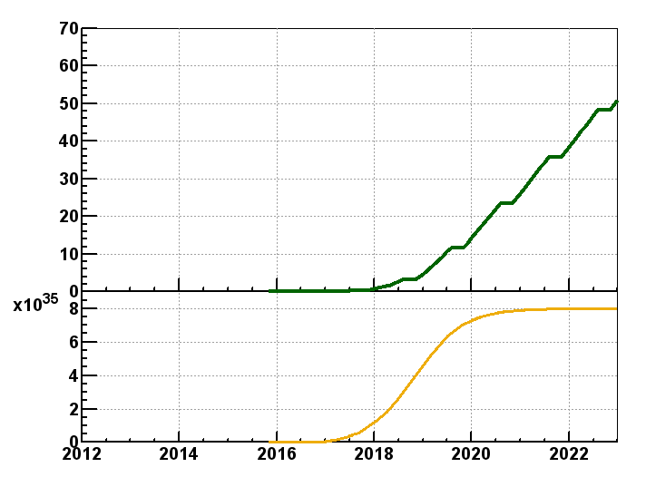
SuperKEKB luminosity projection
Belle/KEKB recorded ~1000 fb⁻¹ . Now change units to ab⁻¹
Goal of Belle II/SuperKEKB
Integrated luminosity
(ab⁻¹)
9 months/year
20 days/month
Commissioning starts
in early 2015.
Shutdown
for upgrade
Peak luminosity
(cm⁻²s⁻¹)
Calendar Year
Notes:
Commissioning starts in 2015, first without final focus superconducting quads then with quads. Belle is tested with cosmics in late 2015, is commissioned with beam and then starts taking data in 2016.

Slide 11
Physics at the Super Flavor Factory

Slide 12
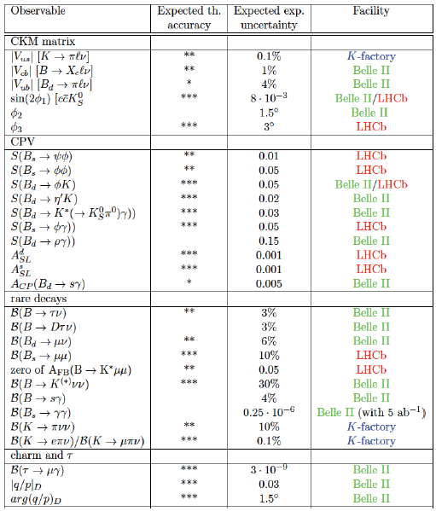
Complementarity of Belle II SFF physics reach and LHCb upgrade
Hard to reduce this table of diverse physics capabilities to a simple and memorable message.
Based on a slide from B. Golob

Slide 13

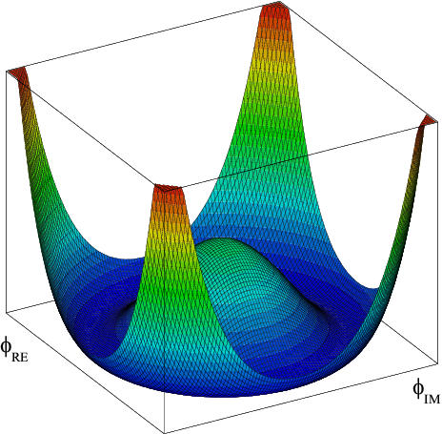
The Higgs boson is now established by experimental results from ATLAS and CMS.
.
Does the GP have a “brother” i.e. the charged Higgs ?
Measurements at a “Super B factory” and direct searches at hadron colliders take complementary approaches to this important question.
Notes:
This prompted Leon Lederman to write a new book entitled “Beyond the God Particle”
Sensitivity from tau nu, D(*) tau nu decays and b→s gamma.
Hadron colliders directly search for H+ →tau nu.

Slide 14
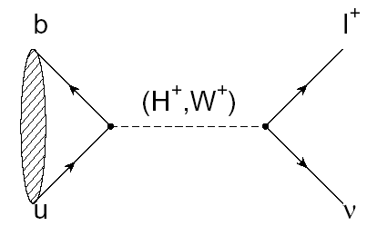
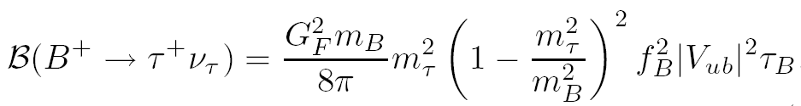

B⁺→τ ⁺ υ_{τ}
(Decays with Large Missing Energy)
Sensitivity to new physics from a charged Higgs
The B meson decay constant, determined by the B wavefunction at the origin
(|V_{ub}| taken from indep. measurements.)

Slide 15
Consumer’s guide to charged Higgs
Higgs doublet of type I (couples with equal strength to upper and lower generations)
Higgs doublet of type II (couples with different strength to u and d-type quarks, tan(β) = v_{u}/v_{d} (favored NP scenario e.g. MSSM)
Higgs doublet of type III (not type I or type II; anything goes)

Slide 16
Why measuring Β−>τν is non-trivial
e⁺
ϒ(4S)
B⁻
B⁺
Most of the sensitivity is from tau modes with 1-prong
ν_{τ}
ν_{e}
ν_{τ}
B⁻→X
B⁺→τ⁺ν_{τ}, τ⁺→e⁺ν_{e}ν_{τ}
The experimental signature is rather difficult: B decays to a single charged track + nothing
(This will be difficult at a hadron collider)

Slide 17
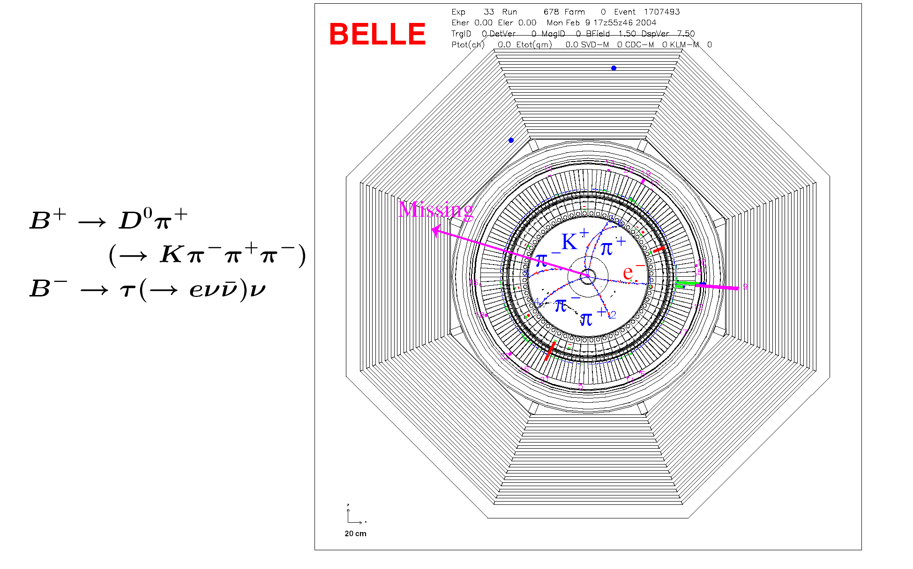
Example of a Missing Energy Decay (B⁻ → τ⁻ ν_{τ} ) in Data
The clean e+e- environment makes this possible

Slide 18
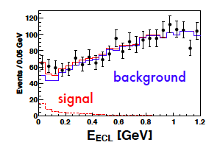
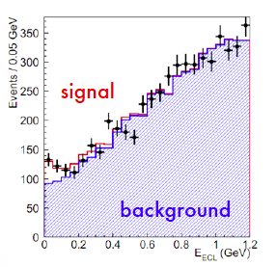
Belle measurement with full data sample and hadronic tags
63±22.5
Idea: With the “single B meson beam”, we look for a single track from a τ, missing energy/momentun and extra calorimeter energy close to zero.
143±35.5
Semileptonic tags
With the full B factory statistics only “evidence”. No single observation.
The horizontal axis is the “Extra Calorimeter Energy”

Slide 19
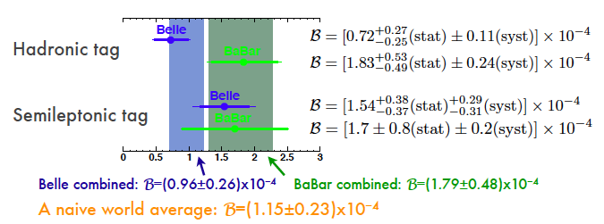
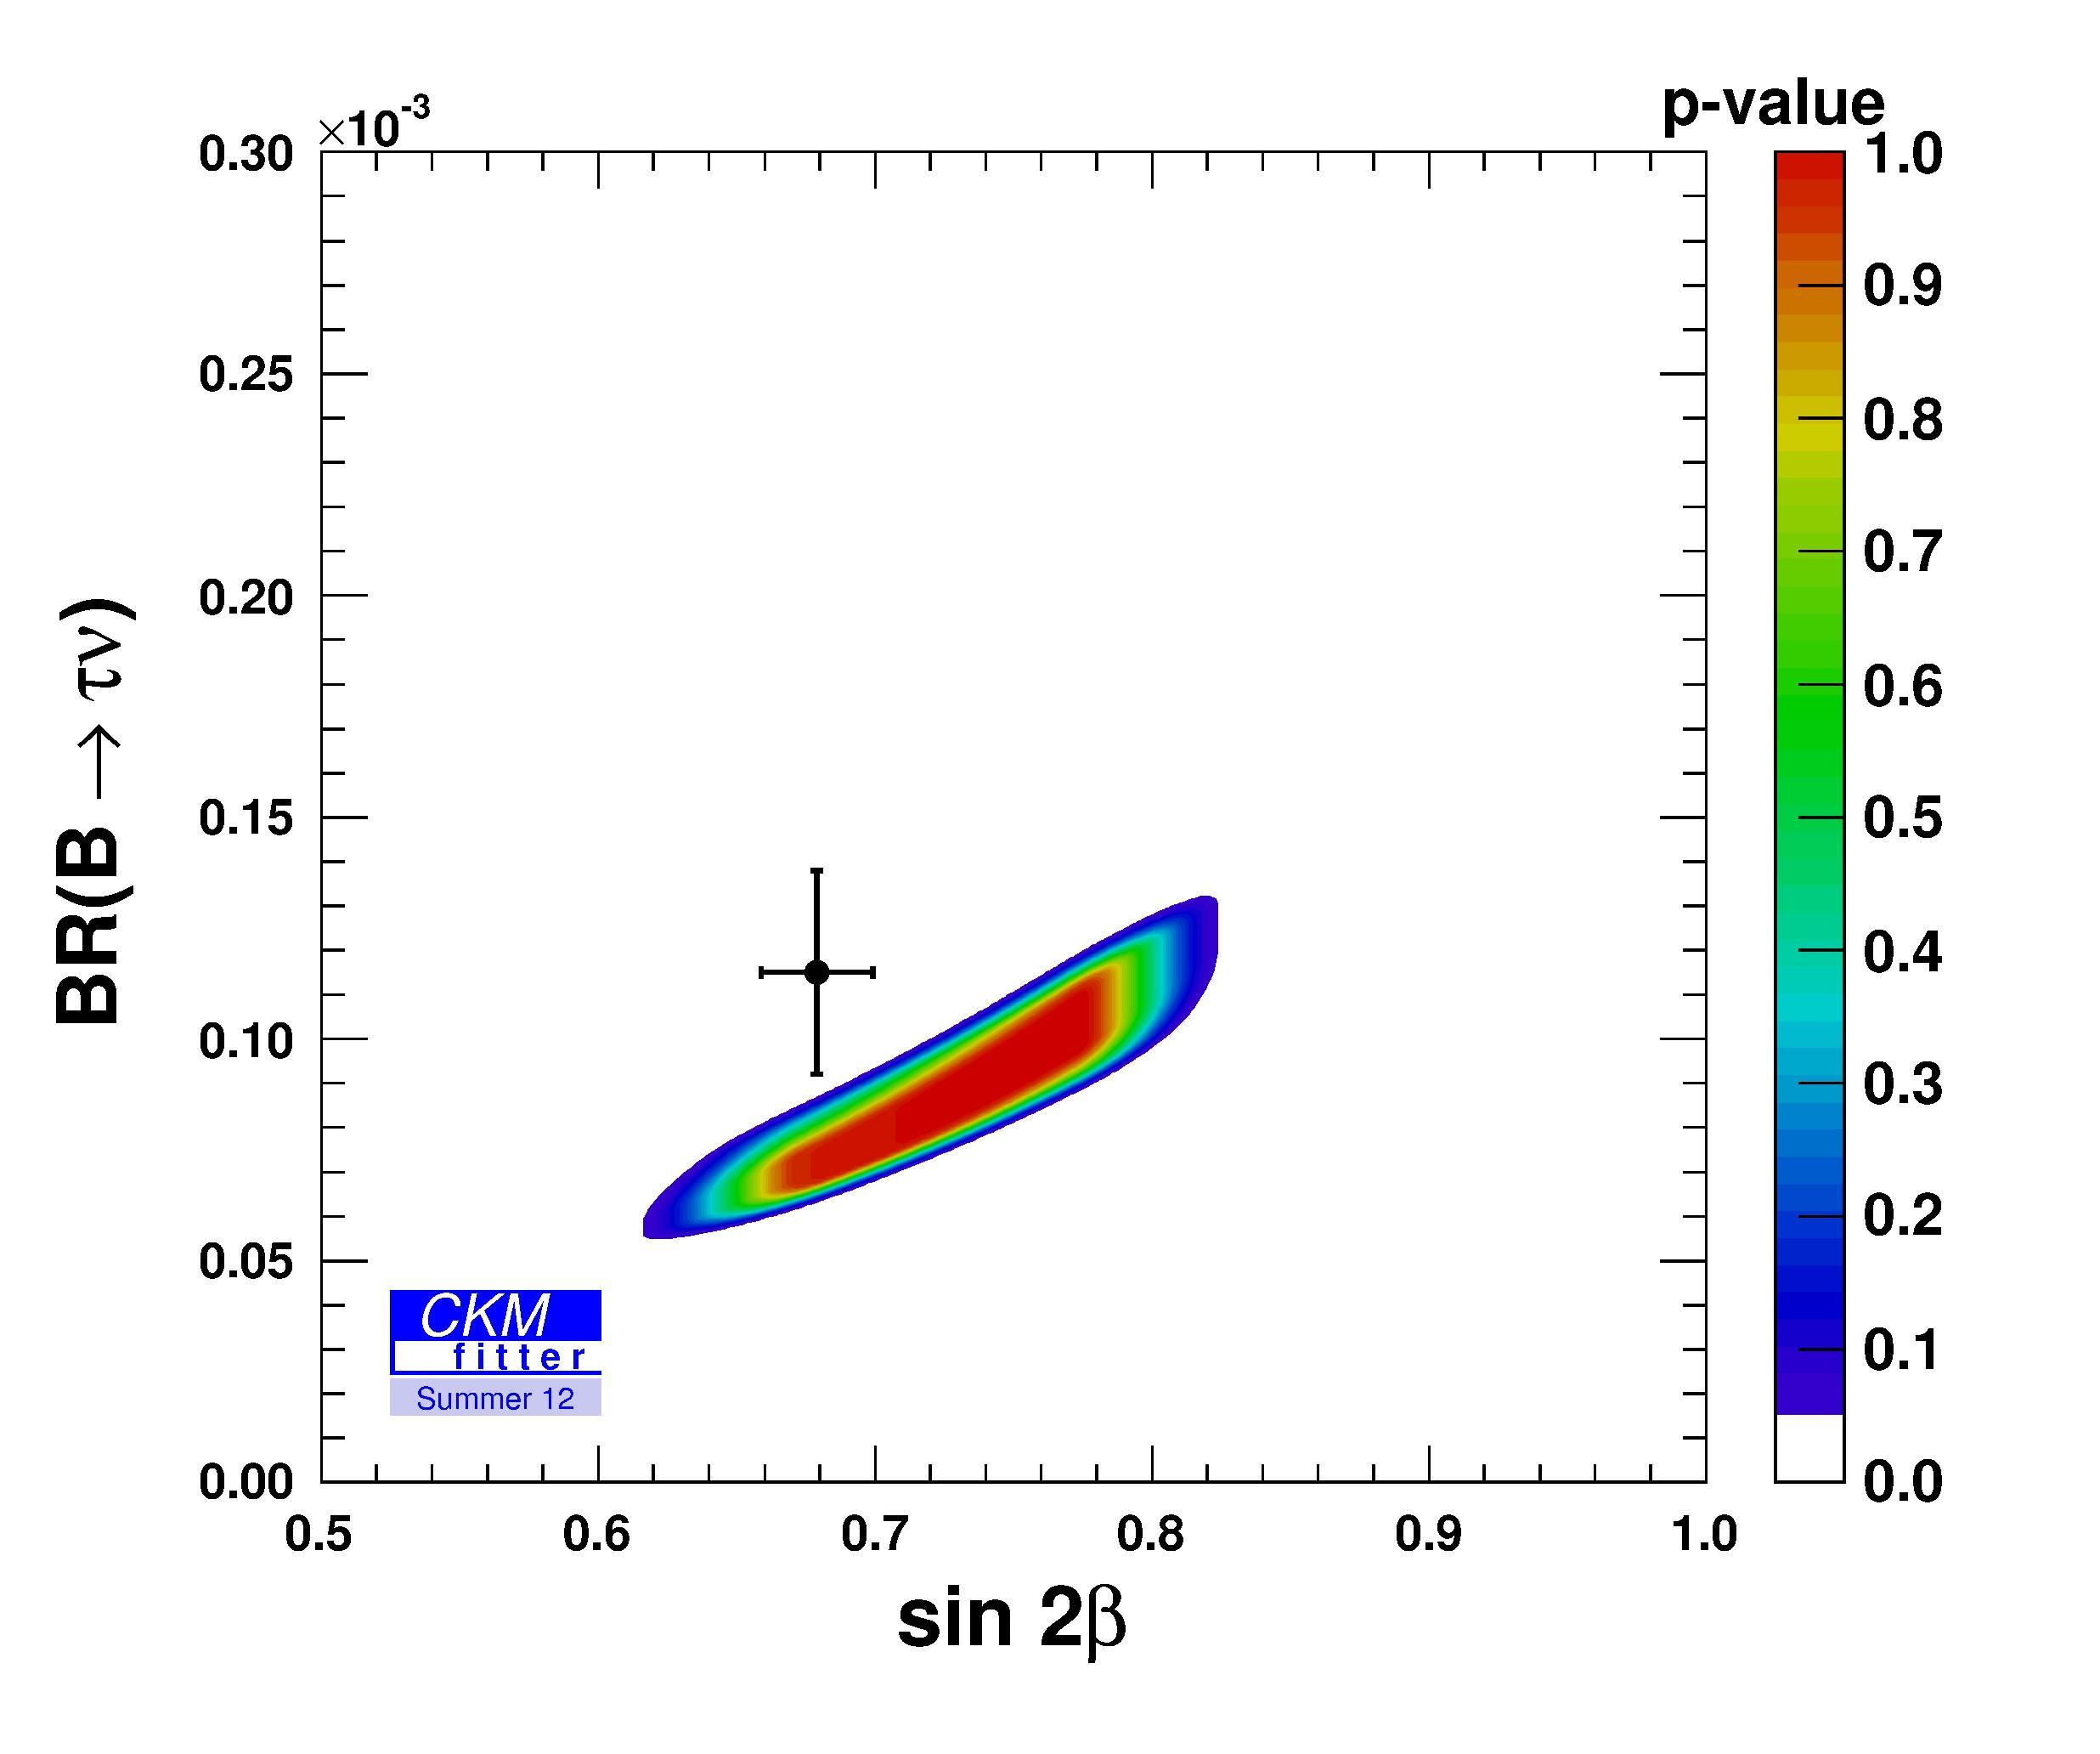
CKMfitter world averages

Slide 20
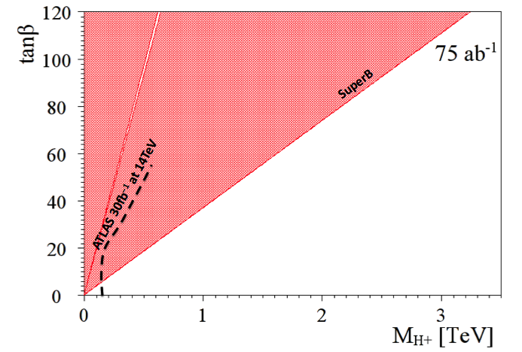
Complementarity of SFF and LHC
(Slide adapted from A. Bevan)
The current combined limit places a stronger constraint than direct searches from LHC exps. for the next few years.
Currently inclusive b to sγ rules out m_{H+} below ~400 GeV/c² range (independent of tanβ)
This region is allowed
http://arxiv.org/abs/1208.2788

Slide 21
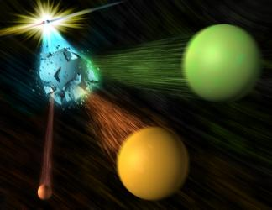
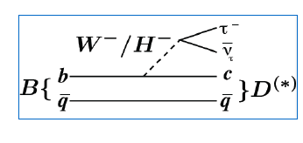
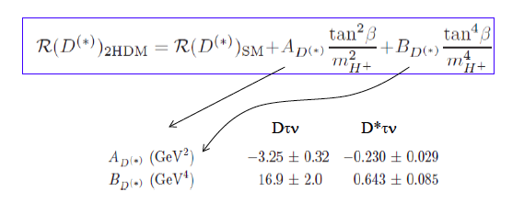

Slide adapted from A. Soffer

Slide 22
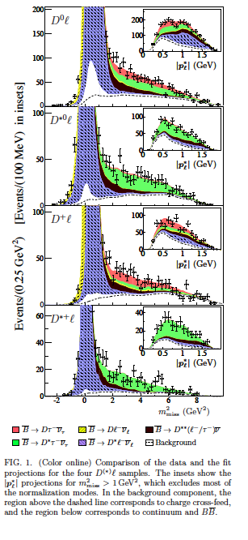
Example from a recent BaBar paper
Signals in B→D^{(*)} τυ (489±63, 888±63)
Missing mass variable:
m_{miss}² =p_{miss}²=(p[e⁺e⁻]-p_{tag}-p_{D(*)}-p_{l})²
P_{l}* = momentum of lepton in B rest frame
Production of B meson pairs at threshold is critical to the separation of backgrounds from the missing energy/ momentum signal.

Slide 23
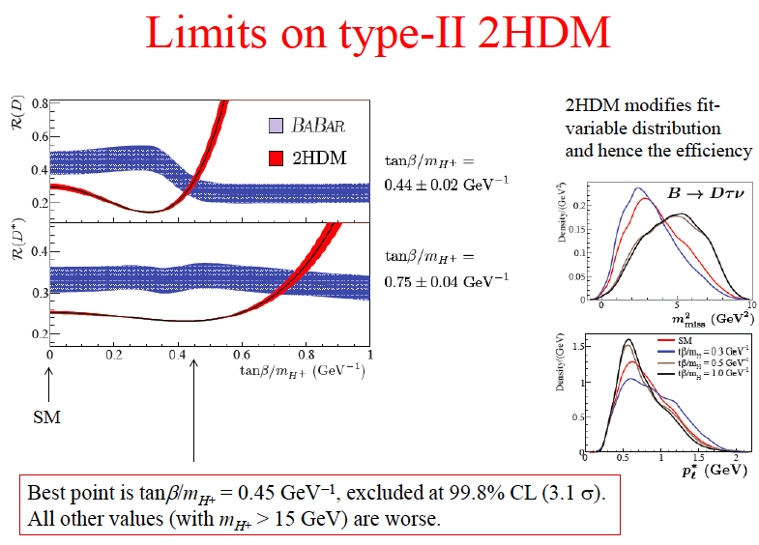

Slide 24
BaBar collaboration, Phys. Rev. Lett. 109, 101802 (2012)
“However, the combination of R(D) and R(D*) excludes the type II 2HDM charged Higgs boson with a 99.8% confidence level for any value of tan(β)/m_{H+}”
In other words, found NP but have killed the 2HDM model

Slide 25
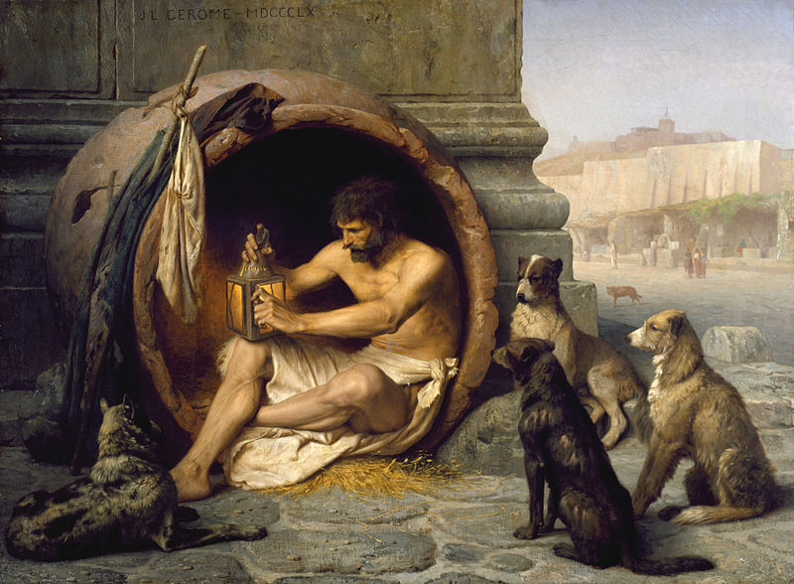
In other words, found NP but have killed the 2HDM model
The original cynic and his followers
BaBar B→D^{(*)}τυ excess at the 3.5σ level. Belle will report their final results on this mode fairly soon. Could the two-Higgs NP model be viable again ?
To resolve these new physics issues related to the charged Higgs, need Super Flavor Factory statistics (reduce statistical errors by ~x10).

Slide 26
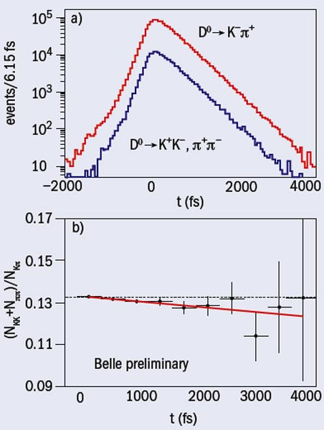
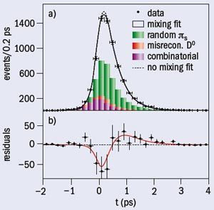
First signals for D mixing from Belle and BaBar in 2007
Lifetime of CP eigenstate and Favored decay differ

Slide 27

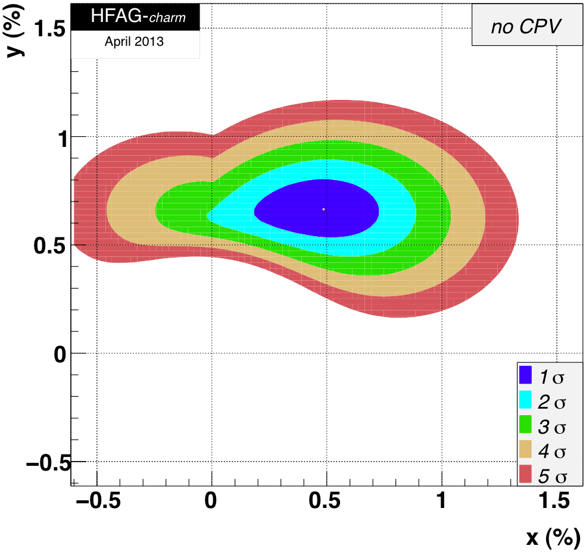
Executive summary of mixing
There are also “primed versions” of x and y, which correspond to a rotation through a strong interaction phase
So far, a strong signal for y not much (<2σ) for x

Slide 28
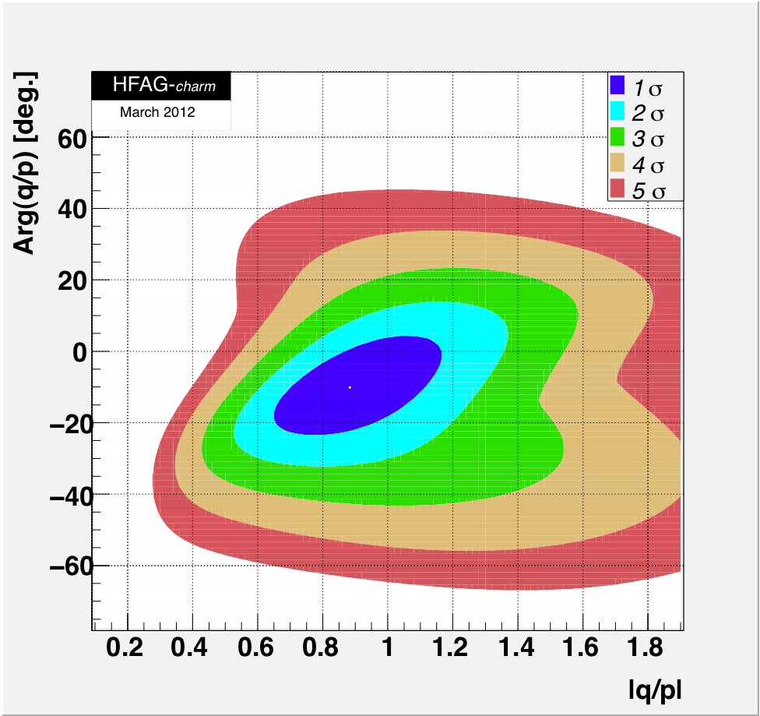
D mixing: Another new physics phase !
CPV in D system negligible in SM
CPV in interf. mix./decay:
The existence of D mixing (if x is non-zero) allows us to look for another poorly constrained new physics phase but this time from up-type quarks.
(c.f. CPV in B_{s} mixing)
Current WA sensitivity ~±15⁰, 50 ab⁻¹ go below 2⁰

Slide 29
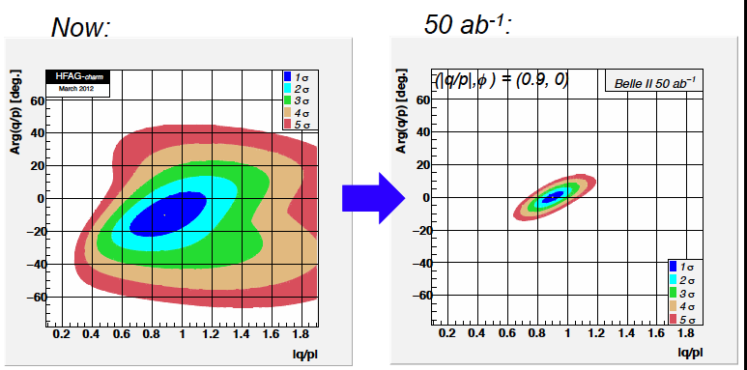
CP Phase in D mixing at Belle II
Based on a slide by Alan Schwartz

Slide 30
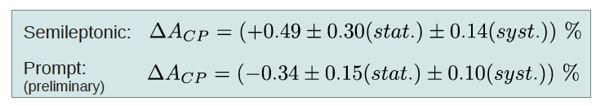
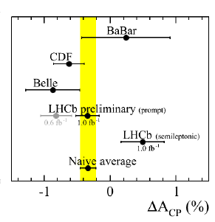
Enigma of charm direct CPV
ΔA_{CP}=A(K⁺K⁻)-A(π⁺ π⁻)
Naïve average from LHCb alone
Is there an effect ? Are systematics under control ?
If the result stabilizes at 0.3%, is NP still required ?

Slide 31
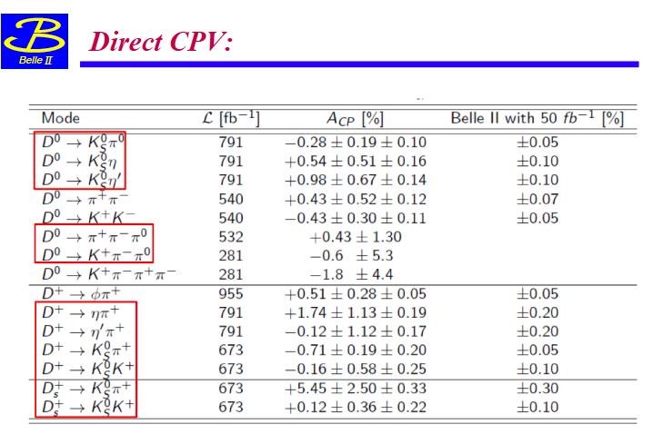
Belle II Direct CPV reach in charm and potential for NP diagnosis
(Missing entry D→π⁰ π⁰ below)
Can achieve useful sensitivity in a variety of modes. Measures individual CP asymmetries rather than differences of asymmetries. Systematics are small and can be calibrated from data.

Slide 32
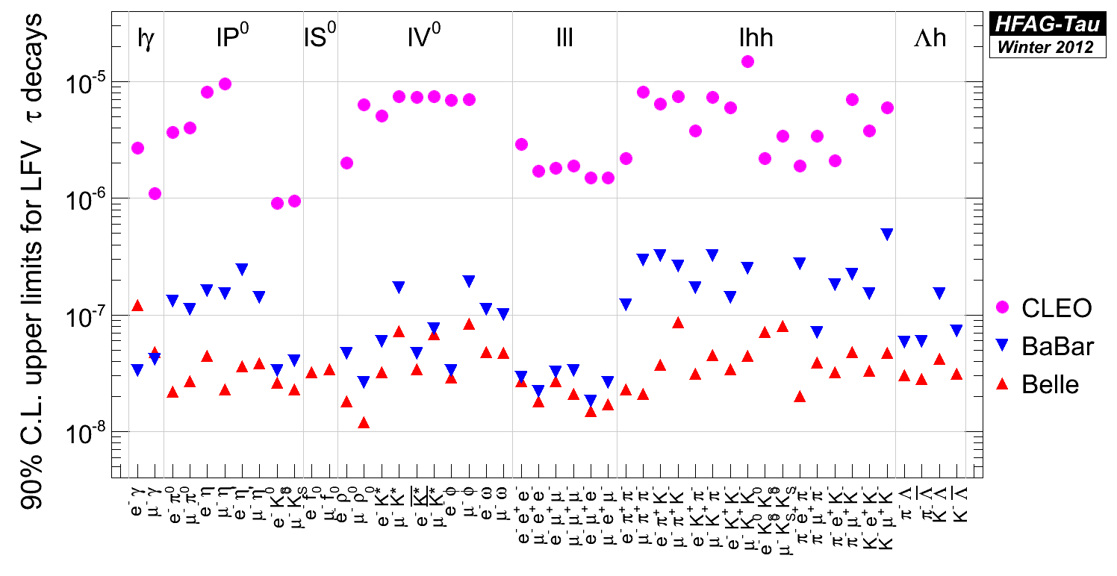
Current experimental status of tau lepton flavor violation
A Super Flavor Factory moves some of the ULs or sensitivities to the 10⁻⁹ level.

Slide 33
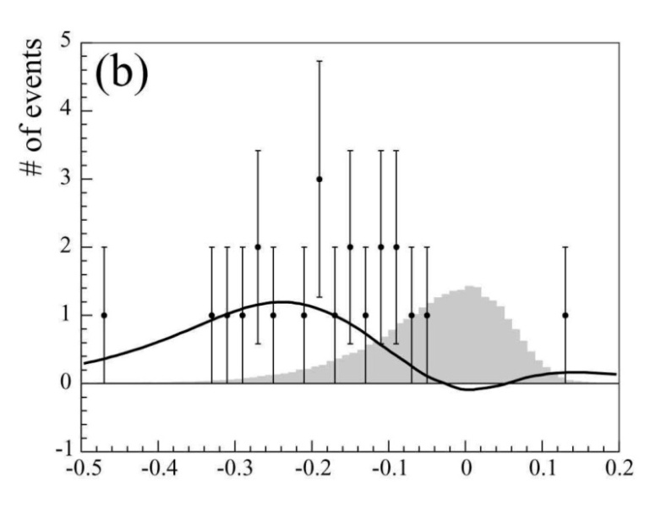
Lepton Flavor Violation in the τ sector
Find or constrain τ → μ γ
γ
expected sig.
B ∼5x10⁻⁷
Belle, PLB66, 16 (2008), 535 fb⁻¹
μ
τ
kinematic variables
for signal isolation:
ΔE=E^{CM}(μγ)-E^{CM}(beam)
M_{inv}=m(μγ)
main background from
“ISR”, which means
ee→ τ(μνν) τ(πν) γ_{ISR}
polarized beam(s) can
help in reducing this
background
(assuming SM couplings!)
e
e
τ
π
signal
ν
ν
ν
γ
μ
τ
e
e
τ
π
background
ν
N.B. Statistics limited: This is a SFF project not tau-charm

Slide 34
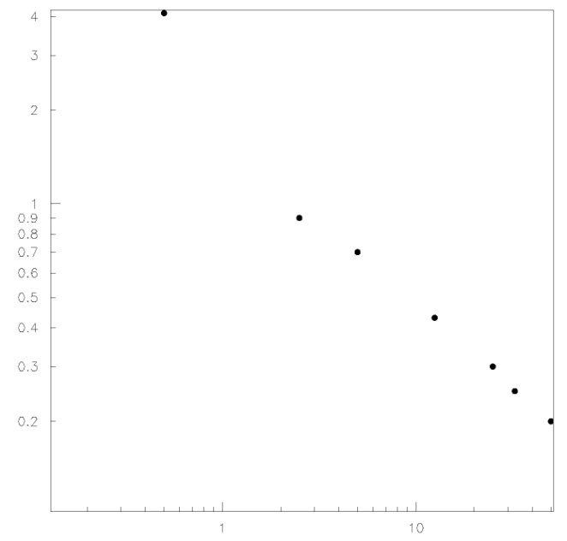
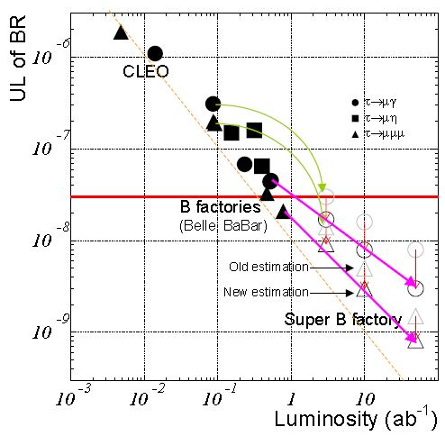
Luminosity scaling of sensitivities for τ → μ γ
UL_{90%}
B(τ → μ γ)
[10⁻⁸]
toy MC study
Search for τ → μ γ
4
2
1
0.4
0.2
w/o polarization:
UL_{90%}(B(τ → μ γ)) ∼ 3x10⁻⁹ @ 50 ab⁻¹
τ → 3l, l h⁰ decays are background free
UL_{90%}(B(τ → μ γ)) scales as 1/ L up to ~10ab⁻¹
B(τ → μ γ)<4.4 x 10⁻⁸
∼ ∝1/L
∼ ∝1/√L
0.2 1 10 L[ab⁻¹]
τ → μ γ
τ → μμμ
τ → μη
Updated
expected
sensitivities
on τ LFV decays
Belle, PLB66, 16 (2008), 535 fb⁻¹
K. Inami, PANIC 2011
(Do not have time to discuss tau CPV)

Slide 35
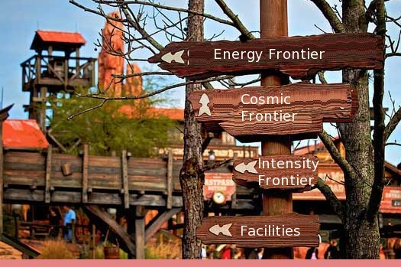
Belle II/SuperKEKB Summary
SuperKEKB/Belle II is the intensity frontier facility for B mesons, charm mesons and tau leptons.
Unique new physics capabilities and unique detector capabilities (“single B meson beam”, neutrals, neutrinos), clean environment with good systematics, which are critical for the next round of NP searches e.g. charged Higgs.)
Credit: R. Lipton

Slide 36
Backup Slides

Slide 37
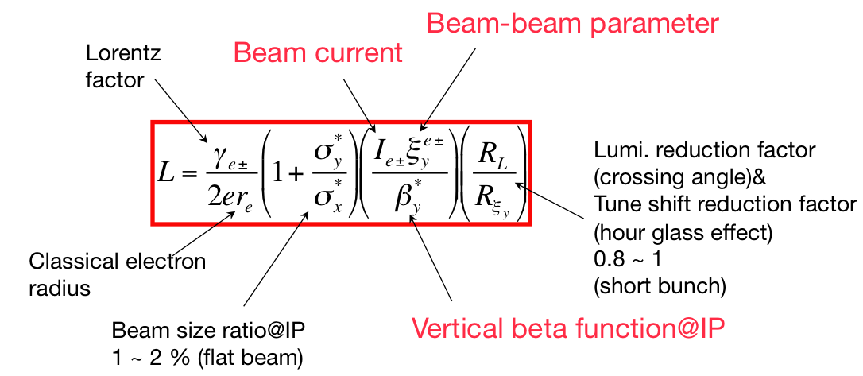
Luminosity Master Equation
-
-
Brute force: Increase beam currents by a factor of 5-10 ! Increase the beam-beam parameter by a factor of a few (crab cavities).
Too hard, too expensive (power, melt beam pipes)
Notes:
37

Slide 38
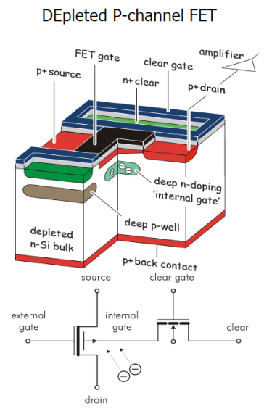
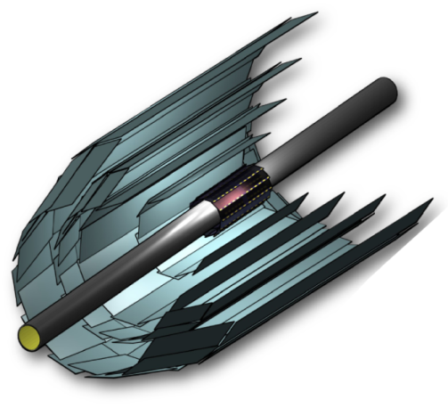
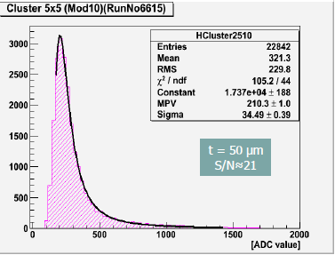
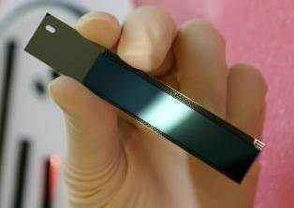
Vertex Detector
DEPFET:
http://aldebaran.hll.mpg.de/twiki/bin/view/DEPFET/WebHome
Beam Pipe r = 10mm
DEPFET
Layer 1 r = 14mm
Layer 2 r = 22mm
DSSD
Layer 3 r = 38mm
Layer 4 r = 80mm
Layer 5 r = 115mm
Layer 6 r = 140mm
Mechanical mockup of pixel detector
DEPFET pixel sensor
DEPFET sensor: very good S/N

Slide 39


SVD Mechanical Mockup
Gearing up for ladder production!

Slide 40




Belle II Central Drift Chamber
Much larger than in Belle!
Wire stringing in a clean room
thousands of wires,
1 year of work...

Slide 41





Forward endcap PID uses an aerogel ring imaging Cerenkov counter
Increases the number of photons without degrading the resolution
Data
4cm aerogel single index
2+2cm aerogel
→NIM A548 (2005) 383

Slide 42


s[mm]
Belle
In e+e- scattering at 10-11 GeV, the critical issue for vertexing is multiple scattering
Belle II’
Belle II
0
1.0
2.0
pβsin(θ)^{5/2} [GeV/c]
Significant improvement in ΔS(K_{S}π⁰γ)
γ
Ks track
π⁺ π⁻
γ
B vertex
IP profile
γ
Larger radial coverage of SVD
B decay point reconstruction
with K_{S} trajectory

Slide 43

HW Exercise
Explain the hierarchy of particle-antiparticle mixing using counting arguments with the appropriate box diagrams.
Why does the Bs oscillate faster than Bd ? Why is D mixing small ?
Which mixing diagrams involve top quark coupling constants ?

Slide 44

Homework exercises:
What is the definition of direct CPV ? How does it differ from CPV induced by mixing ?
What is the experimental evidence for direct CPV in B, B_{s} and kaon decays ?
What is the “superweak model” of Lincoln Wolfenstein ? How has it been ruled out ?

Slide 45

Belle II sensitivity for the dark sector
I. Jaegle

Slide 46

SuperKEKB TDR parameters

Slide 47



A polarized electron beam can produce polarized τ pairs. A proposal was worked out for INFN SuperB.
a)
Some basic requirements:
Polarized electron gun (like at SLC)
Operation at beam energies away from depolarizing resonances
Spin rotators to rotate the electron spin to the longitudinal direction at the IP. A machine lattice that avoids depolarizing effects from vertical bends and solenoids.
b)
c)
Not practical in initial operation of SuperKEKB (no space in straight sections). Upgrade may be possible (U. Wienands)
Slide adapated from D. Hitlin

Slide 48

Table of Belle II detector performance parameters
(Skip this slide) For reference only.

Slide 49


Unique capability
Belle data
BaBar data
In addition to excellent neutral detection from a crystal calorimeter, and good Cerenkov particle id, (Super) B-factories can fully reconstruct one B meson. This gives the equivalent of a “single B meson beam “

Slide 50

From paper by T. Hermann, M. Misiak, M. Steinhauser

Slide 51


Major achievements at Belle (enabled by each succesive jump in luminosity)
Evidence for D⁰ mixing
Observation of direct CP
violation in B g π⁺π⁻
Evidence for B g τν
Observation of b g dγ
Decisive confirmation of
Kobayashi-Maskawa model
Evidence for direct CP
violation in B g K⁺π⁻
Measurements of
CP violation in B g φKs, η’Ks etc.
Observation of CP
violation in B meson
system
Discovery
of X(3872)
Observation of B g K^{(*)}ll

Slide 52


Slide 53
Extended Higgs sector ?
The Higgs boson should have not only relatives:
But also siblings:
Haber, 2012
Branco, Ferreira, Rebelo,
Sher, Silva, arXiv:1106.0034;
Coleppa, Kling, Su, arXiv:1305.0002.
Two Higgs Doublet Model (2HDM):
rich phenomenology, Type II SUSY option
Plus a singlet:
NMSSM, solve the μ-problem, relax fine-tune, light DM.
Triplet Model:
m_{ν} , L-R symmetric theories, LH …
Ellwanger, Gunion et al., 2012
S. King et al., 2012
R. Barbieri et al., 2013, ……
Slide from a review by theory professor Tao Han at the Lepton-Photon Symposium two weeks ago.

Slide 54


Upgrade The KEKB Collider
(Tsukuba, Japan)
8 x 3.5 GeV
22 mrad crossing angle
SCC RF(HER)
Belle detector
World record:
L = 2.1 x 10³⁴/cm²/sec
ARES(LER)
Ares RF cavity
e⁺ source
Downtown Tsukuba, Izakayas

Slide 55
Belle II Detector
KL and muon detector:
Resistive Plate Counter (barrel outer layers)
Scintillator + WLSF + MPPC (end-caps , inner 2 barrel layers)
EM Calorimeter:
CsI(Tl), waveform sampling (barrel)
Pure CsI + waveform sampling (end-caps)
Particle Identification
Time-of-Propagation counter (barrel)
Prox. focusing Aerogel RICH (fwd)
electrons (7GeV)
Beryllium beam pipe
2cm diameter
Vertex Detector
2 layers DEPFET + 4 layers DSSD
positrons (4GeV)
Central Drift Chamber
He(50%):C2H6(50%), small cells, long lever arm, fast electronics

Slide 56


How to make a Super Flavor Factory
-
-
Smaller β_{y}*
(2) Increase beam currents
(3) Increase ξ_{y}
Schematic view of beam collisions with a large, 83 mrad, crossing angle.
Notes:
56

Slide 57
Compare the Parameters for KEKB and SuperKEKB
 | KEKB Design | KEKB Achieved : with crab | SuperKEKB Nano-Beam
Energy (GeV) (LER/HER) | 3.5/8.0 | 3.5/8.0 | 4.0/7.0
β_{y}* (mm) | 10/10 | 5.9/5.9 | 0.27/0.30
β_{x}* (mm) | 330/330 | 1200/1200 | 32/25
ε_{x} (nm) | 18/18 | 18/24 | 3.2/5.3
ε_{y} /ε_{x} (%) | 1 | 0.85/0.64 | 0.27/0.24
σ_{y}(μm) | 1.9 | 0.94 | 0.048/0.062
ξ_{y} | 0.052 | 0.129/0.090 | 0.09/0.081
σ_{z} (mm) | 4 | 6 - 7 | 6/5
I_{beam} (A) | 2.6/1.1 | 1.64/1.19 | 3.6/2.6
N_{bunches} | 5000 | 1584 | 2500
Luminosity (10³⁴ cm⁻² s⁻¹) | 1 | 2.11 | 80
Nano-beams are the key (vertical spot size is ~50nm !!)
This is not a typo
Y. Ohnishi et al.
Notes:
The jump from CESR to the B factories (PEP-II, KEKB) was not significant in per bunch parameters. However, the number of bunches and the beam currents were much larger. There is greater than order of magnitude reduction in beam size and emittance.

Slide 58










KEKB to SuperKEKB
Belle II
Colliding bunches
New IR
e- 2.6 A
New beam pipe
& bellows
New superconducting /permanent final focusing
quads near the IP
e+ 3.6 A
Replace short dipoles with longer ones (LER)
Add / modify RF systems for higher beam current
Low emittance positrons to inject
Positron source
Redesign the lattices of HER & LER to squeeze the emittance
Damping ring
New positron target / capture section
TiN-coated beam pipe with antechambers
Low emittance gun
Low emittance electrons to inject
To obtain x40 higher luminosity

Slide 59



Kaon/Pion(s) in an iTOP GEANT4 simulation
Based on total internal reflection of Cherenkov light.
Differences in kaon/pion time-space correlation are used. (100 ps time resolution is needed for two-body modes)
Marko Petric

Slide 60



Kaons vs pions: distributions in the iTOP
Time in ns
X position
Matt Barrett

Slide 61



Belle II Detector
Detection of muons and KLs: Endcap RPCs and two layers of the barrel have to be replaced with scintillators to handle higher backgrounds (mainly from neutrons).
K_{L} and muon detector:
Resistive Plate Counter (barrel)
Scintillator + WLSF + MPPC (end-caps + barrel 2 inner layers)
Detectors to be installed this fall and in spring 2014

Slide 62
SuperKEKB/Belle II schedule
Calendar
2010
2011
2012
2013
2014
2015
2016
2017
・・・
Japan FY
2010
2011
2012
2013
2014
2015
2016
2017
・・
Mar. 2013
Jan. 2015
SuperKEKB construction
Detector upgrade to Belle II
SuperKEKB operation
Belle II roll in
QCS install
VXD install
Belle roll out
KEKB
operation
Dismantling KEKB
Accelerator tuning
BEAST
Fabrication and tests of ring components
Physics run
Install and set up
Electricity and cooling facility
MR & DR buildings
DR tunnel
Upgraded Linac operation
for SuperKEKB, PF, PF-AR
Linac
Linac upgrade / operation for PF&PF-AR

