Slide 1
Silicon Photomultipliers for Intensity Frontier Experiments
Adam Para, Fermilab
Snowmass on the Mississippi
August 2, 2013

Slide 2
‘Silicon Photomultipliers’ a.k.a. Pixelized Photon Detectors (PPD)
Novel, very attractive photodetectors:
  Robust
  Insensitive to magnetic field
  Low operating voltage
  High Detection Efficiency
  Photon counting, high resolution
Growing number of vendors, types, formfactors:
  Which SiPM should I use for my application?
  What operating condition? How to optimize the operating conditions for a specific measurement?
For every specific experiment the detailed optimization, calibration and monitoring procedure must be developed
A general model of operation is necessary for the overall guidance and for the further improvements of the technology

Slide 3

An Unbiased Review of SiPM’s

Slide 4
Surprising Variety of SiPM’s

Slide 5
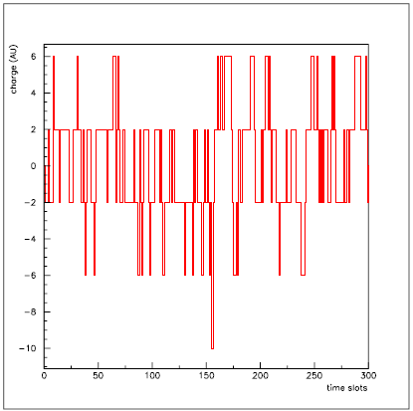
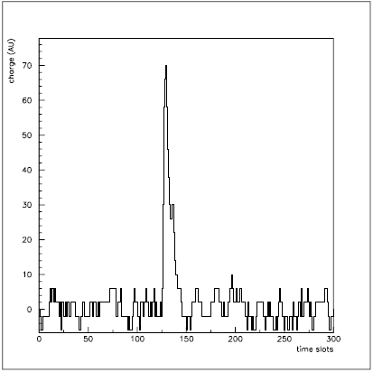
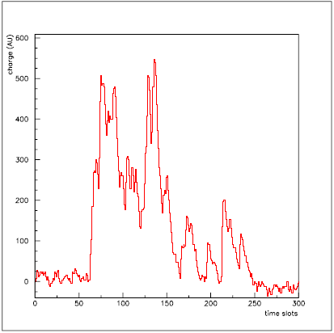
On the Importance of Bias Voltage Optimization
Event Waveform
Event Waveform
Event Waveform
Too Low Bias Voltage
Optimal Bias Voltage
Too High Bias Voltage
These are responses of a SiPM to a single photon signal
Several hundreds of miliVolts can make a very large difference to the response of the SiPM
The optimal operating point depends on the experiment in question

Slide 6
Standard Model of the PPD
There seem to be at least two parameters strongly affecting the response of the PPD to a light signal: temperature and bias voltage
The principal effect is the variation of the breakdown voltage with temperature. At the fixed overvoltage the dependence of the response with temperature is greatly reduced
Given an incoming photon:
  P_{av}(T,V) = probability that an incoming photon will start an avalanche. Amplitude of the single avalanche signal is well defined, but depends on V and T.
  A random avalanche due to a thermal electron may accompany the photon induced signal at a random time, with probability dependent on temperature and voltage R_{dark}(T,V)

Slide 7
Standard Model of the PPD II
For every produced avalanche (independent of its origin ➔ beware of non-linearities)
  P_{ap}(T,V,t-t₀) = probability that an avalanche at time t₀ will lead to another avalanche at time t. The amplitude of this avalanche is suppressed by a factor F_{sup}(t-t₀)
  P_{xtalk}(T,V) = probability that an avalanche in a pixel will induce an avalanche in a neighboring pixel (optical cross-talk). This additional avalanche occurs at ‘the same’ time as the parent avalanche
In an application where the precise measurement of the light intensity is necessary all these factors: P_{av}(T,V), R_{dark}(T,V), P_{ap}(T,V,t-t₀), F_{sup}(t-t₀), P_{xtalk}(T,V) must be known to model the response of the detector and to interpret the measured signal in terms of the number of photons. The importance of various components depends on the type of the photodetectors.
Growing number of increasingly detailed models and simulations (Delft, Sherbrook, TRYUMF, Fermilab,…). Need precise data as an input or as a cross-check

Slide 8
Afterpulses vs Cross Talk
From a perspective of an end-user almost no difference: an apparent increase of the single photon signal at the expense of additional fluctuations ➔ Excess Noise Factor, non-Poissonian fluctuations
Fundamental difference: cross talk pulse originates in a cell different that the one where the primary photon is detected, whereas the afterpulse occurs in the same cell. Requires spatial information to disentangle (CCD camera or digital SiPM)
Operational difference: cross talk occurs at the same time as the primary pulse (photon mediated), afterpulse occurs with some delay. (Some component of cross-talk can be misclassified as afterpulses)
Without the spatial or temporal (waveforms) information the measurements of cross talk and afterpulses are often entangled

Slide 9
Temperature!
Behaviour of the SiPM’s is a convolution of many effects (PDE, dark rate, afterpulses, recharge,..) It is usually very difficult to provide a reliable measurement of a single factor/function
Many of these effects are strong functions of the operating temperature ➔ temperature scan provides a strong constraint, or allows to eliminate some effects from the measurement (like dark rate)
Cryogenic application (Liquid Argon?) require good understanding of the behavior of these detectors at the intended temperatures
NOTE: most of the results shown will be for Hamamatsu MPPC’s
You have to start ‘somewhere’
They have the shortest range of operating conditions, it may be interesting to understand why

Slide 10
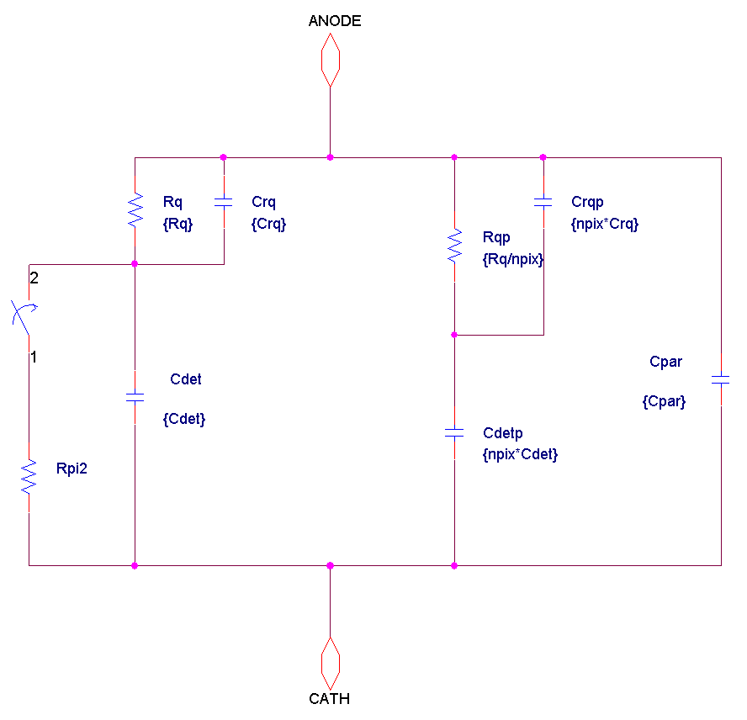
Pulse shapes of the SiPM
Observed pulse shape depends on the detector: capacitances and resistances. It also depends on the readout electronics.
Two components: fast (capacitive) and slow (resistive)
Pulse shape identical for dark pulses and for photon induced pulses
Pulse shapes independent of the bias voltage (once single avalanche pulses are selected)
Hamamatsu, 1x1 mm detector, 50 micron pixels

Slide 11
Pulse Shapes II
Pulse shapes (slow component) depends on the RC of the detector:
  different for 25, 50 and 100 micron detectors
  changes with temperature
  division on the total charge between slow and fast components changes with temperature: height of a single avalanche pulse depends on the temperature (at fixed overvoltage)

Slide 12
‘Single pe’ as a Function of Temperature
‘Single pe’ is often used to define ‘gain’ of the device.
‘single pe’ defined for a measurement related to a total charge of a single avalanche signal is nearly independent on the temperature
‘single pe’ defined via the amplitude of the signal depends strongly on the temperature
the difference between these two measures reflects the variation of the actual shape of the signal, due to the variation of the value of quenching resistance.

Slide 13
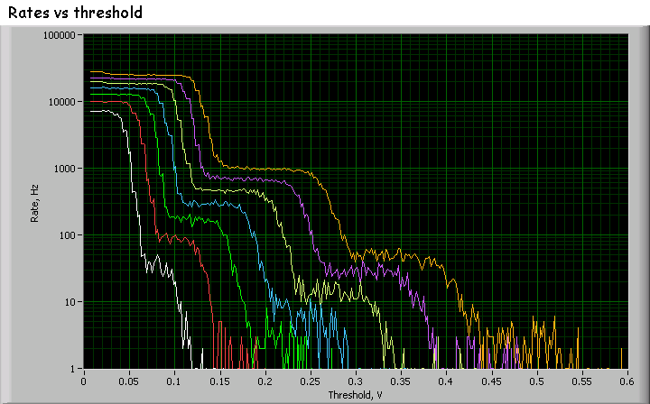
Cross Talk Measurement
Given the dark current rates, the rate of accidental coincidences of two thermally-induced avalanches is very low
The primary source of pulses with double (triple) height is the optical cross talk from the primary avalanche
The ratio of rates of double-to-single avalanche pulses is a direct measurement of cross-talk probability at a given bias voltage and temperature.
Puzzle: probability of 1→2, 2→3, 3→4 cross talks is nearly the same, How could that be? What does it tell us??

Slide 14
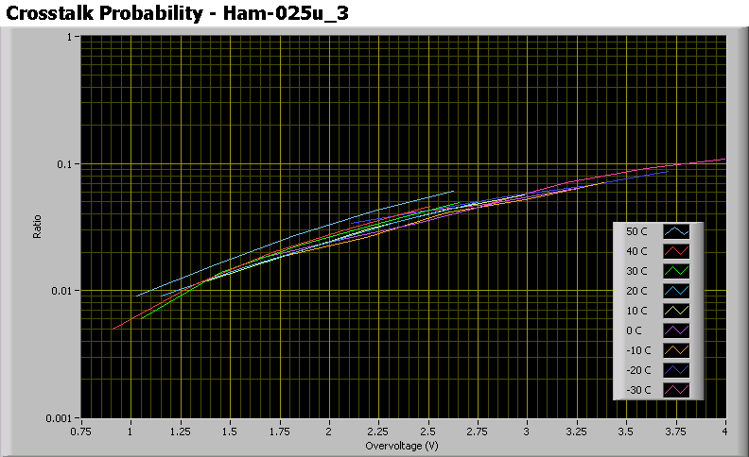
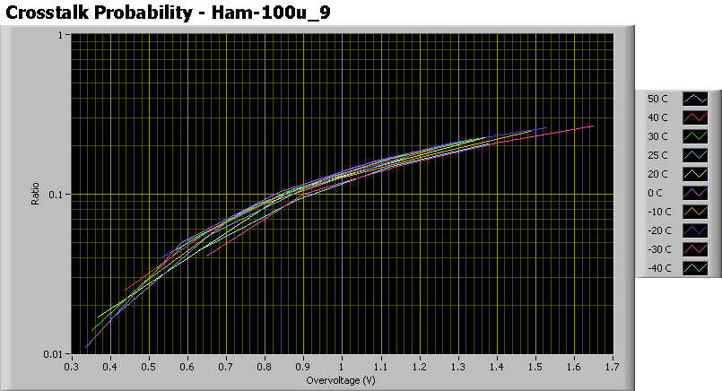
Cross-talk Probabilities
25 μ devices: cross talk in the range of few percent, at typical operating conditions
100 μ devices: cross talk at the level of 10-20% for ~ 1 V overvoltage.
Cross-talk probability does not depend on operating temperature of the device.

Slide 15
Cell Geometry and Cross Talk
At the same gain the cross-talk probability is much larger for smaller size pixels
At the operating point the Hamamatsu detectors have very small cross talk (~few %)

Slide 16
Detection Efficiency
PDE = Geometry (fill factor) x Quantum Efficiency (wavelength) x Geiger probability
Absolute detection efficiency is difficult to measure (coming, though)
detection efficiency is often mis-measured because of afterpulses and cross-talk
Detection efficiency varies strongly with bias voltage/overvoltage (Hamamatsu 1x1 mm, 25 micron shown here)
At fixed overvoltage there is a residual dependence of the detection efficiency on the temperature
at the typical operating voltage the PDE much smaller than the ‘maximal’ one

Slide 17
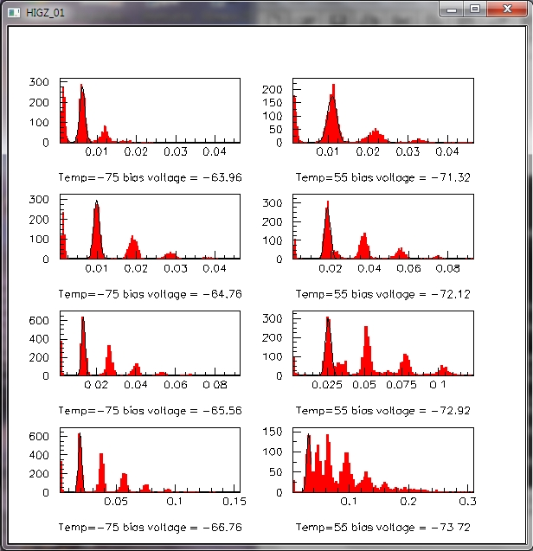
Increasing the bias voltage at different temperatures

Slide 18
Dark Pulses as a Function of Temperature
Record traces triggered on dark pulses (0.3 pe level) at different temperatures and bias voltages
Shown here: -50C, -20C, 20C and 50C at 3V overvoltage
Evidence for significant afterpulsing, increasing with temperature

Slide 19
Afterpulsing Probability as a Function of Voltage and Temperature
Total rate of afterpulses may be converted to a multiplicity of afterpulses per a parent avalanche
Afterpulsing probability increases very strongly with the bias voltage and with temperature

Slide 20
Afterpulses within 100 nsec gate
Studies limited by statistics (DAQ rate of the scope)
Data at different bias voltages summed at fixed temperature
Decay time fit at different temperatures: gives the time constant and the overall rate
dominant time constant is of the order of 5 -10 nsec
Examples shown here: -50C, -20C, 20C, 50C

Slide 21
Amplitude of Afterpulses
Amplitude of a pulse is shown as a function of time since the previous pulse
Examples of data shown at different temperatures
Clear evidence of the reduction of the pulse height during the pixel recovery time
Recovery time varies with temperature (as the result of the variation of the value of quenching resistor)

Slide 22
Summary (I)
TheSiPM’s are coming of age. They are interesting devices but they have little to do with photomultipliers. In fact they are silicon implementations of RPC’s.
Afterpulsing and crosstalk are major detrimental factors affecting the precision of the measurement (Excess Noise Factor).
It is a principal origin of a strong sensitivity of the SiPM’s on the bias voltage
Its importance depends on the specific design: shorter the recovery time more serious the afterpulsing is.
Major progress in the design/fabrication technology. Recent models have these factors greatly reduced.

Slide 23
SiPMs for Intensity Frontier experiments
High rate, high precision experiments. Excellent timing and energy resolution, high detection efficiency. Compact size enabling novel detector geometries.
g-2
Mu2
ORKA:
  Kaon stopping target
  Pion stopping range stack
  Photon Veto system
In addition: CMS upgrade phase 1 and 2. A lot of R&D, evaluation, readout electronics developments (QIE11).

Slide 24
Principal role of SiPMs
g-2: cherenkov light readout from PbF2 crystals. Two shower time resolution
Mu2e: efficient detection of MIPs, over a very large area, with decent timing (better than 5ns) in the possible presence of significant radiation.
ORKA: pion stopping target- High precision energy resolution, high timing resolution, high photon detection efficiency, large dynamic range, fast multi-particle resolution for assisting photon veto system
ORKA: photon veto – low noise (dark count rate), very good time resolution 25 psec.

Slide 25
Numbers/Formfactors
g-2: 1300 3x3 mm² or 9 x 1300 1 mm² (capacitance ←→ timing resolution). Coupled directly to a crystal, perhaps with a light concentrator. 50 microns pixel
Mu2e: fiber coupled, probably ~1.5 mm diameter, 18K pieces
ORKA: pion stopping 4-11 K detectors, depending on the details of the design 1x1 mm2 or 3x3 mm2, 50-100 micron pixel
ORKA: photon veto 21K-43 K, 50-60 micron pixels, 2500-3200 pixels/detector

Slide 26
Spectral sensitivity
g-2: UV/blue (Cherenkov)
Mu2e: WLS => red sensitive
ORKA: pion stopping: 400-50 nm
ORKA: photon veto: green WLS fibers (~500 nm)

Slide 27
Radiation Hardness Requirements
g-2: modest
Mu2e: ~1e9 n/cm (1MeV equivalent)
ORKA: pion stopping: probably not an issue
ORKA: photon veto. Potential problem at small angles, not yet evaluated

Slide 28
Vendors/Contacts
g-2: Hamamatsu, ST, SENSL
Mu2e: HPK, Advansid (baseline), Ketek
ORKA: pion stopping: Hamamatsu, SENSL
ORKA: photon veto: FBK

Slide 29
Comments/Observations
Very different stages of design/readiness (opportunity for transfer of the information, optimization?)
Diversity of applications/experiment driven optimizations
Large body of experience from the ongoing projects (T2K, CALICE, CMS, Proton CT, test beams) provides very helpful guidance.
Major progress in the optimization of the performance of the SiPM’s (very low dark count noise, optimization of the spectral sensitivity, formfactors ←→ Optimization of the design of the experiment.
Very large numbers of detectors to be deployed ➔ need for high throughput facilities for characterization/quality control.
Light capture/transport: fibers vs direct coupling. Light concentrators?
Calibrations and monitoring: keep the temperature or adjust the bias voltage?
Readout electronics: test setups (opportunities for small business SBIR?)vs large scale (ASICS)
Sharing the experience and solution? Periodic working and show and tell meetings? Coordinated test and evaluation campaigne?

