Slide 1
Nu 6 Astrophysical Neutrinos
Conveners:
Kara Hoffman, University of Maryland
Cecilia Lunardini, Arizona State University
Nikolai Tolich, University of Washington

Slide 2
Neutrinos in the early Universe
Neutrinos contribute to cosmic radiation
Data from cosmic microwave background and relic abundance of light elements: compatible with Standard Model
Extra radiation allowed/favored: room for sterile neutrinos
Krauss, Lunardini & Smith, arXiv:1009.4666

Slide 3
Neutrinos contribute to dark matter
Light mass dampens structures at small scales
Reaching ~ 0.1 eV sensitivity would probe the mass hierarchy
Jimenez et al., JCAP 1005:035,2010

Slide 4
Cosmological data can probe new neutrino physics
New interactions, new properties
The “Holy Grail”: is the direct detection of relic neutrinos possible?
Prototypes are exploring zero-threshold inverse beta decay

Slide 5
Solar neutrinos
Answers to the following questions could change our understanding of the formation of the Solar System and the evolution of the Sun:
what is the total solar luminosity in neutrinos?
Requires precise measurements of pp or pep neutrinos
what is the metallicity of the Sun’s core?
Possible with precise measurements of CNO neutrinos
Ideal probe for studying neutrino oscillations
Precise measurements of pep neutrinos would be very sensitive to nonstandard physics.
An observation of a day-versus-night difference would conclusively demonstrate the so-called MSW effect.

Slide 6
Geoneutrinos
Measurements of the geoneutrino flux will determine the amount of heat-producing elements in the earth, which is currently only estimated through indirect means.
KamLAND and Borexino measurements have already ruled out some earth models.
More detectors are required to disentangle local variations
Ideally with some on the ocean floor to measure the mantle contribution.

Slide 7
Supernova neutrinos
Supernovae play a key role in the history of the universe and in shaping our world.
Supernova neutrinos record information about processes in the center of the explosion, allowing us to study the equation of state of the nuclear/quark matter in extreme conditions.
Supernovae provide a source for understanding neutrino interactions and oscillations in regimes inaccessible on Earth.
Supernova in our galaxy are relatively rare (1-3 per century)
To maximize physics from a burst, flavor sensitivity and time evolution are critical.
The flux of neutrinos from all supernovae in cosmic history (DSNB) yields more limited, but complementary, information.

Slide 8
Liquid scintillator detectors
Low background liquid scintillator detectors like Borexino and SNO+ are sensitive to solar neutrinos from the pep reaction and the CNO cycle.
The proposed LENS experiment would precisely measure the entire solar neutrino energy spectrum.
Liquid scintillator detectors are the only existing or proposed geoneutrino detectors.
Liquid scintillator detectors are sensitive to supernova neutrinos, primarily electron anti-neutrinos through neutron inverse beta decay, but also non-electron neutrinos through proton scattering provided their thresholds are low enough.
Large enough detectors could measure the DSNB.

Slide 9
Cherenkov detectors
The SuperK and SNO experiments have measured the ⁸B solar neutrinos flux and neutrino oscillations to better than 5%.
The proposed HyperK detector would measure the solar neutrino day versus night asymmetry with a significance better than 4σ.
Hyper-K would observe ∼250,000 interactions from a core collapse supernova at the galactic center, allowing for very sensitive study of the time evolution of the neutrino signal.
The addition of Gd to the Super-K or Hyper-K detectors would allow for the study of DSNB within the range of most predictions for the total flux.

Slide 10
Liquid argon detectors
Unlike other supernova detectors, which are primarily sensitive to anti-electron neutrinos, the principle signal in a liquid argon detector would be due to electron neutrino interactions.
For a supernova at 10 kpc approximately 1000 events would be expected per 10 kton of liquid argon.
Critical to site detector underground.

Slide 11
Low energy expt summary
Type | Exp. | Loc. | Size (kton) | Status | Solar | Geo | SN
Scint. | Borexino | Italy | 0.3 | Oper. | ** | ** | *
Scint. | KamLAND | Japan | 1 | Oper. | ** | ** | *
Scint. | SNO+ | Canada | 0.8 | Cons. | ** | ** | *
Scint. | RENO-50 | South Korea | 10 | R&D | * | * | **
Scint. | JUNO | China | 20 | R&D | * | * | **
Scint. | Hanohano | TBD (USA) | 20 | R&D | * | ** | **
Scint. | LENA | TBD (Europe) | 50 | R&D | * | ** | **
Scint. | LENS | USA | 0.12 | R&D | ** |  | *
Cher. | SuperK | Japan | 50 | Oper. | ** |  | **
Cher. | IceCube | S. pole | 2000 | Oper. |  |  | **
Cher. | HyperK | Japan | 990 | R&D | ** |  | **
LAr | LBNE | USA | 35 | R&D | * |  | **

Slide 12
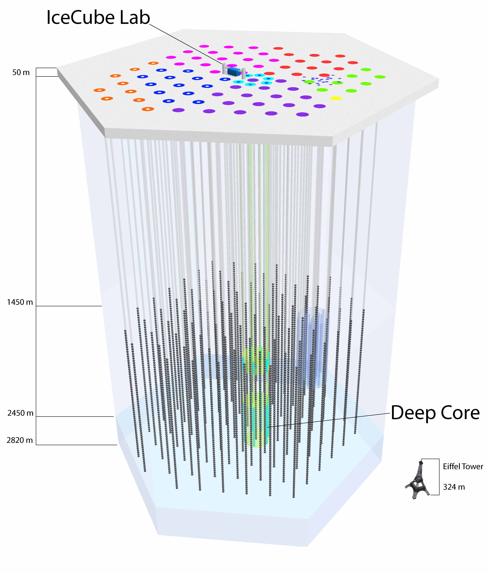
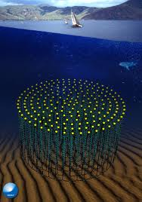
High Energy Neutrino Telescopes
The first kilometer scale neutrino telescope is now taking data, with new facilities planned

Slide 13
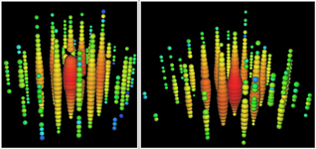
Highest energy neutrinos ever observed!
IceCube has seen events in excess of a PeV

Slide 14
An astrophysical flux?
Flavor composition
Energy spectrum
Zenith distribution
No accompanying air showers
All incompatible with background.
>4 σ effect….so far
Compatible with an approx. E-2 spectrum with an apparent cutoff around 10 PeV

Slide 15
Implications of an astrophysical flux
Still no source identified
Needs more data/observation
IceCube would expect ~100 events in 10 years
Flavor composition interesting for both particle physics and astrophysics
Could benefit form a low density IceCube extension or an air shower veto extension

Slide 16
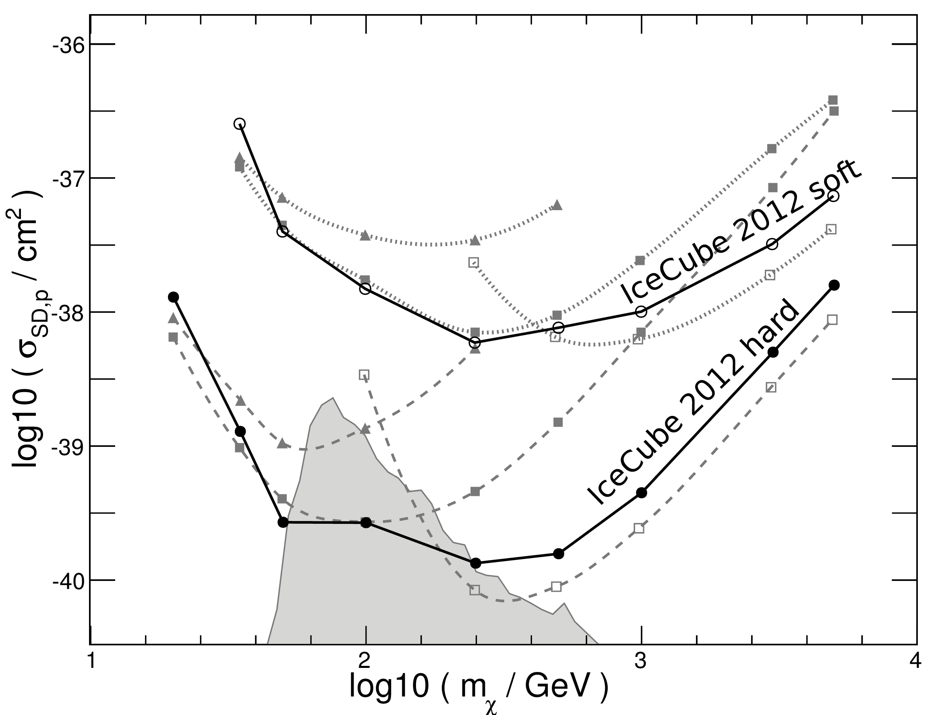
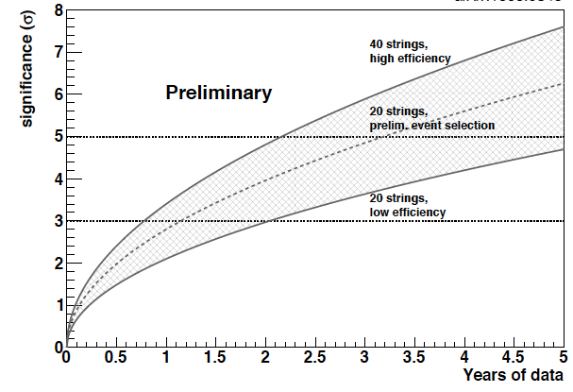
Niche for Neutrino Telescopes in Particle Physics
Neutrino Telescopes are generally proving to be general purpose facilities, with infill arrays extending sensitivities to indirect dark matter searches, as well as allowing neutrino oscillation analyses
ICECUBE/DEEP CORE DARK MATTER SEARCHES- WIMP annihilations in the Sun
NEUTRINO MASS HIERARCHY WITH PINGU
M. G. Aartsen et al., Phys. Rev. Lett. 110 (2013) 131302.
ArXiv: 1306.5846

Slide 17
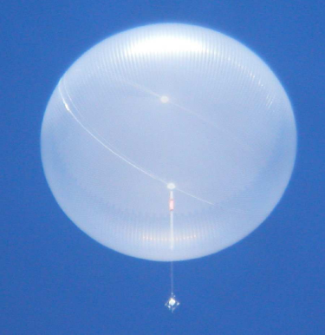
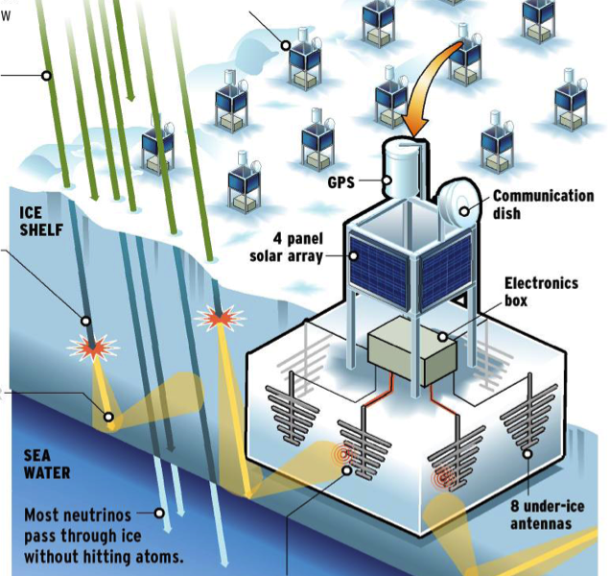
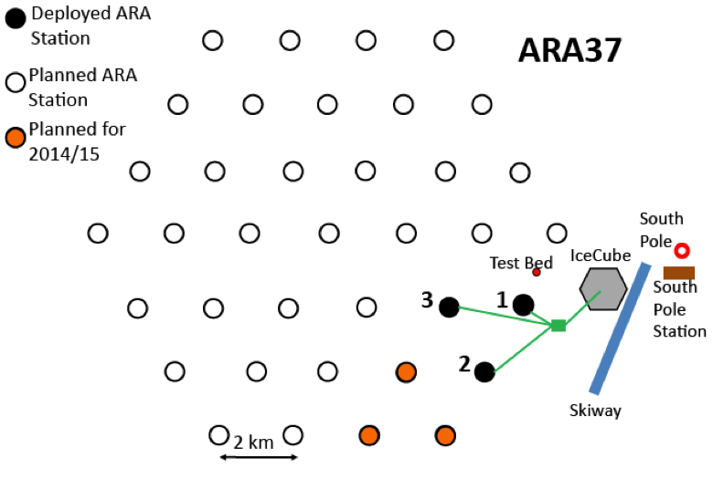
Askaryan Arrays detection of RF impulses from neutrino interactions
Several UHE neutrino telescopes with sensitivity to GZK fluxes are in the prototyping/feasibility phase.
EVA
ARIANNA

Slide 18
Sensitivity of Next Generation GZK neutrino telescopes
Is this the steepening in the cosmic ray spectrum caused by interactions on the CMB, or are accelerators just running out of steam?
What is the compositions of cosmic rays?
Next generation UHE telescopes expected to have sensitivity to the GZK neutrino flux.

