Slide 1
Research and Development Needs in Computational Accelerator Science for the Intensity Frontier
James Amundson
and
Ioanis Kourbanis

Slide 2
Motivation: FNAL Main Injector and Recycler Upgrades
Planned upgrades to the FNAL Main Injector and Recycler provide concrete examples of simulation needs for the Intensity Frontier
  Not covered, but similar: FNAL Booster
  Not covered and different: Project-X Linac

Slide 3
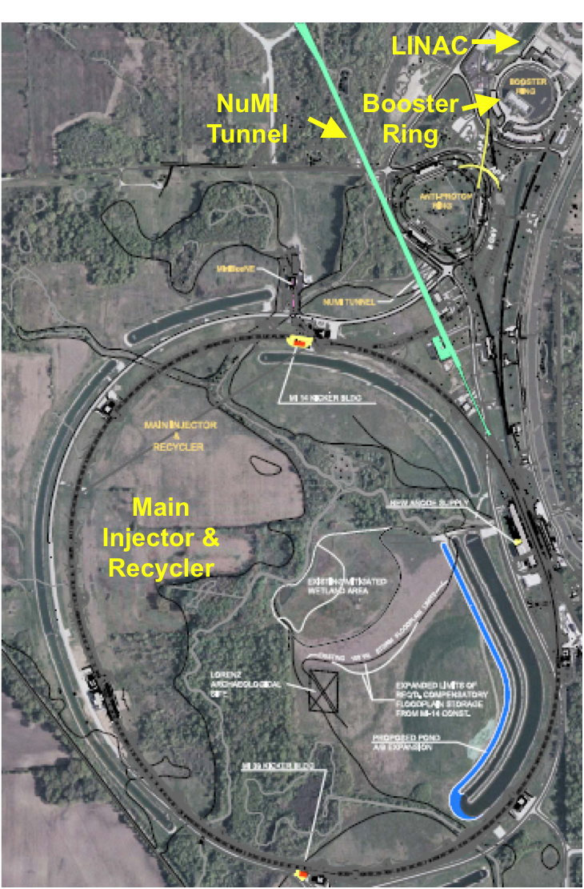
Accelerator and NuMI Upgrades for NOvA
Recycler Ring, RR
  New injection line into RR
  New extraction line from RR
  New 53 MHz RF system
  Instrumentation Upgrades
  New abort kickers
  Decommissioning of pbar components
Main Injector
  Two 53 MHz cavities
  Quad Power Supply Upgrade
  Low Level RF System
NuMI
  Change to medium energy ν beam configuration (new target, horn, configuration)
  Cooling & power supply upgrades

Slide 4
MI Injector Power vs. Energy after NOvA Upgrades

Slide 5
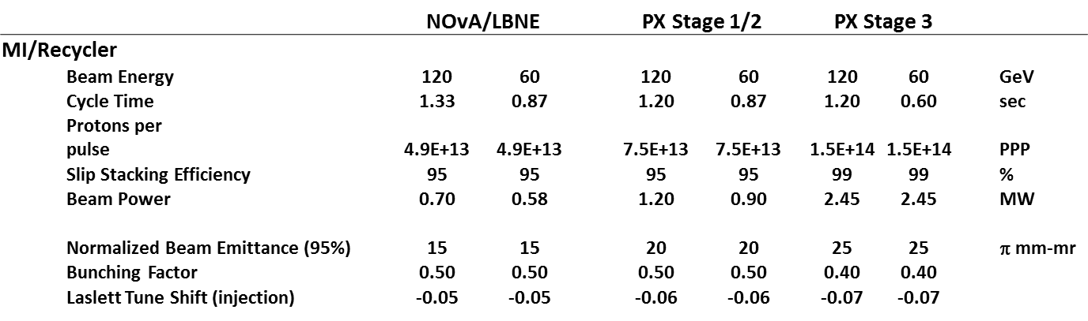
MI/RR Performance Requirements in Project X

Slide 6
MI/RR Upgrades & Modifications for Project X
H- Injection system for Recycler
New 53 MHz RF system for MI and Recycler.
  We cannot accelerate the higher beam power with the current MI RF System.
  Required even for Stage 1.
New second harmonic RF system for MI and Recycler.
  Required for improved bunching factor
Gamma-t jump for MI.
  Avoid longitudinal emittance blow-up and beam loss after transition.
E-cloud mitigation schemes.
Loss control in Recycler.
  Required for NOvA operations and Stage 1.

Slide 7
Issues with High Intensity MI/RR Operation
During slip stacking we have high intensity bunches with high negative chromaticity.
  Losses need to be understood and mitigated.
We need to understand how much space charge tune shift can be tolerated.
  Do we need a second harmonic RF system?
  How about tune spread???
    That affects beam quality and losses due to tails-> collimators, etc
Is electron cloud going to be an Issue?
  Coating of the MI/RR beam pipe is not trivial.
Need realistic beam simulations in both MI and Recycler to address these Issues.

Slide 8
Necessary R&D, studies & requirements
Accurate simulations with realistic models with at least space-charge and impedance. Study effect of space charge tune shifts/spreads
  need them to run long (0.5 s) so you can characterize losses
  Need many runs to try different operational parameters for losses.
  Need the models to be benchmarked and verified with beam measurements (ASTA, UMER,…)
  Need to simulate and understand losses to E-4 level (beam halo, i.e beam distribution to ~10 sigma)
Continue the EC simulations and measurements.
Study different mitigation systems for SC
  Simulation, measurements
  Consider new mitigation techniques both experimentally and with simulation (such as electron lens) both experimentally (ASTA) and with simulation.

Slide 9
Basic simulation requirements
Accurate space charge model
Accurate wakefield model
Electron cloud generation model
Electron cloud-beam dynamics model
Long-term tracking
  At least 1e5 turns
Single- and multi-bunch simulations

Slide 10
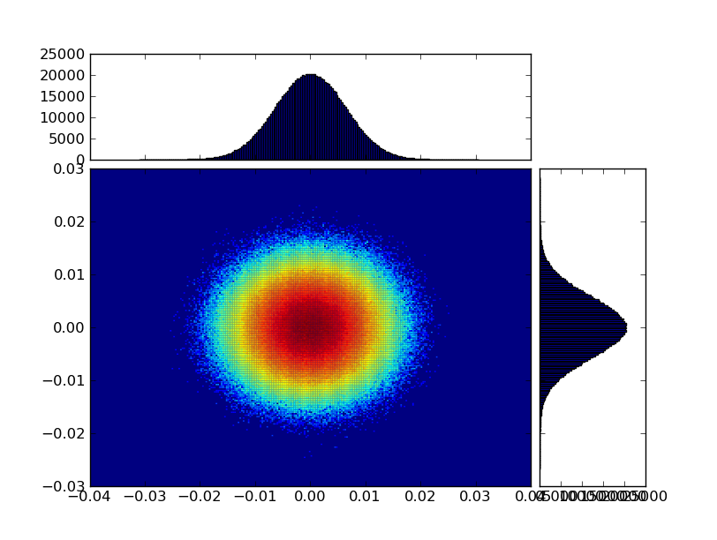
Particle-in-Cell (PIC) for Beam Dynamics
  Internal + External fields
    External field calculations trivially parallelizable
      All P, no IC
    Internal fields
      Require calculations on grids
  Minimal bunch/field structure
    Grids have limited d.o.f.

Slide 11
Scaling achievements to date in beam dynamics
Current beam dynamics simulations can take advantage of current supercomputing resources

Slide 12

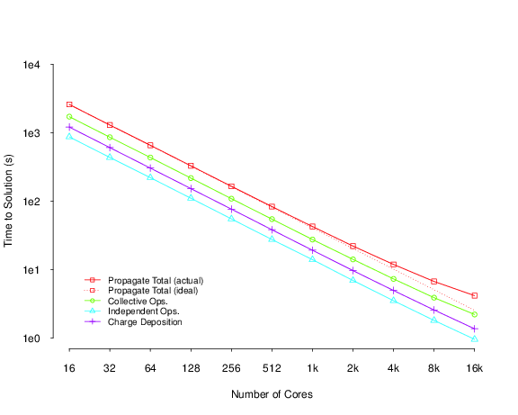
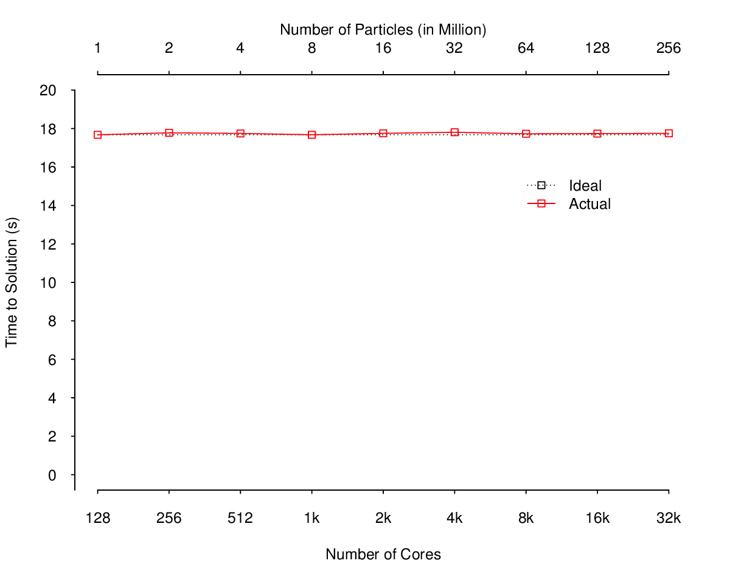
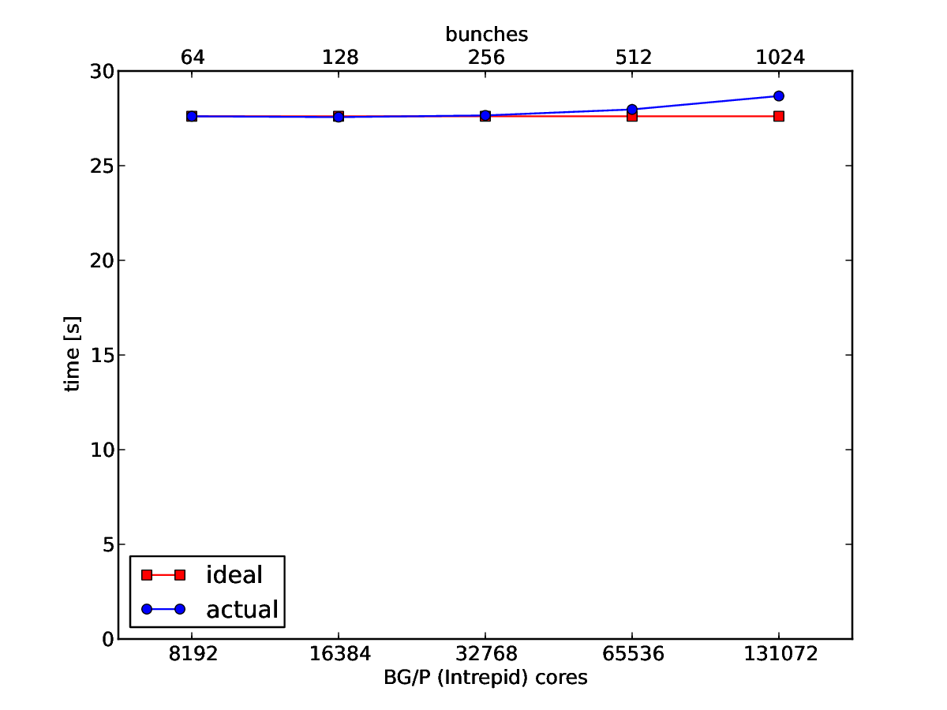
Beam Dynamics: scaling achievements
Synergia
  Single- and multiple-bunch simulations
Scaling results on ALCF machines: Mira (BG/Q) and Intrepid (BG/P)
Weak scaling from 1M to 256M particles
128 to 32,768 cores
Weak scaling from 64 to 1024 bunches
8192 to 131,072 cores
Up to over 10¹⁰ particles
Single-bunch strong scaling from 16 to 16,384 cores
32x32x1024 grid, 105M particles

Slide 13

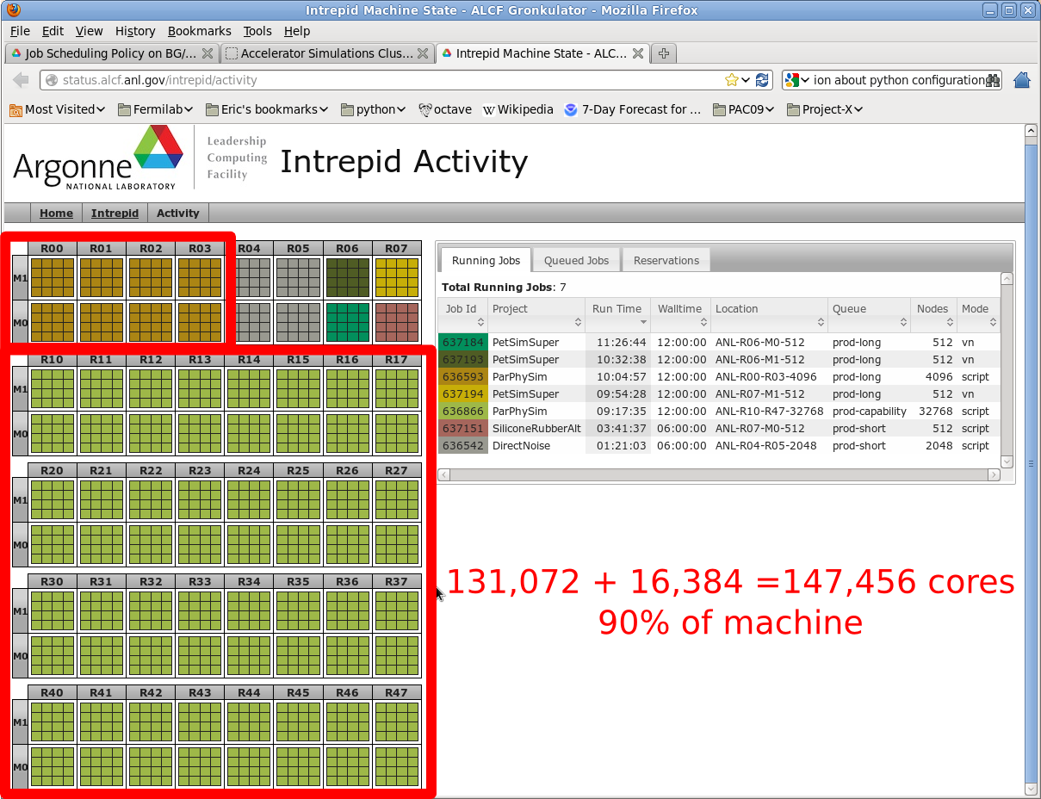
Synergia in production

Slide 14
Scaling challenges in Synergia
Challenge: beam dynamics simulations are big problems requiring many small solves
  Typically 64³ – 128³ (2e5 – 2e6 degrees of freedom)
    Compare with 2.5e10 in OSIRIS scaling benchmark
  Will never scale to 1e6 cores
  Need to do many time steps (1e5 to 1e8)
  Difficult problem for supercomputers
    Good at wide, bad at wide

Slide 15
Synergia: scaling advances
Eliminate particle decomposition
Breakthrough: Redundant field solves (communication avoidance)
  Field solves are a fixed-size problem
    Scale to 1/n^{th} of problem
  Fields are now limited to a small set of cores, so the latter is greatly reduced
  Allows scaling in number of particles
    Not limited by the scalability of the field solves
    Excellent (i.e., easy) scaling

Slide 16
Synergia: large numbers of particles
Many reasons to use more particles and/or more complex particle calculations
  Accuracy of long-term simulations
    Statistical errors in field calculations become more important as the number of steps increases
  Detailed external field calculations
    Significant feature of Synergia
    Application-dependent
  Accurate calculation of small losses
    High-intensity accelerators require very small losses
      Calculating 1e-4 losses at 1% requires 1e8 particles
        Per bunch(!)

Slide 17
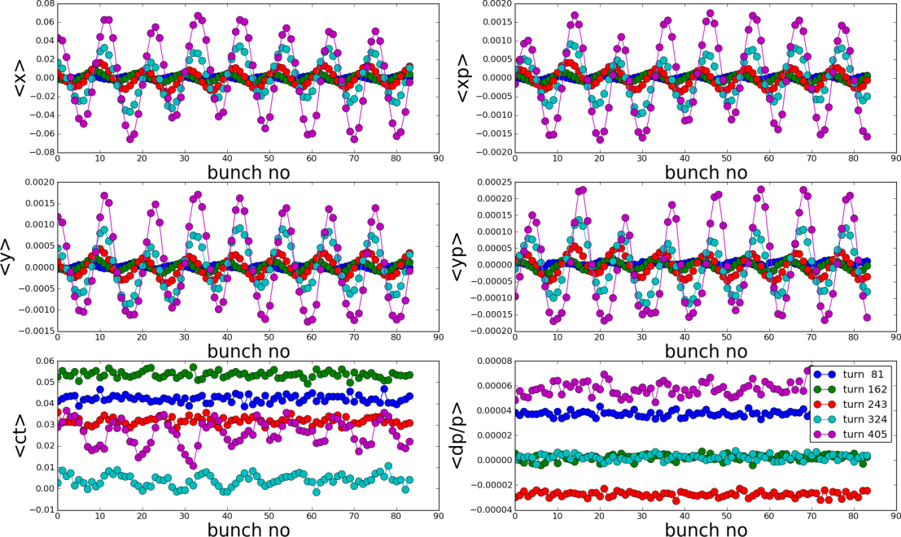
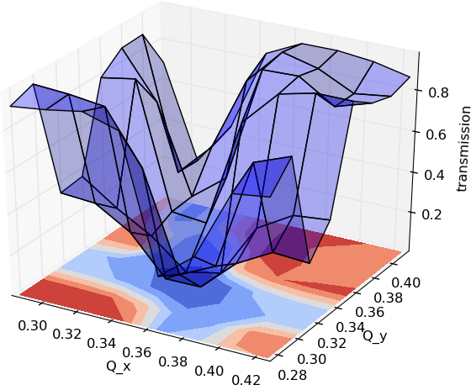
Synergia: new scaling opportunities
Multi-bunch wakefield calculations
  Excellent scaling
    Bunch-to-bunch communications scale as O(1)
      Also relatively small
  Already discovered multi-bunch instabilities in the Fermilab Booster
    Not accessible with “fake” multi-bunch
Parallel sub-jobs
  Parameter scans, optimization
  Part of our workflow system
    Makes it easier on end user
    Avoids error-prone end user editing of job scripts

Slide 18
Synergia: scaling final
Scaling advances are the product of many factors
  Redundant solves (communication avoidance) (x4-x10)
    Every simulation
  Large statistics (x1-x1000)
    Some simulations
  Multiple bunches (x1-x1000)
    Some simulations
  Parallel sub-jobs (x1 – x100)
    Some simulations
Product can be huge (x4 – x1e8)

Slide 19
Computing R&D for near future
GPUs and multicore architectures

Slide 20
Computing R&D for near future
GPUs and Multicore
  Shared memory is back!
  Some things get easier, some harder
    Charge deposition in shared memory systems is the key challenge
Multi-level parallelism very compatible with our communication avoidance approach

Slide 21
Charge deposition in shared memory
  One macro particle contributes up to 8 grid cells in a 3D regular grid
Collaborative updating in shared memory needs proper synchronization or critical region protection
CUDA
No mutex, no lock, no global sync
Atomic add – yes, but not for double precision types
OpenMP
#pragma omp critical
#pragma omp atomic
Both very slow

Slide 22
Charge deposition in shared memory – solution 1
T 1
T 2
T 3
T 4
T n
Parallel reduction
Each thread has a duplicated spatial grid, and charges will be deposited to that grid only
Parallel reduction among all n-copy of spatial grids
CUDA
Concurrency be an issue for GPU
Memory bottleneck at final reduction
OpenMP
Works well at 4 or 8 threads
Scales poorly at higher thread counts

Slide 23
Charge deposition in shared memory – solution 2
Sort particles into their corresponding cells using parallel bucket sort
Grid cells
List of particles
Deposit based on color-coded cells in an interleaved pattern (red-black)
CUDA
High thread concurrency
Good scalability, even the overhead shows reasonable scaling
No memory bottleneck
Better data locality at pushing particles
OpenMP
Non-trivial sorting overhead for low thread counts

Slide 24
Charge deposition in shared memory – solution 2
Grid level interleaving
Iteration_1
Iteration_2
Iteration_3
Iteration_4

Slide 25
Charge deposition in shared memory – solution 2
Thread level interleaving
Step 1:
Deposit at
x=thread_id
Sync-barrier
Step 2:
Deposit at
x=thread_id+1

Slide 26
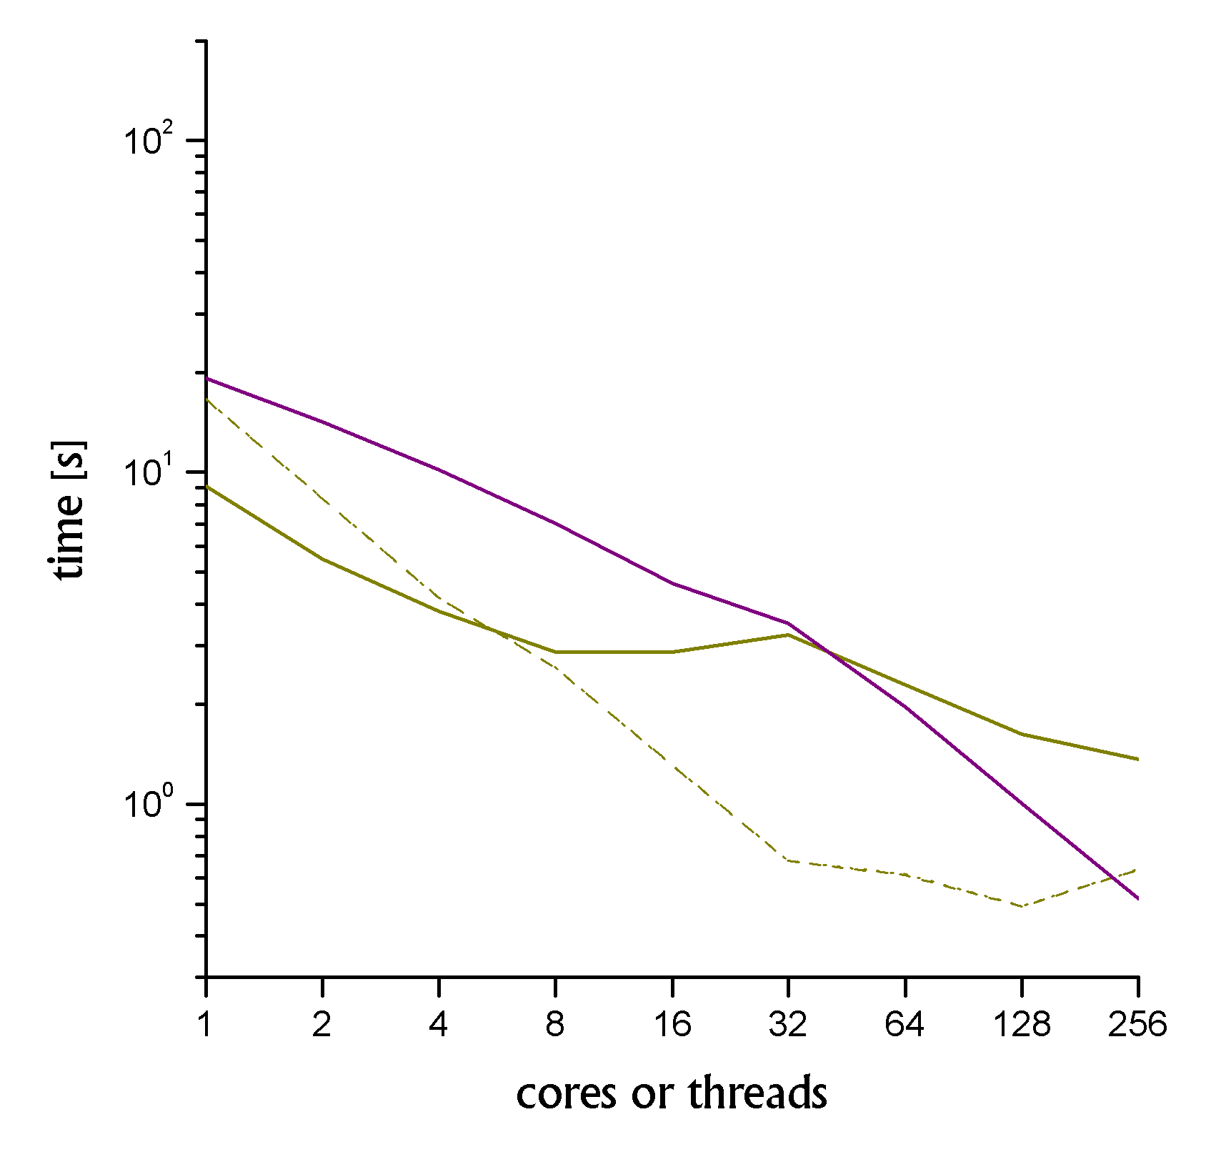
BD: GPU and multicore results
OpenMP results
GPU results
Node
boundary
Scheme 1
Scheme 2

Slide 27
Algorithmic R&D
Algorithmic R&D is necessary to meet future computational accelerator science needs
  Faster single-bunch simulations
    Better scaling
  More accurate field calculations
    Including boundary conditions
Build upon recent advances
  Especially communication avoidance

Slide 28
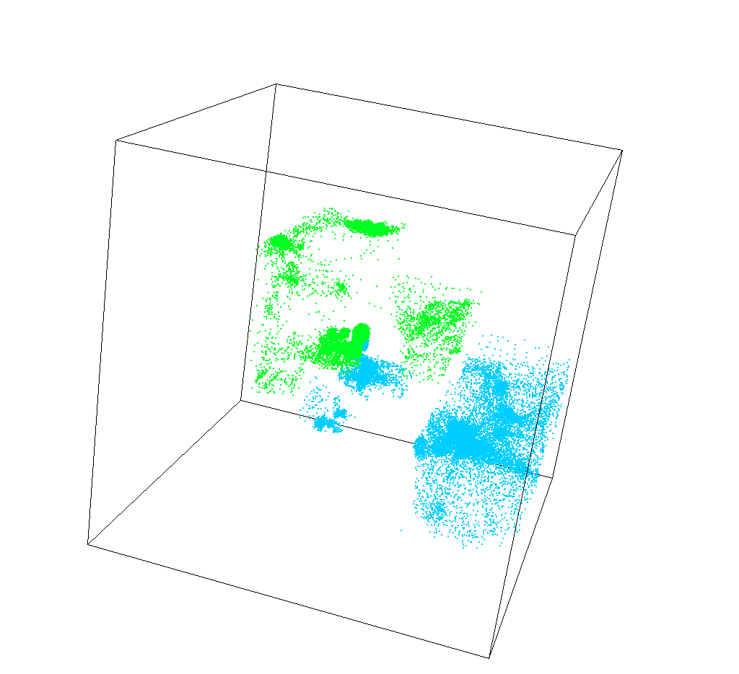
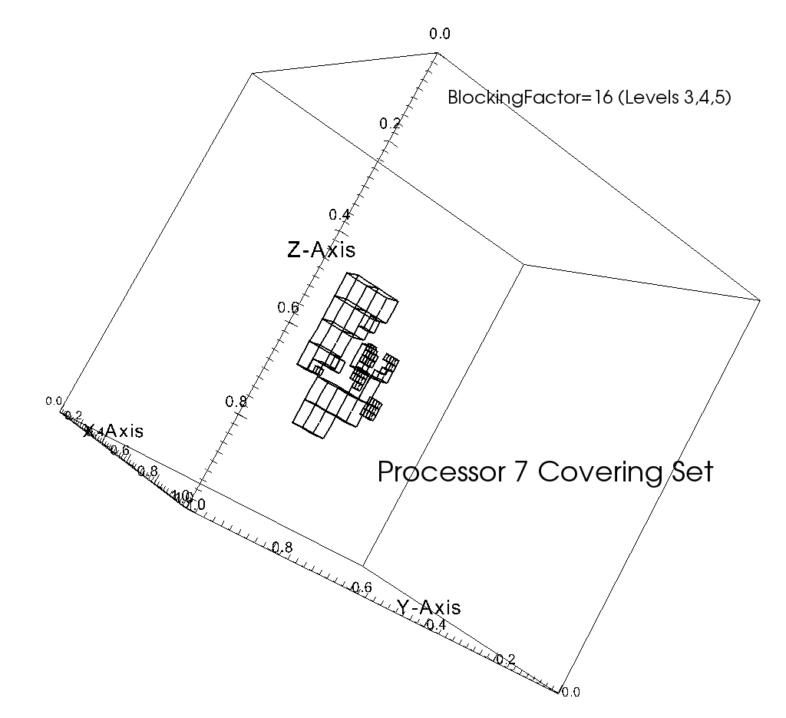

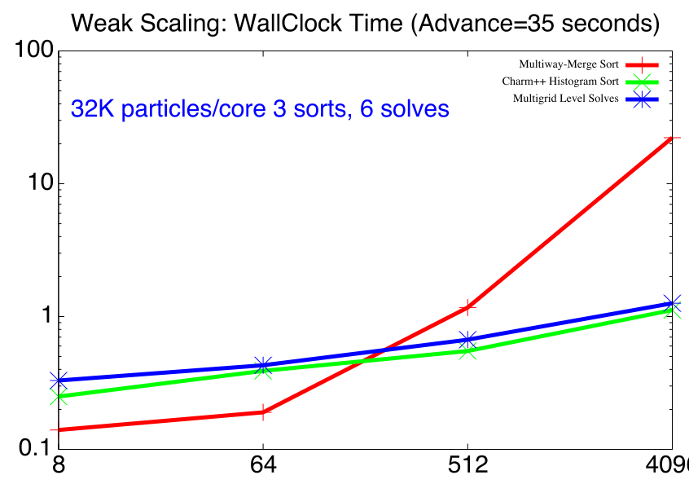
Computing R&D in algorithms: two-grid schemes for PIC
Using the same domain decomposition for the field solve grids and for the particle deposition results in load imbalance.
For simulations for which the are a large number of particles per grid cell, we perform field solves and field-particle transfers with different grids.
Particles handled with sorted space-filling curve, transfers to local “covering set” grids (distributed sorting can be hard!)
The transfer between the two sets of grids is done efficiently, since the amount of field data is small relative to the particle data.

Slide 29
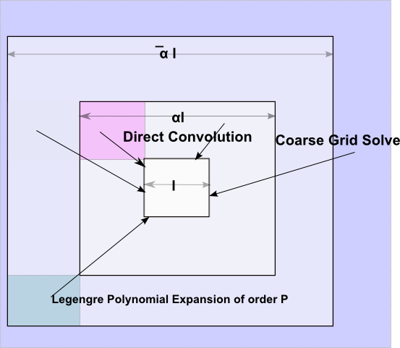
Computing R&D in algorithms: method of local corrections
Potential-theoretic domain -decomposition Poisson solver compatible with AMR grids
One V-cycle solver
  Downsweep: build RHS for coarser grids using discrete convolutions and Legendre polynomial expansions
    exploits higher-order FD property of localization
    Convolutions performed with small FFTs and Hockney 1970
  Coarse solve
    Either MLC again, or FFT
  Upsweep
    Solve for Φ_{h} on boundary of patch
    Interpolation and summations
    Local Discrete Sine Transform Solve
No iteration, accurate, no self-force problems, large number of flops per unit of communication (messages and DRAM).

Slide 30
R&D needs for the coming decade
Physical models
  Space charge and wakefield computations are available for today’s needs
  Higher accuracy field solves will be required for long-term tracking and detailed losses
    Better treatment of boundary conditions
  Detailed models of beam dynamics in the presence of electron clouds not yet available
    Better cloud development models will also be necessary
Computational hardware requirements
  Current simulations are already filling today’s supercomputers
  Detailed models will scale with future hardware developments
Computational algorithm requirements
  In the near term (next five years) GPU and multicore optimizations will be required to take advantage of new supercomputing hardware
    Need to move from prototype stage to production
  In the long term (next ten years) algorithmic developments are needed
    Better scaling
    Higher accuracy
    Better single-bunch performance

