Slide 1
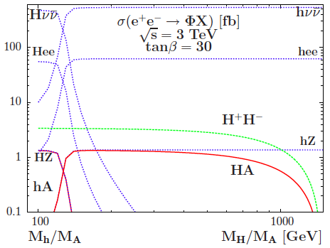
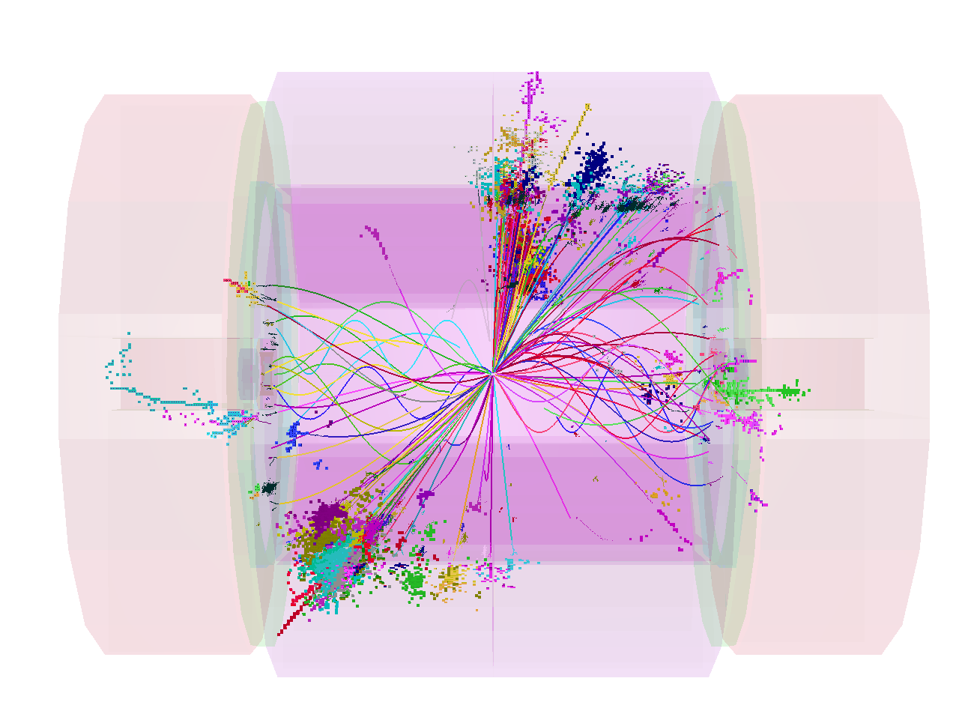
Heavy Higgs I
Heavy Higgs pair production
leaves a clear signature at CLIC
Cross sections ~1 fb
Sensitivity up to close to the
kinematic limit
CLIC with 2 ab⁻¹ at 3 TeV:
highly competitive for
search & measurement
Studies (see CLIC CDR)
with full G4 simulation
+ full event reconstruction
Including beam backgrounds
e.g.

Slide 2
Heavy Higgs II
Studies in CLIC CDR use two example SUSY models
with 750 GeV and 900 GeV (near degenerate) heavy Higgs states
multi-jet final states and
b-tagging + reconstruct di-quark invariant masses
large signal above SM background
2 ab⁻¹
Sensitivity up to
Mass measurement precision ~ 0.3 %

Slide 3
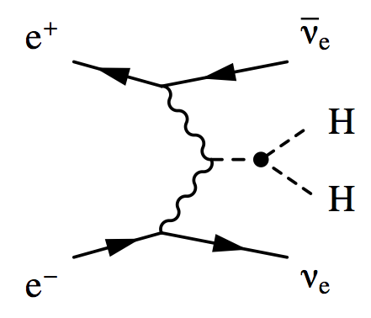
Higgs Self-Coupling: I
Measuring Higgs self-coupling is
challenging for all facilities
Electron-positron annihilation:
Best measured in fusion process
(HZZ cross section is very small)
For
CoM energy all important
cross section at 3 TeV is a
factor 10 larger than at 1 TeV
Challenging final state
b-jets (often quite forward)
+ missing pT
Full simulation studies essential

Slide 4
Higgs Self-Coupling:II
Whitepaper results
full simulation/full reconstruction
b-tagging, jet-pairing, missing p_{T,} …
+ multivariate analysis techniques
SM backgrounds including
Expect small updates for September
A number of diagrams for double Higgs production (-ve interference)
Consequently:

Slide 5
Higgs Self-Coupling:III
A few words on polarisation
Sensitivity can be enhanced using
polarised beams
Assume -80% (i.e. LH) electron polarisation
- essentially comes for free
Further gains possible with RH positron pol.
- not included, since not CLIC baseline
Current results (based on realistic CLIC staged scenario):
 | 1.5 ab⁻¹ @ 1.4 TeV | +2.0 ab⁻¹ @ 3 TeV
Δλ/λ | ± 21 % | ± 10 %
CLIC has “10 sigma” sensitivity to triple Higgs coupling
Analysis improvements possible (although not easy)

