Slide 1

Technologies for Intensities
Beyond the Current Era
CSS2013 Colloquium:
Opportunities with High Intensity Accelerators Beyond the Current Era
Patrick Hurh, Bob Kephart, Mark Palmer
August 4, 2013
Snowmass on the Mississippi

Slide 2
Outline
Accelerator Technologies to
Move Beyond the State of the Art
High Power Targetry
High Intensity Muon Beams
  Including Muon Cooling
Ongoing SRF Needs

Slide 3
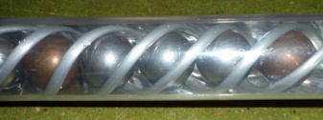
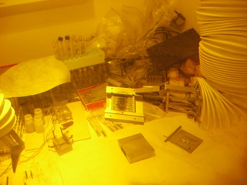
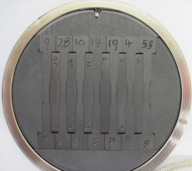
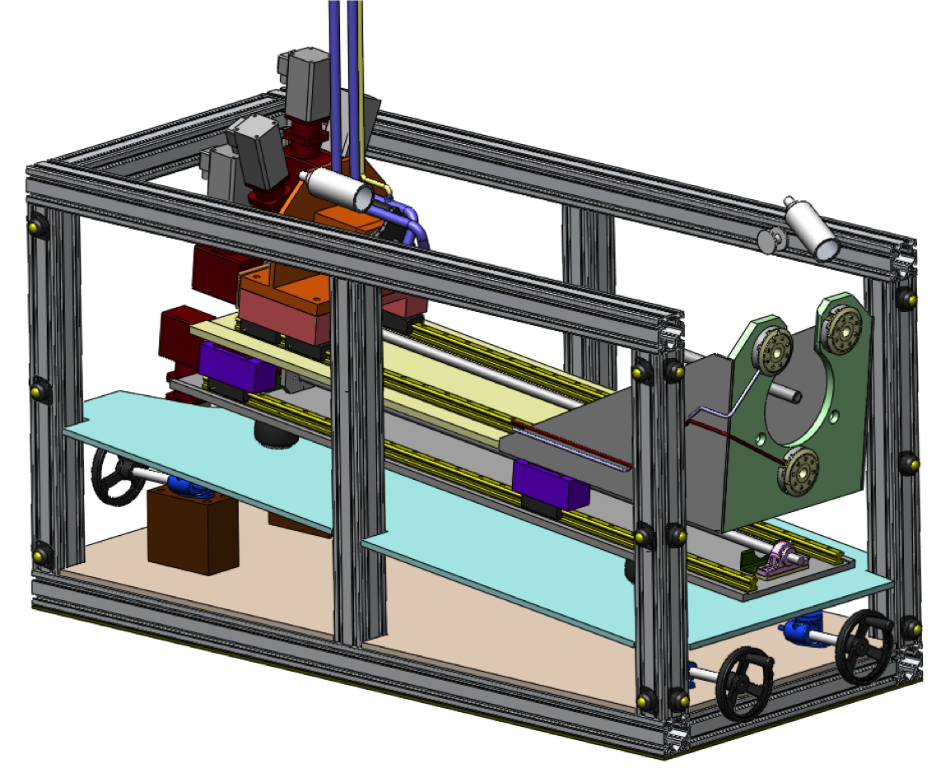
High-Power Target Facilities:
Challenges AT ≥4 MW
Acknowledgments to Patrick Hurh (FNAL)
Notes:
1 center is the remote handler for the LBNE target designed by ORNL (no longer in the baseline design)
2) top left is CFD analysis of a 2 MW beam on Be sphere target study done by RAL for LBNE.
3) top right is a mock up of the flow vanes for the analysis show in 2
4 right is carbon carbon composite samples irradiated at blip BNL in their hot cell
5) bottom left is graphite samples in the SS canister before sealing up to go into blip beam at BNL

Slide 4
Critical Issues: High Power Target Facilities
Target and Window Design Challenges
  Heat removal
  Thermo-mechanical integrity (beam induced stresses)
  Radiation damage
  Optimization for science yield
Facility Design Challenges
  Radiation protection and remote handling
  Radiation accelerated corrosion
  Optimization for science yield

Slide 5
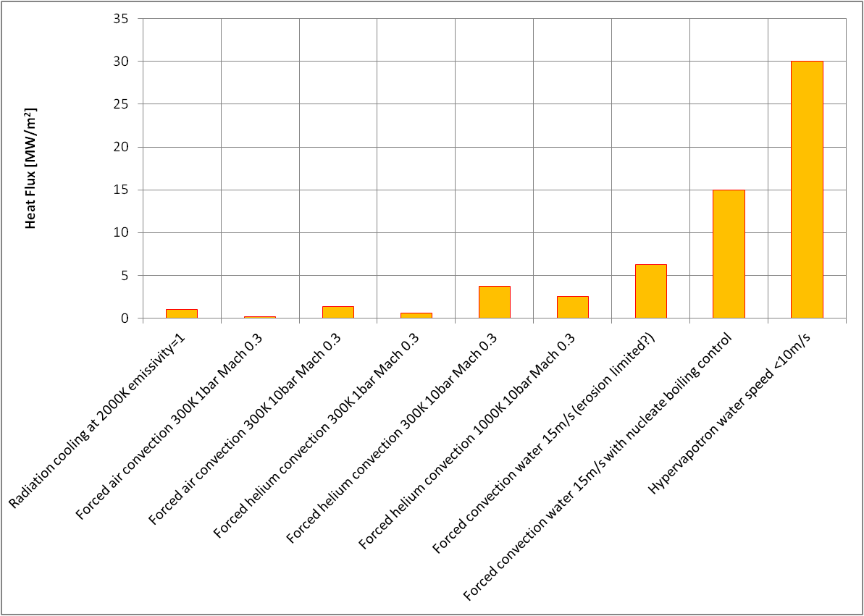
Heat Removal
Target Challenges
At ≥4 MW
Different target applications require very different cooling capacity
  Neutrino production target: 1-2% of beam power left in target
  Spallation neutron target: 95-100% of beam power left in target
Stopping targets & conventional target geometries:
  Approach material limits for solid, static targets
Heat Flux: MW/m²
Summary slide from Tristan Davenne’s (RAL) High Heat Flux Cooling Talk at PASI 2013
Notes:
Tristan’s study showed that one would need greater than 1 sq. meter of surface area to remove 4-6 MW of deposited power using current technology at the most aggressive flow rates. This amount of convective surface area borders on the edge considering trying to optimize yield for science. Nucleate boiling and Hypervapotron cooling are promising but have their own drawbacks.

Slide 6
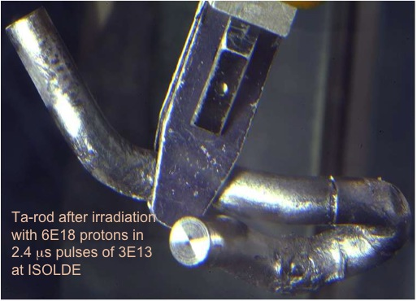
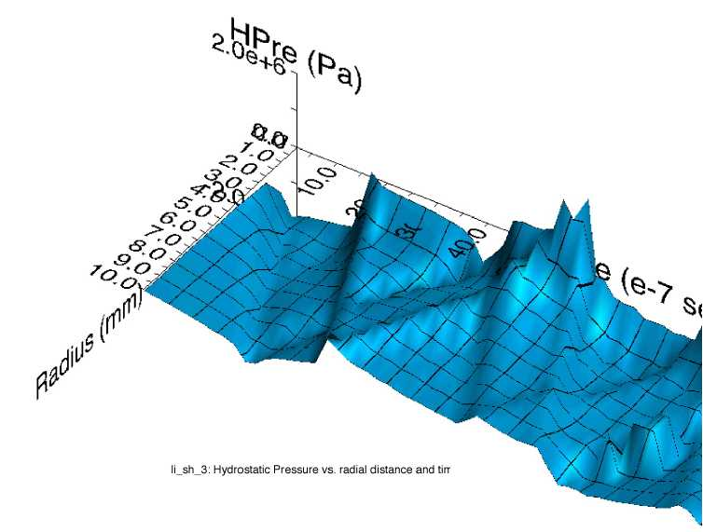
Thermal Shock (Stress Waves)
Target Challenges
Ta-rod after irradiation with 6E18 protons in 2.4 μs pulses of 3E13 at ISOLDE (photo courtesy of J. Lettry)
Simulation of stress wave propagation in Li lens (pbar source, Fermilab)
Fast expansion of material surrounded by cooler material creates a sudden local area of compressive stress
Stress waves (not shock waves) move through the target
Plastic deformation or cracking can occur
Mitigating thermal shock:
  Material Selection
  Segment target length
  Manipulate beam parameters (spot size, intensity)
Also impacts liquid and rotating targets
  Cavitation in liquid metal (SNS)
  Rotating target in CW beam (FRIB)
Notes:
Ta-rod after irradiation with 6E18 protons in 2.4 μs pulses of 3E13 at ISOLDE
One misconception about thermal shock is that it does not apply to CW beam or liquid targets. Pulsed beam on liquid has resulted in problems for SNS and rotating solid targets also set up a dynamic and cyclic effect that must be addressed during R&D.
Material Choices: High specific heat, Low coefficient of thermal expansion, Low modulus of elasticity, High strength (tensile and fatigue) at elevated temperature

Slide 7
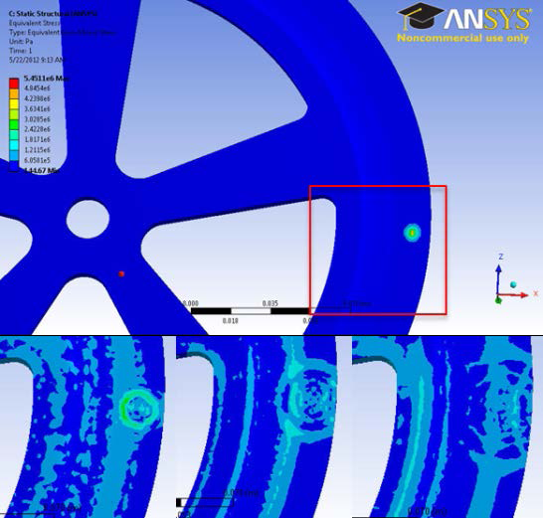
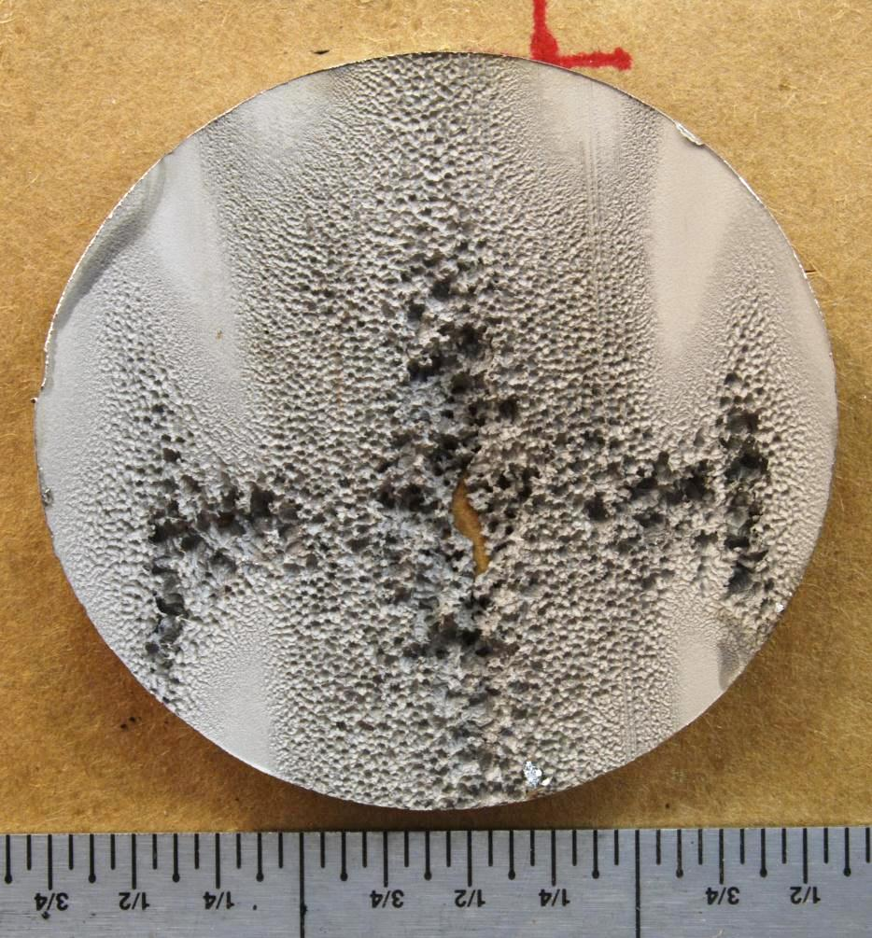
Thermal Shock (Stress Waves)
Target Challenges
Stress developing:
0 μs (top), 1.8 μs, 4.2 μs
and 6 μs. Unit is Pa
Stress wave from the
beam pulse is seen
M. Avilov, FRIB, 06/14/2012
Beam induced cavitation damage in SNS target. B. Riemer for PASI 2012
Notes:
One misconception about thermal shock is that it does not apply to CW beam or liquid targets. Pulsed beam on liquid has resulted in quite some problems for SNS and rotating solid targets also set up a dynamic and cyclic effect that must be addressed during R&D.

Slide 8
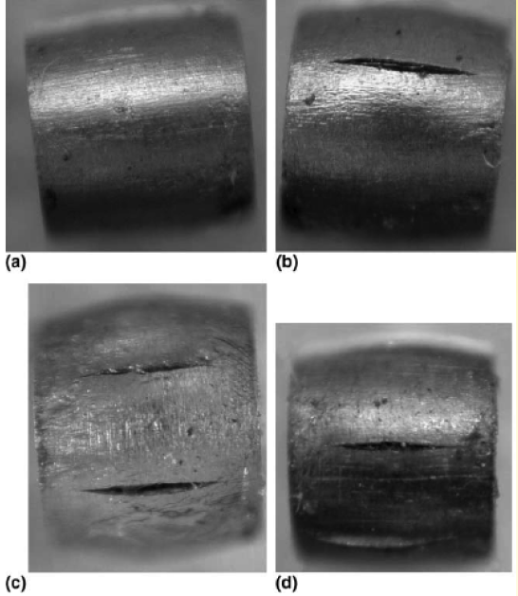
Radiation Damage
Target Challenges
Displacements in metal crystal lattice
  Embrittlement
  Creep
  Swelling
  Fracture toughness reduction
  Thermal/electrical conductivity reduction
  Coefficient of thermal expansion changes
  Accelerated corrosion
  Transmutation products (impurities, gas production)
Very dependent upon irradiation conditions (eg. temperature)
0 DPA
3.2 DPA
14.9 DPA
23.3 DPA
S. A. Malloy, et al., Journal of Nuclear Material, 2005. (LANSCE irradiations)
Notes:
One notes that all the properties that are important for thermo-mechanical health of the target are affected by radiation damage. The dependence on irradiation temperature is due to annealing (or healing) the crystal structure is faster at higher temperatures.

Slide 9
Radiation Damage
p
100+ MeV
n
1-14 MeV
Irradiation Source | DPA rate (dpa/s) | He gas production (appm/DPA) | Irradiation Temp (˚C)
Mixed spectrum fission reactor | 3e-7 | 0.1 | 200-600
Fusion reactor | 1e-6 | 10 | 400-1000
High energy proton beam | 6e-3 | 100 | 100-800
14.9 DPA
23.3 DPA
Effects from low energy neutron irradiations do not equal effects from high energy proton irradiations. Table compares typical irradiation parameters.
Notes:
Irradiation parameters are quite different, especially gas production which is particularly worrisome. However nuclear materials scientists have a lot of expertise that they could lend in this area.

Slide 10
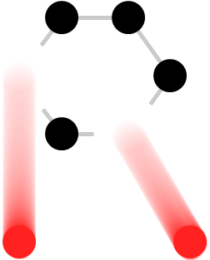



RaDIATE
Collaboration
Radiation Damage In Accelerator Target Environments
Broad aims are threefold:
to generate new and useful materials data for application within the accelerator and fission/fusion communities
to recruit and develop new scientific and engineering experts who can cross the boundaries between these communities
to initiate and coordinate a continuing synergy between research in these communities, benefitting both proton accelerator applications in science and industry and carbon-free energy technologies

Slide 11
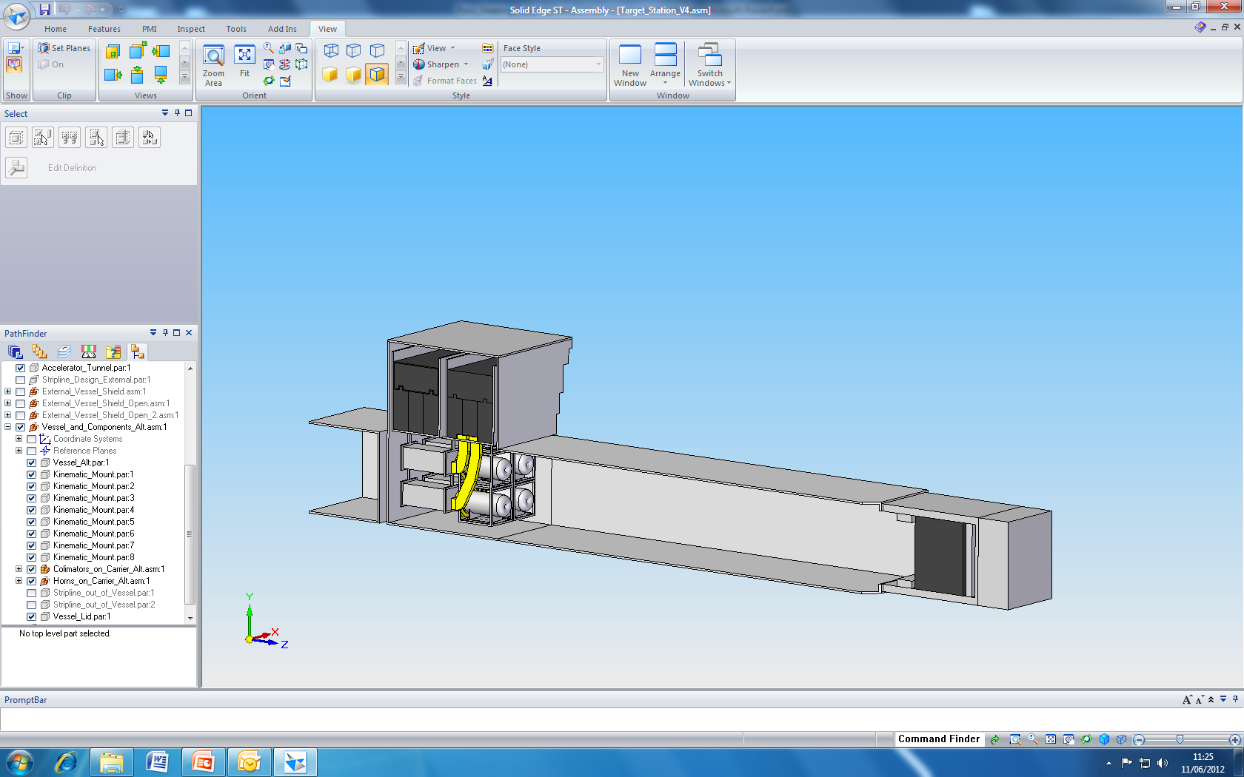
Optimization for Science
Target Challenges
3 major challenges are helped by spreading the beam out
  Decreases peak temp and stresses
  Increases surface area for cooling
  Reduces DPA rate/Increases useable life
Typically reduces science yield per incident particle
  Extensive analysis required to optimize yield (also target lifetime)
  Some novel solutions exist
Some options:
  Liquid metal jets
  Powdered metal jets
  Rotating solid discs
  Multiple targets in one shield pile:
EUROnu design study.
D. Wilcox, RAL/STFC.
Split Proton Beam
Neutrino Beam Direction
Collimators
Horns and Targets
Beam Dump
Decay Volume
Notes:
EUROnu study splits a 4 MW beam into four targets, but uses one shielding pile to create a 4MW facility using existing technology economically. Another idea that I had was to do a spallation source with two targets vertically separated with moderators positioned to provide three levels of neutron channels to instruments with the middle level providing twice the flux as the top and bottom levels. Optimizing target systems in this manner requires thinking about the entire target facility.

Slide 12
Radiation Protection
Facility Challenges
Typically:
  50-75% of the cost of a new target facility is in the civil construction and radiation protection
  75% of the cost of maintaining operations of a target facility is associated with systems and staff to work with radioactive materials
Facility design highly dependent on full life-cycle planning (including disposition of spent radioactive materials)
≥4 MW vs. 1-2 MW:
  Prompt Dose Shielding – minor differences
    Increased shielding thickness
    Increased cooling capacity for shielding
  Remote Handling – nearly identical:
    Increased shielding in casks/hot cells
    Increased cool-down times
  Some previously minor problems could have new significance
    Off-gas systems (esp. for liquid metal targets) will need significant attention
    Loss of coolant scenarios more severe due to possible decay heat issues

Slide 13
Radiation Protection
Facility Challenges
Must apply lessons learned from 1 – 2 MW era:
  Air activation must be carefully assessed and addressed in civil construction plans
  Tritium production in shielding and component materials migrates readily and systems must be incorporated to isolate/collect and dispose of tritium safely (and legally)
  Flexibility must be built into remote handling aspects of the facility design to handle off-normal events
  Single event upsets can take down entire control systems if not shielded appropriately
  Radiation can accelerate corrosion effects significantly; especially hi-strength steels exposed to activated, humid air

Slide 14
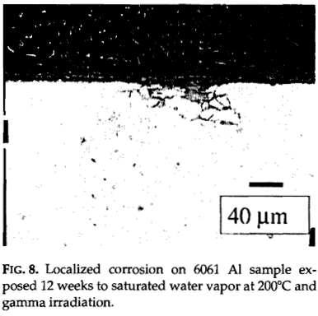
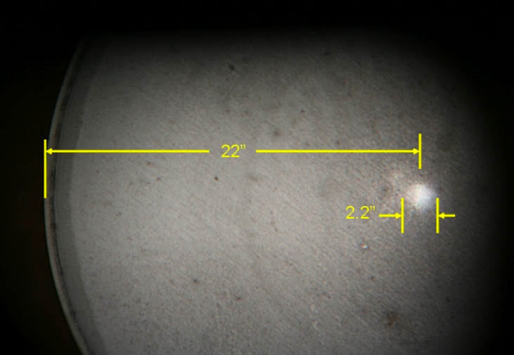
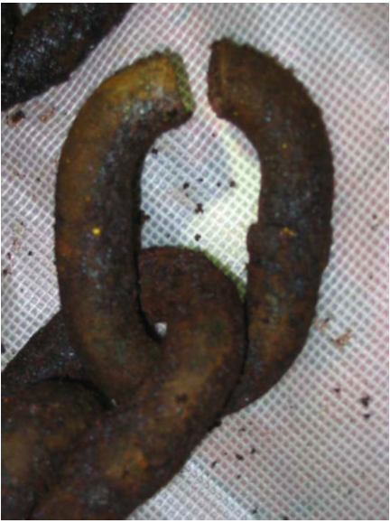
Radiation Accelerated Corrosion
Facility Challenges
Al 6061 samples:
  Displayed significant corrosion after 3.6 Grad
  NuMI target chase air handling condensate
  with pH of 2
  NuMI decay pipe
  window concerns
Photograph of NuMI decay pipe US window showing corroded spot corresponding to beam spot
MiniBooNE
25 m absorber HS steel failure
  Hydrogen embrittlement from accelerated corrosion.
R.L. Sindelar, et al., Materials Characterization 43:147-157 (1999).

Slide 15
Optimization for Science
Facility Challenges
As with the target design, facility design must be optimized considering the following competing parameters:
  Cost (both construction and operational)
  Reliability/availability
  Flexibility
  Science yield
General engineering consensus is that spending more on a reliable, high availability facility that is flexible enough to service several experimental needs will maximize science yield per $ in the long term
Notes:
Note that Reliability/availability and Science yield are linked (ie if a facility is optimized for science yield but not reliable then science yield will lose as well.

Slide 16
High Intensity muon beams
For neutrino factories, colliders and other applications

Slide 17
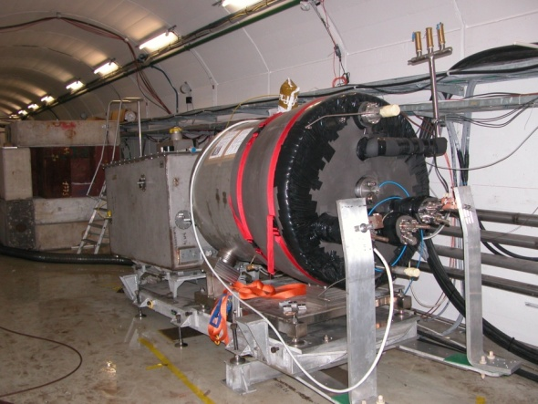

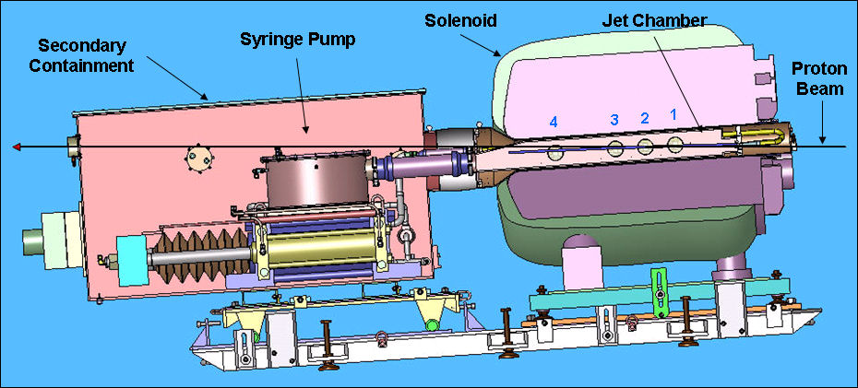
Key Technologies - Target
The MERIT Experiment at the CERN PS
  Demonstrated a 20m/s liquid Hg jet injected
  into a 15 T solenoid and hit with a
  115 KJ/pulse beam!
  Jets could operate with beam powers up to
  8 MW with a repetition rate of 70 Hz
MAP staging aimed at initial 1 MW target
1 cm
Hg jet in a 15 T solenoid
with measured disruption length ~ 28 cm

Slide 18
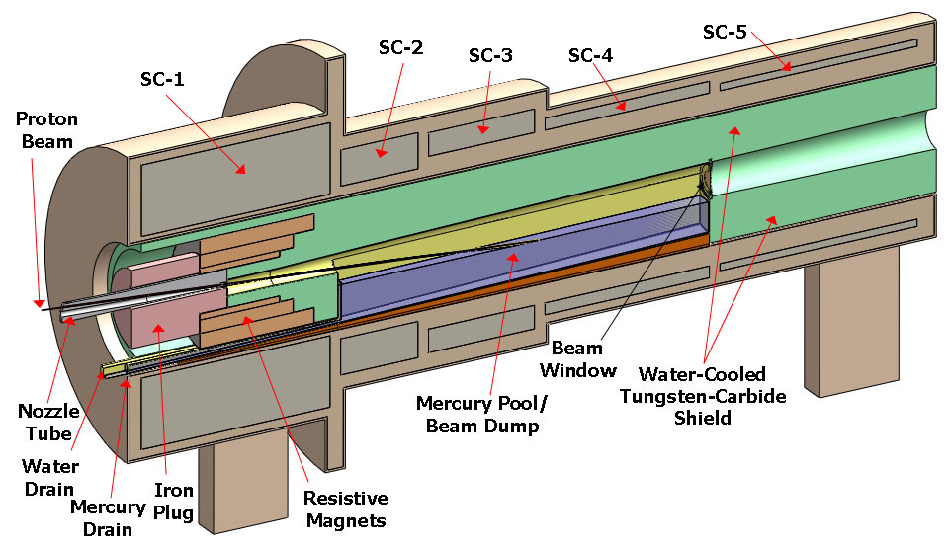
TechnoIogy Challenges – Capture Solenoid
A Neutrino Factory and/or Muon Collider Facility requires challenging magnet design in several areas:
  Target Capture Solenoid (15-20T with large aperture)
  E_{stored} ~ 3 GJ
  O(10MW) resistive
  coil in high radiation
  environment
  Possible application
  for High Temperature
  Superconducting
  magnet technology

Slide 19
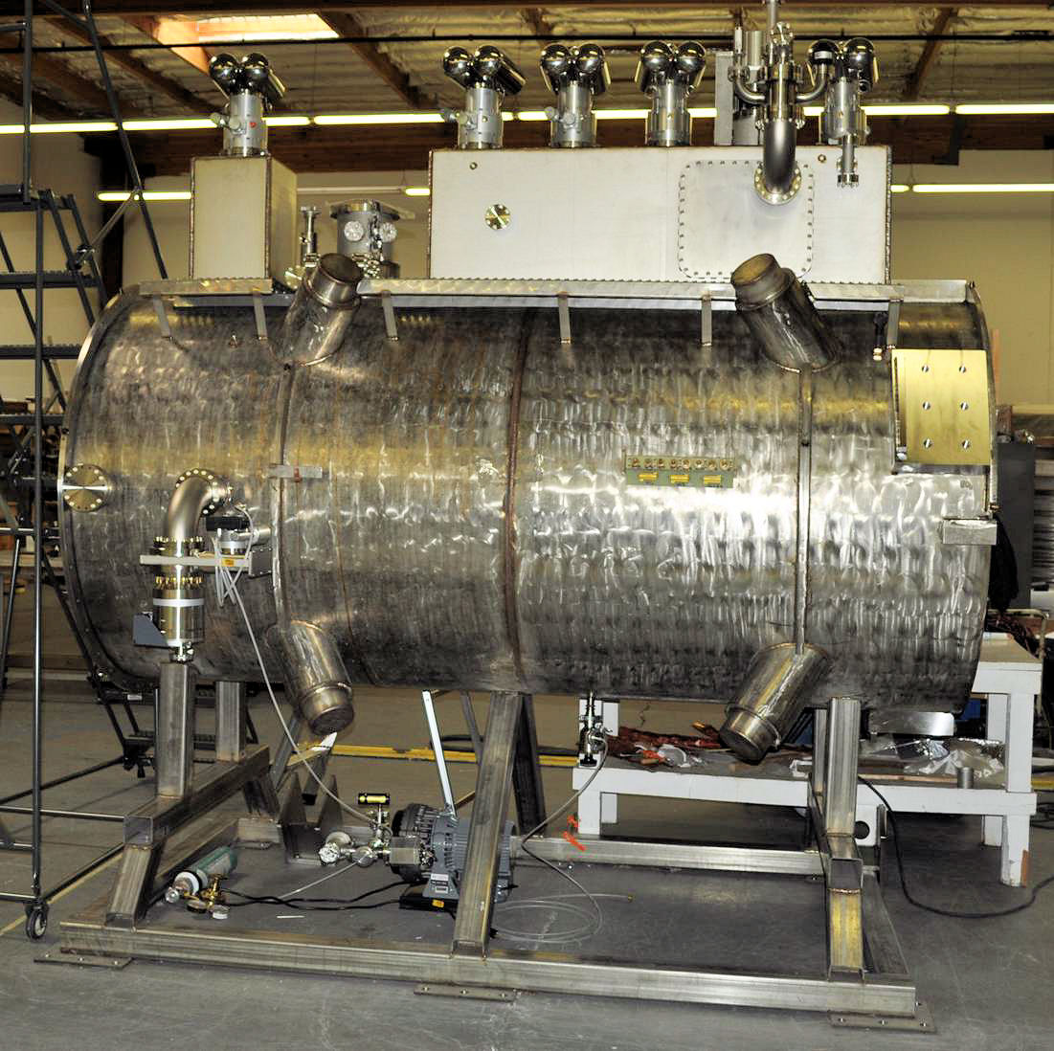
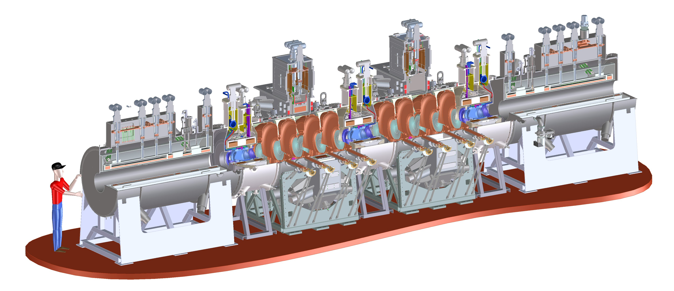
Technology Challenges - Cooling
Tertiary production of muon beams
  Initial beam emittance intrinsically large
  Cooling mechanism required, but no
  radiation damping
Muon Cooling a Ionization Cooling
    dE/dx energy loss in materials
    RF to replace p_{long}
MICE
  The Muon Ionization
  Cooling Experiment:
  Demonstrate the
  method and validate
  our simulations
RF-Coupling
Coil (RFCC)
Units
Spectrometer
Solenoids

Slide 20
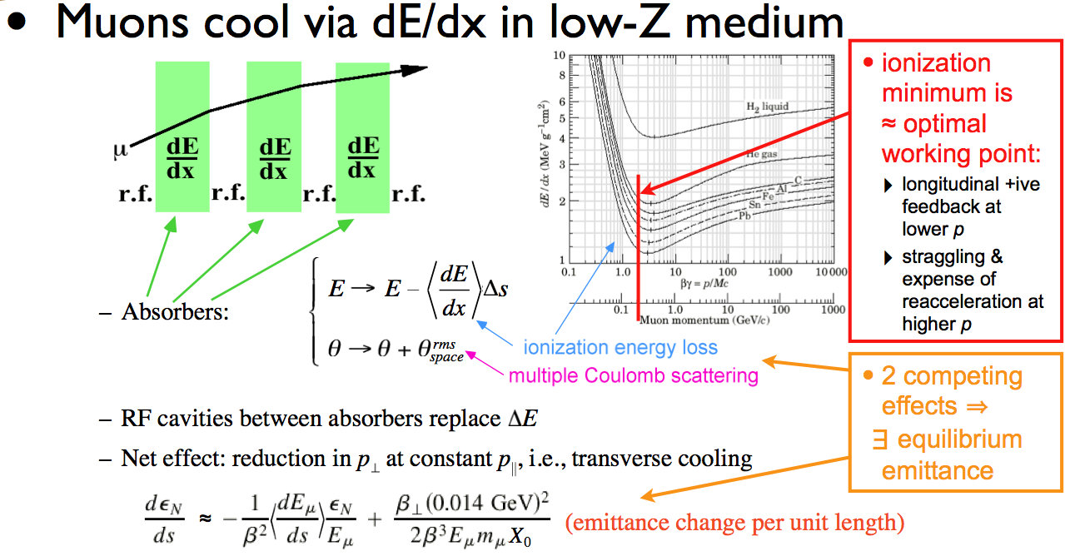
Ionization Cooling

Slide 21
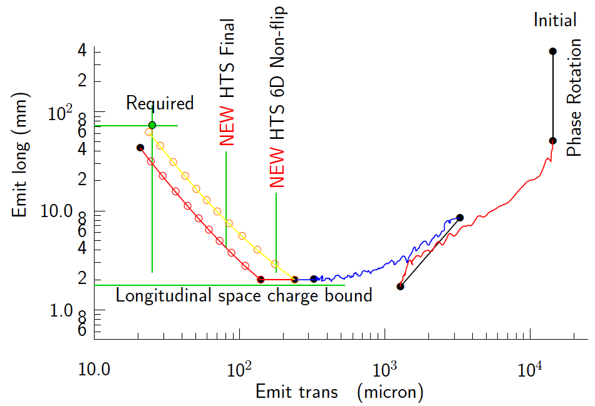
Technology Challenges - Cooling
Development of a cooling channel design to reduce the 6D phase space by a factor of O(10⁶) → MC luminosity of O(10³⁴) cm⁻² s⁻¹
R. Palmer
Some components beyond state-of-art:
  Very high field HTS solenoids (≥30 T)
  High gradient RF cavities operating in multi-Tesla fields
Emittance Reduction
via Ionization Cooling
The program targets critical magnet and cooling cell technology demonstrations within its feasibility phase.

Slide 22
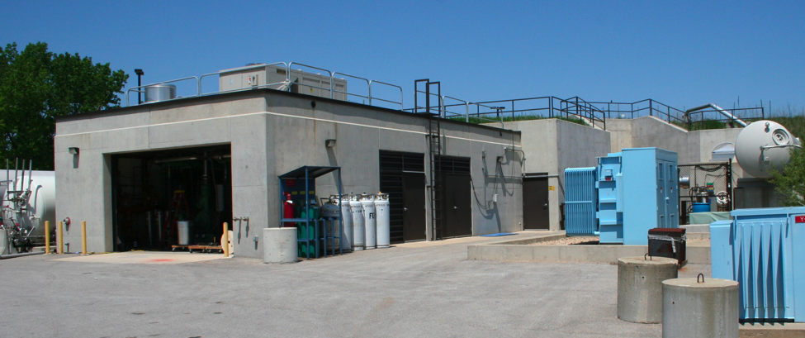
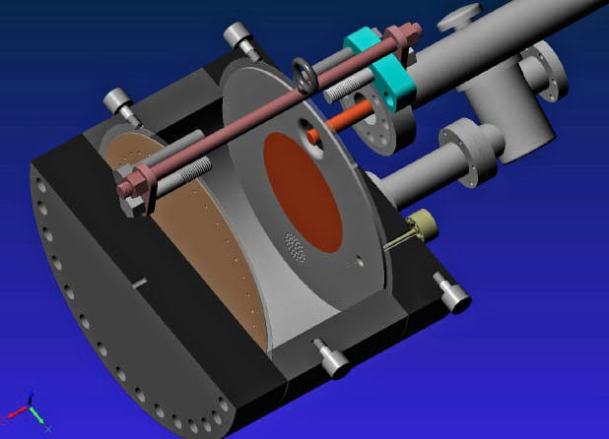
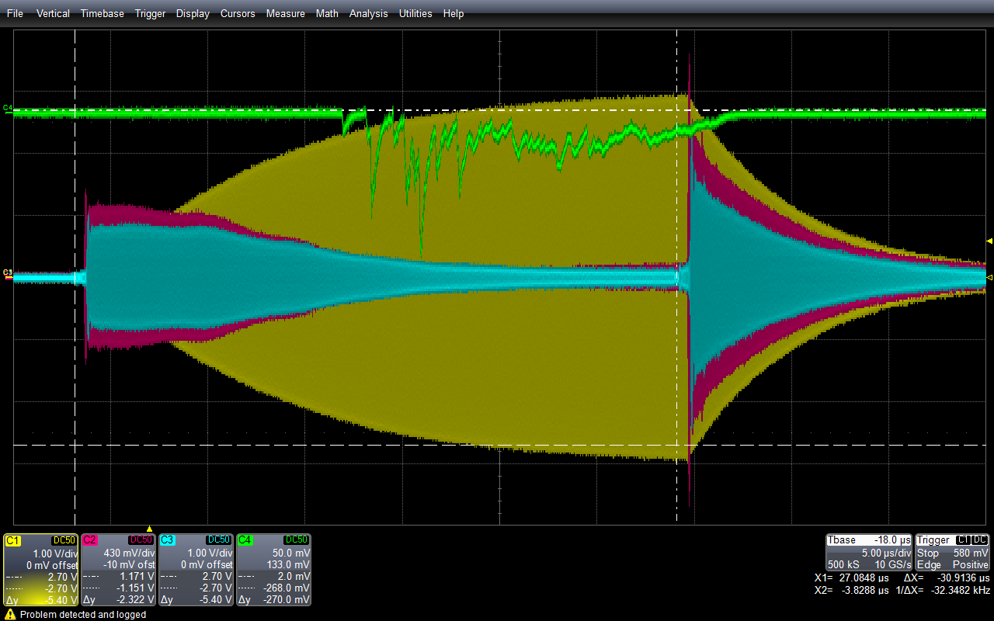
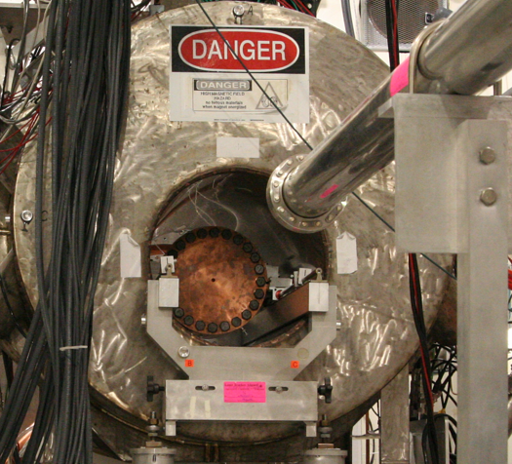
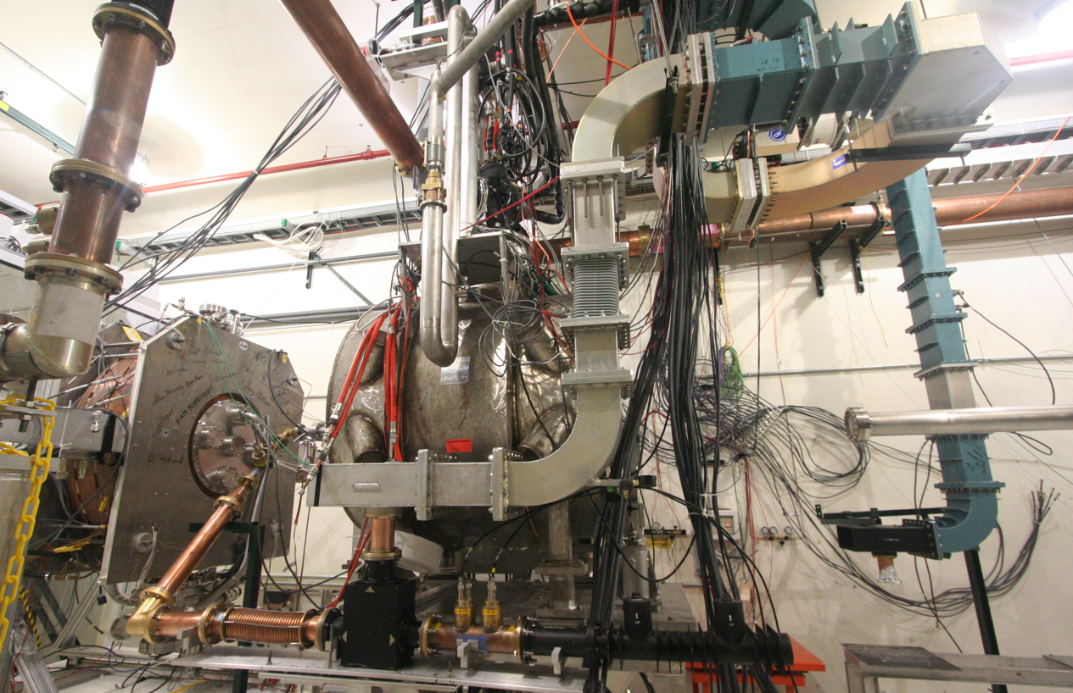
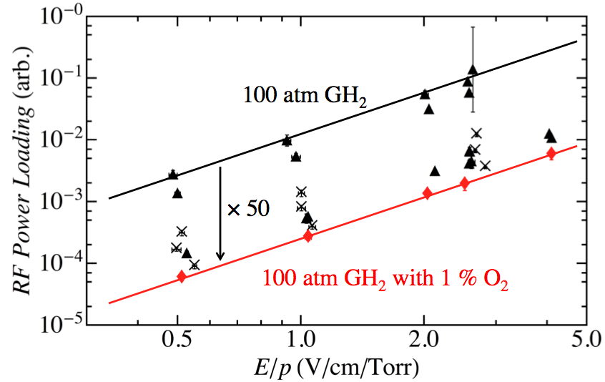
Elements of the R&D Program
MuCool Test Area
Entrance of MTA
exp. hall
Vacuum
RF Cavity
Compressor + refrigerator room
400 MeV
H⁻ Beam
20 MV/m in 3 Tesla
MTA Hall
Gas-Filled RF cell
201 MHz cavity
SC magnet
400 MeV H⁻ beam

Slide 23
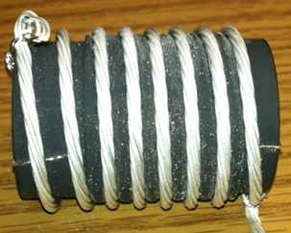
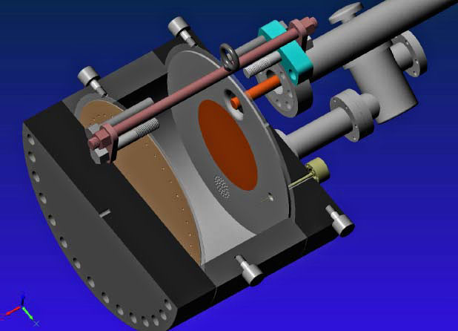
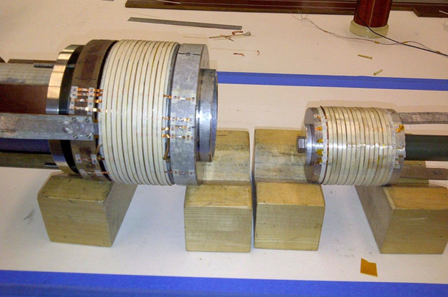
Cooling Channel R&D Effort
Successful Operation of 805 MHz “All Seasons” Cavity in 3T Magnetic Field under Vacuum
MuCool Test Area/Muons Inc
World Record
HTS-only Coil
15T on-axis field
16T on coil
PBL/BNL
Demonstration of High Pressure RF Cavity in 3T Magnetic Field with Beam
Extrapolates to
μ-Collider Parameters
MuCool Test Area
Breakthrough in HTS Cable Performance with Cables Matching Strand Performance
FNAL-Tech Div
T. Shen-Early Career Award
The Path to a Viable
Muon Ionization
Cooling Channel
1% Dry Air (0.2% O2) in GH2
Pure GH2
1% Dry Air
(0.2 % O2)
in GH2 at
B = 3T
~50X reduction in
RF power dissipation
E₀ = 25 MV/m

Slide 24
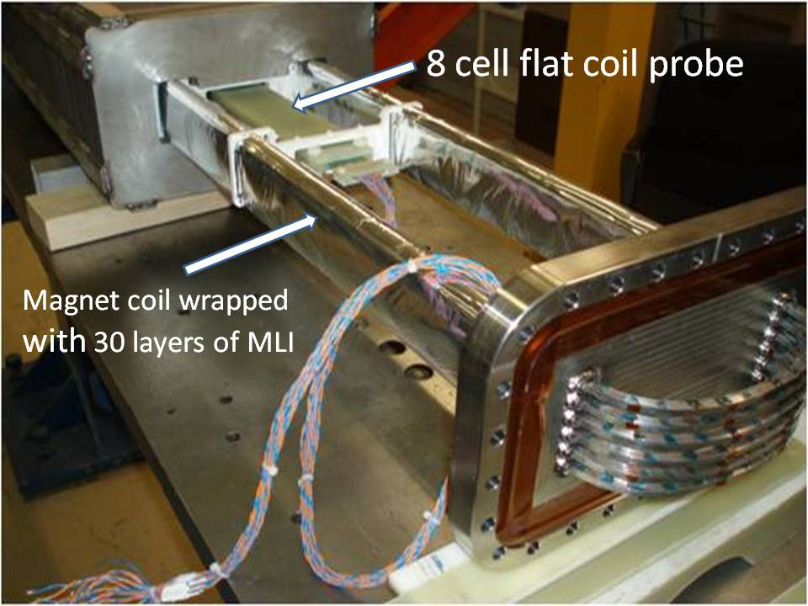
Technology Challenges - Acceleration
Muons require an ultrafast accelerator chain
a Beyond the capability of most machines
Solutions include:
  Superconducting Linacs
  Recirculating Linear Accelerators (RLAs)
  Fixed-Field Alternating-Gradient (FFAG) Machines
  Rapid Cycling Synchrotrons (RCS)
  RCS requires
  2 T p-p magnets
  at f = 400 Hz
  (U Miss & FNAL)
EMMA – FFAG
JEMMRLA Proposal:
JLAB Electron Model of
Muon RLA with Multi-pass
Arcs

Slide 25
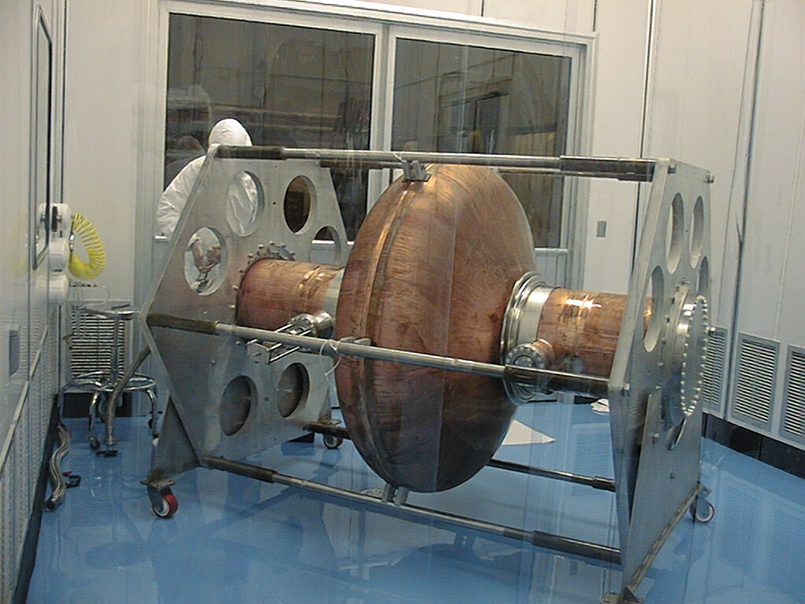
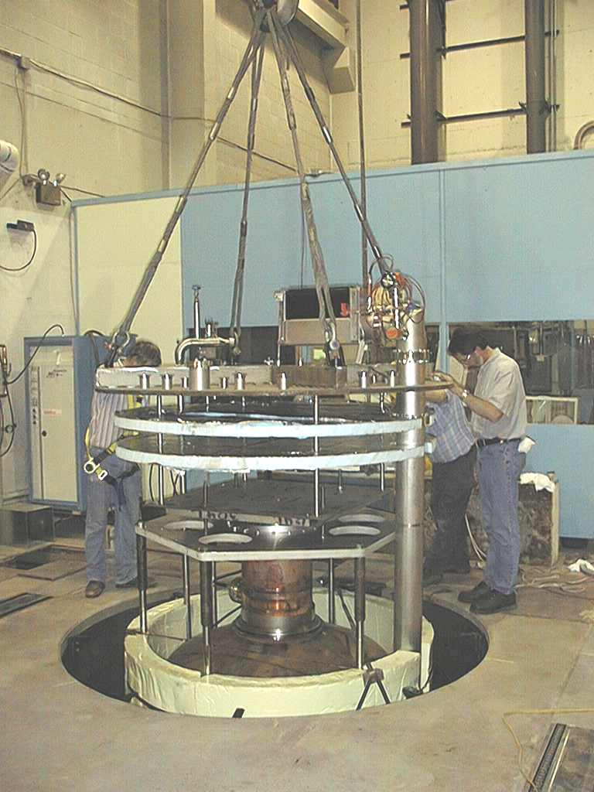
Superconducting RF Development
201 MHz SCRF R&D
Major dia.: 1.4 m
Cavity going into test pit
in Newman basement
(Cornell University)
400mm BT
Cavity length: 2 m
Pit: 5m deep X 2.5m dia.

Slide 26
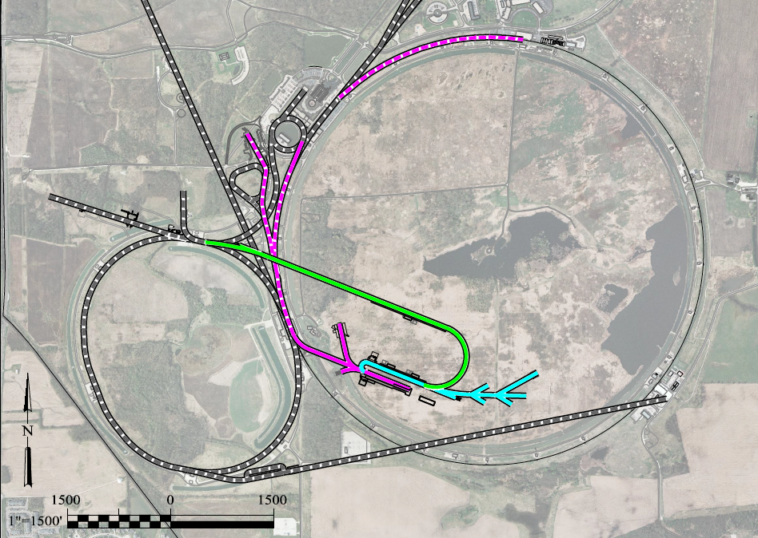
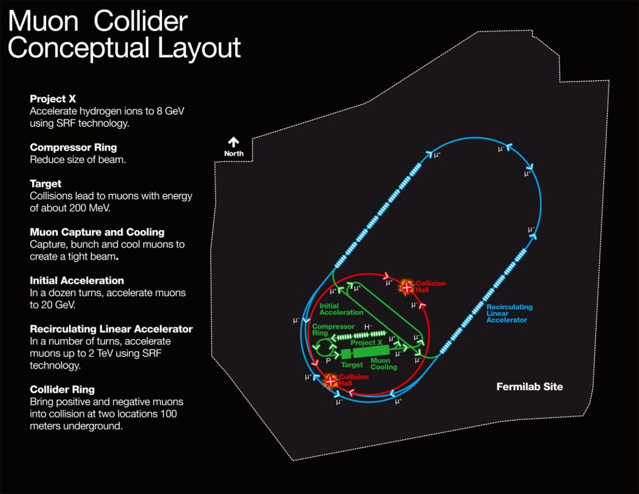
A Muon Accelerator Facility for Cutting Edge Physics on the Intensity and Energy Frontiers
Based on Project X Stage II
A TeV-scale Collider
at Fermilab
To SURF
LBNE
RLA to 63 GeV +
300m Higgs Factory
Buncher/
Compressor
Rings
NF Decay Ring:
νs to SURF
And other potential applications for high quality μ beams in the MeV to TeV energy range
Front End+4D+6D
Linac + RLA to ~5 GeV
Project X
Stage II
Project X
Stage I
A 1.5 TeV collider
would fit within the
Tevatron ring
ft
νSTORM + Muon Beam
R&D Facility
ft
26
Community Summer Study 2013 (CSS2013) - University of Minnesota
July 30, 2013

Slide 27
Ongoing SRF Needs
Acknowledgments to Bob Kephart (FNAL)

Slide 28
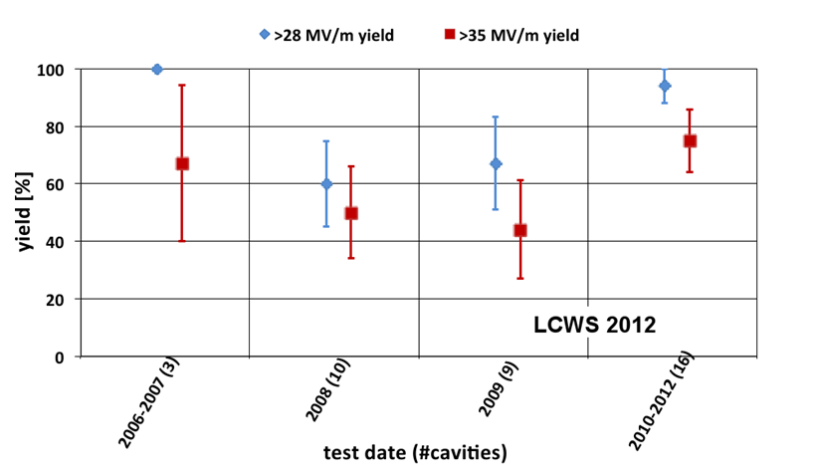
SRF Today: Bulk Nb Cavities
Cavities based on bulk Nb have already reached performance values
> 40 MV/m Eacc that approach the theoretical limits of Nb at ~ 180 mT for 1300 MHz cavities
R&D has also led to surface processing that is cheaper and requires little or no Chemistry (e.g. Centrifugal Barrel Polish)
Improved High Pressure Rinse and assembly techniques mean that Field emission is now often not a limitation
JLAB 12 Gev Upgrade Cavities consistently ~ 25 MV/M
ILC cavity yields > 90% at ~30 MV/M
Q₀ = 10¹⁰ seems achievable
Key technologies for ILC or PX
a ~in place
But… high purity Nb is expensive
a ~ 40% of the cavity cost
So are cryomodules & big cryogenic
refrigerators
What is possible in the future?

Slide 29
SRF Today: Surface R&D
Already a lot of effort in this direction
Determine what matters at an SRF surface and control it!
  Bad topography or particulates
  ➔ Field emission or quenches
  ➔ losses
  ➔ need smooth clean surfaces
  Impurities (e.g. precipitates, oxides, bulk contamination)
  ➔ lower Q0
  ➔ cryogenic load
  Need surfaces with well controlled properties
  But we don’t always know what matters
Performance is steadily getting better
Well established techniques, useable for machines
But…
It is unlikely that bulk Nb cavities built with high purity material and with anything like current processing are going to get a lot cheaper with time!

Slide 30
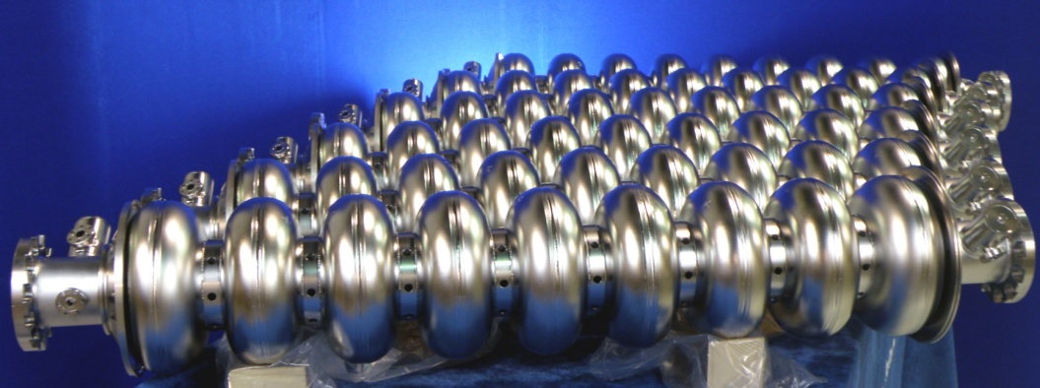
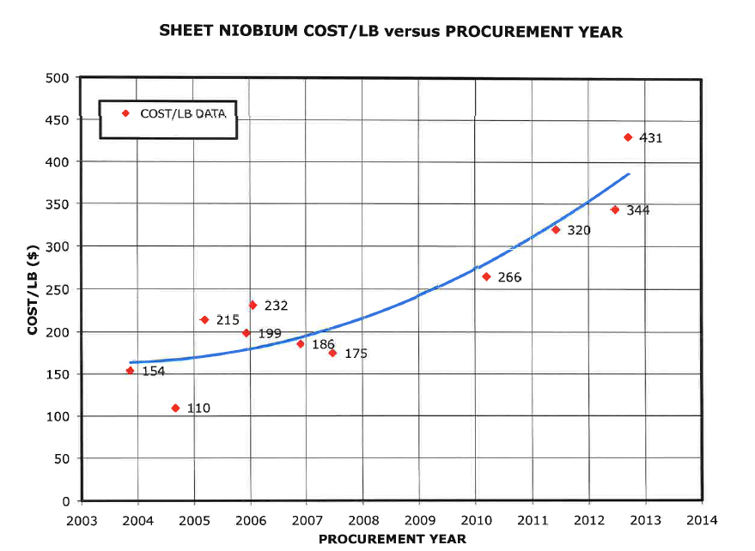
Bulk Nb Cavities
Industrial fabrication technology in hand but cost of bulk Nb material is growing

Slide 31
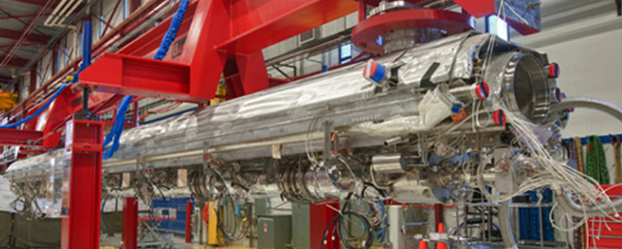
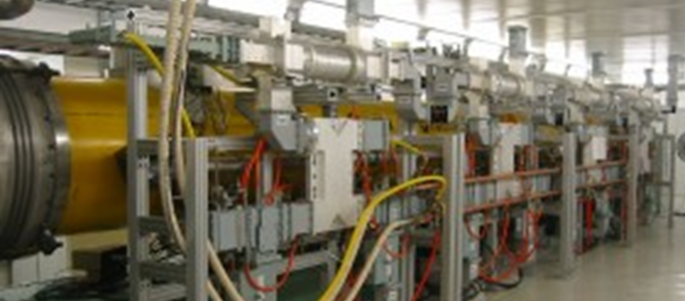
Current Cryomodules (ILC, XFEL, CBEAF)
ILC/XFEL type cryomodule at Fermilab
2 K cryogenic systems
RF distribution
Complicated!
Expensive!

Slide 32
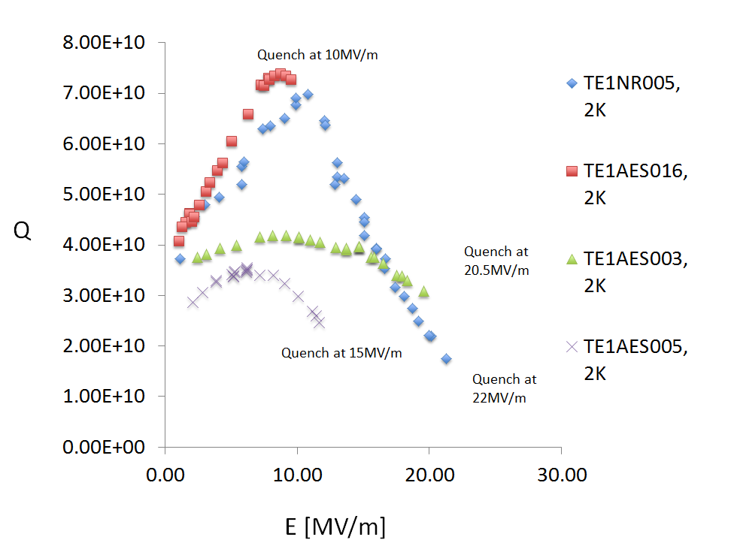
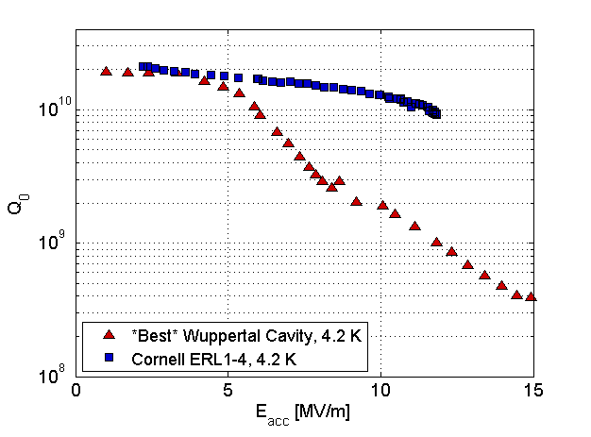
SRF: Its all about the surface!
SRF currents flow only in the top 100 nm of a cavity surface
We pay for a lot of expensive high purity Nb that we do not use!
Q₀ is often determined by surface impurities such as hydrides or defects.
New surface treatment (e.g. Nitrogen or Argon treatment @FNAL) show world record Q₀ at gradients of interest for CW HEP accelerators ( e.g. Project X)
Lower cryogenic costs
Deposited films may allow the use of higher Tc materials resulting high Q₀ at higher temps.
Thin films on e.g. Copper substrate are demonstrated to work. (e.g. LEP)
Could save a lot of money but performance of SRF films are not yet as good as e.g. bulk Nb
Thin film R&D could have a big pay off
Bulk Nb @ 2 K!
FNAL
Cornell
Nb₃Sn
@ 4 K!

Slide 33
The Future of SRF? Lower the Cost!
Low-cost cavities with deposited SRF films
  Bulk material is cheap (e.g. copper or aluminum)
  High Tc film SRF surfaces, better methods ➔ higher gradients
  High Q₀ ➔ enables CW operation
Low-cost cryomodules
  Operate cavities at 4 K or above via conduction or tube cooling
  Equip each cryomodule with cryo-coolers
    No big cryogenics plant or large He inventory!
    No Helium vessels!
    Much cheaper cryomodule, perhaps even more reliable!
Low cost, high efficiency RF
  Solid State or Magnetron based
a Goal: an SRF Linac for HEP built at well below ILC costs
  Seems achievable, and has lots of synergy with industrial use of SRF
  Steady R&D support needed to make this possible

Slide 34
Conclusion
High power targetry will be a crucial element of the accelerators needed for the 21st century
  Considerable R&D is required
  The time for investment is now
Muon accelerators offer potentially unique capabilities for HEP
  A vibrant R&D program needs further support to develop this potential
SRF will be central to a broad range of accelerator applications on the horizon
  Can we develop more cost effective implementations to leverage our HEP aspirations?

Slide 35
Backup Slides

Slide 36
The U.S. Muon Accelerator Program

Slide 37
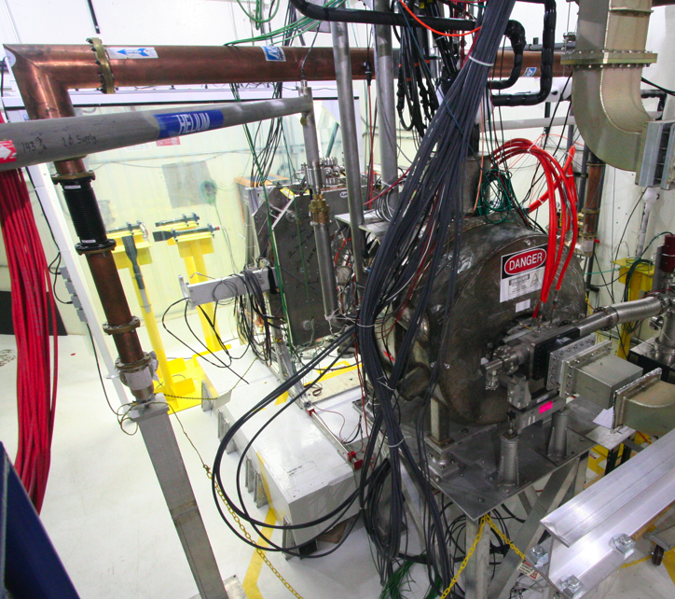
Elements of the R&D Program
MuCool Test Area
Entrance of MTA
exp. hall
Compressor + refrigerator room
201 MHz cavity
MICE
SC magnet
RF-Coupling
Coil (RFCC)
Units
Spectrometer
Solenoids
MTA exp. hall

Slide 38
Cooling Channel R&D Effort
Successful Operation of 805 MHz “All Seasons” Cavity in 3T Magnetic Field under Vacuum
MuCool Test Area/Muons Inc
World Record
HTS-only Coil
15T on-axis field
16T on coil
PBL/BNL
Demonstration of High Pressure RF Cavity in 3T Magnetic Field with Beam
Extrapolates to
μ-Collider Parameters
MuCool Test Area
Breakthrough in HTS Cable Performance with Cables Matching Strand Performance
FNAL-Tech Div
T. Shen-Early Career Award
The Path to a Viable
Muon Ionization
Cooling Channel
1% Dry Air (0.2% O2) in GH2
Pure GH2
1% Dry Air
(0.2 % O2)
in GH2 at
B = 3T
~50X reduction in
RF power dissipation
E₀ = 25 MV/m

Slide 39
The ν Sector
We want to provide
the option to get here

Slide 40
Muon Collider Parameters
Exquisite Energy Resolution
Allows Direct Measurement
of Higgs Width
Success of advanced cooling
concepts a several × 10³²
Site Radiation mitigation with depth and lattice design: ≤ 10 TeV

Slide 41
MAP Timeline
 | 2010 |  | ~2020 |  | ~2030
Muon Accelerator R&D Phase
Proton Driver Implementation – Project X @ FNAL
Intensity Frontier
Energy Frontier
MAP Feasibility Assessment
Advanced Systems R&D
Muon Ionization Cooling Experiment (MICE)
Indicates a date when an informed decision should be possible
Pr X Stage I
Pr X Stage II
Pr X Stage III & IV
IDS-NF RDR
At Fermilab, critical physics production could build on Stage II of Project X
Proposed Muon Storage Ring Facility (νSTORM)
Evolution of Long Baseline ν Factory
Collider Conceptual ➔ Technical Design
Collider Construction ➔
Physics Program

Slide 42
A Muon Accelerator Facility for Cutting Edge Physics on the Intensity and Energy Frontiers
Based on Project X Stage II
A TeV-scale Collider
at Fermilab
To SURF
LBNE
RLA to 63 GeV +
300m Higgs Factory
Buncher/
Compressor
Rings
NF Decay Ring:
νs to SURF
Front End+4D+6D
Linac + RLA to ~5 GeV
Project X
Stage II
Project X
Stage I
A 1.5 TeV collider
would fit within the
Tevatron ring
ft
νSTORM + Muon Beam
R&D Facility
ft
42
Community Summer Study 2013 (CSS2013) - University of Minnesota
July 30, 2013

Slide 43
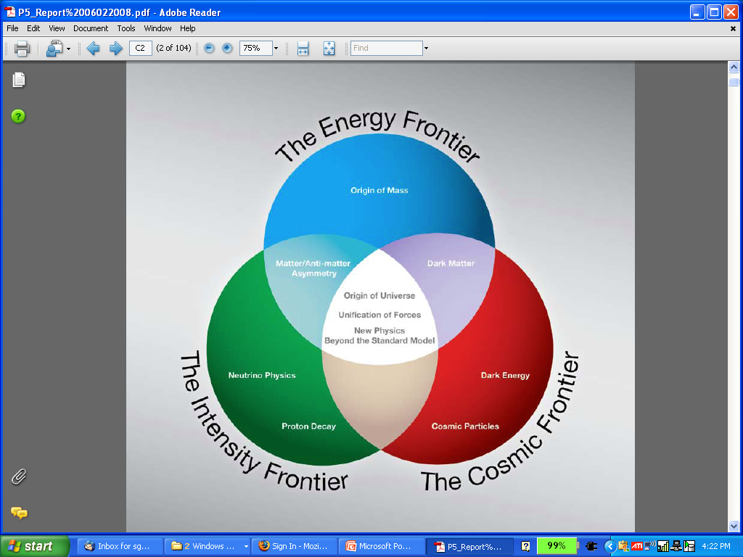
The Aims of the Muon Accelerator Program
  Muon accelerator R&D is focused on developing a facility that can address critical questions spanning two frontiers…
  The Intensity Frontier:
  with a Neutrino Factory producing well-characterized ν beams for precise, high sensitivity studies
  The Energy Frontier:
  with a Muon Collider capable of reaching multi-TeV CoM energies
  and
  a Higgs Factory on the border between these Frontiers
The unique potential of a facility based on muon accelerators is physics reach that SPANS 2 FRONTIERS

Slide 44
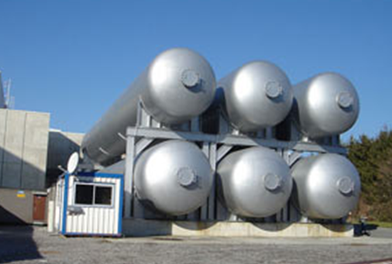
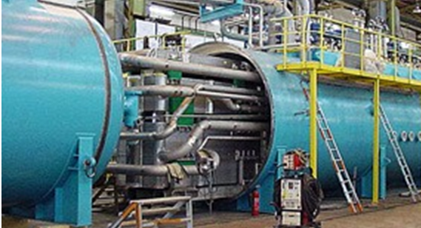
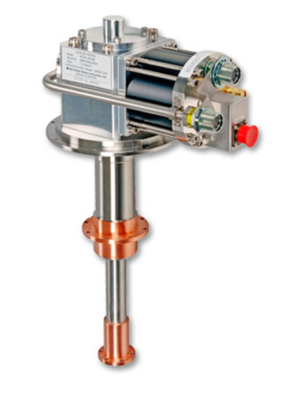

The Future of Cryogenics for HEP?
LHC Helium storage
LHC Cryo-Plant (1of 6)
Cryomodule mounted Cryo-coolers
Compact, NO Liquid Helium!
But…. don’t work well at 2 K

