Slide 1
201 Mhz Cavity Installation

Slide 2
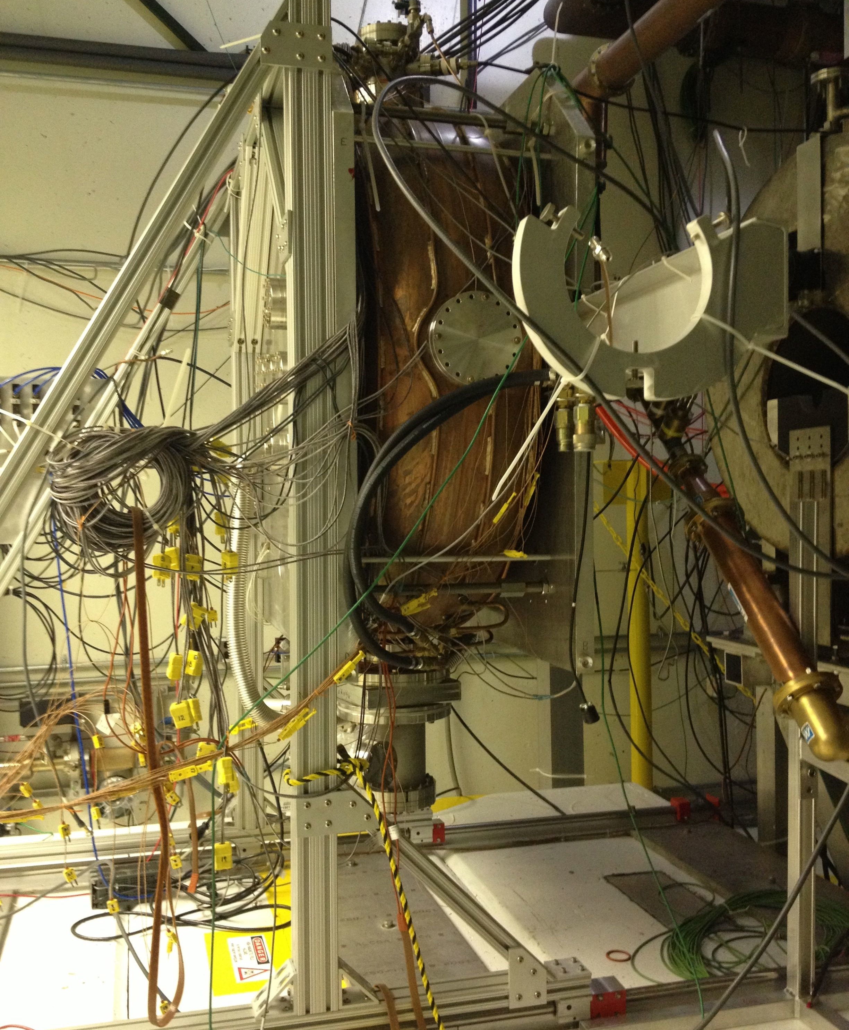
Notes:
Old cavity in MTA Hall

Slide 3
Removing Old 201 Cavity
Came in through door with fork lift
Will go out through labyrinth
Requires new 3 ton Gantry crane
To remove from stage
Will roll out using 4 casters

Slide 4
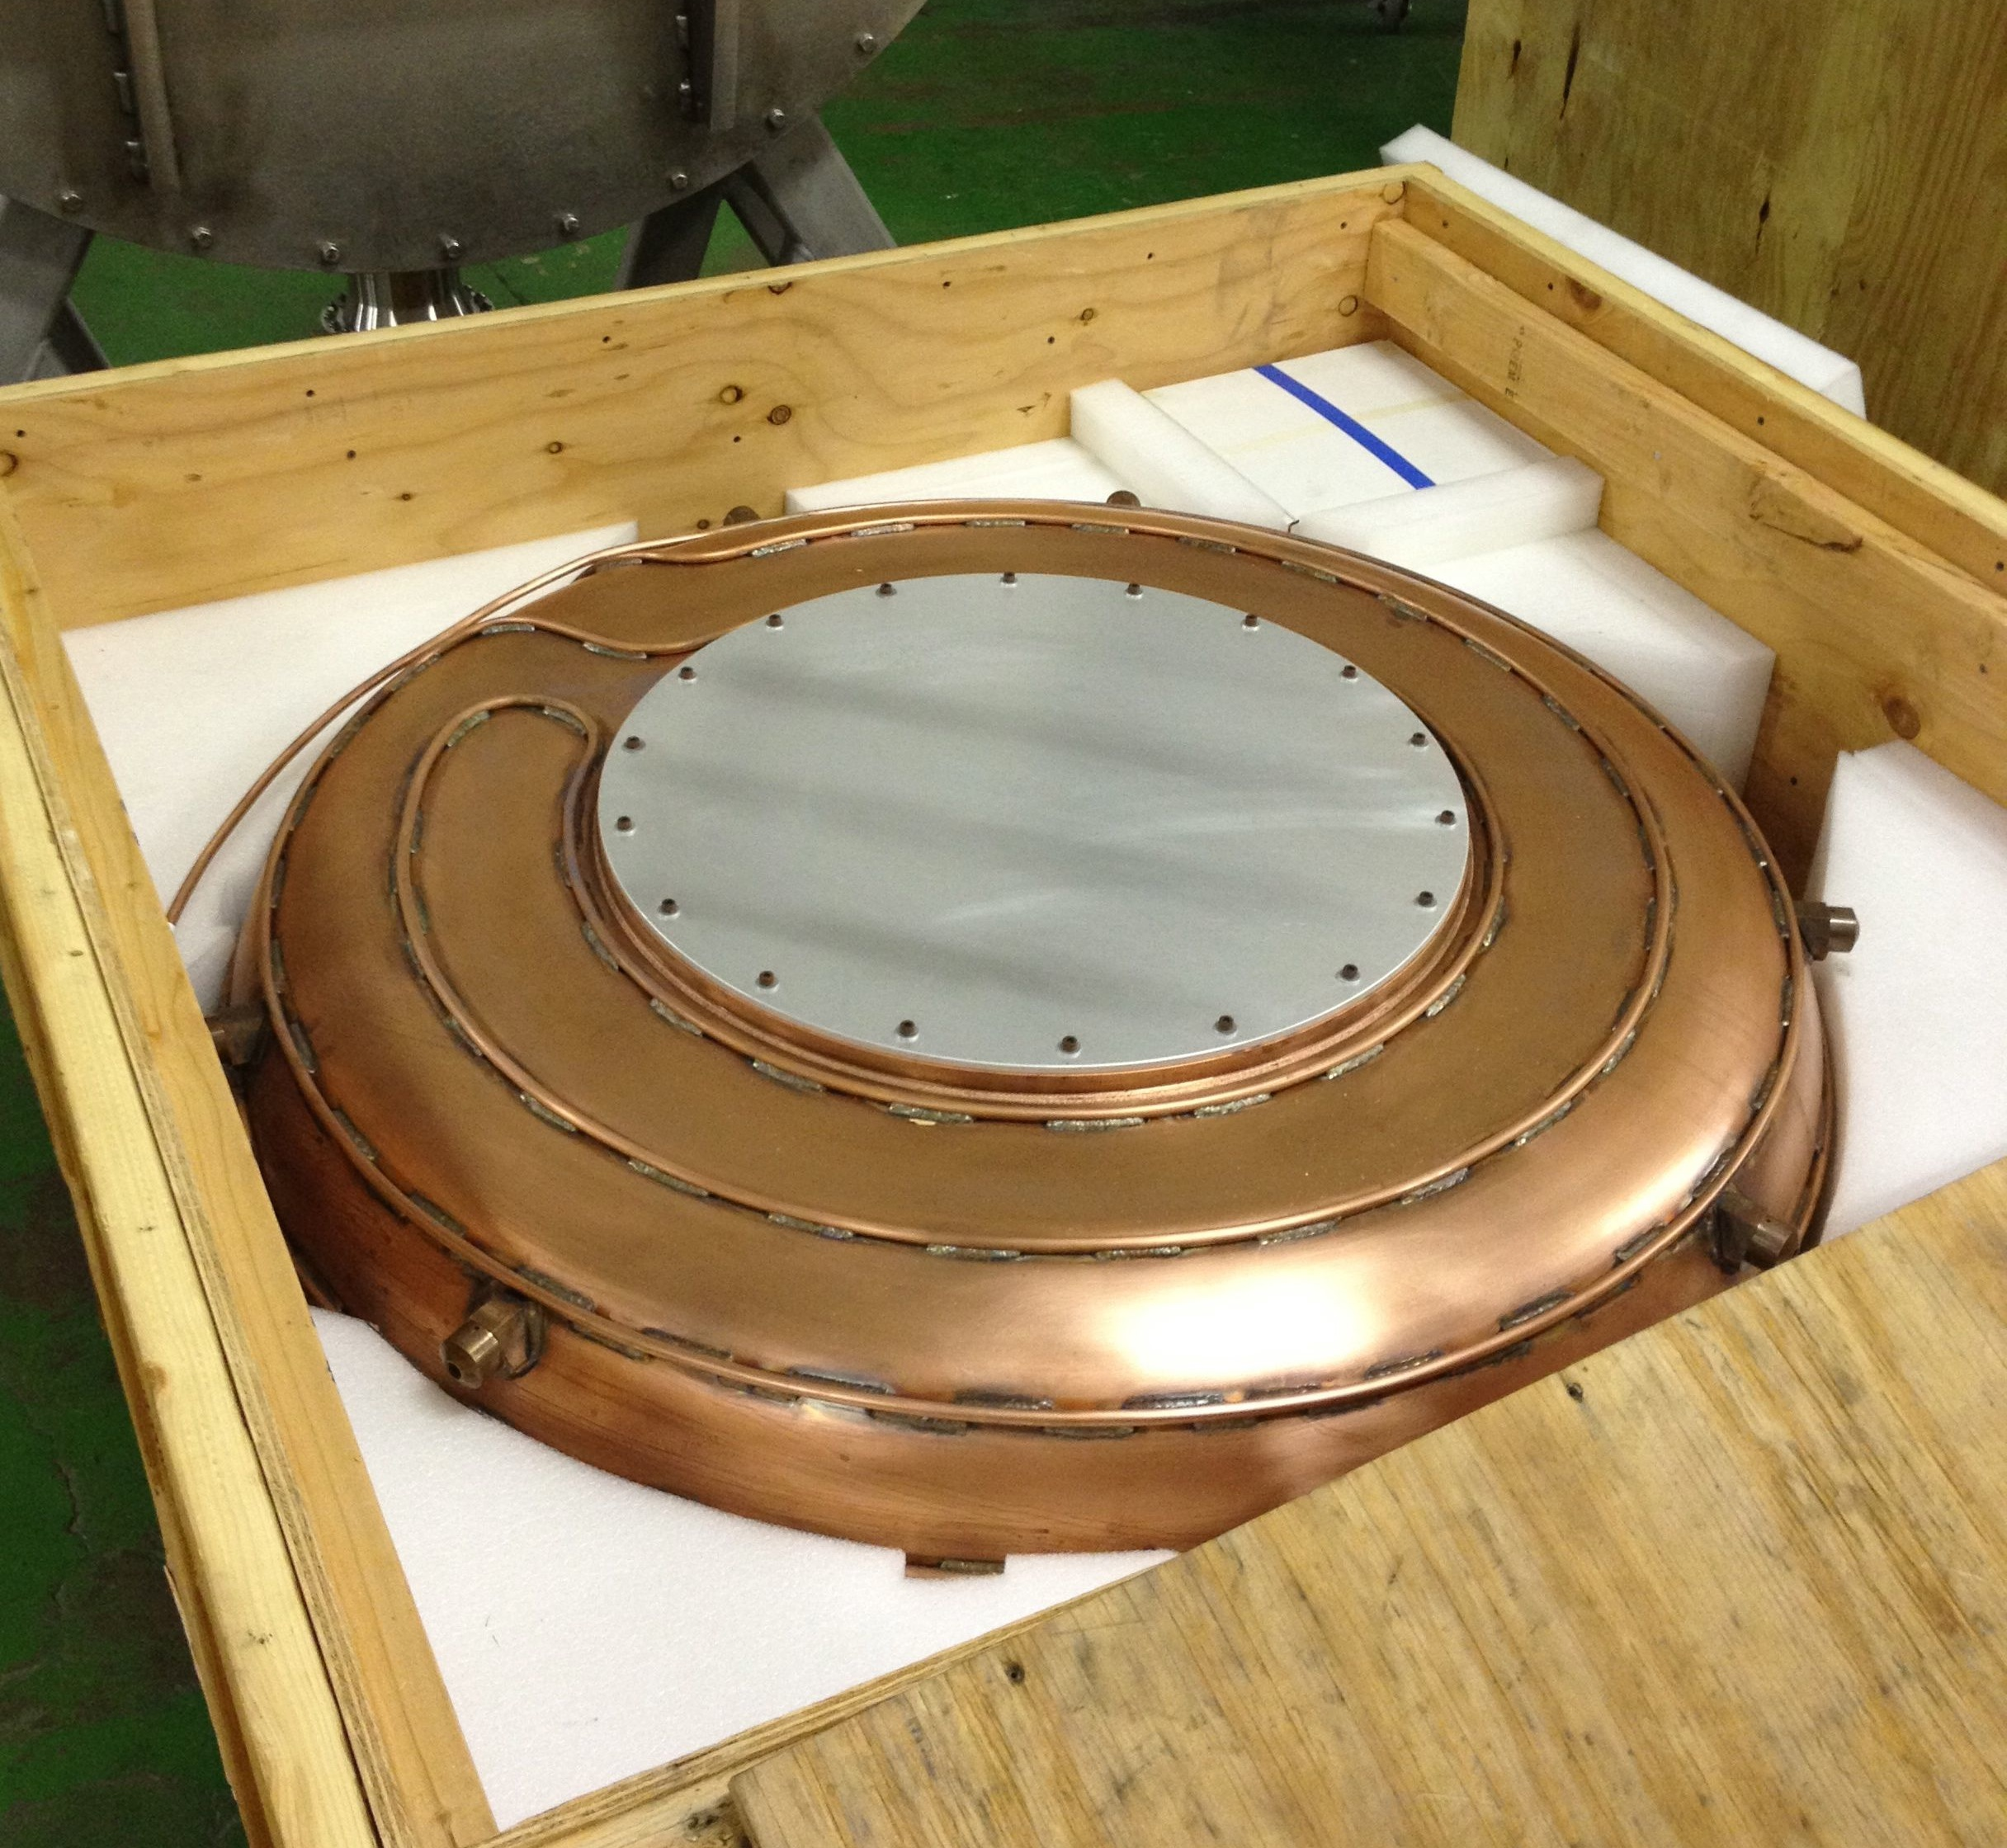
Notes:
New cavity in shipping crate

Slide 5
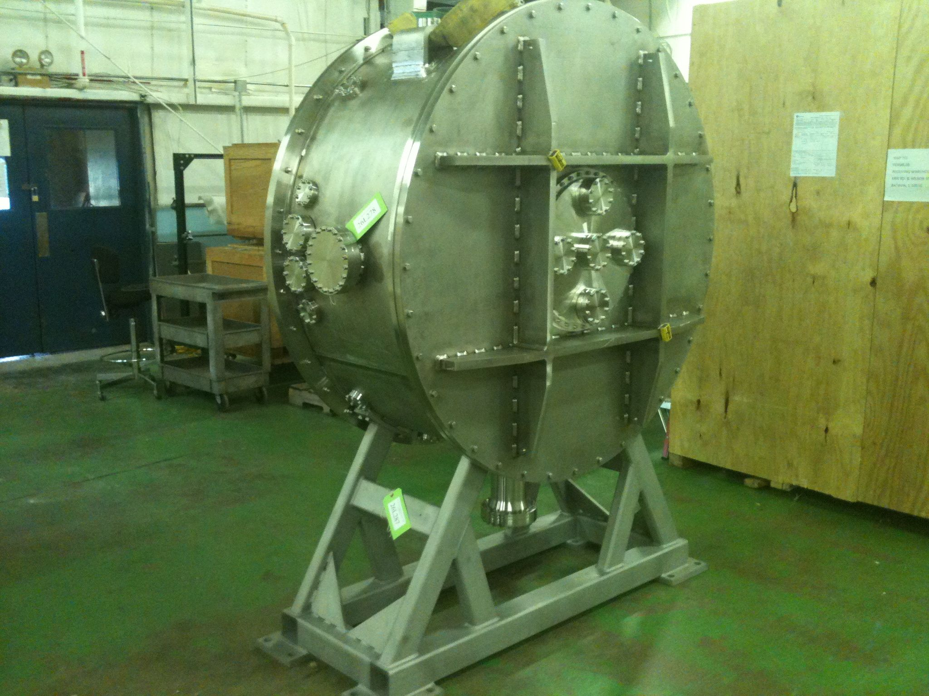
Notes:
Module on operational stand

Slide 6
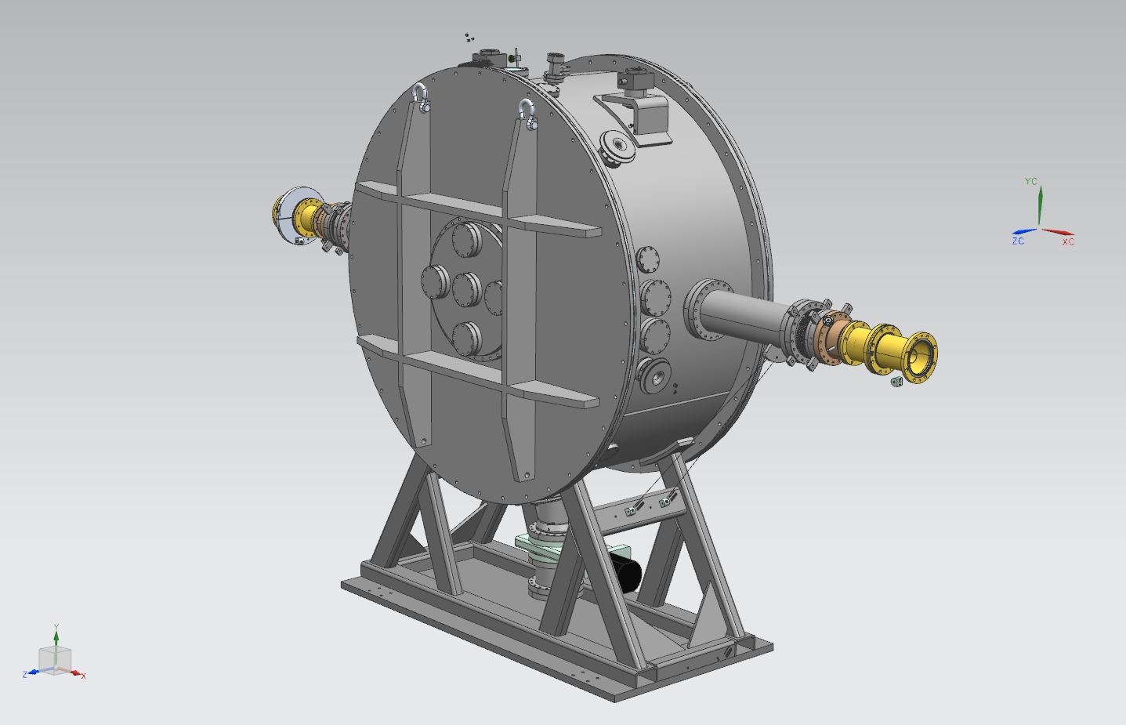
On Operational Stand
Notes:
Model of module on operational stand

Slide 7
201 Module Installation
Will bring into MTA hall through labyrinth
Heavily ribbed doors are too wide for labyrinth
Will remove and roll in doors separately
Put on thin cover plate to keep module inside clean
Stand is too tall for clean room and labyrinth
New “transport” stand is 10” shorter

Slide 8
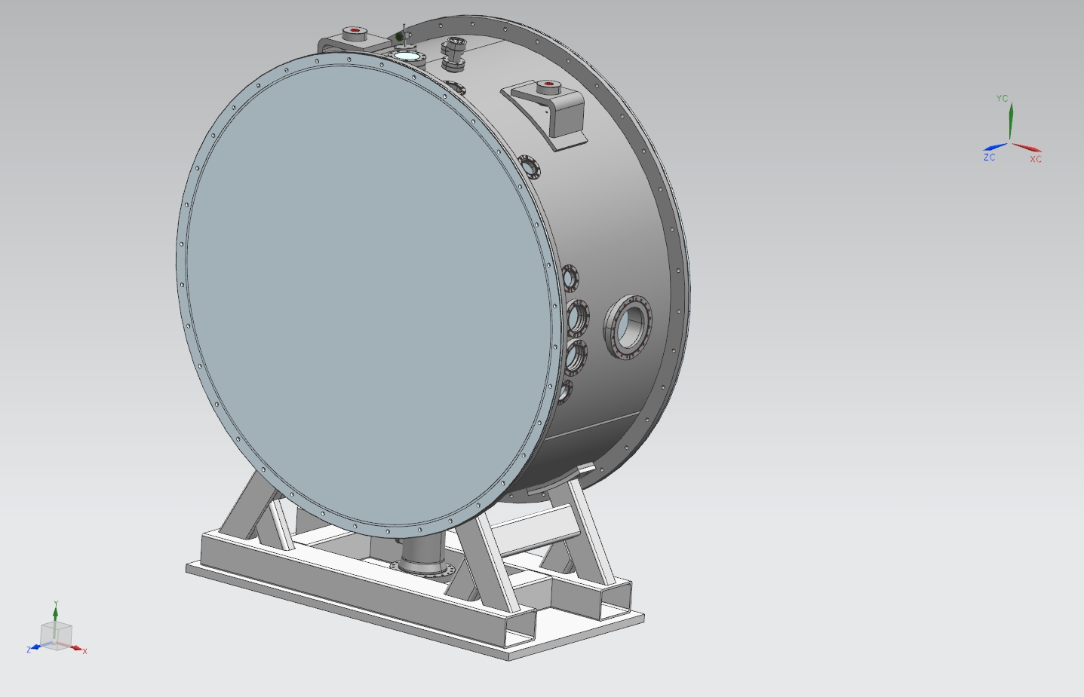
On Transport Stand, thin doors
Notes:
Transport stand with thin cover plates instead of heavy doors. This is how it will be in clean room and through labyrinth.

Slide 9
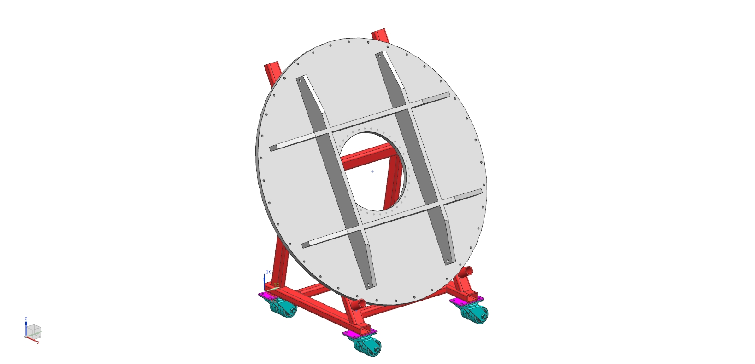
Notes:
Door mover

Slide 10
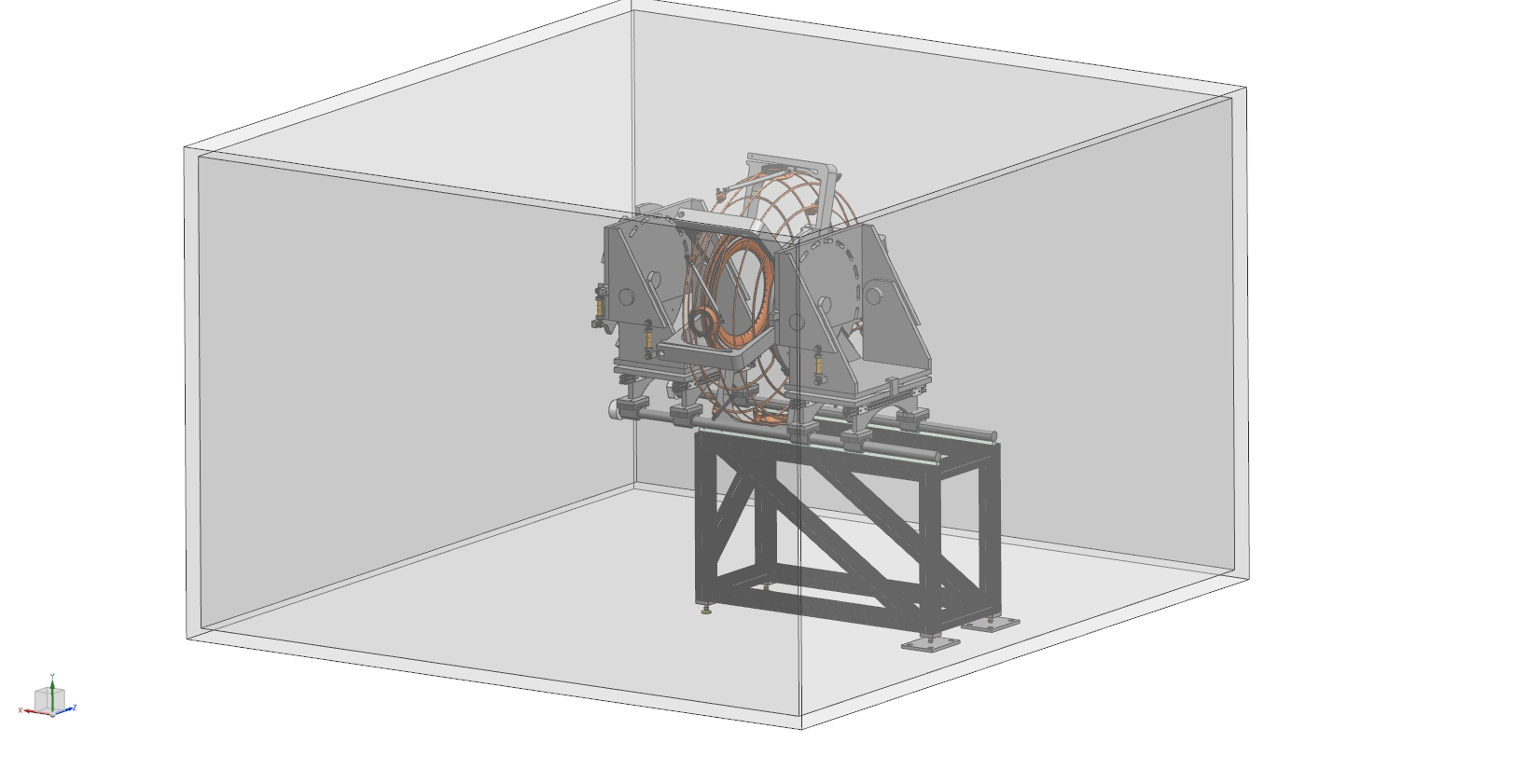
Notes:
Model of clean room with old design of insertion fixture. I may have an updated picture of this Friday…

Slide 11
Lab 6 Clean Room
Once doors removed & transport stand installed
Cavity installation – Vertical
In Lab 6 clean room – Class 100
Insertion picture shown is old design
Allan DeMello is sending new design soon
Mechanical and electrical testing in clean room too

Slide 12
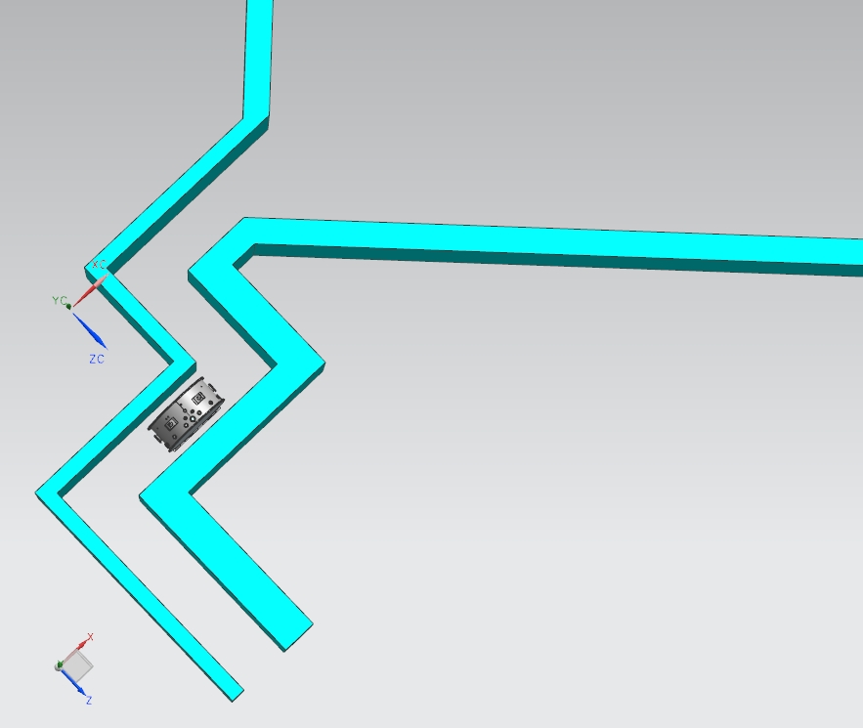
Notes:
Moving module through MTA labyrinth

Slide 13
Assembly in MTA Hall
Remove transport stand, install operational stand
In MTA Clean Room
Install doors
RF Couplers
Other vacuum hardware

Slide 14
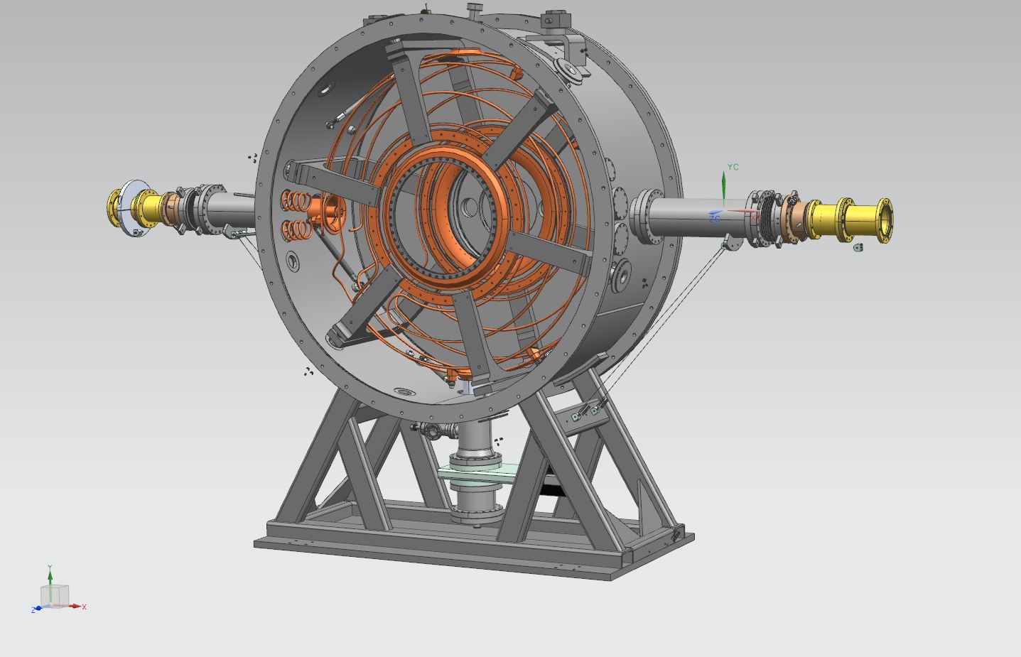
Put on doors in MTA clean room
Notes:
Model of cavity installed in module, back on operational stand.

Slide 15
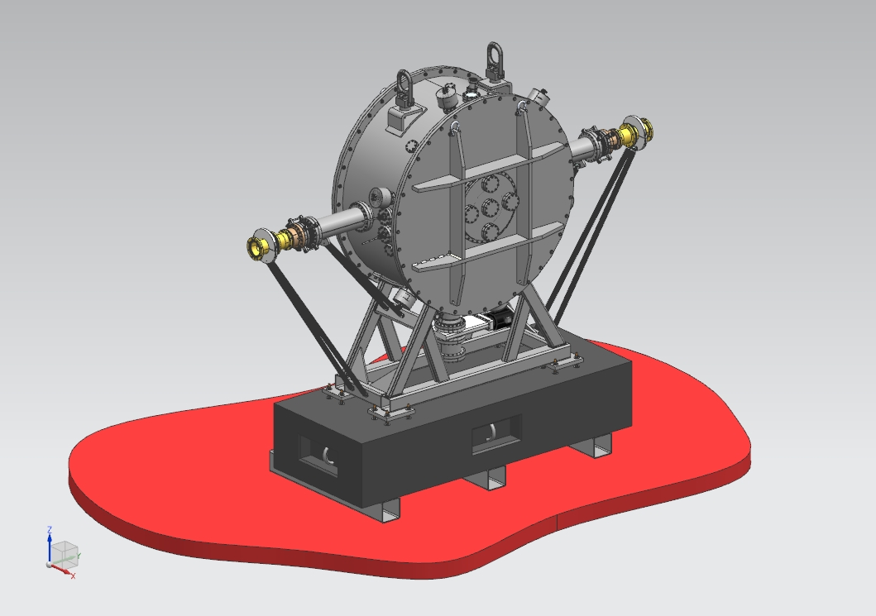
Notes:
Operational stand will be lowered (machined by about 2”) to make centerline match up.

