Slide 1
LRF7 Modifications for MTA
28 May 2013
D. Peterson
Fermilab

Slide 2
Introduction
Linac RF station 7 will need some modifications to run for MTA 201 MHz cavity testing.
Short Term
Amplitude Control via modulator ramping.
Frequency Control via HP8656B.
Mid Term
Tuner Control via RS-485 and pneumatics.
Long Term
New LLRF with phase control and beam sync.

Slide 3
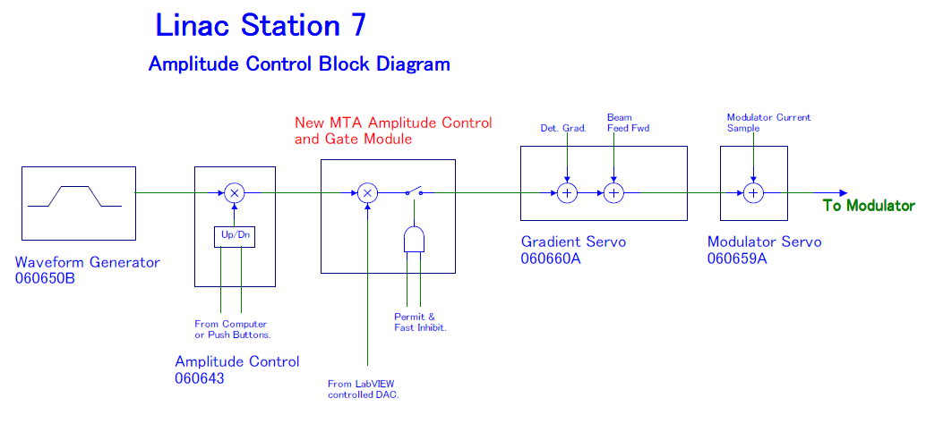

Slide 4
LRF7 Frequency Control
The signal generator only needs to provide frequency control. The driver amplifier is driven into saturation. Overall amplitude control is done by changing the program curve to the Modulator.
Presently using HP8656B Signal Generator.

Slide 6
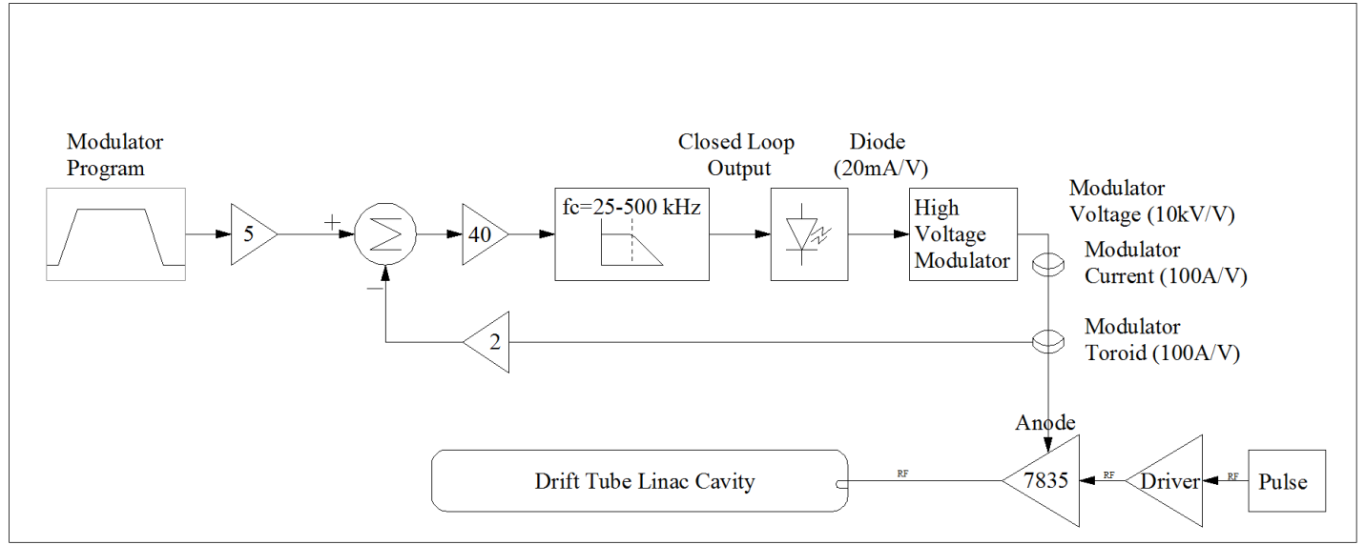
Present System
Amplitude Control
Figure 1.
LRF7 Amplitude Control System
(Modulator Voltage Regulation)
Block diagram courtesy of Trevor Butler

