Slide 1
MTA 201 MHz Cavity Installation Procedure
Jared Gaynier
March 2013

Slide 2
Draft & fabricate insertion fixture
Draft & fabricate tuner mounting fixture
Remove old cavity from MTA Hall
Attach support plates and casters to transport stand
Decide on a lifting solution for module
Implement lifting solution

Slide 3
Move ½ ton gantry from MTA Hall to Lab 6
Clean gantry
Move gantry into Lab 6 clean room
Remove SS covers from module
Transfer module from operational stand to transport stand (with casters)

Slide 4
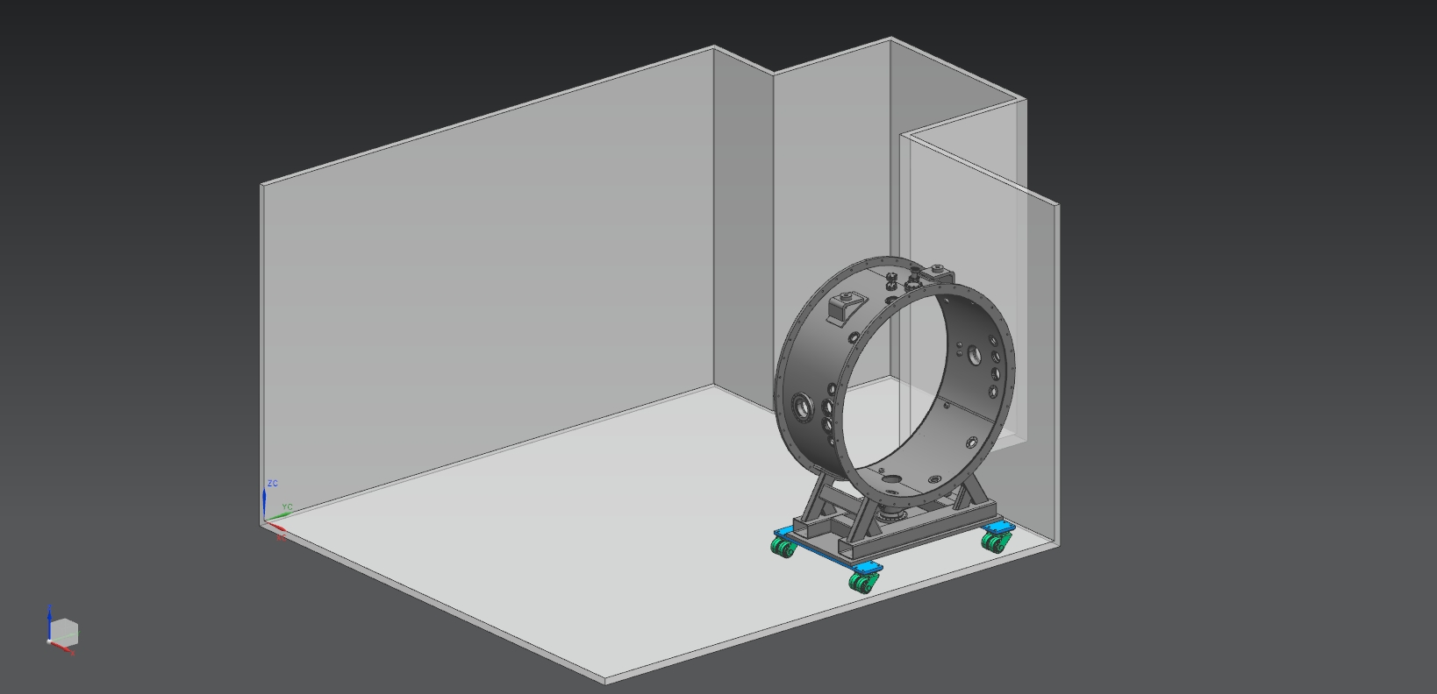
Move module into clean room (off to the side)

Slide 5
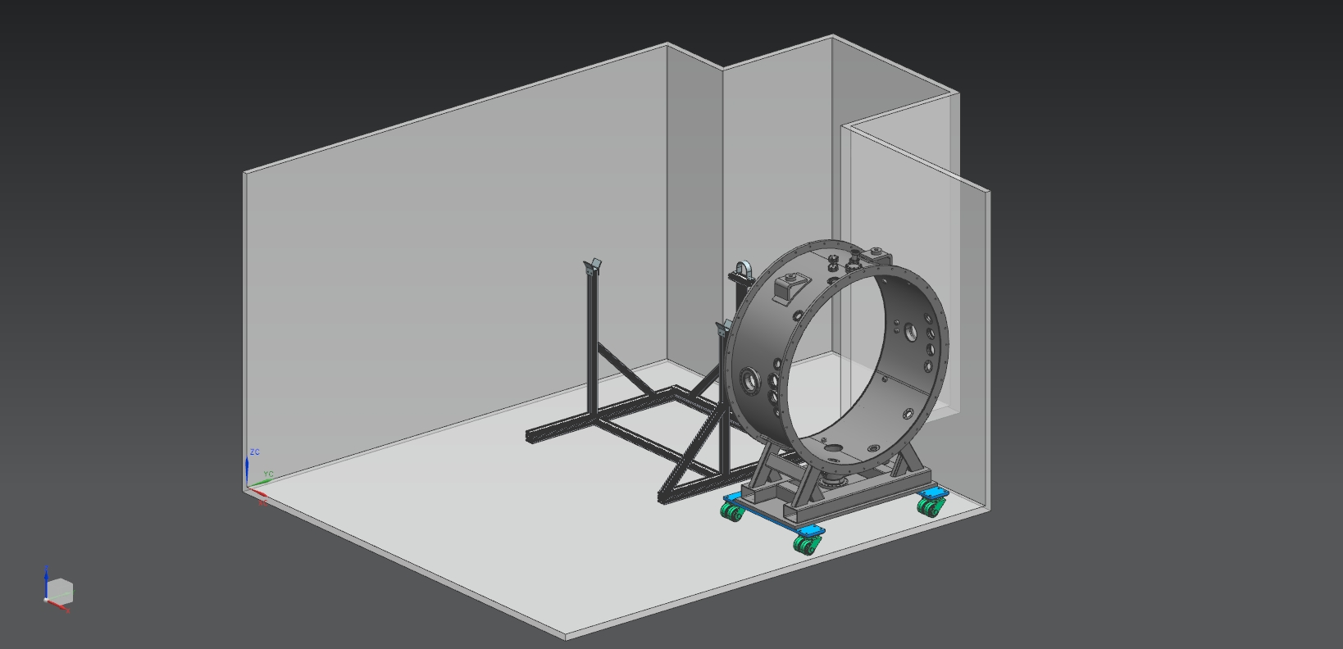
Assemble tuner mounting fixture toward back of room

Slide 6
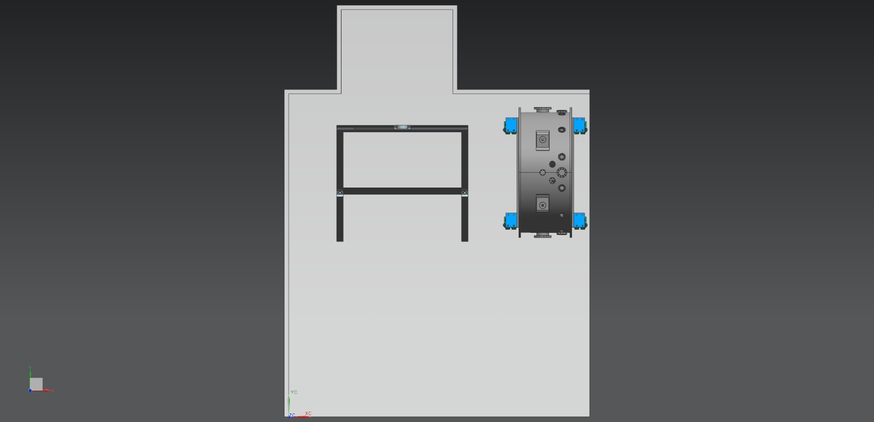

Slide 7
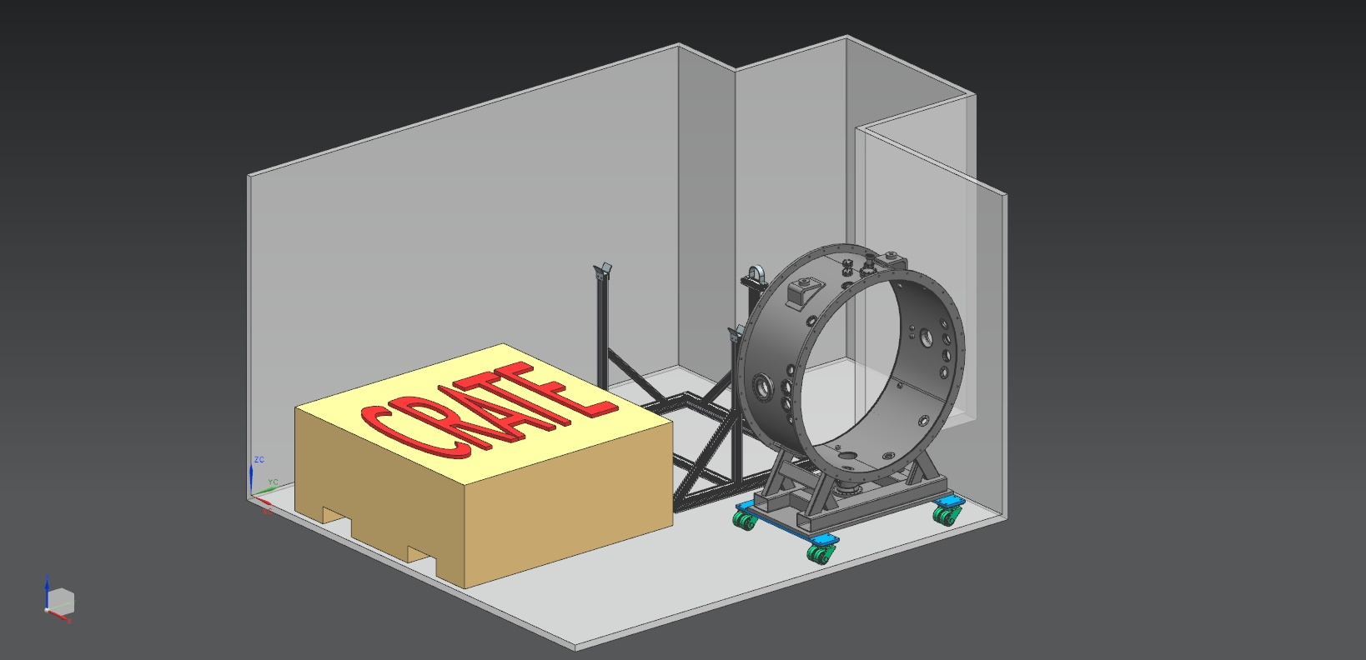
Move cavity crate into clean room, in front of tuner mounting fixture

Slide 8
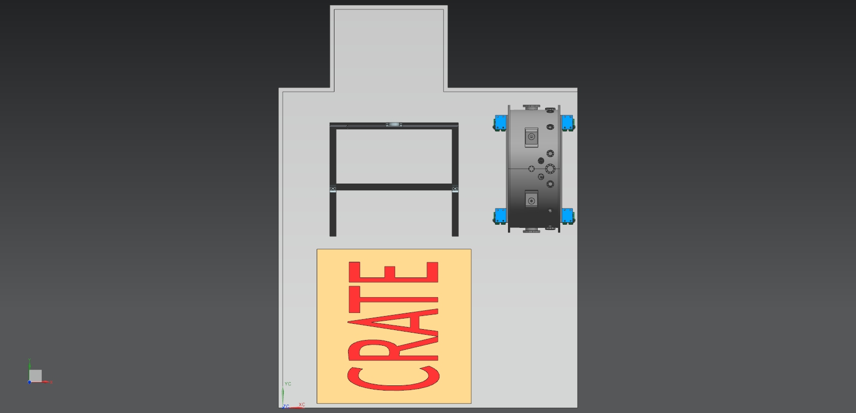

Slide 9
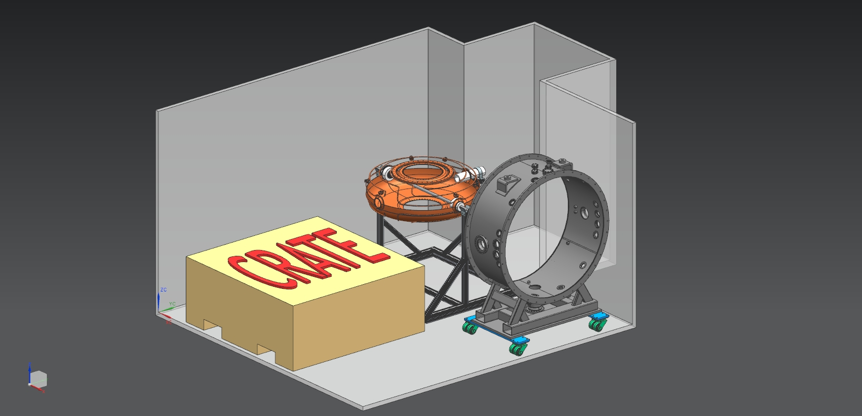
Using gantry crane, remove cavity from crate and place on tuner mounting fixture

Slide 10
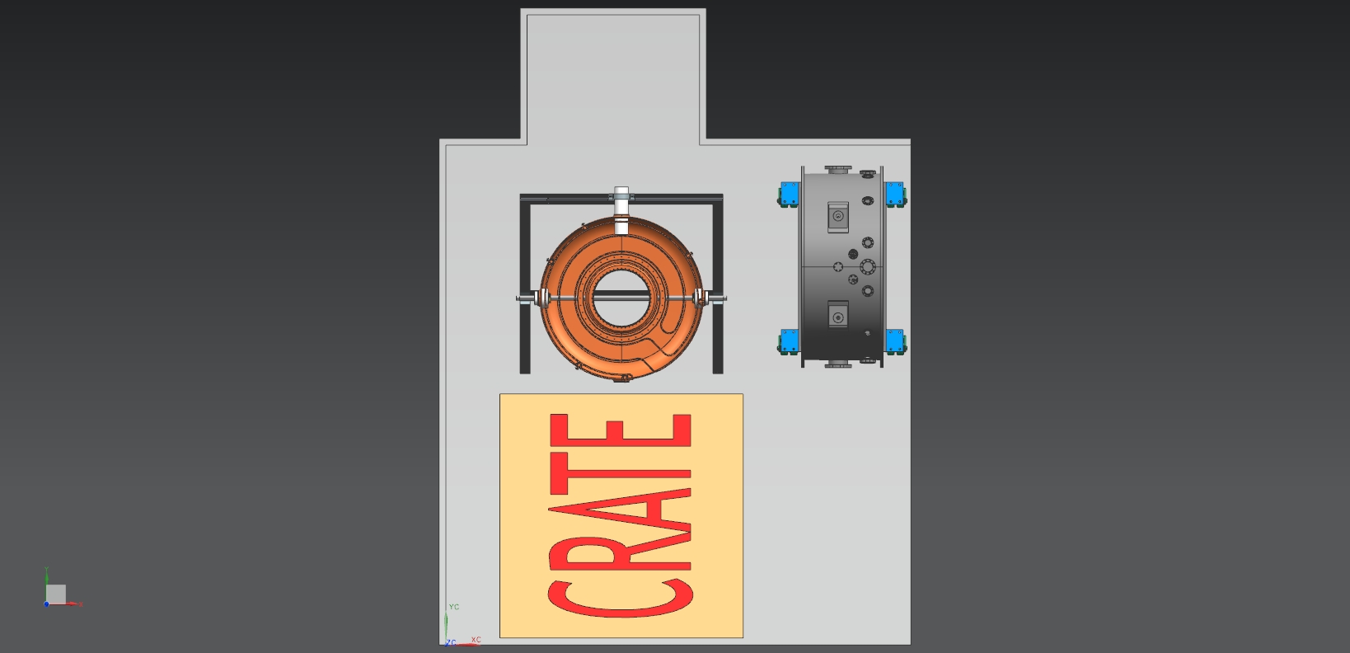

Slide 11
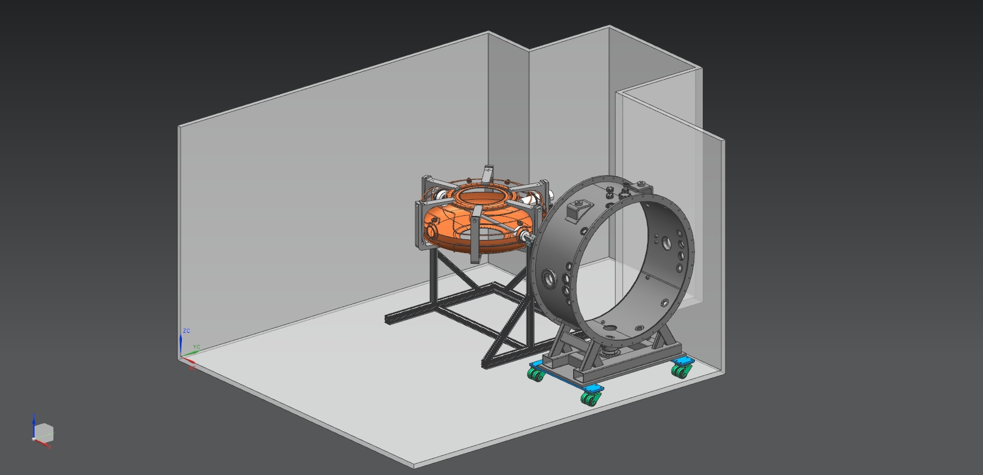
Remove crate from clean room; survey cavity; machine tuners as necessary; install tuners (using gantry as necessary)

Slide 12
Rotate cavity to vertical position

Slide 13
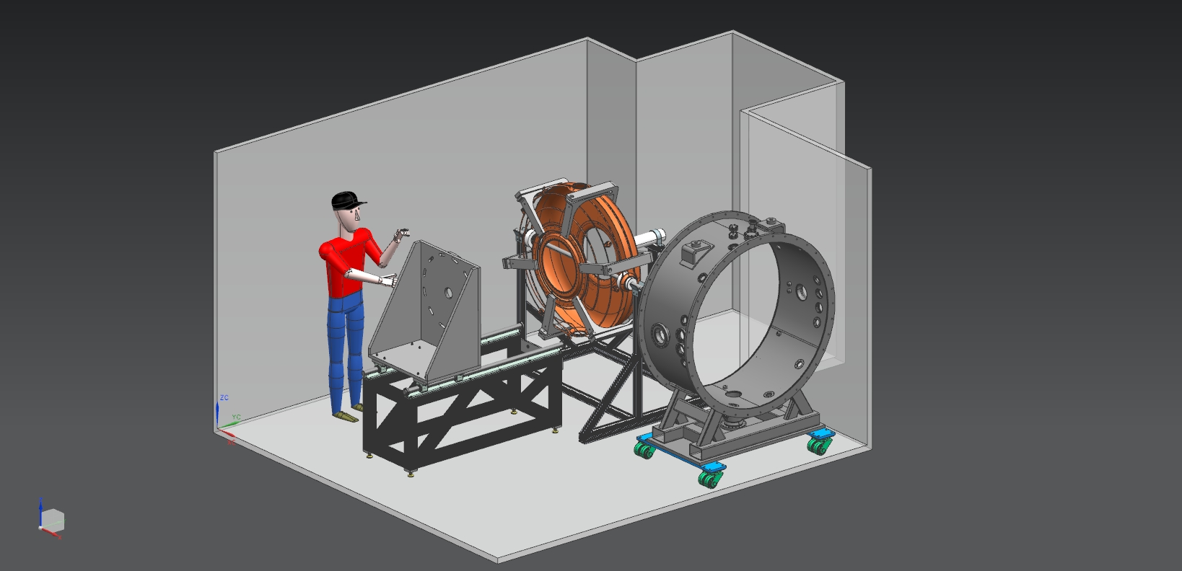
Assemble insertion fixture in front of tuner mounting fixture

Slide 14
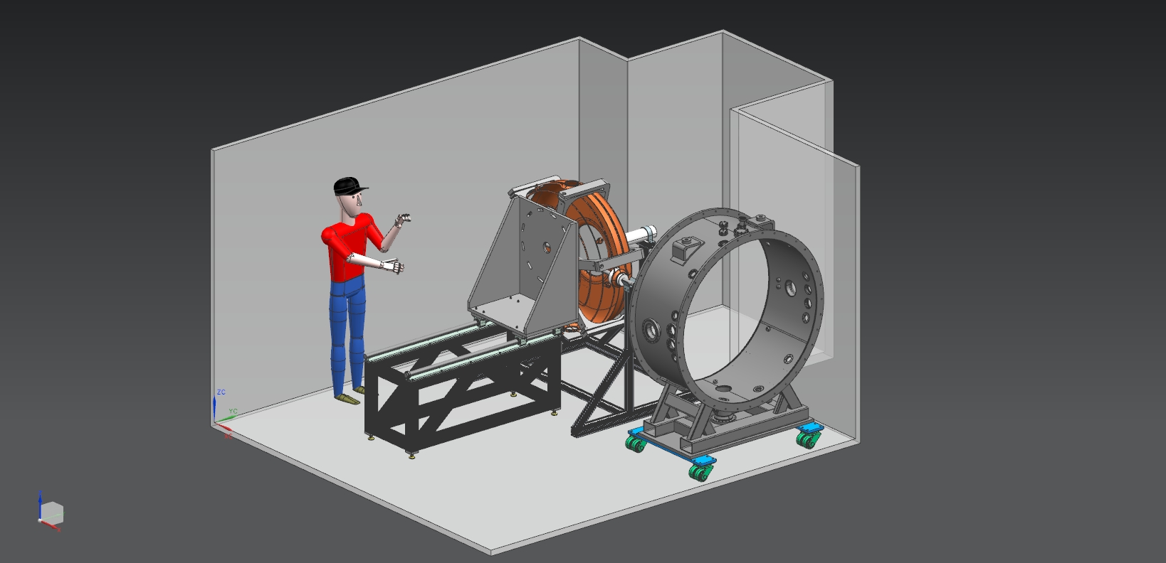
Bolt the cavity to the insertion fixture

Slide 15
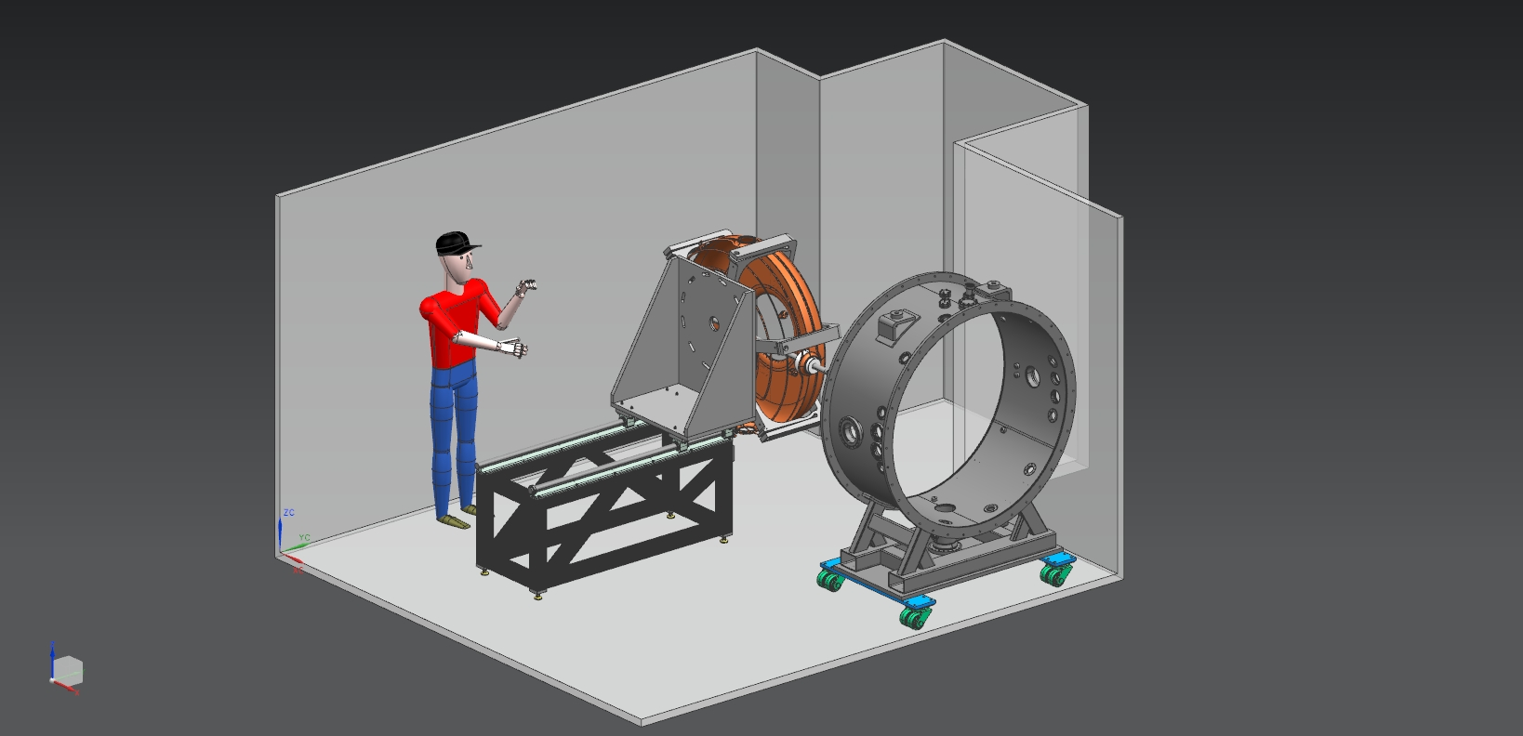
Remove the tuner mounting fixture

Slide 16
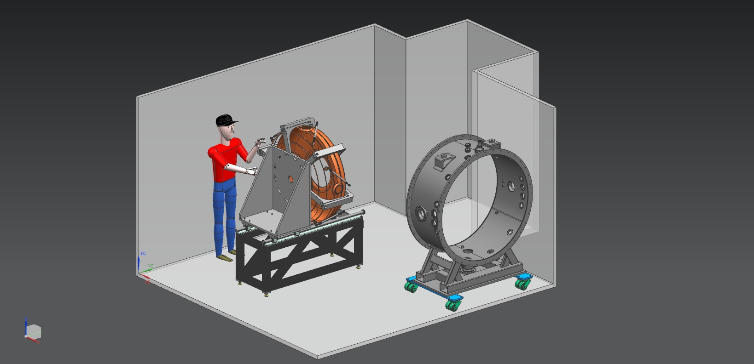
Retract fixture

Slide 17
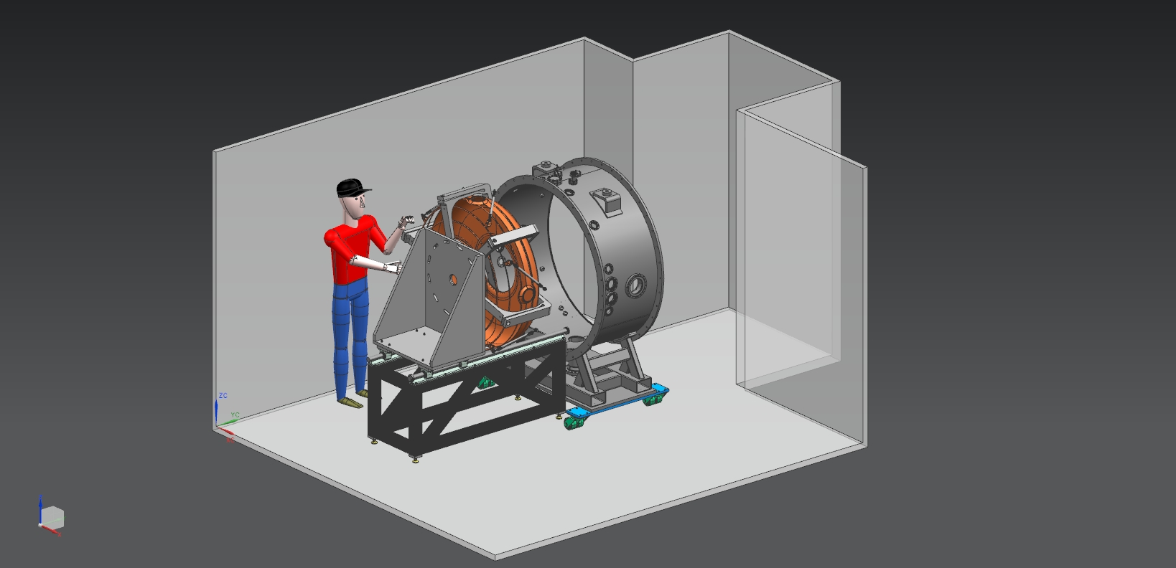
Move the module in front of the insertion fixture

Slide 18
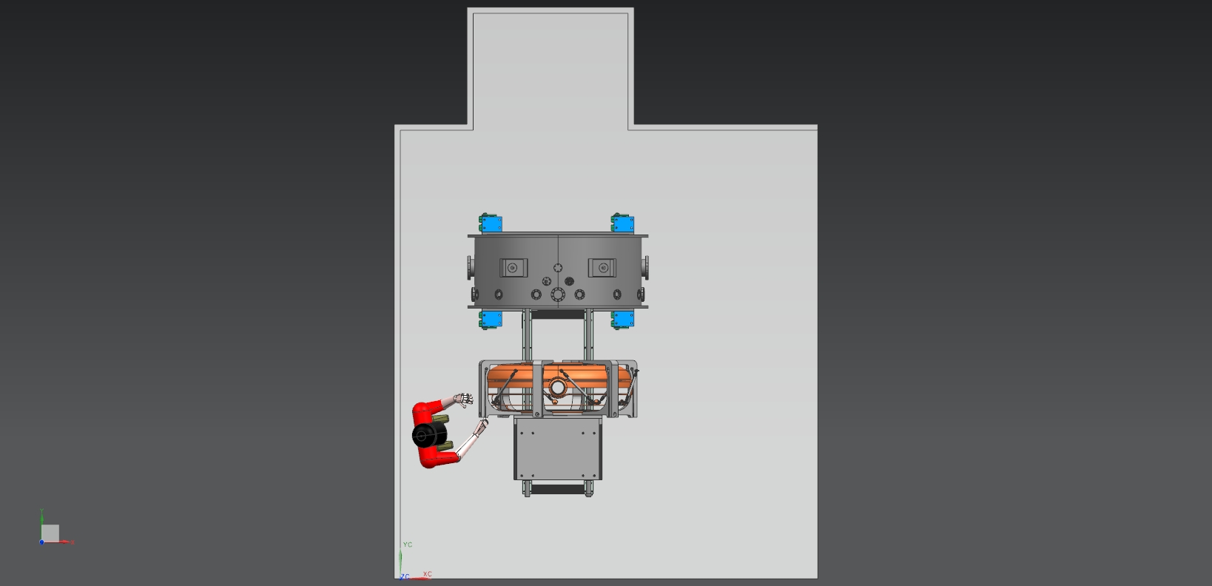

Slide 19
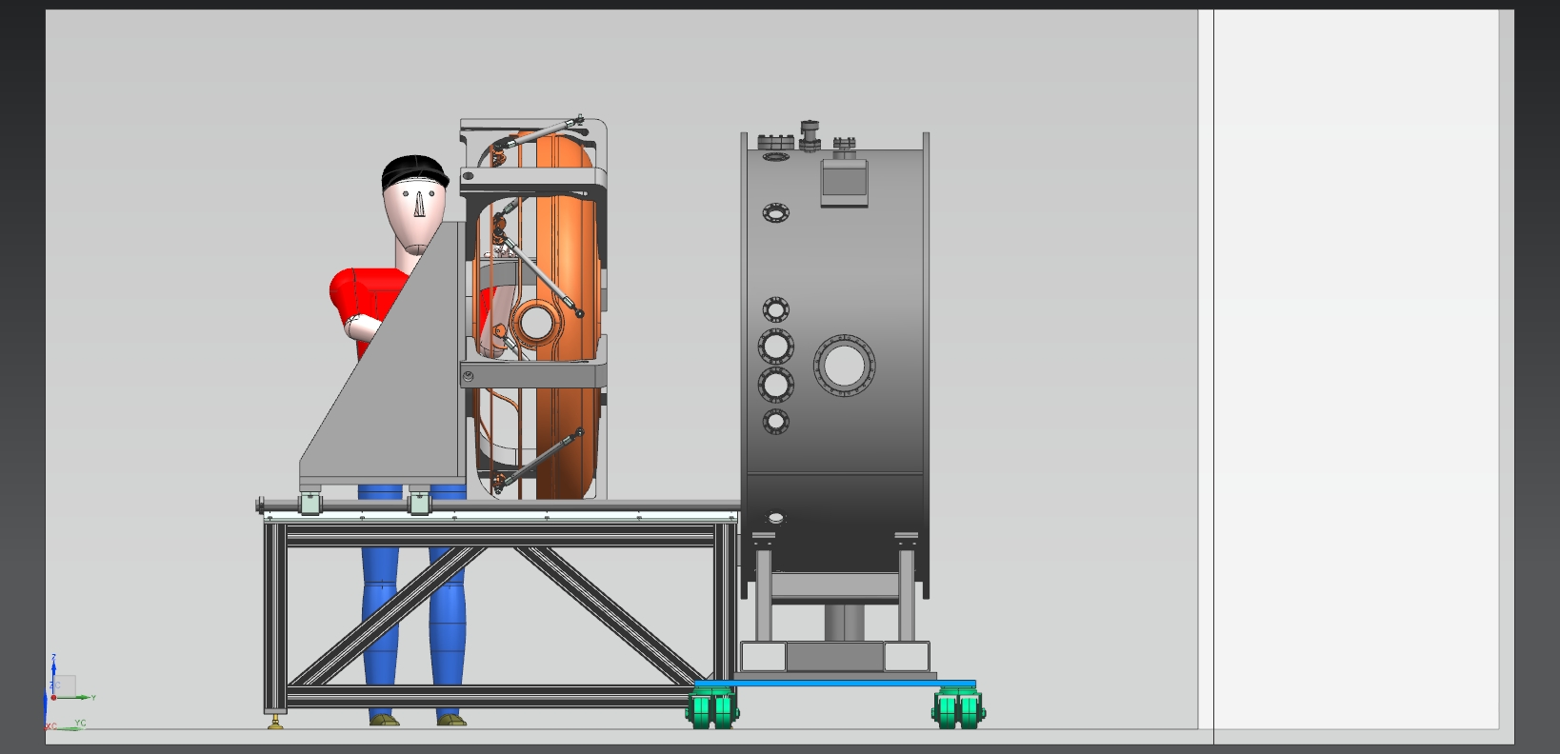

Slide 20
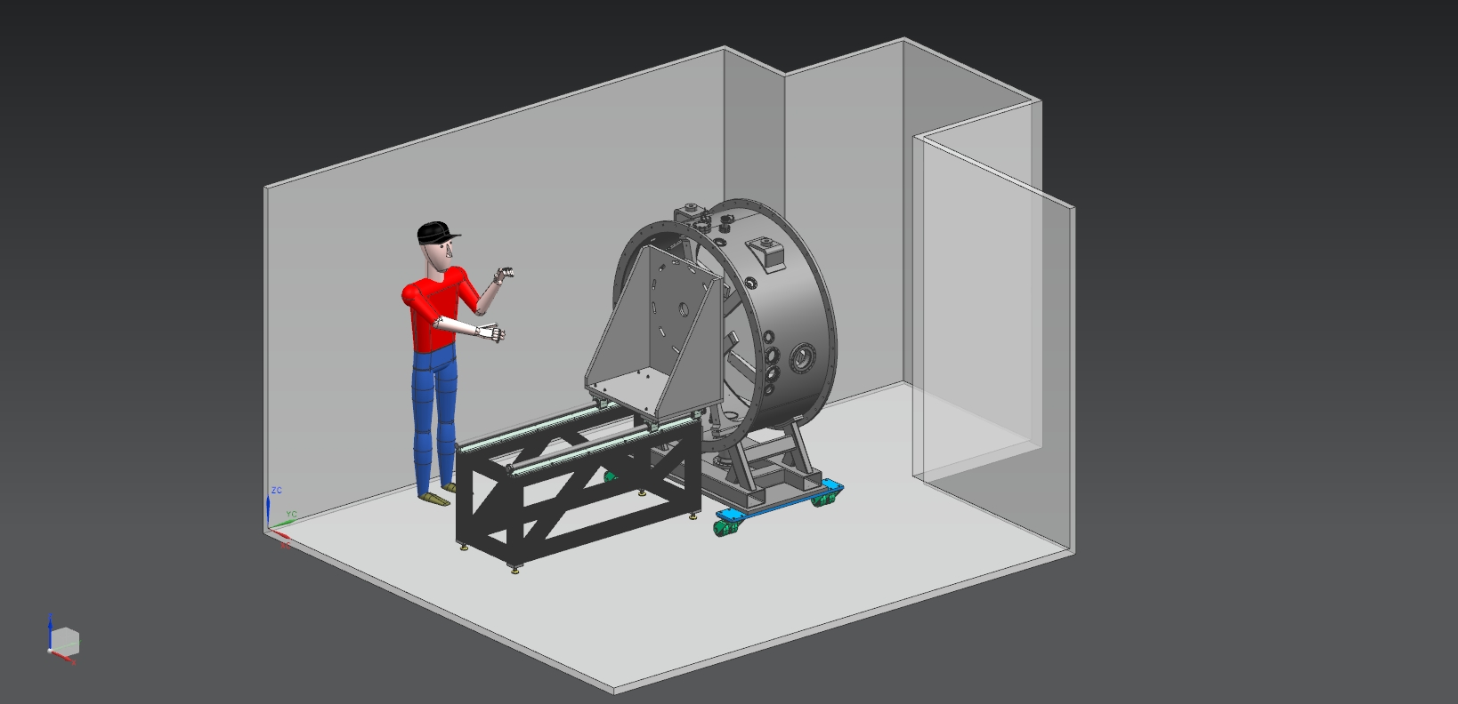
Insert cavity in the module; fasten struts to cavity and module

Slide 21
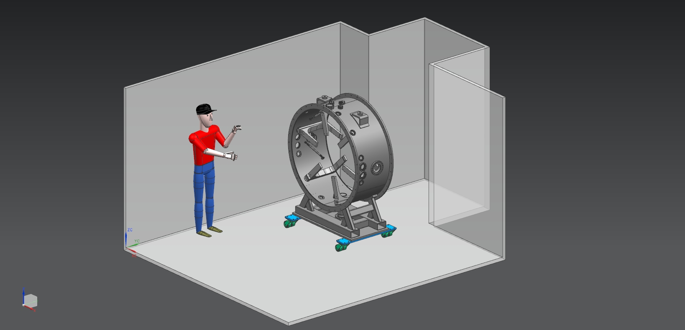
Remove insertion fixture from clean room (or just out of the way); attach arms and other components to module; test as necessary; remove arms and other components; install poly covers

Slide 22
Transport module into MTA Hall clean room
Transport one SS cover into clean room
Remove one poly cover
Install SS cover on module
Transport second SS cover into clean room
Remove second poly cover
Install SS cover on module
Move operational stand into MTA Hall
Transfer module to operational stand
Lift module into place on stage

