Slide 1
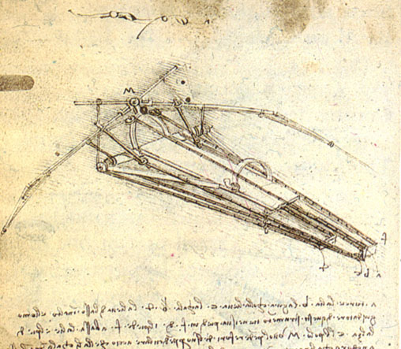
The art event-processing framework
Marc Paterno Jim Kowalkowski

Slide 2
What is art?
art is a modular event-processing framework used by many Intensity Frontier experiments, and even by non-IF users.
It is used as part of DAQ systems and in the offline processing role.

Slide 3
Distribution
The SSI group delivers binary distributions of art and the software tools on which it depends using “relocatable UPS”.
We make use of UPS features that help assure setup of a consistent set of products.
We currently build for SLF5 and SLF6, and are working on support of Darwin 10, 11 and 12; we have requests for Ubuntu 12.
Installation tarballs will be distributed through CVMFS.
Installation of new products does not require any elevated privileges.
Currently products are served from http://oink.fnal.gov/distro.
Some products are delivered in bundles, with a single version number for the bundle.

Slide 4
Support model
Three main avenues for support:
Mailing lists: artists@fnal.gov (to contact the developers), art-stakeholders@fnal.gov (to contact “official points of contact”), art-users@fnal.gov (to communicate among users of art)
Redmine issues tracker:https://cdcvs.fnal.gov/redmine/projects/art/issues
Weekly stakeholder meetings, recently accessible through ReadyTalk.

Slide 5
Requirements and issue tracking
Requirements for art were set primarily long ago.
New requirements come in through the issues system, as feature requests.
Mainly, the issue tracker is used to keep track of bug reports, and fixes for the bugs.
Stakeholder meetings used to verify that fixes are sufficient, and to announce new releases.
Stakeholder meetings are also used to discuss trade-offs in design, when a modification would have “side-effects”.

Slide 6
Feature development
Stakeholder meeting used to set priorities of new features.
Very limited effort is available, because there is no “project” to which to bill time.
Sometimes related projects “support” the development of features needed in art, which then benefits all users of art.

Slide 7
Interfaces with other systems
art has been interfaced to SAM by the production of a UPS product that provides SAM functionality as a plugin service to art, this took some “negotiation” to determine a clear “division of responsibility” between the different bodies of software.
art has a service API to allow introduction of new facilities.
Workflow management has not been interfaced to art, but the design of art is intended to help ease this interfacing:
Many features of the configuration can be controlled through the command line
The configuration language is a simple text format, with a parameter replacement mechanism and configuration “prolog” features to allow a workflow management system to write art configuration files almost trivially.

