Slide 1

An Overview of the
U.S. Muon Accelerator Program
COOL`13
Mürren, Switzerland
Mark A. Palmer
June 10, 2013

Slide 2
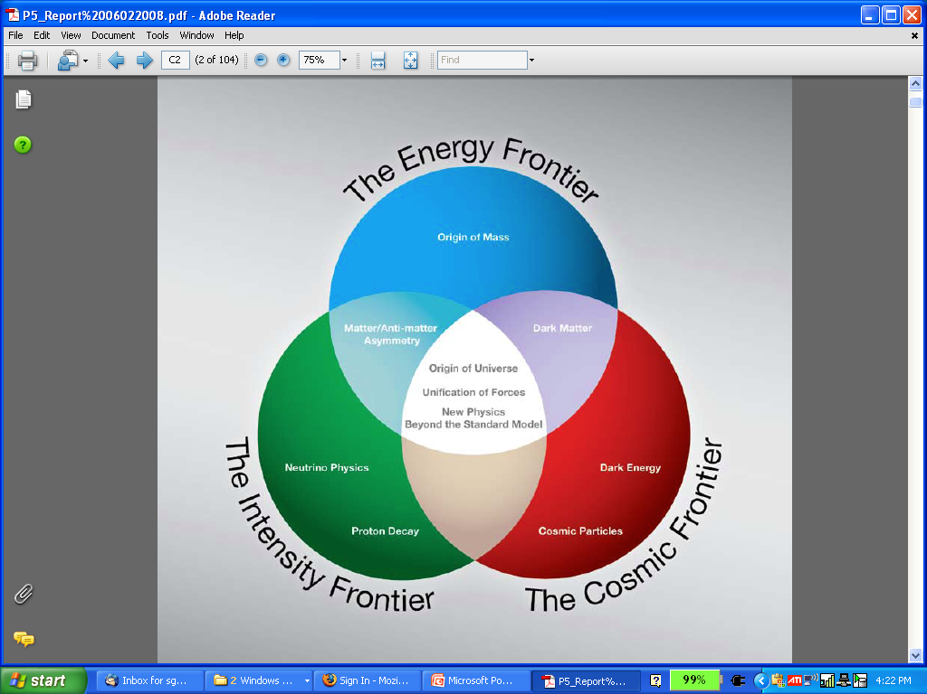
The Aims of the Muon Accelerator Program
  Muon accelerator R&D is focused on developing a facility that can address critical questions spanning two frontiers…
  The Intensity Frontier:
  with a Neutrino Factory producing well-characterized ν beams for precise, high sensitivity studies
  The Energy Frontier:
  with a Muon Collider capable of reaching multi-TeV CoM energies
  and
  a Higgs Factory on the border between these Frontiers
The unique potential of a facility based on muon accelerators is physics reach that SPANS 2 FRONTIERS

Slide 3
Outline
The Physics Motivations
The Muon Accelerator Program
The R&D Challenges
Some Recent R&D Highlights
The Staging Study and Timelines
Conclusion

Slide 4
THE PHYSICS MOTIVATIONs

Slide 5
The Physics Motivations
μ – an elementary charged lepton:
  200 times heavier than the electron
  2.2 μs lifetime at rest
Physics potential for the HEP community using muon beams
  Tests of Lepton Flavor Violation
  Anomalous magnetic moment a hints of new physics (g-2)
  Can provide equal fractions of electron
  and muon neutrinos at high intensity for
  studies of neutrino oscillations –
  the Neutrino Factory concept
  Offers a large coupling to the “Higgs mechanism”
  As with an e⁺e⁻ collider, a μ⁺μ⁻ collider would offer a precision probe of fundamental interactions – in contrast to hadron colliders

Slide 6
Muon Accelerator Physics
Large muon mass strongly
suppresses synchrotron
radiation
  a Muons can be accelerated and
  stored using rings at much
  higher energy than electrons
  a Colliding beams can be of
  higher quality with reduced
  beamstrahlung
Short muon lifetime has impacts as well
  Acceleration and storage time of a muon beam is limited
  Collider a a new class of decay backgrounds must be dealt with
Precision beam energy measurement by g-2 allows precision Higgs width determination
Muon beams produced as tertiary beams:
  Offers key accelerator challenges…
Beamstrahlung in
any e+e- collider
δE/E ∝ γ²

Slide 7
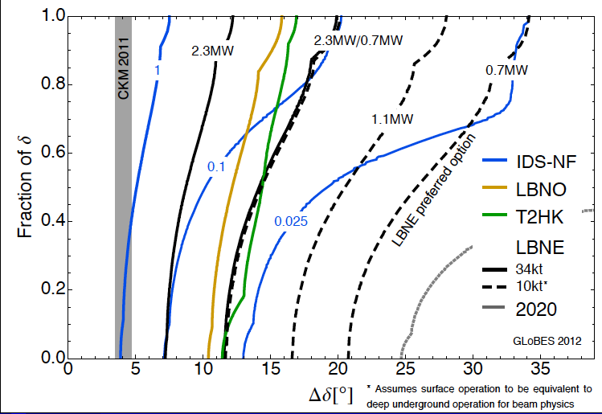
The Physics Needs: Neutrinos
CP violation physics reach of various facilities
Can we probe
the CP violation
in the neutrino
sector at the
same level as in
the CKM Matrix?
Measurement sensitivity
in the quark sector
0.025 IDS-NF:
700kW target,
no cooling,
2×10⁸ s running time
10-15 kTon detector
P. Coloma, P. Huber, J. Kopp, W. Winter – article in preparation

Slide 8
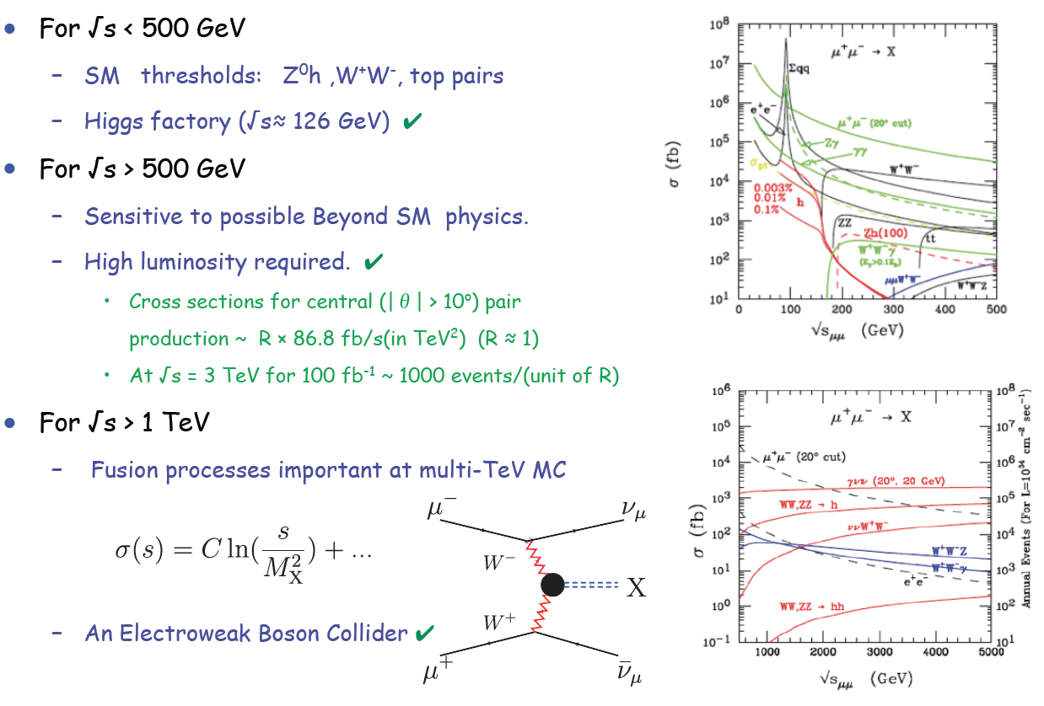
Muon Collider Reach
E. Eichten

Slide 9
Muon Accelerator Program

Slide 10
The Muon Accelerator Program
During this decade:
To deliver results that will permit the high-energy physics community to make an informed choice of the optimal path to a high-energy lepton collider and/or a next-generation neutrino beam facility
As well as…
To explore the path towards a facility that can provide cutting edge performance at both the Intensity Frontier and the Energy Frontier
To validate the concepts that would enable the Fermilab accelerator complex to support these goals

Slide 11
Muon Collider-Neutrino Factory Comparison
NEUTRINO FACTORY
ν Factory Goal:
O(10²¹) μ/year
within the
accelerator
acceptance
Share same complex
MUON COLLIDER

Slide 12
The MAP Feasibility Assessment
Feasibility Assessment: Phase I
FY13 − FY15:
Identify baseline design concepts
Identify high leverage alternative concepts
Identify key engineering paths to pursue:
  RF
  High Field Magnets
Develop critical engineering concepts (eg, 6D Cooling Cell)
Support major systems tests
  MICE Step IV
  MICE RFCC construction & testing
Feasibility Assessment: Phase II
FY16 − FY18:
Technical demonstration of critical baseline concepts
  eg, 6D Cooling cell
Pursue high leverage alternative concepts
Assess technical and cost feasibility of baseline concepts
Support major systems tests
  MICE Step V/VI
  6DICE planning
Beyond
Phases I & II
FY19 ➔
Plan contingent on the conclusions from Phases I & II
Goal is to launch the conceptual & technical design effort towards a staged implementation of a NF & MC?
Advanced systems tests

Slide 13
THE R&D CHALLENGES

Slide 14
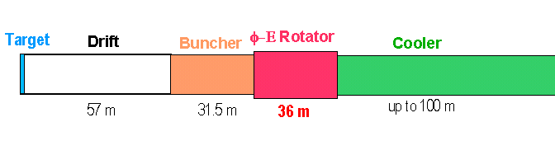
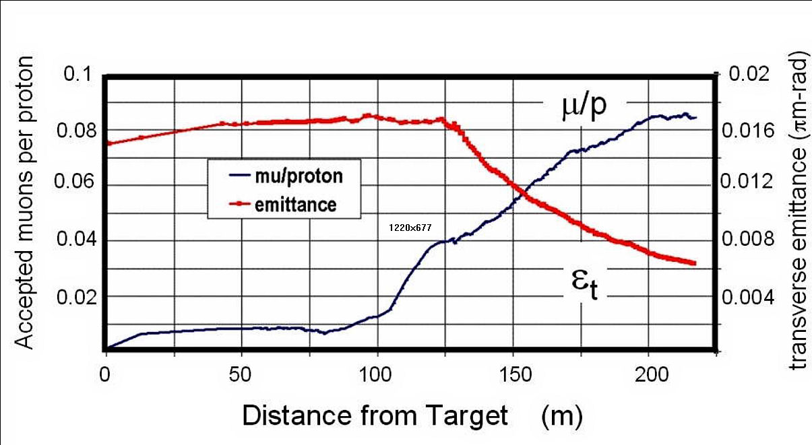
Technology Challenges – Tertiary Production
Neuffer
A multi-MW proton source, e.g., Project X, will enable
O(10²¹) muons/year to be produced, bunched and cooled to fit within the acceptance of an accelerator.

Slide 15
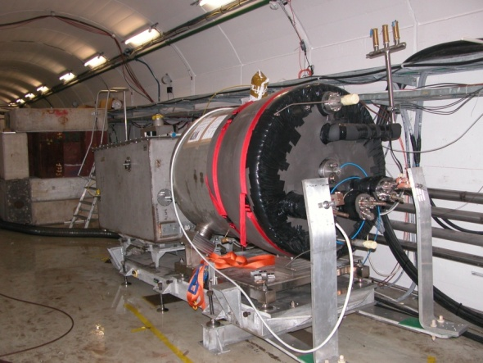
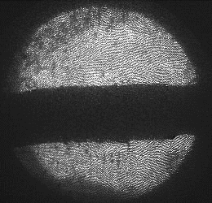
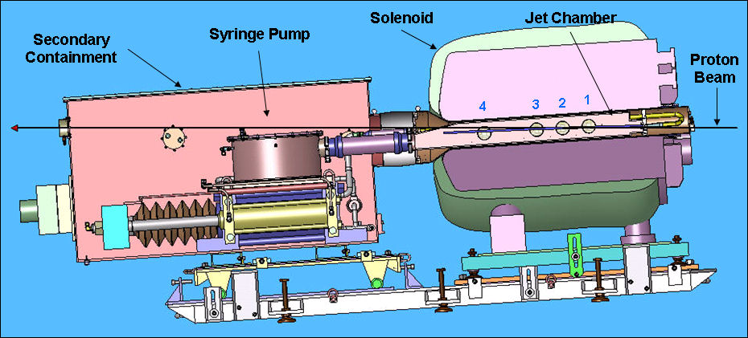
Technology Challenges - Target
The MERIT Experiment at the CERN PS
  Proof-of-principle demonstration of a liquid Hg jet target in high-field solenoid in Fall `07
  Demonstrated a 20m/s liquid Hg jet injected into a 15 T solenoid and hit with a 115 KJ/pulse beam!
  a Technology OK for beam powers up to
  8 MW with a repetition rate of 70 Hz!
1 cm
Hg jet in a 15 T solenoid
with measured disruption length ~ 28 cm

Slide 16
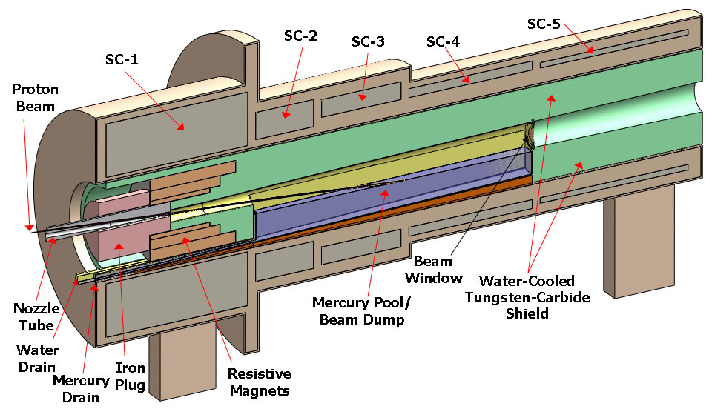
TechnoIogy Challenges – Capture Solenoid
A Neutrino Factory and/or Muon Collider Facility requires challenging magnet design in several areas:
  Target Capture Solenoid (15-20T with large aperture)
  E_{stored} ~ 3 GJ
  O(10MW) resistive
  coil in high radiation
  environment
  Possible application
  for High Temperature
  Superconducting
  magnet technology

Slide 17
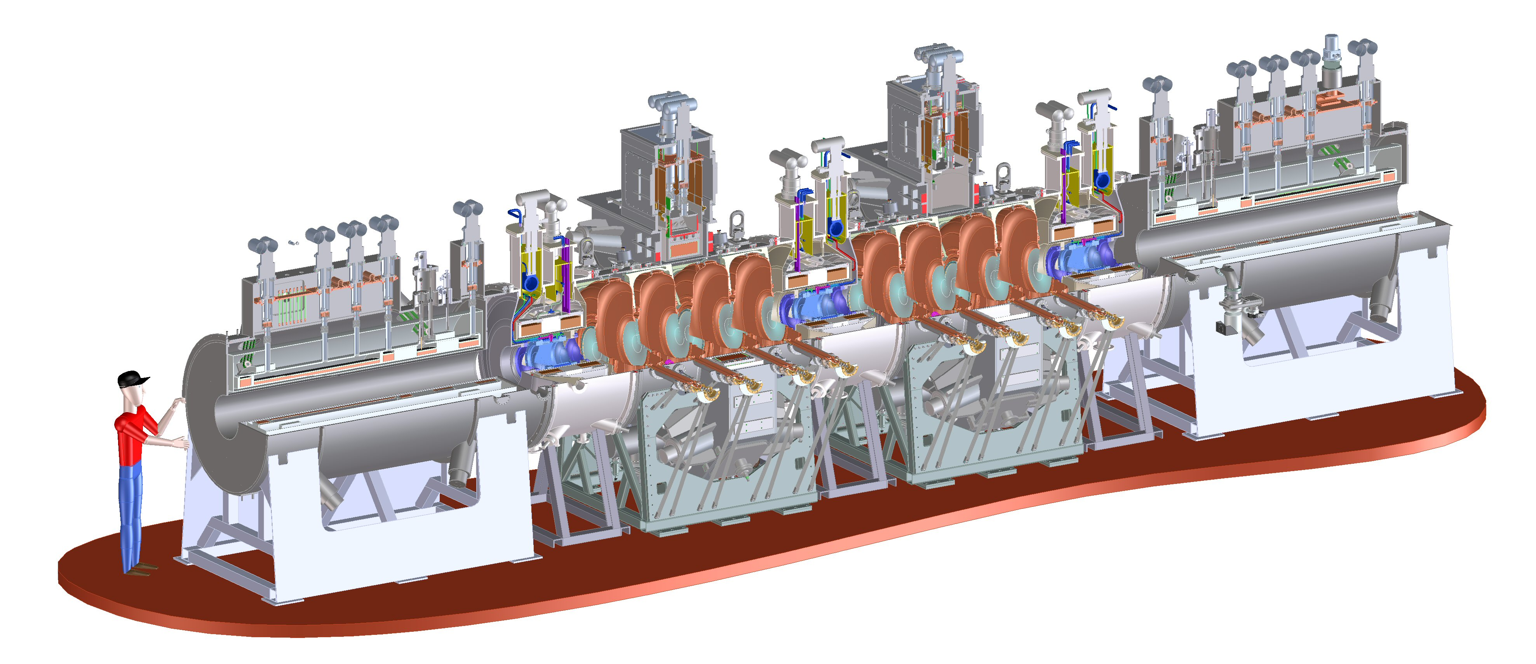
Technology Challenges - Cooling
Tertiary production of muon beams a
  Initial beam emittance intrinsically large
  Cooling mechanism required, but no radiation damping
Muon Cooling a Ionization Cooling
    dE/dx energy loss in materials
    RF to replace p_{long}
MICE
  The Muon Ionization
  Cooling Experiment:
  Demonstrate the
  method and validate
  our simulations
RF-Coupling
Coil (RFCC)
Units
Spectrometer
Solenoids

Slide 18
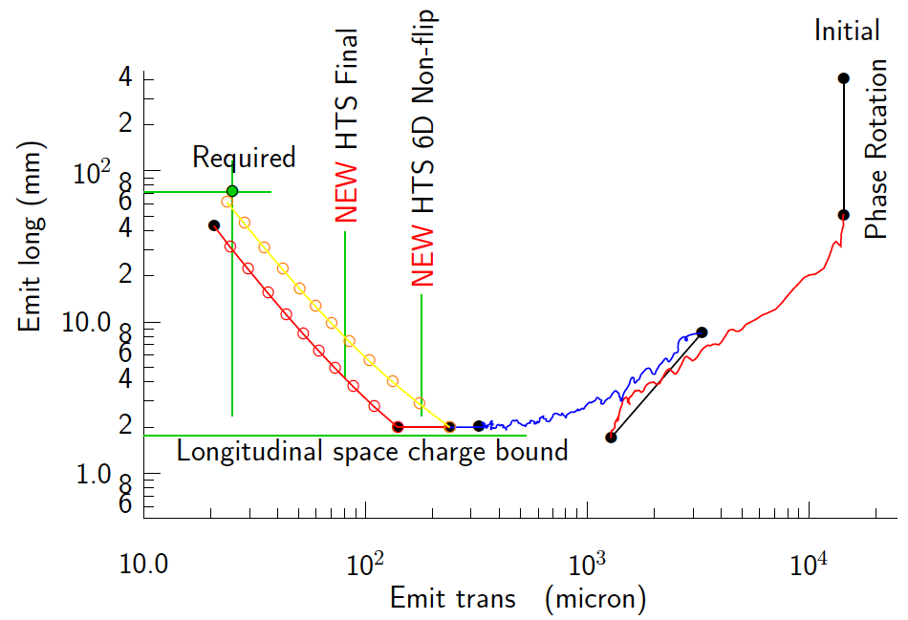
Technology Challenges - Cooling
Development of a cooling channel design to reduce the 6D phase space by a factor of O(10⁶-10⁷) → MC luminosity of O(10³⁴) cm⁻² s⁻¹
R. Palmer
Some components beyond state-of-art:
  Very high field HTS solenoids (≥30 T)
  High gradient RF cavities operating in multi-Tesla fields
Emittance Reduction
via Ionization Cooling
The program targets critical magnet and cooling cell technology demonstrations within its feasibility phase.

Slide 19
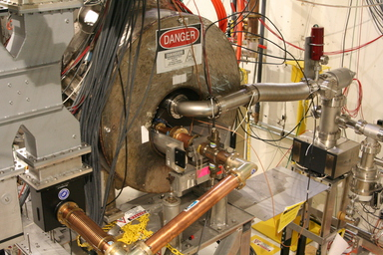
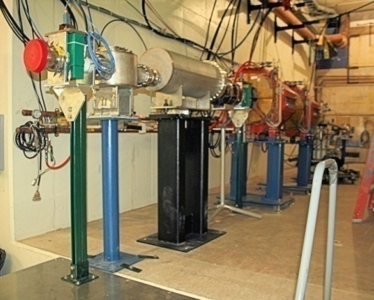
Technology Challenges – RF
A Viable Cooling Channel requires
  Strong focusing and a large
  accelerating gradient to compensate
  for the energy loss in absorbers
  a Large B- and E-fields superimposed
Operation of RF cavities in high
magnetic fields is a necessary element for muon cooling
  Control RF breakdown in the presence of high magnetic fields
  The MuCool Test Area (MTA) at Fermilab is actively investigating:
    Operation of RF cavities in the relevant regimes
    Breakdown mitigation techniques
MTA
Magnet for
RF Studies
MTA
Beamline

Slide 20
Technology Challenges - Acceleration
Muons require an ultrafast accelerator chain
a Beyond the capability of most machines
The accelerator chain requires a range of accelerator technologies
  Superconducting Linacs
  Recirculating Linear Accelerators (RLAs)
    New designs: Utilize multi-pass arcs
    Proposed electron demonstration (JEMMRLA)
  Fixed-Field Alternating-Gradient (FFAG) Machines
        EMMA at Daresbury Lab is a test of the promising non-scaling type
  Rapid Cycling Synchrotrons (RCS/VRCS)
EMMA

Slide 21
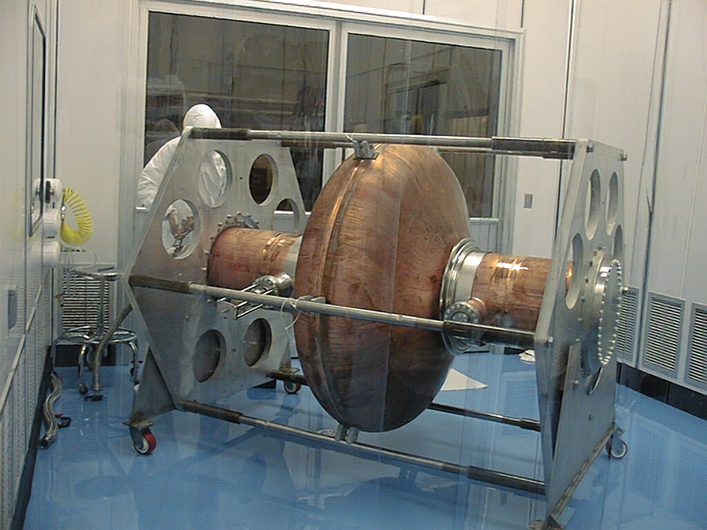
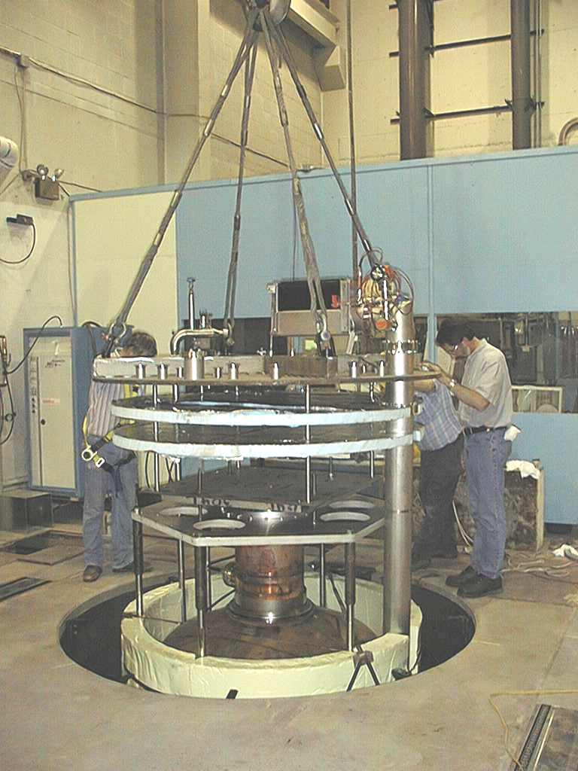
Superconducting RF Development
201 MHz SCRF R&D
Major dia.: 1.4 m
Cavity going into test pit
in Newman basement
(Cornell University)
400mm BT
Cavity length: 2 m
Pit: 5m deep X 2.5m dia.

Slide 22
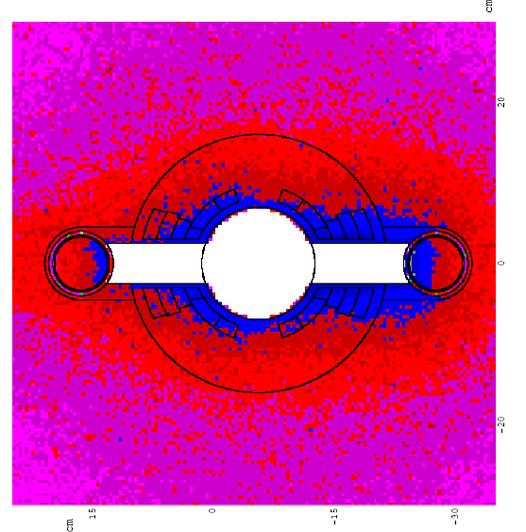
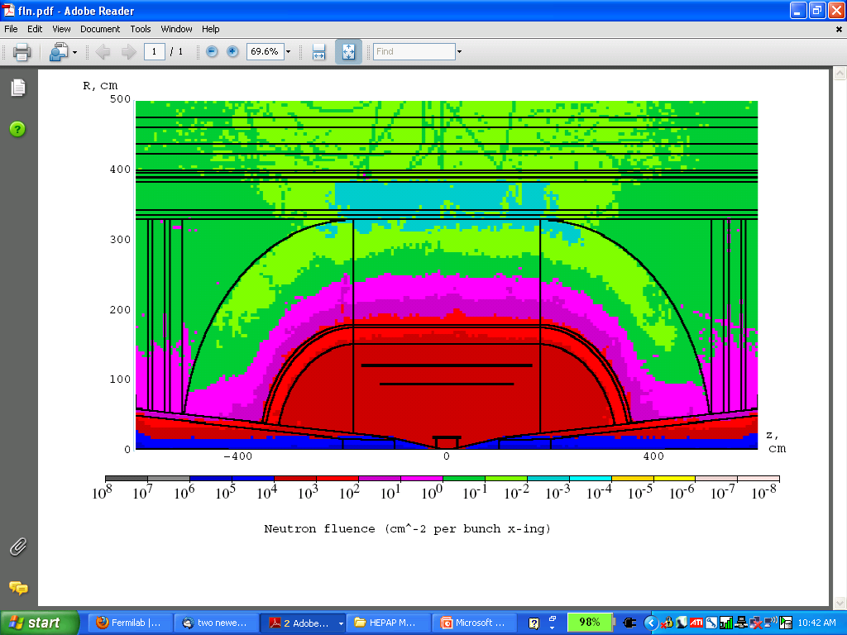
Technology & Design Challenges – Ring, Magnets, Detector
Emittances are relatively large, but muons circulate for ~1000 turns before decaying
  Lattice studies for 126 GeV,
  1.5 & 3 TeV CoM
High field dipoles and
quadrupoles must operate
in high-rate muon decay
backgrounds
  Magnet designs under study
Detector shielding & performance
  Initial studies for 126 GeV, 1.5 TeV, and
  3 TeV using MARS background simulations
  Major focus on optimizing shielding
  configuration
MARS energy deposition map for 1.5 TeV collider dipole

Slide 23
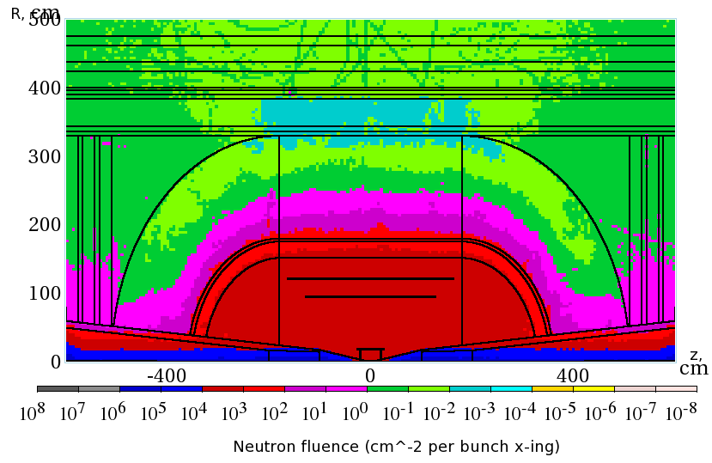
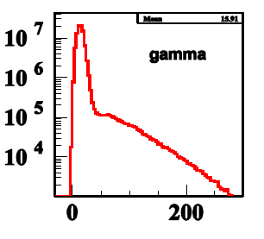
Backgrounds and Detector
Much of the background is soft and out of time
Nanosecond time resolution can reduce backgrounds by three orders of magnitude
Requires a fast, pixelated tracker and calorimeter.
Non-ionizing background ~ 0.1 x LHC
But crossing interval 10μs/25 ns 400 x
 | Cut | Rejection
Tracker hits | 1 ns, dedx | 9x10⁻⁴
Calorimeter neutrons | 2 ns | 2.4x10⁻³
Calorimeter photons | 2 ns | 2.2x10⁻³
GeV/c
ns

Slide 24
Recent R&D Progress – Some Highlights

Slide 25
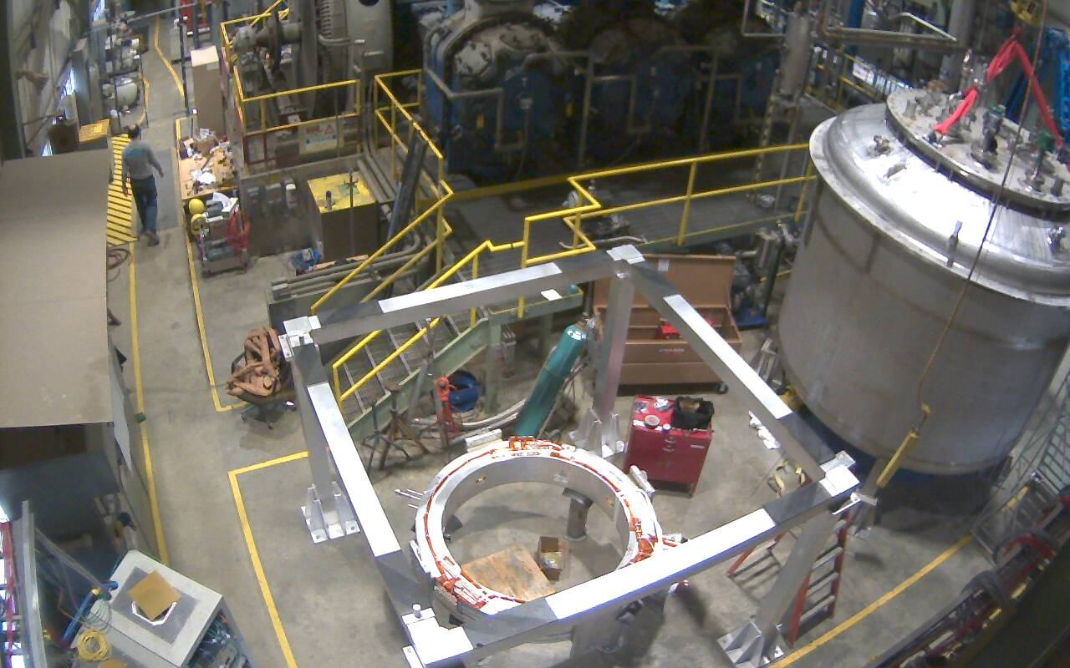
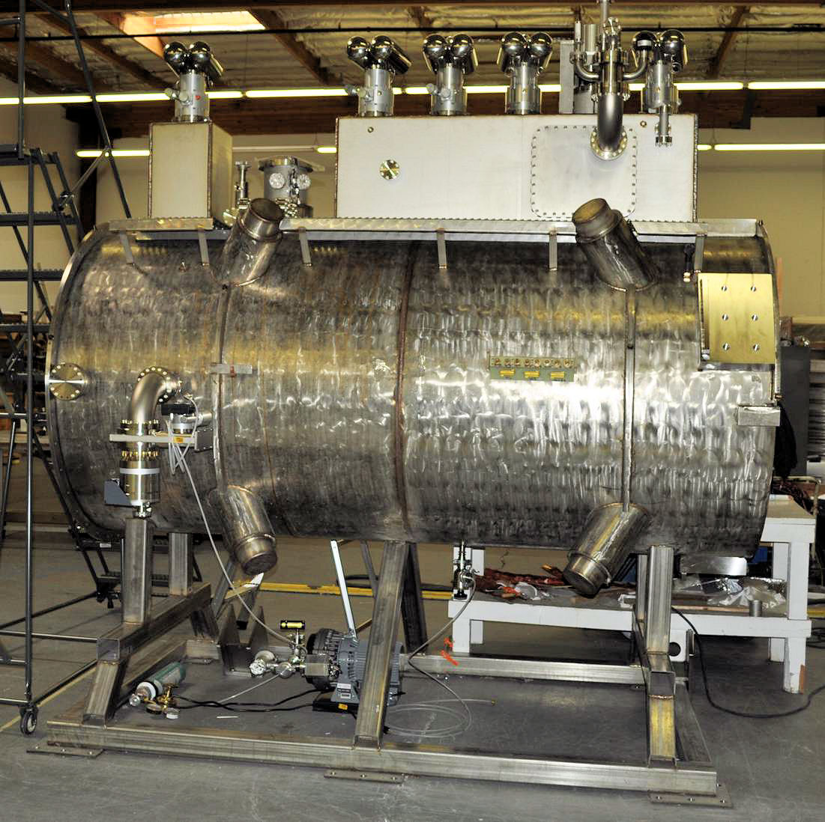
Recent Progress I - MICE
First Coupling Coil Cold Mass
Being Readied for Training
First Spectrometer Solenoid
Now Commissioned!
Fermilab Solenoid Test Facility
Currently preparing for MICE Step IV
Includes:
  Spectrometer Solenoids
  First Focus Coil
Provides:
  Direct measurement of interactions with absorber materials
  Important simulation input
MICE
RF-Coupling
Coil (RFCC)
Units
Spectrometer
Solenoids

Slide 26
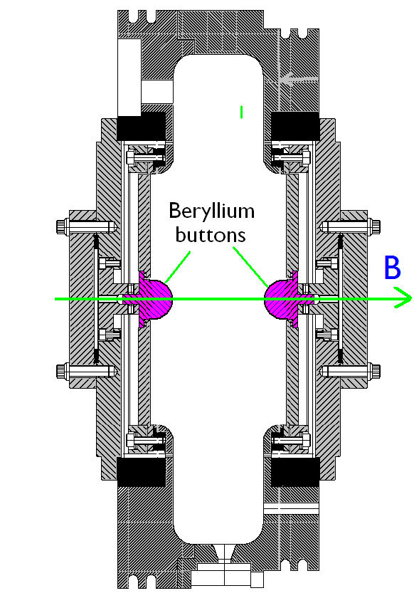
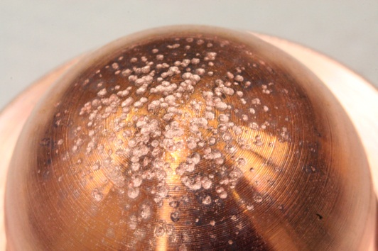
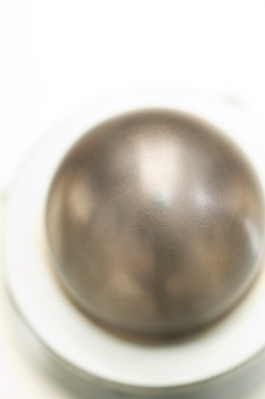
Recent Progress II – Cavity Materials
Breakdown tests with Be and Cu Buttons
Both reached ~31 MV/m
Cu button shows significant pitting
Be button shows minimal damage
a Materials choices offer the possibility of more robust operation in mangetic fields
Cu
Be

Slide 27
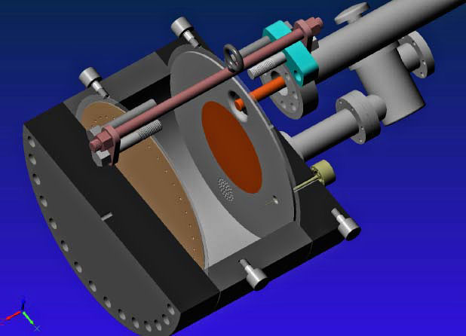
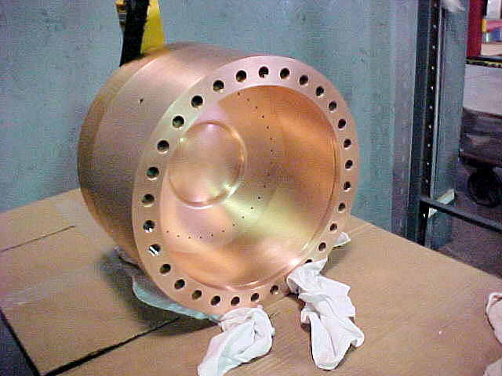
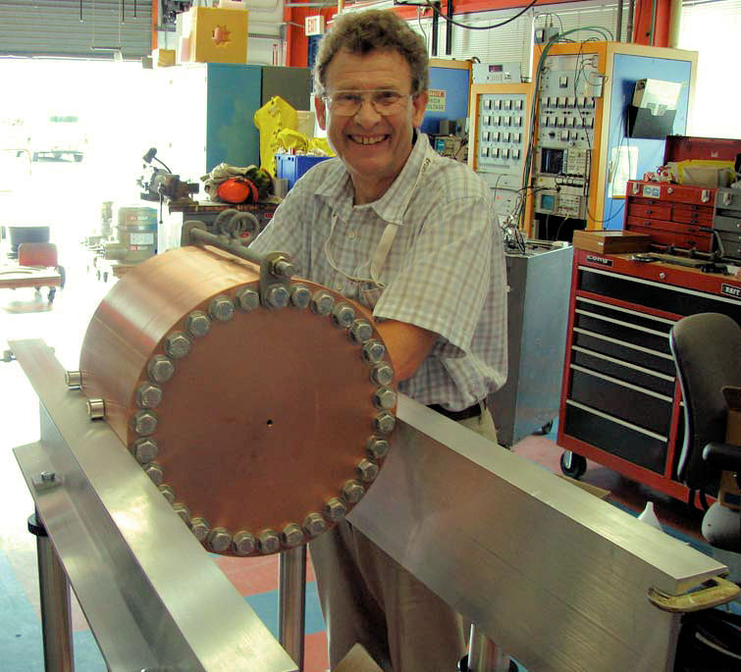
Recent Progress III – Vacuum RF
All-Seasons
Cavity
(designed for both
vacuum and high
pressure operation)
Vacuum Tests at B = 0 T & B = 3 T
  Two cycles: B₀ a B₃ a B₀ a B₃
No difference in maximum stable operating gradient
  Gradient ≈ 25 MV/m
Demonstrates possibility of successful operation of vacuum cavities in magnetic fields with careful design

Slide 28
Recent Progress IV: High Pressure RF
Gas-filled cavity
  Can moderate dark current and breakdown currents in magnetic fields
  Can contribute to cooling
  Is loaded, however, by beam-induced plasma
Electronegative Species
  Dope primary gas
  Can moderate the loading effects of beam-induced plasma by scavenging the relatively mobile electrons
1% Dry Air (0.2 % O2) in GH2
Pure GH2
1% Dry Air
(0.2 % O2)
in GH2 at
B = 3 T
Beam on
~50× change in
RF dissipation
5/22/12
E₀ = 25 MV/m
28
E₀ = 25 MV/m

Slide 29
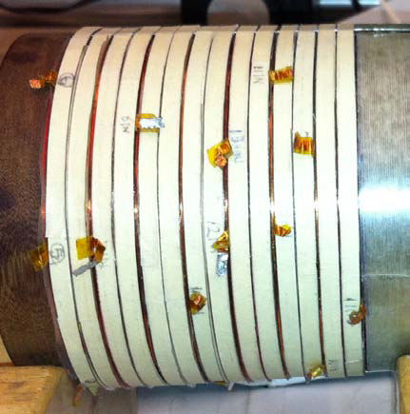
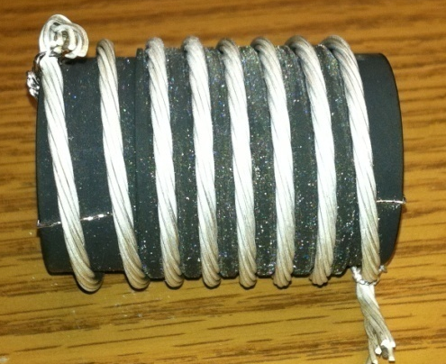
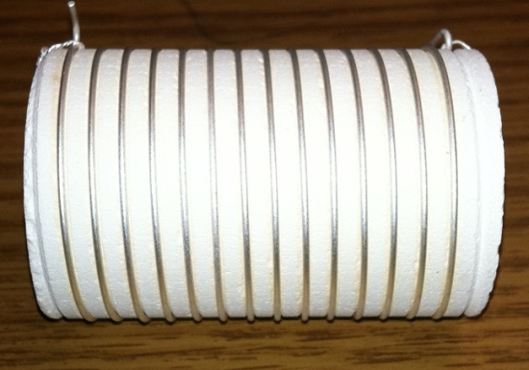
Recent Progress V: High Field Magnets
Progress towards a demonstration of a final
stage cooling solenoid:
Demonstrated 15+ T (16+ T on coil)
  ~25 mm insert HTS solenoid
  BNL/PBL YBCO Design
  Highest field ever in HTS-only solenoid (by a factor of ~1.5)
Will soon begin preparations for a test with HTS insert + mid-sert in NC solenoid at NHFML a >30 T
BSCCO-2212 Cable -
Transport measurements show that FNAL cable attains 105% J_{c} of that of the single-strand
Multi-strand cable utilizing chemically compatible alloy and oxide layer to minimize cracks

Slide 30
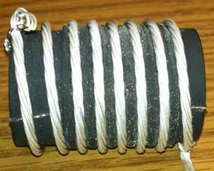
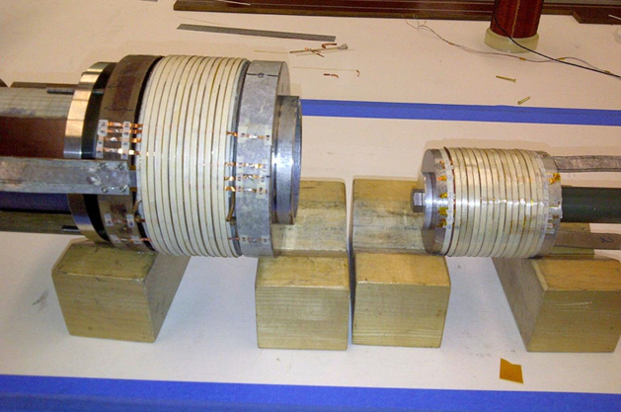
MAP: Recent Technology Highlights
Successful Operation of 805 MHz “All Seasons” Cavity in 3T Magnetic Field under Vacuum
MuCool Test Area/Muons Inc
World Record
HTS-only Coil
15T on-axis field
16T on coil
PBL/BNL
Demonstration of High Pressure RF Cavity in 3T Magnetic Field with Beam
Extrapolates to
μ-Collider Parameters
MuCool Test Area
Breakthrough in HTS Cable Performance with Cables Matching Strand Performance
FNAL-Tech Div
T. Shen-Early Career Award
The Path to a Viable
Muon Ionization
Cooling Channel
1% Dry Air (0.2% O2) in GH2
Pure GH2
1% Dry Air
(0.2 % O2)
in GH2 at
B = 3T
~50X reduction in
RF power dissipation
E₀ = 25 MV/m

Slide 31
The Muon Accelerator Staging Study (MASS) and MAP Timelines

Slide 32
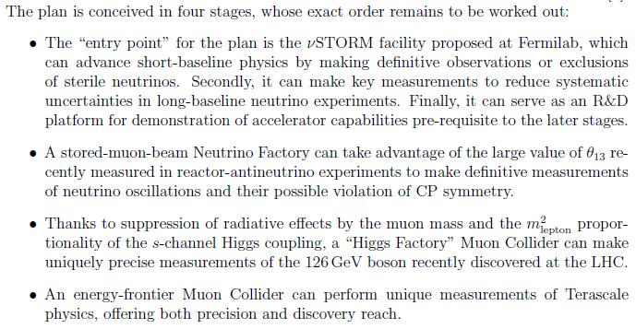
A Staged Muon-Based Neutrino and Collider Physics Program

Slide 33
Muon Accelerators
And Potential Staging Steps
Program Baselines

Slide 34
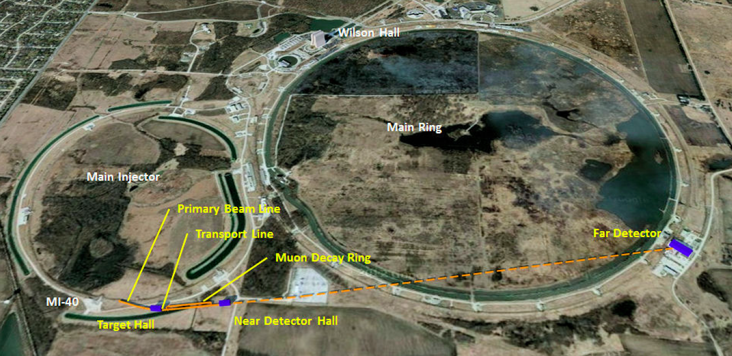
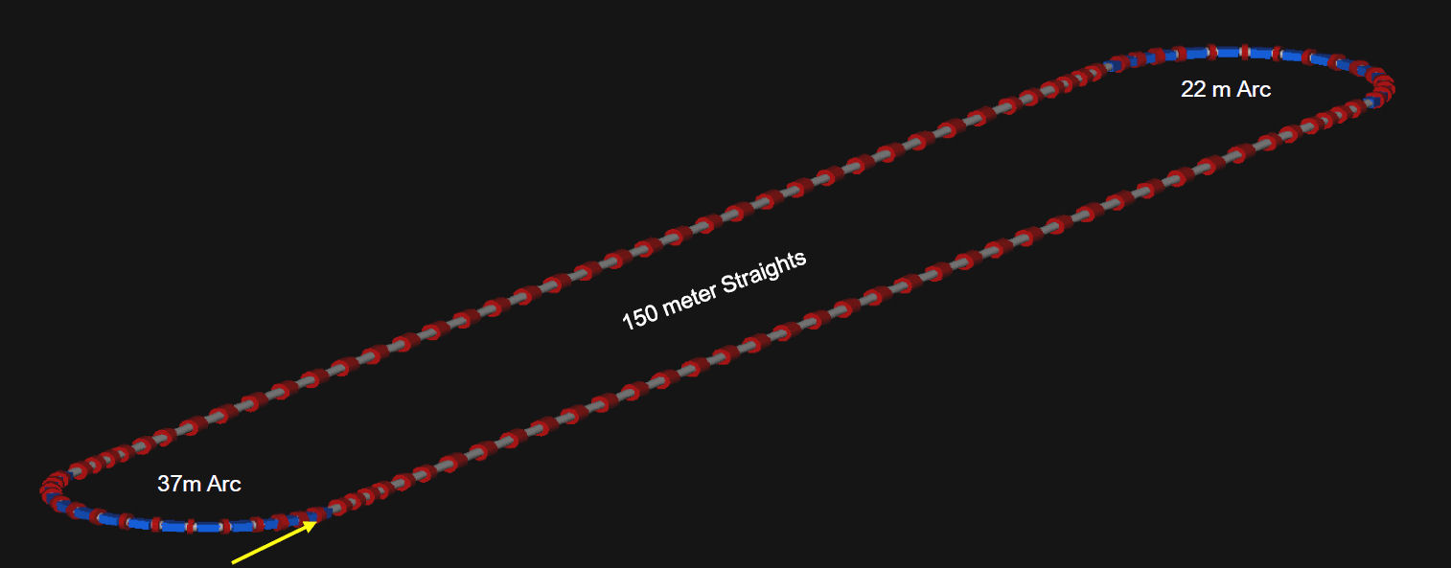
All proposed muon-based accelerators would easily fit at Fermilab
νSTORM (entry level Neutrino Factory)
Intensity Frontier Neutrino Factory
Also a muon-based Higgs Factory or Energy Frontier Muon Collider
νSTORM would provide important physics output and critical R&D leverage

Slide 35

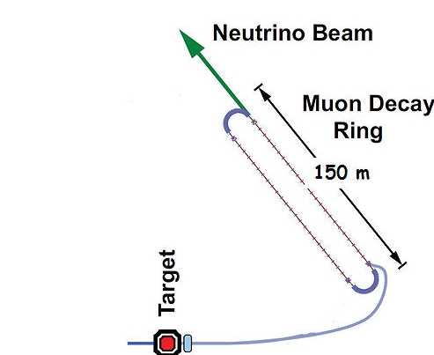
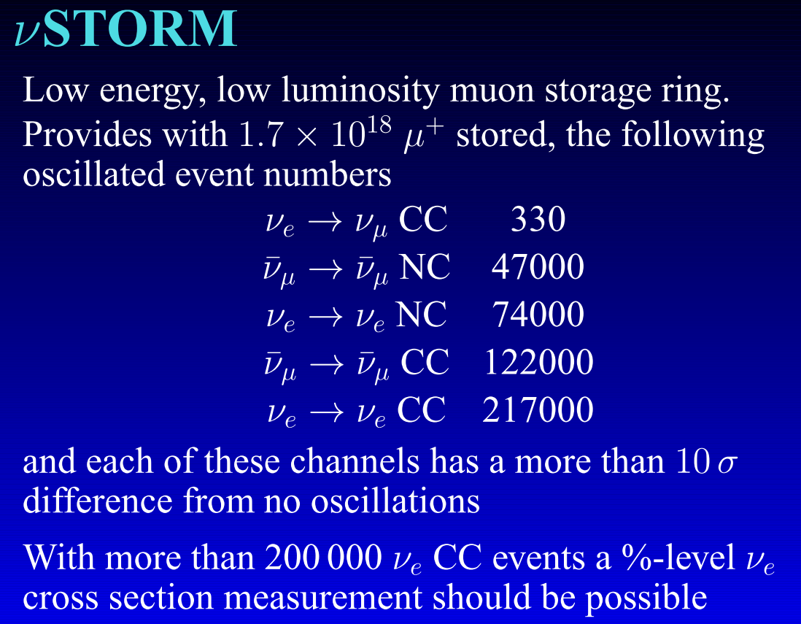
Neutrinos from Stored Muons
(arXiv: 1206.0294 (LOI), Fermilab P-1028)
An entry-level NF?
A.Bross
NuFACT12
DOES NOT
Require the
Development of
ANY
New Technology
3.8 GeV/c
stored μ
10-100kW
NuSTORM Workshop held Sept 21-22 @ FNAL:
(https://indico.fnal.gov/conferenceDisplay.py?confId=5710)

Slide 36
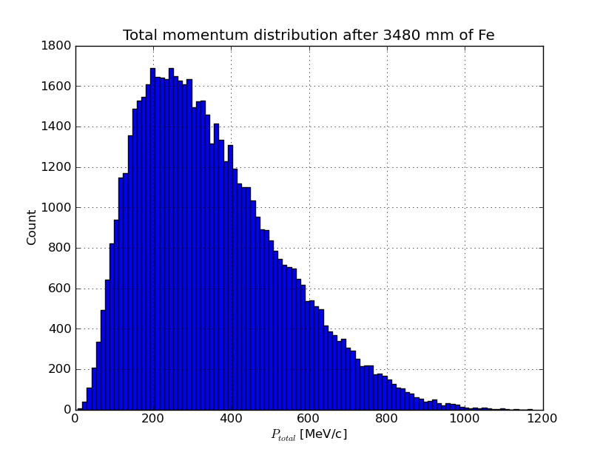
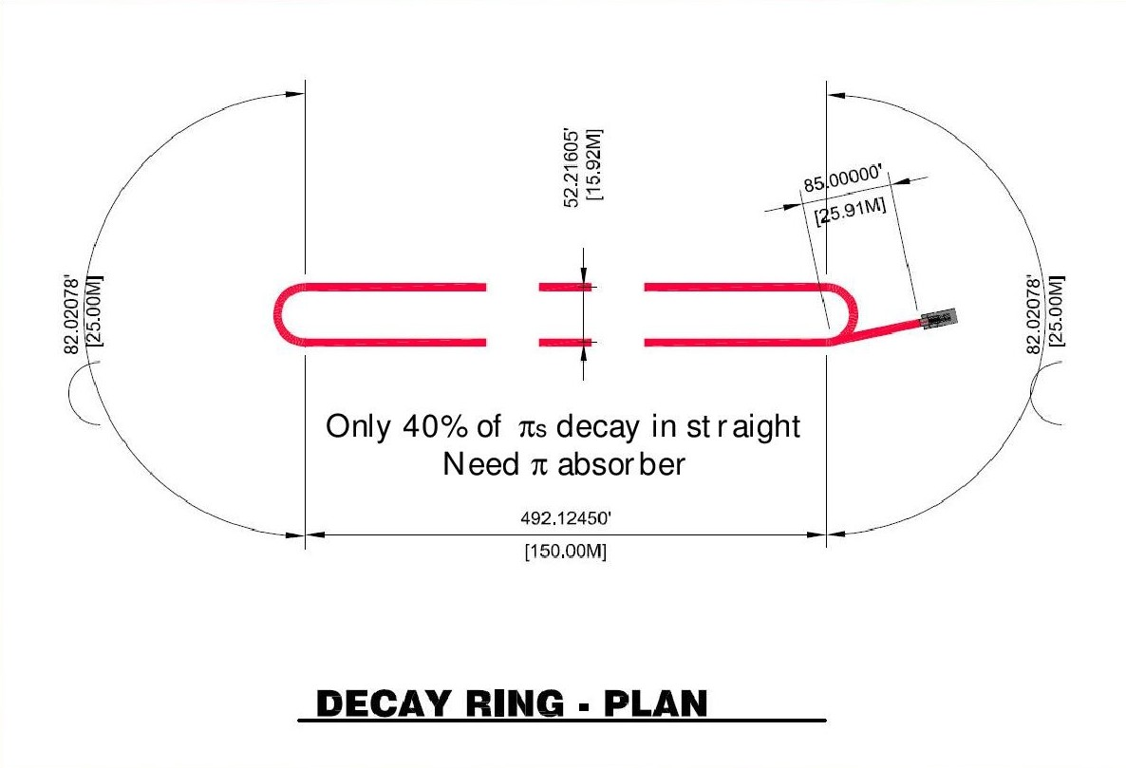
νStorm as an R&D platform
A high-intensity pulsed muon source
100<p_{μ}<300 MeV/c muons
  Using extracted beam from ring
  10¹⁰ muons per 1 μsec pulse
Beam available simultaneously with physics operation
  Sterile ν search
  ν cross section measurements needed for ultimate precision in long baseline measurements
νSTORM also provides the opportunity to design, build and test decay ring instrumentation (BCT, momentum spectrometer, polarimeter) to measure and characterize the circulating muon flux.

Slide 37
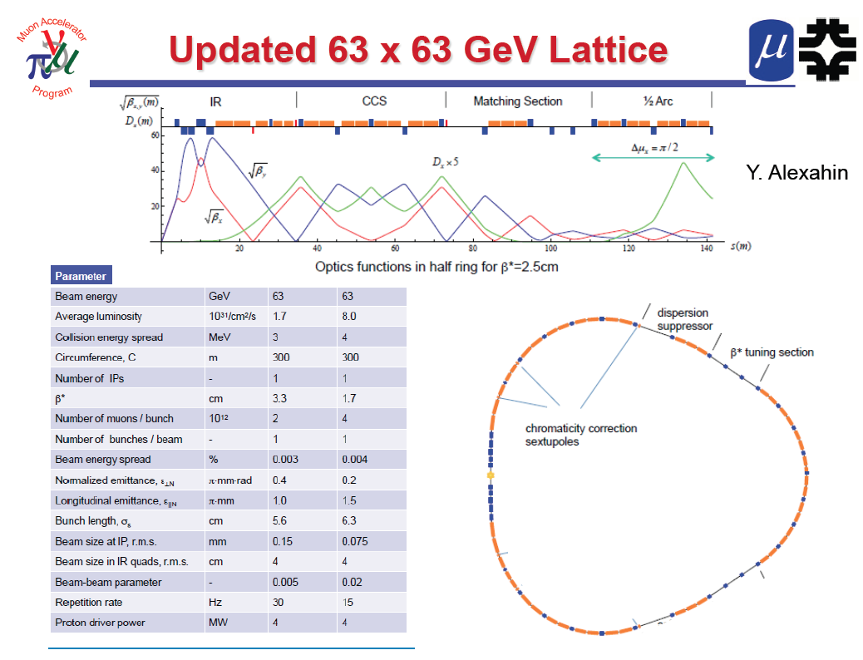
One IP in
the latest
design

Slide 38
Multi-TeV Collider – 1.5 TeV Baseline
Y. Alexahin
Parameter | Unit | Value
Beam energy | TeV | 0.75
Repetition rate | Hz | 15
Average luminosity / IP | 10³⁴/cm²/s | 1.1
Number of IPs, N_{IP} | - | 2
Circumference, C | km | 2.73
β* | cm | 1 (0.5-2)
Momentum compaction, α_{p} | 10⁻⁵ | -1.3
Normalized r.m.s. emittance, ε_{⊥N} | π⋅mm⋅mrad | 25
Momentum spread, σ_{p}/p | % | 0.1
Bunch length, σ_{s} | cm | 1
Number of muons / bunch | 10¹² | 2
Number of bunches / beam | - | 1
Beam-beam parameter / IP, ξ | - | 0.09
RF voltage at 800 MHz | MV | 16
Larger chromatic function (Wy) is corrected first with a single sextupole S1, Wx is corrected with two sextupoles S2, S4 separated by 180° phase advance.

Slide 39
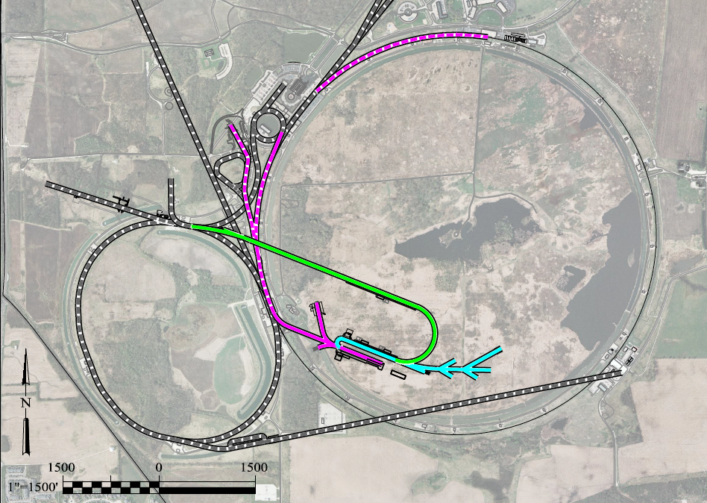
A Muon Accelerator Facility for Cutting Edge Physics on the Intensity and Energy Frontiers
Based on Project X Stage II
To Homestake
LBNE
Buncher/
Accumulator
Rings
RLA to 63 GeV +
300m Higgs Factory
NF Decay Ring:
νs to Homestake
Front End+4D+6D
Project X
Stage III
Linac + RLA to ~5 GeV
Project X
Stage II
Project X
Stage I
A 1.5 TeV collider
would fit within the
Tevatron ring
νSTORM + Muon Beam
R&D Facility

Slide 40
How Could the Staged NF to Homestake Perform?
What if we send beam to LBNE?
1 MW, no muon cooling
a 3 MW, w/cooling
a 4 MW, w/cooling
What if we were able to have a magnetized LAr detector?
Gray bands represent range of possible
detector performance per arXiv:0805.2019
Plots courtesy of P. Huber
Plots assume
100 kt-years

Slide 41
Neutrino Factory Staging (MASS)
Preliminary Staging Plan Based on
Project X Phase 2
* supports multiple detector technologies

Slide 42
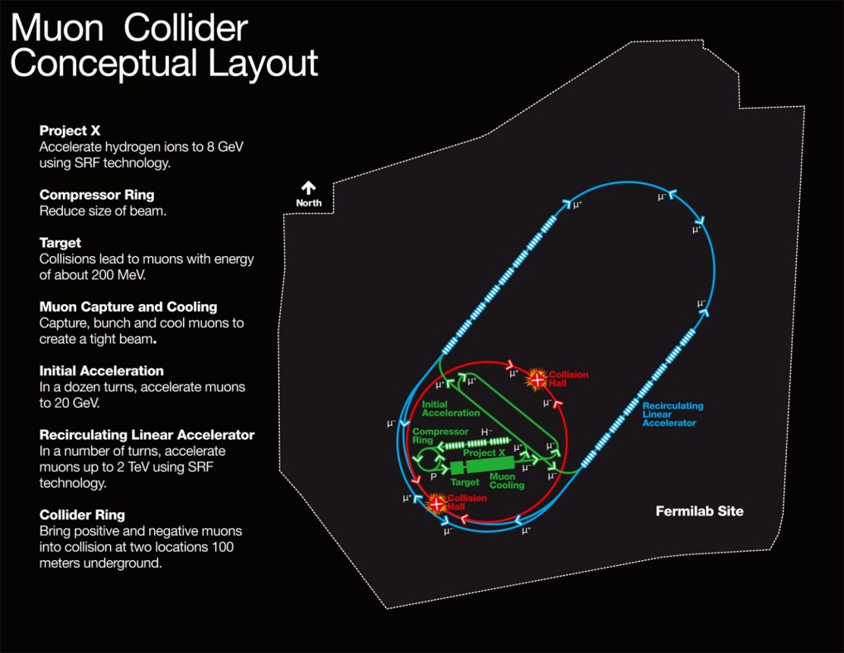
MAP Designs for a Muon-Based Higgs Factory and Energy Frontier Collider
Exquisite Energy
Resolution
Allows Direct
Measurement
of Higgs Width
Site Radiation mitigation with depth and lattice design: ≤ 10 TeV

Slide 43
The Muon Accelerator Program Timeline
At Fermilab, critical physics production could build on Phase II of Project X

Slide 44
Concluding Remarks

Slide 45
Some Thoughts…
The unique feature of muon accelerators is the ability to provide cutting edge performance on both the Intensity and Energy Frontiers
  This is well-matched to the direction specified by the P5 panel for Fermilab
  The possibilities for a staged approach make this particularly appealing in a time of constrained budgets
  νSTORM would represent a critical first step in providing a muon-based accelerator complex
World leading Intensity Frontier performance could be provided with a Neutrino Factory based on Project X Phase II
  This would also provide the necessary foundation for a return to the Energy Frontier with a muon collider on U.S. soil
A Muon Collider Higgs Factory
  Would provide exquisite energy resolution to directly measure the width of the Higgs. This capability would be of crucial importance in the MSSM doublet scenario.
  The first collider on the path to a
  multi-TeV Energy Frontier machine?

Slide 46
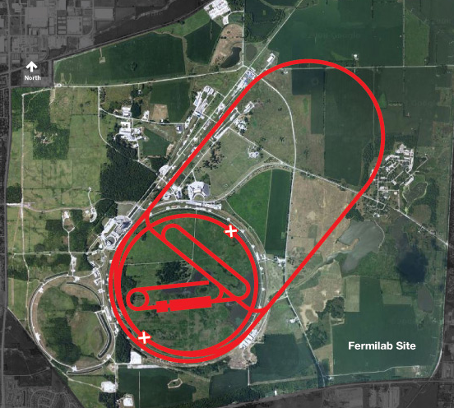
Conclusion
Through the end of this decade, the primary goal of MAP is demonstrating the feasibility of key concepts needed for a neutrino factory and muon collider
a Thus enabling an informed decision on the path forward for the HEP community
Muon Collider Concept
A challenging, but promising, R&D program lies ahead!

Slide 47
Muon Accelerator Program Contacts
MAP Web-Site: http://map.fnal.gov/
MAP Management Team:
Mark Palmer, Director: mapalmer@fnal.gov
Robert Ryne, L1 Manager for Design and Simulation:
rdryne@lbl.gov
Harold Kirk, L1 Manager for Technology Development:
hkirk@bnl.gov
Daniel Kaplan, L1 Manager for Systems Demonstrations:
kaplan@iit.edu
Alan Bross, L1 Manager for MICE Construction:
bross@fnal.gov
Ron Lipton, L1 Manager for Detectors and Physics:
lipton@fnal.gov
US HEP Community Planning Effort
Jean-Pierre Delahaye, Muon Accelerator Staging Study
jpd@slac.stanford.edu

Slide 48
Acknowledgments
I would personally like to thank Steve Geer, Mike Zisman, Bob Palmer as well as the MAP L1 & L2 managers for their help in familiarizing me with the program since I took over as director a year ago
The MAP Effort -
Labs: ANL, BNL, FNAL, JLAB, LBNL, ORNL, SLAC
Universities: Chicago, Cornell, IIT, Princeton,
UC-Berkeley, UCLA, UC-Riverside, UMiss
Companies: Muons, Inc; Particle Beam Lasers

Slide 49
Muon Collider Concept
Muon Collider Block Diagram
Proton source:
For example PROJECT X at 4 MW, with 2±1 ns long bunches
Goal:
Produce a high intensity μ beam whose 6D phase space is reduced by a factor of ~10⁶-10⁷ from its value at the production target
Collider: √s = 3 TeV
Circumference 4.5km
L = 3×10³⁴ cm⁻²s⁻¹
μ/bunch = 2x10¹²
σ(p)/p = 0.1%
ε_{⊥N} = 25 μm, ε_{//N}=72 mm
β* = 5mm
Rep. Rate = 12 Hz

Slide 50
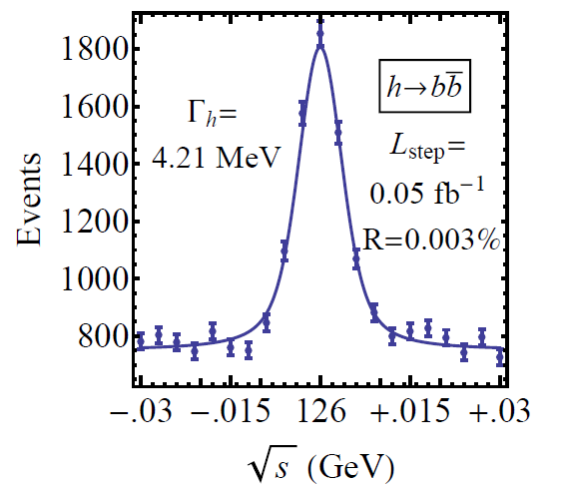
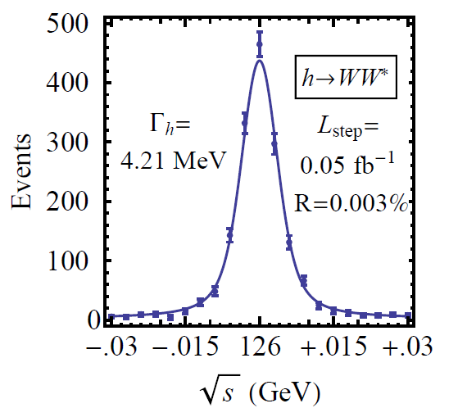
126 GeV Higgs Factory
s-channel coupling of Muons to HIGGS with high cross sections:
Muon Collider of with L = 10³² cm⁻²s⁻¹ @ 63 GeV/beam (50000 Higgs/year)
Competitive with e+/e- Linear Collider with L = 2. 10³⁴ cm⁻²s⁻¹ @ 126 GeV/beam
Sharp resonance: momentum spread of a few × 10⁻⁵
Precision energy measurement provided by g-2 effect and residual polarization in muon beams
Han and Liu
hep-ph 1210.7803
Reduced cooling:
ε_{⊥N} =0.3π⋅mm⋅rad,
ε_{||N} =1π⋅mm⋅rad
Major advantage for Physics of a μ⁺μ⁻ Higgs Factory: possibility of direct measurement of the Higgs boson width (Γ~4MeV FWHM expected)

Slide 51
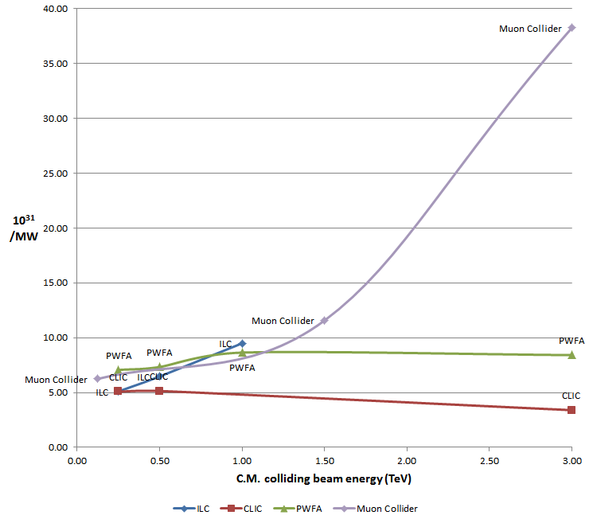
Some Lepton Collider Comparisons
Wall Plug Power:
Estimate assumes a base
70 MW Facility Power requirement as in LC analyses.
Luminosity Metric:
N_{det} × L_{avg} / P_{tot}
Muon Collider

Slide 52
Muon Collider and neutrino factory synergies

Slide 53
Extra Slides Follow

Slide 54
THE R&D CHALLENGES

Slide 55
Technology Challenges – Tertiary Production
Neuffer
A multi-MW proton source, e.g., Project X, will enable
O(10²¹) muons/year to be produced, bunched and cooled to fit within the acceptance of an accelerator.

Slide 56
Technology Challenges - Target
The MERIT Experiment at the CERN PS
  Proof-of-principle demonstration of a liquid Hg jet target in high-field solenoid in Fall `07
  Demonstrated a 20m/s liquid Hg jet injected into a 15 T solenoid and hit with a 115 KJ/pulse beam!
  a Technology OK for beam powers up to
  8 MW with a repetition rate of 70 Hz!
1 cm
Hg jet in a 15 T solenoid
with measured disruption length ~ 28 cm

Slide 57
TechnoIogy Challenges – Capture Solenoid
A Neutrino Factory and/or Muon Collider Facility requires challenging magnet design in several areas:
  Target Capture Solenoid (15-20T with large aperture)
  E_{stored} ~ 3 GJ
  O(10MW) resistive
  coil in high radiation
  environment
  Possible application
  for High Temperature
  Superconducting
  magnet technology

Slide 58
Technology Challenges - Cooling
Tertiary production of muon beams a
  Initial beam emittance intrinsically large
  Cooling mechanism required, but no radiation damping
Muon Cooling a Ionization Cooling
    dE/dx energy loss in materials
    RF to replace p_{long}
MICE
  The Muon Ionization
  Cooling Experiment:
  Demonstrate the
  method and validate
  our simulations
RF-Coupling
Coil (RFCC)
Units
Spectrometer
Solenoids

Slide 59
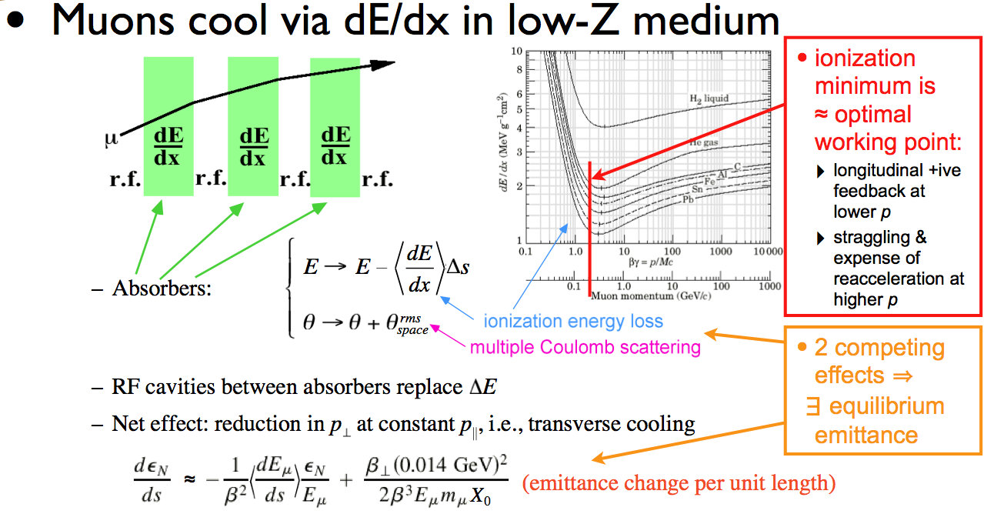
Ionization Cooling

Slide 60
Technology Challenges - Cooling
Development of a cooling channel design to reduce the 6D phase space by a factor of O(10⁶-10⁷) → MC luminosity of O(10³⁴) cm⁻² s⁻¹
R. Palmer
Some components beyond state-of-art:
  Very high field HTS solenoids (≥30 T)
  High gradient RF cavities operating in multi-Tesla fields
Emittance Reduction
via Ionization Cooling
The program targets critical magnet and cooling cell technology demonstrations within its feasibility phase.

Slide 61
Technology Challenges – RF
A Viable Cooling Channel requires
  Strong focusing and a large accelerating gradient to compensate for the energy loss in absorbers
  a Large B- and E-fields superimposed
Operation of RF cavities in high magnetic fields is a necessary element for muon cooling
  Control RF breakdown in the presence of high magnetic fields
  The MuCool Test Area (MTA) at Fermilab is actively investigating:
    Operation of RF cavities in the relevant regimes
    Breakdown mitigation techniques
MTA
Beamline

Slide 62
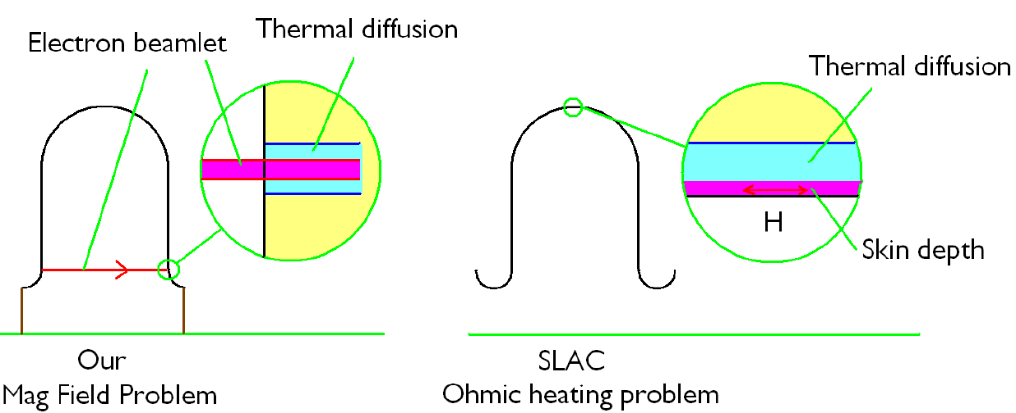
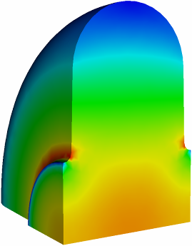
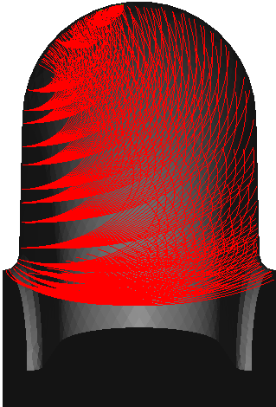


RF Breakdown in Magnetic Fields
The RF breakdown could be related by heating through field emission with external magnetic field and RF field:
  External magnetic field
  Ohmic heating
Possible solutions
  ExB
  Choice of materials
  Surface preparation
  Lower initial temperatures
D. Li
E field contour
B=0 T
B=1 T
Magnetic insulation

Slide 63
Technology Challenges - Acceleration
Muons require an ultrafast accelerator chain
a Beyond the capability of most machines
Several solutions for a muon acceleration scheme have been proposed:
  Superconducting Linacs
  Recirculating Linear Accelerators (RLAs)
  Fixed-Field Alternating-Gradient (FFAG) Machines
        EMMA at Daresbury Lab is a test of the promising non-scaling type
  Rapid Cycling Synchrotrons (RCS/VRCS)
  Hybrid Machines
EMMA

Slide 64




An Initial Acceleration Scheme: RLAs
Pre-linac
S.A. Bogacz
244 MeV
900 MeV
202 m
RLA I
0.9 GeV
3.6 GeV
86 m
0.6 GeV/pass
RLA II
3.6 GeV
12.6 GeV
255 m
2 GeV/pass

Slide 65
Superconducting RF Development
201 MHz SCRF R&D
Major dia.: 1.4 m
Cavity going into test pit
in Newman basement
(Cornell University)
400mm BT
Cavity length: 2 m
Pit: 5m deep X 2.5m dia.

Slide 66
Technology & Design Challenges – Ring, Magnets, Detector
Emittances are relatively large, but muons circulate for ~1000 turns before decaying
  Lattice studies for 126 GeV,
  1.5 & 3 TeV CoM
High field dipoles and
quadrupoles must operate
in high-rate muon decay
backgrounds
  Magnet designs under study
Detector shielding & performance
  Initial studies for 1.5 TeV, then 3 TeV and
  126 GeV
  Shielding configuration
  MARS background simulations
MARS energy deposition map for 1.5 TeV collider dipole

Slide 67



Technology Challenges:
Heat Load in Arc Magnets (N.Mokhov)
Decay products trajectories :
γ
n
e
μ
Horizontal view
Vertical view
Cross-section view
Energy deposition: in the ring dipole cold mass @LHe temp 25 W/m - a factor of ~5 too high!
W rods 80 W/m
in the quadrupole cold mass @LHe temp 38 W/m
in masks between magnets 1.5-3 kW/m
Solutions:
− abandon the open-midplane design, put W absorber inside the dipole bore
− sweep away the decay electrons before they obtain considerable vertical displacement: use combined-function magnets

Slide 68
Backgrounds and Detector
Much of the background is soft and out of time
Nanosecond time resolution can reduce backgrounds by three orders of magnitude
Requires a fast, pixelated tracker and calorimeter.
Non-ionizing background ~ 0.1 x LHC
But crossing interval 10μs/25 ns 400 x
 | Cut | Rejection
Tracker hits | 1 ns, dedx | 9x10⁻⁴
Calorimeter neutrons | 2 ns | 2.4x10⁻³
Calorimeter photons | 2 ns | 2.2x10⁻³
GeV/c
ns

Slide 69
The MAP Feasibility Assessment

Slide 70
The Feasibility Assessment I
MAP was originally proposed as a 5-7 year effort to evaluate the feasibility of Neutrino Factory and Muon Collider Technologies
  Feasibility Assessment Phase in 2 parts
    Phase I: FY13-15
    Phase II: FY16-18
  Approach
    Establish baseline concepts for each segment of the complex
      Prepare baseline design specifications that can be employed in the MAP Technical Demonstrations
      Evaluate realistic performance parameters from those baselines
      Verify feasibility
    Continue to pursue alternative options
      In particular, there exist alternative designs that hold the promise of significantly enhanced performance
      However, the capability (and funds) to implement demonstrations may well be beyond the reach of the feasibility assessment phase of the program

Slide 71
The Feasibility Assessment II
Feasibility Assessment: Phase I
FY13 − FY15:
Identify baseline design concepts
Identify high leverage alternative concepts
Identify key engineering paths to pursue:
  RF
  High Field Magnets
Develop critical engineering concepts (eg, 6D Cooling Cell)
Support major systems tests
  MICE Step IV
  MICE RFCC construction & testing
Feasibility Assessment: Phase II
FY16 − FY18:
Technical demonstration of critical baseline concepts
  eg, 6D Cooling cell
Pursue high leverage alternative concepts
Assess technical and cost feasibility of baseline concepts
Support major systems tests
  MICE Step V/VI
  6DICE planning
Beyond the
Feasibility Assessment
FY19 ➔
Plan contingent on the feasibility assessment!
Can we launch the design effort towards a staged implementation of a NF & MC?
Advanced systems tests
  6DICE?
  Support physics?

Slide 72
The US MAP Feasibility Assessment

Slide 73
Moving Forward with a Muon-based Program
Assuming that we meet our Phase I and Phase II Feasibility Goals, we hope to move forwards a full conceptual design effort including:
  Advanced systems studies may include
    A beam-based 6D ICE
    Front End concepts
    Demonstration of acceleration concepts
  Ideally this involves a staged R&D program coupled to physics needs
    Start providing intensity frontier physics results within the next decade
    Support R&D towards a collider
    Develop a staged approach that takes us to the Intensity Frontier and subsequently onwards to the Energy Frontier
We are very interested in pursuing an expanded international collaboration for this effort!

Slide 74
Recent R&D Progress – Some Highlights

Slide 75




MAP Design & Simulation
MAP Design Efforts
Program Baselines
Staging Study (MASS) Contributions
High Performance Computing
Code Parallelization (G4Beamline, ICOOL)
  Performance improvements > 10⁴
Enables Multi-Objective Parallel Optimization of Accelerator Designs
Liquid Hg Jet Target
Cooling
Channel
Concepts
HCC
Guggenheim
Capture Solenoid (15-20T):
~3 GJ large aperture magnet

Slide 76
Recent Progress I - MICE
First Coupling Coil Cold Mass
Being Readied for Training
First Spectrometer Solenoid
Now Commissioned!
Fermilab Solenoid Test Facility
Currently preparing for MICE Step IV
Includes:
  Spectrometer Solenoids
  First Focus Coil
Provides:
  Direct measurement of interactions with absorber materials
  Important simulation input
MICE
RF-Coupling
Coil (RFCC)
Units
Spectrometer
Solenoids

Slide 77
Recent Progress II – Cavity Materials
Breakdown tests with Be and Cu Buttons
Both reached ~31 MV/m
Cu button shows significant pitting
Be button shows minimal damage
a Materials choices offer the possibility of more robust operation in mangetic fields
Cu
Be

Slide 78
Recent Progress III – Vacuum RF
All-Seasons
Cavity
(designed for both
vacuum and high
pressure operation)
Vacuum Tests at B = 0 T & B = 3 T
  Two cycles: B₀ a B₃ a B₀ a B₃
No difference in maximum stable operating gradient
  Gradient ≈ 25 MV/m
Demonstrates possibility of successful operation of vacuum cavities in magnetic fields with careful design

Slide 79
Recent Progress IV: High Pressure RF
Gas-filled cavity
  Can moderate dark current and breakdown currents in magnetic fields
  Can contribute to cooling
  Is loaded, however, by beam-induced plasma
Electronegative Species
  Dope primary gas
  Can moderate the loading effects of beam-induced plasma by scavenging the relatively mobile electrons
1% Dry Air (0.2 % O2) in GH2
Pure GH2
1% Dry Air
(0.2 % O2)
in GH2 at
B = 3 T
Beam on
~50× change in
RF dissipation
5/22/12
E₀ = 25 MV/m
79
E₀ = 25 MV/m

Slide 80
Recent Progress V: High Field Magnets
Progress towards a demonstration of a final
stage cooling solenoid:
Demonstrated 15+ T (16+ T on coil)
  ~25 mm insert HTS solenoid
  BNL/PBL YBCO Design
  Highest field ever in HTS-only solenoid (by a factor of ~1.5)
Will soon begin preparations for a test with HTS insert + mid-sert in NC solenoid at NHFML a >30 T
BSCCO-2212 Cable -
Transport measurements show that FNAL cable attains 105% J_{c} of that of the single-strand
Multi-strand cable utilizing chemically compatible alloy and oxide layer to minimize cracks

Slide 81
MAP: Recent Technology Highlights
Successful Operation of 805 MHz “All Seasons” Cavity in 3T Magnetic Field under Vacuum
MuCool Test Area/Muons Inc
World Record
HTS-only Coil
15T on-axis field
16T on coil
PBL/BNL
Demonstration of High Pressure RF Cavity in 3T Magnetic Field with Beam
Extrapolates to
μ-Collider Parameters
MuCool Test Area
Breakthrough in HTS Cable Performance with Cables Matching Strand Performance
FNAL-Tech Div
T. Shen-Early Career Award
The Path to a Viable
Muon Ionization
Cooling Channel
1% Dry Air (0.2% O2) in GH2
Pure GH2
1% Dry Air
(0.2 % O2)
in GH2 at
B = 3T
~50X reduction in
RF power dissipation
E₀ = 25 MV/m

Slide 82
Miscellaneous slides

Slide 83

The Physics Needs: Colliders
E. Eichten

Slide 84

Muon Collider Parameters
R.B,Palmer
Depends on cooling scenario:
10³¹a~10³² cm⁻²sec⁻¹

Slide 85
Preliminary Muon Collider
Higgs Factory Parameters
D.Neuffer
AAC12
NuFACT12
Proton Linac 8 GeV
Accumulator,
Buncher
Parameter | Symbol | Value
Proton Beam Power | P_{p} | 4 MW
Bunch frequency | F_{p} | 15 Hz
Protons per bunch | N_{p} | 4×5×10¹³
Proton beam energy | E_{p} | 8 GeV
Number of muon bunches | n_{B} | 1
μ^{+/-}/ bunch | N_{μ} | 5×10¹²
Transverse emittance | ε_{t,N} | 0.0002m
Collision β* | β* | 0.05m
Collision β_{max} | β* | 1000m
Beam size at collision | σ_{x,y} | 0.02cm
Beam size (arcs) | σ_{x,y} | 0.3cm
Beam size IR quad | σ_{max} | 4cm
Collision Beam Energy | E_{μ+},E_{μ_} | 62.5(125geV total)
Storage turns | N_{t} | 1000
Luminosity | L₀ | 10³²
+4→1 bunch combiner
Hg target
Updated designs now underway which leverage developments in our multi-TeV collider designs – Y. Alexahin, etal.
Fermilab staging scenario being
developed in the context of the
MAP Muon Accelerator Staging Study – J-P. Delahaye, etal.
Drift, Bunch, Cool
Linac
RLAs
Collider Ring
δν_{BB} =0.027

Slide 86
Wall Plug Power Estimates
Estimate assumes
a base 70MW
Facility Power
requirement as in
LC analyses.
300 MW
Muon Collider

Slide 87
Luminosity Production Metric
Muon
Collider
Luminosity
Metric:
N_{det} × L_{avg} / P_{tot}

Slide 88

The Physics Needs: Neutrinos (I)
In the neutrino sector it is critical to understand:
  δ_{CP}
  The mass hierarchy
  θ₂₃ = π/4, θ₂₃ < π/4
  or θ₂₃ > π/4
  Resolve the LSND and other short baseline experimental anomalies [perhaps using beams from a muon storage ring (νSTORM) in a short baseline experiment]
  And continue to probe for signs new physics
P. Huber

Slide 89



Muon Cooling and the MTA
MuCool Test Area
Research program aimed at developing viable technologies for operation of RF cavities in the magnetic fields of an ionization cooling channel
Principal thrusts:
  Vacuum pillbox cavities – utilizing Cu or more novel materials (eg, Be walls)
  Pressurized cavities
10⁶ – 10⁷ Emittance Reduction via Ionization Cooling
RF in magnetic fields
Some very high field (30T) magnets
Be button after processing
at 31MV/m in 3T B-field
R. Palmer
805 MHz Modular Cavity for Systematic Vacuum RF Tests – In Fabrication a FY14 Test Program

Slide 90
Muon Ionization Cooling Experiment (MICE)
First Coupling Coil Cold Mass
Being Readied for Training
First Spectrometer Solenoid
Now Commissioned!
Tertiary production of muon beams
  Initial beam emittance intrinsically large
Muon Cooling a Ionization Cooling
    dE/dx energy loss in materials
    RF to replace p_{long}
MICE
RF-Coupling
Coil (RFCC)
Units
Spectrometer
Solenoids

Slide 91
Recent Technology Highlights
Successful Operation of 805 MHz “All Seasons” Cavity in 3T Magnetic Field under Vacuum
MuCool Test Area/Muons Inc
World Record
HTS-only Coil
15T on-axis field
16T on coil
PBL/BNL
Demonstration of High Pressure RF Cavity in 3T Magnetic Field with Beam
Extrapolates to
μ-Collider Parameters
MuCool Test Area
Breakthrough in HTS Cable Performance with Cables Matching Strand Performance
FNAL-Tech Div
T. Shen-Early Career Award
The Path to a Viable
Muon Ionization
Cooling Channel
1% Dry Air (0.2% O2) in GH2
Pure GH2
1% Dry Air
(0.2 % O2)
in GH2 at
B = 3T
~50X reduction in
RF power dissipation
E₀ = 25 MV/m

Slide 92
Muon Accelerator Staging Study (MASS)
Two approaches exist:
  A dedicated “green field” construction project
  A staged development based on evolving capabilities at an existing facility
    Desirable if high quality physics can be produced along the way…
    Can provide clear decision points with well-understood risks for moving forward
    Incremental deployment of expensive or technically challenging elements
2008 P5 Roadmap called for a “world-leading Intensity Frontier program centered at Fermilab”
  Can a Muon Accelerator effort support this goal as well as provide a path to return to an Energy Frontier facility in the US?
  Can a staged Muon Accelerator effort provide both physics output and the necessary accelerator R&D along the way?
  What are the timescales associated with such an effort?

