Slide 1
Project X Technical Board meeting (05/3/13): summary and conclusions
June 18, 2013
Sergei Nagaitsev

Slide 2
Agenda
1. An alternative (improved) new beta=0.92, 650-MHz cavity shape.
2. Project X 650-MHz cavity prototypes strategy: Old cavity shape with an end tuner (1st prototype), followed by a new cavity with an end tuner (2nd prototype).
Slides: http://projectx-docdb.fnal.gov/cgi-bin/ShowDocument?docid=1196

Slide 3
Notes
The original concept (V1) for the 650-MHz high-beta cavity was a “scaled” 1.3-GHz ILC cavity. Similarly, the helium vessel proposed initially was a scaled-up ILC vessel with a blade tuner. Several bare V1 cavities were ordered: 4 to AES and 5 to PAVAC. Two are also being manufactured in India.

Slide 4
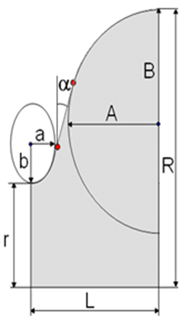
Cavities under production (V1)
 | Mid cell | End cell
r, mm | 50 | 50
R, mm | 200.3 | 200.3
L, mm | 103.8 | 107.0
A, mm | 82.5 | 82.5
B, mm | 84 | 84.5
a, mm | 18 | 20
b, mm | 38 | 39.5
α,° | 5.2 | 7
4 cavities manufactured in AES
Original RF design with 100 mm diameter iris and beam pipe
Stiffening rings: 126 mm radius inter-cells, 134 mm end cell to vessel
Delivery beginning of June
5 cavities under production in PAVAC
Original RF design with 100 mm diameter iris and beam pipe
Stiffening rings: 126 mm radius inter-cells, 134 mm end cell to vessel
Cell forming not started yet
2 cavities scheduled under IIFC
Mid-cell shape single cell will be delivered in July. Original RF design with 100 mm diameter iris and beam pipe
Original RF design with 100 mm diameter iris and beam pipe dies exist
Niobium in hand

Slide 5
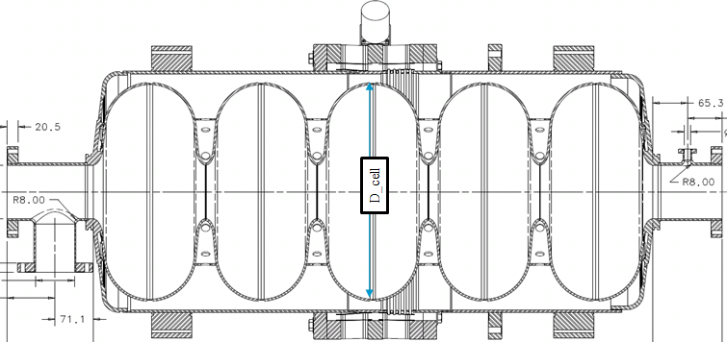
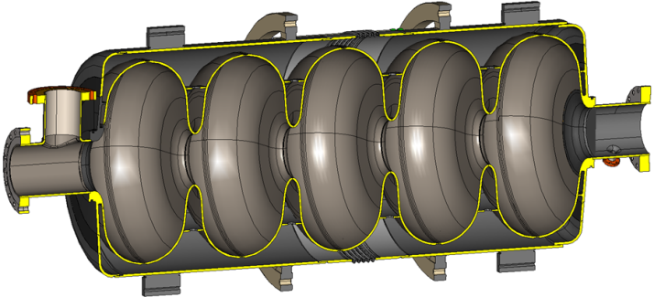
Option I. Dressing of the cavities currently under production (V1 & BT)
Original Helium Vessel with Blade Tuner in the middle
Mechanical design and drawings of Helium Vessel are ready
Mechanical design and drawings of Blade Tuner are ready
Tuner under development in India is plug compatible with Blade Tuner
Nothing purchased yet

Slide 6
Notes
Later analysis of V1 cavities has revealed several undesirable features:
1. The V1 cavity rf structure has weak coupling of the 5th monopole passband to the beam pipe and, thus, there are trapped monopole modes with high Qext , which potentially could compromise the beam emittance and increase the cryogenic losses at high beam current operation.

Slide 7
2. The cavity mechanical design is too stiff, which may be a problem for freq. tuning
3. The Blade Tuner has a hysteresis (freq. fine tuning issue)
4. The helium vessel uses expensive bellows (extra large diameter) and transition spools

Slide 8
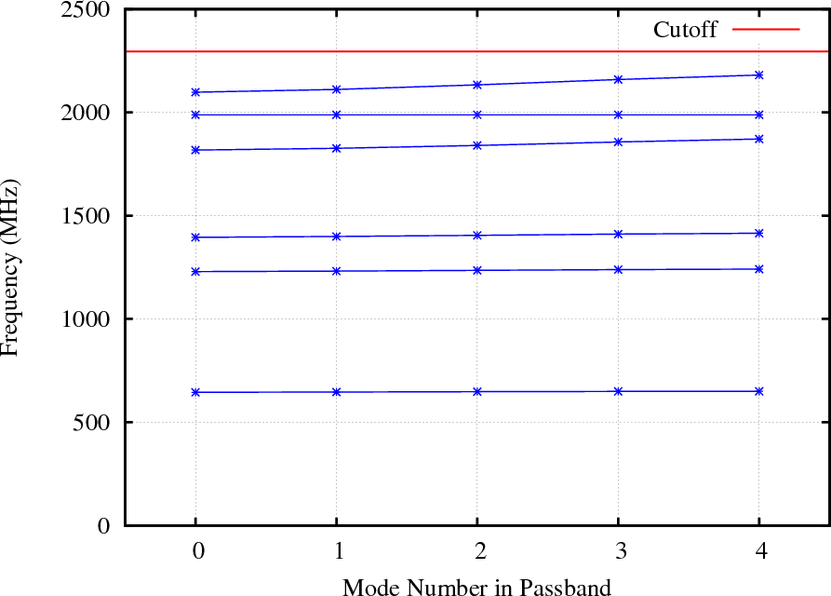
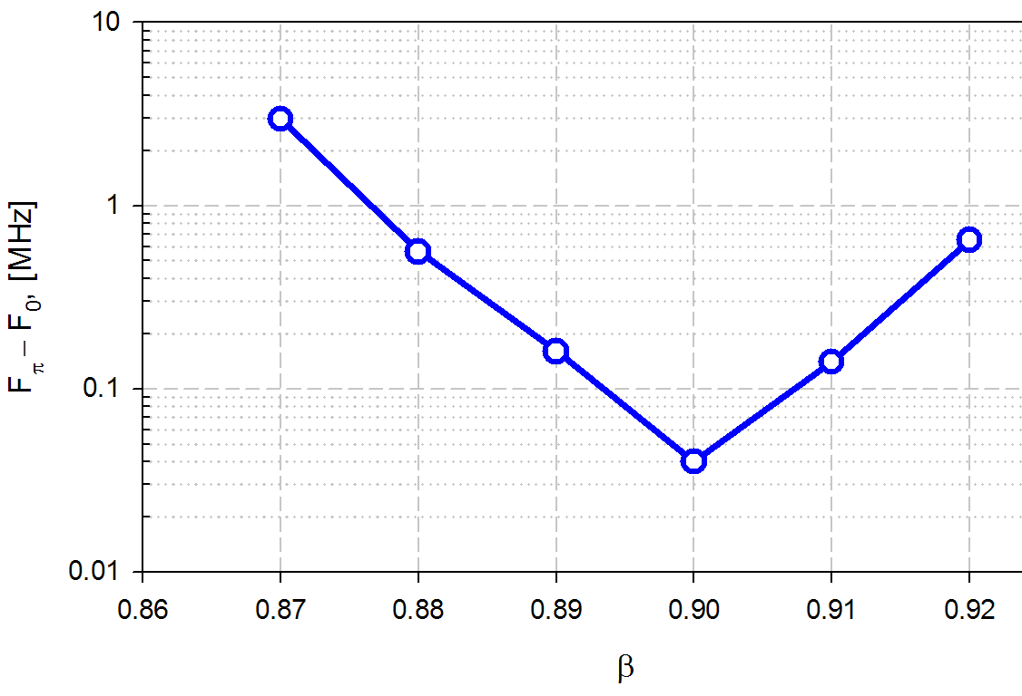
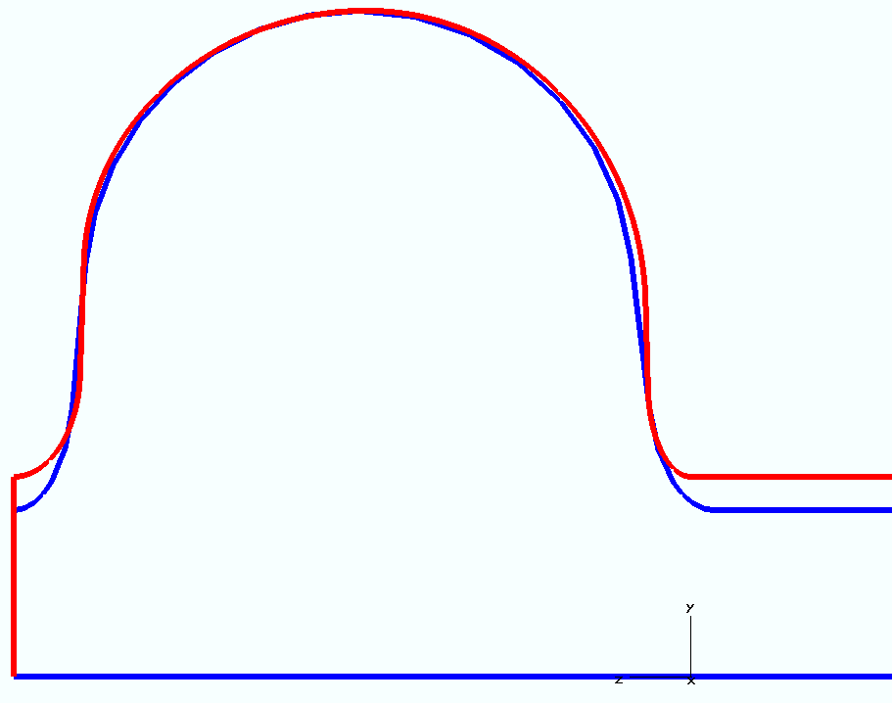
Alternative β=0.92 cavity (V2)
The width of the 5th monopole band vs beta
 | Beta = 0.90 | Beta = 0.92
D_pipe, [mm] | 100 | 118
D_cell, [mm] | 400.5 | 400.2
L_struct, [mm] | 1043.9 | 1043.8
L_max, [mm] | > 1335 | > 1335
OLD & NEW End cell shapes

Slide 9
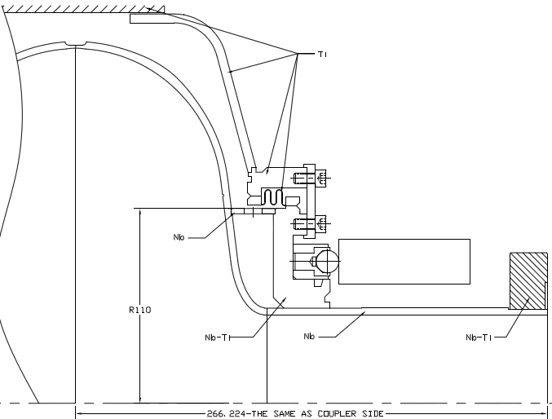
Lever tuner for the cavity

Slide 10
Proposals for Tech. Board
It is proposed to change the cavity shape (V2) and to increase the beam pipe diameter to address the trapped mode issue. It is also proposed to modify some mechanical features of the cavity (location of stiffening ring, etc.) to reduce the stiffness of the cavity. The V2 cavity will have nearly the same length as V1. It is also proposed to stop all work on the blade and wedge tuner designs and to concentrate only on the proposed new helium vessel with an end lever tuner.

Slide 11
What was decided after Tech. Board meeting (05/31/13)?
Accept the proposed V2 cavity shape. This should apply to all new cavities, but not to the 11 V1 cavities being presently manufactured.
Accept the proposal to dress the 5 V1 cavities (3 AES and 2 PAVAC) with a lever end tuner (known as Option II). Use 2 PAVAC V1 cavities for surface treatment development. If successful, these 2 cavities can be later equipped with an end tuner. Propose to our India colleagues to proceed with manufacturing of 2 V1 cavities. This is important for their SRF technology development and if successful, these cavities will be used in cryomodules.
Accept the proposal to use only lever end tuners with new V2 cavities. This is known as Option IV.
Adopt the following cryomodule design strategy: the high-beta 650 Crymodule should be designed to accept both Option II and Option IV dressed cavities, i.e. it should be plug-compatible with regard to two dressed cavity options.
Adopt the following design goal: the low-beta cavity design must be similar to Option IV of high-beta design.
Stop all work on blade and wedge tuners.
In 3 months have a follow-up meeting to discuss the implementation and technical issues (if any) associated with this strategy.

