Slide 1
HEP Program
and
Strategic Planning and Community Process [Snowmass/P5]
Snowmass Energy Frontier Workshop
Seattle, Washington
June 30 – July 3, 2013
Abid Patwa
Program Manager
Office of High Energy Physics
Office of Science, U.S. Department of Energy

Slide 2
Outline
Energy Frontier Program Status & Issues
Budget and Issues
Strategic Planning and Community Process
Summary
2

Slide 3
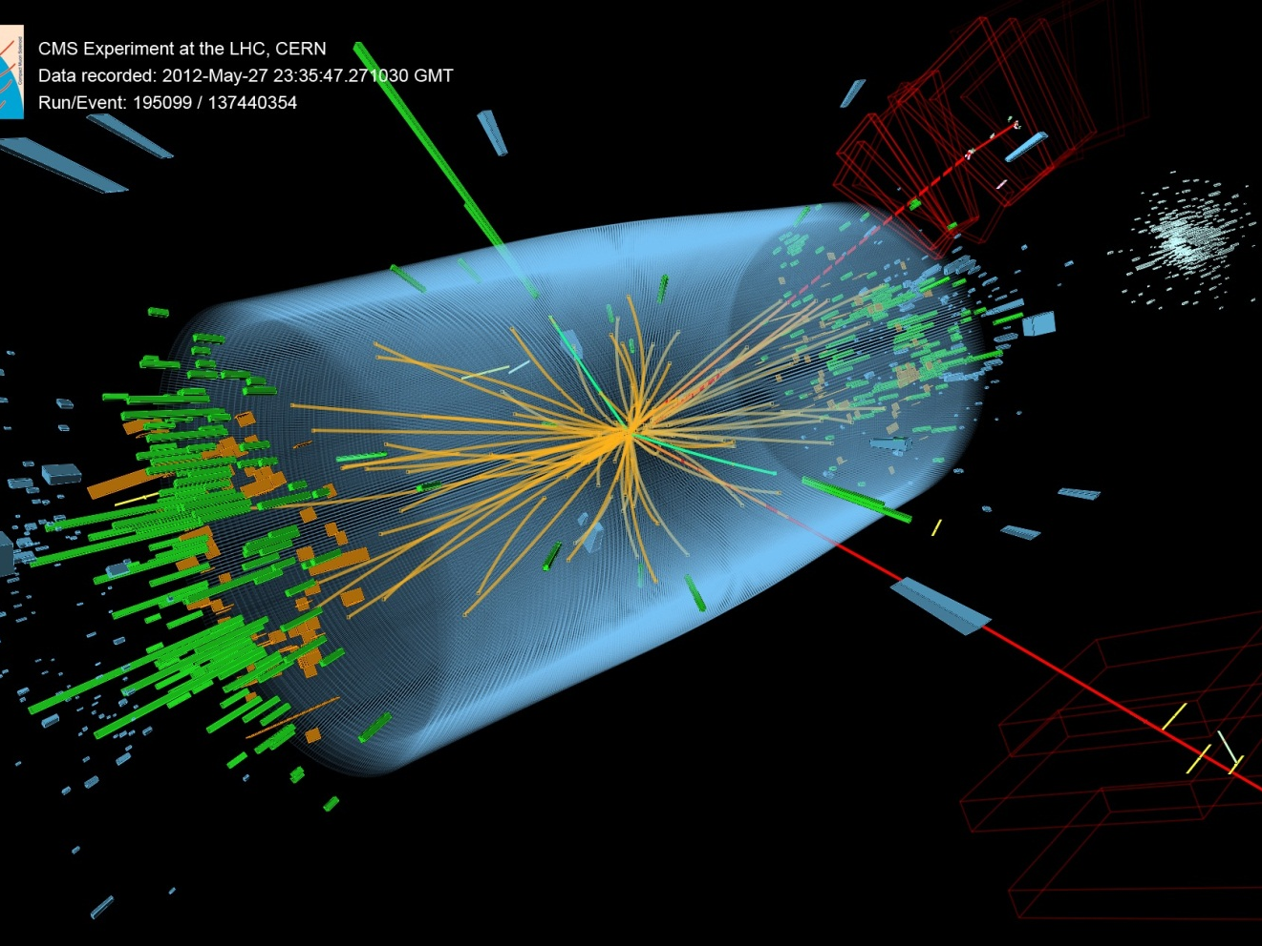
Energy Frontier Program STATUS
Higgs Boson Candidate Event:
H → ZZ → 2e2μ Decay Channel

Slide 4
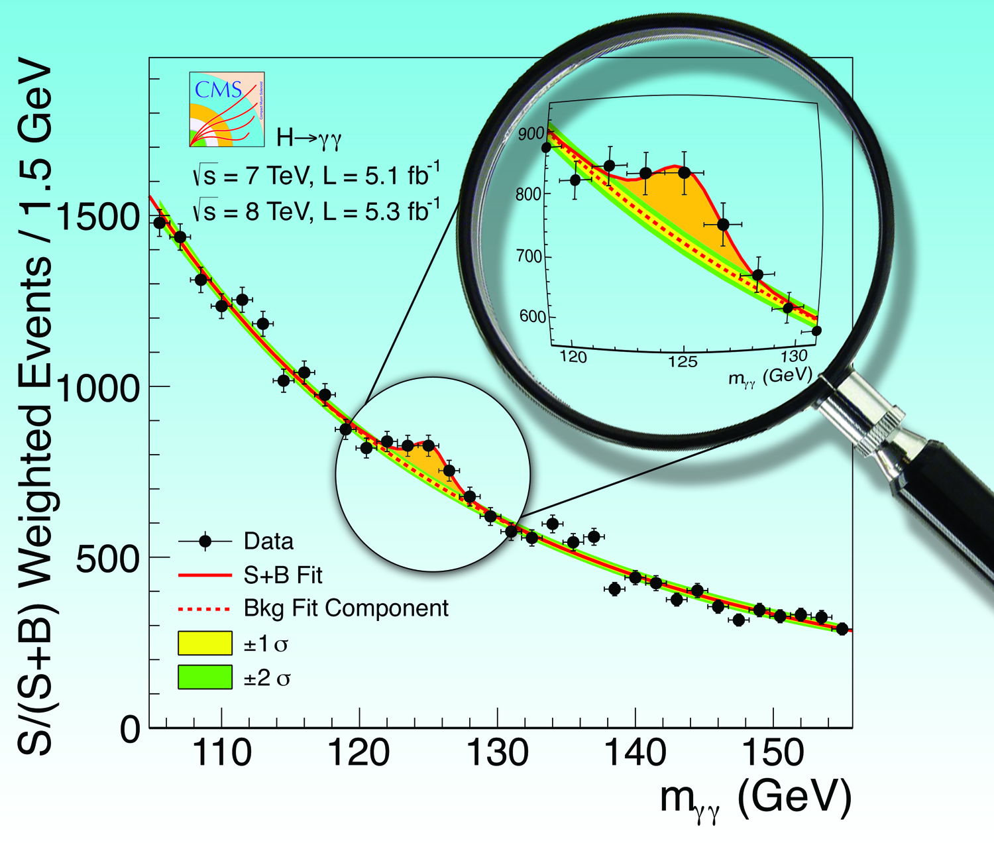
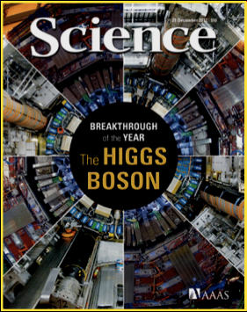
2012: Particle of the Year
July 4, 2012: a particle that looks a lot like the SM Higgs boson has been discovered at CERN
seen by both experiments in multiple decay modes of the Higgs
experiments are actively measuring its properties to determine if the particle is consistent with the one predicted in SM
In 2012, observation was
TIME Magazine: “Particle of the Year”
Science: “Breakthrough of the Year”
The Economist: “A giant leap for science”
Recently, Moriond 2013 results
Measurements from CMS and ATLAS prefer zero spin and positive parity, strongly indicate consistency with a SM Higgs
March 2013: one-page briefing to White House Chief of Staff on Higgs results presented at the Moriond conferences

Slide 5
HEP Energy Frontier Experiments
Experiment | Location | CM Energy; Status | Description | # Institutions; # Countries | #US Institutions | #US Coll.
DZero | Fermilab Tevatron Collider [Batavia, Illinois, USA] | 1.96 TeV; Operations ended: Sept. 30, 2011 | Higgs, Top, Electroweak, SUSY, New Physics, QCD, B-physics | 74 Institutions; 18 Countries | 33 Univ., 1 National Lab | 192
CDF (Collider Detector at Fermilab) | Fermilab Tevatron Collider [Batavia, Illinois, USA] | 1.96 TeV; Operations ended: Sept. 30, 2011 | Higgs, Top, Electroweak, SUSY, New Physics, QCD, B-physics | 55 Institutions; 14 Countries | 26 Univ., 1 National Lab | 224
ATLAS (A Toroidal LHC ApparatuS) | CERN, Large Hadron Collider [Geneva, Switzerland / Meyrin, Switzerland] | 7-8 TeV; 13-14 TeV Run 1 ended: Dec. 2012 Run 2 start: 2015 | Higgs, Top, Electroweak, SUSY, New Physics, QCD, B-physics, and Heavy-Ion | 174 Institutions; 38 Countries | 40 Univ., 4 National Labs | 556
CMS (Compact Muon Solenoid) | CERN, Large Hadron Collider [Geneva, Switzerland / Cessy, France] | 7-8 TeV; 13-14 TeV Run 1 ended: Dec. 2012 Run 2 start: 2015 | Higgs, Top, Electroweak, SUSY, New Physics, QCD, B-physics, and Heavy-Ion | 179 Institutions; 41 Countries | 46 Univ., 1 National Lab | 676
Collaboration data as of May 2013.
US-ATLAS comprises ~21% of the international ATLAS Collaboration
US-CMS comprises ~33% of the international CMS Collaboration
5

Slide 6
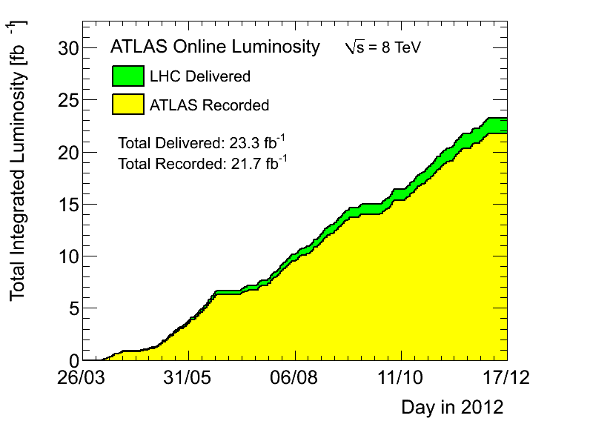
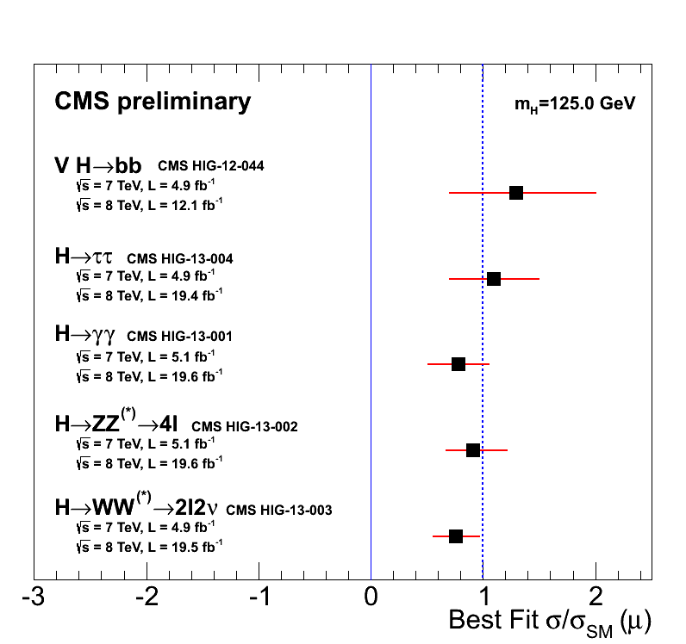
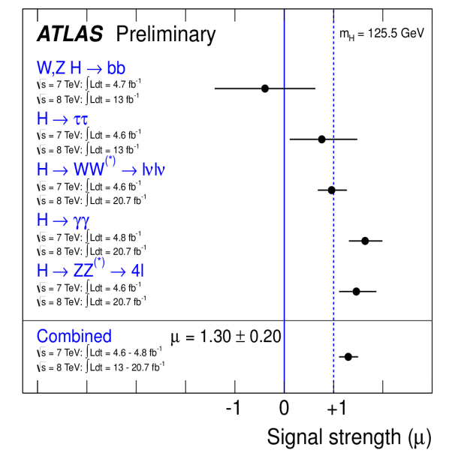
Energy Frontier Status
Fermilab Tevatron (DØ and CDF)
Working with DØ and CDF collaborations on orderly completion of legacy analyses by the early 2014.
Large Hadron Collider (LHC) at CERN
Run I (proton) completed in Dec. 2012
Working with experiments to develop plan for contributions to “Phase-I” upgrades
CD-0 approval last September 2012 ($22-34M each experiment: ATLAS and CMS).
CD-1 reviews scheduled in August 2013.
Current program
Analyze and publish results from LHC Run I
2013-2014 shutdown: repair splices in LHC magnets; detector maintenance and consolidation, upgrades and repairs
In 2015: resume running at 13~14 TeV
Still no smoking guns for BSM physics
What will 13~14 TeV running tell us?
Focus on new physics
Completion of Run I; CMS & ATLAS recorded: ~22 fb⁻¹
ATLAS Signal Strength
[Moriond 2013]
CMS Signal Strength
[Moriond 2013]
6

Slide 7
Energy Frontier Issues
Discussions with CERN about follow-on to LHC Agreement proceeding
Necessary precursor to planning for “Phase-II” upgrades; US scope for “Phase-II” TBD.
Energy Frontier science plan will require high-energy, high-luminosity LHC running
What is the real physics of the TeV scale?
this will likely take a few years to sort itself out
US “Snowmass/P5” process is an important element, along with European and Japanese HEP strategies
Significant collaborations with other regions on future colliders will require a high-level approach between governments
Modest ground-level R&D efforts can continue as funding allows
We support an international process to discuss future HEP facilities that respects the interests of major national and regional partners as well as realistic schedule and fiscal constraints
Once Snowmass/P5 studies and the community input are complete, we will be in a better position to evaluate future US priorities for the HEP program in detail
We encourage active engagement by all interested parties
7

Slide 8
HEP Budget

Slide 9
HEP Budget Overview
FY2014 budget philosophy was to enable new world-leading HEP capabilities in the U.S. through investments on all three frontiers
Accomplished through ramp-down of existing Projects and Research
When we were not able to fully implement this approach, converted planned project funds to R&D: Research → Projects → Research
Therefore the FY14 Request shows increases for Research that are driven by this R&D “bump”, while Construction/MIE funding is only slightly increased
Details in following slides
Impact of these actions:
Several new efforts are delayed:
LHC detector upgrades, LBNE, 2nd Generation Dark Matter detectors
US leadership/partnership capabilities will be challenged by others
Workforce reductions at universities and labs
Key areas in FY2014 Request
Maintaining forward progress on new projects via Construction and Research funding lines
9

Slide 10
Recent Funding Trends
Ramp up ILC and SRF R&D programs
Trading Projects for more Research
In the late 90’s the fraction of the budget devoted to projects was about 20%.
Progress in many fields require new investments to produce new capabilities.
The projects started in 2006 are coming to completion.
New investments are needed to continue US leadership in well defined research areas.
Possibilities for future funding growth are weak. Must make do with what we have.
10

Slide 11
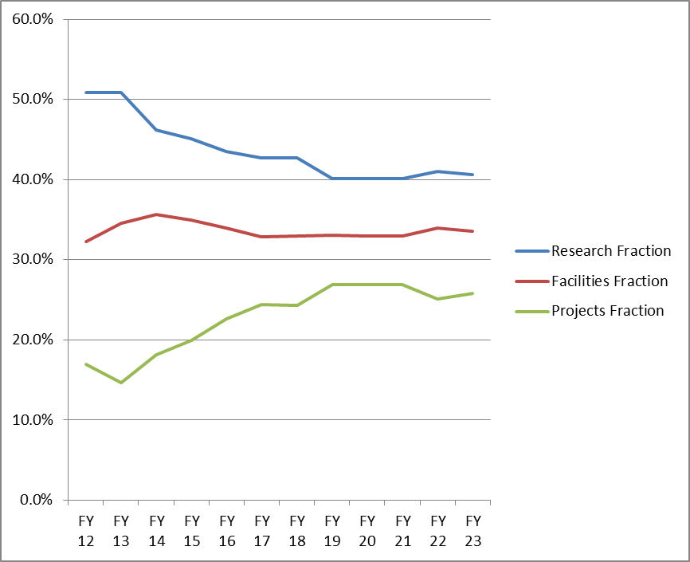
One Possible Future Scenario
Trading Research for more Projects
About 20% (relative) reduction in Research fraction over ~5 years
In order to address priorities, this will not be applied equally across Frontiers.
This necessarily implies reductions in scientific staffing
Some can migrate to Projects but other transitions are more difficult.
We have requested Labs to help manage this transition as gracefully as possible
11

Slide 12
FY 2014 High Energy Physics Budget (Data in new structure, dollars in thousands)
Description | FY 2012 Actual | FY 2013 CR Actual | FY 2014 Request | Explanation of Change
Energy Frontier Exp. Physics | 159,997 | 148,164 | 154,687 | Ramp-down of Tevatron Research
Intensity Frontier Exp. Physics | 283,675 | 287,220 | 271,043 | Completion of NOνA (MIE), partially offset by Fermi Ops
Cosmic Frontier Exp. Physics | 71,940 | 78,943 | 99,080 | Ramp-up of LSST
Theoretical and Computational Physics | 66,965 | 66,398 | 62,870 | Continuing reductions in Research
Advanced Technology R&D | 157,106 | 131,885 | 122,453 | Completion of ILC R&D
Accelerator Stewardship | 2,850 | 3,132 | 9,931 | FY14 includes Stewardship-related Research
SBIR/STTR | 0 | 0 | 21,457
Construction (Line Item) | 28,000 | 11,781 | 35,000 | Mostly Mu2e; no LBNE ramp-up
Total, High Energy Physics: | 770,533 ^{(a)} | 727,523 ^{(b,c)} | 776,521 | wrt FY12: Down -2% after SBIR correction wrt FY13: Up +3.6% after SBIR correction
Ref: Office of Science (SC): | 4,873,634 | 4,621,075 ^{(c)} | 5,152,752
SBIR = Small Business Innovation Research
STTR = Small Business Technology Transfer
^{(a)} The FY 2012 Actual is reduced by $20,327,000 for SBIR/STTR.
^{(b)} The FY 2013 CR Actual is reduced by $20,791,000 for SBIR/STTR. ^{(c)} Reflects sequestration.
12

Slide 13
HEP Energy Frontier
Funding (in $K) | FY 2012 Actual | FY 2013 CR Actual | FY 2014 Request | Comment
Research | 91,757 | 86,172 | 96,129 ^{(a)} | Tevatron ramp-down offset by R&D for LHC detector upgrades
Facilities | 68,240 | 61,992 | 58,558
LHC Detector Ops | 64,846 ^{(b)} | 56,912 | 56,774 | LHC down for maintenance
LHC Upgrade Project | 0 | 3,000 | 0 | LHC detector upgrades (OPC)
Other | 3,394 | 2,080 | 1,784 | IPAs, Detailees, Reviews
TOTAL, Energy Frontier: | 159,997 | 148,164 | 154,687
OPC = Other Project Costs
^{(a)} Includes $12M (= $6M CMS + $6M ATLAS) Phase-1 detector upgrades [R&D];
Therefore, Energy Frontier Core Research FY14 Request = 84,129k
^{(b)} Per interagency MOU, HEP provided LHC Detector Ops funding during FY12 CR
to offset NSF contributions to Homestake de-watering activities.
13

Slide 14
Current LBNE Strategy
We are trying to follow the reconfiguration [phased] plan for LBNE, though it has hit some snags
Out-year budgets are challenging
Some members of the community objected that the phased LBNE was not what P5 (or they) had in mind
The plan, as it currently stands:
Use time before baselining to recruit partners (international and domestic) that expand scope and science reach
Working to get more of the community on board
It seems clear this is necessary. Will it also be sufficient?
Need to get agreement on what is required for success
14

Slide 15
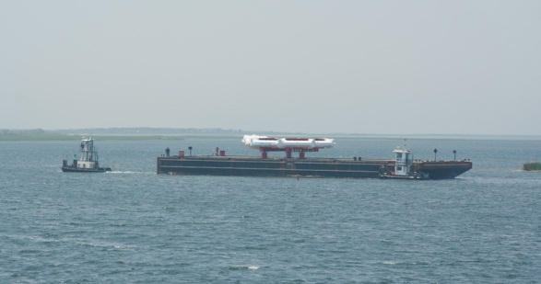
Major Item of Equipment (MIE) Issues
We were not able to implement [most] new MIE starts in the FY14 request
Muon g-2 experiment is the only new start in HEP
Brookhaven National Laboratory
Muon g-2 Ring: On Barge, Departing Southern Long Island
June 25, 2013
This upsets at least 2 major features of our budget strategy:
Strategic plan: “Trading Research for Projects”
Implementation of facilities balanced across Frontiers
15

Slide 16
HEP Physics MIE Funding
Funding (in $K) | FY 2012 Actual | FY 2013 CR Actual | FY 2014 Request | Description
MIE’s | 55,770 | 45,687 | 39,000
Intensity Frontier | 41,240 | 19,480 | 0 | NOνA ramp-down
Intensity Frontier | 6,000 | 5,857 | 0 | MicroBooNE
Intensity Frontier | 500 | 0 | 0 | Reactor Neutrino Detector at Daya Bay
Intensity Frontier | 1,030 | 5,000 | 8,000 | Belle-II
Intensity Frontier | 0 | 5,850 | 9,000 | Muon g-2 Experiment
Cosmic Frontier | 1,500 | 1,500 | 0 | HAWC
Cosmic Frontier | 5,500 | 8,000 | 22,000 | Large Synoptic Survey Telescope (LSST) Camera
TOTAL MIE’s | 55,770 | 45,687 | 39,000
16

Slide 17
HEP Physics Construction Funding
Funding (in $K) | FY 2012 Actual | FY 2013 CR Actual | FY 2014 Request
Construction - TPC | 53,000 | 28,388 | 45,000
Long Baseline Neutrino Experiment | 21,000 | 17,888 | 10,000
TEC | 4,000 | 3,781 | 0
OPC | 17,000 | 14,107 | 10,000
TPC | 21,000 | 17,888 | 10,000
Muon to Electron Conversion Experiment | 32,000 | 10,500 | 35,000
TEC | 24,000 | 8,000 | 35,000
OPC | 8,000 | 2,500 | 0
TPC | 32,000 | 10,500 | 35,000
TEC = Total Estimated Cost (refers to Capital Equipment expenses)
OPC = Other Project Costs
TPC = Total Project Cost
17

Slide 18
Strategic Planning and community process
http://xkcd.com/1116/

Slide 19
Major Recommendations of 2008 Advisory Panel (P5)
The panel recommends that the US maintain a leadership role in world-wide particle physics. The panel recommends a strong, integrated research program at the three frontiers of the field: the Energy Frontier, the Intensity Frontier, and the Cosmic Frontier.
The panel recommends support for the US LHC program, including US involvement in the planned detector and accelerator upgrades. (highest priority)
The panel recommends a world-class neutrino program as a core component of the US program, with the long-term vision of a large detector in the proposed DUSEL and a high-intensity neutrino source at Fermilab.
The panel recommends funding for measurements of rare processes to an extent depending on the funding levels available… (Mu2e)
The panel recommends support for the study of dark matter and dark energy as an integral part of the US particle physics program.
The panel recommends a broad strategic program in accelerator R&D, including work …, along with support of basic accelerator science.
These are still relevant, and this is still the plan.
19

Slide 20
Strategic Planning
The HEP budget puts in place a comprehensive program across the three frontiers
In five years,
The CMS and ATLAS detector upgrades will be installed at CERN.
NOνA, Belle-II, Muon g-2 will be running on the Intensity Frontier.
Mu2e will be in commissioning preparing for first data.
DES will have completed its science program and new mid-scale spectroscopic instrument and DM-G2 should begin operation
The two big initiatives, LSST and LBNE, will be well underway.
Need to start planning now for what comes next
Engaging with DPF community planning process that will conclude this summer.
Will set up a prioritization process – Particle Physics Project Prioritization Panel – (á la P5) using that input.
20

Slide 21
Customized Implementation Strategies
Energy Frontier
US has a leading role in LHC physics collaborations but is not the driver
The issue is the scope and scale of US involvement. Requires US-CERN negotiation
Could also be true for Japanese-hosted ILC
Intensity Frontier
US is the world leader and needs new facilities and/or upgrades of existing facilities to maintain its position
Has the potential to attract new partners to US-led projects
Portfolio of experiments and science case is diverse. This complicates the case. The scale of the projected investments is a big challenge
Cosmic Frontier
US HEP has a leading role in a competitive, multidisciplinary environment
HEP component of the physics case is simple and compelling. Only question is how far one needs to go in precision/setting limits on, e.g., dark matter.
DOE is a technology enabler, not a facilities provider (see NSF, NASA)
Analogous to LHC but the HEP physics goals are not those of the facility owners
DOE supports particle physics goals and HEP-style collaborations
Astronomy and astrophysics is not in our mission nor our modus operandi
21

Slide 22
Joint Agency Letter to the Community
Fundamentally…[planning] is a multi-step process with several important milestones over the coming year, and each step will inform and prepare for the next.
HEP Facilities Subpanel: Advise DOE/SC mgmt. on the scientific impact and technical maturity of planned and proposed SC Facilities, in order to develop a coherent 10-yr SC facilities plan
Subpanel can add or subtract from initial facilities list
Does not exclude/pre-empt later additions
DPF/CSS2013 “Snowmass”: community identifies compelling HEP science opportunities over an approximately 20-year time frame.
Not a prioritization but can make scientific judgments
HEPAP/P5: Advises agencies on new strategic plan and priorities for US HEP in various funding scenarios, using input from #1 and #2 above (among others)
22

Slide 23
Snowmass / P5 Interface
What we hope to see from Snowmass:
What are the most compelling science questions in HEP that can be addressed in the next 10 to 20 years and why?
What are the primary experimental approaches that can be used to address them? Are they likely to answer the question(s) in a “definitive” manner or will follow-on experiments be needed?
What are the “hard questions” (science, technical, cost…) that a given experiment or facility needs to answer to respond to perceived limitations in its proposal?
These topics should be covered in the Snowmass Reports and White Papers. P5 will use these reports and white papers as its starting point.
We expect to have the P5 panel selected and a formal charge issued by the time of the September HEPAP meeting
23

Slide 24
Goals for the P5 Process
DOE/NSF met in early May to kickoff P5 process and agree on goals:
The P5 process takes the science vision of the community and turns it into plan that is feasible and executable over a 10-20 year timescale
HEP MUST have a planning and prioritization process that the community can stand behind and support once the P5 report is complete.
We also need a process that repeats at more less regular intervals (5 years?)
We also want to allow for less comprehensive updates and modest course corrections to the plan along the way (á la P5 updates in 2009, 2010)
Key elements envisioned for the P5 process:
Revisit the questions we use to describe the field
e.g., Quantum Universe, updated and corrected
Decide on the project priorities within budget guidance
in detail for the next 10 years, in broad outline beyond that
Propose the best way to describe the value of HEP research to society
Build on the investment in Snowmass process and outcomes
24

Slide 25
What P5 Is (and is Not)
P5 will prioritize HEP projects over a 10-20 year timeframe within reasonable budget assumptions and position the U.S. to a be a leader in some (but not all) areas of HEP.
This will include an explicit discussion of the necessity (or not) of domestic HEP facilities in order to maintain such a world leadership position.
Necessarily this will involve consideration of technical feasibility as well as plausible timescales and resources for future projects.
There will be budget “fixed points” for projects already under construction and other prior commitments
The charge to P5 will NOT include explicit examination of
Agency review processes
Roles, responsibilities and funding of Labs vs. Universities
Relative funding of experimental HEP vs. theory vs. technology R&D
25

Slide 26
DRAFT New P5 Process (for discussion)
Based on adopting “best practices” from our colleagues in Nuclear Physics and Astrophysics, we are considering the following enhancements to the P5 process for this iteration:
Greatly enlarged P5 panel (~50 members). Previous P5 had 21 members.
Nominations will be sought from HEP and related communities through a ‘Dear Colleague’ letter
Snowmass output (reports, white papers) as a starting point, but may solicit additional material on specific projects
Several “town meetings” as public forums not only to advocate for particular science opportunities but also to prioritize
Each sub-group of the community should be able to prioritize the most important science (and projects) within its specialty. P5 will recommend priorities across the entire field.
Working subgroup for updating the Quantum Universe questions in parallel with science priority discussion
Separate working group elucidating HEP benefits to society
26

Slide 27
DRAFT New P5 Timeline
2013
2014
May
June
July
Aug
Sept
Oct
Nov
Dec
Jan
Feb
Mar
Apr
May
June, July
Fall/Winter 2013:
Town-Hall Meetings [moderated by P5];
(4 or 5, venues and topics TBD)
July 29 – Aug. 6:
Snowmass Meeting in Minnesota
Call for Nominations to P5
Sept. 5 – 6:
HEPAP Meeting
at NSF.
P5 Charge and membership formally announced.
Timeline for P5 meetings announced.
Spring/Summer 2014:
P5 Report(s) due.
Exact dates and deliverables to be spelled out in P5 Charge.
Agencies draft P5 Charge;
HEPAP Chair reviews P5 nominations and begins selection process.
DOE/NSF agree on outlines of P5 process and begins to inform community via presentations and
“Dear Colleague”
Letter.
Winter/Spring 2014:
P5 Meetings
(Phone-in or In-Person).
Exact Dates: TBD
August:
Snowmass Meeting concludes,
reports issued;
Aug. 13 – 17: DPF Santa Cruz Meeting;
P5 Charge sent to HEPAP Chair
27

Slide 28
Draft: Proposed Town Meetings (1)
1st meeting on the overall strategy, questions to describe the field, and discussion of how technology development priorities and other crosscutting issues should be covered in the P5 report
Start with the current P5 plan and possible alternatives as well as global strategy considerations
Need to understand “where we are now” and recognize much has changed since the last P5 – does this also change our strategy? Does this change how we think about the field?
Open discussion of issues so the community can better understand the constraints, and hopefully reach broader agreement.
Fundamental questions for the field and how to unify/connect the Frontiers framework will also be discussed
Input from the Theory community will be especially important in this area
Technology support will NOT be a main focus of P5, but the panel will benefit from wisdom in the community in this area
e.g., Do we have a coherent technology R&D plan that dovetails with the science opportunities? If not, how do we get there?
Note that ‘Accelerator Stewardship’ is an Office of Science wide initiative managed by the HEP office, so should be discussed for information, but will not be modified by P5.
28

Slide 29
Draft: Proposed Town Meetings (2)
Subsequent meetings will focus on open community discussion of project priorities on each of the frontiers: Energy, Intensity, and Cosmic
The process will be moderated by P5 itself, and based on input from Snowmass White Papers and project White Papers updated from the Facility Panel, Snowmass, or just for this purpose.
The expected outcome will be advice to P5 on a prioritized project list by frontier. Each meeting will focus on one frontier, not flaws in the plan of the other frontiers.
The budget guidance to P5 will be public as part of its Charge, so proponents will have a good idea of the total budget envelope that can be considered and can debate what is a “reasonable” budget profile.
P5 will see to it that the meetings to not descend into a shouting contest
Based on the results of the first 4 meetings, we will consider a 5th meeting to ‘wrap up’ and discuss any broad matters arising
29

Slide 30
Next Steps on Snowmass / P5
Agencies welcome input from the community on the shape of the P5 process
We have until the end of Snowmass to modify our P5 plans
the agencies continue to give a series of talks at the Snowmass meetings to solicit further input
information on Snowmass/P5 process is also available from DOE OHEP webpage
Agencies will begin to draft P5 charge
The agencies expect that our community is capable of professional behavior, and look forward to vigorous and open discussions of our challenges and opportunities
encourage active engagement from the entire HEP community in the full process including those from the US that are resident at experiments offshore (e.g., at CERN)
30

Slide 31
Summary

Slide 32
HEP Program Planning – Energy Frontier
Issues and questions we will need to deal with when laying out longer term plans –
and to be able to execute & defend the program
Continue to sharpen the science case: What is the physics motivation for the Phase-2 LHC detector upgrades? How best do we exploit the physics opportunities for high luminosity LHC running? What is the physics motivation for future lepton colliders? Do we need more results from the LHC experiments in order to make the case for future machines?
How far do we need to go in precision measurements and/or setting limits in each respective area of physics research with the current machines?
What computational resources are needed for future participation in large-scale projects and operations such as the LHC and ILC?
How do we maintain or enhance the performance of LHC detectors in the challenging accelerator environment of high instantaneous luminosities and high pile-up?
What is the impact of participation in global projects at a time when the US is trying to advance leadership in a domestic program? Can the impact be quantified?
Need to promote case for the importance of Energy Frontier with other frontiers and overall HEP community
31

Slide 33
Take-Away Messages
The U.S. HEP program is following the strategic plan laid out by the previous HEPAP/P5 studies
Though some of the boundary conditions have changed, we are still trying to implement that plan within the current constraints
FY 2014 request generally supports this, though funding constraints have led to delays in some key projects
Need to maintain progress with projects currently “on the books”
Working to attract partnerships that will extend the science impact
Actively engaged with community in developing new strategic plan
Our only hope to maintain leadership in the long-term is to out-innovate the competition, and exploit unique capabilities
Focus on areas where US can have leadership
“High-risk, high-impact” as opposed to incremental advances
Note this is not an either/or proposition, we need both with appropriate balance
32

Slide 34
REFERENCE SLIDES

Slide 35
Office of
High Energy Physics
Fundamental
to the
Frontiers of
Discovery
HEP’s Mission:
To explore the most fundamental questions about the nature of the universe at the Cosmic, Intensity, and Energy Frontiers of scientific discovery, and to develop the tools and instrumentation that expand that research.
HEP seeks answers to Big Questions:
How does mass originate?
Why is the world matter and not anti-matter?
What is dark energy? Dark matter?
Do all the forces become one and on what scale?
What are the origins of the Universe?
HEP offers high-impact research opportunities for small-scale collaborations at the Cosmic and Intensity Frontiers to full-blown international collaborations at the Energy Frontier. More than 20 physicists supported by the Office of High Energy Physics have received the Nobel Prize.

Slide 36
HEP Physics and Technology
Experimental
Theory
Simulation
The Energy Frontier
Origins of Mass
Matter/Anti-matter
Asymmetry
Dark matter
Neutrino Physics Proton Decay
The Intensity
Frontier
Dark energy
Cosmic Particles
The Cosmic
Frontier
Origin of Universe
Unification of Forces
New Physics
Beyond the Standard Model
Along Three Paths
Accelerators
Detectors
Computing
Enabled by
Advanced Technologies
Physics Frontiers

Slide 37
From Deep Underground to the Tops of Mountains, HEP pushes the Frontiers of Research
Research at the Energy Frontier — HEP supports research where powerful accelerators such as the LHC are used to create new particles, reveal their interactions, and investigate fundamental forces, and where experiments such as ATLAS and CMS explore these phenomena.
Research at Intensity Frontier — Reactor and beam-based neutrino physics experiments such as Daya Bay and LBNE may ultimately answer some of the fundamental questions of our time: why does the Universe seem to be composed of matter and not anti-matter?
Research at the Cosmic Frontier — Through ground-based telescopes, space missions, and deep underground detectors, research at the cosmic frontier aims to explore dark energy and dark matter, which together comprise approximately 95% of the universe.
Theory and computation — Essential to the lifeblood of High Energy Physics, the interplay between theory, computation, and experiment drive the science forward. Computational sciences and resources enhance both data analysis and model building.
Accelerator Science — New accelerator techniques such as plasma wake-field acceleration, researched at LBL’s BELLA and SLACs’ FACET facilities, may eventually lead to higher beam energies than ever before, opening up new realms for discovery.

Slide 38
The Common Goal
A realistic, coherent, shared plan for US HEP
Enabling world-leading facilities and experiments in the US while recognizing the global context and the priorities of other regions
Recognizing the centrality of Fermilab while maintaining a healthy US research ecosystem that has essential roles for both universities and multi-purpose labs
Articulating both the value of basic research and the broader impacts of HEP
Maintaining a balanced and diverse program that can deliver research results consistently

Slide 39
DOE OHEP Organization

Slide 40
Energy frontier

Slide 41
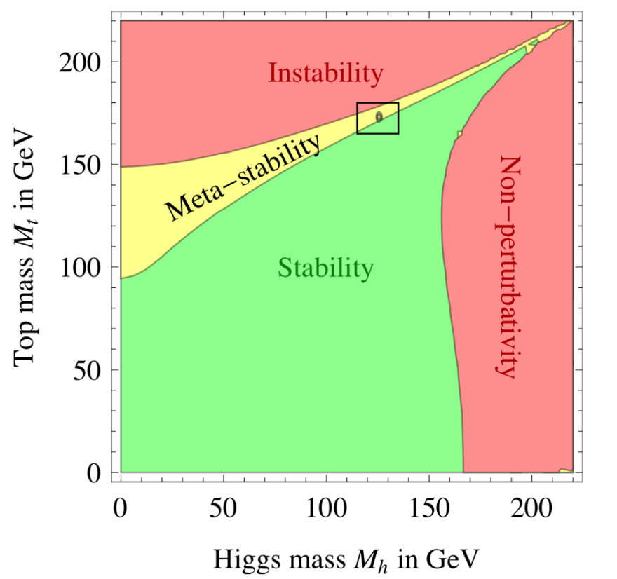
The Higgs may be telling us something…
Ref: Joseph Lykken (Fermilab),
Presentation at DOE OHEP,
April 1, 2013
Motivation for precision measurements of Higgs sector as well as for precision measurements of the top- and W-mass

Slide 42
The LHC Forecast
~3000 fb⁻¹
LS1 LS2 LS3
√s = 7 – 8 TeV
13 ~ 14 TeV
14 TeV
14 TeV
L = 10²⁷→ 7x10³³
1 x10³⁴
2 x10³⁴
5 x10³⁴
Phase – 0 [Shutdown]
<μ> = 20
<μ> = 27
<μ> = 55
Phase – 1 Upgrade
Phase – 2 Upgrade
Integrated Luminosity (fb⁻¹)
<μ> = 140
~300 fb⁻¹
~100 fb⁻¹
25 fb⁻¹
2010
2012
2014
2016
2018
2020
2022
2024
…...
2030
Calendar Year

Slide 43
Broader Impacts of HEP

Slide 44
The Accelerator R&D Stewardship Program
The mission of the HEP long-term accelerator R&D stewardship program is to support fundamental accelerator science and technology development of relevance to many fields and to disseminate accelerator knowledge and training to the broad community of accelerator users and providers.
Strategies:
Improve access to national laboratory accelerator facilities and resources for industrial and for other U.S. government agency users and developers of accelerators and related technology;
Work with accelerator user communities and industrial accelerator providers to develop innovative solutions to critical problems, to the mutual benefit of our customers and the DOE discovery science community;
Serve as a catalyst to broaden and strengthen the community of accelerator users and providers
Strategic plan sent to Congress in October 2012
Incorporated into FY2014 Budget Request as new subprogram in HEP

Slide 45
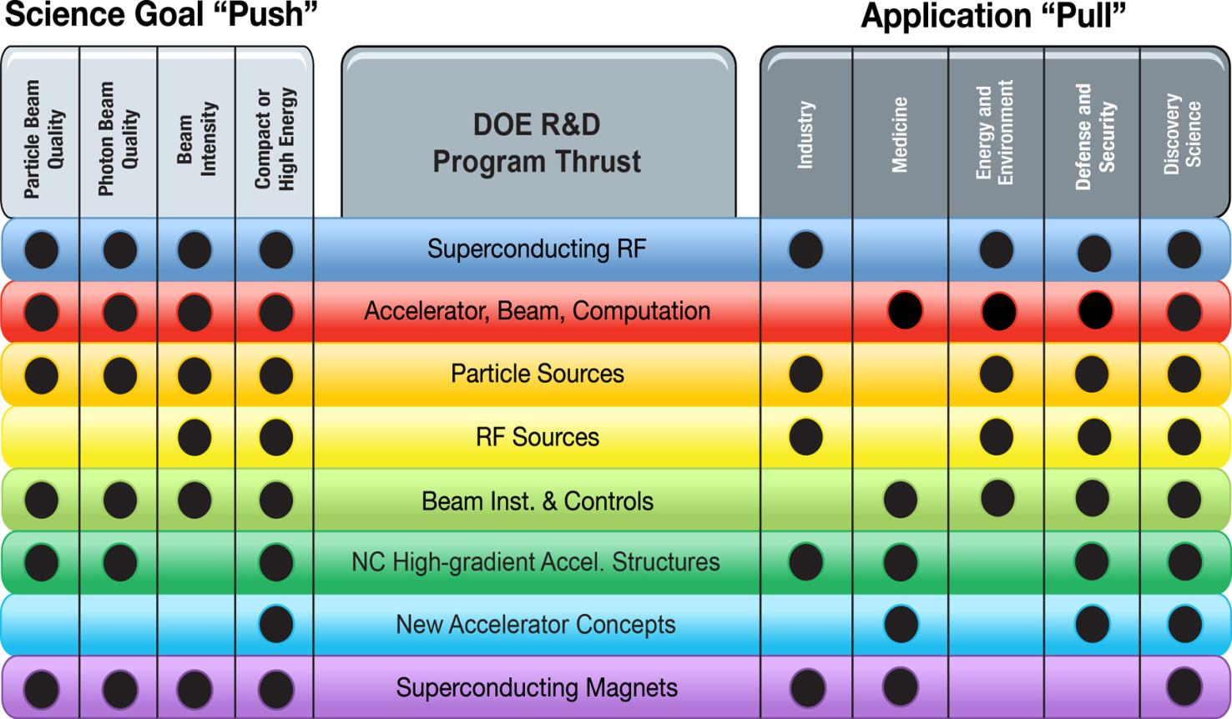
Connecting Accelerator R&D to Science and to End-User Needs

Slide 46
Budget Backup

Slide 47
FY 2014 Request Crosscuts

Slide 48
HEP Physics Funding by Activity
Funding (in $K) | FY 2012 Actual | FY 2013 CR Actual | FY 2014 Request | Explanation of Change wrt FY12
Research | 391,329 | 362,284 | 383,609 | Reduction mostly ILC R&D
Facility Operations and Exp’t Support | 249,241 | 265,305 | 271,561^{(a)} | NOνA ops start-up and Infrastructure improvements
Projects | 129,963 | 99,934 | 99,894
Energy Frontier | 0 | 3,000 | 0 | Phase-1 LHC detector upgrades
Intensity Frontier | 86,570 | 62,794 | 37,000 | NOνA ramp-down, start Muon g-2
Cosmic Frontier | 12,893 | 19,159 | 24,694 | LSST
Other | 2,500 | 3,200 | 3,200 | LQCD hardware
Construction (Line Item) | 28,000 | 11,781 | 35,000 | Mostly Mu2e; no LBNE ramp-up
SBIR/STTR | 0 | 0 | 21,457
TOTAL, HEP | 770,533 | 727,523^{(b)} | 776,521
^{(a)} Includes $1,563K GPE.
^{(b)} Reflects sequestration.

Slide 49
HEP Intensity Frontier
Funding (in $K) | FY 2012 Actual | FY 2013 CR Actual | FY 2014 Request | Comment
Research | 53,261 | 52,108 | 53,562 | Ramp-down of B-factory research offset by increased support for new initiatives
Facilities | 143,844 | 172,318 | 180,481
Expt Ops | 6,615 | 7,354 | 7,245 | Offshore and Offsite Ops
Fermi Ops | 119,544 | 143,128 | 156,438 | Accelerator and Infrastructure improvements
B-factory Ops | 10,031 | 5,654 | 4,600 | Completion of BaBar D&D
Homestake* | 5,478 | 14,000 | 10,000
Other | 2,176 | 2,182 | 2,198 | GPE and Waste Mgmt
Projects | 86,750 | 62,794 | 37,000
Current | 73,770 | 52,794 | 27,000 | NOνA + MicroBooNE ramp-down
Future R&D | 12,880 | 10,000 | 10,000
TOTAL, Intensity Frontier | 283,675 | 287,220 | 271,043
*Per interagency MOU, HEP provided LHC Detector Ops funding during FY12 CR to offset NSF contributions to Homestake dewatering activities.

Slide 50
HEP Cosmic Frontier
Funding (in $K) | FY 2012 Actual | FY 2013 CR Actual | FY 2014 Request | Comment
Research | 47,840 | 48,836 | 62,364 | R&D for G2 Dark Matter
Facilities | 11,207 | 10,948 | 12,022 | Offshore and offsite Ops
Projects | 12,893 | 19,159 | 24,694
Current | 9,153 | 9,500 | 23,200 | LSSTcam fabrication begins
Future R&D | 3,380 | 9,659 | 1,484 | Dark energy and dark matter projects move to conceptual design
TOTAL, Cosmic Frontier | 71,940 | 78,943 | 99,080

Slide 51
HEP Theory and Computation
Funding (in $K) | FY 2012 Actual | FY 2013 CR Actual | FY 2014 Request | Comment
Research | 64,465 | 63,198 | 59,670
HEP Theory | 55,929 | 54,621 | 51,196 | Follows programmatic reductions in Research
Computational HEP | 8,536 | 8,577 | 8,474
Projects | 2,500 | 3,200 | 3,200 | Lattice QCD hardware
TOTAL, Theory and Comp. | 66,965 | 66,398 | 62,870

Slide 52
HEP Advanced Technology R&D
Funding (in $K) | FY 2012 Actual | FY 2013 CR Actual | FY 2014 Request | Comment
Research | 134,006 | 111,888 | 105,303
General Accel. R&D | 59,280 | 61,791 | 57,856 | Selected long-term R&D moves to Accelerator Stewardship
Directed Accel. R&D | 46,587 | 22,692 | 23,500 | Completion of ILC R&D
Detector R&D | 28,139 | 27,405 | 23,947 | Funding for liquid argon R&D is reduced
Facility Operations | 23,100 | 19,997 | 17,150 | Completing SRF infrastructure at Fermilab
TOTAL, Advanced Technology R&D | 157,106 | 131,885 | 122,453

Slide 53
Accelerator Stewardship
Funding (in $K) | FY 2012 Actual | FY 2013 CR Actual | FY 2014 Request | Comment
Research | 0 | 82 | 6,581 | Recast of Accelerator R&D activities relevant to broader impacts
Facility Operations | 2,850 | 3,050 | 3,350 | Incremental FACET ops for stewardship research
TOTAL, Accel. Stewardship | 2,850 | 3,132 | 9,931

Slide 54
HEP Project Status
Subprogram | TPC ($M) | CD Status | CD Date
INTENSITY FRONTIER
Long Baseline Neutrino Experiment (LBNE) | TBD | CD-1 | December 10, 2012
Muon g-2 | 40 | CD-0 | September 18, 2012
Mu2e | 249 | CD-1 | July 11, 2012
Next Generation B Factory Detector Systems (BELLE-II) | 16 | CD-3a | November 8, 2012
NuMI Off-Axis Electron Neutrino Appearance Exp’t (NOνA) | 278 | CD-3b | October 29, 2009
Micro Booster Neutrino Experiment (MicroBooNE) | 19.9 | CD-3b | March 29, 2012
Main INjector ExpeRiment for ν-A (MINERνA) | 16.8 | CD-4 | June 28, 2010 [Finished]
Daya Bay Reactor Neutrino Experiment | 35.5 | CD-4b | August 20, 2012 [Finished]
ENERGY FRONTIER
LHC ATLAS Detector (Phase-1) Upgrade | TBD | CD-0 | September 18, 2012
LHC CMS Detector (Phase-1) Upgrade | TBD | CD-0 | September 18, 2012
COSMIC FRONTIER
Dark Matter (DM-G2) | TBD | CD-0 | September 18, 2012
Large Synoptic Survey Telescope (LSST) | 173 | CD-1 | April 12, 2012
Dark Energy Survey (DES) | 35.1 | CD-4 | June 4, 2012 [Finished]
ADVANCED TECHNOLOGY R&D
Accelerator Project for the Upgrade of the LHC (APUL) | 11.5 | CD-2/3 | July 29, 2011
Berkeley Lab Laser Accelerator (BELLA) | 27.2 | CD-4 | January 17, 2013 [Finished]
Facility for Advanced Accelerator Experimental Tests (FACET) | 14.5 | CD-4 | January 31, 2012 [Finished]

Slide 55
Neutrino Backup

Slide 56
HEP Intensity Frontier Experiments
Experiment | Location | Status | Description | #US Inst. | #US Coll.
Belle II | KEK, Tsukuba, Japan | Physics run 2016 | Heavy flavor physics, CP asymmetries, new matter states | 10 Univ., 1 Lab | 55
CAPTAIN | Los Alamos, NM, USA | R&D; Neutron run 2015 | Cryogenic apparatus for precision tests of argon interactions with neutrinos | 5 Univ., 1 Lab | 20
Daya Bay | Dapeng Penisula, China | Running | Precise determination of θ₁₃ | 13 Univ., 2 Lab | 76
Heavy Photon Search | Jefferson Lab, Newport News, VA, USA | Physics run 2015 | Search for massive vector gauge bosons which may be evidence of dark matter or explain g-2 anomaly | 8 Univ., 2 Lab | 47
K0TO | J-PARC, Tokai , Japan | Running | Discover and measure K_{L}→π⁰νν to search for CP violation | 3 Univ. | 12
LArIAT | Fermilab, Batavia, IL | R&D; Phase I 2013 | LArTPC in a testbeam; develop particle ID & reconstruction | 11 Univ., 3 Lab | 38
LBNE | Fermilab, Batavia, IL & Homestake Mine, SD, USA | CD1 Dec 2012; First data 2023 | Discover and characterize CP violation in the neutrino sector; comprehensive program to measure neutrino oscillations | 48 Univ., 6 Lab | 336
MicroBooNE | Fermilab, Batavia, IL, USA | Physics run 2014 | Address MiniBooNE low energy excess; measure neutrino cross sections in LArTPC | 15 Univ., 2 Lab | 101
MINERνA | Fermilab, Batavia, IL, USA | Med. Energy Run 2013 | Precise measurements of neutrino-nuclear effects and cross sections at 2-20 GeV | 13 Univ., 1 Lab | 48
MINOS+ | Fermilab, Batavia, IL & Soudan Mine, MN, USA | NuMI start-up 2013 | Search for sterile neutrinos, non-standard interactions and exotic phenomena | 15 Univ., 3 Lab | 53
Mu2e | Fermilab, Batavia, IL, USA | First data 2019 | Charged lepton flavor violation search for 𝜇N→eN | 15 Univ., 4 Lab | 106
Muon g-2 | Fermilab, Batavia, IL, USA | First data 2016 | Definitively measure muon anomalous magnetic moment | 13 Univ., 3 Lab, 1 SBIR | 75
NOνA | Fermilab, Batavia, IL & Ash River, MN, USA | Physics run 2014 | Measure ν_{μ}-ν_{e} and ν_{μ}-ν_{μ} oscillations; resolve the neutrino mass hierarchy; first information about value of δ_{cp} (with T2K) | 18 Univ., 2 Lab | 114
ORKA | Fermilab, Batavia, IL, USA | R&D; CD0 2017+ | Precision measurement of K⁺→π⁺νν to search for new physics | 6 Univ., 2 Lab | 26
Super-K | Mozumi Mine, Gifu, Japan | Running | Long-baseline neutrino oscillation with T2K, nucleon decay, supernova neutrinos, atmospheric neutrinos | 7 Univ. | 29
T2K | J-PARC, Tokai & Mozumi Mine, Gifu, Japan | Running; Linac upgrade 2014 | Measure ν_{μ}-ν_{e} and ν_{μ}-ν_{μ} oscillations; resolve the neutrino mass hierarchy; first information about value of δ_{cp} (with NOνA) | 10 Univ. | 70
US-NA61 | CERN, Geneva, Switzerland | Target runs 2014-15 | Measure hadron production cross sections crucial for neutrino beam flux estimations needed for NOνA, LBNE | 4 Univ., 1 Lab | 15
US Short-Baseline Reactor | Site(s) TBD | R&D; First data 2016 | Short-baseline sterile neutrino oscillation search | 6 Univ., 5 Lab | 28
9

Slide 57
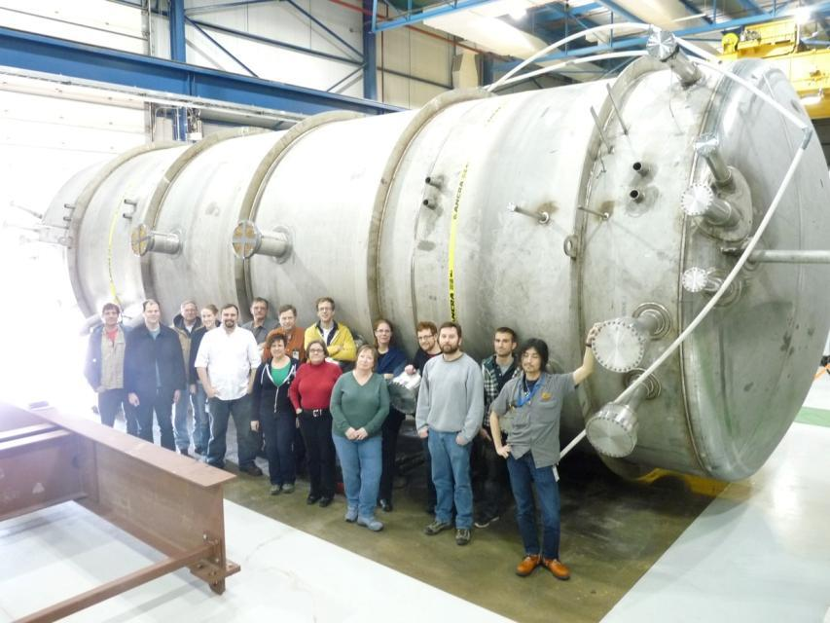
Intensity Frontier Status
Current program: MINERvA, NOvA, T2K, MicroBooNE, Daya Bay, EXO-200
NOvA and MicroBoone will complete construction in FY 2014 (see below + next slide), others taking data
Planned program: 4 projects in design/R&D phase; fabrication not approved yet
Belle-II
Mu2e
LBNE
Muon g-2
Physics Status
Daya Bay, T2K, NOvA, et al. will usher in the era of precision neutrino physics with few % measurements
1st steps in a comprehensive program
MicroBooNE cryostat delivered →

Slide 58
The Questions - the Experimental Program
Key remaining questions:
Where did all the antimatter go ?
Why are there so many different types (“flavors”) of neutrinos?
What is the ordering of neutrino masses?
Are there hidden phenomena we have not yet discovered ?
Experiment | AntiMatter | Flavors | Mass Order | Hidden Sector | Technology R&D
Daya Bay |  | *** | - | - | *
MINOS |  | ** | - | * | *
T2K | * | ** | - | * | *
NOνA | ** | *** | * | ** | *
LBNE | *** | **** | *** | *** | ***
Minerva | -- | --- | --- | * | *
MicroBooNE | -- | -- | --- | ** | **
reactor
high energy ν
low energy ν

Slide 59
Why Study Neutrinos?
Neutrinos are the least understood and most abundant constituents of matter.
They are everywhere, but they hardly interact at all. More than 10 million are inside every person on earth. You don’t notice.
Neutrinos are very, very, very light.
Less than one-millionth the mass of an electron, so light no one has actually been able to measure the mass yet (but we know its not = 0).
Neutrinos come in three “flavors” (types) that can change from one kind to another.
Neutrinos are also very important to our existence.
They are vital to how stars shine and how they produce all the elements beyond hydrogen, including the carbon and oxygen that makes up people.
They may play a key role in why there is any matter at all in the universe.
The Big Bang should have produced equal amounts of matter and antimatter, which should have annihilated into pure energy. Yet almost all the antimatter seems to have vanished and matter is still here.

Slide 60
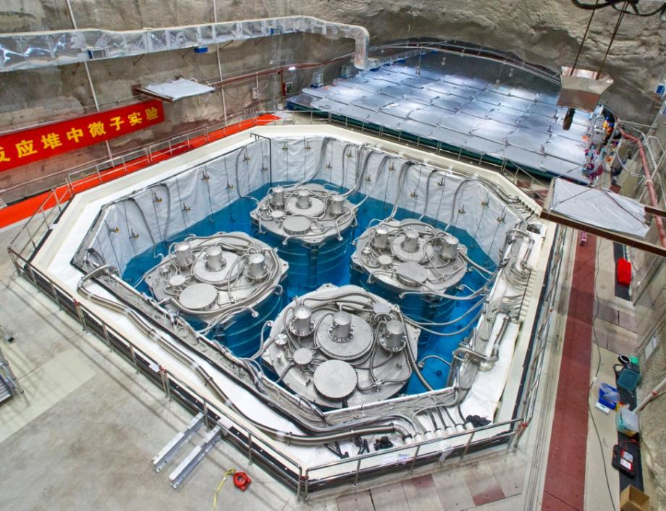
Recent Major Accomplishment
Daya Bay Reactor Neutrino Experiment makes the first definitive measurement of the remaining unknown neutrino mixing angle.
In China, the Daya Bay collaboration led by U.S. and Chinese physicists reported a measurement of the mixing angle responsible for changing muon neutrinos to electron neutrinos. This result means that in the current neutrino oscillation model, the possibility of matter-antimatter asymmetry, and a hierarchy of neutrino masses, can be definitively tested with new experiments.
Daya Bay Far Detector Hall with 4 neutrino detectors

Slide 61
The Long Baseline Neutrino Experiment
Neutrino beam from Fermilab travels ~800 miles to large detector at the Sanford Lab (old Homestake Mine) in Lead, SD. On the way there, some of the neutrinos change type and some interact with matter in the earth. The large detector counts how many neutrinos survive and what type they are. These studies can address many of the key questions about neutrinos.
LBNE is currently has CD-1 approval and is seeking additional domestic and international partners to enhance the physics reach of its initial configuration

Slide 62
Current Intensity Frontier R&D Efforts
Experiment | Location | Status | Description | #US Inst. | #US Coll.
CAPTAIN | Los Alamos, NM, USA | R&D; Neutron run 2015 | Cryogenic apparatus for precision tests of argon interactions with neutrinos | 5 Univ., 1 Lab | 20
Heavy Photon Search | Jefferson Lab, Newport News, VA, USA | Physics run 2015 | Search for massive vector gauge bosons which may be evidence of dark matter or explain g-2 anomaly | 8 Univ., 2 Lab | 47
LArIAT | Fermilab, Batavia, IL | R&D; Phase I 2013 | LArTPC in a test beam; develop particle ID & reconstruction | 11 Univ., 3 Lab | 38
ORKA | Fermilab, Batavia, IL, USA | R&D; CD0 2017+ | Precision measurement of K⁺→π⁺νν to search for new physics | 6 Univ., 2 Lab | 26
US-NA61 | CERN, Geneva, Switzerland | Target runs 2014-15 | Measure hadrons production cross sections crucial for neutrino beam flux estimations needed for NOvA, LBNE | 4 Univ., 1 Lab | 15
US Short-Baseline Reactor | Site(s) TBD | R&D; First data 2016 | Short-baseline sterile neutrino oscillation search | 6 Univ., 5 Lab | 28
Heavy Photon Search: Feb 2013 DOE Briefing; July 11, 2013 DOE Panel Review
Determine whether to fund the design, construction, commissioning, and operation of the first phase of the experiment for the period of FY14-FY16
nEXO R&D: Monthly DOE HEP/NP Phone Calls; July 12, 2013 DOE Panel Review
Determine whether to fund the 5 ton LXe TPC R&D program for the period of FY13-FY16
US Short-Baseline Reactor: Monthly DOE Phone Calls; Apr 2013 DOE Briefing
LArIAT: Monthly DOE Phone Calls; Apr 2013 DOE Briefing
ORKA: May 2012 DOE Briefing; FNAL Stage 1
CAPTAIN: Feb 2012 LANL Review (DOE Observer); Monthly DOE Phone Calls
nuSTORM: Monthly DOE Phone Calls; Proposal to FNAL PAC in June 2013
US-NA61: ?

Slide 63
What Makes HEP Unique?
Collaboration/teamwork
Ambition/”big science”
A long-term view
We invent our own tools
“Americans seem to work very well, only they obviously insist on making everything as big as possible."
—German physicist Franz Simon's impression upon a visit to the US in 1932.
LBNL Staff in 1939

Slide 64
What Are HEP’s limitations?
Middle-aged field
Technology plateau
(At least at Energy Frontier)
Not a national priority
Increased competition for science funding
Long timescale and high threshold for new experiments
Over-reach?
Reliance on international partners

