Slide 1


Mu+ Mu- collider as Higgs factory
Zhen Liu
Mainly based upon work with Tao Han, arixv:1210.7803
Also work by Alexander Conway and Hans Wenzel, arxiv:1304.5270
SNOWMASS Energy Frontier Workshop
UW-Seattle

Slide 2
Why
Precision is important
Key to theoretical interpretations

Slide 3
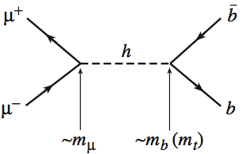
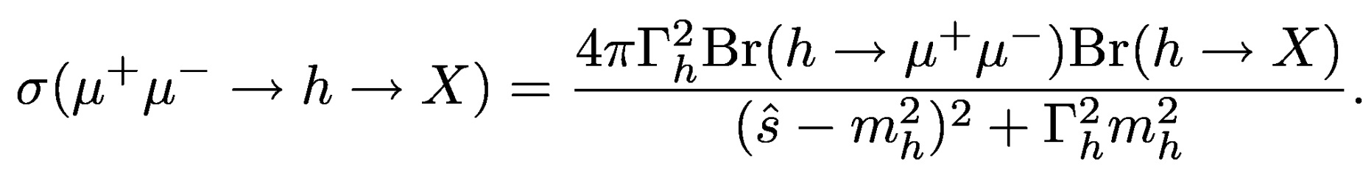

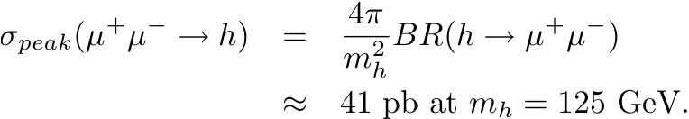
Muon Collider as a Higgs Factory
Resonant Production:
At the peak with a perfect energy resolution:
6
About 40,000 events produced per fb⁻¹

Slide 4

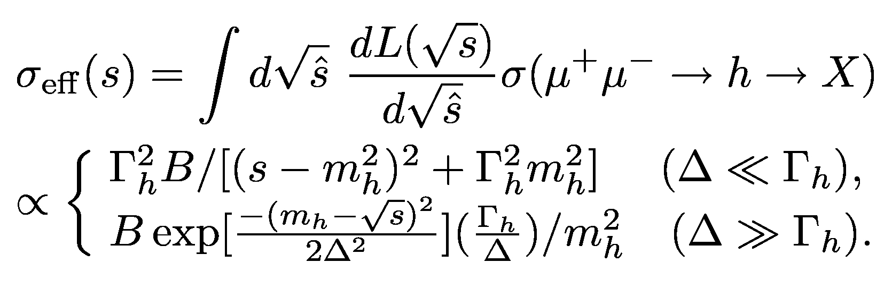
SM Higgs is (very) narrow:
At m_{h}=126 GeV, Γ_{h} = 4.2 MeV
Must convolute with energy profile:

Slide 5
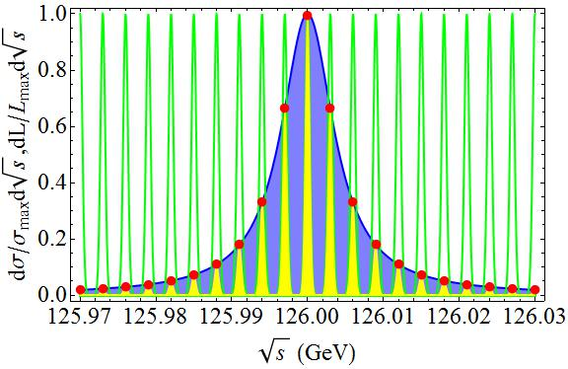
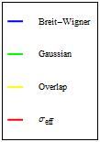
Extreme (good) Case:
Energy Spread much smaller than the physical width:
(Δ = 0.3 MeV, Γ_{h} ≈ 4.2 MeV)
Recall: Z line shape with Γ_{Z} ≈ 2.5 GeV

Slide 6
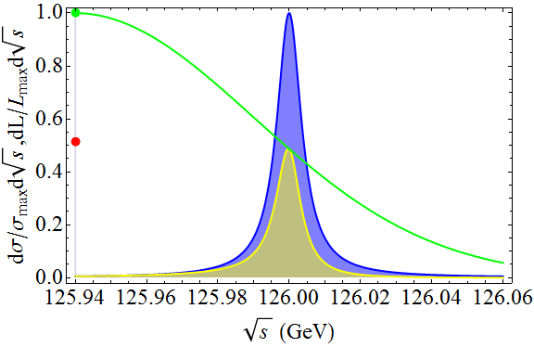
Extreme (bad) Case:
Energy Spread much larger than the physical width:
(Δ = 50 MeV, Γ_{h} ≈ 4.2 MeV)
Recall: J/ψ scan Γ ≈ 93 keV

Slide 7
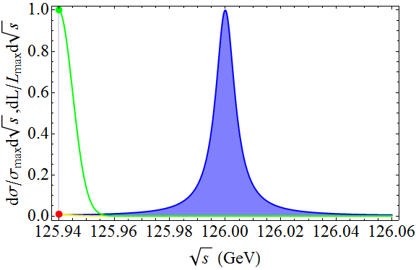
“Normal” (ideal) case:
Energy Spread comparable:
(Δ = 5 MeV, Γ_{h} ≈ 4.2 MeV)
An optimal fitting would reveal Γ_{h}

Slide 8
Remarks on this Method
Similar to Z width scanning
However, the challenges/differences are:
Higgs width much narrower than the Z width
(4.2 MeV v.s. 2.5 GeV)
It’s (almost) simple counting. Not much dependence on the final state resolution. While other colliders with very flat initial state energy distribution, they have to rely on the reconstructed energy of the decay products to see the peak directly.

Slide 9
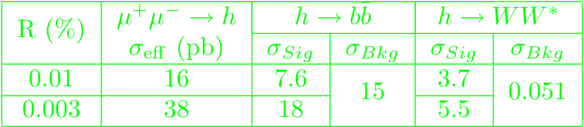
The SM Higgs
Leading signals and background rates
With a cone angle cut: 10º < θ < 170º

Slide 10
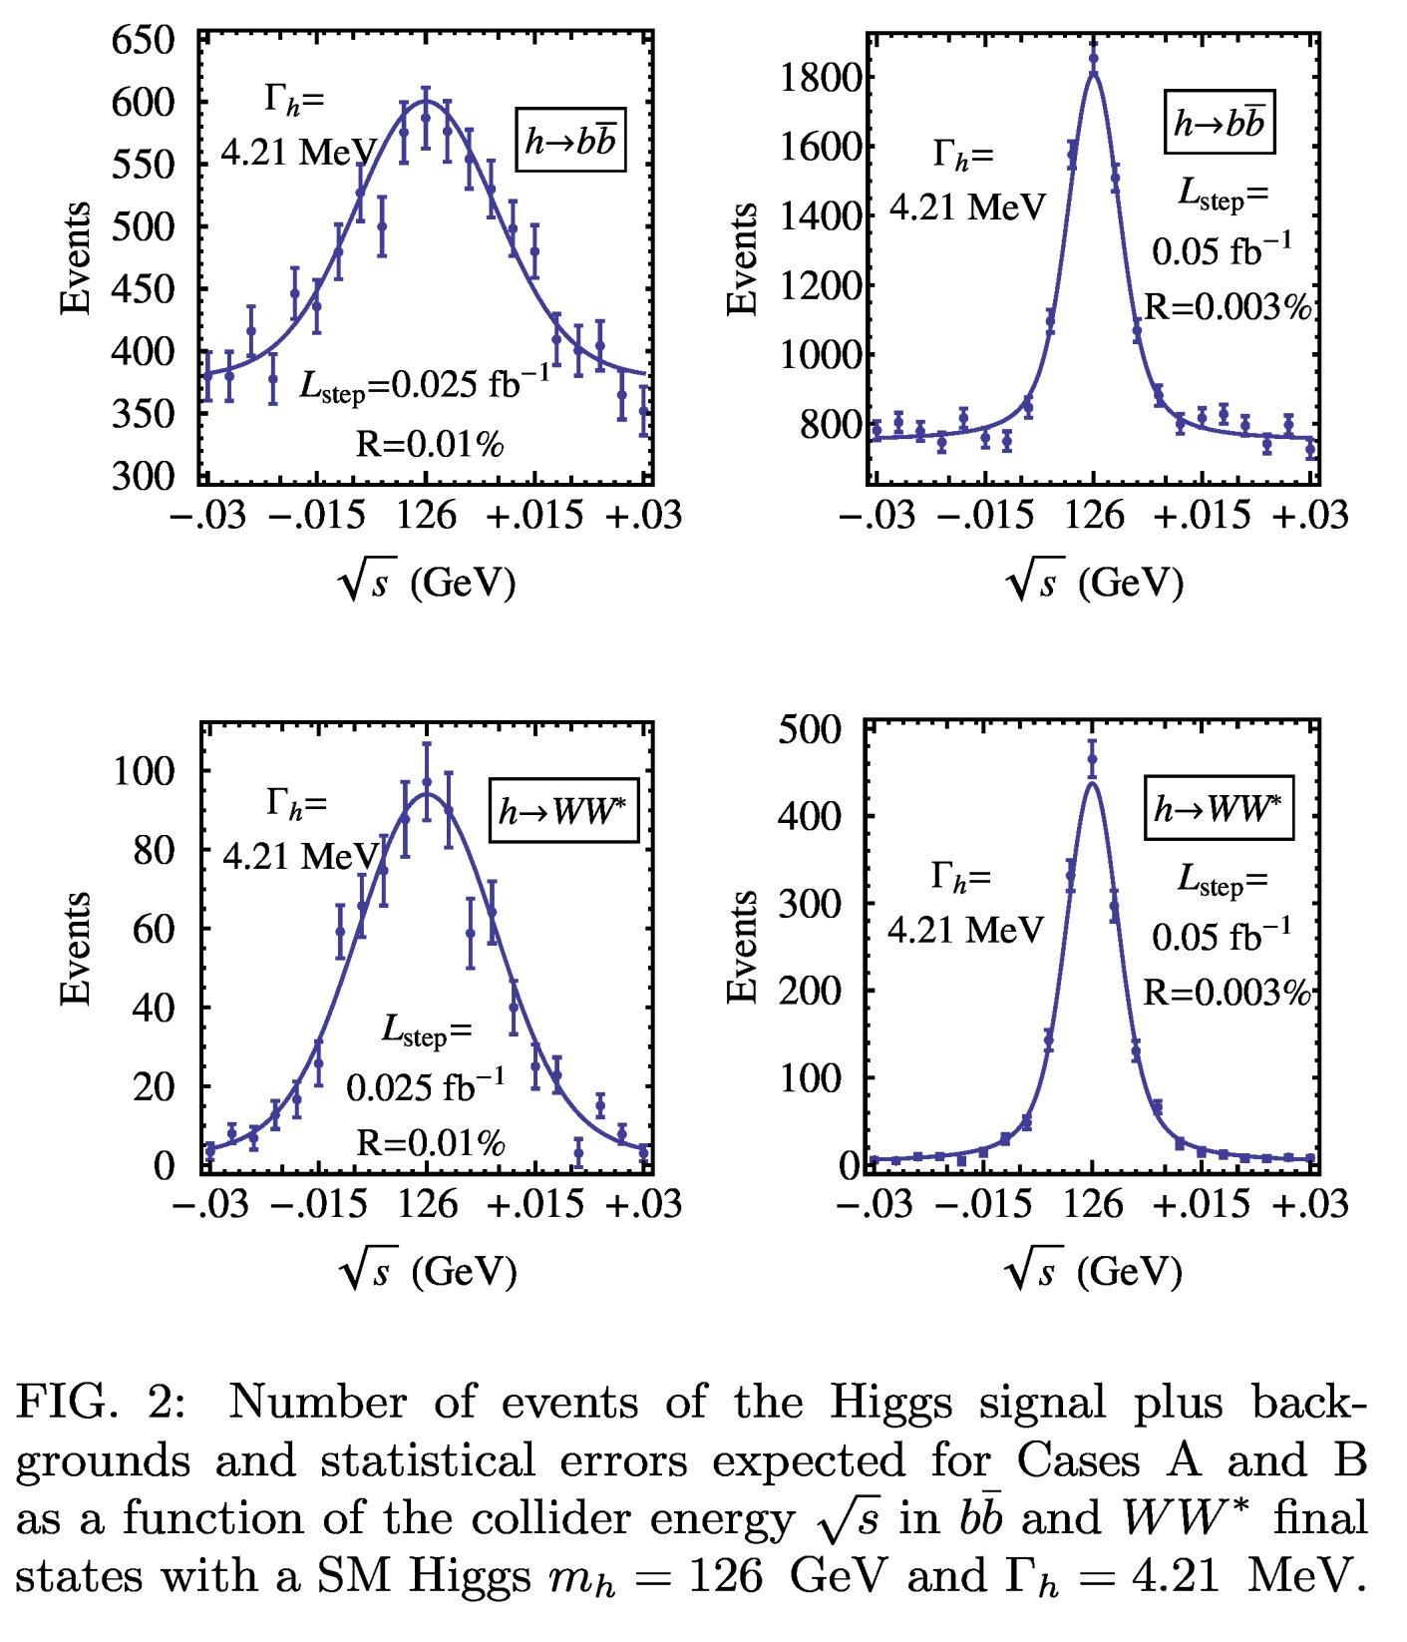
Profile for
SM Higgs
Leading channels
Sig+Bkg
Randomize
Step choice

Slide 11
Fitting procedure:
Three Parameters Fitting
  Width
  Mass
  Cross Section
Minimize χ² over bins
Estimate standard deviation of fitting via χ²_{min} +1

Slide 12

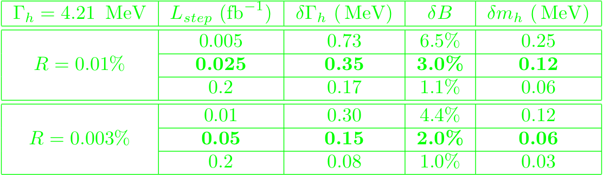
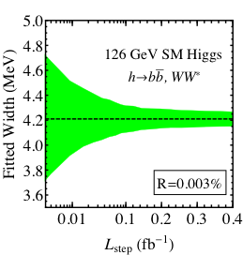
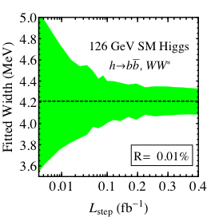
Fitting the SM Higgs

Slide 13
But First, we need to find the Higgs…
Haven’t we already found the Higgs?
We need to make sure its in a mass window +\-~30 MeV to performing the scan to map out the SM-like Higgs boson total width.
It’s important to know how much luminosity needed to be investigated to find the Higgs mass peak region.
Study done by Alexander Conway and Hans Wenzel, arxiv:1304.5270

Slide 14
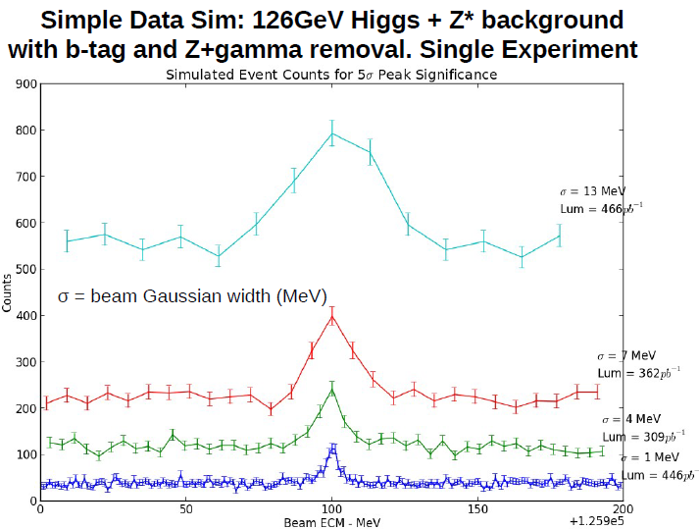
Pinning down the mass of the Higgs

Slide 15
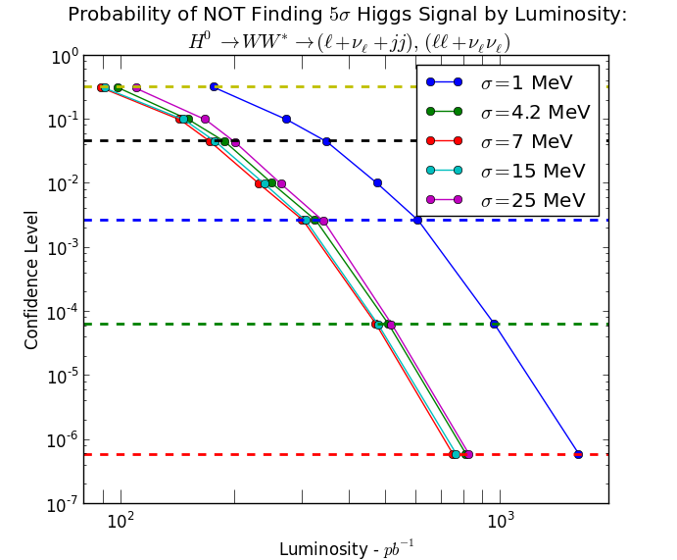
Pinning down the mass of the Higgs

Slide 16
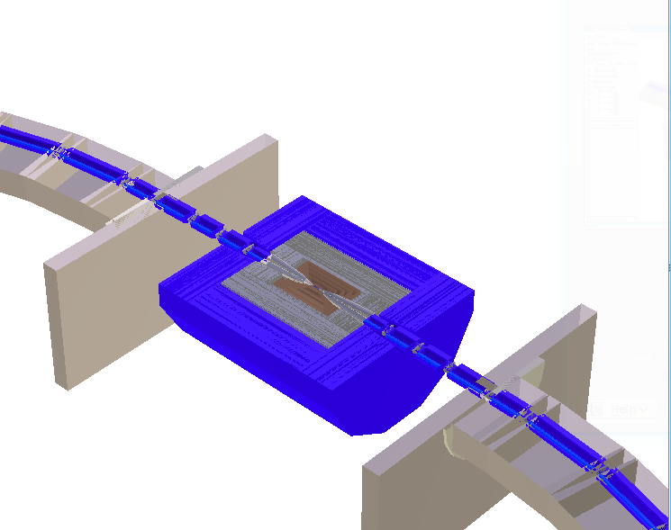
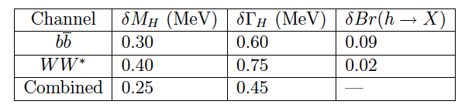
Simulation Studies Underway
Detector and beam transport
Muon Collider-based detector model
Initial generator level simulation - Conway and Wenzel (arXiv:1304.5270) – more conservative assumptions
  Cuts on forward shielding cone (15 deg)
  Cuts to reject Z*/γ background
  Studies of width measurement and BR sensitivity
Full simulation becoming available
  Study timing cuts on background and signal
  Optimize background shielding and beam transport
Decay Backgrounds

Slide 17
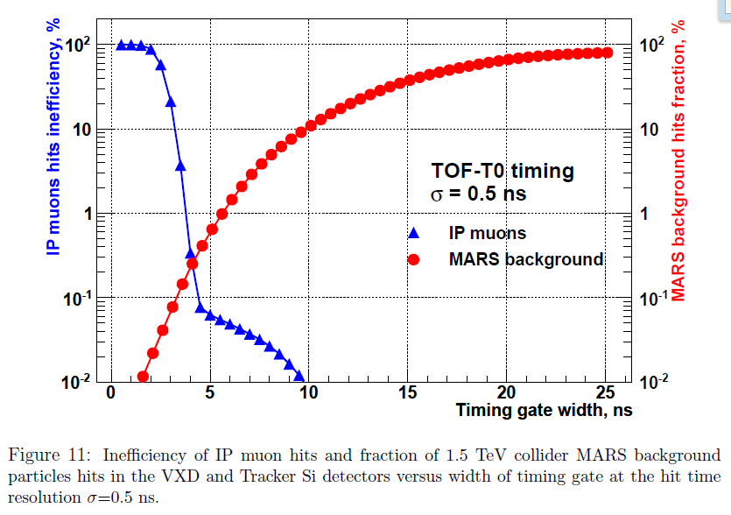
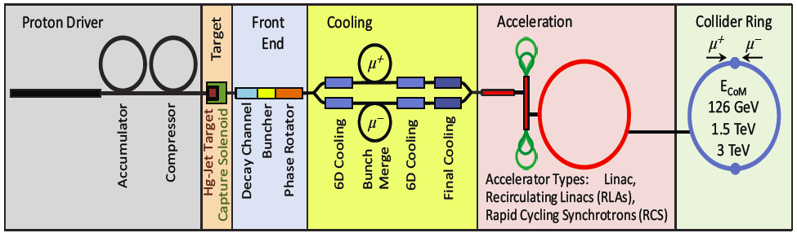
Muon Collider Higgs factory Whitepaper come out soon!
Detector and beam transport
Covering the topics of:
Physics
Collider environment
Detector design
Detector simulations

Slide 18
Summary
Total Width is Important and key to precision
Muon collider is good at it (narrow beam spread, high luminosity)
Pinning down the peak is non-trivial and costs hundreds of inverse picobarn of integrated luminosity
Muon collider whitepaper to come out soon!
Outlook
Physics with Higgs to mu mu coupling
Physics with heavier Higgs bosons
( see Gail Hanson’s talk next)
Breaking the degeneracy in masses
Work on numbers/optimization needed

Slide 19
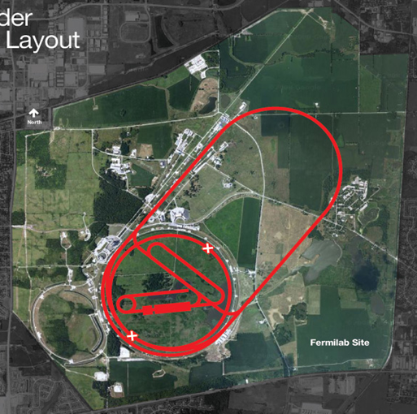
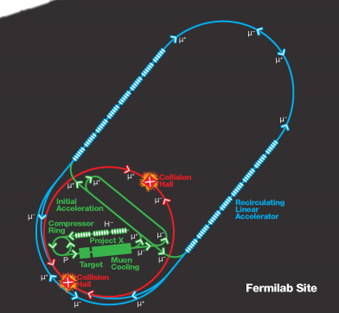
Thank you!

Slide 20
Back Up

Slide 21
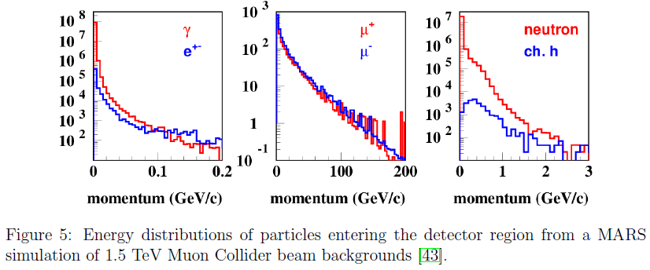
Background

Slide 22
Background

Slide 23
Total Width at LHC and ILC

Slide 24


What Can be Measured?
Model-independent lower bound on total width is achivable.

Slide 25
On the total width determinations
LHC
Assumption on invisible/undetectable
SM-like:
No invisible, undetectable
Invisible from measurement,
no undetectable
Assumption on upper bound
Dominated by σ(bb)[1,2]
The above+Br(Inv)
~25% [2,3]
σ(gg,VV), σ(gg,γγ),
σ(VBF,γγ), ~18%*- [4]
g_{HWW}/g_{HZZ}=SM
g_{HVV}≤g_{HVV}SM
[1] M. Duhrssen, hep-ph/0406323.
[2] V. Barger+M.Inshida+W. Keung, 1203.3456;
[3] B.Yang+P.Drapper+J.Shelton, arXiv: 1112.4496; M. Peskin, arXiv: 1207.2516;
[4] Dobrescu+Lykken, arXiv: 1210.3342.

Slide 26
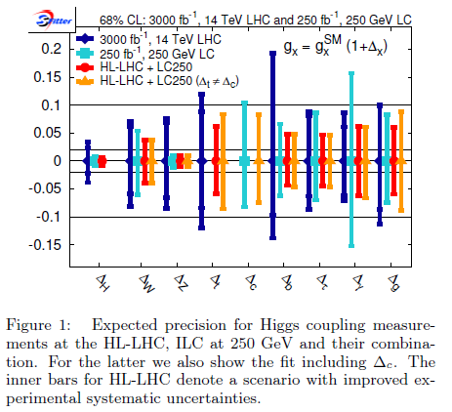

Slide 27
On the total width determinations
LHC
Assumption on invisible/undetectable
SM-like:
No invisible, undetectable
Invisible from measurement,
no undetectable
Assumption on upper bound
Dominated by σ(bb)[1,2]
The above+Br(Inv)
~25% [2,3]
σ(gg,VV), σ(gg,γγ),
σ(VBF,γγ), ~18%*- [4]
g_{HWW}/g_{HZZ}=SM
g_{HVV}≤g_{HVV}SM
[1] M. Duhrssen, hep-ph/0406323.
[2] V. Barger+M.Inshida+W. Keung, 1203.3456;
[3] B.Yang+P.Drapper+J.Shelton, arXiv: 1112.4496; M. Peskin, arXiv: 1207.2516;
[4] Dobrescu+Lykken, arXiv: 1210.3342.

Slide 28
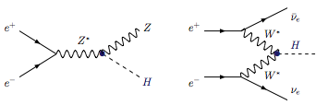


On the total width determinations
“recoil mass technique”:
No additional assumption

Slide 29
Inclusive σ(ZH)
+ other individual channels
250 GeV @250 fb-1
σ(ZH) +
σ(ZH,bb),
σ(vvH,bb),
σ(ZH,WW),
~10%*[1]
500 GeV @500 fb-1
σ(vvH,WW)+
σ(ZH),
σ(ZH,bb),
σ(vvH,bb),
~6%+[2]
ILC
*at 68% C.L., PRELIMINARY
[1] C. F. Duerig, Master thesishttp://lhc-ilc.physik.uni-bonn.de/thesis/
Masterarbeitduerig.pdf;
[2] H. Baer et al., ILC DBD report. http://lcsim.org/papers/DBDPhysics.pdf.

Slide 30
Total Width at Muon Collider

Slide 31
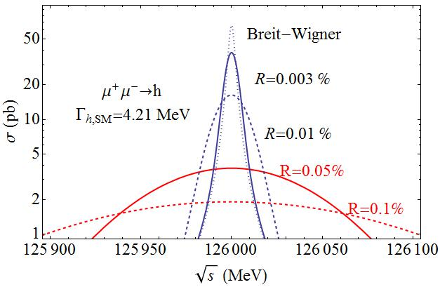
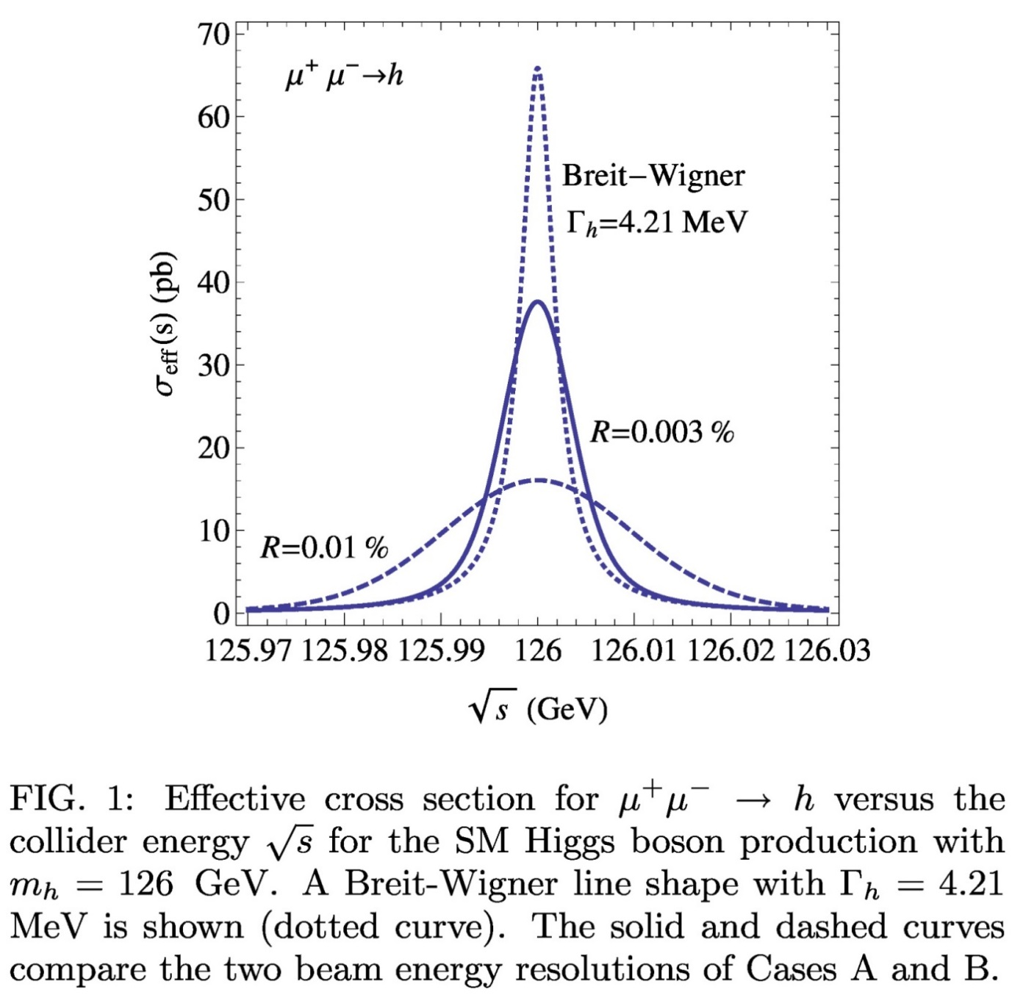
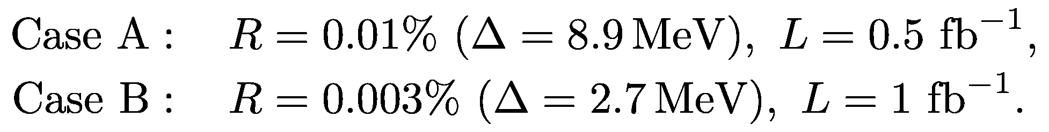

Realistic studies:
* TH and Z. Liu, arXiv: 1210.7803.

