Slide 1
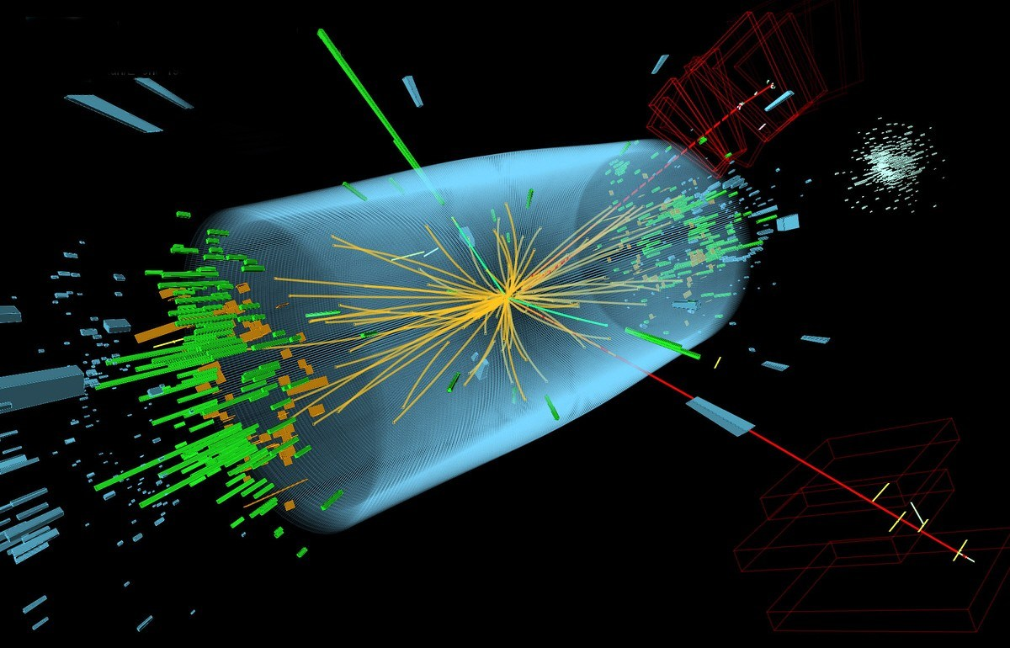
Constraints on Higgs Properties and SUSY Partners in the pMSSM
Cahill-Rowley, JLH, Hoeche, Ismail, Rizzo 1206.4321, 1206.5800, 1211.1981,
1211.7106, in preparation
J. Hewett

Slide 2
The pMSSM Model Framework
The phenomenological MSSM (pMSSM)
Most general CP-conserving MSSM with R-parity
Minimal Flavor Violation, First 2 sfermion generations are degenerate w/ negligible Yukawas
No GUT, SUSY-breaking, high-scale assumptions!
19/20 real, weak-scale parameters (Neutralino/Gravitino LSP)
scalars:
m_{Q1}, m_{Q3}, m_{u1}, m_{d1}, m_{u3}, m_{d3}, m_{L1}, m_{L3}, m_{e1}, m_{e3}
gauginos: M₁, M₂, M₃
tri-linear couplings: A_{b}, A_{t}, A_{τ}
Higgs/Higgsino: μ, M_{A}, tanβ
(Gravitino: M_{G})
Supersymmetry without Prejudice
Berger, Gainer, JLH, Rizzo 0812.0980

Slide 3
REMINDER:
SUSY is not a single
model but a very large
theoretical framework
SUSY
N=1
MSSM
Dirac
gauginos
pMSSM
NMSSM
singlinos
U(1)’
CMSSM
Image by T. Rizzo

Slide 4
Study of the pMSSM (Neutralino/Gravitino LSP)
Scan with Linear Priors
Perform large scan over
Parameters
100 GeV ≤ m_{sfermions} ≤ 4 TeV
50 GeV ≤ |M₁, M₂, μ| ≤ 4 TeV
400 GeV ≤ M₃ ≤ 4 TeV
100 GeV ≤ M_{A} ≤ 4 TeV
1 ≤ tanβ ≤ 60
|A_{t,b,τ}| ≤ 4 TeV
(1 ev ≤ m_{G} ≤ 1 TeV) (log prior)
Subject these points to
Constraints from:
Flavor physics
EW precision measurements
Collider searches
Cosmology
~225,000 models survive constraints for each LSP type!

Slide 5
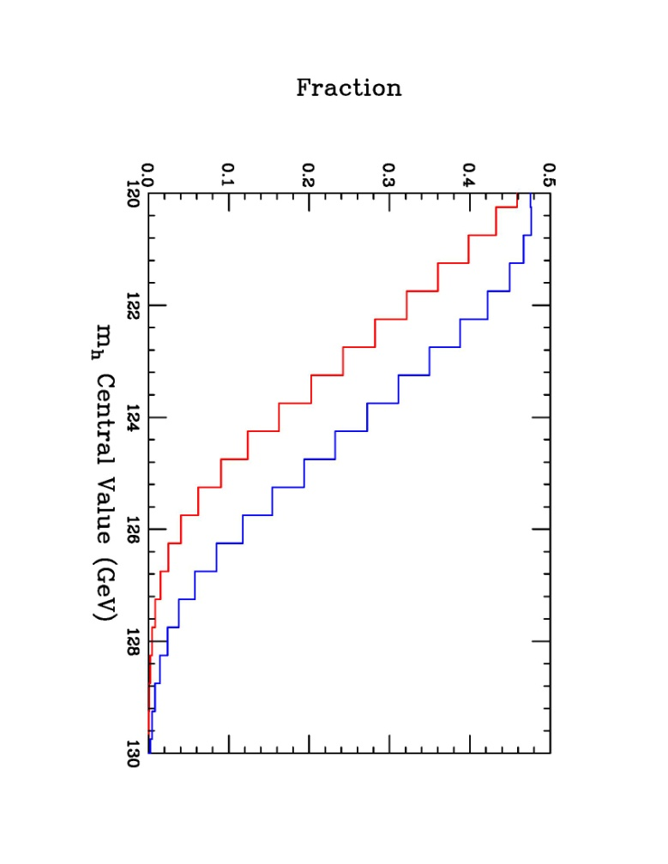
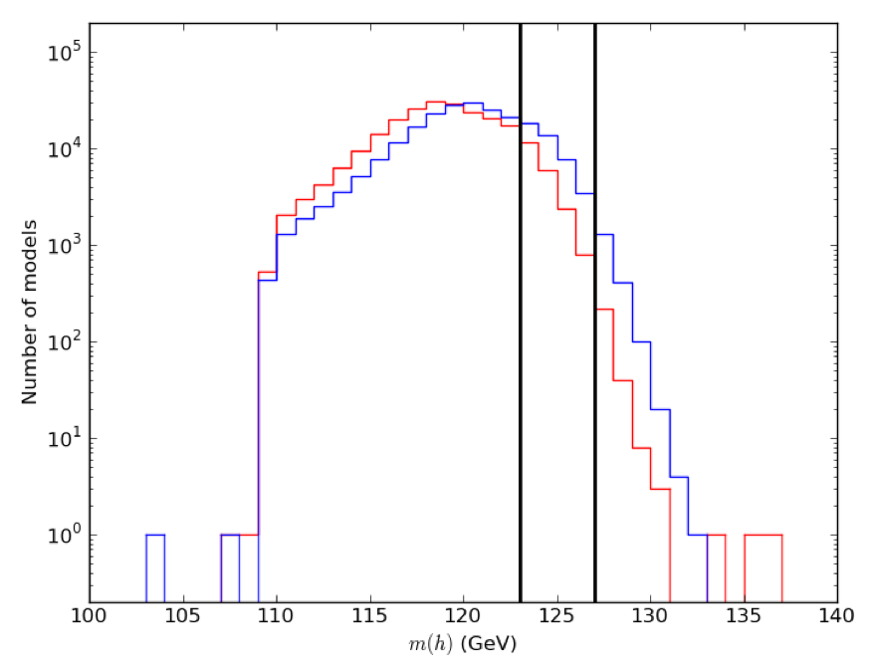
Predictions for Lightest Higgs Mass in the pMSSM
~40k Neutralino models with m_{h} = 126±3 GeV
All results in this talk are for the Neutralino model set only with the correct Higgs mass!
Neutralino LSP
Gravitino LSP

Slide 6
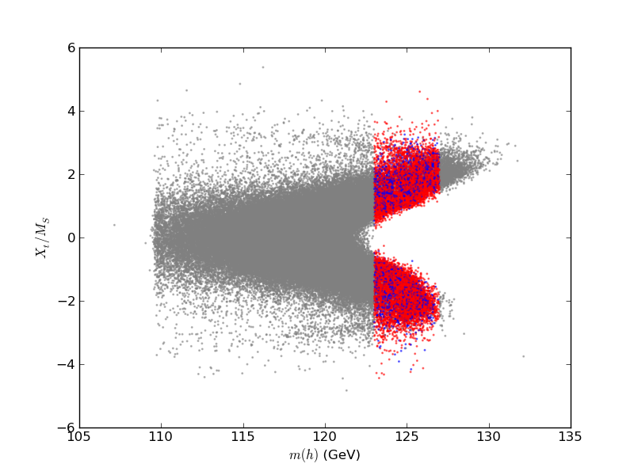
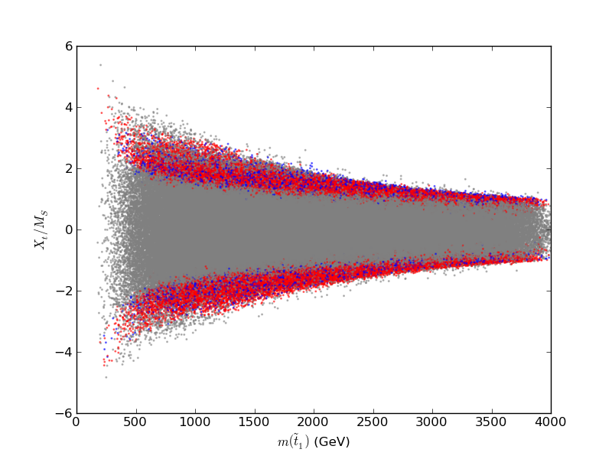
Special parameter regions needed for the
126 GeV Higgs
Need large stop mixing: X_{t} = A_{t} - μcotβ
χ₁⁰ LSP

Slide 7
ATLAS MET-based SUSY Analyses
@ 7/8/14 TeV
Apply the general LHC SUSY MET-based searches to our model sets
We (almost) exclusively follow the ATLAS analysis suite as
closely as possible with fast MC (modified versions of PGS,
Pythia, SoftSUSY, SDECAY, HDECAY)
Generate signal events for every model for all 85 SUSY processes (~10¹³ events!) & scale to NLO with Prospino
Validated our results with ATLAS benchmark models
We combine the various signal regions (as ATLAS does) for
~ 35 analyses: and we quote the coverage for each as well
as the combined result..
This approach is CPU intensive!!

Slide 8
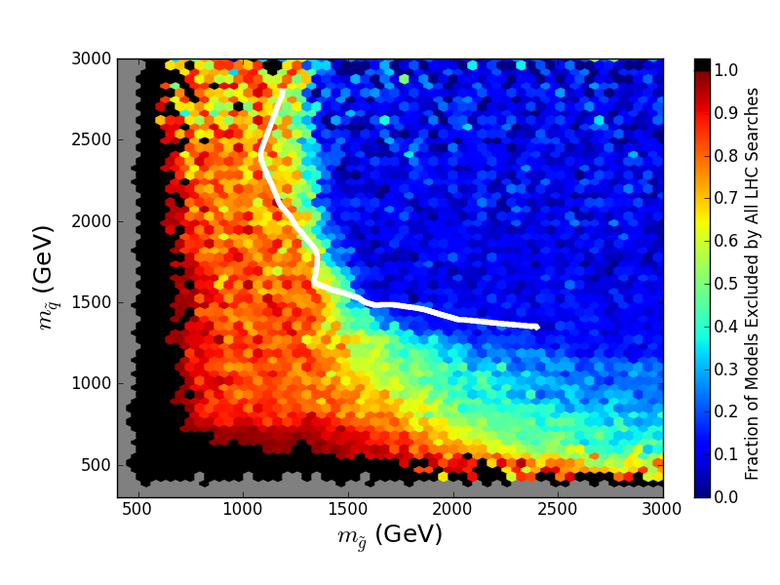
Effects of LHC Searches on Neutralino LSP Model Set 7/8 TeV
Simplified Model result (ATLAS)
All available analyses through 3/1/13
37% of 225k model set excluded

Slide 9
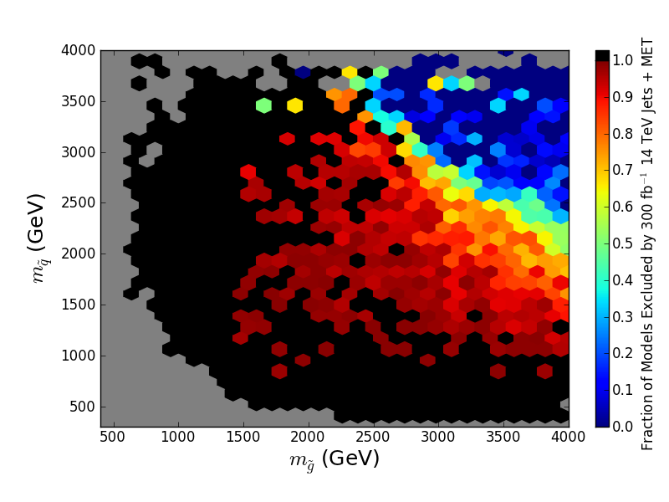
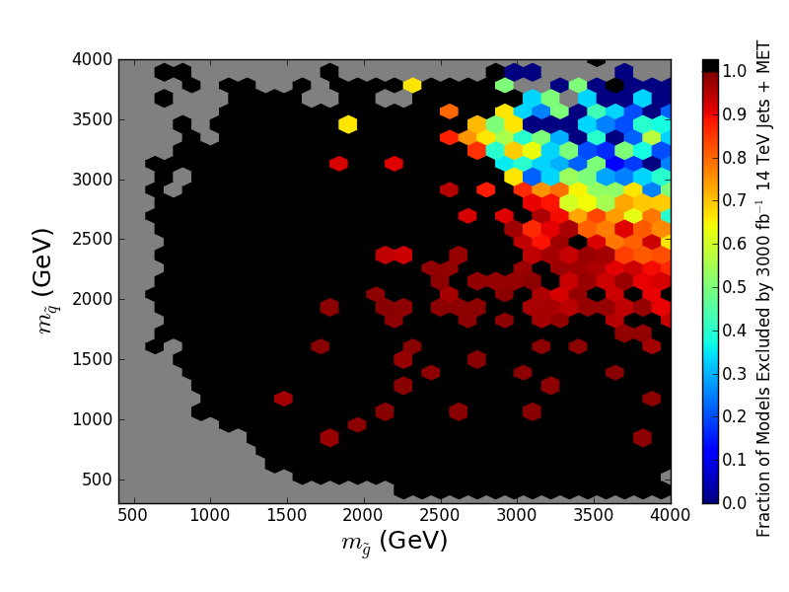
14 TeV LHC pMSSM Coverage for 0.3 & 3 ab⁻¹
Jets+MET Analysis only (ATLAS European Strategy Study)
225k Neutralino LSP model set
300 fb⁻¹: 92.1% of models excluded
3 ab⁻¹: 97.5% of models excluded

Slide 10
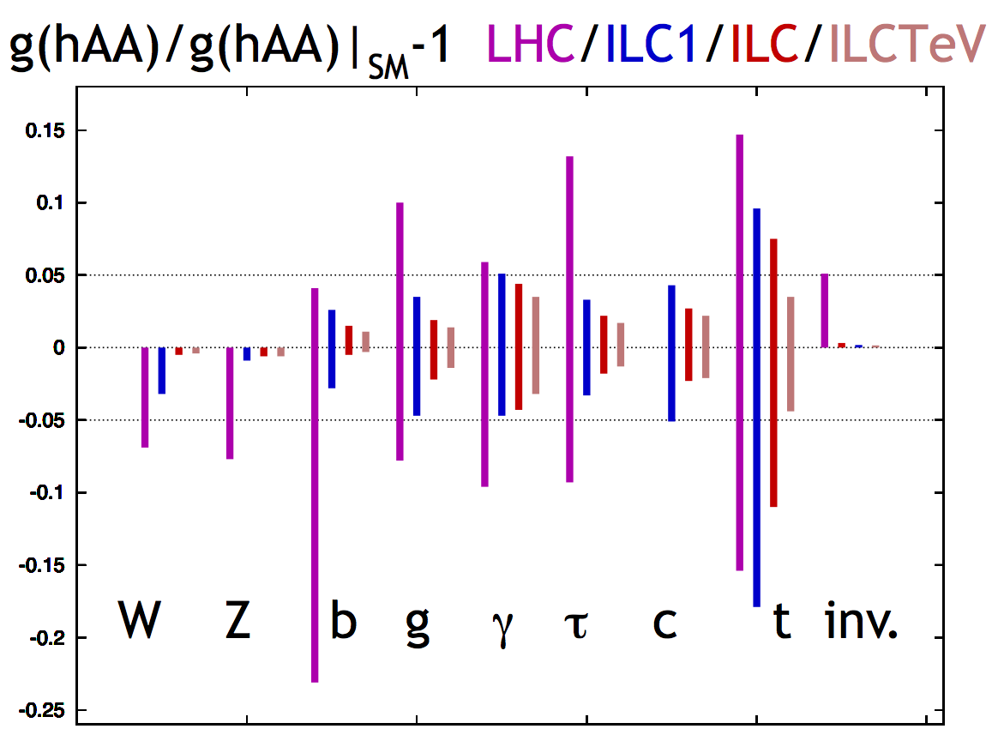
Precision Higgs Measurements
Peskin: 1207.2516

Slide 11
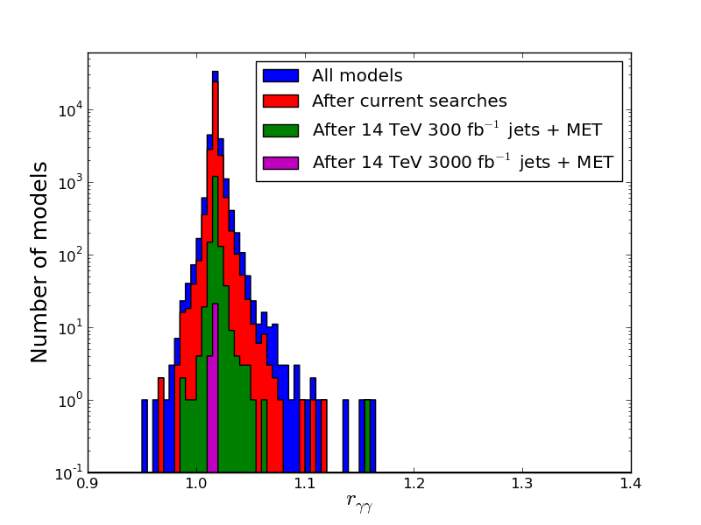
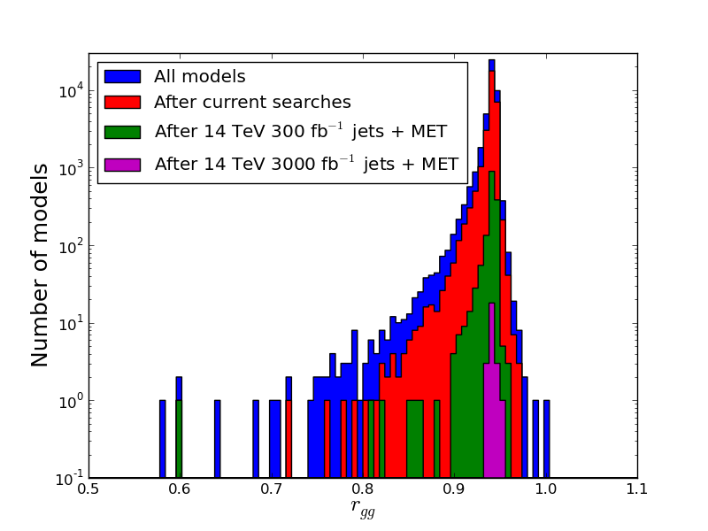
Higgs partial widths in the pMSSM: ΥΥ and gg
r_{XX} = Γ_{XX}|_{pMSSM} / Γ_{XX}|_{SM}
40k models with correct m_{h}
Requirement of large stop mixing implies
non-decoupling
Results in correlated distribution peak with r_{ΥΥ} >1 and r _{gg} <1
Carena etal 1303.4414
r_{ΥΥ}
r_{gg}
Notes:
Not peaked around 1. To get right Higgs mass, the large stop mixing forces these peak values away from one and are correlated between the gamgam and gluglu modes. Delta r_gg = -4 Delta r_gamgam
Note that the different histograms have the same shape, thus cannot make predictions for Higgs couplings from non-observation of SUSY.

Slide 12
Higgs partial widths in the pMSSM: ΥΥ and gg
LHC 14 TeV 300 fb⁻¹ 2σ errors
ILC 500 GeV 500 fb⁻¹ 2σ errors
Centered around 1.0 for the ratio r_{XX}
Peskin:1207.2516
r_{ΥΥ}
r_{gg}
Notes:
Not peaked around 1. To get right Higgs mass, the large stop mixing forces these peak values away from one and are correlated between the gamgam and gluglu modes. Delta r_gg = -4 Delta r_gamgam

Slide 13
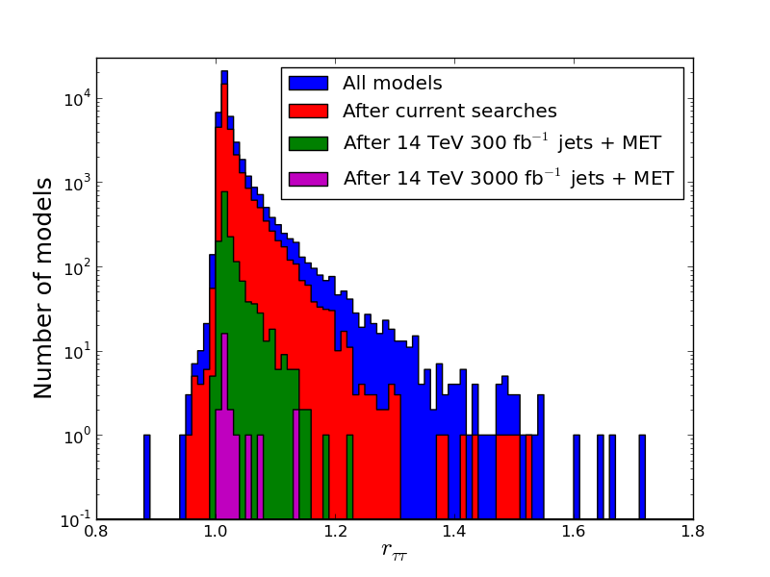
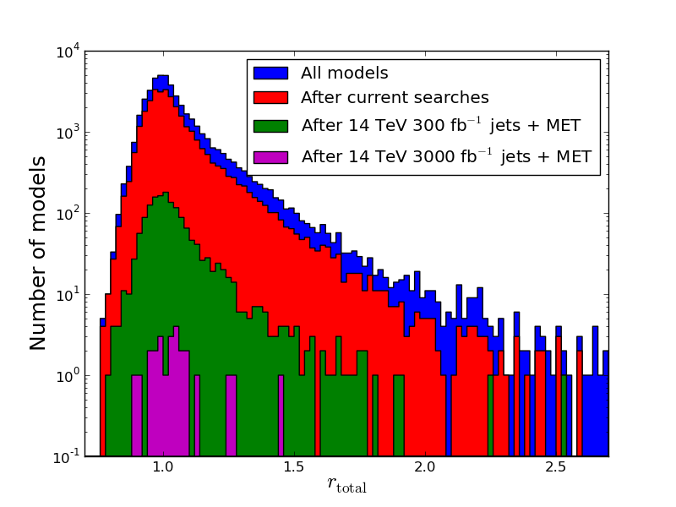
Higgs partial widths in the pMSSM: ττ and Total
r_{ττ}
r_{Total}

Slide 14
Higgs partial widths in the pMSSM: ττ and Total
r_{ττ}
r_{Total}

Slide 15
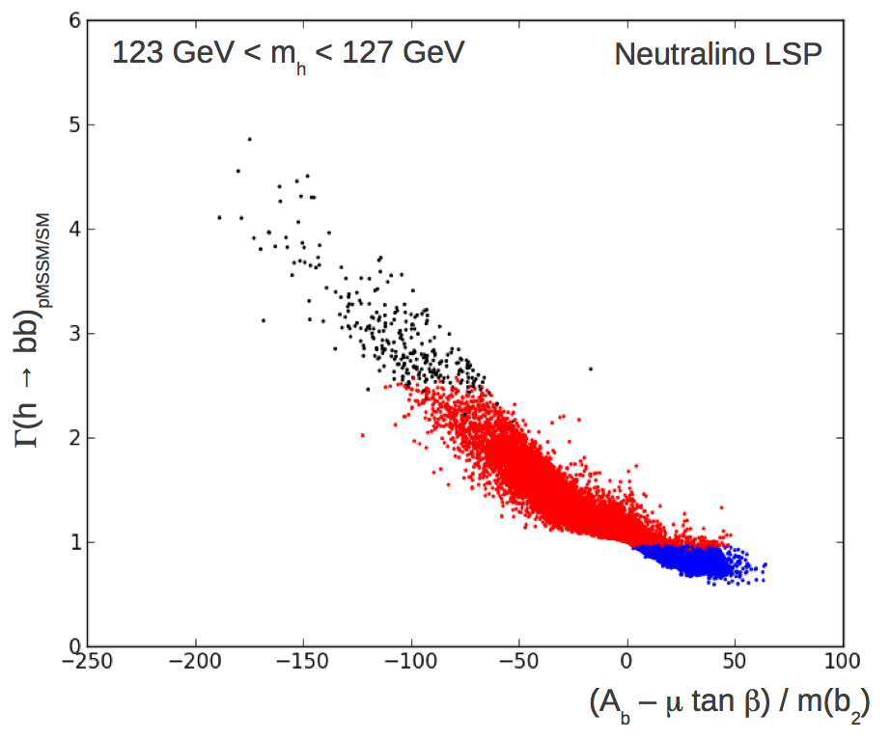
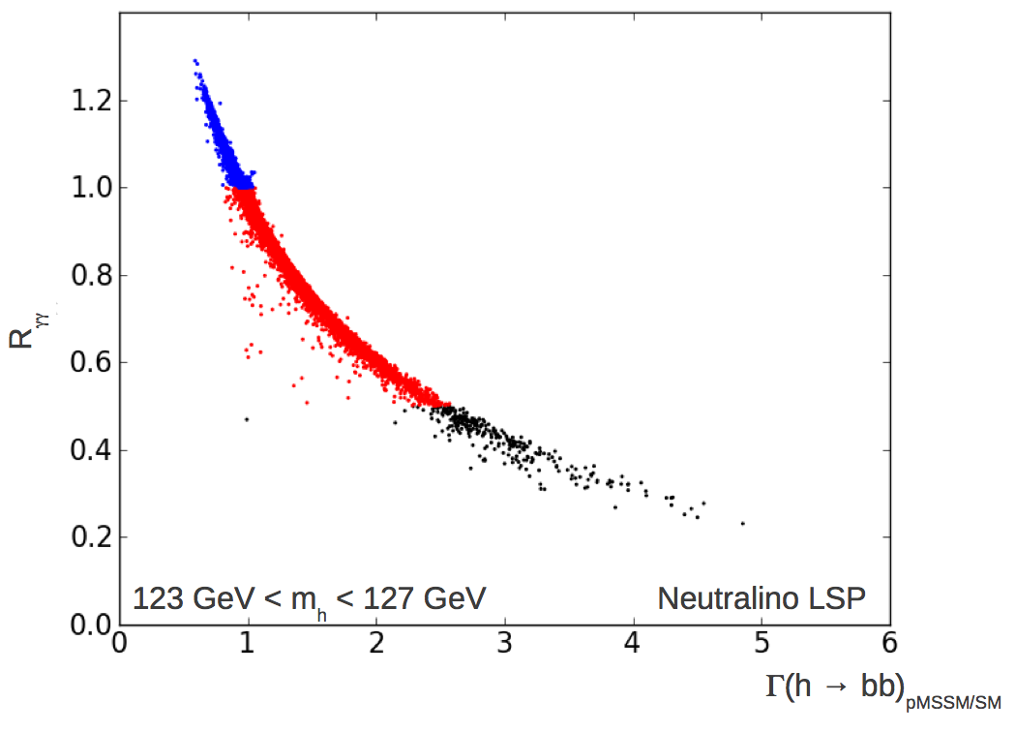
h→bb
Large hbb coupling loop corrections decouple very slowly
especially if there is large sbottom mixing (Haber etal.)
These lead to a significant Higgs width increase/decrease
since it is the dominant decay mode
χ₁⁰ LSP

Slide 16
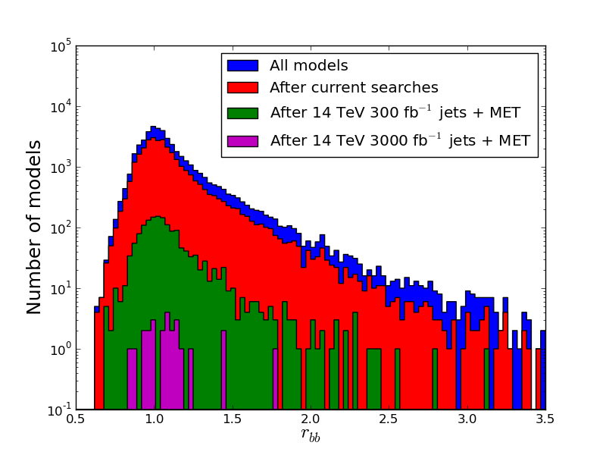
Higgs partial widths in the pMSSM: bb
-
r_{bb}

Slide 17
Higgs partial widths in the pMSSM: bb
-
r_{bb}
Current Bound

Slide 18
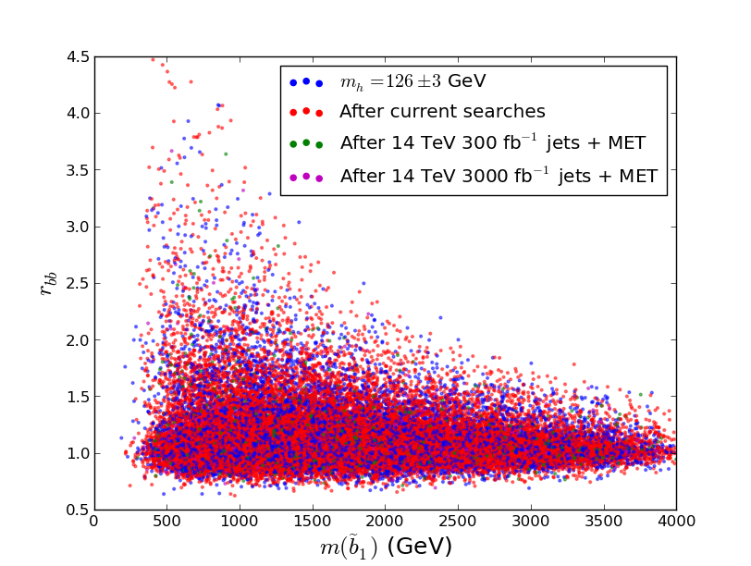
Higgs partial widths in the pMSSM: bb
-
r_{bb}
Current bound

Slide 19
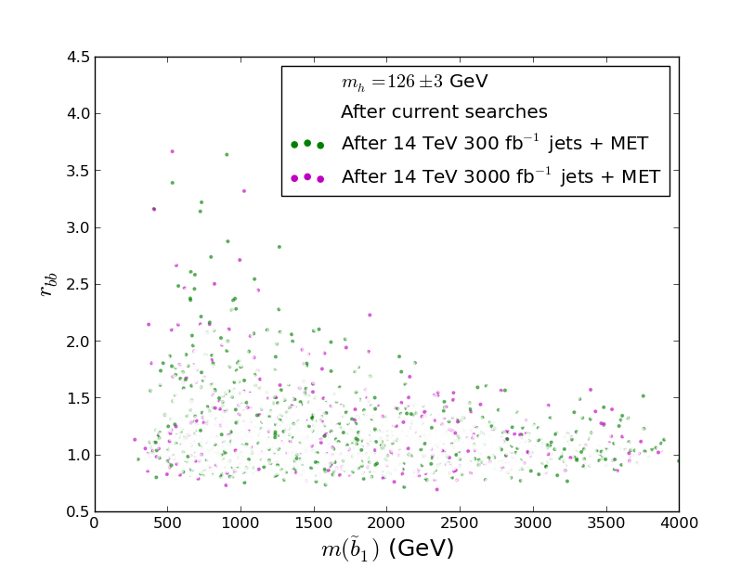
Higgs partial widths in the pMSSM: bb
-
r_{bb}

Slide 20
Higgs partial widths in the pMSSM: bb
-
r_{bb}
Current bound

Slide 21
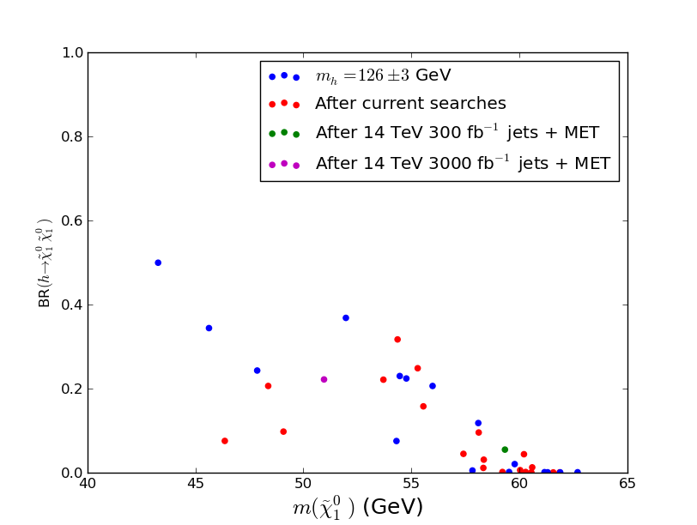
Invisible Width of the Higgs

Slide 22
Invisible Width of the Higgs
Current bound

Slide 23
Conclusions
Relatively easy to accommodate 126±3 GeV Higgs in the pMSSM
SUSY EW corrections need to be performed for WW/ZZ modes in order to compare with future exp’ts
Cannot make predictions for Higgs couplings from non-observation of SUSY direct production
ILC precision on Higgs couplings allows for new physics observation/exclusion beyond LHC reach
Channel dependent
Searching for new physics via precision Higgs measurements is complementary to direct searches at LHC

Slide 24
Backup

Slide 25
Model Constraints
Δρ / W-mass
Γ(Z→ invisible)
Δ(g-2)_{μ}
b →s γ
Meson-Antimeson Mixing
B→τν
B_{s}→μμ
Direct Detection of Dark Matter (SI & SD)
WMAP Dark Matter density upper bound
BBN energy deposition for gravitinos
Relic ν’s & diffuse photon bounds
LEP and Tevatron Direct Higgs & SUSY
searches
LHC stable sparticle searches
No tachyons or color/charge breaking
minima
Stable vacua only

Slide 26
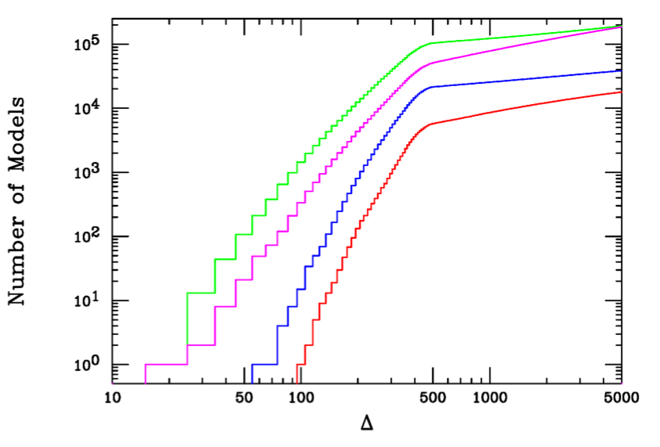
Fine-Tuning in the pMSSM
Neutralino LSP
Gravitino LSP
m_{h} = 126 ± 3 GeV

Slide 27
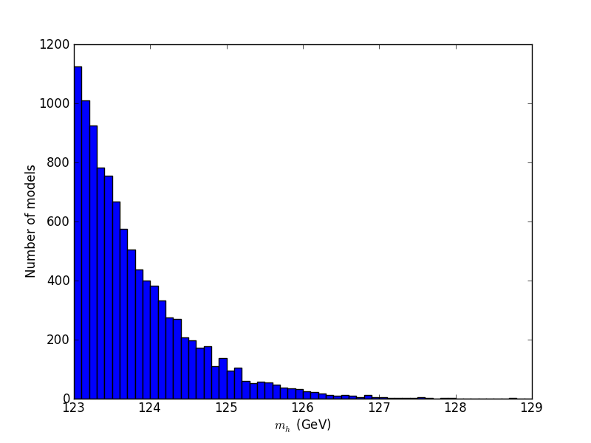
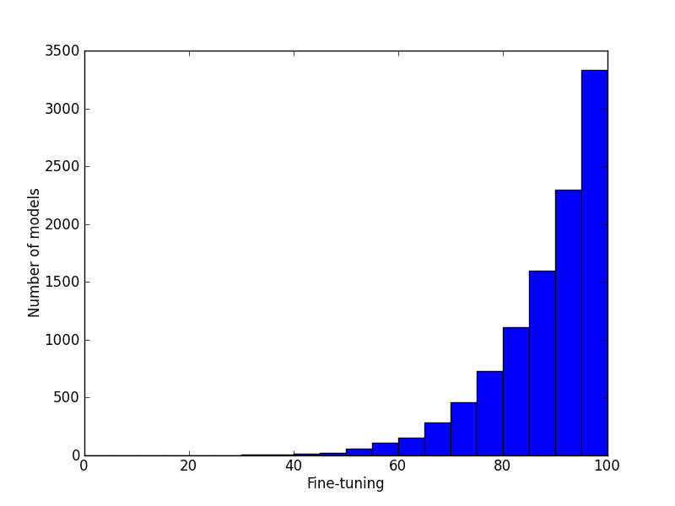
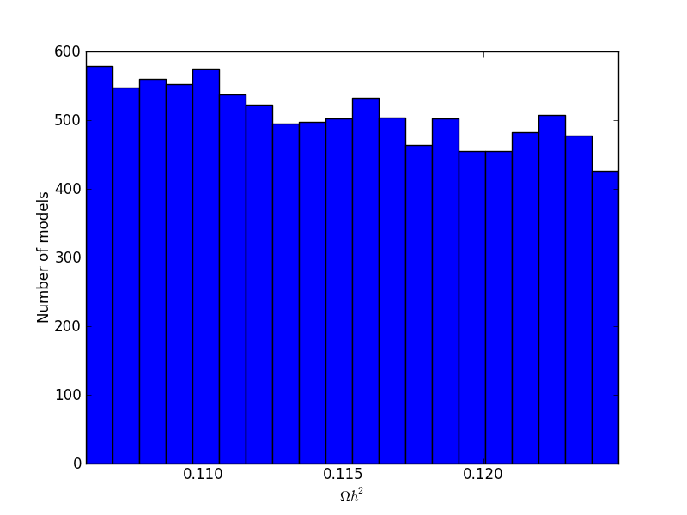
pMSSM Special Low-FT Neutralino LSP Model Set
m_{h} = 126 ± 3 GeV
Ωh² |_{DM} = 0.1153 ± 0.0095
FT better than 1%
~10k model points

Slide 28
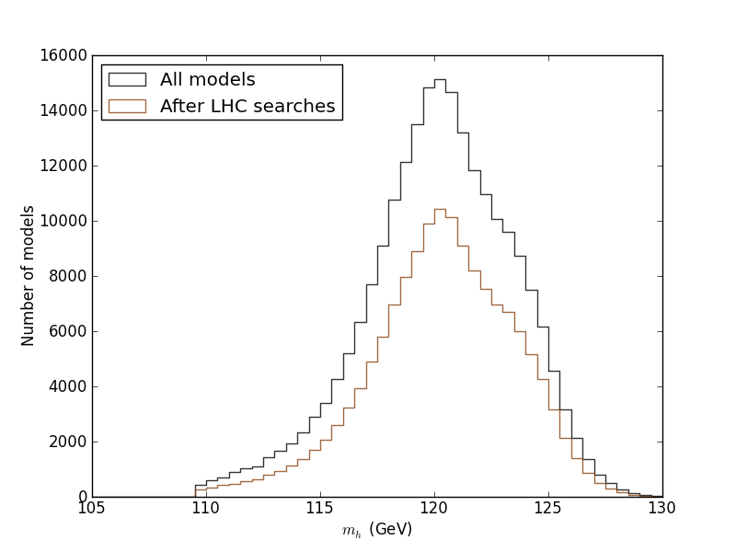
The MET-based searches are roughly independent of the
of the Higgs mass: the predicted mass of the Higgs is roughly
independent of the SUSY searches

Slide 29
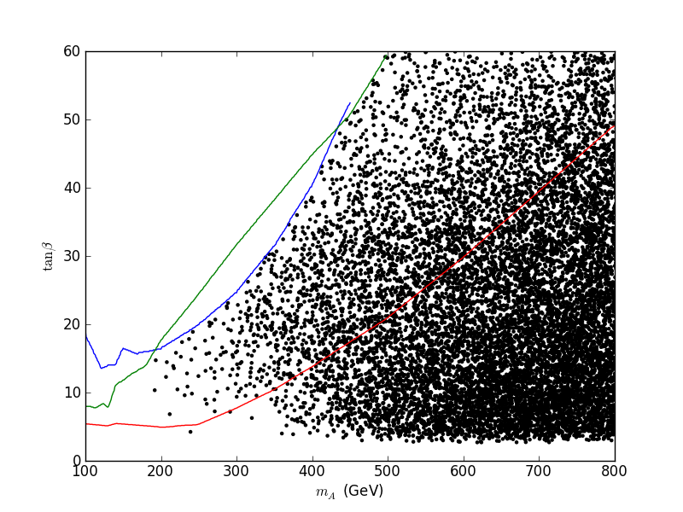
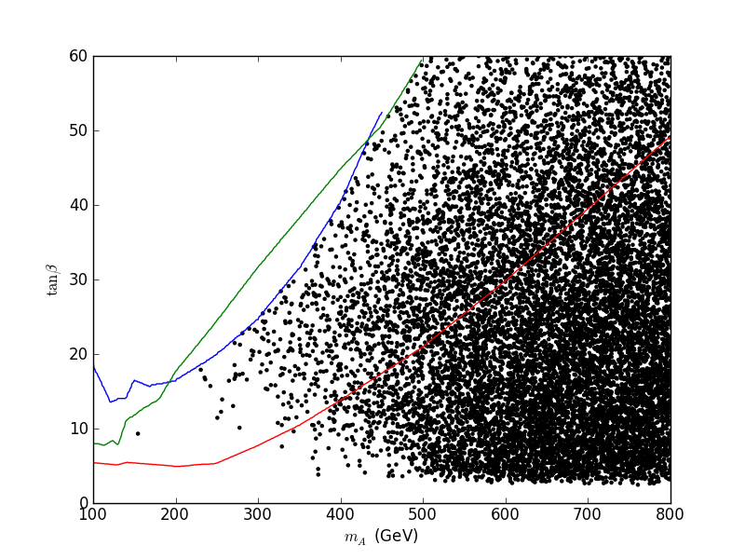
Impact of A,H →ττ Searches
G LSP
tan β
CMS 13 fb⁻¹
χ LSP
M_{A}
3671(3309) models removed from the χ (G) LSP set…

Slide 30
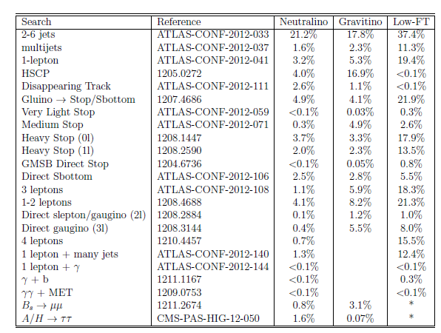
Preliminary Model Set Fractions Excluded by ATLAS Searches
@ 7 TeV
This is useful for comparing searches and model sets

Slide 31
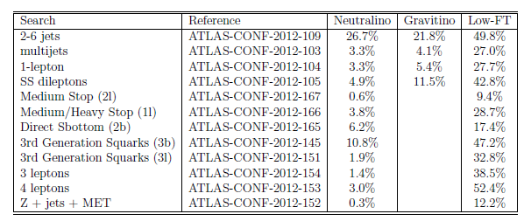
Preliminary Model Set Fractions Excluded by ATLAS Searches
@ 8 TeV
Total Exclusions: ~37% ~46% ~73%
→ ~15 MORE analyses coming ‘soon’ bringing us up to date
with all public ATLAS results as of 6/25/2013
Of course search efficiency plots are much more interesting…

Slide 32
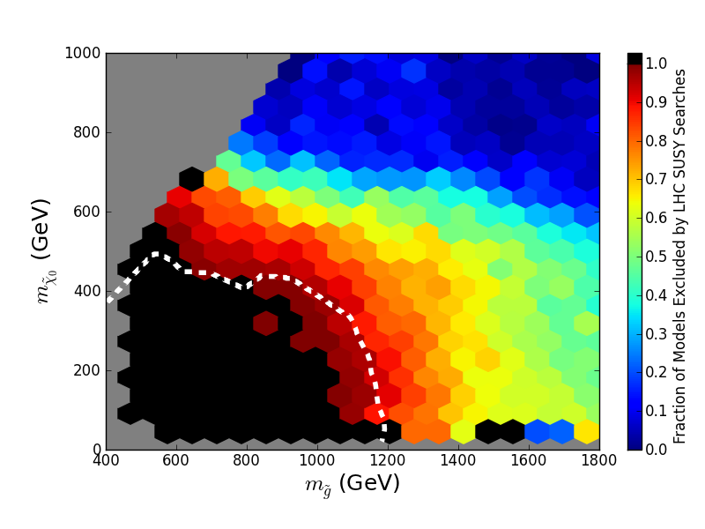
Effects of LHC Searches on Neutralino LSP Sample
Simplified Model Limit (ATLAS)

Slide 33
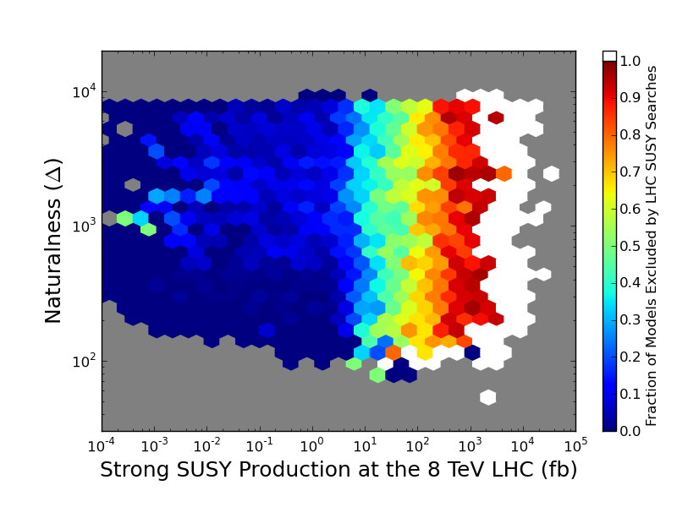
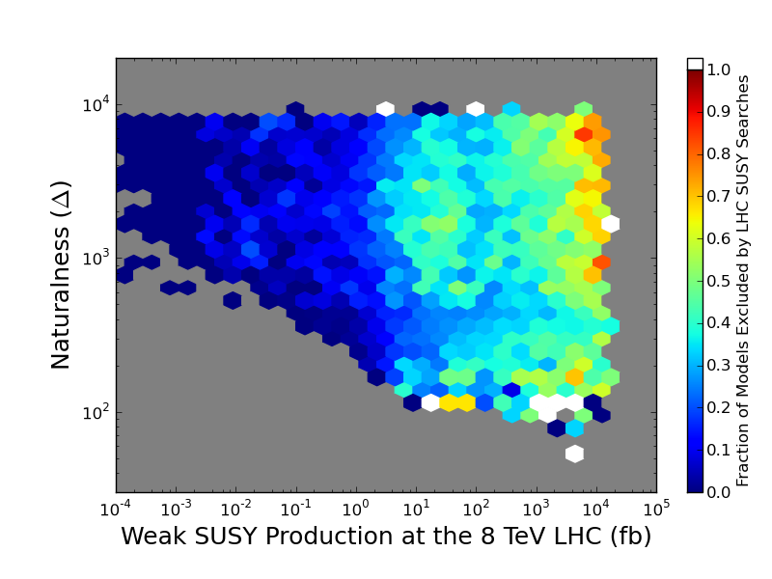
Effects of LHC Searches on Neutralino LSP Sample
Strong SUSY Production
Weak SUSY Production

Slide 34
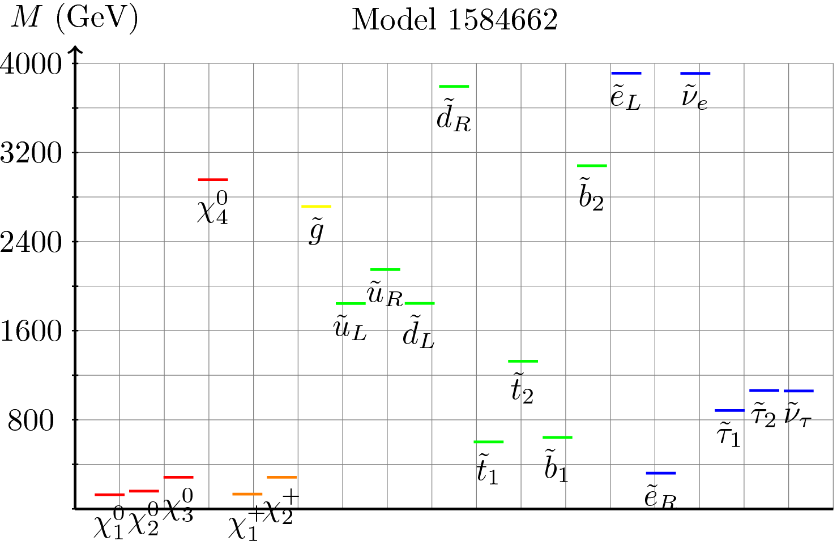
Low Fine-Tuning Model Spectra I

Slide 35
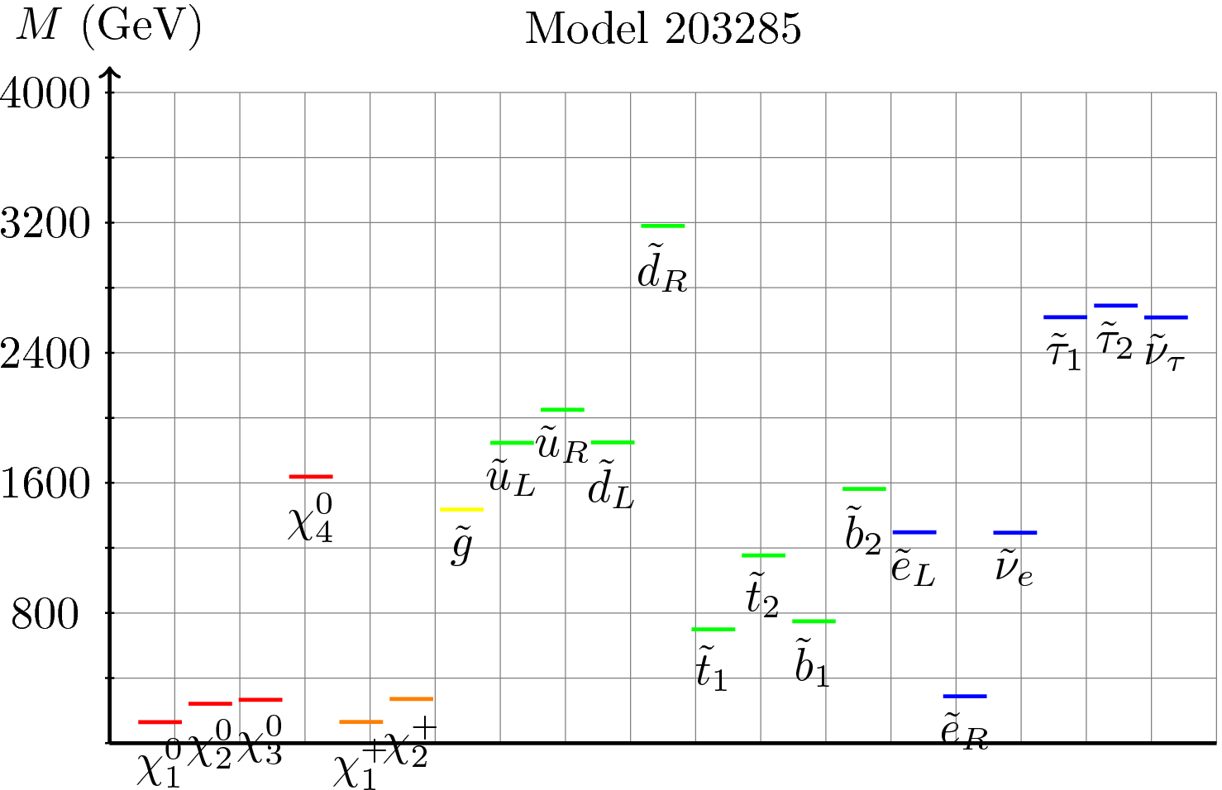
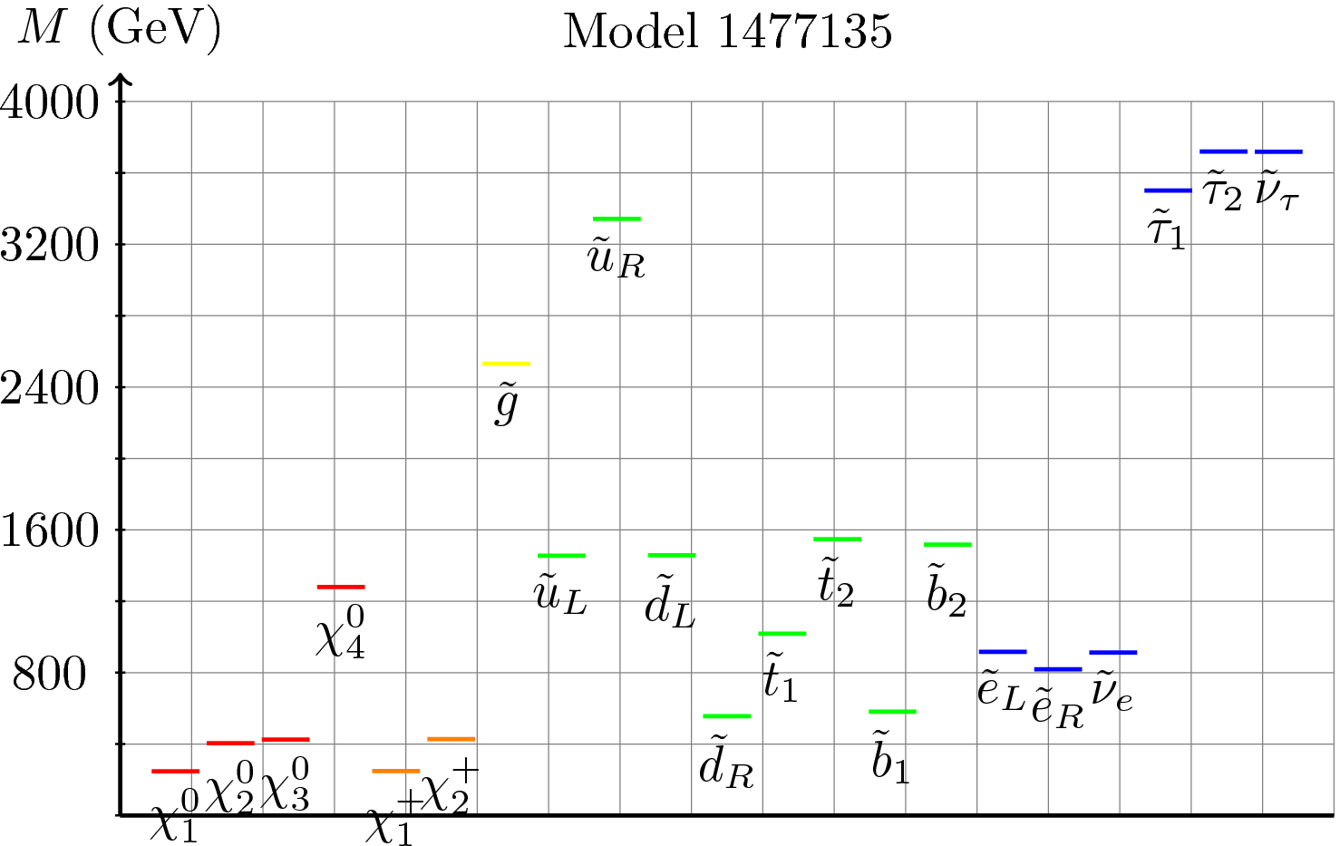
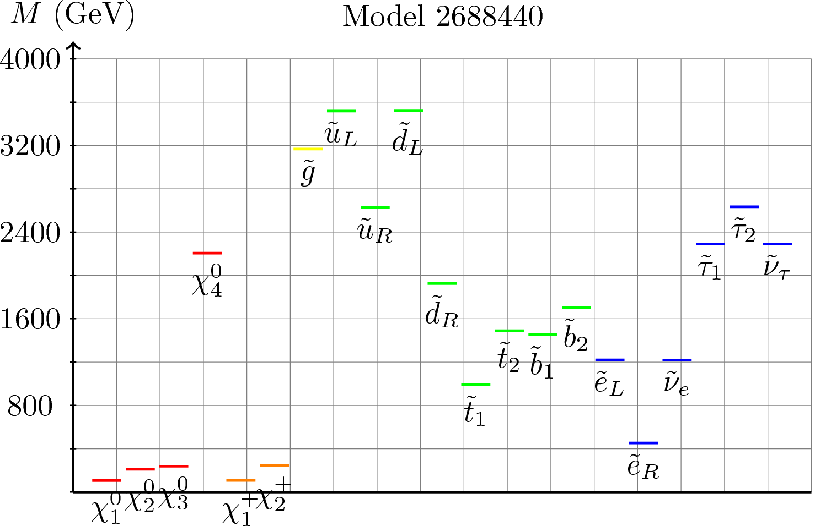
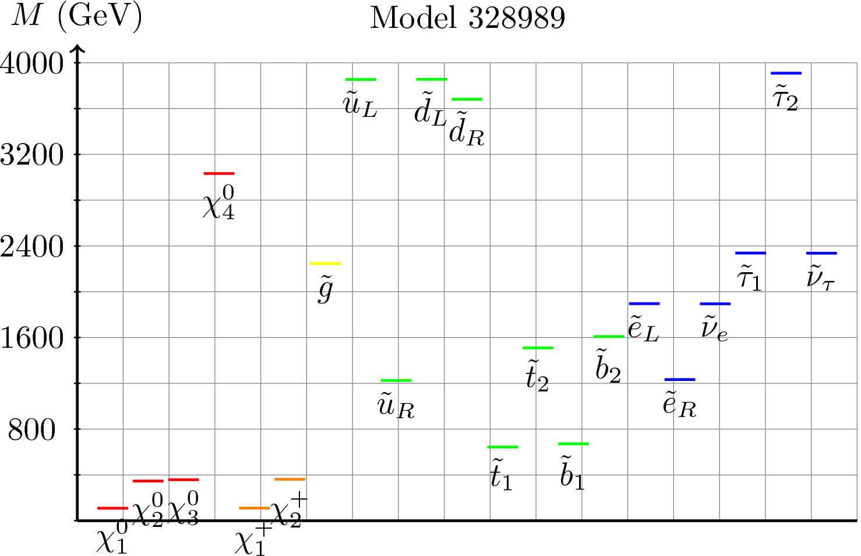
Low Fine-Tuning Model Spectra I

Slide 36
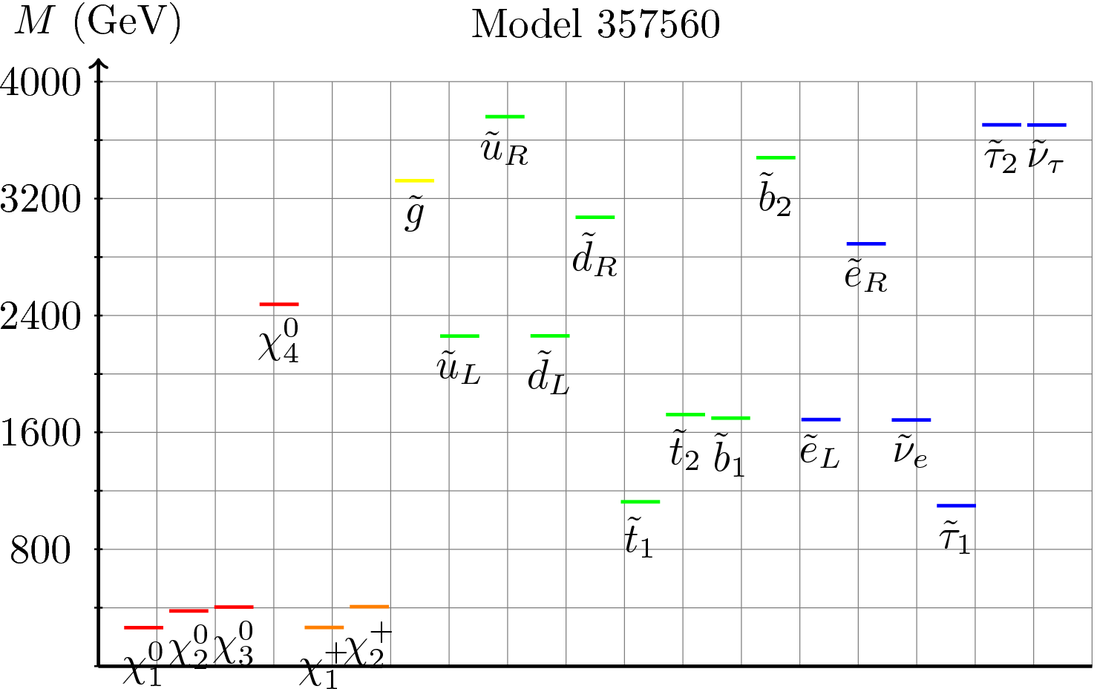
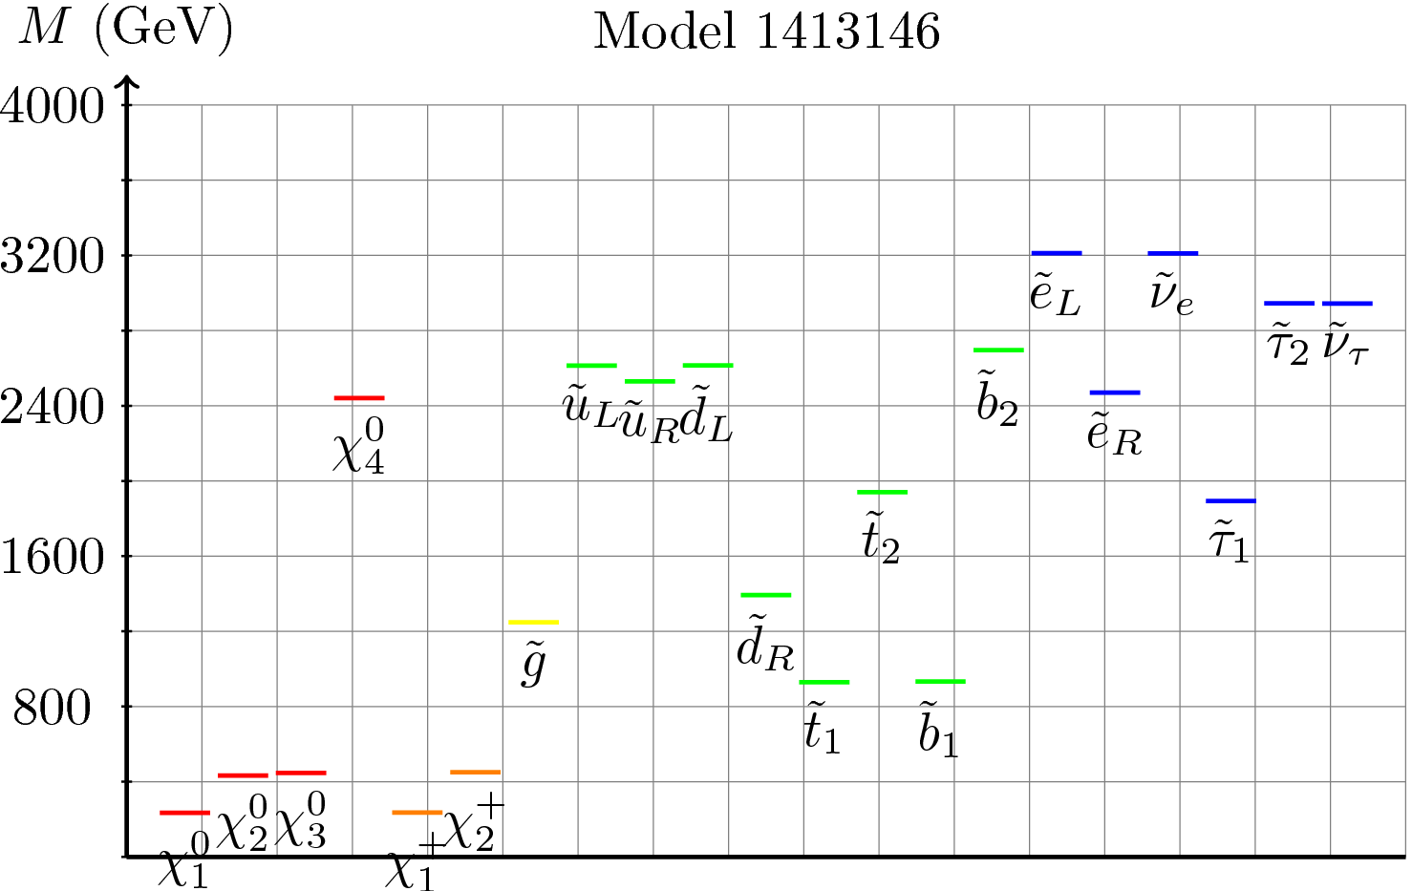
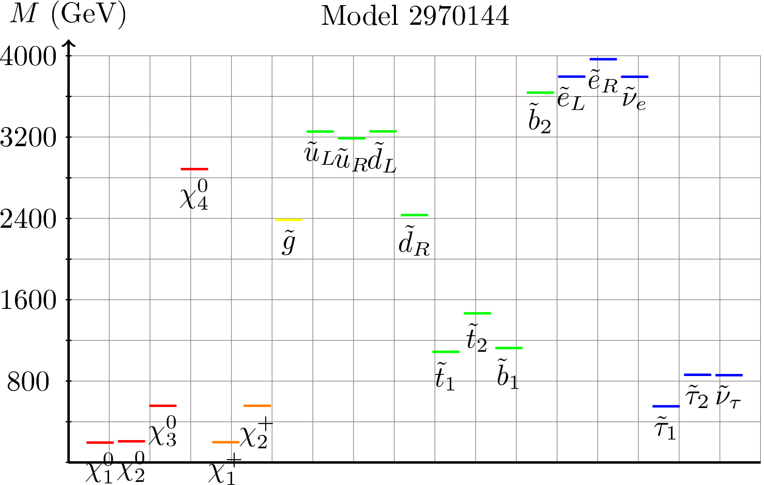
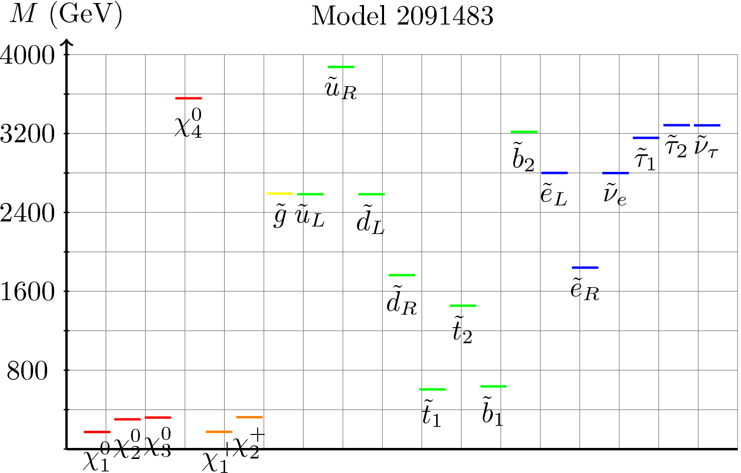
Low Fine-Tuning Model Spectra II

Slide 37
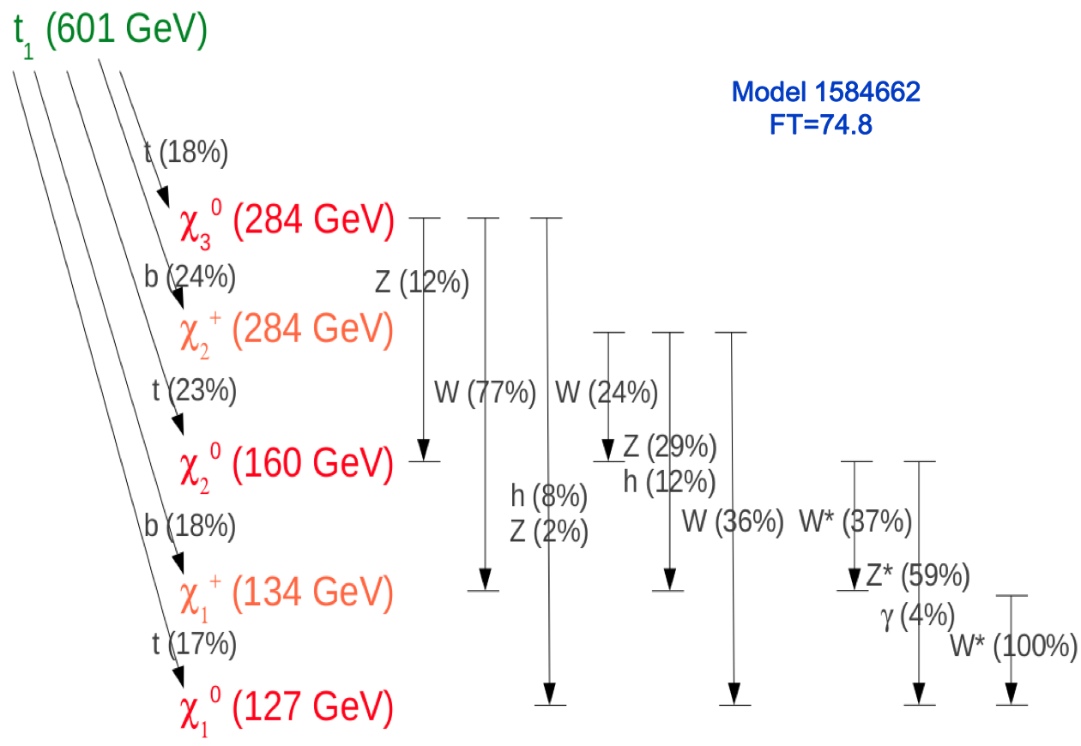

Slide 38
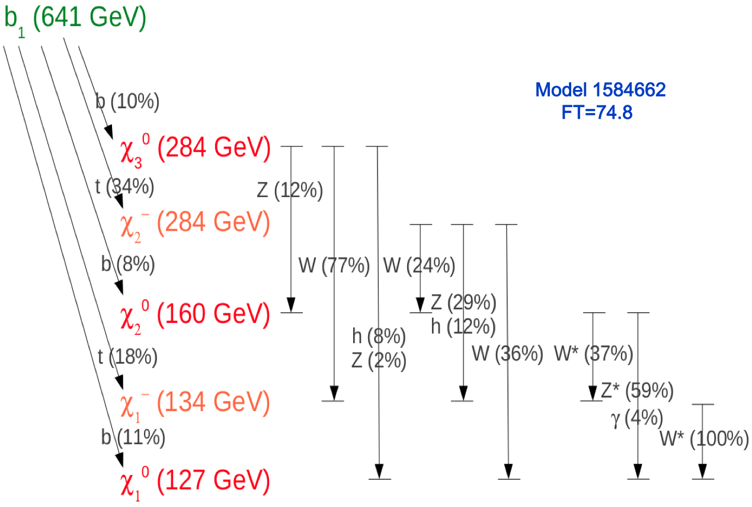
(36%)

Slide 40
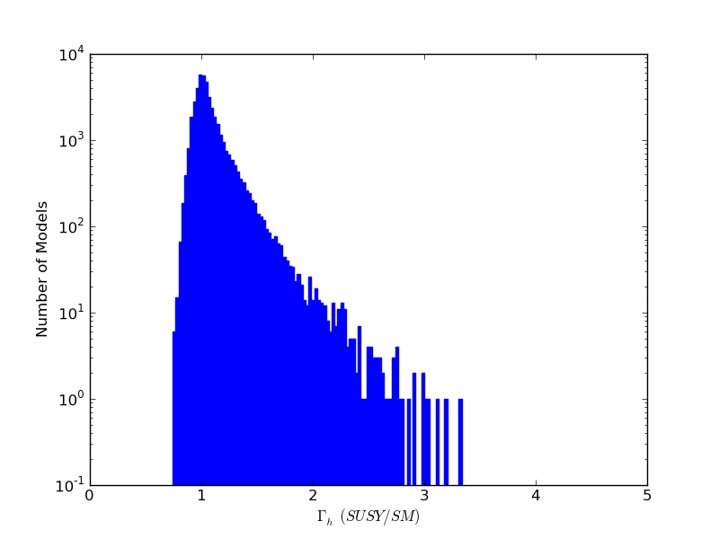
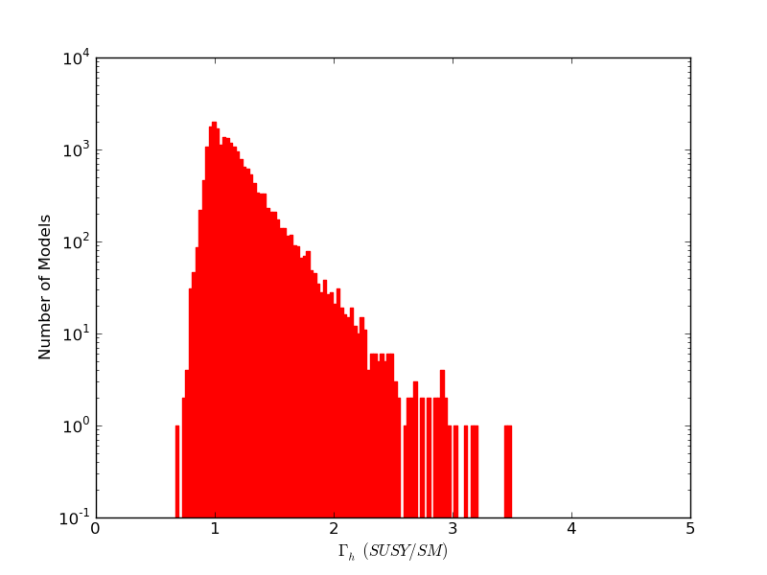
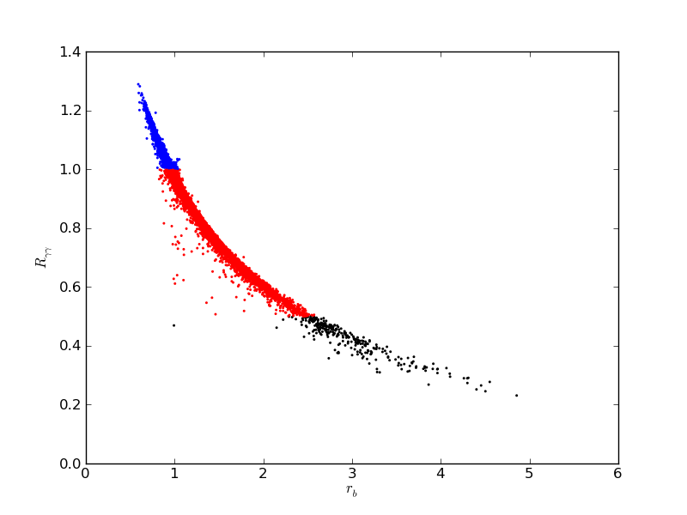
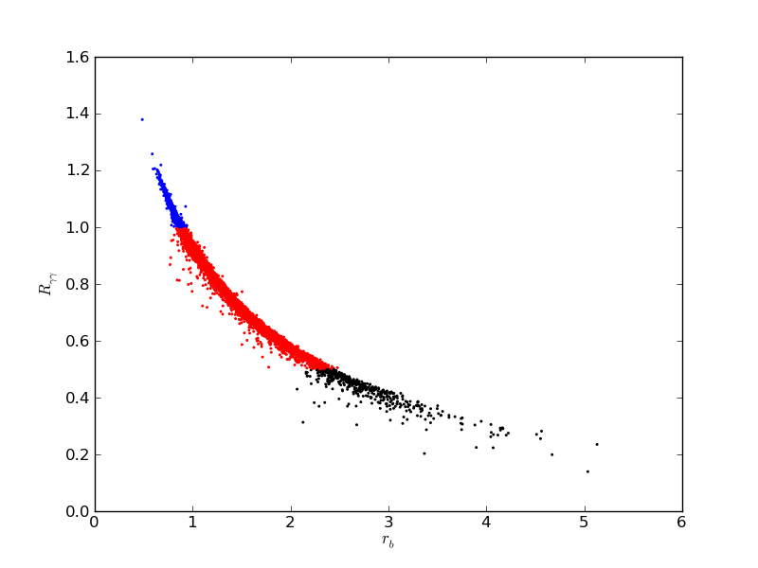
χ₁⁰ LSP
G LSP
Total width
R_{ΥΥ}
r_{b}

