Slide 1
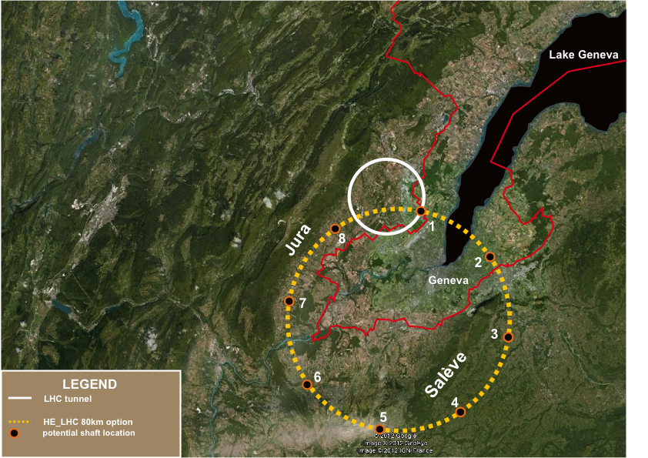
TLEP
Precision physics at the Electroweak scale
TeraZ, OkuW, MegaHiggs and Megatops

Slide 2
possible long-term strategy
TLEP (80-100 km,
e⁺e⁻, up to
~350 GeV c.m.)
LEP
PSB
PS (0.6 km)
LHC (26.7 km)
HL-LHC
HE-LHC?
(33 TeV c.m.)
SPS (6.9 km)
VHE-LHC
(pp, up to
100 TeV c.m.)
“same” detectors!?
& e± (120 GeV)–p (7, 16 & 50 TeV) collisions ([(V)HE-]TLHeC)
≥50 years of e⁺e⁻, pp, ep/A physics at highest energies

Slide 3
What are the possibilities offered by a circular e+e- machine located
in the 80-100 km tunnel that will eventually contain also a 100 TeV pp collider?
-- very powerful machine as you will see
++ offers a feasible multi-step long-term strategy :
-1- the tunnel and TLEP
-2- 100 TeV pp collider with 16 T magnets
-3- e-p, e-ion, p-ion, ion-ion etc…
in 2035 the LEP/LHC tunnel will have been used for 46 years…
the TLEP/VHE-LHC tunnel would be used for > 50 years!

Slide 4
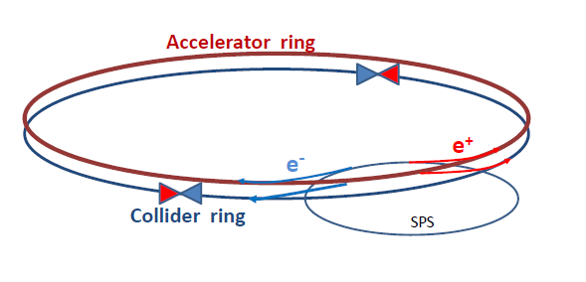
How can one increase over LEP2 (average) luminosity by a factor 500
without exploding the power bill?
Answer is in the B-factory design: a very low vertical emittance ring with
higher intrinsic luminosity and a small value of β_{y}*
electrons and positrons have a much higher chance of interacting
➔ much shorter lifetime (few minutes)
➔ feed beam continuously with a ancillary accelerator
Storage ring has separate beam pipes for e+ and e- for multibunch operation

Slide 6
Important properties of circular e+e- machines:
-- luminosity
-- center-of-mass definition
-- beam polarization and energy calibration
-- IP backgrounds, repetition rate etc…
-- note that at Z peak operate at 40MHz beam Xing

Slide 7
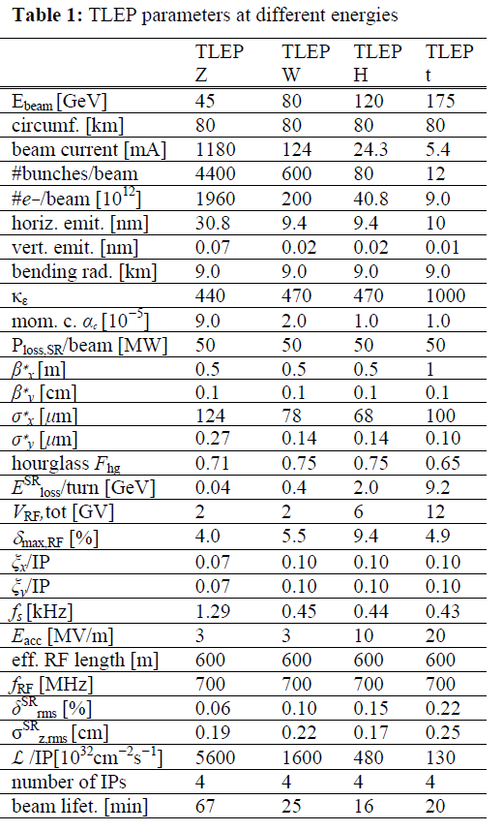
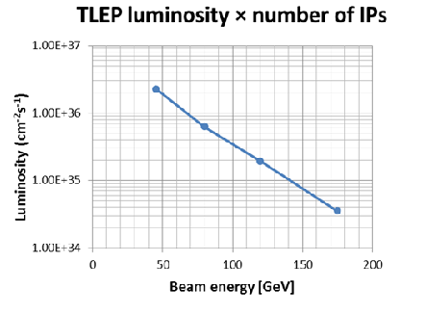
http://arxiv.org/abs/1305.6498.
CONSISTEN T SET OF PARAMETERS FOR TLEP
TAKING INTO ACCOUNT BEAMSTRAHLUNG

Slide 8
TLEP: PARAMETERS & STATISTICS (e⁺e⁻ -> ZH, e⁺e⁻ → W⁺W⁻, e⁺e⁻ → Z,[e⁺e⁻→ t$\overline{t}]$ )
 | TLEP-4 IP, per IP | Stats (4IP)
circumference | 80 km
max beam energy | 175 GeV
no. of IPs | 4
Luminosity/IP at 350 GeV c.m. | 1.3x10³⁴ cm⁻²s⁻¹ | 10⁶‾tt pairs
Luminosity/IP at 240 GeV c.m. | 4.8x10³⁴ cm⁻²s⁻¹ | 2 10⁶ ZH evts
Luminosity/IP at 160 GeV c.m. | 1.6x10³⁵ cm⁻²s⁻¹ | 10⁸ WW pairs
Luminosity/IP at 90 GeV c.m. | 5.6 10³⁵ cm⁻²s⁻¹ | 10¹² Z decays
10 ILC
30 ILC
100 ILC
1000 ILC
at the Z pole repeat the LEP physics programme in a few minutes…

Slide 9
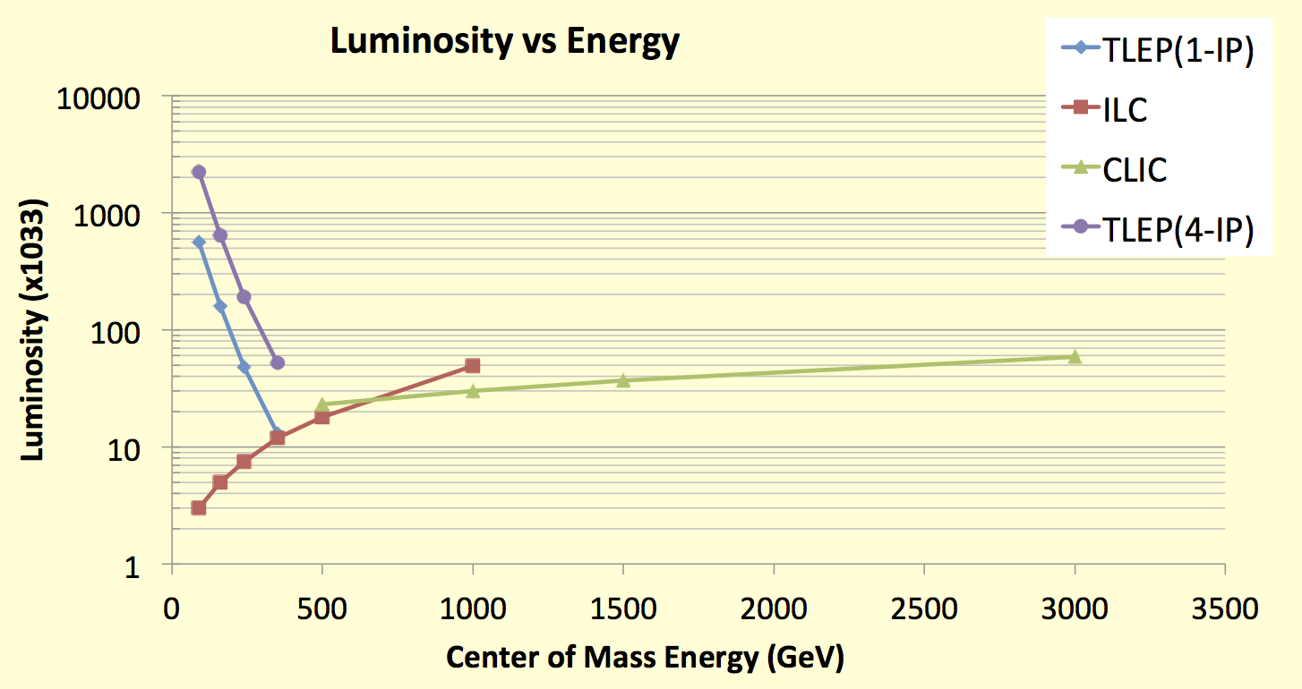
Luminosity of e+ e- colliders
TLEP : Instantaneous lumi at each IP (for 4 IP’s)
Instantaneous lumi summed over 4 IP’s
Z, 2.10³⁶
WW, 6.10³⁵
HZ, 2.10³⁵
tt , 5.10³⁴
Luminosity : Crossing point between circular and linear colliders ~ 400 GeV
As pointed out by H. Shopper in ‘The Lord of the Rings’ (Thanks to Superconducting RF…)
Circular colliders can have several IP’s . Sum scales as ~(N_{IP})^{0.5 – 1}
use 4 IP machine as more reliable predictions using LEP experience

Slide 10
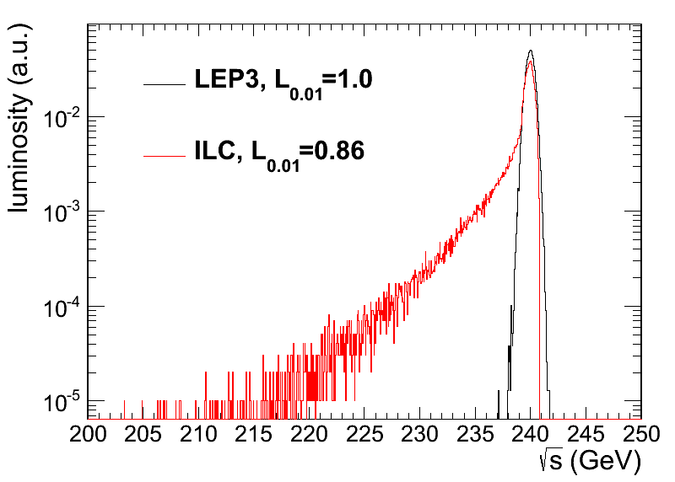
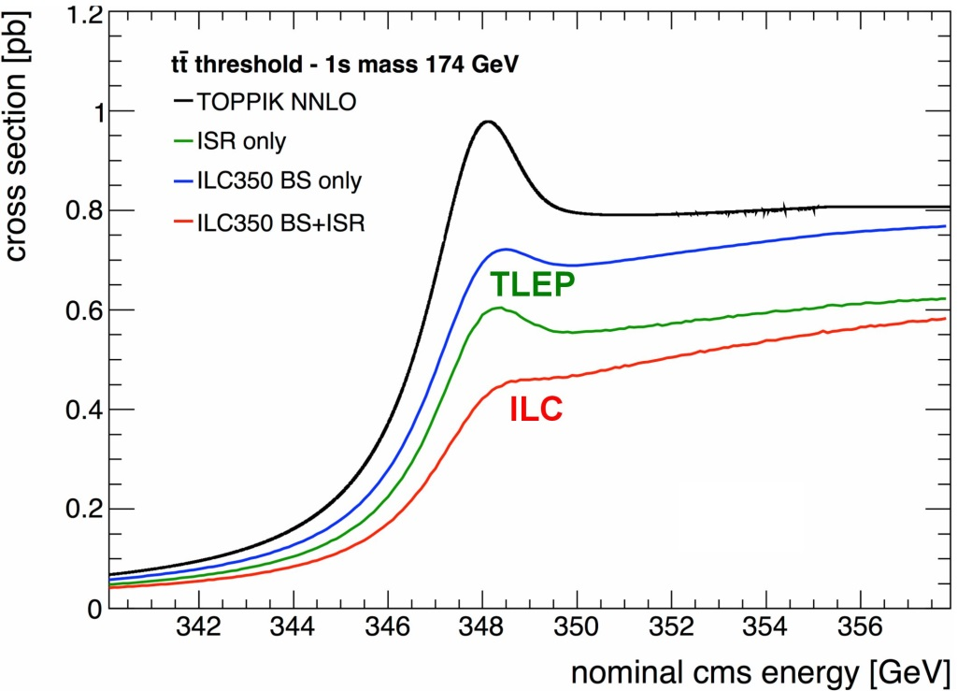
BEAMSTRAHLUNG and energy definition
Luminosity E spectrum
Effect on top threshold
➔
Beamstrahlung @TLEP is important for machine design but benign for physics:
particles are either lost or recycled on a synchrotron oscillation.
➔ some increase of energy spread but no change of average energy
Little resulting systematic error – cross-check wrt orbit of ‘single’ bunches
Little EM background in the experiment, no issue for luminosity measurement, but shielding against synchrotron radiation has to be designed.

Slide 11
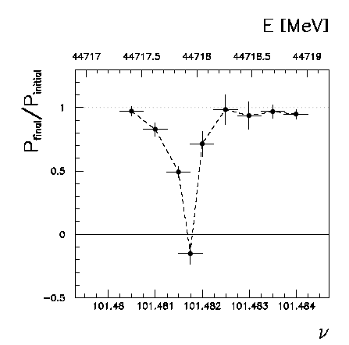
Beam polarization and E-calibration @ TLEP
Precise meast of E_{beam} by resonant depolarization
~100 keV each time the meast is made LEP→
At LEP transverse polarization was achieved routinely at Z peak.
instrumental in 10⁻³ measurement of the Z width in 1993
led to prediction of top quark mass (179+- 20 GeV) in Mar’94
Polarization in collisions was observed (40% at BBTS = 0.04) →
At LEP beam energy spread destroyed polarization above 61 GeV
σ_{E} ∝ E²/√ρ ➔ At TLEP transverse polarization up to at least 81 GeV (WW threshold)
to go to higher energies requires spin rotators and siberian snake (see spares)
TLEP: use ‘single’ bunches to measure the beam energy continuously
→no interpolation errors due to tides, ground motion or trains etc…
<< 100 keV beam energy calibration around Z peak and W pair threshold.
Δm_{Z} ~0.1 MeV, ΔΓ_{Z} ~0.1 MeV, Δm_{W} ~ 0.5 MeV

Slide 12
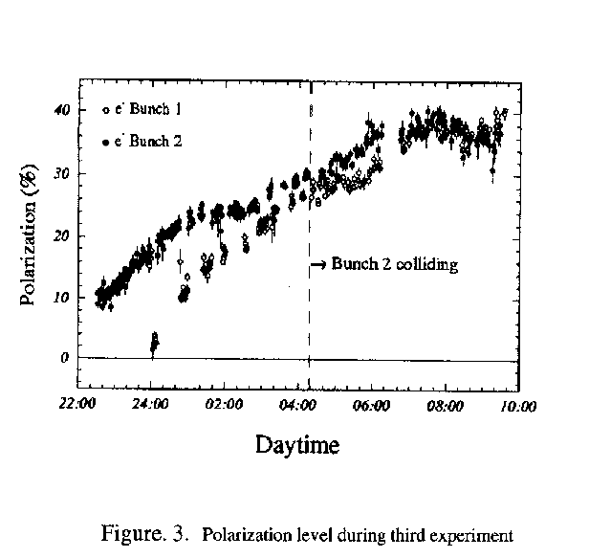
PAC 1995
This was only tried 3 times!
Best result: P = 40% , ξ*_{y}= 0.04 , one IP
Assuming 4 IP and ξ*_{y}= 0.01 ➔
reduce luminositiy somewhat, 10¹¹ Z @ P=40%

Slide 13
TERA-Z and Oku-W
Precision tests of the
closure of the Standard Model

Slide 14
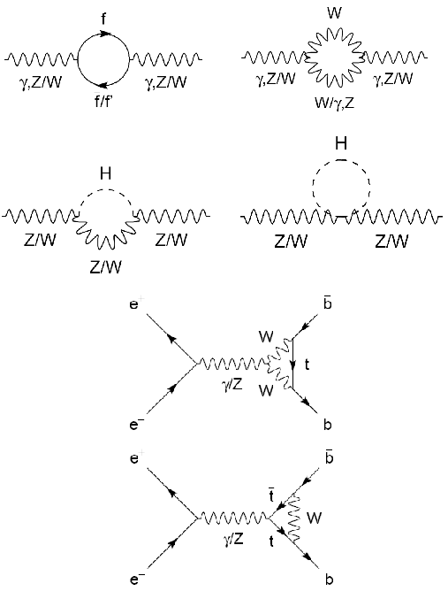
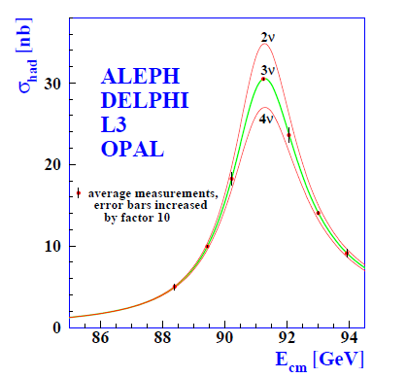
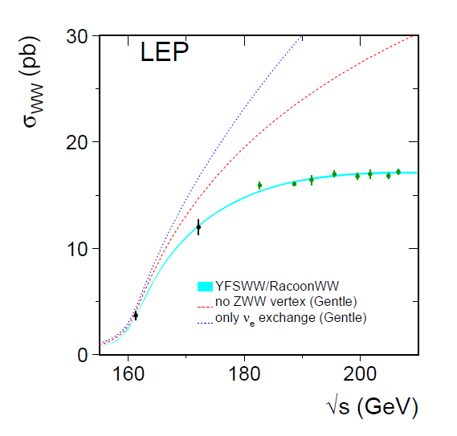
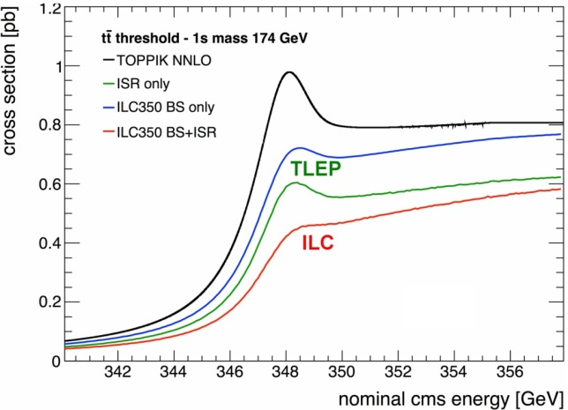
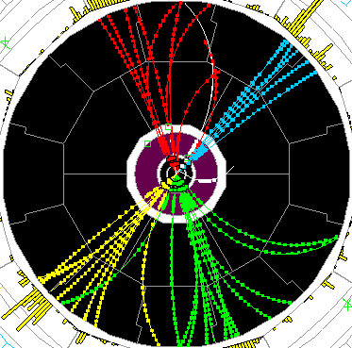
Precision tests of EWSB
Z pole ssymmetries, lineshape
WW threshold scan
tt threshold scan
-
TLEP : Repeat the LEP1 physics programme every 15 mn
Transverse polarization up to the WW threshold
Exquisite beam energy determination (10 keV)
Longitudinal polarization at the Z pole
Measure sin²θ_{W} to 2.10⁻⁶ from A_{LR}
Statistics, statistics: 10¹⁰ tau pairs, 10¹¹ bb pairs, QCD and QED studies etc…

Slide 15
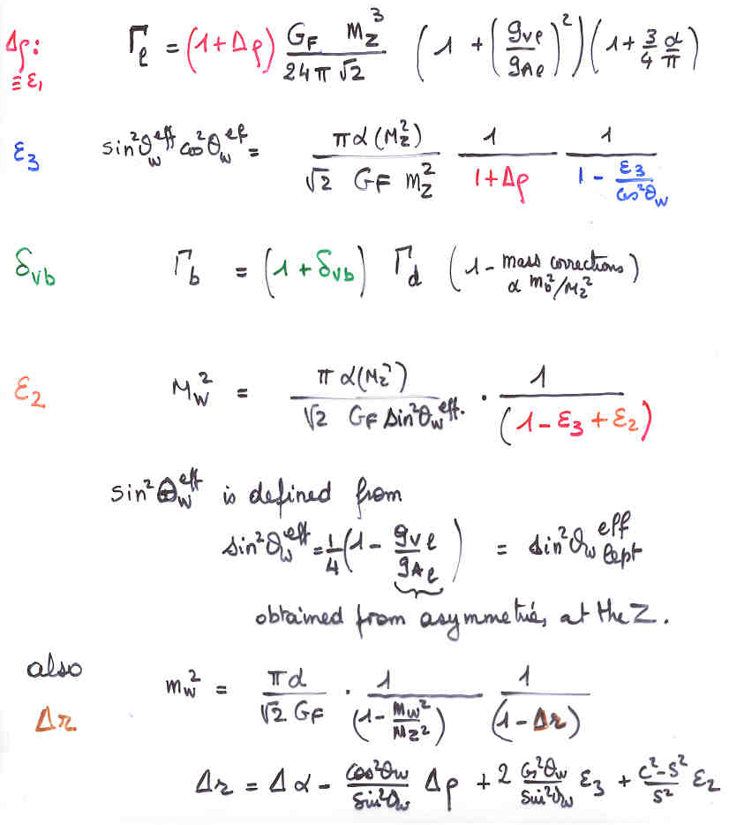
EWRCs
relations to the well measured
G_{F} m_{Z} α_{QED}
at first order:
Δρ = α /π (m_{top}/m_{Z})²
- α /4π log (m_{h}/m_{Z})²
There is much more than the W mass!
ε₃ = cos²θ_{w} α /9π log (m_{h}/m_{Z})²
δ_{νb} =20/13 α /π (m_{top}/m_{Z})²
complete formulae at 2d order
including strong corrections
are available in fitting codes
e.g. ZFITTER , GFITTER
Will need to be improved
for TLEP!

Slide 16
Words of caution:
1. TLEP will have 5.10⁴ more luminosity than LEP at the Z peak, 5.10³ at the
W pair threshold.
Predicting achievable accuracies with statistical errors decreasing by
250 is very difficult. The study is just beginning.
2. The following table are ‘plausible’ precisions based on my experience
and knowledge of the present limitations, most of which from higher order QED
corrections (ex. production of additional lepton pairs etc..).
Many can have experimental cross-checks and errors may get better.
3. The most serious issue is the luminosity measurement which relies on the
calculations/modeling of the low angle Bhabha scattering cross-section.
This dominates the measurement of the hadronic cross section at the Z peak thus
the determination of N_{v} (test of the unitarity of the PMNS matrix)
4. The following is only a sample of possibilities. With 10¹² Z decays, there are
many, many more powerful studies to perform at TERA-Z
e.g. flavour physics with 10¹¹ ‾bb, ‾cc , 10¹⁰ ττ etc…

Slide 17
A Sample of Essential quantities:
X | Physics | Present precision |  | TLEP target Precision –TBS | TLEP key | Issues
M_{Z} MeV/c2 | Input | 91187.5 ±2.1 | Z Line shape scan | <±0.1 MeV/c2 (solid) | E_cal | QED corrections
Γ_{Z} MeV/c2 | Δρ (T) (no Δα!) | 2495.2 ±2.3 | Z Line shape scan | <±0.1 MeV/c2 (solid) | E_cal | QED corrections
Rl | α_{s ,} δ_{b} | 20.767 ± 0.025 | Z Peak | ± 0.002 - 0.0002 | Statistics | QED corrections
N_{ν} | Unitarity of PMNS, sterile ν’s | 2.984 ±0.008 | Z Peak | ±0.001 (?) | environment ->lumi meast | QED corrections to Bhabha scat.
R_{b} | δ_{b} | 0.21629 ±0.00066 | Z Peak | ±0.00002 - 5 | Statistics, small IP | Hemisphere correlations
A_{LR} | Δρ, ε_{3 ,}Δα (T, S ) | 0.1514 ±0.0022 (SLD) | Z peak, polarized | ±0.000015 (solid) | 4 bunch scheme | Polarization in collisions
M_{W} MeV/c2 | Δρ, ε_{3 ,} ε_{2,} Δα (T, S, U) | 80385 ± 15 | Threshold scan | 0.5 (solid) | E_cal & Statistics
m_{top} MeV/c2 | Input | 173200 ± 900 | Threshold scan | 10 | E_cal & Statistics

Slide 18
Measurement of A_{LR}
Verifies polarimeter with experimentally measured cross-section ratios
statistics
ΔA_{LR} =
ΔA_{LR} = 0.000015 with 10¹¹ Z and 40% polarization in collisions.
Δsin²θ_{W}^{eff} (stat) = O(2.10⁻⁶)

Slide 19
At the moment we do not know for sure what is the most sensible scenario
LHC offered 3 possible scenarios: (could not lose)
Discover that there is nothing in this energy range.
➔ This would have been a great surprise and a
great discovery!
Discover SM Higgs Boson
and that nothing else
is within reach
Most Standard scenario
great discovery!
Discover many new effects or particles
great discovery!
NO
So far we are here
But….
Keep looking
in 13/14 TeV data!
Also: understand scaling
of LHC errors with luminosity
Answer in 2018
High precision
High energy
BE PREPARED!

Slide 20
Recommendation from European Strategy (2)
High-priority large-scale scientific activities
Second-highest priority, recommendation #2
Excerpt from the CERN Council deliberation document (22-Mar-2013)
d) To stay at the forefront of particle physics, Europe needs to be in a position to propose an ambitious post-LHC accelerator project at CERN by the time of the next Strategy update, when physics results from the LHC running at 14 TeV will be available.
CERN should undertake design studies for accelerator projects in a global context, with emphasis on proton-proton and electron-positron high-energy frontier machines. These design studies should be coupled to a vigorous accelerator R&D programme, including high-field magnets and high-gradient accelerating structures, in collaboration with national institutes, laboratories and universities worldwide.
The two most promising lines of development towards the new high energy frontier after the LHC are proton-proton and electron-positron colliders. Focused design studies are required in both fields, together with vigorous accelerator R&D supported by adequate resources and driven by collaborations involving CERN and national institutes, universities and laboratories worldwide. The Compact Linear Collider (CLIC) is an electron-positron
machine based on a novel two-beam acceleration technique, which could, in stages, reach a centre-of-mass energy up to 3 TeV. A Conceptual Design Report for CLIC has already been prepared. Possible proton-proton machines of higher energy than the LHC include HE-LHC, roughly doubling the centre-of-mass energy in the present tunnel, and VHE-LHC, aimed at reaching up to 100 TeV in a new circular 80km tunnel. A large tunnel such as this could also host a circular e⁺e⁻ machine (TLEP) reaching energies up to 350 GeV with high luminosity.

Slide 21
CERN Medium term plan -- June 2013:
NB. What ICFA decided to discontinue are the ICFA-beam dynamics workshops
on Higgs Factories -- not the studies of course!

Slide 22
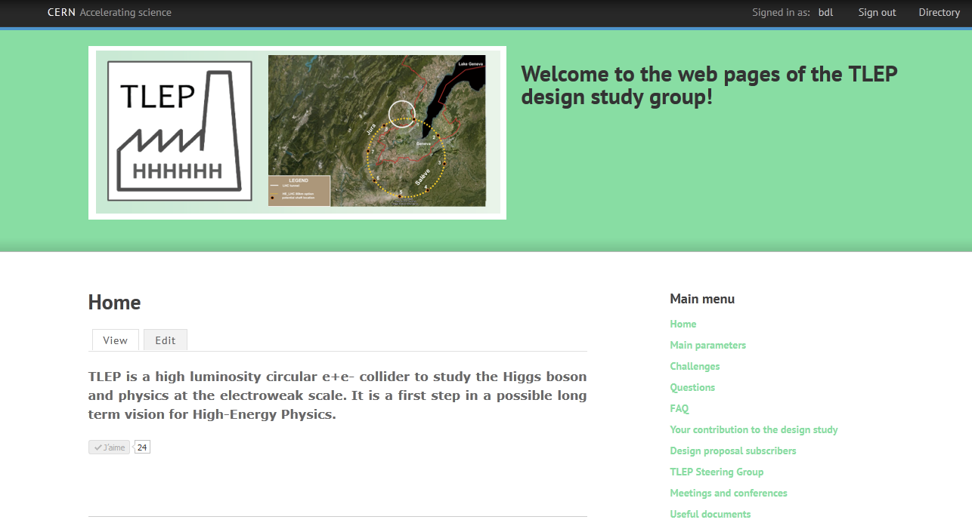
Design Study : http://tlep.web.cern.ch
can suscribe for work, informations, newsletter , etc…
Global collaboration: collaborators from Europe, US, Japan, China ➔
Next events: TLEP workshops 25-26 July 2013, Fermilab
16-18 October 2013, CERN
+ Joint VHE-LHC+ TLEP kick-off meeting in February 2014

Slide 23
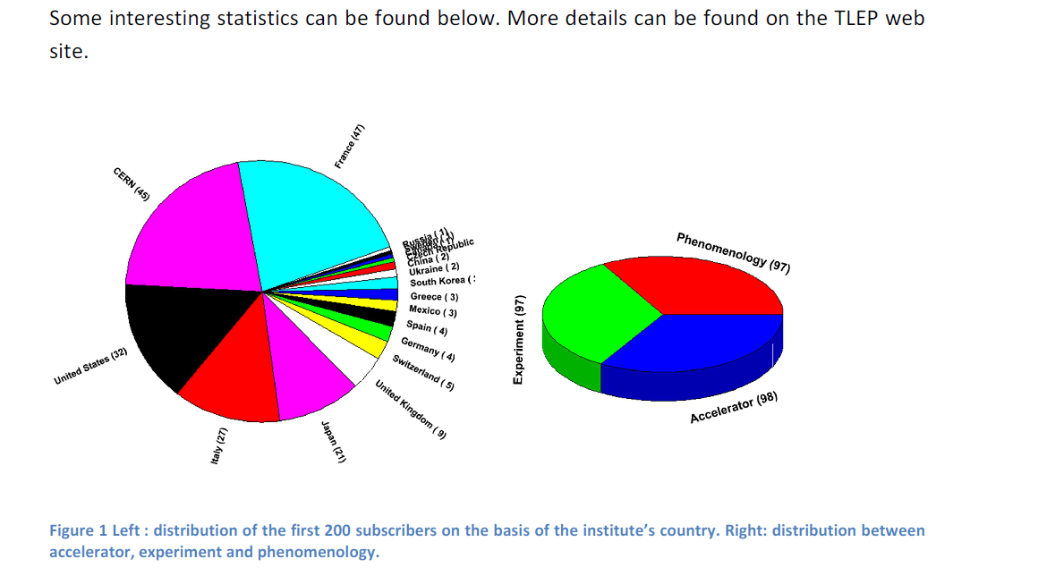
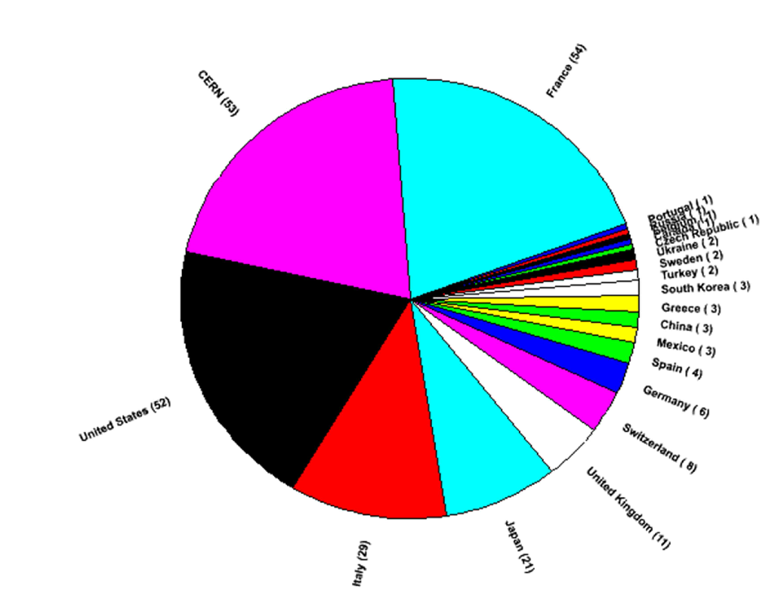
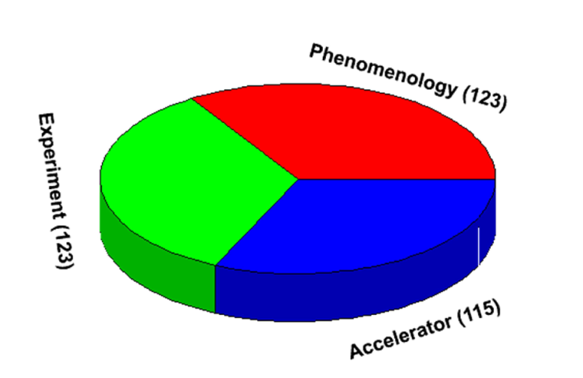
The first 250 subscribers:
The distribution of the country of origin reflects the youth of the TLEP project and the very different levels of awareness in the different countries.
The audience is remarkably well balanced between Accelerator, Experiment, and Phenomenology

Slide 24
Zimmermann

Slide 25
Conclusions
Discovery of H(126) focuses studies of the next machine
News ideas emerging for Higgs factories and beyond
A large e+e- storage ring collider seems the best complement to the LHC
Couple Permil precision on Higgs Couplings (see P. Janot’s talk)
Unbeatable precision on EW quantities (m_{Z} , Γ_{Z}, m_{W} , A_{LR} , R_{b} etc, etc…..)
Most mature technology and safe luminosity estimates.
A first step towards a 100 TeV proton proton collider and a long term vision.
Results of the LHC run at 14 TeV will be a necessary and precious input
Towards an ambitious medium and long term vision
In Europe: Decision to be taken by 2018
-- Design study recommended and being organized : tlep.web.cern.ch
The numbers speak for themselves!

Slide 26
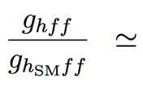
Some guidance from theorists:
New physics affects the Higgs couplings
SUSY , for tanβ = 5
Composite Higgs
Top partners
Other models may give up to 5% deviations with respect to the Standard Model
Sensitivity to “TeV” new physics needs per-cent to sub-per-cent accuracy on couplings for 5 sigma discovery.
LHC discovery/(or not) at 13 TeV will be crucial to understand the strategy for future collider projects
R.S. Gupta, H. Rzehak, J.D. Wells, “How well do we need to measure Higgs boson couplings?”, arXiv:1206.3560 (2012)
H. Baer et al., “Physics at the International Linear Collider”, in preparation, http://lcsim.org/papers/DBDPhysics.pdf

Slide 27
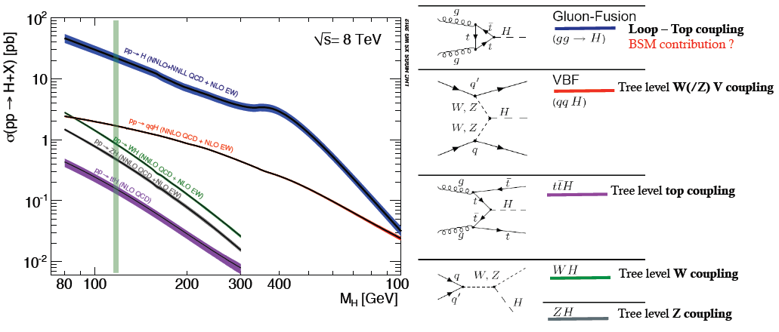
The LHC is a Higgs Factory !
1M Higgs already produced – more than most other Higgs factory projects.
15 Higgs bosons / minute – and more to come (gain factor 3 going to 13 TeV)
Difficulties: several production mechanisms to disentangle and
significant systematics in the production cross-sections σ_{prod} .
Challenge will be to reduce systematics by measuring related processes.
σ_{i→f} ^{observed} ∝ σ_{prod} (g_{Hi} )²(g_{Hf})² extract couplings to anything you can see or produce from
Γ_{H} if i=f as in WZ with H→ ZZ → absolute normalization

Slide 28
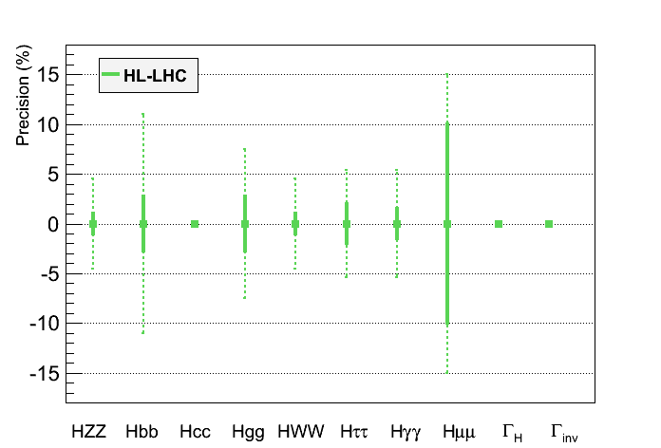
HL-LHC (≡3 ab⁻¹ at 14 TeV):
Highest-priority recommendation from European Strategy
c) The discovery of the Higgs boson is the start of a major programme of work to measure this particle’s properties with the highest possible precision for testing the validity of the Standard Model and to search for further new physics at the energy frontier.
The LHC is in a unique position to pursue this programme.
 | LHC | HL-LHC
End date | 2021 | 2030-35?
N_{H} | 1.7 x 10⁷ | 1.7 x 10⁸
Δm_{H} (MeV) | 100 | 50
Δg_{Hγγ}/g_{Hγγ} | 6.5 – 5.1% | 5.4 – 1.5%
Δg_{Hgg}/g_{Hgg} | 11 – 5.7% | 7.5 – 2.7%
Δg_{Hww}/g_{Hww} | 5.7 – 2.7% | 4.5 – 1.0%
Δg_{HZZ}/g_{HZZ} | 5.7 – 2.7% | 4.5 – 1.0%
Δg_{HHH}/g_{HHH} | -- | < 30%
Δg_{Hμμ}/g_{Hμμ} | <30% | <10%
Δg_{Hττ}/g_{Hττ} | 8.5 – 5.1% | 5.4 – 2.0%
Δg_{Hcc}/g_{Hcc} | -- | --
Δg_{Hbb}/g_{Hbb} | 15 – 6.9% | 11 – 2.7%
Δg_{Htt}/g_{Htt} | 14 – 8.7% | 8.0 – 3.9%
No measurement g_{Hcc} and Γ_{H}
Assume no exotic Scalar decays
?
?
?
In bold, theory uncertainty are assumed to be divided by a factor 2,
experimental uncertainties are assumed to scale with 1/√L,
and analysis performance are assumed to be identical as today
Coupling measurements with precision :
in the range 6-15% with LHC - 300 fb⁻¹
in the range 1-4% with HL-LHC - 3000 fb⁻¹
NB: at LEP theory errors
improved by factor 10 or more….
B. Mele

Slide 29
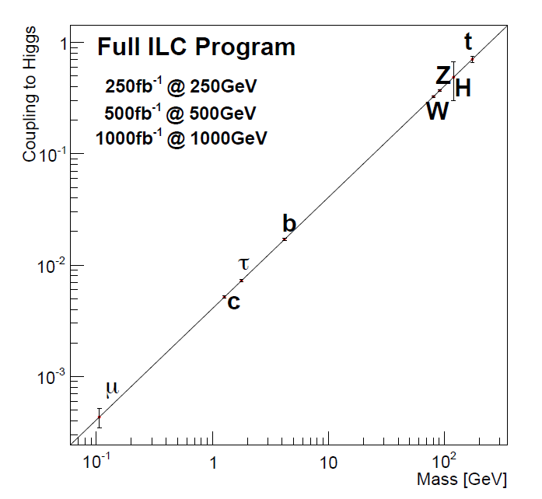
t
Full HL-LHC
H
Z
W
b
τ
μ

Slide 30
Conclusions and outlook (my own view) A project for the next 50 years
The discovery of the H(126) scalar boson opens the way to precise investigations:
-- HL-LHC
-- A lepton collider of sufficient luminosity and precision
-- Best performance with an e+e- circular machine TLEP in a large (80km) tunnel
-- First step towards 100 TeV Very Large Hadron Collider
-- Choice when LHC results at 13 TeV available → 2017-18
in 2035 the LEP/LHC tunnel will have been used for 46 years…
the TLEP/VHE-LHC tunnel would be used for > 50 years!

Slide 31
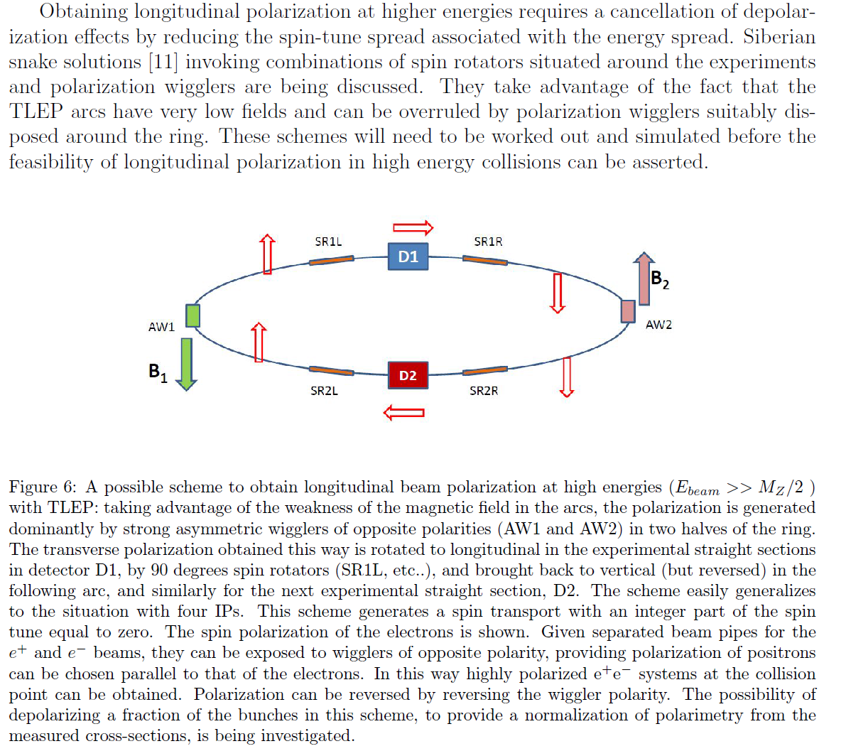

Slide 32
Zimmermann

