Slide 1
Accelerator Capabilities for the Energy Frontier
Mark Palmer
Frontier Capabilities:
Energy Frontier Lepton & Gamma Colliders Sub-Group
July 1, 2013

Slide 2
Outline
Introduction
Hadron Colliders
Lepton and γ−γ Colliders
Closing Comments

Slide 3
Introduction
The Working Groups and Inputs
The Working Group Assessments
The “Boundary Conditions”

Slide 4
Frontier Capabilities Sub-Groups & Inputs
Accelerator Capabilities Convener: Bill Barletta (MIT)
This talk draws principally on materials submitted to 3 of the Capabilities Frontier sub-groups:
  Hadron Colliders
    Sub-conveners: Marco Battaglia (UCSC), Markus Klute (MIT),
    Soren Prestemon (LBNL), & Lucio Rossi (CERN)
    EF Liaison: Eric Prebys (FNAL)
    Sub-Group Meeting at CERN (Feb):
    http://indico.cern.ch/conferenceOtherViews.py?view=standard&confId=223094
  Lepton Colliders
    Sub-conveners: Marco Battaglia (UCSC), Markus Klute (MIT), Kaoru Yokoya (KEK), & myself
    EF Liaison: Tor Raubenheimer (SLAC)
    Sub-Group Meeting at MIT:
    https://indico.cern.ch/conferenceDisplay.py?ovw=True&confId=233944
  R&D Capabilities
    Sub-conveners: Georg Hoffstaeter (Cornell), Mark Hogan (SLAC),
    & Vladimir Shiltsev (FNAL)
    Sub-Group Meeting at Univ. of Chicago:
    https://indico.fnal.gov/conferenceDisplay.py?ovw=True&confId=6326
Submissions covered a broad range of capabilities and possibilities a many contributors to what follows
  Particular thanks to E. Prebys, T. Raubenheimer, S. Henderson

Slide 5
Working Group Assessments
The goal of the aforementioned working groups has been to:
  Summarize the capabilities that can support the physics needs of Energy Frontier
  Evaluate the major technical challenges and cost drivers
  Identify the R&D path required to develop the necessary capabilities
It should be noted that:
  All of the options have some technical challenges
  None of the options under consideration is cheap
  But, we do have real options with contrasting strengths and weaknesses (as well as varying states of readiness)
  a which makes the process of charting an optimal route forward challenging when we are discussing timescales of decades

Slide 6
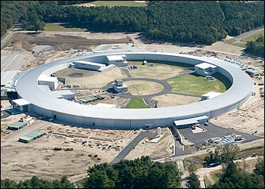
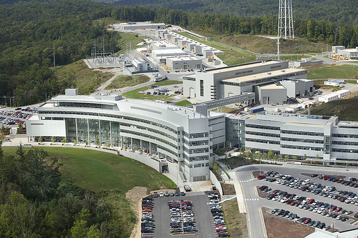
What do you get for a Billion Dollars?
NSLS-II: $0.9B, 0.8 km storage ring
SNS: $1.4B, 1 GeV Linac, Ring, high-power target, 1km
S. Henderson
HF2012

Slide 7
Jim Siegrist’s “Boundary Conditions”
Jim Siegrist, CPM2012
https://indico.fnal.gov/getFile.py/access?contribId=4&sessionId=2&resId=3&materialId=slides&confId=5841
It’s imperative to make the case for the physics we need,
But we must also develop a coherent plan that is realistic if we want to preserve the health and vitality of the U.S. HEP program
The challenges for all of the options presented here go beyond the technical

Slide 8
HADRon Collider Capabilities
LHC and Its Upgrade Path
Very High Energy Options:
VHE-LHC
VLHC

Slide 9
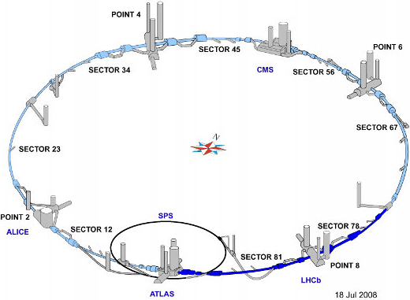
The LHC
Start | Facility | E_{CM} | Lumi (10³⁴ cm⁻²s⁻¹)
2014 | LHC | 13-14 TeV pp | 1a2 Peak
2024 | HL-LHC | 14 TeV pp | 5 Leveled
2024 | LHeC? | 7 TeV p + 60-140 GeV e± | ~.1-1
~2035 | HE-LHC? | 33 TeV pp | ≥2
A >3 decade hadron program
+ ~10 yrs
of physics

Slide 10
The LHC Sequence of Parameters
Parameter | LHC |  | HL-LHC |  | HE-LHC
Bunch Spacing | 25 ns | 50 ns | 25 ns | 50 ns | 50 ns
Beam Energy [TeV] | 6.5-7 | 6.5-7 | 7 | 7 | 16.5
n_{b} | 2808 | 1404 | 2808 | 1404 | 1404
N_{b} (x10¹¹) | 1.15(1.7) | 1.7(2.0) | 2.2 | 3.5 | 1.3
β* [m] | .55 | .55 | .15 | .15 | 0.4-1
σ_{x,y} [μm] | 16.7 | 16.7 | 7.5 | 7.5 | ~10
σ_{z} [cm] | 7.6 | 7.6 | 7.6 | 7.6 | ~6
Total Energy/beam [MJ] | 362 (535) | 267 (314) | 692 | 550 | 482
L (peak) [10³⁴ cm-²s⁻¹] | ~1 (2) | ~1 (2) | 5 | 2.5 | 2
Events/crossing | 27 (54) | 54 (108) | 140 | 140 | ~60
L (int) [fb⁻¹/year] | 40 (80) | 40 (80) | 250 | 250 | 250
L (int) [fb⁻¹, goal] | ~300 |  | ~3000 |  | ---
Detector
Pile-up Issues
of concern
Chosen to
limit Pile-up
() = ultimate parameters

Slide 11

Luminosity “Constraints”*
Total Current, limited by
instabilities (eg, e-cloud)
machine protection issues!
“Brightness”, limited by
Space charge effects
Instabilities
Beam-beam tune shift (ultimate limit)
number of bunches
Bunch size
Geometric factor related to crossing angle and hourglass effect
β*, limited by
magnet technology
chromatic effects
*a la Frank Zimmermann

Slide 12
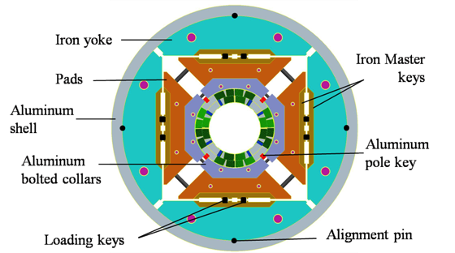
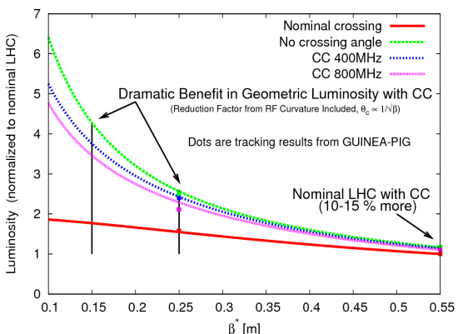
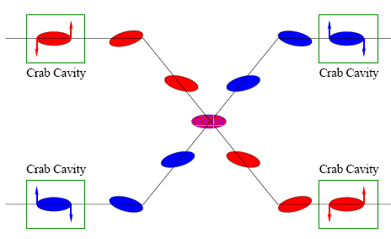
Issues for the HL-LHC
Reduce β*: 55 cm to 15 cm
  Requires move to Nb₃Sn
  Increases effect of crossing
  angle
Baseline plan is to employ
crab cavities

Slide 13
Luminosity Leveling
Original goal of luminosity upgrade: >10³⁵ cm⁻²s⁻¹
  Leads to unacceptable pileup in detectors
New goal: 5x10³⁴ leveled luminosity
Options
  Crab cavities
  β* modifications
  Lateral separation

Slide 14
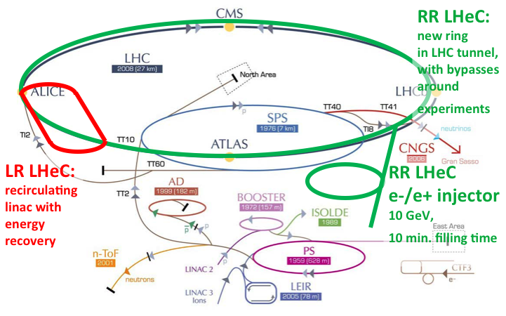
LHeC: Options Considered
RR: e± circulate in new 60 GeV ring, which shares tunnel with LHC
LR: CW Energy recovery linac collides 60 e± with LHC beam
LR:* Pulsed energy recovery linac collides 140 GeV e± with LHC beam

Slide 15
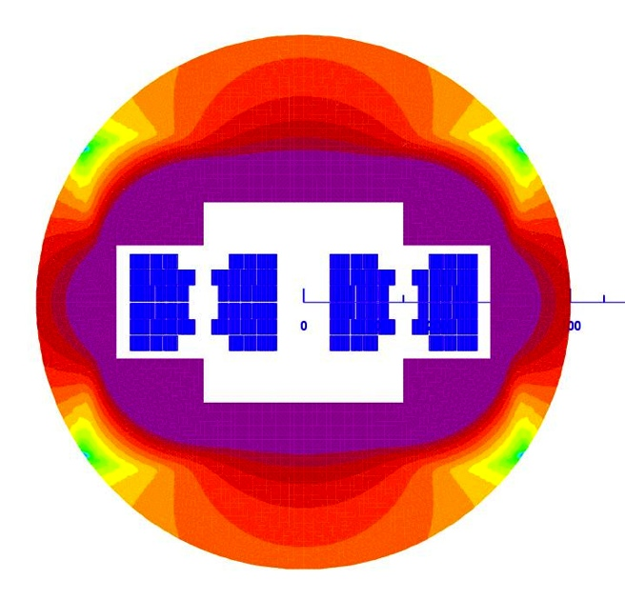
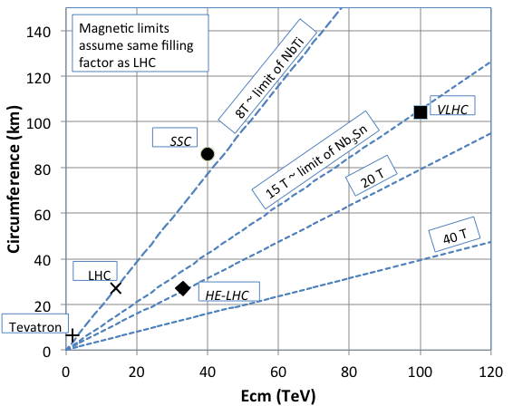
Going Beyond LHC: Limits to Energy
The energy of Hadron colliders is limited by
feasible size and magnet technology. Options:
  Get very large (eg, C~100 km)
  VHE-LHC in TLEP Tunnel or VLHC concept
  More powerful magnets (HTS)
E. Todesco 2010
20 T, 80% ss
30% NbTi
55 %NbSn
15 %HTS
All Je < 400 A/mm2

Slide 16
Important R&D and Questions for HE Hadron Colliders
Magnets, magnets, magnets
  New conductors: Nb₃Sn, HTS, hybrid designs
  Rapid cycling SC magnets
  Rad hardness and energy deposition studies (simulation and experiment).
Machine Protection
  Collimation design and materials research
  Accelerator physics and simulation
    Halo formation and beam loss mechanisms (historically not accurate)
Crossing angle issues
  Crab cavity development
  New ideas: eg, flat beams
Key question for the HEP community:
  Luminosity vs. pile-up as a function of energy
    What luminosity do you need?
    What pile-up can you live with?
E. Prebys

Slide 17
Lepton & Photon Colliders
  e⁺e⁻ Circular Colliders:
  >100 GeV Scale
  Linear Colliders:
    e⁺e⁻ Colliders with
    E < 1 TeV & E1> 1 TeV
    γ-γ Colliders
  μ⁺μ⁻ Colliders: Up to 10 TeV

Slide 18
e⁺e⁻ Circular Colliders
Comments
LEP2 nearly reached the Higgs
Technical Issues
Synchrotron Radiation:
Trends in the Discussion
Re-use of the LEP tunnel (conflict w/LHC) as well as various site-filler options initially discussed
Recent focus: 80-100km ring leading to a
100 TeV scale hadron collider (VHE-LHC/VLHC)
Rings are robust and well-understood technology
RF Efficiency
Energy Bandwidth
Takes a longer term view
Limits SR issues
Collective Effects
Beam Lifetime (~10³ sec) and Top-Up Injection

Slide 19
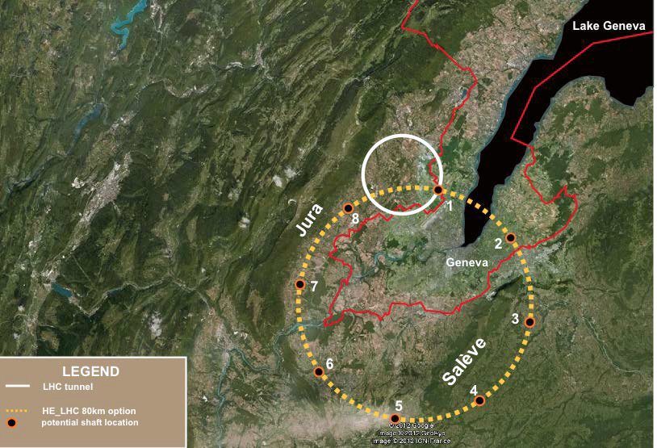
The TLEP Concept
350 GeV C.M. e⁺e⁻
a 100 TeV pp
J. Osborne, C. Waaijer

Slide 20
Electron-Positron Storage Rings:
Parameters for Selected Options
 | LEP2 | TLEP* – HZ | TLEP* - t | FNAL** - HZ
Beam Energy [GeV] | 104.5 | 120 | 175 | 120
Circumference [km] | 26.7 | 80 | 80 | 100
Beam current [mA] | 4 | 24.3 | 5.4 | 12.9
Number of bunches | 4 | 80 | 12 | 34
Bunch population [10¹²] | 0.575 | 40.8 | 9.0 | 0.79
Horizontal emittance [nm] | 48 | 9.4 | 10 | 16
Vertical emittance [nm] | 0.25 | 0.02 | 0.01 | 0.08
β_{x}* [mm] | 1500 | 500 | 1000 | 200
β_{y}* [mm] | 50 | 1 | 1 | 2
Hourglass factor | 0.98 | 0.75 | 0.65 | 0.81
SR power/beam [MW] | 11 | 50 | 50 | 20
Bunch length [mm] | 16 | 1.7 | 2.5 | 3.2
Momentum acceptance [%] | 1.25 | 9.4 | 4.9 | 3.0
Beam-beam parameter / IP | 0.07 | 0.1 | 0.1 | 0.1
Luminosity / IP [10³⁴ cm⁻²s⁻¹] | 0.0125 | 4.8 | 1.3 | 1.8
* Assumes 4 IPs ** Assumes 1 or 2 IPs

Slide 21
e⁺e⁻ Circular Colliders
Status
TLEP Design Study has been launched
Not aware of any other significant effort underway
R&D
Focus on detailed technical assessments
Challenges, but no obvious showstoppers
Time
TLEP: Conceptual Design Report by 2015
TLEP: Technical Design Report by 2018
TLEP: Aiming for construction readiness in 2020’s
Technical Statement

Slide 22
Linear Colliders
Luminosity
The strong fields at the interaction point result in
  A luminosity enhancement characterized by the disruption parameter
  Beamstrahlung emission gives rise to energy spread and backgrounds at the interaction point

Slide 23
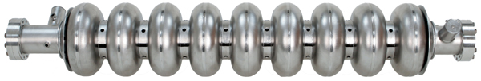
Linear Collider Options
A range of options have been explored
  ILC: Based on SRF technology
  Most mature concept for E_{CM}<1 TeV
  CLIC: Based on drive-beam and NCRF technology
  RF Gradients: 100 MV/m
  Could be applied for E_{CM}<1 TeV, but designs up to 3 TeV are documented
Yield ’10 ~ ’12:
> 90% @ 25 MV/m
~ 80% @ 28 MV/m
~ 70% @ 35 MV/m

Slide 24
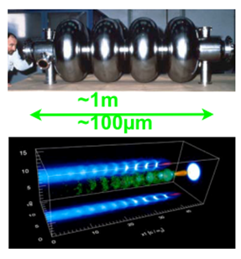
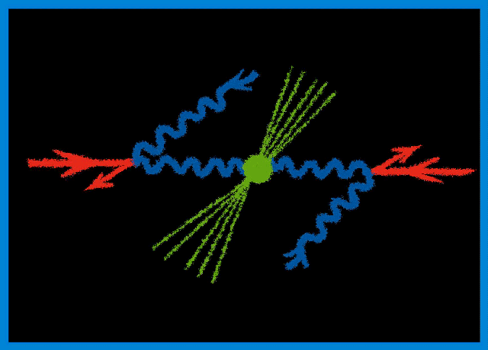
Linear Collider Options
Options (cont’d)
  Wakefield Accelerators:
  Potential for very high energies
  Possibly could be used for LC
  afterburner
  Significant R&D remains
  γ−γ: High power laser beams
  Compton backscattered from
  e⁻ or e⁺ beams
    γγaH cross section ~200fb
    Concept could be applied at an
    ILC or CLIC

Slide 25
ILC Parameters
Centre-of-mass energy | E_{cm} | GeV | 250 | 350 | 500 |  | 1000
Beam energy | E_{beam} | GeV | 125 | 175 | 250 |  | 500
Estimated AC power | P_{AC} | MW | 128 | 142 | 162 |  | 300
Collision rate | f_{rep} | Hz | 5 | 5 | 5 |  | 4
Electron linac rate | f_{linac} | Hz | 10 | 5 | 5 |  | 4
Number of bunches | n_{b} |  | 1312 | 1312 | 1312 |  | 2450
Bunch separation | Dt_{b} | ns | 554 | 554 | 554 |  | 366
Pulse current | I_{beam} | mA | 5.8 | 5.8 | 5.79 |  | 7.6
RMS bunch length | σ_{z} | mm | 0.3 | 0.3 | 0.3 |  | 0.250
Electron polarisation | P₋ | % | 80 | 80 | 80 |  | 80
Positron polarisation | P₊ | % | 30 | 30 | 30 |  | 20
Luminosity (inc. waist shift) | L | ×10³⁴ cm⁻²s⁻¹ | 0.75 | 1.0 | 1.8 |  | 3.6
Fraction of luminosity in top 1% | L_{0.01}/L |  | 87.1% | 77.4% | 58.3% |  | 59.2%

Slide 26
The ILC
Status
Technical Design Report now complete
Decision point on moving forward has been reached
R&D
Most significant R&D issues addressed during ILC Technical Design Phase [SRF cavity R&D, including industrialization; FLASH beam tests; damping ring studies, CESRTA; damping ring and beam delivery system studies at KEK-ATF]
Time
Some technical challenges remain (eg, complete ATF2 program), but no obvious showstoppers
Timescale contingent on decision process and international support
Team ready to move forward with detailed engineering and site-specific design

Slide 27
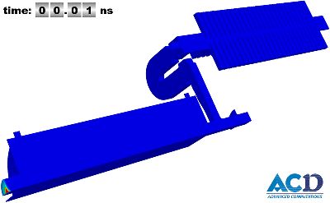
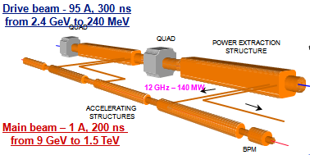
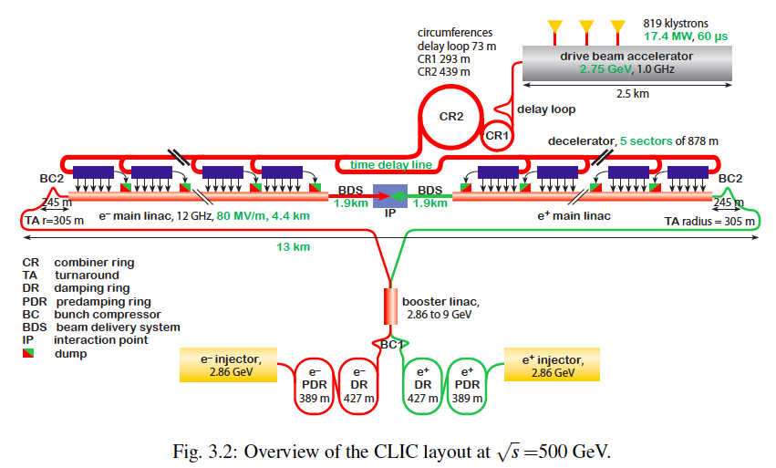
CLIC layout at 500 GeV

Slide 28
Potential Staged CLIC Parameters

Slide 29
Linear Colliders with E > 1 TeV
ILC is ~ 50 km at 1 TeV
    Possible to consider higher gradient SCRF materials or PWFA boost
CLIC design is aimed at upgradable design → 0.5-3 TeV
    Geographic gradient of 4x higher than ILC
Advanced acceleration options (plasma, dielectric)
    Plasma acceleration has made great progress however still huge challenges in beam quality and stability
    Extremely low charge dielectric-laser accelerators may provide only reasonable parameters in multi-TeV regime
    None of AARD options are close to being ready
Some plasma and dielectric options act as transformers taking high power beams → high energy beams
    Possible to develop upgrade options for ILC-like technology?

Slide 30
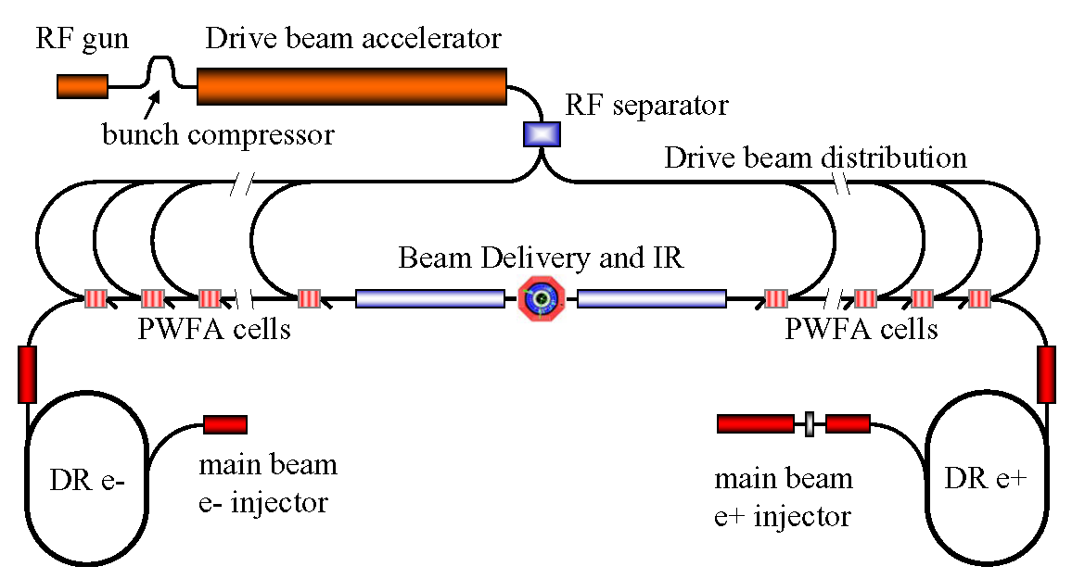
Concept of Beam-Driven Plasma Linac
Concept for a 1 TeV plasma wakefield-based linear collider
  Use conventional Linear Collider concepts for main beam and drive beam generation and focusing and PWFA for acceleration
    Makes good use of PWFA R&D and 30 years of conventional rf R&D
  Concept illustrates
  focus of PWFA
  R&D program
    High efficiency
    Emittance preservation
    Positrons
  Allows study
  of cost-scales
  for further
  optimization of R&D

Slide 31
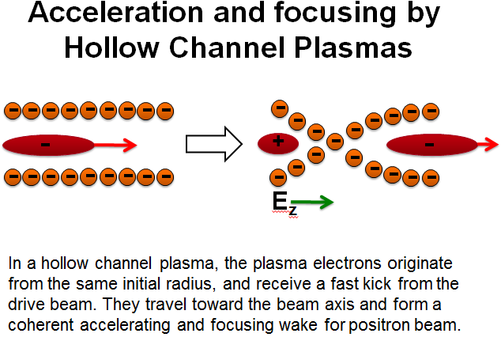
Challenges for Positron
Plasma Wakefield Acceleration
M. Hogan
Positron Witness Bunch
Electron Drive Bunch
+
+
+
+
+
+
Positive Ion Background
-
-
-
-
-
-
-
+
+
+
+
+
+
-
-
-
-
-
-
-
+
+
+
+
+
+
+
+
+
+
+
+
+
+
Accelerating and Defocusing
Field for Positrons
Decelerating and Focusing
Field for Electrons

Slide 32
Possible Linear Collider Parameters
ILC and CLIC parameters from design reports; 10 TeV DBA scaled from Wei Gai
communication; 10 TeV DLA and Plasma Accelerator from 2010 ICUIL/ICFA Workshop

Slide 33
CLIC and Wakefield LCs
Status
CLIC Conceptual Design Report complete
Wakefield Accelerator Concepts – Feasibility being assessed
R&D
CLIC: Focus on technology and advanced systems R&D
Time
Wakefield Accelerators:
CLIC: Timescale dependent on finalized technical design and physics needs
Ability to accelerate positrons
Demonstration of multi-stage acceleration
Understanding the extrapolation of all parameters to the regimes required for HEP accelerator use (emittance preservation, achievable energy spread, beam loading, repetition rate)
Wakefield LCs:
Expect non-HEP applications on the ~decade timescale
Collider R&D phase to fully assess feasibility is likely decades scale
First application might be an ILC “afterburner”

Slide 34
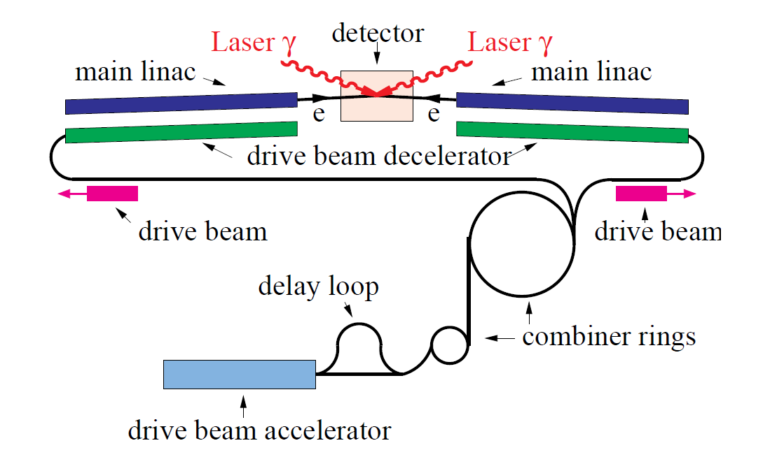
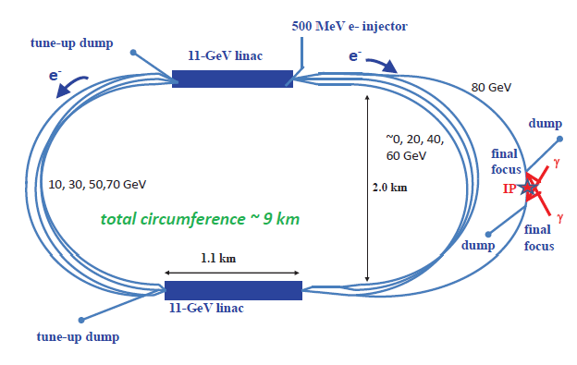
γ−γ Collider Concepts
γ−γ Higgs Factory (E_{CM}~160 GeV, photons carry ~80% of CM E) might represent a `low cost’ option to demonstrate the technology
Relative to LC: No positrons, damping rings, bunch compressors,…
Laser parameters are challenging; requires optical cavity schemes
CLICHÉ: CLIC Higgs Experiment
 | SAPPHiRE
Beam Energy | 80 GeV
Power Consumption | 100 MW
Polarization | 80%
Ave Beam Current | 0.32 mA
E-e- geometric luminosity | 2.2x10^34
Laser wavelength | 351 nm
Repetition rate | 200 kHz
Laser pulse energy | ~5 J

Slide 35
γ−γ Colliders
Status
Principal technical challenge is laser system
R&D
Would need to establish Technical Design
Time
In principle, a decision point could be reached in a few years
Validate feasibility of required laser
Question: Would the community be interested in a standalone facility versus eventual companion capability with an e⁺e⁻ LC?

Slide 36
Muon Accelerator Concepts
Major Challenges

Slide 37
Muon Accelerators
And Potential Staging Steps
Program Baselines

Slide 38
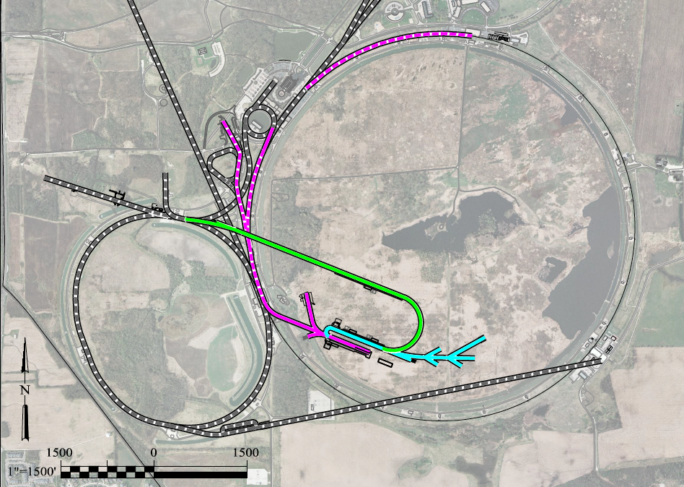
A Muon Accelerator Facility for Cutting Edge Physics on the Intensity and Energy Frontiers
Based on Project X Stage II
To SURF
LBNE
Buncher/
Accumulator
Rings
RLA to 63 GeV +
300m Higgs Factory
NF Decay Ring:
νs to SURF
Front End+4D+6D
Project X
Stage III
Linac + RLA to ~5 GeV
Project X
Stage II
Project X
Stage I
A 1.5 TeV collider
would fit within the
Tevatron ring
ft
νSTORM + Muon Beam
R&D Facility
ft

Slide 39
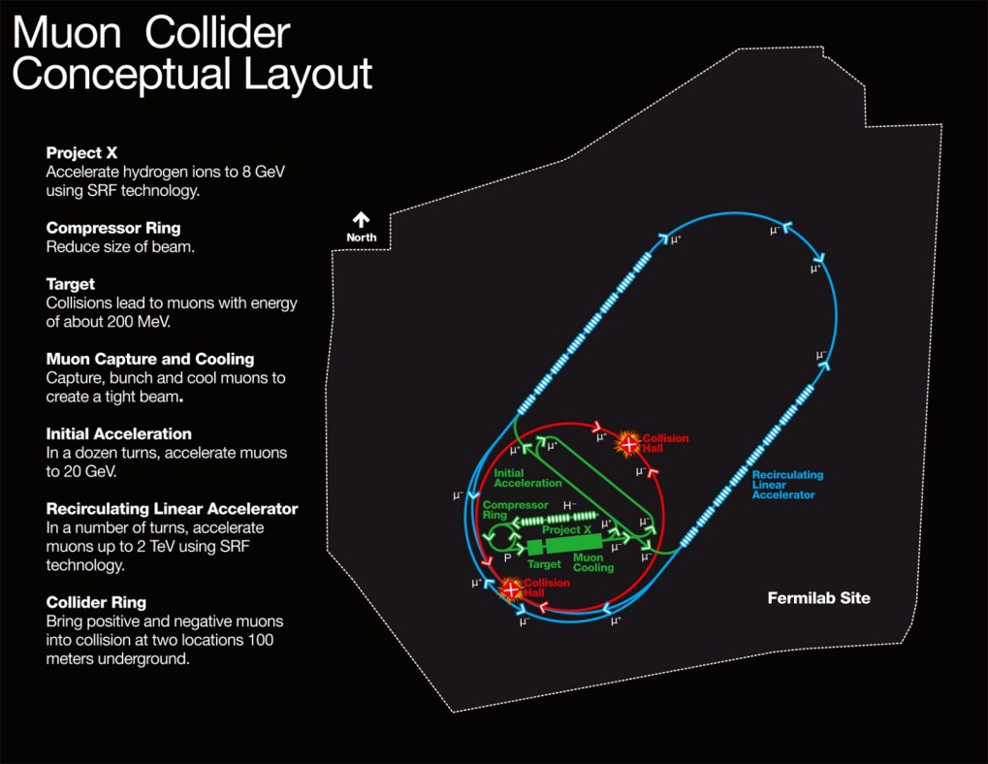
MAP Designs for a Muon-Based Higgs Factory and Energy Frontier Colliders
Exquisite Energy
Resolution
Allows Direct
Measurement
of Higgs Width
Site Radiation mitigation with depth and lattice design: ≤ 10 TeV

Slide 40
Muon Colliders
Status
MAP Feasibility Assessment underway
R&D
Establishing Initial Baseline Design
Muon Ionization Cooling Experiment
Time
Feasibility Report by end of decade
Staging Study: Physics + R&D + Demos required for next stage
Technology R&D: Cooling channel hardware, RF in B-fields, high field magnets (synergistic with HE-LHC needs)
Completion of MICE by end of decade
NuMAX (initial long baseline NF): Informed Decision by ~2020
Collider Options: Informed Decision point by mid-2020s

Slide 41
CLOSING Remarks
Long-Term Perspective
Conclusions

Slide 42
Some Connections…
A theme that has arisen in the capabilities discussions has been that of upgrade paths
  Note that a number of “constrained” options didn’t even get mention in this presentation
There are many special synergies that also come into play:
  TLEP & VHE-LHC
  MC and the Neutrino Program
  Technology linkages (eg, MAP and HE LHC magnet development)
  γ−γ as a companion capability to an LC
  A wakefield accelerator upgrade to a conventional LC
  And this is not an exhaustive list…

Slide 43
Establishing
A Long-Term
Perspective
US-HEP
Energy Frontier
Research Program
Support Strong
Global Connections
Develop the Next Generation(s) of Accelerator Specialists
Nurture a Vibrant and Cutting Edge
Accelerator R&D Program
Maintain Investment in World Class Domestic
HEP Accelerator Capabilities and Infrastructure

Slide 44
Conclusions I
The LHC program for the next 20 years is well-defined
  Questions arise as to what comes next
    For example: Is an investment in a facility such as TLEP desirable on the 10 year timescale because it can lead to a VHE-LHC/VLHC capability in 30 years?
There is little question that the ILC design is, at present, the most complete and well-studied design for a machine targeted at the Higgs
  But, what will we do if the next round of LHC data finally shows something at > 1 TeV?
  On the relevant timescale (assuming advances in the R&D program), we may want to consider comparisons such as the plot on the next page…

Slide 45
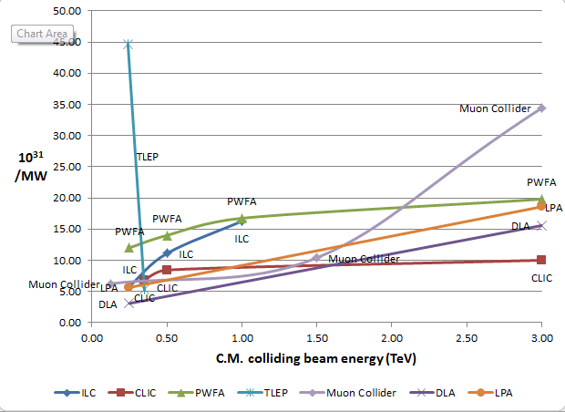
J-P. Delahaye
Luminosity
Metric:
N_{det} × L_{avg} / P_{tot}

Slide 46
Conclusions II
The necessity of US engagement in the ongoing LHC program is clear
As is maintaining global connections if the next collider facility is off-shore
At the same time we cannot ignore other elements of the US HEP program
  Investing in our domestic facilities which support non-collider portions of HEP
  Maintaining a robust R&D program which benefits both our global connections and can open the door to additional world class capabilities in the US
  And continue to train the experts to support the next generation of facilities

