Slide 1
Higgs Couplings at the ILC
Tim Barklow (SLAC)
On behalf of the ILC Higgs White Paper Authors:
D. Asner, T.B., K. Fujii, H.E. Haber, S. Kanemura, A. Miyamoto, G. Weiglein
July 2, 2013

Slide 2
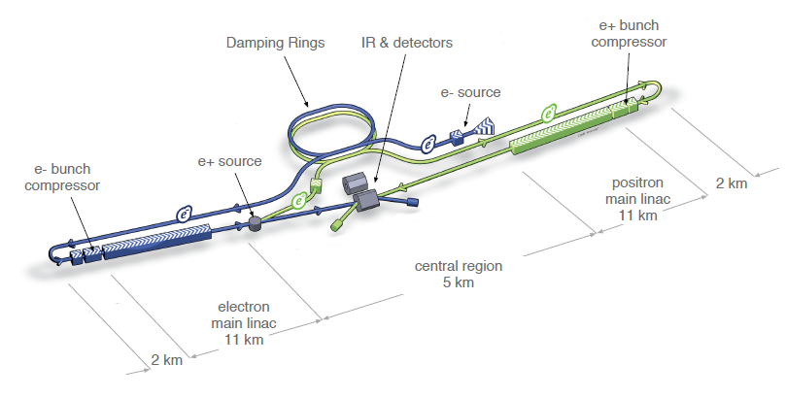
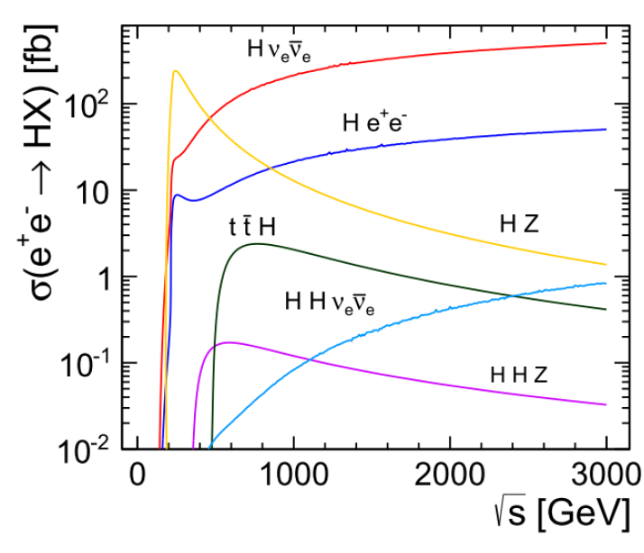

Slide 3
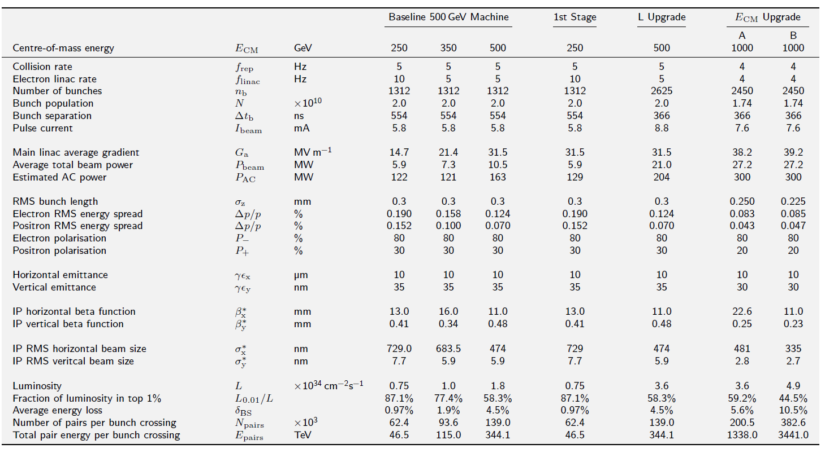
ILC Accelerator Parameters from TDR

Slide 4
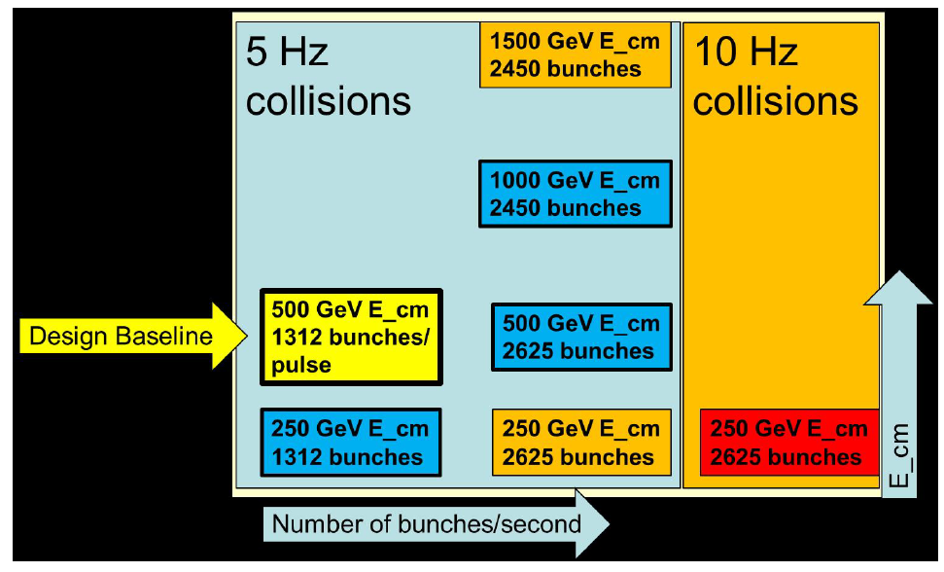
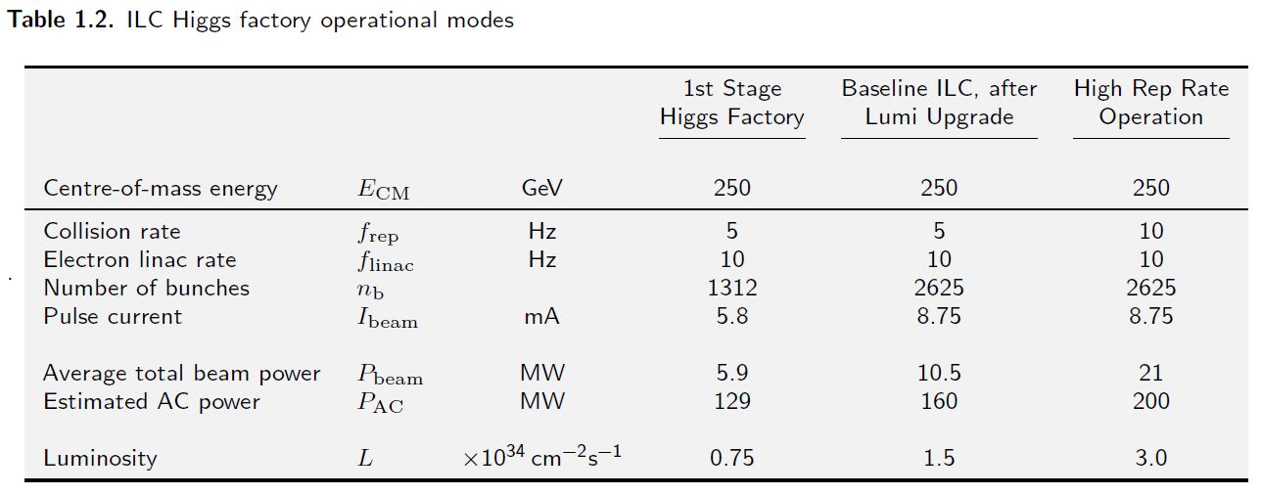
Lumi Upgrade at Ecm=250 GeV*
* not in TDR – private communication from Marc Ross and Nick Walker

Slide 5
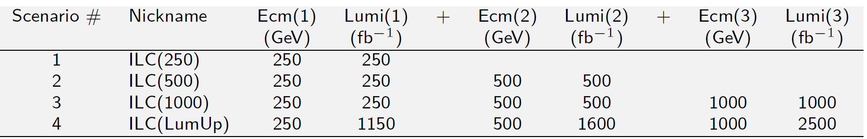
Energy/Lumi Scenarios
Each scenario corresponds to accumulated luminosity at a certain point in time.
Assumption: run for 3X10⁷ s at baseline lumi at each of Ecm=250,500,1000 GeV, in that order. Then go back and run for 3X10⁷ s at upgrade lumi at each of Ecm=250,500,1000 GeV.

Slide 6
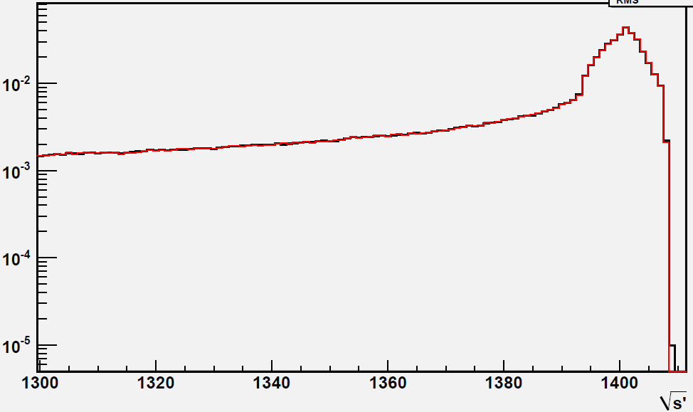
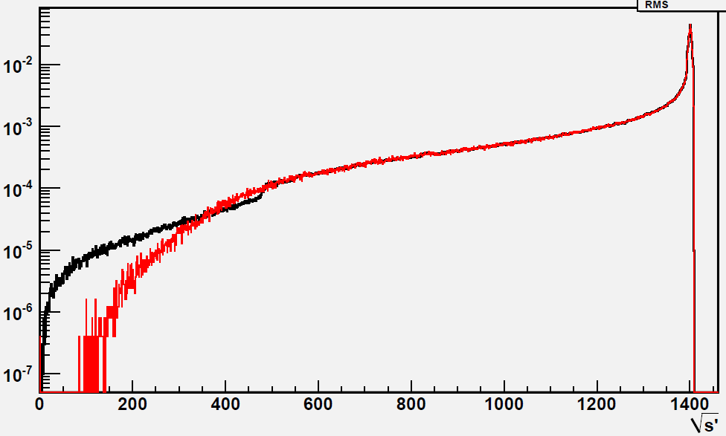
Beamstrahlung
Guinea-Pig
VEGAS MC Integration

Slide 7
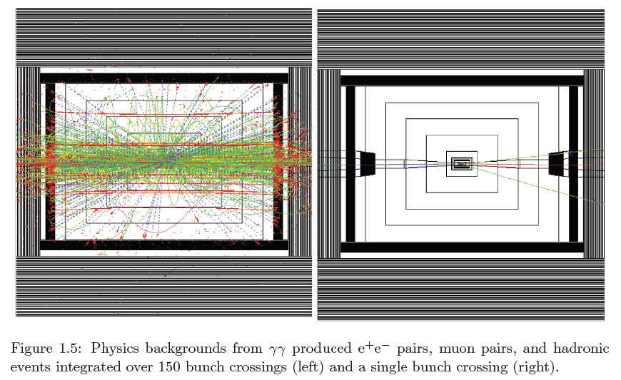

Slide 8
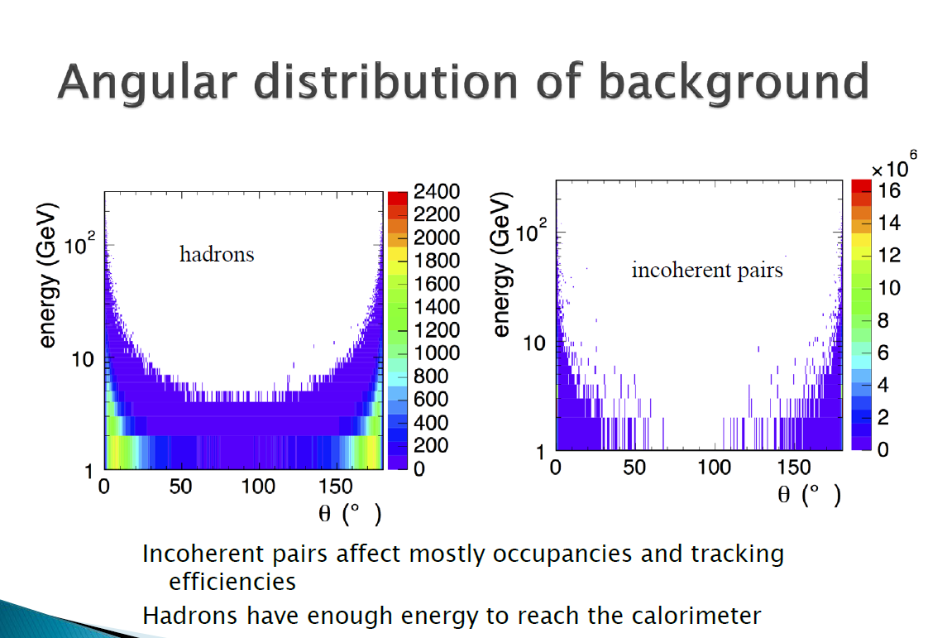

Slide 9
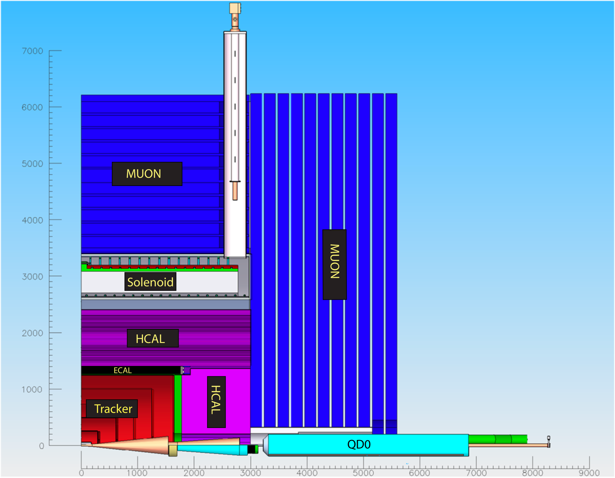
The SiD Detector

Slide 10
SiD Global Parameters

Slide 11
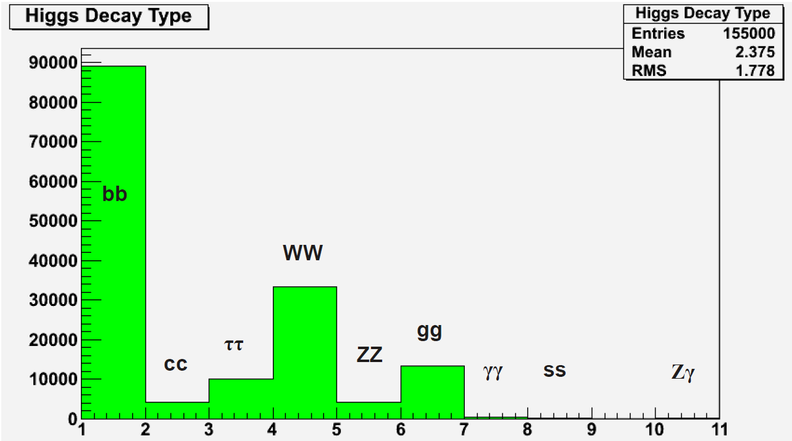
SM Higgs decay mode histogram M_{H}=125 GeV
μμ

Slide 12
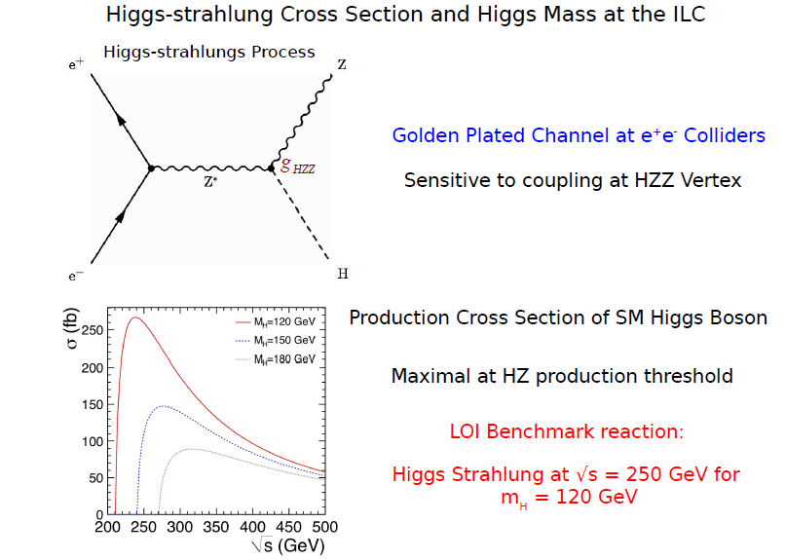
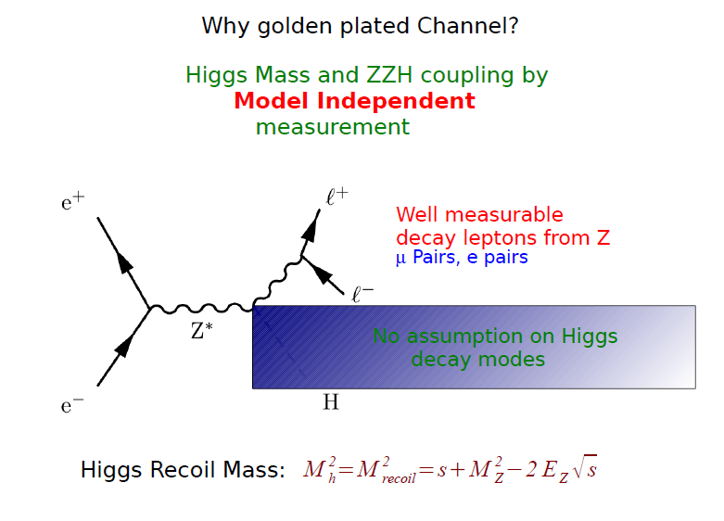

Slide 13
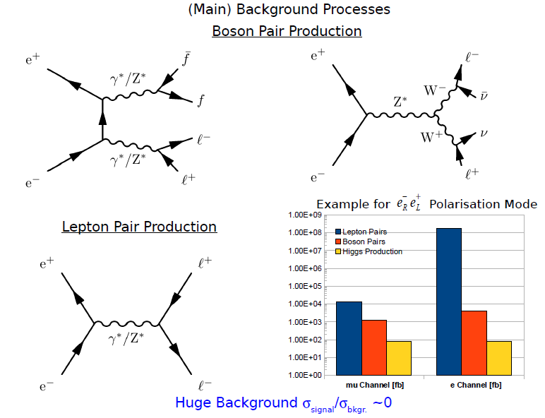

Slide 14
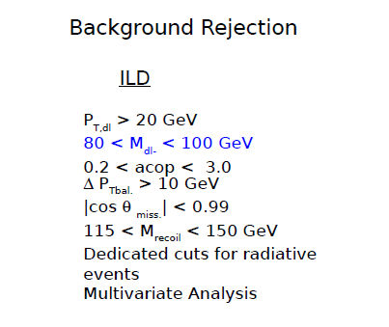

Slide 15
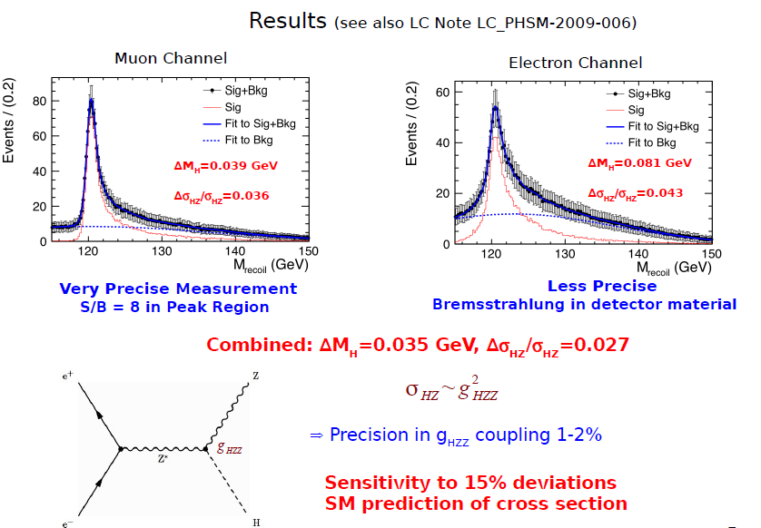

Slide 16
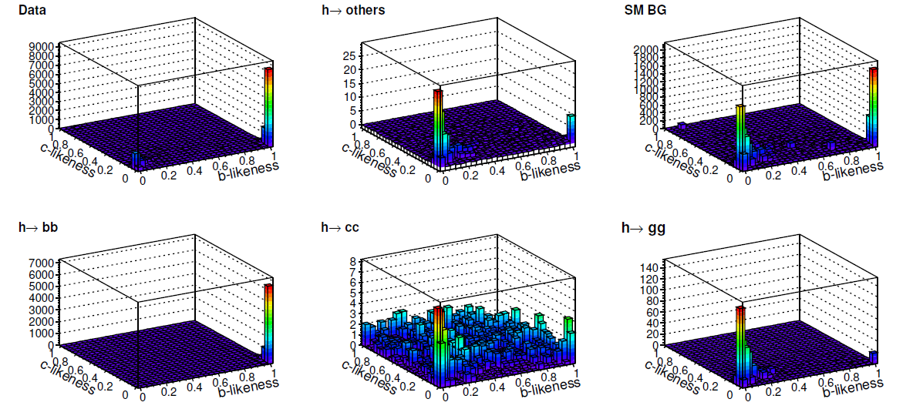

Slide 17
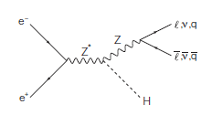
Invisible Higgs Decay
In the SM, an invisible Higgs decay is H → ZZ* →4ν process and its BF is small ~0.1%
If we found sizable invisible Higgs decays, it is clear new physics signal.
  The decay products are dark matter candidates.
At the LHC, one can search for invisible Higgs decays by using recoil mass from Z or summing up BFs of observed decay modes with some assumptions.
  The upper limit is O(10%).
At the ILC, we can search for invisible Higgs decays using a recoil mass technique with model independent way!
  e+e- → ZH
known
measured

Slide 18
Signal and Backgrounds
Signal
  Pseudo signal : e⁺e⁻ → ZH, Z→qq, H→ZZ*→4ν
Backgrounds
  found qqll, qqlν and qqνν final states are the dominant backgrounds.
    other backgrounds also studied
  ZZ semileptonic : one Z→qq, the other Z→ll, ν_{μ}ν_{μ}, ν_{τ}ν_{τ}
  WW semileptonic : one W→qq, the other W→lν
  Zν_{e}ν_{e}, Z→qq
  Weν_{e}, W→qq
  ννH, generic H decays
  qqH, generic H decays
  Polarizations of P(e+,e-)=(+30%,-80%), (-30%, +80%)
    Throughout the slides, denoted as “Left” and “Right” polarizations

Slide 19
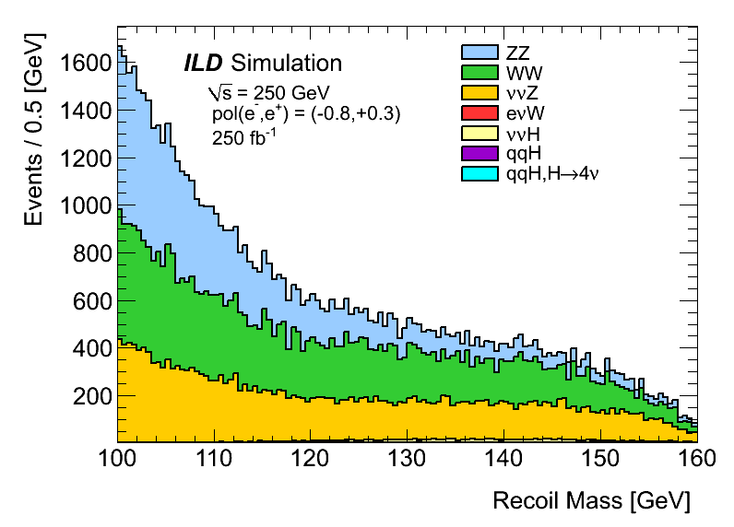
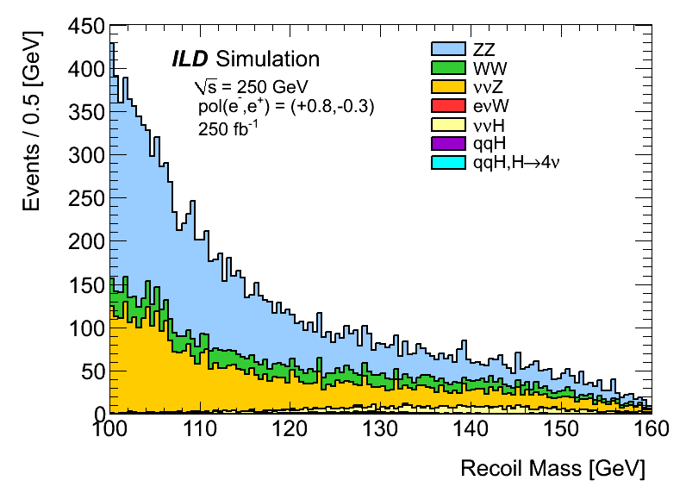
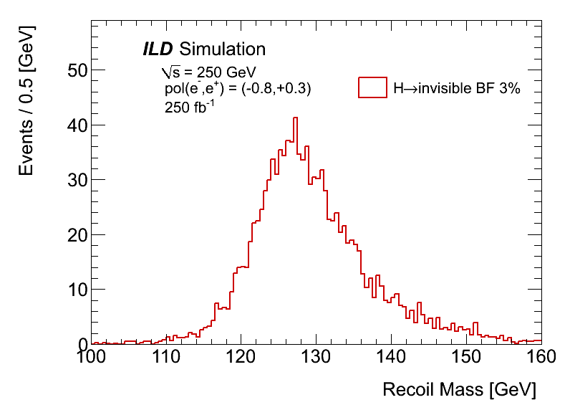
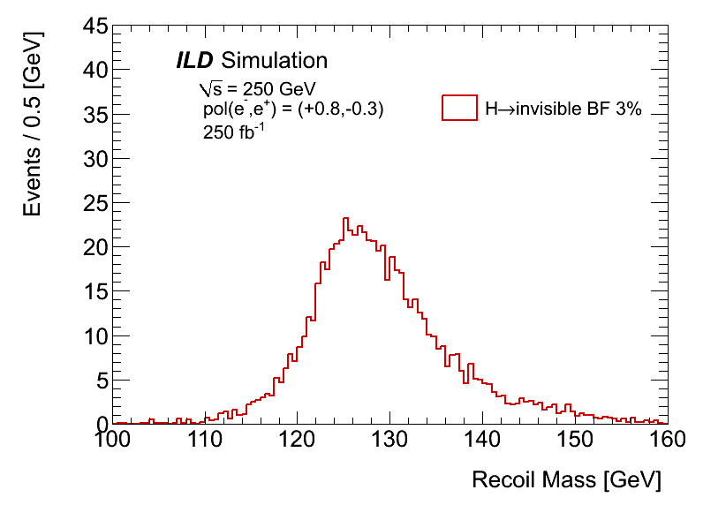
Final Recoil Mass
Dominant backgrounds are ZZ, WW, ννZ
“Left”
“Right”
“Left”
“Right”

Slide 20
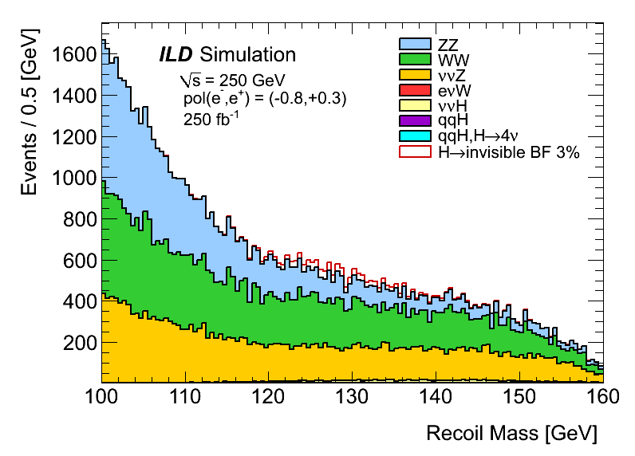
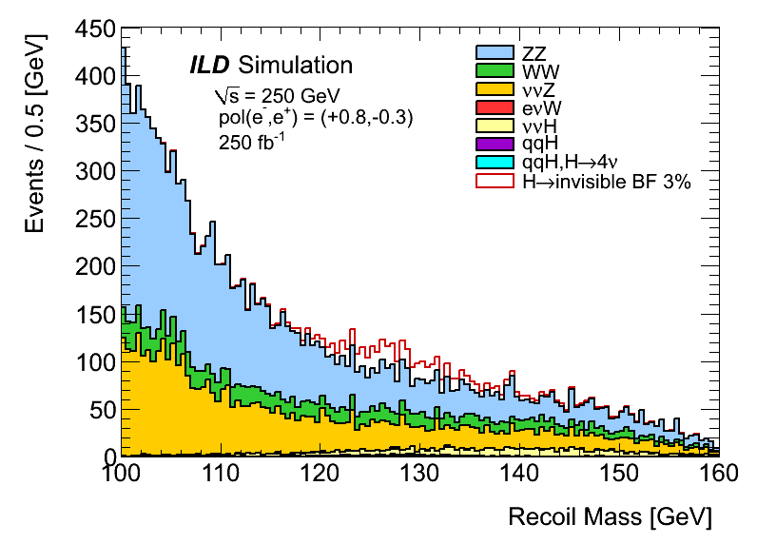
Signal Overlaid
If BF(H→invisible) = 3%
  Signal is clearly seen for “Right” polarization
“Left”
“Right”

Slide 21
Toy MC
Toy MC are performed to set upper limits on the BF
  In the fitting to M_{recoil}, Only yields for signal and backgrounds are floated.
    The backgrounds include a peaking ZH, H→4ν component
  10000 pseudo experiments for each polarization
The results with 250fb⁻¹
  “Left” polarization : BF (H→invisible) < 0.95% @ 95% CL
  “Right” polarization : BF (H→invisible) < 0.69% @ 95% CL
    The invisible does not include a H→ZZ*→4ν final state.
  If 1150fb⁻¹ data is accumulated, 0.44% and 0.32% for “Left” and “Right”
The “Right” result is consistent with fast simulator results I presented at ECFA@DESY
  BF < 0.7% @ 95% CL
From a crude toy MC scan, 5σ observation down to 2.8% and 2.0% for “Left” and “Right”, respectively.
  Need much more toy MC events.

Slide 22
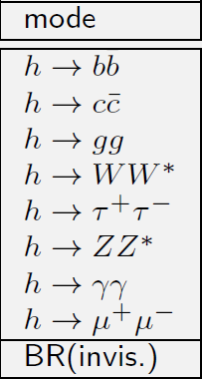
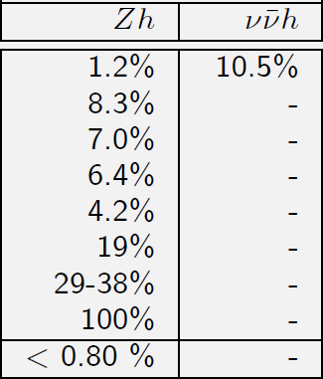
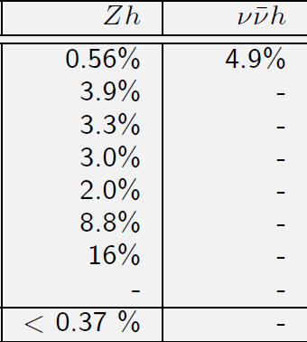

Slide 23
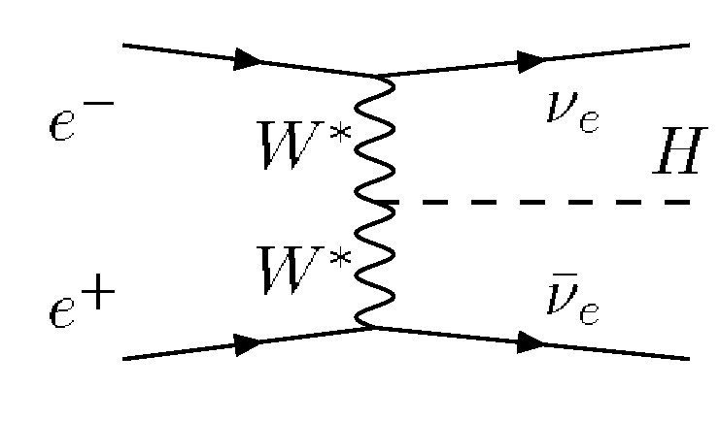
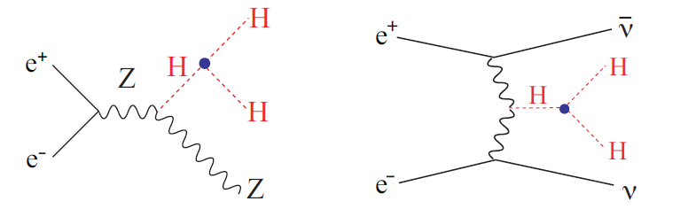
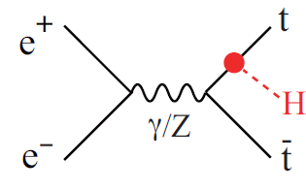

Slide 24
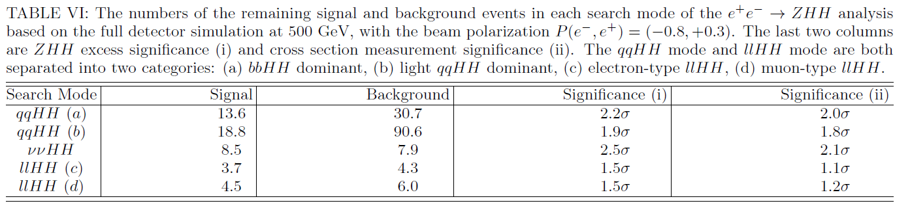

Slide 25
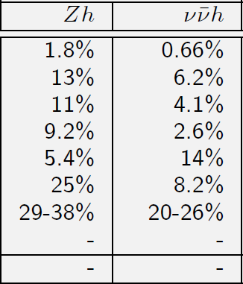
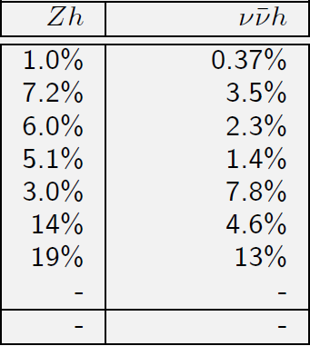

Slide 26
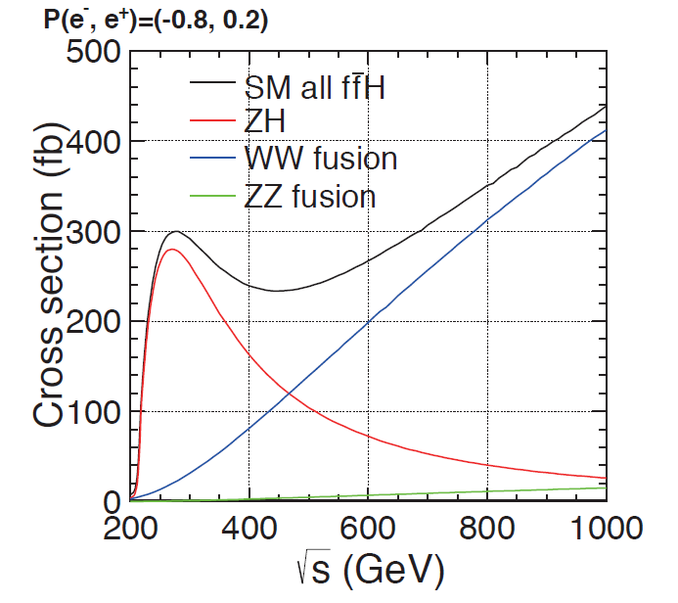
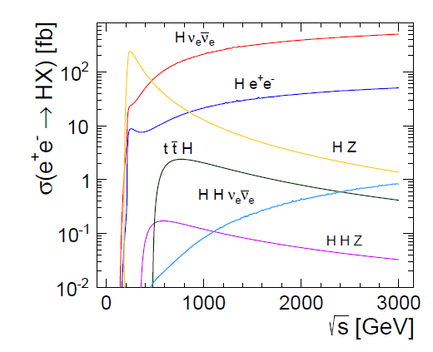

Slide 27
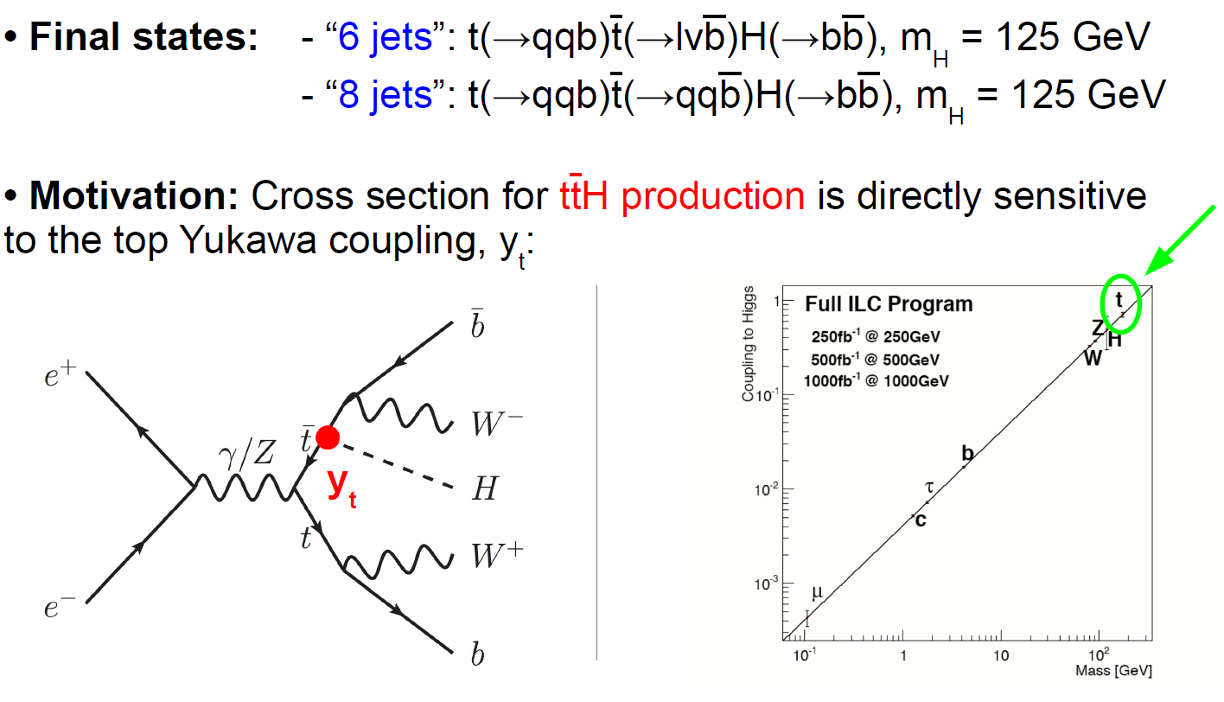
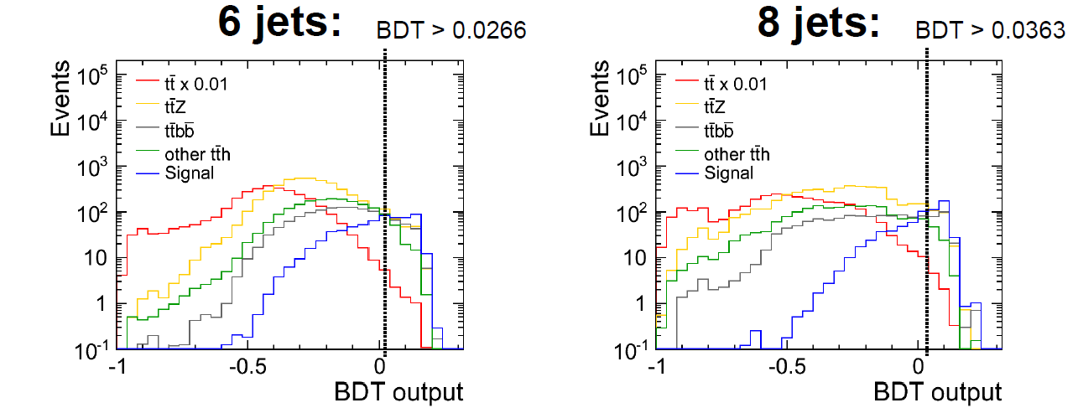
Top Yukawa Coupling at Ecm=1000 GeV

Slide 28
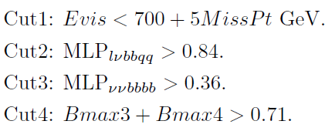
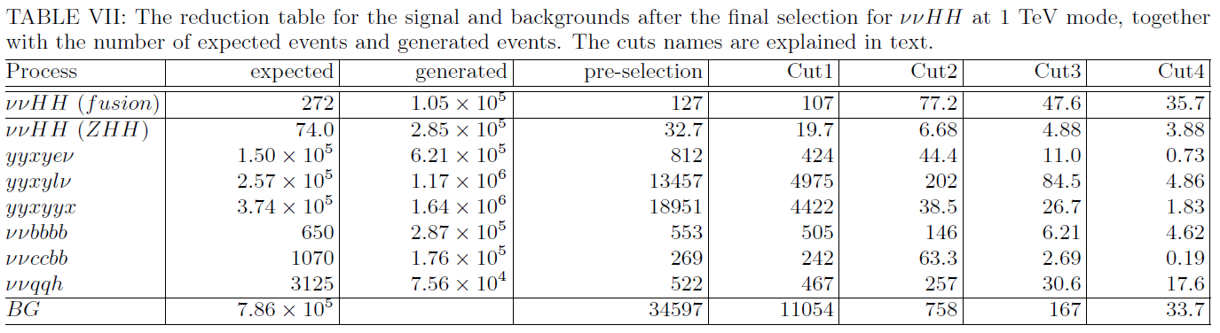

Slide 29
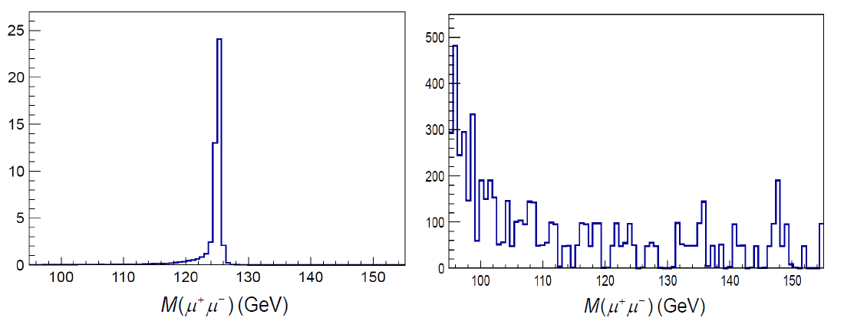
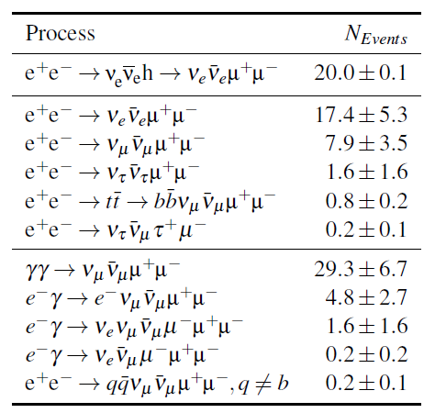

Slide 30
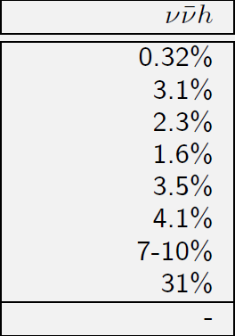
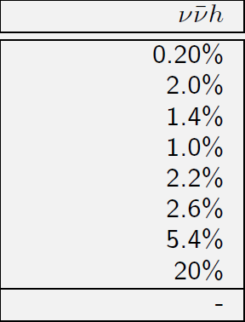

Slide 31
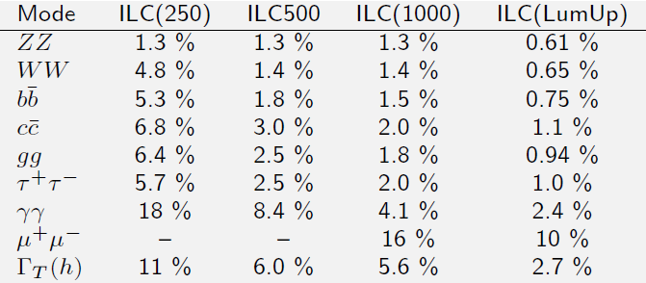

Slide 32
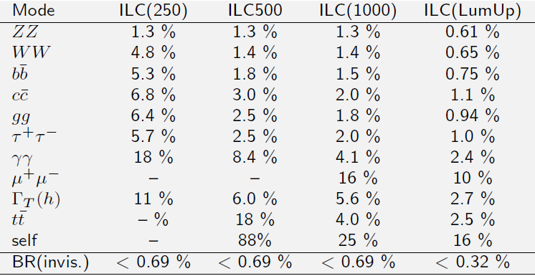

Slide 33
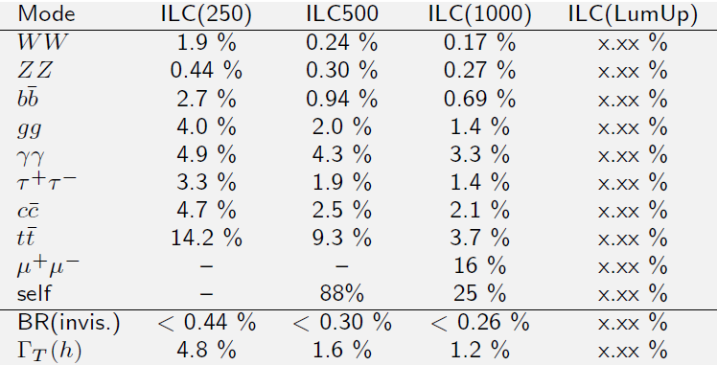

Slide 34
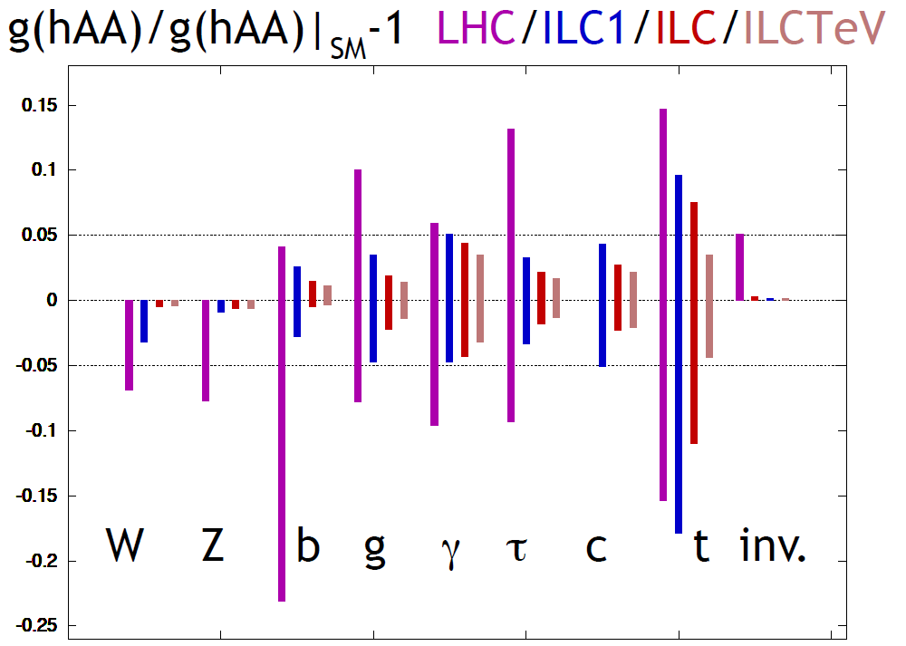

Slide 35
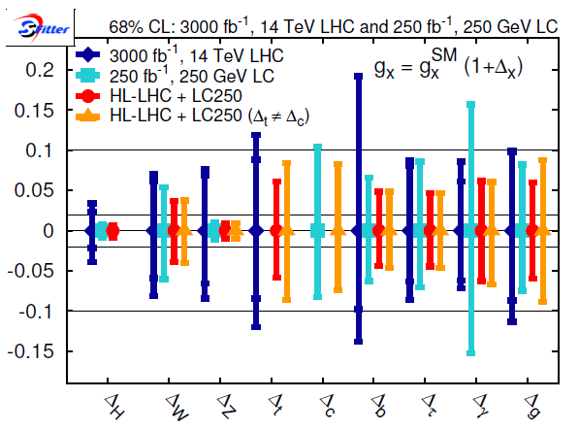
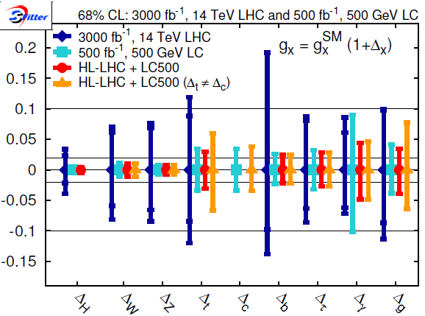

Slide 36
Summary

