Slide 1
A pp and an e+e- Collider in a 100 km ring at Fermilab
VLHC/VLEP
Pushpa Bhat
Fermilab
& C.M. Bhat, W. Chou, E. Gianfiece-Wendt, J. Lykken, M. Medina, G.L.Sabbi, T. Sen, R. Talman
July 25-26, 2013
TLEP Workshop, Fermilab

Slide 2
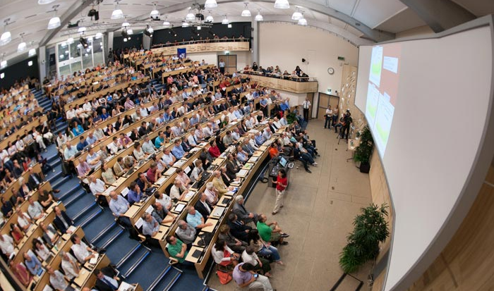
A year ago on July 4th

Slide 3
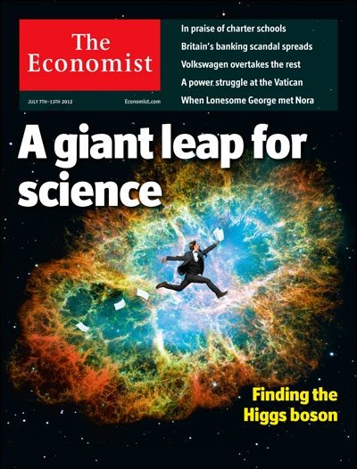
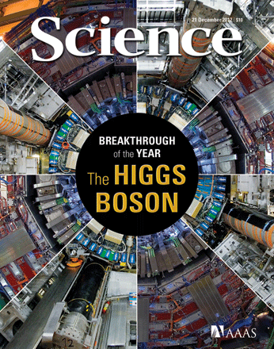
3
Notes:
This summer Fabiola Gianotti of ATLAS and JI of CMS announced the simultaneous observations of a new boson in our respective experiments on July 4th.
It appears to be a Higgs boson. It has been 48 years….

Slide 4

Discovery of the new Millennium
The Higgs Boson
Is it the last missing piece? OR
Is it the harbinger of new physics?
Does it fully explain EWSB?
Is it elementary or composite?
Are there more Higgses?
…

Slide 5

So far so good.. hoping for better!
Thanks to the discovery, the world HEP community is excited, interest in future energy frontier colliders has been reignited, and some old shelved ideas are finding new life.
The LHC data, so far, indicate that the new particle has properties consistent with a SM Higgs boson. But its measured mass is tantalizingly consistent also with an SM-Higgs-like boson from new physics beyond the SM.
We are where we had suspected to find ourselves – a low mass SM-like Higgs found, and nothing else! So far. But, that could change!
5

Slide 6
Physics at the Terascale
To fully elucidate EWSB and understand the Terascale landscape
  Study the Higgs boson that has been found (Mass, width, spin-parity, couplings)
  Search for other physical states at higher mass scales
    Evidence for SUSY, extra dimensions, heavier gauge bosons W’, Z’, heavier fermions, ..
  Measure vector boson scattering and couplings
    Longitudinal vector boson scattering and VBF production
An e+e- collider would be a nice complement to the LHC. A hadron collider at ~100 TeV would be a lot more useful!
6

Slide 7
The Case for a VLHC
Hadron colliders with their broad-band parton collision energies are Discovery Machine, and can make precision measurements!
Historically, each time collision energy of hadrons went up significantly, we have discovered new particles.
Top quark discovered at the Tevatron, after searches at SLC and LEP! And, Higgs discovery came at the LHC.
However, since we have not found any new physics at √s = 8 TeV, if we do find new physics at 13-14 TeV it is likely to be at the limit of LHC reach. (Low hanging fruits?)
“Regardless of what we will ﬁnd at the LHC we will eventually want to have a hadron collider operating in the 100 TeV range.” - U. Baur, HEPAP subpanel, June 2001

Slide 8
The Case for a VLHC
If some new physics is found at the LHC at 13-14 TeV, then it makes a lot more sense to take a big jump in energy (~an order of magnitude) rather than a small one (~x2)
  If some heavy “partner” particles are found, VLHC can find the full suite of partners (SUSY)
  If exotic resonances are found, VLHC can fill out the “tower” of resonances, confirming extra dimensions
  Complete measurements of vector boson scattering, explore fully the mechanism of EWSB, and SUSY breaking if SUSY is found
Higgs Boson:
  VLHC would enable precision measurements of the Higgs including Higgs self-coupling, and rare decays of the Higgs!
VLHC has direct discovery potential in 10’s of TeV range
8

Slide 9
Some History
US HEP/AP Community has been through some phases of “design” and “construction” for 80 – 500 km machines, in the past three decades.
  SSC was going to be 87.1 km in circumference, and √s = 40 TeV. 23 km tunnel bored and 17 shafts in Texas. $2B spent!
    Conception: Snowmass 1983, Design: 1988-90; Construction initiated: 1988, Halted: 1993.
  “VLHC”(1995 -2005) in various incarnations – Primarily 233 km; E_{CM} from 40 TeV (Stage 1) – 200 TeV (Stage 2) . http://vlhc.org/
  Also considered VLLC (Very Large Lepton Collider) in VLHC tunnel
  Pipetron: Low Cost Approach to a VLHC, To achieve > 100 TeV E_{CM} collider at the lowest possible $/TeV
Many workshops, machine/physics/detector studies, HEPAP, VLHC steering committee, etc., R&D for magnets and many other aspects.
9

Slide 10
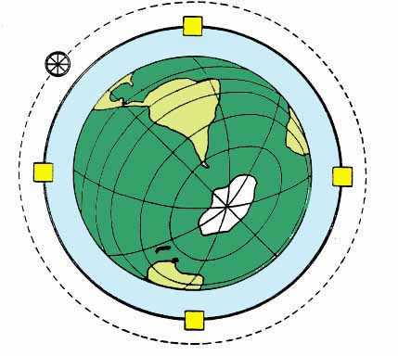
Very Large Hadron Collider at Fermilab
Design Study for a two-stage Very Large Hadron Collider
vlhc.org
FNAL-TM-2149
(2001)
10

Slide 11
VLHC in 2001
Take advantage of the space and excellent geology near Fermilab.
  Build a BIG tunnel.
  Fill it with a “cheap” 40 TeV collider.
  Later, upgrade to a 200 TeV collider in the same tunnel.
11

Slide 12
233 km VLHC
Lake
Michigan
90-150 m deep
73km
Illinois Galena-Plattville dolomite layer is excellent geology for TBMs
Chicago
12

Slide 13
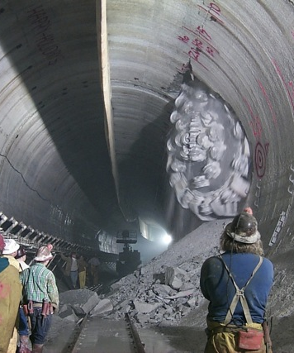
Site studies in Illinois
We know a lot about the geology and tunneling in Illinois.
  Thick, homogeneous dolomite at a depth of 300 – 500 ft
  The Chicago TARP (Tunnel and Reservoir plan): 176 km of tunnel (9 - 33 ft in dia, up to 350 ft underground) completed
  Studied for SSC, VLHC, ILC,..
Many siting options for large rings have been studied.

Slide 14
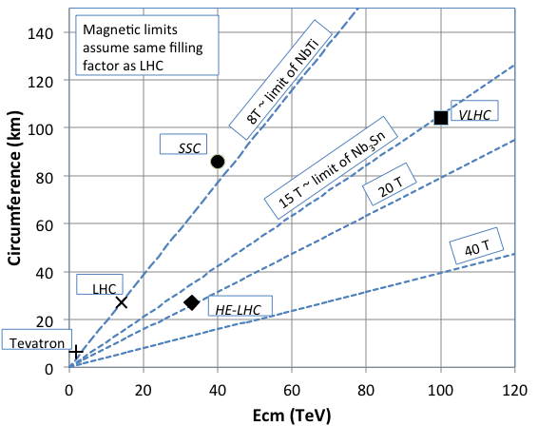
VLHC (2013)
Use high field (~15 T)
Superconducting magnets
in a 100 km ring for a
100 TeV pp collider
http://arxiv.org/pdf/1306.2369v1.pdf
And/OR host a 240-350 GeV
VLEP in 100 km tunnel
Combine the efforts: TLEP/VHE-LHC/VLHC/VLEP
14

Slide 15
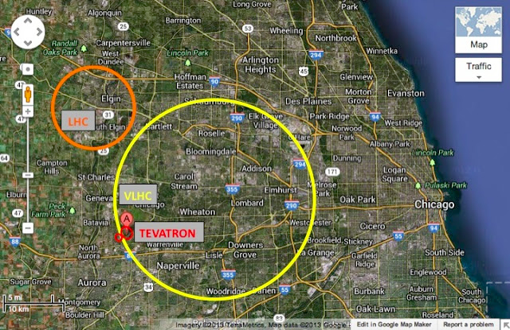
100 km ring for VLHC/VLEP
http://arxiv.org/pdf/1306.2369v1.pdf
PhysicsCentral Blog
http://www.physicscentral.com/buzz/blog/index.cfm?postid=4835100616060881541
15

Slide 16
Back-up

Slide 17
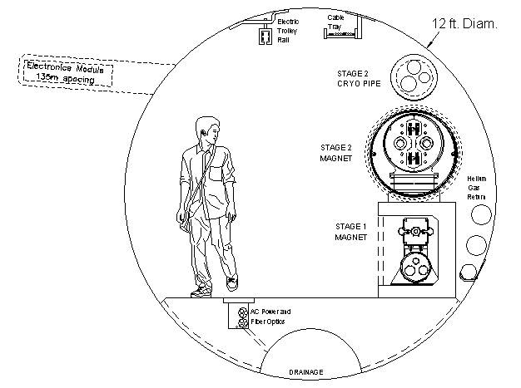
VLHC (2001) Tunnel Cross Section
A lot of experience from Chicago Deep Tunnel project (~90 mi of deep tunnels) and TARP project
Summarized by CMA firm in cost and schedule estimate
12’ dia tunnel 233km + shafts+EDIA, no cont =2B$ (9k$/m)
16’/12’=1.25 in cost
~60 wks construction (4m/hr 16 TBMs)
R&D proposed to redu-ce the cost (roboTBM)

Slide 18
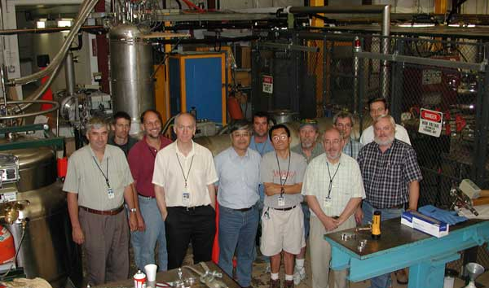
VLHC.org

Slide 19
What’s done by 2005
Tunnel cost and schedule exercise by CMA firm
Transmission line design
100kA power supply and HTS leads built, QPS
104kA transmission line test in MP6
Superferric magnets designed & optimized
14 m of SF magnets built and tested
Good accelerator quality B-field measured at inj energy up to 1.96T
Collider Phase I designed (ZDR)
Many AP issues addressed (e.g.instabilities)
Thorough bottoms-up cost estimate
Shiltsev
2007

Slide 20
Transmission Line Magnet
vacuum chamber
SC transmission line
warm iron and vacuum system
superferric: 2T bend field
100kA Transmission Line
alternating gradient (no quads)
65m Length
30cm support tube/vacuum jacket
100kA return bus
cryo pipes

Slide 21
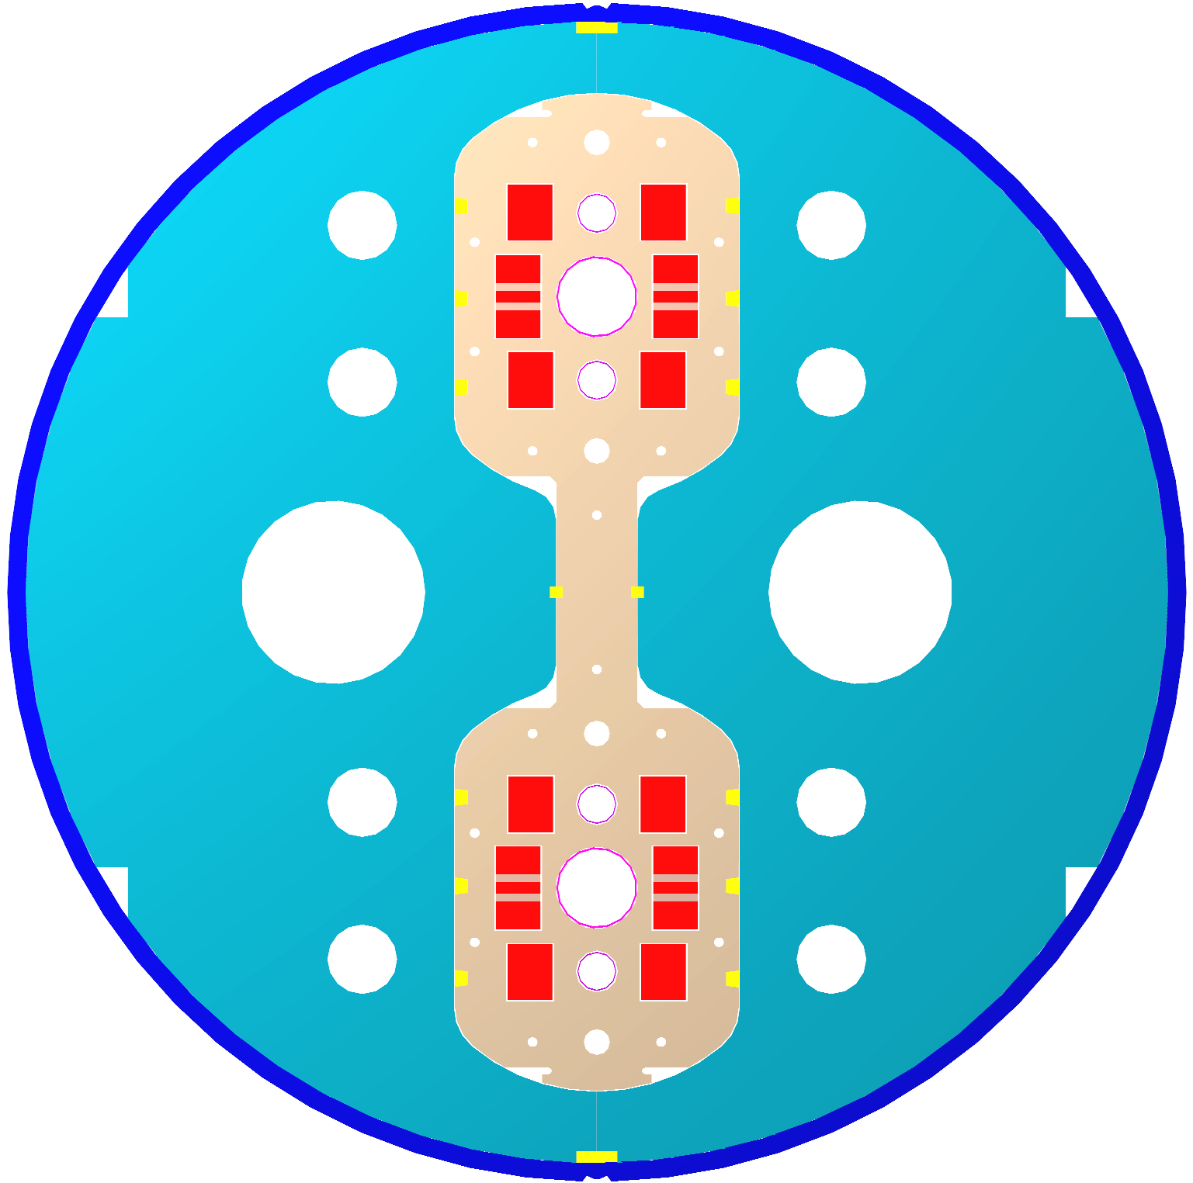
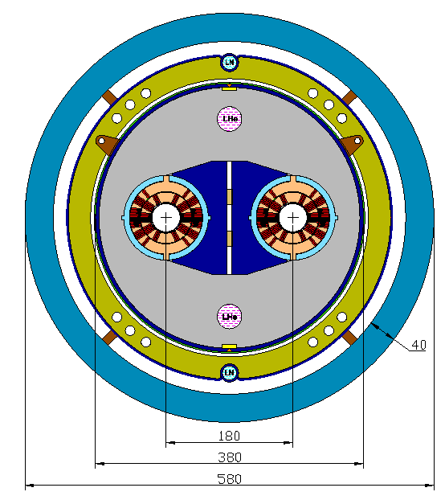
Stage-2: 10T+ Magnets
There are several magnet options for Stage 2. Presently Nb₃Sn is the most promising superconducting material, e.g. LHC IR Upgrade magnets are being developed by US LARP
Stage-2 Dipole Single-layer common coil
Stage-2 Dipole Warm-iron Cosine Θ

Slide 22
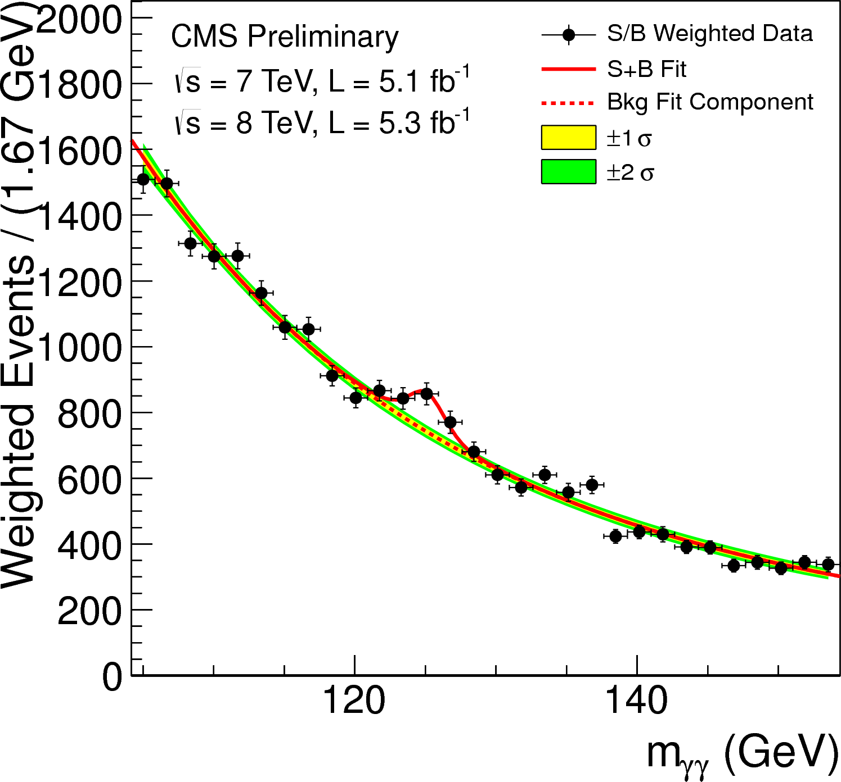
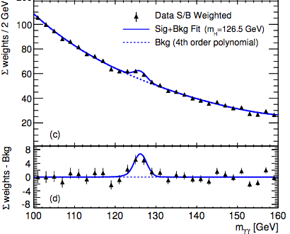
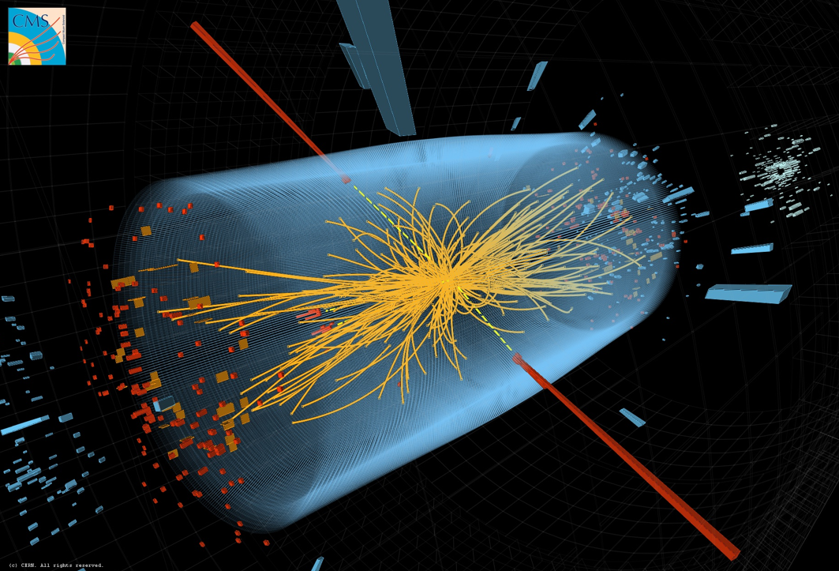
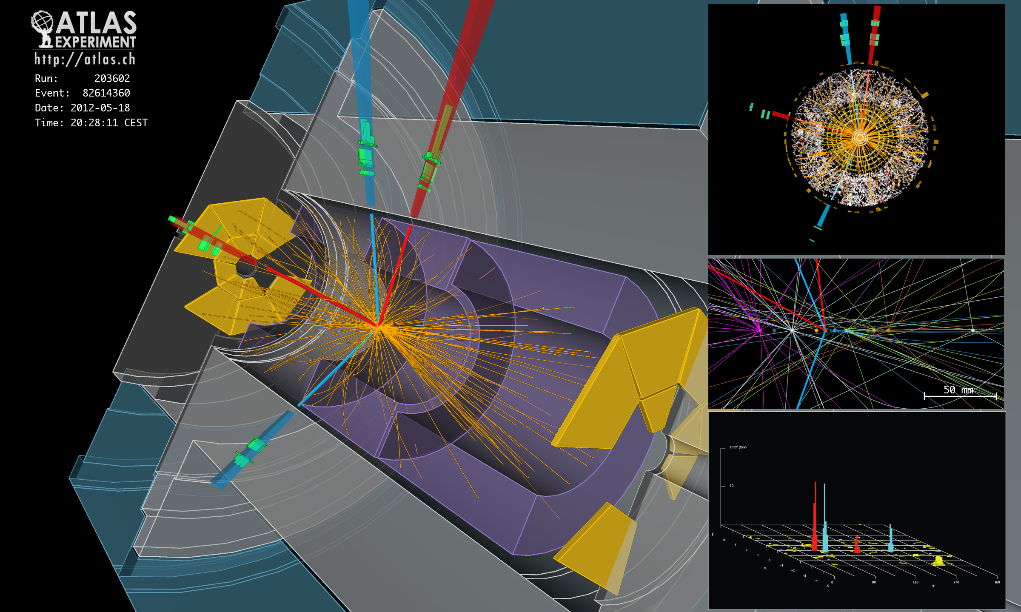
Discovery of the new Millennium

Slide 23
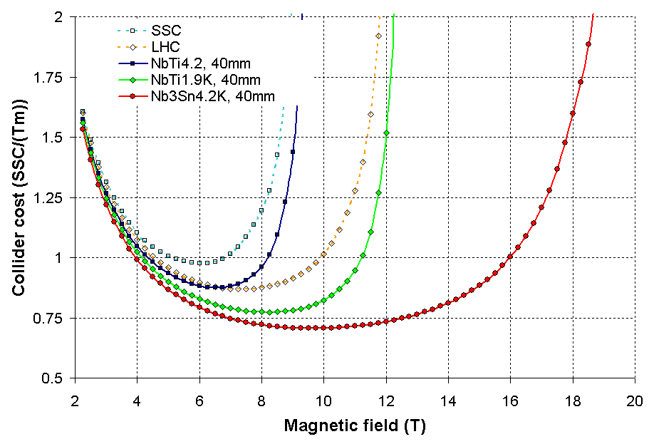
Cost based on SSC estimates
P. Limon
VLHC2001

Slide 24
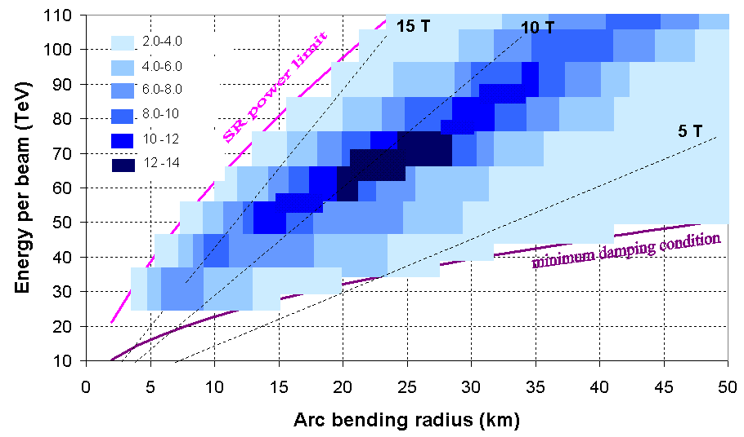
Optimum Magnetic Field
P_{SR}<10 W/m/beam peak t_{L} > 2 t_{sr} Int/cross < 60 L units 10³⁴ cm⁻²s⁻¹
P. Limon
VLHC2001
  The optimum magnetic field for a 100-200 TeV collider is less than the highest field strength attainable because of synchrotron radiation, total collider cost and technical risk → smaller circumference may not be optimal.

