Slide 1
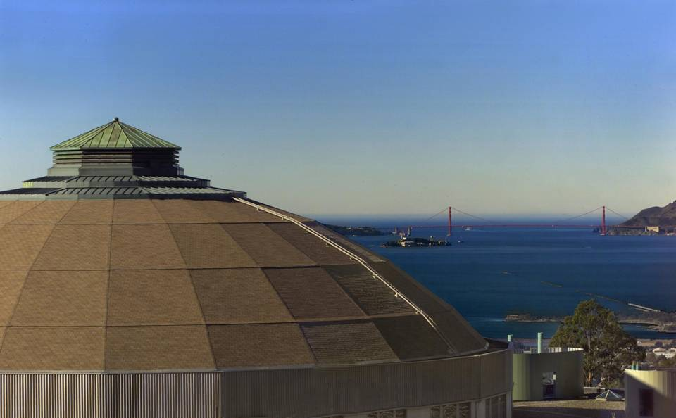
TLEP13 – Fermilab
July 25, 2013
ALS Brightness Upgrade and ALS-II
  Christoph Steier, Hamed Tarawneh, Weishi Wan
  Lawrence Berkeley National Laboratory
  B. Bailey, A. Biocca, A. Black, K. Berg, D. Colomb, N. Li, S Marks, H. Nishimura, A. Madur, E. Norum, C. Pappas, G. Portmann, S. Prestemon, A. Rawlins, D. Robin, S. Rossi, F. Sannibale, T. Scarvie, R. Schlueter, C. Sun, E. Williams, LBNL
  L. Yin, Q. Zhou, J. Jin, J. Zhan, C. Chen, Y. Wen, SINAP

Slide 2
Outline
Introduction - ALS Upgrades
Brightness Upgrade
Future directions (ALS-2)
An attempt using FODO lattice
Summary
2

Slide 3
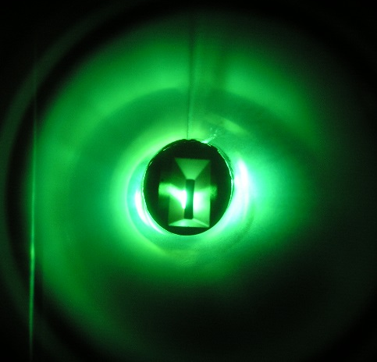
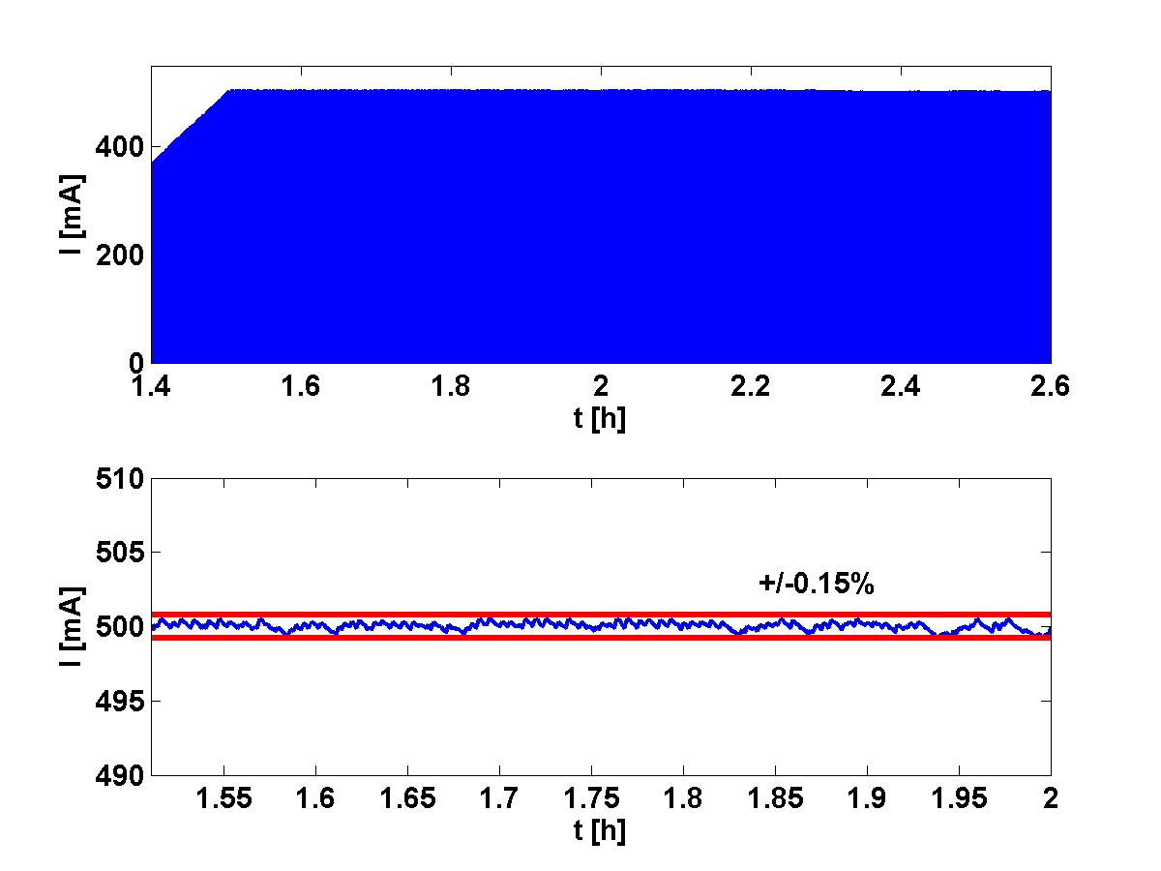
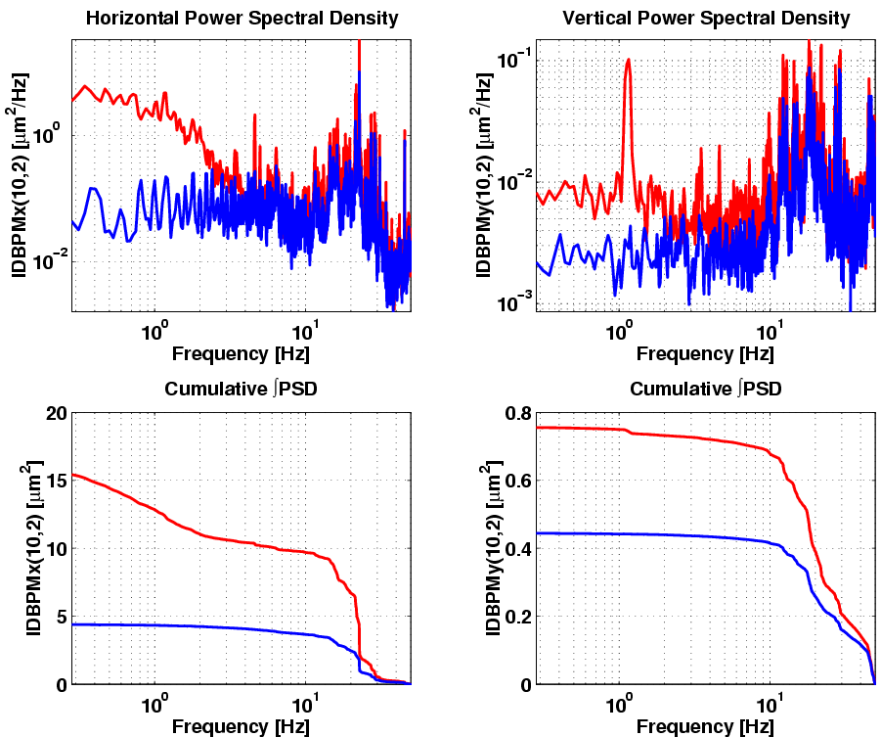
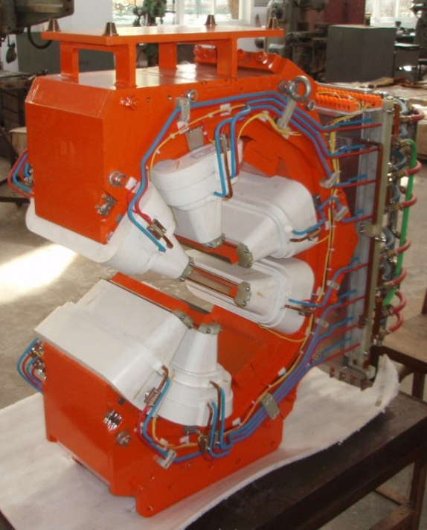
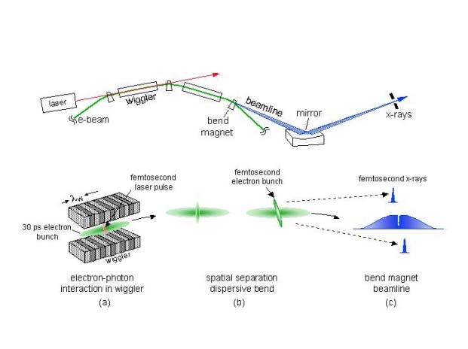
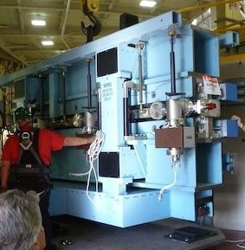
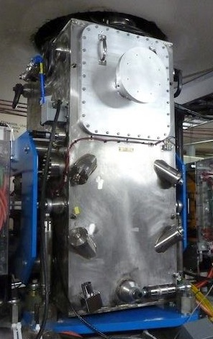
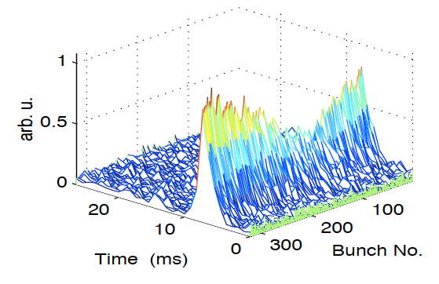
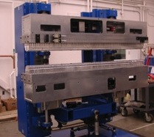
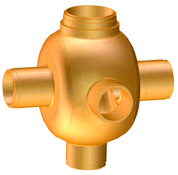
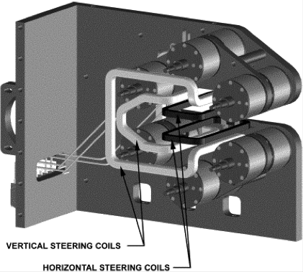
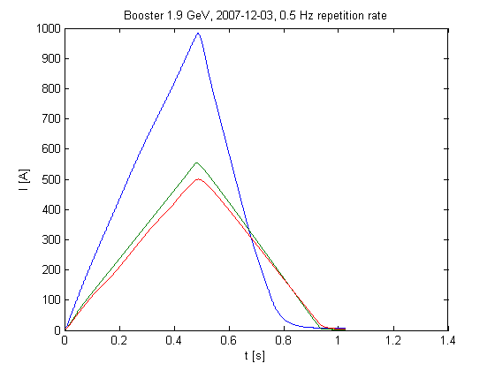
ALS Accelerator Upgrade Timeline
Future
1993
1995
1997
1999
2001
2003
2005
2007
2009
2011
2013
Expanded spectral range
1.5 – 1.9 GeV
Reduced vertical
Beta function
Improved Coupling Control
Brightness, Stability
First Light to users
Diffraction Limited
Upgrade
Fast Orbit Feedback
Submicron orbit stability
Brightness Upgrade
2.0 nm horiz. emittance
Fs-slicing
Bend magnet/Undulator
Broadband Multibunch
Feedbacks
Continuous ID improvements:
Planar, EPU, IVU, Canting/Chicaned
Harmonic Cavities
Lifetime
Full Energy Injection
500 mA
Continuous Top-Off
Reduced vert. emittance
Superbends (hard xray)
Nb3Sn Undulators
3
Notes:
First User Operations
1.5 GeV to 1.9 GeV
Multibunch feedbacks
Added Insertion devices - starting with planer and then EPUS and canted straight, IVU
Harmonic Cavities
Lower vertical beta function lattice 8 - 9
Superbends extending to higher energy
Fast orbit feedback
Femto Beam Slicing
Coupling Control
Increasing the beam current from 400 to 500
Full energy injection and continuous Top-off injection, lower vertical emittance
Lower horizontal emittance lattice
Future ...

Slide 4
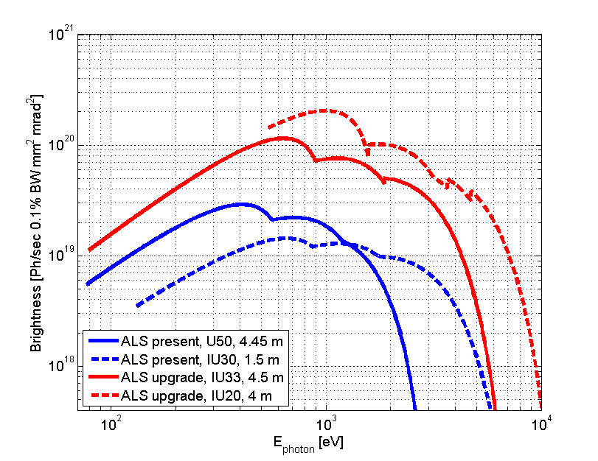
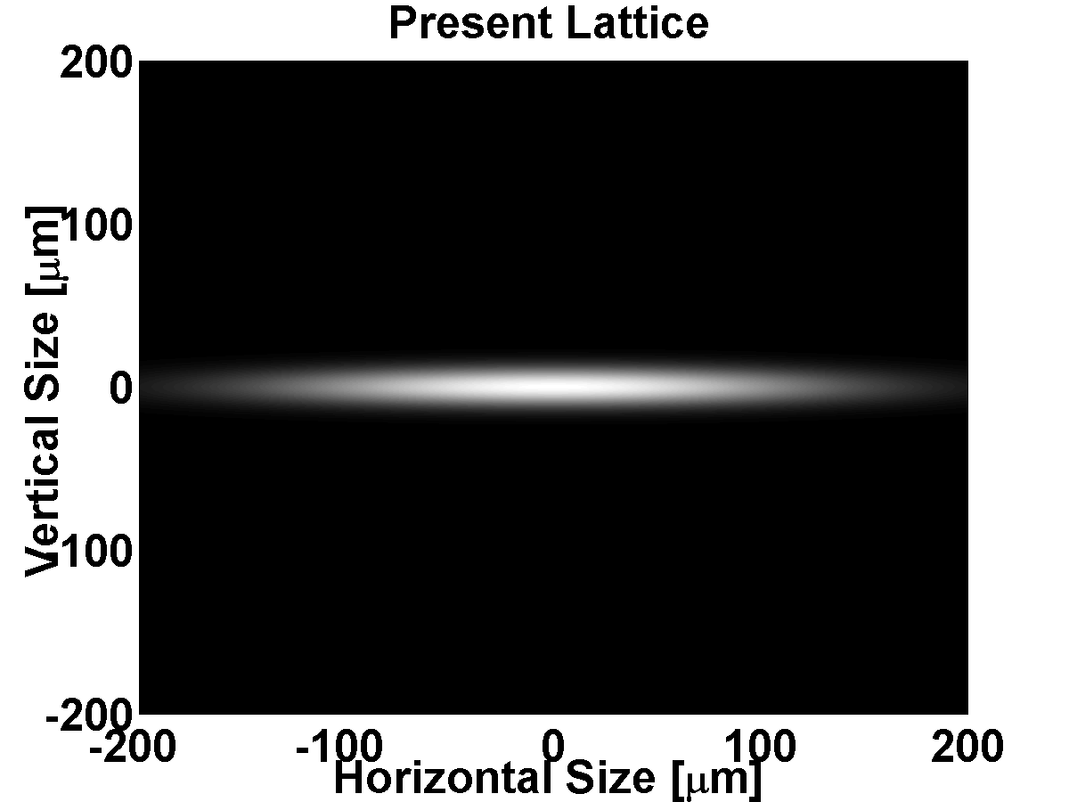
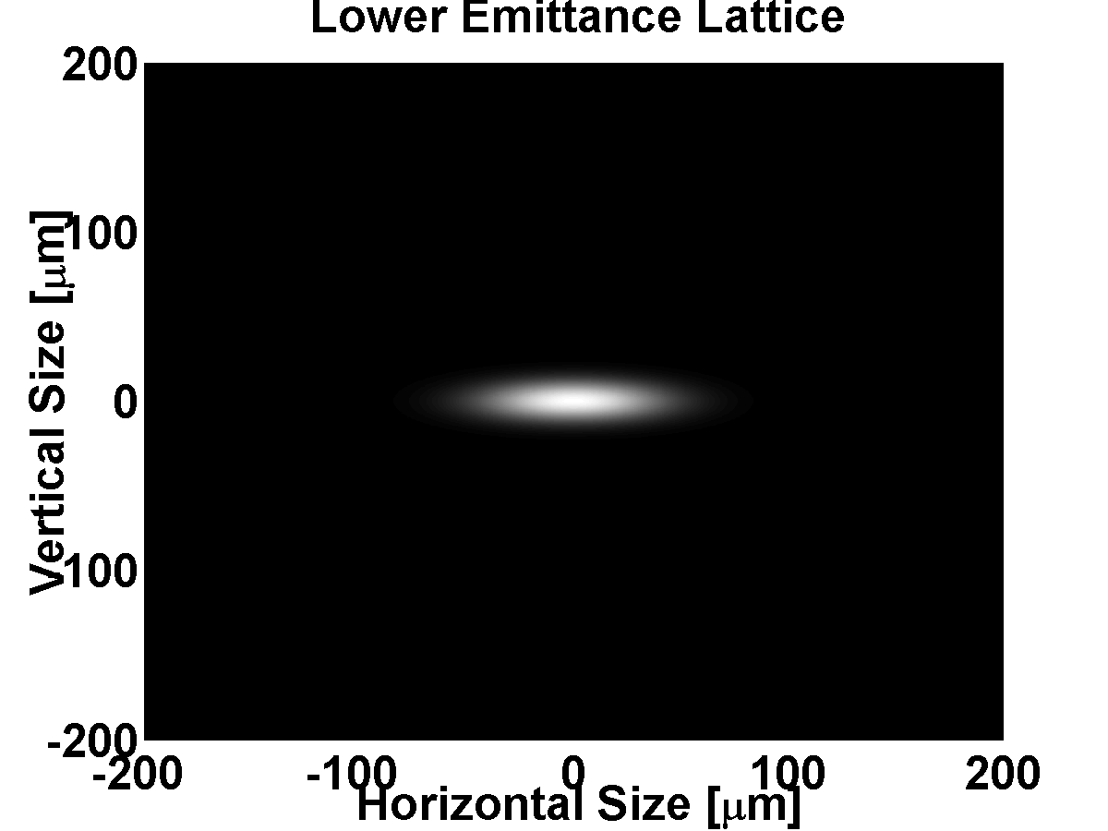
Brightness Upgrade
Scope
Replacement of the current 46 dipole corrector magnets with 48 combined function magnets (sextupole+HCM+VCM+skew), as well as associated power supplies, controls, interlocks, chamber modifications
Funding
ARRA project
Schedule
- Magnet RFP 6/2010
Magnet Installation 10/2012-3/2013
Migration to low emittance 4/2013
Superbend Sourcepoints
68 microns (FWHM)
223 microns (FWHM)
4

Slide 5
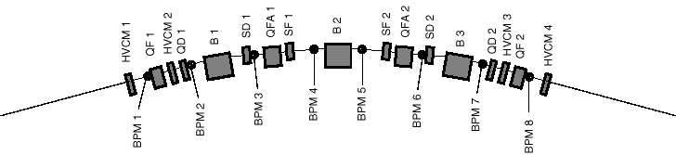
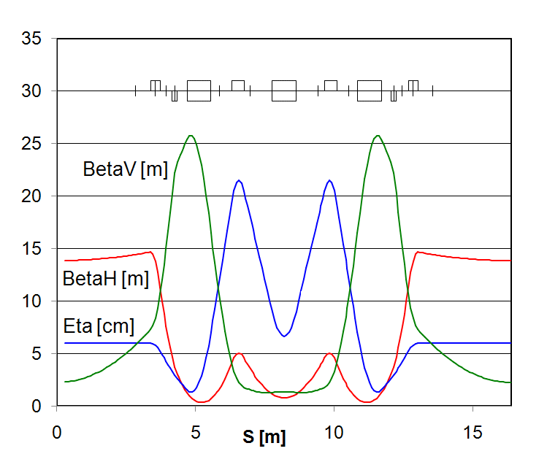
ALS Lattice
Half
Straight
Half
Straight
Arc
The ALS is an example of a low emittance lattice
It is a so called triple bend achromat and minimizes the dispersion at the location where synchrotron radiation is emitted (dipoles)
Those achromat lattices were the major advance in 3rd generation light sources
5

Slide 6
Why do we add sextupoles?
Reducing the equilibrium emittance is achieved changing settings of existing quadrupoles
Problem is nonlinear dynamics:
  Sextupoles are too weak to correct chromaticity
  Strengthening them would dramatically reduce dynamic aperture (lifetime, injection efficiency)
Need additional degrees of freedom
  ‘Harmonic’ Sextupoles
  ALS lattice already full – needed to replace existing corrector magnets with multi-magnets
Possibility for low alpha operation
  THz, short bunches
6

Slide 7
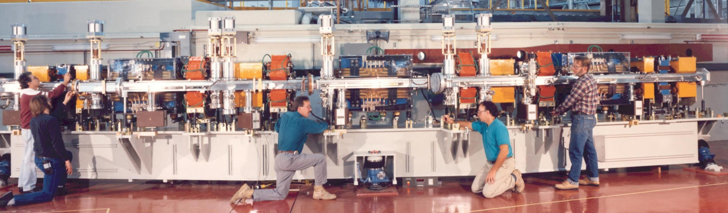
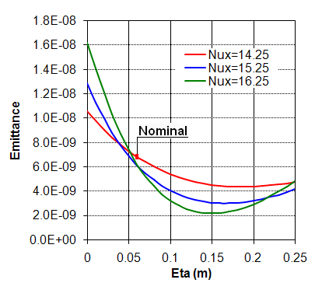
ALS Brightness Upgrade Project
Install New Sextupoles
Horizontal emittance is reduced to 1/3 from 6.3 nm rad to 2.0 nm rad
  Brightness inversely proportional
Completion in spring 2013
Of existing light sources, only PETRA-III has a lower emittance
H. Nishimura, et al.– Proceedings of the 2007 PAC Conf
C. Steier, et al., NIM A, DOI: 10.1016/j.nima.2010.11.077.
7

Slide 8
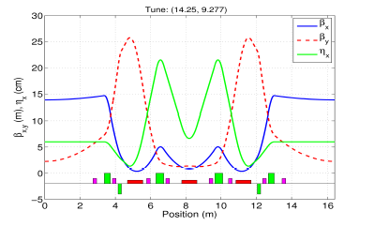
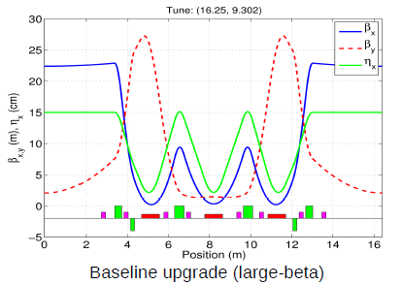
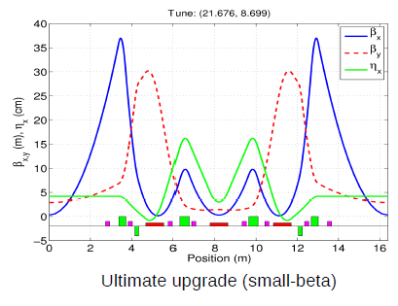
Lattices for ALS upgrade
Current Lattice
New Large β_{x} Lattice
New Small β_{x} Lattice
There are several possible lattices with ~2 nm rad emittance
  3x smaller than the nominal ALS (~6.3 nmrad)
Large β_{x} lattice optimizes brightness for the central bends
Small β_{x} lattice would optimize brightness for the insertion devices further
8

Slide 9
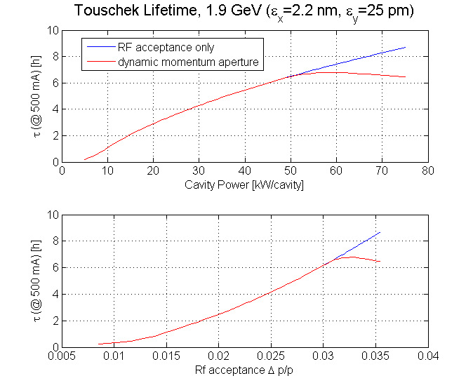
Baseline Lattice: Dynamic Aperture
Dynamic aperture is fairly large (larger than current lattice)
Dynamic Momentum Aperture larger
Touschek Lifetime longer than present lattice
  Despite higher density
9

Slide 10
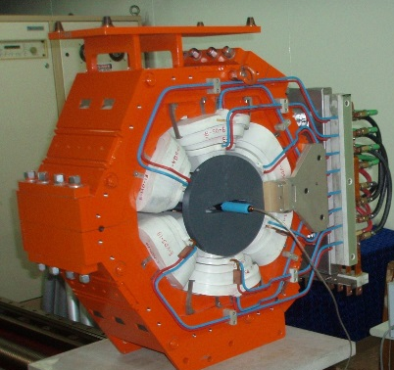
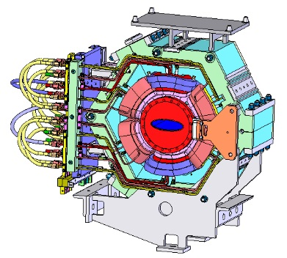
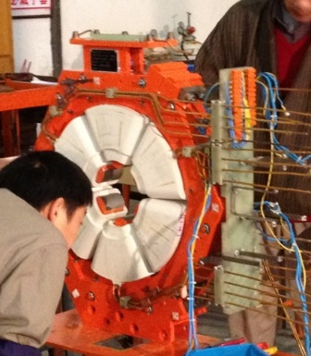
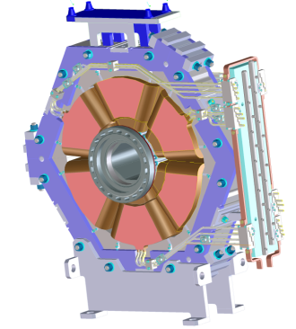
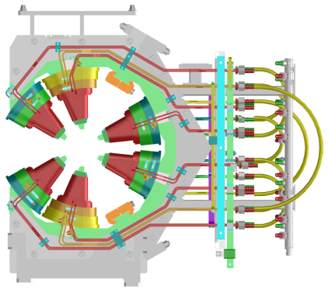
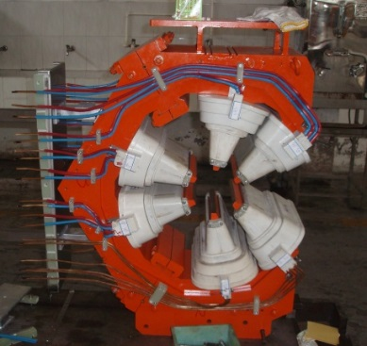
Project History
Existing Correctors
Received funding (summer 09)
Comprehensive project review (12/09)
Awarded magnet contract (9/10)
Detailed magnet design review (3/11)
Prototypes of 3 magnet types complete (12/11)
First set of 13 production magnets shipped (4/12)
All magnets received (8/12)
Pre-Installed 13 of 48 sextupoles (1/13)
Remaining magnets and power supplies installed (3/13)
User operation in high brightness mode (2.0 nm emittance) – since (4/13)
Sextupole / Corrector Multimagnets
10

Slide 11
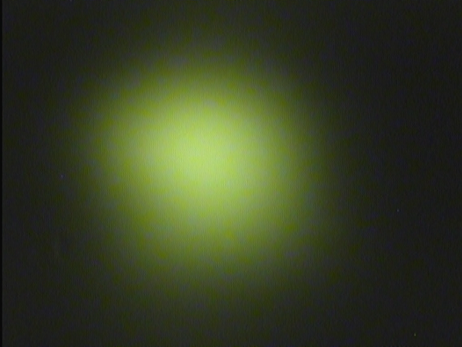
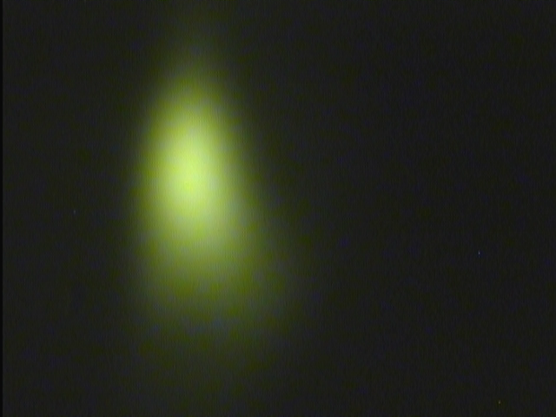
Measured Beamsize Reduction
Above: BL 6.3.1 – Magnetic Spectroscopy; Below: BL 8.2.1, PX
New Lattice
Reduction in
horizontal by factor 3
Old Lattice
11

Slide 12
Brightness Comparison
Comparison to existing and future light sources (and upgrades)
Below 1 keV (soft x-ray) ALS is competitive now
Future: NSLS-II and Max-4 will outperform ALS above 100 eV
Triple Bend Achromat provides very bright bend and Superbend source points from center bend magnets – ALS (2 nm) above NSLS-II 3PW
12

Slide 13
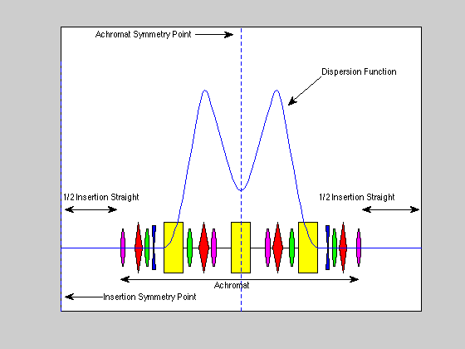
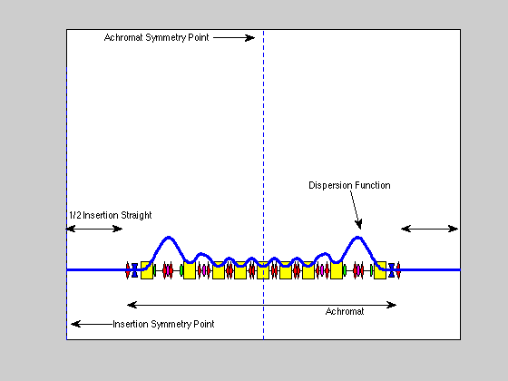
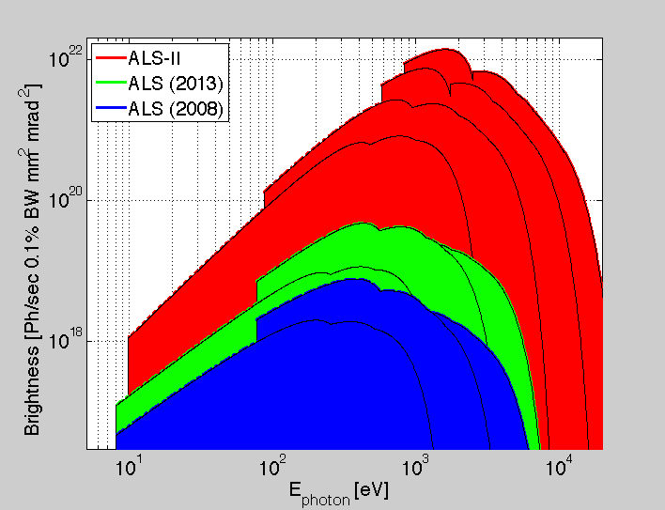
Diffraction Limited Light Sources
Recent realization: Still large potential for storage ring sources
  Smaller vacuum+magnet aperture – Multi bend achromat lattices with low emittance.
  Actively pursued: MAX-IV, SIRIUS, ESRF-2, Spring8-2, BAPS, …
Transverse diffraction limited to 2 keV for ALS size is possible – ALS-II
  Using the ALS tunnel to achieve moderate low emittance with moderate cost.

Slide 14
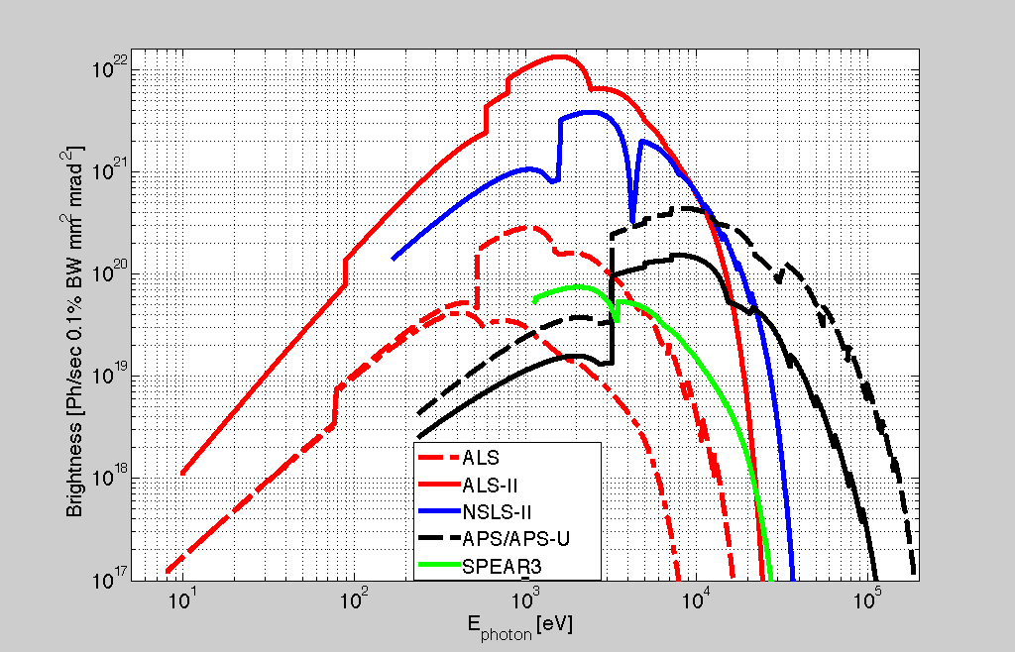
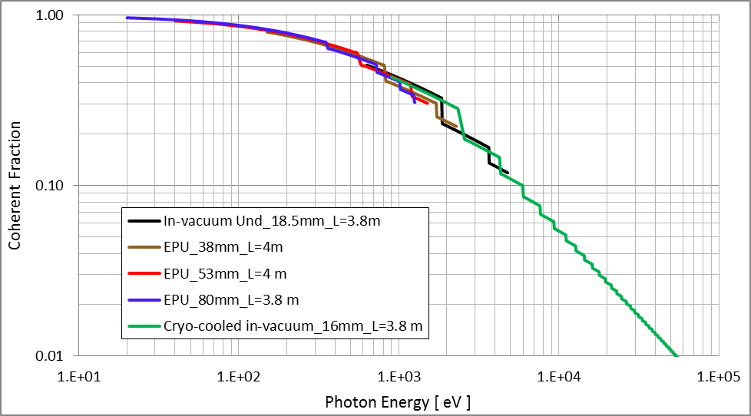
Brightness & Coherent Radiation from ALS-II
Diffraction limited (soft x-ray) ALS upgrade could offer about two orders of magnitude brightness improvement beyond upgrade currently underway.
Coherence of the radiation is another figure of merit of DL source

Slide 15

Candidate Lattice for ALS-II
The storage ring has 12 superperiods with 9 bending magnets.
Center 5 dipole cells have non-zero dispersion but very small. No sextupole magnets there due to small betatron functions (ESRF approach).
Matching cell with two dipoles used to serve;
  To match zero dispersion in the straight sections and low beta values for matching the electron-photon phase spaces.
  Creates high dispersion within the cell for chromatic and harmonic correction.
Straight section length of 5m and total circumference of about 200 m.

Slide 16
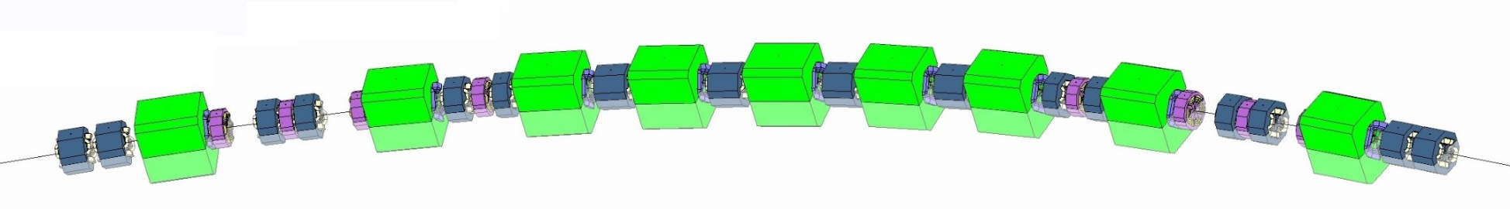
Magnet Arrangement ALS/ALS-II
The ring admittance is defined by the low gap ID, hence small aperture, small size magnets to achieve low emittance without damping wigglers.
No dedicated bending magnet, only strong, shifted quadrupole magnet.

Slide 17
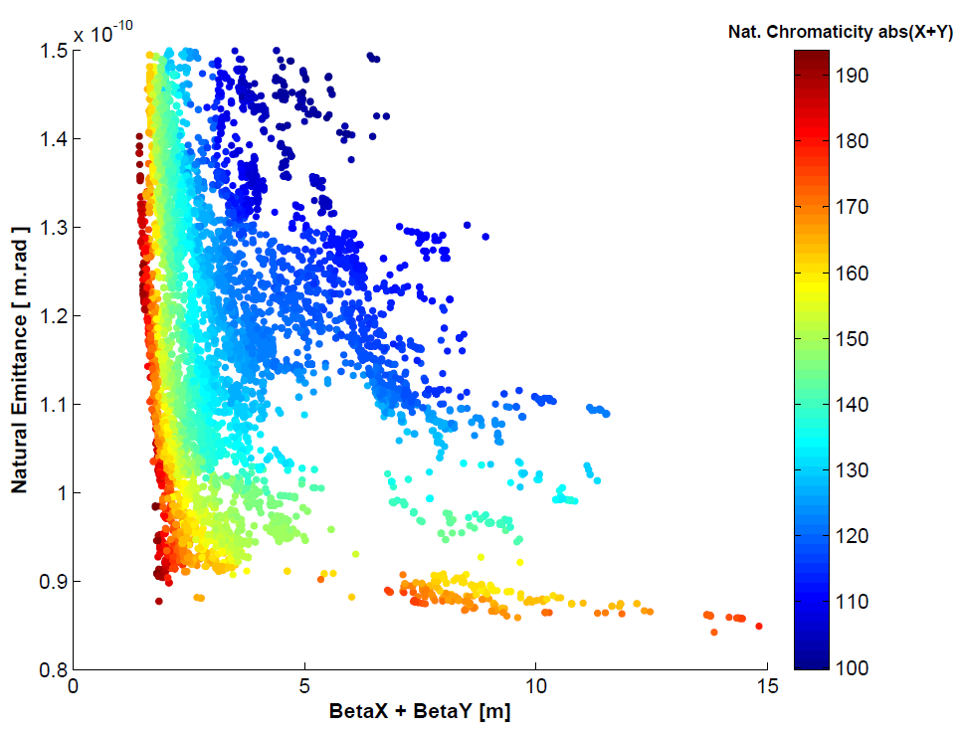
Lattice Optimization using MOGA
Multi-Objective Genetic Algorithm (MOGA) has been used with;
  9 parameters (7 QM & 2 BM)
  8 constraints (stability, J_{x,y,e}>0, max. β_{x,y} & D_{x}, frac.ν_{x,y}<0.5).
  3 Objectives ε_{nat}, ξ_{x,y} & [β_{x} + β_{y} ] at the middle of S. Section.
The objectives take into account some of the nonlinear dynamics needs too.
β_{x} ≈4 m & D_{x} =0 are chosen (σ_{x,y}=15 ). Further optimization towards smaller beta functions in progress.
  With On-Axis injection scheme, The dynamic aperture will define the Beta functions in the straight sections.
Energy | 2 GeV
Nat. Emittance | 106 pm.rad
Tunes ν_{x}/ν_{y} | 41.13 / 26.21
Nat. Chromaticity [x/y] | -68 / -64
Mom. Comp. factor | 2.54×10⁻⁴
Energy Spread | 8.13×10⁻⁴
τ_{x}/τ_{y}/τ_{l} [msec] | 8/16/15
Bending Angle | 3.33 Degrees

Slide 18
Betatron Functions & Beam Sizes of Candidate Lattice

Slide 19
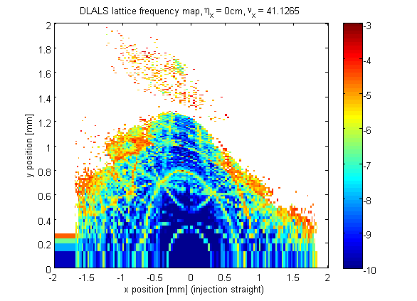
Nonlinear Dynamics of ALS-II Lattice
4 sextupole families with +0.5 chromaticity in both planes. Strong sextupoles are needed which results small dynamic aperture.
Optimization of driving terms and higher order chromaticities.
Achieved Dynamic aperture is >200 times the beam sizes. It appears sufficient for on-axis injection of small emittance beam and sufficient Touschek lifetime.
Tight tolerances on alignment and multipole contents within good field region of ±5mm.
Lattice Frequency map with errors

Slide 20
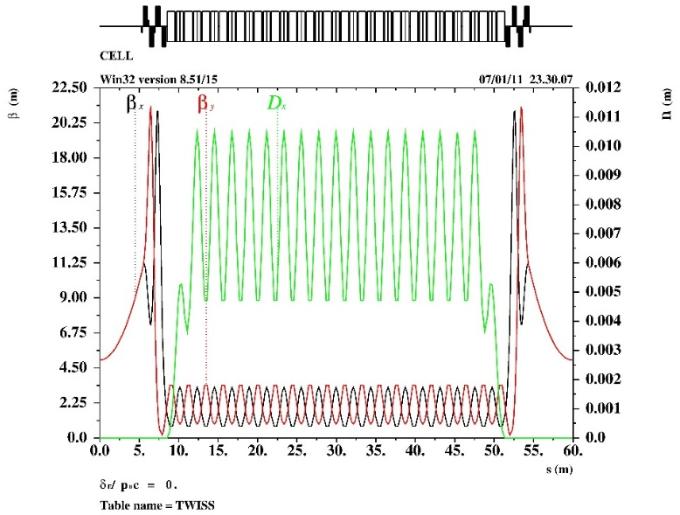
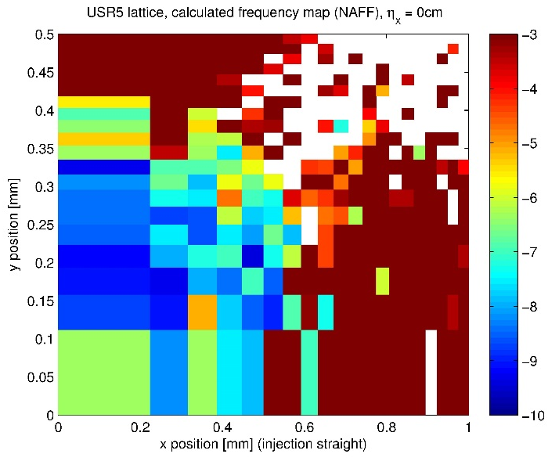
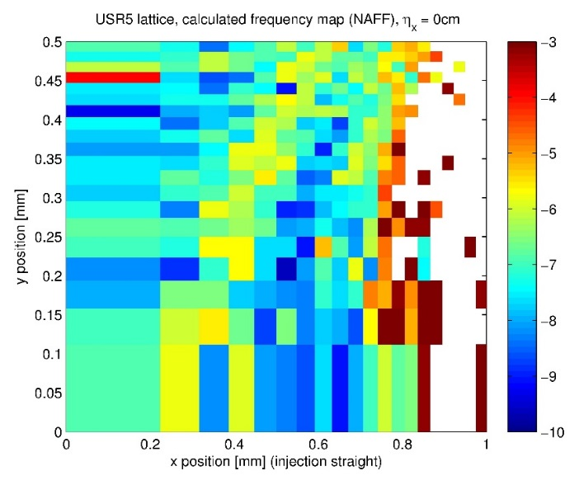
An Attempt to Achieve 5 pm
Yuhai’s challenge: 5 GeV, 2 km, 5 pm
Work on PEPX: < 30 pm, good DA
  Key: resonance suppression
A 19 bend arc section (36 total)
  μ_{x} = 5/19, μ_{y} = 4/19
  Resonances up to the 6th order suppressed (3 μ_{x}+ μ_{y} = 1 with the help of the midplane symmetry)
Octupoles in the straight (3 families)
Superperiod
Oct. off
Oct. on

Slide 21
Summary
Biggest challenge (as well as opportunity) for ALS – Continuous Renewal
  Well balanced plan between machine/facilities upgrades and beamline/endstation renewal
Major Machine Renewal example: Brightness upgrade reduced horizontal emittance from 6.3 to 2.0 nm
Beamlines can resolve brightness increase and realize (full) benefit
Dramatic performance improvements beyond ALS are possible (at moderate cost) and are now being actively studied.
  Long term goal to keep LBNL as (world leading) center for soft x-ray science with complementary state-of-the-art facilities: NGLS and ALS-2
There may still be some room left for FODO lattice
21

Slide 22
Backup Slides
22

Slide 23
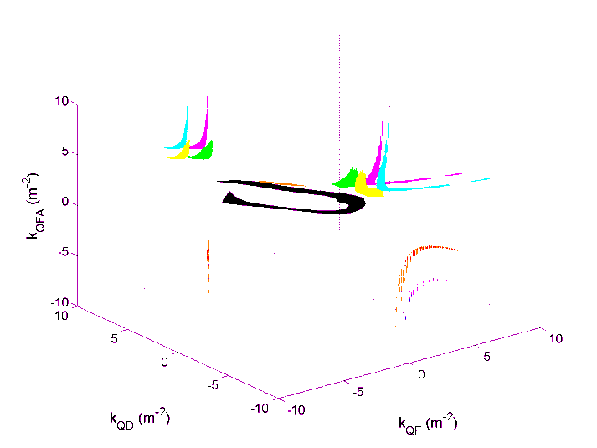
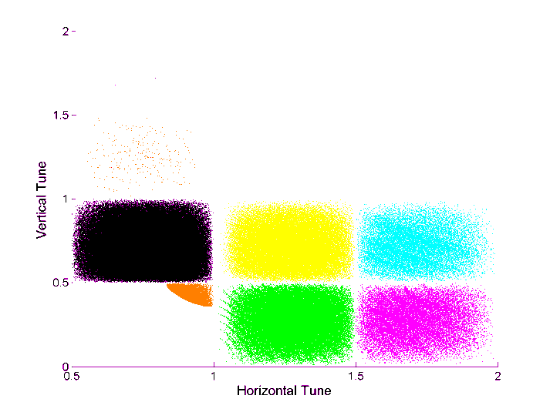
Lattice optimization
GLASS – Global Analysis of All Stable Solutions D. Robin, et al. PRSTAB 11, 024002 (2008)
  Tool to look for optimum lattice solution for highly periodic lattices (few parameters)
MOGA – Multi Objective Genetic Algorithms
L. Yang et. al, NIM A 609 (2009) 50-57
  First accelerator use for photo injectors (Bazarov et al./Cornell)
  Moderate computation time for larger dimensional parameter spaces
  Integrated optimization of linear+nonlinear lattice
  Frequency Maps (quantitative diffusion rates) C. Steier, et al., 10.1016/j.nima.2010.11.077
  In use for years for studies of global dynamics (simulation and measurement).
  Can also be used as merit function (e.g. for MOGA)
23

