Slide 1
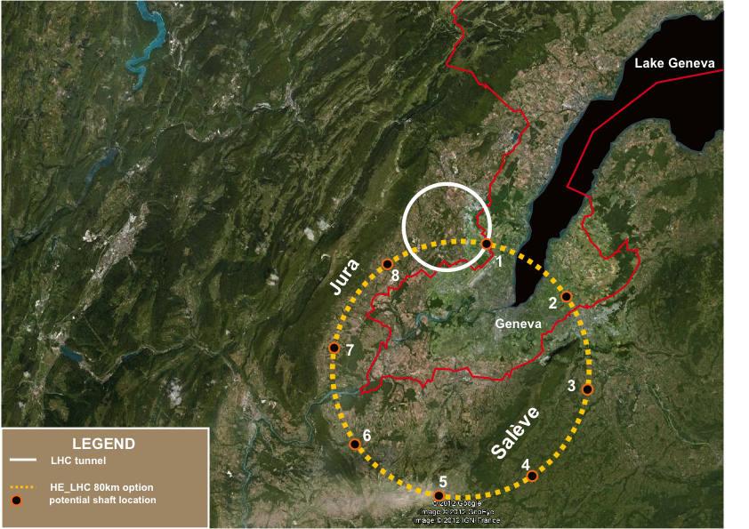
Detector Ideas for TLEP
(and VHE-LHC)
http://tlep.web.cern.ch/content/useful-documents
ATLEPH
TOPAL
E.Meschi
CERN/PH
GMS

Slide 2
WG11:The Mandate
The objective of the working group is to propose hardware solutions that would match the constraints from the studies of the Working Groups "Electroweak Precision Measurements at the Z pole" and "H(126) Properties", in particular. Synergies with linear collider developments ought to be sought whenever appropriate. In general, the whole detector must be particle-flow friendly, i.e, with adequate calorimeter granularity and good hadron detection efficiency down to 1 GeV, large magnetic field, light tracker, and excellent muon efficiency.
This should be achieved in strict connection with:
  Aforementioned physics working groups (define the physics benchmarks and corresponding simulation parameters)
  Experimental environment working group (a.k.a. “Machine Interface”)
  Online and Offline software working group

Slide 3
WG11: a possible modus operandi
Focus on the “flagship” TLEP physics goals for a detector CDR, use fast but not parametric simulation
  Higgs mass
  Higgs couplings
  Higgs width
prepare a small number (4?) of variations, use fast or parametric simulation to evaluate physics performance on a wider palette of processes (including W,Z,tt)
  Privilege areas not accessible to LHC
  Include representative channels for all energies
  Use fast (parametric?) simulation
Converge on one or two design to simulate in detail
  GEANT simulation and use existing reconstruction framework
Have a clear plan for the evolution of the detector(s) towards the pp machine

Slide 4
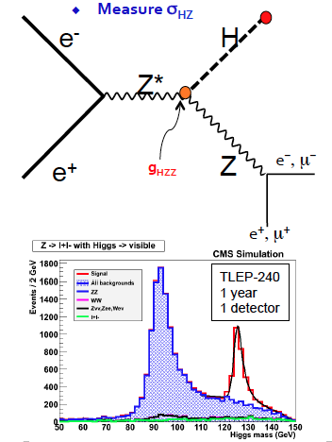
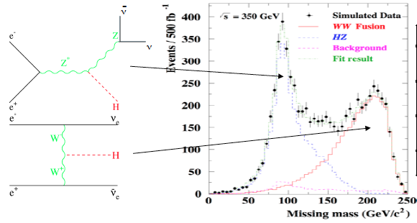
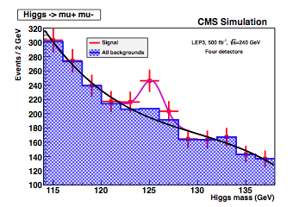
Basic benchmarks
Missing mass
  Calorimeter
  energy resolution
Higgs recoil mass
  muon and tracking
Hadronic BRs
  bb,cc,gg tagging
Luminosity
H->mumu
  muon P_{t} resolution

Slide 5
Why TLEP and VHE-LHC experiments together
Design caverns, services and detectors (at least the basic [infra]structure) to be re-used in pp collisions (as new)
Tera Z factory sets the scale for DAQ (2600 bunches)
  also forward EM calorimetry (lumi)
TLEP(H) sets the scale for precision (tracker, ECAL, particle flow, b-tagging)
VHE‐LHC sets the scale for magnetic field, calorimeter depths, tracker pT reach, muon systems
A tenable cost sets the ultimate scale for what can be done
  Given technology evolution to be expected, targeting detectors at same total final cost as ATLAS/CMS seems realistic
A roadmap from day one of TLEP physics to day one of VHE-LHC physics, would represent a major novel feature of this project
  Just like with tunnel+machine, the net cost of the TLEP detectors should be considered over the total cost of the program.

Slide 6
Simulation
CMS is developing a “modular” fast simulation
It is (will be) possible to modify the inner tracker geometry (e.g. number and position of pixel layers, geometry of Si tracker)
Later on, calorimeter resolution and segmentation will be tunable
Competitive with fully parametric (a la Delphes)
Phase 2 upgrades also considering new technologies, e.g. imaging calorimeter

Slide 7
TLEP (…and VHE-LHC) detectors

Slide 8
Interaction Regions
Top-up ring position with respect to detector
  Relative position
  Passthrough
    Horror scenario: all detectors have a circular hole somewhere in the calorimeter
  Bypass option and implications
  Even more exotic possibilities ?
Final focusing quads position and size
  Impact on detector design (FFQ inside detector)
  Options for the magnet
  NOTA BENE: the FFQ poses serious engineering problems to ILC experiments
    Not least because of the “flip-flop” scheme

Slide 9
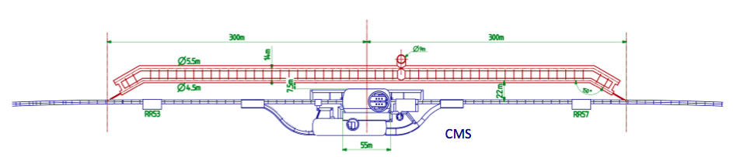
Bypass
CLEVER RELATIVE ARRANGEMENT OF ARCS AND SS POSSIBLE ?
LENGTH OF NON-STANDARD TUNNEL SIZE ? COST ?
BYPASS SCHEME
FOR LHeC…
LENGTH NEEDED FOR TLEP ?
ADDITIONAL COST ?

Slide 10
Magnetic Structure
Solenoid: at VHE-LHC strong fields and large lever arm will be needed to preserve *some* momentum resolution for multi-TeV tracks
Large bore diameter solenoids would allow bigger lever arm
  large tracking detectors…
    R&D needed, cost, channel count ☹
  Initial cost of calorimeters higher ☹ due to larger volume to cover
  Can be partially compensated (in the active material) by reducing granularity as showers will be “opened up” further ☺
  Absorber cost will definitely increase ☹
Alternative magnetic structures (a la ATLAS) would allow staging the toroids

Slide 11
A Solenoid for TLEP expts
TLEP-H/W/Z require a modest magnetic field but…
  …No point in making a more compact tracker
    Because of power distribution, cooling and readout issues
However…
  ECAL/HCAL MUST be inside the solenoid
    Only way to have acceptable resolution for photons
    Support PF jet algorithms
Current experience: CMS (similar parameters as ILC detectors)
  Larger bore diameters deemed to be challenging to engineer
  Is this going to evolve in the future? (new htSC materials, progress in cryogenics, experience with operating current SC magnets,…)

Slide 12
Vertex Detector
Vertex detector capable of transverse i.p. resolution of order 5 μm in barrel (~10GeV)
  For b and c tagging
  Single point resolution of the same order and >4 layers required
  For comparison, CMS ~20 μm
So… flavor tagging is the real challenge: extreme demand in impact parameter resolution
  Beam pipe material
  Innermost layer radius
  Lightweight construction to minimize multiple scattering
  σ(d) = √(a² + b²/p²sin³θ)
  Good point resolution (a) useless if m.s. term (b) large
ILC/CLIC R&D: the key parameter is the material budget
  Thin sensors
  lightweight composite structures
  Open structure with gas flow cooling
Must look into: power distribution, low-power VFE, integrated on-chip cooling and photonics
~10⁹ channels: readout a challenge

Slide 13
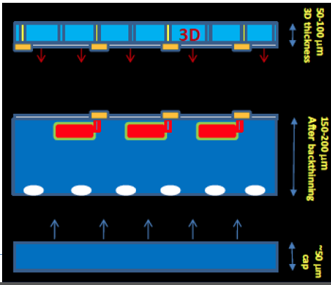
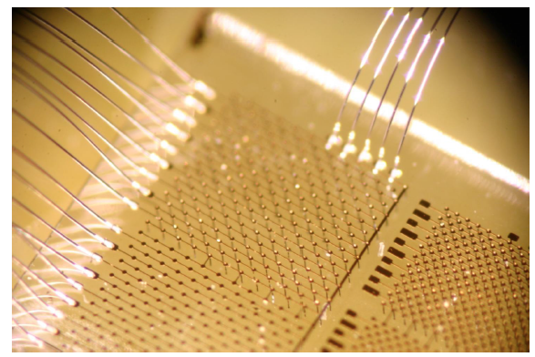
Vertex Detector
Limiting the material inside the tracker is essential for maintaining or improving tracker performance
R&D for phase 2 LHC detectors: exploring new sensor technology
  Thin planar sensors (slim edge etc.)
  3D sensor with embedded micro-cooling
  Diamond sensors

Slide 14
Tracking
Momentum resolution σ(p_{T})/p_{T}² better than 10⁻⁴ (10⁻⁵ ?) for TLEP-H
σ(p_{T})/p_{T}²~ 1/BL²√N
  Very different situation at TLEP and XLHC
  TLEP: tradeoff between B strength and sufficient number of high resolution points
    TPC with GEM or Micromegas amplification … (background, space charge atTeraZ)
  VHE-LHC: multi-TeV objects -> play with lever arm (N points) and B strength
An all-silicon tracker certainly a viable option for TLEP
  Moderate number of high-precision points (not different in scale from CMS)
    Forward tracking more important than at LEP
  Challenges again are lightweight support structure and services (power distribution, cooling)
  R&D for LHC phase2 detectors certainly relevant
    Optimized power distribution, use of store capacitors
      Compact large capacitance dev for portables and other applications
    Front-end electronics with longer pipelines, low-power optical systems
    Cooling in relationship to all of the above

Slide 15
Tracking
Relatively compact silicon tracker (or TPC) sufficient for TLEP (and all its variations) – material budget fundamental
  Cooling, infrastructure
  Power distribution and readout -> low-power rad-hard VFE, on-chip photonics (lots of fun R&D)
  Will pay off already at the TeraZ stage
  Additional layers can be added (resolution ~ 1/L²√N) -> large silicon surfaces… R&D needed, cost, channel count ☹
LEP-H poses most stringent requirements on impact parameter resolution (e.g. c-tagging)
The choice of (at least one) TPC experiment may end up being compelling
  keeping evolutionary/modular architecture open

Slide 16
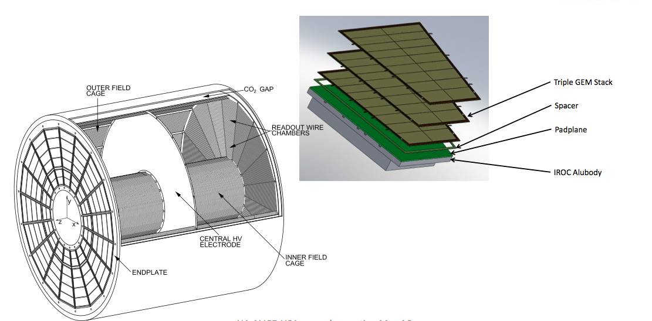
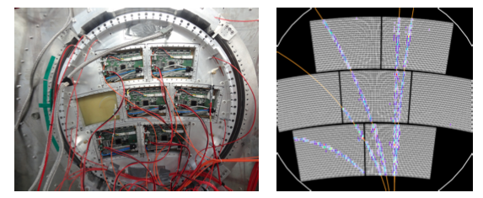
TPC: Valuable R&D from ILC and ALICE
CONTINUOUS READOUT
@ 50 kHz
SOFTWARE DATA REDUCTION
ALICE
Phase 2
TPC
LARGE
PROTOTYPE
For ILD

Slide 17
Calorimetry
ECAL intrinsic resolution better than 1% @60GeV
  To reconstruct H->γγ
Jet energy resolution
  Integrate particle-flow techniques
  Less stringent requirements on HCAL resolution
  Good granularity required (ECAL)
  Shower barycenter determination more important than standalone resolution (HCAL)
  Goal of σ(E)/E better than 4% for PF jets
ECAL: Moderate increase in transverse segmentation (wrt LHC detectors) sufficient to reach necessary resolutions for LEP-H
  Can be profited of in pp
  Longitudinal segmentation, what are the real needs ?
HCAL: Increasing the solenoid field and/or radius may help a bit the Particle Flow algorithms by separating the charged/neutral components further

Slide 18
Calorimetry
ILC/CLIC Tungsten/SiPad multilayer sampling ECAL with extreme segmentation (CALICE)
  Probably insufficient resolution for H->γγ (S~15%, C~1%)
  But attractive as an evolutionary solution for XLHC
  Study tradeoff for segmentation/number of channels
PbWO₄ crystals (CMS)
  Cost, readout, transverse segmentation
  Containment and transparency for XLHC
  Longitudinal segmentation ☹
LAr???
HCAL challenge: reasonable resolution and granularity sufficient to support PF algorithms
  Analog vs. digital HCAL
  Absorber material, photodetectors
  Combined analog and binary readout ? On-detector shower barycenter ?
Clearly should explore other solutions as well

Slide 19
Muons
The real challenge for muons is at VHE-LHC
Muon Identification >95%
  Envision modular extensions to cover multi-TeV muons
Many technologies under study for both LHC Phase 2 and ILC
  Besides the current Drift Tubes, Cathode Strip Chamber, RPC…
  Scintillating extruded strips read out by SiPM
  GEM

Slide 20
DAQ and Trigger
Can we read out and record data from a detector with ~10⁹-10¹⁰ channels ?
Do we need a trigger ?
TLEP-H/T
  Low occupancy, sparse readout, zero suppression, Bx rate ~100 kHz -> can and should read out every bunch crossing !
  Rate of interesting events (including background) <1 kHz
  Event size ?: 1-10MB with solid-state tracking depending on quality of zero-suppression/compression algorithms affordable at front-end
    -> switched networks with aggregated b/w up to 1TB/s (e.g. planned 1MHz readout for LHC phase 2 CMS)
    Technology is in hand today (cost ☹)
  Also explore other possibilities: e.g. integrate over (multiple) turn
Trigger
  Front-end electronics built to support it wherever possible
  optical fast paths, configurable pipelines…
  To be looked at for TeraZ and beyond
  Privilege read out speed and software HLT wherever possible

Slide 21
BLUEDEPTH
a BLUEprint Detector Proposal for TLEP and the next Hadron collider
Identify a common structure for all potential design
Identify two or three technologies to study in depth for each subdetector
Fast simulation of core parameters
Detailed simulation of one or two more promising alternatives (GEANT ?)
Extract coverage, resolution, efficiencies to use in parametric simulation
Build on the experience and infrastructures of the current LHC detectors (simulation, sw infrastructure)
Always include a modular evolution for the proton machine in the design

Slide 22
BLUEDEPTH-A@TLEP
INST.YOKE
BARREL MUON
INST. YOKE/
ENDCAP
MUON
SC SOLENOID @ 2T
HCAL
ECAL
OTK-I
FTK
I
VERTEX
DET
BARREL
TK-I
ECAP
TK-I
BHABHACAL
TOP-UP
RING INSERT
(dipole?)
FFQ

Slide 23
BLUEDEPTH-B@TLEP
INST.YOKE
BARREL MUON
INST. YOKE/
ENDCAP
MUON
SC SOLENOID @ 2T
HCAL
ECAL
FTK
I
TPC
VERTEX
DET
BHABHACAL
TOP-UP
RING INSERT
(dipole?)
BARREL
TK-I
ECAP
TK-I
FFQ

Slide 24
BLUEDEPTH@VHE-LHC
INST.YOKE
BARREL MUON
INST. YOKE/
ENDCAP
MUON
TAILCATCHER
SC SOLENOID @ 4T
HCAL
ECAL
OTK-II
FTK
II
VFCAL
(size and position not to scale)
BARREL
TK-II
ECAP
TK-II
VERTEX
DET
LUMICAL

Slide 25
Ready for conclusions. But first, a proposal
…remember the Tevatron punchline about the “Energy Saver” ….?

Slide 26
TLEP: the Money Saver

Slide 27
Conclusion
  Detector studies for TLEP and a future VHE-LHC can start from our experience with the LHC detectors
  Valuable R&D for phase 2
  ILC developments
  Simulation tools and framework developed at LHC (e.g. CMS) an excellent starting point

Slide 28
Backup

Slide 29
Experimental Infrastructure (civil engineering, Interaction point design, size of the caverns) are tailored for the ultimate pp collider (100 TeV, 5E35)
Modular detector design allows to evolve them from TLEP-H to XLHC
  By adding or replacing, or simply turning on features
  Pay attention to not introduce brick walls
“Options” (TeraZ, GigaWW) are a clear way to foster the above (e.g. TeraZ 2600 bunches, lumi ~1E36!!!)
Some design choices will lend themselves better than others to this modular, evolutionary scheme
  Identify them and promote R&D in that direction

Slide 30
Passthrough
Top-Up and Collider
SHARE THE SAME PIPE AT IP
CLEVER ARRANGEMENT OF BEAM TIMING
REQUIRES DIPOLE AT FFQ
M.Zanetti
accelerating beam outside FFQ, crossing
the IP region with an angle w.r.t the colliding
beam line, in this case at most atan(0.3/5).
At FFQ (say 4m) accelerating
Beam at 24 cm (FFQ radius 10cm).
integration of a D1 magnet with the focusing quads?
BREAKS DOWN FOR TeraZ

