Slide 1
Progress of dielectric loaded gas-filled RF test at MTA
K. Yonehara
APC, Fermilab

Slide 2
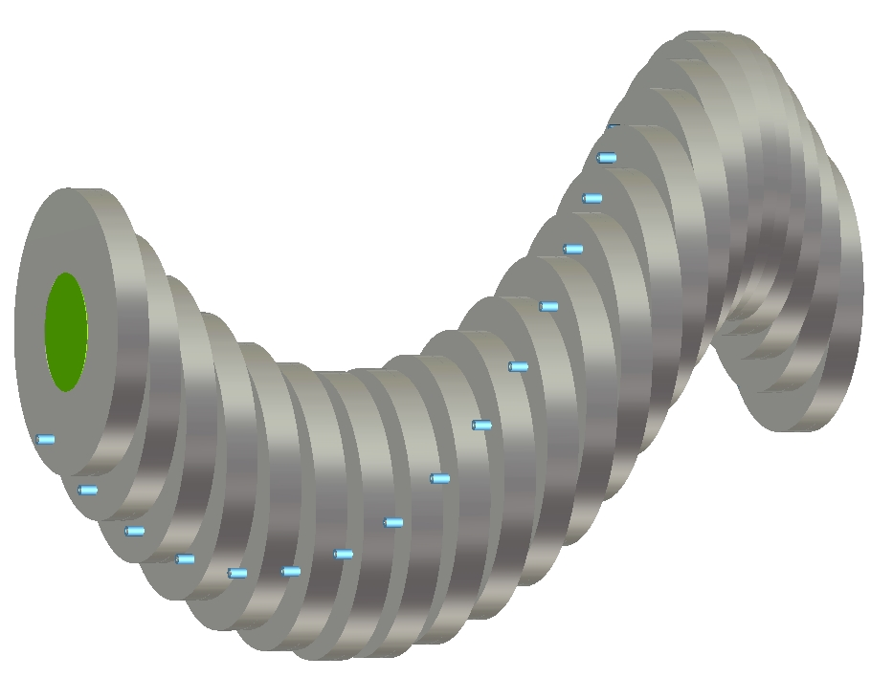
Goal of the project
HCC RF cell
(F. Marhauser)
Make a compact RF system by loading a dielectric material in a RF system
A compact accelerator system is attractive in general
Dielectric loaded RF system has been investigated for long time
Especially, a helical cooling channel requires a small radius RF system
λ_{HCC} ~ λ_{RF} (V. Balbekov & KY, EPAC’08 THPC110)
Ceramic disk
Be RF win
RF power feeding line
(Access from z direction)

Slide 3
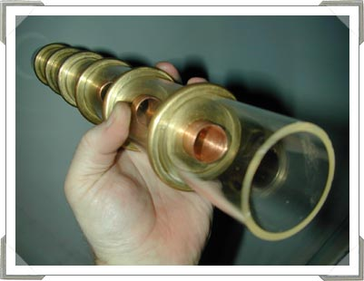
Goal of the first experiment (I)
Critical issue is a Surface Breakdown
Ceramic has relatively large secondary electron emission (SEE) yield (SEE > 1)
Primary electron generates more than one electron
It induces a cascade process
Similar as a multipactor process
Fill a buffer gas to eliminate the surface breakdown
Electrostatic accelerator, e.g. Van der Graaff
RF power window, e.g. High power Klystron
No application for RF accelerator system
This concept works only for muon accelerator/cooler
Electron cascade
E
Ceramic
Van der Graaff tube

Slide 4
Goal of the first experiment (II)
Surface breakdown process can be terminated in a gas-filled RF cavity
Verify this model
Since this is the first proof of principle test we do not care about a RF power dissipation in a loaded ceramic material
Material search will be the next step

Slide 5
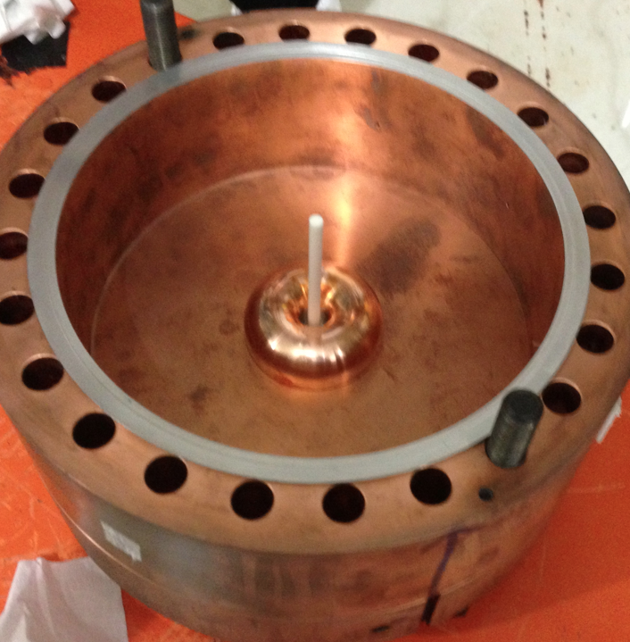
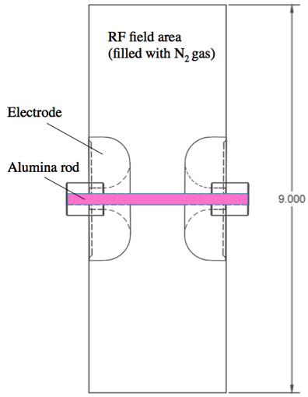
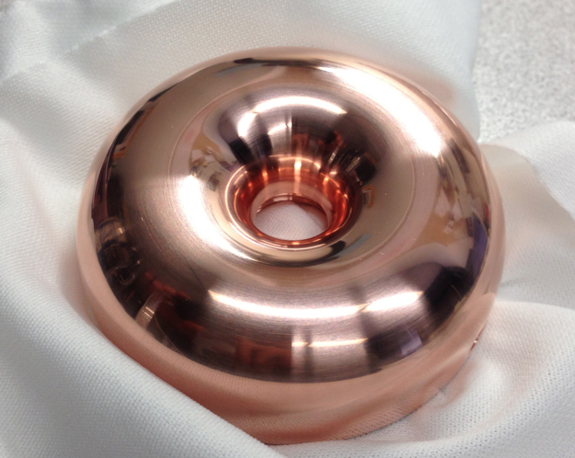
Design test cell
Minimize field gradient at triple junction
Metallic body, ceramic rod and GN₂
Triple junction
Donut shape copper electrode
Frequency = 814.544 MHz @ 1 atm
Q_{L} = 4,250 from RF calibration

Slide 6
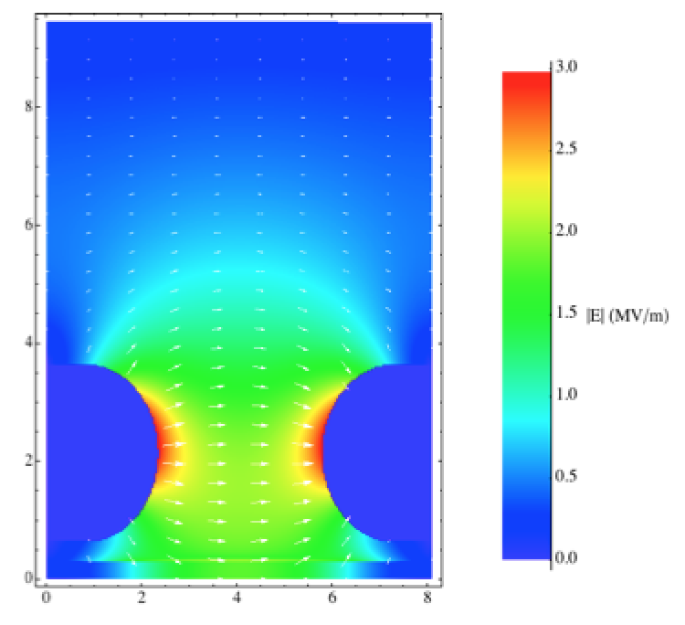
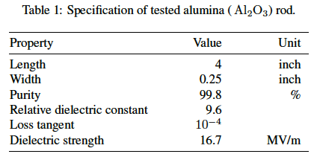
Simulated RF field distribution
Simulated RF field
Parallel field on a ceramic rod
Field enhancement 1.5
@Electrode
Low field at triple junction
Triple junction
RF field distribution in SF simulation

Slide 7
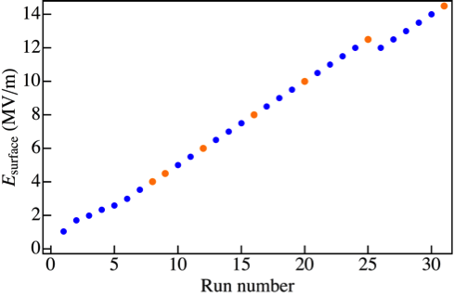
Maximum gradient search on surface of a ceramic rod
In order to avoid permanent damage of ceramic rod, applied RF amplitude was gradually ramped up
0.5 MV/m step
RF system was recovered even we had a breakdown
• N₂ gas pressure = 1,000 psi
• Observed unusual BD event at
E_{surface} < 10 MV/m
• Observed usual BD event at
E_{surface} > 10 MV/m
• Long run at E_{surface} = 12 MV/m
• No BD during 2 hrs long run
(RF rep rate = 10 Hz)
• Multiple BD at 14.5 MV/m
long run

Slide 8
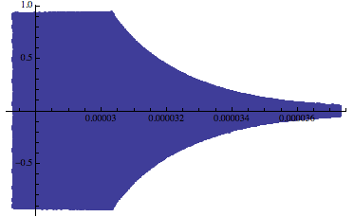
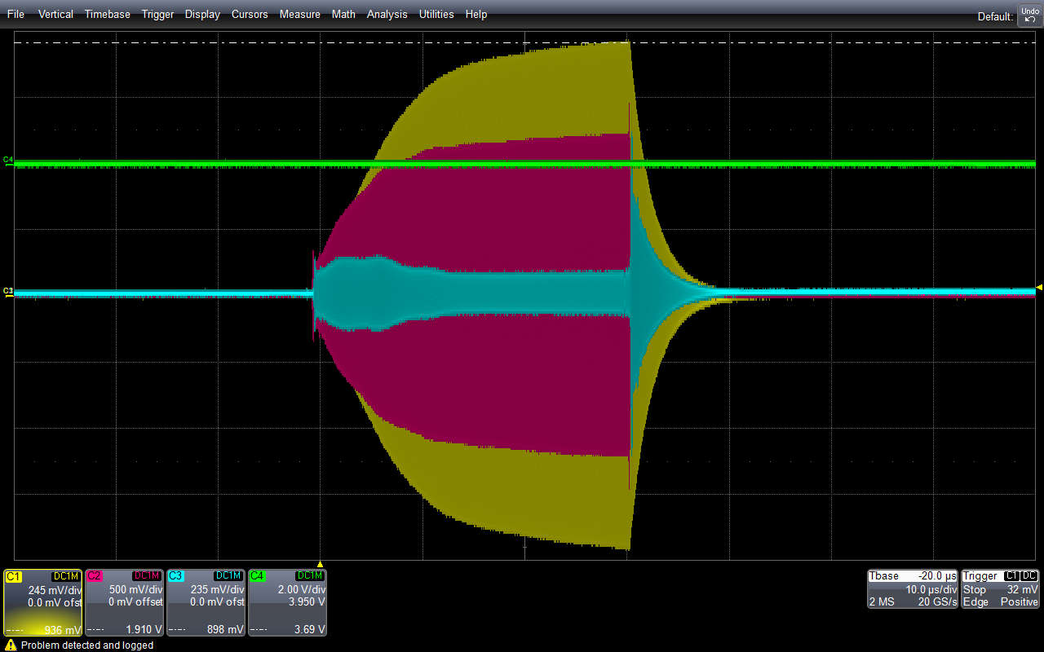
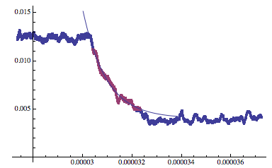
Observed quality factor
RF decay signal
Optical signal
Reflected pwr
Forward pwr
Decay constant
RF pickup
Observed Quality factor = 4554.02 ± 569.40
Observed frequency = 800.566 ± 0.004 MHz in 2 hrs

Slide 9
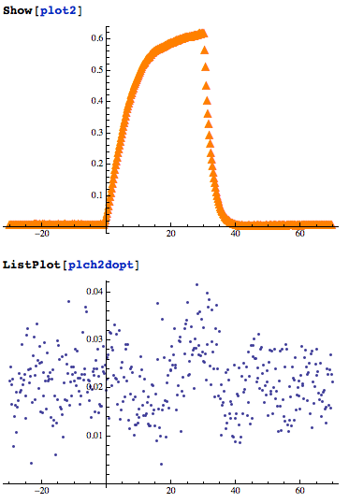
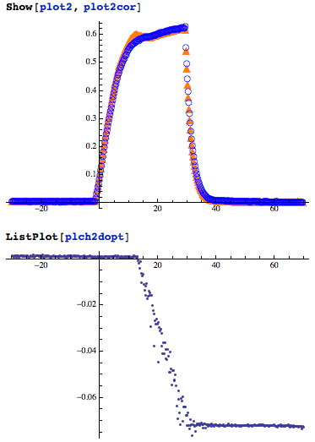
Weak breakdown at low RF gradient
No breakdown
Weak breakdown
PU
PU
Optical signal
Optical signal
• Continuously build
weak light with offset
• Some current flow on
PMT GND (?)

Slide 10
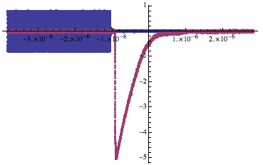
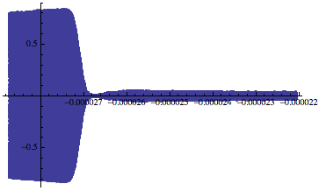
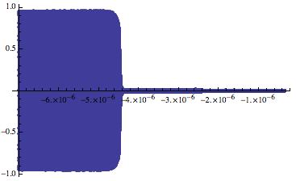
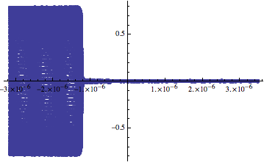
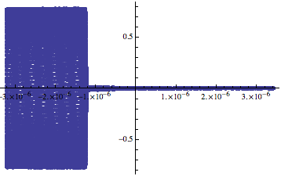
Breakdown at high RF gradient
RF signal
τ = 162.5 ns
Optical signal
τ = 106.9 ns
τ = 73.9 ns
τ = 3.6 ns
• Observed decay time constants, τ
• Various τ at various BD locations

Slide 11
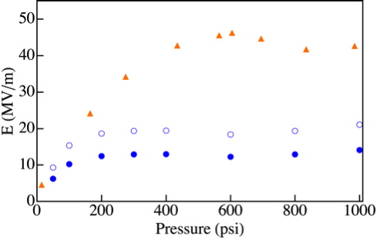
Gas pressure dependence
Gas BD slope
• Open blue circle: peak E at electrode
Close blue circle: surface E
• Orange triangle:
Compare old HPRF test with GN₂
• At p < 200 psi, observed peak E
(open circle) shows gas BD
• At p > 200 psi, observed peak E
shows a plateau
• The plateau seems to be determined
by the dielectric strength of ceramic
rod
Metallic BD
Old cavity test
RF gradient at highest point
(convex of electrode)
RF gradient on ceramic rod

Slide 12
Consider breakdown mechanism
Weak breakdown
Some amount of BD light came out from test cell
Never seen such a BD in past gas-filled RF test
It looks like a multipactor in a vacuum cavity
It disappeared in higher RF gradient
Is it a surface breakdown?
Regular breakdown
Observed intense BD light at high RF gradient
Maximum RF gradient is close to the dielectric strength of alumina rod

Slide 13
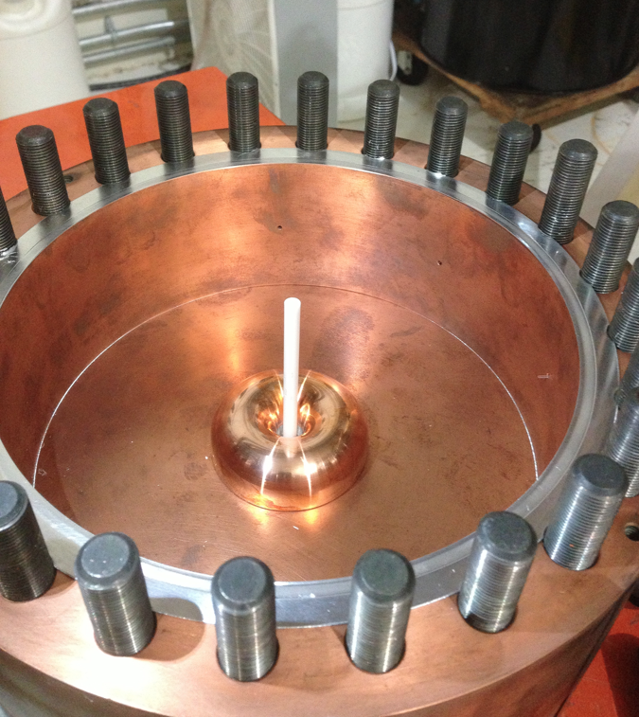
Open cavity after first run
• Saw a small piece of broken ceramic
• Saw one breakdown spot on a Cu
electrode

Slide 14
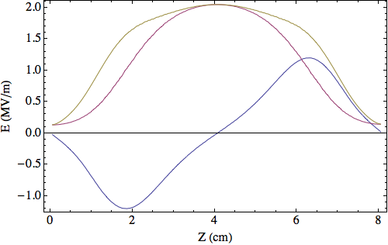
Inspect ceramic rod after test
Crack
Top
Bottom
Crack
Top
Bottom
• Since bottom part of rod is inserted to the rod holder deeper than top
location of cracks is the middle of cavity that is the highest RF gradient

Slide 15
Summary
Pressure measurement shows that there is a transition of BD mechanisms at p ~ 200 psi
Gas BD at p < 200 psi
New BD (plateau) at p > 200 psi
Saw weak BD
Surface BD?
The plateau can be the dielectric strength of ceramic rod (15 ~ 16 MV/m)
This can explain why ceramic rod is broken

Slide 16
Discussion and future plan
These are just hypothesis although everything can be explained
We do not know when the ceramic was broken
Plan in near future (in 2013)
Measure maximum RF gradient w/o ceramic rod
Repeat the same test with a new ceramic rod (same material)
Repeat the same test with different materials
TiO
Teflon

