Slide 1
Technology Development MAP Friday Meeting
Harold Kirk
Brookhaven National Laboratory
June 14, 2013

Slide 2
Outline
TD Highlights
L2 Summary reports
Topical Report - Progress of dielectric loaded gas-filled RF test at the MTA , K. Yonehara, FNAL

Slide 3
Technology Development Highlights for May, 2013
RF Studies
Modular 805MHz Cavity on track for delivery by end of FY13 (SLAC, LBNL)
Lab G Magnet re-trained to 5T (FNAL)
Targets
Studies for 1MW, 3GeV proton target initiated
Magnets
New Biscco 2212 wire tested to J_{c} of 160A/mm² at 5T
12 IPAC13 TD related papers presented

Slide 4
June 14, 2013
03 01: Normal Conducting RF
Derun Li
Modular cavity (collaboration with SLAC)
Cavity fabrication in progress and will be delivered to Fermilab by end of FY13
Test plan is being developed
201 MHz cavity
Preparation for testing at MTA using the single cavity vessel and accessory components:
RF coupler fabrication
MP simulation studies in a B field
MICE magnets: SS and CC
EP of the remaining MICE cavities at LBNL
Update of cryostat drawings for the first CC cold-mass
Sign off of the interface document between LBNL and FNAL
Fabrication of the modular cavity
PO of Be plates for the modular cavity
RF coupler fabrication for the 201 MHz cavity
Modular cavity
Fabrication at SLAC continues
Ready for PO of the Be plates
Bi-weekly meetings at SLAC to monitor/oversee fabrication progress
Support the single cavity installation at MTA, Fermilab
Updated and completed the fabrication drawings of the RF coupler for 201 MHz MICE cavity, quotation from LBNL received.
Actuators fabrication complete and delivered to Fermilab
Cryostat (vacuum vessel) fabrication for MICE CC magnet continued at LBNL, very good progress
Continue the modular cavity fabrication
EP of the remaining MICE cavities at LBNL
Development of the modular cavity testing plan
Data analysis of previous 805 MHz testing results
MP simulation studies of the MICE cavity and coupler with external magnetic fields and explore other possible solutions
Fabrication of two 201 MHz RF couplers for the first MICE cavity in preparation for the testing at MTA
Support MTA RF testing programs
Sign-off of the interface document between LBNL and Fermilab
Continue the fabrication of the modular cavity at SLAC
Continue development of the modular cavity test plan
Support of the 201 MHz installation at MTA, Fermilab
MP studies of 201-MHz cavities in B field
Oversee 201-MHz cavity coupler fabrication
TiN-coating of the coupler
Oversee the CC cryostat fabrication at LBNL

Slide 5
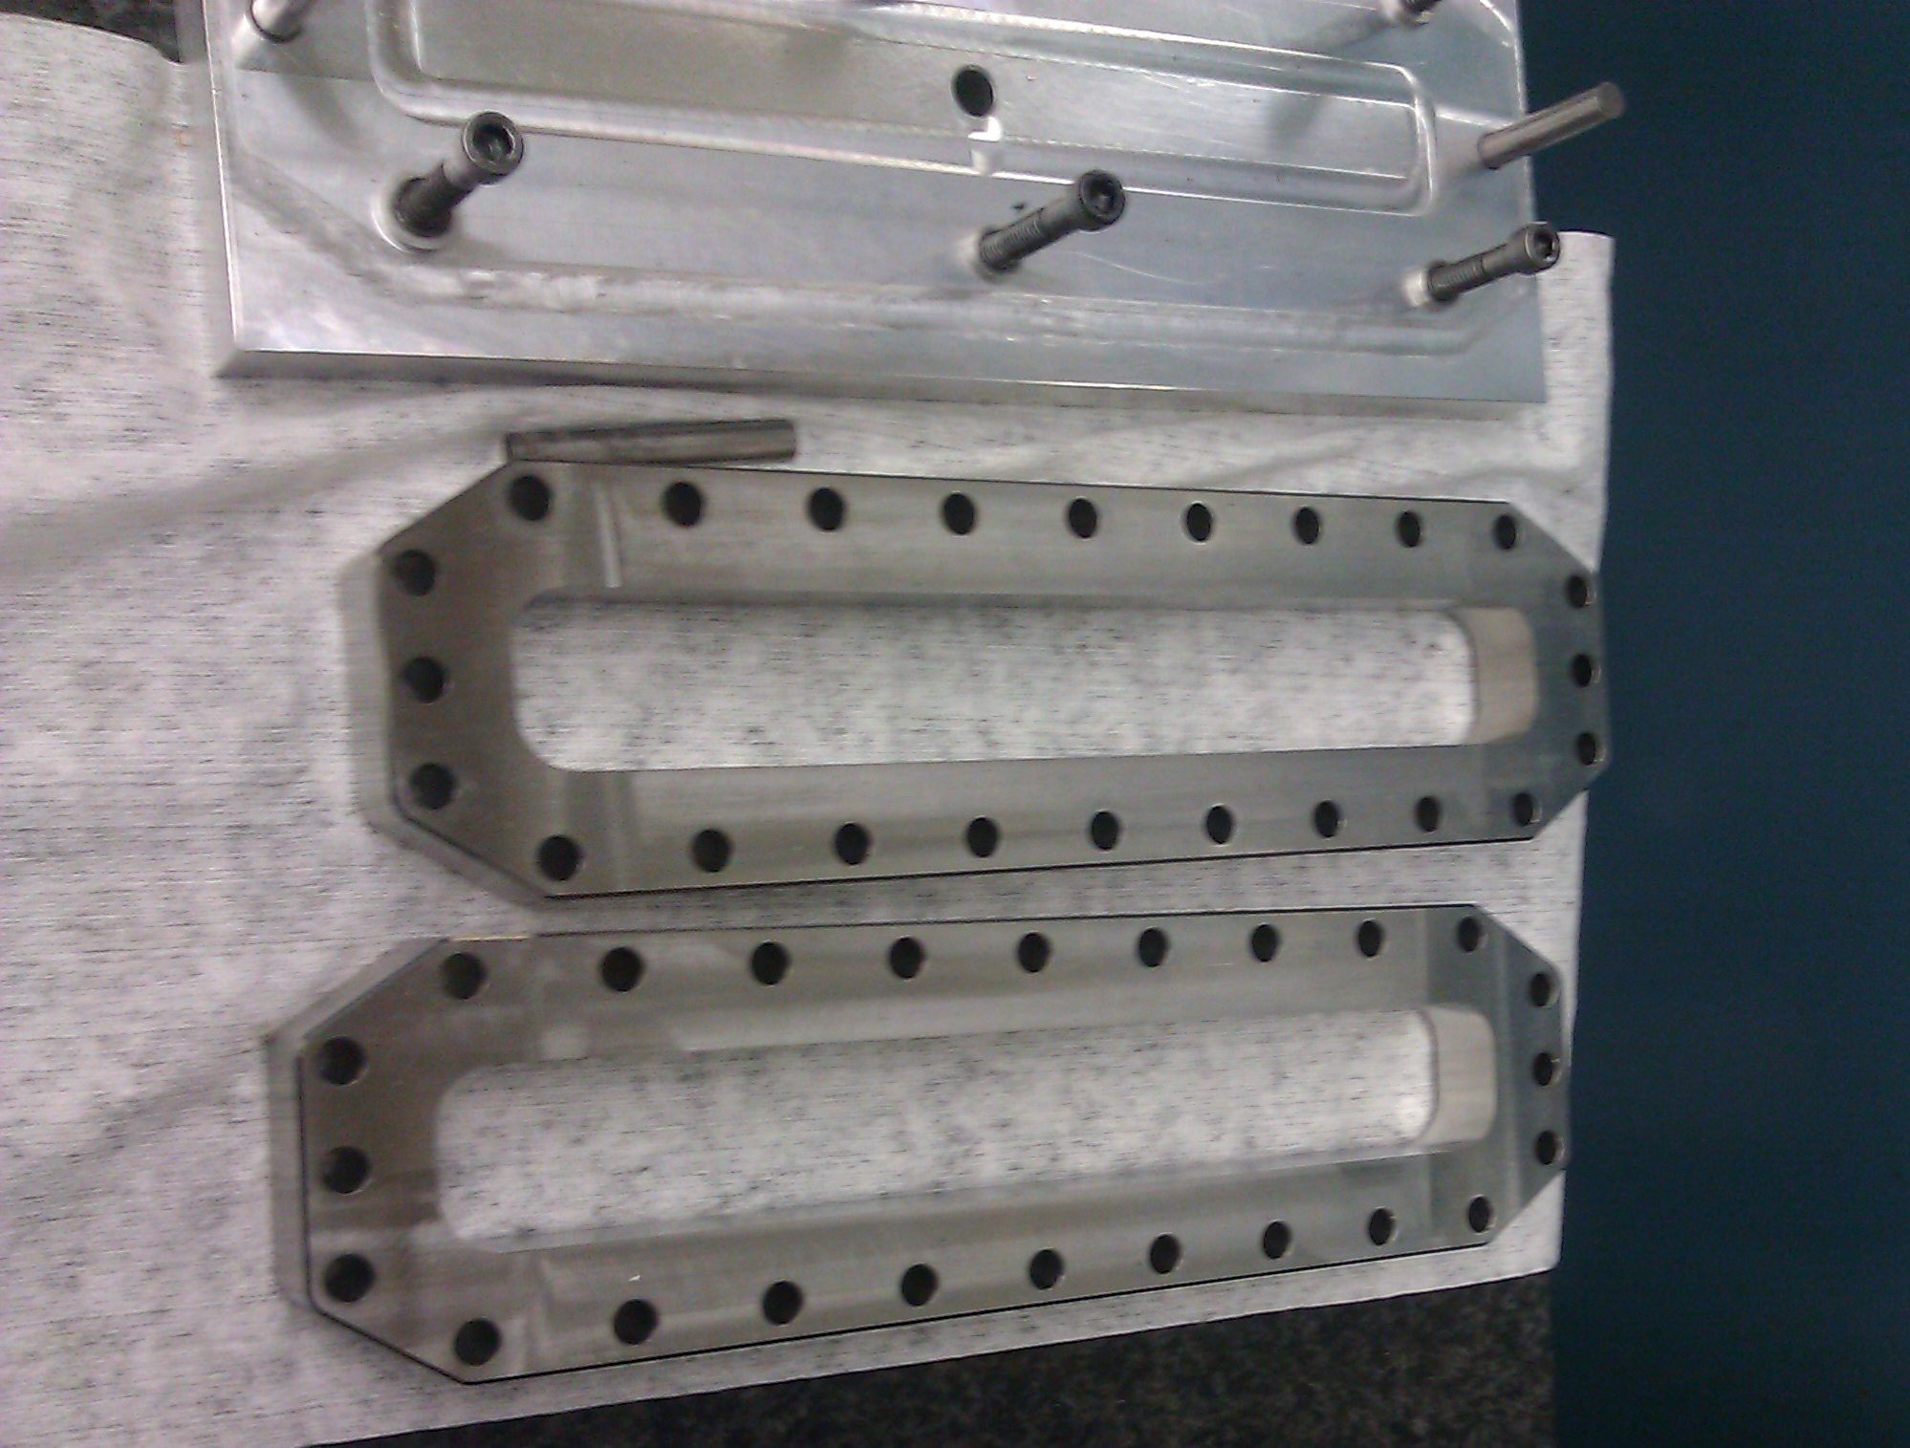
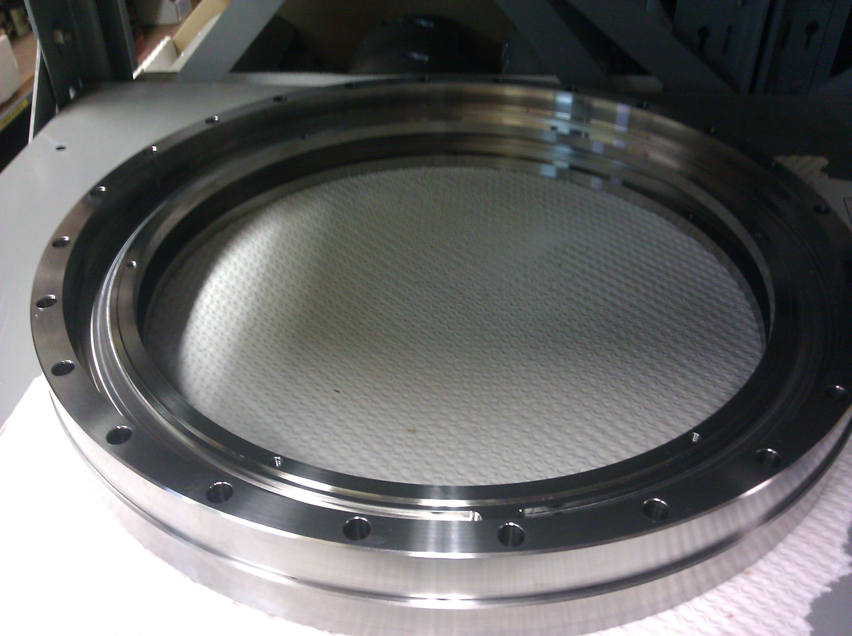
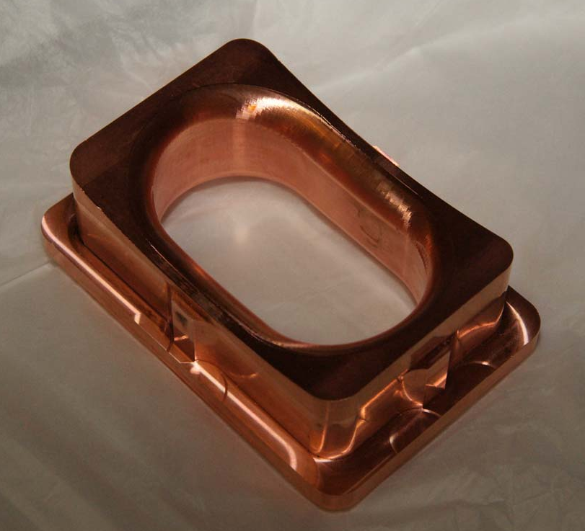
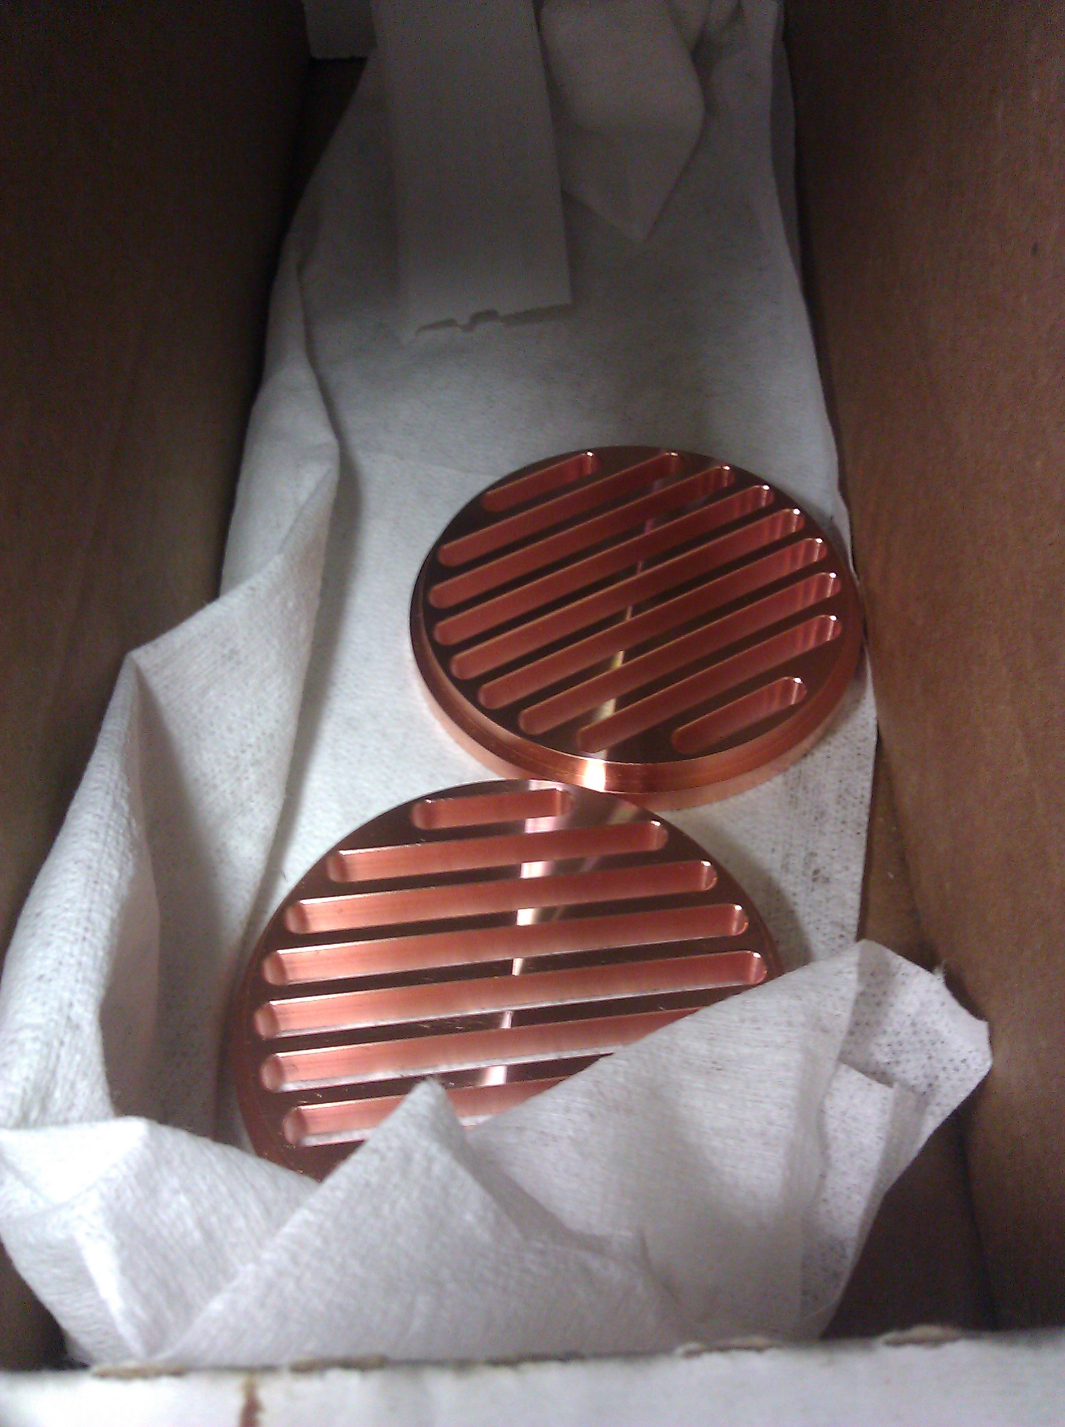
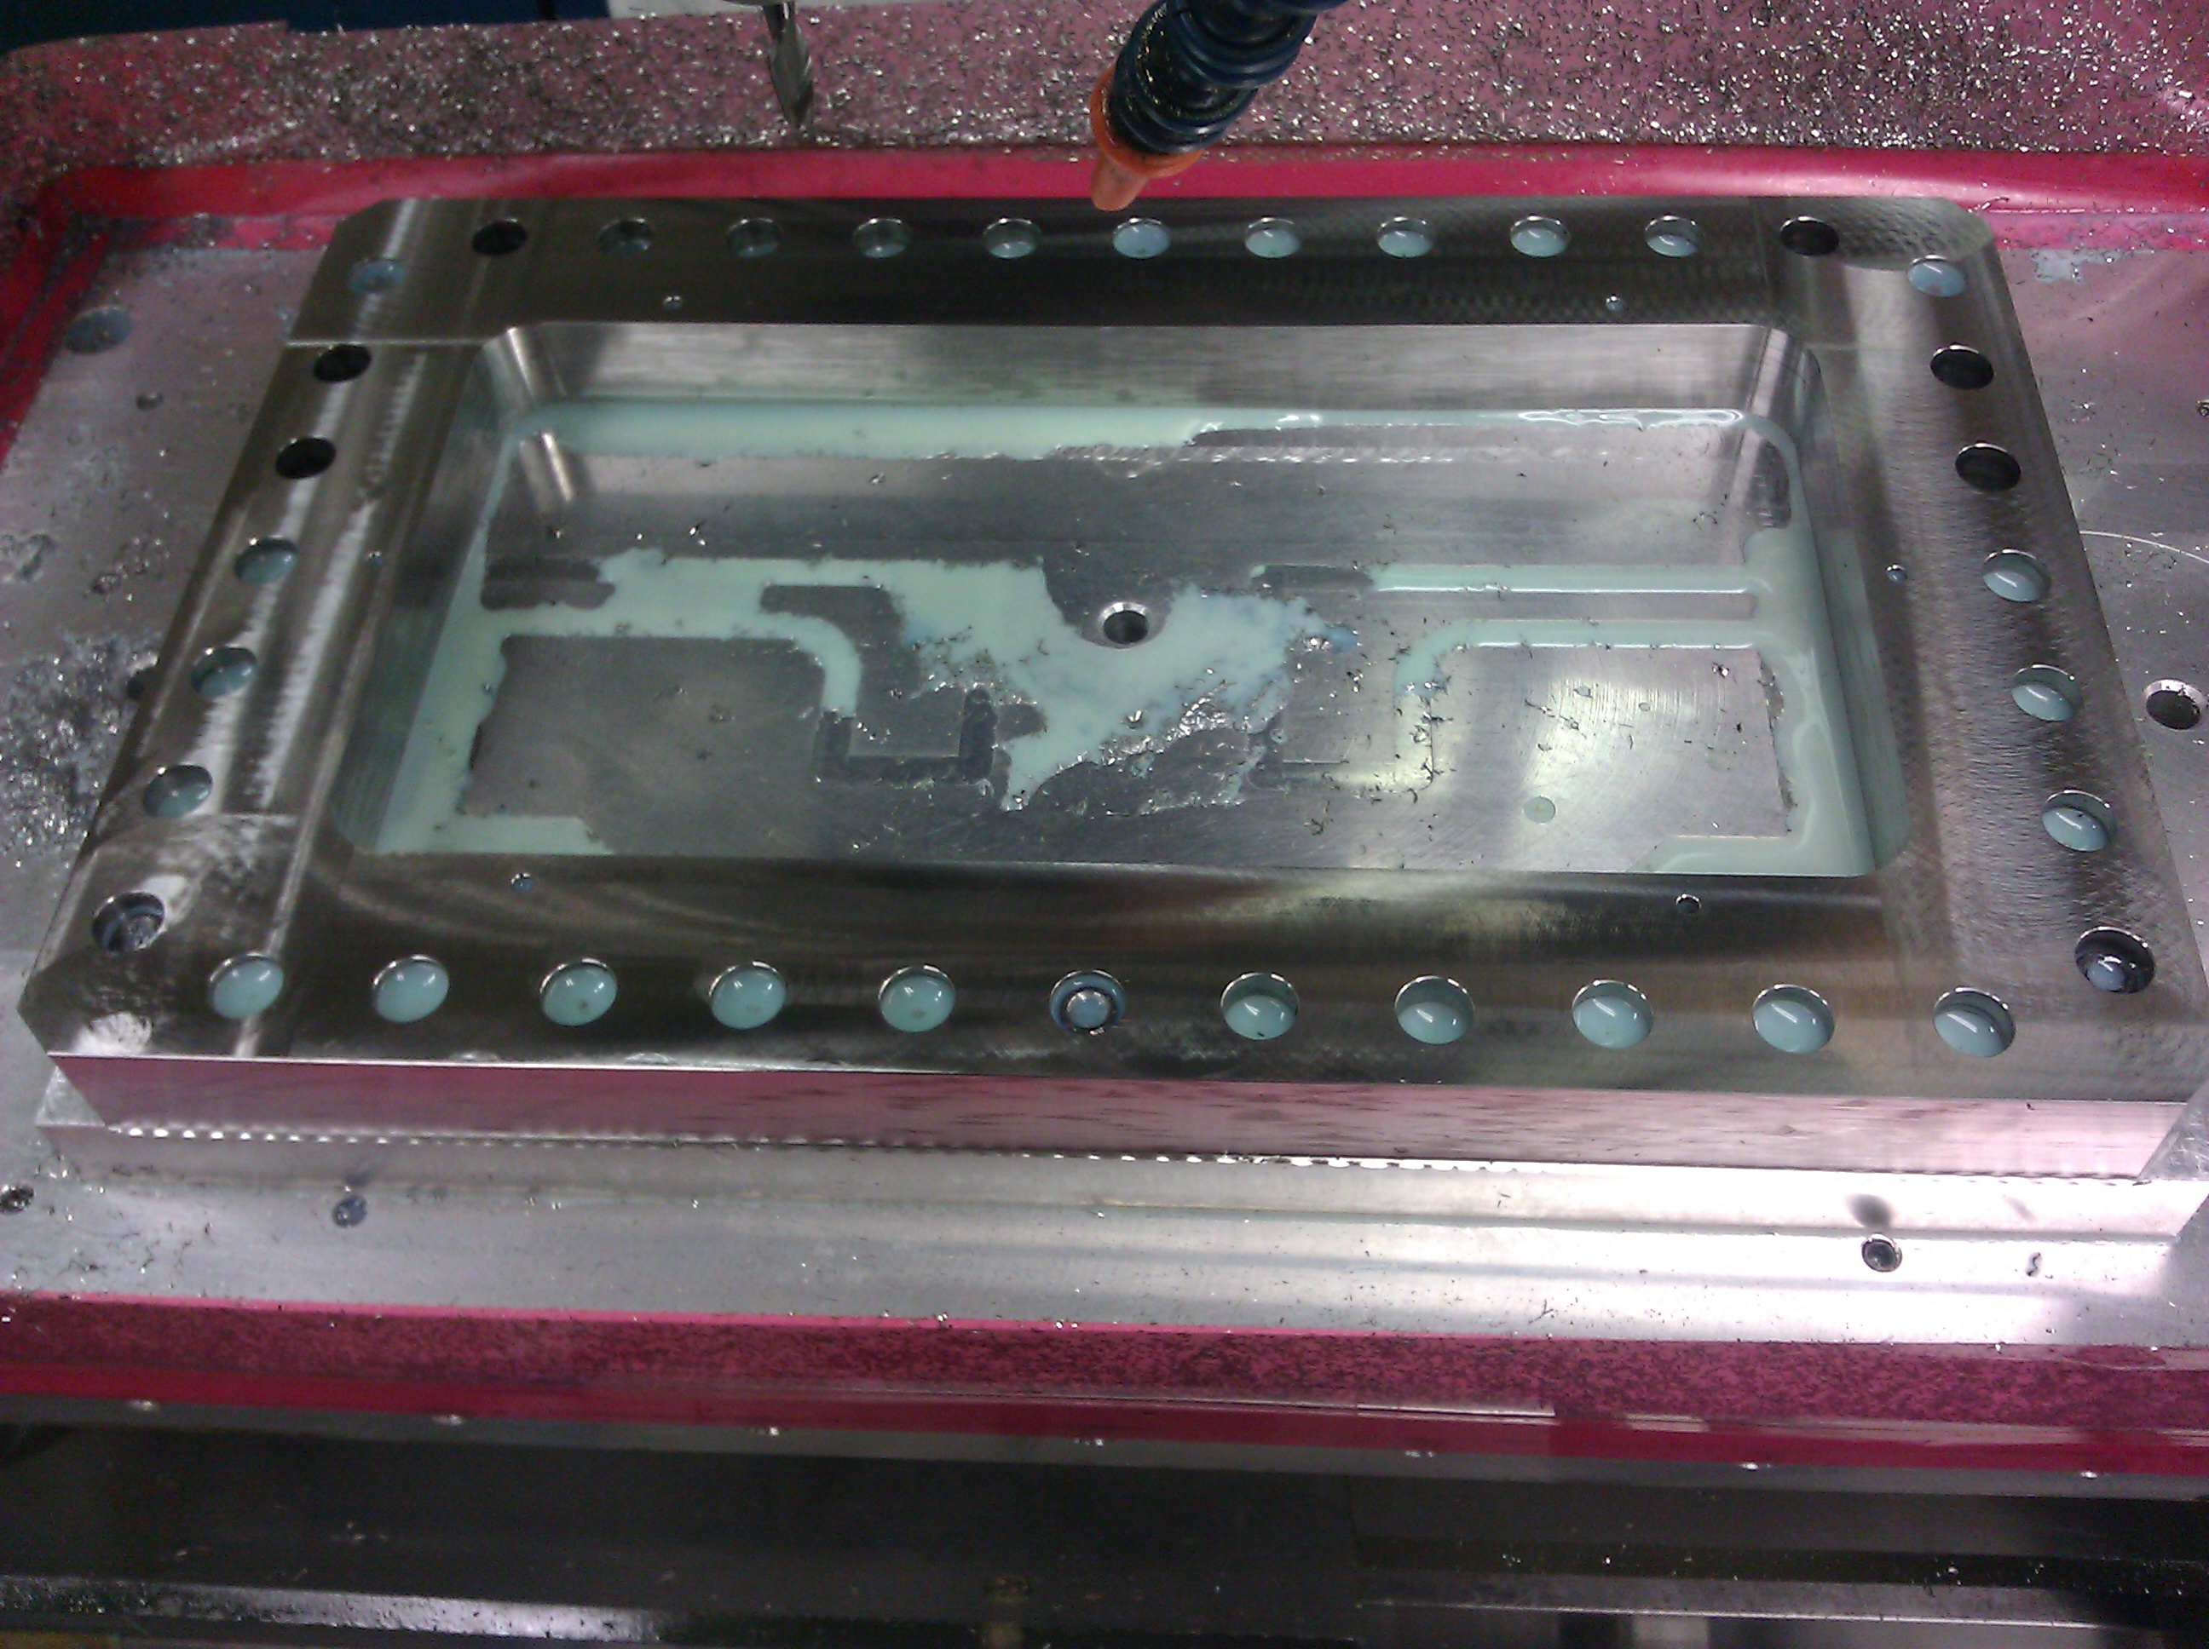
The Modular Cavity Fabrication
Parts are being fabricated, and the cavity will be brazed, low power measured at SLAC
The cavity will be delivered to MTA,
Fermilab for high power test by end
of FY2013

Slide 6
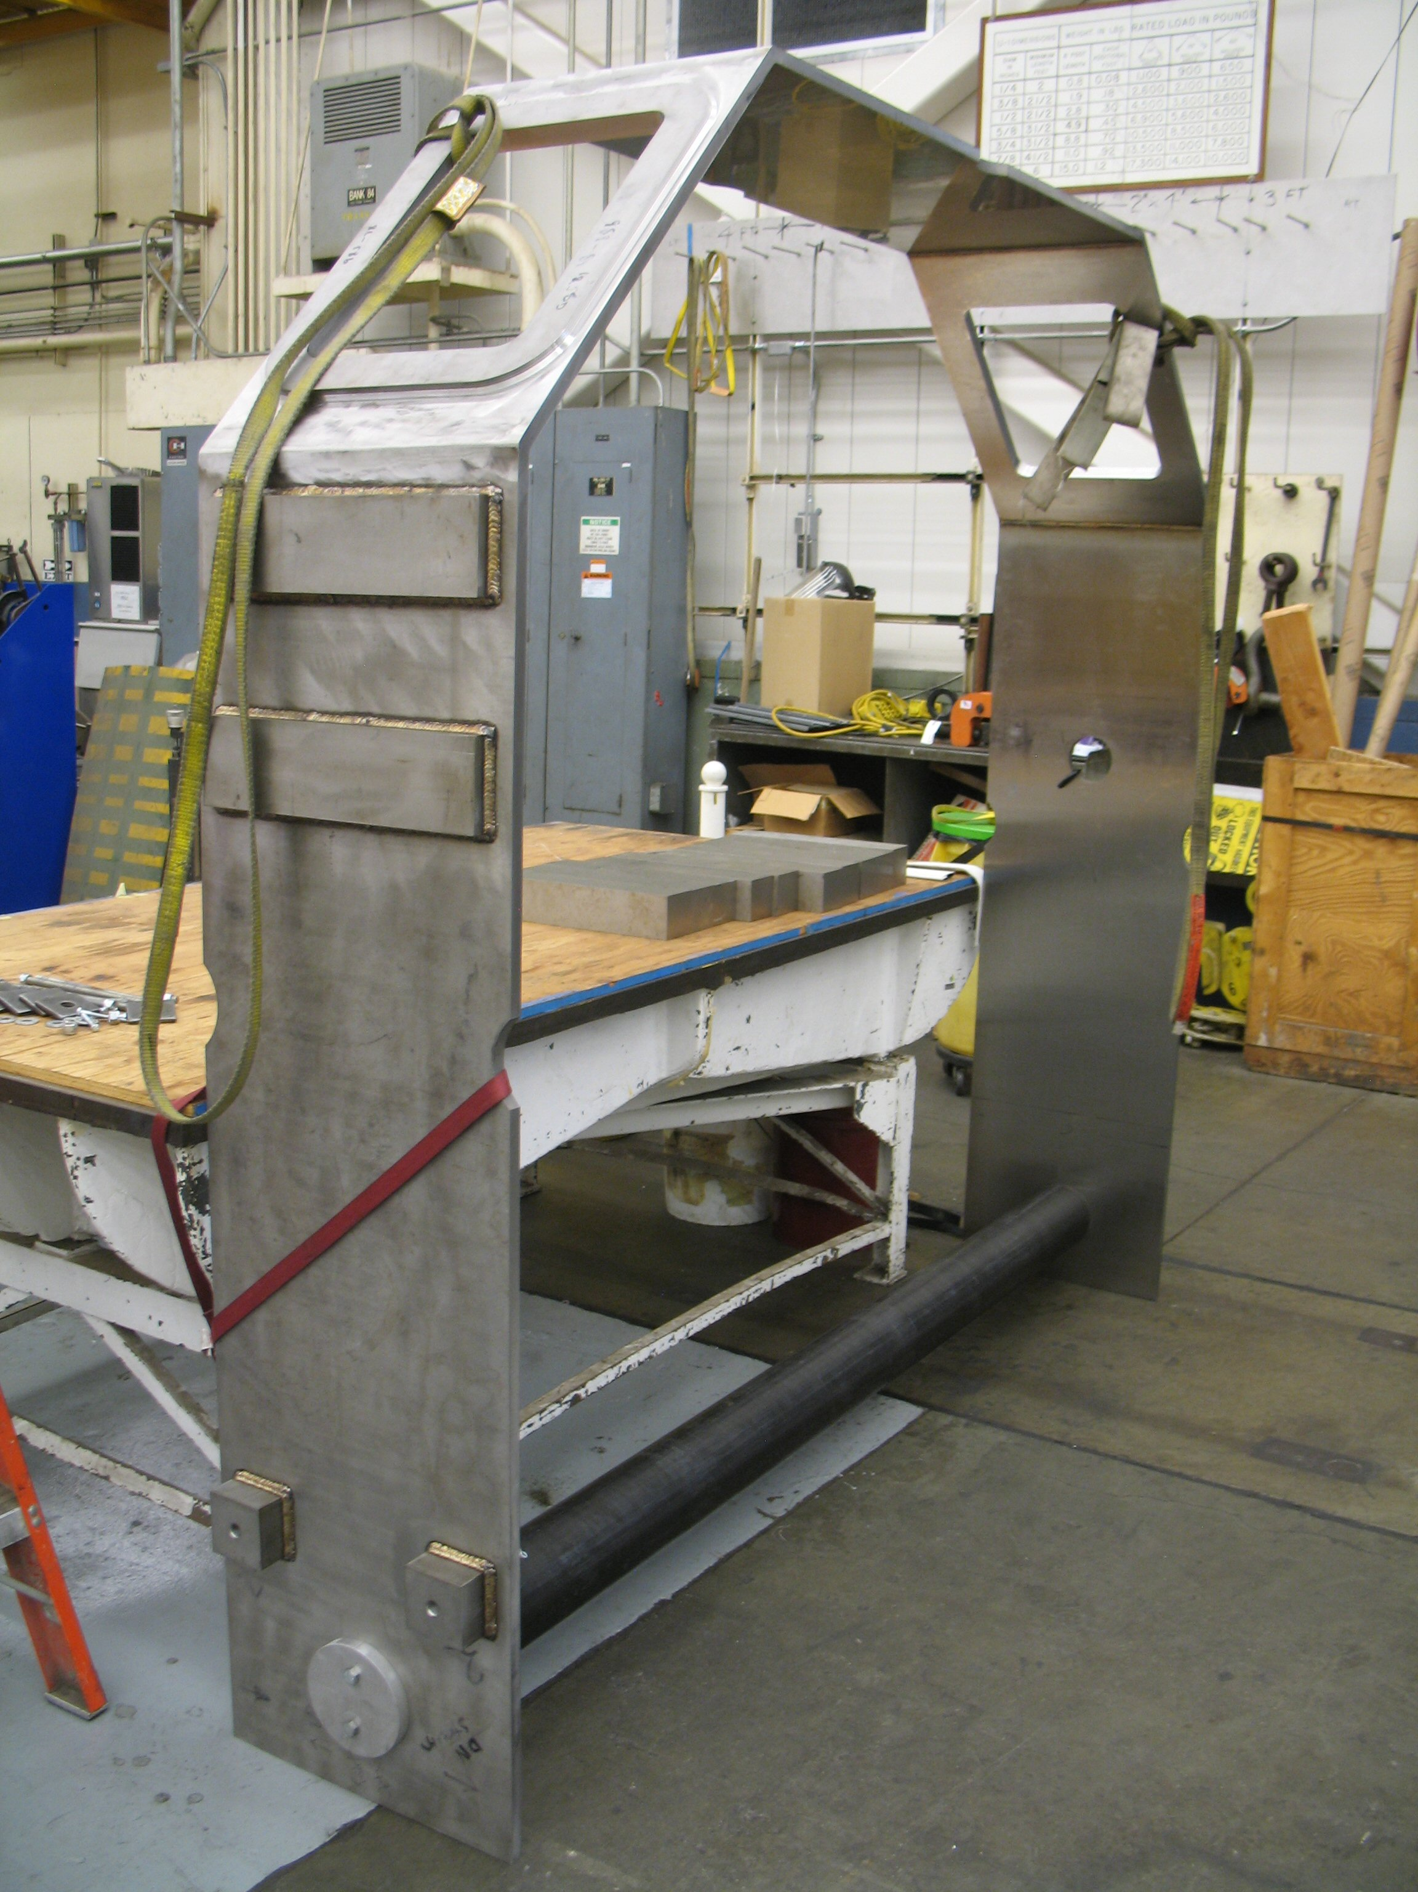
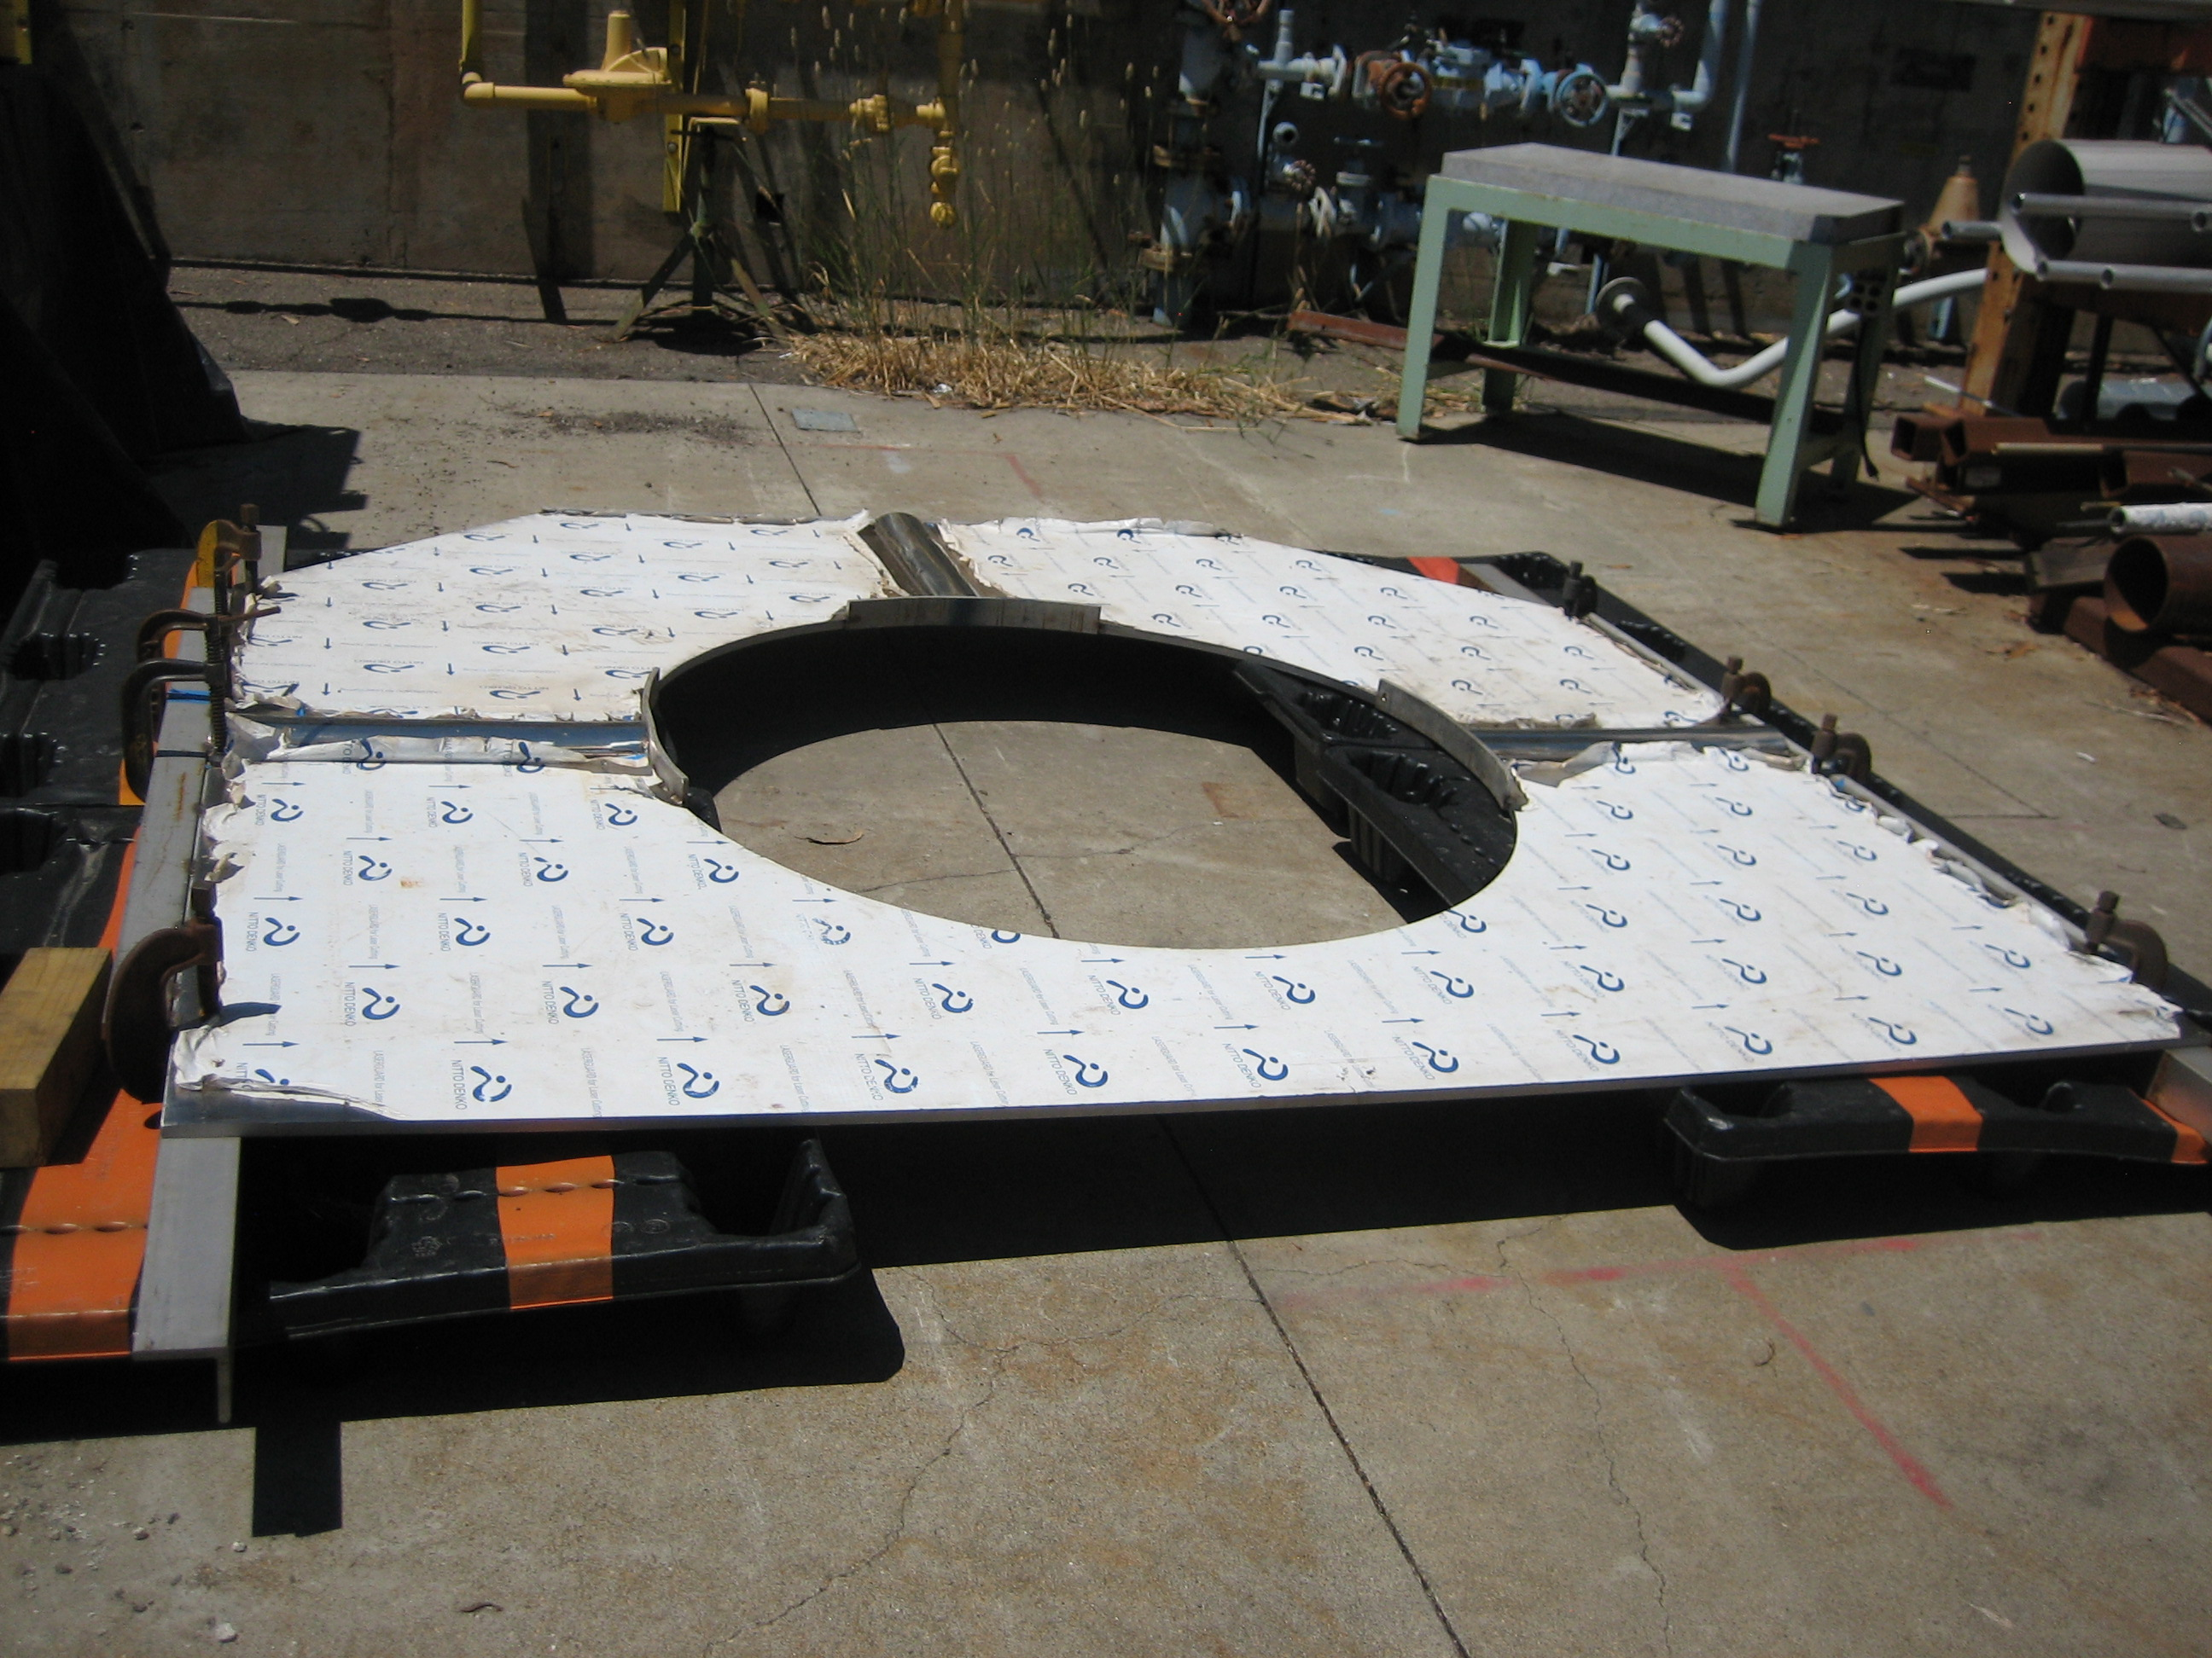
Cryostat Vessel Fabrication
Large vessel with tight tolerance
New Water Jet cuts the parts
Fixture developed to minimize distortion due to welding and handling
CC Cryostat Vessel Fabrication at LBNL
Design

Slide 7
14 June, 2013
3.2 – Superconducting RF
Don Hartill
.
Begun examining stored energy issues for both 325MHz and 650MHz SRF cavities
Research Instruments continues work for completion of the two 500 MHz cavities
Research Instruments shipment of 500 MHz cavities expected by end of FY13
Testing of 500 MHz explosion-bonded cavities expected in late spring and early summer. Testing to be completed by mid-summer
Preparation of 3GHz electroformed cavity by summer
500MHz cavity preparations by Research Instruments
Progress for the SRF program will be reported at the MAP Collaboration meeting at FNAL

Slide 8
June 13, 2013
Magnets – 03-03
J. Tompkins
Rapid Cycling Magnets /HTS : Completed engineering design of Rapid Cycling HTS Magnet test system to be assembled at E4R enclosure
[….]
Summary of Previous Month
HTS (2212) Program - The new 19x36 wire PMM130411 was heat treated and its I_{c} was measured up to 14 T. At 5 T, its I_{c} reached 160 A. Test fixtures were designed and being machined for the coil .
HTS Magnets / ReBCO - Repairs have been made to one double pancake; a new diagonal splice has been used; the splice and one pancake have been repaired. The same repair has then been applied to 9 of the 12 double pancakes
Helical Solenoid (HCC) – Progress in the investigation of using 3d printing to create parts for the coil former and shell; conceptual designs are in development – parametrized cable added to the model, which follows the actual winding path
General Magnet Design - No activities in May-June except paper writing and presentation at IPAC2013 and slide preparation to the CM.
Rapid Cycling Magnets / Conv – We are working on twisting bunches of conductors to make Roebel cables to ensure that the amount of flux going through current loops is the same.
Rapid Cycling Magnets / HTS - Procurement of materials for magnet and lead cryostats complete; components of magnet and leads cryostat submitted for fabrication at VMS; study of scaling the HTS rapid cycling magnet for the Muon Accelerator
HTS (2212 ) Program – Continue work to develop tooling and Rutherford cable from the improved conductor; wind, react, and test coil using 1.2 mm single strand using overpressure processing.
HTS Magnets/ReBCO – Disassembly and examination of midsert coil and inspection of individual pancake coils; identify source of degradation; development of formal test procedure; failure analysis report
Helical Solenoid (HCC) - Development of magnet specifications; development of preliminary magnetic, mechanical, & cryogenic designs
General Magnet Design – continued collaboration on development of CR/IR magnets: cross-sections, field characteristics, heat loads, etc. with CR Group (Mokhov) on requirements, as needed
Rapid Cycling Magnets – HTS Continue with fabrication of system components; begin assembly of test system
Rapid Cycling Magnets – Conv Develop procedure for transposed Cu strands; test and compare to calculations
Upcoming Work (Next Month)
HTS (2212) Program - The critical current facility has been shut down for safety review. Once it is back to operation, the coil will be tested at 4.2 K and in fields up to 14 T. Its quench characteristics will be tested and analyzed.
HTS Magnets / ReBCO – cont. with repair and apply to all coils (damaged or not); assembly al 24 pancakes into 12 double pancakes; test each double pancake.
Helical Solenoid (HCC) - Continue with initial design and engineering studies; magnetic and mechanical analysis (FEA) to set dimensions. With base dimensions set, designs for coil winding tooling will be developed
General Magnet Design – No plans for July (preparation to MT-23) work will be resumed in Aug-September focusing on HF SR magnet concepts.
Rapid Cycling Magnets / Conv – we plan to run OPERA 2D simulations of eddy currents in the iron laminations near the pole faces to find the magnitude of the second order derivative. Higher order moments can affect the lattice.
Rapid Cycling Magnets /HTS - Proceed with splicing of HTS strands to power lead; complete fabrication of magnet and leads cryostat components at VMS; continue study of applying HTS rapid cycling magnet technology for the Muon Accelerator

Slide 9
14 June 2013
03.04 Targets and Absorbers
Kirk McDonald
Ding: Finalized IPAC13 paper, began pion production calculations for 3 GeV proton beam.
Weggel: Finalized IPAC13 paper; continued effort on coil configurations for short “tapers.”
Sayed: Finalized IPAC13 paper;
Graves: Finalized IPAX13 paper; more preliminary drawings of short-taper magnet systems.
Yan: Continued simulations of nozzle in the MERIT experiment, including effect of a weld bead.
McDonald: Present 5 Target System papers at IPAC13.
Extend target system conceptual design up to start of buncher (including chicane in decay/drift region).
A big new effort, to continue over several quarters, is to evaluate Target-System options for staging scenarios, with initial emphasis on 3-GeV proton energy, 1-MW power. Reconsider a toroidal-horn option, as well as the (baseline) solenoid- capture option.
A preliminary sketch of effort needed to evaluate staged scenarios for the Target System is at http://www.hep.princeton.edu/~mcdonald/mumu/target/staging_effort.pdf
Begin studies of Target Systems for 3-GeV, 1-MW staging option.

Slide 10
14 June 2013
3.5 – MuCool Test Area
Yağmur Torun
201-MHz vacuum RF: assembly work about to start
Infrastructure – on track but late: beamline upgrade, RF switch re-commissioning, station-2 vacuum system
Data analysis: HPRF beam test PRL draft under revision (B. Freemire, K. Yonehara, A. Tollestrup, M. Chung); beam spot analysis RSI published (M. Jana); all-season cavity data review in progress
Mechanical support for RF program
Electrical support for beamline upgrade
Single-Cavity Module assembly, installation
Pillbox with grid windows, all-season cavity high-B run
Beamline commissioning
Solenoid: training complete (J. Volk, M. Leonova, J. Makara)
Dielectric loaded HPRF: cavity reassembled/tested without rod (K. Yonehara, G. Flanagan, A. Moretti)
201-MHz Single-Cavity Module: much progress at installation workshop (May 28-29), tuner response tested, instrumentation plan formed (L. Somaschini, D. Peterson, R. Pasquinelli, A. Moretti); safety documentation prepared (J. Volk)
Data analysis/publication
magnetic insulation
Be-Cu buttons
HPRF beam test
Current program
All-season cavity in magnetic field
B > 3T
Dielectric-loaded HPRF
Next on the list
Grid windows on pillbox cavity
201-MHz Single-Cavity Module
New 805-MHz modular cavity
Other
Beamline commissioning
805-MHz all-season cavity: operation in B>3T
DL-HPRF cavity: retesting with dielectric rod
Old pillbox cavity: install grid windows
201-MHz Single-Cavity module: RF control system upgrade, tuner instrumentation tests, mount/dress cavity in Lab-6, start LLRF measurements
Modular cavity: instrumentation

