Slide 1
Oleg Sotnikov
Novosibirsk State University
1 master course
INP scientific advisor A. L. Sanin
Commissioning photo-injector gun on ASTA
PARTI supervisor E. Harms

Slide 2
Advanced Superconducting Test Accelerator (ASTA)
ASTA is unique among accelerator user facilities in six principal ways:
• High repetition-rate
• High average power
• High energy: ASTA accelerates electrons to ~1 GeV
• Extremely stable beams
• Superconducting technology
• Storage ring

Slide 3
Advanced Superconducting Test Accelerator (ASTA)
Photocathode laser: illuminates the photocathode by 263 mm wavelength light which is directed by a 45° off-axis mirror downstream of the RF coupler.
Electron gun: 10 mm diameter molybdenum disk coated with Cs₂Te.
Beamline elements: the electron gun is followed by two SRF cryomodules to accelerate beam to 50 MeV.
Low energy diagnostics: BPM’s, profile monitors, resistive wall monitor, loss monitors.
High energy beamlines: The beam will be initially transported from the cryomodule string to the first high energy spectrometer magnet by a 4-quad matching section, a 4-quad FODO lattice, and an additional 4 quad matching section. This region of beamline is 45 m in length and is intended to house future AARD experiments.

Slide 4
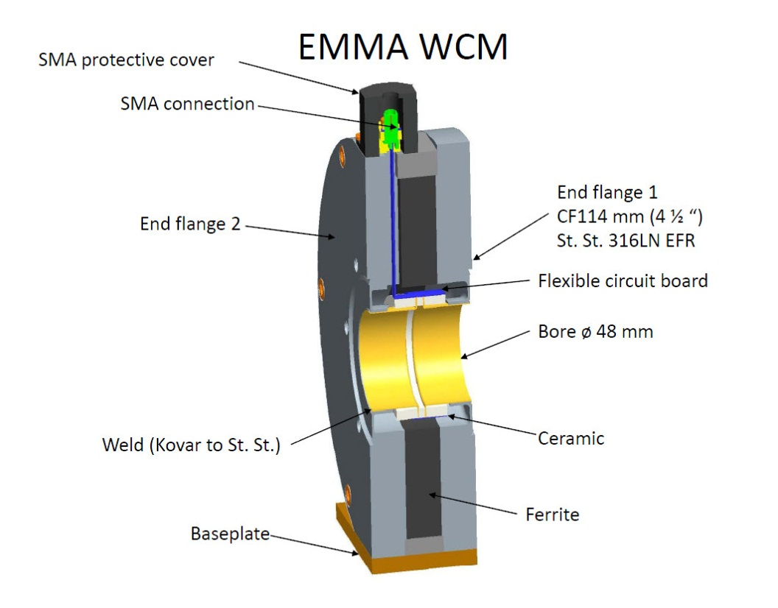
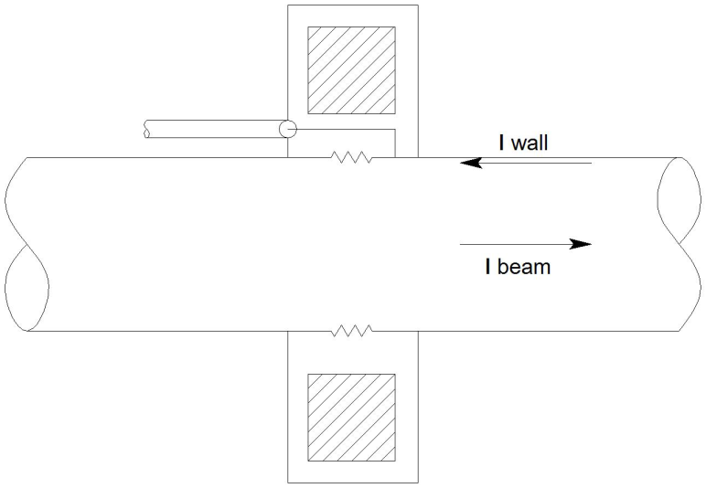
Resistive wall current monitor
A resistive wall current monitor, basically consist of a resistive gap along a conducting pipe. Charged particles traveling inside the vacuum pipe, produces an image current along the inside surface that has equal magnitude but opposite sign. When this image current passes through the resistive gap, a voltage signal is produced.

Slide 5
Internship goals
What will I do?
Calibrate resistive wall monitor (with Scientist & Engineer)
Understand monitor operation
Prepare a Users Guide
Participate in SRF Cavity cold operation (as conditions allow)
What would I get?
Study electron accelerator physics on ASTA
Get better understanding of international collaboration on big physical devices like ASTA

Slide 6
Thank you for attention!

Slide 7
Recent results
mV
I_{in}, mV
Freq of signal, Hz

