Slide 1
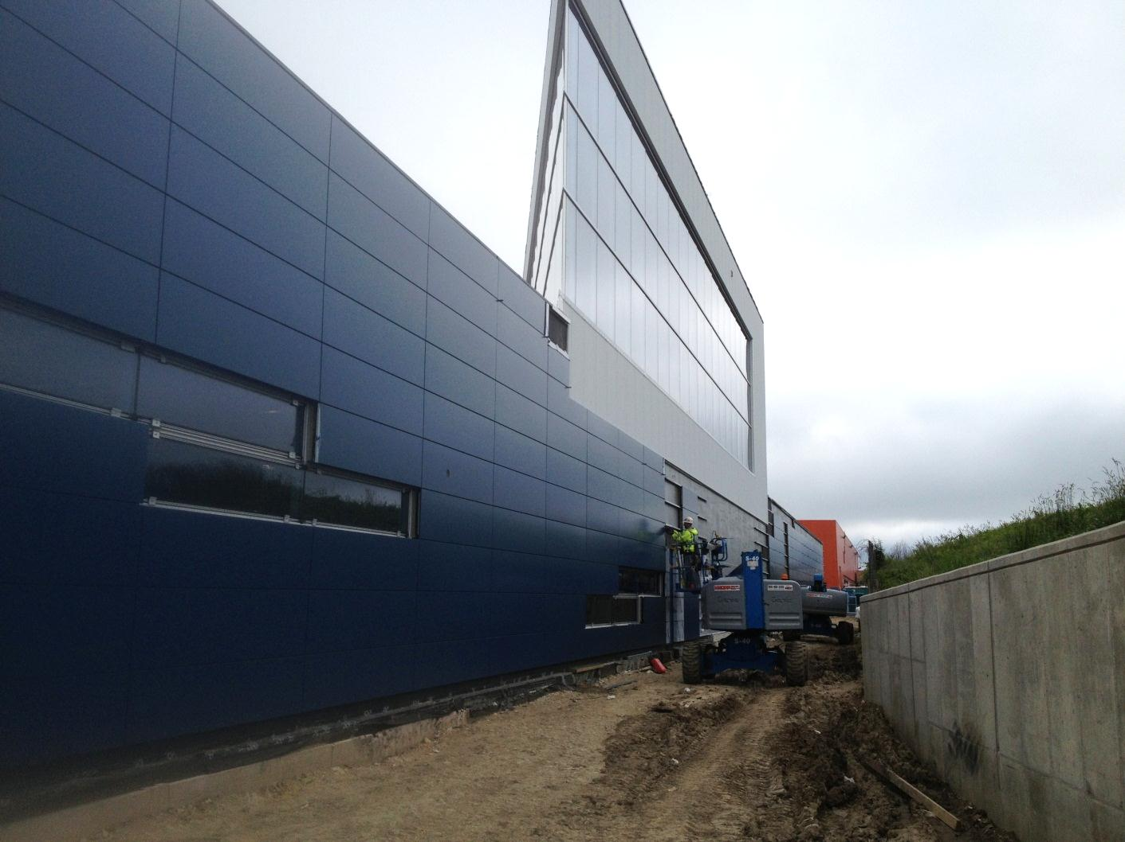
OTE Building PMG Report
June 24, 2013
Rhonda Merchut

Slide 2
Agenda
OTE Building Project:
  Coordination
  State Activities
  Schedule
  Fiscal
  Summary Action Items

Slide 3
OTE Outfitting GPP G13-211
FY 13: $2M for VoIP/networking & Contingency.
  Layout studies underway. Coordination with WH Space Task Force.
  Initial discussions w/ security. Arrangements underway for site visit for security system vendor.
  Networking/VoIP planning underway.
    CD site visit 6/20/13.
    Coordination w/ OTE contractor to allow early access to building for underfloor cable installation.

Slide 4
IASU Update (IGPP)
Phase 2 scope approximately 85% complete.
CDF Coordination
West ramp concrete replacement complete and returned to use.
Interior coordination for completion of bridge installation.

Slide 5
OTE Project Status:
Shop drawing review substantially complete.
350 RFI’s rec’d from contractor have been responded to.
Schedule Oversight on-going. Contractor has accelerated schedule.
Financial Oversight on-going.
Safety procedures continue to be expanded as more subs come onto the project.

Slide 6
OTE Project Status:
LEED procedures & Action Plan implemented.
  Contractor reporting 99% construction waste has been recycled.
  On track to meet goal of 20% (by cost) of regionally manufactured materials.
  On track to meet goal of 20% (by cost) of recycled content in materials used.
  Commissioning activities underway.

Slide 7
OTE Construction Status:
40-50 workers daily in the past month
  Exterior Enclosure
    Building is fully enclosed and substantially weather tight:
    Window framing & glazing 1st, 2nd, & 3rd floors
    Roofing
    Doors
  In-wall & under floor MEP underway.
  Framing, gyp board, and painting underway for partitions, walls, ceilings.
  Elevator installation underway.
  Geothermal field continues.

Slide 8
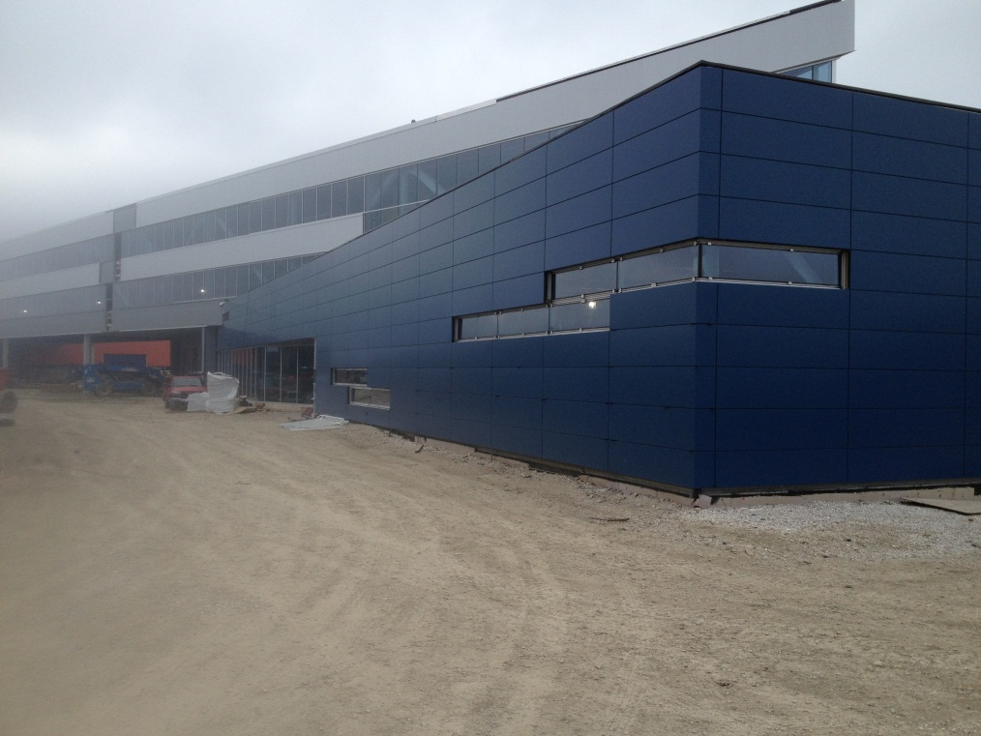
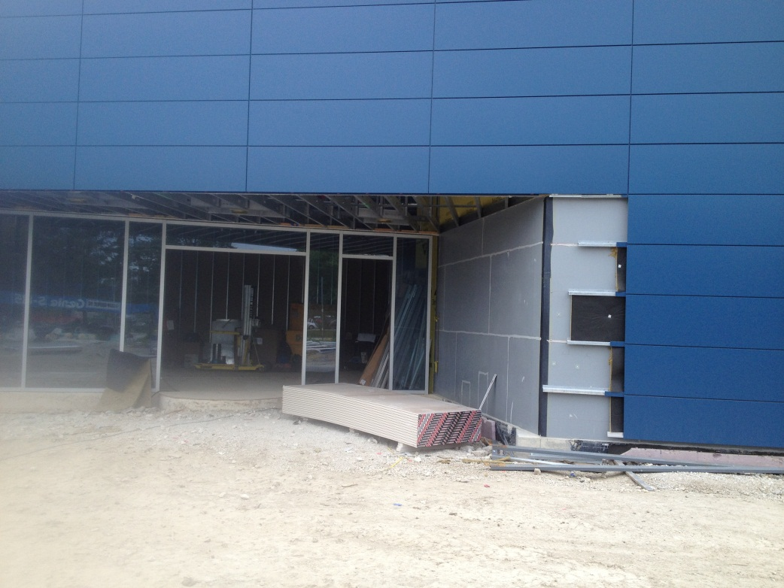
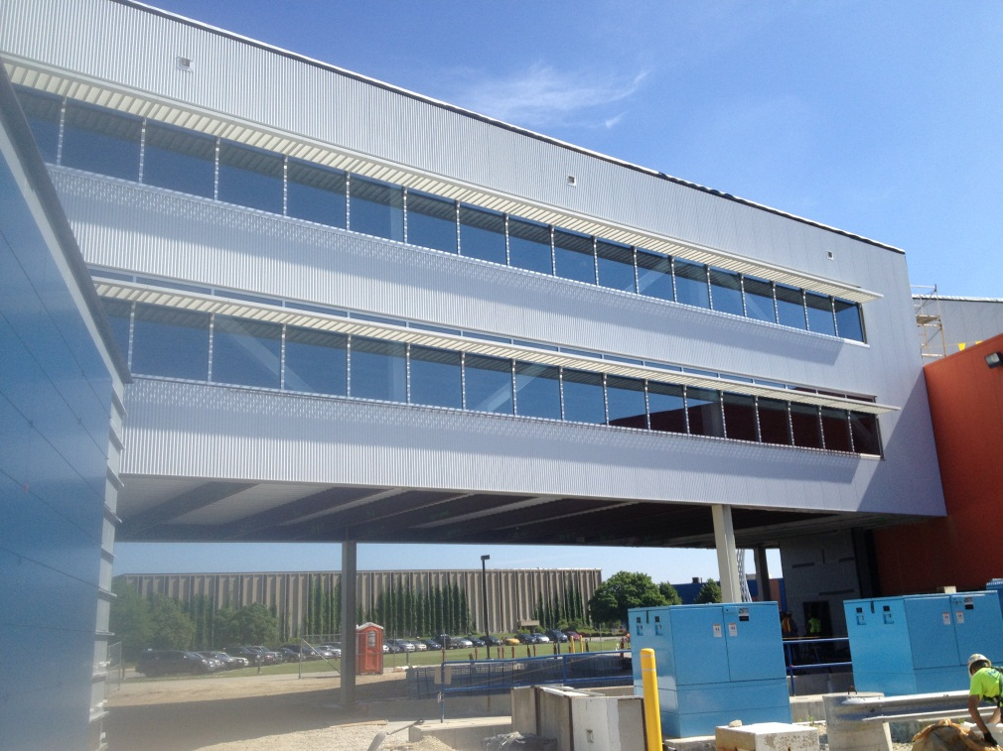
Exterior Panels

Slide 9
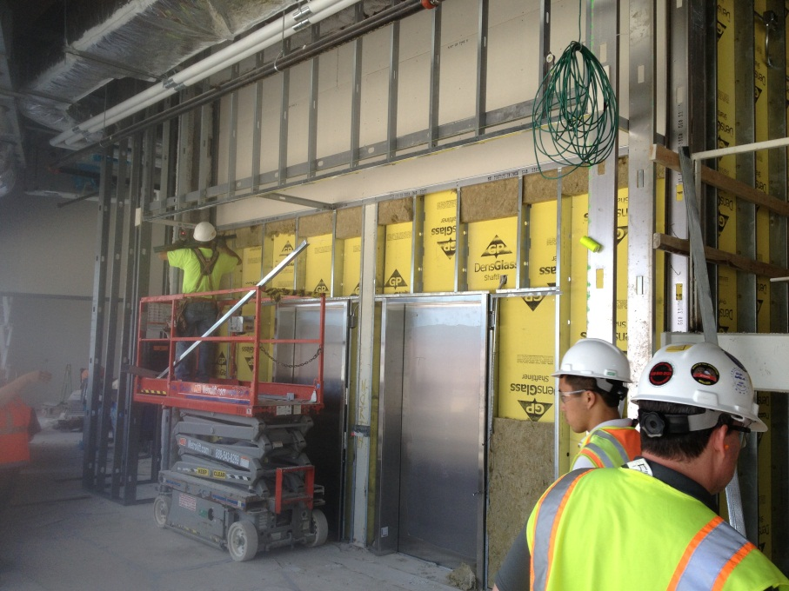
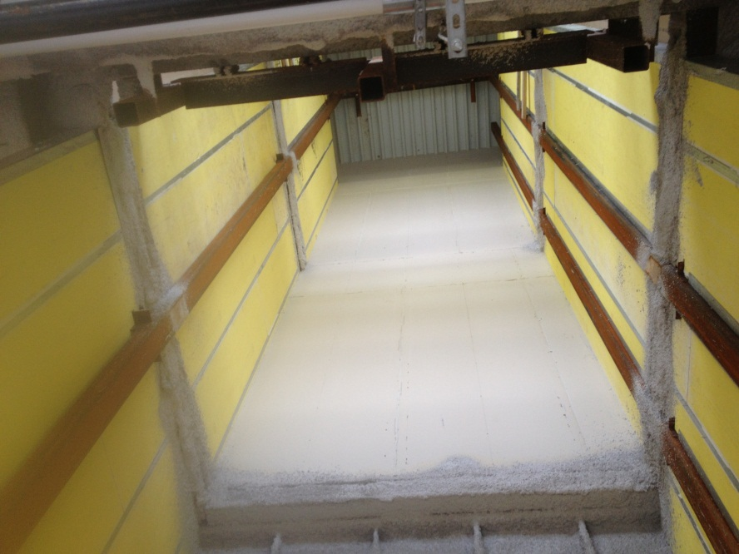
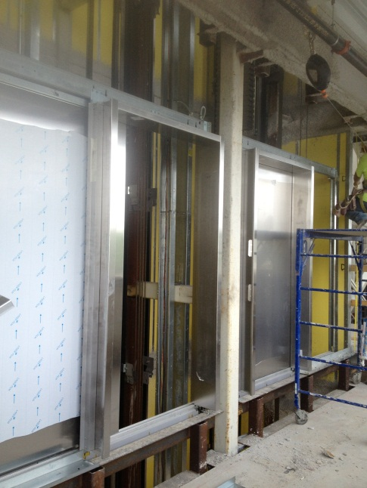
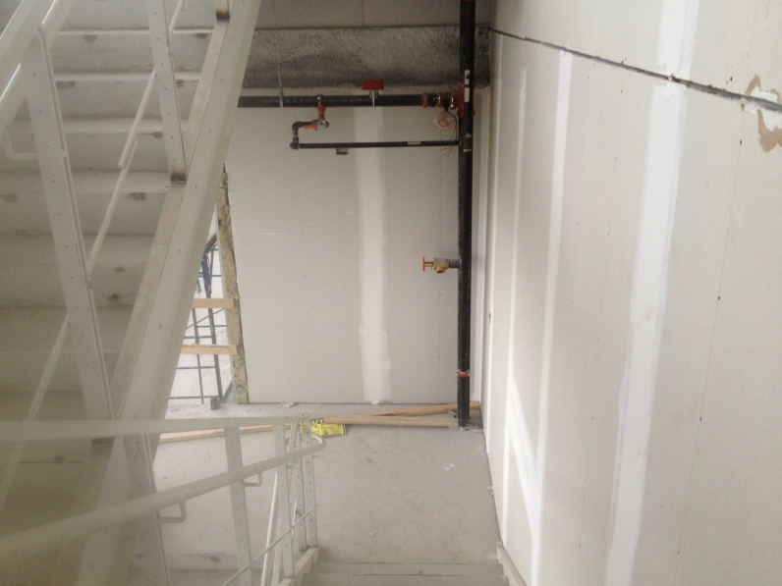
Elevators & Stairs

Slide 10
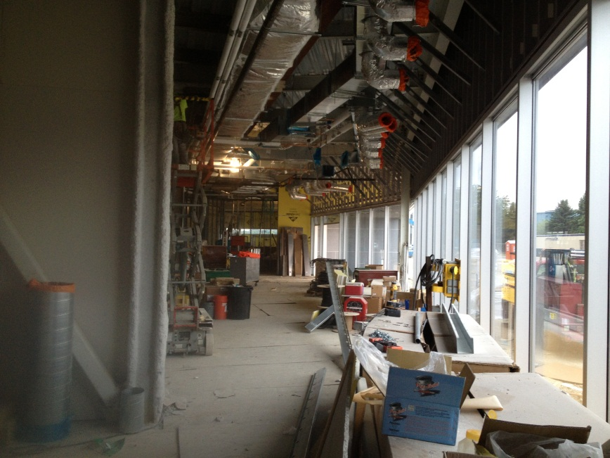
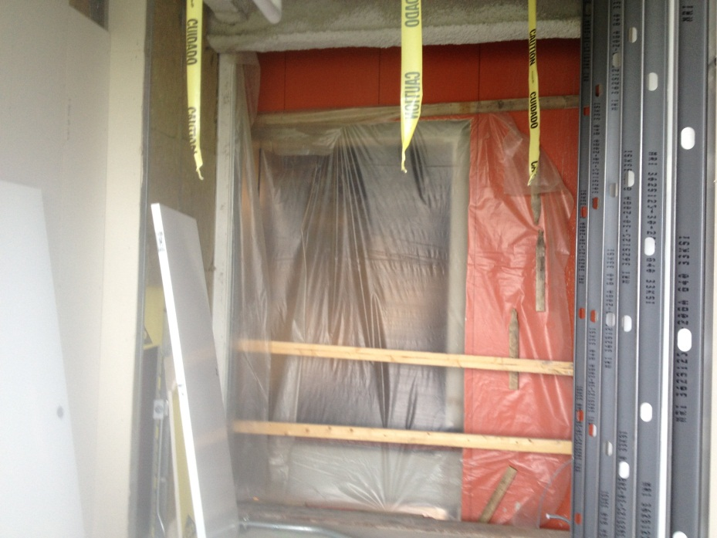
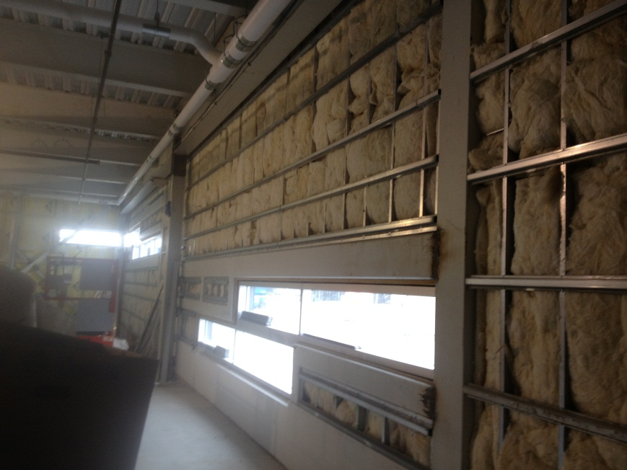

Slide 11
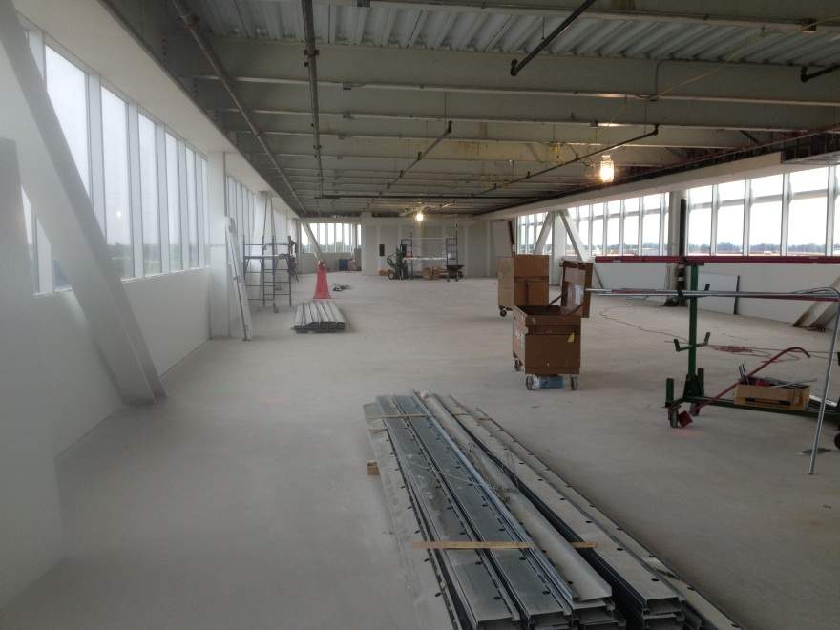
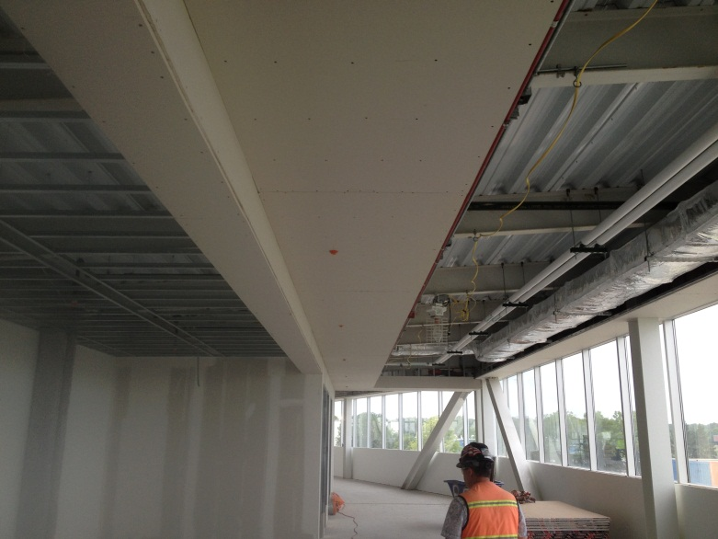
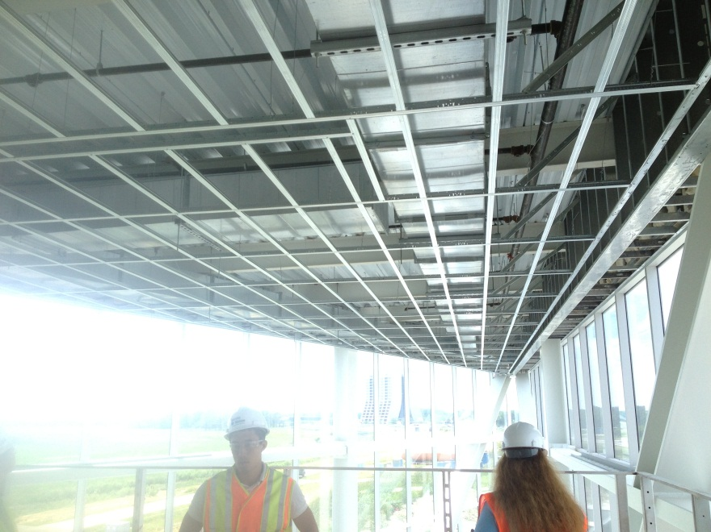
Framing & Gyp Board

Slide 12
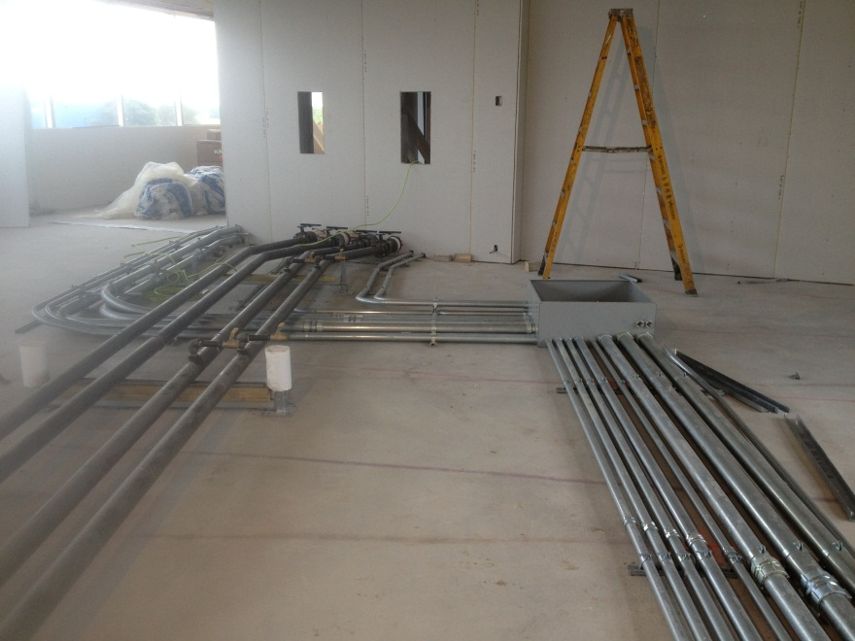
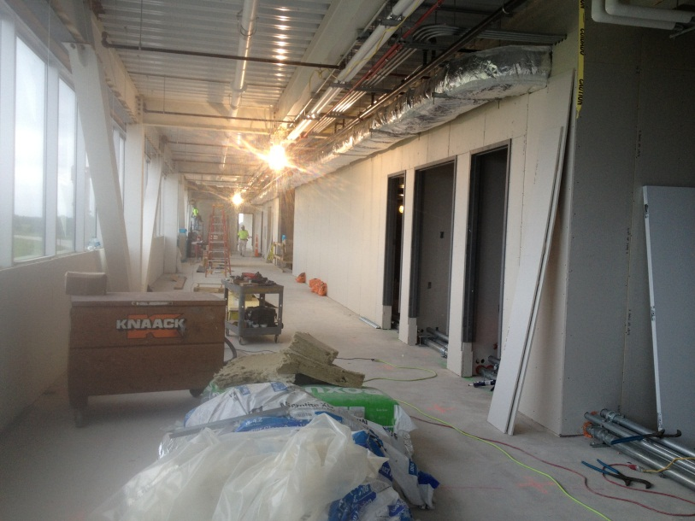
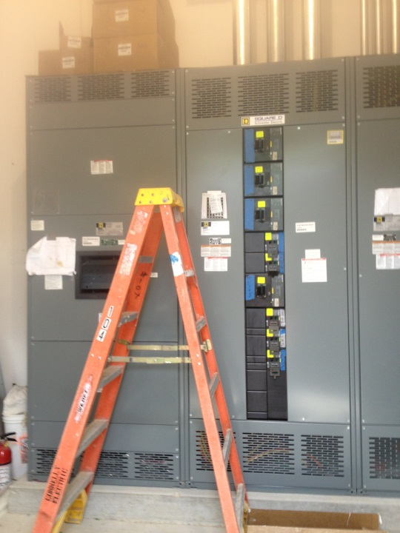
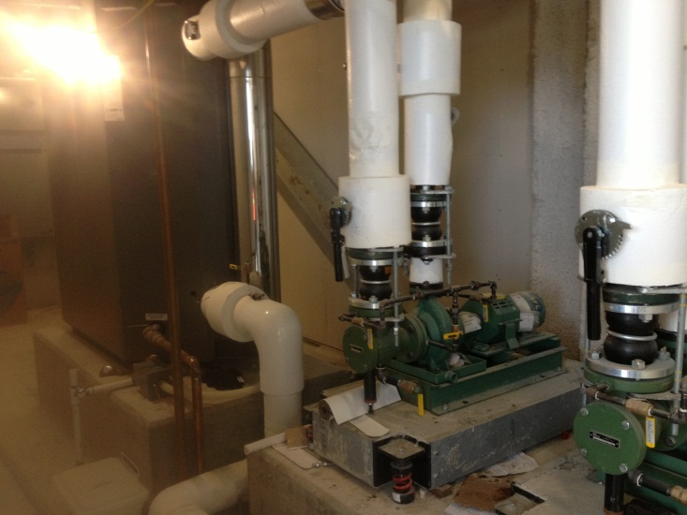
MEP

Slide 13
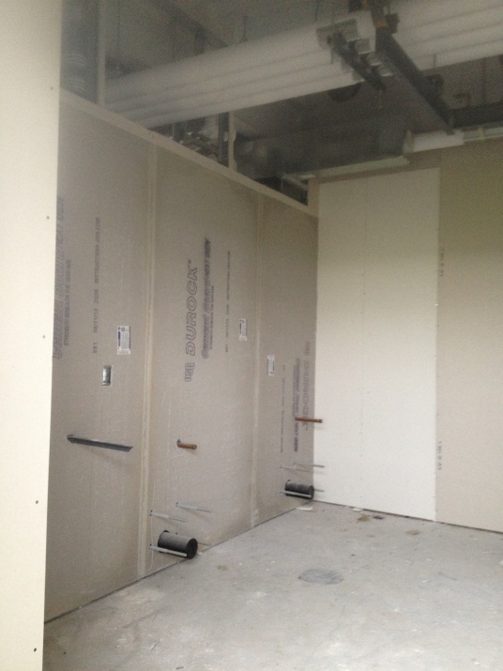
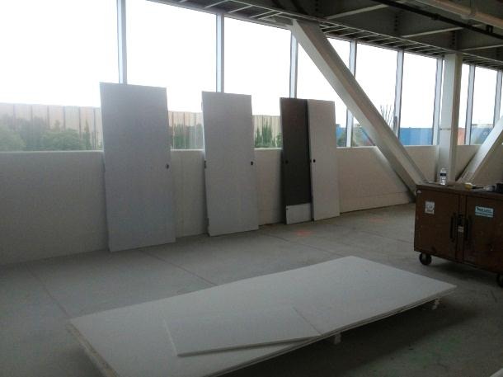
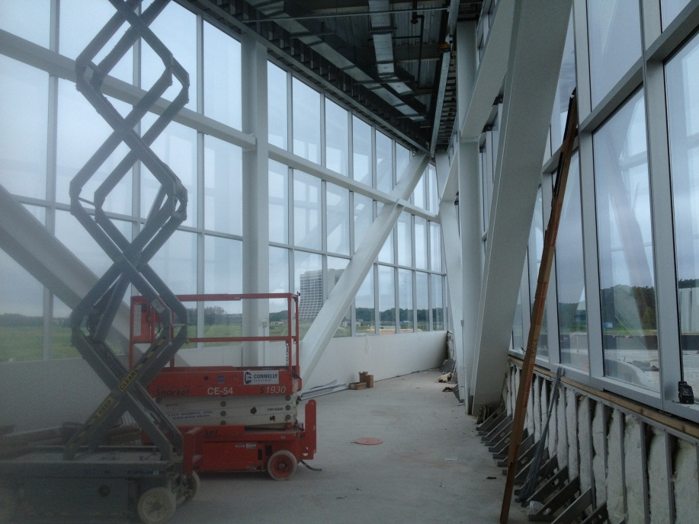
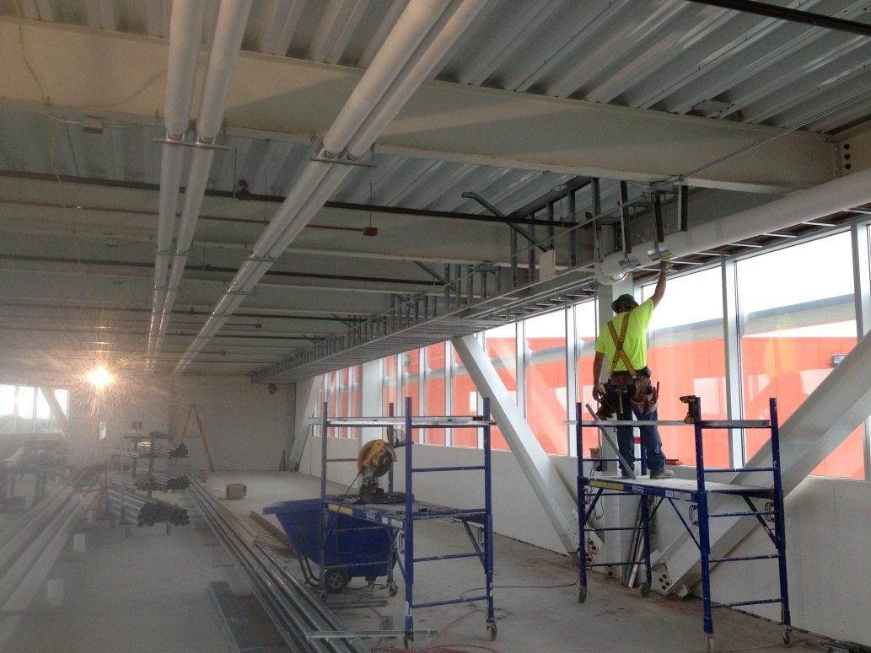
Interior Fit-up

Slide 14
Two Week Look Ahead
Gyp board installation
Painting
Door installation
Ceiling grid installation
Tile installation
Exterior detailing
MEP, FP under floor & in-wall pipe runs
Elevator installation
Geothermal

Slide 15
State DCEO Activities
DCEO quarterly report to State for quarter ending 5/31/13 to be submitted.
  Anticipate reporting $13.5M has been costed to date.
Project on schedule for grants to be 100% costed by 5/31/14 grant requirement.

Slide 16
Contractual Schedule Adjustments
No Schedule Adjustments
MS 1 Bldg Shell Complete: 6/19/13
MS 2 Substantial Completion: 11/5/13
  (Project is fully costed at MS 2, retention remains)
MS 3, Project Complete: 1/29/14

Slide 17
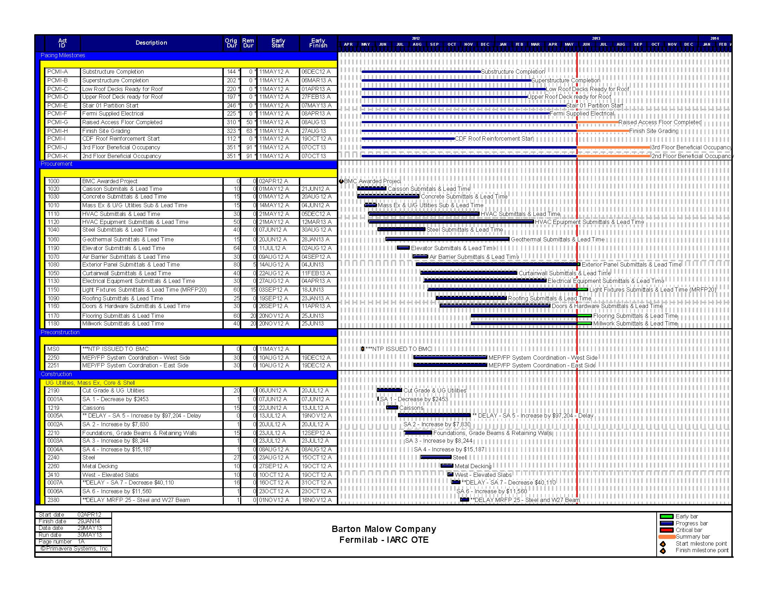
BMC Schedule- May

Slide 18
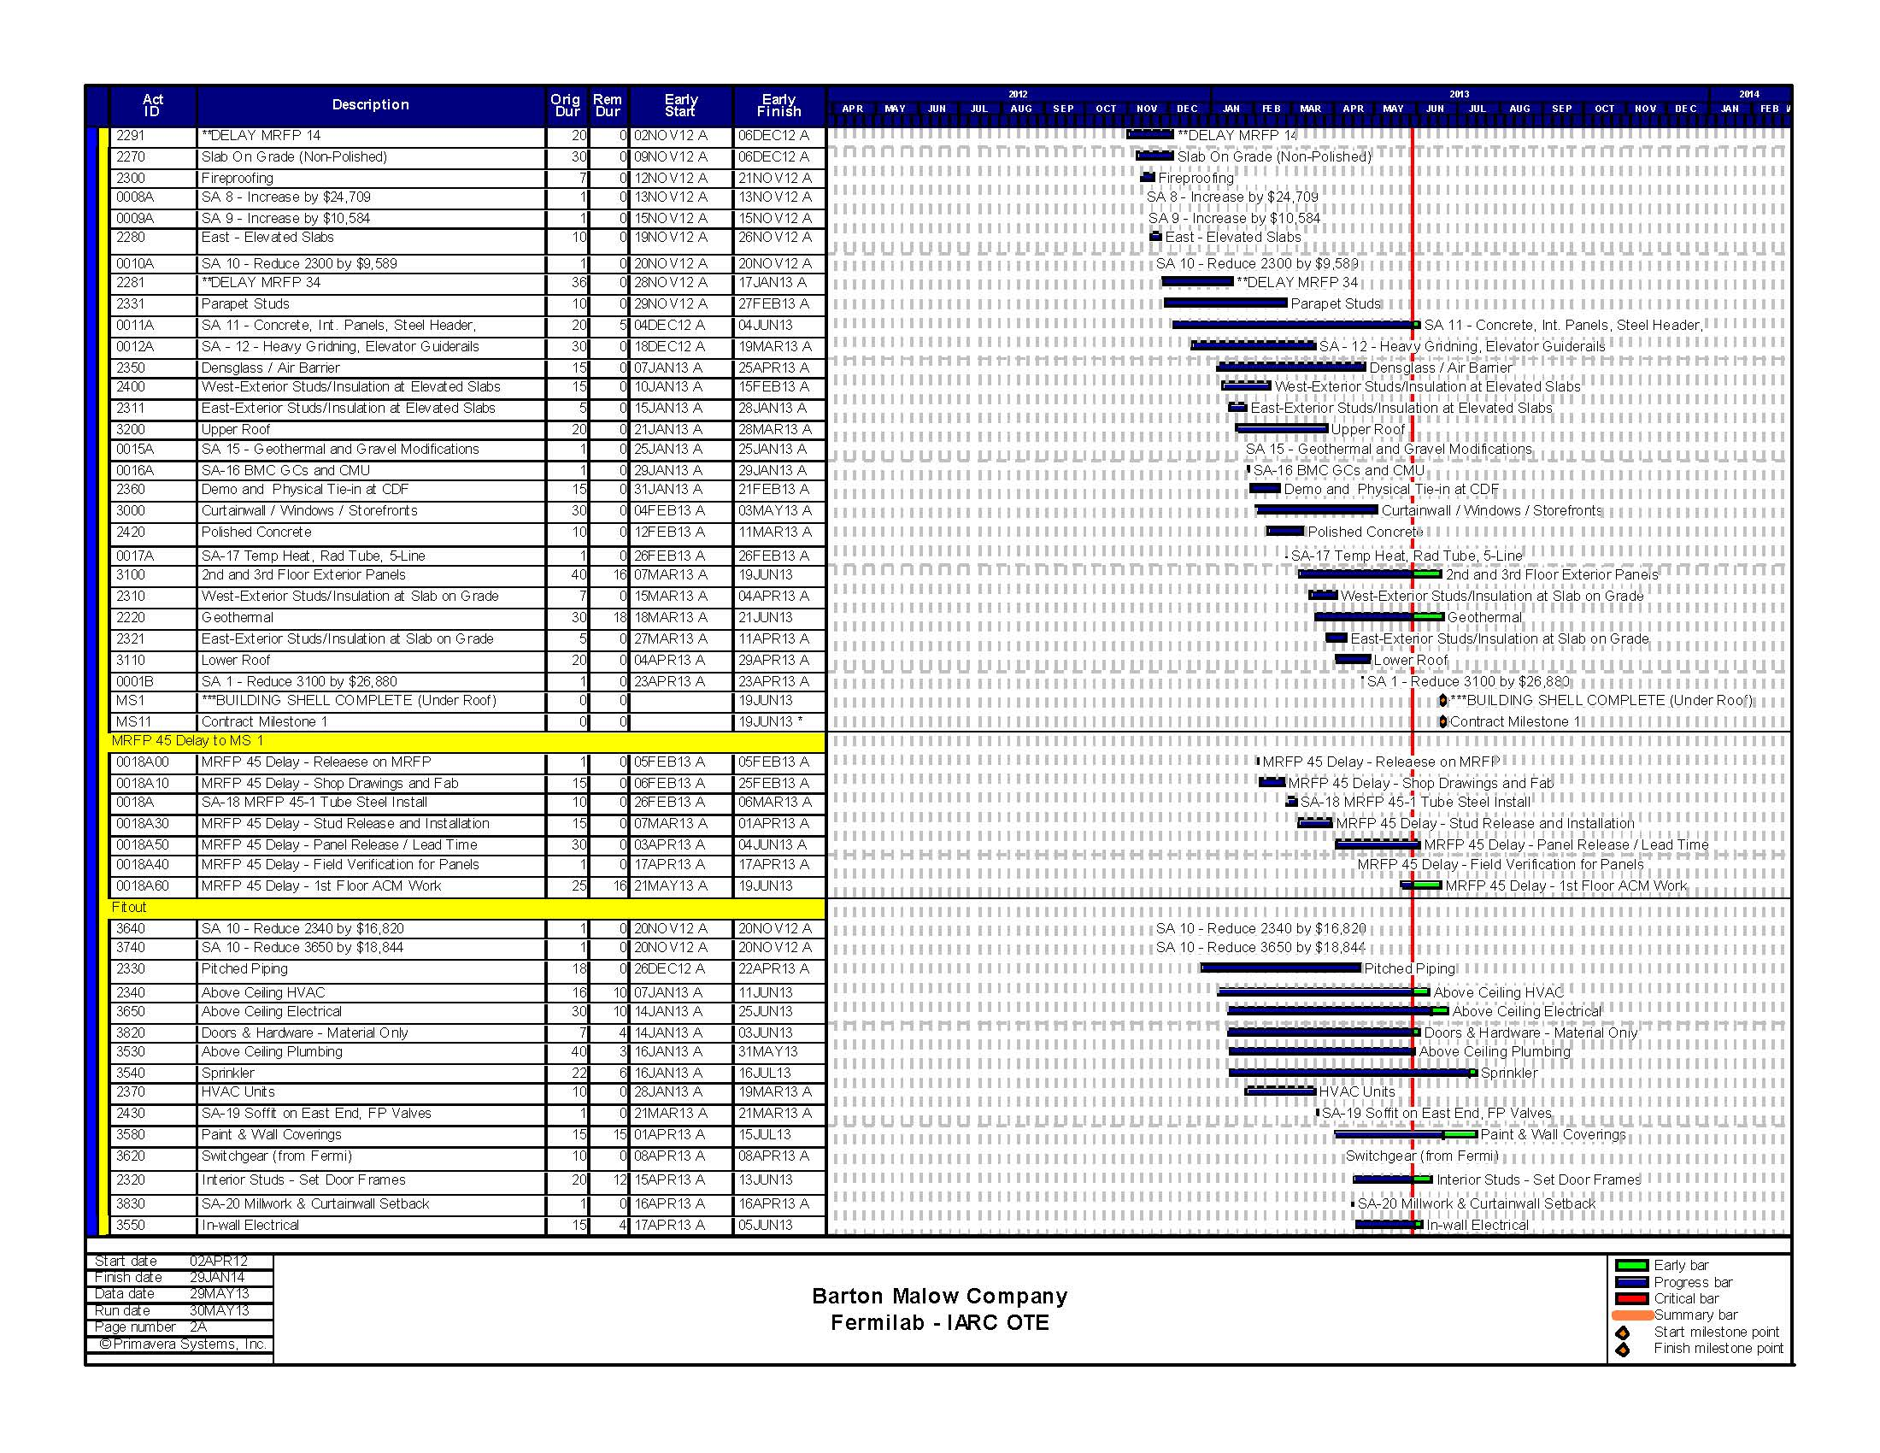
BMC Schedule- May

Slide 19
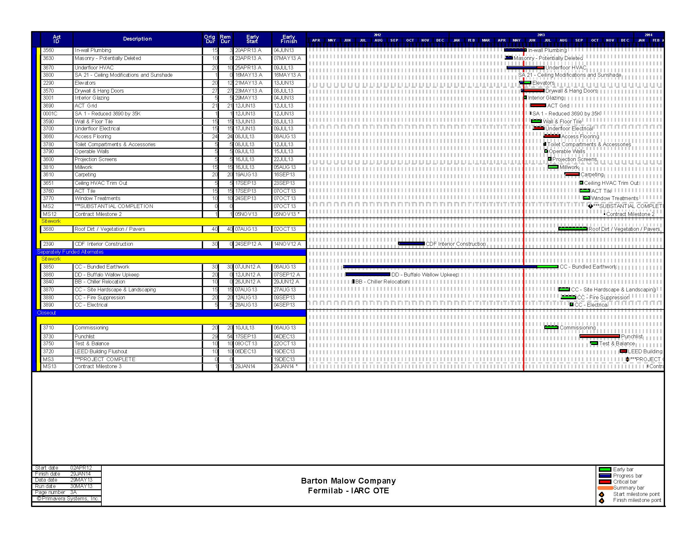
BMC Schedule- May

Slide 20
June Activities
2013
Oct
Nov
Dec
Jan
Feb
Mar
Apr
May
Jun Jul Aug Sep
Oct
Nov
Dec
Jan
Feb
...
...
...
Above Ceiling Plumbing, Above Ceiling Plumbing
Doors & Hardware - Material Only, Doors & Hardware - Material Only
Exterior Panel Submittals & Lead Time, Exterior Panel Submittals & Lead Time
...
...
Interior Glazing
In-wall Plumbing, In-wall Plumbing
...
...
...
...
...
SA 11 - Concrete, Int. Panels, Steel Header,, SA 11 - Concrete, Int. Panels, Steel Header,
In-wall Electrical, In-wall Electrical
$750K
Above Ceiling HVAC, Above Ceiling HVAC
SA 1 - Reduced 3690 by 35K Elevators, Elevators
$200K
...
...
Interior Studs - Set Door Frames, Interior Studs - Set Door Frames
Light Fixtures Submittals & Lead Time (MRFP20), Light Fixtures Submittals & Lead Time (MRFP20)
2nd and 3rd Floor Exterior Panels, 2nd and 3rd Floor Exterior Panels
MRFP 45 Delay - 1st Floor ACM Work, MRFP 45 Delay - 1st Floor ACM Work
$500K
...
...
...
Geotherm al, Geothermal
$200K
...
...
...
...
...
Flooring Submittals & Lead Time, Flooring Submittals & Lead Time Millwork Submittals & Lead Time, Millwork Submittals & Lead Time
Above Ceiling Electrical, Above Ceiling Electrical
Wall & Floor Tile
$250K
Drywall & Hang Doors, Drywall & Hang Doors
...
...
...
...
...
Underfloor HVAC, Underfloor HVAC Underfloor Electrical, Underfloor Electrical
ACT Grid
Paint & Wall Coverings, Paint & Wall Coverings
Sprinkler, Sprinkler
...
...
...
...
...
CC - Bundled Earthwork, CC - Bundled Earthwork
Access Flooring, Access Flooring
CC - Site Hardscape & Landscaping, CC - Site Hardscape & Landscaping
Carpeting, Carpeting
Roof Dirt / Vegetation / Pavers, Roof Dirt / Vegetation / Pavers
...
Window Treatments, Window Treatments

Slide 21
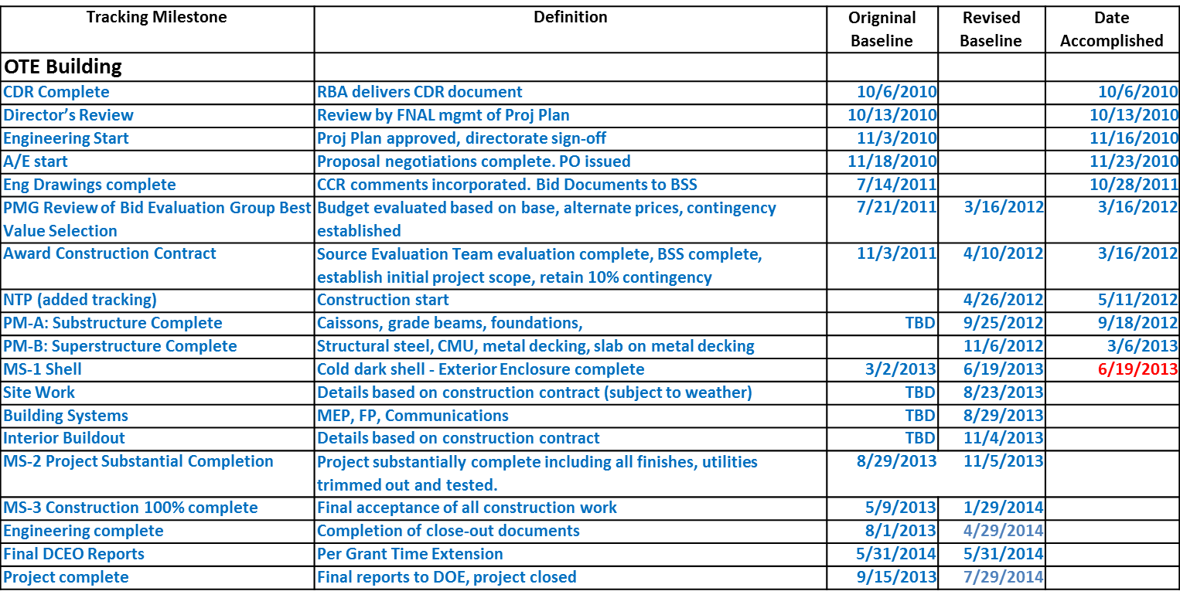
Project Plan Tracking Milestones
Project is fully costed at MS 2, retention remains

Slide 22
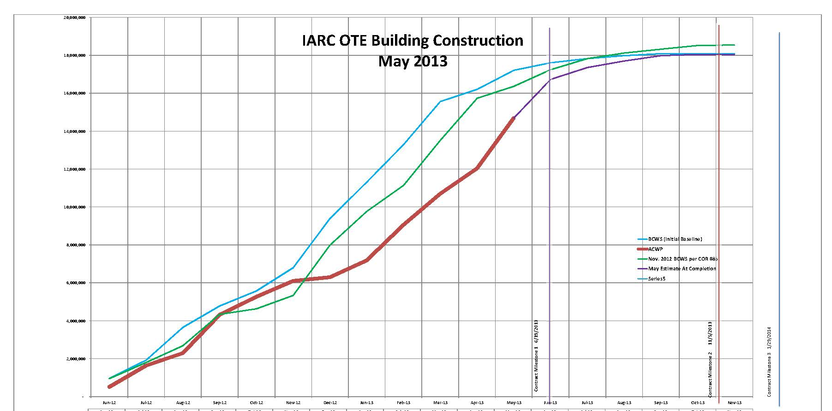
BMC Construction BCWS & ACWP
Based on 5/28/13 Update:
78% Complete based on cost
67% Complete based on time

Slide 23
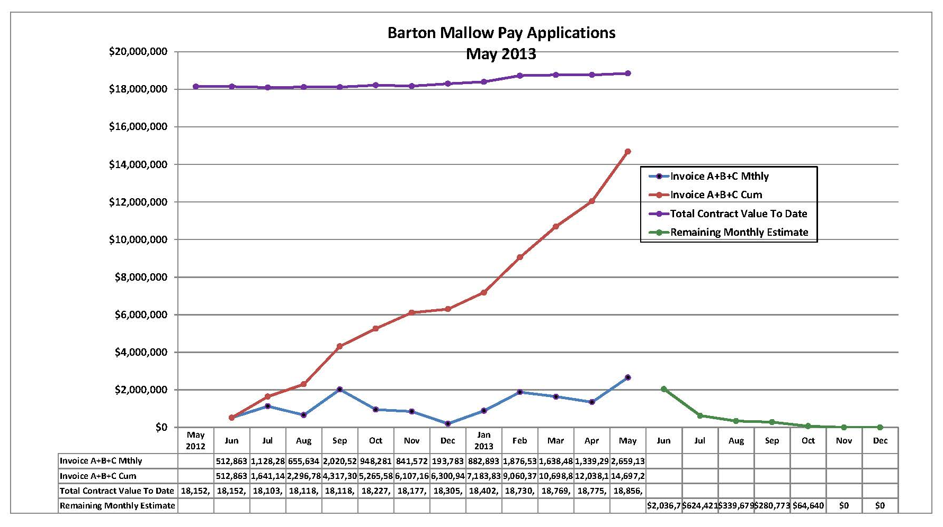
BMC Monthly Costing
Monthly Average to date: $1,225,000.
Required Monthly Average to complete: $420,000

Slide 24
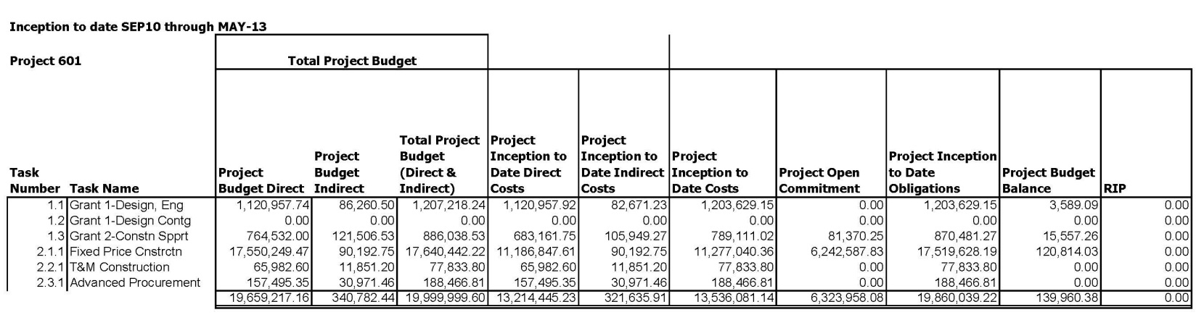
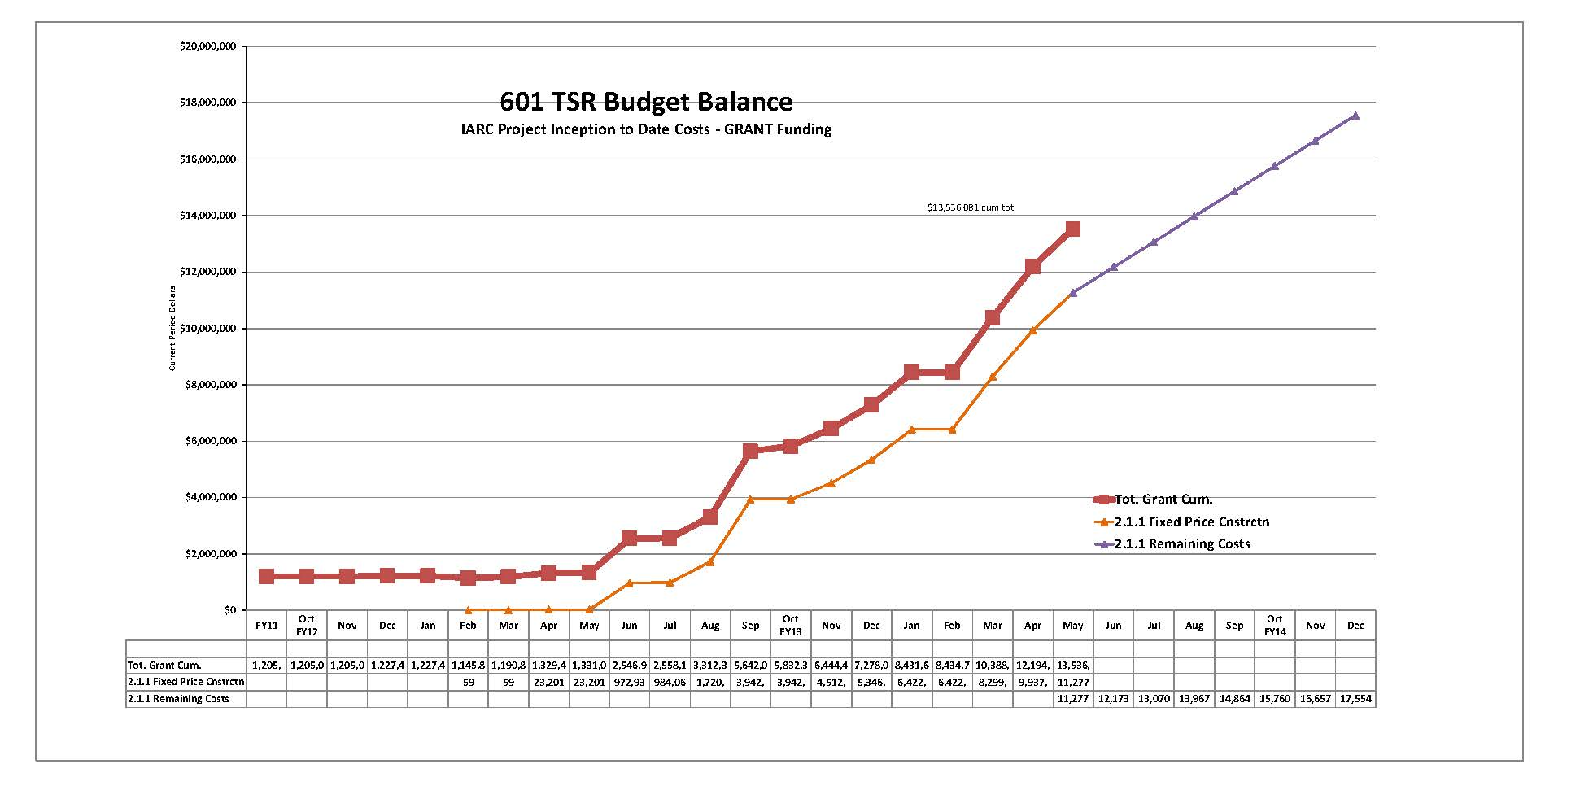
601 TSR Budget Balance
ALL Grant Costing w/ BMC Projection
67% costed. Does not include $2.6 M 5/28/13 BMC invoice

Slide 25
Financial
OTE Grant Costs with FY13 GPP Contingency
(Does Not Include FY13 Equipment & Furnishings or IGPP)
Projected Cost Analysis
Project 601 |  | Reallocated Baseline Budget (obligates full grants) 12/31/12 |  |  | Budget to Complete as of 5/31/13 (SA 21) |  |  | Project Budget Balance to Complete
 |  | Indirect Baseline Direct Budget Budget BAC |  |  | ITD Obligations ITD Obl Direct Indirect Costs Total
1.0 | EDI
1.1 | Grant 1 Design ED | $1,120,958 | $86,261 | $1,207,218 | $1,120,958 | $82,671 | $1,203,629 | $3,589
1.2 | Grant 1 Design Contingency | $0 | $0 | $0 | $0 | $0 | $0 | $0
1.3 | Grant 2 Construction Support I | $764,532 | $121,507 | $886,039 | $764,532 | $105,949 | $870,481 | $15,557
2.0 | Construction
2.1.1 | Fixed Price Construction | $17,550,249 | $90,193 | $17,640,442 | $17,429,435 | $90,193 | $17,519,628 | $120,814
2.2.1 | T&M Construction | $65,983 | $11,851 | $77,834 | $65,983 | $11,851 | $77,834 | $0
2.3.1 | Adv Procurement | $157,495 | $30,971 | $188,467 | $157,495 | $30,971 | $188,467 | $0
Project G13-211 Contingency
2.1 | Fixed Price Const Contingency | $950,000 | $0 | $950,000 | $470,745 | $0 | $470,745 | $479,255
2.2 | T&M Const Contingency | $40,683 | $9,317 | $50,000 | $0 | $0 | $0 | $50,000
 |  |  |  |  | $0 | $0 | $0 | $0
TOTALS |  | $20,649,900 $350,099 $21,000,000 |  |  | $20,009,148 $321,636 $20,330,784 |  |  | $669,216

Slide 26
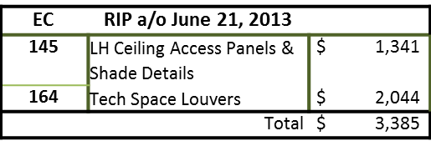
Financial – Estimated at Completion
601 + G13221 Funding
COR's a/o June 21, 2013
126‐1 | AV Equipment | $ | (816)
141 | Snow & Water Manage | $ | 5,597
142‐1 | Spray FP Stair 02 | $ | 4,924
154‐2 | Windows at Corr 107 | $ | 3,510
157 | Tech Space Coord | $ | 3,725
160 | Mecho Shade Mods | $ | 34,756
164 | Add'l Access Doors | $ | 5,653
168 | Door 313A Mods | $ | 2,199
169 | Ext Soffit Mods | $ | (22,389)
176 | Exp Joint CDF Bridge | $ | 1,703
177 | RAF at Steel Bracing | $ | 48,167
183 | Spray FP at Col J/2 | $ | 551
Total $ |  |  | 30,231
SA's Issued After 5/31/13
22 Issued 6/5/13 | $ | 14,750
Total $ |  | 14,750
 | Obligated a/o SA 21 (5/7/13) | $ | 20,330,784
 | SA's & Anticipated EC's | $ | 48,366
Estimate At Completion |  | $ | 20,379,150

Slide 27
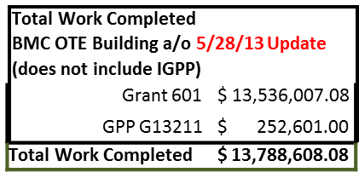
Financial – Available Contingency
601 + G13221 Funding
c
Total Contra a/o SA 21 (does not inc Grant GPP | t Amount lude IGPP) $ 17,389,510.67 $ 355,630.53
 | $ | 17,745,141.20
Remaining Work to Complete | $ | 3,956,533.12
Previous available contingency a/o 4/25/13: $656,624
Contingency (does not include IGPP)
Total Budget 12/31/12 | $21,000,000
EAC | $20,379,150
a/o 6/21/13
Available Contingency | $620,850 | 15.7% of remaining work

Slide 28
Contingency Management
Sources available to fund change orders:
  IGPP;
  DOE backstop (GPP Outfitting project);
  Value engineering main construction work
  Grant Funding

Slide 29
Summary Action Items
Building Construction:
  shop drawing & change order review, RFI responses
  construction coordination & oversight.
  schedule oversight
  financial oversight
Discussions for procurement of furnishings
Space and programing discussions
VoIP, networking discussions
  Install main cable runs
Security walk-thru

