Slide 1
RF Losses for 160 mm End Group Length
Beam Pipe Aperture, [mm] | 100 | 118
Q_{BELLOWS} * | >1E14 | 4.1E12
Q_{FLANGES} * | 2.1E13 | 8.4E11
* For stainless steel with σ = 1.5E6 Siemens/m
160

Slide 2
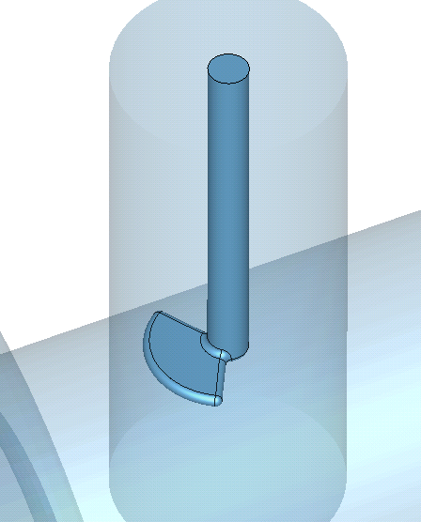
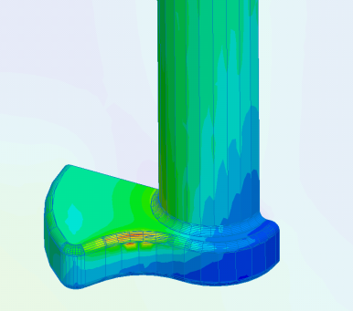
Q_{ext} tuning for Beta=0.92 Cavity and 118mm Beam Pipe
75 mm
120⁰ Sector Antenna Tip
Antenna Depth
Surface Magnetic Field
10 mm
P_{loss} < 1 W
for 35 kW Input RF

